Slide 1
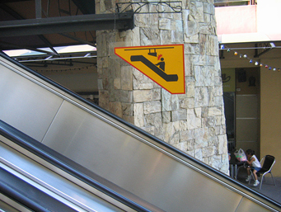
Welcome to CS 5! Be sure to watch your head…

Slide 3
Using a Euro, Yuan the deadline comes next time I'll try to make the Mark. I'm Pounding it into my brain, but I have to Peso much attention to other deadlines in the classes I Currency have - but if this keeps up, my grade will be demolished into Rubles.
hw0 highlights…
0 xE** -> N 0 # Once upon a time, there was
0 *x** -> E 1 # an extremely sad, lost Picobot. Ze
0 NEx* -> W 3 # traveled around a sad, dark maze
0 NEWx -> S 2 # in search of shelter and food.
# Finally, Picobot found a gingerbread
1 ***x -> S 2 # house deep in the corners of the maze.
1 *x*S -> E 1 # Though Picobot knew ze could never find
1 xE*S -> N 0 # zer way around the maze without keeping
1 NExS -> W 3 # zerself near the right-hand wall, ze
# decided the gingerbread house would be
2 **x* -> W 3 # worth disobeying zer program.
2 **Wx -> S 2 # Picobot thoroughly enjoyed zer
2 *xWS -> E 1 # gingerbread meal, but when ze tried to
2 xEWS -> N 0 # find zer way back to the maze, ze was so
# confused ze didn't know what to do.
3 x*** -> N 0 # Picobot began to sit in the corner,
3 N*x* -> W 3 # sighing in despair.
3 N*Wx -> S 2 # Suddenly came a noble grutor who
3 NxWS -> E 1 # showed Picobot the way through the maze.
# And there was much rejoicing. THE END
elif user == 'HMC':
if comp == 'CMC':
print 'CMC is closer to all of the other 5 Cs. I win.'
elif comp == 'Pitzer':
print 'Pitzer is closer to Starbucks. I win.'
print 'Teeheehee! Looks like I won!'
answer = raw_input("Wait, are you a Grutor?!")
if answer == 'yes':
print 'I am so sorry! I mean YOU win!'
else:
print 'Then I DO win! Hahaha'
E.F.
full RPS-25

Slide 4
Using a Euro, Yuan the deadline comes next time I'll try to make the Mark. I'm Pounding it into my brain, but I have to Peso much attention to other deadlines in the classes I Currency have - but if this keeps up, my grade will be demolished into Rubles.
hw0 highlights…
0 xE** -> N 0 # Once upon a time, there was
0 *x** -> E 1 # an extremely sad, lost Picobot. Ze
0 NEx* -> W 3 # traveled around a sad, dark maze
0 NEWx -> S 2 # in search of shelter and food.
# Finally, Picobot found a gingerbread
1 ***x -> S 2 # house deep in the corners of the maze.
1 *x*S -> E 1 # Though Picobot knew ze could never find
1 xE*S -> N 0 # zer way around the maze without keeping
1 NExS -> W 3 # zerself near the right-hand wall, ze
# decided the gingerbread house would be
2 **x* -> W 3 # worth disobeying zer program.
2 **Wx -> S 2 # Picobot thoroughly enjoyed zer
2 *xWS -> E 1 # gingerbread meal, but when ze tried to
2 xEWS -> N 0 # find zer way back to the maze, ze was so
# confused ze didn't know what to do.
3 x*** -> N 0 # Picobot began to sit in the corner,
3 N*x* -> W 3 # sighing in despair.
3 N*Wx -> S 2 # Suddenly came a noble grutor who
3 NxWS -> E 1 # showed Picobot the way through the maze.
# And there was much rejoicing. THE END
user = raw_input("Hello! This is Professor Oak. …")
comp = random.choice ( ['BULBASAUR!','CHARMANDER!','SQUIRTLE!'] )
cheesy =
random.choice ( ['Heh-you snooze you lose',
'I was here, and boy are you a loser!',
"You can't ignore my girth!",
"I'm Gary Oak! And I don't lose to chumps like you!",
'I would never lose to a loser like you. I have my own cheerleading squad!',
"I'll be waiting outside the Pokemon center just to battle you again!" ] )
if user == 'SQUIRTLE':
if comp == 'BULBASAUR!':
print 'Your SQUIRTLE used Water Gun!'
time.sleep(2)
print 'It was not very effective...'
time.sleep(2)
print "Gary's BULBASAUR used Vine Whip!"
time.sleep(2)
print 'It was super effective!'
time.sleep(2)
print 'Your Squirtle fainted!'
time.sleep(2)
print 'Gary is the winner!'
time.sleep(3)
print "Gary:", cheesy
elif user == 'HMC':
if comp == 'CMC':
print 'CMC is closer to all of the other 5 Cs. I win.'
elif comp == 'Pitzer':
print 'Pitzer is closer to Starbucks. I win.'
print 'Teeheehee! Looks like I won!'
answer = raw_input("Wait, are you a Grutor?!")
if answer == 'yes':
print 'I am so sorry! I mean YOU win!'
else:
print 'Then I DO win! Hahaha'
E.F.
full RPS-25

Slide 5
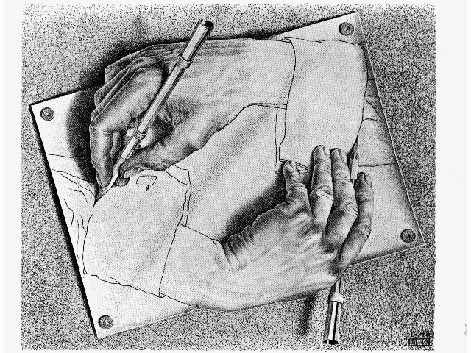
CS 5: now recursing…
Or re-cursing, depending on your feelings about recursion!
Homework 0 - graded
We're computationally complete!
What's next?
Homework 1 - submitted
map and its applications
pr0 reading - Watson!
pr1 lab – Tue./Wed.
List Comprehensions
pr2, pr3 - Python probs…
Hw 2 - upcoming Mon.

Slide 6
functional programming
>>> 'fun' in 'functional'
True
representation via list structures (data)
leverage self-similarity (recursion)
create small building blocks (functions)
Composed together -- to solve/investigate problems.
Functional programming
conceptually concise
vs.
efficient for the computer…
functional
procedural or sequential

Slide 7
Data
[13,14,15]
Functions
sum( )

Slide 8
sum range
def sum(L):
""" input: L, a list of #s
output: L's sum
"""
if len(L) == 0:
return 0.0
else:
return L[0] + sum(L[1:])
Base Case
Recursive Case

Slide 9
sum range
step?
what's cookin' here?
def range(low,hi ):
""" input: ints low and hi
output: int list from low to hi
"""
if low >= hi:
return []
else:
return
excluding hi

Slide 10
sum and range
I've seen sum of this before... ?
>>> sum(range(1,101))

Slide 11
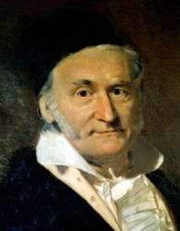
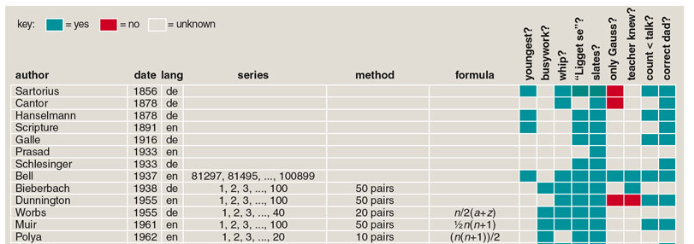
sum and range
1784
>>> sum(range(1,101))
5050
Looks sort of scruffy for a 7-year old… !
and 100 more…
http://www.americanscientist.org/template/AssetDetail/assetid/50686

Slide 12
Data
[13,14,15]
Functions
sum( )
42
…together

Slide 13
Map
def dbl(x):
return 2*x
>>> map(dbl, [0,1,2,3,4,5])
[0, 2, 4, 6, 8, 10]
def sq(x):
return x**2
>>> map(sq, range(6))
[0, 1, 4, 9, 16, 25]
def is_a(x):
return x == 'a'
>>> map(is_a, 'go away!')
[0, 0, 0, 1, 0, 1, 0, 0]
What does map do?
Hey… these look a bit False to me!

Slide 14
Map
def dbl(x):
return 2*x
>>> map(dbl, [0,1,2,3,4,5])
[0, 2, 4, 6, 8, 10]
def sq(x):
return x**2
>>> map(sq, range(6))
[0, 1, 4, 9, 16, 25]
def is_a(x):
return int(x=='a')
>>> map(is_a, 'go away!')
[0, 0, 0, 1, 0, 1, 0, 0]
Now I have 0 to complain about!
(1) map always returns a list
(2) map(f,L) calls f on each item in L

Slide 15
Map, managed!
Map manages recursion for you…
What map could this refer to?
def map(f,L):
""" maps f onto the list L """
if L == []:
return []
else:
return
… and you don't even need the map!

Slide 16
List Comprehensions
The same as map, only better!
this "runner" variable can have any name...
input
>>> [ 2*x for x in [0,1,2,3,4,5] ]
[0, 2, 4, 6, 8, 10]
output
What's happening here?

Slide 17
List Comprehensions
The same as map, only better!
this "runner" variable can have any name...
x takes on each value
input
>>> [ 2*x for x in [0,1,2,3,4,5] ]
[0, 2, 4, 6, 8, 10]
and 2*x is output for each one
output
OK – got it. But what about that name?

Slide 18
>>> [ 2*x for x in [0,1,2,3,4,5] ]
[0, 2, 4, 6, 8, 10]
List Comprehensions?
Is this really the best name Guido Van Rossum could think of?

Slide 19
>>> [ 2*x for x in [0,1,2,3,4,5] ]
[0, 2, 4, 6, 8, 10]
List Comprehensions?
Funlists
Google maps
Datafuncs!
A list comprehension by any other name would be as sweet…

Slide 20
Quiz!
A range of list comprehensions...
Write Python's result for each L.C.:
Name(s): ___________________________
[ n**2 for n in range(0,5) ]
[ 42 for z in [0,1,2] ]
[ z for z in [0,1,2] ]
[ s[1::2] for s in ['aces','451!'] ]
[ -7*b for b in range(-6,6) if abs(b)>4 ]
[ a*(a-1) for a in range(8) if a%2==1 ]
I wonder if these will be useful ?!

Slide 21
Quiz!
A range of list comprehensions...
Write Python's result for each L.C.:
Join with a neighbor and try this on the back page first
[ n**2 for n in range(0,5) ]
[ 42 for z in [0,1,2] ]
[ z for z in [0,1,2] ]
[ s[1::2] for s in ['aces','451!'] ]
[ -7*b for b in range(-6,6) if abs(b)>4 ]
[ a*(a-1) for a in range(8) if a%2==1 ]
I wonder if these will be useful ?!

Slide 22
Quiz!
A range of list comprehensions...
Write Python's result for each L.C.:
Join with a neighbor and try this on the back page first
[ n**2 for n in range(0,5) ]
[ 0, 1, 4, 9 ]
[ 42 for z in [0,1,2] ]
[ z for z in [0,1,2] ]
[ 42, 42, 42 ]
[ 0, 1, 2 ]
[ s[1::2] for s in ['aces','451!'] ]
[ -7*b for b in range(-6,6) if abs(b)>4 ]
[ 42, 35, -35 ]
[ a*(a-1) for a in range(8) if a%2==1 ]
I wonder if these will be useful ?!

Slide 23
Create your own LCs
input
>>> [ _______ for x in range(4) ]
[0, 14, 28, 42]
output
input
>>> [ _____________ for c in 'igotit' ]
[True, False, False, False, True, False]
[ 1, 0, 0, 0, 1, 0 ]
output
What about this?

Slide 24
LCs vs. raw recursion
def len(L):
if L == []:
return 0
else:
return 1 + len(L[1:])
len(L)
scrabble score!
def sScore(s):
if len(s) == 0:
return 0
else:
return letScore(s[0]) + \
sScore(s[1:])
sScore(s)
def sajak(s):
if len(s) == 0:
return 0
else:
if s[0] not in 'aeiou':
return sajak(s[1:])
else:
return 1+sajak(s[1:])
# of vowels
8 lines! Aargh!
sajak(s)

Slide 25
Using LCs
'cs5'
def
len(L):
LC = [1 for x in L]
print LC
return sum( LC )
Sweet!
But one-liners are my specialty…

Slide 26
"One-line" LCs
'cs5'
def
len(L):
LC = [1 for x in L]
print LC
return sum( LC )
Sweet!
But one-liners are my specialty…
def
len(L):
return sum([1 for x in L])
Maybe too terse!

Slide 27
Using LCs
def
letScore(c):
stuff to get score…
return score
'quiz'
scrabble score!
def
sScore(s):
LC = [ for c in s]
return sum( LC )

Slide 28
'sequoia'
Remember True == 1 and False == 0
# of vowels
def
sajak(s):
LC = [ for c in s]
return sum( LC )
42
[3,42,5,7,42]
# of times e is in L
def
count(e,L):
LC = [ for x in L ]
return sum( LC )
using if instead…
def
count(e,L):
LC = [ 1 for x in L if ]
return sum( LC )

Slide 29
Write each of these functions using list comprehensions…
Go!
input: L, any list of #s
output: the # of odd #s in L
def nodds(L):
example: nodds( [3,4,5,7,42] ) == 3
LC = [ for x in L ]
return sum(LC)
Y are your #s
W are the winning #s
inputs: Y and W, two lists of "lottery" numbers (ints)
output: the # of matches between Y & W
def lotto(Y,W):
example: lotto( [5,7,42,47] , [3,5,7,44,47] ) == 3
input: N, an int >= 2
output: the # of positive divisors of N
def ndivs(N):
example: numdivs(12) == 6 (1,2,3,4,6,12)
input: P, an int >= 2
output: the list of prime #s up to + incl. P
def primesUpTo(P):
example: primesUpTo(12) == [2,3,5,7,11]
Extra!

Slide 30
inputs: L, any list of #s
output: the # of odd #s in L
example: nodds( [3,4,5,7,42] ) == 3
def nodds(L):
LC = [ for x in L ]
return sum(LC)
def nodds(L):
LC = [ 1 for x in L ]
return sum(LC)

Slide 31
Y are your #s
W are the winning #s
inputs: Y and W, two lists of "lottery" numbers (ints)
output: the # of matches between Y & W
example: lotto( [5,7,42,47] , [3,5,7,44,47] ) == 3
def lotto(Y,W):
LC = [ for w in W ]
return sum(LC)
def lotto(Y,W):
LC = [ 1 for w in W ]
return sum(LC)
… could adapt to "y in Y", too.

Slide 32
input: N, an int >= 2
output: the # of positive divisors of N
example: numdivs(12) == 6 (1,2,3,4,6,12)
def ndivs(N):
LC = [ for n in range(1,N+1)]
return sum(LC)
Extra! A list of all primes up to P…
def primesUpto( P ):

Slide 33
1
def recip(x): return 1.0/x
1
0.5
y =
x
area
0
1
2
3
4
5
6
7
8
9
10
Lab 2:
Integrating Python
1
0.5
0
low = 1.0
hi = 10.0

Slide 34
def recip(x): return 1.0/x
1
1
y =
0.5
x
area
0
1
2
3
4
5
6
7
8
9
10
scaledfracs(low,hi,N)
step along x-axis
f_of_fracs(f,low,hi,N)
apply f to each
integrate(f,low,hi,N)
integrate!
only a few lines...
Where are the LCs?

Slide 35
Maya Lin, Architect…

Slide 36
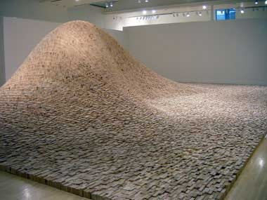
Maya Lin, Artist and Computer Scientist…
"two-by-four landscape"

Slide 37
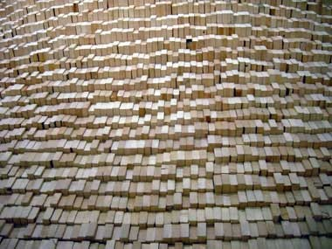
Maya Lin, Artist and Computer Scientist…
One building block, deliberately applied, over 50,000 times…

Slide 38
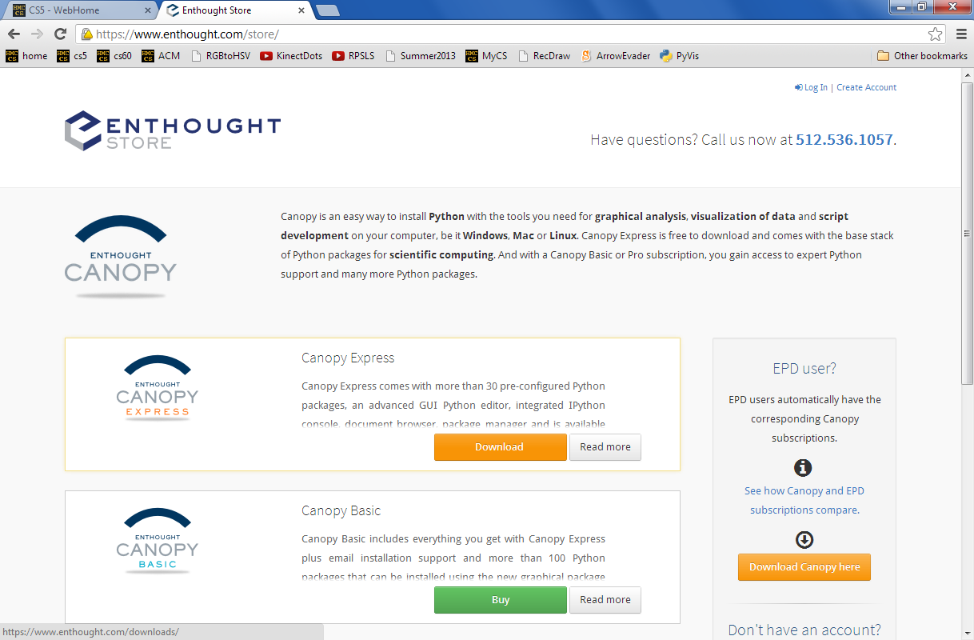
Canopy and matplotlib

Slide 39
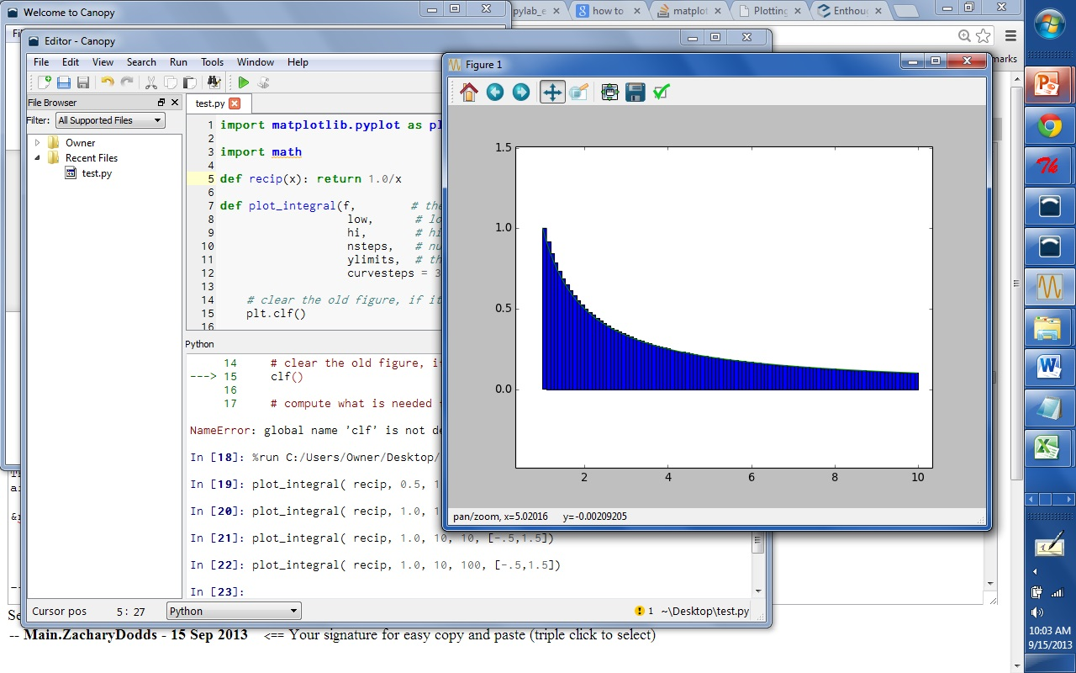
Canopy and matplotlib

Slide 40
See you at Lab!
This must be a sine of what's to come, 'cos it'd be a real tangent otherwise...

Slide 42
input: Y and W, two lists of "lottery" numbers (ints)
W are the winning numbers
output: the # of matches between Y & W
Y are your numbers
example: lotto([5,7,42,47],[3,5,7,44,47]) == 3
def lotto(Y,W):
LC = [
return sum(LC)

Slide 43
input: N, an int >= 2
output: the number of positive divisors of N
Extra!
example: numdivs(12) == 6 (1,2,3,4,6,12)
def numdivs(N):
What if you want the divisors themselves? or prime #s?
def primesUpto( P ):
How could you use this to compute all of the prime numbers up to P?

Slide 44
sum and range
I've seen this before... ?
>>> sum(range(1,101))

Slide 45
List Comprehensions
The same as map, only better!
this "runner" variable can have any name...
input
>>> [ 2*x for x in [0,1,2,3,4,5] ]
[0, 2, 4, 6, 8, 10]
output
What is going on here?

Slide 46
List Comprehensions
The same as map, only better!
this "runner" variable can have any name...
input
>>> [ 2*x for x in [0,1,2,3,4,5] ]
[0, 2, 4, 6, 8, 10]
(1) x takes on each value in the list or string
(2) The operation 2*x happens for each x
output
So clear, I don't even NEED a map!

Slide 47
Quiz!
A range of list comprehensions...
What's Python's result for each L.C.:
First/last name(s):_______________________
[ n**2 for n in range(0,5) ]
[ 42 for z in [0,1,2] ]
[ z for z in [0,1,2] ]
[ s[1::2] for s in ['aces','451!'] ]
[ -7*b for b in range(-6,6) if abs(b)>4 ]
[ a*(a-1) for a in range(8) if a%2==1 ]
I wonder if these will be useful?!

Slide 48
Create your own!
input
>>> [ _______ for y in range(6) ]
[0, 1, 4, 9, 16, 25]
output
input
>>> [ __________ for c in 'igotit' ]
[True, False, False, False, True, False]
[ 1, 0, 0, 0, 1, 0 ]
output
What about this?

Slide 49
Raw recursion vs. LCs ?
def
len(L):
LC = [1 for x in L]
return sum( LC )
scrabble score!
def
sScore(s):
LC = [ letScore(c) for c in s]
return sum( LC )
I prefer one-liners!

Slide 50
vs. List Comprehensions
# of vowels
def
sajak(s):
LC = [ for c in s]
return sum( LC )
Remember True == 1 and False == 0
# of odd elements
def
numOdds(L):
LC = [ for x in L]
return sum( LC )

Slide 51
Quiz
input: e, any element L, any list or string
Remember True == 1 and False == 0
output: the # of times L contains e
example: count('f', 'fluff') == 3
Write
def count(e,L):
LC = [ for x in L ]
return sum(LC)
don't use e here!
use e in here somehow…

Slide 52
Write
input: Y and W, two lists of lottery numbers (ints)
W are the winning numbers
output: the # of matches between Y & W
Y are your numbers
example: lotto([5,7,42,44],[3,5,7,44]) == 3
def lotto(Y,W):
LC = [ w in Y for w in W ]
return sum(LC)

Slide 53
Extra!
input: N, an int >= 2
output: the number of positive divisors of N
def numdivs(N):
example: numdivs(12) == 6 (1,2,3,4,6,12)
What if you want the divisors themselves? or prime #s?
def primesUpto( P ):
How could you use this to compute all of the prime numbers up to P?
return [ p in range(2,P+1) if numdivs(p)==2 ]

Slide 54
Recursion -- not just numbers
Self-similarity elsewhere...
Natural phenomena
Relationships
how much here is leaf vs. stem?
What is an “ancestor” ?
Names -- acronyms
The TTP Project

Slide 55
Recursion -- not just numbers
Self-similarity elsewhere...
Natural phenomena
Relationships
how much here is leaf vs. stem?
What is an “ancestor” ?
Names -- acronyms
The TTP Project

Slide 56
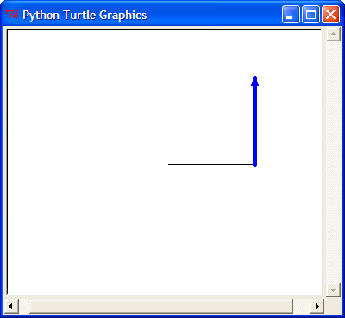
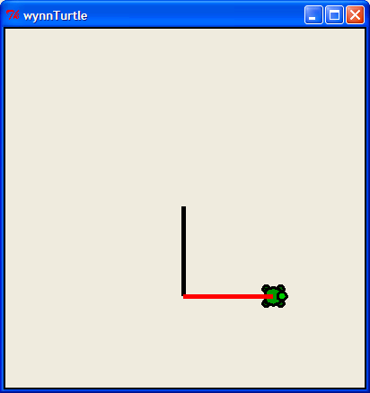
Next time: The Visual Arts ?
from turtle import *
reset()
left(90)
forward(50)
right(90)
backward(50)
down() or up()
color('green')
tracer(1) or tracer(0)
width(5)
and lots more!
www.cs.hmc.edu/twiki/bin/view/CS5/TurtleDirections
for turtle help
Basic turtle graphics
degrees!
states if the pen draws or not
states if the pen animates or not
More turtly turtle graphics

Slide 57
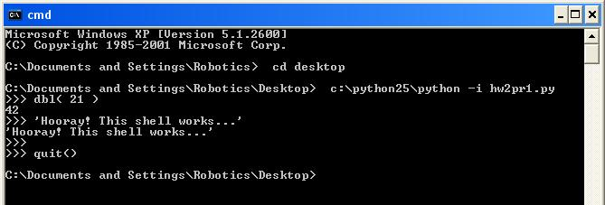
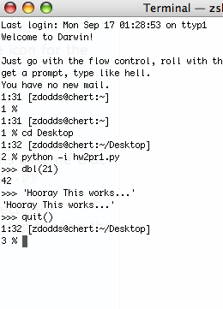
The Python shell
IDLE uses Python's graphics - but built-in shells do not
"command window"
"terminal window"
c:\python25\python -i hw2pr1.py
python -i hw2pr1.py

Slide 58
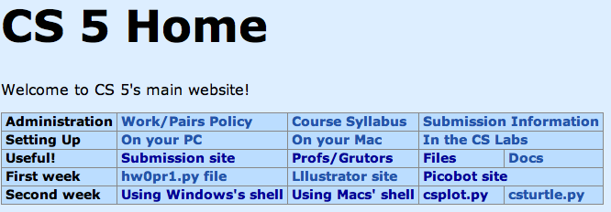
csplot.py
Links to pages with detailed instructions on opening a non-IDLE shell.
Links to two files providing graphics capabilities.
IDLE can still be used as your code editor!

Slide 59
A random aside…
import random
for more explanation, try dir(random) or help(random)
random.choice( L )
chooses 1 element from the list L
random.choice( ['north', 'case', 'west'] )
How would you get a random int from 0 to 9?
random.uniform(low,hi)
chooses a random float from low to hi
random.uniform(41.0, 43.0)
How likely is this to return 42 ?

Slide 60
Randomness vs. Determinism
Are there random numbers?
Can a computer generate them?
RNG
A “black box” model of a random number generator.
Output

Slide 61
Map: a higher-order function
def map( f, L ):
""" map returns a new list where each element of L has been f-efied
"""
if :
else:
test for base case
Key Idea
Functions are data!
Hey - I'm the only star allowed around here…
In Python, functions can take other functions as input…

Slide 62
List Comprehensions
The same as map, only better!
input
>>> [ 2*x for x in [0,1,2,3,4,5] ]
[0, 2, 4, 6, 8, 10]
output
What is going on here?
and the "running" variable can have any name...

Slide 63
List Comprehensions
The same as map, only better!
input
>>> [ 2*x for x in [0,1,2,3,4,5] ]
[0, 2, 4, 6, 8, 10]
(1) x takes on each value in the list or string
(2) The operation 2*x happens for each x
output
and the "running" variable can have any name...

Slide 64
List Comprehensions
The same as map, only better!
input
>>> [ _______ for y in range(6) ]
[0, 1, 4, 9, 16, 25]
output
input
>>> [ __________ for c in 'igotit' ]
[True, False, False, False, True, False]
output

Slide 65
vs. List Comprehensions
# of vowels
def
sajak(s):
LC = [ for c in s]
return sum( LC )
Remember True == 1 and False == 0
# of odd elements
def
numOdds(L):
LC = [ for x in L]
return sum( LC )

Slide 66
Quiz
Write each of these functions concisely using list comprehensions…
Name(s):
Write
input: e, any element L, any list or string
Remember True == 1 and False == 0
output: the # of times L contains e
def count(e,L):
example: count('f', 'fluff') == 3
LC = [ for x in L ]
return sum(LC)
don't use e here!
use e in here somehow…
Write
def lotto(Y,W):
input: Y and W, two lists of lottery numbers (ints)
W are the winning numbers
output: the # of matches between Y & W
Y are your numbers
example: lotto([5,7,42,44],[3,5,7,44]) == 3
Extra!
input: N, an int >= 2
def numdivs(N):
output: the number of positive divisors of N
example: numdivs(12) == 6 (1,2,3,4,6,12)
How could you use this to compute all of the prime numbers up to P?
def primesUpto( P ):

Slide 67
Quiz
input: e, any element L, any list or string
Remember True == 1 and False == 0
output: the # of times L contains e
example: count('f', 'fluff') == 3
Write
def count(e,L):
LC = [ for x in L ]
return sum(LC)
don't use e here!
use e in here somehow…

Slide 68
Write
input: Y and W, two lists of lottery numbers (ints)
W are the winning numbers
output: the # of matches between Y & W
Y are your numbers
example: lotto([5,7,42,44],[3,5,7,44]) == 3
def lotto(Y,W):

Slide 69
Extra!
input: N, an int >= 2
output: the number of positive divisors of N
def numdivs(N):
example: numdivs(12) == 6 (1,2,3,4,6,12)
What if you want the divisors themselves? or prime #s?
def primesUpto( P ):
How could you use this to compute all of the prime numbers up to P?

Slide 70
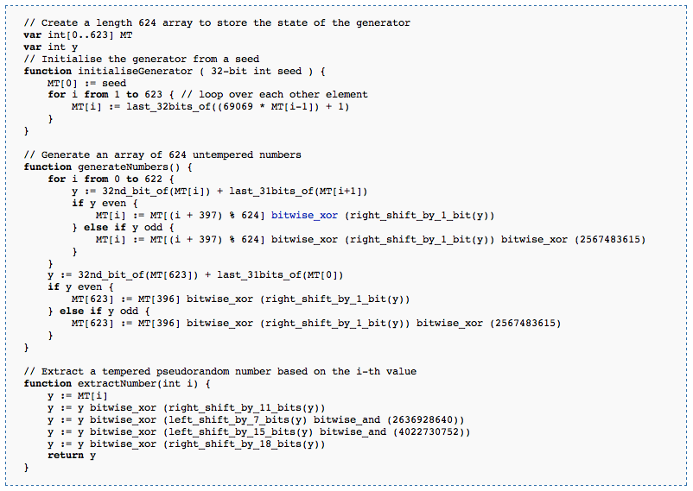
Randomness vs. Determinism
Are there random numbers?
Can a computer generate them?
Yes
Not without help!
The RNG revealed.
Periodic!
Output
p = 2¹⁹⁹³⁷-1
http://en.wikipedia.org/wiki/Mersenne_twister

Slide 71
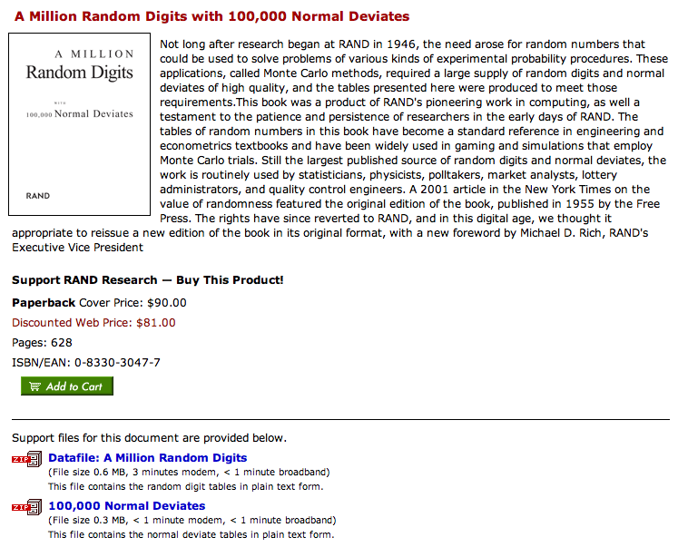
Some random history…
True randomness is valuable!
but not that valuable!
http://www.rand.org/pubs/monograph_reports/MR1418/index.html
Inevitable correlations among the published values

Slide 72
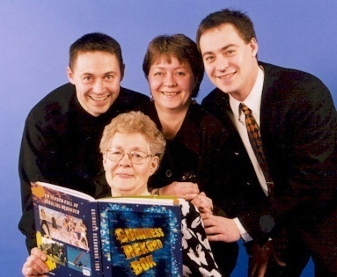
True Randomness !
http://www.leapzine.com/hr/
random, but not!
an enthusiastic endorser
LavaRnd’s lava lamps
using a chaotic physical system to seed random number generators
(Patent 5,732,138: "Method for seeding a pseudo-random number generator with a cryptographic hash of a digitization of a chaotic system.")
www.wired.com/wired/archive/11.08/random.html
This has since been “improved”…

Slide 73
A random program…
from random import *
def guess( hidden ):
""" guesses the user's #, "hidden" """
compguess = choice( range(100) )
if compguess == hidden: # at last!
print 'I got it!'
else:
guess( hidden )
This guesser is a bit suspicious…
print guesses ?
num guesses ?

Slide 74
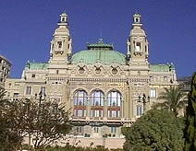
The two Monte Carlos
Making random numbers work for you!
Monte Carlo casino, Monaco
Monte Carlo methods, Math/CS

Slide 75
Monte Carlo in action
Suppose you roll two dice.
What are the chances that you roll doubles?
input is the total number of rolls
def countDoubles( N ):
""" inputs a # of two-dice rolls
outputs the # of doubles """
if N == 0:
return 0
else:
d1 = choice( [1,2,3,4,5,6] )
d2 = choice( range(1,7) )
if d1 != d2:
return countDoubles( N - 1 )
else:
return
one roll of two dice
where is the doubles check?
what should the last line be?

Slide 76
1
def recip(x): return 1.0/x
0.5
1
y =
area
x
0
1
2
3
4
5
6
7
8
9
10
1
How might we find this area using Monte Carlo?
0.5
0
1
2
3
4
5
6
7
8
9
10
low = 1.0
hi = 10.0
N == 9 == total number of steps (rectangles)
steps(low,hi,N)
fsteps(recip,low,hi,N)
finteg(f,low,hi,N)

Slide 77
1
def recip(x): return 1.0/x
0.5
1
y =
area
x
0
1
2
3
4
5
6
7
8
9
10
Numerical Integration
Lab 2: Monday or Tuesday
steps(low,hi,N)
fsteps(recip,low,hi,N)
finteg(f,low,hi,N)

Slide 78
See you at Lab!

Slide 79
print: Making programs talk to you!
Debugging had to be discovered. I can remember the exact instant when I realized that a large part of my life from then on was going to be spent in finding mistakes in my own programs.
- Maurice Wilkes
Programming: the art of debugging an empty file.
- The Jargon File
http://www.tuxedo.org/~esr/jargon/

Slide 80
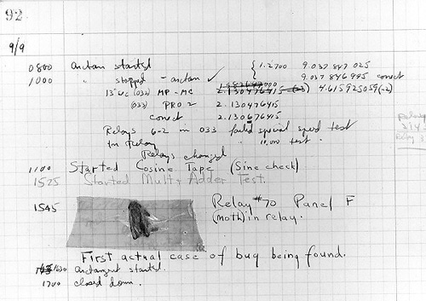
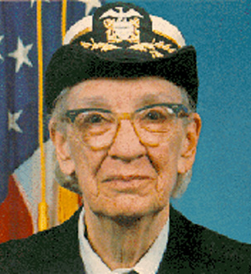
The first bug
Grace Hopper
from the UNIVAC 1
“In the days they used oxen for heavy pulling, when one ox couldn't budge a log, they didn't try to grow a larger ox. We shouldn't be trying for bigger and better computers, but for better systems of computers.”

Slide 81
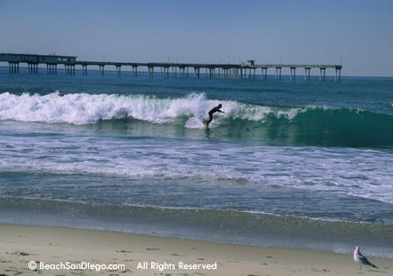
Top 5 reasons to sign up to come to the
Find out what CS is really all about
Meet other women (and a few men too) who do CS
Bond with your fellow Mudders (including Prof. Alvarado)
Helen Greiner (!) and Sally Ride are keynote speakers
Get a free trip to San Diego…

Slide 82
When is it?
October 4-7 (we’ll leave Wed. afternoon and return Sat. night)
Who can sign up?
Anyone! You don’t have to be a CS Major (or a woman)
How do I sign up?
Email Christine (alvarado@cs.hmc.edu) by Friday, Sept. 22
Where do I get more information?
http://www.cs.hmc.edu/~alvarado/ghc06.html
http://gracehopper.org/

Slide 83
Real visual recursion
How many times has the light bounced before reaching the camera from various items here??

Slide 84
Quiz
Write each of these two functions concisely using list comprehensions…
Write
input: s, a string
def countas(s):
output: the # of 'a' characters in s
example: countas('alphabet') == 2
return sum( [ x=='a' for x in s ] )
return sum( [ x=='ctg' for x in s ] )
return sum( [ s[i:i+3]=='ctg' for i in range(len(s)) ] )
Extra: How could this be modified to find the 'ctg' repeats that cause myotonic dystrophy?

Slide 85
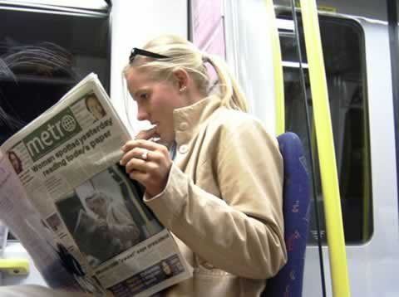

Slide 86
Solutions
Show a high-level (using map, reduce, etc.) solution for each and a low-level (raw recursion) for each.
The ascent - composing more sophisticated applications
The descent? - to deeper and deeper understandings of these things ("too deep" Fox Trot cartoon)

Slide 87
Syntax
Show the list comprehension syntax…
Do some examples & puzzles
Have a puzzle with if (used as a filter, too)
Try out the new syntax…

Slide 88
Specification:
Let W be a list of the six current winning lotto numbers (in order). A “ticket” is a list of six elements: [#1, #2, #3, #4, #5, #6 ], also in order. lottoScore(T) inputs a ticket and outputs its number of matches.
Examples:
W = [ 4, 8, 15, 29, 33, 47 ]; lottoScore([14, 15, 28, 30, 31, 42]); 1
lottoScore([4, 8, 15, 16, 32, 33]); 4
Code:
Notes:
I don’t know if this really works...

Slide 89
Specification:
lottoScore(W,T) takes both the winning numbers and a ticket as inputs and returns the number of matches... .
Example:
lottoScore( [4, 8, 15, 29, 33, 47], [4, 8, 15, 16, 32, 33] ); 4
Code:
“merge” technique ...
Notes:
I don’t know if this really works...

Slide 90
Today's forecast…
Specification:
dropGemini(L) takes in a list of birthdays (pairs like [6,5]) and returns an identical list w/o the Gemini.
US style
Example:
dropGemini([ [2,19], [3,13], [5,28], [6,11], [6,13], [7,29] ]); [ [2,19], [3,13], [7,29] ]
Code:
Notes:
I don’t know if this really works...

Slide 91
Applications
Lottery ticket applications - my favorite! with prizes for solvers

Slide 92
Do you remember…
That should do it… review slide.
Look ahead to lab.
Look ahead to Wed. :
revisiting randomness (lottery tie-in)
show a quick teaser example of the coolness of list comprehensions, e.g., analyze the primality instinct game by playing 1000000 times and counting the number of wins…

Slide 93
Recursion -- warning !
def fac(N):
return N * fac(N-1)
This is legal code!
try it out…
fall forever… was that Dumbledore or Gandalf?

Slide 94
Recursion Examples
def matchscore(a,b):
""" input: any two strings, a and b
output: the number of same characters in
the same location in both a and b
"""
This sentence is false.

Slide 95
CS 5 today
The building blocks of functional computing
data, sequences
We're computationally complete!
conditionals
recursion
So what now?
John Paul Jones, Paul McCartney, Flea (jazz Charles Mingus), Jakes: Phil Lesh
Living without a bass case!
http://www.stylusmagazine.com/articles/weekly_article/stylus-magazines-top-50-basslines-of-all-time.htm

Slide 96
1
0.5
1
y =
area
x
0
1
2
3
4
5
6
7
8
9
10
1
0.5
0
1
2
3
4
5
6
7
8
9
10
xmin = 1.0
xmax = 10.0
nsteps = 9

Slide 97
def sum(L):
""" input: a list of numbers, L
output: L's sum
"""
if len(L) == 0:
return 0.0
else:
return L[0] + sum(L[1:])
sum
sum([1,2,3,4])
L
>>> L = [1,2,3,4]
>>> sum(L)
L[0] + sum(L[1:])
1 + sum([2,3,4])

Slide 98
Depends what you mean by real …
(show recursion.swf)

Slide 100
sum, range
def range(low,hi):
""" input: two ints, low and hi
output: int list from low up to hi
"""
if hi <= low:
return []
else:
return
what's cookin' here?
excluding hi

Slide 101
sum and range
>>> sum(range(1,101))
I've seen this before... ?

Slide 102
A recursive spiral …

Slide 104
sum, range, max
max( [ 5, 42, 1, 7, 100 ] )
def max(L):
""" input: a nonempty sequence of values, L
output: L's maximum
"""
if len(L) == 1:
return L[0]
elif

Slide 105
sum, range, max
def max(L):
""" input: a nonempty sequence of values, L
output: L's maximum
"""
if len(L) == 1:
return L[0]
elif L[0] > L[1]:
return max( L[0:1] + L[2:] )
else:
return max( L[1:] )

Slide 106
max( [3, 7, 1, 42, -10, 1024, 55, 716] )
How many times does each block get called for this 8-element list?
def max(L):
""" docstring here """
if len(L) == 1:
return L[0]
elif L[0] > L[1]:
return max( L[0:1] + L[2:] )
else:
return max( L[1:] )
Base Case (if)
Second Case (elif)
Third Case (else)

Slide 107
max( [3, 7, 1, 42, -10, 1024, 55, 716] )
Third Case (else)
max( [7, 1, 42, -10, 1024, 55, 716] )
How many times does each block get called for this 8-element list?
def max(L):
""" docstring here """
if len(L) == 1:
return L[0]
elif L[0] > L[1]:
return max( L[0:1] + L[2:] )
else:
return max( L[1:] )
Base Case (if)
Second Case (elif)
Third Case (else)

Slide 108
max( [3, 7, 1, 42, -10, 1024, 55, 716] )
Third Case (else)
max( [7, 1, 42, -10, 1024, 55, 716] )
Second Case (elif)
max( [7, 42, -10, 1024, 55, 716] )
How many times does each block get called for this 8-element list?
def max(L):
""" docstring here """
if len(L) == 1:
return L[0]
elif L[0] > L[1]:
return max( L[0:1] + L[2:] )
else:
return max( L[1:] )
Base Case (if)
Second Case (elif)
Third Case (else)

Slide 109
max( [3, 7, 1, 42, -10, 1024, 55, 716] )
Third Case (else)
max( [7, 1, 42, -10, 1024, 55, 716] )
Second Case (elif)
max( [7, 42, -10, 1024, 55, 716] )
max( [42, -10, 1024, 55, 716] )
Third Case (else)
max( [42, 1024, 55, 716] )
Second Case (elif)
Third Case (else)
max( [1024, 55, 716] )
Second Case (elif)
max( [1024, 716] )
Second Case (elif)
max( [1024] )
Base Case (if)
1024
How many times does each block get called for this 8-element list?
def max(L):
""" docstring here """
if len(L) == 1:
return L[0]
elif L[0] > L[1]:
return max( L[0:1] + L[2:] )
else:
return max( L[1:] )
Base Case (if)
Second Case (elif)
Third Case (else)

Slide 110
Quiz
Write each of these two functions concisely using list comprehensions…
Name(s):
Write
input: s, a string
def countas(s):
output: the # of 'a' characters in s
Remember True == 1 and False == 0
example: countas('alphabet') == 2
Extra: How could this be modified to find the 'ctg' repeats that cause myotonic dystrophy?
Write
input: Y and W, two lists of ints (lottery numbers)
W are the winning numbers
def lottoScore(Y,W):
output: the # of matching numbers in Y & W
Y are your numbers
example: lottoScore([5,7,42,44],[3,5,7,44]) == 3

Slide 111
A list comprehension by any other name would be as sweet…
List Comprehensions
len
def len(L):
if L == []:
return 0
else:
return 1 + len(L[:])
Raw Recur-sion
last time
len
def len(L):
return sum( )
List Comp
this time

Slide 112
List Comprehensions
len
def len(L):
if L == []:
return 0
else:
return 1 + len(L[:])
Raw Recursion
def len(L):
return sum( [ 1 for x in L ] )
List Comp

Slide 113
List Comprehensions
scrabbleScore
def scrabbleScore(s):
if len(s) == 0:
return 0
else:
return recursive step
Raw Recursion
last time
def scrabbleScore(s):
return sum( )
List Comp
this time

Slide 114
List Comprehensions
scrabbleScore
def scrabbleScore(s):
if len(s) == 0:
return 0
else:
return recursive step
Raw Recursion
def scrabbleScore(s):
return sum( [ letScore(x) for x in s ] )
List Comp

Slide 115
Write
input: s, a string
def countas(s):
output: the # of 'a' characters in s
example: countas('alphabet') == 2

Slide 116
Write
input: Y and W, two lists of ints (lottery numbers)
W are the winning numbers
def lottoScore(Y,W):
output: the # of matching numbers in Y & W
Y are your numbers
example: lottoScore([5,7,42,44],[3,5,7,44]) == 3
Note: does this work for strings?

Slide 117
Write
input: s, a string
def countas(s):
output: the # of 'a' characters in s
example: countas('alphabet') == 2
return sum( [ x=='a' for x in s ] )
Extra: How could this be modified to find the 'ctg' repeats that cause myotonic dystrophy?

Slide 118
Write
input: s, a string
def countas(s):
output: the # of 'a' characters in s
example: countas('alphabet') == 2
return sum( [ x=='a' for x in s ] )
Extra: How could this be modified to find the 'ctg' repeats that cause myotonic dystrophy?
return sum( [ x=='ctg' for x in s ] )
Does this work?

Slide 119
Write
input: s, a string
def countas(s):
output: the # of 'a' characters in s
example: countas('alphabet') == 2
return sum( [ x=='a' for x in s ] )
Extra: How could this be modified to find the 'ctg' repeats that cause myotonic dystrophy?
return sum( [ x=='ctg' for x in s ] )
No!
return sum( [ s[i:i+3]=='ctg' for i in range( ) ] )
What range should this be?

Slide 120
Map, recursively
(1) map always returns a list
def map(f,L):
(2) map(f,L) calls f on each item in L

Slide 121
Summary of today…
>>> [ 2**x for x in range(10) ]
[1, 2, 4, 8, 16, 32, 64, 128, 256, 512]
list comprehensions
>>> map( math.sqrt, [0, 1, 4, 9] )
[0.0, 1.0, 2.0, 3.0]
map
building blocks…
max, min, range, sum, len, …

Slide 122
while we're here…
def rps():
""" plays rock-paper-scissors """
answer = 'yes'
while answer == 'yes':
#
# plays RPS one time
#
answer = raw_input('Again? ')
print 'Bye!'
test
loop while the test is true
outside of the loop
there's self-similarity here, for sure!

Slide 123
No while needed!
def rps():
""" plays rock-paper-scissors """
#
# plays RPS one time
#
answer = raw_input('Again? ')
if answer == 'yes':
rps() # recurse!
else:
print 'Bye!'

Slide 124
if name == 'Rock': # is it Rock?
print 'I too choose Rock! However, mine is larger. I win.'
elif name == 'Paper': # otherwise, is it Paper?
print 'I choose Rock! Rock can rip through Paper. I win.'
elif name == 'Scissors': # otherwise, is it Scissors?
print 'I choose Rock! Rock can smash Scissors. I win.'
else: # in the case of typos or silly choices...
print name, '????'
print 'Don\'t you know how to play Rock, Paper, Scissors?! NOTE: program is case-sensitive! Please capitalize all selections in the future. In the meantime...I win by default!'
One of the RPS programs…

Slide 125
A recursive spiral …

Slide 126
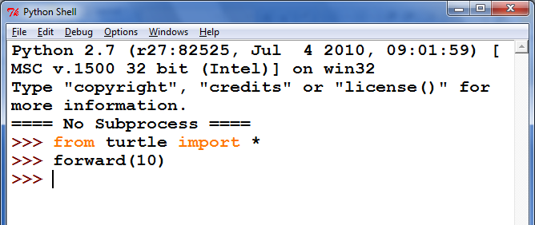
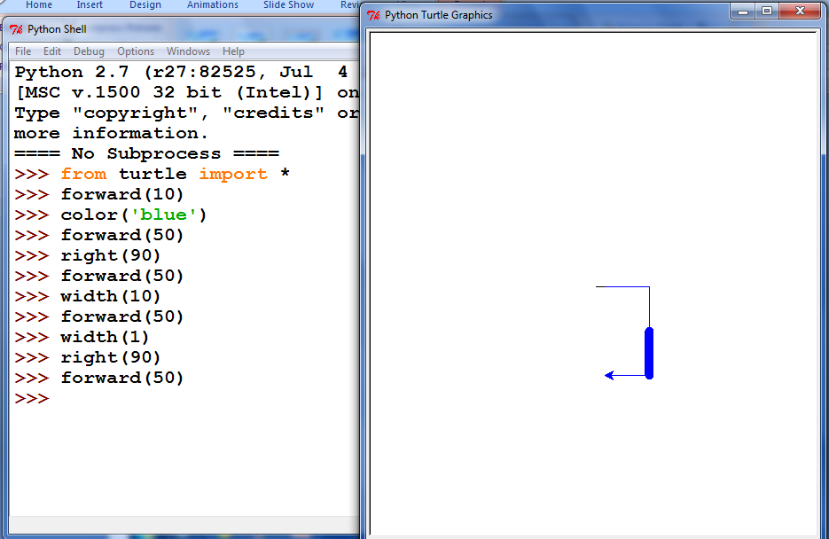

Slide 127
Your Darth Vader proposes an alliance with the other Vader
The other Darth Vader agrees
Together the Darth Vaders over throw the sith lord and begin their own rein of horror
The Darth Vaders are victorious
The galaxy loses
I choose paper !
MMM MMMM
MM M
MM M
MM M
MMM M
MM M
MM M
MMM M
MMMMMM M
MM MMMMM M
MM MM MMM M
MMMMMMMMMMM MMM M
MM M MMMM MMM
M M MMMM MMM MM
M MM M MMM MM MM M
M M M M MMM MMM MMM M
M M MMM MM MMM MM
MMMM M M M M MMM MM MM MM
M M M M M M MM MM M MMMMMMMMM
M M M M M MM MMM M MMMM M
MM M M M M M MMM M MMM M
MM M M M M M MM MM MM
M M M M M M M M MMMMMMM M
M M M M M M MMMMM M
MM M M MM MMMM MMMMM MM
MM M M MMMM MMMM MM M MM
MMM MM M M MM MMMM MM MM MM MM
MM MMM M MMM MM MM MM MM
MM MM M MM M MMMM MM MM MM MMM
M M M MM M M M MM M M M
M M M MMM M M M MM M MMMMMMMMMMMMMM
MMM M M MM MM M M MMMMMMMM MM
MMMMMM M M MM MM M MMMMMMMM MMMMMMMMMM M
MMMMMM M M M M MM MMM MMMMMM MM
MM MMMM M M MMM MM MMM MMM MMMMMMMMM
MM MMM M MMM MM MMM MMMM MM MM M
MM MMM MM M M MMM MMMM MMM MM M
MM MMM MM MM MM M M MM MM
MM MM M MMMM MM MM M MM MM
MM MMM MM MMM MMM MM MMMM MMMM
MM MMMM MM MM MM M MM MMM MM MM MM
M M M M M MMM MMM M MM MM M
MM M M M MMM MM M MM M M
MMMMMM MM M M M MM MM MM M
MMM M M M M M MM MM MM MMM M
MMMM M MM M MM MM MM MMM
M MM M M M MM MM MM MM MMM MM
M MMM M M M M M M MM MM MM M
M M MMM M MMM MMM MM MMM
MM M M MMM M MM M M MM
MM M M MM M MMM MM MM M
M M M MM M MM MMMMMMMM
M MMMM MM M MM MM MMMMM MM
MMMMM M M M M MM MM MMM MMMM M MM
MMMMM MMMM M MM M MMMMMM MMMM MMMMMMMMM
MMMM MMM MM M MMMM MMMM MMMM M
MM MM M MMM M MMMM MMMM MMMM MMMMMMMMMM M
M M M MMMMMM MMM MMMM MMMMM MM MM M
MMMM M M MMMMMMM MM MMMMM MMM MM M
MMMMM MM M M M MMM MMM MM MM MM M MM
MM M MM M M MM MM MM MMM MM
MM M MMM M M M MM M MM MMM M
MM M M M M M MM M MM MMM MMMMMMMMM MM
MMM MM M M M M M M MM MMM MMMMM MMMMMMMMMMMMM
MMMMM M MM MM M M MMM M MMM MMMM MM
MMMM M M M M M M M M MMMMMM MMMM MMMM M
MMMMM M M M MM MMM MMMM MMMM MMM MMM MM
M MMMM MM M M MMMMM MM MMM MMM MMMM
M MMM MMMMM M MM MM MM MMM MMM M
M MMM MM MMMM M M M MM MMM MM
M M M M MMM MM MM MMMMMMMMMMMMMMMMMM
M MM M M M MM M MMMMMMMM MM MMMM
MM MMM M MM M MMMM MMM MM MMMMMM
M MM M M M MM MMM M MM
M M MM M MM M MM MM M
M M M MM MM M MM MM M
M M MMM M MM MM MM M MMMMMMMMMMMM
M M M MM MM M MMMMMM
MMM MM MM M
M MMM M M
MMM MM
M M
Hi... Let's play rock, paper, scissors! What do you choose?
>>>
Chooose your character (Obi-Wan, Anakin, Padme, Darth Vader) Darth Vader
user chose Darth Vader
comp chose Darth Vader
Darth Vader stumbles upon another Darth Vader
0 xE** -> N 0 # Once upon a time, there was
0 *x** -> E 1 # an extremely sad, lost Picobot. Ze
0 NEx* -> W 3 # traveled around a sad, dark maze
0 NEWx -> S 2 # in search of shelter and food.
# Finally, Picobot found a gingerbread
1 ***x -> S 2 # house deep in the corners of the maze.
1 *x*S -> E 1 # Though Picobot knew ze could never find
1 xE*S -> N 0 # zer way around the maze without keeping
1 NExS -> W 3 # zerself near the right-hand wall, ze
# decided the gingerbread house would be
2 **x* -> W 3 # worth disobeying zer program.
2 **Wx -> S 2 # Picobot thoroughly enjoyed zer
2 *xWS -> E 1 # gingerbread meal, but when ze tried to
2 xEWS -> N 0 # find zer way back to the maze, ze was so
# confused ze didn't know what to do.
3 x*** -> N 0 # Picobot began to sit in the corner,
3 N*x* -> W 3 # sighing in despair.
3 N*Wx -> S 2 # Suddenly, along came a noble grutor who
3 NxWS -> E 1 # showed Picobot the way through the maze.
# And there was much rejoicing. THE END

Slide 128
y = 2x
(7.5,15)
(5,10)
(2.5,5)
(0,0)
0x2.5
5x2.5
10x2.5
15x2.5
Areas of 4 rectangles

