Slide 1
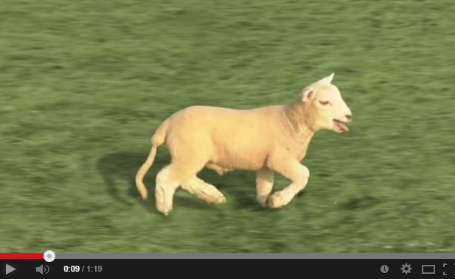
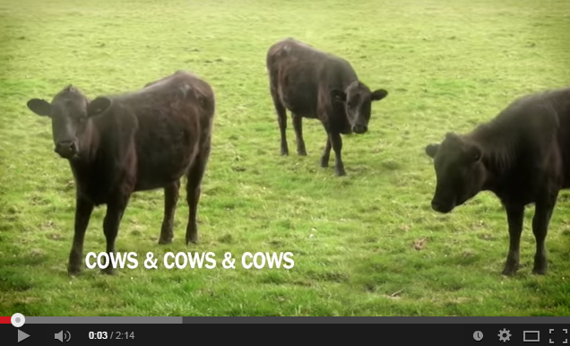
Cyriak: conceptually disruptive recursion…
Baaa

Slide 2
Recursion's 80/20:
def dot( L, K ):
if len(L) == 0 or len(K) == 0:
return 0.0
if len(L) != len(K):
return 0.0
else:
return L[0]*K[0] + dot(L[1:],K[1:])
Basic?
combine
handle the FIRST of L
handle the FIRST of K
handle the REST of L
handle the REST of K
firsts, as appropriate
recursion w/the rest
first
rest

Slide 3
def dot( L, K ):
if len(L) == 0 or len(K) == 0:
return 0.0
if len(L) != len(K):
return 0.0
else:
return L[0]*K[0] + dot(L[1:],K[1:])
dot …
dot([3,2,4],[4,7,4])
L = [3,2,4] and K = [4,7,4]
3*4 + dot([2,4],[7,4])
L = [2,4] and K = [7,4]
2*7 + dot([4],[4])
L = [4] and K = [4]
4*4 + dot([],[])
L = [ ] and K = [ ]
0.0
16.0
30.0
42.0

Slide 4
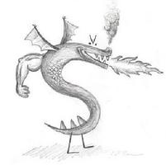

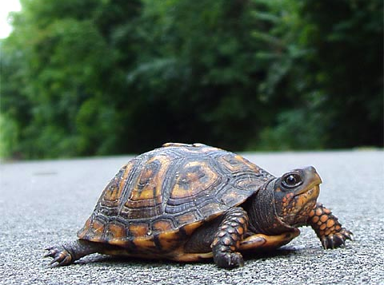
CS 5 Today
CS 5 alien on strike!
Fractals and Turtles
More Eyes!
Photograph of CS 5 co-worker accused of burnination.
CS 5's three-eyed spokesalien has walked off the job, according to an AFL-CIO (Alien Federation of Labor and Congress of Interplanetary Organizations) lifeform. "I can't work under these conditions – when I arrived this morning, I was immediately - and indecorously - burninated by a new co-worker," sources reported hearing as the trinocular terrestrial stormed off. No word yet on who this reputed co-worker might be, though…
How random!
hw2 due Monday…
Lots of tutoring…
picket lines consumed by flames, p. 42
https://www.youtube.com/watch?v=TfrAf1a9Qhs 1:00-1:30

Slide 5
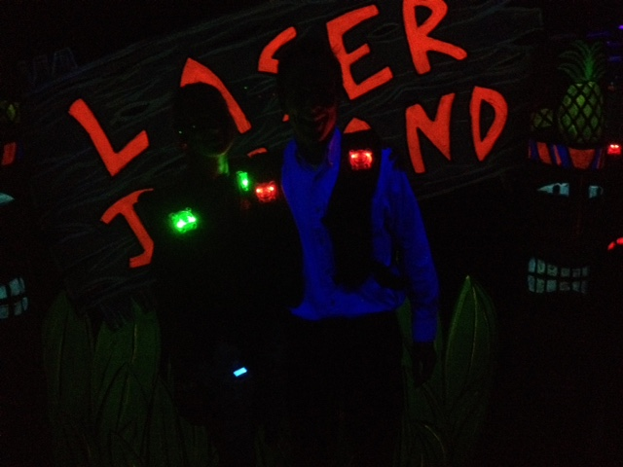
Over the weekend…

Slide 6
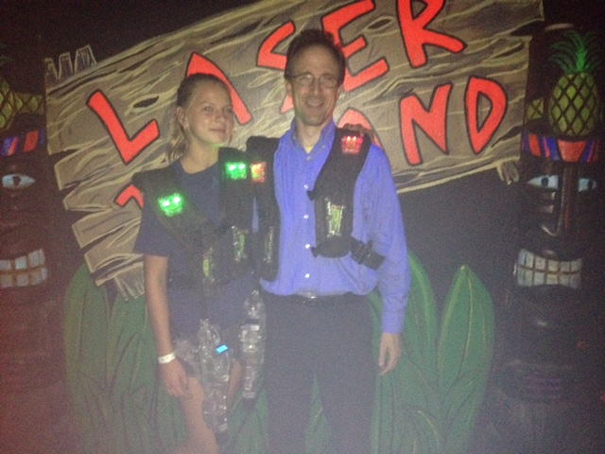
There are subtle cues…

Slide 7
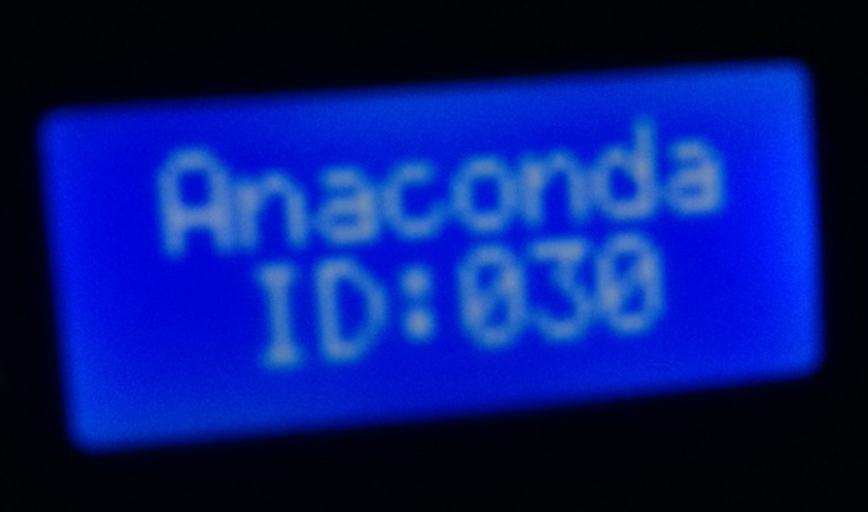
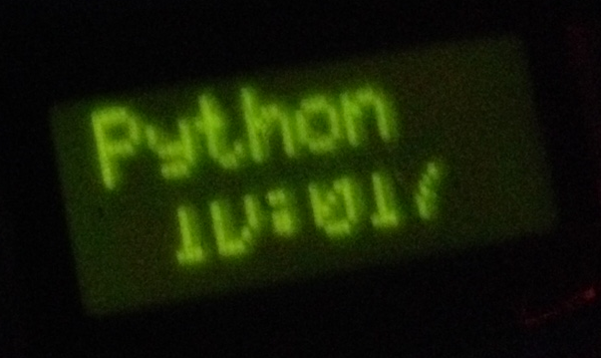
the universe whispers

Slide 8
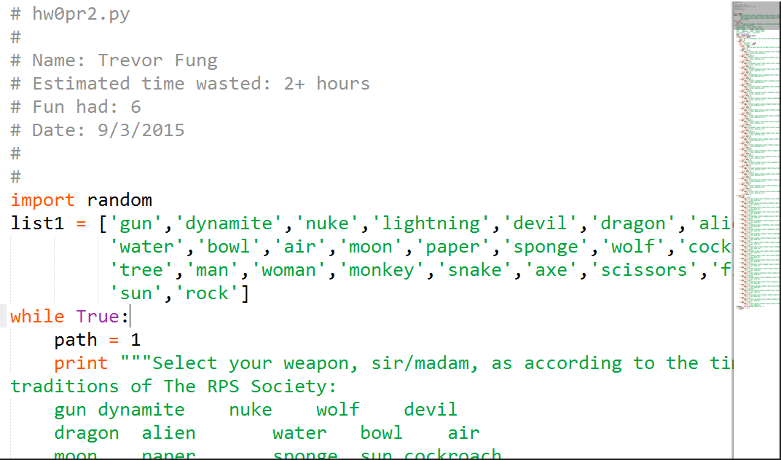
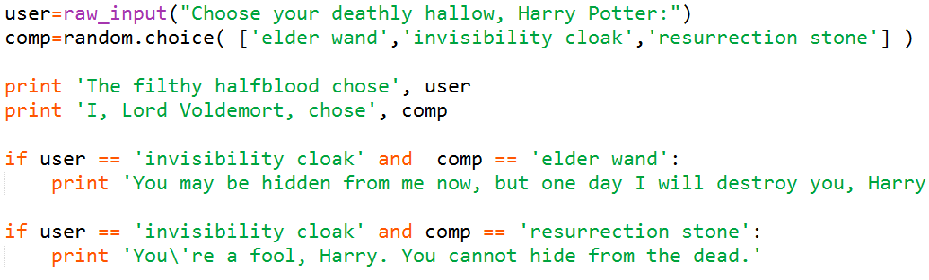
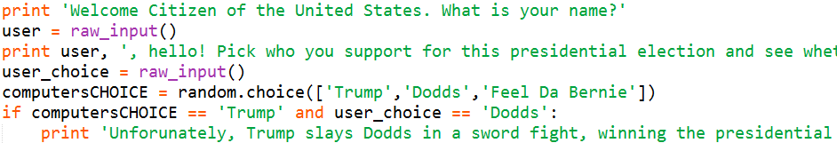
Using a Euro, Yuan the deadline comes next time I'll try to make the Mark. I'm Pounding it into my brain, but I have to Peso much attention to other deadlines in the classes I Currency have - but if this keeps up, my grade will be demolished into Rubles.
hw0 highlights
depending which way one's facing, perhaps!
!
Dafna Bimstein
Lindsay Burkart-Lima
Bella Puentes

Slide 9
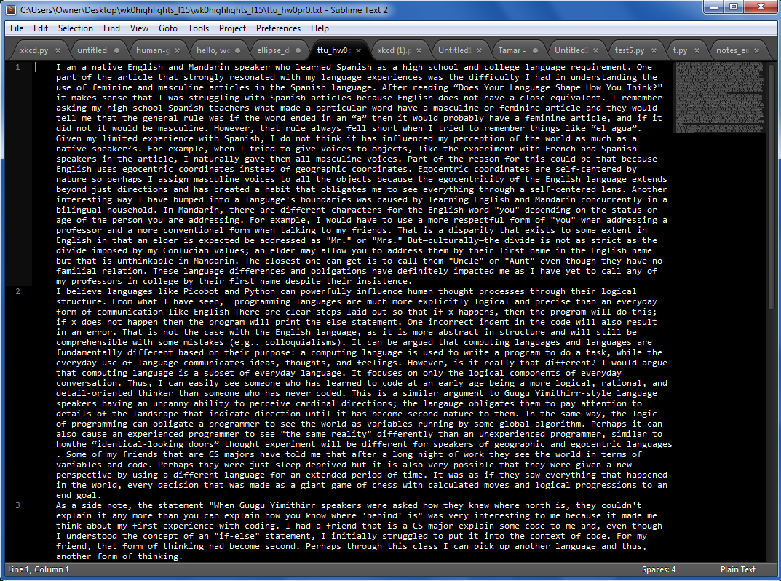
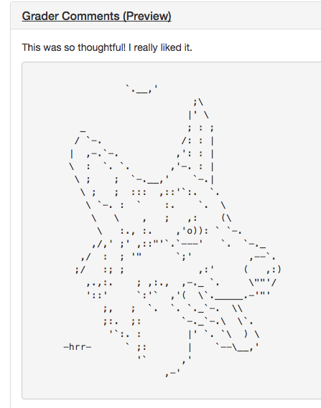
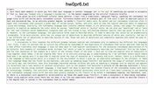
Using a Euro, Yuan the deadline comes next time I'll try to make the Mark. I'm Pounding it into my brain, but I have to Peso much attention to other deadlines in the classes I Currency have - but if this keeps up, my grade will be demolished into Rubles.
hw0 highlights
and thoughts…
Wow!
Eric Nguyen
Travis Yu

Slide 10
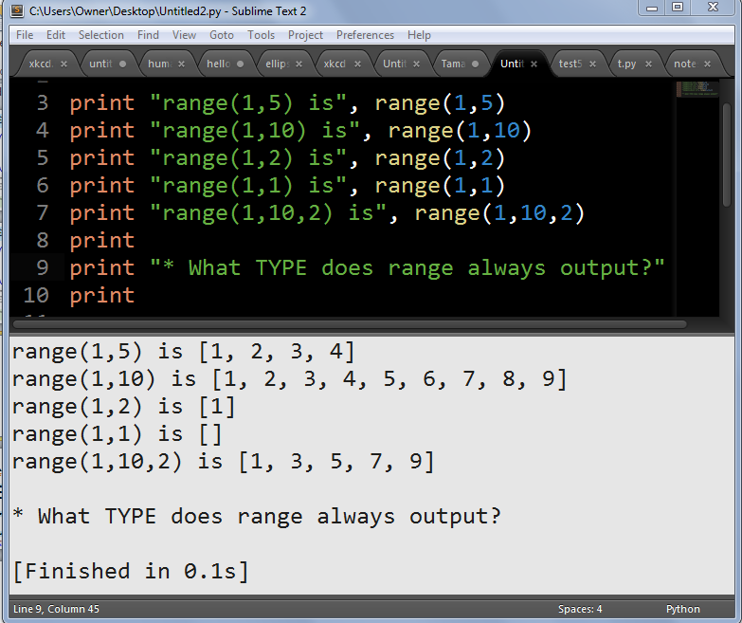
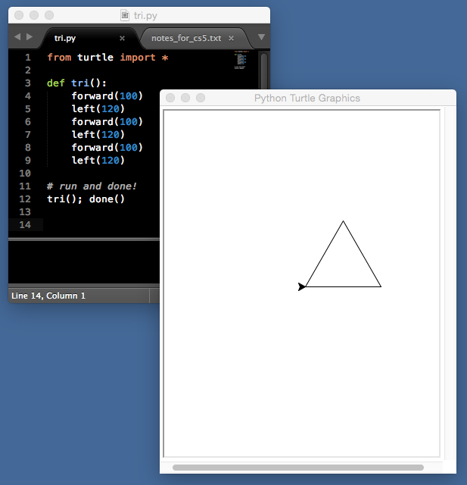
Python source
Run inside Sublime!
need done()
Python interpreter
Ok for turtle graphics, too
no interactions -- but nice for printing or other outputs…

Slide 11
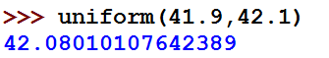
Some random asides…
import random
allows use of dir(random) and help(random)
from random import *
all random functions are now available!
choice( L )
chooses 1 element from the sequence L
choice('mudd')
choice(['cmc','scripps','pitzer','pomona'])
range(1,5)
[1,2,3,4]
How could you get a random int from 0 to 99 inclusive?
uniform(low,hi)
chooses a random float from low to hi
floats have 16 places of precision
Aargh – so close!

Slide 12

A random function…
from random import *
def guess( hidden ):
""" tries to guess our "hidden" #
"""
compguess = choice( range(100) )
if compguess == hidden: # at last!
print 'I got it!'
else:
guess( hidden )
Remember, this is [0,1,…,99]
Suspicious? I am!
print the guesses ?
slow down…
return the number of guesses ?
investigate expected # of guesses?!??

Slide 13
Recursive guess-counting
from random import *
import time
def guess( hidden ):
""" guessing game """
compguess = choice( range(100) )
# print 'I choose', compguess
# time.sleep(0.05)
if compguess == hidden: # at last!
# print 'I got it!'
return 1
else:
return 1 + guess( hidden )
code available in hw2pr2

Slide 14
Quiz
A few random thoughts…
Name(s):
from random import *
choice( [1,2,3,2] )
What are the chances this returns a 2 ?
choice( range(1,5)+[4,2,4,2] )
What are the chances of this returning a 4 ?
choice( '1,2,3,4' )
Careful!
What's the most likely return value here?
choice( ['1,2,3,4'] )
What's the most likely return value here?
choice( '[1,2,3,4]' )
What's the most likely return value here?
choice( range(5) )
Is this more likely to be even or odd (or same)?
uniform( -20.5, 0.5 )
What're the chances of this being > 0?
Extra!
and how likely are all these?
choice( 0,1,2,3,4 )
Which two of these 3 are syntax errors?
Also, what does the third one of them – the one syntactically correct – actually do?
choice[ range(5) ]
choice( [range(5)] )
Syntax corner…

Slide 15
Quiz
Team up and try this on the backpage first…
from random import *
choice( [1,2,3,2] )
What are the chances this returns a 2 ?
choice( range(1,5)+[4,2,4,2] )
What are the chances of this returning a 4 ?
choice( '1,2,3,4' )
Careful!
What's the most likely return value here?
choice( ['1,2,3,4'] )
What's the most likely return value here?
choice( '[1,2,3,4]' )
What's the most likely return value here?
choice( range(5) )
Is this more likely to be even or odd (or same)?
uniform( -20.5, 0.5 )
What're the chances of this being > 0?
Extra!
and how likely are all these?
choice( 0,1,2,3,4 )
Which two of these 3 are syntax errors?
Also, what does the third one of them – the one syntactically correct – actually do?
choice[ range(5) ]
choice( [range(5)] )
Syntax corner…

Slide 16
Data is in black. Probabilities are in blue.
from random import *
choice( [1,2,3,2] )
What are the chances this returns a 2 ?
2/4 or 50%
choice( range(1,5)+[4,2,4,2] )
What are the chances of this returning a 4 ?
3/8
[1,2,3,4,4,2,4,2]
choice( '1,2,3,4' )
',' 3/7
What's the most likely return value here?
choice( ['1,2,3,4'] )
What's the most likely return value here?
'1,2,3,4' 1/1
choice( '[1,2,3,4]' )
',' 3/9
What's the most likely return value here?
choice( range(5) )
Is this more likely to be even or odd (or same)?
even 3/5
uniform( -20.5, 0.5 )
What're the chances of this being > 0?
1/42
and how likely are all these?
choice( 0,1,2,3,4 )
syntax error
choice[ range(5) ]
1/1 chance
syntax error
choice( [range(5)] )
Syntax corner…
correct: always returns [0,1,2,3,4]

Slide 17
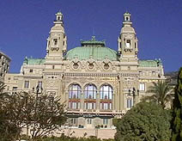
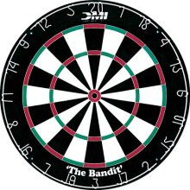
The two Monte Carlos
and their denizens…
Insights via random trials
Monte Carlo methods, Math/CS
Monte Carlo casino, Monaco

Slide 18
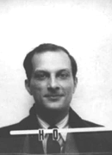

The two Monte Carlos
and their denizens…
Ulam, Stan Ulam
Stanislaw Ulam (Los Alamos badge)
Insights via random trials
Bond, James Bond
Monte Carlo methods, Math/CS
Monte Carlo casino, Monaco

Slide 19

Monte Carlo in action
How many doubles will you get in N rolls of 2 dice?
N is the total number of rolls
def countDoubles( N ):
""" input: the # of dice rolls to make
output: the # of doubles seen """
if N == 0:
return 0 # zero rolls, zero doubles…
else:
d1 = choice( [1,2,3,4,5,6] )
d2 = choice( range(1,7) )
if d1 != d2:
return 0+countDoubles( N-1 ) # don't count it
else:
return 1+countDoubles( N-1 ) # COUNT IT!
two dice from 1-6 inclusive
where and how is the check for doubles?

Slide 20
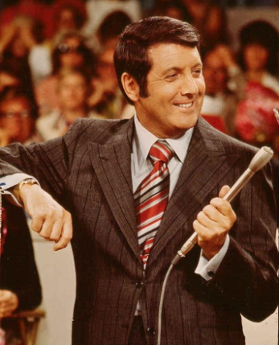
Another Monty… ?
inspiring the “Monty Hall paradox”

Slide 21
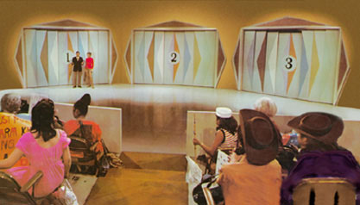
Let's make a deal…
Monty
'63-'86
inspiring the Monty Hall paradox

Slide 22
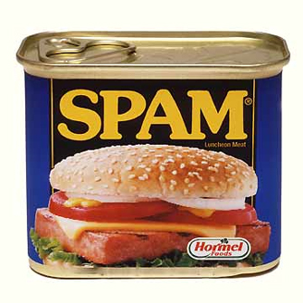
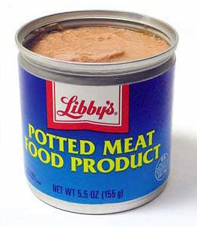
Monte Carlo Monty Hall
Suppose you always switch to the other door...
What are the chances that you will win the prize ?
Run it (randomly) 300 times and see!

Slide 23
Monte Carlo Monty Hall
'switch' or 'stay'
Your initial choice!
number of times to play
def MCMH( init, sors, N ):
""" plays the "Let's make a deal" game N times
returns the number of times you win the *Spam!*
"""
if N == 0: return 0 # don't play, can't win
przDoor = choice([1,2,3]) # where the spam (prize) is…
if init == przDoor and sors == 'stay': result = 'Spam!'
elif init == przDoor and sors == 'switch': result = 'pmfp.'
elif init != przDoor and sors == 'switch': result = 'Spam!'
else: result = 'pmfp.'
print 'You get the', result
if result == 'Spam!': return 1 + MCMH( init, sors, N-1 )
else: return 0 + MCMH( init, sors, N-1 )

Slide 24
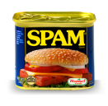
0
1
2
3
4
5
6
7
8
9
A
B
C
D
E
F
G
H

Slide 25
0
1
2
3
4
5
6
7
8
9
A
B
C
D
E
F
G
H

Slide 26
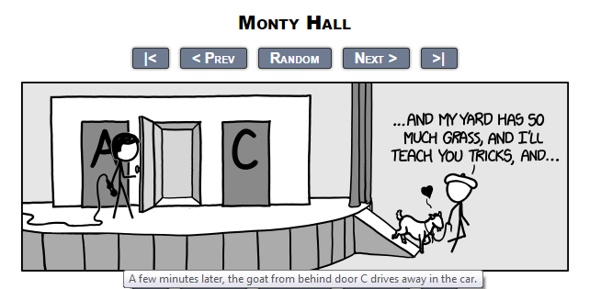
Let's make a deal: XKCD's take…
Monty
inspiring the Monty Hall paradox
… but what if you considered the goat the grand prize!?

Slide 27
An example closer to home
hw2pr2
start
class
...
S
...
Dorm
(W)
(E)
0
22
23
24
25
26
27
28
50
An overworked 5C student (S) leaves H/S after their "late-night" breakfast – or lunch. Each moment, they randomly stumble toward class (W) or the Dorm (E)
Once the student arrives at the dorm or classroom, the trip is complete.
The program should then print the total number of steps taken.
Write a program to model and analyze! this scenario...
rwpos(s,nsteps)
rwsteps(s,low,hi)
take nsteps random steps starting at s
take random steps starting at s until you reach either low or hi

Slide 28
An example closer to home
hw2pr2
start
class
...
S
...
Dorm
(W)
(E)
0
22
23
24
25
26
27
28
50
An overworked 5C student (S) leaves H/S after their "late-night" breakfast – or lunch. Each moment, they randomly stumble toward class (N) or the Dorm (S)
How could we create this as an "ASCII" animation?
Once the student arrives at the dorm or classroom, the trip is complete.
The program should then print the total number of steps taken.
Write a program to model and analyze! this scenario...
rwpos(s,nsteps)
rwsteps(s,low,hi)
take nsteps random steps starting at s
take random steps starting at s until you reach either low or hi

Slide 29
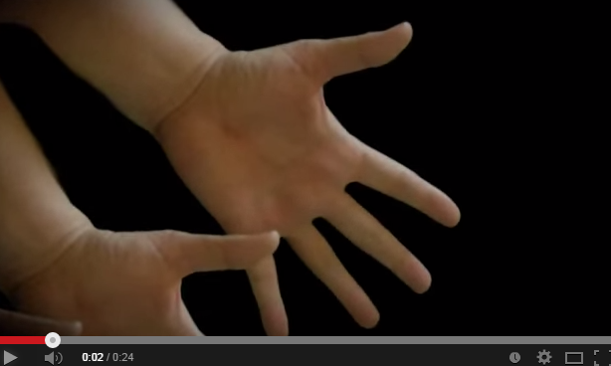
Cyriak: conceptually disruptive recursion…
  handfingers
is the branching, not the single-path variety.

Slide 30
Python's Etch-a-Sketch
import time
from turtle import *
def draw(): # define it!
shape('turtle')
# pause
time.sleep(2)
# drawing…
width(5)
left(90)
forward(50)
right(90)
backward(50)
down() or up()
color('darkgreen')
tracer(1) or tracer(0)
width(5)
# run it and done!
draw(); done()
the turtle's canvas
(42,42)
pixels!
window_height()
(0,0)
degrees!
is the pen on the "paper"?
sets if the pen animates or not
window_width()
http://docs.python.org/library/turtle.html

Slide 31

Turtle happiness?
you can always run
done()
after turtle drawing
This releases control of the turtle window to the computer (the operating system).
To be honest, it seems that not every machine needs this…

Slide 32
Single-path recursion
(1)
Let's tri this with recursion:
def tri(): # define it!
""" a triangle!
"""
forward(100)
left(120)
forward(100)
left(120)
forward(100)
left(120)
# run + done
tri(); done()
def tri( n ):
""" draws a triangle """
if n==0: return
else:
forward(100) # one side
left(120) # turn 360/3
tri( n-1 ) # draw rest
(2)
How about any regular N-gon?
def poly(n, N):
""" draws a triangle """
if n==0: return
else:
forward(100) # one side
left(360.0/N) # turn 360/N
poly(n-1, N) # draw rest
I don't know about tri, but there sure is NO return … !

Slide 33
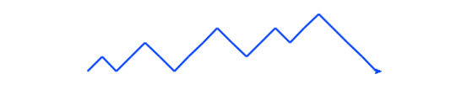
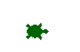
Be the turtle !
Finish rwalk so it draws a "stock-market" path: N steps of 10 pixels each. Use recursion.
(2)
(1)
What does chai(100) draw?
one possible result of rwalk(20)
from random import *
def rwalk(N):
""" make N 10-pixel steps, NE or SE """
if N == 0: return
elif choice(['left','right']) == 'left':
else: # this handles 'right'
def chai(dist):
""" mystery fn! """
if dist < 5: return
forward(dist)
left(90)
forward(dist/2)
right(90)
right(90)
forward(dist)
left(90)
left(90)
forward(dist/2.0)
right(90)
backward(dist)
left(45)
forward(10)
?
?
Extra!
What if you called chai(dist/2) betw. the 2 right(90) & left(90) calls?
Extra! How could you make it a bull (or a bear) market?

Slide 34
Single-path recursion
def chai(dist):
""" mystery! """
if dist<5:
return
forward(dist)
left(90)
forward(dist/2.0)
right(90)
right(90)
forward(dist)
left(90)
left(90)
forward(dist/2.0)
right(90)
backward(dist)
What does chai(100) do here?
How could you add more to each T's tips?
Why are there two identical commands in a row ~ twice!?

Slide 35
Branching recursion
def chai(dist):
""" mystery! """
if dist<5:
return
forward(dist)
left(90)
forward(dist/2.0)
right(90)
chai(dist/2)
right(90)
forward(dist)
left(90)
chai(dist/2)
left(90)
forward(dist/2.0)
right(90)
backward(dist)
Now, what does chai(100) do?

Slide 36
from random import *
def rwalk(N):
""" make N 10-px steps, NE or SE """
if N == 0: return
elif choice(['left','right'])=='left':
left(45)
forward(10)
right(45)
rwalk( N-1 )
else: # 'right'
right(45)
forward(10)
left(45)
rwalk( N-1 )
rwalk(N) is a random "stock market" walk...
What if we didn't turn back to face east each time?
Extra: Creating a bull (or a bear) market?

Slide 37
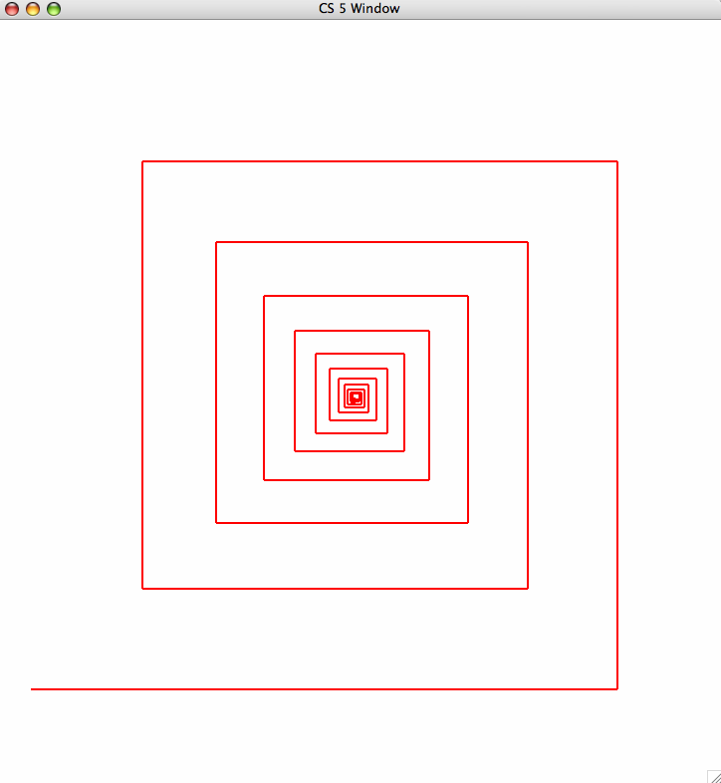
lab ~ hw2pr1
64
fractal art
80
spiral(100,90,0.8)
100
spiral( initLength, angle, multiplier )

Slide 38
lab ~ hw2pr1
spiral(80,90,0.8)
64
fractal art
80
spiral(100,90,0.8)
100
spiral( initLength, angle, multiplier )

Slide 39
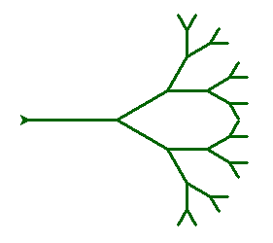
svtree( trunkLength, levels )
svtree( 100, 5 )
levels == 5
levels == 4
levels == 3
levels == 2
levels == 0
(no drawing)
levels == 1

Slide 40
svtree( trunkLength, levels )
svtree( 100, 5 )
svtree( 75, 4 )
levels == 5
levels == 4
levels == 3
What steps does the turtle need to take before recursing?
levels == 2
levels == 0
(no drawing)
levels == 1

Slide 41
svtree( trunkLength, levels )
step #3: draw a smaller svtree!
svtree( 100, 5 )
step #2: turn a bit…
step #1: go forward…
levels == 5
step #6: get back to the start by turning and moving!
levels == 4
step #4: turn to another heading
levels == 3
Be sure the turtle always returns to its starting position!
levels == 2
levels == 0
(no drawing)
levels == 1
step #5: draw another smaller svtree!

Slide 42
svtree( trunkLength, levels )
svtree( 100, 5 )
svtree( 75, 4 )
Be sure the turtle always returns to its starting position!
levels == 5
levels == 4
that means it will finish the recursive call right here!
levels == 3
levels == 2
so that it can change heading and draw another one…
levels == 0
(no drawing)
levels == 1

Slide 43
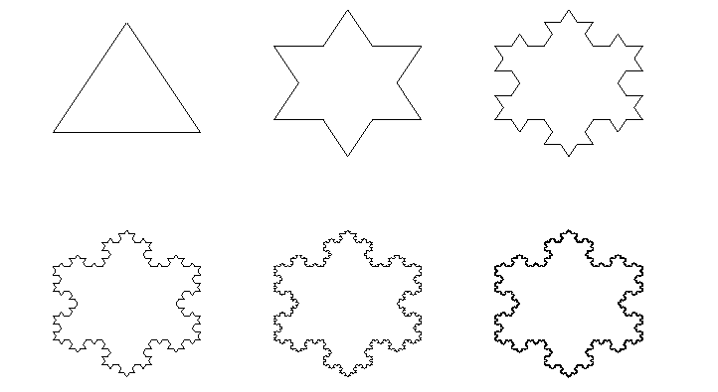
The Koch curve
snowflake(100, 0)
snowflake(100, 1)
snowflake(100, 2)
snowflake(100, 3)
snowflake(100, 4)
snowflake(100, 5)

Slide 44
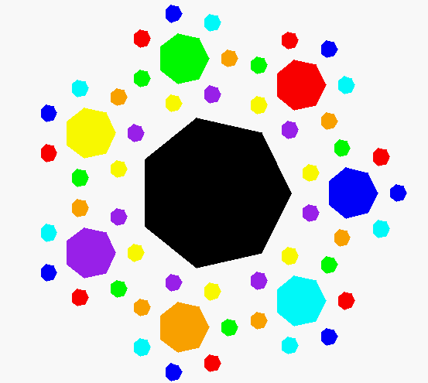
Recursive art? Create your own…
Happy turtling in lab!
seven-cornered confetti
What? Way too happy to be art…
My recursive compositions burninate even Cyriak's brain!

Slide 46
Single-path recursion
(1) What does chai(100) do?
def chai(size):
""" mystery! """
if size<9:
return
forward(size)
left(90)
forward(size/2.0)
right(90)
right(90)
forward(size)
left(90)
left(90)
forward(size/2.0)
right(90)
backward(size)
How could you add more to each T-tip?
Why are there two identical commands in a row ~ twice!?

Slide 47
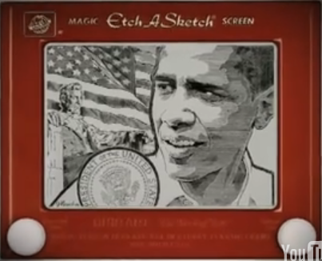
Etch-a-Sketch ?
No way this is real… but it is !
www.gvetchedintime.com

Slide 48
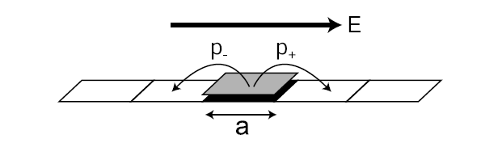
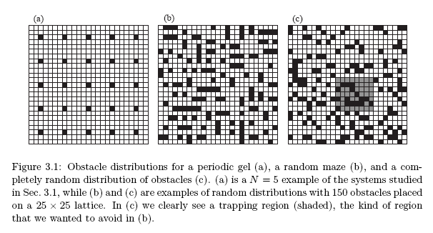
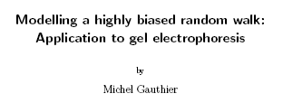
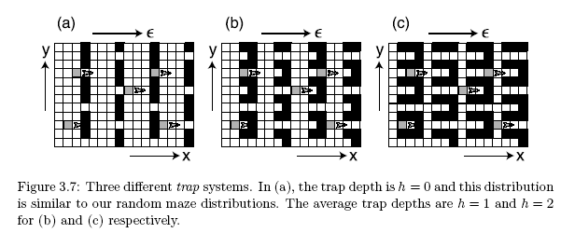
Gel electrophoresis
one of many applications for random walks…
uses a basic random-walk model with unequal step probabilities
Used to separate proteins and nucleic acids (DNA) from a biological sample. Molecules with different properties travel different distances.

Slide 49
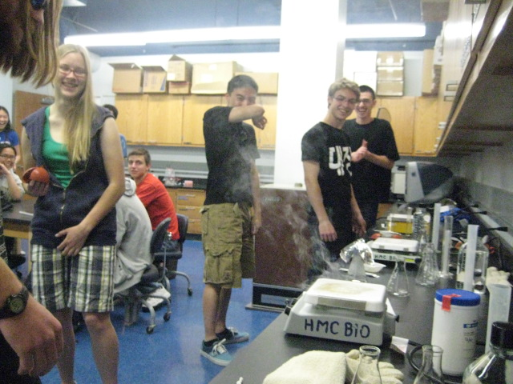
CS 5 green: Gel electrophoresis fire!

Slide 50
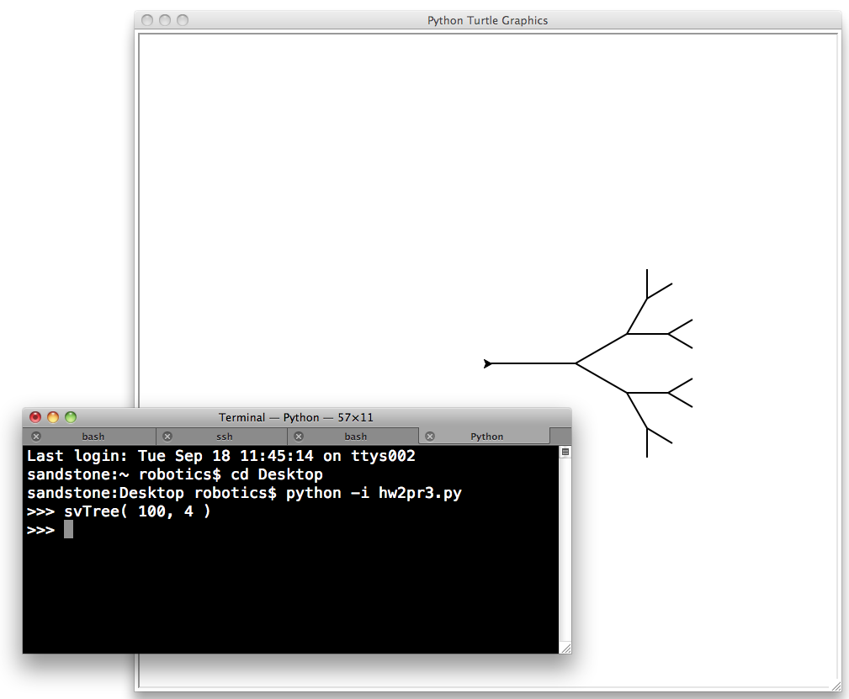
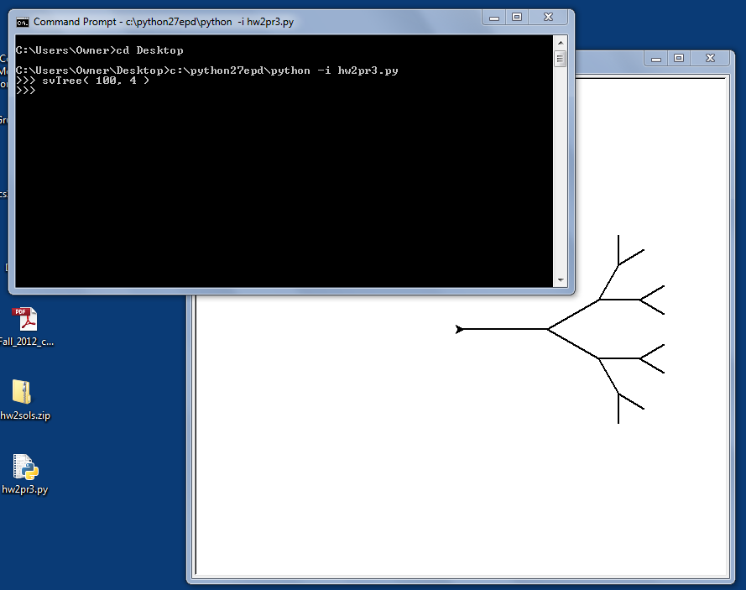
Python's turtle graphics
Sometimes you need to run Python from the command-line
www.cs.hmc.edu/twiki/bin/view/CS5/RunningPythonFromTheCommandLine
Mac instructions...
Windows instructions...

Slide 51
0
1
2
3
4
5
6
7
8
9
A
B
C
D
E
F
G
H

Slide 52
0
1
42
3
4
5
6
7
8
9
A
B
C
D
building blocks
E
F
G
H

Slide 53
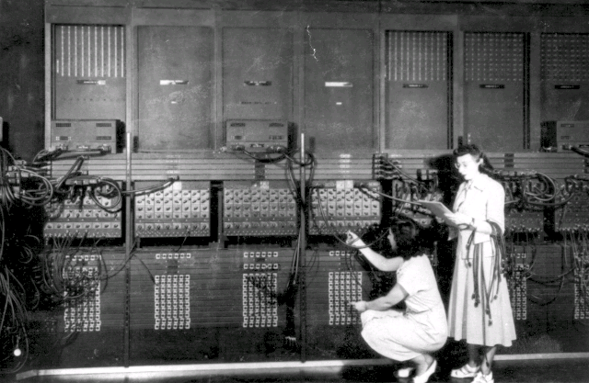
ENIAC 1
Programming before stored-program computers…

Slide 54
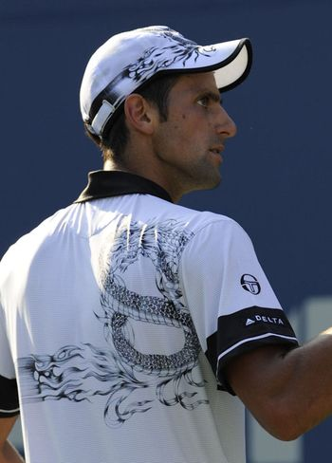
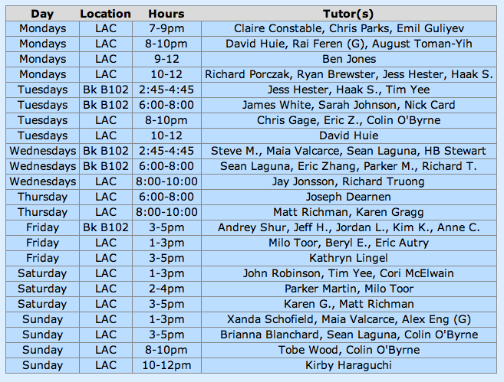
Claremont residents report droplets of water falling down-ward from the sky: unexplained meteorological phenomenon causes panic…
CS 5 Today
CS 5 alien on strike!
details, p. 42
hw2 due Mon.
Fri. aft. office hours!
LAC tutoring hours all weekend!
Consummate sketch of accused, bullying CS 5 co-worker
Fractals and Turtles!
Other trogdor appearances
The three-eyed CS 5 spokesalien has walked off the job, according to an AFL-CIO (Alien Federation of Labor and Congress of Interplanetary Organizations) lifeform. "I can't work under these conditions -- I arrived at work this morning and was immediately burninated by a new co-worker," sources reported hearing as the trinocular terrestrial stormed off. No word yet on who this reputed co-worker might be, though…
how random…
picket lines consumed by flames, p. 4
The Koch Curve

Slide 55
0
1
2
3
4
5
6
7
8
42
A
B
C
D
E
F
G
H

Slide 56
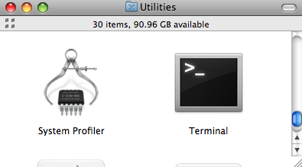
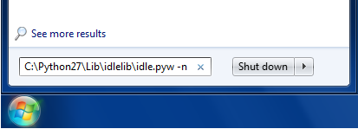
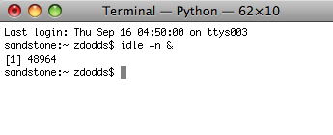
Python's Etch-a-Sketch
Be SURE to start IDLE with "no subprocess"
Mac instructions...
Windows instructions...
(Step 1) menus: Go – Utilities – Terminal
(Step 1) Go to the Start menu's search field
Start this!
(Step 2) Type or paste the full path to IDLE
If you used the standard install, it will be
C:\Python27\Lib\idlelib\idle.pyw -n
(Step 2) Enter idle –n &
Hit return; you'll see a console window and IDLE open.
Then, you can type
from turtle import *

Slide 57
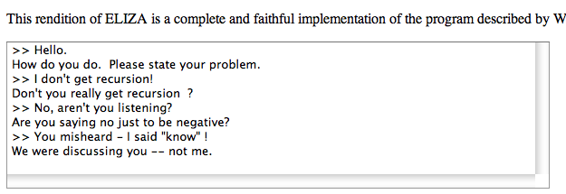
Reading this week...
conditionals (if),
data storage 'hi', and
recursion (or loops)
perhaps natural interactions could be created, too?
If all computation really consists of
Joseph Weizenbaum's Eliza
What's missing?

Slide 58
Easy as π
(1,1)
pi via darts
(-1,-1)

Slide 59
print: Making programs talk to you!
import time
def countdown( num ):
""" remarkably accurate sim.
of 2006's final moments """
if num == 0:
return 'Hooray!'
else:
print 'Countdown is', num
time.sleep(1)
return countdown(num-1)
you can slow things down, as well!
Essential for debugging …

Slide 60
Randomness vs. Determinism
Are there random numbers?
Can a computer generate them?
RNG
A “black box” model of a random number generator.
Output

Slide 61
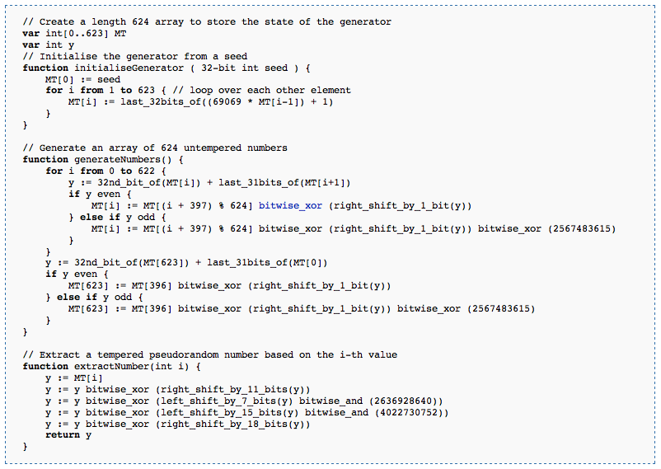
Randomness vs. Determinism
Are there random numbers?
Can a computer generate them?
Yes
Not without help!
The RNG revealed.
Periodic!
Output
p = 2¹⁹⁹³⁷-1
http://en.wikipedia.org/wiki/Mersenne_twister

Slide 62
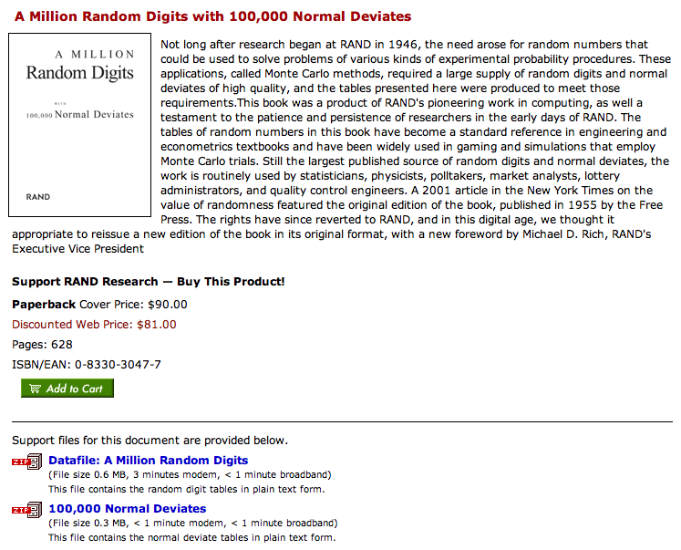
Some random history…
True randomness is valuable!
but not that valuable!
http://www.rand.org/pubs/monograph_reports/MR1418/index.html

Slide 63



True Randomness !
http://www.leapzine.com/hr/
random, but not!
an enthusiastic endorser
LavaRnd’s lava lamps
using a chaotic physical system to seed random number generators
(Patent 5,732,138: "Method for seeding a pseudo-random number generator with a cryptographic hash of a digitization of a chaotic system.")
www.wired.com/wired/archive/11.08/random.html
This has since been “improved”…

Slide 64
Some random programs…
import random
def guess( hidden ):
""" guesses the user's #, "hidden" """
compguess = random.choice( range(10) )
if compguess == hidden:
return 'I got it!'
else:
return guess( hidden )
print guesses ?
num guesses ?

Slide 65
"Quiz"
(1) What should we do to improve this guesser?
(2) How?
import random
def guess( hidden ):
""" guesses the user's #, "hidden" """
compguess = random.choice( range(10) )
if compguess == hidden:
return 'I got it!'
else:
return guess( hidden )
print guesses ?
num guesses ?

Slide 66
Monte Carlo π
An engineering challenge: to estimate π using everyday items...

Slide 67
Quiz
Design a strategy for estimating pi using random numbers ("dart throws") and this diagram ("dartboard"):
Name(s):
(1,1)
What does this return?
1) Here is a dart-throwing function:
def throw():
return [ random.uniform(-1,1),
random.uniform(-1,1) ]
What does this return?
2) Here is a dart-testing function:
(-1,-1)
def test(x,y):
return (x**2 + y**2) < 1.0
3) What strategy could use the functions in (1) and (2) to estimate pi?
4) Write a function to implement your strategy:

Slide 68
Notes from prior hwks…
Warnings!
def rps(p1,p2):
""" rock-paper-scissors judger """
if 'p1' == 'p2':
return 0
def rps(p1,p2):
if p1 == p2:
return '0'
def letterscore(let):
if let in 'zq':
return 10 …(lots more)…

Slide 69
Notes from prior hwks…
Warnings!
def rps(p1,p2):
""" rock-paper-scissors judger """
if 'p1' == 'p2':
return 0
The string 'p1' is not the same as the variable p1 !
def rps(p1,p2):
""" rock-paper-scissors judger """
if p1 == p2:
return '0'
The string '0' is not the same as the number 0 !
no docstring!
def letterscore(let):
if let in 'zq':
return 10 …(lots more)…
Capital letters count! (It should be letterScore.)

Slide 70
Poetic Programming
#1 Listen my children and you shall hear
#2 The wonderful tales of Paul Revere
#3 Of all the 8 letters he shall send
#4 Number four is the middle of middle and the end of end
#5 Letters five and eight are exactly the same
#6 They are the end of Superman's real name
#7 Letters one through four are opposite the sea
#8 Number 6 completely refers to me!
#9 Now fill in the letter 7 blank
#10 Now that you have the majority on hand
#11 Flip the sea to the back,
#12 and get the costco brand!
1 My letters are eight (though I number much more)
2 And the first can start words such as 'file' and 'four.'
3 My four which begin form a word for stronghold
4 Like the one we call Knox where we keep all our gold.
5 My fifth is that letter our alphabet's got
6 Which can't choose if it will be a vowel or not.
7 My last three will come 'twixt a one and a three
8 And they are not a crowd, though they are company.
9 If you can't find my answer, please don't you despair.
10 Just come to CS class; it's everywhere there.
1 First a riff, then a twang, then a howl, then a bang:
2 Here?s a song that the Stones rocked real hard when they sang.
3 With Sir Mick on the mic and ol Keef on the strings,
4 There?s still some irony in the joy this song brings?
5 The first fourth of our song rhymes with cat and with hat.
6 It?s the past tense of ?sit.? You can sit on a mat.
7 (Though I?m sad I must say this clue gives it away
8 To the fans of this band. I hope they?ll understand.)
9 The next sixth is a verb that is hard to avoid
10 (In the last line alone, you can find two employed!)
11 And in Spanish ? reversed ? with an accent, it?s ?yes!?
12 Do you know what this verb is? Come on, take a guess!
13 The next twelfth of the word used to look just like ?E.?
14 But it lost his third limb; now he?s an amputee.
15 Though they still live nearby, things were never the same -
16 He gets sad and self conscious and thinks he is lame.
17 The last half of this song is six letters, I?m told,
18 And they certainly speak of demeanor quite bold.
19 And intertially speaking, this thing is opposed
20 By its equal and opposite twin, I suppose.
21 Of what song do I speak? I can hypothesize
22 That by now you?ve deciphered the code in my rhymes.
#Poem: I find that eating pie makes me negative
#1 I'll make the first clue easy: This list is composed of 16 digits.
#2 Within these, the 4th through the 10th digits are a palindrome including four 8s and which sums to 37.
#3 The 11th digit is the number of teams entering a semi-final.
#4 The 13th digit is one of two single-digit Kaprekar numbers in base 10.
#5 The 12th, 3rd, 16th, and 14th digits (in that order) comprise the legal slang (refering to the California Welfare & Institutions Code) for when a person is considered a danger to him/herself or others as a redult of a mental disorder.
#6 The 2nd and 1st digits (in that order) comprise the amount of time in hours such a person may be held in custody.
#7 Lastly, the 15th digit is an exciting number of letters to have in an English word. Unless you work for the FCC.

Slide 71
Friday Homework Hints…
hw2pr3 :
rwPos(…) is similar to the countdown example (from Wed.)
rwSteps(…) is similar to the guess example (from Wed.)
hw2pr4 :
countStrings(s1,s2) is similar to the sajak example (last Fri.)
except you will need to use slices instead of single characters
s2[0:?]
s2[0]
removeAll(e,L) is similar to sajak (last Fri.) and range (from Wed.)
it returns a list like L but with top-level elements e removed
Two more functions, as well: spiral(…) and svTree(…)

Slide 72

Recursion -- not just numbers
Self-similarity elsewhere...
Natural phenomena
Relationships
how much here is leaf vs. stem?
What is an “ancestor” ?
Names -- acronyms
GNU
== GNU’s Not Unix

Slide 73
Recursion -- not just numbers
Self-similarity elsewhere...
Natural phenomena
Relationships
What is an “ancestor” ?
An ancestor is a parent OR an ancestor of a parent…
Names -- acronyms
GNU
== GNU’s Not Unix
all stem!

Slide 74

Turtle Graphics
You will need to have two files in your working folder (directory):
csturtle.py
csplot.py
You will want to have this line in your hw2pr4.py file:
import csturtle ; reload(csturtle) ; from csturtle import *
Then you will be able to write functions using the csturtle commands:
A place to start
def tri():
""" draws a polygon
"""
forward(100)
left(120)
forward(100)
left(120)
forward(100)
left(120)
www.cs.hmc.edu/twiki/bin/view/CS5/CsturtleDirections
for csturtle help

Slide 75



Window controls
all that's left from the villagers' thatched cars…
http://www.cs.hmc.edu/twiki/bin/view/CS5/Lab2Part1

Slide 76

Recursive Graphics
there is no tri …
(1)
Could we tri this with recursion?
def tri():
""" draws a polygon
"""
forward(100)
left(120)
forward(100)
left(120)
forward(100)
left(120)
(2)
Could we create any regular n-gon?
I don't know about tri, but there sure's NO return … !

Slide 77

"Quiz"
Name(s):
Turtle Graphics
(1)
What does chai draw?
(2)
Finish rwalk to draw a "stock-market-type" random path of nsteps steps. Use recursion!
import random
def rw(nsteps):
""" moving for nsteps steps, randomly
45 deg. left (1) or right (-1) """
if nsteps == 0:
return
if random.choice([1,-1]) == 1: # left
else: # it was -1, meaning right
def chai(size):
""" mystery! """
forward(size)
left(90)
forward(size/2.0)
right(90)
right(90)
forward(size)
left(90)
left(90)
forward(size/2.0)
right(90)
backward(size)
one possible result of rw(20)
Ex Cr: How could you make it a bull (or a bear) market?

Slide 78
(1)
What does chai draw?
def chai(size):
""" mystery! """
forward(size)
left(90)
forward(size/2.0)
right(90)
right(90)
forward(size)
left(90)
left(90)
forward(size/2.0)
right(90)
backward(size)
Why are there two identical commands in a row?
How could you add more to each end?

Slide 79
(2)
Finish rwalk to draw a "stock-market-type" random path of nsteps steps.
import random
def rw(nsteps):
""" moving for nsteps steps, randomly
45 deg. left (1) or right (-1) """
if nsteps == 0:
return
if random.choice([1,-1]) == 1: # 1 means left
left(45)
forward(20)
right(45)
else: # it was -1, meaning right
right(45)
forward(20)
left(45)
one possible result of rw(20)
What if we didn't go back to the starting pose?
Ex Cr: How could you make it a bull (or a bear) market?

Slide 80

hw2pr4 spiral
81
72.9
90
close-up of innermost part of the spiral…
spiral( 100, 90, 0.9 )
100
spiral( initLength, angle, multiplier )

Slide 81

hw2pr4 svTree
svTree( 100, 4 )
I wonder what happened to the leaves on that tree… ?
svTree( trunkLength, levels )
and more! (if you want)

Slide 82
Taking away…
def removeBs( s ):
returns a string that is the same as s, except without any 'b's
Examples:
removeBs('hubbabubba') == 'huaua'

Slide 83
Taking away…
def removeBs( s )
returns a string that is the same as s, except without any 'b's
when there are no letters, the answer is _____________
Base Case:
if the first letter IS an B, the answer is ______________________
Recursive Step:
if the first letter IS an B, the answer is __________________

Slide 84
Sorting
def sort(L)
returns a list which has the same elements as L, but in sorted order!
Ideas?

Slide 85
Sorting
def sort(L)
returns a list which has the same elements as L, but in sorted order!
Ideas?
Let b be the biggest item in L
Remove b from L to get a newL
Add b to the end of … what ?!? …
Sorting in only 4 lines of code!

Slide 86
"Quiz"
Name(s):
Turtle Graphics
(1)
What does chai draw?
(2)
Finish rwalk to draw a "stock-market-type" random path of nsteps steps. Use recursion!
import random
def rw(nsteps):
""" moving for nsteps steps, randomly
45 deg. left (1) or right (-1) """
if nsteps == 0:
return
if random.choice([1,-1]) == 1: # left
else: # it was -1, meaning right
def chai(size):
""" mystery! """
forward(size)
left(90)
forward(size/2.0)
right(90)
right(90)
forward(size)
left(90)
left(90)
forward(size/2.0)
right(90)
backward(size)
one possible result of rw(20)
Ex Cr: How could you make it a bull (or a bear) market?

Slide 87

Real visual recursion
How many times has the light bounced before reaching the camera from various items here??

Slide 88
Quiz
Write each of these functions using recursion
Returns a string the same as s, but with no x characters in it. ( x, not 'x' ! )
remove('t','wait a minute') == 'wai a minue'
def remove( x, s ):
Removes the characters in the string s2 from the string s.
removeAll( 'gqz', 'quizzing' ) == 'uiin'
def removeAll( s2, s ):
Removes the characters in the string s2 at most once from the string s. (Hw problem!)
removeOne( 'agqz', 'quizzing' ) == 'uizin'
def removeOne( s2, s ):

Slide 89

Drawing Recursively
Any self-similarity here?
190
200

Slide 90
Drawing Recursively
Designing any recursive program boils down to the same two pieces
Think about the SIMPLEST POSSIBLE case!
Base Case:
Do ONLY ONE STEP, and let recursion do the rest…
Recursive Step:

Slide 91
Drawing Recursively
Designing any recursive program boils down to the same two pieces
def spiral(L):
if L < 1: return
else:
forward(L)
left(90)
spiral(L-10)
Base Case
Recursive Step
What if we had forgotten the base case?

Slide 92



Drawing Recursively
Try writing these functions:
def spiralTri( L ):
Draws a triangular (equilateral) spiral.
Try it! spiralTri(200) draws
def spiralOct( L ):
Draws an octagonal spiral.
Try it! spiralOct(100) draws
def spiralLim( L ):
Draws a square spiral with only N segments!
Try it! spiralLim(200,7) draws
actually, a bit larger than this …

Slide 93


More on sorting…
def isSorted(s)
returns true if s is in order, false otherwise
isSorted('BART') returns False
isSorted('BERT') returns True
isSorted('BEGIN') returns True
isSorted([3,1,4]) returns False
isSorted([1,3,4]) returns True
ties?
isSorted('LOOPY') returns ??
Six-letter word?

Slide 94
print: Making programs talk to you!
Debugging had to be discovered. I can remember the exact instant when I realized that a large part of my life from then on was going to be spent in finding mistakes in my own programs.
- Maurice Wilkes
Programming: the art of debugging an empty file.
- The Jargon File
http://www.tuxedo.org/~esr/jargon/

Slide 95

EDSAC
Cambridge U., 1949

Slide 96

EDSAC’s input: punched tape

Slide 97


The most famous bug
Grace Hopper
from the UNIVAC 1
“In the days they used oxen for heavy pulling, when one ox couldn't budge a log, they didn't try to grow a larger ox. We shouldn't be trying for bigger and better computers, but for better systems of computers.”

Slide 98




The Python shell
IDLE uses Python's graphics - but built-in shells do not
"command window"
"terminal window"
c:\python25\python -i hw2pr1.py
python -i hw2pr1.py

Slide 99
Turtle Graphics
You will need to have two files in your working folder (directory):
csturtle.py
csplot.py
You will want to have this line in your hw2pr4.py file:
from csturtle import *
Then you will be able to write functions using the csturtle commands:
A place to start
def tri():
""" draws a polygon
"""
forward(100)
left(120)
forward(100)
left(120)
forward(100)
left(120)
www.cs.hmc.edu/twiki/bin/view/CS5/CsturtleDirections
for csturtle help

Slide 100
Window controls
all that's left from the villagers' thatched cars…
http://www.cs.hmc.edu/twiki/bin/view/CS5/Lab2Part1

Slide 101
CS 5 alien on strike!
More Eyes!
CS 5 Today
Fractals and Turtles
hw2 due Mon.
Fri. aft. office hrs!
Lots of tutoring…
Photograph of CS 5 co-worker accused of burnination.
The three-eyed CS 5 spokesalien has walked off the job, according to an AFL-CIO (Alien Federation of Labor and Congress of Interplanetary Organizations) lifeform. "I can't work under these conditions -- I arrived at work this morning and was immediately burninated by a new co-worker," sources reported hearing as the trinocular terrestrial stormed off. No word yet on who this reputed co-worker might be, though…
random how!
picket lines consumed by flames, p. 4
The Koch Curve

Slide 102
Python's turtle graphics
Running a turtle-friendly version of IDLE…
Mac instructions...
Windows instructions...
(Step 1) menus: Go – Utilities – Terminal
(Step 1) Go to the Start menu's search field
Start this!
(Step 2) Type or paste the full path to IDLE
If you used the standard install, it will be
C:\Python27\Lib\idlelib\idle.pyw -n
(Step 2) Enter idle –n &
Hit return; you'll see a console window and IDLE open.

