Slide 1
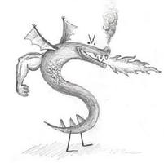
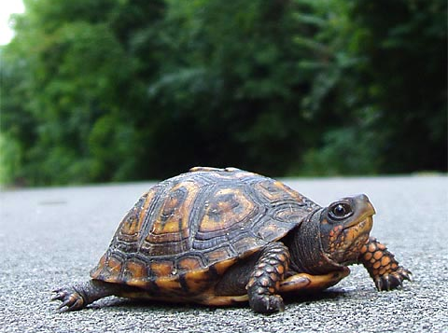
CS 5 Today
CS 5 alien on strike!
More Eyes!
hw2 due Mon.
Fractals and Turtles
Fri. aft. office hrs!
Lots of tutoring…
Photograph of CS 5 co-worker accused of burnination.
CS 5's three-eyed spokesalien has walked off the job, according to an AFL-CIO (Alien Federation of Labor and Congress of Interplanetary Organizations) lifeform. "I can't work under these conditions – when I arrived this morning, I was immediately - and indecorously - burninated by a new co-worker," sources reported hearing as the trinocular terrestrial stormed off. No word yet on who this reputed co-worker might be, though…
random how!
picket lines consumed by flames, p. 42
The Koch Curve

Slide 2
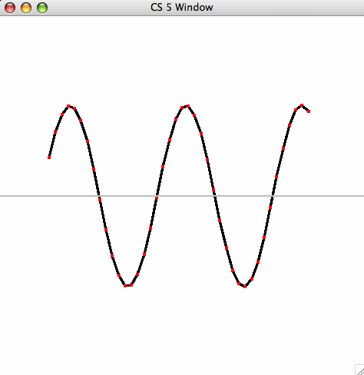
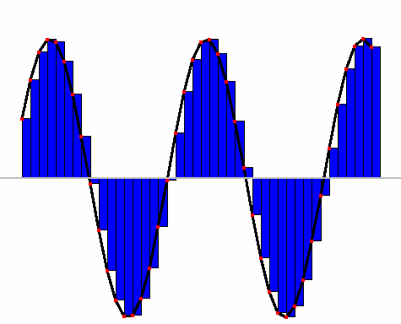
Lab 2: Integration
def unitfracs(N):
return [ float(x)/N for x in range(N) ]
fractional steps
0
1
41
42
42
42
def scaledfracs(low,hi,N):
return [ low + (hi-low)*x for x in unitfracs(N) ]
x values
0
1
6
10
10
15
7
7
7
def f_of_fracs(f,low,hi,N):
return [ f(x) for x in scaledfracs(low,hi,N) ]
y values
10
16
def integrate(f,low,hi,N):
return sum(f_of_fracs(f,low,hi,N))*(hi-low)/N
10
16
heights
width

Slide 3
A random aside…
import random
allows use of dir(random) and help(random)
from random import *
all random functions are now available!
choice( L )
chooses 1 element from the sequence L
choice( 'pitzer' )
choice( ['north', 'linde', 'west'] )
How would you get a random int from 0 to 99 inclusive?
uniform(low,hi)
chooses a random float from low to hi
floats have 16 places of precision
Here, 14 of them are after the decimal point

Slide 4
Quiz
A few random thoughts…
Name(s):
from random import *
choice( [1,2,3,2] )
What are the chances this returns a 2 ?
choice( range(1,5)+[4,2,4,2] )
What are the chances of this returning a 4 ?
choice( '1,2,3,4' )
What's the most likely return value here?
choice( ['1,2,3,4'] )
What's the most likely return value here?
choice( '[1,2,3,4]' )
What's the most likely return value here?
choice( range(5) )
Is this more likely to be even or odd?
choice( 0,1,2,3,4 )
choice[ range(5) ]
Which two of these are syntax errors? What does the third, "correct" one do?
choice( [range(5)] )
uniform( 41.9,42.1 )
What're the chances of this being > 42.05 ?
== 42.0?
'7' in str(uniform(41.9,42.1))
What are the chances of this being True ?
Extras !

Slide 5
Quiz
Try this on the back page first…
from random import *
choice( [1,2,3,2] )
What are the chances this returns a 2 ?
2 / 4 or 50%
choice( range(1,5)+[4,2,4,2] )
What are the chances of this returning a 4 ?
3 / 8
choice( '1,2,3,4' )
',' (3 / 7)
What's the most likely return value here?
choice( ['1,2,3,4'] )
'1,2,3,4' (1 / 1)
What's the most likely return value here?
choice( '[1,2,3,4]' )
',' (3 / 9)
What's the most likely return value here?
choice( range(5) )
even (3/5)
Is this more likely to be even or odd?
choice( 0,1,2,3,4 )
syntax error
choice[ range(5) ]
Which two of these are syntax errors? What does the third, "correct" one do?
syntax error
choice( [range(5)] )
correct: always returns [0,1,2,3,4]
uniform( 41.9,42.1 )
What're the chances of this being > 42.05 ?
== 42.0?
'7' in str(uniform(41.9,42.1))
What are the chances of this being True ?
Extras !

Slide 6
A random function…
from random import *
def guess( hidden ):
""" tries to guess the user's "hidden" #
"""
compguess = choice( range(100) )
if compguess == hidden: # at last!
print 'I got it!'
else:
guess( hidden )
This seems a bit suspicious…
print the guesses ?
slow down…
return the number of guesses ?

Slide 7
Recursive guess-counting
from random import *
import time
def guess( hidden ):
""" guessing game """
compguess = choice( range(100) )
# print 'I choose', compguess
# time.sleep(0.05)
if compguess == hidden: # at last!
# print 'I got it!'
return 1
else:
return 1 + guess( hidden )

Slide 8
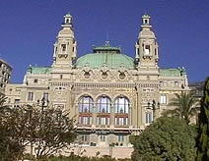
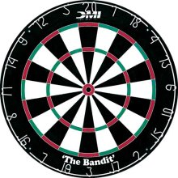
The two Monte Carlos
and their denizens…
Insights via random trials
Monte Carlo methods, Math/CS
Monte Carlo casino, Monaco

Slide 9
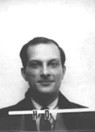
The two Monte Carlos
and their denizens…
Ulam, Stan Ulam
Stanislaw Ulam (Los Alamos badge)
Insights via random trials
Bond, James Bond
Monte Carlo methods, Math/CS
Monte Carlo casino, Monaco

Slide 10
Monte Carlo in action
How many doubles will you get in N rolls of 2 dice?
N is the total number of rolls
def countDoubles( N ):
""" input: the # of dice rolls to make
output: the # of doubles seen """
if N == 0:
return 0 # zero rolls, zero doubles…
else:
d1 = choice( [1,2,3,4,5,6] )
d2 = choice( range(1,7) )
if d1 != d2:
return countDoubles( N-1 ) # don't count it
else:
return 1+countDoubles( N-1 ) # COUNT IT!
one roll
where is the doubles check?

Slide 11
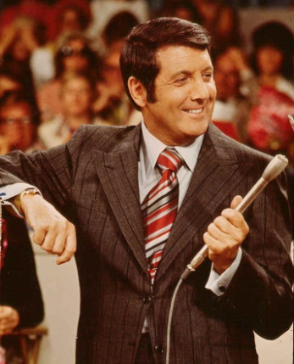
Another Monty… ?
inspiring the “Monty Hall paradox”

Slide 12
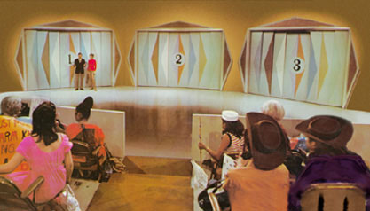
Let's make a deal…
Monty
'63-'86
inspiring the Monty Hall paradox

Slide 13
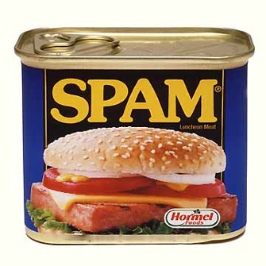
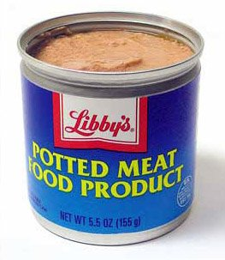
Monte Carlo Monty Hall
Suppose you always switch to the other door...
What are the chances that you will win the prize ?
Run it (randomly) 300 times and see!

Slide 14
Monte Carlo Monty Hall
'switch' or 'stay'
Your initial choice!
number of times to play
def MCMH( init, sors, N ):
""" plays the "Let's make a deal" game N times
returns the number of times you win the *Spam!*
"""
if N == 0: return 0 # don't play, can't win
przDoor = choice([1,2,3]) # where is the spam (prize)
if init == przDoor and sors == 'stay': result = 'Spam!'
elif init == przDoor and sors == 'switch': result = 'pmfp.'
elif init != przDoor and sors == 'switch': result = 'Spam!'
else: result = 'pmfp.'
print 'You get the', result
if result == 'Spam!': return 1 + MCMH( init, sors, N-1 )
else: return 0 + MCMH( init, sors, N-1 )

Slide 15
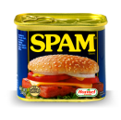
0
1
42
3
4
5
6
7
8
9
A
B
C
D
E
F
G
H

Slide 16
0
1
42
3
4
5
6
7
8
9
A
B
C
D
E
F
G
H

Slide 17
An example closer to home
hw2pr2
H/S
Olin
...
S
...
Linde
(W)
(E)
0
22
23
24
25
26
27
28
50
An overworked HMC student (S) leaves H/S after their “late-night” breakfast and, each moment, randomly stumbles toward Olin (W) or toward Linde (E)
Once the student arrives at the dorm or classroom, the trip is complete.
The program should then print the total number of steps taken.
Write a program to model and analyze! this scenario...
rwPos(s,nsteps)
rwSteps(s,low,hi)
take nsteps random steps starting at s
take random steps starting at s until you reach either low or hi

Slide 18
An example closer to home
hw2pr2
H/S
Olin
...
S
...
Linde
(W)
(E)
0
22
23
24
25
26
27
28
50
An overworked HMC student (S) leaves H/S after their “late-night” breakfast and, each moment, randomly stumbles toward Olin (W) or toward Linde (E)
How could we create this as an "ASCII" animation?
Once the student arrives at the dorm or classroom, the trip is complete.
The program should then print the total number of steps taken.
Write a program to model and analyze! this scenario...
rwPos(s,nsteps)
rwSteps(s,low,hi)
take nsteps random steps starting at s
take random steps starting at s until you reach either low or hi

Slide 19
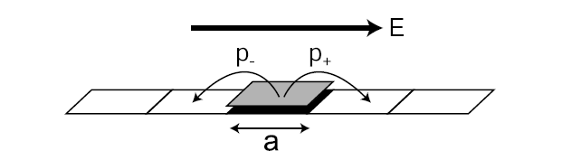
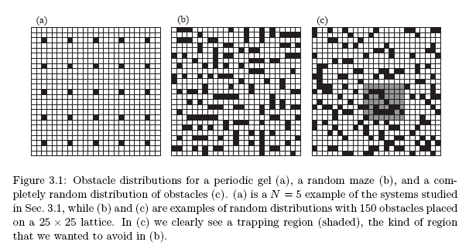
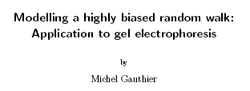
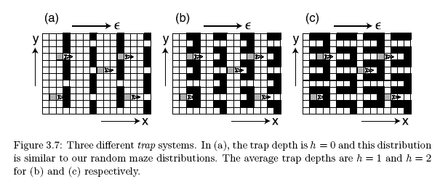
Gel electrophoresis
one of many applications for random walks…
uses a basic random-walk model with unequal step probabilities
Used to separate proteins and nucleic acids (DNA) from a biological sample. Molecules with different properties travel different distances.

Slide 20
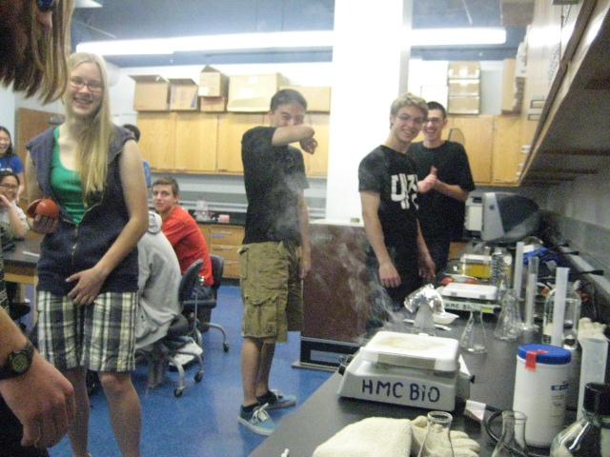
CS 5 green: Gel electrophoresis fire!

Slide 21
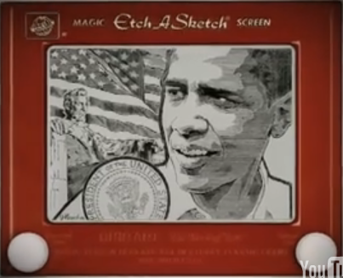
Etch-a-Sketch ?
No way this is real… but it is !
www.gvetchedintime.com

Slide 22
Python's Etch-a-Sketch
from turtle import *
Turtle Canvas
reset()
shape('turtle') # cool!
width(5)
left(90)
forward(50)
right(90)
backward(50)
down() or up()
color('darkgreen')
tracer(1) or tracer(0)
width(5)
pixels!
(42,42)
degrees!
pixels!
states if the pen draws or not
window_height()
(0,0)
states if the pen animates or not
window_width()
http://docs.python.org/library/turtle.html

Slide 23
Do. Or do not.
Recursive Graphics
There is no tri.
(1)
Could we tri this with recursion?
def tri( n ):
""" draws a triangle """
def tri():
""" draws a
triangle
"""
forward(100)
left(120)
forward(100)
left(120)
forward(100)
left(120)
(2)
Could we create any regular n-gon?
def poly( n, N ):
""" draws a polygon """
I don't know about tri, but there sure is NO return … !
this is provided in hw2pr3.zip

Slide 24
Be the turtle !
(2)
Finish rwalk so it draws a "stock-market" path: N steps of 10 pixels each. Use recursion.
(1)
What does chai draw?
from random import *
def rwalk(N):
""" N 10-pixel steps, each NE or SE """
if N == 0: return
if choice(['left','right']) == 'left':
else: # this handles 'right'
def chai(size):
""" mystery! """
forward(size)
left(90)
forward(size/2.0)
right(90)
right(90)
forward(size)
left(90)
left(90)
forward(size/2.0)
right(90)
backward(size)
Ex Cr: How could you make it a bull (or a bear) market?
one possible result of rw(20)

Slide 25
(1)
What does chai draw?
def chai(size):
""" mystery! """
forward(size)
left(90)
forward(size/2.0)
right(90)
right(90)
forward(size)
left(90)
left(90)
forward(size/2.0)
right(90)
backward(size)
Why are there two identical commands in a row?
How could you add more to each T-tip?

Slide 26
(2) rwalk is a random stock market walk...
from random import *
def rwalk(N):
""" N 10-px steps, NE or SE """
if N == 0: return
if choice(['left','right'])=='left':
else: # 'right'
What if we didn't turn back to face forward each time?
Extra: How could you make it a bull (or a bear) market?

Slide 27
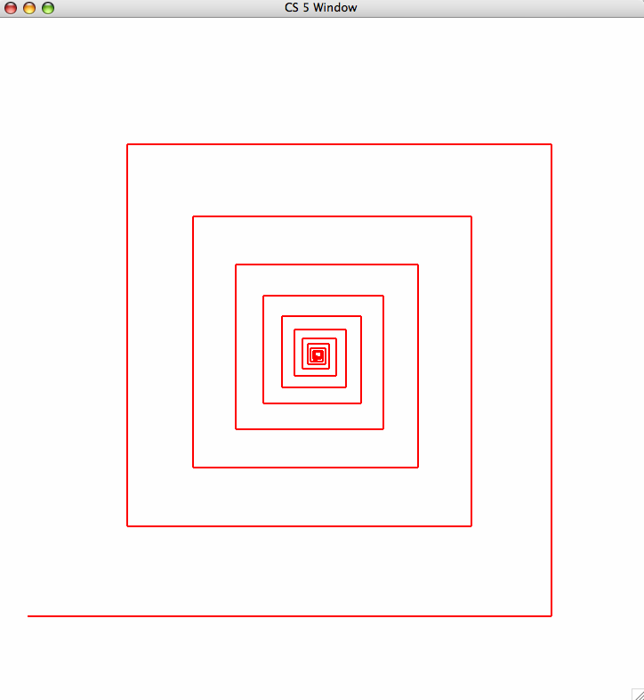
hw2pr3 spiral
81
72.9
90
close-up of innermost part of the spiral…
spiral( 100, 90, 0.9 )
100
spiral( initLength, angle, multiplier )

Slide 28
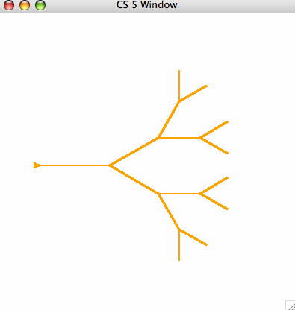
hw2pr3 svtree
Level 1
Level 2
I wonder what happened to the leaves on that tree… ?
Burninated, perhaps?
Level 3
Level 4
svtree( 100, 4 )
svtree( trunkLength, levels )

Slide 29
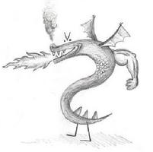
The Koch curve
This one might burninate your brain!
snowflake(100, 0)
snowflake(100, 1)
snowflake(100, 2)
snowflake(100, 3)
snowflake(100, 4)
snowflake(100, 5)

Slide 30
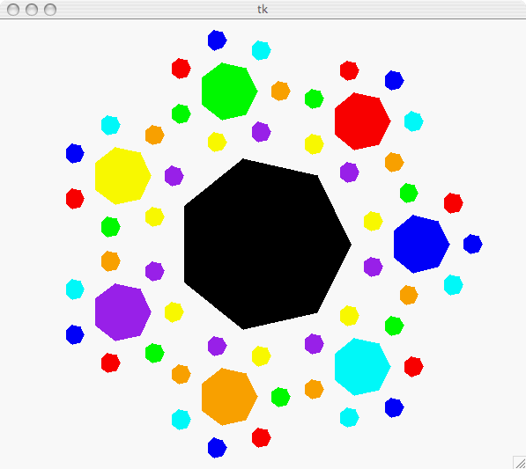
Have a great weekend!
Happy turtling with hw2…

Slide 32
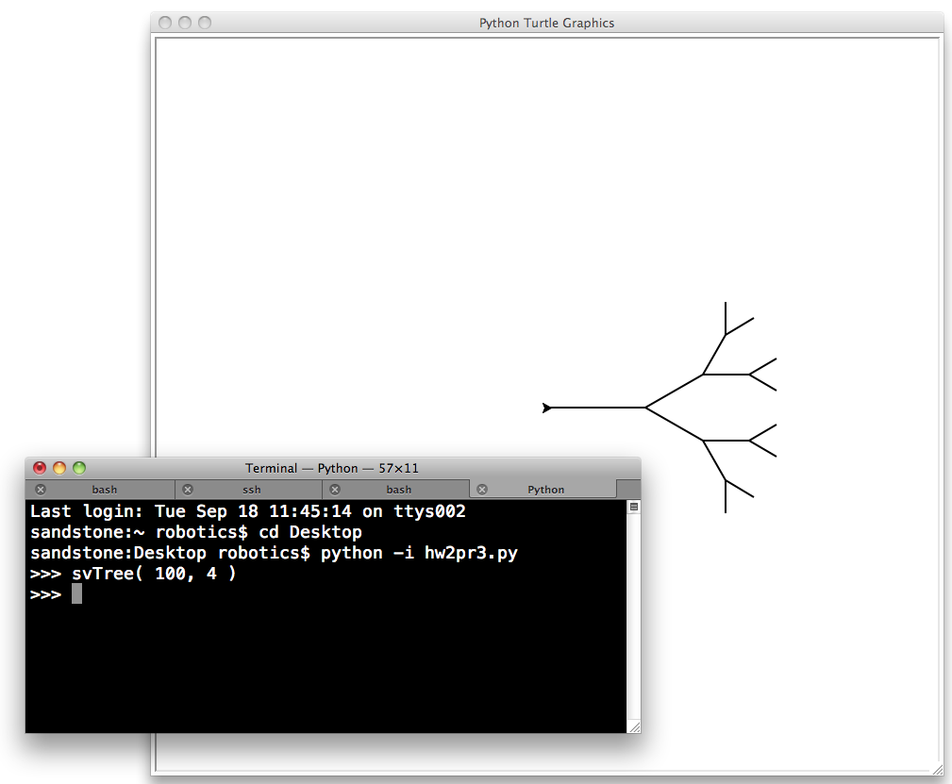
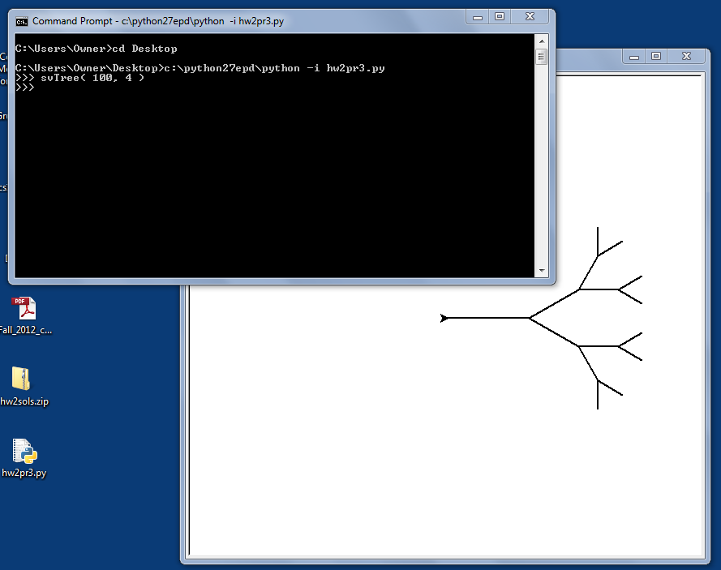
Python's turtle graphics
Sometimes you need to run Python from the command-line
www.cs.hmc.edu/twiki/bin/view/CS5/RunningPythonFromTheCommandLine
Mac instructions...
Windows instructions...

Slide 33
0
1
42
3
4
5
6
7
8
9
A
B
C
D
building blocks
E
F
G
H

Slide 34
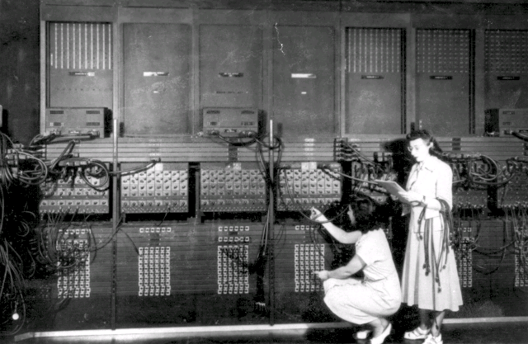
ENIAC 1
Programming before stored-program computers…

Slide 35
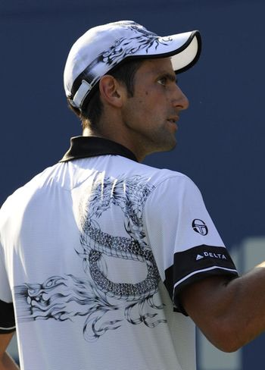
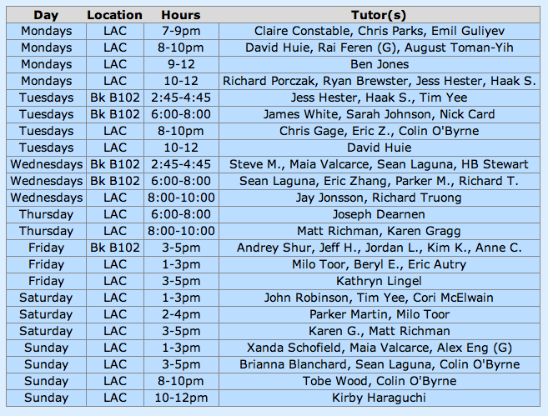
Claremont residents report droplets of water falling down-ward from the sky: unexplained meteorological phenomenon causes panic…
CS 5 Today
CS 5 alien on strike!
details, p. 42
hw2 due Mon.
Fri. aft. office hours!
LAC tutoring hours all weekend!
Consummate sketch of accused, bullying CS 5 co-worker
Fractals and Turtles!
Other trogdor appearances
The three-eyed CS 5 spokesalien has walked off the job, according to an AFL-CIO (Alien Federation of Labor and Congress of Interplanetary Organizations) lifeform. "I can't work under these conditions -- I arrived at work this morning and was immediately burninated by a new co-worker," sources reported hearing as the trinocular terrestrial stormed off. No word yet on who this reputed co-worker might be, though…
how random…
picket lines consumed by flames, p. 4
The Koch Curve

Slide 36
0
1
2
3
4
5
6
7
8
42
A
B
C
D
E
F
G
H

Slide 37
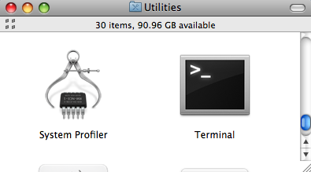
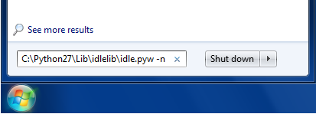
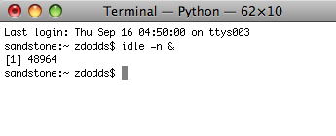
Python's Etch-a-Sketch
Be SURE to start IDLE with "no subprocess"
Mac instructions...
Windows instructions...
(Step 1) menus: Go – Utilities – Terminal
(Step 1) Go to the Start menu's search field
Start this!
(Step 2) Type or paste the full path to IDLE
If you used the standard install, it will be
C:\Python27\Lib\idlelib\idle.pyw -n
(Step 2) Enter idle –n &
Hit return; you'll see a console window and IDLE open.
Then, you can type
from turtle import *

Slide 38
Reading this week...
conditionals (if),
data storage 'hi', and
recursion (or loops)
perhaps natural interactions could be created, too?
If all computation really consists of
Joseph Weizenbaum's Eliza
What's missing?

Slide 39
Easy as π
(1,1)
pi via darts
(-1,-1)

Slide 40
print: Making programs talk to you!
import time
def countdown( num ):
""" remarkably accurate sim.
of 2006's final moments """
if num == 0:
return 'Hooray!'
else:
print 'Countdown is', num
time.sleep(1)
return countdown(num-1)
you can slow things down, as well!
Essential for debugging …

Slide 41
Randomness vs. Determinism
Are there random numbers?
Can a computer generate them?
RNG
A “black box” model of a random number generator.
Output

Slide 42
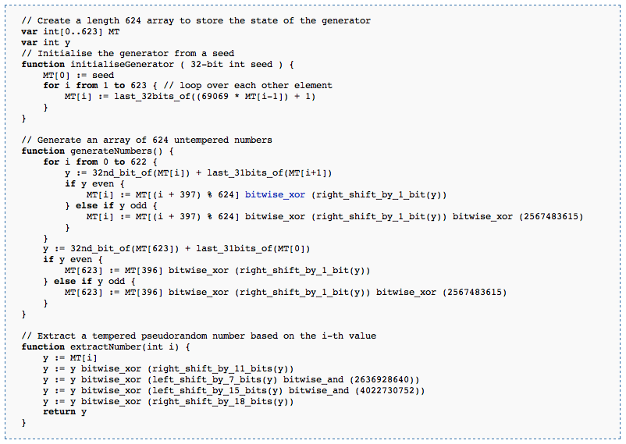
Randomness vs. Determinism
Are there random numbers?
Can a computer generate them?
Yes
Not without help!
The RNG revealed.
Periodic!
Output
p = 2¹⁹⁹³⁷-1
http://en.wikipedia.org/wiki/Mersenne_twister

Slide 43
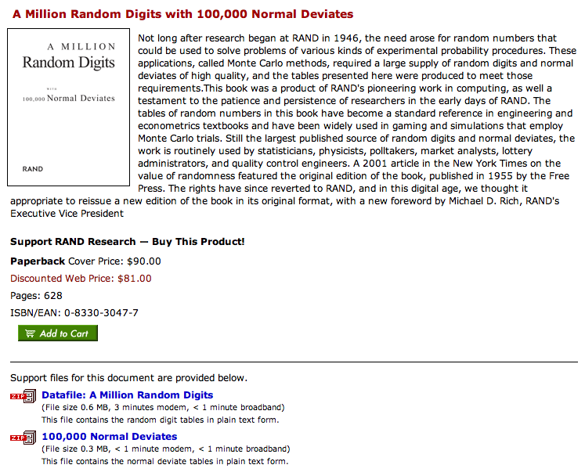
Some random history…
True randomness is valuable!
but not that valuable!
http://www.rand.org/pubs/monograph_reports/MR1418/index.html

Slide 44
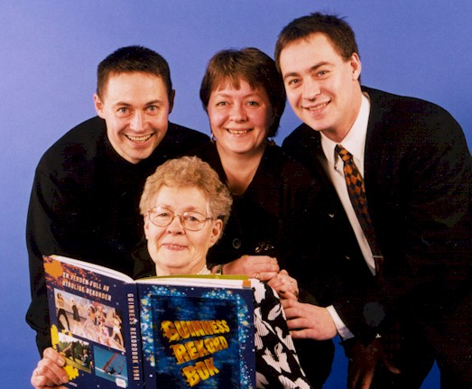
True Randomness !
http://www.leapzine.com/hr/
random, but not!
an enthusiastic endorser
LavaRnd’s lava lamps
using a chaotic physical system to seed random number generators
(Patent 5,732,138: "Method for seeding a pseudo-random number generator with a cryptographic hash of a digitization of a chaotic system.")
www.wired.com/wired/archive/11.08/random.html
This has since been “improved”…

Slide 45
Some random programs…
import random
def guess( hidden ):
""" guesses the user's #, "hidden" """
compguess = random.choice( range(10) )
if compguess == hidden:
return 'I got it!'
else:
return guess( hidden )
print guesses ?
num guesses ?

Slide 46
"Quiz"
(1) What should we do to improve this guesser?
(2) How?
import random
def guess( hidden ):
""" guesses the user's #, "hidden" """
compguess = random.choice( range(10) )
if compguess == hidden:
return 'I got it!'
else:
return guess( hidden )
print guesses ?
num guesses ?

Slide 47
Monte Carlo π
An engineering challenge: to estimate π using everyday items...

Slide 48
Quiz
Design a strategy for estimating pi using random numbers ("dart throws") and this diagram ("dartboard"):
Name(s):
(1,1)
What does this return?
1) Here is a dart-throwing function:
def throw():
return [ random.uniform(-1,1),
random.uniform(-1,1) ]
What does this return?
2) Here is a dart-testing function:
(-1,-1)
def test(x,y):
return (x**2 + y**2) < 1.0
3) What strategy could use the functions in (1) and (2) to estimate pi?
4) Write a function to implement your strategy:

Slide 49
Notes from prior hwks…
Warnings!
def rps(p1,p2):
""" rock-paper-scissors judger """
if 'p1' == 'p2':
return 0
def rps(p1,p2):
if p1 == p2:
return '0'
def letterscore(let):
if let in 'zq':
return 10 …(lots more)…

Slide 50
Notes from prior hwks…
Warnings!
def rps(p1,p2):
""" rock-paper-scissors judger """
if 'p1' == 'p2':
return 0
The string 'p1' is not the same as the variable p1 !
def rps(p1,p2):
""" rock-paper-scissors judger """
if p1 == p2:
return '0'
The string '0' is not the same as the number 0 !
no docstring!
def letterscore(let):
if let in 'zq':
return 10 …(lots more)…
Capital letters count! (It should be letterScore.)

Slide 51
Poetic Programming
#1 Listen my children and you shall hear
#2 The wonderful tales of Paul Revere
#3 Of all the 8 letters he shall send
#4 Number four is the middle of middle and the end of end
#5 Letters five and eight are exactly the same
#6 They are the end of Superman's real name
#7 Letters one through four are opposite the sea
#8 Number 6 completely refers to me!
#9 Now fill in the letter 7 blank
#10 Now that you have the majority on hand
#11 Flip the sea to the back,
#12 and get the costco brand!
1 My letters are eight (though I number much more)
2 And the first can start words such as 'file' and 'four.'
3 My four which begin form a word for stronghold
4 Like the one we call Knox where we keep all our gold.
5 My fifth is that letter our alphabet's got
6 Which can't choose if it will be a vowel or not.
7 My last three will come 'twixt a one and a three
8 And they are not a crowd, though they are company.
9 If you can't find my answer, please don't you despair.
10 Just come to CS class; it's everywhere there.
1 First a riff, then a twang, then a howl, then a bang:
2 Here?s a song that the Stones rocked real hard when they sang.
3 With Sir Mick on the mic and ol Keef on the strings,
4 There?s still some irony in the joy this song brings?
5 The first fourth of our song rhymes with cat and with hat.
6 It?s the past tense of ?sit.? You can sit on a mat.
7 (Though I?m sad I must say this clue gives it away
8 To the fans of this band. I hope they?ll understand.)
9 The next sixth is a verb that is hard to avoid
10 (In the last line alone, you can find two employed!)
11 And in Spanish ? reversed ? with an accent, it?s ?yes!?
12 Do you know what this verb is? Come on, take a guess!
13 The next twelfth of the word used to look just like ?E.?
14 But it lost his third limb; now he?s an amputee.
15 Though they still live nearby, things were never the same -
16 He gets sad and self conscious and thinks he is lame.
17 The last half of this song is six letters, I?m told,
18 And they certainly speak of demeanor quite bold.
19 And intertially speaking, this thing is opposed
20 By its equal and opposite twin, I suppose.
21 Of what song do I speak? I can hypothesize
22 That by now you?ve deciphered the code in my rhymes.
#Poem: I find that eating pie makes me negative
#1 I'll make the first clue easy: This list is composed of 16 digits.
#2 Within these, the 4th through the 10th digits are a palindrome including four 8s and which sums to 37.
#3 The 11th digit is the number of teams entering a semi-final.
#4 The 13th digit is one of two single-digit Kaprekar numbers in base 10.
#5 The 12th, 3rd, 16th, and 14th digits (in that order) comprise the legal slang (refering to the California Welfare & Institutions Code) for when a person is considered a danger to him/herself or others as a redult of a mental disorder.
#6 The 2nd and 1st digits (in that order) comprise the amount of time in hours such a person may be held in custody.
#7 Lastly, the 15th digit is an exciting number of letters to have in an English word. Unless you work for the FCC.

Slide 52
Friday Homework Hints…
hw2pr3 :
rwPos(…) is similar to the countdown example (from Wed.)
rwSteps(…) is similar to the guess example (from Wed.)
hw2pr4 :
countStrings(s1,s2) is similar to the sajak example (last Fri.)
except you will need to use slices instead of single characters
s2[0:?]
s2[0]
removeAll(e,L) is similar to sajak (last Fri.) and range (from Wed.)
it returns a list like L but with top-level elements e removed
Two more functions, as well: spiral(…) and svTree(…)

Slide 53
Recursion -- not just numbers
Self-similarity elsewhere...
Natural phenomena
Relationships
how much here is leaf vs. stem?
What is an “ancestor” ?
Names -- acronyms
GNU
== GNU’s Not Unix

Slide 54
Recursion -- not just numbers
Self-similarity elsewhere...
Natural phenomena
Relationships
What is an “ancestor” ?
An ancestor is a parent OR an ancestor of a parent…
Names -- acronyms
GNU
== GNU’s Not Unix
all stem!

Slide 55
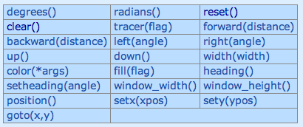
Turtle Graphics
You will need to have two files in your working folder (directory):
csturtle.py
csplot.py
You will want to have this line in your hw2pr4.py file:
import csturtle ; reload(csturtle) ; from csturtle import *
Then you will be able to write functions using the csturtle commands:
A place to start
def tri():
""" draws a polygon
"""
forward(100)
left(120)
forward(100)
left(120)
forward(100)
left(120)
www.cs.hmc.edu/twiki/bin/view/CS5/CsturtleDirections
for csturtle help

Slide 56
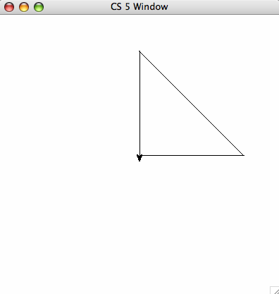
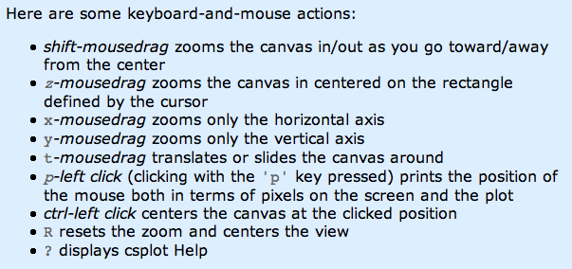
Window controls
all that's left from the villagers' thatched cars…
http://www.cs.hmc.edu/twiki/bin/view/CS5/Lab2Part1

Slide 57
Recursive Graphics
there is no tri …
(1)
Could we tri this with recursion?
def tri():
""" draws a polygon
"""
forward(100)
left(120)
forward(100)
left(120)
forward(100)
left(120)
(2)
Could we create any regular n-gon?
I don't know about tri, but there sure's NO return … !

Slide 58
"Quiz"
Name(s):
Turtle Graphics
(1)
What does chai draw?
(2)
Finish rwalk to draw a "stock-market-type" random path of nsteps steps. Use recursion!
import random
def rw(nsteps):
""" moving for nsteps steps, randomly
45 deg. left (1) or right (-1) """
if nsteps == 0:
return
if random.choice([1,-1]) == 1: # left
else: # it was -1, meaning right
def chai(size):
""" mystery! """
forward(size)
left(90)
forward(size/2.0)
right(90)
right(90)
forward(size)
left(90)
left(90)
forward(size/2.0)
right(90)
backward(size)
one possible result of rw(20)
Ex Cr: How could you make it a bull (or a bear) market?

Slide 59
(1)
What does chai draw?
def chai(size):
""" mystery! """
forward(size)
left(90)
forward(size/2.0)
right(90)
right(90)
forward(size)
left(90)
left(90)
forward(size/2.0)
right(90)
backward(size)
Why are there two identical commands in a row?
How could you add more to each end?

Slide 60
(2)
Finish rwalk to draw a "stock-market-type" random path of nsteps steps.
import random
def rw(nsteps):
""" moving for nsteps steps, randomly
45 deg. left (1) or right (-1) """
if nsteps == 0:
return
if random.choice([1,-1]) == 1: # 1 means left
left(45)
forward(20)
right(45)
else: # it was -1, meaning right
right(45)
forward(20)
left(45)
one possible result of rw(20)
What if we didn't go back to the starting pose?
Ex Cr: How could you make it a bull (or a bear) market?

Slide 61
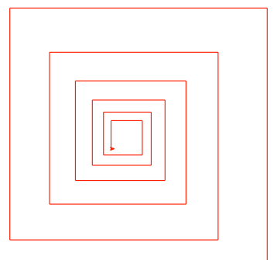
hw2pr4 spiral
81
72.9
90
close-up of innermost part of the spiral…
spiral( 100, 90, 0.9 )
100
spiral( initLength, angle, multiplier )

Slide 62
hw2pr4 svTree
svTree( 100, 4 )
I wonder what happened to the leaves on that tree… ?
svTree( trunkLength, levels )
and more! (if you want)

Slide 63
Taking away…
def removeBs( s ):
returns a string that is the same as s, except without any 'b's
Examples:
removeBs('hubbabubba') == 'huaua'

Slide 64
Taking away…
def removeBs( s )
returns a string that is the same as s, except without any 'b's
when there are no letters, the answer is _____________
Base Case:
if the first letter IS an B, the answer is ______________________
Recursive Step:
if the first letter IS an B, the answer is __________________

Slide 65
Sorting
def sort(L)
returns a list which has the same elements as L, but in sorted order!
Ideas?

Slide 66
Sorting
def sort(L)
returns a list which has the same elements as L, but in sorted order!
Ideas?
Let b be the biggest item in L
Remove b from L to get a newL
Add b to the end of … what ?!? …
Sorting in only 4 lines of code!

Slide 67
"Quiz"
Name(s):
Turtle Graphics
(1)
What does chai draw?
(2)
Finish rwalk to draw a "stock-market-type" random path of nsteps steps. Use recursion!
import random
def rw(nsteps):
""" moving for nsteps steps, randomly
45 deg. left (1) or right (-1) """
if nsteps == 0:
return
if random.choice([1,-1]) == 1: # left
else: # it was -1, meaning right
def chai(size):
""" mystery! """
forward(size)
left(90)
forward(size/2.0)
right(90)
right(90)
forward(size)
left(90)
left(90)
forward(size/2.0)
right(90)
backward(size)
one possible result of rw(20)
Ex Cr: How could you make it a bull (or a bear) market?

Slide 68
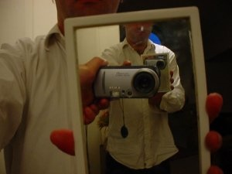
Real visual recursion
How many times has the light bounced before reaching the camera from various items here??

Slide 69
Quiz
Write each of these functions using recursion
Returns a string the same as s, but with no x characters in it. ( x, not 'x' ! )
remove('t','wait a minute') == 'wai a minue'
def remove( x, s ):
Removes the characters in the string s2 from the string s.
removeAll( 'gqz', 'quizzing' ) == 'uiin'
def removeAll( s2, s ):
Removes the characters in the string s2 at most once from the string s. (Hw problem!)
removeOne( 'agqz', 'quizzing' ) == 'uizin'
def removeOne( s2, s ):

Slide 70
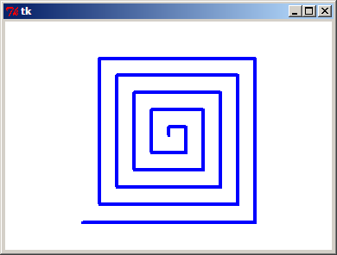
Drawing Recursively
Any self-similarity here?
190
200

Slide 71
Drawing Recursively
Designing any recursive program boils down to the same two pieces
Think about the SIMPLEST POSSIBLE case!
Base Case:
Do ONLY ONE STEP, and let recursion do the rest…
Recursive Step:

Slide 72
Drawing Recursively
Designing any recursive program boils down to the same two pieces
def spiral(L):
if L < 1: return
else:
forward(L)
left(90)
spiral(L-10)
Base Case
Recursive Step
What if we had forgotten the base case?

Slide 73
Drawing Recursively
Try writing these functions:
def spiralTri( L ):
Draws a triangular (equilateral) spiral.
Try it! spiralTri(200) draws
def spiralOct( L ):
Draws an octagonal spiral.
Try it! spiralOct(100) draws
def spiralLim( L ):
Draws a square spiral with only N segments!
Try it! spiralLim(200,7) draws
actually, a bit larger than this …

Slide 74
More on sorting…
def isSorted(s)
returns true if s is in order, false otherwise
isSorted('BART') returns False
isSorted('BERT') returns True
isSorted('BEGIN') returns True
isSorted([3,1,4]) returns False
isSorted([1,3,4]) returns True
ties?
isSorted('LOOPY') returns ??
Six-letter word?

Slide 75
print: Making programs talk to you!
Debugging had to be discovered. I can remember the exact instant when I realized that a large part of my life from then on was going to be spent in finding mistakes in my own programs.
- Maurice Wilkes
Programming: the art of debugging an empty file.
- The Jargon File
http://www.tuxedo.org/~esr/jargon/

Slide 76
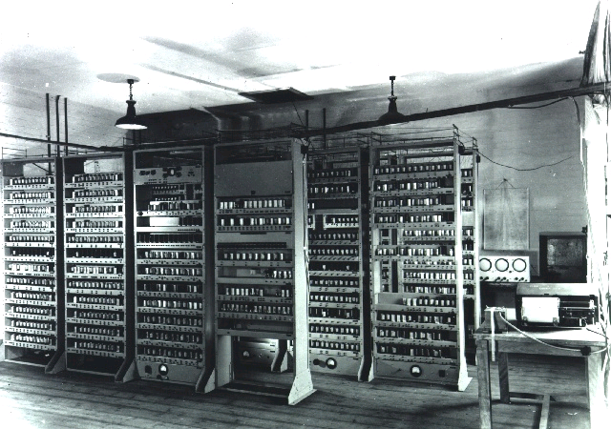
EDSAC
Cambridge U., 1949

Slide 77
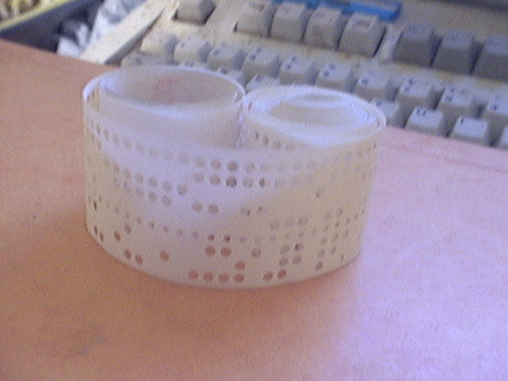
EDSAC’s input: punched tape

Slide 78
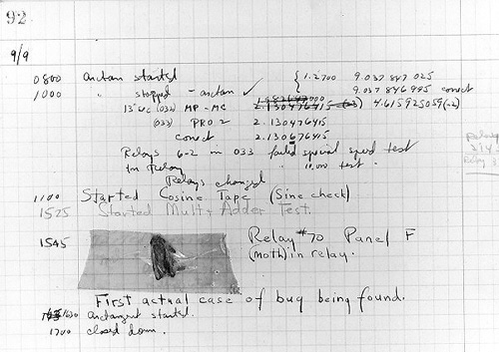
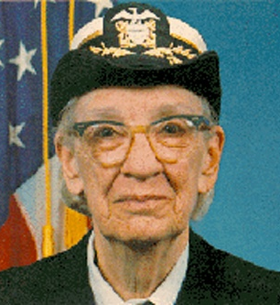
The most famous bug
Grace Hopper
from the UNIVAC 1
“In the days they used oxen for heavy pulling, when one ox couldn't budge a log, they didn't try to grow a larger ox. We shouldn't be trying for bigger and better computers, but for better systems of computers.”

Slide 79
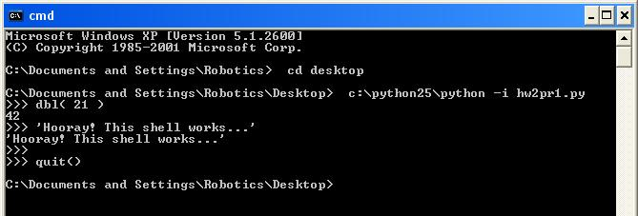
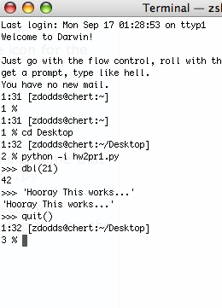
The Python shell
IDLE uses Python's graphics - but built-in shells do not
"command window"
"terminal window"
c:\python25\python -i hw2pr1.py
python -i hw2pr1.py

Slide 80
Turtle Graphics
You will need to have two files in your working folder (directory):
csturtle.py
csplot.py
You will want to have this line in your hw2pr4.py file:
from csturtle import *
Then you will be able to write functions using the csturtle commands:
A place to start
def tri():
""" draws a polygon
"""
forward(100)
left(120)
forward(100)
left(120)
forward(100)
left(120)
www.cs.hmc.edu/twiki/bin/view/CS5/CsturtleDirections
for csturtle help

Slide 81
Window controls
all that's left from the villagers' thatched cars…
http://www.cs.hmc.edu/twiki/bin/view/CS5/Lab2Part1

Slide 82
CS 5 alien on strike!
More Eyes!
CS 5 Today
Fractals and Turtles
hw2 due Mon.
Fri. aft. office hrs!
Lots of tutoring…
Photograph of CS 5 co-worker accused of burnination.
The three-eyed CS 5 spokesalien has walked off the job, according to an AFL-CIO (Alien Federation of Labor and Congress of Interplanetary Organizations) lifeform. "I can't work under these conditions -- I arrived at work this morning and was immediately burninated by a new co-worker," sources reported hearing as the trinocular terrestrial stormed off. No word yet on who this reputed co-worker might be, though…
random how!
picket lines consumed by flames, p. 4
The Koch Curve

Slide 83
Python's turtle graphics
Running a turtle-friendly version of IDLE…
Mac instructions...
Windows instructions...
(Step 1) menus: Go – Utilities – Terminal
(Step 1) Go to the Start menu's search field
Start this!
(Step 2) Type or paste the full path to IDLE
If you used the standard install, it will be
C:\Python27\Lib\idlelib\idle.pyw -n
(Step 2) Enter idle –n &
Hit return; you'll see a console window and IDLE open.

