Slide 1

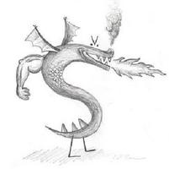
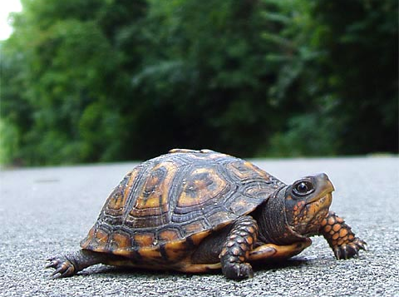
CS 5 Today
CS 5 alien on strike!
More Eyes!
hw2 due Monday…
Fractals and Turtles
Mon. aft. office hrs!
Lots of tutoring…
Photograph of CS 5 co-worker accused of burnination.
CS 5's three-eyed spokesalien has walked off the job, according to an AFL-CIO (Alien Federation of Labor and Congress of Interplanetary Organizations) lifeform. "I can't work under these conditions – when I arrived this morning, I was immediately - and indecorously - burninated by a new co-worker," sources reported hearing as the trinocular terrestrial stormed off. No word yet on who this reputed co-worker might be, though…
random how!
picket lines consumed by flames, p. 42
https://www.youtube.com/watch?v=TfrAf1a9Qhs 1:00-1:30

Slide 2
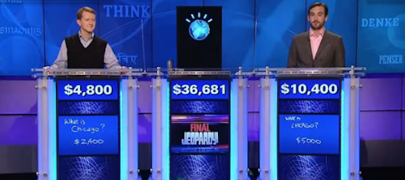

Reading this week…
https://www.youtube.com/watch?v=lI-M7O_bRNg 3:00-3:42
Category: U.S. Cities. Clue: Its largest airport is named for a World War II hero, its second largest for a World War II battle.
Watson
Burninated by syntax!

Slide 3
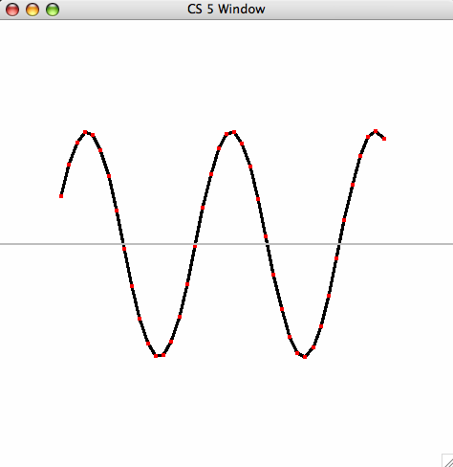
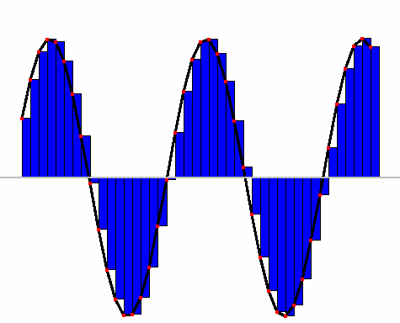
Lab 2: Integration
def unitfracs(N):
return [ float(x)/N for x in range(N) ]
fractional steps
0
1
41
42
42
42
def scaledfracs(low,hi,N):
return [ low + (hi-low)*x for x in unitfracs(N) ]
x values
0
1
6
10
10
15
7
7
7
def f_of_fracs(f,low,hi,N):
return [ f(x) for x in scaledfracs(low,hi,N) ]
y values
10
16
def integrate(f,low,hi,N):
return sum(f_of_fracs(f,low,hi,N))*(hi-low)/N
10
16
heights
width

Slide 4
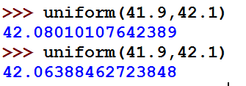
A random aside…
import random
allows use of dir(random) and help(random)
from random import *
all random functions are now available!
uniform(low,hi)
chooses a random float from low to hi
floats have 16 places of precision
Here, 14 of them are after the decimal point
choice( L )
chooses 1 element from the sequence L
choice( 'mudd' )
choice( ['north', 'linde', 'west'] )
How would you get a random int from 0 to 99 inclusive?

Slide 5
A random function…
from random import *
def guess( hidden ):
""" tries to guess our "hidden" #
"""
compguess = choice( range(100) )
if compguess == hidden: # at last!
print 'I got it!'
else:
guess( hidden )
Suspicious? I am!
print the guesses ?
slow down…
return the number of guesses ?
investigate expected # of guesses?!??

Slide 6
Recursive guess-counting
from random import *
import time
def guess( hidden ):
""" guessing game """
compguess = choice( range(100) )
# print 'I choose', compguess
# sys.stdout.flush()
# time.sleep(0.05)
if compguess == hidden: # at last!
# print 'I got it!'
return 1
else:
return 1 + guess( hidden )
code available in hw2pr2

Slide 7
Empirical Hypothesis Testing…
a.k.a.
# this line runs guess(42) 1000 times!
LC = [ guess(42) for x in range(1000) ]
# Let's look at the first 10 of them:
print LC[0:10]
# Let's find the average:
print "av. guesses:", sum(LC)*1.0/len(LC)
Run it a zillion times!
Hah! Now I see why they told me I'd be making a zillion euros!

Slide 8
On balance?
Hah! Now I see why they told me I'd be making a zillion euros!

Slide 9
Quiz
A few random thoughts…
Name(s):
from random import *
choice( [1,2,3,2] )
What are the chances this returns a 2 ?
choice( range(1,5)+[4,2,4,2] )
What are the chances of this returning a 4 ?
choice( '1,2,3,4' )
What's the most likely return value here?
choice( ['1,2,3,4'] )
What's the most likely return value here?
choice( '[1,2,3,4]' )
Careful
What's the most likely return value here?
choice( range(5) )
Is this more likely to be even or odd?
choice( 0,1,2,3,4 )
choice[ range(5) ]
Which two of these are syntax errors? What does the third, "correct" one do?
choice( [range(5)] )
uniform( 41.9,42.1 )
What're the chances of this being > 42.05 ?
== 42.0?
'7' in str(uniform(41.9,42.1))
What are the chances of this being True ?
Extras!

Slide 10
Quiz
Team up and try this on the backpage first…
from random import *
choice( [1,2,3,2] )
What are the chances this returns a 2 ?
choice( range(1,5)+[4,2,4,2] )
What are the chances of this returning a 4 ?
choice( '1,2,3,4' )
What's the most likely return value here?
choice( ['1,2,3,4'] )
What's the most likely return value here?
choice( '[1,2,3,4]' )
What's the most likely return value here?
choice( range(5) )
Is this more likely to be even or odd?
choice( 0,1,2,3,4 )
choice[ range(5) ]
Which two of these are syntax errors? What does the third, "correct" one do?
choice( [range(5)] )
uniform( 41.9,42.1 )
What're the chances of this being > 42.05 ?
== 42.0?
'7' in str(uniform(41.9,42.1))
What are the chances of this being True ?
Extras !

Slide 11
Data is in black. Probabilities in blue.
choice( [1,2,3,2] )
What are the chances this returns a 2 ?
2/4 or 50%
choice( range(1,5)+[4,2,4,2] )
What are the chances of this returning a 4 ?
3/8
choice( '1,2,3,4' )
',' 3/7
What's the most likely return value here?
choice( ['1,2,3,4'] )
'1,2,3,4' 1/1
What's the most likely return value here?
choice( '[1,2,3,4]' )
',' 3/9
What's the most likely return value here?
choice( range(5) )
even 3/5
Is this more likely to be even or odd?
choice( 0,1,2,3,4 )
syntax error
choice[ range(5) ]
syntax error
1/1
choice( [range(5)] )
correct: always returns [0,1,2,3,4]
small!
uniform( 41.9,42.1 )
1/4
What're the chances of this being > 42.05 ?
== 42.0?
'7' in str(uniform(41.9,42.1))
What are the chances of this being True ?
not so small!

Slide 12
Zillion-times testing!
# this line runs our test 1000000 times…
LC = [ str(uniform(41.9,42.1)) for x in range(1000000) ]
# Find the ones with 7s:
LCw7 = [ 1.0 for s in LC if '7' in s ]
# Look at the first 10 of the originals:
print LC[0:10]
# Let's find the average:
print "av. guesses:", sum(LCw7)/len(LC)
needs a more continental name…

Slide 13
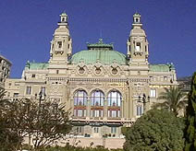
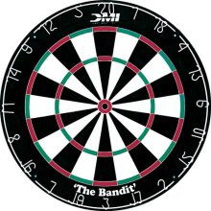
The two Monte Carlos
and their denizens…
Insights via random trials
Monte Carlo methods, Math/CS
Monte Carlo casino, Monaco

Slide 14
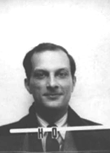

The two Monte Carlos
and their denizens…
Ulam, Stan Ulam
Stanislaw Ulam (Los Alamos badge)
Insights via random trials
Bond, James Bond
Monte Carlo methods, Math/CS
Monte Carlo casino, Monaco

Slide 15

Monte Carlo in action
How many doubles will you get in N rolls of 2 dice?
N is the total number of rolls
def countDoubles( N ):
""" input: the # of dice rolls to make
output: the # of doubles seen """
if N == 0:
return 0 # zero rolls, zero doubles…
else:
d1 = choice( [1,2,3,4,5,6] )
d2 = choice( range(1,7) )
if d1 != d2:
return countDoubles( N-1 ) # don't count it
else:
return 1+countDoubles( N-1 ) # COUNT IT!
two dice from 1-6 inclusive
where is the check for doubles?

Slide 16
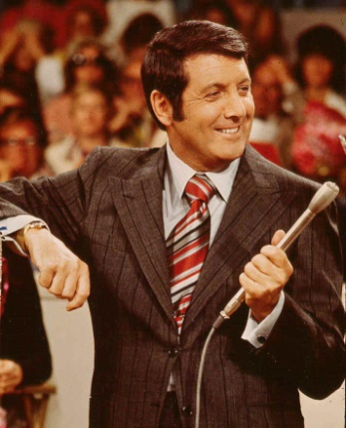
Another Monty… ?
inspiring the “Monty Hall paradox”

Slide 17
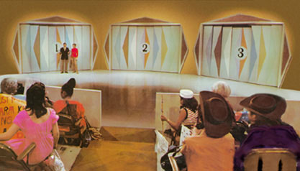
Let's make a deal…
Monty
'63-'86
inspiring the Monty Hall paradox

Slide 18
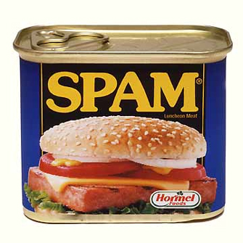
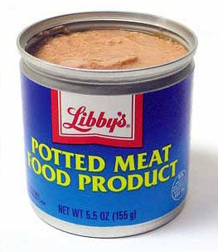
Monte Carlo Monty Hall
Suppose you always switch to the other door...
What are the chances that you will win the prize ?
Run it (randomly) 300 times and see!

Slide 19
Monte Carlo Monty Hall
'switch' or 'stay'
Your initial choice!
number of times to play
def MCMH( init, sors, N ):
""" plays the "Let's make a deal" game N times
returns the number of times you win the *Spam!*
"""
if N == 0: return 0 # don't play, can't win
przDoor = choice([1,2,3]) # where the spam (prize) is…
if init == przDoor and sors == 'stay': result = 'Spam!'
elif init == przDoor and sors == 'switch': result = 'pmfp.'
elif init != przDoor and sors == 'switch': result = 'Spam!'
else: result = 'pmfp.'
print 'You get the', result
if result == 'Spam!': return 1 + MCMH( init, sors, N-1 )
else: return 0 + MCMH( init, sors, N-1 )

Slide 20
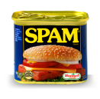
0
1
42
3
4
5
6
7
8
9
A
B
C
D
E
F
G
H

Slide 21
0
1
42
3
4
5
6
7
8
9
A
B
C
D
E
F
G
H

Slide 22
An example closer to home
hw2pr2
H/S
West Dorm
Shan
...
S
...
(W)
(E)
0
22
23
24
25
26
27
28
50
An overworked HMC student (S) leaves H/S after their "late-night" breakfast and, each moment, randomly stumbles toward class (W) or toward West Dorm (E)
Once the student arrives at the dorm or classroom, the trip is complete.
The program should then print the total number of steps taken.
Write a program to model and analyze! this scenario...
rwpos(s,nsteps)
rwsteps(s,low,hi)
take nsteps random steps starting at s
take random steps starting at s until you reach either low or hi

Slide 23
An example closer to home
hw2pr2
H/S
West Dorm
Shan
...
S
...
(W)
(E)
0
22
23
24
25
26
27
28
50
An overworked HMC student (S) leaves H/S after their "late-night" breakfast and, each moment, randomly stumbles toward class (W) or toward West Dorm (E)
How could we create this as an "ASCII" animation?
Once the student arrives at the dorm or classroom, the trip is complete.
The program should then print the total number of steps taken.
Write a program to model and analyze! this scenario...
rwpos(s,nsteps)
rwsteps(s,low,hi)
take nsteps random steps starting at s
take random steps starting at s until you reach either low or hi

Slide 24
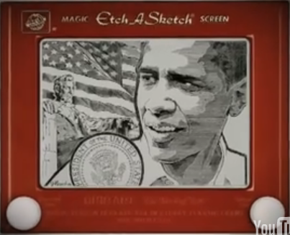
Etch-a-Sketch ?
No way this is real… but it is !
www.gvetchedintime.com

Slide 25
Python's Etch-a-Sketch
the turtle's canvas
import time
from turtle import *
def draw():
shape('turtle')
# pause
time.sleep(2)
# drawing…
width(5)
left(90)
forward(50)
right(90)
backward(50)
down() or up()
color('darkgreen')
tracer(1) or tracer(0)
width(5)
(42,42)
degrees!
window_height()
(0,0)
pixels!
sets if the pen draws or not
window_width()
sets if the pen animates or not
http://docs.python.org/library/turtle.html

Slide 26

Turtle happiness?
always run
mainloop()
after turtle drawing!
done() works, too!
This releases control of the turtle window to the computer (the operating system)

Slide 27
Recursive Graphics
(1)
Could we tri this with recursion?
def tri( n ):
""" draws a triangle """
if n==0:
return
else:
forward(100) # one side
left(120)
tri( n-1 ) # draw rest
def tri():
""" draws a
triangle
"""
forward(100)
left(120)
forward(100)
left(120)
forward(100)
left(120)
(2)
Could we create any regular N-gon?
def poly( n, N ):
""" draws a polygon """
I don't know about tri, but there sure is NO return … !
this is provided in hw2pr3.zip

Slide 28
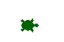
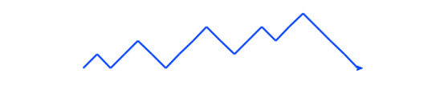
Be the turtle !
(2)
Finish rwalk so it draws a "stock-market" path: N steps of 10 pixels each. Use recursion.
(1)
What does chai(100) draw?
from random import *
def rwalk(N):
""" N 10-pixel steps, NE or SE """
if N == 0: return
if choice(['left','right']) == 'left':
else: # this handles 'right'
left(45)
forward(10)
def chai(size):
""" mystery! """
forward(size)
left(90)
forward(size/2.0)
right(90)
right(90)
forward(size)
left(90)
left(90)
forward(size/2.0)
right(90)
backward(size)
Ex Cr: How could you make it a bull (or a bear) market?
one possible result of rw(20)

Slide 29
(1) What does chai(100) do?
def chai(size):
""" mystery! """
if size<9:
return
forward(size)
left(90)
forward(size/2.0)
right(90)
right(90)
forward(size)
left(90)
left(90)
forward(size/2.0)
right(90)
backward(size)
How could you add more to each T-tip?
Why are there two identical commands in a row ~ twice!?

Slide 30
from random import *
def rwalk(N):
""" N 10-px steps, NE or SE """
if N == 0: return
if choice(['left','right'])=='left':
left(45)
forward(10)
right(45)
rwalk( N-1 )
else: # 'right'
right(45)
forward(10)
left(45)
rwalk( N-1 )
(2) rwalk is a random stock market walk...
What if we didn't turn back to face east each time?
Extra: Creating a bull (or a bear) market?

Slide 31
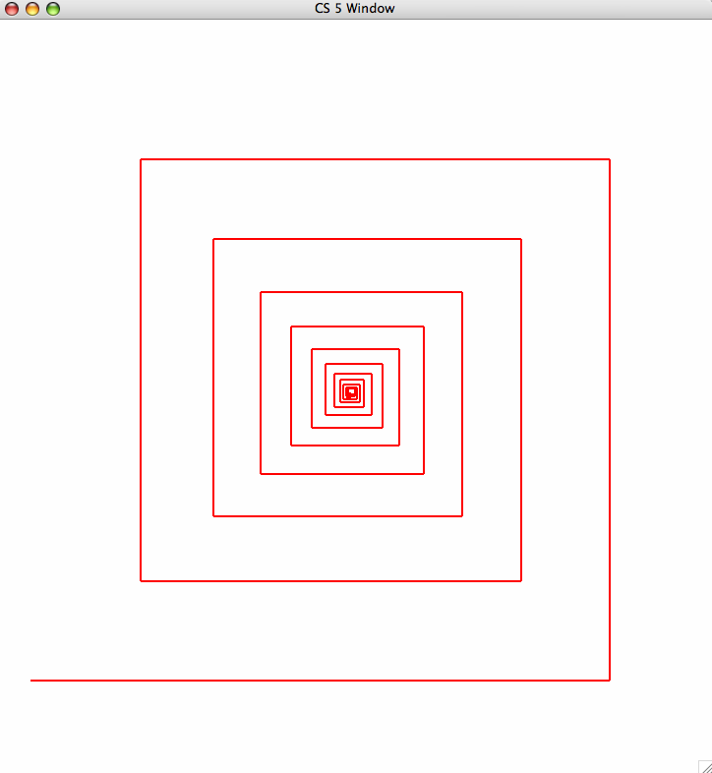
hw2pr3
81
fractal art!
90
spiral(100,90,0.9)
100
spiral( initLength, angle, multiplier )

Slide 32
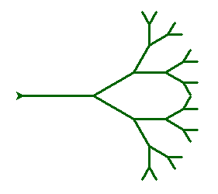
svtree( trunkLength, levels )
svtree( 100, 5 )
levels == 5
levels == 4
levels == 3
levels == 2
Be sure the turtle always returns to its starting position!
levels == 0
(no drawing)
levels == 1

Slide 33
svtree( trunkLength, levels )
svtree( 100, 5 )
svtree( 75, 4 )
levels == 5
levels == 4
levels == 3
levels == 2
Be sure the turtle always returns to its starting position!
levels == 0
(no drawing)
levels == 1

Slide 34
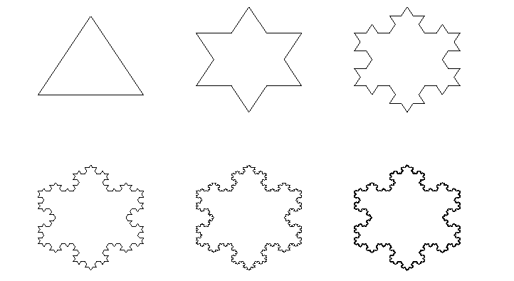
The Koch curve
snowflake(100, 0)
snowflake(100, 1)
snowflake(100, 2)
snowflake(100, 3)
snowflake(100, 4)
snowflake(100, 5)

Slide 35
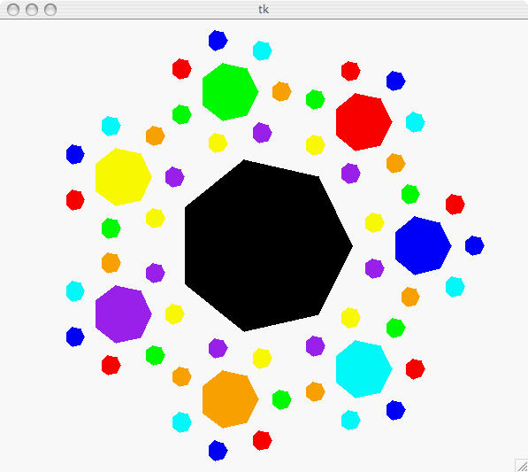
Have a great weekend!
Happy turtling with hw2…

Slide 37
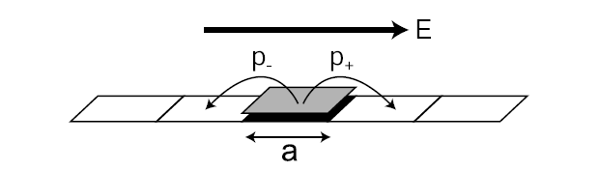
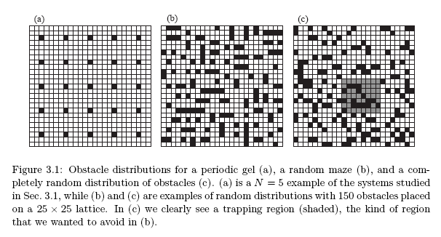
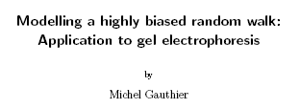
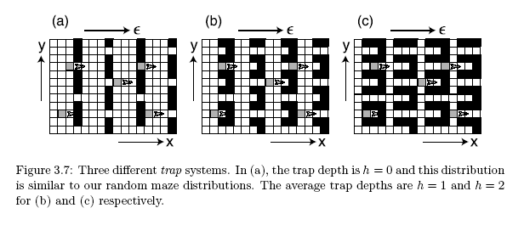
Gel electrophoresis
one of many applications for random walks…
uses a basic random-walk model with unequal step probabilities
Used to separate proteins and nucleic acids (DNA) from a biological sample. Molecules with different properties travel different distances.

Slide 38
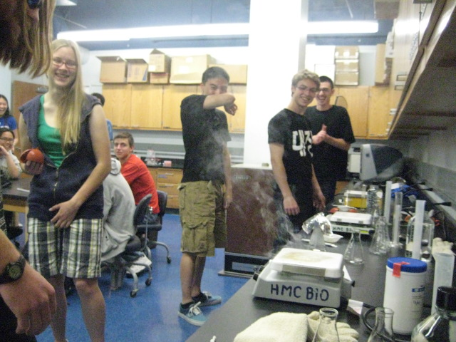
CS 5 green: Gel electrophoresis fire!

Slide 39
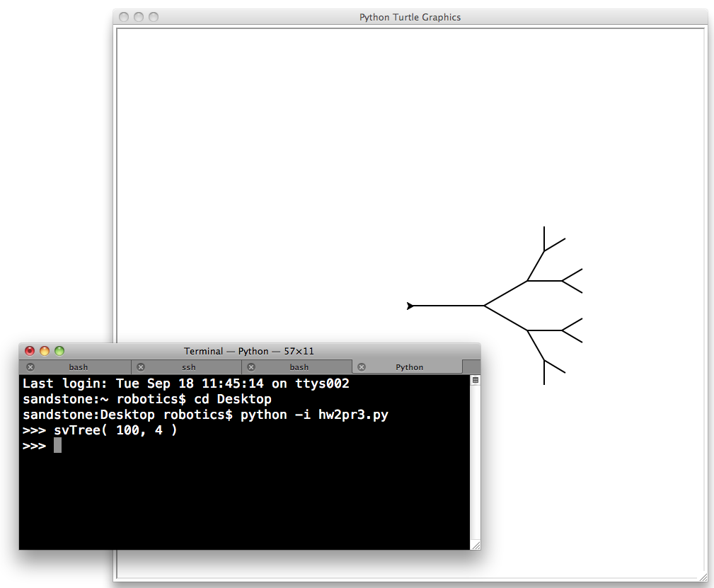
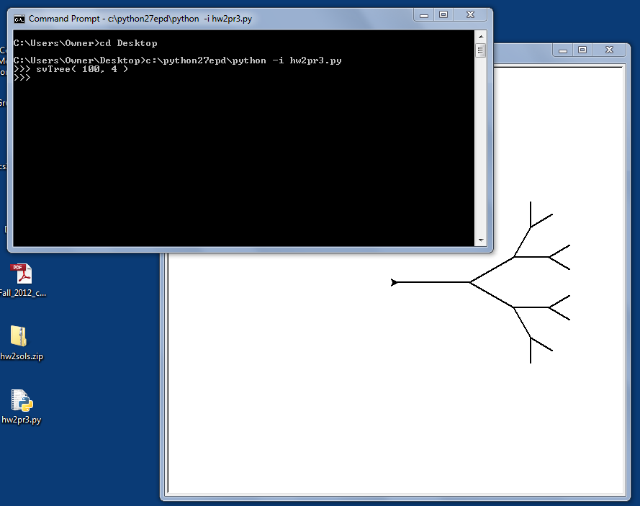
Python's turtle graphics
Sometimes you need to run Python from the command-line
www.cs.hmc.edu/twiki/bin/view/CS5/RunningPythonFromTheCommandLine
Mac instructions...
Windows instructions...

Slide 40
0
1
42
3
4
5
6
7
8
9
A
B
C
D
building blocks
E
F
G
H

Slide 41
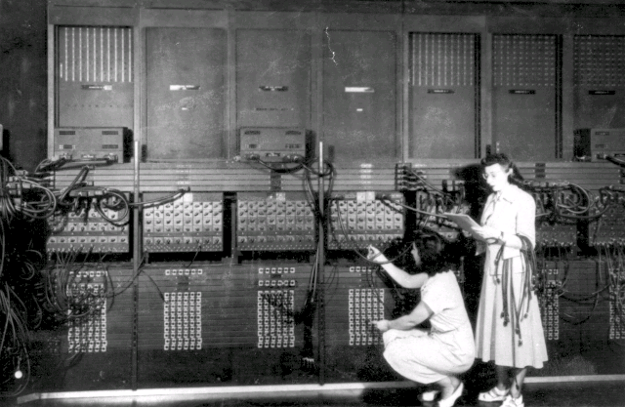
ENIAC 1
Programming before stored-program computers…

Slide 42
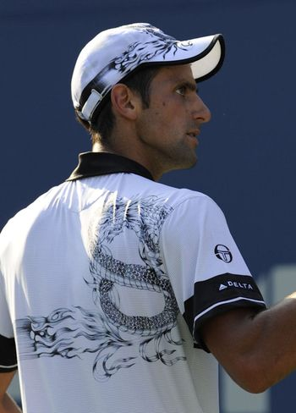
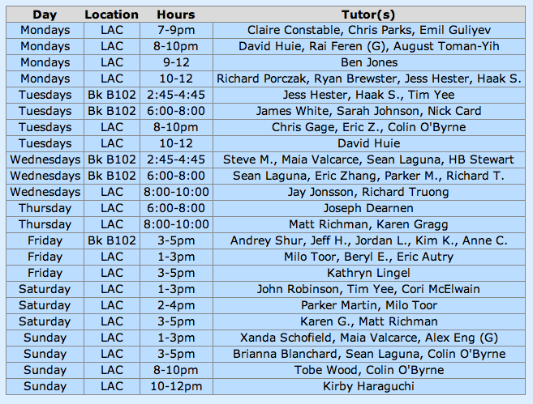
Claremont residents report droplets of water falling down-ward from the sky: unexplained meteorological phenomenon causes panic…
CS 5 Today
CS 5 alien on strike!
details, p. 42
hw2 due Mon.
Fri. aft. office hours!
LAC tutoring hours all weekend!
Consummate sketch of accused, bullying CS 5 co-worker
Fractals and Turtles!
Other trogdor appearances
The three-eyed CS 5 spokesalien has walked off the job, according to an AFL-CIO (Alien Federation of Labor and Congress of Interplanetary Organizations) lifeform. "I can't work under these conditions -- I arrived at work this morning and was immediately burninated by a new co-worker," sources reported hearing as the trinocular terrestrial stormed off. No word yet on who this reputed co-worker might be, though…
how random…
picket lines consumed by flames, p. 4
The Koch Curve

Slide 43
0
1
2
3
4
5
6
7
8
42
A
B
C
D
E
F
G
H

Slide 44
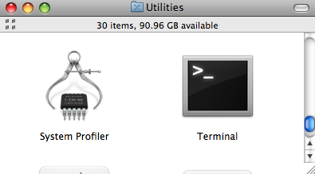
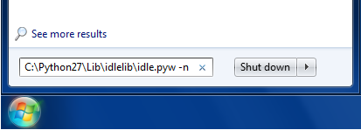
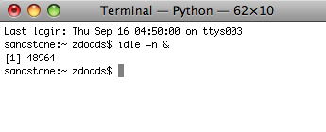
Python's Etch-a-Sketch
Be SURE to start IDLE with "no subprocess"
Mac instructions...
Windows instructions...
(Step 1) menus: Go – Utilities – Terminal
(Step 1) Go to the Start menu's search field
Start this!
(Step 2) Type or paste the full path to IDLE
If you used the standard install, it will be
C:\Python27\Lib\idlelib\idle.pyw -n
(Step 2) Enter idle –n &
Hit return; you'll see a console window and IDLE open.
Then, you can type
from turtle import *

Slide 45
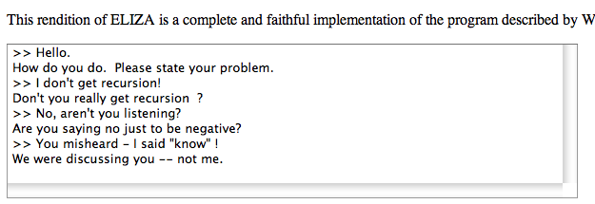
Reading this week...
conditionals (if),
data storage 'hi', and
recursion (or loops)
perhaps natural interactions could be created, too?
If all computation really consists of
Joseph Weizenbaum's Eliza
What's missing?

Slide 46
Easy as π
(1,1)
pi via darts
(-1,-1)

Slide 47
print: Making programs talk to you!
import time
def countdown( num ):
""" remarkably accurate sim.
of 2006's final moments """
if num == 0:
return 'Hooray!'
else:
print 'Countdown is', num
time.sleep(1)
return countdown(num-1)
you can slow things down, as well!
Essential for debugging …

Slide 48
Randomness vs. Determinism
Are there random numbers?
Can a computer generate them?
RNG
A “black box” model of a random number generator.
Output

Slide 49
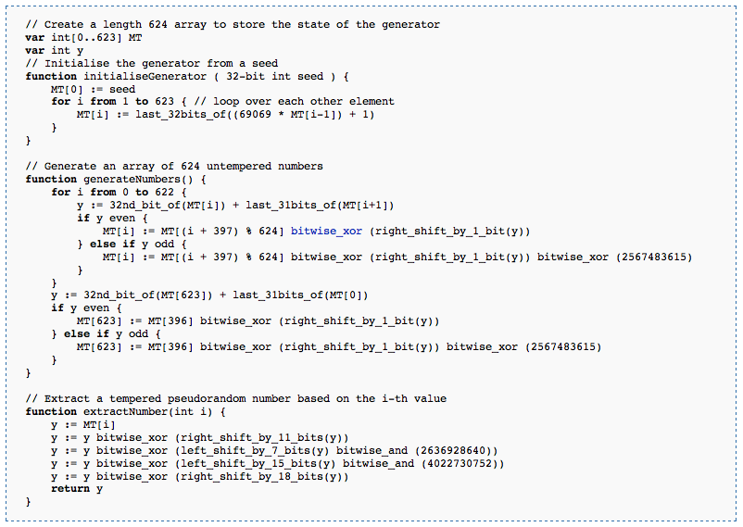
Randomness vs. Determinism
Are there random numbers?
Can a computer generate them?
Yes
Not without help!
The RNG revealed.
Periodic!
Output
p = 2¹⁹⁹³⁷-1
http://en.wikipedia.org/wiki/Mersenne_twister

Slide 50
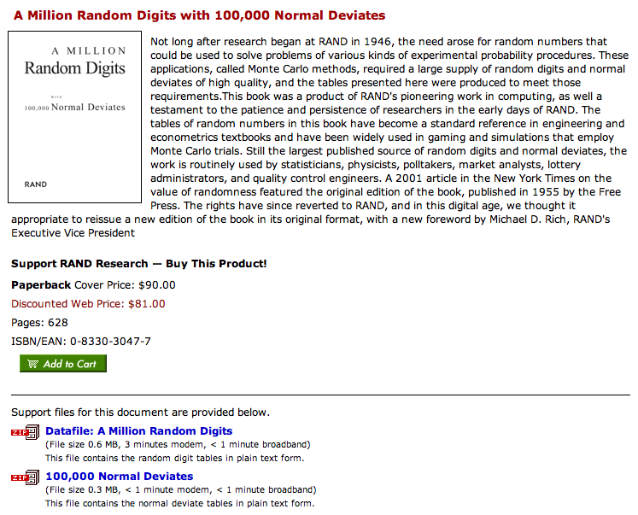
Some random history…
True randomness is valuable!
but not that valuable!
http://www.rand.org/pubs/monograph_reports/MR1418/index.html

Slide 51
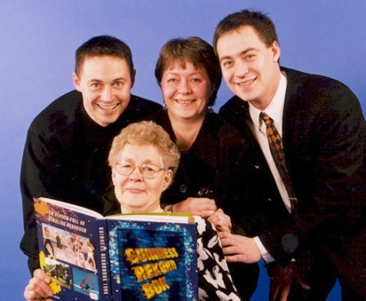


True Randomness !
http://www.leapzine.com/hr/
random, but not!
an enthusiastic endorser
LavaRnd’s lava lamps
using a chaotic physical system to seed random number generators
(Patent 5,732,138: "Method for seeding a pseudo-random number generator with a cryptographic hash of a digitization of a chaotic system.")
www.wired.com/wired/archive/11.08/random.html
This has since been “improved”…

Slide 52
Some random programs…
import random
def guess( hidden ):
""" guesses the user's #, "hidden" """
compguess = random.choice( range(10) )
if compguess == hidden:
return 'I got it!'
else:
return guess( hidden )
print guesses ?
num guesses ?

Slide 53
"Quiz"
(1) What should we do to improve this guesser?
(2) How?
import random
def guess( hidden ):
""" guesses the user's #, "hidden" """
compguess = random.choice( range(10) )
if compguess == hidden:
return 'I got it!'
else:
return guess( hidden )
print guesses ?
num guesses ?

Slide 54
Monte Carlo π
An engineering challenge: to estimate π using everyday items...

Slide 55
Quiz
Design a strategy for estimating pi using random numbers ("dart throws") and this diagram ("dartboard"):
Name(s):
(1,1)
What does this return?
1) Here is a dart-throwing function:
def throw():
return [ random.uniform(-1,1),
random.uniform(-1,1) ]
What does this return?
2) Here is a dart-testing function:
(-1,-1)
def test(x,y):
return (x**2 + y**2) < 1.0
3) What strategy could use the functions in (1) and (2) to estimate pi?
4) Write a function to implement your strategy:

Slide 56
Notes from prior hwks…
Warnings!
def rps(p1,p2):
""" rock-paper-scissors judger """
if 'p1' == 'p2':
return 0
def rps(p1,p2):
if p1 == p2:
return '0'
def letterscore(let):
if let in 'zq':
return 10 …(lots more)…

Slide 57
Notes from prior hwks…
Warnings!
def rps(p1,p2):
""" rock-paper-scissors judger """
if 'p1' == 'p2':
return 0
The string 'p1' is not the same as the variable p1 !
def rps(p1,p2):
""" rock-paper-scissors judger """
if p1 == p2:
return '0'
The string '0' is not the same as the number 0 !
no docstring!
def letterscore(let):
if let in 'zq':
return 10 …(lots more)…
Capital letters count! (It should be letterScore.)

Slide 58
Poetic Programming
#1 Listen my children and you shall hear
#2 The wonderful tales of Paul Revere
#3 Of all the 8 letters he shall send
#4 Number four is the middle of middle and the end of end
#5 Letters five and eight are exactly the same
#6 They are the end of Superman's real name
#7 Letters one through four are opposite the sea
#8 Number 6 completely refers to me!
#9 Now fill in the letter 7 blank
#10 Now that you have the majority on hand
#11 Flip the sea to the back,
#12 and get the costco brand!
1 My letters are eight (though I number much more)
2 And the first can start words such as 'file' and 'four.'
3 My four which begin form a word for stronghold
4 Like the one we call Knox where we keep all our gold.
5 My fifth is that letter our alphabet's got
6 Which can't choose if it will be a vowel or not.
7 My last three will come 'twixt a one and a three
8 And they are not a crowd, though they are company.
9 If you can't find my answer, please don't you despair.
10 Just come to CS class; it's everywhere there.
1 First a riff, then a twang, then a howl, then a bang:
2 Here?s a song that the Stones rocked real hard when they sang.
3 With Sir Mick on the mic and ol Keef on the strings,
4 There?s still some irony in the joy this song brings?
5 The first fourth of our song rhymes with cat and with hat.
6 It?s the past tense of ?sit.? You can sit on a mat.
7 (Though I?m sad I must say this clue gives it away
8 To the fans of this band. I hope they?ll understand.)
9 The next sixth is a verb that is hard to avoid
10 (In the last line alone, you can find two employed!)
11 And in Spanish ? reversed ? with an accent, it?s ?yes!?
12 Do you know what this verb is? Come on, take a guess!
13 The next twelfth of the word used to look just like ?E.?
14 But it lost his third limb; now he?s an amputee.
15 Though they still live nearby, things were never the same -
16 He gets sad and self conscious and thinks he is lame.
17 The last half of this song is six letters, I?m told,
18 And they certainly speak of demeanor quite bold.
19 And intertially speaking, this thing is opposed
20 By its equal and opposite twin, I suppose.
21 Of what song do I speak? I can hypothesize
22 That by now you?ve deciphered the code in my rhymes.
#Poem: I find that eating pie makes me negative
#1 I'll make the first clue easy: This list is composed of 16 digits.
#2 Within these, the 4th through the 10th digits are a palindrome including four 8s and which sums to 37.
#3 The 11th digit is the number of teams entering a semi-final.
#4 The 13th digit is one of two single-digit Kaprekar numbers in base 10.
#5 The 12th, 3rd, 16th, and 14th digits (in that order) comprise the legal slang (refering to the California Welfare & Institutions Code) for when a person is considered a danger to him/herself or others as a redult of a mental disorder.
#6 The 2nd and 1st digits (in that order) comprise the amount of time in hours such a person may be held in custody.
#7 Lastly, the 15th digit is an exciting number of letters to have in an English word. Unless you work for the FCC.

Slide 59
Friday Homework Hints…
hw2pr3 :
rwPos(…) is similar to the countdown example (from Wed.)
rwSteps(…) is similar to the guess example (from Wed.)
hw2pr4 :
countStrings(s1,s2) is similar to the sajak example (last Fri.)
except you will need to use slices instead of single characters
s2[0:?]
s2[0]
removeAll(e,L) is similar to sajak (last Fri.) and range (from Wed.)
it returns a list like L but with top-level elements e removed
Two more functions, as well: spiral(…) and svTree(…)

Slide 60

Recursion -- not just numbers
Self-similarity elsewhere...
Natural phenomena
Relationships
how much here is leaf vs. stem?
What is an “ancestor” ?
Names -- acronyms
GNU
== GNU’s Not Unix

Slide 61
Recursion -- not just numbers
Self-similarity elsewhere...
Natural phenomena
Relationships
What is an “ancestor” ?
An ancestor is a parent OR an ancestor of a parent…
Names -- acronyms
GNU
== GNU’s Not Unix
all stem!

Slide 62
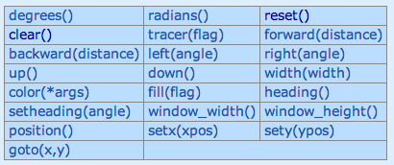
Turtle Graphics
You will need to have two files in your working folder (directory):
csturtle.py
csplot.py
You will want to have this line in your hw2pr4.py file:
import csturtle ; reload(csturtle) ; from csturtle import *
Then you will be able to write functions using the csturtle commands:
A place to start
def tri():
""" draws a polygon
"""
forward(100)
left(120)
forward(100)
left(120)
forward(100)
left(120)
www.cs.hmc.edu/twiki/bin/view/CS5/CsturtleDirections
for csturtle help

Slide 63

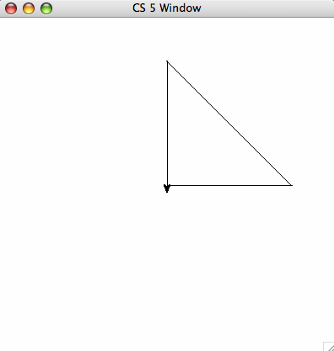
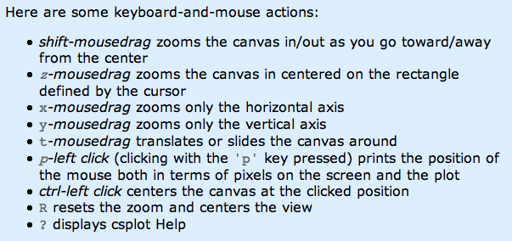
Window controls
all that's left from the villagers' thatched cars…
http://www.cs.hmc.edu/twiki/bin/view/CS5/Lab2Part1

Slide 64

Recursive Graphics
there is no tri …
(1)
Could we tri this with recursion?
def tri():
""" draws a polygon
"""
forward(100)
left(120)
forward(100)
left(120)
forward(100)
left(120)
(2)
Could we create any regular n-gon?
I don't know about tri, but there sure's NO return … !

Slide 65
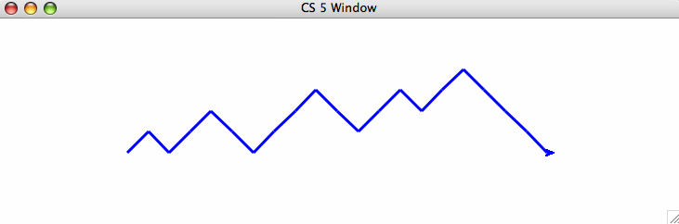
"Quiz"
Name(s):
Turtle Graphics
(1)
What does chai draw?
(2)
Finish rwalk to draw a "stock-market-type" random path of nsteps steps. Use recursion!
import random
def rw(nsteps):
""" moving for nsteps steps, randomly
45 deg. left (1) or right (-1) """
if nsteps == 0:
return
if random.choice([1,-1]) == 1: # left
else: # it was -1, meaning right
def chai(size):
""" mystery! """
forward(size)
left(90)
forward(size/2.0)
right(90)
right(90)
forward(size)
left(90)
left(90)
forward(size/2.0)
right(90)
backward(size)
one possible result of rw(20)
Ex Cr: How could you make it a bull (or a bear) market?

Slide 66
(1)
What does chai draw?
def chai(size):
""" mystery! """
forward(size)
left(90)
forward(size/2.0)
right(90)
right(90)
forward(size)
left(90)
left(90)
forward(size/2.0)
right(90)
backward(size)
Why are there two identical commands in a row?
How could you add more to each end?

Slide 67
(2)
Finish rwalk to draw a "stock-market-type" random path of nsteps steps.
import random
def rw(nsteps):
""" moving for nsteps steps, randomly
45 deg. left (1) or right (-1) """
if nsteps == 0:
return
if random.choice([1,-1]) == 1: # 1 means left
left(45)
forward(20)
right(45)
else: # it was -1, meaning right
right(45)
forward(20)
left(45)
one possible result of rw(20)
What if we didn't go back to the starting pose?
Ex Cr: How could you make it a bull (or a bear) market?

Slide 68
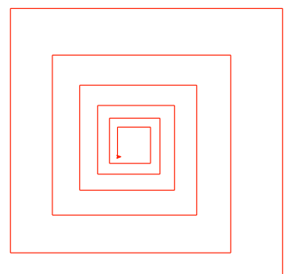
hw2pr4 spiral
81
72.9
90
close-up of innermost part of the spiral…
spiral( 100, 90, 0.9 )
100
spiral( initLength, angle, multiplier )

Slide 69
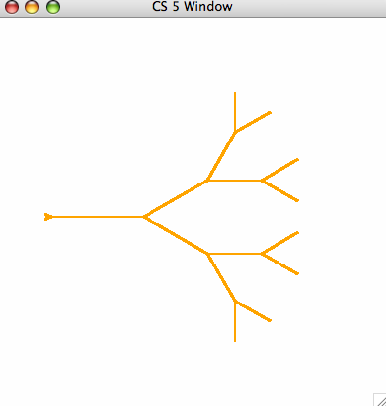
hw2pr4 svTree
svTree( 100, 4 )
I wonder what happened to the leaves on that tree… ?
svTree( trunkLength, levels )
and more! (if you want)

Slide 70
Taking away…
def removeBs( s ):
returns a string that is the same as s, except without any 'b's
Examples:
removeBs('hubbabubba') == 'huaua'

Slide 71
Taking away…
def removeBs( s )
returns a string that is the same as s, except without any 'b's
when there are no letters, the answer is _____________
Base Case:
if the first letter IS an B, the answer is ______________________
Recursive Step:
if the first letter IS an B, the answer is __________________

Slide 72
Sorting
def sort(L)
returns a list which has the same elements as L, but in sorted order!
Ideas?

Slide 73
Sorting
def sort(L)
returns a list which has the same elements as L, but in sorted order!
Ideas?
Let b be the biggest item in L
Remove b from L to get a newL
Add b to the end of … what ?!? …
Sorting in only 4 lines of code!

Slide 74
"Quiz"
Name(s):
Turtle Graphics
(1)
What does chai draw?
(2)
Finish rwalk to draw a "stock-market-type" random path of nsteps steps. Use recursion!
import random
def rw(nsteps):
""" moving for nsteps steps, randomly
45 deg. left (1) or right (-1) """
if nsteps == 0:
return
if random.choice([1,-1]) == 1: # left
else: # it was -1, meaning right
def chai(size):
""" mystery! """
forward(size)
left(90)
forward(size/2.0)
right(90)
right(90)
forward(size)
left(90)
left(90)
forward(size/2.0)
right(90)
backward(size)
one possible result of rw(20)
Ex Cr: How could you make it a bull (or a bear) market?

Slide 75

Real visual recursion
How many times has the light bounced before reaching the camera from various items here??

Slide 76
Quiz
Write each of these functions using recursion
Returns a string the same as s, but with no x characters in it. ( x, not 'x' ! )
remove('t','wait a minute') == 'wai a minue'
def remove( x, s ):
Removes the characters in the string s2 from the string s.
removeAll( 'gqz', 'quizzing' ) == 'uiin'
def removeAll( s2, s ):
Removes the characters in the string s2 at most once from the string s. (Hw problem!)
removeOne( 'agqz', 'quizzing' ) == 'uizin'
def removeOne( s2, s ):

Slide 77
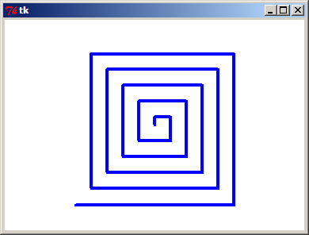
Drawing Recursively
Any self-similarity here?
190
200

Slide 78
Drawing Recursively
Designing any recursive program boils down to the same two pieces
Think about the SIMPLEST POSSIBLE case!
Base Case:
Do ONLY ONE STEP, and let recursion do the rest…
Recursive Step:

Slide 79
Drawing Recursively
Designing any recursive program boils down to the same two pieces
def spiral(L):
if L < 1: return
else:
forward(L)
left(90)
spiral(L-10)
Base Case
Recursive Step
What if we had forgotten the base case?

Slide 80
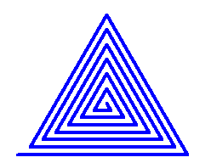
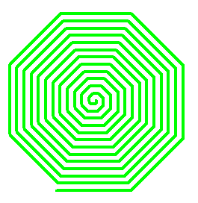
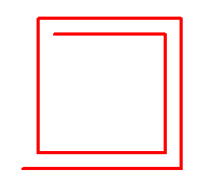
Drawing Recursively
Try writing these functions:
def spiralTri( L ):
Draws a triangular (equilateral) spiral.
Try it! spiralTri(200) draws
def spiralOct( L ):
Draws an octagonal spiral.
Try it! spiralOct(100) draws
def spiralLim( L ):
Draws a square spiral with only N segments!
Try it! spiralLim(200,7) draws
actually, a bit larger than this …

Slide 81


More on sorting…
def isSorted(s)
returns true if s is in order, false otherwise
isSorted('BART') returns False
isSorted('BERT') returns True
isSorted('BEGIN') returns True
isSorted([3,1,4]) returns False
isSorted([1,3,4]) returns True
ties?
isSorted('LOOPY') returns ??
Six-letter word?

Slide 82
print: Making programs talk to you!
Debugging had to be discovered. I can remember the exact instant when I realized that a large part of my life from then on was going to be spent in finding mistakes in my own programs.
- Maurice Wilkes
Programming: the art of debugging an empty file.
- The Jargon File
http://www.tuxedo.org/~esr/jargon/

Slide 83
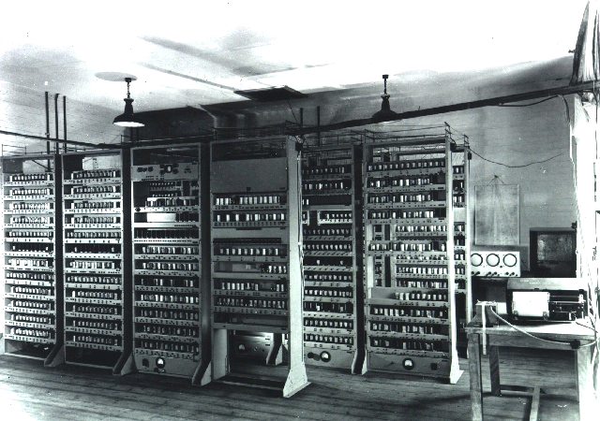
EDSAC
Cambridge U., 1949

Slide 84
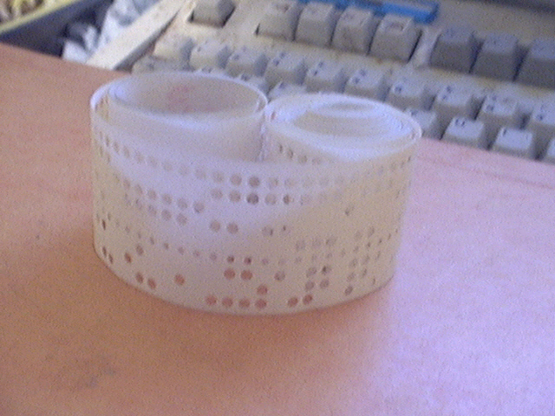
EDSAC’s input: punched tape

Slide 85


The most famous bug
Grace Hopper
from the UNIVAC 1
“In the days they used oxen for heavy pulling, when one ox couldn't budge a log, they didn't try to grow a larger ox. We shouldn't be trying for bigger and better computers, but for better systems of computers.”

Slide 86




The Python shell
IDLE uses Python's graphics - but built-in shells do not
"command window"
"terminal window"
c:\python25\python -i hw2pr1.py
python -i hw2pr1.py

Slide 87
Turtle Graphics
You will need to have two files in your working folder (directory):
csturtle.py
csplot.py
You will want to have this line in your hw2pr4.py file:
from csturtle import *
Then you will be able to write functions using the csturtle commands:
A place to start
def tri():
""" draws a polygon
"""
forward(100)
left(120)
forward(100)
left(120)
forward(100)
left(120)
www.cs.hmc.edu/twiki/bin/view/CS5/CsturtleDirections
for csturtle help

Slide 88
Window controls
all that's left from the villagers' thatched cars…
http://www.cs.hmc.edu/twiki/bin/view/CS5/Lab2Part1

Slide 89
CS 5 alien on strike!
More Eyes!
CS 5 Today
Fractals and Turtles
hw2 due Mon.
Fri. aft. office hrs!
Lots of tutoring…
Photograph of CS 5 co-worker accused of burnination.
The three-eyed CS 5 spokesalien has walked off the job, according to an AFL-CIO (Alien Federation of Labor and Congress of Interplanetary Organizations) lifeform. "I can't work under these conditions -- I arrived at work this morning and was immediately burninated by a new co-worker," sources reported hearing as the trinocular terrestrial stormed off. No word yet on who this reputed co-worker might be, though…
random how!
picket lines consumed by flames, p. 4
The Koch Curve

Slide 90
Python's turtle graphics
Running a turtle-friendly version of IDLE…
Mac instructions...
Windows instructions...
(Step 1) menus: Go – Utilities – Terminal
(Step 1) Go to the Start menu's search field
Start this!
(Step 2) Type or paste the full path to IDLE
If you used the standard install, it will be
C:\Python27\Lib\idlelib\idle.pyw -n
(Step 2) Enter idle –n &
Hit return; you'll see a console window and IDLE open.

