Slide 1
This would make me hungry… but I ate breakfast this morning!
Computing to the max
The not-so-subtle art of singling out the best (and worst) of anything…
Last hw?
a comparison comparison
N-step sleepwalking?
'm&ms'
'coffee'
Turtle graphics??
Artistic renderings!!!
[ 0, 42 ]
[ 4, 2 ]
fractal-tree humans?
True
'True'
This week!
> or <
Hw #3 due next Monday…
Computing with language
NEW! Schedule-able office/tutoring hours!!
What's in a Writ1 paper, anyway?
Battle-tested ciphers & how to break them…

Slide 3
max
A recipe for life ?
and python already has it for us…
The real problem is knowing what we want to maximize!

Slide 4
to the max
And I thought $100 was overpriced!
NASDAQ: GOOG
Want the highest price?
max( [475.5, 458.0, 441.3, 470.8, 532.8, 520.9] )
'nov'
'jan'
'mar'
'may'
'jul'
'sep'
What if the months are in there, as well?
max( [ [470.8,'may'], [532.8,'jul'], [520.9,'sep'] ] )
max( [ ['may',470.8], ['jul',532.8], ['sep',520.9] ] )

Slide 5
to the max
And I thought $100 was overpriced!
NASDAQ: GOOG
Want the highest price?
max( [475.5, 458.0, 441.3, 470.8, 532.8, 520.9] )
'nov'
'jan'
'mar'
'may'
'jul'
'sep'
What if the months are in there, as well?
max( [ [470.8,'may'], [532.8,'jul'], [520.9,'sep'] ] )
max( [ ['may',470.8], ['jul',532.8], ['sep',520.9] ] )
Mudd's max?
L = ['Harvey', 'Mudd', 'College', 'seeks', 'to', 'educate', 'engineers,', 'scientists', 'and', 'mathematicians', 'well-versed', 'in', 'all', 'of', 'these', 'areas', 'and', 'in', 'the', 'humanities', 'and', 'the', 'social', 'sciences', 'so', 'that', 'they', 'may', 'assume', 'leadership', 'in', 'their', 'fields', 'with', 'a', 'clear', 'understanding', 'of', 'the', 'impact', 'of', 'their', 'work', 'on', 'society']
max(L)
Or Mudd's min?
min(L)

Slide 6
writing max
def max( L ):
""" returns the max element from L
input: L, a nonempty list
"""
if len(L) < 2: # one element is the max.
return L[0]
elif L[0] < L[1] : #1 wins
return max( L[1:] )
else: #0 wins
return max( L[0:1] + L[2:] )
Spacey! I like it!

Slide 7
scrabble-score max
def bestWord( L ):
""" returns L's max-scrabble-score word
input: L, a list of strings (words)
"""
if len(L) < 2: # one element is the max
return L[0]
elif L[0] < L[1] : #1 wins
return bestWord( L[1:] )
else: #0 wins
return bestWord( L[0:1] + L[2:] )
What do we need here?

Slide 8
scrabble-score max
def bestWord( L ):
""" returns L's max-scrabble-score word
input: L, a list of strings (words)
"""
if len(L) < 2: # one element is the max
return L[0]
elif sScore(L[0]) < sScore(L[1]): #1 wins
return bestWord( L[1:] )
else: #0 wins
return bestWord( L[0:1] + L[2:] )
What else might be nice to know ?

Slide 9
A more comprehensive solution
def bestWord( L ):
""" returns L's max-scrabble-score word
"""
LoL = [ [sScore(w), w] for w in L ]
bestpair = max( LoL )
return bestpair[1]
This does look funny!

Slide 10
A more comprehensive solution
I loathe hazy code!
L = [ 'aliens', 'zap', 'hazy', 'code' ]
def bestWord( L ):
""" returns L's max-scrabble-score word
"""
LoL = [ [sScore(w), w] for w in L ]
bestpair = max( LoL )
return bestpair[1]
LoL = [ [6,'aliens'], [9,'zap'], [19,'hazy'], [5,'code'] ]
bestpair = [19,'hazy']
'hazy'

Slide 11
Other examples…
What is bestnumb ?
What is mostnumb ?
>>> bestnumb( [10,20,30,40,50,60,70] )
40
>>> bestnumb( [100,200,300,400] )
100
>>> bestnumb( [1,2,3,4,5,6,7,8,7] )
8
>>> mostnumb( [1,2,3,4,5,6,7,8,7] )
7
These functions have made me number

Slide 12
Quiz
L = [ 'aliens', 'zap', 'hazy', 'code' ]
Name(s):
def beststr(L):
LoL = [ [len(s),s] for s in L ]
bst = max( LoL )
return bst[1]
1. What is LoL?
Extra!
Change exactly three characters so that 3 is returned.
2. What is bst?
3. What is returned?
L = [ 30, 40, 50 ]
Use the LoL method to write these two functions
def bestnumb(L):
""" returns the # in L closest to 42 """
LoL = [ ]
bst =
return bst[1]
Hint: Python has abs(x) built-in
L = [ 3,4,5,7,6,7 ]
def mostnumb( L ):
""" returns the item most often in L """
LoL = [ ]
bst =
return bst[1]
Hint: Define a helper function!
def help(e,L):

Slide 13
Quiz
L = [ 'aliens', 'zap', 'hazy', 'code' ]
Try this on the back page first!
def beststr(L):
LoL = [ [len(s),s] for s in L ]
bst = max( LoL )
return bst[1]
1. What is LoL?
2. What is bst?
Extra!
Change exactly three characters so that 3 is returned.
3. What is returned?
Use the LoL method to write these two functions
def bestnumb(L):
""" returns the # in L closest to 42 """
LoL = [ ]
bst = max( LoL )
return bst[1]
Hint: Python has abs(x) built-in
def mostnumb( L ):
""" returns the item most often in L """
LoL = [ ]
bst = max( LoL )
return bst[1]
Hint: Define a helper function!
def count(e,L):
LC = [e==x for x in L]
return sum(LC)

Slide 14
L = [ 'aliens', 'zap', 'hazy', 'code' ]
def beststr(L):
LoL = [ [len(s),s] for s in L ]
bst = max( LoL )
return bst[1]
1. What is LoL?
[ [6,'aliens'], [3,'zap'], [4,'hazy'], [4,'code'] ]
2. What is bst?
[6,'aliens']
'aliens'
3. What is returned?
Extra! Change exactly three characters so that 3 is returned.

Slide 15
Example
def bestnumb( L ):
""" returns the # closest to 42 in L """
LoL = [ [abs(x-42),x] for x in L ]
bst = min( LoL )
return bst[1]
[30,40,50]
L
[[12,30],[2,40],[8,50]]
LoL
[2,40]
bst
40

Slide 16
Helper function: count(e,L)
Example
def count( e, L ):
""" returns the # of e's in L """
LC = [ e==x for x in L ]
return sum( LC )
L
[6,7,7,8]
[ [1,6], [2,7], [2,7], [1,8] ]
LoL
bst
[2,7]
def mostnumb( L ):
""" returns the item most often in L """
LoL = [ [count(x,L),x] for x in L ]
bst = max( LoL )
return bst[1]
7

Slide 17
Today's lab: big data?
Any guesses as to what kind of data this is?
I find your lack of faith in this data disturbing.

Slide 18
Today's lab: sound data!

Slide 19
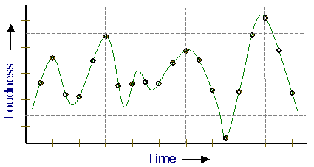
Sound
physics
continuous variation of air pressure vs. time
air pressure
sampling
samples taken every 1/22050th of a second (or some sampling rate)
time
quantization
Each sample is measured on a loudness scale from -32,768 to 32,767. (This fits into 2 bytes.)
storage
These two bytes are called a frame. Raw audio data - such as what is written to the surface of a CD - is simply a list of these frames.
pulse code modulation = PCM data

Slide 20
Computing with language
ideas / meaning
language / words / phrases
Python strings are here.
strings
numbers / bits

Slide 21
Computing with language
open questions in AI …
ideas / meaning
language / words / phrases
processing language – how English-y is it?
strings
how strings are represented and stored
numbers / bits

Slide 22
Caesar Cipher: encipher
encipher( 'I <3 Latin' , 0 )
'I <3 Latin'
'J <3 Mbujo'
'K <3 Ncvkp'
'L <3 Odwlq'
'M <3 Pexmr'
'N <3 Qfyns'
returns
encipher( 'I <3 Latin' , 1 )
returns
encipher( 'I <3 Latin' , 2 )
returns
encipher( 'I <3 Latin' , 3 )
returns
encipher( 'I <3 Latin' , 4 )
returns
encipher( 'I <3 Latin' , 5 )
returns
encipher( 'I <3 Latin' , 25 )
'H <3 Kzshm'
returns

Slide 23
Caesar Cipher: encipher
should return the string s with each alphabetic character shifted/wrapped by n places in the alphabet
encipher(s,n)
encipher( 'I <3 Latin' , 0 )
'I <3 Latin'
'J <3 Mbujo'
'K <3 Ncvkp'
'L <3 Odwlq'
'M <3 Pexmr'
'N <3 Qfyns'
returns
encipher( 'I <3 Latin' , 1 )
returns
encipher( 'I <3 Latin' , 2 )
returns
encipher( 'I <3 Latin' , 3 )
returns
encipher( 'I <3 Latin' , 4 )
returns
encipher( 'I <3 Latin' , 5 )
returns
encipher( 'I <3 Latin' , 25 )
'H <3 Kzshm'
returns

Slide 24
ASCII
American Standard Code for Information Interchange
1 byte
8 bits
The SAME bits represent an integer or a string, depending on type: int or str

Slide 25
ASCII
American Standard Code for Information Interchange
over in memory…
value:
'/'
00101111
type: str
bits
name:
Identical bits are stored in each variable!
The types determine how to interpret the bits; the names don't matter at all…
1 byte
value:
8 bits
47
00101111
type: int
bits
The SAME bits represent an integer or a string, depending on type: int or str
name:

Slide 26
ASCII
convert # to char
chr
ord
convert char to #

Slide 27
chr and ord
abcdefghijklmnopqrstuvwxyz
ASCII values
97
99
101
103
105
107
109
111
113
115
117
119
122
ABCDEFGHIJKLMNOPQRSTUVWXYZ
65
67
69
71
73
75
77
79
81
83
85
87
90
ord( c )
Input: a string of one character, c
Conversion functions
Output: an integer, the ASCII value of c
chr( n )
Input: an integer in range(255)
Output: a one-char. string of that ASCII value
[ [i,chr(i)] for i in range(128) ]
Try these!
[ ord(i) for i in '**** CS! ****' ]

Slide 28
chr, ord,
and rot13
What is ord('U')/2?
What is chr( ord('i')+13 )?
What is chr( ord('W')+13 )?
Finish rot13 to "shift" letters by 13 spots…
def rot13( c ):
""" rotate c by 13 chars, "wrapping" as needed; NON-LETTERS don't change """
if 'a' <= c <= 'z': # test if c is a lowercase letter
new_ord = ord(c) + 13 # if so, find the # 13 spots ahead
if new_ord <= ord('z'): # check if it's in bounds!
return chr(new_ord) # if so, return it
else: # otherwise
return # what to return?
elif # what test should go here?
# what would go here, if we had room?
else: # what should be done in the else?
How would this change if we wanted to rotate by n spots?

Slide 29
Rot 13
def rot13( c ):
""" rotates c by 13 chars, "wrapping" as needed
NON-LETTERS don't change!
"""
if 'a' <= c <= 'z':
new_ord = ord(c) + 13
if new_ord <= ord('z'):
return chr(new_ord)
else:
return chr( )
elif 'A' <= c <= 'Z': # upper-case test!
else:
Rotate n? Rotate an entire string?

Slide 30
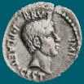
Caesar Cipher: decipher
Caesar
Brutus
>>> decipher('Bzdrzq bhogdq? H oqdedq Bzdrzq rzkzc.')
'Caesar cipher? I prefer Caesar salad.'
>>> decipher('Hu lkbjhapvu pz doha ylthpuz hmaly dl mvynla '\
'lclyfaopun dl ohcl slhyulk.')
'An education is what remains after we forget everything we have learned.'
>>> decipher('Uifz xpsl ju pvu xjui b qfodjm!')
>>> decipher('gv vw dtwvg')
But how ?

Slide 31
Decipher?
Strategies?
Algorithms?

Slide 32
gv vw dtwvg
hw wx euxwh
ix xy fvyxi
jy yz gwzyj
kz za hxazk
la ab iybal
mb bc jzcbm
nc cd kadcn
od de lbedo
pe ef mcfep
qf fg ndgfq
rg gh oehgr
sh hi pfihs
ti ij qgjit
uj jk rhkju
vk kl silkv
wl lm tjmlw
xm mn uknmx
yn no vlony
zo op wmpoz
ap pq xnqpa
bq qr yorqb
cr rs zpsrc
ds st aqtsd
et tu brute
fu uv csvuf
Decipher?
All possible decipherings
Strategies?
Algorithms?

Slide 33
gv vw dtwvg
hw wx euxwh
ix xy fvyxi
jy yz gwzyj
kz za hxazk
la ab iybal
mb bc jzcbm
nc cd kadcn
od de lbedo
pe ef mcfep
qf fg ndgfq
rg gh oehgr
sh hi pfihs
ti ij qgjit
uj jk rhkju
vk kl silkv
wl lm tjmlw
xm mn uknmx
yn no vlony
zo op wmpoz
ap pq xnqpa
bq qr yorqb
cr rs zpsrc
ds st aqtsd
et tu brute
fu uv csvuf
[0, 'gv vw dtwvg'],
[2, 'hw wx euxwh'],
[2, 'ix xy fvyxi'],
[0, 'jy yz gwzyj'],
[2, 'kz za hxazk'],
[4, 'la ab iybal'],
[0, 'mb bc jzcbm'],
[1, 'nc cd kadcn'],
[4, 'od de lbedo'],
[3, 'pe ef mcfep'],
[0, 'qf fg ndgfq'],
[2, 'rg gh oehgr'],
[2, 'sh hi pfihs'],
[3, 'ti ij qgjit'],
[2, 'uj jk rhkju'],
[1, 'vk kl silkv'],
[0, 'wl lm tjmlw'],
[1, 'xm mn uknmx'],
[2, 'yn no vlony'],
[3, 'zo op wmpoz'],
[2, 'ap pq xnqpa'],
[1, 'bq qr yorqb'],
[0, 'cr rs zpsrc'],
[1, 'ds st aqtsd'],
[4, 'et tu brute'],
[3, 'fu uv csvuf']
Decipher?
All possible decipherings
Score them all
Strategies?
Algorithms?
quantifying Englishness?

Slide 34
gv vw dtwvg
hw wx euxwh
ix xy fvyxi
jy yz gwzyj
kz za hxazk
la ab iybal
mb bc jzcbm
nc cd kadcn
od de lbedo
pe ef mcfep
qf fg ndgfq
rg gh oehgr
sh hi pfihs
ti ij qgjit
uj jk rhkju
vk kl silkv
wl lm tjmlw
xm mn uknmx
yn no vlony
zo op wmpoz
ap pq xnqpa
bq qr yorqb
cr rs zpsrc
ds st aqtsd
et tu brute
fu uv csvuf
[0, 'gv vw dtwvg'],
[2, 'hw wx euxwh'],
[2, 'ix xy fvyxi'],
[0, 'jy yz gwzyj'],
[2, 'kz za hxazk'],
[4, 'la ab iybal'],
[0, 'mb bc jzcbm'],
[1, 'nc cd kadcn'],
[4, 'od de lbedo'],
[3, 'pe ef mcfep'],
[0, 'qf fg ndgfq'],
[2, 'rg gh oehgr'],
[2, 'sh hi pfihs'],
[3, 'ti ij qgjit'],
[2, 'uj jk rhkju'],
[1, 'vk kl silkv'],
[0, 'wl lm tjmlw'],
[1, 'xm mn uknmx'],
[2, 'yn no vlony'],
[3, 'zo op wmpoz'],
[2, 'ap pq xnqpa'],
[1, 'bq qr yorqb'],
[0, 'cr rs zpsrc'],
[1, 'ds st aqtsd'],
[4, 'et tu brute'],
[3, 'fu uv csvuf']
Decipher?
All possible decipherings
max!
Score them all
Strategies?
Algorithms?
yields the "most English" phrase

Slide 35
Measuring Englishness
Very English-y
"Call me Ishmael."
"Attack at dawn!"
"rainbow, table, candle"
higher scores
"Yow! Legally-imposed CULTURE-reduction is CABBAGE-BRAINED!"
"quadruplicity drinks procrastination"
"Hold the newsreader's nose squarely, waiter, or friendly milk will countermand my trousers."
quantifying Englishness?
"the gostak distims the doshes"
"hension, framble, bardle"
"jufict, stofwus, lictpub"
"itehbs, rsnevtr, khbsota"
lower scores
"epadxo, nojarpn, gdxokpw"
"h o q dedqBzdrzqrzkzc"
All of these sound good to me!
Not English-y

Slide 36
gv vw dtwvg
hw wx euxwh
ix xy fvyxi
jy yz gwzyj
kz za hxazk
la ab iybal
mb bc jzcbm
nc cd kadcn
od de lbedo
pe ef mcfep
qf fg ndgfq
rg gh oehgr
sh hi pfihs
ti ij qgjit
uj jk rhkju
vk kl silkv
wl lm tjmlw
xm mn uknmx
yn no vlony
zo op wmpoz
ap pq xnqpa
bq qr yorqb
cr rs zpsrc
ds st aqtsd
et tu brute
fu uv csvuf
[0, 'gv vw dtwvg'],
[2, 'hw wx euxwh'],
[2, 'ix xy fvyxi'],
[0, 'jy yz gwzyj'],
[2, 'kz za hxazk'],
[4, 'la ab iybal'],
[0, 'mb bc jzcbm'],
[1, 'nc cd kadcn'],
[4, 'od de lbedo'],
[3, 'pe ef mcfep'],
[0, 'qf fg ndgfq'],
[2, 'rg gh oehgr'],
[2, 'sh hi pfihs'],
[3, 'ti ij qgjit'],
[2, 'uj jk rhkju'],
[1, 'vk kl silkv'],
[0, 'wl lm tjmlw'],
[1, 'xm mn uknmx'],
[2, 'yn no vlony'],
[3, 'zo op wmpoz'],
[2, 'ap pq xnqpa'],
[1, 'bq qr yorqb'],
[0, 'cr rs zpsrc'],
[1, 'ds st aqtsd'],
[4, 'et tu brute'],
[3, 'fu uv csvuf']
Decipher?
All possible decipherings
max!
Score them all
Strategies?
Algorithms?
"Englishness" score based on #-of-vowels

Slide 37
gv vw dtwvg
hw wx euxwh
ix xy fvyxi
jy yz gwzyj
kz za hxazk
la ab iybal
mb bc jzcbm
nc cd kadcn
od de lbedo
pe ef mcfep
qf fg ndgfq
rg gh oehgr
sh hi pfihs
ti ij qgjit
uj jk rhkju
vk kl silkv
wl lm tjmlw
xm mn uknmx
yn no vlony
zo op wmpoz
ap pq xnqpa
bq qr yorqb
cr rs zpsrc
ds st aqtsd
et tu brute
fu uv csvuf
[6.9e-05, 'gv vw dtwvg'],
[3.6e-05, 'hw wx euxwh'],
[1.4e-07, 'ix xy fvyxi'],
[8.8e-11, 'jy yz gwzyj'],
[7.2e-10, 'kz za hxazk'],
[0.01503, 'la ab iybal'],
[3.7e-08, 'mb bc jzcbm'],
[0.00524, 'nc cd kadcn'],
[0.29041, 'od de lbedo'],
[0.00874, 'pe ef mcfep'],
[7.3e-07, 'qf fg ndgfq'],
[0.06410, 'rg gh oehgr'],
[0.11955, 'sh hi pfihs'],
[3.1e-06, 'ti ij qgjit'],
[1.1e-08, 'uj jk rhkju'],
[2.6e-05, 'vk kl silkv'],
[0.00012, 'wl lm tjmlw'],
[3.1e-06, 'xm mn uknmx'],
[0.02011, 'yn no vlony'],
[1.5e-06, 'zo op wmpoz'],
[1.9e-07, 'ap pq xnqpa'],
[5.7e-08, 'bq qr yorqb'],
[0.00024, 'cr rs zpsrc'],
[0.02060, 'ds st aqtsd'],
[0.45555, 'et tu brute'],
[0.00011, 'fu uv csvuf']
Decipher?
All possible decipherings
S
c
o
r
e
s
Strategies?
Algorithms?
"Englishness" based on letter-probabilities
max!

Slide 38
We'll see you in Lab3 !
hear

Slide 39
Aside: web scraping
How could we grab today's stock price via Python?

Slide 40
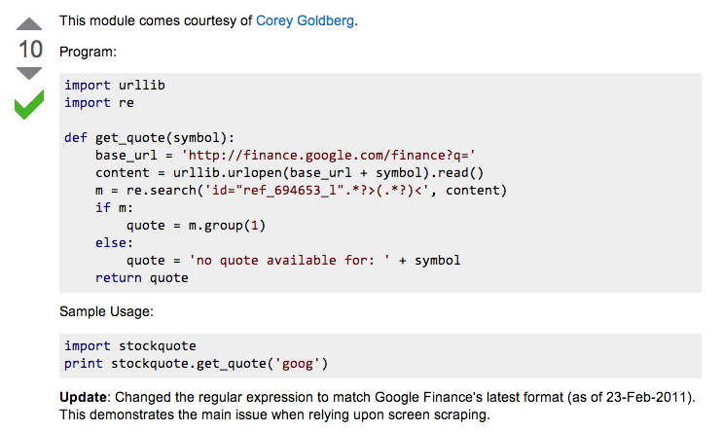
Example: web scraping
http://stackoverflow.com/questions/5081710/how-to-create-a-stock-quote-fetching-app-in-python

Slide 41
Regular Expressions
a huge string-processing library
many tutorials available…
developers.google.com/edu/python/regular-expressions?csw=1

Slide 42
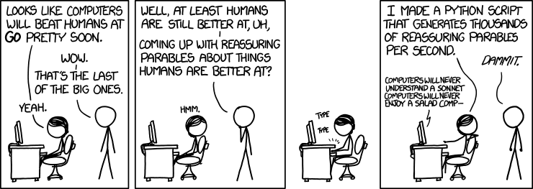
String-processing perspective…
with thanks to Jacquelyn Zehner!
http://stackoverflow.com/questions/5081710/how-to-create-a-stock-quote-fetching-app-in-python

Slide 44
Caesar Cipher: decipher
Caesar
[0, 'gv vw dtwvg'],
[2, 'hw wx euxwh'],
[2, 'ix xy fvyxi'],
[0, 'jy yz gwzyj'],
[2, 'kz za hxazk'],
[4, 'la ab iybal'],
[0, 'mb bc jzcbm'],
[1, 'nc cd kadcn'],
[4, 'od de lbedo'],
[3, 'pe ef mcfep'],
[0, 'qf fg ndgfq'],
[2, 'rg gh oehgr'],
[2, 'sh hi pfihs'],
[3, 'ti ij qgjit'],
[2, 'uj jk rhkju'],
[1, 'vk kl silkv'],
[0, 'wl lm tjmlw'],
[1, 'xm mn uknmx'],
[2, 'yn no vlony'],
[3, 'zo op wmpoz'],
[2, 'ap pq xnqpa'],
[1, 'bq qr yorqb'],
[0, 'cr rs zpsrc'],
[1, 'ds st aqtsd'],
[4, 'et tu brute'],
[3, 'fu uv csvuf']
Brutus
number-of-vowels score
max
won't always be correct!
all 26 possibilities

Slide 45
Caesar Cipher: decipher
Caesar
[6.9e-05, 'gv vw dtwvg'],
[3.6e-05, 'hw wx euxwh'],
[1.4e-07, 'ix xy fvyxi'],
[8.8e-11, 'jy yz gwzyj'],
[7.2e-10, 'kz za hxazk'],
[0.01503, 'la ab iybal'],
[3.7e-08, 'mb bc jzcbm'],
[0.00524, 'nc cd kadcn'],
[0.29041, 'od de lbedo'],
[0.00874, 'pe ef mcfep'],
[7.3e-07, 'qf fg ndgfq'],
[0.06410, 'rg gh oehgr'],
[0.11955, 'sh hi pfihs'],
[3.1e-06, 'ti ij qgjit'],
[1.1e-08, 'uj jk rhkju'],
[2.6e-05, 'vk kl silkv'],
[0.00012, 'wl lm tjmlw'],
[3.1e-06, 'xm mn uknmx'],
[0.02011, 'yn no vlony'],
[1.5e-06, 'zo op wmpoz'],
[1.9e-07, 'ap pq xnqpa'],
[5.7e-08, 'bq qr yorqb'],
[0.00024, 'cr rs zpsrc'],
[0.02060, 'ds st aqtsd'],
[0.45555, 'et tu brute'],
[0.00011, 'fu uv csvuf']
Brutus
letter-prob. score
max
not always correct, but better!
all 26 possibilities

Slide 46
Caesar Cipher: decipher
gv vw dtwvg
hw wx euxwh
ix xy fvyxi
jy yz gwzyj
kz za hxazk
la ab iybal
mb bc jzcbm
nc cd kadcn
od de lbedo
pe ef mcfep
qf fg ndgfq
rg gh oehgr
sh hi pfihs
ti ij qgjit
uj jk rhkju
vk kl silkv
wl lm tjmlw
xm mn uknmx
yn no vlony
zo op wmpoz
ap pq xnqpa
bq qr yorqb
cr rs zpsrc
ds st aqtsd
et tu brute
fu uv csvuf
Caesar
Brutus
decipher('gv vw dtwvg')
Strategy using max:
(1) consider all possible answers
(2) give them each a score
(3) use our techniques to get max
Score for "Englishness"?
up to you…
all 26 possibilities

Slide 47
Solutions…
Hints:
abs( x ) is built-in to Python
Use bestWord as a guide:
def bestWord( L ):
""" example code """
LOL = [ [scsc(w), w] for w in L ]
bestPair = max( LOL )
return bestPair[1]
L
def bestNumber( L ):
""" returns the # in
L closest to 42 """
LoL =
[30,40,50]
[[12,30],[2,40],[8,50]]
[2,40]
40

Slide 48
Solutions…
Hints:
abs( x ) is built-in to Python
Use bestWord as a guide:
def bestWord( L ):
""" example code """
LOL = [ [scsc(w), w] for w in L ]
bestPair = max( LOL )
return bestPair[1]
L
def bestNumber( L ):
""" returns the # in
L closest to 42 """
LoL =
[30,40,50]
[[12,30],[2,40],[8,50]]
[2,40]
40

Slide 49
Solutions…
def count( e, L ):
""" returns the # of e's in L """
return sum( [e==x for x in L] )
def mode( L ):
""" returns the element
appearing most often in L """

Slide 50
The last word on bestWord
def scrabbleScore(w):
# see homework #1!
Let's abbreviate this function as scsc(w)
using raw recursion
def bestWord( L ):
""" finds the "best" word from L, a list of words
here, "best" means highest scrabble score """
if len(L) < 2: return L[0]
elif scsc(L[0]) < scsc(L[1]): return bestWord( L[1:] )
else: return bestWord( L[0:1] + L[2:] )
using max
def bestWord( L ):
""" returns the word in L w/max scrabble score """
LoL = [ [scsc(w), w] for w in L ]
bestPair = max( LoL )
return bestPair

Slide 51
What is CS really about
thinking like a machine
thinking for a machine
variables
42
storage
int
guess
libraries
sequences
deciding how to use existing tools …
'w'
'a'
'r'
't'
str
s[0]
str
s[1]
str
s[2]
str
s[3]
functions
creating your own tools ...
if…elif…else
making decisions (conditionals)
classes
(later)
recursion
creating your own data structures ...
repeated, self-similar actions

Slide 52
Top-down program design
Given: a description of the problem
translation!
Wanted: a function that solves it

Slide 53
Top-down program design
Given: a description of the problem
translation!
Wanted: a function that solves it
with as much detail as possible
1. Visualize what the program will do
2. Break up the work into a set of smaller tasks
analysis
3. Compose solutions for these tasks (functions)
What do you need for each?
variables, lists, if…elif…else, recursion
synthesis
Are these tasks still too big? if so, go to step 1…
1. Visualize what the function will do ...

Slide 54
Top-down program design
Given: a description of the problem
translation!
Wanted: a function that solves it
with as much detail as possible
1. Visualize what the program will do
2. Break up the work into a set of smaller tasks
Examples...
3. Compose solutions for these tasks (functions)
What do you need for each?
variables, lists, if…elif…else, recursion
Are these tasks still too big? if so, go to step 1…
1. Visualize what the function will do ...

Slide 55
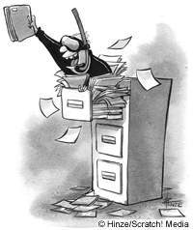
Files
Want to analyze your hum paper?
f becomes the "file object" representing humpaper.txt in this case.
Make sure you saved your paper as "plain text" (not .doc or .pdf) or else all sorts of weird formatting characters will show up!
f = file('humpaper.txt')
text = f.read()
words = text.split()
text is now one BIG string
words is now one BIG list of words (strings)
max(words)
or anything else you might want to investigate… !
min(words)
Two households, both alike in dignity,
In fair Verona, where we lay our scene,
From ancient grudge break to new mutiny,
Where civil blood makes civil hands unclean.
decode(text)

Slide 56
Representing Sound
physics
continuous plot of air pressure vs. time
sampling
samples taken every ~ 1/22050th of a second
quantization
Each sample is measured on a loudness scale from -32,768 to 32,767. (This fits into 2 bytes.)
storage
These two bytes are called a frame. Raw audio data - such as what is written to the surface of a CD - is simply a list of these frames.
pulse code modulation = PCM data

Slide 57
Break up
def remAll( e, L ):
""" this function removes all of the elements
e from the top level of the list L
"""
if len(L) == 0: # L is empty
return L
elif
else:
removeAll(42, [5,7,42,8,42])
[5,7,8]
removeAll('q', 'qaqqlqqiqeqqnqqqqs')
'aliens'

Slide 58
Warm up...
def removeAll( e, L ):
""" this function removes all of the elements
e from the top level of the list L
"""
if len(L) == 0:
return L # L is empty
elif
else:
removeAll(42, [5,7,42,8,42])
[5,7,8]
removeAll('q', 'qcqoqmqpqquqtqeqrq')
'computer'

Slide 59
Taking only one…
def removeAll( e, L ):
""" this function removes all of the elements
e from the top level of the list L
"""
if len(L) == 0:
return L # L is empty
elif e == L[0]:
return removeAll(e,L[1:]) # remove this one
# AND later ones…
else:
return L[0:1] + removeAll(e,L[1:])
# keep the non-e element and then keep going
How could we change this to removeOne?
removeOne(42, [5,7,42,8,42])
removeOne('p', 'computer programming')
[5,7,8,42]
'comuter programming'

Slide 60
"Best" word
def scrabbleScore(w):
# see homework #1!
Let's abbreviate this function as scsc(w)
def bestWord( L ):
""" finds the "best" word from L, a list of words
here, "best" means highest scrabble score """
if len(L) < 2:
return L[0]
elif
return
else:
return
What else might be nice to know ??

Slide 61
"Best" word
def scrabbleScore(w):
# see homework #1!
Let's abbreviate this function as scsc(w)
def bestWord( L ):
""" finds the "best" word from L, a list of words
here, "best" means highest scrabble score """
if len(L) < 2:
return L[0]
elif
return
else:
return
What else might be nice to know ??

Slide 62
A suggestion
def scrabbleScore(w):
# see homework #1!
Let's abbreviate this function as scsc(w)
def bestWord( L ):
""" returns the word in L w/maximum
scrabble score """
LOL = [ [scsc(w), w] for w in L ] # LOL!
bestPair = max( LOL )
return bestPair
What's so funny?

Slide 63
"Quiz"
Hints:
abs( x ) is built-in to Python
Solutions…
Use bestWord as a guide:
def bestWord( L ):
""" example code """
LOL = [ [scsc(w), w] for w in L ]
bestPair = max( LOL )
return bestPair[1]
Write this function using max:
def bestNumber( L ):
""" returns the # in L closest to 42 """
L
[30,40,50]
[[12,30],[2,40],[8,50]]
[2,40]
40

Slide 64
"Quiz"
Hint:
Solutions…
Consider defining a helper function !
Write this function however you like:
def mode( L ):
""" returns the element appearing most often in L """

Slide 65
"Quiz"
Nothing but the best!
Name(s):
Hints:
abs( x ) is built-in to Python
Write this function using max or recursively :
def bestNumber( L ):
""" returns the # in L closest to 42 """
Use bestWord as a guide:
def bestWord( L ):
""" example code """
LOL = [ [scsc(w), w] for w in L ]
bestPair = max( LOL )
return bestPair
Write this function however you like:
Hint:
Consider defining a helper function !
def mode( L ):
""" returns the element appearing most often in L """
Extra Credit: What four-letter word scores highest in scrabble?

Slide 66
"Quiz"
Hints:
abs( x ) is built-in to Python
Solutions…
Use bestWord as a guide:
def bestWord( L ):
""" example code """
LOL = [ [scsc(w), w] for w in L ]
bestPair = max( LOL )
return bestPair
Write this function using max:
def bestNumber( L ):
""" returns the # in L closest to 42 """

Slide 67
"Quiz"
Solutions…
Write this function however you like:
Hint:
Consider defining a helper function !
def mode( L ):
""" returns the element appearing most often in L """

Slide 68
chr and ord
abcdefghijklmnopqrstuvwxyz
ASCII VALUES
97
99
101
103
105
107
109
111
113
115
117
119
122
ABCDEFGHIJKLMNOPQRSTUVWXYZ
65
67
69
71
73
75
77
79
81
83
85
87
90
ord('a') is 97
chr(66) is 'B'
What is chr( ord('i')+13 ) ?
What is chr( ord('P')+13 ) ?
How can we wrap this around?

Slide 69
Rot 13
def rot13( c ):
""" rotates c by 13 chars, "wrapping" as needed
NON-LETTERS DO NOT CHANGE!
"""
if 'a' <= c <= 'z':
new_ord = ord(c) + 13
if new_ord <= ord('z'):
return chr(new_ord)
else:
return
elif
else:
How would you rotate an entire string?

Slide 70
Turtle fun?

Slide 71
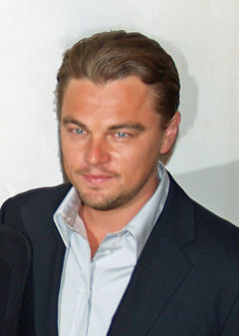
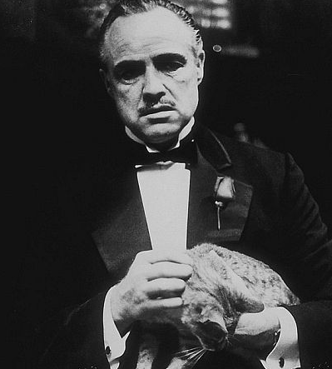
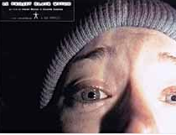
top N Lists
1. Titanic
2. Lord of the Rings 3
1. The Godfather
2. The Shawshank Redemption
1. The Blair Witch Project
2. Road to Ruin

Slide 72
top1List
def top1List( L ):
""" returns a list of the top element in L """
if len(L) < 1: return L
else: return [ max(L) ]

Slide 73
top2List
def top1List( L ):
""" returns a list of the top element in L """
if len(L) < 1: return L
else: return [ max(L) ]
def top2List( L ):
""" returns a list of the top 2 elements in L """
if len(L) < 2: return L
mx = max(L) # get the biggest element
newL = removeOne( mx, L ) # get rid of mx
return [ mx ] + top1List( newL )

Slide 74
top N List
def top3List( L ):
""" returns a list of the top 3 elements in L """
if len(L) < 3: return L
top N?

Slide 75
Files
Want to analyze your hum paper?
f becomes the "file object" representing humpaper.txt in this case.
You will first need to save your file as "plain text" or else all the special formatting characters will still be in there!
f = file('humpaper.txt')
text = f.read()
words = text.split()
text is now one BIG string
words is now one BIG list of words (strings)
max(words)
or anything else you might want to investigate… !
min(words)
Two households, both alike in dignity,
In fair Verona, where we lay our scene,
From ancient grudge break to new mutiny,
Where civil blood makes civil hands unclean.

Slide 76
Some legs to stand on…
It looks like I'm a head here!
decipher
max
encipher
score
adv(c,n)
creating more and more capable compositions
ord
chr

Slide 77
Some legs to stand on…
It looks like I'm a head here!
decipher
max
encipher
score
adv(c,n)
creating more and more capable compositions
ord
chr
computer organization
data representation
circuits
how are even these fundamentals physically realized ?!

Slide 78
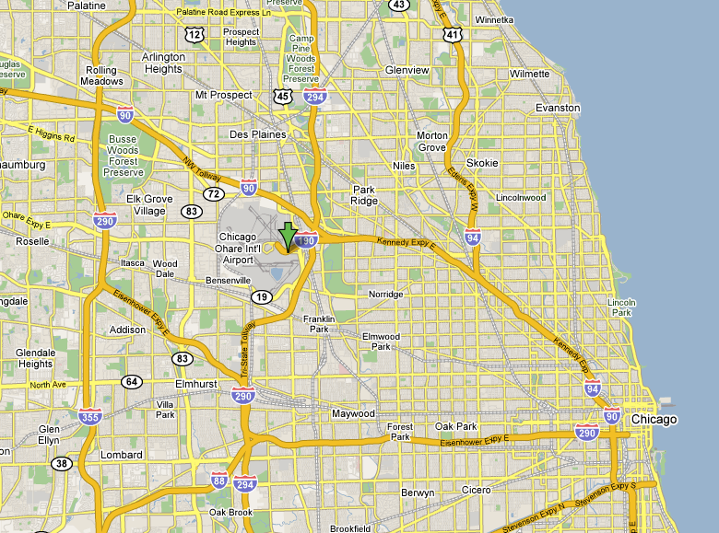
CHR and ORD
Orchard Field

Slide 79
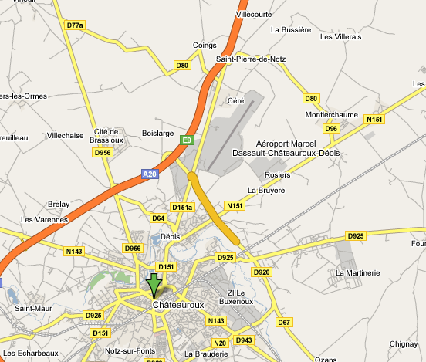
CHR and ORD
Chateauroux

Slide 80
ASCII
American Standard Code for Information Interchange
ASCII is a table that tells the computer how to represent characters as bits!
8 bits = 1 byte

Slide 81
chr and ord
abcdefghijklmnopqrstuvwxyz
functions for these conversions
97
122
ABCDEFGHIJKLMNOPQRSTUVWXYZ
65
90
ord( c )
Input: a string of one character, c
Output: an integer, the ASCII value of c
chr( n )
Input: an integer in range(255)
Output: a one-char. string of that ASCII value

Slide 82
Binary Storage / Representation
8 bits = 1 byte = 1 box
The SAME bits represent integers, if the variable has type int instead of str
value:
'*'
00101010
type: str
bits
name:
Identical bits are stored in each variable!
1 bit
The types determine how to interpret the bits; the names don't matter at all…
value:
42
00101010
1 byte = 8 bits
type: int
bits
name:

Slide 83
chr and ord
abcdefghijklmnopqrstuvwxyz
functions for these conversions
97
122
ABCDEFGHIJKLMNOPQRSTUVWXYZ
65
90
ord( c )
Input: a string of one character, c
Output: an integer, the ASCII value of c
chr( n )
Input: an integer in range(255)
Output: a one-char. string of that ASCII value
[ [i,chr(i)] for i in range(128) ]
try these!
[ ord(i) for i in '**** CS! ****' ]

Slide 84
chr and ord
Orchard Field

Slide 85
chr and ord
Chateauroux

Slide 86
Caesar Cipher: encipher
encipher( 'gv vw dtwvg' , 0 )
'gv vw dtwvg'
'hw wx euxwh'
'ix xy fvyxi'
'jy yz gwzyj'
'kz za hxazk'
'la ab iybal'
returns
encipher( 'gv vw dtwvg' , 1 )
returns
encipher( 'gv vw dtwvg' , 2 )
returns
encipher( 'gv vw dtwvg' , 3 )
returns
encipher( 'gv vw dtwvg' , 4 )
returns
encipher( 'gv vw dtwvg' , 5 )
returns
encipher( 'gv vw dtwvg' , 25 )
'fu uv csvuf'
returns
Output

Slide 87
Caesar Cipher: encipher
gv vw dtwvg
hw wx euxwh
ix xy fvyxi
jy yz gwzyj
kz za hxazk
la ab iybal
mb bc jzcbm
nc cd kadcn
od de lbedo
pe ef mcfep
qf fg ndgfq
rg gh oehgr
sh hi pfihs
ti ij qgjit
uj jk rhkju
vk kl silkv
wl lm tjmlw
xm mn uknmx
yn no vlony
zo op wmpoz
ap pq xnqpa
bq qr yorqb
cr rs zpsrc
ds st aqtsd
et tu brute
fu uv csvuf
encipher( 'gv vw dtwvg' , 0 )
'gv vw dtwvg'
'hw wx euxwh'
'ix xy fvyxi'
'jy yz gwzyj'
'kz za hxazk'
'la ab iybal'
returns
encipher( 'gv vw dtwvg' , 1 )
returns
encipher( 'gv vw dtwvg' , 2 )
returns
encipher( 'gv vw dtwvg' , 3 )
returns
encipher( 'gv vw dtwvg' , 4 )
returns
encipher( 'gv vw dtwvg' , 5 )
returns
encipher( 'gv vw dtwvg' , 25 )
'fu uv csvuf'
returns
Output
decipher?
all 26 possibilities

Slide 88
Caesar Cipher: decipher
>>> decipher('Bzdrzq bhogdq? H oqdedq Bzdrzq rzkzc.')
'Caesar cipher? I prefer Caesar salad.'
>>> decipher('Hu lkbjhapvu pz doha ylthpuz hmaly dl mvynla '\
'lclyfaopun dl ohcl slhyulk.')
'An education is what remains after we forget everything we have learned.'
But how to do this… ?

Slide 89
Rot 13: characters
def rotc( c ):
""" rotates a single char. c ahead by n chars
'wrapping around' as needed """

Slide 90
Rot 13: strings
def rots( S ):
""" rotates a string ahead by 13 chars. """

Slide 91
Sorting
def sort(L)
returns a list which has the same elements as L, but in sorted order!

Slide 92
Computing with text
Bits/Numbers
Language
Ideas
Characters
Representation
Meaning

Slide 93
Sorting
def sort(L)
returns a list which has the same elements as L, but in sorted order!
What is sorting doing?
What is one piece?

Slide 94
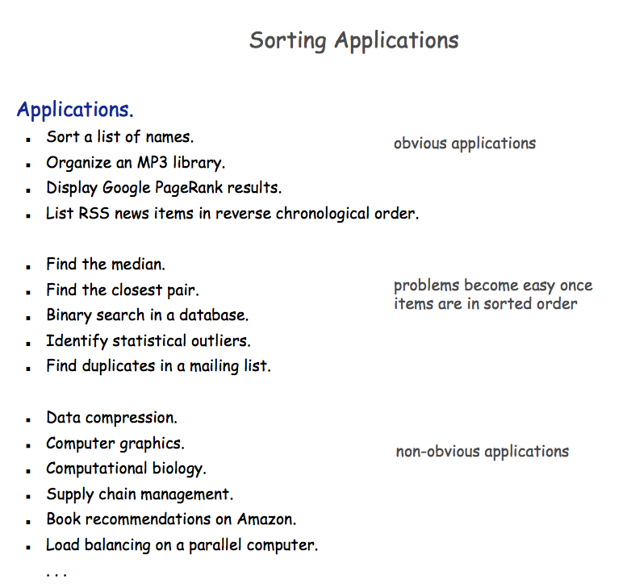

Slide 95
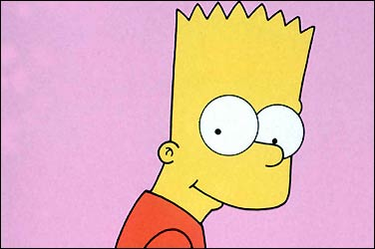
Random sorting…
def randSort( L ):
""" crazy sorting """
newL = random.sample( L, len(L) )
if isSorted(newL):
return newL
else:
return randSort(L) # try again…
A random permutation of L !
this function is totally random, dude!
Mmmm… sorting!

Slide 96
Random sorting…
def isSorted(s)
returns True if s is in order, False otherwise
isSorted('BART') returns False
isSorted('BERT') returns True
isSorted('BEGIN') returns True
isSorted([3,1,4]) returns False
isSorted([1,3,4]) returns True
ties?
isSorted('LOOPY') returns ??
Six-letter word?

Slide 97
Random sorting…
def isSorted(s):
returns True if s is in order, False otherwise
""" see the description in this box """
if len(s) < 2:
return
elif s[0] > s[1]:
return
else:
return
ties?
Six-letter word?

Slide 98
Random sorting…
def isSorted(s):
returns True if s is in order, False otherwise
""" see the description in this box """
if len(s) < 2:
return True
elif s[0] > s[1]:
return False
else:
return isSorted( s[1:] )
ties?
Six-letter word?

Slide 99
Almost the end…
def sort(L)
returns a list which has the same elements as L, but in sorted order!
Let e be the max element in L
Where should e go?
and what helper function might we want… ?

Slide 100
removeOne
def removeOne( e, L ):
""" this function removes one e from L
if L is a list, e is an element
if L is a string, e is a one-char. string
"""
if len(L) == 0:
return L # L is empty
elif e == L[0]:
return L[1:] # the element e is now gone
else:
return L[0:1] + removeOne( e, L[1:] ) # keep going

Slide 101
Computing with language
ideas / meaning
language / words / phrases
strings
numbers / bits

Slide 102
Computing with language
open questions in AI …
ideas / meaning
language / words / phrases
computing with language - recognizing English!
strings
how strings are represented and stored
numbers / bits

Slide 103
ASCII
American Standard Code for Information Interchange
ASCII is a table that tells the computer how to represent characters as bits!
8 bits = 1 byte

Slide 104
ASCII
American Standard Code for Information Interchange
ASCII is a table that tells the computer how to represent characters as bits!
value:
'*'
00101010
type: str
bits
name:
Identical bits are stored in each variable!
8 bits = 1 byte
The types determine how to interpret the bits; the names don't matter at all…
value:
42
00101010
The SAME bits represent integers, if the variable has type int instead of str
bits
type: int
name:

Slide 105
chr and ord
abcdefghijklmnopqrstuvwxyz
functions for these conversions
97
122
ABCDEFGHIJKLMNOPQRSTUVWXYZ
65
90
ord( c )
Input: a string of one character, c
Output: an integer, the ASCII value of c
chr( n )
Input: an integer in range(255)
Output: a one-char. string of that ASCII value

Slide 106
chr and ord
abcdefghijklmnopqrstuvwxyz
functions for these conversions
97
122
ABCDEFGHIJKLMNOPQRSTUVWXYZ
65
90
ord( c )
Input: a string of one character, c
Output: an integer, the ASCII value of c
chr( n )
Input: an integer in range(255)
Output: a one-char. string of that ASCII value
[ [i,chr(i)] for i in range(128) ]
try these!
[ ord(i) for i in '**** CS! ****' ]

Slide 107
chr and ord
Orchard Field

Slide 108
chr and ord
Chateauroux

Slide 109
Caesar Cipher: encipher
encipher( 'gv vw dtwvg' , 0 )
'gv vw dtwvg'
'hw wx euxwh'
'ix xy fvyxi'
'jy yz gwzyj'
'kz za hxazk'
'la ab iybal'
returns
encipher( 'gv vw dtwvg' , 1 )
returns
encipher( 'gv vw dtwvg' , 2 )
returns
encipher( 'gv vw dtwvg' , 3 )
returns
encipher( 'gv vw dtwvg' , 4 )
returns
encipher( 'gv vw dtwvg' , 5 )
returns
encipher( 'gv vw dtwvg' , 25 )
'fu uv csvuf'
returns
Output

Slide 110
Caesar Cipher: encipher
gv vw dtwvg
hw wx euxwh
ix xy fvyxi
jy yz gwzyj
kz za hxazk
la ab iybal
mb bc jzcbm
nc cd kadcn
od de lbedo
pe ef mcfep
qf fg ndgfq
rg gh oehgr
sh hi pfihs
ti ij qgjit
uj jk rhkju
vk kl silkv
wl lm tjmlw
xm mn uknmx
yn no vlony
zo op wmpoz
ap pq xnqpa
bq qr yorqb
cr rs zpsrc
ds st aqtsd
et tu brute
fu uv csvuf
encipher( 'gv vw dtwvg' , 0 )
'gv vw dtwvg'
'hw wx euxwh'
'ix xy fvyxi'
'jy yz gwzyj'
'kz za hxazk'
'la ab iybal'
returns
encipher( 'gv vw dtwvg' , 1 )
returns
encipher( 'gv vw dtwvg' , 2 )
returns
encipher( 'gv vw dtwvg' , 3 )
returns
encipher( 'gv vw dtwvg' , 4 )
returns
encipher( 'gv vw dtwvg' , 5 )
returns
encipher( 'gv vw dtwvg' , 25 )
'fu uv csvuf'
returns
Output
decipher?
all 26 possibilities

Slide 111
Caesar Cipher: decipher
>>> decipher('Bzdrzq bhogdq? H oqdedq Bzdrzq rzkzc.')
'Caesar cipher? I prefer Caesar salad.'
>>> decipher('Hu lkbjhapvu pz doha ylthpuz hmaly dl mvynla '\
'lclyfaopun dl ohcl slhyulk.')
'An education is what remains after we forget everything we have learned.'
But how to do this… ?

Slide 112
See you Friday (coded!)

Slide 113
Google at its public offering ~ $ 100

Slide 114
