Slide 1

This would make me hungry… but I ate breakfast this morning!
Computing to the max
The not-so-subtle art of singling out the best (and worst) of anything…
Last hw?
N-step sleepwalking?
a comparison comparison
Turtle graphics??
Artistic renderings!!!
'm+ms'
'coffee'
[ 0, 42 ]
[ 4, 2 ]
This week!
True
'True'
> or <
Hw #3 due next Monday…
pr0: Are we The Matrix?
Computing with language
pr1: Lab…
pr2: Sorting + Caesar!
What's in a Writ1 paper, anyway?
Battle-tested ciphers & how to break them…

Slide 2
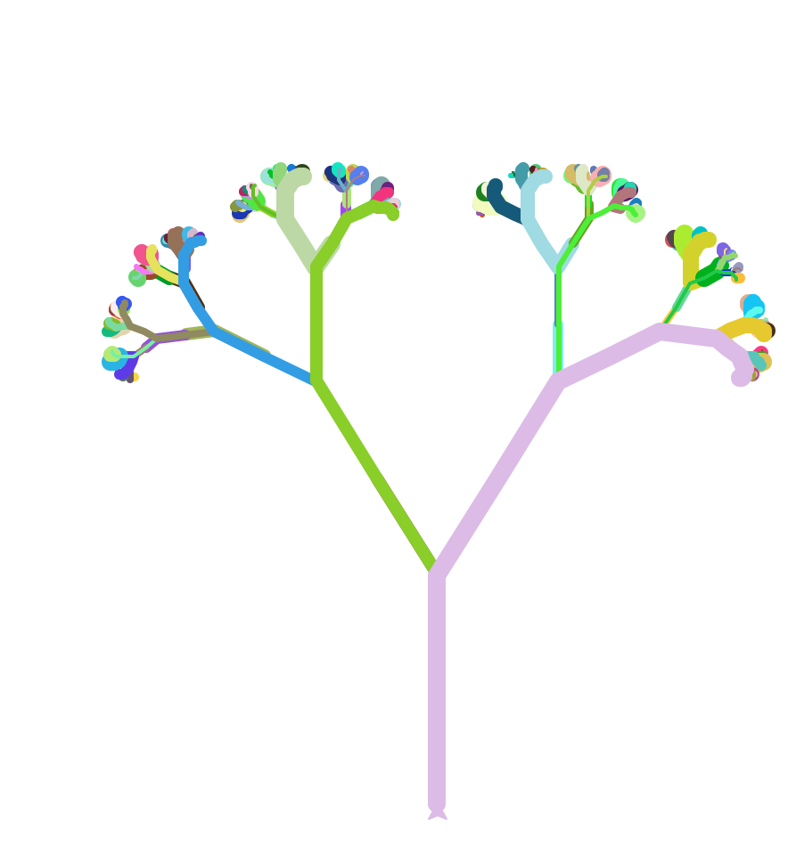
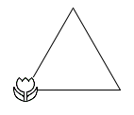
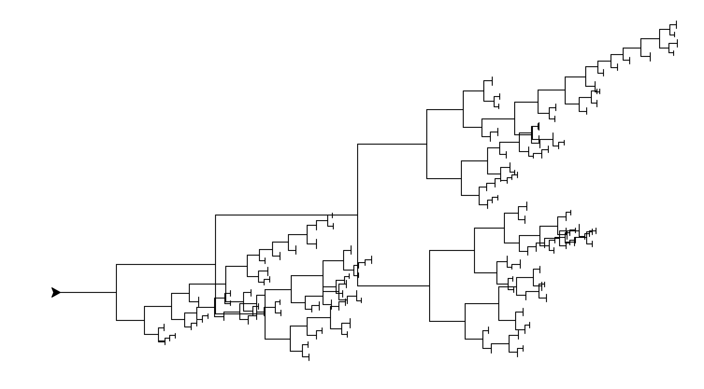
Extra-credit forest…
and Evy Larsen!
thank you to Flo Walsh!

Slide 3
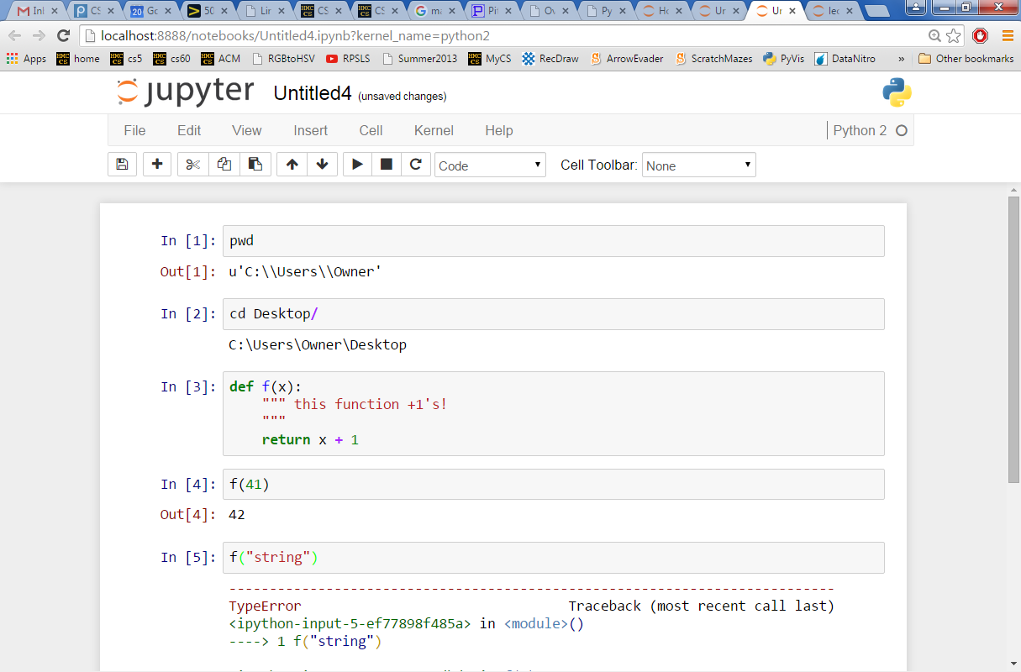
CS5 in the browser – sort of …
try it out this week in lab…
instructions are at the start of this week's Lab…

Slide 4
This would make me hungry… but I ate breakfast this morning!
Computing to the max
The not-so-subtle art of singling out the best (and worst) of anything…
Last hw?
N-step sleepwalking?
Turtle graphics??
a comparison comparison
Artistic renderings!!!
'm+ms'
'coffee'
[ 0, 42 ]
[ 4, 2 ]
This week!
True
'True'
Hw #3 due next Monday…
> or <
pr0: Are we The Matrix?
Computing with language
pr1: Lab…
pr2: Sorting + Caesar!
What's in a Writ1 paper, anyway?
Battle-tested ciphers & how to break them…

Slide 5
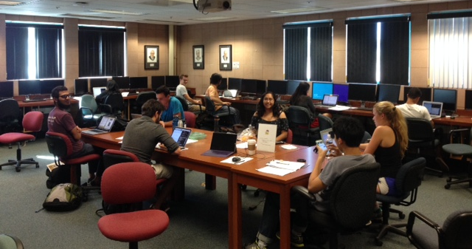
Notes from our amazing CS5 grutors…
Join in!
and/or join my office hours on Fridays, 2:30-4:30 or so @ the LAC lab
and others!

Slide 6
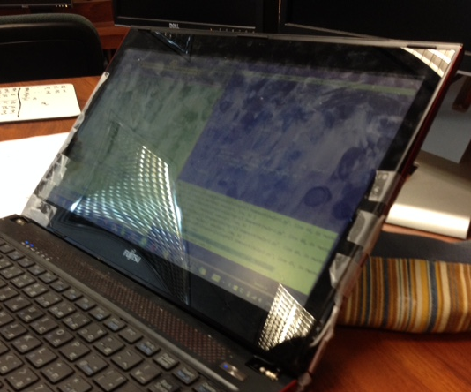
Notes from our amazing CS5 grutors…
Join in!
No matter what's holding your machine together!
and/or join my office hours on Fridays, 2:30-4:30 or so @ the LAC lab
and others!

Slide 7
max
A recipe for life ?
and python already has it for us…
The real problem is knowing what we want to maximize!

Slide 8
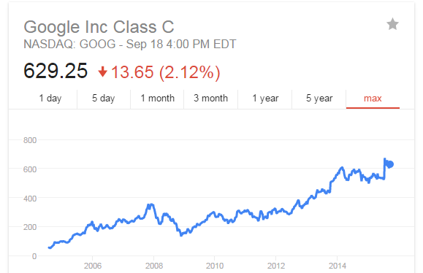
to the max
And I thought $100 was overpriced!
NASDAQ: GOOG
Want the highest price?
max( [475.5, 458.0, 441.3, 470.8, 532.8, 520.9] )
ST
'nov'
'jan'
'mar'
'may'
'jul'
'sep'
What if the months are in there, as well?
max( [ [470.8,'may'], [532.8,'jul'], [520.9,'sep'] ] )
STm
max( [ ['may',470.8], ['jul',532.8], ['sep',520.9] ] )
mST

Slide 9
to the max
And I thought $100 was overpriced!
NASDAQ: GOOG
Want the highest price?
max( [475.5, 458.0, 441.3, 470.8, 532.8, 520.9] )
ST
'nov'
'jan'
'mar'
'may'
'jul'
'sep'
What if the months are in there, as well?
max( [ [470.8,'may'], [532.8,'jul'], [520.9,'sep'] ] )
STm
max( [ ['may',470.8], ['jul',532.8], ['sep',520.9] ] )
mST
Mudd's max?
MSt
L = ['Harvey', 'Mudd', 'College', 'seeks', 'to', 'educate', 'engineers,', 'scientists', 'and', 'mathematicians', 'well-versed', 'in', 'all', 'of', 'these', 'areas', 'and', 'in', 'the', 'humanities', 'and', 'the', 'social', 'sciences', 'so', 'that', 'they', 'may', 'assume', 'leadership', 'in', 'their', 'fields', 'with', 'a', 'clear', 'understanding', 'of', 'the', 'impact', 'of', 'their', 'work', 'on', 'society']
max(L)
Or Mudd's min?
min(L)

Slide 10
recursive max
[ 7, 10, -2, 41, -46, 42, 15 ]
def max( L ):
""" returns the max element from L
input: L, a nonempty list
"""
if len(L) < 2: # one element is the max.
return L[0]
rest_max = max(L[1:]) # max of the rest
if L[0] > rest_max :
return L[0] # either L[0]
else:
return rest_max # … or rest_max wins!
I prefer max_rest

Slide 11
max with scrabble-score
['Harvey', 'Mudd', 'College', 'seeks', 'to', 'educate', … ]
Which element has the highest scrabble score?
def maxSS( L ):
""" returns L's highest scrabble-scoring
element (input: L, a nonempty list)
"""
if len(L) < 2: # one element is the max.
return L[0]
rest_max = maxSS(L[1:]) # max of the rest
if L[0] > rest_max :
return L[0] # either L[0]
else:
return rest_max # … or rest_max wins!
Spacey! I like it!

Slide 12
max with scrabble-score
['Harvey', 'Mudd', 'College', 'seeks', 'to', 'educate', … ]
Which element has the highest scrabble score?
def maxSS( L ):
""" returns L's highest scrabble-scoring
element (input: L, a nonempty list)
"""
if len(L) < 2: # one element is the max.
return L[0]
rest_max = maxSS(L[1:]) # max of the rest
if sScore(L[0]) > sScore(rest_max):
return L[0] # either L[0]
else:
return rest_max # … or rest_max wins!

Slide 13
A more comprehensive solution
L = [ 'aliens', 'zap', 'hazy', 'code' ]
def maxSS( L ):
""" returns L's max-scrabble-score word
"""
LoL = [ [sScore(w), w] for w in L ]
bestpair = max( LoL )
return bestpair[1]
This does look funny!

Slide 14
A more comprehensive solution
L = [ 'aliens', 'zap', 'hazy', 'code' ]
I loathe hazy code!
def maxSS( L ):
""" returns L's max-scrabble-score word
"""
LoL = [ [sScore(w), w] for w in L ]
bestpair = max( LoL )
return bestpair[1]
LoL = [ [6,'aliens'], [14,'zap'], [19,'hazy'], [7,'code'] ]
bestpair = [19,'hazy']
'hazy'

Slide 15
Everything … is a max problem?
I know the best word here… but does Python?
L = [ 'aliens', 'zap', 'hazy', 'code' ]
def revviestword( L ):
""" another example – what's returned?
"""
LoL = [ [w[::-1], w] for w in L ]
bestpair = max( LoL )
return bestpair[1]
LoL = [ [ 'sneila' ,'aliens'], [ 'paz' ,'zap'], [ 'yzah' ,'hazy'], [ 'edoc' ,'code'] ]
bestpair =

Slide 16
Other examples…
What is bestnumb ?
What is mostnumb ?
>>> bestnumb( [10,20,30,40,50,60,70] )
40
>>> bestnumb( [100,200,300,400] )
100
>>> bestnumb( [1,2,3,4,5,6,7,8,7] )
8
>>> mostnumb( [1,2,3,4,5,6,7,8,7] )
7
These functions have made me number

Slide 17
L = [ 'aliens', 'zap', 'hazy', 'code' ]
Name(s)
Quiz
def maxlen(L):
LoL = [ [len(s),s] for s in L ]
bstpr = max( LoL )
return bstpr[1]
1. What is LoL?
here is a start: LoL is [ [6,'aliens'], [3,'zap'], ___________, __________ ]
2. What is bstpr?
Extra!
Change exactly three characters in this code so that 3 is returned.
3. What is returned?
L = [ 30, 40, 50 ]
Use the LoL method to write these two functions
def bestnumb(L):
""" returns the # in L closest to 42 """
LoL = [ ]
bstpr =
return bstpr[1]
Hint: Python has abs(x) built-in
L = [ 3,4,5,7,6,7 ]
def mostnumb( L ):
""" returns the item most often in L """
LoL = [ ]
bstpr =
return bstpr[1]
Hint: Define a helper function!
def count(e,L):
""" count e's in L """

Slide 18
Quiz
L = [ 'aliens', 'zap', 'hazy', 'code' ]
Try this on the back page first!
def maxlen(L):
LoL = [ [len(s),s] for s in L ]
bstpr = max( LoL )
return bstpr[1]
1. What is LoL?
[ [6,'aliens'], [3,'zap'], [4,'hazy'], [4,'code'] ]
2. What is bstpr?
[6,'aliens']
Extra!
Change exactly three characters in this code so that 3 is returned.
3. What is returned?
'aliens'
L = [ 30, 40, 50 ]
def bestnumb(L):
""" returns the # in L closest to 42 """
LoL = [ [abs(x-42),x] for x in L ]
bstpr = min( LoL )
return bstpr[1]
Hint: Python has abs(x) built-in
L = [ 3,4,5,7,6,7 ]
def mostnumb( L ):
""" returns the item most often in L """
LoL = [ [count(e,L),e] for e in L ]
bstpr = max( LoL )
return bstpr[1]
Hint: Define a helper function!
def count(e,L):
LC = [1 for x in L \
if x==e]
return sum(LC)

Slide 19
L = [ 'aliens', 'zap', 'hazy', 'code' ]
def maxlen(L):
LoL = [ [len(s),s] for s in L ]
bstpr = max( LoL )
return bstpr[1]
1. What is LoL?
[ [6,'aliens'], [3,'zap'], [4,'hazy'], [4,'code'] ]
2. What is bstpr?
[6,'aliens']
'aliens'
3. What is returned?
Extra! Change exactly three characters in this code so that 3 is returned.

Slide 20
bestnumb
[30,40,50]
L
[[12,30],[2,40],[8,50]]
LoL
[2,40]
bstpr
[ 30, 40, 50 ]
40
bstpr[1]
def bestnumb( L ):
""" returns the # closest to 42 in L """
LoL = [ [abs(x-42),x] for x in L ]
bstpr = min( LoL )
return bstpr[1]

Slide 21
Helper function: count(e,L)
mostnumb
def count( e, L ):
""" returns the # of e's in L """
LC = [ 1 for x in L if x==e ]
return sum( LC )
L
[6,7,7,8]
LoL
[ [1,6], [2,7], [2,7], [1,8] ]
bstpr
[2,7]
[6,7,7,8]
bstpr[1]
7
def mostnumb( L ):
""" returns the item most often in L """
LoL = [ [count(e,L),e] for e in L ]
bstpr = max( LoL )
return bstpr[1]
Could you use x here instead of e?

Slide 22
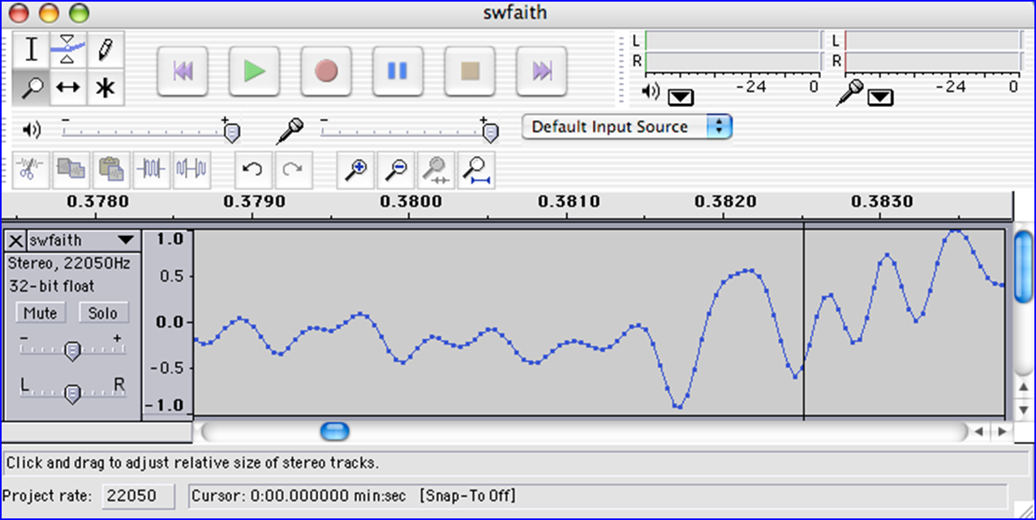
Today's lab: big data?
Any guesses as to what kind of data this is?
I find your lack of faith in this data disturbing.

Slide 23

Today's lab: sound data!
what are the vertical and horizontal axes here?

Slide 24
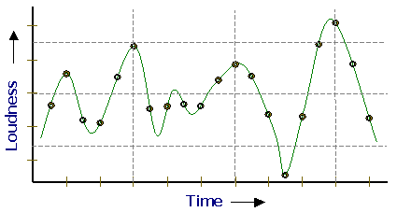
Sound
physics
continuous variation of air pressure vs. time
air pressure
sampling
samples taken every 1/22050th of a second (or some sampling rate)
time
quantization
Each sample is measured on a loudness scale from -32,768 to 32,767. (This fits into 2 bytes.)
storage
These two bytes are called a frame. Raw audio data - such as what is written to the surface of a CD - is simply a list of these frames.
pulse code modulation = PCM data

Slide 25

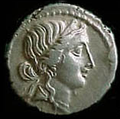


Computing with language
ideas / meaning
language / words / phrases
Python strings are here.
strings
numbers / bits

Slide 26
Computing with language
open questions in AI …
ideas / meaning
overlap of CS + ROW!
language / words / phrases
This week…
processing language – how English-y is it?
strings
how strings are represented and stored
numbers / bits
Next week…

Slide 27
Caesar Cipher: encipher
What is it doing?
encipher(s,n)
encipher( 'I <3 Latin' , 0 )
'I <3 Latin'
'J <3 Mbujo'
'K <3 Ncvkp'
'L <3 Odwlq'
'M <3 Pexmr'
'N <3 Qfyns'
returns
encipher( 'I <3 Latin' , 1 )
returns
encipher( 'I <3 Latin' , 2 )
returns
encipher( 'I <3 Latin' , 3 )
returns
encipher( 'I <3 Latin' , 4 )
returns
encipher( 'I <3 Latin' , 5 )
returns
encipher( 'I <3 Latin' , 25 )
'H <3 Kzshm'
returns

Slide 28
Caesar Cipher: encipher
should return the string s with each alphabetic character shifted/wrapped by n places in the alphabet
encipher(s,n)
encipher( 'I <3 Latin' , 0 )
'I <3 Latin'
'J <3 Mbujo'
'K <3 Ncvkp'
'L <3 Odwlq'
'M <3 Pexmr'
'N <3 Qfyns'
returns
encipher( 'I <3 Latin' , 1 )
returns
encipher( 'I <3 Latin' , 2 )
returns
encipher( 'I <3 Latin' , 3 )
returns
encipher( 'I <3 Latin' , 4 )
returns
encipher( 'I <3 Latin' , 5 )
returns
encipher( 'I <3 Latin' , 25 )
'H <3 Kzshm'
returns

Slide 29
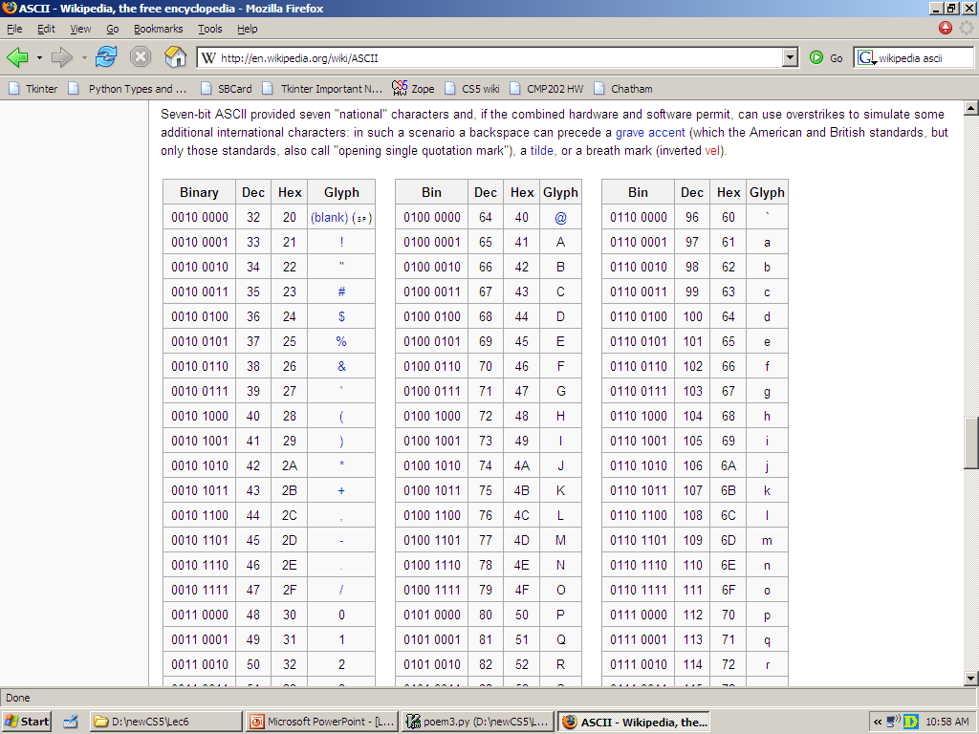
ASCII
American Standard Code for Information Interchange
1 byte
8 bits
The SAME bits represent an integer or a string, depending on type: int or str

Slide 30
ASCII
American Standard Code for Information Interchange
over in memory…
value:
'/'
00101111
type: str
bits
name:
Identical bits are stored in each variable!
The types determine how to interpret the bits; the names don't matter at all…
1 byte
value:
8 bits
47
00101111
type: int
bits
The SAME bits represent an integer or a string, depending on type: int or str
name:

Slide 31
ASCII
convert # to char
chr
ord
convert char to #
This is why 'College' < 'clear' !
Julius spr'15

Slide 32
ASCII
convert # to char
[ [i,chr(i)] for i in range(128) ]
chr
ord
[ ord(i) for i in '**** CS! ****' ]
convert char to #
This is why 'College' < 'clear' !
Julius spr'15

Slide 33
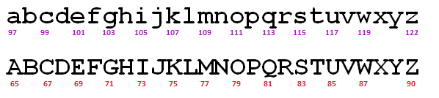
chr, ord,
and rot13
rot13('a') should output 'n'
rot13('m') should output 'z'
rot13('n') should output 'a'
rot13('N') should output 'A'
rot13(' ') should output ' '
space + other characters

Slide 34
ASCII
chr value
abcdefghijklmnopqrstuvwxyz
97
ord value
99
101
103
105
107
109
111
113
115
117
119
122
chr value
ABCDEFGHIJKLMNOPQRSTUVWXYZ
65
ord value
67
69
71
73
75
77
79
81
83
85
87
90
convert # to char
chr
What is ord('U')/2?
What is chr( ord('i')+13 )?
ord
What is chr( ord('W')+13 )?
convert char to #

Slide 35
Writing Rot 13
def rot13( c ):
""" rotates c by 13 chars, "wrapping" as needed
NON-LETTERS don't change!
"""
if 'a' <= c <= 'z':
new_ord = ord(c) + 13
if new_ord <= ord('z'):
return chr(new_ord)
else:
return chr( )
elif 'A' <= c <= 'Z': # upper-case test!
else:
(1) How can the code "wrap" around the end of the alphabet to the other side?
(2) How will upper case be different from lowercase – only note the differences…
(3) What if c is not a letter?
Extra: How could you rotate n places, instead of 13?

Slide 36
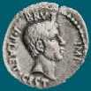
Caesar Cipher: decipher
Caesar
Brutus
>>> decipher('Bzdrzq bhogdq? H oqdedq Bzdrzq rzkzc.')
'Caesar cipher? I prefer Caesar salad.'
S1
S2
>>> decipher('Hu lkbjhapvu pz doha ylthpuz hmaly dl mvynla '\
'lclyfaopun dl ohcl slhyulk.')
'An education is what remains after we forget everything we have learned.'
>>> decipher('Uifz xpsl ju pvu xjui b qfodjm!')
PL
LAT
>>> decipher('gv vw dtwvg')
But how ?

Slide 37
Decipher?
Strategies?
Algorithms?

Slide 38
gv vw dtwvg
hw wx euxwh
ix xy fvyxi
jy yz gwzyj
kz za hxazk
la ab iybal
mb bc jzcbm
nc cd kadcn
od de lbedo
pe ef mcfep
qf fg ndgfq
rg gh oehgr
sh hi pfihs
ti ij qgjit
uj jk rhkju
vk kl silkv
wl lm tjmlw
xm mn uknmx
yn no vlony
zo op wmpoz
ap pq xnqpa
bq qr yorqb
cr rs zpsrc
ds st aqtsd
et tu brute
fu uv csvuf
Decipher?
All possible decipherings
Strategies?
Algorithms?

Slide 39
gv vw dtwvg
hw wx euxwh
ix xy fvyxi
jy yz gwzyj
kz za hxazk
la ab iybal
mb bc jzcbm
nc cd kadcn
od de lbedo
pe ef mcfep
qf fg ndgfq
rg gh oehgr
sh hi pfihs
ti ij qgjit
uj jk rhkju
vk kl silkv
wl lm tjmlw
xm mn uknmx
yn no vlony
zo op wmpoz
ap pq xnqpa
bq qr yorqb
cr rs zpsrc
ds st aqtsd
et tu brute
fu uv csvuf
[0, 'gv vw dtwvg'],
[2, 'hw wx euxwh'],
[2, 'ix xy fvyxi'],
[0, 'jy yz gwzyj'],
[2, 'kz za hxazk'],
[4, 'la ab iybal'],
[0, 'mb bc jzcbm'],
[1, 'nc cd kadcn'],
[4, 'od de lbedo'],
[3, 'pe ef mcfep'],
[0, 'qf fg ndgfq'],
[2, 'rg gh oehgr'],
[2, 'sh hi pfihs'],
[3, 'ti ij qgjit'],
[2, 'uj jk rhkju'],
[1, 'vk kl silkv'],
[0, 'wl lm tjmlw'],
[1, 'xm mn uknmx'],
[2, 'yn no vlony'],
[3, 'zo op wmpoz'],
[2, 'ap pq xnqpa'],
[1, 'bq qr yorqb'],
[0, 'cr rs zpsrc'],
[1, 'ds st aqtsd'],
[4, 'et tu brute'],
[3, 'fu uv csvuf']
Decipher?
All possible decipherings
Score them all
Strategies?
Algorithms?
quantifying Englishness?

Slide 40
gv vw dtwvg
hw wx euxwh
ix xy fvyxi
jy yz gwzyj
kz za hxazk
la ab iybal
mb bc jzcbm
nc cd kadcn
od de lbedo
pe ef mcfep
qf fg ndgfq
rg gh oehgr
sh hi pfihs
ti ij qgjit
uj jk rhkju
vk kl silkv
wl lm tjmlw
xm mn uknmx
yn no vlony
zo op wmpoz
ap pq xnqpa
bq qr yorqb
cr rs zpsrc
ds st aqtsd
et tu brute
fu uv csvuf
[0, 'gv vw dtwvg'],
[2, 'hw wx euxwh'],
[2, 'ix xy fvyxi'],
[0, 'jy yz gwzyj'],
[2, 'kz za hxazk'],
[4, 'la ab iybal'],
[0, 'mb bc jzcbm'],
[1, 'nc cd kadcn'],
[4, 'od de lbedo'],
[3, 'pe ef mcfep'],
[0, 'qf fg ndgfq'],
[2, 'rg gh oehgr'],
[2, 'sh hi pfihs'],
[3, 'ti ij qgjit'],
[2, 'uj jk rhkju'],
[1, 'vk kl silkv'],
[0, 'wl lm tjmlw'],
[1, 'xm mn uknmx'],
[2, 'yn no vlony'],
[3, 'zo op wmpoz'],
[2, 'ap pq xnqpa'],
[1, 'bq qr yorqb'],
[0, 'cr rs zpsrc'],
[1, 'ds st aqtsd'],
[4, 'et tu brute'],
[3, 'fu uv csvuf']
Decipher?
All possible decipherings
max!
Score them all
Strategies?
Algorithms?
yields the "most English" phrase

Slide 41
Measuring Englishness
Very English-y
"Call me Ishmael."
"Attack at dawn!"
"rainbow, table, candle"
higher scores
"Yow! Legally-imposed CULTURE-reduction
is CABBAGE-BRAINED!"
"quadruplicity drinks procrastination"
"Hold the newsreader's nose squarely, waiter, or
friendly milk will countermand my trousers."
quantifying Englishness?
"the gostak distims the doshes"
"hension, framble, bardle"
"jufict, stofwus, lictpub"
"itehbs, rsnevtr, khbsota"
lower scores
"epadxo, nojarpn, gdxokpw"
"h o q dedqBzdrzqrzkzc"
All of these sound
good to me!
Not English-y

Slide 42
gv vw dtwvg
hw wx euxwh
ix xy fvyxi
jy yz gwzyj
kz za hxazk
la ab iybal
mb bc jzcbm
nc cd kadcn
od de lbedo
pe ef mcfep
qf fg ndgfq
rg gh oehgr
sh hi pfihs
ti ij qgjit
uj jk rhkju
vk kl silkv
wl lm tjmlw
xm mn uknmx
yn no vlony
zo op wmpoz
ap pq xnqpa
bq qr yorqb
cr rs zpsrc
ds st aqtsd
et tu brute
fu uv csvuf
[0, 'gv vw dtwvg'],
[2, 'hw wx euxwh'],
[2, 'ix xy fvyxi'],
[0, 'jy yz gwzyj'],
[2, 'kz za hxazk'],
[4, 'la ab iybal'],
[0, 'mb bc jzcbm'],
[1, 'nc cd kadcn'],
[4, 'od de lbedo'],
[3, 'pe ef mcfep'],
[0, 'qf fg ndgfq'],
[2, 'rg gh oehgr'],
[2, 'sh hi pfihs'],
[3, 'ti ij qgjit'],
[2, 'uj jk rhkju'],
[1, 'vk kl silkv'],
[0, 'wl lm tjmlw'],
[1, 'xm mn uknmx'],
[2, 'yn no vlony'],
[3, 'zo op wmpoz'],
[2, 'ap pq xnqpa'],
[1, 'bq qr yorqb'],
[0, 'cr rs zpsrc'],
[1, 'ds st aqtsd'],
[4, 'et tu brute'],
[3, 'fu uv csvuf']
Decipher?
All possible decipherings
max!
Score them all
Strategies?
Algorithms?
"Englishness" score based on #-of-vowels

Slide 43
gv vw dtwvg
hw wx euxwh
ix xy fvyxi
jy yz gwzyj
kz za hxazk
la ab iybal
mb bc jzcbm
nc cd kadcn
od de lbedo
pe ef mcfep
qf fg ndgfq
rg gh oehgr
sh hi pfihs
ti ij qgjit
uj jk rhkju
vk kl silkv
wl lm tjmlw
xm mn uknmx
yn no vlony
zo op wmpoz
ap pq xnqpa
bq qr yorqb
cr rs zpsrc
ds st aqtsd
et tu brute
fu uv csvuf
[6.9e-05, 'gv vw dtwvg'],
[3.6e-05, 'hw wx euxwh'],
[1.4e-07, 'ix xy fvyxi'],
[8.8e-11, 'jy yz gwzyj'],
[7.2e-10, 'kz za hxazk'],
[0.01503, 'la ab iybal'],
[3.7e-08, 'mb bc jzcbm'],
[0.00524, 'nc cd kadcn'],
[0.29041, 'od de lbedo'],
[0.00874, 'pe ef mcfep'],
[7.3e-07, 'qf fg ndgfq'],
[0.06410, 'rg gh oehgr'],
[0.11955, 'sh hi pfihs'],
[3.1e-06, 'ti ij qgjit'],
[1.1e-08, 'uj jk rhkju'],
[2.6e-05, 'vk kl silkv'],
[0.00012, 'wl lm tjmlw'],
[3.1e-06, 'xm mn uknmx'],
[0.02011, 'yn no vlony'],
[1.5e-06, 'zo op wmpoz'],
[1.9e-07, 'ap pq xnqpa'],
[5.7e-08, 'bq qr yorqb'],
[0.00024, 'cr rs zpsrc'],
[0.02060, 'ds st aqtsd'],
[0.45555, 'et tu brute'],
[0.00011, 'fu uv csvuf']
Decipher?
All possible decipherings
S
c
o
r
e
s
Strategies?
Algorithms?
"Englishness" based on letter-probabilities
max!

Slide 44
We'll see you in Lab3 !
hear
Earbuds are helpful (unless you really like Darth Vader!)

Slide 46
scrabble-score max
['Harvey', 'Mudd', 'College', 'seeks', 'to', 'educate', … ]
def bestWord( L ):
""" returns L's max-scrabble-score word
input: L, a list of strings (words)
"""
if len(L) < 2: # one element is the max
return L[0]
elif L[0] < L[1] : #1 wins
return bestWord( L[1:] )
else: #0 wins
return bestWord( L[0:1] + L[2:] )
What do we need here?

Slide 47
variation: max
[ 7, 10, -2, 41, -46, 42, 15 ]
def max( L ):
""" returns the max element from L
input: L, a nonempty list
"""
if len(L) < 2: # one element is the max.
return L[0]
rest_max = max(L[1:]) # max of the rest
if L[0] > rest_max : # L[0]…
return L[0]
else:
return rest_max # … or rest_max wins!
Spacey! I like it!

Slide 48
general-purpose max
[ 7, 10, -2, 41, -46, 42, 15 ]
def max( L ):
""" returns the max element from L
input: L, a nonempty list
"""
if len(L) < 2: # one element is the max.
return L[0]
rest_max = max(L[1:]) # max of the rest
if L[0] > rest_max : # L[0]…
return L[0]
else:
return rest_max # … or rest_max wins!
Spacey! I like it!

Slide 49
general-purpose max
[ 7, 10, -2, 41, -46, 42, 15 ]
def max( L ):
""" returns the max element from L
input: L, a nonempty list
"""
if len(L) < 2: # one element is the max.
return L[0]
rest_max = max(L[1:]) # max of the rest
if sScore(L[0]) > sScore(rest_max): # L[0]…
return L[0]
else:
return rest_max # … or rest_max wins!

Slide 50
scrabble-score max
['Harvey', 'Mudd', 'College', 'seeks', 'to', 'educate', … ]
def bestWord( L ):
""" returns L's max-scrabble-score word
input: L, a list of strings (words)
"""
if len(L) < 2: # one element is the max
return L[0]
elif sScore(L[0]) < sScore(L[1]): #1 wins
return bestWord( L[1:] )
else: #0 wins
return bestWord( L[0:1] + L[2:] )
What do we need here?
What else might be nice to know ?

Slide 51
sword button?

Slide 52
chr and ord
abcdefghijklmnopqrstuvwxyz
ASCII values
97
ord value
99
101
103
105
107
109
111
113
115
117
119
122
ABCDEFGHIJKLMNOPQRSTUVWXYZ
65
ord value
67
69
71
73
75
77
79
81
83
85
87
90
ord( c )
Input: a string of one character, c
Conversion functions
Output: an integer, the ASCII value of c
chr( n )
Input: an integer in range(255)
Output: a one-char. string of that ASCII value

Slide 53
chr, ord,
and rot13
Finish rot13 to "shift" a letter, c, by 13 spots…
def rot13( c ):
""" rotate c by 13 chars, "wrapping" as needed; NON-LETTERS don't change """
if 'a' <= c <= 'z': # test if c is a lowercase letter
new_ord = ord(c) + 13 # if so, find the # 13 spots ahead
if new_ord <= ord('z'): # check if it's in bounds!
return chr(new_ord) # if so, return it
else: # otherwise
return # what to return?
elif # what test should go here?
# what would go here, if we had room?
else: # what should be done in the else?
How would this change if we wanted to rotate by n spots?

Slide 54


sword button?

Slide 55
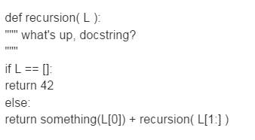
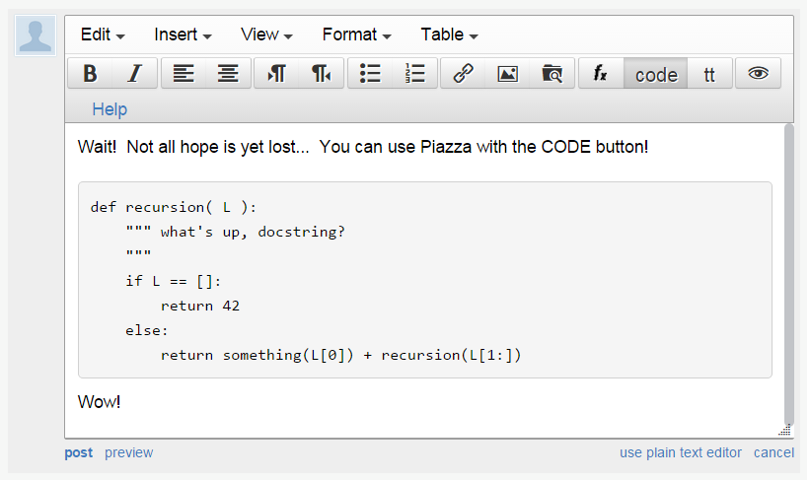
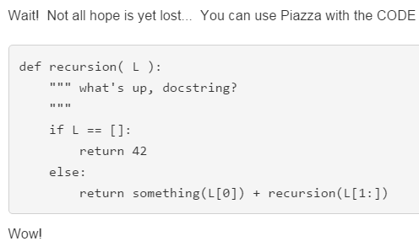
sword button?
code button!
creating a private post to Piazza because something is not working… ?
bugs, vanquished!
code button – then paste

Slide 56
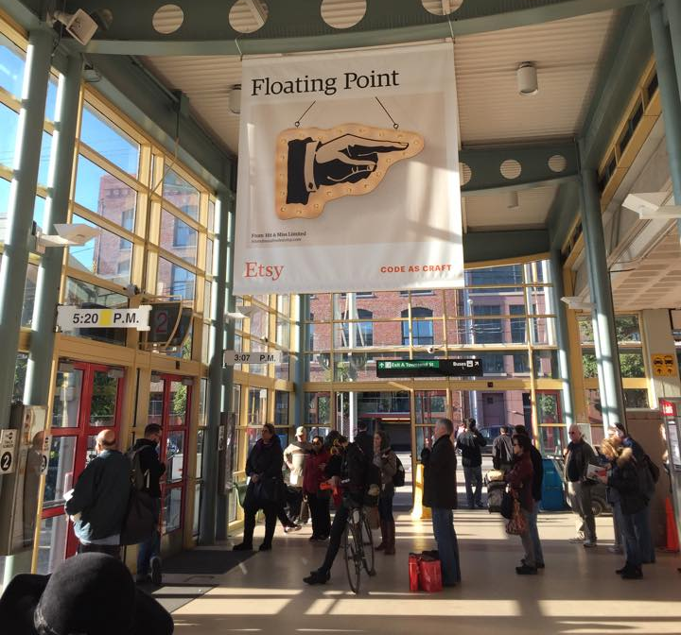
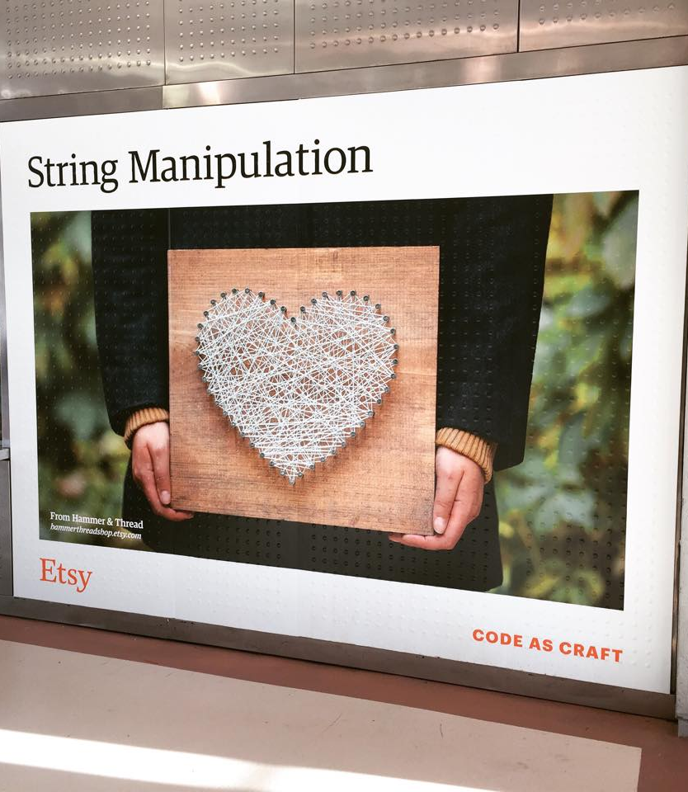
Syntax vs. Semantics
Karen and Erin!
Plus – you might consider coming to the Career Fair this Friday at HMC's LAC…

Slide 57
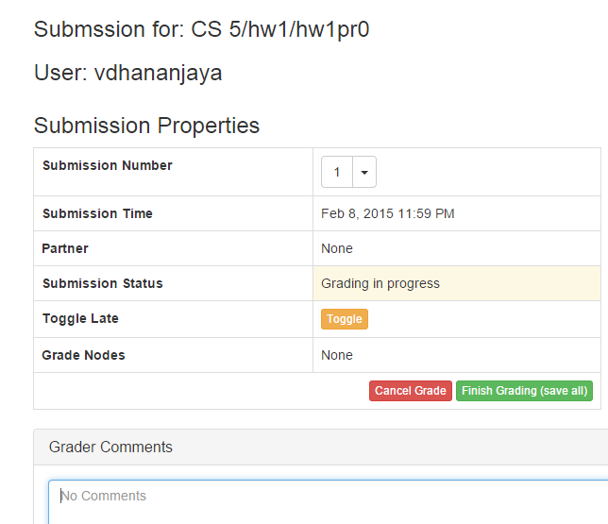
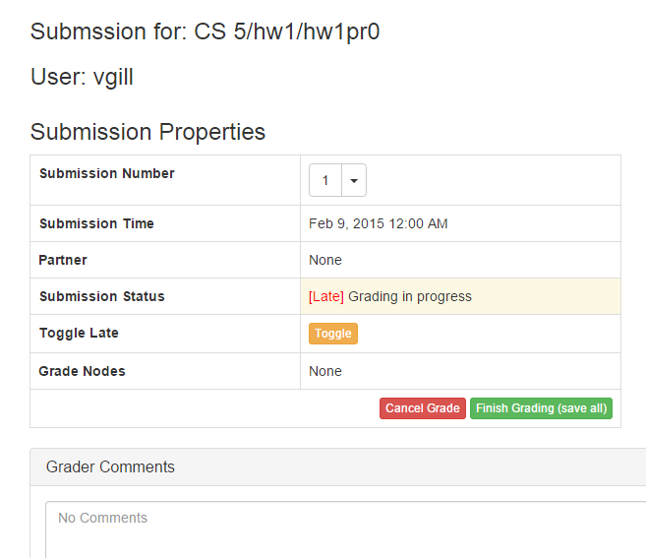
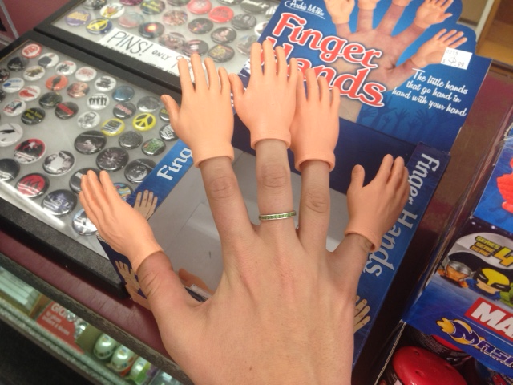
thanks, Nina!

Slide 58
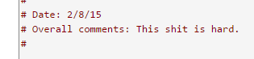
thanks, Nina!

Slide 59
Caesar Cipher: decipher
Caesar
Brutus
>>> decipher('Bzdrzq bhogdq? H oqdedq Bzdrzq rzkzc.')
'Caesar cipher? I prefer Caesar salad.'
S1
S2
Becca's connection with Islamic studies…
>>> decipher('Hu lkbjhapvu pz doha ylthpuz hmaly dl mvynla '\
'lclyfaopun dl ohcl slhyulk.')
'An education is what remains after we forget everything we have learned.'
>>> decipher('Uifz xpsl ju pvu xjui b qfodjm!')
PL
LAT
>>> decipher('gv vw dtwvg')
But how ?

Slide 60
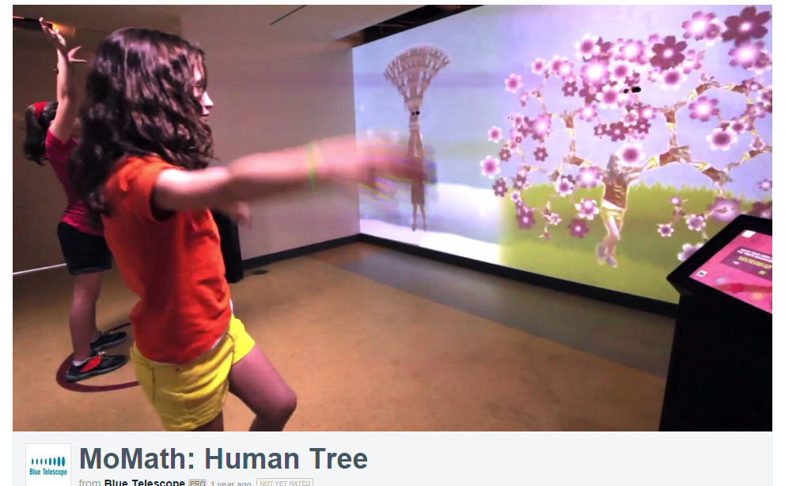


Slide 61
Rot 13
def rot13( c ):
""" rotates c by 13 chars, "wrapping" as needed
NON-LETTERS don't change!
"""
if 'a' <= c <= 'z':
new_ord = ord(c) + 13
if new_ord <= ord('z'):
return chr(new_ord)
else:
return chr( )
elif 'A' <= c <= 'Z': # upper-case test!
else:
Rotate n? Rotate an entire string?

Slide 62
Rot 13
def rot13( c ):
""" rotates c by 13 chars, "wrapping" as needed
NON-LETTERS don't change!
"""
if 'a' <= c <= 'z':
new_ord = ord(c) + 13
if new_ord <= ord('z'):
return chr(new_ord)
else:
return chr( )
elif 'A' <= c <= 'Z': # upper-case test!
else:
Rotate n? Rotate an entire string?

Slide 63
A more comprehensive solution
I loathe hazy code!
L = [ 'aliens', 'zap', 'hazy', 'code' ]
def bestWord( L ):
""" returns L's max-scrabble-score word
"""
LoL = [ [sScore(w), w] for w in L ]
bestpair = max( LoL )
return bestpair[1]
LoL = [ [6,'aliens'], [14,'zap'], [19,'hazy'], [7,'code'] ]
bestpair = [19,'hazy']
'hazy'

Slide 64
chr, ord,
and rot13
What is ord('U')/2?
What is chr( ord('i')+13 )?
What is chr( ord('W')+13 )?
Finish rot13 to "shift" letters by 13 spots…
def rot13( c ):
""" rotate c by 13 chars, "wrapping" as needed; NON-LETTERS don't change """
if 'a' <= c <= 'z': # test if c is a lowercase letter
new_ord = ord(c) + 13 # if so, find the # 13 spots ahead
if new_ord <= ord('z'): # check if it's in bounds!
return chr(new_ord) # if so, return it
else: # otherwise
return # what to return?
elif # what test should go here?
# what would go here, if we had room?
else: # what should be done in the else?
How would this change if we wanted to rotate by n spots?

Slide 65
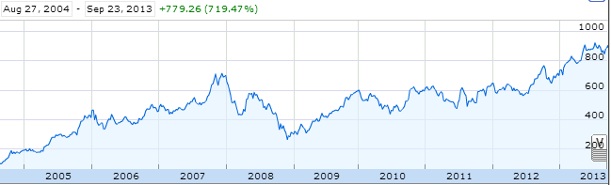
Aside: web scraping
How could we grab today's stock price via Python?

Slide 66
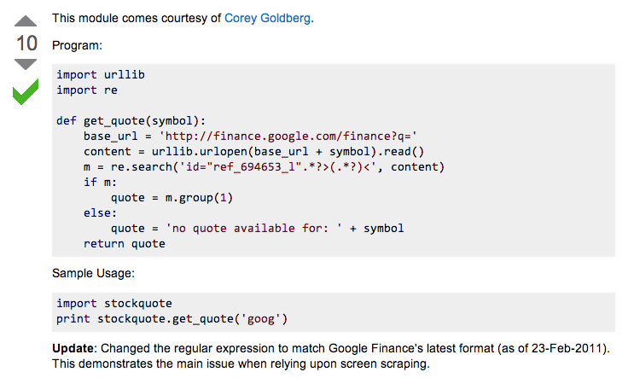
Example: web scraping
http://stackoverflow.com/questions/5081710/how-to-create-a-stock-quote-fetching-app-in-python

Slide 67
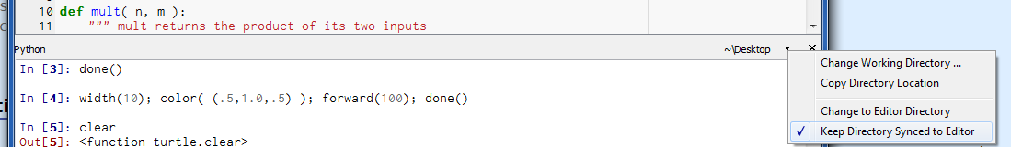

Slide 68
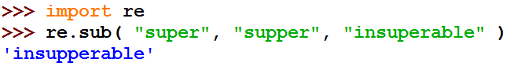
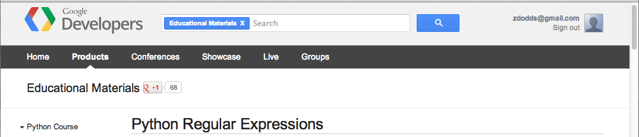
Regular Expressions
a huge string-processing library
many tutorials available…
developers.google.com/edu/python/regular-expressions?csw=1

Slide 69
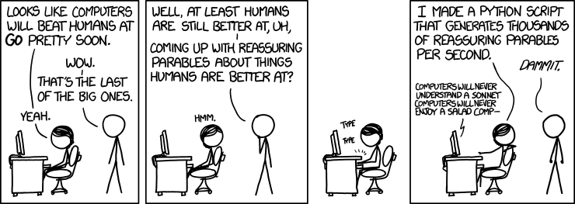
String-processing perspective…
with thanks to Jacquelyn Zehner!
http://stackoverflow.com/questions/5081710/how-to-create-a-stock-quote-fetching-app-in-python

Slide 71
Caesar Cipher: decipher
Caesar
[0, 'gv vw dtwvg'],
[2, 'hw wx euxwh'],
[2, 'ix xy fvyxi'],
[0, 'jy yz gwzyj'],
[2, 'kz za hxazk'],
[4, 'la ab iybal'],
[0, 'mb bc jzcbm'],
[1, 'nc cd kadcn'],
[4, 'od de lbedo'],
[3, 'pe ef mcfep'],
[0, 'qf fg ndgfq'],
[2, 'rg gh oehgr'],
[2, 'sh hi pfihs'],
[3, 'ti ij qgjit'],
[2, 'uj jk rhkju'],
[1, 'vk kl silkv'],
[0, 'wl lm tjmlw'],
[1, 'xm mn uknmx'],
[2, 'yn no vlony'],
[3, 'zo op wmpoz'],
[2, 'ap pq xnqpa'],
[1, 'bq qr yorqb'],
[0, 'cr rs zpsrc'],
[1, 'ds st aqtsd'],
[4, 'et tu brute'],
[3, 'fu uv csvuf']
Brutus
number-of-vowels score
max
won't always be correct!
all 26 possibilities

Slide 72
Caesar Cipher: decipher
Caesar
[6.9e-05, 'gv vw dtwvg'],
[3.6e-05, 'hw wx euxwh'],
[1.4e-07, 'ix xy fvyxi'],
[8.8e-11, 'jy yz gwzyj'],
[7.2e-10, 'kz za hxazk'],
[0.01503, 'la ab iybal'],
[3.7e-08, 'mb bc jzcbm'],
[0.00524, 'nc cd kadcn'],
[0.29041, 'od de lbedo'],
[0.00874, 'pe ef mcfep'],
[7.3e-07, 'qf fg ndgfq'],
[0.06410, 'rg gh oehgr'],
[0.11955, 'sh hi pfihs'],
[3.1e-06, 'ti ij qgjit'],
[1.1e-08, 'uj jk rhkju'],
[2.6e-05, 'vk kl silkv'],
[0.00012, 'wl lm tjmlw'],
[3.1e-06, 'xm mn uknmx'],
[0.02011, 'yn no vlony'],
[1.5e-06, 'zo op wmpoz'],
[1.9e-07, 'ap pq xnqpa'],
[5.7e-08, 'bq qr yorqb'],
[0.00024, 'cr rs zpsrc'],
[0.02060, 'ds st aqtsd'],
[0.45555, 'et tu brute'],
[0.00011, 'fu uv csvuf']
Brutus
letter-prob. score
max
not always correct, but better!
all 26 possibilities

Slide 73
Caesar Cipher: decipher
gv vw dtwvg
hw wx euxwh
ix xy fvyxi
jy yz gwzyj
kz za hxazk
la ab iybal
mb bc jzcbm
nc cd kadcn
od de lbedo
pe ef mcfep
qf fg ndgfq
rg gh oehgr
sh hi pfihs
ti ij qgjit
uj jk rhkju
vk kl silkv
wl lm tjmlw
xm mn uknmx
yn no vlony
zo op wmpoz
ap pq xnqpa
bq qr yorqb
cr rs zpsrc
ds st aqtsd
et tu brute
fu uv csvuf
Caesar
Brutus
decipher('gv vw dtwvg')
Strategy using max:
(1) consider all possible answers
(2) give them each a score
(3) use our techniques to get max
Score for "Englishness"?
up to you…
all 26 possibilities

Slide 74
Solutions…
Hints:
abs( x ) is built-in to Python
Use bestWord as a guide:
def bestWord( L ):
""" example code """
LOL = [ [scsc(w), w] for w in L ]
bestPair = max( LOL )
return bestPair[1]
L
def bestNumber( L ):
""" returns the # in
L closest to 42 """
LoL =
[30,40,50]
[[12,30],[2,40],[8,50]]
[2,40]
40

Slide 75
Solutions…
Hints:
abs( x ) is built-in to Python
Use bestWord as a guide:
def bestWord( L ):
""" example code """
LOL = [ [scsc(w), w] for w in L ]
bestPair = max( LOL )
return bestPair[1]
L
def bestNumber( L ):
""" returns the # in
L closest to 42 """
LoL =
[30,40,50]
[[12,30],[2,40],[8,50]]
[2,40]
40

Slide 76
Solutions…
def count( e, L ):
""" returns the # of e's in L """
return sum( [e==x for x in L] )
def mode( L ):
""" returns the element
appearing most often in L """

Slide 77
The last word on bestWord
def scrabbleScore(w):
# see homework #1!
Let's abbreviate this function as scsc(w)
using raw recursion
def bestWord( L ):
""" finds the "best" word from L, a list of words
here, "best" means highest scrabble score """
if len(L) < 2: return L[0]
elif scsc(L[0]) < scsc(L[1]): return bestWord( L[1:] )
else: return bestWord( L[0:1] + L[2:] )
using max
def bestWord( L ):
""" returns the word in L w/max scrabble score """
LoL = [ [scsc(w), w] for w in L ]
bestPair = max( LoL )
return bestPair

Slide 78
What is CS really about
thinking like a machine
thinking for a machine
variables
42
storage
int
guess
libraries
sequences
deciding how to use existing tools …
'w'
'a'
'r'
't'
str
s[0]
str
s[1]
str
s[2]
str
s[3]
functions
creating your own tools ...
if…elif…else
making decisions (conditionals)
classes
(later)
recursion
creating your own data structures ...
repeated, self-similar actions

Slide 79
Top-down program design
Given: a description of the problem
translation!
Wanted: a function that solves it

Slide 80
Top-down program design
Given: a description of the problem
translation!
Wanted: a function that solves it
with as much detail as possible
1. Visualize what the program will do
2. Break up the work into a set of smaller tasks
analysis
3. Compose solutions for these tasks (functions)
What do you need for each?
variables, lists, if…elif…else, recursion
synthesis
Are these tasks still too big? if so, go to step 1…
1. Visualize what the function will do ...

Slide 81
Top-down program design
Given: a description of the problem
translation!
Wanted: a function that solves it
with as much detail as possible
1. Visualize what the program will do
2. Break up the work into a set of smaller tasks
Examples...
3. Compose solutions for these tasks (functions)
What do you need for each?
variables, lists, if…elif…else, recursion
Are these tasks still too big? if so, go to step 1…
1. Visualize what the function will do ...

Slide 82
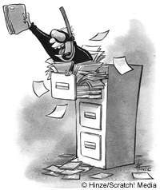
Files
Want to analyze your hum paper?
f becomes the "file object" representing humpaper.txt in this case.
Make sure you saved your paper as "plain text" (not .doc or .pdf) or else all sorts of weird formatting characters will show up!
f = file('humpaper.txt')
text = f.read()
words = text.split()
text is now one BIG string
words is now one BIG list of words (strings)
max(words)
or anything else you might want to investigate… !
min(words)
Two households, both alike in dignity,
In fair Verona, where we lay our scene,
From ancient grudge break to new mutiny,
Where civil blood makes civil hands unclean.
decode(text)

Slide 83
Representing Sound
physics
continuous plot of air pressure vs. time
sampling
samples taken every ~ 1/22050th of a second
quantization
Each sample is measured on a loudness scale from -32,768 to 32,767. (This fits into 2 bytes.)
storage
These two bytes are called a frame. Raw audio data - such as what is written to the surface of a CD - is simply a list of these frames.
pulse code modulation = PCM data

Slide 84
Break up
def remAll( e, L ):
""" this function removes all of the elements
e from the top level of the list L
"""
if len(L) == 0: # L is empty
return L
elif
else:
removeAll(42, [5,7,42,8,42])
[5,7,8]
removeAll('q', 'qaqqlqqiqeqqnqqqqs')
'aliens'

Slide 85
Warm up...
def removeAll( e, L ):
""" this function removes all of the elements
e from the top level of the list L
"""
if len(L) == 0:
return L # L is empty
elif
else:
removeAll(42, [5,7,42,8,42])
[5,7,8]
removeAll('q', 'qcqoqmqpqquqtqeqrq')
'computer'

Slide 86
Taking only one…
def removeAll( e, L ):
""" this function removes all of the elements
e from the top level of the list L
"""
if len(L) == 0:
return L # L is empty
elif e == L[0]:
return removeAll(e,L[1:]) # remove this one
# AND later ones…
else:
return L[0:1] + removeAll(e,L[1:])
# keep the non-e element and then keep going
How could we change this to removeOne?
removeOne(42, [5,7,42,8,42])
removeOne('p', 'computer programming')
[5,7,8,42]
'comuter programming'

Slide 87
"Best" word
def scrabbleScore(w):
# see homework #1!
Let's abbreviate this function as scsc(w)
def bestWord( L ):
""" finds the "best" word from L, a list of words
here, "best" means highest scrabble score """
if len(L) < 2:
return L[0]
elif
return
else:
return
What else might be nice to know ??

Slide 88
"Best" word
def scrabbleScore(w):
# see homework #1!
Let's abbreviate this function as scsc(w)
def bestWord( L ):
""" finds the "best" word from L, a list of words
here, "best" means highest scrabble score """
if len(L) < 2:
return L[0]
elif
return
else:
return
What else might be nice to know ??

Slide 89
A suggestion
def scrabbleScore(w):
# see homework #1!
Let's abbreviate this function as scsc(w)
def bestWord( L ):
""" returns the word in L w/maximum
scrabble score """
LOL = [ [scsc(w), w] for w in L ] # LOL!
bestPair = max( LOL )
return bestPair
What's so funny?

Slide 90
"Quiz"
Hints:
abs( x ) is built-in to Python
Solutions…
Use bestWord as a guide:
def bestWord( L ):
""" example code """
LOL = [ [scsc(w), w] for w in L ]
bestPair = max( LOL )
return bestPair[1]
Write this function using max:
def bestNumber( L ):
""" returns the # in L closest to 42 """
L
[30,40,50]
[[12,30],[2,40],[8,50]]
[2,40]
40

Slide 91
"Quiz"
Hint:
Solutions…
Consider defining a helper function !
Write this function however you like:
def mode( L ):
""" returns the element appearing most often in L """

Slide 92
"Quiz"
Nothing but the best!
Name(s):
Hints:
abs( x ) is built-in to Python
Write this function using max or recursively :
def bestNumber( L ):
""" returns the # in L closest to 42 """
Use bestWord as a guide:
def bestWord( L ):
""" example code """
LOL = [ [scsc(w), w] for w in L ]
bestPair = max( LOL )
return bestPair
Write this function however you like:
Hint:
Consider defining a helper function !
def mode( L ):
""" returns the element appearing most often in L """
Extra Credit: What four-letter word scores highest in scrabble?

Slide 93
"Quiz"
Hints:
abs( x ) is built-in to Python
Solutions…
Use bestWord as a guide:
def bestWord( L ):
""" example code """
LOL = [ [scsc(w), w] for w in L ]
bestPair = max( LOL )
return bestPair
Write this function using max:
def bestNumber( L ):
""" returns the # in L closest to 42 """

Slide 94
"Quiz"
Solutions…
Write this function however you like:
Hint:
Consider defining a helper function !
def mode( L ):
""" returns the element appearing most often in L """

Slide 95
chr and ord
abcdefghijklmnopqrstuvwxyz
ASCII VALUES
97
99
101
103
105
107
109
111
113
115
117
119
122
ABCDEFGHIJKLMNOPQRSTUVWXYZ
65
67
69
71
73
75
77
79
81
83
85
87
90
ord('a') is 97
chr(66) is 'B'
What is chr( ord('i')+13 ) ?
What is chr( ord('P')+13 ) ?
How can we wrap this around?

Slide 96
Rot 13
def rot13( c ):
""" rotates c by 13 chars, "wrapping" as needed
NON-LETTERS DO NOT CHANGE!
"""
if 'a' <= c <= 'z':
new_ord = ord(c) + 13
if new_ord <= ord('z'):
return chr(new_ord)
else:
return
elif
else:
How would you rotate an entire string?

Slide 97
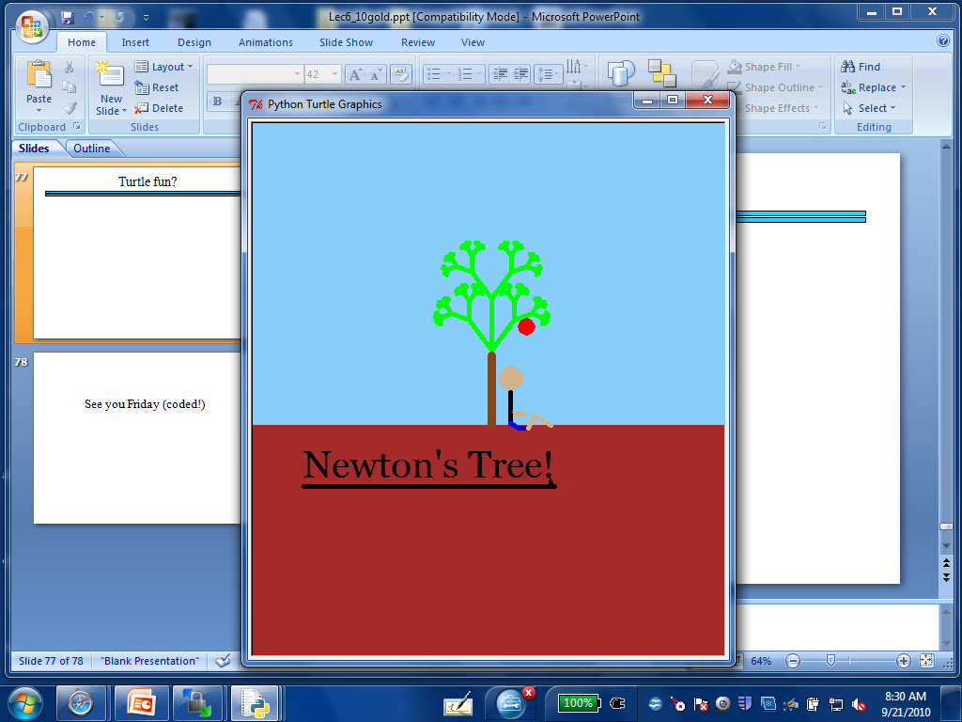
Turtle fun?

Slide 98
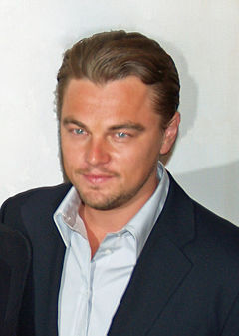
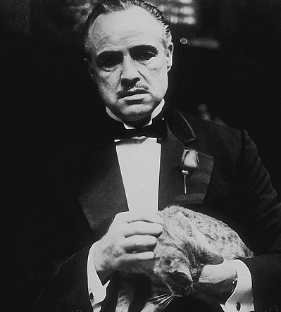
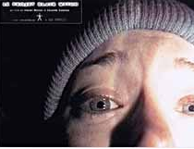
top N Lists
1. Titanic
2. Lord of the Rings 3
1. The Godfather
2. The Shawshank Redemption
1. The Blair Witch Project
2. Road to Ruin

Slide 99
top1List
def top1List( L ):
""" returns a list of the top element in L """
if len(L) < 1: return L
else: return [ max(L) ]

Slide 100
top2List
def top1List( L ):
""" returns a list of the top element in L """
if len(L) < 1: return L
else: return [ max(L) ]
def top2List( L ):
""" returns a list of the top 2 elements in L """
if len(L) < 2: return L
mx = max(L) # get the biggest element
newL = removeOne( mx, L ) # get rid of mx
return [ mx ] + top1List( newL )

Slide 101
top N List
def top3List( L ):
""" returns a list of the top 3 elements in L """
if len(L) < 3: return L
top N?

Slide 102
Files
Want to analyze your hum paper?
f becomes the "file object" representing humpaper.txt in this case.
You will first need to save your file as "plain text" or else all the special formatting characters will still be in there!
f = file('humpaper.txt')
text = f.read()
words = text.split()
text is now one BIG string
words is now one BIG list of words (strings)
max(words)
or anything else you might want to investigate… !
min(words)
Two households, both alike in dignity,
In fair Verona, where we lay our scene,
From ancient grudge break to new mutiny,
Where civil blood makes civil hands unclean.

Slide 103
Some legs to stand on…
It looks like I'm a head here!
decipher
max
encipher
score
adv(c,n)
creating more and more capable compositions
ord
chr

Slide 104
Some legs to stand on…
It looks like I'm a head here!
decipher
max
encipher
score
adv(c,n)
creating more and more capable compositions
ord
chr
computer organization
data representation
circuits
how are even these fundamentals physically realized ?!

Slide 105
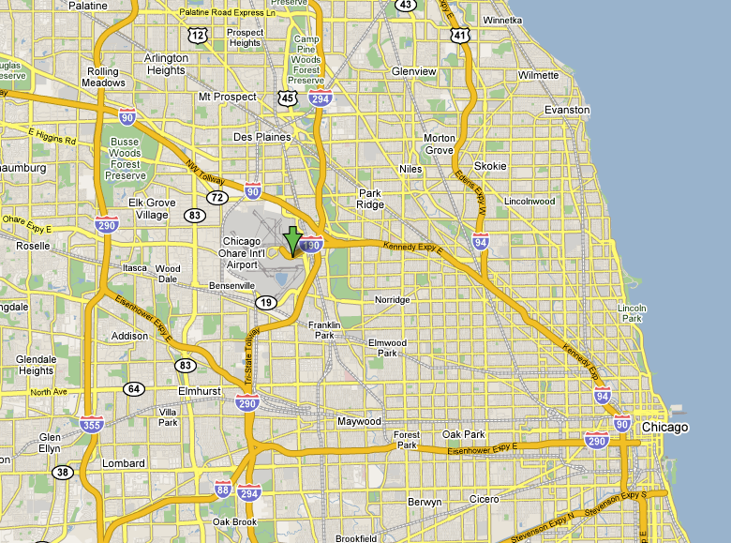
CHR and ORD
Orchard Field

Slide 106
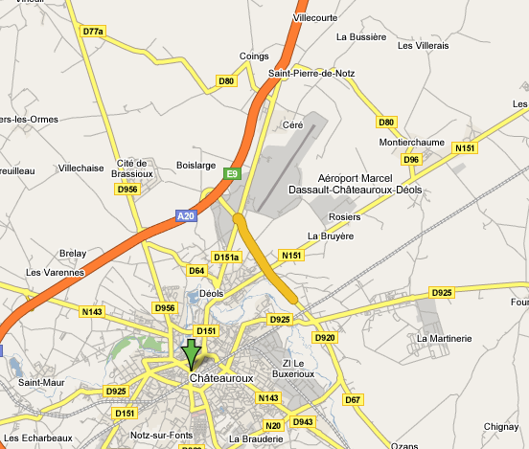
CHR and ORD
Chateauroux

Slide 107
ASCII
American Standard Code for Information Interchange
ASCII is a table that tells the computer how to represent characters as bits!
8 bits = 1 byte

Slide 108
chr and ord
abcdefghijklmnopqrstuvwxyz
functions for these conversions
97
122
ABCDEFGHIJKLMNOPQRSTUVWXYZ
65
90
ord( c )
Input: a string of one character, c
Output: an integer, the ASCII value of c
chr( n )
Input: an integer in range(255)
Output: a one-char. string of that ASCII value

Slide 109

Binary Storage / Representation
8 bits = 1 byte = 1 box
The SAME bits represent integers, if the variable has type int instead of str
value:
'*'
00101010
type: str
bits
name:
Identical bits are stored in each variable!
1 bit
The types determine how to interpret the bits; the names don't matter at all…
value:
42
00101010
1 byte = 8 bits
type: int
bits
name:

Slide 110
chr and ord
abcdefghijklmnopqrstuvwxyz
functions for these conversions
97
122
ABCDEFGHIJKLMNOPQRSTUVWXYZ
65
90
ord( c )
Input: a string of one character, c
Output: an integer, the ASCII value of c
chr( n )
Input: an integer in range(255)
Output: a one-char. string of that ASCII value
[ [i,chr(i)] for i in range(128) ]
try these!
[ ord(i) for i in '**** CS! ****' ]

Slide 111
chr and ord
Orchard Field

Slide 112
chr and ord
Chateauroux

Slide 113
Caesar Cipher: encipher
encipher( 'gv vw dtwvg' , 0 )
'gv vw dtwvg'
'hw wx euxwh'
'ix xy fvyxi'
'jy yz gwzyj'
'kz za hxazk'
'la ab iybal'
returns
encipher( 'gv vw dtwvg' , 1 )
returns
encipher( 'gv vw dtwvg' , 2 )
returns
encipher( 'gv vw dtwvg' , 3 )
returns
encipher( 'gv vw dtwvg' , 4 )
returns
encipher( 'gv vw dtwvg' , 5 )
returns
encipher( 'gv vw dtwvg' , 25 )
'fu uv csvuf'
returns
Output

Slide 114
Caesar Cipher: encipher
gv vw dtwvg
hw wx euxwh
ix xy fvyxi
jy yz gwzyj
kz za hxazk
la ab iybal
mb bc jzcbm
nc cd kadcn
od de lbedo
pe ef mcfep
qf fg ndgfq
rg gh oehgr
sh hi pfihs
ti ij qgjit
uj jk rhkju
vk kl silkv
wl lm tjmlw
xm mn uknmx
yn no vlony
zo op wmpoz
ap pq xnqpa
bq qr yorqb
cr rs zpsrc
ds st aqtsd
et tu brute
fu uv csvuf
encipher( 'gv vw dtwvg' , 0 )
'gv vw dtwvg'
'hw wx euxwh'
'ix xy fvyxi'
'jy yz gwzyj'
'kz za hxazk'
'la ab iybal'
returns
encipher( 'gv vw dtwvg' , 1 )
returns
encipher( 'gv vw dtwvg' , 2 )
returns
encipher( 'gv vw dtwvg' , 3 )
returns
encipher( 'gv vw dtwvg' , 4 )
returns
encipher( 'gv vw dtwvg' , 5 )
returns
encipher( 'gv vw dtwvg' , 25 )
'fu uv csvuf'
returns
Output
decipher?
all 26 possibilities

Slide 115
Caesar Cipher: decipher
>>> decipher('Bzdrzq bhogdq? H oqdedq Bzdrzq rzkzc.')
'Caesar cipher? I prefer Caesar salad.'
>>> decipher('Hu lkbjhapvu pz doha ylthpuz hmaly dl mvynla '\
'lclyfaopun dl ohcl slhyulk.')
'An education is what remains after we forget everything we have learned.'
But how to do this… ?

Slide 116
Rot 13: characters
def rotc( c ):
""" rotates a single char. c ahead by n chars
'wrapping around' as needed """

Slide 117
Rot 13: strings
def rots( S ):
""" rotates a string ahead by 13 chars. """

Slide 118
Sorting
def sort(L)
returns a list which has the same elements as L, but in sorted order!

Slide 119
Computing with text
Bits/Numbers
Language
Ideas
Characters
Representation
Meaning

Slide 120
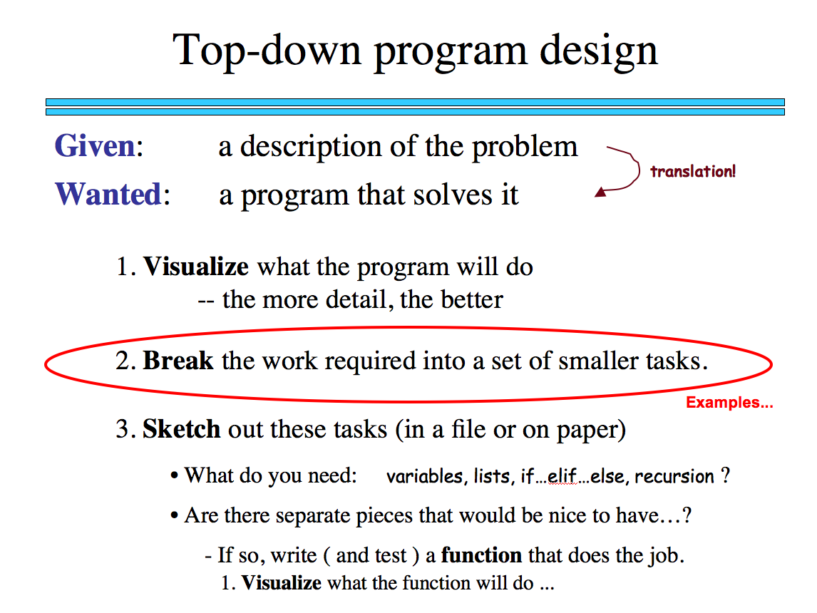
Sorting
def sort(L)
returns a list which has the same elements as L, but in sorted order!
What is sorting doing?
What is one piece?

Slide 121
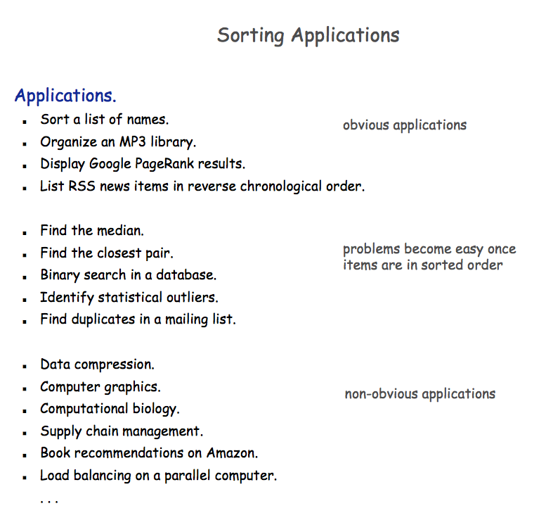

Slide 122

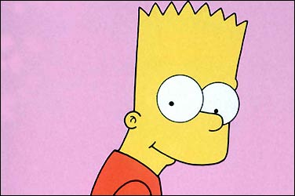
Random sorting…
def randSort( L ):
""" crazy sorting """
newL = random.sample( L, len(L) )
if isSorted(newL):
return newL
else:
return randSort(L) # try again…
A random permutation of L !
this function is totally random, dude!
Mmmm… sorting!

Slide 123

Random sorting…
def isSorted(s)
returns True if s is in order, False otherwise
isSorted('BART') returns False
isSorted('BERT') returns True
isSorted('BEGIN') returns True
isSorted([3,1,4]) returns False
isSorted([1,3,4]) returns True
ties?
isSorted('LOOPY') returns ??
Six-letter word?

Slide 124
Random sorting…
def isSorted(s):
returns True if s is in order, False otherwise
""" see the description in this box """
if len(s) < 2:
return
elif s[0] > s[1]:
return
else:
return
ties?
Six-letter word?

Slide 125
Random sorting…
def isSorted(s):
returns True if s is in order, False otherwise
""" see the description in this box """
if len(s) < 2:
return True
elif s[0] > s[1]:
return False
else:
return isSorted( s[1:] )
ties?
Six-letter word?

Slide 126
Almost the end…
def sort(L)
returns a list which has the same elements as L, but in sorted order!
Let e be the max element in L
Where should e go?
and what helper function might we want… ?

Slide 127
removeOne
def removeOne( e, L ):
""" this function removes one e from L
if L is a list, e is an element
if L is a string, e is a one-char. string
"""
if len(L) == 0:
return L # L is empty
elif e == L[0]:
return L[1:] # the element e is now gone
else:
return L[0:1] + removeOne( e, L[1:] ) # keep going

Slide 128
Computing with language
ideas / meaning
language / words / phrases
strings
numbers / bits

Slide 129
Computing with language
open questions in AI …
ideas / meaning
language / words / phrases
computing with language - recognizing English!
strings
how strings are represented and stored
numbers / bits

Slide 130
ASCII
American Standard Code for Information Interchange
ASCII is a table that tells the computer how to represent characters as bits!
8 bits = 1 byte

Slide 131
ASCII
American Standard Code for Information Interchange
ASCII is a table that tells the computer how to represent characters as bits!
value:
'*'
00101010
type: str
bits
name:
Identical bits are stored in each variable!
8 bits = 1 byte
The types determine how to interpret the bits; the names don't matter at all…
value:
42
00101010
The SAME bits represent integers, if the variable has type int instead of str
bits
type: int
name:

Slide 132
chr and ord
abcdefghijklmnopqrstuvwxyz
functions for these conversions
97
122
ABCDEFGHIJKLMNOPQRSTUVWXYZ
65
90
ord( c )
Input: a string of one character, c
Output: an integer, the ASCII value of c
chr( n )
Input: an integer in range(255)
Output: a one-char. string of that ASCII value

Slide 133
chr and ord
abcdefghijklmnopqrstuvwxyz
functions for these conversions
97
122
ABCDEFGHIJKLMNOPQRSTUVWXYZ
65
90
ord( c )
Input: a string of one character, c
Output: an integer, the ASCII value of c
chr( n )
Input: an integer in range(255)
Output: a one-char. string of that ASCII value
[ [i,chr(i)] for i in range(128) ]
try these!
[ ord(i) for i in '**** CS! ****' ]

Slide 134
chr and ord
Orchard Field

Slide 135
chr and ord
Chateauroux

Slide 136
Caesar Cipher: encipher
encipher( 'gv vw dtwvg' , 0 )
'gv vw dtwvg'
'hw wx euxwh'
'ix xy fvyxi'
'jy yz gwzyj'
'kz za hxazk'
'la ab iybal'
returns
encipher( 'gv vw dtwvg' , 1 )
returns
encipher( 'gv vw dtwvg' , 2 )
returns
encipher( 'gv vw dtwvg' , 3 )
returns
encipher( 'gv vw dtwvg' , 4 )
returns
encipher( 'gv vw dtwvg' , 5 )
returns
encipher( 'gv vw dtwvg' , 25 )
'fu uv csvuf'
returns
Output

Slide 137
Caesar Cipher: encipher
gv vw dtwvg
hw wx euxwh
ix xy fvyxi
jy yz gwzyj
kz za hxazk
la ab iybal
mb bc jzcbm
nc cd kadcn
od de lbedo
pe ef mcfep
qf fg ndgfq
rg gh oehgr
sh hi pfihs
ti ij qgjit
uj jk rhkju
vk kl silkv
wl lm tjmlw
xm mn uknmx
yn no vlony
zo op wmpoz
ap pq xnqpa
bq qr yorqb
cr rs zpsrc
ds st aqtsd
et tu brute
fu uv csvuf
encipher( 'gv vw dtwvg' , 0 )
'gv vw dtwvg'
'hw wx euxwh'
'ix xy fvyxi'
'jy yz gwzyj'
'kz za hxazk'
'la ab iybal'
returns
encipher( 'gv vw dtwvg' , 1 )
returns
encipher( 'gv vw dtwvg' , 2 )
returns
encipher( 'gv vw dtwvg' , 3 )
returns
encipher( 'gv vw dtwvg' , 4 )
returns
encipher( 'gv vw dtwvg' , 5 )
returns
encipher( 'gv vw dtwvg' , 25 )
'fu uv csvuf'
returns
Output
decipher?
all 26 possibilities

Slide 138
Caesar Cipher: decipher
>>> decipher('Bzdrzq bhogdq? H oqdedq Bzdrzq rzkzc.')
'Caesar cipher? I prefer Caesar salad.'
>>> decipher('Hu lkbjhapvu pz doha ylthpuz hmaly dl mvynla '\
'lclyfaopun dl ohcl slhyulk.')
'An education is what remains after we forget everything we have learned.'
But how to do this… ?

Slide 139
See you Friday (coded!)

Slide 140
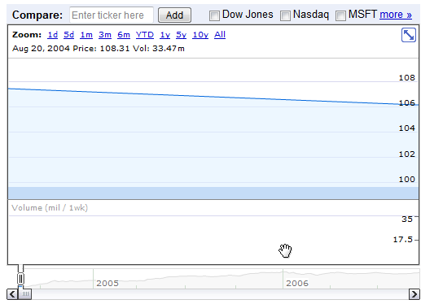
Google at its public offering ~ $ 100

Slide 141
