Slide 1
BR 5 Snczx
Gesundheit!
Algorithms
Determining Englishness...
Classifying life
Putting stuff in order
Jotto
ASCII !
HW 3
Hw #3 due Monday
"Office" hrs: Fri. 2-4pm
IndexError
TypeError
HumanError
Weekend tutoring? ~ yes!...
This week's reading…

Slide 2
Computing with text
open questions in AI …
ideas / meaning
language / words / phrases
computing with language - recognizing English!
strings
how strings are represented and stored
numbers / bits

Slide 3
Caesar Cipher: encipher
encipher( 'I <3 Latin' , 0 )
'I <3 Latin'
'J <3 Mbujo'
'K <3 Ncvkp'
'L <3 Odwlq'
'M <3 Pexmr'
'N <3 Qfyns'
returns
encipher( 'I <3 Latin' , 1 )
returns
encipher( 'I <3 Latin' , 2 )
returns
encipher( 'I <3 Latin' , 3 )
returns
encipher( 'I <3 Latin' , 4 )
returns
…
encipher( 'I <3 Latin' , 5 )
returns
encipher( 'I <3 Latin' , 25 )
'H <3 Kzshm'
returns
should return the string s with each alphabetic character shifted/wrapped by n places in the alphabet
encipher( s , n )
Historically bad decision #43:
Brutus won't mind if I use his salary to bring Skrillex to the Colosseum next month...

Slide 4
ASCII
American Standard Code for Information Interchange
value:
'/'
00101111
type: str
bits
name:
Identical bits are stored in each variable!
8 bits = 1 byte
The SAME bits represent integers, if the variable has type int instead of str
The types determine how to interpret the bits; the names don't matter at all…
value:
47
00101111
type: int
bits
name:

Slide 5
ASCII
American Standard Code for Information Interchange
convert # to char
chr
ord
convert char to #

Slide 6
chr and ord
abcdefghijklmnopqrstuvwxyz
ASCII VALUES
97
99
101
103
105
107
109
111
113
115
117
119
122
ABCDEFGHIJKLMNOPQRSTUVWXYZ
65
67
69
71
73
75
77
79
81
83
85
87
90
ord( c )
Input: a string of one character, c
Output: an integer, the ASCII value of c
CONVERTERS
chr( n )
Input: an integer in range(255)
Output: a one-char. string of that ASCII value
[ [i,chr(i)] for i in range(128) ]
Try these!
[ ord(i) for i in '**** CS! ****' ]

Slide 7
chr and ord
abcdefghijklmnopqrstuvwxyz
ASCII VALUES
97
99
101
103
105
107
109
111
113
115
117
119
122
ABCDEFGHIJKLMNOPQRSTUVWXYZ
65
67
69
71
73
75
77
79
81
83
85
87
90
ord('a') is 97
chr(66) is 'B'
What is chr( ord('i')+13 ) ?
What is chr( ord('P')+13 ) ?
How do we wrap?

Slide 8
Rot 13
def rot13( c ):
""" rotates c by 13 chars, "wrapping" as needed
NON-LETTERS DO NOT CHANGE!
"""
if 'a' <= c <= 'z':
new_ord = ord(c) + 13
if new_ord <= ord('z'):
return chr(new_ord)
else:
return
elif
else:
How would you rotate an entire string?

Slide 9
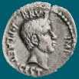
Caesar Cipher: decipher
>>> decipher('Bzdrzq bhogdq? H oqdedq Bzdrzq rzkzc.')
'Caesar cipher? I prefer Caesar salad.'
>>> decipher('Hu lkbjhapvu pz doha ylthpuz hmaly dl mvynla '\
'lclyfaopun dl ohcl slhyulk.')
'An education is what remains after we forget everything we have learned.'
>>> decipher('Uifz xpsl ju pvu xjui b qfodjm!')
>>> decipher('gv vw dtwvg')
But how ?

Slide 10
Caesar Cipher: decipher
gv vw dtwvg
hw wx euxwh
ix xy fvyxi
jy yz gwzyj
kz za hxazk
la ab iybal
mb bc jzcbm
nc cd kadcn
od de lbedo
pe ef mcfep
qf fg ndgfq
rg gh oehgr
sh hi pfihs
ti ij qgjit
uj jk rhkju
vk kl silkv
wl lm tjmlw
xm mn uknmx
yn no vlony
zo op wmpoz
ap pq xnqpa
bq qr yorqb
cr rs zpsrc
ds st aqtsd
et tu brute
fu uv csvuf
Caesar
Brutus
decipher('gv vw dtwvg')
Strategy using max:
(1) consider all possible answers
(2) give them each a score
(3) use our techniques to get max
Score for "Englishness"?
up to you…
all 26 possibilities

Slide 11
Caesar Cipher: Englishness
"call me Ishmael"
"attack at dawn"
A lot
"rainbow, table, candle"
"Yow! Legally-imposed CULTURE-reduction is CABBAGE-BRAINED!"
"quadruplicity drinks procrastination"
"Hold the newsreader's nose squarely, waiter, or friendly milk will countermand my trousers."
Where might you put "Twas brillig, and the slithy toves" ?
"the gostak distims the doshes"
"hension, framble, bardle"
They all sound good to me!
"jufict, stofwus, lictpub"
"itehbs, rsnevtr, khbsota"
"epadxo, nojarpn, gdxokpw"
"h o q dedqBzdrzqrzkzc"
Not so much

Slide 12
Caesar Cipher: decipher
Caesar
[0, 'cr rs zpsrc']
[0, 'gv vw dtwvg']
[0, 'jy yz gwzyj']
[0, 'mb bc jzcbm']
[0, 'qf fg ndgfq']
[0, 'wl lm tjmlw']
[1, 'bq qr yorqb']
[1, 'ds st aqtsd']
[1, 'nc cd kadcn']
[1, 'vk kl silkv']
[1, 'xm mn uknmx']
[2, 'ap pq xnqpa']
[2, 'hw wx euxwh']
[2, 'ix xy fvyxi']
[2, 'kz za hxazk']
[2, 'rg gh oehgr']
[2, 'sh hi pfihs']
[2, 'uj jk rhkju']
[2, 'yn no vlony']
[3, 'fu uv csvuf']
[3, 'pe ef mcfep']
[3, 'ti ij qgjit']
[3, 'zo op wmpoz']
[4, 'et tu brute']
[4, 'la ab iybal']
[4, 'od de lbedo']
Brutus
number-of-vowels score
max
won't always be correct!
all 26 possibilities

Slide 13
Caesar Cipher: decipher
Caesar
[0.4680, 'jy yz gwzyj']
[0.4960, 'mb bc jzcbm']
[0.5420, 'uj jk rhkju']
[0.5567, 'ix xy fvyxi']
[0.5597, 'qf fg ndgfq']
[0.5718, 'fu uv csvuf']
[0.5753, 'bq qr yorqb']
[0.5833, 'kz za hxazk']
[0.5859, 'xm mn uknmx']
[0.5880, 'gv vw dtwvg']
[0.5902, 'vk kl silkv']
[0.6110, 'ap pq xnqpa']
[0.6304, 'zo op wmpoz']
[0.6318, 'wl lm tjmlw']
[0.6717, 'cr rs zpsrc']
[0.6735, 'hw wx euxwh']
[0.6963, 'nc cd kadcn']
[0.7153, 'ti ij qgjit']
[0.7398, 'la ab iybal']
[0.7442, 'yn no vlony']
[0.7867, 'pe ef mcfep']
[0.7880, 'sh hi pfihs']
[0.7918, 'rg gh oehgr']
[0.8213, 'ds st aqtsd']
[0.8609, 'od de lbedo']
[0.9082, 'et tu brute']
Brutus
letter-prob. score
max
not always correct, but better!
all 26 possibilities

Slide 14
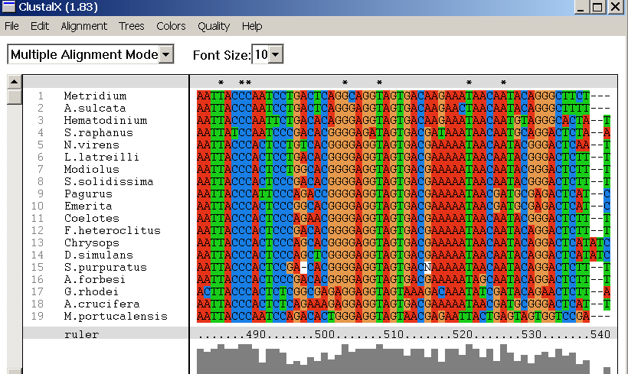
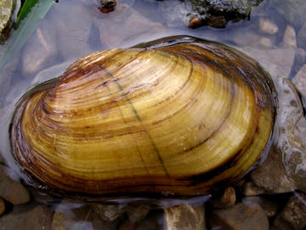
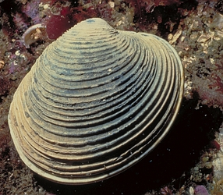
CS Design…
but design of what? code? Algorithms!
Screenshot from the ClustalX multiple subsequence alignment tool...
Subsequences
(Jotto)
(Sorting)

Slide 15
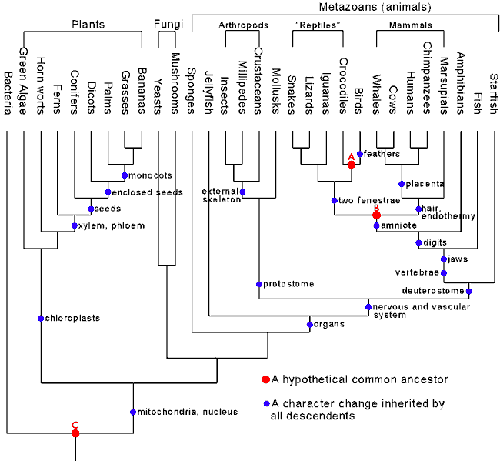
Phylogeny!
Hey!?
Trinocular aliens
?
What was gained (or lost) here?

Slide 16
Subsequences: visualizing...
def subseq( s, sbig )
sbig is the bigger string in which we are looking for s
s is the subsequence to find (or not find)
subseq('ctg', 'cataga')
True or False?
subseq('ctg', 'tacggta')
subseq('aliens', 'always frighten dragons')
subseq('trogdor', 'that dragon is gone for good')
Here there be NO dragons!
Why do these succeed? Or fail?

Slide 17
Breaking down…
subseq( s, sbig )
subseq('ctg', 'tacggta')
What is a small (initial) piece of the problem?
How would we describe it in terms of the inputs?
What is left after handling this piece?
Are there other functions we will need?
Hey - I've seen something like this before!

Slide 18
Helper functions…
def remAll( e, L ):
""" this function removes all elements equal to
e from the top level of the list or string L
"""
# code written last time
def remOne( e, L ):
""" this function removes ONE element equal to
e from the top level of the list or string L,
as long as there is such an element
"""
# code written last time
Is either really what we want, or another variant?

Slide 19
from remOne to remUpto
def remOne( e, S ):
""" returns the string S with everything
** UPTO ** the first e removed
"""
if len(S) == 0:
return ''
elif e == S[0]:
return S[1:]
else:
return S[0:1] + remOne(e,S[1:])
What has to change to make this remOne function into remUpto?
Notes:
def removeUpto( c, s ):
""" this function removes all of s up to and
including the first occurrence of c
s is any string, c is a 1-character string
"""
if len(s) == 0:
return s # s is empty
elif c == s[0]:
return s[1:] # the character c is now gone
else:
return removeUpto( c, s[1:] ) # keep going

Slide 20
Subsequences: Sketching out…
def subseq( s, sbig ):
""" returns True if s is a subsequence of
sbig; False otherwise. Both are strings.
"""
Base Case(s)
Recursive Step(s)
What cases will we need for subseq ?
Notes:
def subseq( s, sbig ):
""" returns True if s is a subsequence of
sbig; False otherwise, both are strings
"""
if len(s) == 0:
return True
elif s[0] not in sbig:
return False
else:
restofsbig = removeUpto( s[0], sbig )
return subseq( s[1:], restofsbig )

Slide 21
Notes:
def subseq( s, sbig ):
""" returns True if s is a subsequence of
sbig; False otherwise, both are strings
"""
if len(s) == 0:
return True
elif s[0] not in sbig:
return False
else:
restofsbig = removeUpto( s[0], sbig )
return subseq( s[1:], restofsbig )

Slide 22
Notes:
def subseq( s, sbig ):
""" returns True if s is a subsequence of
sbig; False otherwise, both are strings
"""
if len(s) == 0:
return True
elif s[0] not in sbig:
return False
else:
restofsbig = removeUpto( s[0], sbig )
return subseq( s[1:], restofsbig )

Slide 23
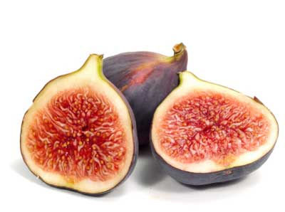
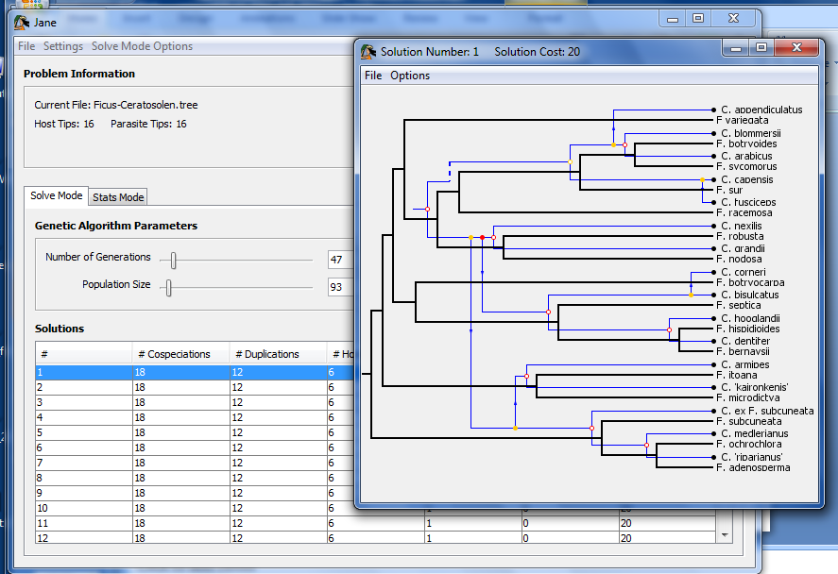
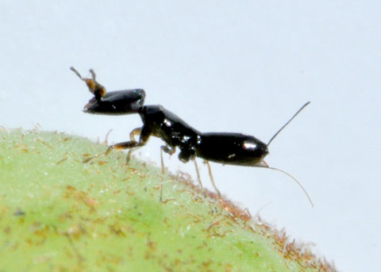
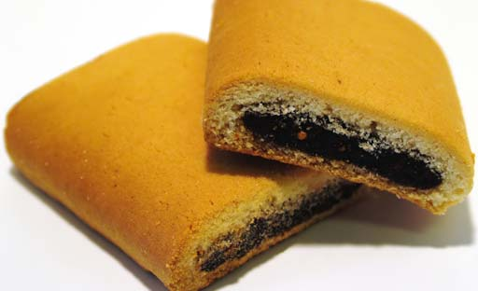
Subsequences @ HMC?
host: figs
parasite: wasps
Jane!
together: newtons!

Slide 24
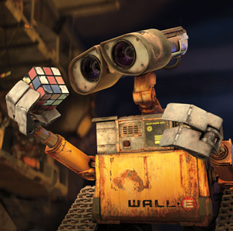
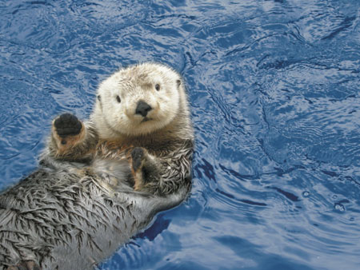
Jotto !
These are two cute

Slide 25
Getting started...
Name(s): ____________________
jotto('geese', 'seems')
What will each of these jotto-scoring examples return?
jotto('fluff', 'lulls')
jotto('pears', 'diner')
Extra! Which of these 8 is the cruellest hidden jotto word?
jotto('xylyl', 'slyly')
jotto( s1, s2 )
should return the jotto score for any strings s1 and s2
sort( L )
should return a new list that is the sorted version of the input L
don't need to write code for these...
Brainstorm algorithms for these problems -- what helper functions might help each one?

Slide 26
Getting started...
Name(s): ____________________
jotto('geese', 'seems')
What will each of these jotto-scoring examples return?
jotto('fluff', 'lulls')
jotto('pears', 'diner')
Extra! Which of these 8 is the cruellest hidden jotto word?
jotto('xylyl', 'slyly')
jotto( s1, s2 )
should return the jotto score for any strings s1 and s2
sort( L )
should return a new list that is the sorted version of the input L
don't need to write code for these...
Brainstorm algorithms for these problems -- what helper functions might help each one?

Slide 27
Getting started...
Name(s): ____________________
jotto('geese', 'seems')
What will each of these jotto-scoring examples return?
jotto('fluff', 'lulls')
jotto('pears', 'diner')
Extra! Which of these 8 is the cruellest hidden jotto word?
jotto('xylyl', 'slyly')
Please hand those to the right...
jotto( s1, s2 )
should return the jotto score for any strings s1 and s2
sort( L )
should return a new list that is the sorted version of the input L
don't need to write code for these...
Brainstorm algorithms for these problems -- what helper functions might help each one?

Slide 28
Getting started...
Thoughts?
jotto('geese', 'seems')
What will each of these jotto-scoring examples return?
jotto('fluff', 'lulls')
jotto('pears', 'diner')
Extra! Which of these 8 is the cruellest hidden jotto word?
jotto('xylyl', 'slyly')
jotto( s1, s2 )
should return the jotto score for any strings s1 and s2
sort( L )
should return a new list that is the sorted version of the input L
don't need to write code for these...
Brainstorm algorithms for these problems -- what helper functions might help each one?

Slide 29
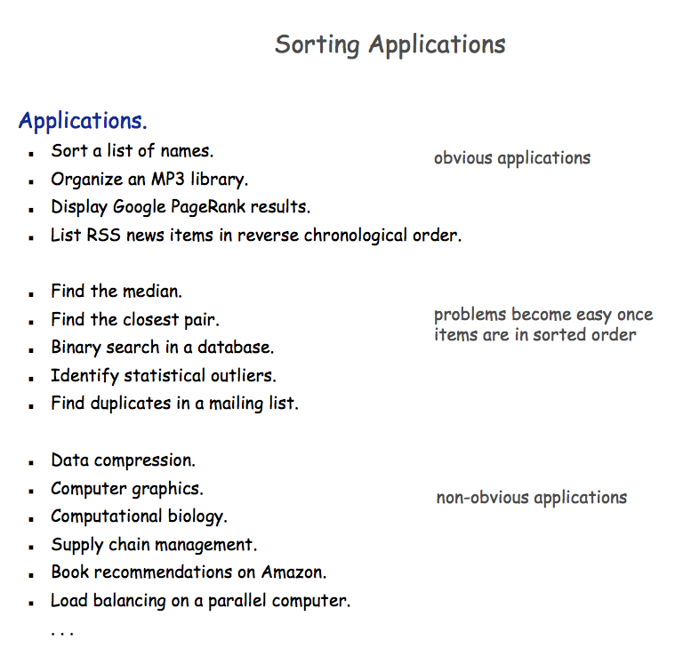

Slide 30
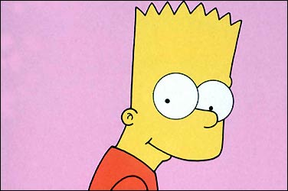
A sorting algorithm…
Input a list, L
Randomly permute L
Check if L is sorted
Repeat as necessary...
Mmmm… sorting!
in code:
How fast will this be?
from random import *
def randSort( L ):
""" crazy sorting """
newL = sample( L, len(L) )
if isSorted(newL):
return newL
else:
return randSort(L)
returns a random permutation of L
this function is totally random, dude!

Slide 31
checking if a list is sorted...
def isSorted(s):
returns True if s is in order, False otherwise
isSorted('BART') returns False
No way I'm False, man.
isSorted('BERT') returns True
isSorted('BEGIN') returns True
isSorted([3,1,4]) returns False
isSorted([1,3,4]) returns True
Too true!
isSorted('LOOPY') returns ??
Six-letter words?

Slide 32
checking if sorted...
def isSorted(s):
isSorted('BEGIN')
True
isSorted('END')
False
returns True if s is in order, False otherwise
if len(s) < 2:
return
elif s[0] < s[1]:
return
else:
return
six-letter word?

Slide 33
Weet bksa ed xecumeha 3!

Slide 34
Algorithm Analysis
def isSorted(s):
""" True if s is sorted else False """
if len(s) < 2:
return True
elif s[0] < s[1]:
return isSorted( s[1:] )
else:
return False
If the original string had N chars, how many "steps" would it take to run isSorted ?
in the BEST case? in the WORST case?

Slide 35
Sorting out sorting
Theorem 1:
No sorting algorithm can sort n numbers in fewer than n steps.
Theorem 2:
No comparison-based sorting algorithm can sort n numbers asymptotically faster than n log₂ n.
Sorting Algorithm Worst-case Asymptotic Time
Insertion Sort n²
Bubble Sort n²
Quicksort n²
Mergesort n log₂ n
Heapsort n log₂ n

Slide 36
Does it matter?
Our "super"computer: 1 billion steps/second
Number of elements
Our algorithm's running time...
N steps
N² steps
N! steps
N = 10 el.
< 1sec.
< 1sec.
< 1sec.
N = 10³ el.
< 1sec.
< 1sec.
> lifespan
N = 10⁶ el.
< 1sec.
16.7 minutes
> lifespan
N = 10⁹ el.
1 sec.
31.7 years
> lifespan
total time to finish...

Slide 37
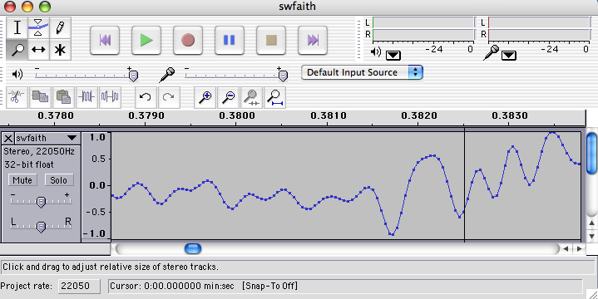
Do real data sets get so big?
Yes!

Slide 38
Weet bksa ed xecumeha 3!
and have a great weekend...

Slide 39
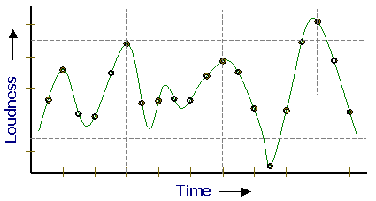
Representing Sound
physics
continuous plot of air pressure vs. time
sampling
samples taken every ~ 1/22050th of a second
quantization
Each sample is measured on a scale from -32,768 to 32,767. (This fits into 2 bytes.)
storage
These two bytes are called a frame. Raw audio data - such as what is written to the surface of a CD - is simply a list of these frames.
This problem SOUNDS like fun!
pulse code modulation = PCM data

Slide 40
Subsequences: Sketching out…
def subseq( s, sbig ):
""" returns True if s is a subsequence of
sbig; False otherwise. Both are strings.
"""
Base Case(s)
Recursive Step(s)
Notes:
def subseq( s, sbig ):
""" returns True if s is a subsequence of
sbig; False otherwise, both are strings
"""
if len(s) == 0:
return True
elif s[0] not in sbig:
return False
else:
restofsbig = removeUpto( s[0], sbig )
return subseq( s[1:], restofsbig )

Slide 41
Asymptotic Analysis
3n + 42
“Asymptotic” is a fancy word!
42n+4242
“asymptotically linear”
100 n
(0.1)n² + n + 1
“asymptotically quadratic”
100 n²
n³ - 100n² + 2n + 42
2n³ + 10
1/5 n³
“asymptotically cubic”

Slide 42
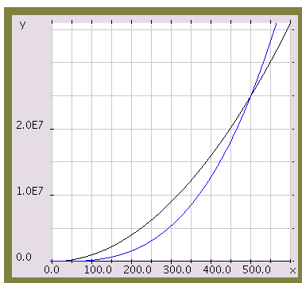
Asymptotic Analysis
Those look like two awesome water-slides!
100 n²
1/5 n³
n

Slide 43
Almost the end…
def sort(L)
returns a list which has the same elements as L, but in sorted order!
Let e be the max element in L
Where should e go?
and what helper function might we want… ?

Slide 44
Algorithm Analysis
def isSorted(s):
""" docstring! """
if L == []:
return 0
elif e == L[0]:
return 1 + count(e,L[1:])
else:
return count(e,L[1:])
If the original list had N elements, about how many "steps" would it take to run count(e,N)

Slide 45
Jotto scoring clicker trial
What is the score for jotto('geese','seems')
C
2
A
0
D
3
B
1
E
4

Slide 46
JOTTO clicker question
If you had to choose one of these, which helper function would you use for your jotto algorithm?
C
removeUpto
A
removeAll
D
B
remove these options from your selection!
removeOne
E

Slide 47
SORT clicker question
If you had to choose one of these, which helper function would you use for your sort algorithm?
C
removeUpto
A
removeAll
D
remove this question from the HW!
B
removeOne
E
Choose me!

Slide 48
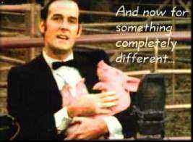
And now for something completely different…

Slide 49
top1List
def top1List( L ):
""" returns a list of the top element in L """
if len(L) < 1: return L
else: return [ max(L) ]

Slide 50
top2List
def top1List( L ):
""" returns a list of the top element in L """
if len(L) < 1: return L
else: return [ max(L) ]
def top2List( L ):
""" returns a list of the top 2 elements in L """
if len(L) < 2: return L
mx = max(L) # get the biggest element
newL = removeOne( mx, L ) # get rid of mx
return [ mx ] + top1List( newL )

Slide 51
top3List
def top3List( L ):
""" returns a list of the top 3 elements in L """
if len(L) < 3: return L
def topNList( n, L ):
""" returns a list of the top n elements in L """
top N?

Slide 52
Sorting
def sort(L)
returns a list which has the same elements as L, but in sorted order!

Slide 53
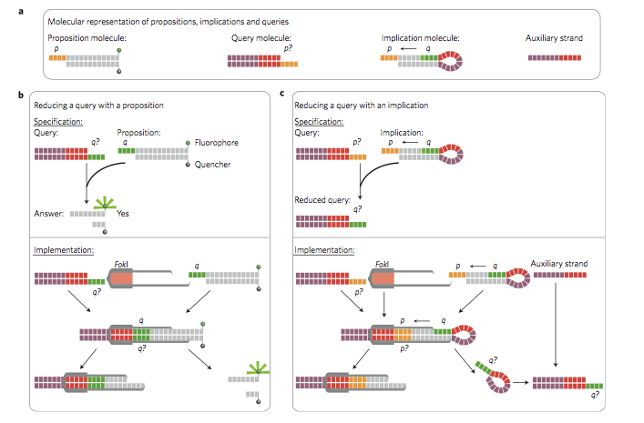
Reading this week: molecular computing
with robots...

Slide 54
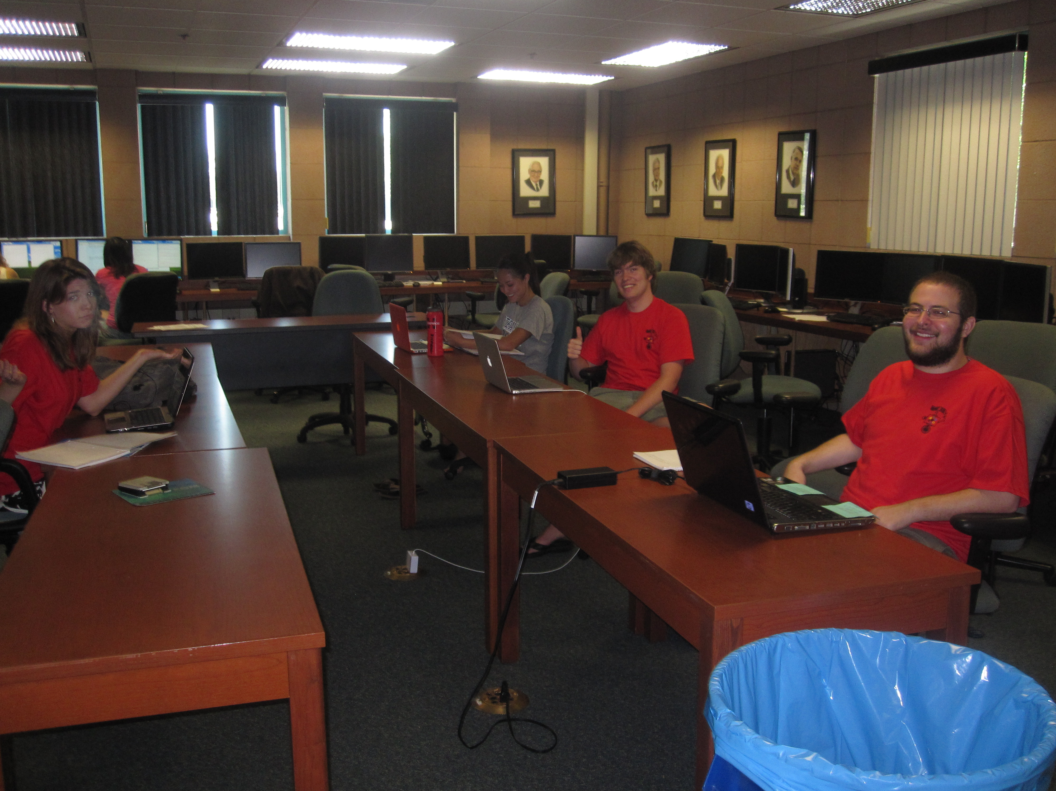
lonely on Friday afternoons... (not Monday evenings, however!)

