Slide 1
BR 5 Snczx
Gesundheit!
Algorithms
Englishness...
Classifying life
Removing/Sorting
and Jotto!
HW 3
Hw #3 due Monday
"Office" hrs: Fri. 2-4pm
Weekend tutoring? yes!
IndexError
TypeError
HumanError
This week's reading…

Slide 2
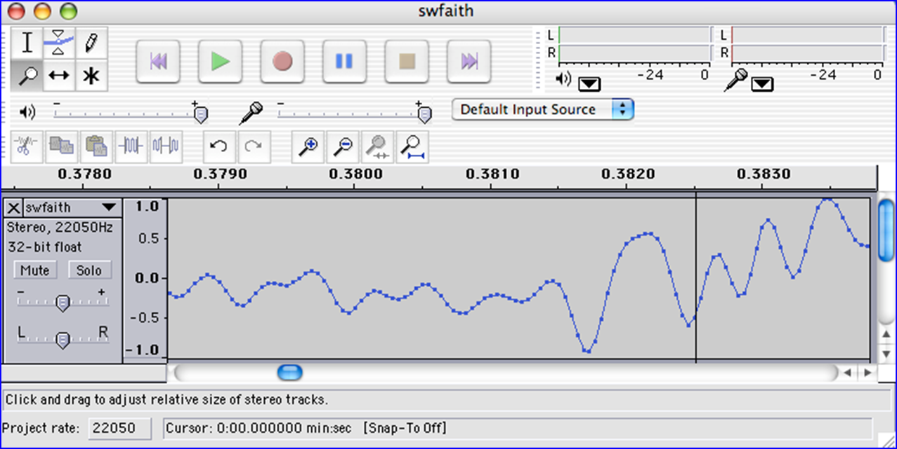
We saw you in Lab3…
heard

Slide 3
Caesar Cipher: encipher
should return the string s with each alphabetic character shifted/wrapped by n places in the alphabet
encipher(s,n)
encipher( 'I <3 Latin' , 0 )
'I <3 Latin'
'J <3 Mbujo'
'K <3 Ncvkp'
'L <3 Odwlq'
'M <3 Pexmr'
'N <3 Qfyns'
returns
encipher( 'I <3 Latin' , 1 )
returns
encipher( 'I <3 Latin' , 2 )
returns
encipher( 'I <3 Latin' , 3 )
returns
encipher( 'I <3 Latin' , 4 )
returns
encipher( 'I <3 Latin' , 5 )
returns
encipher( 'I <3 Latin' , 25 )
'H <3 Kzshm'
returns

Slide 4
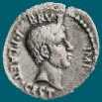
Caesar Cipher: decipher
Caesar
Brutus
>>> decipher('Bzdrzq bhogdq? H oqdedq Bzdrzq rzkzc.')
'Caesar cipher? I prefer Caesar salad.'
>>> decipher('Hu lkbjhapvu pz doha ylthpuz hmaly dl mvynla '\
'lclyfaopun dl ohcl slhyulk.')
'An education is what remains after we forget everything we have learned.'
>>> decipher('Uifz xpsl ju pvu xjui b qfodjm!')
>>> decipher('gv vw dtwvg')
But how ?

Slide 5
Decipher?
Strategies?
Algorithms?

Slide 6
gv vw dtwvg
hw wx euxwh
ix xy fvyxi
jy yz gwzyj
kz za hxazk
la ab iybal
mb bc jzcbm
nc cd kadcn
od de lbedo
pe ef mcfep
qf fg ndgfq
rg gh oehgr
sh hi pfihs
ti ij qgjit
uj jk rhkju
vk kl silkv
wl lm tjmlw
xm mn uknmx
yn no vlony
zo op wmpoz
ap pq xnqpa
bq qr yorqb
cr rs zpsrc
ds st aqtsd
et tu brute
fu uv csvuf
Decipher?
All possible decipherings
Strategies?
Algorithms?

Slide 7
gv vw dtwvg
hw wx euxwh
ix xy fvyxi
jy yz gwzyj
kz za hxazk
la ab iybal
mb bc jzcbm
nc cd kadcn
od de lbedo
pe ef mcfep
qf fg ndgfq
rg gh oehgr
sh hi pfihs
ti ij qgjit
uj jk rhkju
vk kl silkv
wl lm tjmlw
xm mn uknmx
yn no vlony
zo op wmpoz
ap pq xnqpa
bq qr yorqb
cr rs zpsrc
ds st aqtsd
et tu brute
fu uv csvuf
[0, 'gv vw dtwvg'],
[2, 'hw wx euxwh'],
[2, 'ix xy fvyxi'],
[0, 'jy yz gwzyj'],
[2, 'kz za hxazk'],
[4, 'la ab iybal'],
[0, 'mb bc jzcbm'],
[1, 'nc cd kadcn'],
[4, 'od de lbedo'],
[3, 'pe ef mcfep'],
[0, 'qf fg ndgfq'],
[2, 'rg gh oehgr'],
[2, 'sh hi pfihs'],
[3, 'ti ij qgjit'],
[2, 'uj jk rhkju'],
[1, 'vk kl silkv'],
[0, 'wl lm tjmlw'],
[1, 'xm mn uknmx'],
[2, 'yn no vlony'],
[3, 'zo op wmpoz'],
[2, 'ap pq xnqpa'],
[1, 'bq qr yorqb'],
[0, 'cr rs zpsrc'],
[1, 'ds st aqtsd'],
[4, 'et tu brute'],
[3, 'fu uv csvuf']
Decipher?
All possible decipherings
Score them all
Strategies?
Algorithms?
quantifying Englishness?

Slide 8
gv vw dtwvg
hw wx euxwh
ix xy fvyxi
jy yz gwzyj
kz za hxazk
la ab iybal
mb bc jzcbm
nc cd kadcn
od de lbedo
pe ef mcfep
qf fg ndgfq
rg gh oehgr
sh hi pfihs
ti ij qgjit
uj jk rhkju
vk kl silkv
wl lm tjmlw
xm mn uknmx
yn no vlony
zo op wmpoz
ap pq xnqpa
bq qr yorqb
cr rs zpsrc
ds st aqtsd
et tu brute
fu uv csvuf
[0, 'gv vw dtwvg'],
[2, 'hw wx euxwh'],
[2, 'ix xy fvyxi'],
[0, 'jy yz gwzyj'],
[2, 'kz za hxazk'],
[4, 'la ab iybal'],
[0, 'mb bc jzcbm'],
[1, 'nc cd kadcn'],
[4, 'od de lbedo'],
[3, 'pe ef mcfep'],
[0, 'qf fg ndgfq'],
[2, 'rg gh oehgr'],
[2, 'sh hi pfihs'],
[3, 'ti ij qgjit'],
[2, 'uj jk rhkju'],
[1, 'vk kl silkv'],
[0, 'wl lm tjmlw'],
[1, 'xm mn uknmx'],
[2, 'yn no vlony'],
[3, 'zo op wmpoz'],
[2, 'ap pq xnqpa'],
[1, 'bq qr yorqb'],
[0, 'cr rs zpsrc'],
[1, 'ds st aqtsd'],
[4, 'et tu brute'],
[3, 'fu uv csvuf']
Decipher?
All possible decipherings
max!
Score them all
Strategies?
Algorithms?
yields the "most English" phrase

Slide 9
Measuring Englishness
Very English-y
"Call me Ishmael."
"Attack at dawn!"
"rainbow, table, candle"
higher scores
"Yow! Legally-imposed CULTURE-reduction is CABBAGE-BRAINED!"
"quadruplicity drinks procrastination"
"Hold the newsreader's nose squarely, waiter, or friendly milk will countermand my trousers."
quantifying Englishness?
"the gostak distims the doshes"
"hension, framble, bardle"
"jufict, stofwus, lictpub"
"itehbs, rsnevtr, khbsota"
lower scores
"epadxo, nojarpn, gdxokpw"
"h o q dedqBzdrzqrzkzc"
All of these sound good to me!
Not English-y

Slide 10
gv vw dtwvg
hw wx euxwh
ix xy fvyxi
jy yz gwzyj
kz za hxazk
la ab iybal
mb bc jzcbm
nc cd kadcn
od de lbedo
pe ef mcfep
qf fg ndgfq
rg gh oehgr
sh hi pfihs
ti ij qgjit
uj jk rhkju
vk kl silkv
wl lm tjmlw
xm mn uknmx
yn no vlony
zo op wmpoz
ap pq xnqpa
bq qr yorqb
cr rs zpsrc
ds st aqtsd
et tu brute
fu uv csvuf
[0, 'gv vw dtwvg'],
[2, 'hw wx euxwh'],
[2, 'ix xy fvyxi'],
[0, 'jy yz gwzyj'],
[2, 'kz za hxazk'],
[4, 'la ab iybal'],
[0, 'mb bc jzcbm'],
[1, 'nc cd kadcn'],
[4, 'od de lbedo'],
[3, 'pe ef mcfep'],
[0, 'qf fg ndgfq'],
[2, 'rg gh oehgr'],
[2, 'sh hi pfihs'],
[3, 'ti ij qgjit'],
[2, 'uj jk rhkju'],
[1, 'vk kl silkv'],
[0, 'wl lm tjmlw'],
[1, 'xm mn uknmx'],
[2, 'yn no vlony'],
[3, 'zo op wmpoz'],
[2, 'ap pq xnqpa'],
[1, 'bq qr yorqb'],
[0, 'cr rs zpsrc'],
[1, 'ds st aqtsd'],
[4, 'et tu brute'],
[3, 'fu uv csvuf']
Decipher?
All possible decipherings
max!
Score them all
Strategies?
Algorithms?
"Englishness" score based on #-of-vowels

Slide 11
gv vw dtwvg
hw wx euxwh
ix xy fvyxi
jy yz gwzyj
kz za hxazk
la ab iybal
mb bc jzcbm
nc cd kadcn
od de lbedo
pe ef mcfep
qf fg ndgfq
rg gh oehgr
sh hi pfihs
ti ij qgjit
uj jk rhkju
vk kl silkv
wl lm tjmlw
xm mn uknmx
yn no vlony
zo op wmpoz
ap pq xnqpa
bq qr yorqb
cr rs zpsrc
ds st aqtsd
et tu brute
fu uv csvuf
[6.9e-05, 'gv vw dtwvg'],
[3.6e-05, 'hw wx euxwh'],
[1.4e-07, 'ix xy fvyxi'],
[8.8e-11, 'jy yz gwzyj'],
[7.2e-10, 'kz za hxazk'],
[0.01503, 'la ab iybal'],
[3.7e-08, 'mb bc jzcbm'],
[0.00524, 'nc cd kadcn'],
[0.29041, 'od de lbedo'],
[0.00874, 'pe ef mcfep'],
[7.3e-07, 'qf fg ndgfq'],
[0.06410, 'rg gh oehgr'],
[0.11955, 'sh hi pfihs'],
[3.1e-06, 'ti ij qgjit'],
[1.1e-08, 'uj jk rhkju'],
[2.6e-05, 'vk kl silkv'],
[0.00012, 'wl lm tjmlw'],
[3.1e-06, 'xm mn uknmx'],
[0.02011, 'yn no vlony'],
[1.5e-06, 'zo op wmpoz'],
[1.9e-07, 'ap pq xnqpa'],
[5.7e-08, 'bq qr yorqb'],
[0.00024, 'cr rs zpsrc'],
[0.02060, 'ds st aqtsd'],
[0.45555, 'et tu brute'],
[0.00011, 'fu uv csvuf']
Decipher?
All possible decipherings
S
c
o
r
e
s
Strategies?
Algorithms?
"Englishness" based on letter-probabilities
max!

Slide 12
Design…
but design of what? Code?
remAll(e,L)
Top-down design
remove all e's from L
Visualize
remAll(42,[5,7,42,8,42])
Split into parts
[5,7,8]
Build each part
Combine
remAll('q','qaqqlqqiqqiiqeqqnqs')
Test
'aliiiens'

Slide 13
Design…
but design of what? Code?
remAll(e,L)
Top-down design
remove all e's from L
Visualize
def remAll( e, L ):
if len(L) == 0:
elif e == L[0]:
else:
Split into parts
L empty
Build each part
L[0] is e
Combine
L[0] isn't e
Test

Slide 14
Design…
but design of what? Code?
remAll(e,L)
Top-down design
remove all e's from L
Visualize
def remAll( e, L ):
if len(L) == 0:
return L
elif e == L[0]:
return remAll(L[1:])
else:
return L[0:1] + remAll(L[1:])
Split into parts
Build each part
Combine
Test

Slide 15
Design…
but design of what? Code? Algorithms!
Code?
syntax
Algorithms!
ideas!

Slide 16
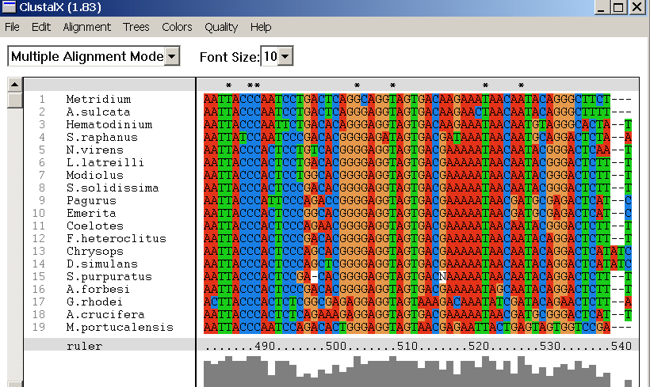
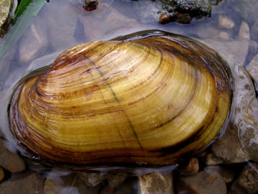
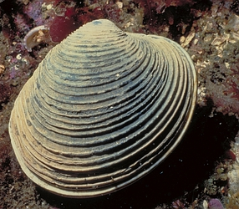
Design…
but design of what? Code? Algorithms!
Screenshot from the ClustalX multiple subsequence alignment tool...
Algorithmic challenge: How to find the best common subsequences among these very big genome strings ?!?
Subsequences
(Jotto)
(Sorting)

Slide 17
Subsequences: visualize
def subseq( s, sbig )
sbig is the bigger string in which we are looking for s
s is the subsequence to find (or not)
T or F?
subseq('', 'cataga')
subseq('ctg', 'cataga')
subseq('ctg', 'tacggta')
subseq('aliens', 'always frighten dragons')
subseq('trogdor', 'that dragon is gone for good')
Here there be NO dragons!
Why do these succeed? Or fail?

Slide 18
Quiz
Algorithm design
Name(s): _________________________________
2
def remAll( e, L ):
""" removes all e's from L """
if len(L) == 0:
return L
elif e == L[0]:
return remAll(L[1:])
else:
return L[0:1] + remAll(L[1:])
Make changes to remAll so that it removes elements upto and including the first e in L. (We could call it remUpto.)
1
Change remAll so that it removes only one e from L. (We could call it remOne.)
def subseq( s, sbig ):
""" returns True if s is a subseq. of sbig,
False otherwise. Both are strings.
"""
if s == '':
return True
3
Write the other cases needed for subseq…
Notes:
def subseq( s, sbig ):
""" returns True if s is a subsequence of
sbig; False otherwise, both are strings
"""
if len(s) == 0:
return True
elif s[0] not in sbig:
return False
else:
restofsbig = removeUpto( s[0], sbig )
return subseq( s[1:], restofsbig )

Slide 19
from remAll to remOne
def remAll( e, S ):
""" returns seq. S with all e's rmovd
"""
if len(S) == 0:
return S
elif e == S[0]:
return remAll( e, S[1:] )
else:
return S[0:1] + remAll( e, S[1:] )
remOne(8,[7,8,9,8])
[7,9,8]
remOne('d','coded')
'coed'
Notes:
def removeUpto( c, s ):
""" this function removes all of s up to and
including the first occurrence of c
s is any string, c is a 1-character string
"""
if len(s) == 0:
return s # s is empty
elif c == s[0]:
return s[1:] # the character c is now gone
else:
return removeUpto( c, s[1:] ) # keep going

Slide 20
from remOne to remUpto
def remOne( e, S ):
""" returns seq. S with first e rmoved
"""
if len(S) == 0:
return S
elif e == S[0]:
return S[1:]
else:
return S[0:1] + remOne( e, S[1:] )
remUpto(8,[7,8,9,8])
[9,8]
remUpto('d','coded')
'ed'
Notes:
def removeUpto( c, s ):
""" this function removes all of s up to and
including the first occurrence of c
s is any string, c is a 1-character string
"""
if len(s) == 0:
return s # s is empty
elif c == s[0]:
return s[1:] # the character c is now gone
else:
return removeUpto( c, s[1:] ) # keep going

Slide 21
Subseq ~ sketching it out…
subseq( s, sbig )
subseq('ctg', 'tacggta')
What is a small (initial) piece of the problem?
How would we describe it in terms of the inputs?
What is left after handling this piece?
Are there other functions we will need?

Slide 22
Subseq ~ trying it
def subseq( s, sbig ):
""" returns True if s is a subseq. of sbig;
False otherwise. Both are strings.
"""
if s == '': return True
Base case(s)
Recursive step(s)
Notes:
def subseq( s, sbig ):
""" returns True if s is a subsequence of
sbig; False otherwise, both are strings
"""
if len(s) == 0:
return True
elif s[0] not in sbig:
return False
else:
restofsbig = removeUpto( s[0], sbig )
return subseq( s[1:], restofsbig )

Slide 23
Notes:
def subseq( s, sbig ):
""" returns True if s is a subsequence of
sbig; False otherwise, both are strings
"""
if len(s) == 0:
return True
elif s[0] not in sbig:
return False
else:
restofsbig = removeUpto( s[0], sbig )
return subseq( s[1:], restofsbig )

Slide 24
Notes:
def subseq( s, sbig ):
""" returns True if s is a subsequence of
sbig; False otherwise, both are strings
"""
if len(s) == 0:
return True
elif s[0] not in sbig:
return False
else:
restofsbig = removeUpto( s[0], sbig )
return subseq( s[1:], restofsbig )

Slide 25
Design…
but design of what? Code? Algorithms!
Code?
syntax
Algorithms!
ideas!

Slide 26
hw3pr2: LCS
Longest Common Subsequence
'HUMAN'
'CGCTGAGCTAGGCA...'
'CHIMPANZEE'
'ATCCTAGGTAACTG...'
+10⁹more
Eye oneder if this haz other aplications?

Slide 27
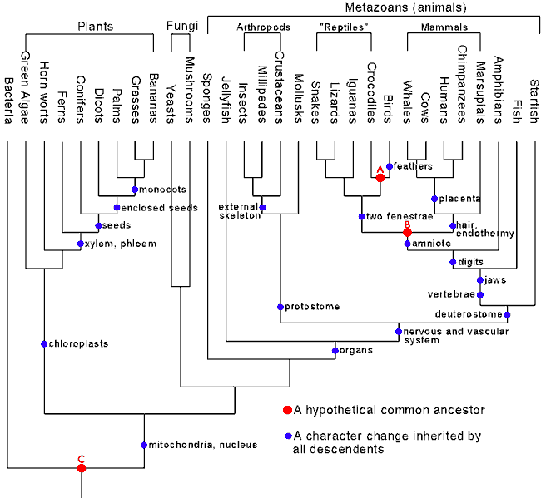
Hey!?
Trinocular aliens
?
Phylogeny
What was gained (or lost) here?

Slide 28
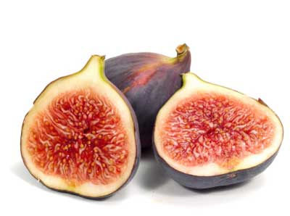
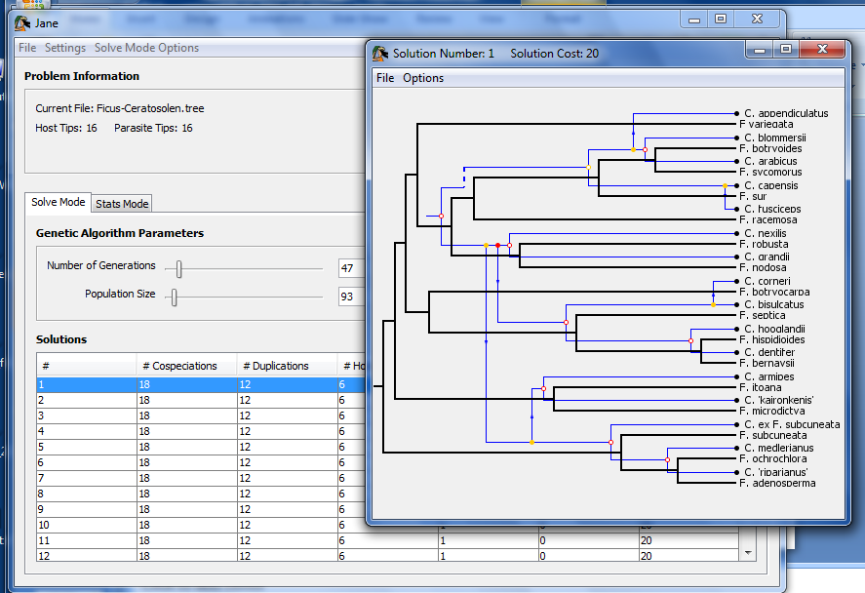
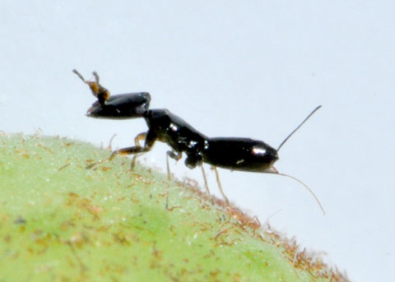
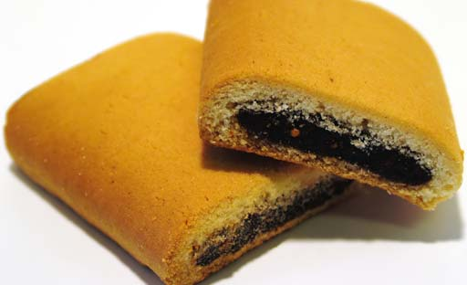
Subsequences @ HMC?
host: figs
parasites: wasps
Jane!
together: newtons!

Slide 29
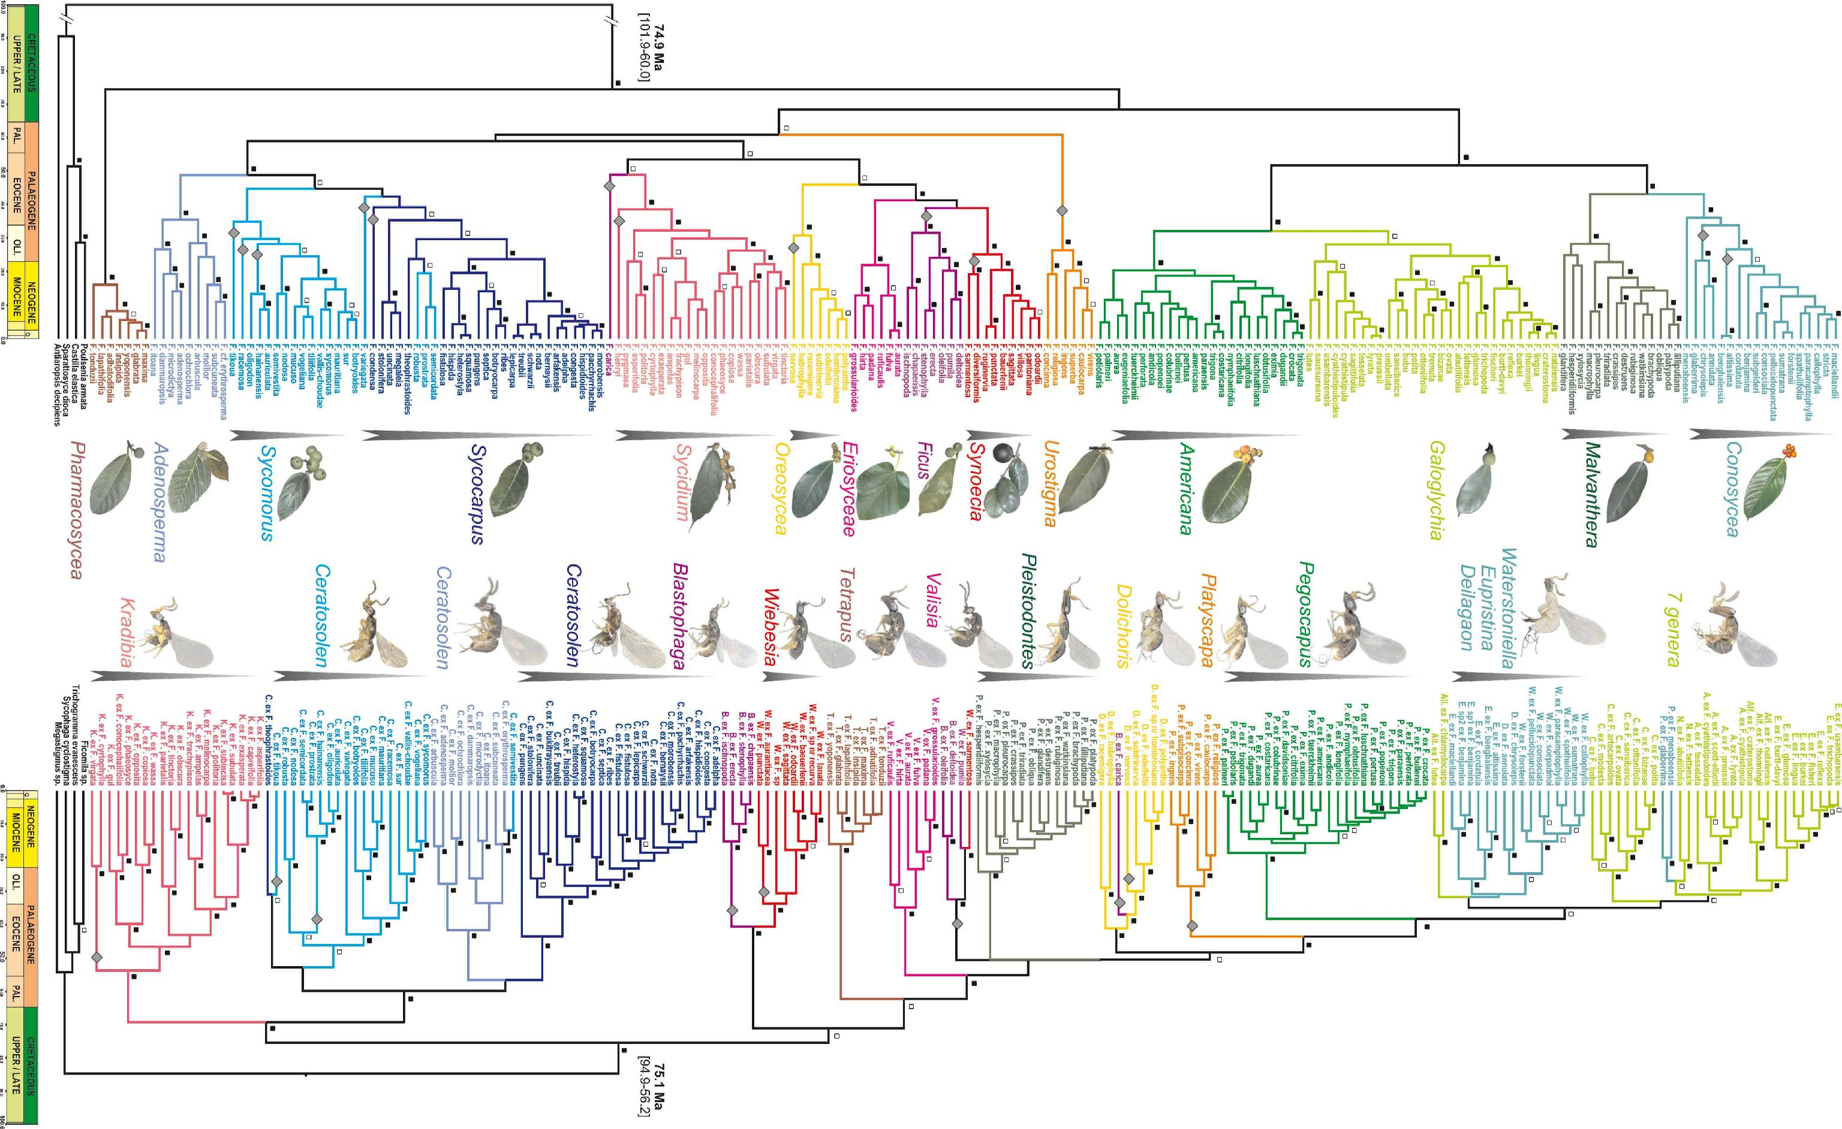
Jane's Challenge: 6 continents, 100s of species…

Slide 30
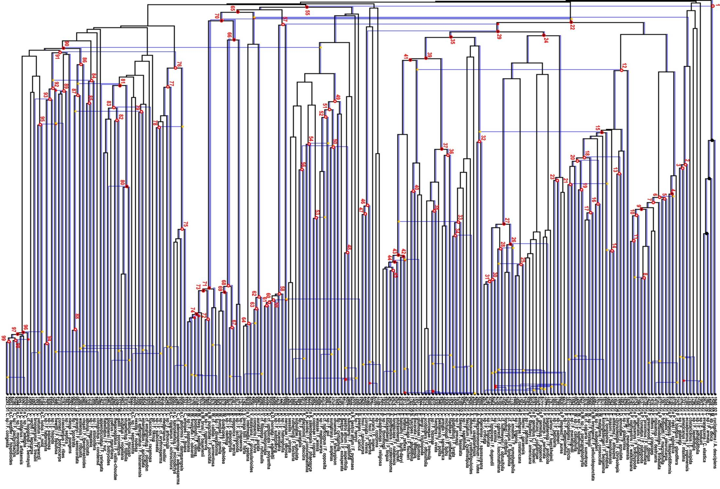
Complete!
Largest co-phylogeny ever computed (2012)

Slide 31
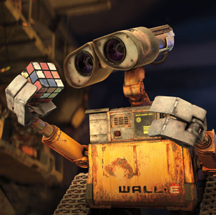
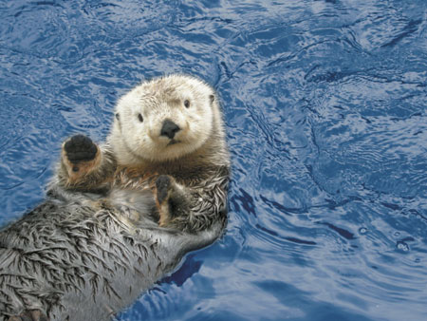
also in hw3pr2: Jotto !
a word-guessing game…
robot
otter
These are two cute

Slide 32
Getting started...
What will each of these jotto-scoring examples return?
jotto('geese', 'seems')
jotto('fluff', 'lulls')
jotto('pears', 'diner')
jotto('xylyl', 'slyly')
Extra! Which of these 8 is the cruellest hidden jotto word?
jotto(s1,s2)
sort( L )
LCS(s1,s2)
should return the jotto score for any strings s1 and s2
should return a new list that is the sorted version of the input L
should return the longest common subsequence of strings s1 and s2
don't need to write any code for these (yet...)
but think about how you'd approach them
Brainstorm algorithms for these problems -- what helper functions might help each one?

Slide 33
What will each of these jotto-scoring examples return?
Thoughts?
3
jotto('geese', 'seems')
2
jotto('fluff', 'lulls')
2
pears
jotto('pears', 'diner')
4
Extra! Which of these 8 is the cruellest hidden jotto word?
jotto('xylyl', 'slyly')
jotto(s1,s2)
sort( L )
LCS(s1,s2)
should return the jotto score for any strings s1 and s2
should return a new list that is the sorted version of the input L
should return the longest common subsequence of strings s1 and s2
don't need to write any code for these (yet...)
but think about how you'd approach them
Brainstorm algorithms for these problems -- what helper functions might help each one?

Slide 34
Aside: web scraping
How could we grab today's stock price via Python?

Slide 35
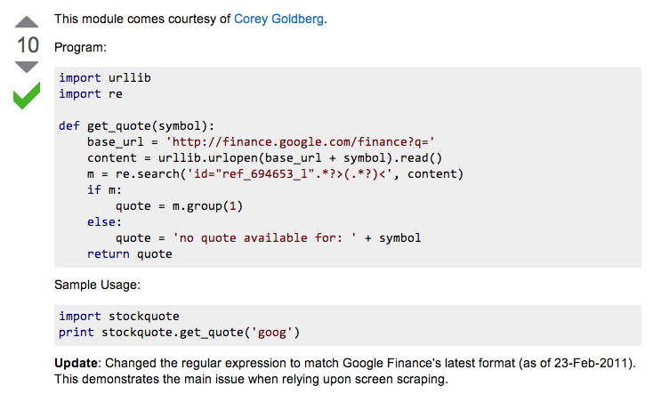
Example: web scraping
http://stackoverflow.com/questions/5081710/how-to-create-a-stock-quote-fetching-app-in-python

Slide 36
Regular Expressions
a huge string-processing library
a library for processing huge strings
many tutorials available…
developers.google.com/edu/python/regular-expressions?csw=1

Slide 37
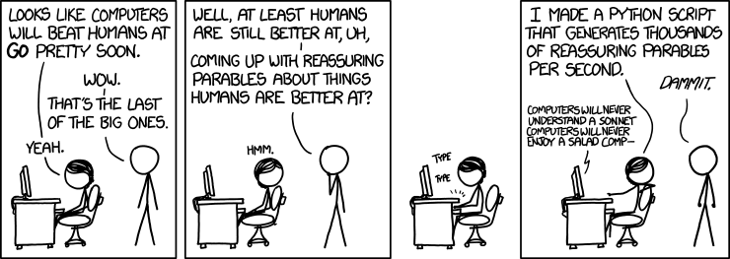
String-processing perspective…
with thanks to Jacquelyn Zehner!
http://stackoverflow.com/questions/5081710/how-to-create-a-stock-quote-fetching-app-in-python

Slide 38
Weet bksa ed xecumeha 3!
and have a great weekend, too ... !

Slide 39
Weet bksa ed xecumeha 3!
Good luck on homework 3!
and have a great weekend, too ... !

Slide 41
Getting started...
Thoughts?
jotto('geese', 'seems')
What will each of these jotto-scoring examples return?
jotto('fluff', 'lulls')
jotto('pears', 'diner')
Extra! Which of these 8 is the cruellest hidden jotto word?
jotto('xylyl', 'slyly')
jotto( s1, s2 )
should return the jotto score for any strings s1 and s2
sort( L )
should return a new list that is the sorted version of the input L
don't need to write code for these...
Brainstorm algorithms for these problems -- what helper functions might help each one?

Slide 42
Helper functions…
def remAll( e, L ):
""" this function removes all elements equal to
e from the top level of the list or string L
"""
# code written last time
def remOne( e, L ):
""" this function removes ONE element equal to
e from the top level of the list or string L,
as long as there is such an element
"""
# code written last time
Is either really what we want, or another variant?

Slide 43
Breaking down…
subseq( s, sbig )
subseq('ctg', 'tacggta')
What is a small (initial) piece of the problem?
How would we describe it in terms of the inputs?
What is left after handling this piece?
Are there other functions we will need?
Hey - I've seen something like this before!

Slide 44
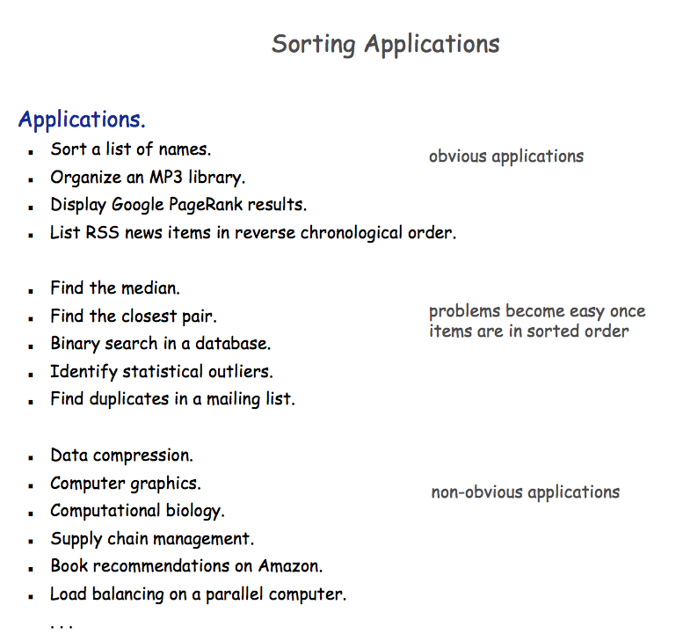

Slide 45
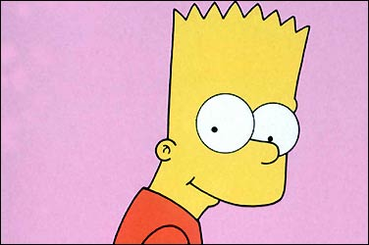
A sorting algorithm…
Input a list, L
Randomly permute L
Check if L is sorted
Repeat as necessary...
Mmmm… sorting!
in code:
How fast will this be?
from random import *
def randSort( L ):
""" crazy sorting """
newL = sample( L, len(L) )
if isSorted(newL):
return newL
else:
return randSort(L)
returns a random permutation of L
this function is totally random, dude!

Slide 46
checking if a list is sorted...
def isSorted(s):
returns True if s is in order, False otherwise
isSorted('BART') returns False
No way I'm False, man.
isSorted('BERT') returns True
isSorted('BEGIN') returns True
isSorted([3,1,4]) returns False
isSorted([1,3,4]) returns True
Too true!
isSorted('LOOPY') returns ??
Six-letter words?

Slide 47
checking if sorted...
def isSorted(s):
isSorted('BEGIN')
True
isSorted('END')
False
returns True if s is in order, False otherwise
if len(s) < 2:
return
elif s[0] < s[1]:
return
else:
return
six-letter word?

Slide 48
Algorithm Analysis
def isSorted(s):
""" True if s is sorted else False """
if len(s) < 2:
return True
elif s[0] < s[1]:
return isSorted( s[1:] )
else:
return False
If the original string had N chars, how many "steps" would it take to run isSorted ?
in the BEST case? in the WORST case?

Slide 49
Sorting out sorting
Theorem 1:
No sorting algorithm can sort n numbers in fewer than n steps.
Theorem 2:
No comparison-based sorting algorithm can sort n numbers asymptotically faster than n log₂ n.
Sorting Algorithm Worst-case Asymptotic Time
Insertion Sort n²
Bubble Sort n²
Quicksort n²
Mergesort n log₂ n
Heapsort n log₂ n

Slide 50
Does it matter?
Our "super"computer: 1 billion steps/second
Number of elements
Our algorithm's running time...
N steps
N² steps
N! steps
N = 10 el.
< 1sec.
< 1sec.
< 1sec.
N = 10³ el.
< 1sec.
< 1sec.
> lifespan
N = 10⁶ el.
< 1sec.
16.7 minutes
> lifespan
N = 10⁹ el.
1 sec.
31.7 years
> lifespan
total time to finish...

Slide 51
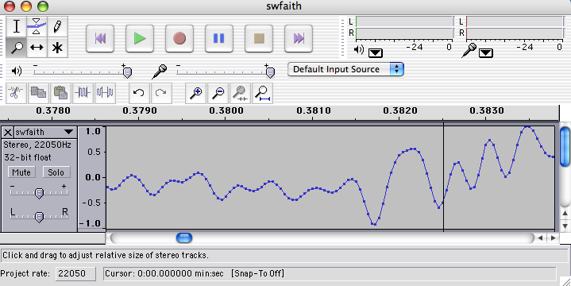
Do real data sets get so big?
Yes!

Slide 52
Weet bksa ed xecumeha 3!
and have a great weekend...

Slide 54
Phylogeny!
Hey!?
Trinocular aliens
?
What was gained (or lost) here?

Slide 55
Visualize
def removeAll( e, L ):
""" this function removes all of the elements
e from the top level of the list L
"""
removeAll(42, [5,47,42,48,42])
removeAll('q', 'qaqqlqqiqqiiqeqqnqqqqs')
What are you trying to hide here... ?

Slide 56
removeOne
One
def removeAll( e, L ):
""" this function removes all of the elements
e from the top level of the list L
"""
if len(L) == 0:
return L
elif e == L[0]:
return removeAll(e,L[1:])
else:
return L[0:1] + removeAll(e,L[1:])
# keep the non-e element and going
How could we change this to removeOne?
removeOne(42, [5,7,42,8,42])
removeOne('p', 'computer programming')
[5,7,8,42]
'comuter programming'

Slide 57
Getting started...
Name(s): ____________________
jotto('geese', 'seems')
What will each of these jotto-scoring examples return?
jotto('fluff', 'lulls')
jotto('pears', 'diner')
Extra! Which of these 8 is the cruellest hidden jotto word?
jotto('xylyl', 'slyly')
jotto( s1, s2 )
should return the jotto score for any strings s1 and s2
sort( L )
should return a new list that is the sorted version of the input L
don't need to write code for these...
Brainstorm algorithms for these problems -- what helper functions might help each one?

Slide 58
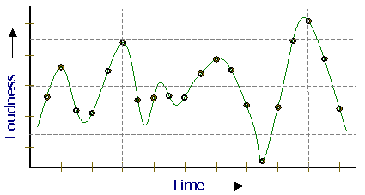
Representing Sound
physics
continuous plot of air pressure vs. time
sampling
samples taken every ~ 1/22050th of a second
quantization
Each sample is measured on a scale from -32,768 to 32,767. (This fits into 2 bytes.)
storage
These two bytes are called a frame. Raw audio data - such as what is written to the surface of a CD - is simply a list of these frames.
This problem SOUNDS like fun!
pulse code modulation = PCM data

Slide 59
Subsequences: Sketching out…
def subseq( s, sbig ):
""" returns True if s is a subsequence of
sbig; False otherwise. Both are strings.
"""
Base Case(s)
Recursive Step(s)
Notes:
def subseq( s, sbig ):
""" returns True if s is a subsequence of
sbig; False otherwise, both are strings
"""
if len(s) == 0:
return True
elif s[0] not in sbig:
return False
else:
restofsbig = removeUpto( s[0], sbig )
return subseq( s[1:], restofsbig )

Slide 60
Asymptotic Analysis
3n + 42
“Asymptotic” is a fancy word!
42n+4242
“asymptotically linear”
100 n
(0.1)n² + n + 1
“asymptotically quadratic”
100 n²
n³ - 100n² + 2n + 42
2n³ + 10
1/5 n³
“asymptotically cubic”

Slide 61
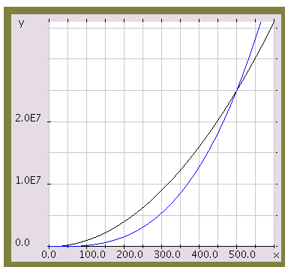
Asymptotic Analysis
Those look like two awesome water-slides!
100 n²
1/5 n³
n

Slide 62
Almost the end…
def sort(L)
returns a list which has the same elements as L, but in sorted order!
Let e be the max element in L
Where should e go?
and what helper function might we want… ?

Slide 63
Algorithm Analysis
def isSorted(s):
""" docstring! """
if L == []:
return 0
elif e == L[0]:
return 1 + count(e,L[1:])
else:
return count(e,L[1:])
If the original list had N elements, about how many "steps" would it take to run count(e,N)

Slide 64
Computing with text
open questions in AI …
ideas / meaning
language / words / phrases
computing with language - recognizing English!
strings
how strings are represented and stored
numbers / bits

Slide 65
Caesar Cipher: encipher
encipher( 'I <3 Latin' , 0 )
'I <3 Latin'
'J <3 Mbujo'
'K <3 Ncvkp'
'L <3 Odwlq'
'M <3 Pexmr'
'N <3 Qfyns'
returns
encipher( 'I <3 Latin' , 1 )
returns
encipher( 'I <3 Latin' , 2 )
returns
encipher( 'I <3 Latin' , 3 )
returns
encipher( 'I <3 Latin' , 4 )
returns
…
encipher( 'I <3 Latin' , 5 )
returns
encipher( 'I <3 Latin' , 25 )
'H <3 Kzshm'
returns
should return the string s with each alphabetic character shifted/wrapped by n places in the alphabet
encipher( s , n )
Historically bad decision #43:
Brutus won't mind if I use his salary to bring Skrillex to the Colosseum next month...

Slide 66
ASCII
American Standard Code for Information Interchange
value:
'/'
00101111
type: str
bits
name:
Identical bits are stored in each variable!
8 bits = 1 byte
The SAME bits represent integers, if the variable has type int instead of str
The types determine how to interpret the bits; the names don't matter at all…
value:
47
00101111
type: int
bits
name:

Slide 67
ASCII
American Standard Code for Information Interchange
convert # to char
chr
ord
convert char to #

Slide 68
chr and ord
abcdefghijklmnopqrstuvwxyz
ASCII VALUES
97
99
101
103
105
107
109
111
113
115
117
119
122
ABCDEFGHIJKLMNOPQRSTUVWXYZ
65
67
69
71
73
75
77
79
81
83
85
87
90
ord( c )
Input: a string of one character, c
Output: an integer, the ASCII value of c
CONVERTERS
chr( n )
Input: an integer in range(255)
Output: a one-char. string of that ASCII value
[ [i,chr(i)] for i in range(128) ]
Try these!
[ ord(i) for i in '**** CS! ****' ]

Slide 69
chr and ord
abcdefghijklmnopqrstuvwxyz
ASCII VALUES
97
99
101
103
105
107
109
111
113
115
117
119
122
ABCDEFGHIJKLMNOPQRSTUVWXYZ
65
67
69
71
73
75
77
79
81
83
85
87
90
ord('a') is 97
chr(66) is 'B'
What is chr( ord('i')+13 ) ?
What is chr( ord('P')+13 ) ?
How do we wrap?

Slide 70
Rot 13
def rot13( c ):
""" rotates c by 13 chars, "wrapping" as needed
NON-LETTERS DO NOT CHANGE!
"""
if 'a' <= c <= 'z':
new_ord = ord(c) + 13
if new_ord <= ord('z'):
return chr(new_ord)
else:
return
elif
else:
How would you rotate an entire string?

Slide 71
Caesar Cipher: decipher
>>> decipher('Bzdrzq bhogdq? H oqdedq Bzdrzq rzkzc.')
'Caesar cipher? I prefer Caesar salad.'
>>> decipher('Hu lkbjhapvu pz doha ylthpuz hmaly dl mvynla '\
'lclyfaopun dl ohcl slhyulk.')
'An education is what remains after we forget everything we have learned.'
>>> decipher('Uifz xpsl ju pvu xjui b qfodjm!')
>>> decipher('gv vw dtwvg')
But how ?

Slide 72
Caesar Cipher: decipher
gv vw dtwvg
hw wx euxwh
ix xy fvyxi
jy yz gwzyj
kz za hxazk
la ab iybal
mb bc jzcbm
nc cd kadcn
od de lbedo
pe ef mcfep
qf fg ndgfq
rg gh oehgr
sh hi pfihs
ti ij qgjit
uj jk rhkju
vk kl silkv
wl lm tjmlw
xm mn uknmx
yn no vlony
zo op wmpoz
ap pq xnqpa
bq qr yorqb
cr rs zpsrc
ds st aqtsd
et tu brute
fu uv csvuf
Caesar
Brutus
decipher('gv vw dtwvg')
Strategy using max:
(1) consider all possible answers
(2) give them each a score
(3) use our techniques to get max
Score for "Englishness"?
up to you…
all 26 possibilities

Slide 73
Caesar Cipher: Englishness
"call me Ishmael"
"attack at dawn"
A lot
"rainbow, table, candle"
"Yow! Legally-imposed CULTURE-reduction is CABBAGE-BRAINED!"
"quadruplicity drinks procrastination"
"Hold the newsreader's nose squarely, waiter, or friendly milk will countermand my trousers."
Where might you put "Twas brillig, and the slithy toves" ?
"the gostak distims the doshes"
"hension, framble, bardle"
They all sound good to me!
"jufict, stofwus, lictpub"
"itehbs, rsnevtr, khbsota"
"epadxo, nojarpn, gdxokpw"
"h o q dedqBzdrzqrzkzc"
Not so much

Slide 74
Caesar Cipher: decipher
Caesar
[0, 'cr rs zpsrc']
[0, 'gv vw dtwvg']
[0, 'jy yz gwzyj']
[0, 'mb bc jzcbm']
[0, 'qf fg ndgfq']
[0, 'wl lm tjmlw']
[1, 'bq qr yorqb']
[1, 'ds st aqtsd']
[1, 'nc cd kadcn']
[1, 'vk kl silkv']
[1, 'xm mn uknmx']
[2, 'ap pq xnqpa']
[2, 'hw wx euxwh']
[2, 'ix xy fvyxi']
[2, 'kz za hxazk']
[2, 'rg gh oehgr']
[2, 'sh hi pfihs']
[2, 'uj jk rhkju']
[2, 'yn no vlony']
[3, 'fu uv csvuf']
[3, 'pe ef mcfep']
[3, 'ti ij qgjit']
[3, 'zo op wmpoz']
[4, 'et tu brute']
[4, 'la ab iybal']
[4, 'od de lbedo']
Brutus
number-of-vowels score
max
won't always be correct!
all 26 possibilities

Slide 75
Caesar Cipher: decipher
Caesar
[0.4680, 'jy yz gwzyj']
[0.4960, 'mb bc jzcbm']
[0.5420, 'uj jk rhkju']
[0.5567, 'ix xy fvyxi']
[0.5597, 'qf fg ndgfq']
[0.5718, 'fu uv csvuf']
[0.5753, 'bq qr yorqb']
[0.5833, 'kz za hxazk']
[0.5859, 'xm mn uknmx']
[0.5880, 'gv vw dtwvg']
[0.5902, 'vk kl silkv']
[0.6110, 'ap pq xnqpa']
[0.6304, 'zo op wmpoz']
[0.6318, 'wl lm tjmlw']
[0.6717, 'cr rs zpsrc']
[0.6735, 'hw wx euxwh']
[0.6963, 'nc cd kadcn']
[0.7153, 'ti ij qgjit']
[0.7398, 'la ab iybal']
[0.7442, 'yn no vlony']
[0.7867, 'pe ef mcfep']
[0.7880, 'sh hi pfihs']
[0.7918, 'rg gh oehgr']
[0.8213, 'ds st aqtsd']
[0.8609, 'od de lbedo']
[0.9082, 'et tu brute']
Brutus
letter-prob. score
max
not always correct, but better!
all 26 possibilities

Slide 76
Jotto scoring clicker trial
What is the score for jotto('geese','seems')
C
2
A
0
D
3
B
1
E
4

Slide 77
JOTTO clicker question
If you had to choose one of these, which helper function would you use for your jotto algorithm?
C
removeUpto
A
removeAll
D
B
remove these options from your selection!
removeOne
E

Slide 78
SORT clicker question
If you had to choose one of these, which helper function would you use for your sort algorithm?
C
removeUpto
A
removeAll
D
remove this question from the HW!
B
removeOne
E
Choose me!

Slide 79
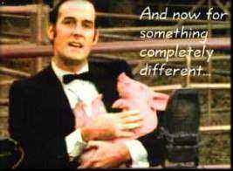
And now for something completely different…

Slide 80
top1List
def top1List( L ):
""" returns a list of the top element in L """
if len(L) < 1: return L
else: return [ max(L) ]

Slide 81
top2List
def top1List( L ):
""" returns a list of the top element in L """
if len(L) < 1: return L
else: return [ max(L) ]
def top2List( L ):
""" returns a list of the top 2 elements in L """
if len(L) < 2: return L
mx = max(L) # get the biggest element
newL = removeOne( mx, L ) # get rid of mx
return [ mx ] + top1List( newL )

Slide 82
top3List
def top3List( L ):
""" returns a list of the top 3 elements in L """
if len(L) < 3: return L
def topNList( n, L ):
""" returns a list of the top n elements in L """
top N?

Slide 83
Sorting
def sort(L)
returns a list which has the same elements as L, but in sorted order!

Slide 84
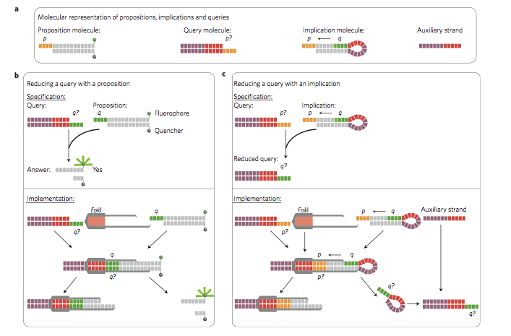
Reading this week: molecular computing
with robots...

Slide 85
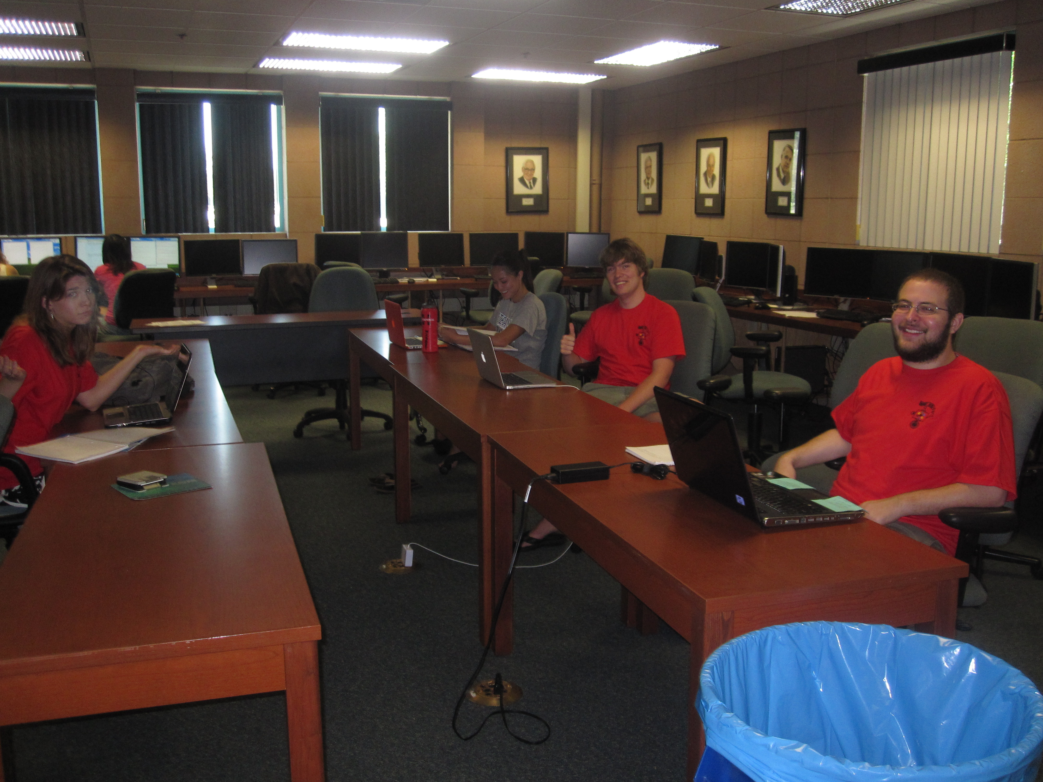
lonely on Friday afternoons... (not Monday evenings, however!)

