Slide 1
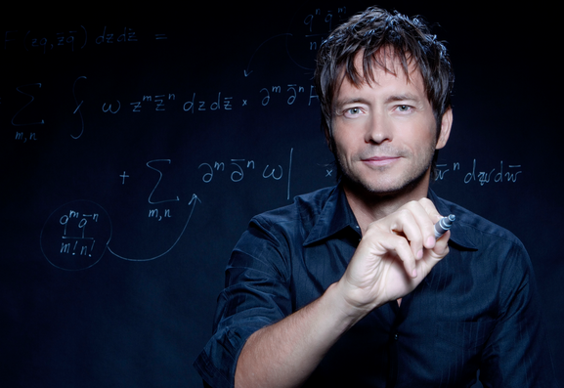
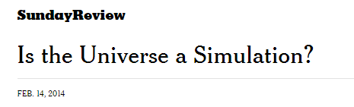
BR 5 Snczx
Gesundheit!
Algorithms
Edward Frenkel
Englishness...
Classifying life
Removing/Sorting
and Jotto!
HW 3
Hw #3 due Monday
"Office" hrs: Mon. 2-4pm
Weekend tutoring? yes!

Slide 2
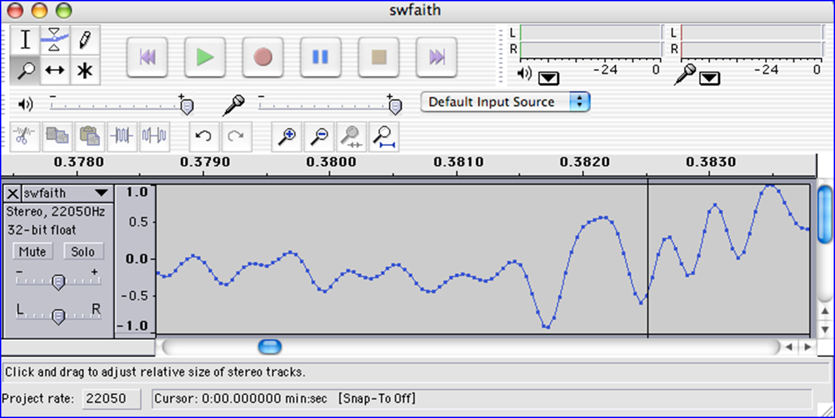
We saw you in Lab3…
heard

Slide 3
Caesar Cipher: encipher
should return the string s with each alphabetic character shifted/wrapped by n places in the alphabet
encipher(s,n)
encipher( 'I <3 Latin' , 0 )
'I <3 Latin'
'J <3 Mbujo'
'K <3 Ncvkp'
'L <3 Odwlq'
'M <3 Pexmr'
'N <3 Qfyns'
returns
encipher( 'I <3 Latin' , 1 )
returns
encipher( 'I <3 Latin' , 2 )
returns
encipher( 'I <3 Latin' , 3 )
returns
encipher( 'I <3 Latin' , 4 )
returns
encipher( 'I <3 Latin' , 5 )
returns
encipher( 'I <3 Latin' , 25 )
'H <3 Kzshm'
returns

Slide 4
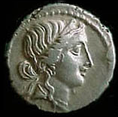
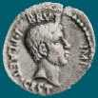
Caesar Cipher: decipher
Caesar
Brutus
>>> decipher('Bzdrzq bhogdq? H oqdedq Bzdrzq rzkzc.')
'Caesar cipher? I prefer Caesar salad.'
>>> decipher('Hu lkbjhapvu pz doha ylthpuz hmaly dl mvynla '\
'lclyfaopun dl ohcl slhyulk.')
'An education is what remains after we forget everything we have learned.'
>>> decipher('Uifz xpsl ju pvu xjui b qfodjm!')
>>> decipher('gv vw dtwvg')
But how ?

Slide 5
Decipher?
Strategies?
Algorithms?

Slide 6
gv vw dtwvg
hw wx euxwh
ix xy fvyxi
jy yz gwzyj
kz za hxazk
la ab iybal
mb bc jzcbm
nc cd kadcn
od de lbedo
pe ef mcfep
qf fg ndgfq
rg gh oehgr
sh hi pfihs
ti ij qgjit
uj jk rhkju
vk kl silkv
wl lm tjmlw
xm mn uknmx
yn no vlony
zo op wmpoz
ap pq xnqpa
bq qr yorqb
cr rs zpsrc
ds st aqtsd
et tu brute
fu uv csvuf
[0, 'gv vw dtwvg'],
[2, 'hw wx euxwh'],
[2, 'ix xy fvyxi'],
[0, 'jy yz gwzyj'],
[2, 'kz za hxazk'],
[4, 'la ab iybal'],
[0, 'mb bc jzcbm'],
[1, 'nc cd kadcn'],
[4, 'od de lbedo'],
[3, 'pe ef mcfep'],
[0, 'qf fg ndgfq'],
[2, 'rg gh oehgr'],
[2, 'sh hi pfihs'],
[3, 'ti ij qgjit'],
[2, 'uj jk rhkju'],
[1, 'vk kl silkv'],
[0, 'wl lm tjmlw'],
[1, 'xm mn uknmx'],
[2, 'yn no vlony'],
[3, 'zo op wmpoz'],
[2, 'ap pq xnqpa'],
[1, 'bq qr yorqb'],
[0, 'cr rs zpsrc'],
[1, 'ds st aqtsd'],
[4, 'et tu brute'],
[3, 'fu uv csvuf']
Decipher?
All possible decipherings
Score them all
Strategies?
Algorithms?
quantifying Englishness?

Slide 7
gv vw dtwvg
hw wx euxwh
ix xy fvyxi
jy yz gwzyj
kz za hxazk
la ab iybal
mb bc jzcbm
nc cd kadcn
od de lbedo
pe ef mcfep
qf fg ndgfq
rg gh oehgr
sh hi pfihs
ti ij qgjit
uj jk rhkju
vk kl silkv
wl lm tjmlw
xm mn uknmx
yn no vlony
zo op wmpoz
ap pq xnqpa
bq qr yorqb
cr rs zpsrc
ds st aqtsd
et tu brute
fu uv csvuf
[0, 'gv vw dtwvg'],
[2, 'hw wx euxwh'],
[2, 'ix xy fvyxi'],
[0, 'jy yz gwzyj'],
[2, 'kz za hxazk'],
[4, 'la ab iybal'],
[0, 'mb bc jzcbm'],
[1, 'nc cd kadcn'],
[4, 'od de lbedo'],
[3, 'pe ef mcfep'],
[0, 'qf fg ndgfq'],
[2, 'rg gh oehgr'],
[2, 'sh hi pfihs'],
[3, 'ti ij qgjit'],
[2, 'uj jk rhkju'],
[1, 'vk kl silkv'],
[0, 'wl lm tjmlw'],
[1, 'xm mn uknmx'],
[2, 'yn no vlony'],
[3, 'zo op wmpoz'],
[2, 'ap pq xnqpa'],
[1, 'bq qr yorqb'],
[0, 'cr rs zpsrc'],
[1, 'ds st aqtsd'],
[4, 'et tu brute'],
[3, 'fu uv csvuf']
Decipher?
All possible decipherings
max!
Score them all
Strategies?
Algorithms?
yields the "most English" phrase

Slide 8
Measuring Englishness
Very English-y
"Call me Ishmael."
"Attack at dawn!"
"rainbow, table, candle"
higher scores
"Yow! Legally-imposed CULTURE-reduction
is CABBAGE-BRAINED!"
"quadruplicity drinks procrastination"
"Hold the newsreader's nose squarely, waiter, or
friendly milk will countermand my trousers."
quantifying Englishness?
"the gostak distims the doshes"
"hension, framble, bardle"
"jufict, stofwus, lictpub"
"itehbs, rsnevtr, khbsota"
lower scores
"epadxo, nojarpn, gdxokpw"
"h o q dedqBzdrzqrzkzc"
All of these sound
good to me!
Not English-y

Slide 9
gv vw dtwvg
hw wx euxwh
ix xy fvyxi
jy yz gwzyj
kz za hxazk
la ab iybal
mb bc jzcbm
nc cd kadcn
od de lbedo
pe ef mcfep
qf fg ndgfq
rg gh oehgr
sh hi pfihs
ti ij qgjit
uj jk rhkju
vk kl silkv
wl lm tjmlw
xm mn uknmx
yn no vlony
zo op wmpoz
ap pq xnqpa
bq qr yorqb
cr rs zpsrc
ds st aqtsd
et tu brute
fu uv csvuf
[0, 'gv vw dtwvg'],
[2, 'hw wx euxwh'],
[2, 'ix xy fvyxi'],
[0, 'jy yz gwzyj'],
[2, 'kz za hxazk'],
[4, 'la ab iybal'],
[0, 'mb bc jzcbm'],
[1, 'nc cd kadcn'],
[4, 'od de lbedo'],
[3, 'pe ef mcfep'],
[0, 'qf fg ndgfq'],
[2, 'rg gh oehgr'],
[2, 'sh hi pfihs'],
[3, 'ti ij qgjit'],
[2, 'uj jk rhkju'],
[1, 'vk kl silkv'],
[0, 'wl lm tjmlw'],
[1, 'xm mn uknmx'],
[2, 'yn no vlony'],
[3, 'zo op wmpoz'],
[2, 'ap pq xnqpa'],
[1, 'bq qr yorqb'],
[0, 'cr rs zpsrc'],
[1, 'ds st aqtsd'],
[4, 'et tu brute'],
[3, 'fu uv csvuf']
Decipher?
All possible decipherings
max!
Score them all
Strategies?
Algorithms?
"Englishness" score based on #-of-vowels

Slide 10
gv vw dtwvg
hw wx euxwh
ix xy fvyxi
jy yz gwzyj
kz za hxazk
la ab iybal
mb bc jzcbm
nc cd kadcn
od de lbedo
pe ef mcfep
qf fg ndgfq
rg gh oehgr
sh hi pfihs
ti ij qgjit
uj jk rhkju
vk kl silkv
wl lm tjmlw
xm mn uknmx
yn no vlony
zo op wmpoz
ap pq xnqpa
bq qr yorqb
cr rs zpsrc
ds st aqtsd
et tu brute
fu uv csvuf
[6.9e-05, 'gv vw dtwvg'],
[3.6e-05, 'hw wx euxwh'],
[1.4e-07, 'ix xy fvyxi'],
[8.8e-11, 'jy yz gwzyj'],
[7.2e-10, 'kz za hxazk'],
[0.01503, 'la ab iybal'],
[3.7e-08, 'mb bc jzcbm'],
[0.00524, 'nc cd kadcn'],
[0.29041, 'od de lbedo'],
[0.00874, 'pe ef mcfep'],
[7.3e-07, 'qf fg ndgfq'],
[0.06410, 'rg gh oehgr'],
[0.11955, 'sh hi pfihs'],
[3.1e-06, 'ti ij qgjit'],
[1.1e-08, 'uj jk rhkju'],
[2.6e-05, 'vk kl silkv'],
[0.00012, 'wl lm tjmlw'],
[3.1e-06, 'xm mn uknmx'],
[0.02011, 'yn no vlony'],
[1.5e-06, 'zo op wmpoz'],
[1.9e-07, 'ap pq xnqpa'],
[5.7e-08, 'bq qr yorqb'],
[0.00024, 'cr rs zpsrc'],
[0.02060, 'ds st aqtsd'],
[0.45555, 'et tu brute'],
[0.00011, 'fu uv csvuf']
Decipher?
All possible decipherings
S
c
o
r
e
s
Strategies?
Algorithms?
"Englishness" based on letter-probabilities
max!

Slide 11
Design…
remAll(e,L)
remove all e's from L
Top-down design
Visualize
Split into parts
Build each part
Combine
Test

Slide 12
Design…
remAll(e,L)
remove all e's from L
Top-down design
remAll(42,[5,7,42,8,42])
Visualize
[5,7,8]
Split into parts
Build each part
Combine
remAll('q','qaqqlqqiqqiiqeqqnqs')
Test
'aliiiens'

Slide 13
Design…
remAll(e,L)
remove all e's from L
Top-down design
it
Use it!
remAll(42,[5,7,42,8,42])
Visualize
[5,7,8]
Split into parts
Build each part
it
Combine
remAll('q','qaqqlqqiqqiiqeqqnqs')
Test
'aliiiens'
Lose it!

Slide 14
Design…
remAll(e,L)
remove all e's from L
Top-down design
it
if L[0] != e
Use it!
remAll(42,[5,7,42,8,42])
Visualize
keep L[0]
+ remove e from the rest
[5,7,8]
Split into parts
Build each part
it
Combine
remAll('q','qaqqlqqiqqiiqeqqnqs')
Test
drop L[0]
+ remove e from the rest
'aliiiens'
Lose it!
if L[0] == e

Slide 15
Design…
remAll(e,L)
remove all e's from L
Top-down design
it
if L[0] != e
remAll(42,[5,7,42,8,42])
Use it!
Visualize
keep L[0]
+ remove e from the rest
[5,7,8]
Split into parts
- or -
Build each part
it
Combine
remAll('q','qaqqlqqiqqiiqeqqnqs')
Lose it!
Test
drop L[0]
+ remove e from the rest
'aliiiens'
if L[0] == e

Slide 16
Design…
remAll(e,L)
remove all e's from L
Top-down design
Visualize
def remAll( e, L ):
if len(L) == 0:
elif L[0] != e:
else:
Split into parts
L empty
Build each part
L[0] wasn't e
Combine
L[0] was e
Test

Slide 17
Design…
remAll(e,L)
remove all e's from L
Top-down design
Visualize
def remAll( e, L ):
if len(L) == 0:
return L
elif L[0] != e:
return L[0:1] + remAll(e,L[1:])
else:
return remAll(e,L[1:])
Split into parts
Build each part
Combine
Use it!
Test
Lose it!

Slide 18
Design…
but design of what?
Code?
syntax
Algorithms!
ideas!

Slide 19
Variations…
remAll(8, [7,8,9,8]) [7,9]
remAll
remOne(8, [7,8,9,8]) [7,9,8]
remOne
remUpto(8,[7,8,9,8]) [9,8]
remUpto
remAll('d', 'coded') 'coe'
remAll
remOne('d', 'coded') 'coed'
remOne
remUpto('d','coded') 'ed'
remUpto
Notes:
def removeUpto( c, s ):
""" this function removes all of s up to and
including the first occurrence of c
s is any string, c is a 1-character string
"""
if len(s) == 0:
return s # s is empty
elif c == s[0]:
return s[1:] # the character c is now gone
else:
return removeUpto( c, s[1:] ) # keep going

Slide 20
Subsequences
in order, but not necessarily adjacent…
def subseq( s, sbig )
True or False?
s is the subsequence to find (or not)
sbig is the bigger string in which we are looking for s
T or F?
subseq('', 'cataga')
subseq('ctg', 'cataga')
subseq('ctg', 'tacggta')
subseq('aliens', 'always frighten dragons')
subseq('trogdor', 'that dragon is gone for good')
Here there be NO dragons!
Why do these succeed? Or fail?

Slide 21
Quiz
Algorithm design
Name(s): _________________________________
def remAll( e, L ):
""" removes all e's from L """
if len(L) == 0:
return L
elif L[0] != e:
return L[0:1] + remAll(e,L[1:])
else:
return remAll(e,L[1:])
2
1
Make changes to remAll so that it removes elements upto and including the first e in L. (We could call it remUpto.)
Change remAll so that it removes only one e from L. (We could call it remOne.)
remOne(8,[7,8,9,8])
[7,9,8]
remUpto('d','coded') 'ed'
def subseq( s, sbig ):
""" returns True if s is a subseq. of sbig,
False otherwise. Both are strings.
"""
if s == '':
return True
if
3
Write the other cases needed for subseq…
Notes:
def subseq( s, sbig ):
""" returns True if s is a subsequence of
sbig; False otherwise, both are strings
"""
if len(s) == 0:
return True
elif s[0] not in sbig:
return False
else:
restofsbig = removeUpto( s[0], sbig )
return subseq( s[1:], restofsbig )

Slide 22
from remAll to remOne
def remAll( e, L ):
""" returns seq. L with all e's rmovd
"""
if len(L) == 0:
return L
elif L[0] != e:
return L[0:1] + remAll( e, L[1:] )
else:
return remAll( e, L[1:] )
remOne(8,[7,8,9,8])
[7,9,8]
remOne('d','coded')
'coed'
Notes:
def removeUpto( c, s ):
""" this function removes all of s up to and
including the first occurrence of c
s is any string, c is a 1-character string
"""
if len(s) == 0:
return s # s is empty
elif c == s[0]:
return s[1:] # the character c is now gone
else:
return removeUpto( c, s[1:] ) # keep going

Slide 23
from remOne to remUpto
def remOne( e, L ):
""" returns seq. L with one e rmovd
"""
if len(L) == 0:
return L
elif L[0] != e:
return L[0:1] + remOne( e, L[1:] )
else:
return L[1:]
remUpto(8,[7,8,9,8])
[9,8]
remUpto('d','coded')
'ed'
Notes:
def removeUpto( c, s ):
""" this function removes all of s up to and
including the first occurrence of c
s is any string, c is a 1-character string
"""
if len(s) == 0:
return s # s is empty
elif c == s[0]:
return s[1:] # the character c is now gone
else:
return removeUpto( c, s[1:] ) # keep going

Slide 24
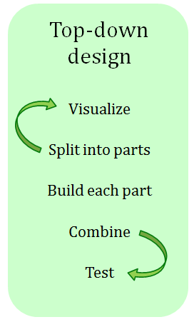
Subseq ~ sketching it out…
subseq( s, sbig )
subseq('ctg', 'tacggta')
What is a small (initial) piece of the problem?
Use it!
How would we describe it in terms of the inputs?
- or -
What is left after handling this piece?
Lose it!
Are there other functions we will need?

Slide 25

Subseq ~ trying it out…
def subseq( s, sbig ):
""" returns True if s is a subseq. of sbig;
False otherwise. Both are strings.
"""
if s == '': return True
Base case(s)
Recursive step(s)
Notes:
def subseq( s, sbig ):
""" returns True if s is a subsequence of
sbig; False otherwise, both are strings
"""
if len(s) == 0:
return True
elif s[0] not in sbig:
return False
else:
restofsbig = removeUpto( s[0], sbig )
return subseq( s[1:], restofsbig )

Slide 26
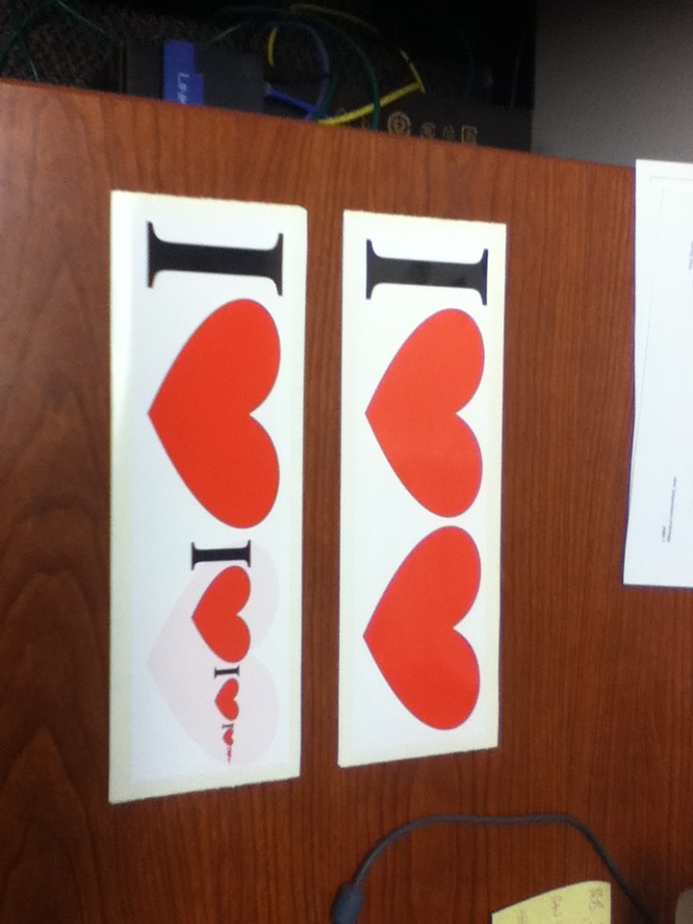
Notes:
def subseq( s, sbig ):
""" returns True if s is a subsequence of
sbig; False otherwise, both are strings
"""
if len(s) == 0:
return True
elif s[0] not in sbig:
return False
else:
restofsbig = removeUpto( s[0], sbig )
return subseq( s[1:], restofsbig )

Slide 27

Notes:
def subseq( s, sbig ):
""" returns True if s is a subsequence of
sbig; False otherwise, both are strings
"""
if len(s) == 0:
return True
elif s[0] not in sbig:
return False
else:
restofsbig = removeUpto( s[0], sbig )
return subseq( s[1:], restofsbig )

Slide 28
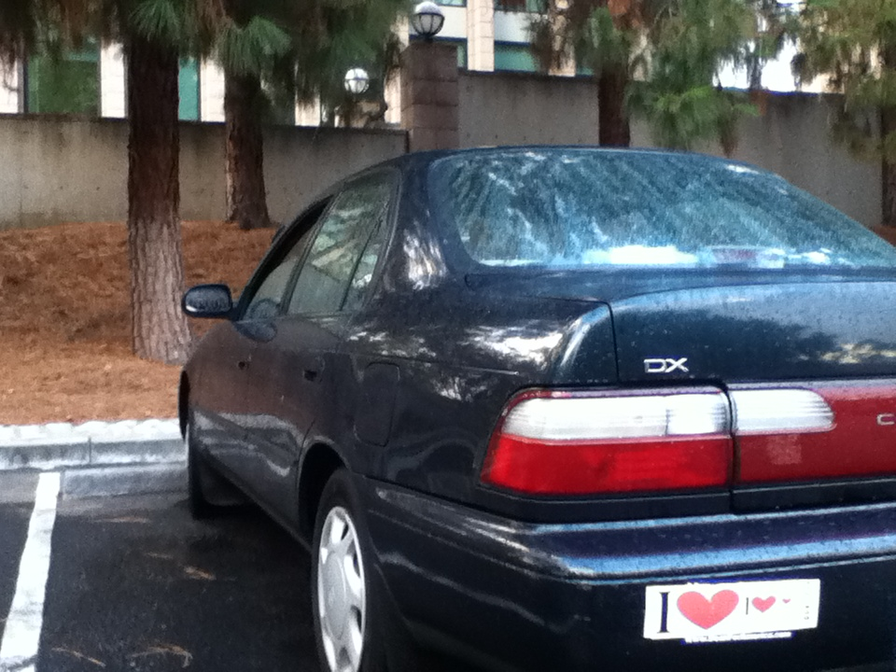
Notes:
def subseq( s, sbig ):
""" returns True if s is a subsequence of
sbig; False otherwise, both are strings
"""
if len(s) == 0:
return True
elif s[0] not in sbig:
return False
else:
restofsbig = removeUpto( s[0], sbig )
return subseq( s[1:], restofsbig )

Slide 29
Subseq ~ trying it out…
def subseq( s, sbig ):
""" returns True if s is a subseq. of sbig;
False otherwise. Both are strings.
"""
if s == '':
return True
Base case(s)
Recursive step(s)
Notes:
def subseq( s, sbig ):
""" returns True if s is a subsequence of
sbig; False otherwise, both are strings
"""
if len(s) == 0:
return True
elif s[0] not in sbig:
return False
else:
restofsbig = removeUpto( s[0], sbig )
return subseq( s[1:], restofsbig )

Slide 30
Subseq ~ trying it out…
def subseq( s, sbig ):
""" returns True if s is a subseq. of sbig;
False otherwise. Both are strings.
"""
if s == '':
return True
elif s[0] not in sbig:
return False
else:
sbigrest = remUpto( s[0], sbig )
return subseq( s[1:], sbigrest )
Lose it!
Base case(s)
it
Recursive step(s)
Use it!
Notes:
def subseq( s, sbig ):
""" returns True if s is a subsequence of
sbig; False otherwise, both are strings
"""
if len(s) == 0:
return True
elif s[0] not in sbig:
return False
else:
restofsbig = removeUpto( s[0], sbig )
return subseq( s[1:], restofsbig )

Slide 31
hw3pr2: LCS
Longest Common Subsequence
'HUMAN'
'CGCTGAGCTAGGCA...'
'CHIMPANZEE'
'ATCCTAGGTAACTG...'
+10⁹more
Eye oneder if this haz other aplications?

Slide 32
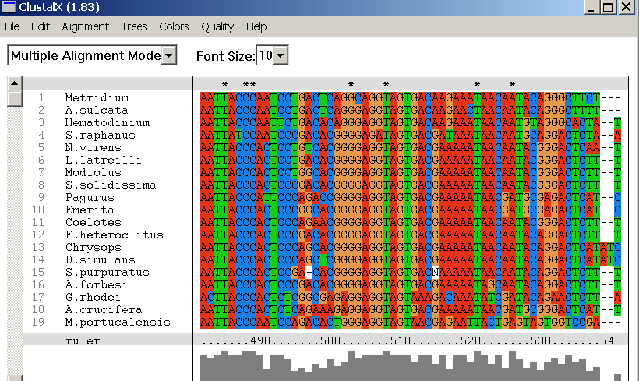
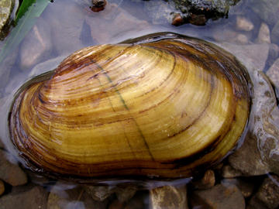
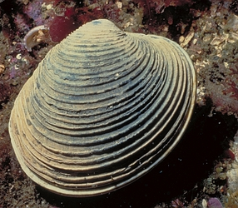
design of what? Code? Algorithms!
Why?
Screenshot from the ClustalX multiple subsequence alignment tool...
Algorithmic challenge: How to find the best common subsequences among these very big genome strings ?!?
Subsequences
(Jotto)
(Sorting)

Slide 33
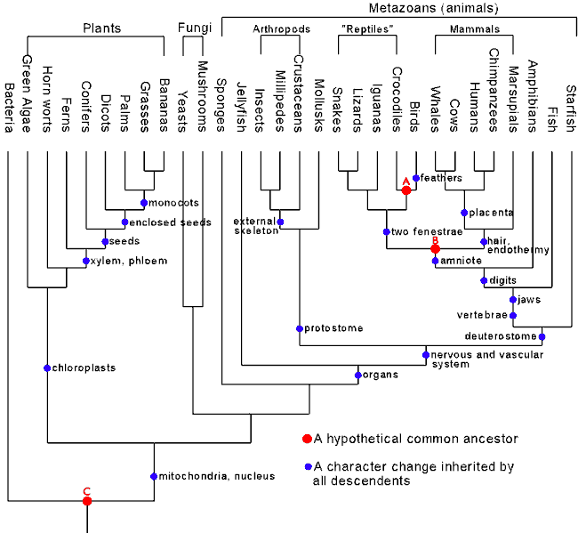
Hey!?
Trinocular aliens
?
Phylogeny
What was gained (or lost) here?

Slide 34
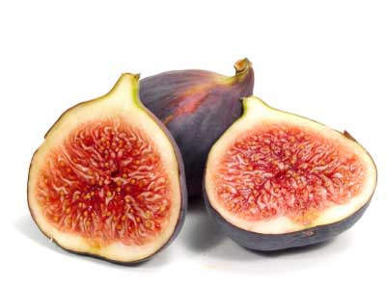
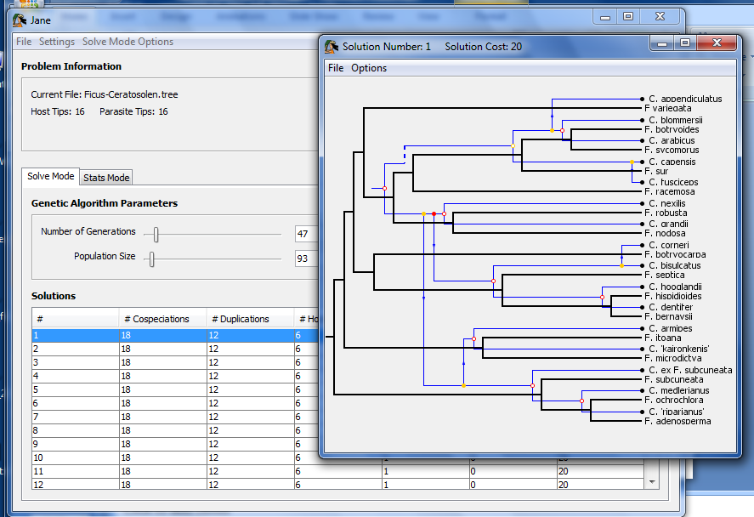
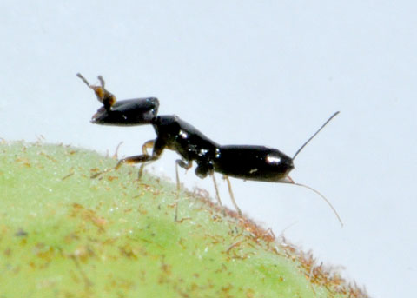
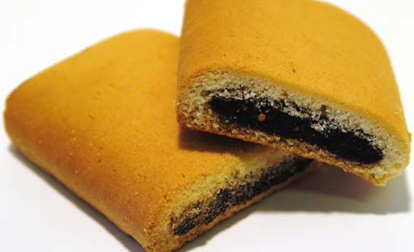
Subsequences @ HMC
host: figs
Jane
parasites: wasps
together:

Slide 35

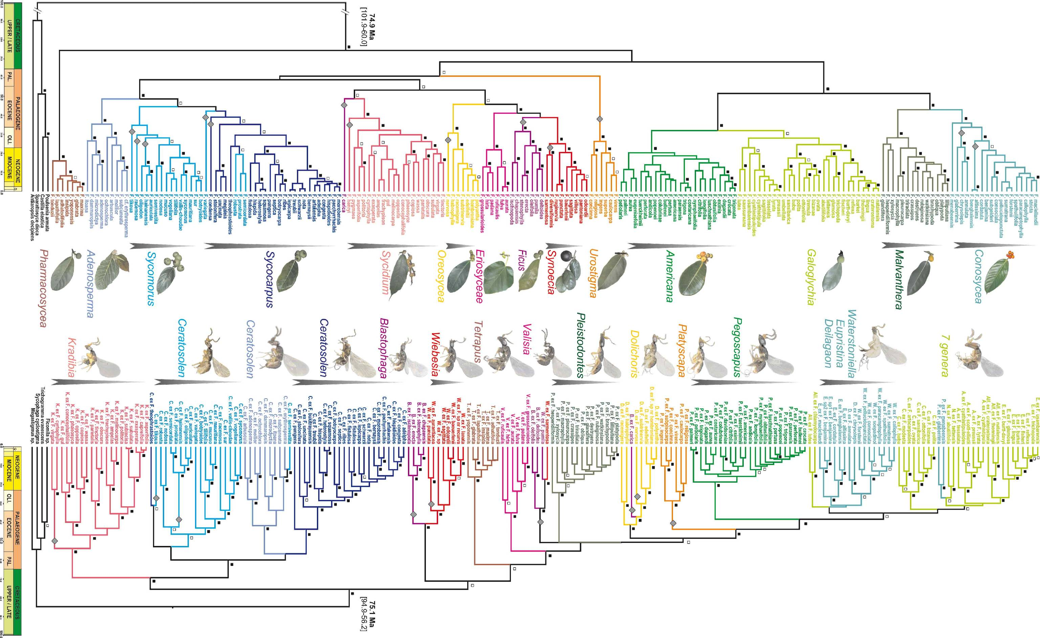
Jane's Challenge: 6 continents, 100s of species…

Slide 36
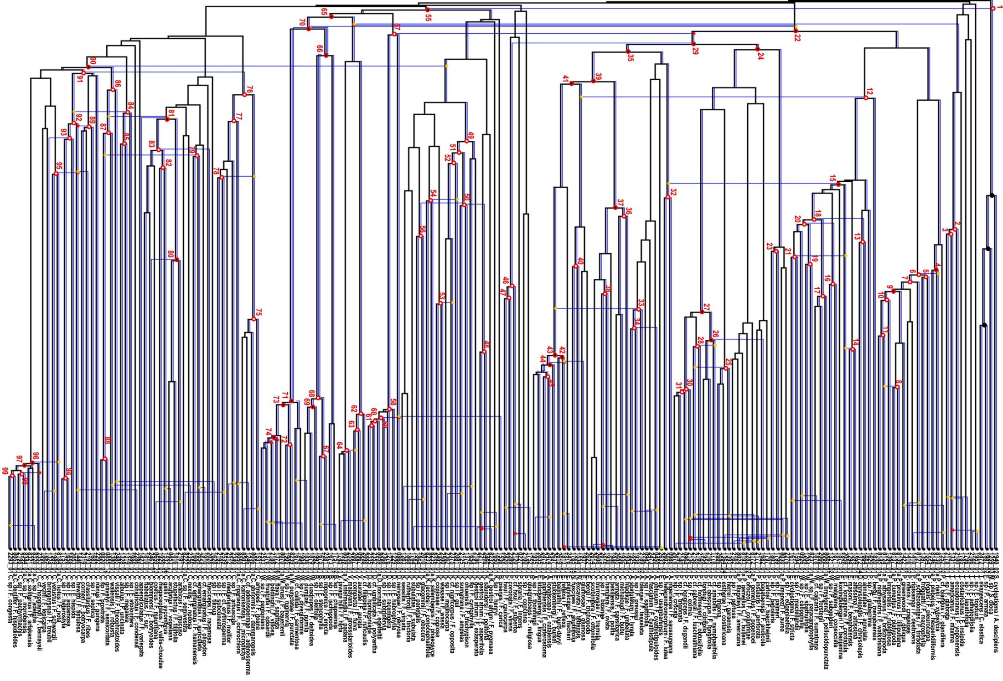
Complete!
Largest co-phylogeny ever computed '12

Slide 37
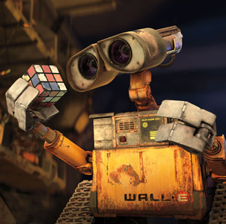
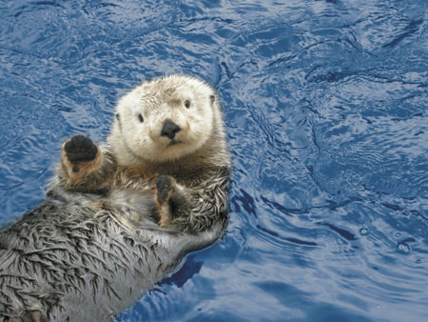
also in hw3pr2: Jotto !
a word-guessing game…
robot
otter
These are two cute

Slide 38
Getting started...
What will each of these jotto-scoring examples return?
jotto('geese', 'seems')
jotto('fluff', 'lulls')
jotto('pears', 'diner')
jotto('xylyl', 'slyly')
Extra! Which of these 8 is the cruellest hidden jotto word?
jotto(s1,s2)
sort( L )
LCS(s1,s2)
should return the jotto score for any strings s1 and s2
should return a new list that is the sorted version of the input L
should return the longest common subsequence of strings s1 and s2
don't need to write any code for these (yet...)
but think about how you'd approach them
Use it!
Lose it!
Brainstorm algorithms for these problems -- what helper functions might help each one?

Slide 39
decipher( 'Weet bksa ed xecumeha 3!' )

Slide 40
decipher( 'Weet bksa ed xecumeha 3!' )
Good luck on homework 3!
and have a great weekend, too ... !

Slide 41
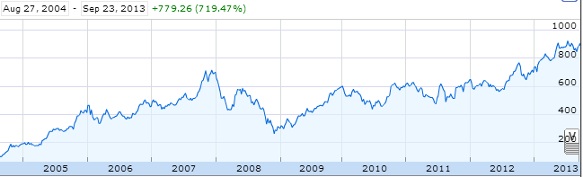
Aside: web scraping
How could we grab today's stock price via Python?

Slide 42
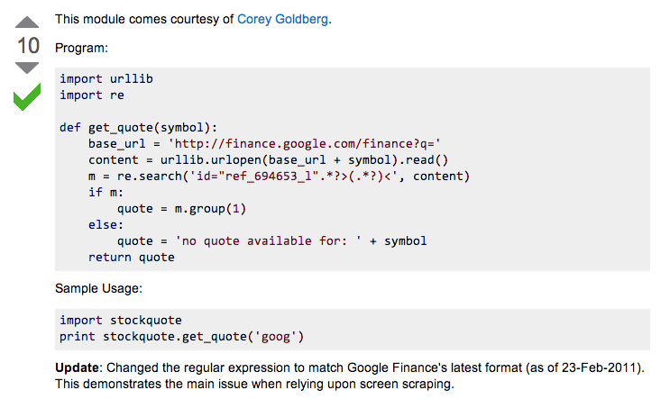
Example: web scraping
http://stackoverflow.com/questions/5081710/how-to-create-a-stock-quote-fetching-app-in-python

Slide 43
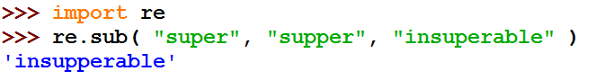
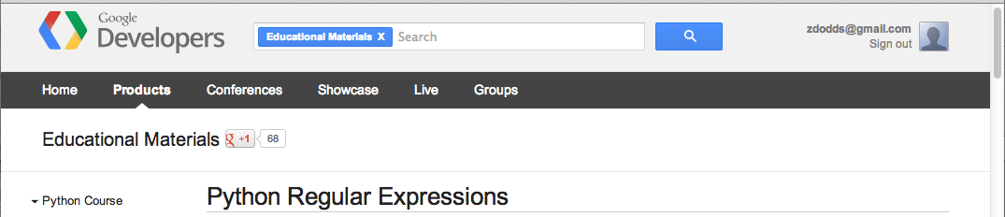
Regular Expressions
a huge string-processing library
a library for processing huge strings
many tutorials available…
developers.google.com/edu/python/regular-expressions?csw=1

Slide 44
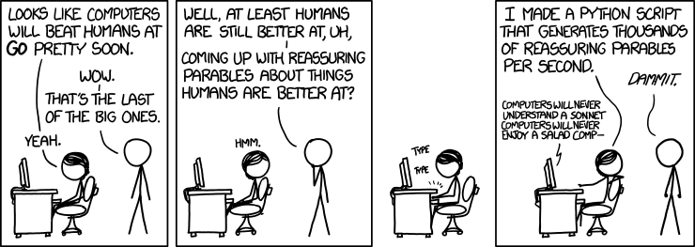
String-processing perspective…
with thanks to Jacquelyn Zehner!
http://stackoverflow.com/questions/5081710/how-to-create-a-stock-quote-fetching-app-in-python

Slide 45
Hey!?
Trinocular aliens
?
Phylogeny
What was gained (or lost) here?

Slide 46
What will each of these jotto-scoring examples return?
Thoughts?
3
jotto('geese', 'seems')
2
jotto('fluff', 'lulls')
2
pears
jotto('pears', 'diner')
4
Extra! Which of these 8 is the cruellest hidden jotto word?
jotto('xylyl', 'slyly')
jotto(s1,s2)
sort( L )
LCS(s1,s2)
should return the jotto score for any strings s1 and s2
should return a new list that is the sorted version of the input L
should return the longest common subsequence of strings s1 and s2
don't need to write any code for these (yet...)
but think about how you'd approach them
Brainstorm algorithms for these problems -- what helper functions might help each one?

Slide 47
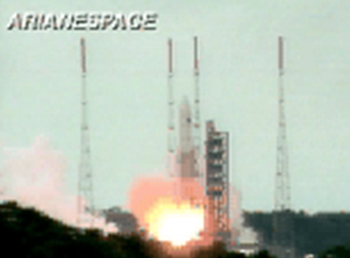
BR 5 Snczx
Gesundheit!
Algorithms
Englishness...
Classifying life
Removing/Sorting
and Jotto!
HW 3
Hw #3 due Monday
"Office" hrs: Fri. 2-4pm
Weekend tutoring? yes!
IndexError
TypeError
HumanError
This week's reading…

Slide 49
also in hw3pr2: Jotto !
a word-guessing game…
robot
otter
These are two cute

Slide 50
Getting started...
Thoughts?
jotto('geese', 'seems')
What will each of these jotto-scoring examples return?
jotto('fluff', 'lulls')
jotto('pears', 'diner')
Extra! Which of these 8 is the cruellest hidden jotto word?
jotto('xylyl', 'slyly')
jotto( s1, s2 )
should return the jotto score for any strings s1 and s2
sort( L )
should return a new list that is the sorted version of the input L
don't need to write code for these...
Brainstorm algorithms for these problems -- what helper functions might help each one?

Slide 51
Helper functions…
def remAll( e, L ):
""" this function removes all elements equal to
e from the top level of the list or string L
"""
# code written last time
def remOne( e, L ):
""" this function removes ONE element equal to
e from the top level of the list or string L,
as long as there is such an element
"""
# code written last time
Is either really what we want, or another variant?

Slide 52
Breaking down…
subseq( s, sbig )
subseq('ctg', 'tacggta')
What is a small (initial) piece of the problem?
How would we describe it in terms of the inputs?
What is left after handling this piece?
Are there other functions we will need?
Hey - I've seen something like this before!

Slide 53
Notes:
def subseq( s, sbig ):
""" returns True if s is a subsequence of
sbig; False otherwise, both are strings
"""
if len(s) == 0:
return True
elif s[0] not in sbig:
return False
else:
restofsbig = removeUpto( s[0], sbig )
return subseq( s[1:], restofsbig )

Slide 54
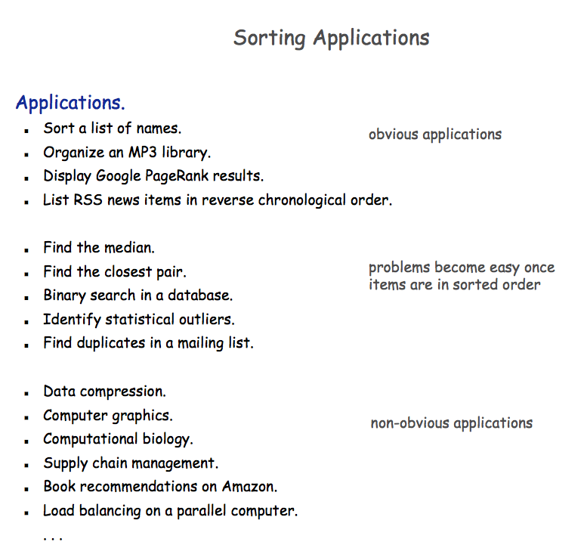

Slide 55

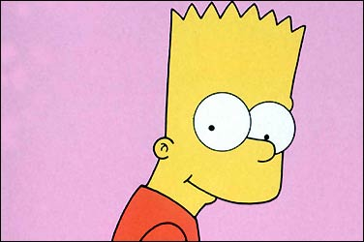
A sorting algorithm…
Input a list, L
Randomly permute L
Check if L is sorted
Repeat as necessary...
Mmmm… sorting!
in code:
How fast will this be?
from random import *
def randSort( L ):
""" crazy sorting """
newL = sample( L, len(L) )
if isSorted(newL):
return newL
else:
return randSort(L)
returns a random permutation of L
this function is totally random, dude!

Slide 56

checking if a list is sorted...
def isSorted(s):
returns True if s is in order, False otherwise
isSorted('BART') returns False
No way I'm False, man.
isSorted('BERT') returns True
isSorted('BEGIN') returns True
isSorted([3,1,4]) returns False
isSorted([1,3,4]) returns True
Too true!
isSorted('LOOPY') returns ??
Six-letter words?

Slide 57
checking if sorted...
def isSorted(s):
isSorted('BEGIN')
True
isSorted('END')
False
returns True if s is in order, False otherwise
if len(s) < 2:
return
elif s[0] < s[1]:
return
else:
return
six-letter word?

Slide 58
Algorithm Analysis
def isSorted(s):
""" True if s is sorted else False """
if len(s) < 2:
return True
elif s[0] < s[1]:
return isSorted( s[1:] )
else:
return False
If the original string had N chars, how many "steps" would it take to run isSorted ?
in the BEST case? in the WORST case?

Slide 59
Sorting out sorting
Theorem 1:
No sorting algorithm can sort n numbers in fewer than n steps.
Theorem 2:
No comparison-based sorting algorithm can sort n numbers asymptotically faster than n log₂ n.
Sorting Algorithm Worst-case Asymptotic Time
Insertion Sort n²
Bubble Sort n²
Quicksort n²
Mergesort n log₂ n
Heapsort n log₂ n

Slide 60

Does it matter?
Our "super"computer: 1 billion steps/second
Number of elements
Our algorithm's running time...
N steps
N² steps
N! steps
N = 10 el.
< 1sec.
< 1sec.
< 1sec.
N = 10³ el.
< 1sec.
< 1sec.
> lifespan
N = 10⁶ el.
< 1sec.
16.7 minutes
> lifespan
N = 10⁹ el.
1 sec.
31.7 years
> lifespan
total time to finish...

Slide 61
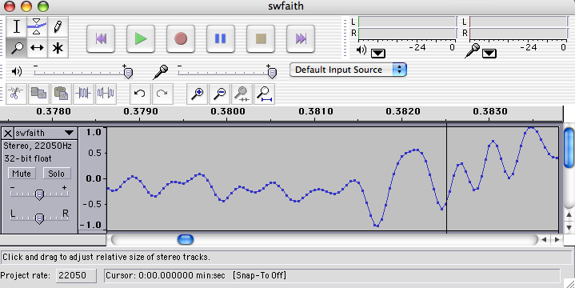
Do real data sets get so big?
Yes!

Slide 62
Weet bksa ed xecumeha 3!
and have a great weekend...

Slide 64
Phylogeny!
Hey!?
Trinocular aliens
?
What was gained (or lost) here?

Slide 65
Visualize
def removeAll( e, L ):
""" this function removes all of the elements
e from the top level of the list L
"""
removeAll(42, [5,47,42,48,42])
removeAll('q', 'qaqqlqqiqqiiqeqqnqqqqs')
What are you trying to hide here... ?

Slide 66
removeOne
One
def removeAll( e, L ):
""" this function removes all of the elements
e from the top level of the list L
"""
if len(L) == 0:
return L
elif e == L[0]:
return removeAll(e,L[1:])
else:
return L[0:1] + removeAll(e,L[1:])
# keep the non-e element and going
How could we change this to removeOne?
removeOne(42, [5,7,42,8,42])
removeOne('p', 'computer programming')
[5,7,8,42]
'comuter programming'

Slide 67
Getting started...
Name(s): ____________________
jotto('geese', 'seems')
What will each of these jotto-scoring examples return?
jotto('fluff', 'lulls')
jotto('pears', 'diner')
Extra! Which of these 8 is the cruellest hidden jotto word?
jotto('xylyl', 'slyly')
jotto( s1, s2 )
should return the jotto score for any strings s1 and s2
sort( L )
should return a new list that is the sorted version of the input L
don't need to write code for these...
Brainstorm algorithms for these problems -- what helper functions might help each one?

Slide 68
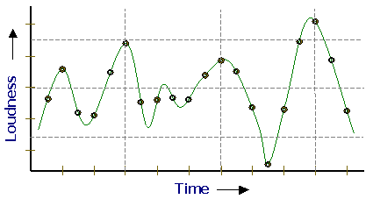
Representing Sound
physics
continuous plot of air pressure vs. time
sampling
samples taken every ~ 1/22050th of a second
quantization
Each sample is measured on a scale from -32,768 to 32,767.
(This fits into 2 bytes.)
storage
These two bytes are called a frame. Raw audio data - such as what is written to the surface of a CD - is simply a list of these frames.
This problem SOUNDS like fun!
pulse code modulation = PCM data

Slide 69
Subsequences: Sketching out…
def subseq( s, sbig ):
""" returns True if s is a subsequence of
sbig; False otherwise. Both are strings.
"""
Base Case(s)
Recursive Step(s)
Notes:
def subseq( s, sbig ):
""" returns True if s is a subsequence of
sbig; False otherwise, both are strings
"""
if len(s) == 0:
return True
elif s[0] not in sbig:
return False
else:
restofsbig = removeUpto( s[0], sbig )
return subseq( s[1:], restofsbig )

Slide 70
Asymptotic Analysis
3n + 42
“Asymptotic” is a fancy word!
42n+4242
“asymptotically linear”
100 n
(0.1)n² + n + 1
“asymptotically quadratic”
100 n²
n³ - 100n² + 2n + 42
2n³ + 10
1/5 n³
“asymptotically cubic”

Slide 71
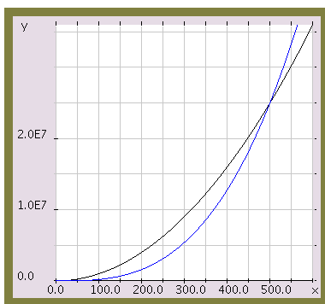
Asymptotic Analysis
Those look like two awesome water-slides!
100 n²
1/5 n³
n

Slide 72
Almost the end…
def sort(L)
returns a list which has the same elements as L, but in sorted order!
Let e be the max element in L
Where should e go?
and what helper function might we want… ?

Slide 73
Algorithm Analysis
def isSorted(s):
""" docstring! """
if L == []:
return 0
elif e == L[0]:
return 1 + count(e,L[1:])
else:
return count(e,L[1:])
If the original list had N elements, about how many "steps" would it take to run count(e,N)

Slide 74



Computing with text
open questions in AI …
ideas / meaning
language / words / phrases
computing with language - recognizing English!
strings
how strings are represented and stored
numbers / bits

Slide 75
Caesar Cipher: encipher
encipher( 'I <3 Latin' , 0 )
'I <3 Latin'
'J <3 Mbujo'
'K <3 Ncvkp'
'L <3 Odwlq'
'M <3 Pexmr'
'N <3 Qfyns'
returns
encipher( 'I <3 Latin' , 1 )
returns
encipher( 'I <3 Latin' , 2 )
returns
encipher( 'I <3 Latin' , 3 )
returns
encipher( 'I <3 Latin' , 4 )
returns
…
encipher( 'I <3 Latin' , 5 )
returns
encipher( 'I <3 Latin' , 25 )
'H <3 Kzshm'
returns
should return the string s with each alphabetic character shifted/wrapped by n places in the alphabet
encipher( s , n )
Historically bad decision #43:
Brutus won't mind if I use his salary to bring Skrillex to the Colosseum next month...

Slide 76
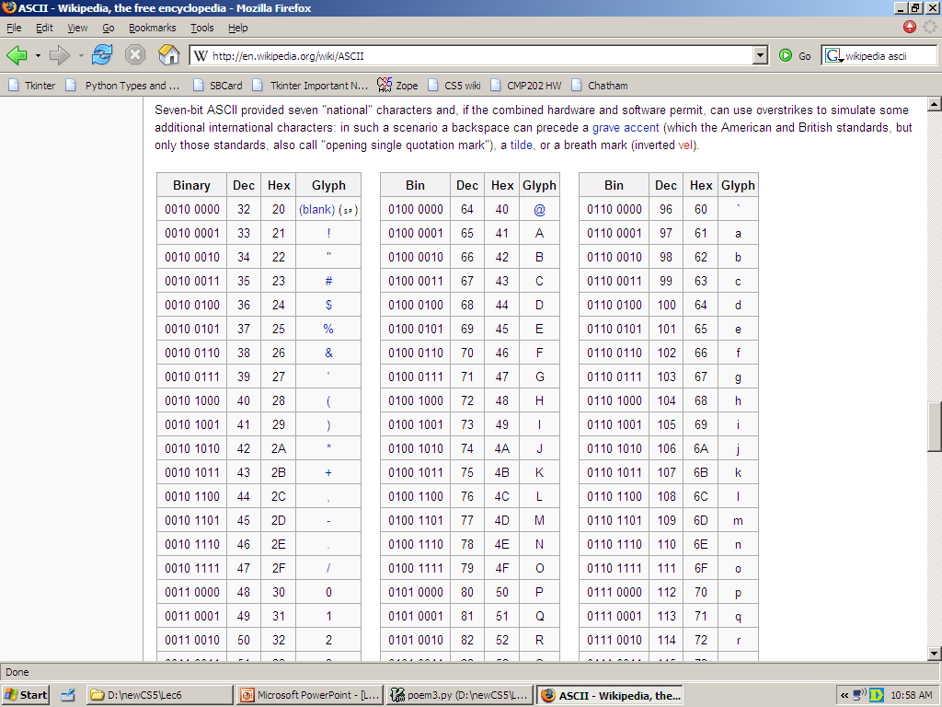
ASCII
American Standard Code for Information Interchange
value:
'/'
00101111
type: str
bits
name:
Identical bits are stored in each variable!
8 bits = 1 byte
The SAME bits represent integers, if the variable has type int instead of str
The types determine how to interpret the bits; the names don't matter at all…
value:
47
00101111
type: int
bits
name:

Slide 77
ASCII
American Standard Code for Information Interchange
convert # to char
chr
ord
convert char to #

Slide 78
chr and ord
abcdefghijklmnopqrstuvwxyz
ASCII VALUES
97
99
101
103
105
107
109
111
113
115
117
119
122
ABCDEFGHIJKLMNOPQRSTUVWXYZ
65
67
69
71
73
75
77
79
81
83
85
87
90
ord( c )
Input: a string of one character, c
Output: an integer, the ASCII value of c
CONVERTERS
chr( n )
Input: an integer in range(255)
Output: a one-char. string of that ASCII value
[ [i,chr(i)] for i in range(128) ]
Try these!
[ ord(i) for i in '**** CS! ****' ]

Slide 79
chr and ord
abcdefghijklmnopqrstuvwxyz
ASCII VALUES
97
99
101
103
105
107
109
111
113
115
117
119
122
ABCDEFGHIJKLMNOPQRSTUVWXYZ
65
67
69
71
73
75
77
79
81
83
85
87
90
ord('a') is 97
chr(66) is 'B'
What is chr( ord('i')+13 ) ?
What is chr( ord('P')+13 ) ?
How do we wrap?

Slide 80
Rot 13
def rot13( c ):
""" rotates c by 13 chars, "wrapping" as needed
NON-LETTERS DO NOT CHANGE!
"""
if 'a' <= c <= 'z':
new_ord = ord(c) + 13
if new_ord <= ord('z'):
return chr(new_ord)
else:
return
elif
else:
How would you rotate an entire string?

Slide 81
Caesar Cipher: decipher
>>> decipher('Bzdrzq bhogdq? H oqdedq Bzdrzq rzkzc.')
'Caesar cipher? I prefer Caesar salad.'
>>> decipher('Hu lkbjhapvu pz doha ylthpuz hmaly dl mvynla '\
'lclyfaopun dl ohcl slhyulk.')
'An education is what remains after we forget everything we have learned.'
>>> decipher('Uifz xpsl ju pvu xjui b qfodjm!')
>>> decipher('gv vw dtwvg')
But how ?

Slide 82
Caesar Cipher: decipher
gv vw dtwvg
hw wx euxwh
ix xy fvyxi
jy yz gwzyj
kz za hxazk
la ab iybal
mb bc jzcbm
nc cd kadcn
od de lbedo
pe ef mcfep
qf fg ndgfq
rg gh oehgr
sh hi pfihs
ti ij qgjit
uj jk rhkju
vk kl silkv
wl lm tjmlw
xm mn uknmx
yn no vlony
zo op wmpoz
ap pq xnqpa
bq qr yorqb
cr rs zpsrc
ds st aqtsd
et tu brute
fu uv csvuf
Caesar
Brutus
decipher('gv vw dtwvg')
Strategy using max:
(1) consider all possible answers
(2) give them each a score
(3) use our techniques to get max
Score for "Englishness"?
up to you…
all 26 possibilities

Slide 83
Caesar Cipher: Englishness
"call me Ishmael"
"attack at dawn"
A lot
"rainbow, table, candle"
"Yow! Legally-imposed CULTURE-reduction
is CABBAGE-BRAINED!"
"quadruplicity drinks procrastination"
"Hold the newsreader's nose squarely, waiter, or
friendly milk will countermand my trousers."
Where might you put "Twas brillig, and the slithy toves" ?
"the gostak distims the doshes"
"hension, framble, bardle"
They all sound
good to me!
"jufict, stofwus, lictpub"
"itehbs, rsnevtr, khbsota"
"epadxo, nojarpn, gdxokpw"
"h o q dedqBzdrzqrzkzc"
Not so much

Slide 84
Caesar Cipher: decipher
Caesar
[0, 'cr rs zpsrc']
[0, 'gv vw dtwvg']
[0, 'jy yz gwzyj']
[0, 'mb bc jzcbm']
[0, 'qf fg ndgfq']
[0, 'wl lm tjmlw']
[1, 'bq qr yorqb']
[1, 'ds st aqtsd']
[1, 'nc cd kadcn']
[1, 'vk kl silkv']
[1, 'xm mn uknmx']
[2, 'ap pq xnqpa']
[2, 'hw wx euxwh']
[2, 'ix xy fvyxi']
[2, 'kz za hxazk']
[2, 'rg gh oehgr']
[2, 'sh hi pfihs']
[2, 'uj jk rhkju']
[2, 'yn no vlony']
[3, 'fu uv csvuf']
[3, 'pe ef mcfep']
[3, 'ti ij qgjit']
[3, 'zo op wmpoz']
[4, 'et tu brute']
[4, 'la ab iybal']
[4, 'od de lbedo']
Brutus
number-of-vowels score
max
won't always be correct!
all 26 possibilities

Slide 85
Caesar Cipher: decipher
Caesar
[0.4680, 'jy yz gwzyj']
[0.4960, 'mb bc jzcbm']
[0.5420, 'uj jk rhkju']
[0.5567, 'ix xy fvyxi']
[0.5597, 'qf fg ndgfq']
[0.5718, 'fu uv csvuf']
[0.5753, 'bq qr yorqb']
[0.5833, 'kz za hxazk']
[0.5859, 'xm mn uknmx']
[0.5880, 'gv vw dtwvg']
[0.5902, 'vk kl silkv']
[0.6110, 'ap pq xnqpa']
[0.6304, 'zo op wmpoz']
[0.6318, 'wl lm tjmlw']
[0.6717, 'cr rs zpsrc']
[0.6735, 'hw wx euxwh']
[0.6963, 'nc cd kadcn']
[0.7153, 'ti ij qgjit']
[0.7398, 'la ab iybal']
[0.7442, 'yn no vlony']
[0.7867, 'pe ef mcfep']
[0.7880, 'sh hi pfihs']
[0.7918, 'rg gh oehgr']
[0.8213, 'ds st aqtsd']
[0.8609, 'od de lbedo']
[0.9082, 'et tu brute']
Brutus
letter-prob. score
max
not always correct, but better!
all 26 possibilities

Slide 86
Jotto scoring clicker trial
What is the score for jotto('geese','seems')
C
2
A
0
D
3
B
1
E
4

Slide 87
JOTTO clicker question
If you had to choose one of these, which helper function would you use for your jotto algorithm?
C
removeUpto
A
removeAll
D
B
remove these options from your selection!
removeOne
E

Slide 88
SORT clicker question
If you had to choose one of these, which helper function would you use for your sort algorithm?
C
removeUpto
A
removeAll
D
remove this question from the HW!
B
removeOne
E
Choose me!

Slide 89
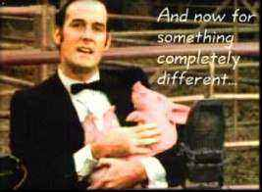
And now for something completely different…

Slide 90
top1List
def top1List( L ):
""" returns a list of the top element in L """
if len(L) < 1: return L
else: return [ max(L) ]

Slide 91
top2List
def top1List( L ):
""" returns a list of the top element in L """
if len(L) < 1: return L
else: return [ max(L) ]
def top2List( L ):
""" returns a list of the top 2 elements in L """
if len(L) < 2: return L
mx = max(L) # get the biggest element
newL = removeOne( mx, L ) # get rid of mx
return [ mx ] + top1List( newL )

Slide 92
top3List
def top3List( L ):
""" returns a list of the top 3 elements in L """
if len(L) < 3: return L
def topNList( n, L ):
""" returns a list of the top n elements in L """
top N?

Slide 93
Sorting
def sort(L)
returns a list which has the same elements as L, but in sorted order!

Slide 94

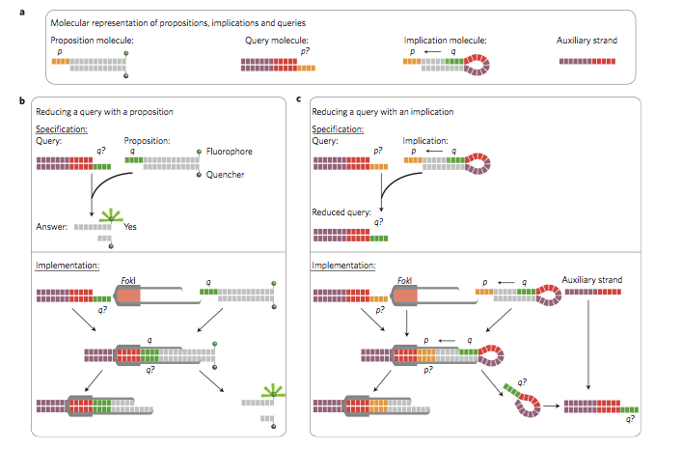
Reading this week: molecular computing
with robots...

Slide 95
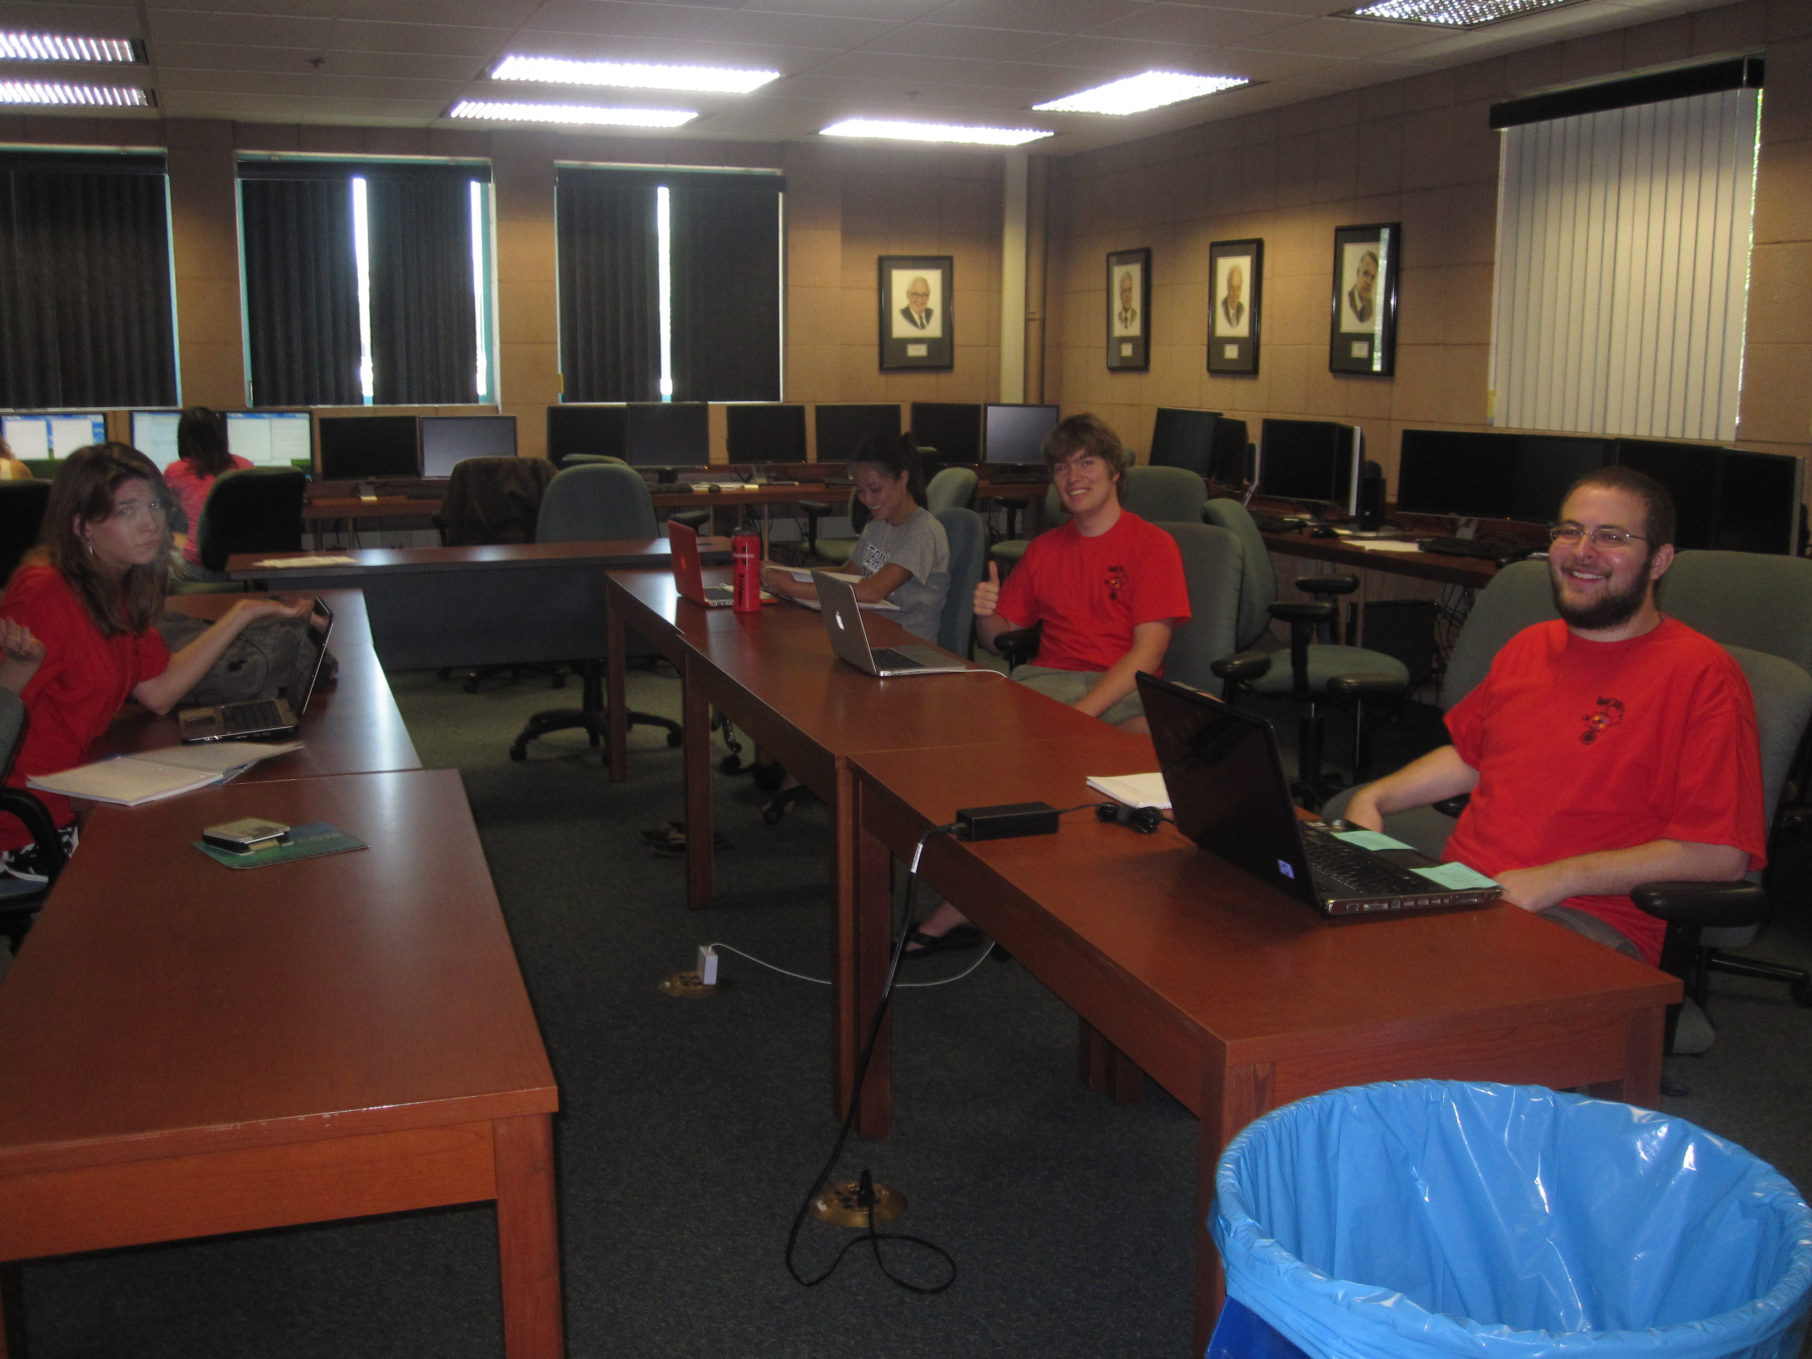
lonely on Friday afternoons... (not Monday evenings, however!)

