Slide 1
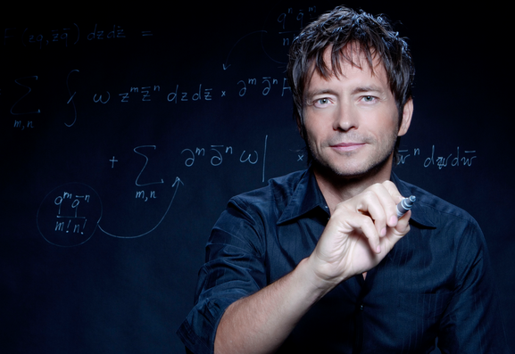
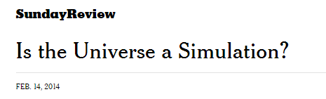
BR 5 Snczx
Gesundheit!
Algorithms
Edward Frenkel
Englishness...
Classifying life
Removing/Sorting
and Jotto!
HW 3
Hw #3 due Monday, 11:59
"Office" hrs: Fri. 2:30-4:30
Weekend tutoring? yes!

Slide 2
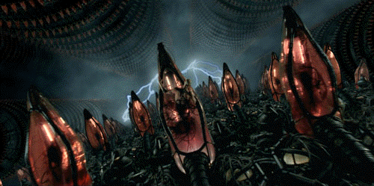
BR 5 Snczx
Gesundheit!
Algorithms
?
Edward Frenkel
Englishness...
Classifying life
Removing/Sorting
and Jotto!
HW 3
Hw #3 due Monday
"Office" hrs: Mon. 2-4pm
Weekend tutoring? yes!

Slide 3
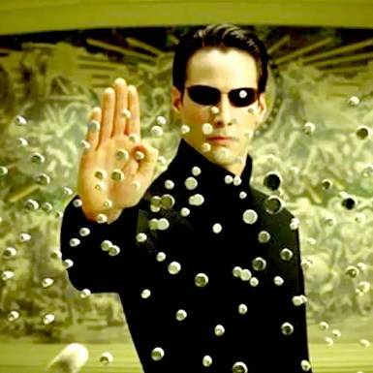
BR 5 Snczx
Gesundheit!
Algorithms
!
Edward Frenkel
Englishness...
Classifying life
Removing/Sorting
and Jotto!
HW 3
Hw #3 due Monday
"Office" hrs: Mon. 2-4pm
Weekend tutoring? yes!

Slide 4
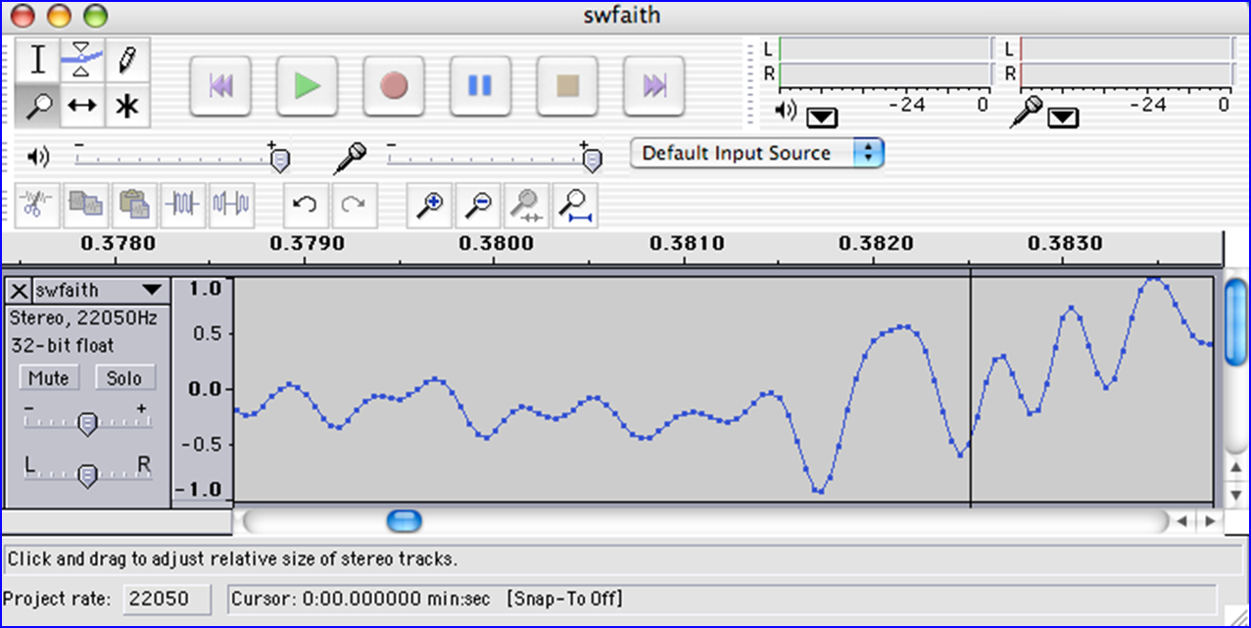
We saw you in Lab3…
heard

Slide 5
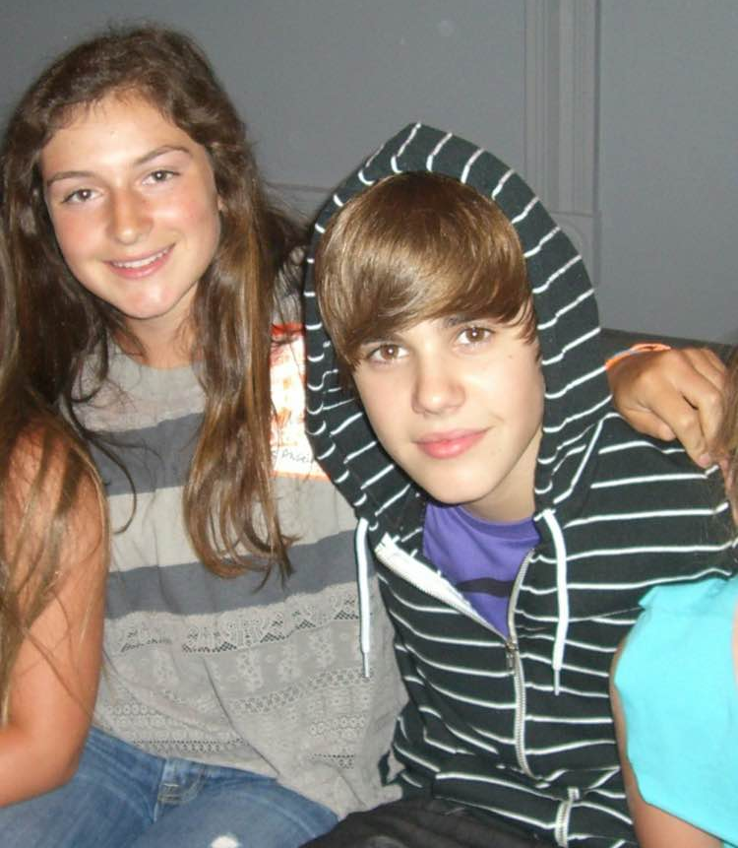
We saw you in Lab3…
heard
Thanks, Sarah!

Slide 6
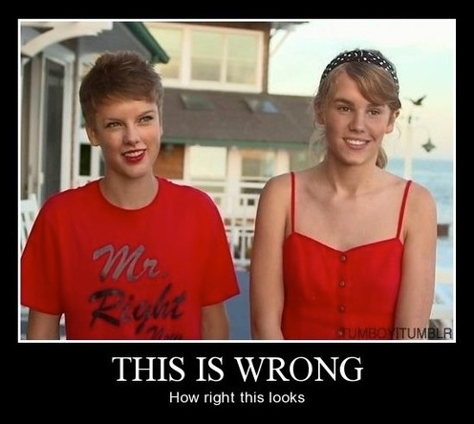
We saw you in Lab3…
heard
Thanks, Sarah!
+ Merritt + Montana

Slide 7
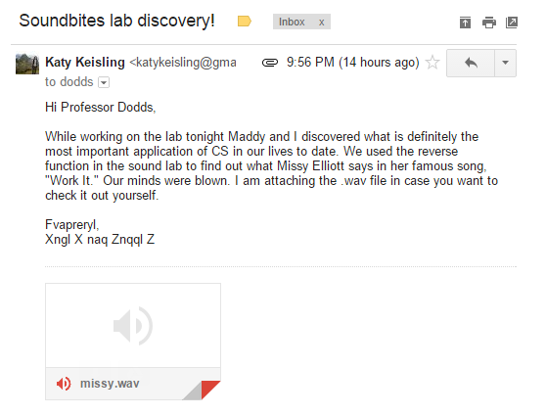
We saw you in Lab3…
heard

Slide 8
Caesar Cipher: encipher
should return the string s with each alphabetic character shifted/wrapped by n places in the alphabet
encipher(s,n)
encipher( 'I <3 Latin' , 0 )
'I <3 Latin'
'J <3 Mbujo'
'K <3 Ncvkp'
'L <3 Odwlq'
'M <3 Pexmr'
'N <3 Qfyns'
returns
encipher( 'I <3 Latin' , 1 )
returns
encipher( 'I <3 Latin' , 2 )
returns
encipher( 'I <3 Latin' , 3 )
returns
encipher( 'I <3 Latin' , 4 )
returns
encipher( 'I <3 Latin' , 5 )
returns
encipher( 'I <3 Latin' , 25 )
'H <3 Kzshm'
returns

Slide 9
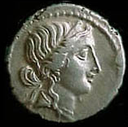
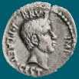
Caesar Cipher: decipher
Caesar
Brutus
>>> decipher('Bzdrzq bhogdq? H oqdedq Bzdrzq rzkzc.')
'Caesar cipher? I prefer Caesar salad.'
S1
S2
>>> decipher('Hu lkbjhapvu pz doha ylthpuz hmaly dl mvynla '\
'lclyfaopun dl ohcl slhyulk.')
'An education is what remains after we forget everything we have learned.'
>>> decipher('Uifz xpsl ju pvu xjui b qfodjm!')
PL, PL2
>>> decipher('gv vw dtwvg')
LAT
But how ?

Slide 10
Decipher?
Strategies?
Algorithms?

Slide 11
gv vw dtwvg
hw wx euxwh
ix xy fvyxi
jy yz gwzyj
kz za hxazk
la ab iybal
mb bc jzcbm
nc cd kadcn
od de lbedo
pe ef mcfep
qf fg ndgfq
rg gh oehgr
sh hi pfihs
ti ij qgjit
uj jk rhkju
vk kl silkv
wl lm tjmlw
xm mn uknmx
yn no vlony
zo op wmpoz
ap pq xnqpa
bq qr yorqb
cr rs zpsrc
ds st aqtsd
et tu brute
fu uv csvuf
Decipher?
All possible decipherings
Strategies?
Algorithms?

Slide 12
gv vw dtwvg
hw wx euxwh
ix xy fvyxi
jy yz gwzyj
kz za hxazk
la ab iybal
mb bc jzcbm
nc cd kadcn
od de lbedo
pe ef mcfep
qf fg ndgfq
rg gh oehgr
sh hi pfihs
ti ij qgjit
uj jk rhkju
vk kl silkv
wl lm tjmlw
xm mn uknmx
yn no vlony
zo op wmpoz
ap pq xnqpa
bq qr yorqb
cr rs zpsrc
ds st aqtsd
et tu brute
fu uv csvuf
[0, 'gv vw dtwvg'],
[2, 'hw wx euxwh'],
[2, 'ix xy fvyxi'],
[0, 'jy yz gwzyj'],
[2, 'kz za hxazk'],
[4, 'la ab iybal'],
[0, 'mb bc jzcbm'],
[1, 'nc cd kadcn'],
[4, 'od de lbedo'],
[3, 'pe ef mcfep'],
[0, 'qf fg ndgfq'],
[2, 'rg gh oehgr'],
[2, 'sh hi pfihs'],
[3, 'ti ij qgjit'],
[2, 'uj jk rhkju'],
[1, 'vk kl silkv'],
[0, 'wl lm tjmlw'],
[1, 'xm mn uknmx'],
[2, 'yn no vlony'],
[3, 'zo op wmpoz'],
[2, 'ap pq xnqpa'],
[1, 'bq qr yorqb'],
[0, 'cr rs zpsrc'],
[1, 'ds st aqtsd'],
[4, 'et tu brute'],
[3, 'fu uv csvuf']
Decipher?
All possible decipherings
Score them all
Strategies?
Algorithms?
What strategy is this?

Slide 13
gv vw dtwvg
hw wx euxwh
ix xy fvyxi
jy yz gwzyj
kz za hxazk
la ab iybal
mb bc jzcbm
nc cd kadcn
od de lbedo
pe ef mcfep
qf fg ndgfq
rg gh oehgr
sh hi pfihs
ti ij qgjit
uj jk rhkju
vk kl silkv
wl lm tjmlw
xm mn uknmx
yn no vlony
zo op wmpoz
ap pq xnqpa
bq qr yorqb
cr rs zpsrc
ds st aqtsd
et tu brute
fu uv csvuf
[0, 'gv vw dtwvg'],
[2, 'hw wx euxwh'],
[2, 'ix xy fvyxi'],
[0, 'jy yz gwzyj'],
[2, 'kz za hxazk'],
[4, 'la ab iybal'],
[0, 'mb bc jzcbm'],
[1, 'nc cd kadcn'],
[4, 'od de lbedo'],
[3, 'pe ef mcfep'],
[0, 'qf fg ndgfq'],
[2, 'rg gh oehgr'],
[2, 'sh hi pfihs'],
[3, 'ti ij qgjit'],
[2, 'uj jk rhkju'],
[1, 'vk kl silkv'],
[0, 'wl lm tjmlw'],
[1, 'xm mn uknmx'],
[2, 'yn no vlony'],
[3, 'zo op wmpoz'],
[2, 'ap pq xnqpa'],
[1, 'bq qr yorqb'],
[0, 'cr rs zpsrc'],
[1, 'ds st aqtsd'],
[4, 'et tu brute'],
[3, 'fu uv csvuf']
Decipher?
All possible decipherings
max!
Score them all
Strategies?
Algorithms?
Using LoL to find the "most English" rotation

Slide 14
Measuring Englishness
Very English-y
"Call me Ishmael."
"Attack at dawn!"
"rainbow, table, candle"
higher scores
"Yow! Legally-imposed CULTURE-reduction
is CABBAGE-BRAINED!"
"quadruplicity drinks procrastination"
"Hold the newsreader's nose squarely, waiter, or
friendly milk will countermand my trousers."
quantifying "Englishness"?
"the gostak distims the doshes"
"hension, framble, bardle"
"jufict, stofwus, lictpub"
"itehbs, rsnevtr, khbsota"
lower scores
"epadxo, nojarpn, gdxokpw"
"h o q dedqBzdrzqrzkzc"
All of these sound
good to me!
Not English-y

Slide 15
gv vw dtwvg
hw wx euxwh
ix xy fvyxi
jy yz gwzyj
kz za hxazk
la ab iybal
mb bc jzcbm
nc cd kadcn
od de lbedo
pe ef mcfep
qf fg ndgfq
rg gh oehgr
sh hi pfihs
ti ij qgjit
uj jk rhkju
vk kl silkv
wl lm tjmlw
xm mn uknmx
yn no vlony
zo op wmpoz
ap pq xnqpa
bq qr yorqb
cr rs zpsrc
ds st aqtsd
et tu brute
fu uv csvuf
[0, 'gv vw dtwvg'],
[2, 'hw wx euxwh'],
[2, 'ix xy fvyxi'],
[0, 'jy yz gwzyj'],
[2, 'kz za hxazk'],
[4, 'la ab iybal'],
[0, 'mb bc jzcbm'],
[1, 'nc cd kadcn'],
[4, 'od de lbedo'],
[3, 'pe ef mcfep'],
[0, 'qf fg ndgfq'],
[2, 'rg gh oehgr'],
[2, 'sh hi pfihs'],
[3, 'ti ij qgjit'],
[2, 'uj jk rhkju'],
[1, 'vk kl silkv'],
[0, 'wl lm tjmlw'],
[1, 'xm mn uknmx'],
[2, 'yn no vlony'],
[3, 'zo op wmpoz'],
[2, 'ap pq xnqpa'],
[1, 'bq qr yorqb'],
[0, 'cr rs zpsrc'],
[1, 'ds st aqtsd'],
[4, 'et tu brute'],
[3, 'fu uv csvuf']
Decipher?
All possible decipherings
max!
Score them all
Strategies?
Algorithms?
"Englishness" score is the #-of-vowels

Slide 16
gv vw dtwvg
hw wx euxwh
ix xy fvyxi
jy yz gwzyj
kz za hxazk
la ab iybal
mb bc jzcbm
nc cd kadcn
od de lbedo
pe ef mcfep
qf fg ndgfq
rg gh oehgr
sh hi pfihs
ti ij qgjit
uj jk rhkju
vk kl silkv
wl lm tjmlw
xm mn uknmx
yn no vlony
zo op wmpoz
ap pq xnqpa
bq qr yorqb
cr rs zpsrc
ds st aqtsd
et tu brute
fu uv csvuf
[6.9e-05, 'gv vw dtwvg'],
[3.6e-05, 'hw wx euxwh'],
[1.4e-07, 'ix xy fvyxi'],
[8.8e-11, 'jy yz gwzyj'],
[7.2e-10, 'kz za hxazk'],
[0.01503, 'la ab iybal'],
[3.7e-08, 'mb bc jzcbm'],
[0.00524, 'nc cd kadcn'],
[0.29041, 'od de lbedo'],
[0.00874, 'pe ef mcfep'],
[7.3e-07, 'qf fg ndgfq'],
[0.06410, 'rg gh oehgr'],
[0.11955, 'sh hi pfihs'],
[3.1e-06, 'ti ij qgjit'],
[1.1e-08, 'uj jk rhkju'],
[2.6e-05, 'vk kl silkv'],
[0.00012, 'wl lm tjmlw'],
[3.1e-06, 'xm mn uknmx'],
[0.02011, 'yn no vlony'],
[1.5e-06, 'zo op wmpoz'],
[1.9e-07, 'ap pq xnqpa'],
[5.7e-08, 'bq qr yorqb'],
[0.00024, 'cr rs zpsrc'],
[0.02060, 'ds st aqtsd'],
[0.45555, 'et tu brute'],
[0.00011, 'fu uv csvuf']
Decipher?
All possible decipherings
S
c
o
r
e
s
Strategies?
Algorithms?
"Englishness" based on letter-probabilities
max!

Slide 17
DIY Design…
remAll(e,L)
remove all e's from L

Slide 18
Design…
remAll(e,L)
remove all e's from L
Top-down design
remAll(42,[5,7,42,8,42])
Visualize
[5,7,8]
Split into parts
Build each part
Combine
remAll('q','qaqqlqqiqqiiqeqqnqs')
Test
'aliiiens'

Slide 19
Design…
remAll(e,L)
remove all e's from L
Top-down design
it
Use it!
'the rest'
remAll(42,[5,7,42,8,42])
Visualize
'it'
[5,7,8]
Split into parts
L[0] and L[1:]
'the rest'
Build each part
it
Combine
'the rest'
remAll('q','qaqqlqqiqqiiqeqqnqs')
Test
'aliiiens'
Lose it!

Slide 20
Design…
remAll(e,L)
remove all e's from L
Top-down design
it
Use it!
'the rest'
remAll(42,[5,7,42,8,42])
Visualize
keep L[0]
+ remove e from the rest
[5,7,8]
Split into parts
Build each part
it
Combine
'the rest'
remAll('q','qaqqlqqiqqiiqeqqnqs')
Test
drop L[0]
+ remove e from the rest
'aliiiens'
Lose it!

Slide 21
Design…
remAll(e,L)
remove all e's from L
Top-down design
it
Use it!
remAll(42,[5,7,42,8,42])
Use it!
Visualize
keep L[0]
+ remove e from the rest
[5,7,8]
Split into parts
- or -
Build each part
it
Combine
remAll('q','qaqqlqqiqqiiqeqqnqs')
Lose it.
Test
drop L[0]
+ remove e from the rest
'aliiiens'
Lose it!

Slide 22
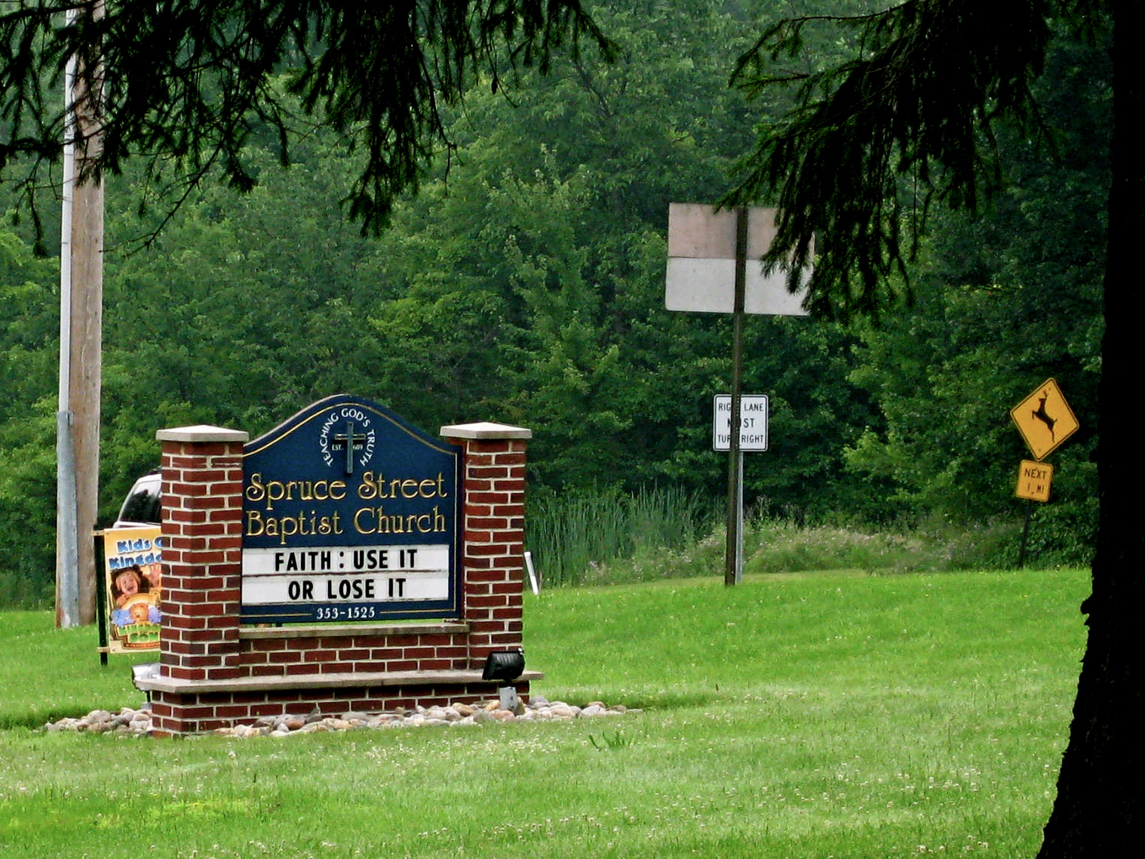
Allie Russell, '12
speaking of roadside church signs…

Slide 23
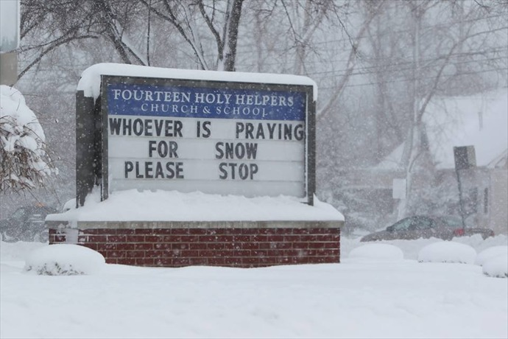
speaking of roadside church signs…

Slide 24
Design ~ code
remAll(e,L)
remove all e's from L
Top-down design
Visualize
def remAll( e, L ):
if len(L) == 0:
elif L[0] != e:
else:
L empty
Split into parts
it
Build each part
it wasn't e
Combine
it was e
Test

Slide 25
Design ~ code
remAll(e,L)
remove all e's from L
Top-down design
Visualize
def remAll( e, L ):
if len(L) == 0:
return L
elif L[0] != e:
return L[0:1] + remAll(e,L[1:])
else:
return remAll(e,L[1:])
Split into parts
Build each part
Use it!
Combine
Test
Lose it!

Slide 26
Teal… !
remAll(e,L)
remove all e's from L
Top-down design
Visualize
def remAll( e, L ):
if len(L) == 0:
return L
elif L[0] != e:
return L[0:1] + remAll(e,L[1:])
else:
return remAll(e,L[1:])
Split into parts
Build each part
Use it!
Combine
Test
Lose it!

Slide 27
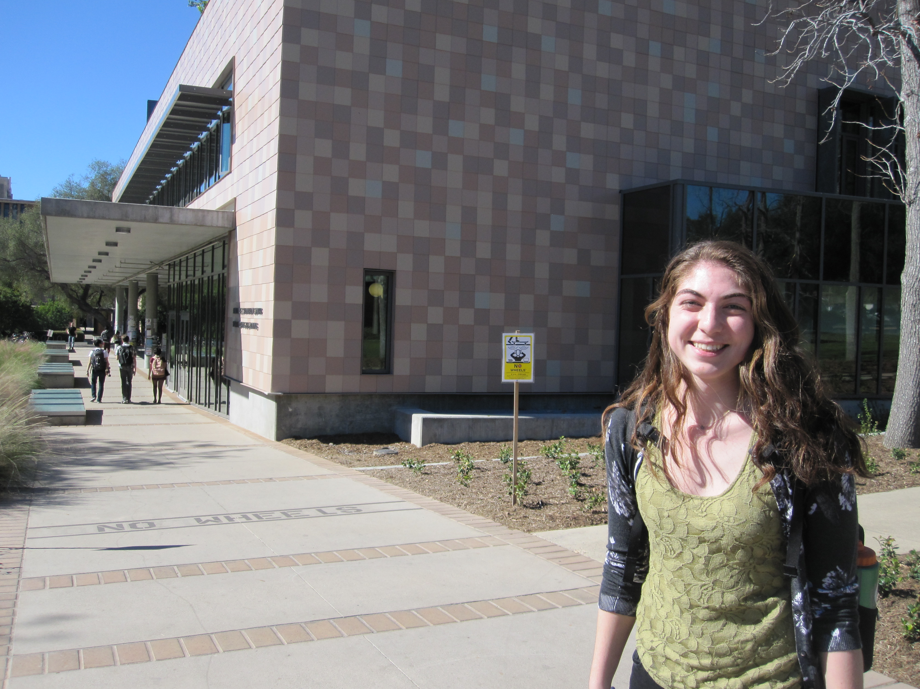
Teal… !
remAll(e,L)
remove all e's from L
Top-down design
Visualize
def remAll( e, L ):
if len(L) == 0:
return L
elif L[0] != e:
return L[0:1] + remAll(e,L[1:])
else:
return remAll(e,L[1:])
Split into parts
Build each part
Combine
Use it!
Test
Lose it!

Slide 28
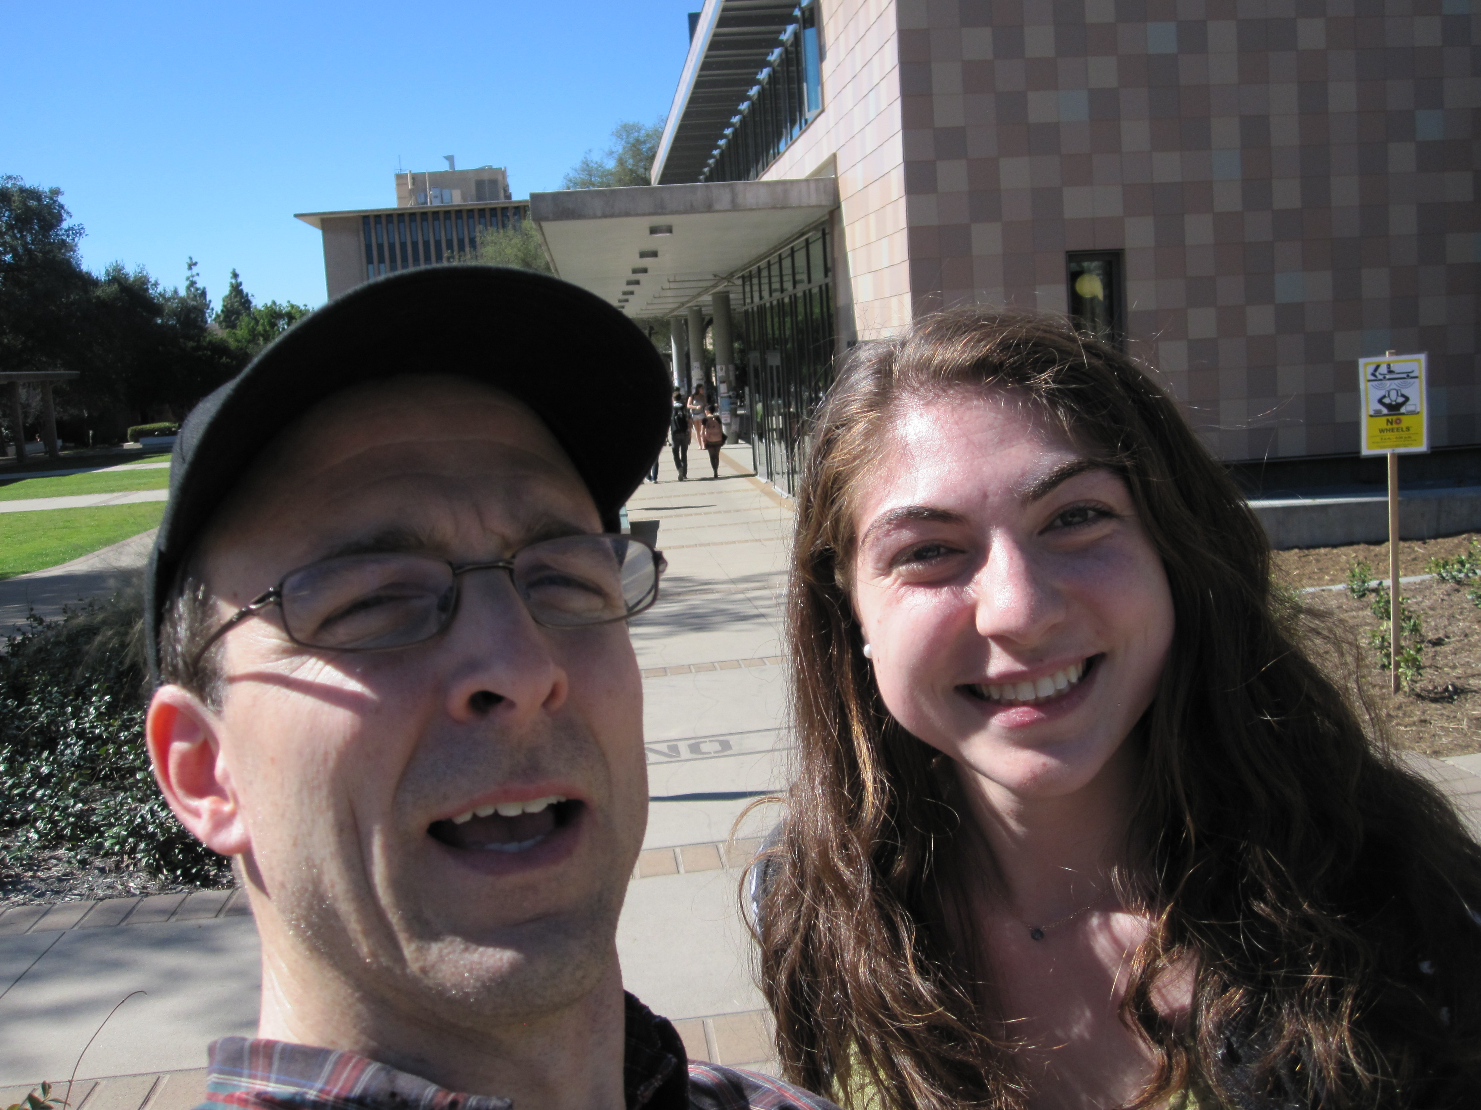
Teal… !
remAll(e,L)
remove all e's from L
A not-so-successful selfie!
Top-down design
Visualize
def remAll( e, L ):
if len(L) == 0:
return L
elif L[0] != e:
return L[0:1] + remAll(e,L[1:])
else:
return remAll(e,L[1:])
Split into parts
Build each part
Combine
Use it!
Test
Lose it!

Slide 29
Design…
design of what?
Code?
syntax
Algorithms!
ideas!

Slide 30
What's the problem?!
Top-down design
Visualize
Split into parts
Which one of these steps is the most important?
Build each part
Combine
Test

Slide 31
What's the problem?!
Top-down design
Visualize
understanding what the problem demands!!
Split into parts
Build each part
Combine
Test
I want some examples!

Slide 32
other rem examples…
remAll(8, [7,8,9,8]) [7,9]
remAll
remOne(8, [7,8,9,8]) [7,9,8]
remOne
remUpto(8,[7,8,9,8]) [9,8]
remUpto
remAll('d', 'coded') 'coe'
remAll
remOne('d', 'coded') 'coed'
remOne
remUpto('d','coded') 'ed'
remUpto
Notes:
def removeUpto( c, s ):
""" this function removes all of s up to and
including the first occurrence of c
s is any string, c is a 1-character string
"""
if len(s) == 0:
return s # s is empty
elif c == s[0]:
return s[1:] # the character c is now gone
else:
return removeUpto( c, s[1:] ) # keep going

Slide 33
Subsequences
in order, but not necessarily adjacent…
def subseq( s, sbig )
True or False?
s is the subsequence to find (or not)
sbig is the bigger string in which we are looking for s
T or F?
True
subseq('', 'cataga')
subseq('ctg', 'cataga')
True
subseq('ctg', 'tacggta')
False
True
subseq('aliens', 'always frighten dragons')
subseq('trogdor', 'that dragon is gone for good')
False
Here there be NO dragons!
Why are these True? or False?

Slide 34
Quiz
Algorithm design
Name(s):
1
def remAll( e, L ):
""" removes all e's from L """
if len(L) == 0:
return L
elif L[0] != e:
return L[0:1] + remAll(e,L[1:])
else:
return remAll(e,L[1:])
Change remAll so that it removes only one e from L. (We could call it remOne.)
remOne(8,[7,8,9,8])
[7,9,8]
2
Make more changes to remAll so that it removes elements upto and including the first e in L. (We could call it remUpto.)
remUpto('d','coded') 'ed'
Hint: these two mostly involve crossing stuff out…
def subseq( s, sbig ):
""" returns True if s is a subseq. of sbig,
False otherwise. Both are strings.
"""
if s == '':
return True
if
3
Write the other cases needed for subseq…
Challenge…
Hint: What helper function might be useful here?
Notes:
def subseq( s, sbig ):
""" returns True if s is a subsequence of
sbig; False otherwise, both are strings
"""
if len(s) == 0:
return True
elif s[0] not in sbig:
return False
else:
restofsbig = removeUpto( s[0], sbig )
return subseq( s[1:], restofsbig )

Slide 35
from remAll to remOne
def remAll( e, L ):
""" returns seq. L with all e's rmovd
"""
if len(L) == 0:
return L
elif L[0] != e:
return L[0:1] + remAll( e, L[1:] )
else:
return remAll( e, L[1:] )
remOne(8,[7,8,9,8])
[7,9,8]
remOne('d','coded')
'coed'
Notes:
def removeUpto( c, s ):
""" this function removes all of s up to and
including the first occurrence of c
s is any string, c is a 1-character string
"""
if len(s) == 0:
return s # s is empty
elif c == s[0]:
return s[1:] # the character c is now gone
else:
return removeUpto( c, s[1:] ) # keep going

Slide 36
from remOne to remUpto
def remOne( e, L ):
""" returns seq. L with one e rmoved
"""
if len(L) == 0:
return L
elif L[0] != e:
return L[0:1] + remOne( e, L[1:] )
else:
return L[1:]
remUpto(8,[7,8,9,8])
[9,8]
remUpto('d','coded')
'ed'
Notes:
def removeUpto( c, s ):
""" this function removes all of s up to and
including the first occurrence of c
s is any string, c is a 1-character string
"""
if len(s) == 0:
return s # s is empty
elif c == s[0]:
return s[1:] # the character c is now gone
else:
return removeUpto( c, s[1:] ) # keep going

Slide 37

Subseq ~ trying (coding) it out…
def subseq( s, sbig ):
""" returns True if s is a subseq. of sbig;
False otherwise. Both are strings.
"""
if s == '': return True
Base case(s)
Recursive step(s)
Notes:
def subseq( s, sbig ):
""" returns True if s is a subsequence of
sbig; False otherwise, both are strings
"""
if len(s) == 0:
return True
elif s[0] not in sbig:
return False
else:
restofsbig = removeUpto( s[0], sbig )
return subseq( s[1:], restofsbig )

Slide 38
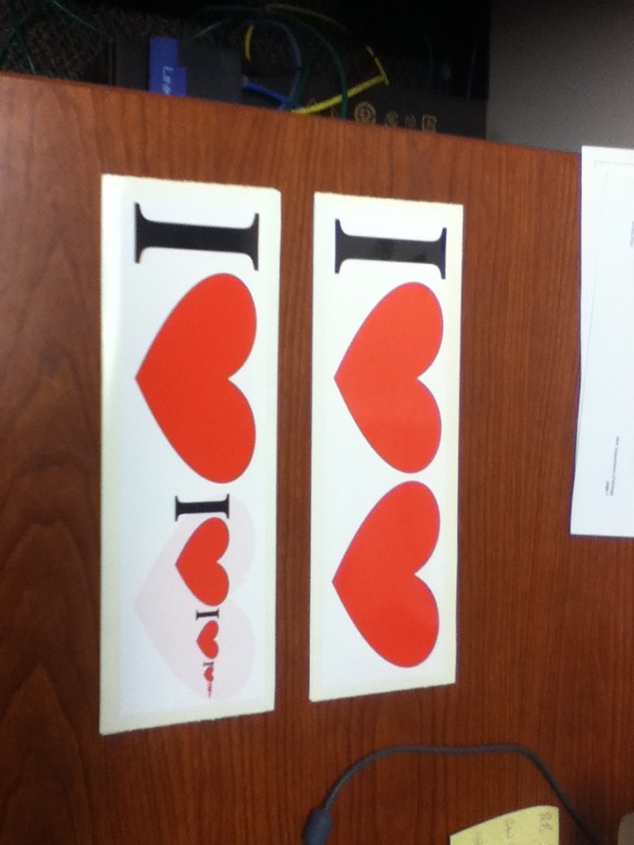
Notes:
def subseq( s, sbig ):
""" returns True if s is a subsequence of
sbig; False otherwise, both are strings
"""
if len(s) == 0:
return True
elif s[0] not in sbig:
return False
else:
restofsbig = removeUpto( s[0], sbig )
return subseq( s[1:], restofsbig )

Slide 39

Notes:
def subseq( s, sbig ):
""" returns True if s is a subsequence of
sbig; False otherwise, both are strings
"""
if len(s) == 0:
return True
elif s[0] not in sbig:
return False
else:
restofsbig = removeUpto( s[0], sbig )
return subseq( s[1:], restofsbig )

Slide 40
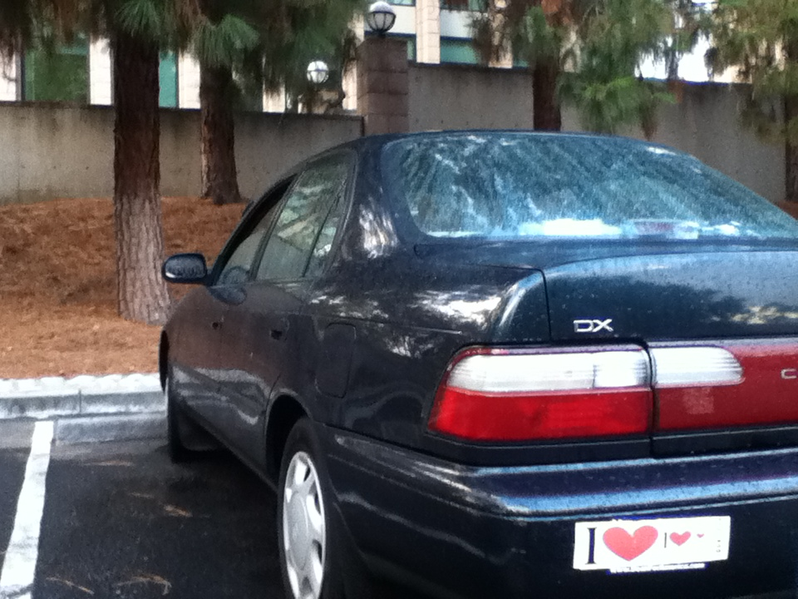
Notes:
def subseq( s, sbig ):
""" returns True if s is a subsequence of
sbig; False otherwise, both are strings
"""
if len(s) == 0:
return True
elif s[0] not in sbig:
return False
else:
restofsbig = removeUpto( s[0], sbig )
return subseq( s[1:], restofsbig )

Slide 41

Subseq ~ trying (coding) it out…
def subseq( s, sbig ):
""" returns True if s is a subseq. of sbig;
False otherwise. Both are strings.
"""
if s == '': return True
Base case(s)
Recursive step(s)
Let's try it in Sublime directly…
Notes:
def subseq( s, sbig ):
""" returns True if s is a subsequence of
sbig; False otherwise, both are strings
"""
if len(s) == 0:
return True
elif s[0] not in sbig:
return False
else:
restofsbig = removeUpto( s[0], sbig )
return subseq( s[1:], restofsbig )

Slide 42
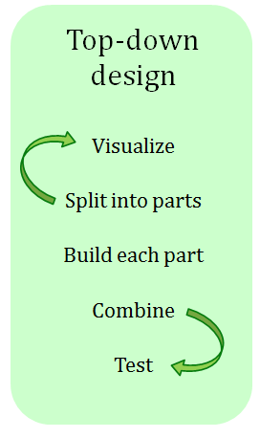
Subseq ~ thinking it out…
subseq( s, sbig )
subseq('ctg', 'tacggta')
What is a small (initial) piece of the problem?
Use it!
How would we describe it in terms of the inputs?
- or -
What is left after handling this piece?
Lose it!
Are there other functions we will need?

Slide 43
Subseq ~ trying (coding) it out…
def subseq( s, sbig ):
""" returns True if s is a subseq. of sbig;
False otherwise. Both are strings.
"""
if s == '':
return True
elif s[0] not in sbig:
return False
else:
sbigrest = remUpto( s[0], sbig )
return subseq( s[1:], sbigrest )
Base case(s)
it
Recursive step(s)
Where are the useit and loseit here?
Notes:
def subseq( s, sbig ):
""" returns True if s is a subsequence of
sbig; False otherwise, both are strings
"""
if len(s) == 0:
return True
elif s[0] not in sbig:
return False
else:
restofsbig = removeUpto( s[0], sbig )
return subseq( s[1:], restofsbig )

Slide 44
Subseq ~ trying (coding) it out…
def subseq( s, sbig ):
""" returns True if s is a subseq. of sbig;
False otherwise. Both are strings.
"""
if s == '':
return True
elif s[0] not in sbig:
return False
else:
sbigrest = remUpto( s[0], sbig )
return subseq( s[1:], sbigrest )
Lose it!
Base case(s)
it
Recursive step(s)
Use it!
Notes:
def subseq( s, sbig ):
""" returns True if s is a subsequence of
sbig; False otherwise, both are strings
"""
if len(s) == 0:
return True
elif s[0] not in sbig:
return False
else:
restofsbig = removeUpto( s[0], sbig )
return subseq( s[1:], restofsbig )

Slide 45
hw3pr2: use it or lose it
Longest Common Subsequence
LCS( S, T )
Jotto Score counting
jscore( s1, s2 )
binary list and general list sorting
blsort( L ), gensort( L )
exact_change making
exact_change( t, L )

Slide 46
hw3pr2: use it or lose it
Longest Common Subsequence
LCS( S, T )
'HUMAN'
'CGCTGAGCTAGGCA...'
'CHIMPANZEE'
'ATCCTAGGTAACTG...'
+10⁹more
Eye oneder if this haz other aplications?

Slide 47
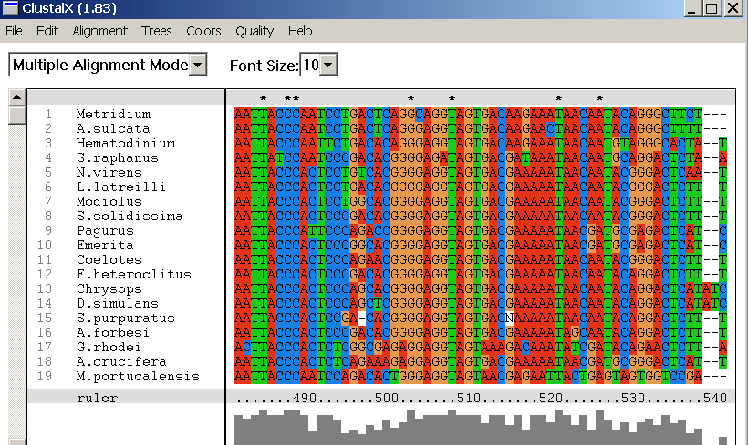
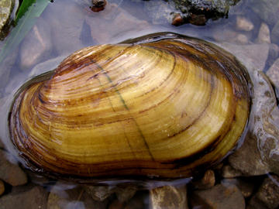
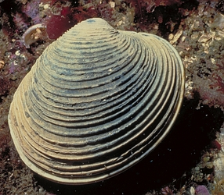
design of what? Code? Algorithms!
Why LCS?
Screenshot from the ClustalX multiple subsequence alignment tool...
Algorithmic challenge: How to find the best common subsequences among these very big genome strings ?!?

Slide 48
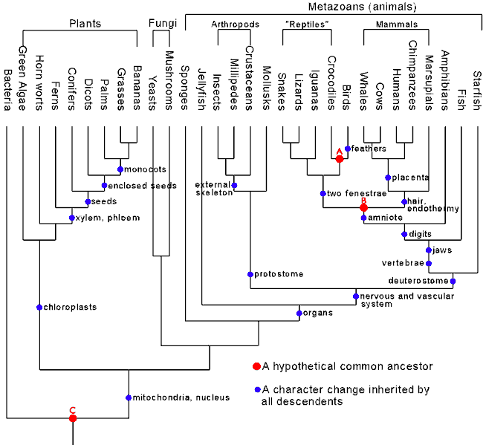
Hey!?
Trinocular aliens
?
Phylogeny
What was gained (or lost) here?

Slide 49
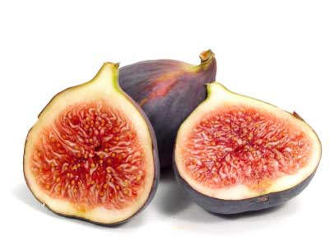
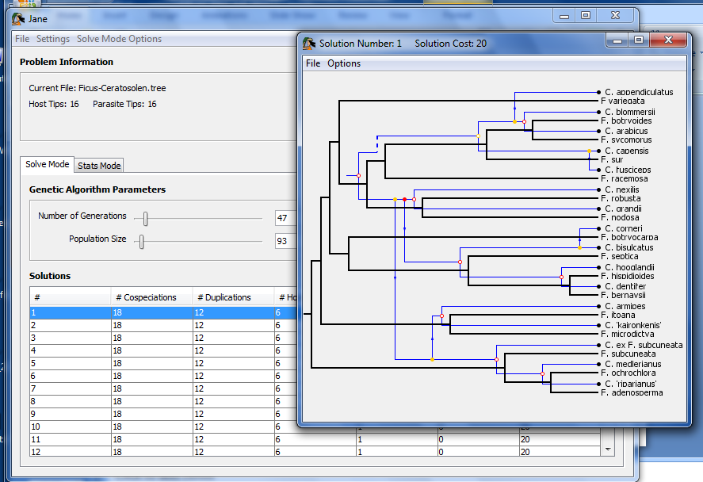
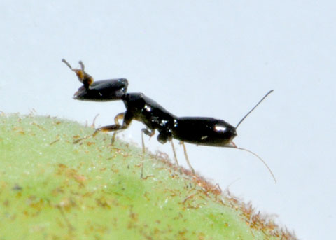
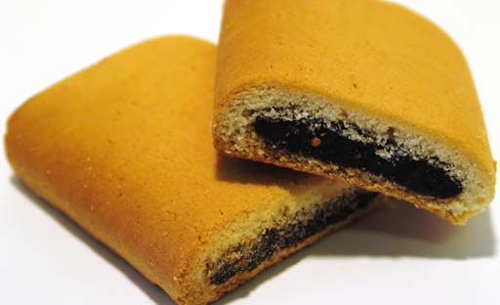
Subsequences @ HMC
host: figs
Jane
parasites: wasps
matching two phylogenies together
together:

Slide 50

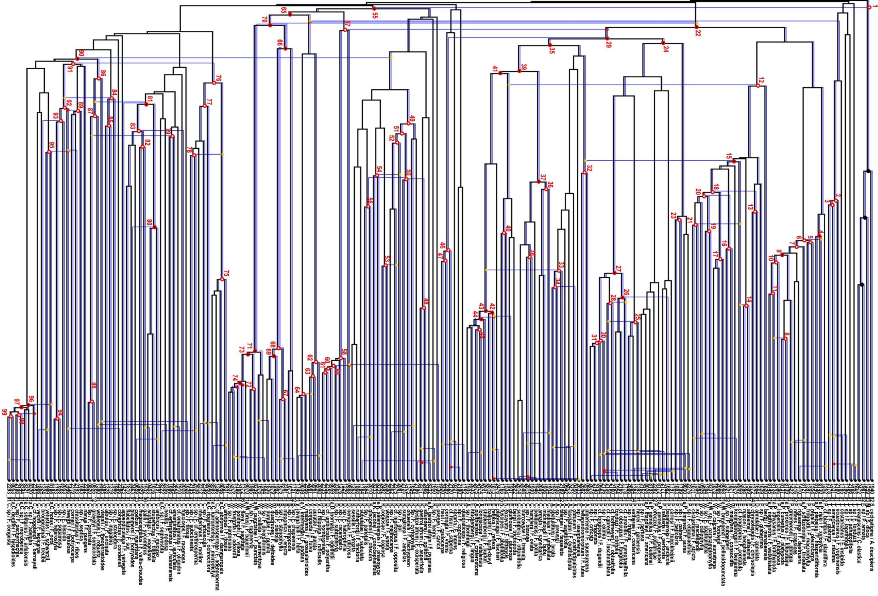
Complete!
Jane
Largest co-phylogeny ever computed (2012)

Slide 51
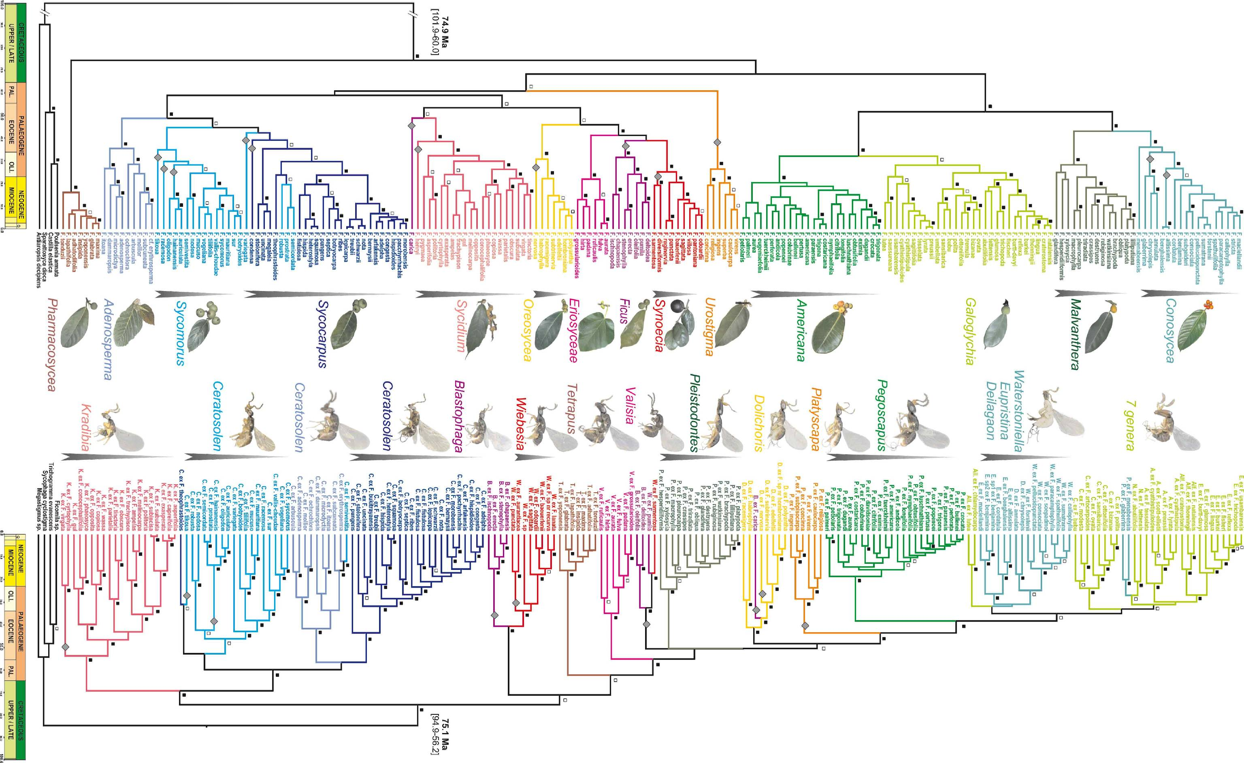
Jane's source data: 100s of species, 6 continents …

Slide 52
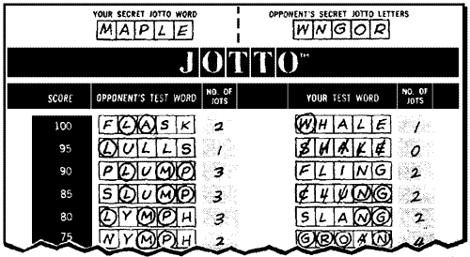
also in hw3pr2: Jotto !
a word-guessing game…
jscore( S, T )
robot

Slide 53
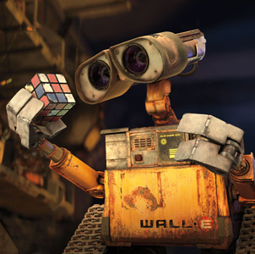
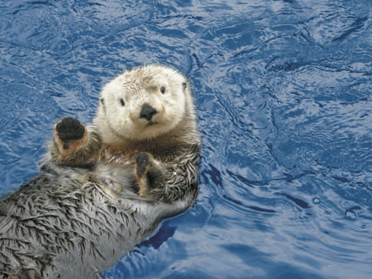
also in hw3pr2: Jotto !
a word-guessing game…
jscore( S, T )
'robot'
'otter'
These are two cute
jscore( 'robot', 'otter' )
Let's try it!

Slide 54
should return the jotto score for any strings s1 and s2
should return a new list that is the sorted version of the input L
should return the longest common subsequence of strings S and T
jscore(s1,s2)
sort( L )
LCS(S,T)
jscore('robot', 'otter')
sort( [42,5,7] )
LCS( 'ctga', 'tagca' )
'tga'
3
[5,7,42]
jscore('geese', 'seems')
sort( [42,7] )
LCS( 'tga', 'tagca' )
jscore('fluff', 'lulls')
sort( [42] )
LCS( 'tga', 'a' )
jscore('pears', 'diner')
sort( [ ] )
LCS( 'gattaca', 'ctctgcgat')
jscore('xylyl', 'slyly')
blsort( [1,0,1] )
Extra! Which of these 10 is the cruellest hidden jotto word?
binary-list sort: same as sort, but all of the #s are 0 or 1
don't write any code for these…
do try the examples + brainstorm
Brainstorm algorithms for these problems -- what helper functions might help each one?
exact_change( 42, [25,30,2,5] )
True
returns True if any subset of elements in L add up to t; returns False otherwise
exact_change( 42, [40,17,1,7] )
exact_change( 42, [18,21,100] )
exact_change(t,L)
exact_change( 42, [22,16,3,17,2] )
exact_change( 20, [16,3,17,2] )

Slide 55
should return the jotto score for any strings s1 and s2
should return a new list that is the sorted version of the input L
should return the longest common subsequence of strings S and T
jscore(s1,s2)
sort( L )
LCS(S,T)
jscore('robot', 'otter')
sort( [42,5,7] )
LCS( 'ctga', 'tagca' )
'tga'
3
[5,7,42]
sort( [42,7] )
LCS( 'tga', 'tagca' )
'tga'
jscore('geese', 'seems')
3
[7,42]
sort( [42] )
LCS( 'tga', 'a' )
'a'
jscore('fluff', 'lulls')
2
[42]
jscore('pears', 'diner')
[ ]
LCS( 'gattaca', 'ctctgcgat')
2
sort( [ ] )
jscore('xylyl', 'slyly')
blsort( [1,0,1] )
'ttca'
4
[0,1,1]
Extra! Which of these 10 is the cruellest hidden jotto word?
binary-list sort: same as sort, but all of the #s are 0 or 1
don't write any code for these…
do try the examples + brainstorm
Brainstorm algorithms for these problems -- what helper functions might help each one?
exact_change( 42, [25,30,2,5] )
True
returns True if any subset of elements in L add up to t; returns False otherwise
exact_change( 42, [40,17,1,7] )
False
exact_change( 42, [18,21,100] )
False
exact_change(t,L)
exact_change( 42, [22,16,3,17,2] )
True
exact_change( 20, [16,3,17,2] )
True

Slide 56
should return the jotto score for any strings s1 and s2
should return a new list that is the sorted version of the input L
should return the longest common subsequence of strings S and T
jscore(s1,s2)
sort( L )
LCS(S,T)
jscore('robot', 'otter')
sort( [42,5,7] )
LCS( 'ctga', 'tagca' )
'tga'
3
[5,7,42]
sort( [42,7] )
LCS( 'tga', 'tagca' )
'tga'
jscore('geese', 'seems')
3
[7,42]
sort( [42] )
LCS( 'tga', 'a' )
'a'
jscore('fluff', 'lulls')
2
[42]
jscore('pears', 'diner')
[ ]
LCS( 'gattaca', 'ctctgcgat')
2
sort( [ ] )
jscore('xylyl', 'slyly')
blsort( [1,0,1] )
'ttca'
4
[0,1,1]
Extra! Which of these 10 is the cruellest hidden jotto word?
binary-list sort: same as sort, but all of the #s are 0 or 1
Use it!
Lose it!
Use it!
don't write any code for these…
min
do try the examples + brainstorm
just recursion here…
remOne
Use it!
Lose it!
remOne
Brainstorm algorithms for these problems -- what helper functions might help each one?
exact_change( 42, [25,30,2,5] )
True
Use it!
returns True if any subset of elements in L add up to t; returns False otherwise
exact_change( 42, [40,17,1,7] )
False
Lose it!
exact_change( 42, [18,21,100] )
False
exact_change(t,L)
exact_change( 42, [22,16,3,17,2] )
True
… and here
exact_change( 20, [16,3,17,2] )
True

Slide 57
decipher( 'Weet bksa ed xecumeha 3!' )
kxn rkfo k qbokd goouoxn ...

Slide 58
decipher( 'Weet bksa ed xecumeha 3!' )
Good luck on homework 3!
kxn rkfo k qbokd goouoxn ...
and have a great weekend ...

Slide 60
Getting started...
What will each of these jotto-scoring examples return?
3
jotto('geese', 'seems')
jotto('fluff', 'lulls')
2
pears
2
jotto('pears', 'diner')
jotto('xylyl', 'slyly')
4
Extra! Which of these 8 is the cruellest hidden jotto word?
jotto(s1,s2)
sort( L )
LCS(s1,s2)
should return the jotto score for any strings s1 and s2
should return a new list that is the sorted version of the input L
should return the longest common subsequence of strings s1 and s2
Use it!
Use it!
don't need to write any code for these (yet...)
but think about how you'd approach them
Lose it!
min
Use it!
just recursion… but MORE of it!
remOne
remOne
Lose it!
Brainstorm algorithms for these problems -- what helper functions might help each one?

Slide 61
also in hw3pr2: Jotto !
a word-guessing game…
robot
otter
These are two cute

Slide 62
Getting started...
What will each of these jotto-scoring examples return?
jotto('geese', 'seems')
jotto('fluff', 'lulls')
jotto('pears', 'diner')
jotto('xylyl', 'slyly')
Extra! Which of these 8 is the cruellest hidden jotto word?
jotto(s1,s2)
sort( L )
LCS(s1,s2)
should return the jotto score for any strings s1 and s2
should return a new list that is the sorted version of the input L
should return the longest common subsequence of strings s1 and s2
don't need to write any code for these (yet...)
but think about how you'd approach them
Use it!
Lose it!
Brainstorm algorithms for these problems -- what helper functions might help each one?

Slide 63
from remAll to remOne
def remAll( e, L ):
""" returns seq. L with all e's rmovd
"""
if len(L) == 0:
return L
elif L[0] != e:
return L[0:1] + remAll( e, L[1:] )
else:
return remAll( e, L[1:] )
remOne(8,[7,8,9,8])
[7,9,8]
remOne('d','coded')
'coed'
Notes:
def removeUpto( c, s ):
""" this function removes all of s up to and
including the first occurrence of c
s is any string, c is a 1-character string
"""
if len(s) == 0:
return s # s is empty
elif c == s[0]:
return s[1:] # the character c is now gone
else:
return removeUpto( c, s[1:] ) # keep going

Slide 64
from remOne to remUpto
def remOne( e, L ):
""" returns seq. L with one e rmovd
"""
if len(L) == 0:
return L
elif L[0] != e:
return L[0:1] + remOne( e, L[1:] )
else:
return L[1:]
remUpto(8,[7,8,9,8])
[9,8]
remUpto('d','coded')
'ed'
Notes:
def removeUpto( c, s ):
""" this function removes all of s up to and
including the first occurrence of c
s is any string, c is a 1-character string
"""
if len(s) == 0:
return s # s is empty
elif c == s[0]:
return s[1:] # the character c is now gone
else:
return removeUpto( c, s[1:] ) # keep going

Slide 65
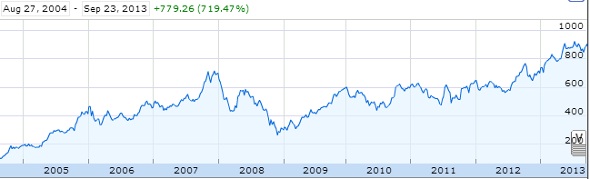
Aside: web scraping
How could we grab today's stock price via Python?

Slide 66
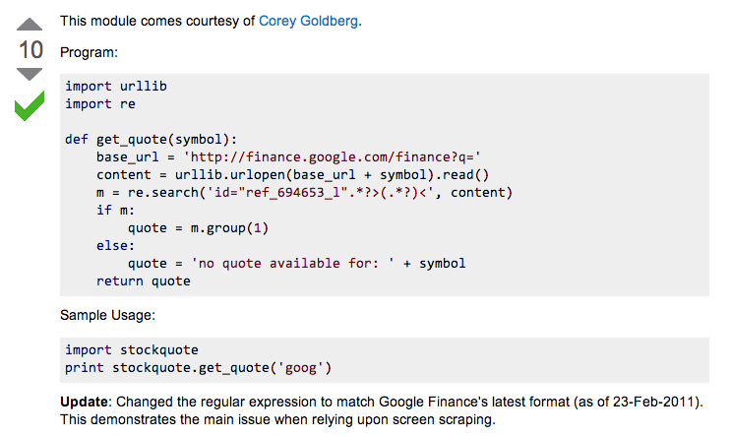
Example: web scraping
http://stackoverflow.com/questions/5081710/how-to-create-a-stock-quote-fetching-app-in-python

Slide 67
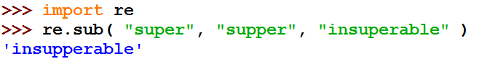
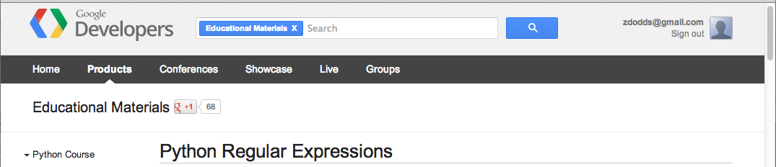
Regular Expressions
a huge string-processing library
a library for processing huge strings
many tutorials available…
developers.google.com/edu/python/regular-expressions?csw=1

Slide 68
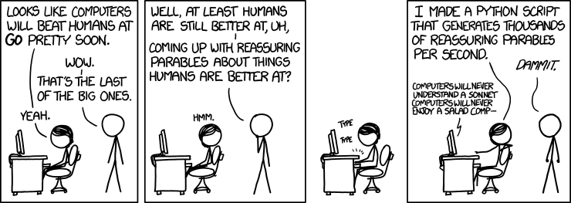
String-processing perspective…
with thanks to Jacquelyn Zehner!
http://stackoverflow.com/questions/5081710/how-to-create-a-stock-quote-fetching-app-in-python

Slide 69
Hey!?
Trinocular aliens
?
Phylogeny
What was gained (or lost) here?

Slide 70
What will each of these jotto-scoring examples return?
Thoughts?
3
jotto('geese', 'seems')
2
jotto('fluff', 'lulls')
2
pears
jotto('pears', 'diner')
4
Extra! Which of these 8 is the cruellest hidden jotto word?
jotto('xylyl', 'slyly')
jotto(s1,s2)
sort( L )
LCS(s1,s2)
should return the jotto score for any strings s1 and s2
should return a new list that is the sorted version of the input L
should return the longest common subsequence of strings s1 and s2
don't need to write any code for these (yet...)
but think about how you'd approach them
Brainstorm algorithms for these problems -- what helper functions might help each one?

Slide 71
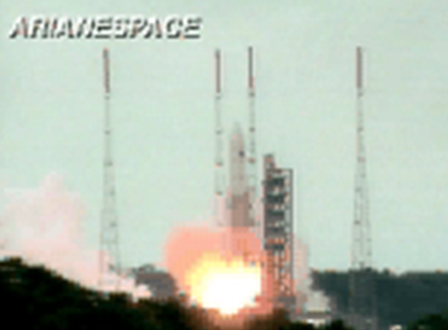
BR 5 Snczx
Gesundheit!
Algorithms
Englishness...
Classifying life
Removing/Sorting
and Jotto!
HW 3
Hw #3 due Monday
"Office" hrs: Fri. 2-4pm
Weekend tutoring? yes!
IndexError
TypeError
HumanError
This week's reading…

Slide 73
What's the problem?!
remove all e's from L
removes one e from L
remOne( e, L )
remAll( e, L )
removes upto the first e in L
sorts L (L is binary or L is general)
remUpto( e, L )
blsort( L )
gensort( L )
T or F: s is a subsequence of sbig?
returns # letters shared by s1, s2
subseq( s, sbig )
jscore( s1, s2 )
can_cancel( L )
exact_change( t, L )
T or F: a subset of L
T or F: a subset of L adds to t
LCS( S, T )

Slide 74
also in hw3pr2: Jotto !
a word-guessing game…
robot
otter
These are two cute

Slide 75
Getting started...
Thoughts?
jotto('geese', 'seems')
What will each of these jotto-scoring examples return?
jotto('fluff', 'lulls')
jotto('pears', 'diner')
Extra! Which of these 8 is the cruellest hidden jotto word?
jotto('xylyl', 'slyly')
jotto( s1, s2 )
should return the jotto score for any strings s1 and s2
sort( L )
should return a new list that is the sorted version of the input L
don't need to write code for these...
Brainstorm algorithms for these problems -- what helper functions might help each one?

Slide 76
Helper functions…
def remAll( e, L ):
""" this function removes all elements equal to
e from the top level of the list or string L
"""
# code written last time
def remOne( e, L ):
""" this function removes ONE element equal to
e from the top level of the list or string L,
as long as there is such an element
"""
# code written last time
Is either really what we want, or another variant?

Slide 77
Breaking down…
subseq( s, sbig )
subseq('ctg', 'tacggta')
What is a small (initial) piece of the problem?
How would we describe it in terms of the inputs?
What is left after handling this piece?
Are there other functions we will need?
Hey - I've seen something like this before!

Slide 78
Notes:
def subseq( s, sbig ):
""" returns True if s is a subsequence of
sbig; False otherwise, both are strings
"""
if len(s) == 0:
return True
elif s[0] not in sbig:
return False
else:
restofsbig = removeUpto( s[0], sbig )
return subseq( s[1:], restofsbig )

Slide 79
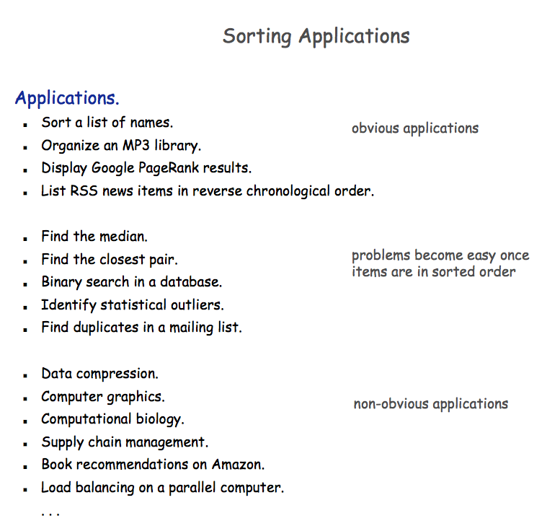

Slide 80


A sorting algorithm…
Input a list, L
Randomly permute L
Check if L is sorted
Repeat as necessary...
Mmmm… sorting!
in code:
How fast will this be?
from random import *
def randSort( L ):
""" crazy sorting """
newL = sample( L, len(L) )
if isSorted(newL):
return newL
else:
return randSort(L)
returns a random permutation of L
this function is totally random, dude!

Slide 81

checking if a list is sorted...
def isSorted(s):
returns True if s is in order, False otherwise
isSorted('BART') returns False
No way I'm False, man.
isSorted('BERT') returns True
isSorted('BEGIN') returns True
isSorted([3,1,4]) returns False
isSorted([1,3,4]) returns True
Too true!
isSorted('LOOPY') returns ??
Six-letter words?

Slide 82
checking if sorted...
def isSorted(s):
isSorted('BEGIN')
True
isSorted('END')
False
returns True if s is in order, False otherwise
if len(s) < 2:
return
elif s[0] < s[1]:
return
else:
return
six-letter word?

Slide 83
Algorithm Analysis
def isSorted(s):
""" True if s is sorted else False """
if len(s) < 2:
return True
elif s[0] < s[1]:
return isSorted( s[1:] )
else:
return False
If the original string had N chars, how many "steps" would it take to run isSorted ?
in the BEST case? in the WORST case?

Slide 84
Sorting out sorting
Theorem 1:
No sorting algorithm can sort n numbers in fewer than n steps.
Theorem 2:
No comparison-based sorting algorithm can sort n numbers asymptotically faster than n log₂ n.
Sorting Algorithm Worst-case Asymptotic Time
Insertion Sort n²
Bubble Sort n²
Quicksort n²
Mergesort n log₂ n
Heapsort n log₂ n

Slide 85

Does it matter?
Our "super"computer: 1 billion steps/second
Number of elements
Our algorithm's running time...
N steps
N² steps
N! steps
N = 10 el.
< 1sec.
< 1sec.
< 1sec.
N = 10³ el.
< 1sec.
< 1sec.
> lifespan
N = 10⁶ el.
< 1sec.
16.7 minutes
> lifespan
N = 10⁹ el.
1 sec.
31.7 years
> lifespan
total time to finish...

Slide 86
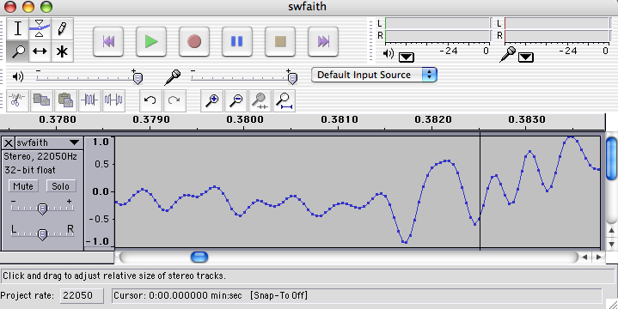
Do real data sets get so big?
Yes!

Slide 87
Weet bksa ed xecumeha 3!
and have a great weekend...

Slide 89
Phylogeny!
Hey!?
Trinocular aliens
?
What was gained (or lost) here?

Slide 90
Visualize
def removeAll( e, L ):
""" this function removes all of the elements
e from the top level of the list L
"""
removeAll(42, [5,47,42,48,42])
removeAll('q', 'qaqqlqqiqqiiqeqqnqqqqs')
What are you trying to hide here... ?

Slide 91
removeOne
One
def removeAll( e, L ):
""" this function removes all of the elements
e from the top level of the list L
"""
if len(L) == 0:
return L
elif e == L[0]:
return removeAll(e,L[1:])
else:
return L[0:1] + removeAll(e,L[1:])
# keep the non-e element and going
How could we change this to removeOne?
removeOne(42, [5,7,42,8,42])
removeOne('p', 'computer programming')
[5,7,8,42]
'comuter programming'

Slide 92
Getting started...
Name(s): ____________________
jotto('geese', 'seems')
What will each of these jotto-scoring examples return?
jotto('fluff', 'lulls')
jotto('pears', 'diner')
Extra! Which of these 8 is the cruellest hidden jotto word?
jotto('xylyl', 'slyly')
jotto( s1, s2 )
should return the jotto score for any strings s1 and s2
sort( L )
should return a new list that is the sorted version of the input L
don't need to write code for these...
Brainstorm algorithms for these problems -- what helper functions might help each one?

Slide 93
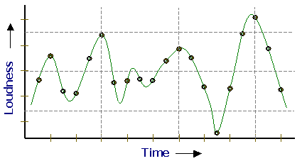
Representing Sound
physics
continuous plot of air pressure vs. time
sampling
samples taken every ~ 1/22050th of a second
quantization
Each sample is measured on a scale from -32,768 to 32,767.
(This fits into 2 bytes.)
storage
These two bytes are called a frame. Raw audio data - such as what is written to the surface of a CD - is simply a list of these frames.
This problem SOUNDS like fun!
pulse code modulation = PCM data

Slide 94
Subsequences: Sketching out…
def subseq( s, sbig ):
""" returns True if s is a subsequence of
sbig; False otherwise. Both are strings.
"""
Base Case(s)
Recursive Step(s)
Notes:
def subseq( s, sbig ):
""" returns True if s is a subsequence of
sbig; False otherwise, both are strings
"""
if len(s) == 0:
return True
elif s[0] not in sbig:
return False
else:
restofsbig = removeUpto( s[0], sbig )
return subseq( s[1:], restofsbig )

Slide 95
Asymptotic Analysis
3n + 42
“Asymptotic” is a fancy word!
42n+4242
“asymptotically linear”
100 n
(0.1)n² + n + 1
“asymptotically quadratic”
100 n²
n³ - 100n² + 2n + 42
2n³ + 10
1/5 n³
“asymptotically cubic”

Slide 96
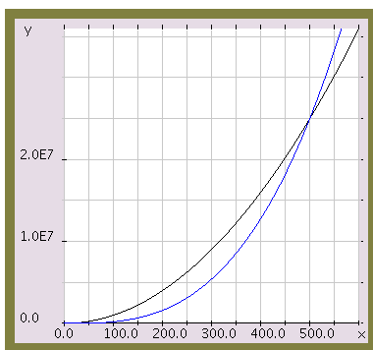
Asymptotic Analysis
Those look like two awesome water-slides!
100 n²
1/5 n³
n

Slide 97
Almost the end…
def sort(L)
returns a list which has the same elements as L, but in sorted order!
Let e be the max element in L
Where should e go?
and what helper function might we want… ?

Slide 98
Algorithm Analysis
def isSorted(s):
""" docstring! """
if L == []:
return 0
elif e == L[0]:
return 1 + count(e,L[1:])
else:
return count(e,L[1:])
If the original list had N elements, about how many "steps" would it take to run count(e,N)

Slide 99



Computing with text
open questions in AI …
ideas / meaning
language / words / phrases
computing with language - recognizing English!
strings
how strings are represented and stored
numbers / bits

Slide 100
Caesar Cipher: encipher
encipher( 'I <3 Latin' , 0 )
'I <3 Latin'
'J <3 Mbujo'
'K <3 Ncvkp'
'L <3 Odwlq'
'M <3 Pexmr'
'N <3 Qfyns'
returns
encipher( 'I <3 Latin' , 1 )
returns
encipher( 'I <3 Latin' , 2 )
returns
encipher( 'I <3 Latin' , 3 )
returns
encipher( 'I <3 Latin' , 4 )
returns
…
encipher( 'I <3 Latin' , 5 )
returns
encipher( 'I <3 Latin' , 25 )
'H <3 Kzshm'
returns
should return the string s with each alphabetic character shifted/wrapped by n places in the alphabet
encipher( s , n )
Historically bad decision #43:
Brutus won't mind if I use his salary to bring Skrillex to the Colosseum next month...

Slide 101
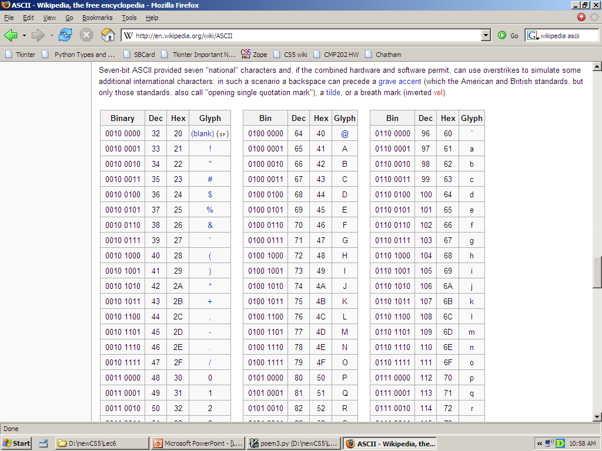
ASCII
American Standard Code for Information Interchange
value:
'/'
00101111
type: str
bits
name:
Identical bits are stored in each variable!
8 bits = 1 byte
The SAME bits represent integers, if the variable has type int instead of str
The types determine how to interpret the bits; the names don't matter at all…
value:
47
00101111
type: int
bits
name:

Slide 102
ASCII
American Standard Code for Information Interchange
convert # to char
chr
ord
convert char to #

Slide 103
chr and ord
abcdefghijklmnopqrstuvwxyz
ASCII VALUES
97
99
101
103
105
107
109
111
113
115
117
119
122
ABCDEFGHIJKLMNOPQRSTUVWXYZ
65
67
69
71
73
75
77
79
81
83
85
87
90
ord( c )
Input: a string of one character, c
Output: an integer, the ASCII value of c
CONVERTERS
chr( n )
Input: an integer in range(255)
Output: a one-char. string of that ASCII value
[ [i,chr(i)] for i in range(128) ]
Try these!
[ ord(i) for i in '**** CS! ****' ]

Slide 104
chr and ord
abcdefghijklmnopqrstuvwxyz
ASCII VALUES
97
99
101
103
105
107
109
111
113
115
117
119
122
ABCDEFGHIJKLMNOPQRSTUVWXYZ
65
67
69
71
73
75
77
79
81
83
85
87
90
ord('a') is 97
chr(66) is 'B'
What is chr( ord('i')+13 ) ?
What is chr( ord('P')+13 ) ?
How do we wrap?

Slide 105
Rot 13
def rot13( c ):
""" rotates c by 13 chars, "wrapping" as needed
NON-LETTERS DO NOT CHANGE!
"""
if 'a' <= c <= 'z':
new_ord = ord(c) + 13
if new_ord <= ord('z'):
return chr(new_ord)
else:
return
elif
else:
How would you rotate an entire string?

Slide 106
Caesar Cipher: decipher
>>> decipher('Bzdrzq bhogdq? H oqdedq Bzdrzq rzkzc.')
'Caesar cipher? I prefer Caesar salad.'
>>> decipher('Hu lkbjhapvu pz doha ylthpuz hmaly dl mvynla '\
'lclyfaopun dl ohcl slhyulk.')
'An education is what remains after we forget everything we have learned.'
>>> decipher('Uifz xpsl ju pvu xjui b qfodjm!')
>>> decipher('gv vw dtwvg')
But how ?

Slide 107
Caesar Cipher: decipher
gv vw dtwvg
hw wx euxwh
ix xy fvyxi
jy yz gwzyj
kz za hxazk
la ab iybal
mb bc jzcbm
nc cd kadcn
od de lbedo
pe ef mcfep
qf fg ndgfq
rg gh oehgr
sh hi pfihs
ti ij qgjit
uj jk rhkju
vk kl silkv
wl lm tjmlw
xm mn uknmx
yn no vlony
zo op wmpoz
ap pq xnqpa
bq qr yorqb
cr rs zpsrc
ds st aqtsd
et tu brute
fu uv csvuf
Caesar
Brutus
decipher('gv vw dtwvg')
Strategy using max:
(1) consider all possible answers
(2) give them each a score
(3) use our techniques to get max
Score for "Englishness"?
up to you…
all 26 possibilities

Slide 108
Caesar Cipher: Englishness
"call me Ishmael"
"attack at dawn"
A lot
"rainbow, table, candle"
"Yow! Legally-imposed CULTURE-reduction
is CABBAGE-BRAINED!"
"quadruplicity drinks procrastination"
"Hold the newsreader's nose squarely, waiter, or
friendly milk will countermand my trousers."
Where might you put "Twas brillig, and the slithy toves" ?
"the gostak distims the doshes"
"hension, framble, bardle"
They all sound
good to me!
"jufict, stofwus, lictpub"
"itehbs, rsnevtr, khbsota"
"epadxo, nojarpn, gdxokpw"
"h o q dedqBzdrzqrzkzc"
Not so much

Slide 109
Caesar Cipher: decipher
Caesar
[0, 'cr rs zpsrc']
[0, 'gv vw dtwvg']
[0, 'jy yz gwzyj']
[0, 'mb bc jzcbm']
[0, 'qf fg ndgfq']
[0, 'wl lm tjmlw']
[1, 'bq qr yorqb']
[1, 'ds st aqtsd']
[1, 'nc cd kadcn']
[1, 'vk kl silkv']
[1, 'xm mn uknmx']
[2, 'ap pq xnqpa']
[2, 'hw wx euxwh']
[2, 'ix xy fvyxi']
[2, 'kz za hxazk']
[2, 'rg gh oehgr']
[2, 'sh hi pfihs']
[2, 'uj jk rhkju']
[2, 'yn no vlony']
[3, 'fu uv csvuf']
[3, 'pe ef mcfep']
[3, 'ti ij qgjit']
[3, 'zo op wmpoz']
[4, 'et tu brute']
[4, 'la ab iybal']
[4, 'od de lbedo']
Brutus
number-of-vowels score
max
won't always be correct!
all 26 possibilities

Slide 110
Caesar Cipher: decipher
Caesar
[0.4680, 'jy yz gwzyj']
[0.4960, 'mb bc jzcbm']
[0.5420, 'uj jk rhkju']
[0.5567, 'ix xy fvyxi']
[0.5597, 'qf fg ndgfq']
[0.5718, 'fu uv csvuf']
[0.5753, 'bq qr yorqb']
[0.5833, 'kz za hxazk']
[0.5859, 'xm mn uknmx']
[0.5880, 'gv vw dtwvg']
[0.5902, 'vk kl silkv']
[0.6110, 'ap pq xnqpa']
[0.6304, 'zo op wmpoz']
[0.6318, 'wl lm tjmlw']
[0.6717, 'cr rs zpsrc']
[0.6735, 'hw wx euxwh']
[0.6963, 'nc cd kadcn']
[0.7153, 'ti ij qgjit']
[0.7398, 'la ab iybal']
[0.7442, 'yn no vlony']
[0.7867, 'pe ef mcfep']
[0.7880, 'sh hi pfihs']
[0.7918, 'rg gh oehgr']
[0.8213, 'ds st aqtsd']
[0.8609, 'od de lbedo']
[0.9082, 'et tu brute']
Brutus
letter-prob. score
max
not always correct, but better!
all 26 possibilities

Slide 111
Jotto scoring clicker trial
What is the score for jotto('geese','seems')
C
2
A
0
D
3
B
1
E
4

Slide 112
JOTTO clicker question
If you had to choose one of these, which helper function would you use for your jotto algorithm?
C
removeUpto
A
removeAll
D
B
remove these options from your selection!
removeOne
E

Slide 113
SORT clicker question
If you had to choose one of these, which helper function would you use for your sort algorithm?
C
removeUpto
A
removeAll
D
remove this question from the HW!
B
removeOne
E
Choose me!

Slide 114
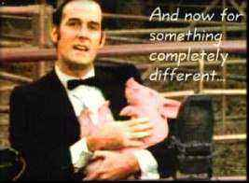
And now for something completely different…

Slide 115
top1List
def top1List( L ):
""" returns a list of the top element in L """
if len(L) < 1: return L
else: return [ max(L) ]

Slide 116
top2List
def top1List( L ):
""" returns a list of the top element in L """
if len(L) < 1: return L
else: return [ max(L) ]
def top2List( L ):
""" returns a list of the top 2 elements in L """
if len(L) < 2: return L
mx = max(L) # get the biggest element
newL = removeOne( mx, L ) # get rid of mx
return [ mx ] + top1List( newL )

Slide 117
top3List
def top3List( L ):
""" returns a list of the top 3 elements in L """
if len(L) < 3: return L
def topNList( n, L ):
""" returns a list of the top n elements in L """
top N?

Slide 118
Sorting
def sort(L)
returns a list which has the same elements as L, but in sorted order!

Slide 119

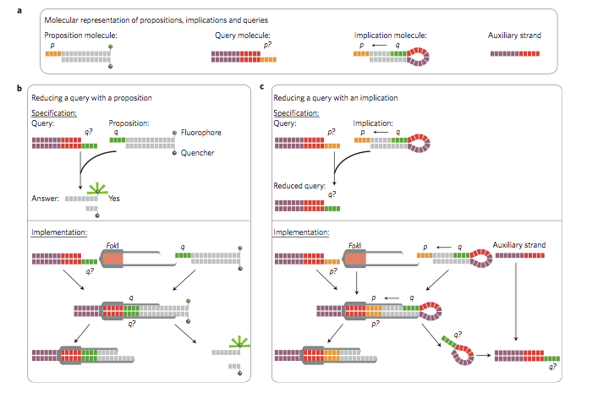
Reading this week: molecular computing
with robots...

Slide 120
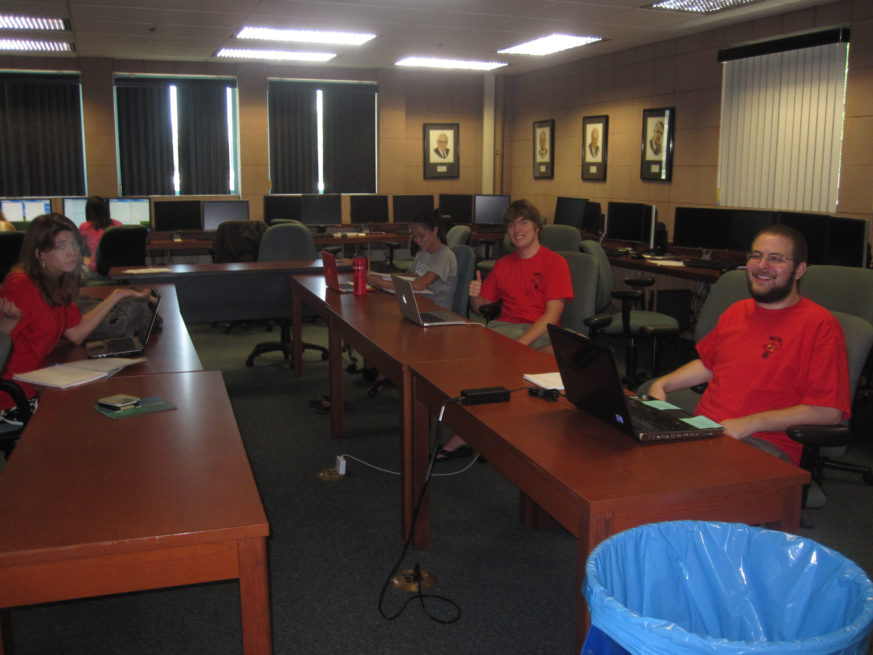
lonely on Friday afternoons... (not Monday evenings, however!)

Slide 121
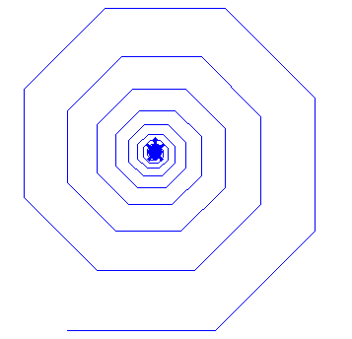
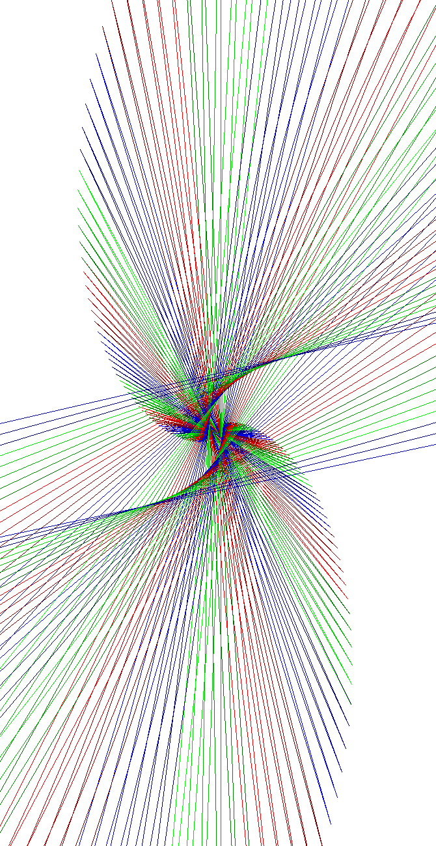

Spirals et al.
Jacob R.
Austin C.

Slide 122
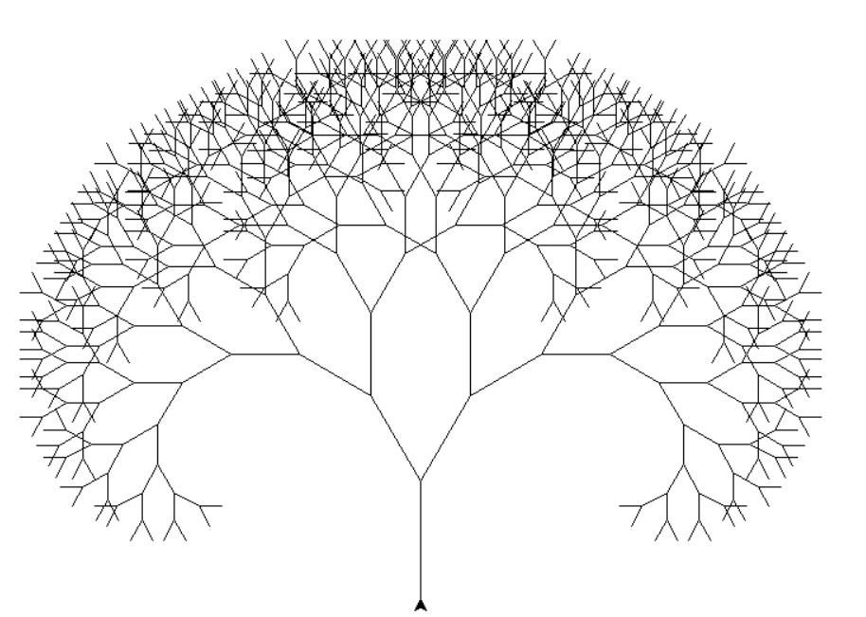
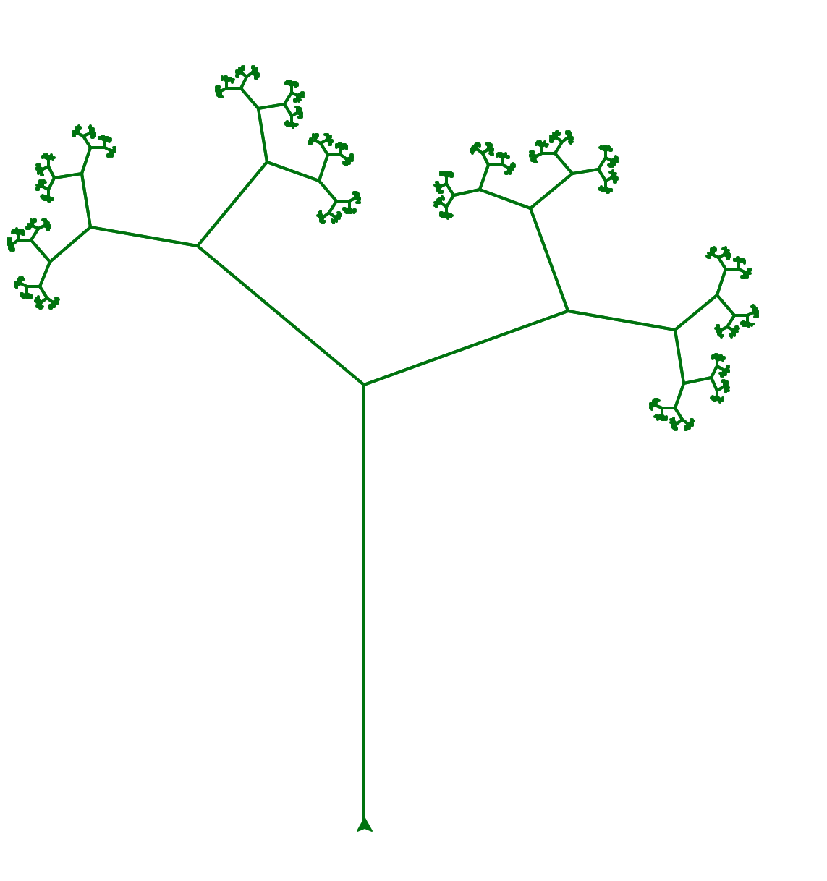
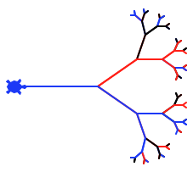
Trees
Errick Jackson
Katelyn B.

Slide 123
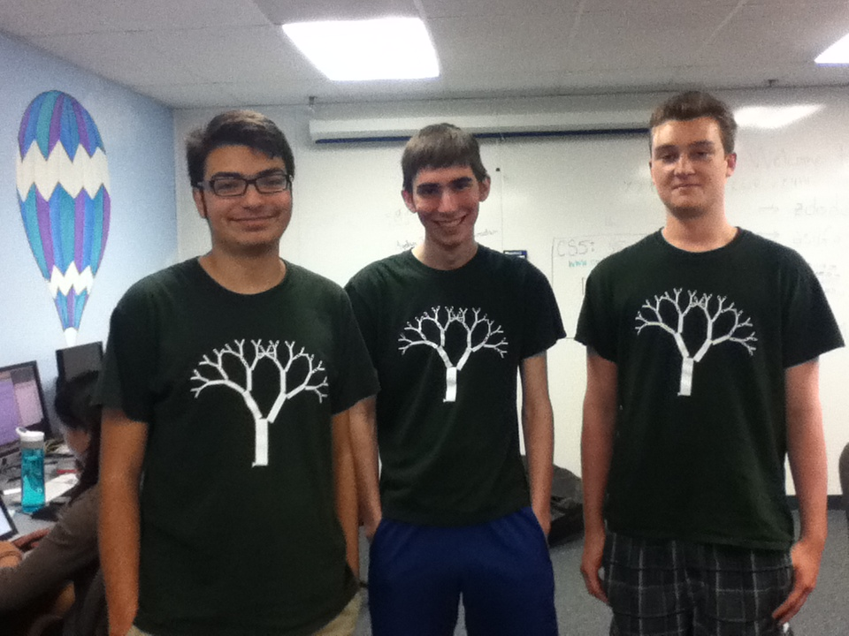
Trees

Slide 124


Trees
Marissa L.
and snowflakes…

Slide 125


Kevin B.

Slide 126


Treeflakes?

Slide 127


Others… !
C. Hoyt
Annie Ludlow

Slide 128


Snowflake?
svtree?
It all depends on how you define success ...

Slide 129

treefail3.png
Snowflake?
svtree?
It all depends on how you define success ...

Slide 130

Snowflake?
svTree?
It all depends on how you define success ...
SNOWFLAKE?!

