Slide 1
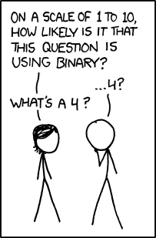
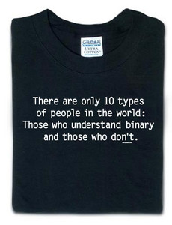
CS 101 Today
Jotto Corner
The Top-10 list of binary jokes...
am guess
bagel: 2
first: 0
my guess
diner: 1
ghost: 2
Lani C.
pm guess
alien: 0
slope: 2
my guess
diner: 2
sassy: 0
Madeline M.
Looking Back – Looking Forward
Programming as composition
Representation and Organization
"clay" = functions
"clay" = data, bits (!)

Slide 2
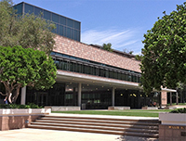
Thursday AM?
Physics would like to use Macalister at 8:10am, so…
No change if you're sticking to the afternoon…
we will meet here at 8:10 am and 1:15pm
or, you can always go to Macalister and take an E&M exam!

Slide 3
Some legs to stand on… ?
decipher
max
encipher
score
rot(c,n)
program organization
creating more and more capable compositions
ord
chr

Slide 4
Some legs to stand on!
It looks like I'm a head here…
decipher
max
encipher
score
rot(c,n)
program organization
creating more and more capable compositions
ord
chr
bits!
circuits
computer organization
how are even these fundamentals physically realized ?!

Slide 5
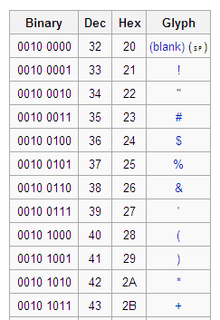
Binary Storage & Representation
8 bits = 1 byte = 1 box
The SAME bits can represent different pieces of data, depending on type
value:
value:
'*'
42
00101010
00101010
type: str
bits
bits
type: int
name:
name:
The same bits are in each container.
But why these bits?

Slide 6
What is 42 ?

Slide 7
Base 10
ONEs column
TENs column
42
What is 42 ?
4 tens + 2 ones
HUNDREDs column
TENs column
ONEs column
123
1 hundred + 2 tens + 3 ones

Slide 8
Base 2
Base 10
each column represents the base's next power
ONEs column
TENs column
THIRTYTWOs col.
EIGHTs column
SIXTEENs col.
FOURs column
TWOs column
ONEs column
42
101010
4 tens + 2 ones
128's column
HUNDREDs column
SIXTYFOURs col
THIRTYTWOs col.
EIGHTs column
SIXTEENs col.
FOURs column
TWOs column
ONEs column
TENs column
ONEs column
123
--------
1 hundred + 2 tens + 3 ones
Write 123 in binary…

Slide 9
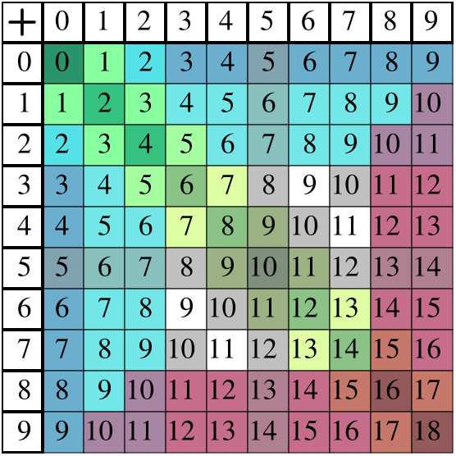
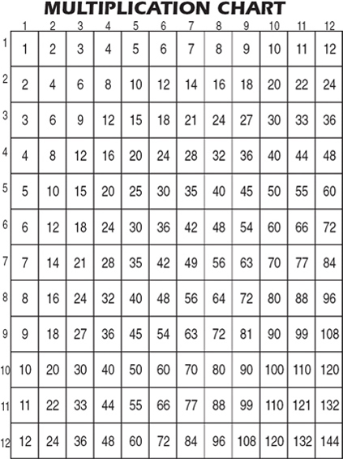
Binary math
Decimal math
tables of basic facts
+
How big are these two tables?
Addition
*
Multiplication

Slide 10
Binary math
Decimal math
tables of basic facts
+
Addition
*
Multiplication

Slide 11
Quiz
In binary, I'm an 11-eyed alien!
Name(s):
32
16
8
4
2
1
110011
10001000
Convert these two binary numbers to decimal:
28
101
Convert these two decimal numbers to binary:
WITHOUT converting to decimal !
Add these two binary numbers:
Multiply these binary numbers:
101101
101101
+
1110
*
1110
1
1
529
Hint: Remember these algorithms? They're the same in binary!
529
+
742
*
2
Extra! Can you figure out the last binary digit (bit) of 7,053 without determining any other bits? The last two? three?
1271
1058

Slide 12
Convert these two binary numbers to decimal:
32
16
8
4
2
1
128
64
32
16
8
4
2
1
110011
10001000
Convert these two decimal numbers to binary:
28
101
32
16
8
4
2
1
128
64
32
16
8
4
2
1
Extra! Can you figure out the last two binary digits of 78,922,353 without determining any other bits?
We'll return to this in a bit…

Slide 13
Add these two binary numbers WITHOUT converting to decimal !
1
Hint:
529
+
742
Do you remember this algorithm? It's the same!
101101
1271
+
1110
45
14

Slide 14
Multiply these two binary numbers WITHOUT converting to decimal !
529
Hint:
*
42
Do you remember this algorithm? It's the same!
101101
1058
2116
*
1110
22218
A machine could - and probably should - be doing this !
45
14

Slide 15
Beyond Binary
base 1
digits: 1
111111111111111111111111111111111111111111
32
16
8
4
2
1
101010
base 2
digits: 0, 1
27
9
3
1
base 3
digits: 0, 1, 2
42 ?
There are 10 kinds of "people" in the universe: those who know ternary, those who don't, and those who think this is a binary joke!

Slide 16
Beyond Binary
base 1
digits: 1
111111111111111111111111111111111111111111
32
16
8
4
2
1
101010
base 2
digits: 0, 1
27
9
3
1
1120
base 3
digits: 0, 1, 2
base 4
base 5
Which of these isn't 42...?
base 6
222
60
54
46
39
base 7
base 8
and what are the bases of the rest?
base 9
base 10
42
digits: 0, 1, 2, 3, 4, 5, 6, 7, 8, 9
base 11
base 12

Slide 17
base 1
digits: 1
111111111111111111111111111111111111111111
128
64
32
16
8
4
2
1
101010
base 2
digits: 0, 1
81
27
9
3
1
1120
base 3
digits: 0, 1, 2
64
16
4
1
base 4
digits: 0, 1, 2, 3
222
125
25
5
1
base 5
digits: 0, 1, 2, 3, 4
132
216
36
6
1
base 6
digits: 0, 1, 2, 3, 4, 5
110
49
7
1
base 7
digits: 0, 1, 2, 3, 4, 5, 6
60
64
8
1
base 8
52
digits: 0, 1, 2, 3, 4, 5, 6, 7
81
9
1
base 9
46
digits: 0, 1, 2, 3, 4, 5, 6, 7, 8
100
10
1
base 10
42
digits: 0, 1, 2, 3, 4, 5, 6, 7, 8, 9
121
11
1
base 11
39
digits: 0, 1, 2, 3, 4, 5, 6, 7, 8, 9, A
Hexadecimal
256
16
1
base 16
2A
digits: 0, 1, 2, 3, 4, 5, 6, 7, 8, 9, A, B, C, D, E, F

Slide 18
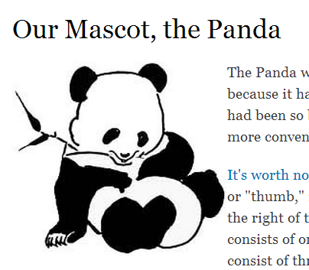
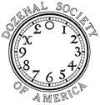
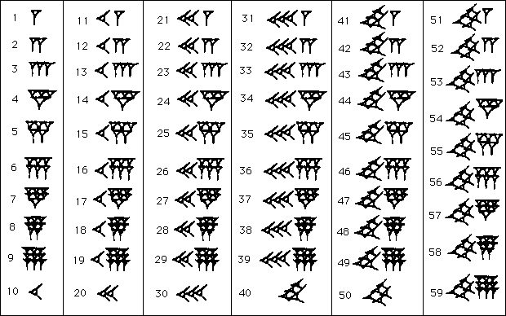

Off base?
Base 12 –
"Duodecimal Society" "Dozenal Society"
Base 20 – Americas
Base 60 – Ancient Sumeria
Olmec base-20 number representations
Eastern Mexico, 1200 BC - 600 AD
Echoes of these bases still bounce around…
Notes:
Echoes:
dozen, gross -- show donzenal society pages:
http://www.dozenal.org/index.php?u=31
http://www.polar.sunynassau.edu/~dozenal/
British units: 12 inches, 12 ounces (Latin: uncia)
time: 12 hours
60: seconds, minutes, circular arcs -- from a 360 day calendar of the ancient sumerians and babylonians (circle of the sun going around the earth)
base 20 -- even though there is no evidence in Europe…
fingers + toes
"four score and seven years ago"
languages exhibit it:
French
Twenty (vingt) is used as a base number in the French language names of numbers from 60 to 99. So for example, quatre-vingts, the French word for 80 literally means "four twenties", and soixante quinze, the word for 75 is literally "sixty-fifteen.").

Slide 19
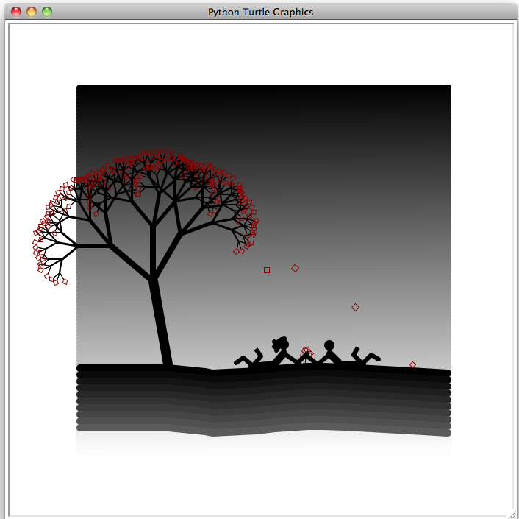
Who are these two?
(1) Bella and Edward
(2)
Harry and Ginny
(3)
Anakin and Padme
(4)
Lily and Severus
a turtle-drawn portrait from a year or two ago…

Slide 20
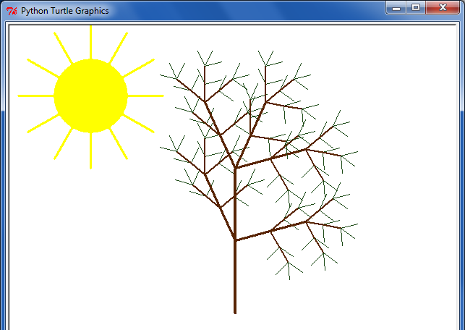
| -_-_-_-_-_-_-_,------, |
| _-_-_-_-_-_-_-| /\_/\ |
| -_-_-_-_-_-_-~|__( ^ .^) |
| _-_-_-_-_-_-_-"" "" |
| -_-_-_-_-_-_-_,------, |
| _-_-_-_-_-_-_-| /\_/\ |
| -_-_-_-_-_-_-~|__( ^ .^) |
| _-_-_-_-_-_-_-"" "" |
| -_-_-_-_-_-_-_,------, |
| _-_-_-_-_-_-_-| /\_/\ |
| -_-_-_-_-_-_-~|__( ^ .^) |
| _-_-_-_-_-_-_-"" "" |
| -_-_-_-_-_-_-_,------, |
| _-_-_-_-_-_-_-| /\_/\ |
| -_-_-_-_-_-_-~|__( ^ .^) |
| _-_-_-_-_-_-_-"" "" |
| -_-_-_-_-_-_-_,------, |
| _-_-_-_-_-_-_-| /\_/\ |
| -_-_-_-_-_-_-~|__( ^ .^) |
| _-_-_-_-_-_-_-"" "" |
| -_-_-_-_-_-_-_,------, |
| _-_-_-_-_-_-_-| /\_/\ |
| -_-_-_-_-_-_-~|__( ^ .^) |
| _-_-_-_-_-_-_-"" "" |
| -_-_-_-_-_-_-_,------, |
| _-_-_-_-_-_-_-| /\_/\ |
| -_-_-_-_-_-_-~|__( ^ .^) |
| _-_-_-_-_-_-_-"" "" |
| -_-_-_-_-_-_-_,------, |
| _-_-_-_-_-_-_-| /\_/\ |
| -_-_-_-_-_-_-~|__( ^ .^) |
| _-_-_-_-_-_-_-"" "" |
| -_-_-_-_-_-_-_,------, |
| _-_-_-_-_-_-_-| /\_/\ |
| -_-_-_-_-_-_-~|__( ^ .^) |
| _-_-_-_-_-_-_-"" "" |
|-_-_-_-_-_-_-_,------, |
|_-_-_-_-_-_-_-| /\_/\ |
|-_-_-_-_-_-_-~|__( ^ .^) |
|_-_-_-_-_-_-_-"" "" |
68
Eye-catching submissions...
ASCII wanderings...
and turtle art

Slide 21
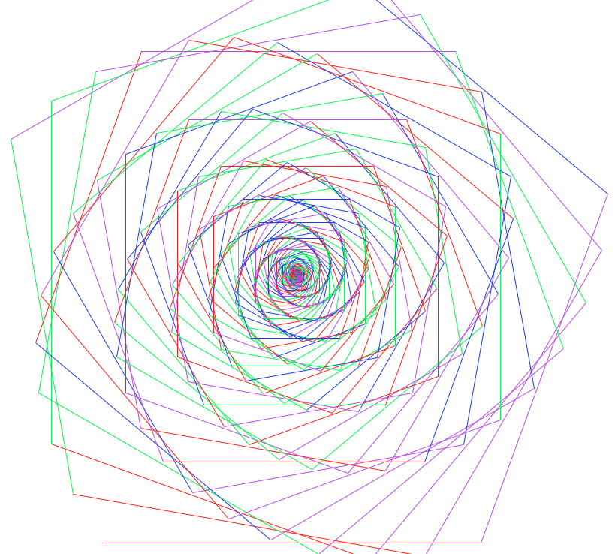
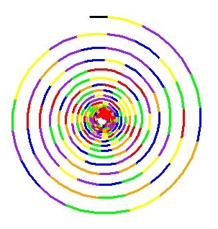
Spirals
Savannah Baron
Phong Nguyen

Slide 22
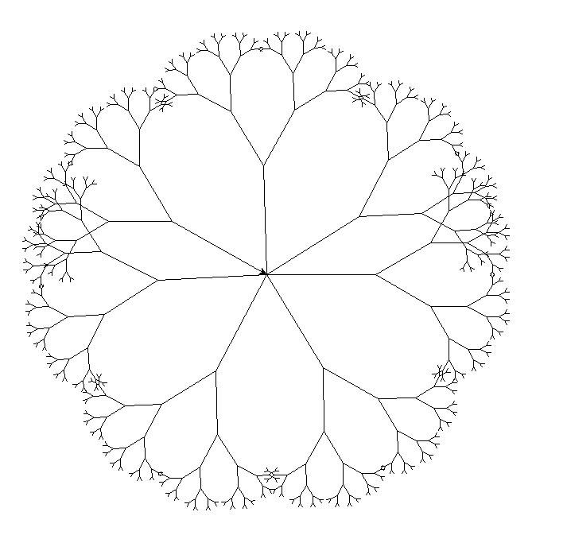
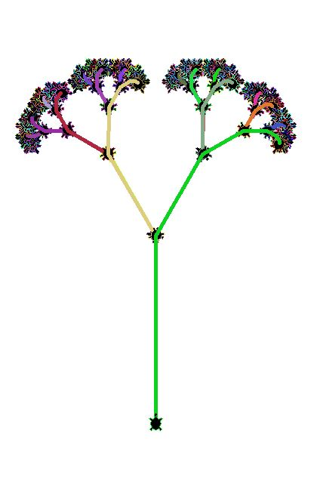
Trees
Ian Song
Jeremy Wang

Slide 23
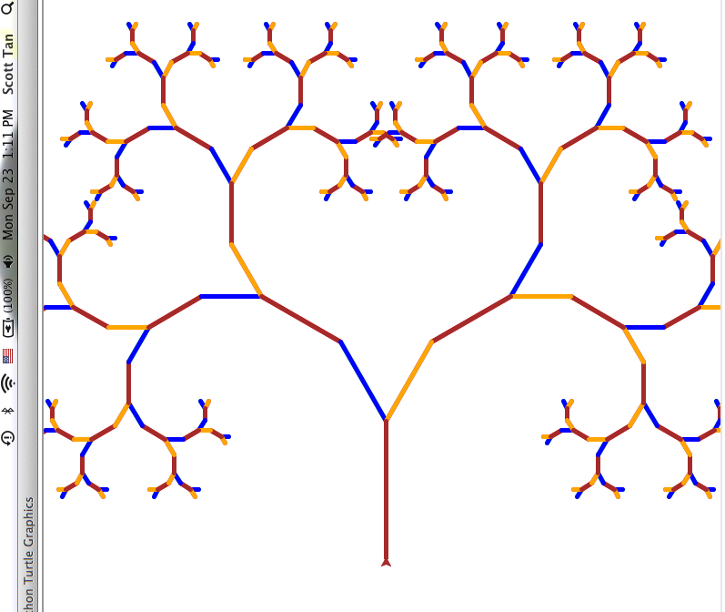
Scott Tan

Slide 24
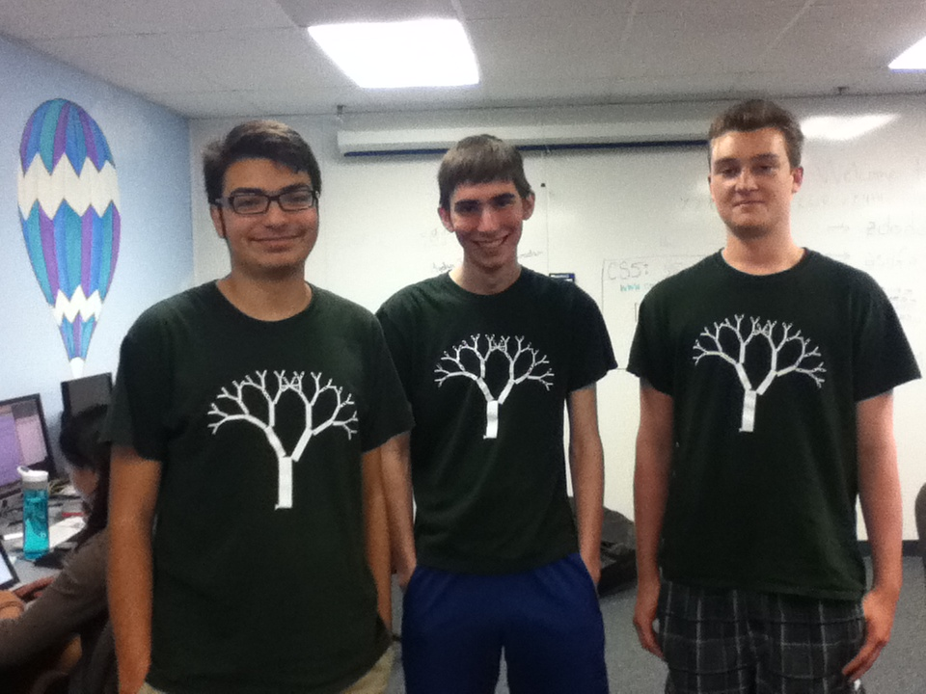

Slide 25
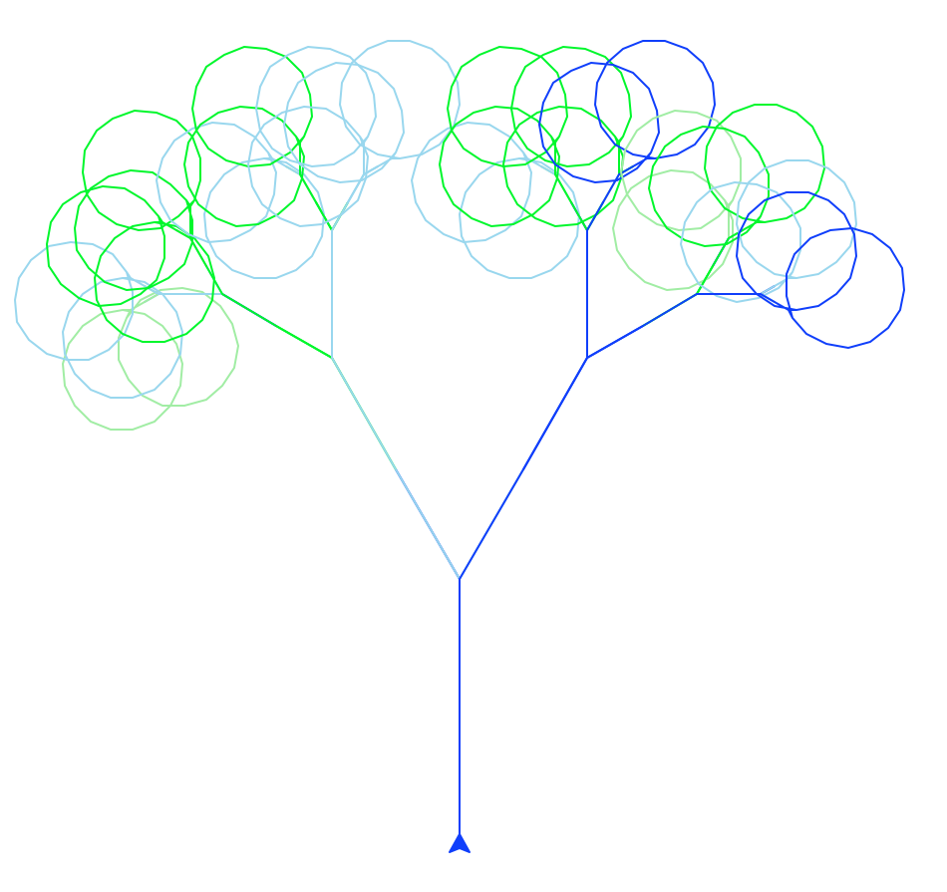
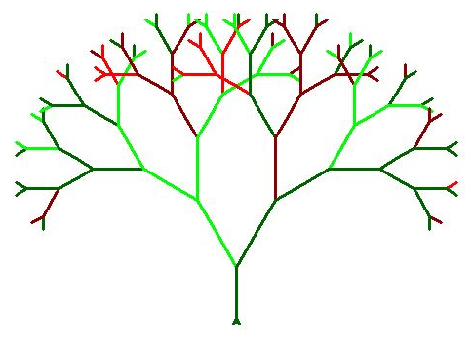
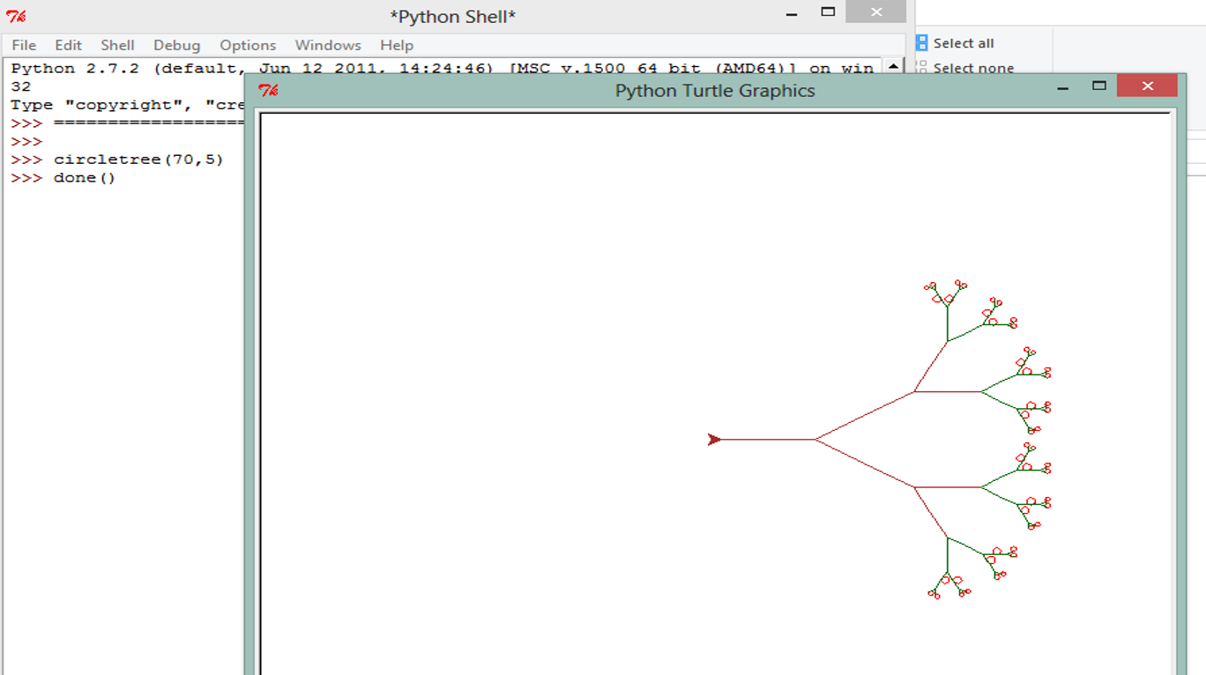
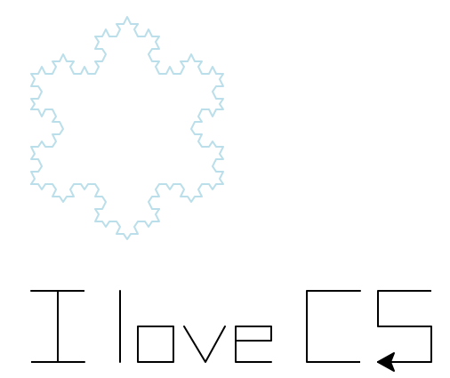
Trees
Phong Nguyen
Kathleen Kohl
Annisa Dea

Slide 26
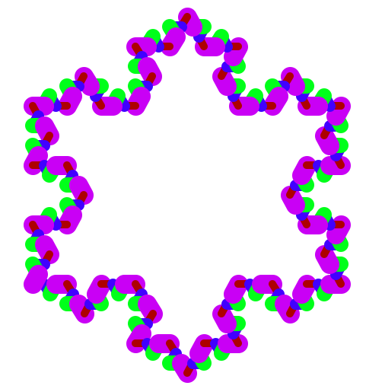
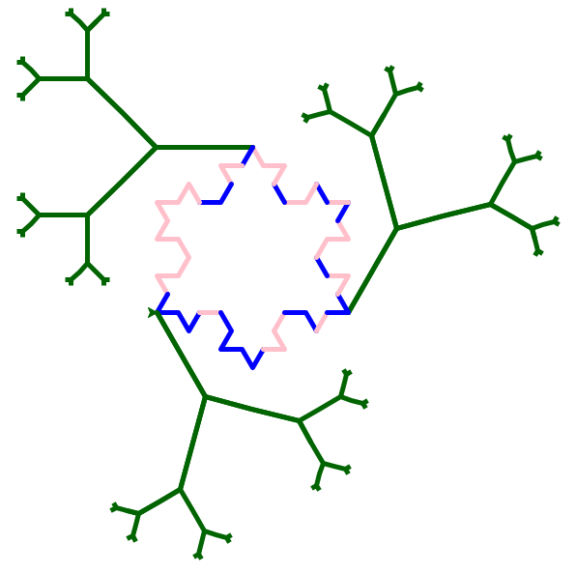
Treeflake?
Willie Zuniga
Nathan Miller

Slide 27
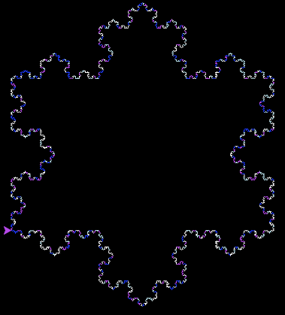
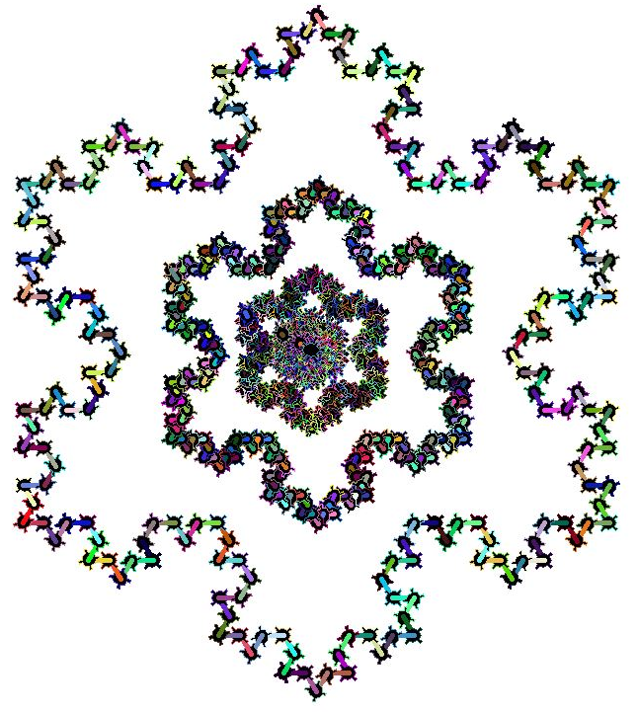
Snowflakes
Savannah Baron
Ian Song

Slide 28
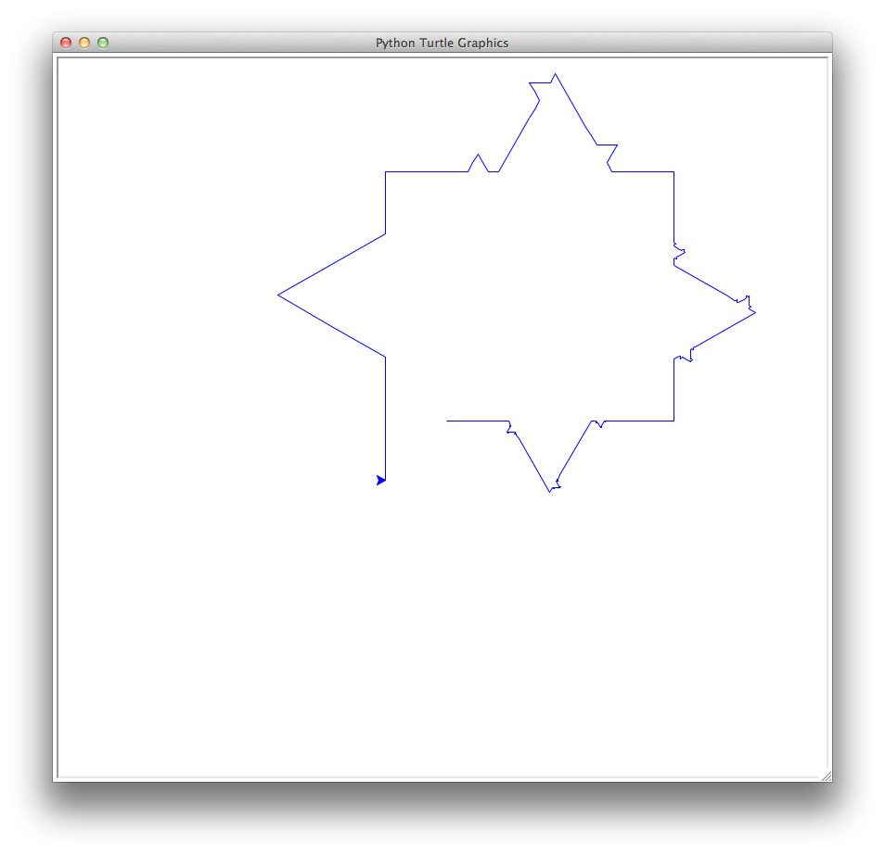
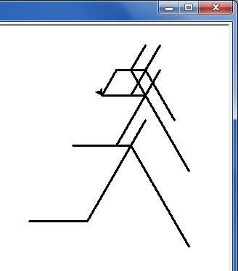
Snowflake?
svtree?
All depends on how you define "success" ...

Slide 29
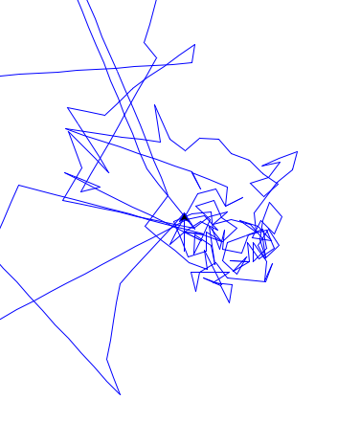
Snowflake?
svTree?
All depends on how you define "success" ...
SNOWFLAKE?!

Slide 30
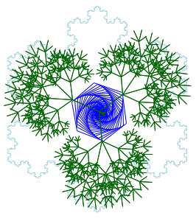
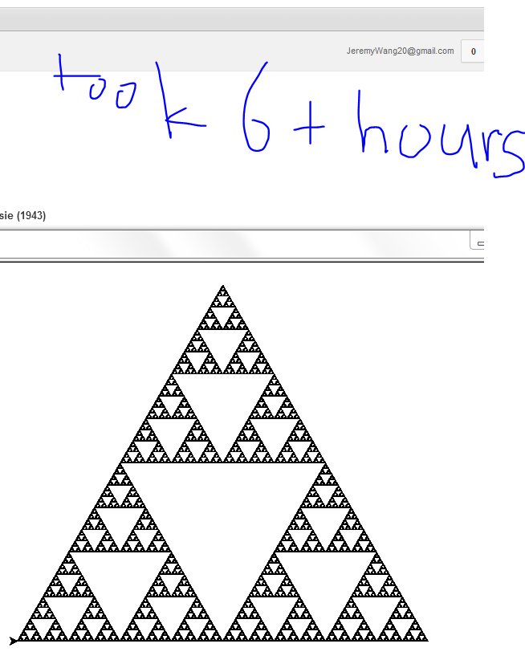
Others!?
Jeremy Wang
Thor Kamphefner

Slide 31
Jeremy Wang
Thor Kamphefner
Su Min's "Better than the snowflake!"

Slide 32
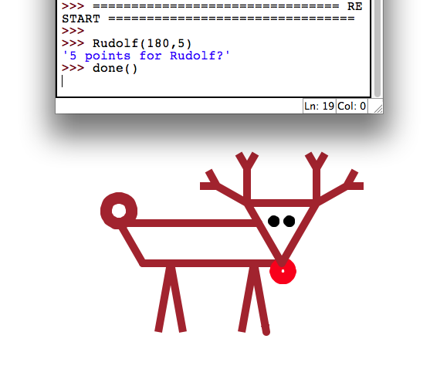
Su Min Ha

Slide 33
Back to binary…

Slide 34
Lab 4: Computing in binary
base 2
base 10
…
4
2
1
100
10
1
=
139
This first step of left-to-right conversion into binary is tricky to program... Why?
You mean aside from having to think in binary?

Slide 35
Lab 4: Computing in binary
base 2
base 10
128
64
32
16
8
4
2
1
100
10
1
=
139
This first step of left-to-right conversion into binary is tricky to program... Why?
It's tricky to find the largest power needed…

Slide 36
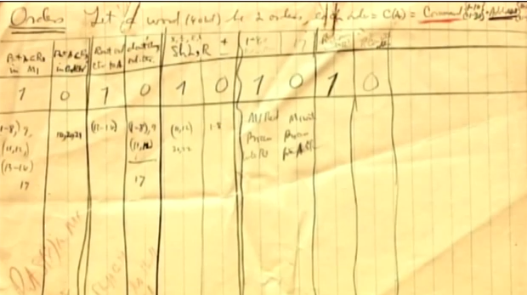
Extra! Can you figure out the last binary digit (bit) of 7,053 without determining any other bits? The last two? three?
b.d. ~ binary digit ~ bit
"bit" first appeared in print in 1948 (Claude Shannon)
early document allocating different bits to control or data portions of a processor's work

Slide 37
Extra! Can you figure out the last binary digit (bit) of 7,053 without determining any other bits? The last two? three?
…
8s
4s
2s
1s
53

Slide 38
Lab 4: Computing in binary
base 2
base 10
128
64
32
16
8
4
2
1
100
10
1
=
139
Try right-to-left!
What does the fact that 139 is ODD tell us?!

Slide 39
Lab 4: Computing in binary
base 2
base 10
128
64
32
16
8
4
2
1
100
10
1
10001011
=
139
Right-to-left works!
numToBinary( N )
binaryToNum( S )
You'll write these right! (-to-left)
And to represent binary numbers? Strings!
'10001011'

Slide 40
Lab 4: Computing in binary
base 2
base 10
128
64
32
16
8
4
2
1
100
10
1
10001011
=
139
def numToBinary( N ):
if N == 0:
return ''
elif N%2 == 0:
return numToBinary( ) +
else:
return numToBinary( ) +
empty string represents leading 0s
If N is even, what is the final bit?
?
If N is odd, what is the final bit?

Slide 41
Reasoning, bit by bit
<<
>>
Python did always look a little shifty to me…
left-shift
right-shift
left-shift by 1
3: 11
3 << 1
6
What does left-shifting do to the value of a #?
left-shift by 2
3: 11
3 << 2
What does right-shifting do to the value of a #?
right-shift by 2
101010
42 >> 2

Slide 42
Reasoning, bit by bit
<<
>>
left-shift
right-shift
left-shift by 1
3: 11
3 << 1
6
&
|
and
or
left-shift by 2
bitwise and
3 << 2
5: 101
5 & 6
3: 11
6: 110
12
4
& 100
right-shift by 2
bitwise or
42 >> 2
5: 101
5 | 6
101010
6: 110
7
10
& 111

Slide 43
Being bit-wise
Evaluate these bitwise operations
You don't need to convert to binary for these three…!
14: 1110
13: 1011
7 << 1
You'll need to use binary here.
14 & 13
5 << 4
14 | 13
170 >> 2
In processors shifts, ands, ors, adds, and subtractions are much faster than multiplying, dividing, and mod, which are relatively slow.
N/4
Given this, what is a way to compute these statements using combinations from only the fast operations above?
N*7
N*17
N%16

Slide 44
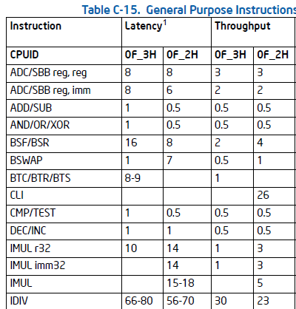
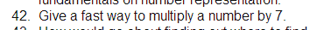
Intel x86 processor instructions and their speeds (2011)
In processors shifts, ands, ors, adds, and subtractions are much faster than multiplying, dividing, and mod, which are relatively slow.
Old Microsoft interview question:
www.dailyjobquestions.com/microsoft-questions.html

Slide 45
Intel x86 processor instructions and their speeds (2011)
In processors shifts, ands, ors, adds, and subtractions are much faster than multiplying, dividing, and mod, which are relatively slow.
+ MOD
N/4
Given this, what is a way to compute these statements using combinations from only the fast operations above?
N*7
N*17
N%16

Slide 46
Insight: Russian Peasants' Multiplication
Notes:
This algorithm for multiplying two numbers was evidently widely used by peasants in Russia into the 19th century and is evidently still used in some parts of Russia!
The algorithm goes like this: Write down the two numbers side-by-side. In this case, 21 and 6. Then divide 21 by 2 (rounding down) and multiply 6 by 2. Repeat this process until the number in the left column becomes 1. Then, highlight those rows in which the first number is odd. In those rows, collect all the number in the second column and add them up. That’s the desired product!

Slide 47
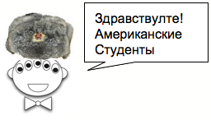
Insight: Russian Peasants' Multiplication
The RPM algorithm
21 × 6 == 126
Write the factors in two columns.
Repeatedly halve the LEFT and double the RIGHT.
Pull out the RIGHT values where the LEFT values are odd.
Sum those values for the answer!
21 6
Why does this work?
11 × 15 == 165
11 15
Hey, buddy, can you spare an eye?
(Translation: “Hello, American Students!” I've been told there's a typo here, too!)
Notes:
This algorithm for multiplying two numbers was evidently widely used by peasants in Russia into the 19th century and is evidently still used in some parts of Russia!
The algorithm goes like this: Write down the two numbers side-by-side. In this case, 21 and 6. Then divide 21 by 2 (rounding down) and multiply 6 by 2. Repeat this process until the number in the left column becomes 1. Then, highlight those rows in which the first number is odd. In those rows, collect all the number in the second column and add them up. That’s the desired product!

Slide 48
Insight: Russian Peasants' Multiplication
110
10101
6
x
21
21 6
10 12
5 24
2 48
1 96
110
0000
11000
000000
1100000
6
24
96
6
12
24
48
+
96
+
1111110
126
126
Decimal
Binary
Notes:
To see why it works, let’s convert the numbers in both columns to binary.

Slide 49
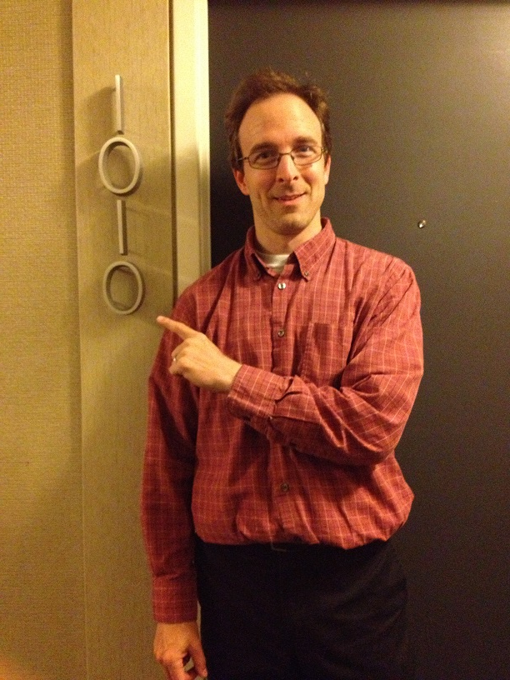
See you in lab – in a bit!
When traveling, always insist on binary!

Slide 51
Binary math
Decimal math
tables of basic facts
Addition
+
Multiplication
*

Slide 52
Insight: Multiplication with Russian Peasants
21 × 6 == 126
Write the factors in two columns.
Repeatedly halve the LEFT and double the RIGHT.
Pull out the RIGHT values where the LEFT values are odd.
Sum those values for the answer.
21 6
Try it. Why does it work?
11 × 15 == 165
11 15
Hey, buddy, can you spare an eye?
(Translation: “Hello, American Students!” I've been told there's a typo here, too!)
Notes:
This algorithm for multiplying two numbers was evidently widely used by peasants in Russia into the 19th century and is evidently still used in some parts of Russia!
The algorithm goes like this: Write down the two numbers side-by-side. In this case, 21 and 6. Then divide 21 by 2 (rounding down) and multiply 6 by 2. Repeat this process until the number in the left column becomes 1. Then, highlight those rows in which the first number is odd. In those rows, collect all the number in the second column and add them up. That’s the desired product!

Slide 53
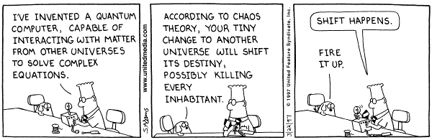
Shift happens...
100
10
1
42
def leftshift( s ):
""" left-shift by one bit """
return s + '0'
420
What does left-shifting do to the value of a decimal number?
4
2
1
11
110
What does it do to the value of a binary number?

Slide 54
Shift happens...
100
10
1
420
def rightshift( s ):
""" right-shift by one bit """
return
42
What does right-shifting do to the value of a decimal number?
4
2
1
110
11
What does it do to the value of a binary number?

Slide 55
A bit of intuition…
Sometimes the bits are almost visible:
21 << 1
5 & 6
5 | 6
?
?
?
21 >> 1
5 ^ 6
?
?
What will these output values be?

Slide 56
Insight: Multiplication with Russian Peasants
110
10101
6
x
21
21 6
10 12
5 24
2 48
1 96
110
0000
11000
000000
1100000
6
24
96
6
12
24
48
+
96
+
1111110
126
126
Decimal
Binary
Notes:
To see why it works, let’s convert the numbers in both columns to binary.

Slide 57
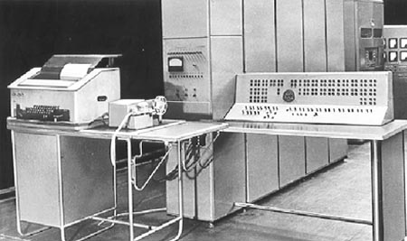

Why binary ?
Simplest, but requires the most space…
And only is this galaxy did those experiments fail !
There were experiments with ternary computation…
50 of these Setun ternary machines were made at Moscow University ~1958
They were deployed throughout the CCCP.
Redesigns continued until about 1970…
http://sovietcomputing.com/node/47
http://museum.e-ukraine.org/PHOTOS/Setun-1.html

Slide 58

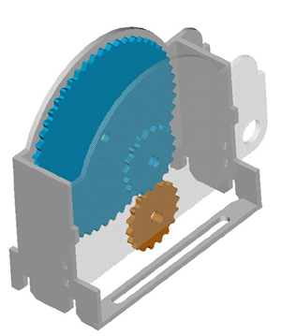
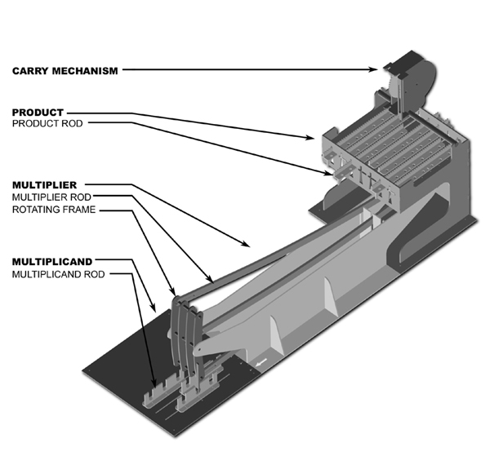
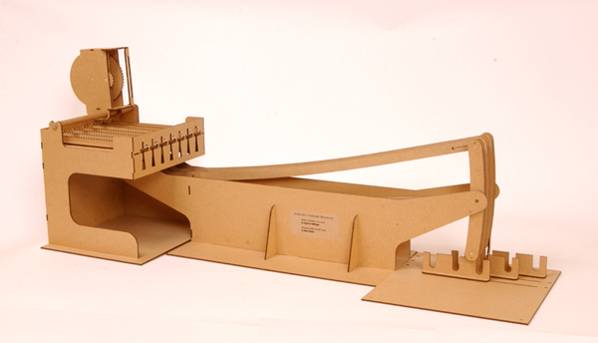
Thomas Fowler's Ternary Computer
finally some sanity in human computing!
balanced ternary calculations from Fowler's papers
the carry mechanism
the reconstruction
the computational components
T. Fowler 1777-1843, Treasurer of the Poor Law Union
Notes:
http://www.mortati.com/glusker/fowler/fowlerbio.htm
"In the 1830’s, Fowler was Treasurer of the Poor Law Union. This job required a considerable number of repetitive monetary calculations, made more complex by the pre-decimal British currency."

Slide 59
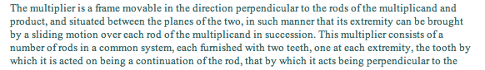
The machine was rebuilt from two sources:
a two-page description (with no images) by mathematician A. DeMorgan
http://www.mortati.com/glusker/fowler/index.htm

Slide 60
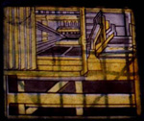
The machine was rebuilt from two sources:
a two-page description (with no images) by mathematician A. DeMorgan
a picture of it as a stained-glass window in Fowler's church: St. Michael's of Great Torrington, North Devon, U.K.!
http://www.mortati.com/glusker/fowler/index.htm

Slide 61
This week's homework may be submitted in two formats: electronically or in stained glass.
See you in Lab!

Slide 62
Base 2
Base 10
each column represents another power of the base
TWOS
THOUSANDTHS
HUNDRETHS
DECIMAL point
ONES
QUARTERS
TENTHS
ONES
EIGHTHS
BINARY point
HALVES
10.011
2.375
0.0001100110011001100110011...
0.1
Now I see the "point" of binary!

Slide 63
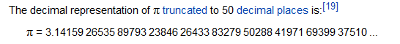
Floats? Let's look at math.pi...
>>> import math
>>> math.pi
3.141592653589793
Seems ok...
How to get the least significant figures?

Slide 64
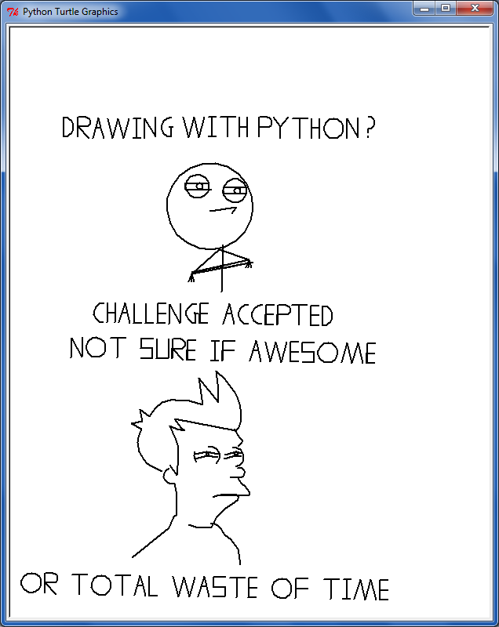
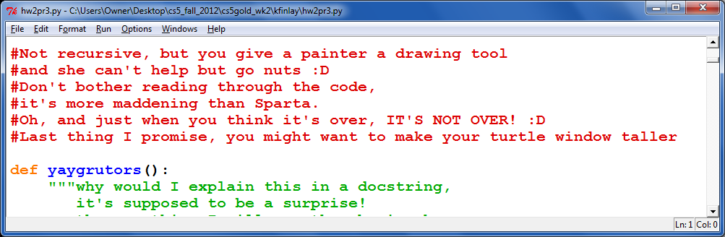
?!?!

Slide 65
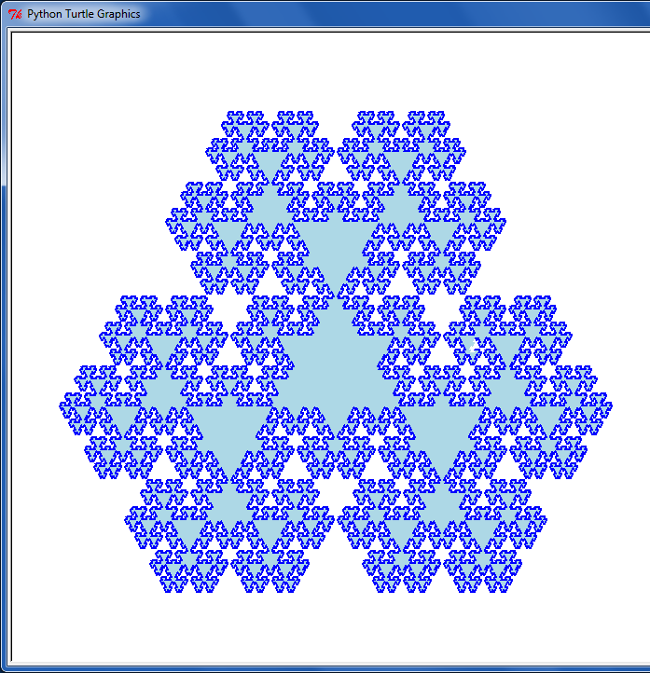
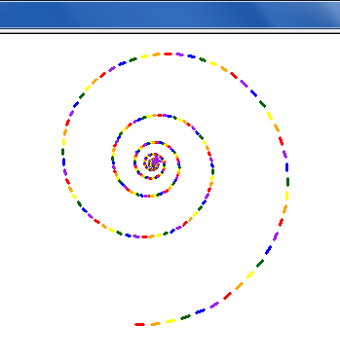
Eye-catching submissions...

Slide 66
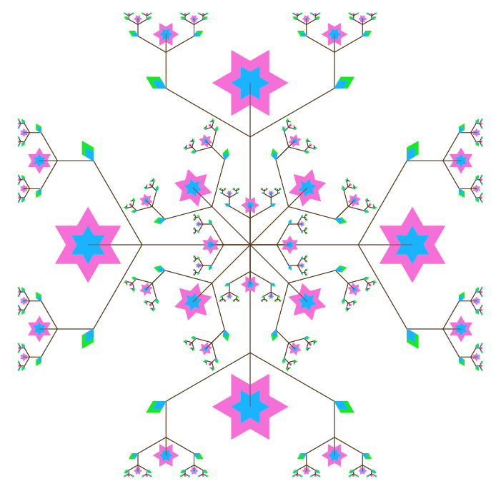
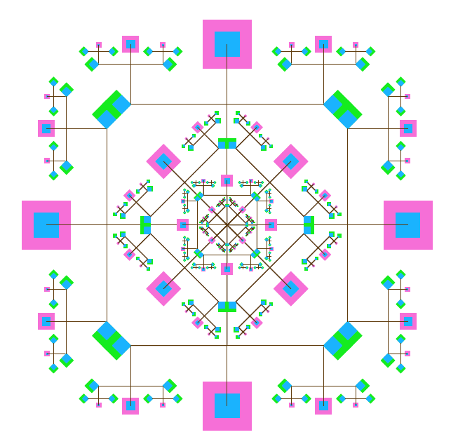
Eye-catching submissions...

Slide 67


Turtle Art…

Slide 68


Bits everywhere!
LA County Fair
most binary dessert!

Slide 69
Imagine if we had only 4 bits …
.0625
.125
We could only represent these values!
.25
.5
0.0000
0.0000
How would the machine represent 8/10 ?
0.0001
0.0625
0.0010
0.1250
We might type the decimal value 0.8
The computer represents it as the closest available float:
This float's decimal value is 0.8125
So, it acts like you typed 0.8125 !
Including when the value gets printed
0.0011
0.1875
0.0100
0.2500
0.0101
0.3125
…
…
0.1100
0.7500
0.1101
0.8125
0.1110
0.8750
0.1111
0.9375
4 bits

Slide 70


IEEE* floats
*Institute of Electrical and Electronics Engineers
Python uses double precision floats
64 bits == 8 bytes each

Slide 71
Base 2
Base 10
each column represents another power of the base
TENs column
ONEs column
THIRTYTWOs col.
EIGHTs column
SIXTEENs col.
FOURs column
TWOs column
ONEs column
42
101010
4 tens + 2 ones
128s column
SIXTYFOURs col
THIRTYTWOs col.
HUNDREDs column
EIGHTs column
SIXTEENs col.
FOURs column
TWOs column
ONEs column
TENs column
ONEs column
123
--------
1 hundred + 2 tens + 3 ones
Write 123 in binary…

Slide 72
Binary math
Decimal math
tables of basic facts
Addition
+
Multiplication
*

Slide 73
MULTIPLY these two binary numbers WITHOUT converting to decimal !
529
*
42
Hint:
101101
Do you remember this algorithm? It's the same!
1058
*
1110
2116
22218

Slide 74
Lab 4
base 2
base 10
RIGHT-to-LEFT conversion !
128
64
32
16
8
4
2
1
100
10
1
10001000
=
136
def numToBinary( N ):
if N == 0:
return ''
elif N%2==0:
return
Which other operators will you need in this recursive case of numToBinary?

Slide 75
Base 2
Base 10
each column represents another power of the base
TENs column
ONEs column
THIRTYTWOs col.
EIGHTs column
SIXTEENs col.
FOURs column
TWOs column
ONEs column
42
101010
4 tens + 2 ones
128s column
SIXTYFOURs col
THIRTYTWOs col.
HUNDREDs column
EIGHTs column
SIXTEENs col.
FOURs column
TWOs column
ONEs column
TENs column
ONEs column
123
--------
1 hundred + 2 tens + 3 ones
Write 123 in binary…

Slide 76
Binary math
Decimal math
tables of basic facts
Addition
+
Multiplication
*

Slide 77
"Quiz"
There are 10 kinds of "people" in the universe: those who use binary, and those who do not!
Name(s):
32
16
8
4
2
1
Convert these two binary numbers to decimal:
110011
10001000
Convert these two decimal numbers to binary:
28
101
WITHOUT converting to decimal !
Add these two binary numbers:
Multiply these binary numbers:
101101
101101
+
1110
*
1110
1
529
+
Hint: Remember this algorithm? It's the same…
742
1271

Slide 78
Off base?
All this focus on 10 seems so alien!
Base 60 – Ancient Sumeria
Base 12 – "Duodecimal Society" "Dozenal Society"
Olmec base-20 number representation (East Mexico, 1200 BC-600 AD)
Base 20 – America, precolombus
Echoes of these bases are still bouncing around…
Notes:
Echoes:
dozen, gross -- show donzenal society pages:
http://www.dozenal.org/index.php?u=31
http://www.polar.sunynassau.edu/~dozenal/
British units: 12 inches, 12 ounces (Latin: uncia)
time: 12 hours
60: seconds, minutes, circular arcs -- from a 360 day calendar of the ancient sumerians and babylonians (circle of the sun going around the earth)
base 20 -- even though there is no evidence in Europe…
fingers + toes
"four score and seven years ago"
languages exhibit it:
French
Twenty (vingt) is used as a base number in the French language names of numbers from 60 to 99. So for example, quatre-vingts, the French word for 80 literally means "four twenties", and soixante quinze, the word for 75 is literally "sixty-fifteen.").

Slide 79
Lab 4
base 2
base 10
RIGHT-to-LEFT conversion !
128
64
32
16
8
4
2
1
100
10
1
10001000
=
136
def numToBinary( N ):
if N == 0:
return ''
elif N%2==0:
return
Which other operators will you need in this recursive case of numToBinary?

Slide 80
Beyond Binary
base 1
digits: 1
111111111111111111111111111111111111111111
128
64
32
16
8
4
2
1
101010
base 2
digits: 0, 1
base 10
42
digits: 0, 1, 2, 3, 4, 5, 6, 7, 8, 9

Slide 81
Beyond Binary
base 1
digits: 1
111111111111111111111111111111111111111111
128
64
32
16
8
4
2
1
101010
base 2
digits: 0, 1
81
27
9
3
1
base 3
digits: 0, 1, 2
base 10
42
digits: 0, 1, 2, 3, 4, 5, 6, 7, 8, 9

Slide 82

What isn't 42?
(A)
222
Wake Forest U.
(D)
46
(B)
60
(E)
39
(C)
54
Only one of these is not 42, regardless of the base of the numbering system... Which?
Notes:
Jeopardy music?
Backwards?

Slide 83

The power of shifting…
100
10
1
420
def rightshift( s ):
""" right-shift by 1 """
return
42
What does right-shifting do to the value of a decimal number?
4
2
1
110
11
What does it do to the value of a binary number?

Slide 84

Speed…
What would be a fast way to determine these values… ?
other than typing them into Python ?!?
5 << 4
100 >> 3
In many processors shifting, adding, and subtracting are faster than multiplying and dividing.
What is a "fast" way to multiply N*7 or N*17 ?
On an Intel Pentium, an integer multiply takes 10 clock ticks (cycles).
The same chip can do 2 additions in one clock tick (cycle).
http://www.xmission.com/pub/lists/fractint/archive/v01.n028

Slide 85
Lab 4
base 2
base 10
RIGHT-to-LEFT conversion !
128
64
32
16
8
4
2
1
100
10
1
10001000
=
136
def numToBinary( N ):
if N == 0:
return ''
elif N%2==0:
return
(A)
(B)
(C)
(D)
(E)
%
/
%,/
+,%
+,/
Which other operators will you need in this recursive case of numToBinary?

Slide 86
Aside: Multiplication with Russian Peasants
Compute 21 × 6:
21 6
10 12
5 24
2 48
1 96
Write the factors in two columns. Repeatedly halve and double, respectively.
Add the right-hand values in rows where the left-hand side is ODD…
Odd is an understatement here!
(Translation: “Hello, American Students!”)
Notes:
This algorithm for multiplying two numbers was evidently widely used by peasants in Russia into the 19th century and is evidently still used in some parts of Russia!
The algorithm goes like this: Write down the two numbers side-by-side. In this case, 21 and 6. Then divide 21 by 2 (rounding down) and multiply 6 by 2. Repeat this process until the number in the left column becomes 1. Then, highlight those rows in which the first number is odd. In those rows, collect all the number in the second column and add them up. That’s the desired product!

Slide 87
Aside: Multiplication with Russian Peasants
110
10101
110
000
11000
000
1100000
The values in binary…
110
1010 1100
101 11000
10 110000
1 1100000
1111110
1111110
This is just the grade-school algorithm for multiplication!
Why the doubling? Why the halving?

Slide 88
sinking with floats
.0625
Imagine we had only 4 bits …
.125
.25
.5
0.0000
0.0000
0.0001
0.0625
0.0010
0.1250
0.0011
0.1875
0.0100
0.2500
lots of gaps in here…
0.0101
0.3125
…
…
0.1100
0.7500
0.1101
0.8125
0.1110
0.8750
0.1111
0.9375
In reality, 23 bits or 52 bits will be used to represent the fractional part of a floating-point number
4 bits

