Slide 1



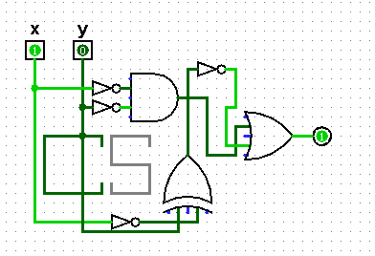
Jotto Corner
CS 101 Today
am guess
bagel: 2
first: 0
my guess
diner: 1
ghost: 2
plumb: ?
Lani C.
Too many bits? Compress!
Below binary: physical circuits
pm guess
alien: 0
slope: 2
my guess
diner: 2
sassy: 0
thumb: ?
Madi M.
King of ANDs
Queen of ORs
Jack of NOTs
Hw #4 due Mon. 10/7
pr0 (reading) Ray K.!
pr1 (lab) binary ~ decimal
pr2 conversions + compressions
extra image processing...
This circuit seems to be using KNOT gates!
Fri aft. in LAC, as usual...

Slide 2

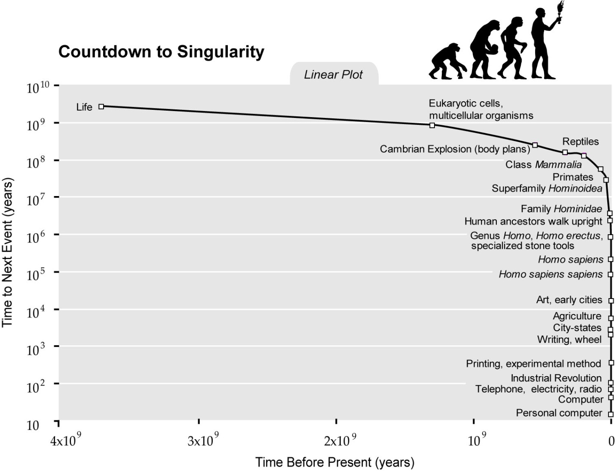
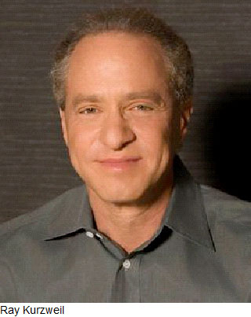

Ray Kurzweil
?

Slide 3
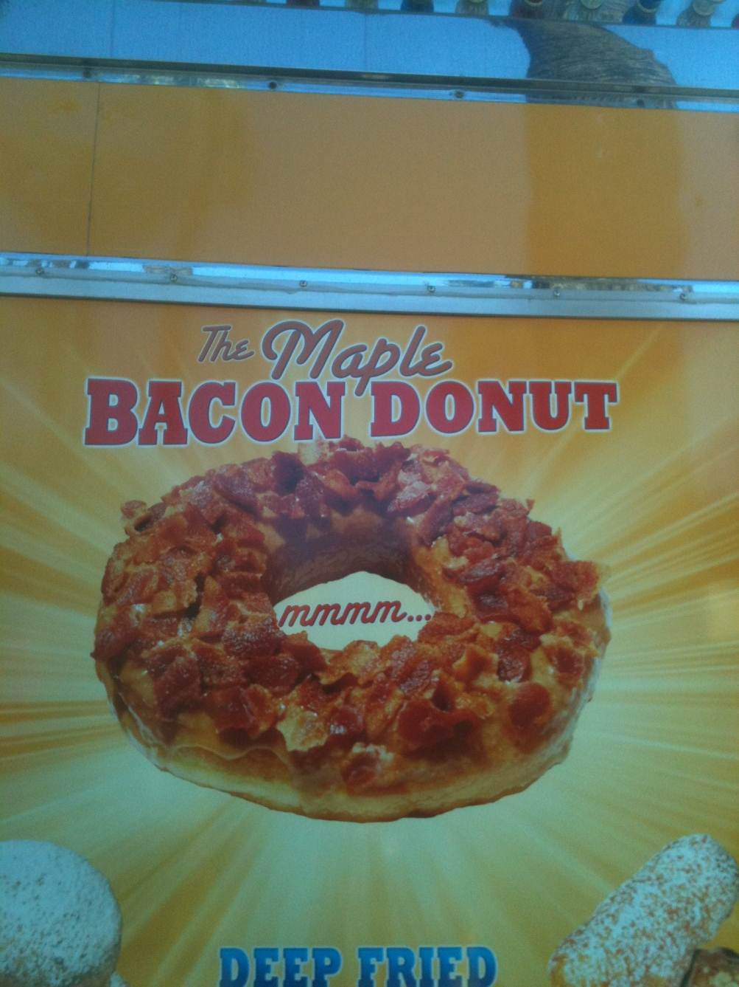
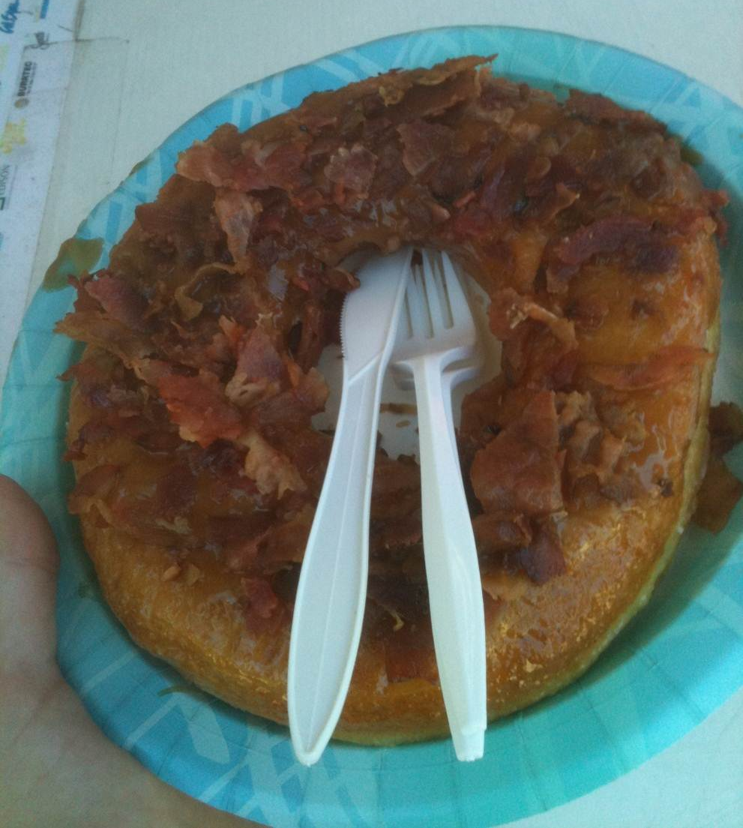
What Ray can't eat, at least if he wants to live forever…
LA County Fair…

Slide 4

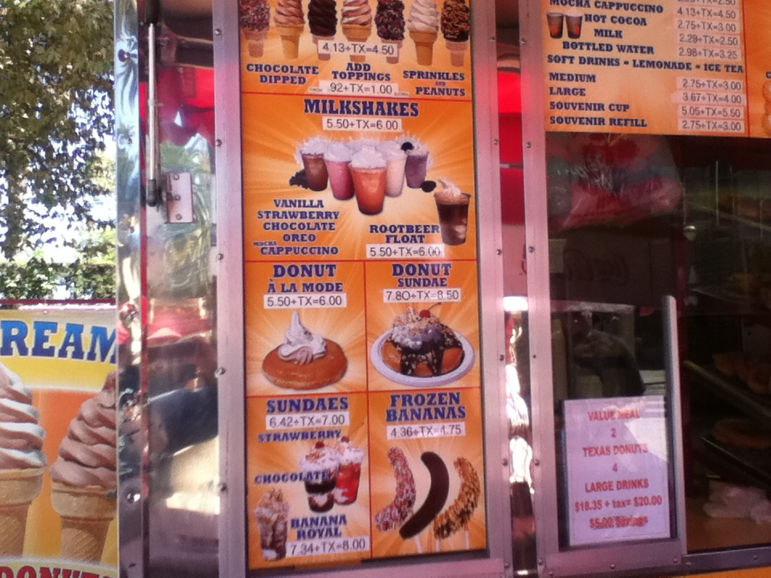
Different underlying assumptions…

Slide 5
Lab Debriefing & hw4pr2.py
in
42
ntb( 42 )
ntb( 21 ) + '0'
ntb( 10 ) + '1'
ntb( 5 ) + '0'
ntb( 2 ) + '1'
ntb( 1 ) + '0'
ntb( 0 ) + '1'
'101010'
''
out
def numToBin( N ):
""" converts a decimal int to a binary string
"""
if N==0: return ''
elif N%2==0: return numToBin( N/2 ) + '0'
elif N%2==1: return numToBin( N/2 ) + '1'
awfully similar…

Slide 6
Lab Debriefing & hw4pr2.py
in
42
ntb( 42 )
ntb( 21 ) + '0'
ntb( 10 ) + '1'
ntb( 5 ) + '0'
ntb( 2 ) + '1'
ntb( 1 ) + '0'
ntb( 0 ) + '1'
'101010'
''
out
def numToBin( N ):
""" converts a decimal int to a binary string
"""
if N==0: return ''
else: return numToBin( N/2 ) + str( N%2 )
Aha!
What if you wanted base-3 output?! base-B output?

Slide 7
Lab Debriefing & hw4pr2.py
in
btn('101010')
'101010'
2*btn('10101') + 0
2*btn('1010') + 1
2*1
2*btn('101') + 0
2*2*2*1
2*btn('10') + 1
2*2*2*2*2*1
2*btn('1') + 0
2*btn('') + 1
42
0
out
def binToNum( S ):
""" converts a binary string to a decimal int
"""
if S=='': return 0
else: return 2*binToNum(S[:-1]) + int( S[-1] )
Aha!
What if you wanted base-3 input?! base-B input?
saves the need for another if

Slide 8
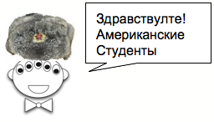
Insight: Russian Peasants' Multiplication
The RPM algorithm
21 × 6 == 126
Write the factors in two columns.
Repeatedly halve the LEFT and double the RIGHT.
Pull out the RIGHT values where the LEFT values are odd.
Sum those values for the answer!
21 6
Why does this work?
11 × 15 == 165
11 15
Hey, buddy, can you spare an eye?
(Translation: “Hello, American Students!” I've been told there's a typo here, too!)
Notes:
This algorithm for multiplying two numbers was evidently widely used by peasants in Russia into the 19th century and is evidently still used in some parts of Russia!
The algorithm goes like this: Write down the two numbers side-by-side. In this case, 21 and 6. Then divide 21 by 2 (rounding down) and multiply 6 by 2. Repeat this process until the number in the left column becomes 1. Then, highlight those rows in which the first number is odd. In those rows, collect all the number in the second column and add them up. That’s the desired product!

Slide 9
Insight: Russian Peasants' Multiplication
110
10101
6
x
21
21 6
10 12
5 24
2 48
1 96
110
0000
11000
000000
1100000
6
24
96
6
12
24
48
+
96
+
1111110
126
126
Decimal
Binary
Notes:
To see why it works, let’s convert the numbers in both columns to binary.

Slide 10
But why binary ?

Slide 11
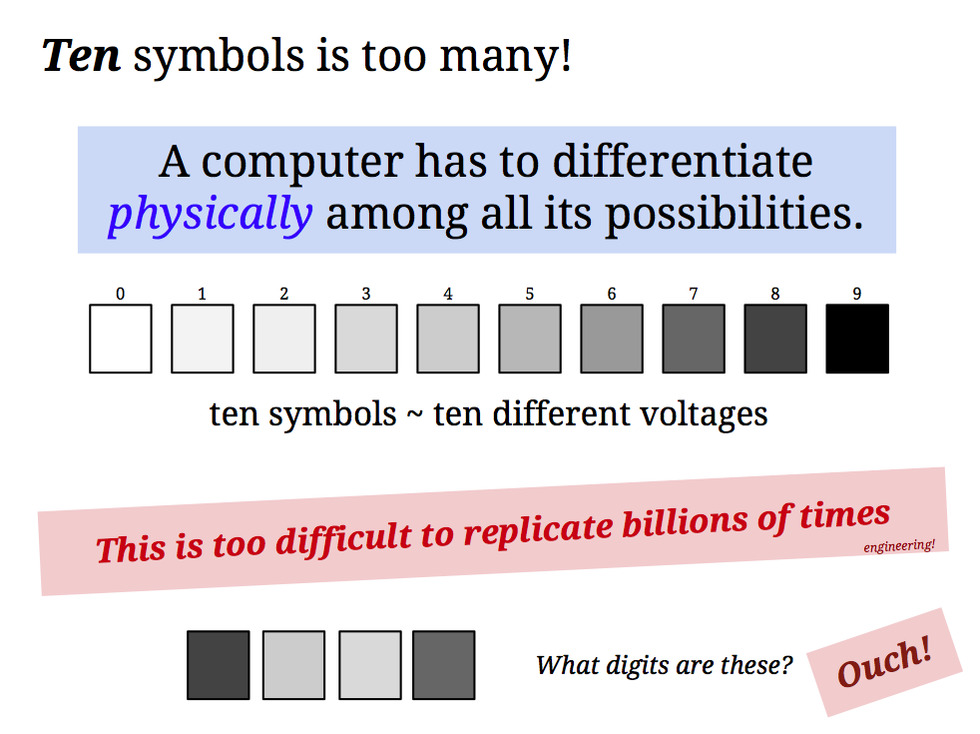

Slide 12
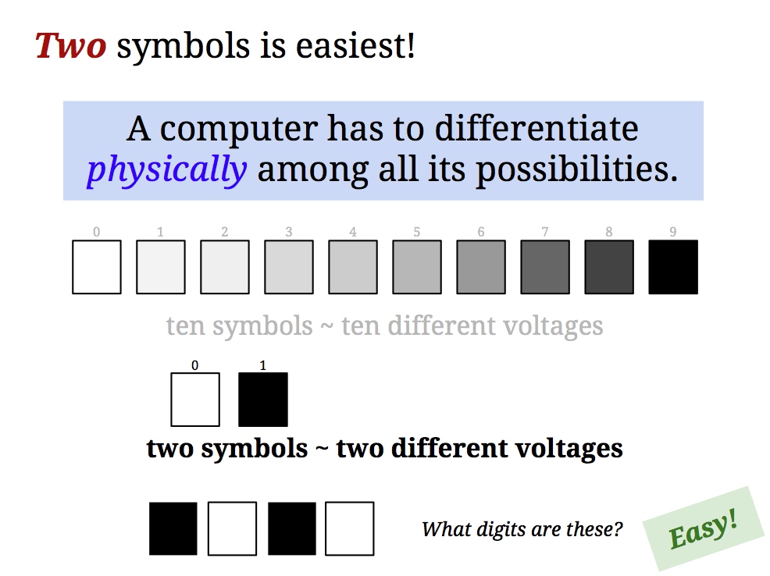
But why binary ?

Slide 13
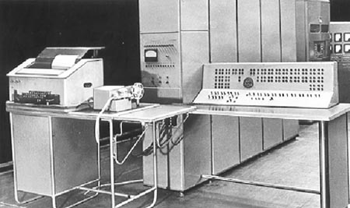

Ternary computers…
There were experiments...
Only is this galaxy did those experiments fail !
50 of these Setun ternary machines were made at Moscow U. ~1958
They were deployed throughout the CCCP. Redesigns continued until about 1970…
http://sovietcomputing.com/node/47
http://museum.e-ukraine.org/PHOTOS/Setun-1.html

Slide 14

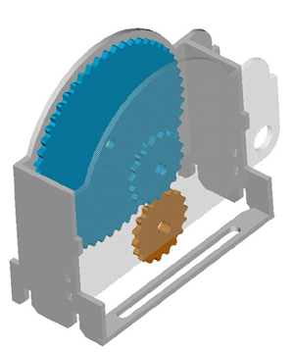
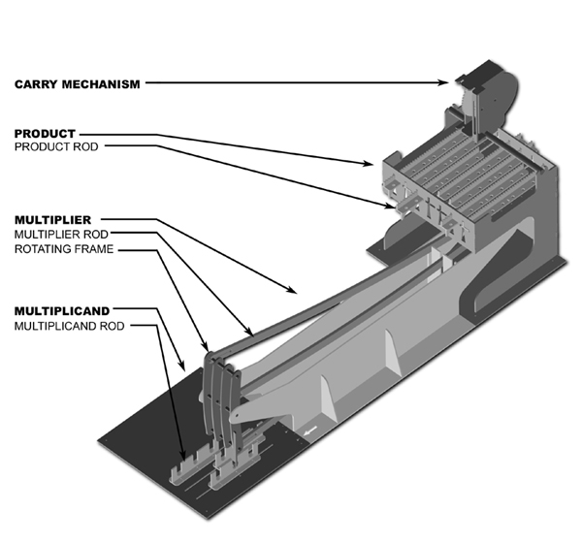
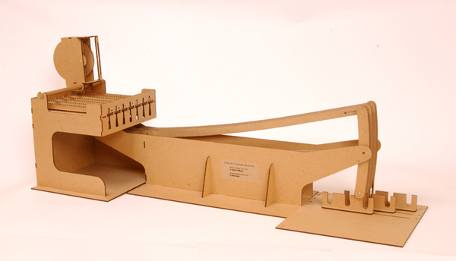
Thomas Fowler's Ternary Computer
finally some sanity in human computing!
balanced ternary calculations from Fowler's papers
the carry mechanism
the reconstruction
the computational components
T. Fowler 1777-1843, Treasurer of the Poor Law Union
Notes:
http://www.mortati.com/glusker/fowler/fowlerbio.htm
"In the 1830’s, Fowler was Treasurer of the Poor Law Union. This job required a considerable number of repetitive monetary calculations, made more complex by the pre-decimal British currency."

Slide 15
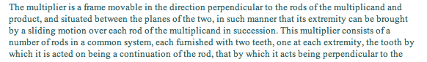
Fowler's machine was rebuilt from two sources:
a two-page description (with no images) by mathematician A. DeMorgan
http://www.mortati.com/glusker/fowler/index.htm

Slide 16
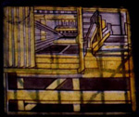
Fowler's machine was rebuilt from two sources:
a two-page description (with no images) by mathematician A. DeMorgan
a picture of it as a stained-glass window in Fowler's church: St. Michael's of Great Torrington, North Devon, U.K.!
http://www.mortati.com/glusker/fowler/index.htm

Slide 17
Adding in decimal?
this is circuit addition: all syntax!
e.g., S = '31' T = '11'
def add10(S,T):
""" adds the *strings* S and T
as decimal numbers
"""
if len(S) == 0: return T
if len(T) == 0: return S
eS = S[-1]
eT = T[-1]
if eS == '0' and eT == '1': return add10(S[:-1],T[:-1]) + '1'
if eS == '1' and eT == '1': return add10(S[:-1],T[:-1]) + '2'
if eS == '2' and eT == '1': return add10(S[:-1],T[:-1]) + '3'
if eS == '3' and eT == '1': return add10(S[:-1],T[:-1]) + '4'
# Lots more rules - how many in all?
eS ~ the "end of S"
eT ~ the "end of T"
how about for hw4: addB?

Slide 18
Carrying on…
e.g., S = '…3' T = '…9'
def add10(S,T):
""" adds the *strings* S and T
as decimal numbers """
if len(S) == 0: return T
if len(T) == 0: return S
eS = S[-1]
eT = T[-1]
if eS == '0' and eT == '1': return add10(S[:-1],T[:-1]) + '1'
if eS == '1' and eT == '1': return add10(S[:-1],T[:-1]) + '2'
if eS == '2' and eT == '1': return add10(S[:-1],T[:-1]) + '3'
if eS == '3' and eT == '1': return add10(S[:-1],T[:-1]) + '4'
# what if we have to carry to the next column?
if eS == '3' and eT == '9':
return
how about for hw4: addB?

Slide 19

Hw4: backstory
Hi, Mom!
MASA "deep-space" image (same web presence as NASA!)

Slide 20
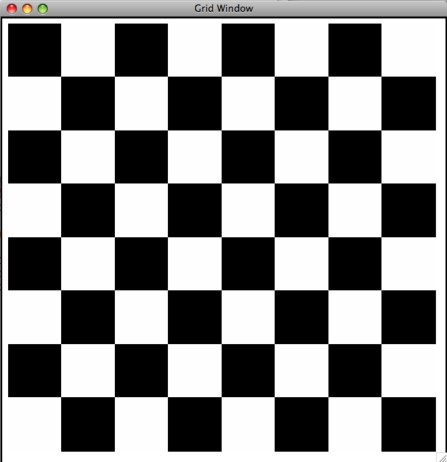
Hw4: binary image compression
10101010
01010101
10101010
01010101
10101010
01010101
10101010
01010101
Binary Image
Encoding as raw bits
just one big string of 64 characters
"1010101001010101101010100101010110101010010101011010101001010101"

Slide 21

Hw4: binary image compression
00000000
00000000
11111111
11111111
00000000
00000000
00000000
00001111
Binary Image
Encoding as raw bits
just one big string of 64 characters
If our images tend to have long streaks of unchanging data, how might we represent it more efficiently, but still in binary?
"0000000000000000111111111111111100000000000000000000000000001111"

Slide 22

Hw4: binary image compression
0 is the first digit
1 is the next digit
0 is the next digit
1 is the final digit
00000000
00000000
11111111
11111111
00000000
00000000
00000000
00001111
There are 16 of them.
Again, there are 16 of them.
There are 4
There are 28
0100001100000111001100
One possible idea:
digit #ofthem
See any problems with this?

Slide 23
fixed-width image compression
0 is the first digit
1 is the next digit
and so on…
00000000
00000000
11111111
11111111
00000000
00000000
00000000
00001111
There are 16 of them.
Again, there are 16 of them.
28 zeros
4 ones
00010000100100000001110010000100
7 bits: # of repeats
7 bits: # of repeats
8-bit data block
8-bit data block
8-bit data block
8-bit data block
We need fixed-width blocks:
digit #ofthem
What are the tradeoffs?
8-bits total

Slide 24
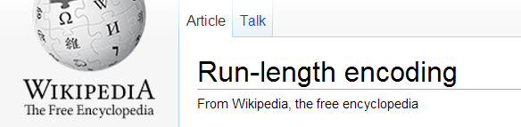
If you use 7 bits to hold the # of consecutive repeats, what is the largest number of bits that one block can represent?
00010000
7 bits?
1 bit: the initial pixel
7 bits: # of repeats
B bits?
8-bit total data block

Slide 25
hw4 pr3
What helper function(s) might help here?
def compress( I ):
""" returns the RLE of the
input binary image, I """
def uncompress( CI ):
""" returns the binary image I
from the run-length-encoded,
"compressed" input, CI """

Slide 26
Quiz
Name(s) _________________________________
Examples…
Write a recursive function, frontNum(S)
It should return the # of times the first element of the input S appears consecutively at the start of S:
>>> frontNum('1111010')
4
>>> frontNum('00111000010')
2
def frontNum(S):
if
return
elif
return
else:
return
Is there an especially simple base-case test?
shortest
longest
What are the BEST / WORST compression results you can get for an 8x8 input image (64 bits)?
EXTRA! How can you change the algorithm so that compressed images are always smaller than the originals?
I'm over-compressed!

Slide 27
shortest compressed representation
longest compressed representation
What are the BEST and the WORST compression results you can get for an 8x8 image input (64 bits)?
EXTRA
How can you change this compression algorithm so that all compressed images are smaller than their originals ? That is, how can we make compression always work ?

Slide 28

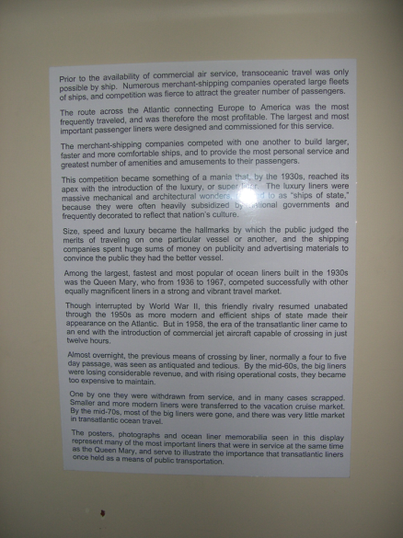
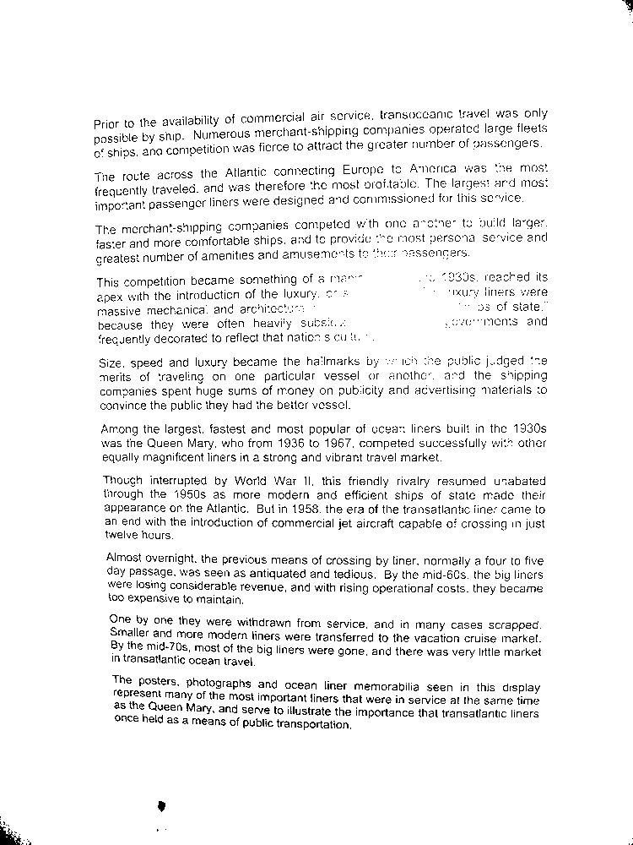
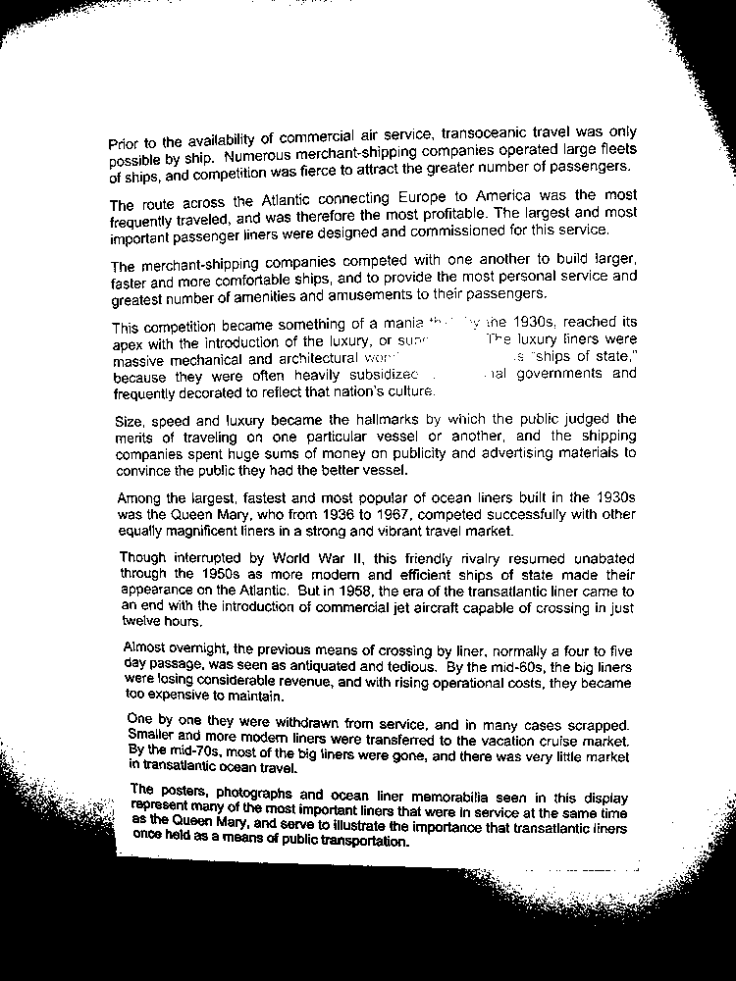
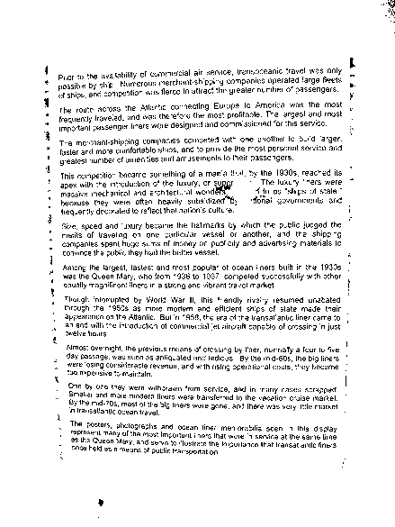
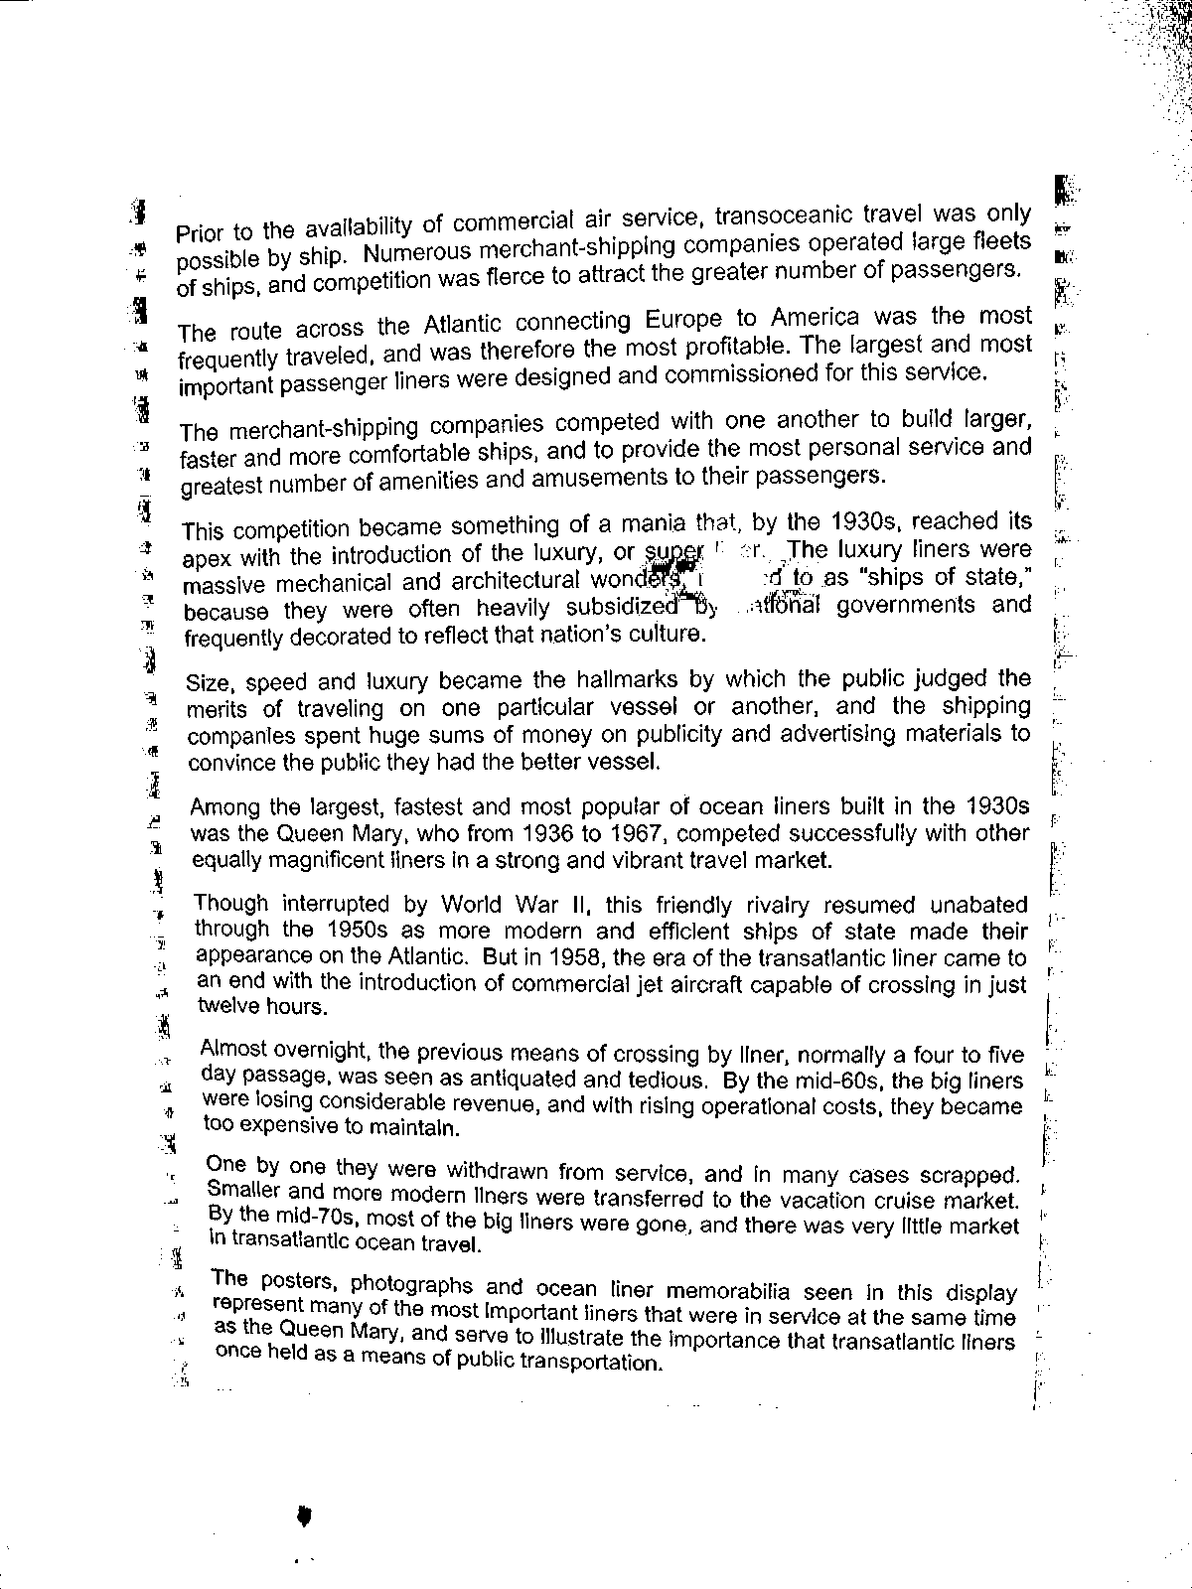
Binary images in practice...
Original Image
T = 78/255
T = 120/255
Adaptive T
T = 120/255
Adaptive Threshold

Slide 29
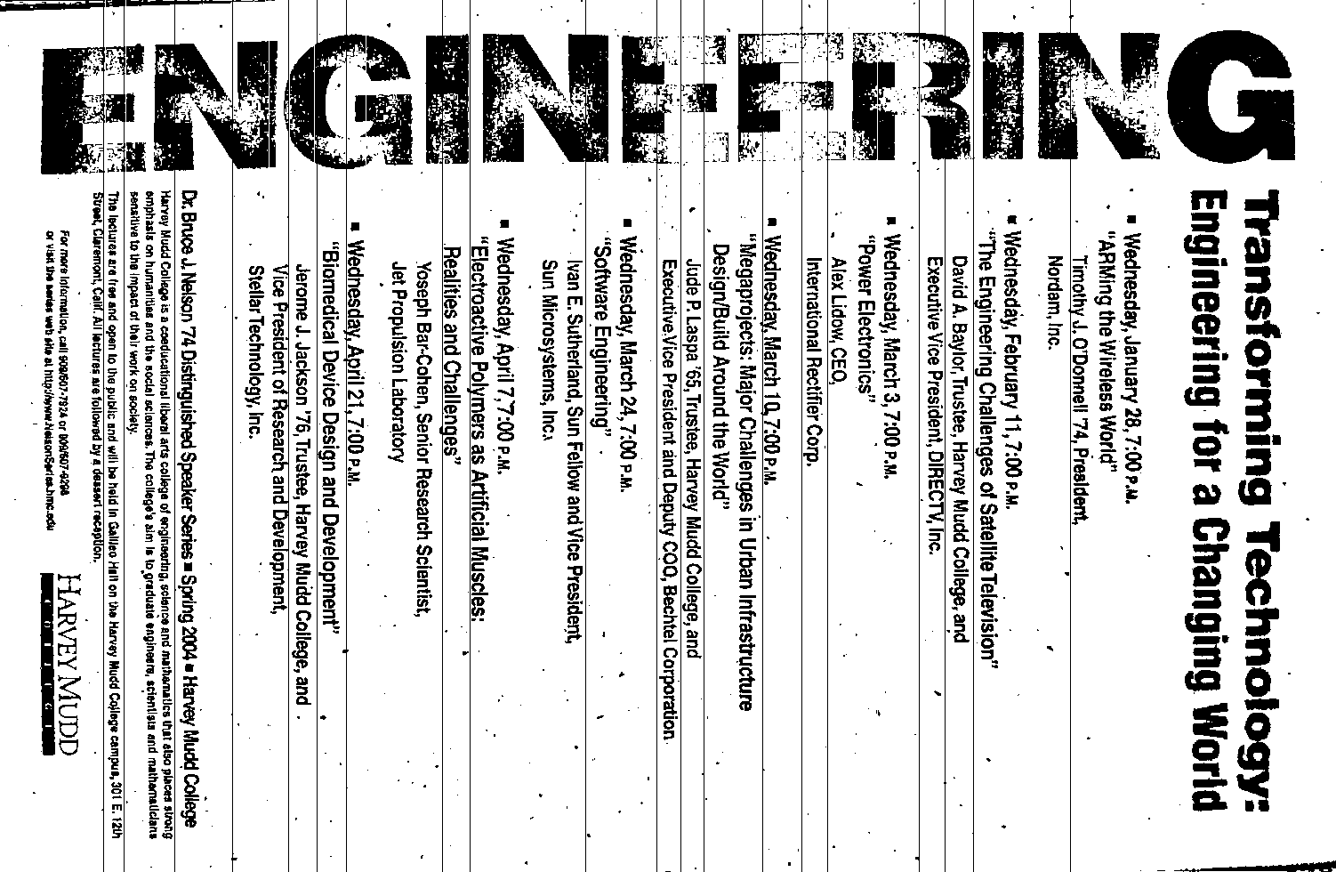
Portrait vs. landscape?

Slide 30


Portrait vs. landscape?
Intensity profiles
Lots of peaks == lots of text lines
This landscape image is determined to contain a portrait document.
few peaks == few text lines
Right-side up?

Slide 31
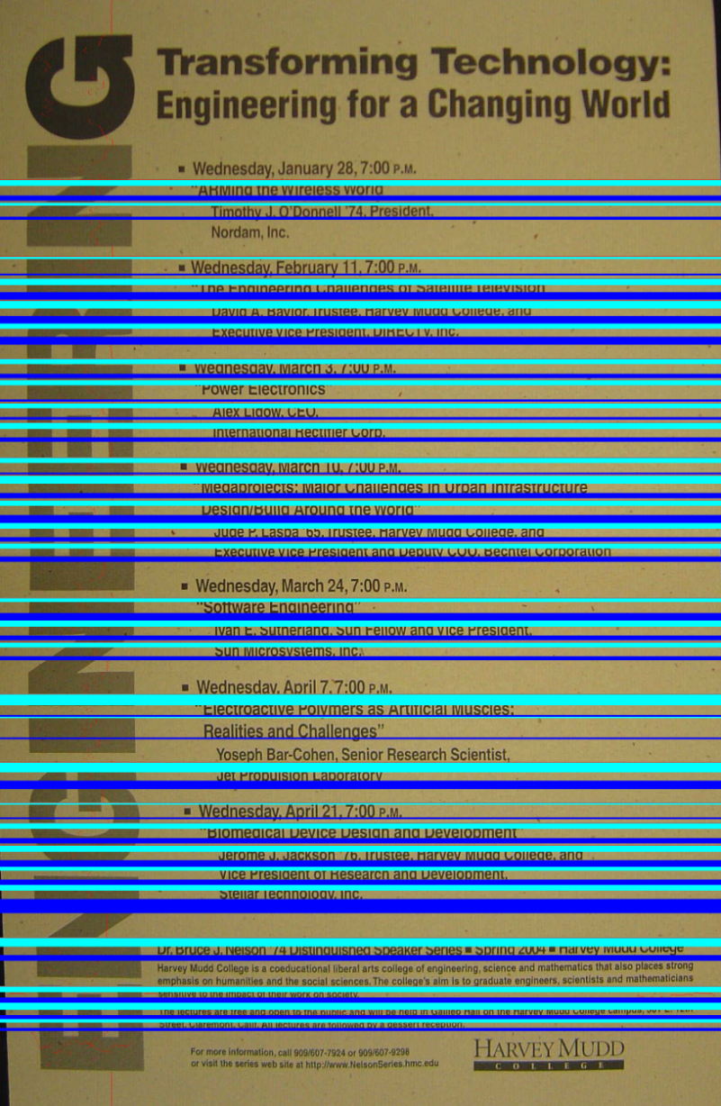

Up vs. down?
Each line is divided into three parts
The top and bottom “thirds” are compared for text density
The higher-density direction is presumed to be ascenders.

Slide 32
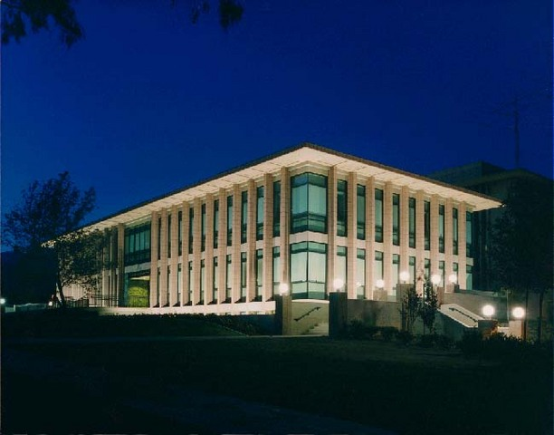

hw4pr3 (extra)
Image processing...
import cs5png
Pix = cs5png.getRGB( 'olin.png' )
Images are represented by Python lists of ... ?
newIM = invert( Pix )
cs5png.saveRGB( Pix )

Slide 33
It's all bits!
images, text, sounds, data, …
even the string 'forty-two' is represented as a sequence of bits…
'forty-two'
11001101101111111001011101001111001101101111010011101111101111
8*9 == 72 bits
9 ASCII characters
8 bits each
All computation boils down to manipulating bits!

Slide 34
In a computer, each bit is represented as a voltage (1 is +5v and 0 is 0v)
Computation is simply the deliberate combination of those voltages!
000000
0
ADDER circuit
0
000000
Even when the machine's OFF, it's computing some things correctly!
0
000000

Slide 35
In a computer, each bit is represented as a voltage (1 is +5v and 0 is 0v)
Computation is simply the deliberate combination of those voltages!
101010
42
(1) set input voltages
(2) perform computation
ADDER circuit
51
Hey - what's that green thing?
110011
(3) read output voltages
9
001001
Richard Feynman: "Computation is just a physics experiment that always works!"

Slide 36
All computation
is simply functions of bits
00
00
000
00
01
001
00
10
010
00
11
011
01
00
001
01
01
010
01
10
011
01
11
bitwise
addition function
100
10
00
010
10
01
011
10
10
100
10
11
101
11
00
011
11
01
100
11
10
101
11
11
110
A
B
2 two-bit inputs
output, A+B

Slide 37
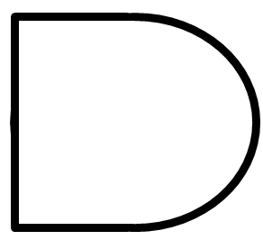
Circuits
are physical functions of bits!
inputs
AND
output
AND outputs 1 when ALL inputs are 1
otherwise it outputs 0

Slide 38
Circuits
are physical functions of bits!
x
inputs
AND
output
y
output
input
output
x
y
AND(x,y)
AND's function:
0
0
0
0
1
0
"Truth table"
1
0
0
1
1
1

Slide 39
AND
inputs
AND
output
How many different input combinations yield an output of 0 here?
AND outputs 1 when ALL inputs are 1
otherwise it outputs 0

Slide 40
Circuits
are physical functions of bits!
x
y
inputs
z
AND
output
output
w
input
output
x
y
z
w
AND(xyzw)
AND's function:
0
0
0
0
0
0
0
0
1
0
fifteen 0s
…12 more rows not shown…
0
1
1
1
0
0
1
1
1
1
1
one 1

Slide 41
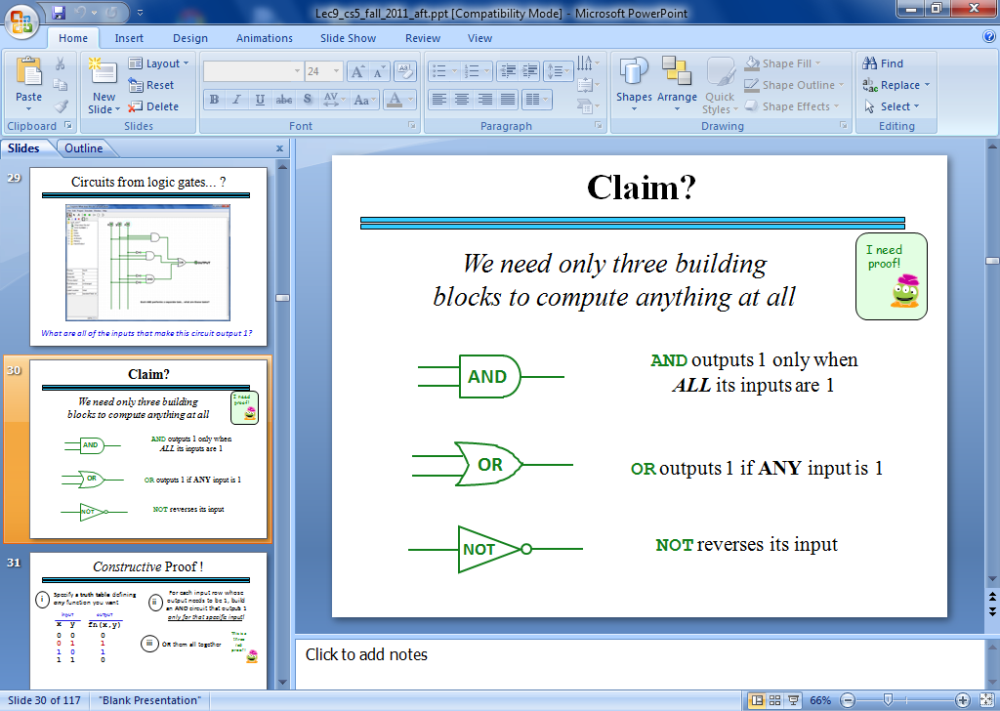
Our building blocks: logic gates
input
output
input
output
x
y
AND(x,y)
x
y
OR(x,y)
input
output
x
NOT(x)
0
0
0
0
0
0
0
1
0
0
1
1
0
1
1
0
0
1
0
1
1
0
1
1
1
1
1
1
AND outputs 1 only if ALL inputs are 1
OR outputs 1 if ANY input is 1
NOT reverses its input
AND
OR
NOT

Slide 42
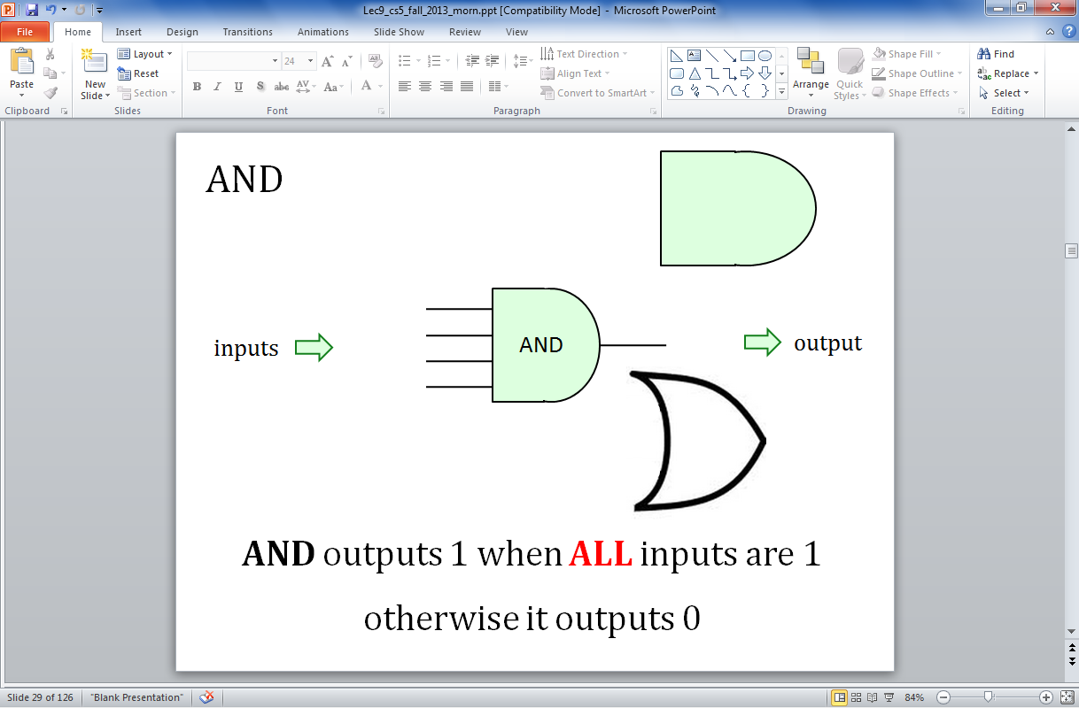
OR
inputs
OR
output
OR outputs 1 when ANY input is 1
It outputs 0 only if all inputs are 0.

Slide 43
OR
x
inputs
OR
output
y
output
input
output
x
y
OR(x,y)
OR's function:
0
0
0
0
1
1
1
0
1
1
1
1

Slide 44
OR
inputs
OR
output
How many different input combinations yield an output of 1 here?
OR outputs 1 when ANY input is 1
It outputs 0 only if all inputs are 0.

Slide 45
OR
x
y
inputs
z
OR
output
output
w
input
output
x
y
z
w
OR(xyzw)
OR's function:
0
0
0
0
0
one 0
0
0
0
1
1
…12 more rows not shown…
1
1
1
1
0
1
fifteen 1s
1
1
1
1
1

Slide 46
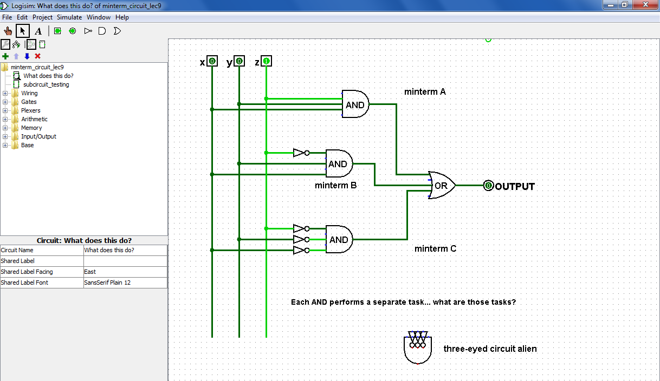
From gates to circuits...
What inputs make this circuit output 1?
Logisim

Slide 47
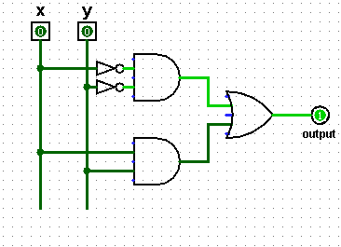
Try it!
Fill in the function values (truth table) for this circuit…
input
output
x
y
top
AND
(A)
0
0
OR
(B)
0
1
(C)
1
0
lower
AND
(D)
1
1
(1) Which gate implements line (A) of the truth table?
(2) Which gate implements line (D) of the truth table?
(3) Which gates implement the other lines of the truth table?
(4) How would the table change if the top NOT gate were removed?

Slide 48
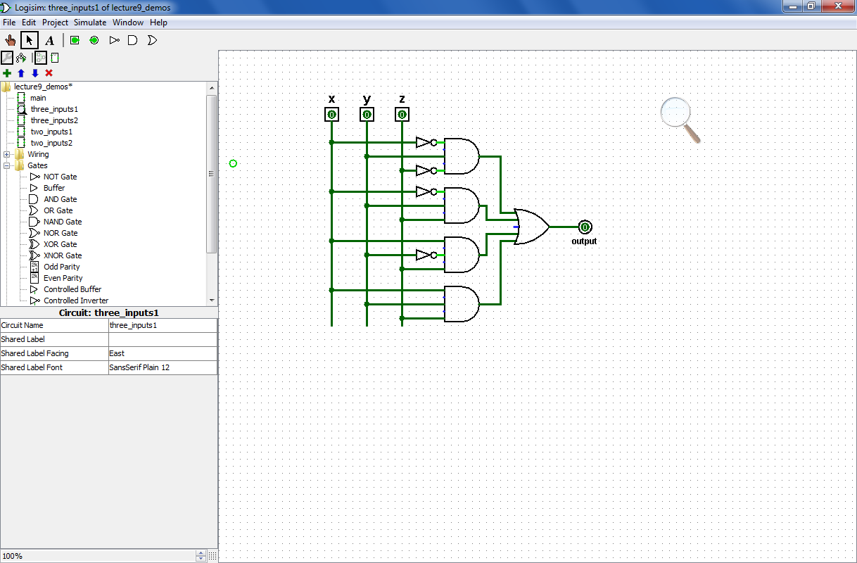
Try it!
Fill in the function values (truth table) for this circuit…
input
output
A
x
y
z
0
0
0
0
0
1
B
0
1
0
0
1
1
1
0
0
C
1
0
1
1
1
0
1
1
1
D
(1) Which truth table lines do the AND gates A,B,C,D implement?
(2) This circuit uses 9 logic gates – could it use fewer?
(3) If the inputs are considered the bits of a three-bit integer, xyz, what property of integers does this circuit compute?

Slide 49
Try it!
Given the truth table on the right, draw the circuit that implements it!
input
output
x
y
z
0
0
0
0
0
0
1
1
0
1
0
1
output
0
1
1
0
1
0
0
1
1
0
1
0
1
1
0
0
1
1
1
1
(1) Use the previous examples as a guide…
(2) Use a single OR gate beside the output…
(3) How many AND gates will be needed "upstream" of that OR gate? Which of the AND gates' inputs will need NOT gates?

Slide 50
Claim
We need only these three building blocks to compute anything at all
I need proof!
AND
AND outputs 1 iff ALL its inputs are 1
OR
OR outputs 1 iff ANY input is 1
NOT
NOT reverses its input

Slide 51
Constructive Proof !
Specify a truth table defining any function you want
For each input row whose output needs to be 1, build an AND circuit that outputs 1 only for that specific input!
i
ii
input
output
x
y
fn(x,y)
0
0
0
This is a three i'ed proof!
0
1
1
iii
OR them all together
1
0
1
1
1
0

Slide 52
Constructive Proof !
Specify a truth table defining any function you want
For each input row whose output needs to be 1, build an AND circuit that outputs 1 only for that specific input!
i
ii
input
output
x
y
fn(x,y)
0
0
0
0
1
1
iii
OR them all together
1
0
1
1
1
0
x
y
NOT
AND
Does this work for the red row?
x
y
Does this work for any other rows?

Slide 53
Constructive Proof !
Specify a truth table defining any function you want
For each input row whose output needs to be 1, build an AND circuit that outputs 1 only for that specific input!
i
ii
input
output
x
y
fn(x,y)
0
0
0
0
1
1
iii
OR them all together
1
0
1
1
1
0
How did we handle the rows outputting zero?
x
y
NOT
AND
OR
NOT
AND
x
y

Slide 54
Constructive Proof !
Specify a truth table defining any function you want
For each input row whose output needs to be 1, build an AND circuit that outputs 1 only for that specific input!
i
ii
input
output
x
y
fn(x,y)
This is a constructive proof that AND, OR, and NOT suffice to build any (boolean) function!
0
0
0
0
1
1
iii
OR them all together
1
0
1
1
1
0
How did we handle the rows outputting zero?
x
y
NOT
AND
OR
NOT
AND
x
y

Slide 55
Constructive Proof !
Specify a truth table defining any function you want
For each input row whose output needs to be 1, build an AND circuit that outputs 1 only for that specific input!
i
ii
But... ALL functions are just boolean functions: because everything is in binary!
input
output
x
y
fn(x,y)
This is a constructive proof that AND, OR, and NOT suffice to build any (boolean) function!
0
0
0
0
1
1
iii
OR them all together
1
0
1
1
1
0
How did we handle the rows outputting zero?
x
y
NOT
AND
OR
NOT
AND
x
y

Slide 56
Try it!
Given the truth table on the right, draw the circuit that implements it!
input
output
x
y
z
0
0
0
0
0
0
1
1
0
1
0
1
output
0
1
1
0
1
0
0
1
1
0
1
0
1
1
0
0
1
1
1
1
(1) Use the previous examples as a guide…
(2) Use a single OR gate beside the output…
(3) How many AND gates will be needed "upstream" of the OR gate? Which of the AND gates' inputs will need NOT gates?

Slide 57
Next 2 weeks
from circuit design…
…to a full computer!
Have a great weekend!

Slide 59
Try it...
Specify a truth table defining any function you want
For each input row whose output needs to be 1, build an AND circuit that outputs 1 only for that specific input!
1
2
input
output
x
y
fn(x,y)
0
0
1
3
OR them all together
0
1
0
1
0
0
1
1
1
x
y
x
y
How did we handle the rows outputting zero?

Slide 60
Try it!
Fill in the function values (truth table) for this circuit…
input
output
x
y
(A)
0
0
(B)
0
1
(C)
1
0
(D)
1
1
(1) Which gate implements line (A) of the truth table?
(2) Which gate implements line (D) of the truth table?
(3) Which gates implement the other lines of the truth table?
(4) How would the table change if the top NOT gate were removed?

Slide 61
Try it!
Fill in the function values (truth table) for this circuit…
input
output
A
x
y
z
0
0
0
0
0
1
B
0
1
0
0
1
1
1
0
0
C
1
0
1
1
1
0
1
1
1
D
(1) Which truth table lines do the AND gates A,B,C,D implement?
(2) This circuit uses 9 logic gates – could it use fewer?
(3) If the inputs are considered the bits of a three-bit integer, xyz, what property of integers does this circuit compute?

Slide 62
Try it!
Fill in the function values (truth tables) for these two circuits!
input
output
x
y
z
input
output
x
y
0
0
0
0
0
1
0
0
0
1
0
0
1
0
1
1
1
0
1
0
0
1
1
1
0
1
1
1
0
1
1
1

Slide 63
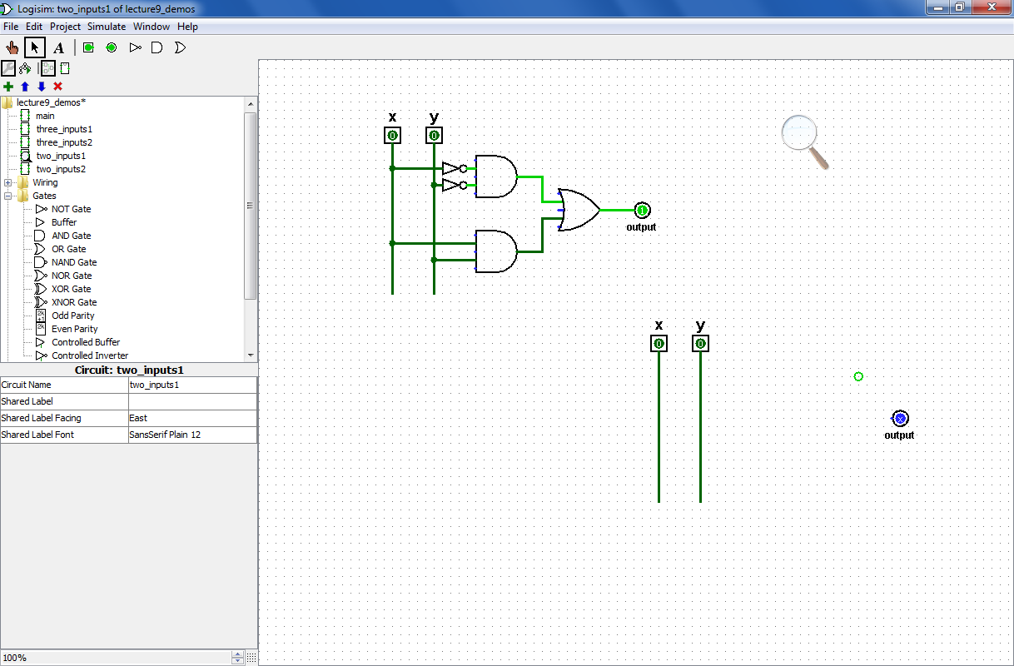
Try it!
Design circuits that implement the functions (truth tables) shown below.
input
output
x
y
z
input
output
x
y
0
0
0
0
0
1
0
0
0
1
0
0
1
0
1
1
1
0
1
0
0
1
1
1
0
1
1
1
0
1
1
1

Slide 64
DIY: design-it-yourself…
x
y
z
fn(x,y,z)
0
0
0
0
0
0
1
1
0
1
0
1
0
1
1
0
1
0
0
1
1
0
1
0
1
1
0
0
1
1
1
1
This looks like fn !

Slide 65
Circuits
are physical functions of bits!
x
y
inputs
z
AND
output
output
w
input
output
x
y
z
w
AND(x,y)
0
0
0
0
0
AND's function:
0
0
0
1
0
fifteen 0s
…12 more rows not shown…
0
1
1
1
0
0
1
1
1
1
1
one 1

Slide 66
AND
AND
NOT
inputs
AND
output
OR
AND outputs 1 when ALL inputs are 1
otherwise it outputs 0

Slide 67
All computation
… consists of functions of bits, or boolean values
Boolean inputs x,y,… can only be 0 or 1.
Boolean functions can output only 0 or 1.
inputs
output
x
y
fn(x,y)
0
0
0
0
1
1
1
0
1
1
1
0
This seems fn !
Truth table

Slide 68
Lots of bits!
inputs
output
x
y
z
fn(x,y,z)
0
0
0
0
0
0
1
1
0
1
0
1
0
1
1
0
1
0
0
1
1
0
1
0
1
1
0
0
1
1
1
1
Even more fn !
Truth table

Slide 69
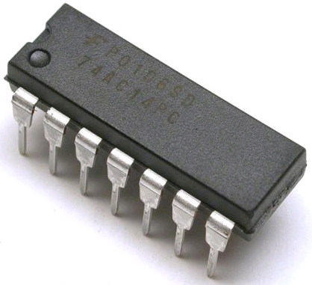
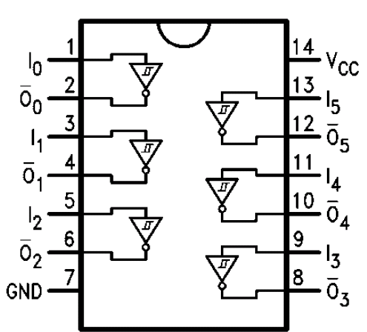
Physical Logic Gates...
6 NOT gates:
Notes:
these quotes are important to yahoo… !

Slide 70
Claim!
We need only three building blocks to compute anything at all
Three – of course!
AND outputs 1 iff ALL its inputs are 1
AND
OR outputs 1 iff ANY input is 1
OR
NOT
NOT reverses its input

Slide 71
"Quiz"
Name(s):
Write a recursive function frontNum(s) It. should return the # of times the first element of the input s appears consecutively AT THE FRONT of that string:
>>> frontNum('1111010')
4
>>> frontNum('00111000010')
2
def frontNum(s):
Examples…
shortest compressed representation
longest compressed representation
EXTRA
What are the BEST and the WORST compression results you can get for an 8x8 input image (64 bits)?
How can you change fixed-length compression so that all compressed images are smaller than their originals ? That is, how can we make compression always "work" ?

Slide 72
Write a recursive function frontNum(s) It. should return the # of times the first element of the input s appears consecutively AT THE FRONT of that string:
>>> frontNum('00111000010')
2
>>> frontNum('1111010')
4
Examples…
def frontNum(s):

Slide 73
shortest compressed representation
longest compressed representation
What are the BEST and the WORST compression results you can get for an 8x8 image input (64 bits)?
EXTRA
How can you change this compression algorithm so that all compressed images are smaller than their originals ? That is, how can we make compression always work ?

Slide 74
Minterm Expansion
Truth Table
… is a proof that AND, OR, and NOT suffice to construct any function!
input
output
x
y
XOR(x,y)
0
0
0
0
1
1
1
0
1
1
1
0
Process
Build circuits of NOTs and AND that computes each "1" row.
OR them together.
Notes:
74

Slide 75
Bit functions are truth tables!
Truth Table
input
output
Any function can be represented as a table of inputs and outputs.
x
y
XOR(x,y)
0
0
0
0
1
1
1
0
1
1
1
0
If we create a circuit that always outputs 0, how much does it already do correctly !?
What more do we need?
Notes:
75

Slide 76
Minterm Expansion
Truth Table
input
output
x
y
XOR(x,y)
0
0
0
0
1
1
What is a circuit that outputs 1 ONLY WHEN x is 0 and y is 1 ?
1
0
1
1
1
0
x
y
output
Notes:
76

Slide 77
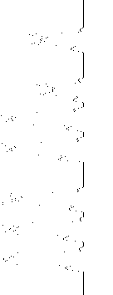
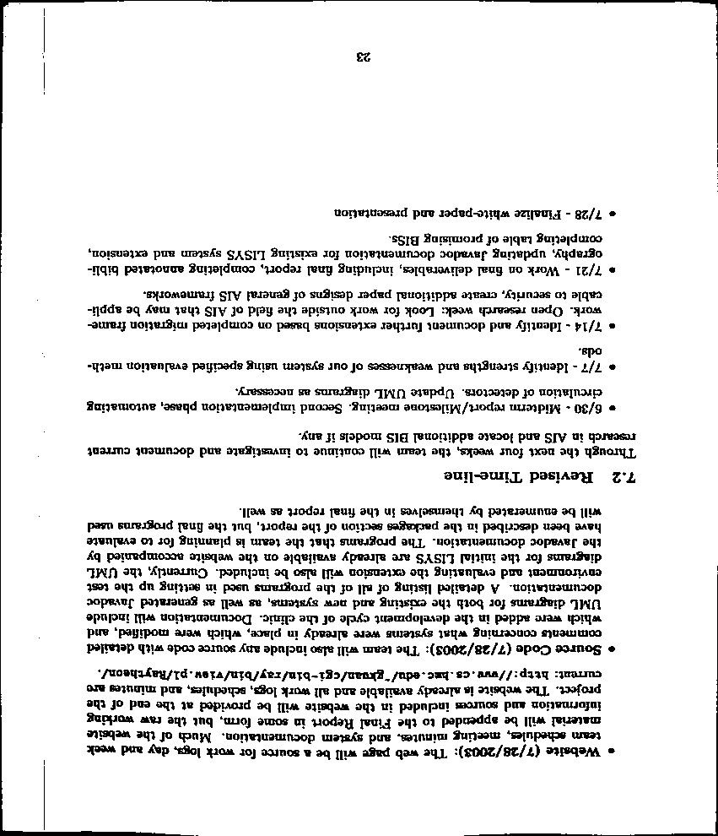
What's in the image?
What do these peaks mean?
Plot of total intensity across each row of pixels
Why is it important to have binarized first?

Slide 78
Minterm Expansion
1
Specify the Truth Table defining the function
2
Build separate circuits for each output-1 row using ANDs and NOTs
Combine them with OR.
input
output
x
y
XOR(x,y)
0
0
0
0
1
1
1
0
1
1
1
0
KEY
input x
This circuit always outputs 0 - except for the second row, when x is 0 and y is 1
AND
input y
This is not a bubble, it's a NOT bubble!
What about the third row?
Notes:
78

Slide 79
Minterm Expansion
1
Specify the Truth Table defining the function
2
Build separate circuits for each output-1 row using ANDs and NOTs
Combine them with OR.
input
output
x
y
XOR(x,y)
0
0
0
0
1
1
1
0
1
1
1
0
input x
AND
KEY
input y
This circuit always outputs 0 - except for the third row!
AND
Notes:
79

Slide 80
Minterm Expansion
1
Specify the Truth Table defining the function
2
Build separate circuits for each output-1 row using ANDs and NOTs
Combine them with OR.
input
output
x
y
XOR(x,y)
0
0
0
0
1
1
1
0
1
1
1
0
input x
AND
input y
output
OR
AND
These are not bubbles, they’re NOT bubbles
Notes:
80

Slide 81
Minterm Expansion
1
Specify the Truth Table defining the function
2
Build separate circuits for each output-1 row using ANDs and NOTs
Combine them with OR.
input
output
x
y
XOR(x,y)
Or you can start here…
0
0
0
0
1
1
"the formula"
1
0
1
3
xy + xy
1
1
0
input x
AND
input y
output
OR
AND
Notes:
81

Slide 82
"Rails"
1
Specify the Truth Table defining the function
2
Build separate circuits for each output-1 row using ANDs and NOTs
Combine them with OR.
input
output
x
y
x
y
XOR(x,y)
x
y
0
0
0
0
1
1
1
0
1
AND
1
1
0
OR
AND
This wire ("rail") carries x's value.
This wire ("rail") carries y's value.
Notes:
82

Slide 83
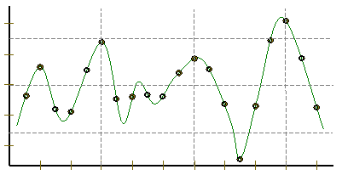
Representing Sound
Ex. Cr.
physics
continuous plot of air pressure vs. time
sampling
samples taken every ~ 1/22050nd of a second
Pressure
Time
quantization
Each sample is measured on a pressure scale from -32,767 to 32,767. (This fits into 2 bytes.)
storage
pulse code modulation
Raw audio data - such as what is written to the surface of a CD - is simply a list of these values.
plus formatting information
uncompressed sound data

Slide 84
Constructive Proof !
Specify a truth table defining any function you want
For each input row whose output needs to be 1, build an AND circuit that outputs 1 only for that specific input!
i
ii
input
output
x
y
fn(x,y)
0
0
0
0
1
1
iii
OR them all together
1
0
1
1
1
0
NOT
AND
OR
NOT
AND
x
y

Slide 85
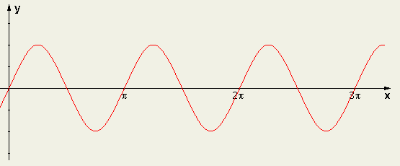
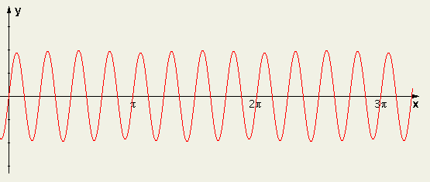
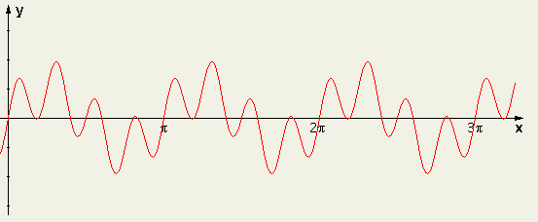
Sound: frequency
Ex. Cr.
We can create "pure" tones with a sine or cosine wave.
sin(2x)
We can add "pure" tones to create chords or other effects
sin(8x)
Any sound data is simply a sum of sine and cosine waves
A list of frequencies + their strength represents any sound!
sin(2x) + sin(8x)
How can we tell what frequencies make up a particular sound?
multiply by the frequency you want to test, and then add!

Slide 86
A bit of intuition…
Sometimes the bits are almost visible:
21 << 1
5 & 6
5 | 6
42
?
?
21 >> 1
5 ^ 6
10
?

Slide 87
More bits of Python
Which results will Python produce here?
5 & 6
5 | 6
A
0
1
B
1
0
C
2
3
D
3
5
E
4
7

Slide 88
Minterm Expansion
1
Specify the Truth Table defining the function
2
Build separate circuits for each output-1 row using ANDs and NOTs
Combine them with OR.
input
output
x
y
XOR(x,y)
0
0
0
0
1
1
1
0
1
1
1
0
KEY
input x
This circuit always outputs 0 - except for the second row, when x is 0 and y is 1
AND
input y
This is not a bubble, it's a NOT bubble!
What about the third row?
Notes:
88

Slide 89
Minterm Expansion
Specify a truth table defining any function you want
For each input row whose output needs to be 1, build an AND circuit that outputs 1 only for that specific input!
1
2
input
output
x
y
fn(x,y)
0
0
0
3
OR them all together
0
1
1
1
0
1
1
1
0
input x
AND
input y
output
OR
AND
How did we handle the rows outputting zero?

Slide 90

Claim: All computation
1
Specify the Truth Table defining the function
Formula !
1.5
input
output
x
y
XOR(x,y)
0
0
0
SELECT EACH ROW whose output is 1.
0
1
1
2
1
0
1
1
1
0
then combine…
I need proof!
Requires only 3 gates: AND, OR, and NOT

Slide 91
Minterm Expansion
1
Specify the Truth Table defining the function
Formula !
1.5
input
output
x
y
XOR(x,y)
0
0
0
SELECT EACH ROW whose output is 1.
0
1
1
2
1
0
1
1
1
0
then combine…

Slide 92
Minterm Expansion
1
Specify the Truth Table defining the function
Formula !
1.5
xy + xy
input
output
This is a constructive proof that AND, OR, and NOT suffice to construct any (boolean) function!
x
y
XOR(x,y)
0
0
0
SELECT EACH ROW whose output is 1.
0
1
1
2
1
0
1
1
1
0
then combine…
input x
AND
input y
output
OR
AND
These are not bubbles, they’re NOT bubbles
Notes:
92

Slide 93
Designing a circuit
the not equal circuit (!=)
We usually know what we want to do…
We just have to determine how to build it!
"English"
Truth Table
Formula
What is the general way to get a formula?
input bits
output bit
f(x,y) should output 1 when x != y otherwise, output 0
x
y
x != y
0
0
0
1
1
0
1
1
Circuit

Slide 94

Logic Gates
input
output
input
output
x
y
AND(x,y)
x
y
OR(x,y)
input
output
0
0
0
0
0
0
x
NOT(x)
0
1
0
0
1
1
0
1
1
0
0
1
0
1
1
0
1
1
1
1
1
1
input
x
x
y
x
y
NOT
AND
OR
xy
x + y
x
output
"x and y"
"x or y"
"not x"

Slide 95
A bit of intuition…
Sometimes the bits are almost visible:
10101
101
110
101
110
21 << 1
5 & 6
5 | 6
10101
101
110
000
21 >> 1
5 ^ 6
~0
This is NOT legal Python! Is it?

Slide 96
Which way is up?
This landscape image is determined to contain a portrait document.
Intensity profiles
Right-side up?

Slide 97
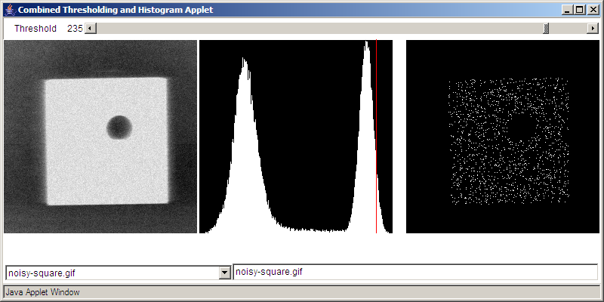
Binary Data
All data is binary…
I consider myself naturally ternary
But some data is naturally binary!
Original Image
Histogram of intensities
BINARY image

Slide 98
hw4pr4 (extra)
IM will be a Python list.
What structure will IM have ?
import cs5png
IM = cs5png.getRGB( 'olin.png' )
cs5png.saveRGB( IM, 'out.png' )
A
C
just a list
a list of lists of lists
B
D
a list of lists
a list of lists of lists of lists!
E
a list of lists of lists of lists of lists!!

Slide 99
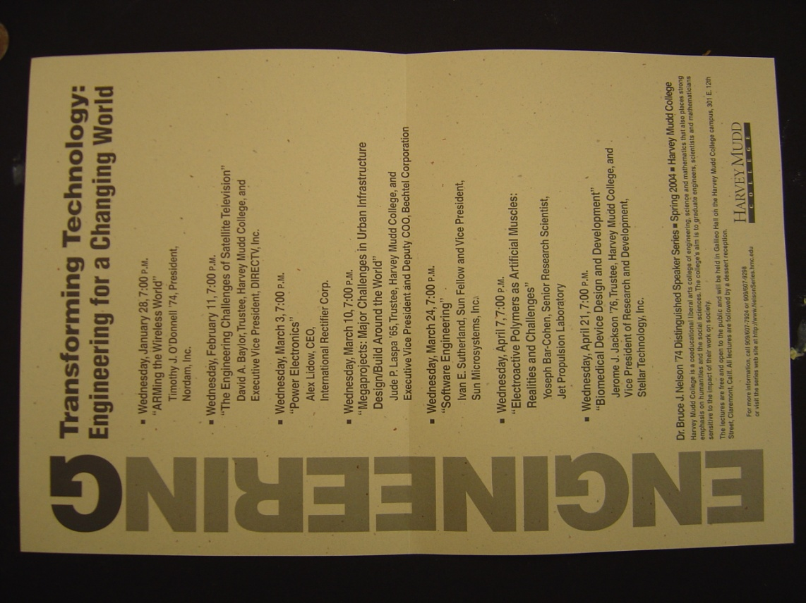
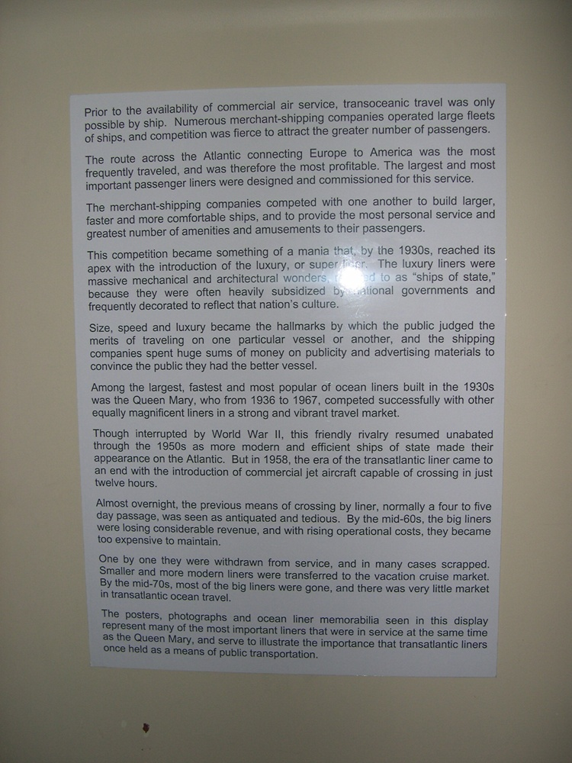
HMC clinic …
camera ~ scanner

Slide 100
CS 101 Today
Jessica's word
diner 2
diner 1
Too many bits? Compress!
Beyond binary … to bits themselves
In 2009 Chris did the floating pt. stuff in the previous lecture
Hw #4: due 10/7 @ 11:59 pm
King of ANDs
Queen of ORs
Jack of NOTs
Hw #5: due 10/14 @ 11:59 pm
Mon., 10/15 in-class
Exam 1:
>>> .1
Tue., 10/16 in-class
"Quiz"-type problems (+ reading)
0.10000000000001
may bring 1 page of notes
>>> .01*10 == .01/.1
False
What is python thinking?!?

Slide 101
CS 101 Today
Matt's word
diner 1
diner 1
Binary - is it ever used by people?
Beyond binary … to bits themselves
Hw #4: due 10/7 @ 11:59 pm
King of ANDs
Queen of ORs
Jack of NOTs
Hw #5: due 10/14 @ 11:59 pm
Mon., 10/15 in-class
Exam 1:
>>> .1
Tue., 10/16 in-class
"Quiz"-type problems (+ reading)
0.10000000000001
may bring 1 page of notes
>>> .01*10 == .01/.1
False
What is python thinking?!?

Slide 102
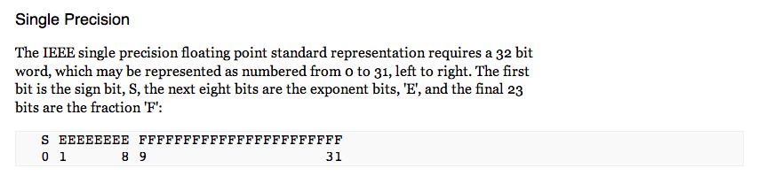
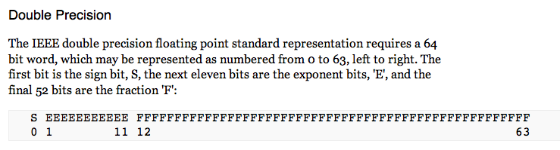
IEEE* floats
*Institute of Electrical and Electronics Engineers
Python uses double precision floats
64 bits == 8 bytes each

Slide 103
.0625
sinking with floats
.125
.25
.5
0.0000
0.0000
exact decimal equivalents
0.0001
0.0625
0.0010
0.1250
0.0011
0.1875
0.0100
0.2500
0.0101
0.3125
In reality, 23 bits or 52 bits will be used to represent the fractional part of a floating-point number
…
…
0.1100
0.7500
0.1101
0.8125
0.1110
0.8750
0.1111
0.9375
lots of gaps in here…
4 bits
Imagine we had only 4 bits …

Slide 104
.0625
sinking with floats !
.125
.25
.5
0.0000
0.0000
0.0001
0.0625
We type the decimal value 0.1
The computer represents it as the closest available float:
This float's decimal value is 0.1250
So, it acts like you typed 0.1250 !
The "error" is
  necessarily limited binary precision
  our own high expectations!
  not fundamentally a rounding issue
0.0010
0.1250
0.0011
0.1875
0.0100
0.2500
0.0101
0.3125
…
…
0.1100
0.7500
0.1101
0.8125
0.1110
0.8750
0.1111
0.9375
4 bits

Slide 105
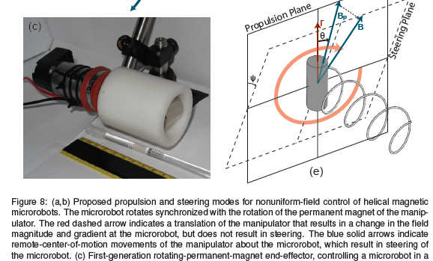
Low-level AI?
"Actuation"
"Sensing"

Slide 106
.0625
sinking with floats !
.125
.25
.5
0.0000
0.0000
0.0001
0.0625
We type the decimal value 0.1
The computer represents it as the closest available float:
This float's decimal value is 0.1250
So, it acts like you typed 0.1250 !
The "error" is
  necessarily limited binary precision
  our own high expectations!
  not fundamentally a rounding issue
0.0010
0.1250
0.0011
0.1875
0.0100
0.2500
0.0101
0.3125
…
…
0.1100
0.7500
0.1101
0.8125
0.1110
0.8750
0.1111
0.9375
4 bits
Additional work can be done to compute with the decimal digits themselves - and thus avoid these issues.
from decimal import *
str vs. int

Slide 107
Designing a circuit
the equals to circuit (==)
We usually know what we want to do…
We just have to determine how to build it!
"English"
Truth Table
Formula
What is the general way to get a formula?
input bits
output bit
f(x,y) should output 1 when x = y otherwise, output 0
x
y
x == y
0
0
0
1
1
0
1
1
Circuit

Slide 108
"Quiz"
Name(s):
Write a recursive function startCount(s) It. should return the # of times the first element of the input s appears consecutively AT THE START of that string:
def startCount(s):
>>> startCount('1111010')
4
>>> startCount('00111000010')
2
Examples…
shortest compressed representation
longest compressed representation
What are the BEST and the WORST compression results you can get for an 8x8 square input?
EXTRA
How can you change this compression algorithm so that all compressed images are smaller than their originals? That is, how can we make compression always work?

Slide 109
I thought that binary came already built-in
Building in Binary
Underneath the strings, floats, and ints are simply bits…
'forty-two'
how many bits are used to represent this data?

Slide 110
I thought that binary came already built-in
Building in Binary
Underneath the strings, floats, and ints are simply bits…
'forty-two'
how many bits are used to represent this data?
11001101101111111001011101001111001101101111010011101111101111
9*8 bits == 72 bits
8 bits each for 9 ASCII characters

Slide 111
Building in Binary
Underneath the strings, floats, and ints are simply bits…
Each bit is represented as a voltage (1 is +5v or 0 is 0v)
It might be stored in memory
Or carried along wires to interact with other information
42
101010
input
output
+
adder
110011
51
which is
in decimal
input
9
001001

Slide 112
All computation…
bit values
reduces to functions of boolean values
binary values
other aliases
Boolean variables x,y,… can only be 0 or 1.
or True/False
Boolean functions can output only 0 or 1.
Truth tables describe boolean functions:
Everything is finite (no real numbers!)
input
output
x
y
f(x,y)

Slide 113
All computation
bit values
reduces to functions of boolean values
binary values
Boolean variables x,y,… can only be 0 or 1.
Boolean functions can output only 0 or 1.
Truth tables describe boolean functions:
input
output
x
y
f(x,y)
There are 4 possible input combinations for x and y :
0
0
0
0
1
0
What is this f?
1
0
0
1
1
1
It's a lousy, two-bit function, if you ask me!

Slide 114
Basic Boolean functions
input
output
input
output
x
y
AND(x,y)
x
y
OR(x,y)
input
output
0
0
0
0
0
0
x
NOT(x)
0
1
0
0
1
1
0
1
1
0
0
1
0
1
1
0
1
1
1
1
1
1
AND outputs 1 only if BOTH inputs are 1
OR outputs 1 if EITHER input is 1
NOT reverses its input
It must mean something that there are three of these functions…

Slide 115
Logic Gates
input
output
input
output
x
y
AND(x,y)
x
y
OR(x,y)
input
output
0
0
0
0
0
0
x
NOT(x)
0
1
0
0
1
1
0
1
1
0
0
1
0
1
1
0
1
1
1
1
1
1
input
input
x
y
x
x
y
Not a bubble, a not bubble… !
x + y
x
xy
output
"x or y"
output
"x and y"
"not x"

Slide 116
Logic Gates
x
y
x
y
x
input
Any function of bits can be built from these three gates:
NOT
AND
OR
and that means?
xy
x + y
x
"x and y"
"x or y"
"not x"
output

Slide 117
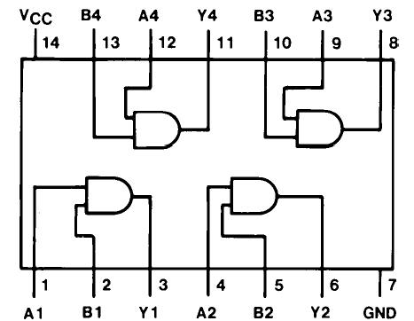
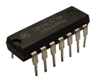
Logic Gates
x
y
x
y
x
input
Any function of bits can be built from these three gates:
NOT
AND
OR
and that means?
xy
x + y
x
"x and y"
"x or y"
"not x"
output
"Quad and gate"
these quotes are important to google… !

Slide 118
Sound: frequency
Ex. Cr.
We can create "pure" tones with a sine or cosine wave.
sin(2x)
We can add "pure" tones to create chords or other effects
sin(8x)
Any sound data is simply a sum of sine and cosine waves
A list of frequencies + their strength represents any sound!
sin(2x) + sin(8x)
How can we tell what frequencies make up a particular sound?
multiply by the frequency you want to test, and then add!

Slide 119
I thought that binary came already built-in
Building in Binary
Underneath the strings, floats, and ints are simply bits…
'forty-two'
how many bits are used to represent this data?
11001101101111111001011101001111001101101111010011101111101111
9*8 bits == 72 bits
8 bits each for 9 ASCII characters

Slide 120
Building in Binary
Underneath the strings, floats, and ints are simply bits…
Each bit is represented as a voltage (1 is +5v or 0 is 0v)
It might be stored in memory
Or carried along wires to interact with other information
42
101010
input
output
+
adder
110011
51
which is
in decimal
input
9
001001

Slide 121
All computation
bit values
reduces to functions of boolean values
binary values
Boolean variables x,y,… can only be 0 or 1.
Boolean functions can output only 0 or 1.
Truth tables describe boolean functions:
input
output
x
y
f(x,y)
There are 4 possible input combinations for x and y :
0
0
0
0
1
0
What is this f?
1
0
0
1
1
1
It's a lousy, two-bit function, if you ask me!

Slide 122
Basic Boolean functions
input
output
input
output
x
y
AND(x,y)
x
y
OR(x,y)
input
output
0
0
0
0
0
0
x
NOT(x)
0
1
0
0
1
1
0
1
1
0
0
1
0
1
1
0
1
1
1
1
1
1
AND outputs 1 only if BOTH inputs are 1
OR outputs 1 if EITHER input is 1
NOT reverses its input
It must mean something that there are three of these functions…

Slide 123
Logic Gates
input
output
input
output
x
y
AND(x,y)
x
y
OR(x,y)
input
output
0
0
0
0
0
0
x
NOT(x)
0
1
0
0
1
1
0
1
1
0
0
1
0
1
1
0
1
1
1
1
1
1
input
input
x
y
x
x
y
Not a bubble, a not bubble… !
x + y
x
xy
output
"x or y"
output
"x and y"
"not x"

Slide 124
Logic Gates
x
y
x
y
x
input
Any function of bits can be built from these three gates:
NOT
AND
OR
and that means?
xy
x + y
x
"x and y"
"x or y"
"not x"
output
"Quad and gate"
these quotes are important to yahoo… !

Slide 125
Designing a circuit
the not equal circuit (!=)
We usually know what we want to do…
We just have to determine how to build it!
"English"
Truth Table
Formula
What is the general way to get a formula?
input bits
output bit
f(x,y) should output 1 when x != y otherwise, output 0
x
y
x != y
0
0
0
1
1
0
1
1
Circuit

Slide 126
I think we'll need a bit more (or several)
Try it!
the less than or equal circuit (<=)
We usually know what we want to do…
We just have to determine how to build it!
"English"
Truth Table
Formula
What is the general way to get a formula?
input bits
output bit
f(x,y) should output 1 when x <= y otherwise, output 0
x
y
x != y
0
0
0
1
1
0
1
1
Circuit

Slide 127
Good luck with Hw 4!

Slide 128
Designing a circuit
the equals to circuit (==)
We usually know what we want to do…
We just have to determine how to build it!
"English"
Truth Table
Formula
What is the general way to get a formula?
input bits
output bit
f(x,y) should output 1 when x = y otherwise, output 0
x
y
x == y
0
0
0
1
1
0
1
1
Circuit

Slide 129
"Quiz"
Name(s):
Write a recursive function startCount(s) It. should return the # of times the first element of the input s appears consecutively AT THE START of that string:
def startCount(s):
>>> startCount('1111010')
4
>>> startCount('00111000010')
2
Examples…
shortest compressed representation
longest compressed representation
What are the BEST and the WORST compression results you can get for an 8x8 square input?
EXTRA
How can you change this compression algorithm so that all compressed images are smaller than their originals? That is, how can we make compression always work?

Slide 130
Constructing a circuit
For example, start with the formula
The Truth Table
The circuit
input
output
x + y
x
y
x + y
In English…

Slide 131
Constructing a circuit
the not equal test
More often we know what we want from f
But we have to figure out how to build it!
In English…
Truth Table
Formula
Is there a general way to get a formula?
f(x,y) should output 1 when x != y
Circuit

Slide 132
Circuit-building
"Quiz"
Name(s):
Design a "less than or equal to" circuit for 2 bits:
input
output
x
y
x <= y
(1) Create a truth table
x <= y
0
0
0
1
1
0
1
1
(2) Create a formula
(3) Design a circuit for it…
Ex. Cr.: how many different boolean functions with 2 inputs are there?
How about with N inputs?

Slide 133
Design a "less than or equal to" circuit for 2 bits:
input
output
x
y
x <= y
(1) Create a truth table
x <= y
0
0
0
1
1
0
1
1

Slide 134
Design a "less than or equal to" circuit for 2 bits:
input
output
x
y
x <= y
(1) Create a truth table
x <= y
0
0
1
0
1
1
1
0
0
1
1
1
(2) Create a formula
(3) Design a circuit for it…
2-bits? N-bits?
Friday: more bits!

Slide 135
See you Friday!

Slide 136
"Easy"
You think you know when you can learn, are more sure when you can write, even more when you can teach, but certain when you can program.
Subtleties in tasks we take for granted…

Slide 137
What are these shifts?
One strategy for these:
Convert the 5 and 100 to binary
Shift left or right
Convert back to decimal
5 << 4
100 >> 3
128
64
32
16
8
4
2
1
128
64
32
16
8
4
2
1
Shifting, adding, and subtracting are faster than multiplying and dividing.
Knowing this, what is a "faster" strategy for multiplying a number N by 7 ?

Slide 138
Write a recursive function startCount(s) It. should return the # of times the first element of the input s appears consecutively AT THE START of that string:
>>> startCount('00111000010')
2
>>> startCount('1111010')
4
Examples…
def SC(s):

Slide 139
Write a recursive function startCount(s) It. should return the # of times the first element of the input s appears consecutively AT THE START of that string:
>>> startCount('00111000010')
2
>>> startCount('1111010')
4
Examples…
def SC(s
default arguments!

Slide 140
See you in Lab!

Slide 141
Shiftiness with Python
"Quiz"
Shiftiness with Python
Name(s):
Shiftiness with Python
What will be the results of these shifts ?
One strategy for these:
5 << 4
Convert the 5 and 100 to binary
Shift left or right
100 >> 3
Convert back to decimal
Shifting, adding, and subtracting are faster than multiplying and dividing.
Knowing this, what is a "faster" strategy for multiplying a number N by 7 ?
Write a recursive function startCount(s) It. should return the # of times the first element of the input s appears consecutively AT THE START of that string:
def startCount(s):
>>> startCount('00111000010')
2
>>> startCount('1111010')
4
Examples…

Slide 142

50 of these Setun ternary machines were made at Moscow University ~1958
They were deployed all over the CCCP.
A redesign was underway until 1970…
http://sovietcomputing.com/node/47
http://museum.e-ukraine.org/PHOTOS/Setun-1.html
Notes:
in 1970 - he was moved to an attic room in a student dormatory at MSU! The new univ. rector felt that computer design was not a real science and sought to get rid of Nikolai Brusentsov - also, there had been inquiries from foreign interests, but those were never filled…
He continued working at MSU until very recently (how recently?)

