Slide 1
More bits of CS!
Jotto Corner
Camille C.
am guess
alien: 2
chord: 2
…
my guess
diner: 0
ghost: 2
…
Too many bits? Compress!
Below binary: physical circuits
432 words left…
428 words left…
Circuit design, part 1
I'd call this a KNOT gate…
Hw #4 due Mon. 10/6
pr0 (reading) A bug and a crash!
pr1 (lab) binary ~ decimal
pr2 conversion + compression
extra image processing...
This circuit was NOT, in fact, designed!
Mon aft. in LAC, as usual...
Next week CS5, the gathering (+black +42)

Slide 2
Ariane 5
This week's reading…
IndexError
TypeError
HumanError
16 bits
64 bits
version 4
version 5

Slide 3
Use it or lose it!

Slide 4
Use it or lose it!
t
L
t
L
exact_change( 12, [ 1,5,1,1,1,5 ] )
True
exact_change( 12, [ 10,5,1,5,5 ] )
False
Can you make the target value t with the coins in L ?
def exact_change( t, L ):
if t == 0: return True
if t < 0 or L == []: return False
USEIT = exact_change( t-L[0], L[1:] )
LOSEIT = exact_change( t, L[1:] )
return USEIT or LOSEIT

Slide 5
Use it or lose it - or lose-it!
S
T
S
T
LCS('richard','kristin')
'ri'
LCS('gattaca','tacgaacta')
'gaaca'
What's the longest common subsequence of S and T ?
def LCS( S, T ):
if S == '' or T == '': return ''
if S[0] == T[0]: # USEIT!
return S[0] + LCS( S[1:], T[1:] )
LI_S = LCS( S[1:], T ) # LOSEIT from S
LI_T = LCS( S, T[1:] ) # LOSEIT from T
if len( LI_S ) > len( LI_T ): return LI_S
else: return LI_T

Slide 6
Lab Debriefing & hw4pr2.py

Slide 7
Lab Debriefing & hw4pr2.py
in
42
ntb( 42 )
ntb( 21 ) + '0'
ntb( 10 ) + '1'
ntb( 5 ) + '0'
ntb( 2 ) + '1'
ntb( 1 ) + '0'
ntb( 0 ) + '1'
'101010'
''
out
def numToBin( N ):
""" converts a decimal int to a binary string
"""
if N==0: return ''
elif N%2==0: return numToBin( N/2 ) + '0'
elif N%2==1: return numToBin( N/2 ) + '1'
these are awfully similar…

Slide 8
Lab Debriefing & hw4pr2.py
in
42
ntb( 42 )
ntb( 21 ) + '0'
ntb( 10 ) + '1'
ntb( 5 ) + '0'
ntb( 2 ) + '1'
ntb( 1 ) + '0'
ntb( 0 ) + '1'
'101010'
''
out
def numToBin( N ):
""" converts a decimal int to a binary string
"""
if N==0: return ''
else: return numToBin( N/2 ) + str( N%2 )
Aha!
What if you wanted base-3 output?! base-B output?

Slide 9
Lab Debriefing & hw4pr2.py
in
btn('101010')
'101010'
2*btn('10101') + 0
2*btn('1010') + 1
2*1
2*btn('101') + 0
2*2*2*1
2*btn('10') + 1
2*2*2*2*2*1
2*btn('1') + 0
2*btn('') + 1
42
0
out
def binToNum( S ):
""" converts a binary string to a decimal int
"""
if S=='': return 0
elif S[-1]=='0': return 2*binToNum(S[:-1]) + 0
elif S[-1]=='1': return 2*binToNum(S[:-1]) + 1
again, too similar!

Slide 10
Lab Debriefing & hw4pr2.py
in
btn('101010')
'101010'
2*btn('10101') + 0
2*btn('1010') + 1
2*1
2*btn('101') + 0
2*2*2*1
2*btn('10') + 1
2*2*2*2*2*1
2*btn('1') + 0
2*btn('') + 1
42
0
out
def binToNum( S ):
""" converts a binary string to a decimal int
"""
if S=='': return 0
else: return 2*binToNum(S[:-1]) + int( S[-1] )
Aha!
What if you wanted base-3 input?! base-B input?
saves the need for another if

Slide 11
OK, so binary > decimal
>
but why not balanced ternary ?

Slide 12
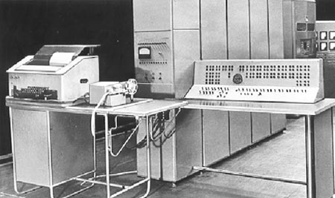
Balanced ternary computers…
I feel unbalanced…
50 of these Setun ternary machines were made at Moscow U. ~1958
+5v
This wasn't even the first!
0v
-5v
This project was discontinued in 1970… though not because of the ternary design!

Slide 13
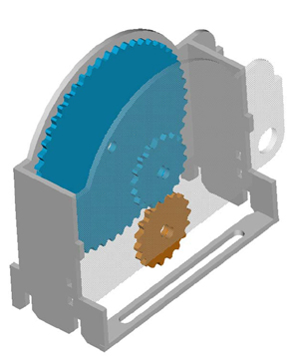
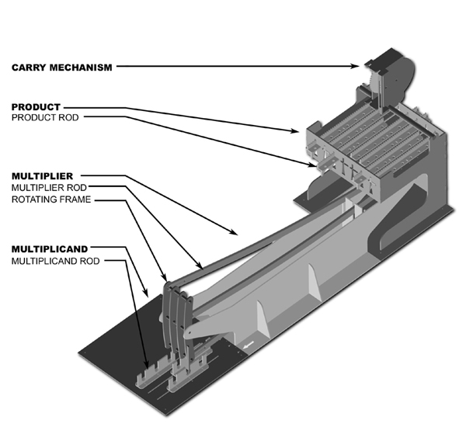
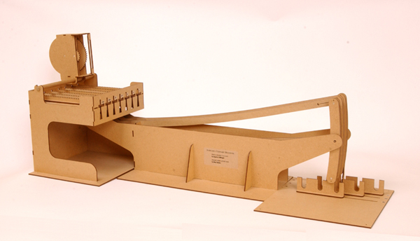
Thomas Fowler's Ternary Computer – from the 1830's!
balanced ternary calculations from Fowler's papers
T. Fowler 1777-1843, Treasurer of the Poor Law Union
the 3:1 carry mechanism
the 2005 reconstruction
ternary representation
Notes:
http://www.mortati.com/glusker/fowler/fowlerbio.htm
"In the 1830’s, Fowler was Treasurer of the Poor Law Union. This job required a considerable number of repetitive monetary calculations, made more complex by the pre-decimal British currency."

Slide 14
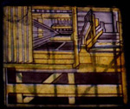
Fowler's machine was rebuilt from two sources:
a two-page description (but no images!) by mathematician A. DeMorgan
a picture of it as a stained-glass window in Fowler's church: St. Michael's of Great Torrington, North Devon, U.K.!
http://www.mortati.com/glusker/fowler/index.htm

Slide 15
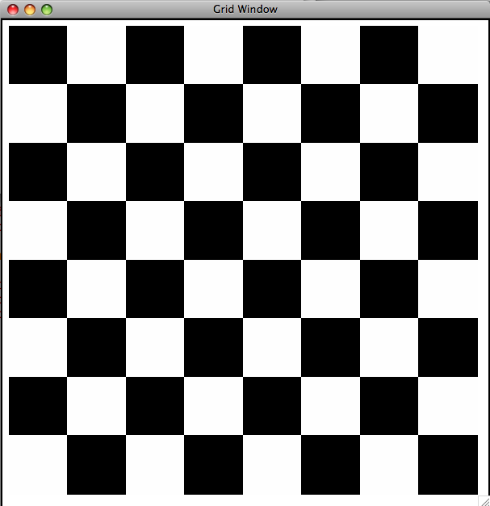
Hw4: binary image compression
10101010
01010101
10101010
01010101
10101010
01010101
10101010
01010101
Binary Image
Encoding as raw bits
one big string of 64 characters
"1010101001010101101010100101010110101010010101011010101001010101"

Slide 16
likelier images to compress…
home!

Slide 17
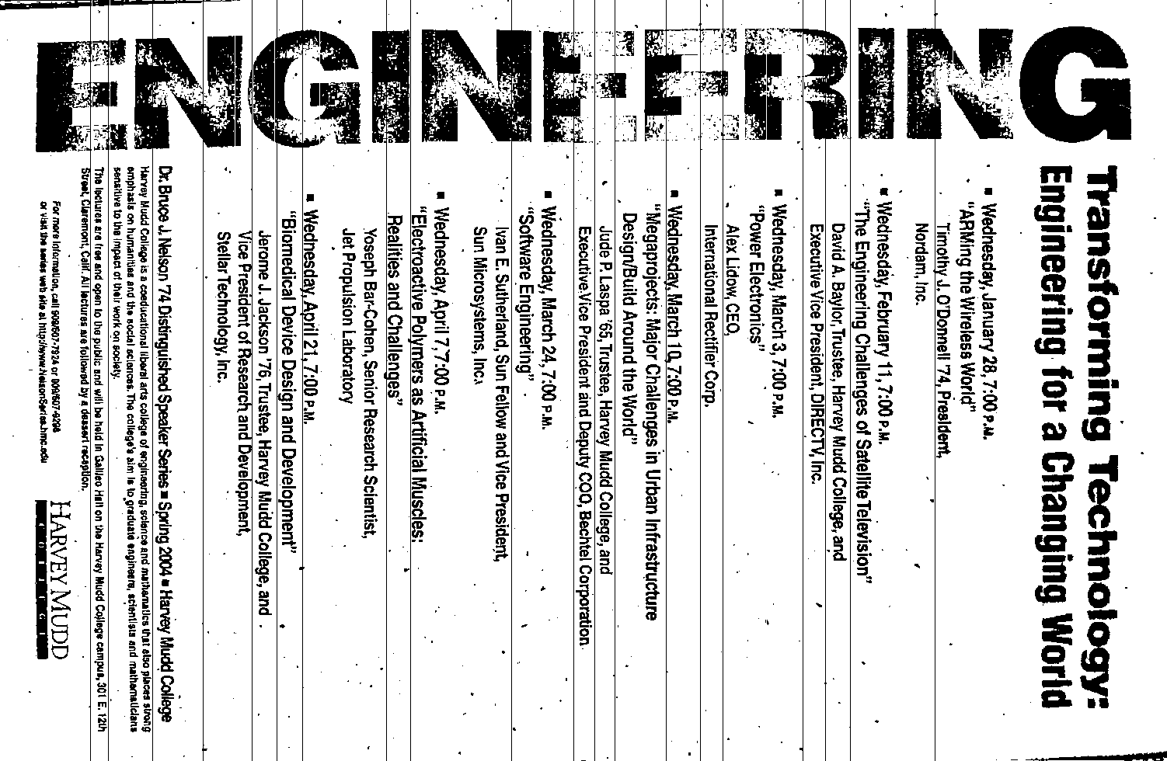
likelier images to compress…

Slide 18
Hw4: binary image compression
00000000
00000000
11111111
11111111
00000000
00000000
00000000
00001111
same-data streaks
Binary Image
Encoding as raw bits
one big string of 64 characters
If our images tend to have long streaks of unchanging data, how might we represent it more efficiently, but still in binary?
"0000000000000000111111111111111100000000000000000000000000001111"

Slide 19
Hw4: binary image compression
0 is the first digit
1 is the next digit
0 is the next digit
1 is the final digit
00000000
00000000
11111111
11111111
00000000
00000000
00000000
00001111
There are 16 of them.
Again, there are 16 of them.
There are 28
There are 4
0100001100000111001100
0100001100000111001100
One possible idea:
bit #repeats
See any problems with this?

Slide 20
Hw4: binary image compression
0 is the first digit
00000000
00000000
00000000
00000000
00000000
00000000
00000000
000000…
and there are 1,098,188 of them.
0100001100000111001100
It's ambiguous! this could just be a huge number of 0 pixels!
0100001100000111001100
1,098,188 zeros!
One possible idea:
bit #repeats
See any problems with this?

Slide 21
fixed-width image compression
0 is the first digit
1 is the next digit
and so on…
00000000
00000000
11111111
11111111
00000000
00000000
00000000
00001111
There are 16 of them.
Again, there are 16 of them.
28 zeros
4 ones
00010000100100000001110010000100
7 bits: # of repeats
7 bits: # of repeats
8-bit data block
8-bit data block
8-bit data block
8-bit data block
00010000100100000001110010000100
We need fixed-width blocks:
bit #repeats
8-bits total

Slide 22
If you use 7 bits to hold the # of consecutive repeats, what is the largest number of bits that one block can represent?
00010000
7 bits?
1 bit: the initial pixel
7 bits: # of repeats
B bits?
8-bit total data block
What if you need a larger # of repeats?

Slide 23
hw4 pr3
def compress( I ):
""" returns the RLE of the
input binary image, I """
def uncompress( CI ):
""" returns the binary image I
from the run-length-encoded,
"compressed" input, CI """

Slide 24
hw4 pr3
a binary image
"0000000000000000111111111111111100000000000000000000000000001111"
What helper function(s) might be useful here?
def compress( I ):
""" returns the RLE of the
input binary image, I """
the "compressed" image
00010000100100000001110010000100
def uncompress( CI ):
""" returns the binary image I
from the run-length-encoded,
"compressed" input, CI """
back to the original binary image
"0000000000000000111111111111111100000000000000000000000000001111"

Slide 25
Quiz
Name(s) _________________________________
Don't hand this in…
Examples…
Write a recursive function, frontNum(S)
It should return the # of times the first element of the input S appears consecutively at the start of S:
>>> frontNum('1111010')
4
>>> frontNum('00111000010')
2
def frontNum(S):
if
return
elif
return
else:
return
len(S)<=1:
S[0] …
shortest
longest
What are the BEST / WORST compression results you can get for an 8x8 input image (64 bits)?
EXTRA! How can you change the algorithm so that compressed images are always smaller than the originals?

Slide 26
shortest compressed representation
longest compressed representation
What are the BEST and the WORST compression results you can get for an 8x8 image input (64 bits)?
??
How could we improve this compression algorithm so that all compressed images are smaller than their originals ? That is, how can we make compression always work ?

Slide 27
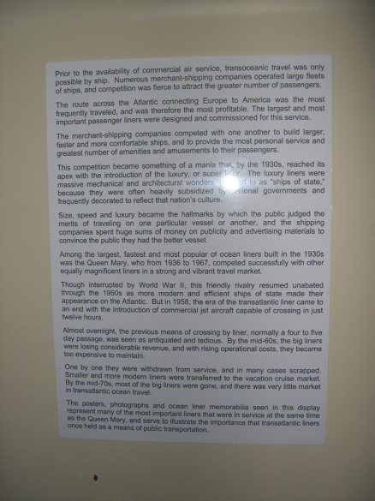
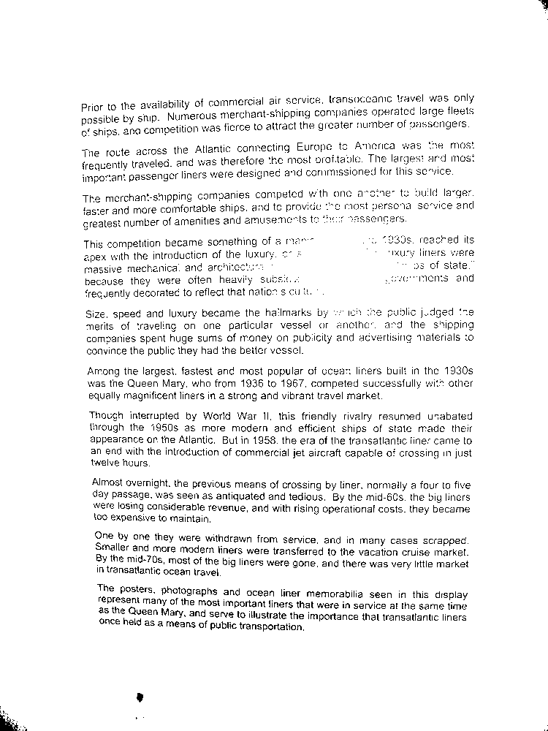
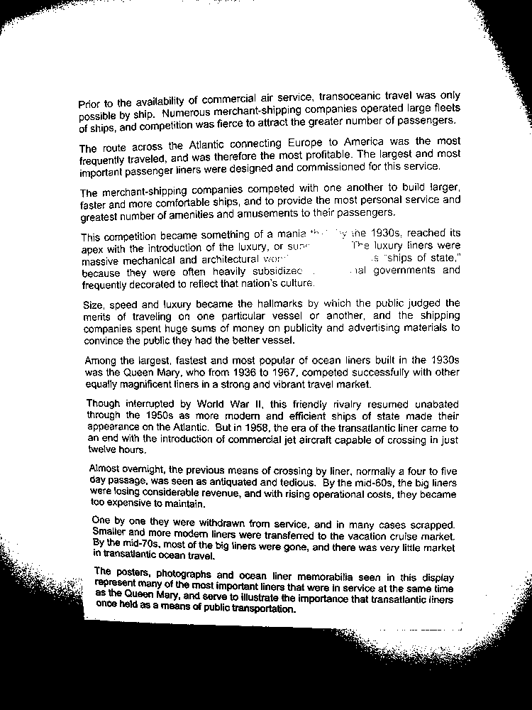
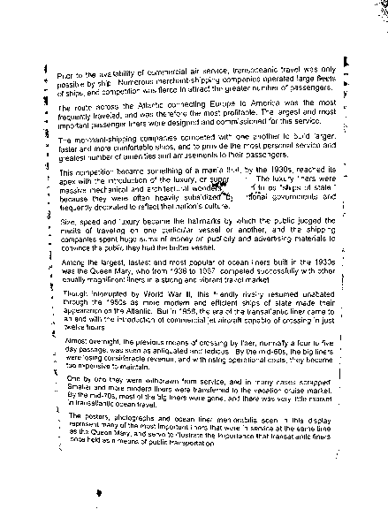
Binary images in practice...
Original Image
T = 78/255
T = 120/255
Adaptive T
T = 120/255
Adaptive Threshold

Slide 28
Portrait vs. landscape?

Slide 29
Portrait vs. landscape?
Intensity profiles
Lots of peaks == lots of text lines
This landscape image is determined to contain a portrait document.
few peaks == few text lines
Right-side up?

Slide 30
Portrait vs. landscape?
Intensity profiles
Lots of peaks == lots of text lines
This landscape image is determined to contain a portrait document.
few peaks == few text lines
Right-side up?

Slide 31
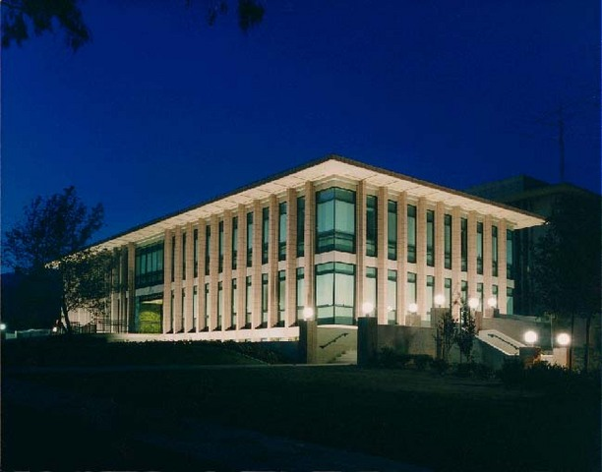
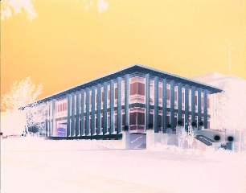
hw4pr3 (extra)
Image processing...
import cs5png
Pix = cs5png.getRGB( 'olin.png' )
Images are represented by Python lists of ... ?
newIM = invert( Pix )
cs5png.saveRGB( Pix )

Slide 32
It's all bits!
images, text, sounds, data, …
even the string 'forty-two' is represented as a sequence of bits…
'forty-two'
11001101101111111001011101001111001101101111010011101111101111
8*9 == 72 bits
9 ASCII characters
8 bits each
All computation boils down to manipulating bits!

Slide 33
In a computer, each bit is represented as a voltage (1 is +5v and 0 is 0v)
Computation is simply the deliberate combination of those voltages!
101010
(1) set input voltages
42
ADDER circuit
What's that green box?
9
001001

Slide 34
In a computer, each bit is represented as a voltage (1 is +5v and 0 is 0v)
Computation is simply the deliberate combination of those voltages!
101010
(1) set input voltages
42
(2) perform computation
ADDER circuit
What's that green box?
110011
9
001001

Slide 35
In a computer, each bit is represented as a voltage (1 is +5v and 0 is 0v)
Computation is simply the deliberate combination of those voltages!
101010
(1) set input voltages
42
(2) perform computation
ADDER circuit
51
What's that green box?
110011
(3) read output voltages
9
001001
Richard Feynman: "Computation is just a physics experiment that always works!"

Slide 36
All computation
is simply functions of bits
binary inputs A and B
output, A+B
00
00
000
00
01
001
00
10
This week: you'll build this in Python.
010
00
11
011
01
00
001
01
01
010
01
10
011
01
11
bitwise
addition function
100
10
00
010
10
01
011
10
10
100
10
11
101
11
00
011
11
01
100
11
10
101
11
11
110
Next week: you'll design this with wires.
A
B

Slide 37
is circuit addition!
Adding strings?
S = '31'
T = '11'
def add10(S,T):
""" adds the *strings* S and T
as decimal numbers
"""
if len(S) == 0: return T
if len(T) == 0: return S
eS = S[-1]
eT = T[-1]
if eS == '0' and eT == '1': return add10(S[:-1],T[:-1]) + '1'
if eS == '1' and eT == '1': return add10(S[:-1],T[:-1]) + '2'
if eS == '2' and eT == '1': return add10(S[:-1],T[:-1]) + '3'
if eS == '3' and eT == '1': return add10(S[:-1],T[:-1]) + '4'
# Lots more rules - how many in all?
eS ~ the "end of S"
eT ~ the "end of T"

Slide 38
Carrying on…
S = '23'
T = '19'
def add10(S,T):
""" adds the *strings* S and T
as decimal numbers """
if len(S) == 0: return T
if len(T) == 0: return S
eS = S[-1]
eT = T[-1]
if eS == '0' and eT == '1': return add10(S[:-1],T[:-1]) + '1'
if eS == '1' and eT == '1': return add10(S[:-1],T[:-1]) + '2'
if eS == '2' and eT == '1': return add10(S[:-1],T[:-1]) + '3'
if eS == '3' and eT == '1': return add10(S[:-1],T[:-1]) + '4'
# what if we have to carry to the next column?
if eS == '3' and eT == '9':
return
hw4: addB

Slide 39
Our building blocks: logic gates
AND outputs 1 only if ALL inputs are 1
OR outputs 1 if ANY input is 1
NOT reverses its input
AND
OR
NOT
These circuits are physical functions of bits…
… and all mathematical functions can be built from them!

Slide 40
AND
inputs
AND
output
AND outputs 1 when ALL inputs are 1
otherwise it outputs 0

Slide 41
AND
x
inputs
AND
output
y
output
input
output
x
y
AND(x,y)
AND's function:
0
0
0
0
1
0
"Truth table"
1
0
0
1
1
1

Slide 42
AND
inputs
AND
output
How many different input combinations yield an output of 0 here?
AND outputs 1 when ALL inputs are 1
otherwise it outputs 0

Slide 43
AND
is a physical function of bits!
x
y
inputs
z
AND
output
output
w
input
output
x
y
z
w
AND(xyzw)
AND's function:
0
0
0
0
0
0
0
0
1
0
fifteen 0s
…12 more rows not shown…
0
1
1
1
0
0
1
1
1
1
1
one 1

Slide 44
OR
inputs
OR
output
OR outputs 1 when ANY input is 1
It outputs 0 only if all inputs are 0.

Slide 45
OR
x
inputs
OR
output
y
output
input
output
x
y
OR(x,y)
OR's function:
0
0
0
0
1
1
1
0
1
1
1
1

Slide 46
OR
inputs
OR
output
How many different input combinations yield an output of 1 here?
OR outputs 1 when ANY input is 1
It outputs 0 only if all inputs are 0.

Slide 47
OR
x
y
inputs
z
OR
output
output
w
input
output
x
y
z
w
OR(xyzw)
OR's function:
0
0
0
0
0
one 0
0
0
0
1
1
…12 more rows not shown…
1
1
1
1
0
1
fifteen 1s
1
1
1
1
1

Slide 48
NOT
"NOT bubble" (optional)
inputs
x
NOT
output
NOT's function:
input
output
x
NOT(x)
0
1
one 1
1
0
one 0

Slide 49
Our building blocks: logic gates
input
output
input
output
x
y
AND(x,y)
x
y
OR(x,y)
input
output
x
NOT(x)
0
0
0
0
0
0
0
1
0
0
1
1
0
1
1
0
0
1
0
1
1
0
1
1
1
1
1
1
AND outputs 1 only if ALL inputs are 1
OR outputs 1 if ANY input is 1
NOT reverses its input
AND
OR
NOT

Slide 50
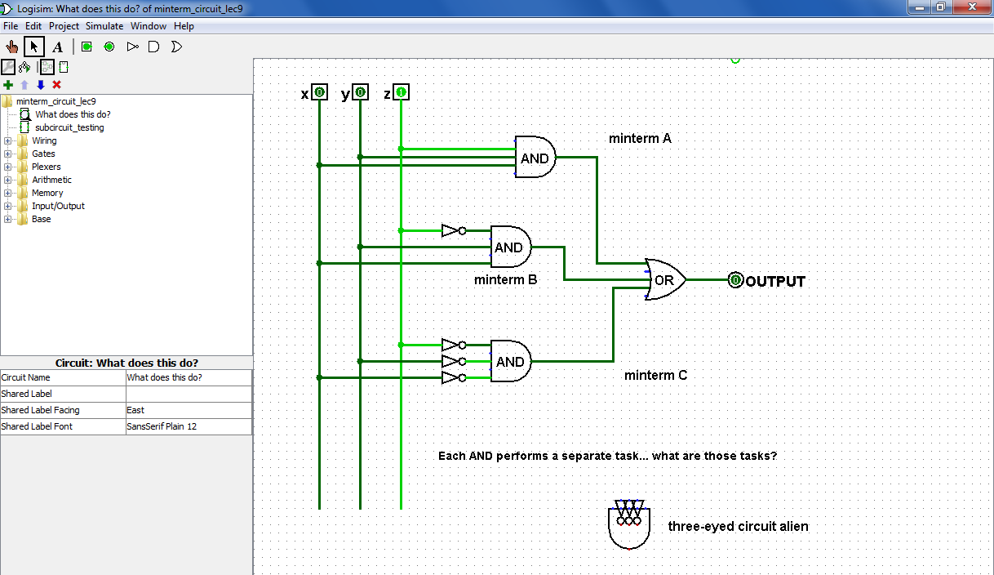
From gates to circuits...
What inputs make this circuit output 1?
Logisim
What inputs make this circuit output 0?

Slide 51
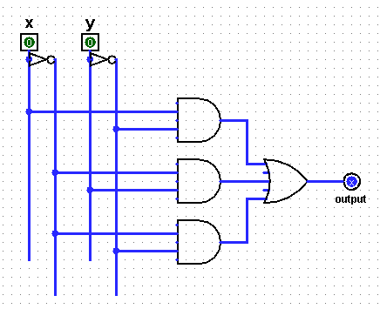
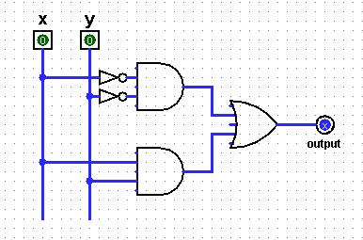
Quiz
Find the outputs for these circuits
Name(s) ___________________________________
inputs
output
truth table
inputs
output
truth table
x
y
x
y
(A)
0
0
0
0
(B)
0
1
0
1
(C)
1
0
1
0
(D)
1
1
1
1
top
AND
top
AND
OR
middle
AND
OR
lower
AND
bottom AND
(1) Which gate runs line (A) of the truth table?
Can you tell which gates implement each line of the truth table above?
(2) Which gate runs line (D) of the truth table?

Slide 52
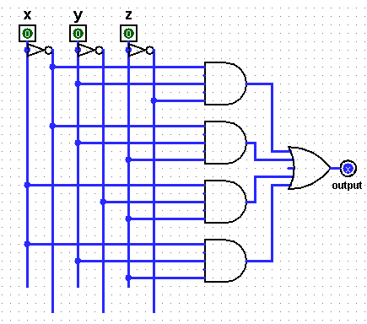
Fill in the function values (truth table) for this circuit…
Three bits ?
input
output
x
y
z
A
0
0
0
0
0
1
0
1
0
B
0
1
1
1
0
0
C
1
0
1
1
1
0
1
1
1
D
(1) Which truth table lines do the AND gates A, B, C, and D implement?
(2) This circuit uses 9 logic gates – could it use fewer?
(3) What property of integers (up to 7) does this circuit compute?

Slide 53
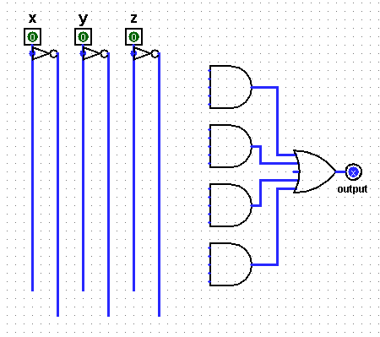
DIY !
Draw the upstream wires to build a circuit for the truth table at left…
input
output
x
y
z
A
0
0
0
0
0
0
1
1
0
1
0
1
B
0
1
1
0
1
0
0
1
C
1
0
1
0
1
1
0
0
1
1
1
1
D
(*) Given a truth table, could you now design the circuit for it?

Slide 54
Claim !?
We need only these three building blocks to compute anything at all
I need proof!
AND
AND outputs 1 iff ALL its inputs are 1
OR
OR outputs 1 iff ANY input is 1
NOT
NOT reverses its input

Slide 55
from circuit design…
next 2 weeks
…to a full computer!
Have a great weekend!

Slide 57
Constructive Proof !
Specify a truth table defining any function you want
For each input row whose output needs to be 1, build an AND circuit that outputs 1 only for that specific input!
i
ii
input
output
x
y
fn(x,y)
0
0
0
This is a three i'ed proof!
0
1
1
iii
OR them all together
1
0
1
1
1
0

Slide 58
Constructive Proof !
Specify a truth table defining any function you want
For each input row whose output needs to be 1, build an AND circuit that outputs 1 only for that specific input!
i
ii
input
output
x
y
fn(x,y)
0
0
0
0
1
1
iii
OR them all together
1
0
1
1
1
0
x
y
NOT
AND
Does this work for the red row?
x
y
Does this work for any other rows?

Slide 59
Constructive Proof !
Specify a truth table defining any function you want
For each input row whose output needs to be 1, build an AND circuit that outputs 1 only for that specific input!
i
ii
input
output
x
y
fn(x,y)
0
0
0
0
1
1
iii
OR them all together
1
0
1
1
1
0
How did we handle the rows outputting zero?
x
y
NOT
AND
OR
NOT
AND
x
y

Slide 60
Constructive Proof !
Specify a truth table defining any function you want
For each input row whose output needs to be 1, build an AND circuit that outputs 1 only for that specific input!
i
ii
input
output
x
y
fn(x,y)
This is a constructive proof that AND, OR, and NOT suffice to build any (boolean) function!
0
0
0
0
1
1
iii
OR them all together
1
0
1
1
1
0
How did we handle the rows outputting zero?
x
y
NOT
AND
OR
NOT
AND
x
y

Slide 61
Constructive Proof !
Specify a truth table defining any function you want
For each input row whose output needs to be 1, build an AND circuit that outputs 1 only for that specific input!
i
ii
But... ALL functions are just boolean functions: because everything is in binary!
input
output
x
y
fn(x,y)
This is a constructive proof that AND, OR, and NOT suffice to build any (boolean) function!
0
0
0
0
1
1
iii
OR them all together
1
0
1
1
1
0
How did we handle the rows outputting zero?
x
y
NOT
AND
OR
NOT
AND
x
y

Slide 62
Try it!
Given the truth table on the right, draw the circuit that implements it!
input
output
x
y
z
0
0
0
0
0
0
1
1
0
1
0
1
output
0
1
1
0
1
0
0
1
1
0
1
0
1
1
0
0
1
1
1
1
(1) Use the previous examples as a guide…
(2) Use a single OR gate beside the output…
(3) How many AND gates will be needed "upstream" of the OR gate? Which of the AND gates' inputs will need NOT gates?

Slide 63
Try it!
Fill in the output values for this circuit…
(truth table)
input
output
x
y
top
AND
(A)
0
0
OR
(B)
0
1
(C)
1
0
lower
AND
(D)
1
1
(1) Which gate implements line (A) of the truth table?
(2) Which gate implements line (D) of the truth table?
Rails and NAND! This one – hand in…
(3) Which gates implement the other lines of the truth table?
(4) How would the table change if the top NOT gate were removed?

Slide 64
Try it!
Fill in the function values (truth table) for this circuit…
input
output
A
x
y
z
0
0
0
B
0
0
1
0
1
0
0
1
1
C
1
0
0
1
0
1
D
1
1
0
1
1
1
(1) Which truth table lines do the AND gates A,B,C,D implement?
Rails and prime and oddparity !
(2) This circuit uses 9 logic gates – could it use fewer?
(3) If the inputs are considered the bits of a three-bit integer, xyz, what property of integers does this circuit compute?

Slide 65
Try it!
Given the truth table on the right, draw the circuit that implements it!
input
output
x
y
z
0
0
0
0
0
0
1
1
0
1
0
1
output
0
1
1
0
1
0
0
1
1
0
1
0
1
1
0
0
1
1
1
1
(1) Use the previous examples as a guide…
(2) Use a single OR gate beside the output…
(3) How many AND gates will be needed "upstream" of that OR gate? Which of the AND gates' inputs will need NOT gates?

Slide 67
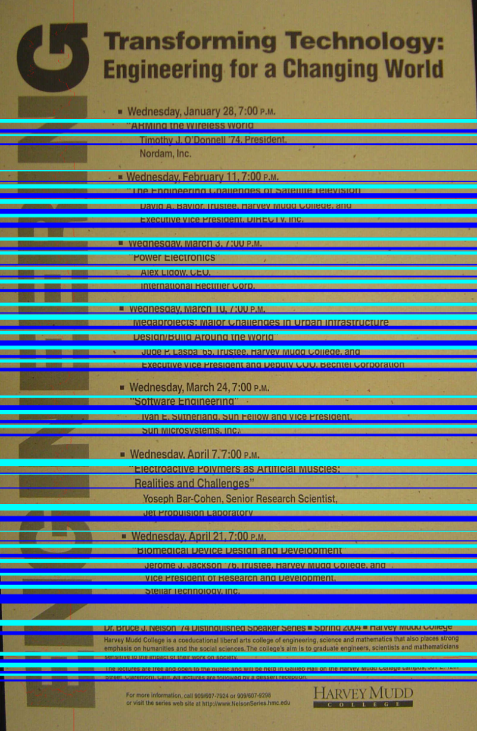
Up vs. down?
Each line is divided into thirds…
Top and bottom “thirds” are compared for text density
The higher-density direction is presumed to be ascenders ~ up!

Slide 68
likelier images to compress

Slide 69
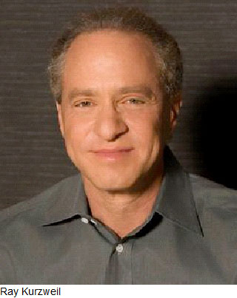
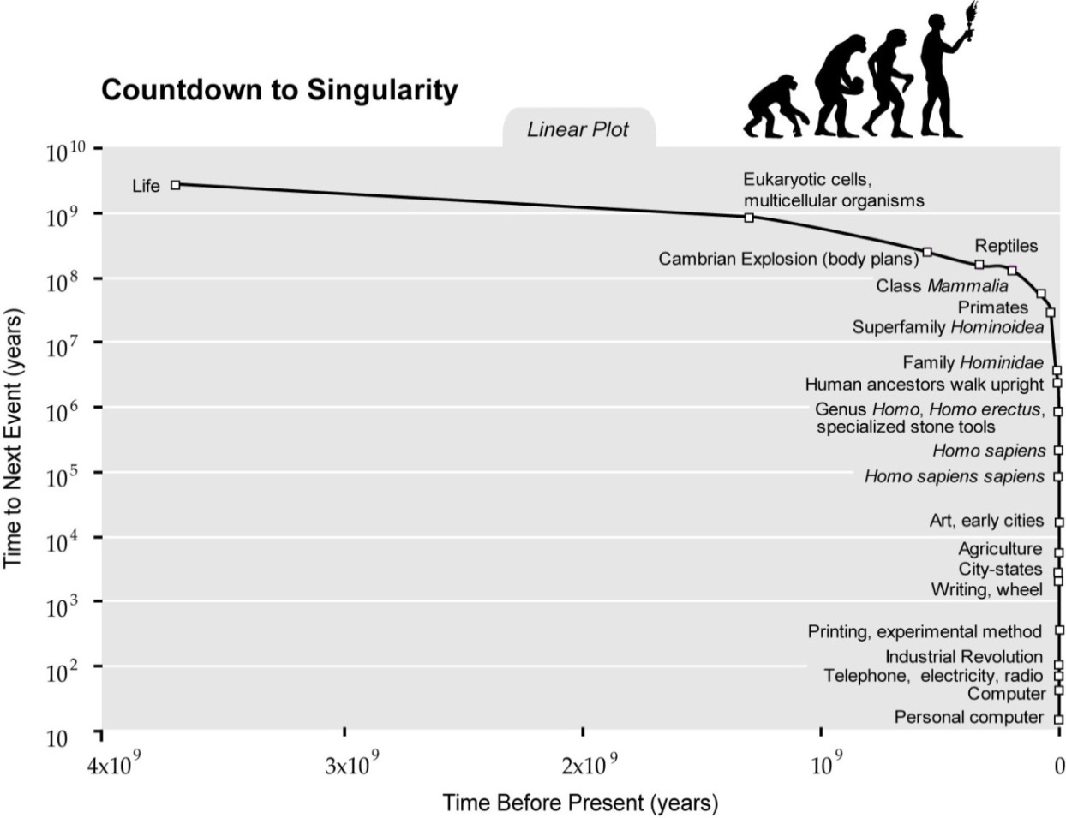
Ray Kurzweil

Slide 70
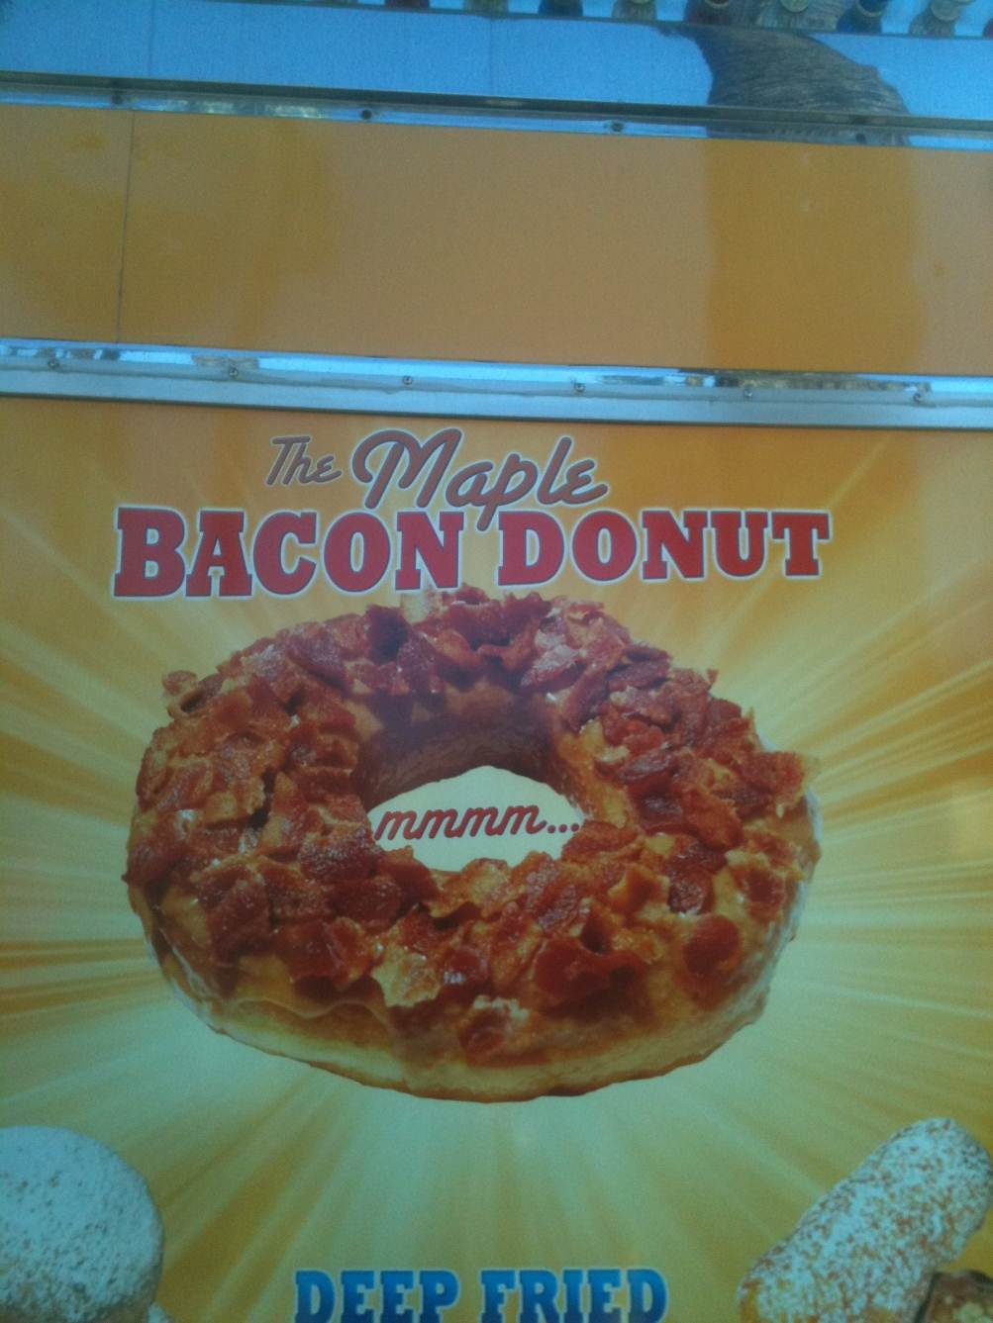
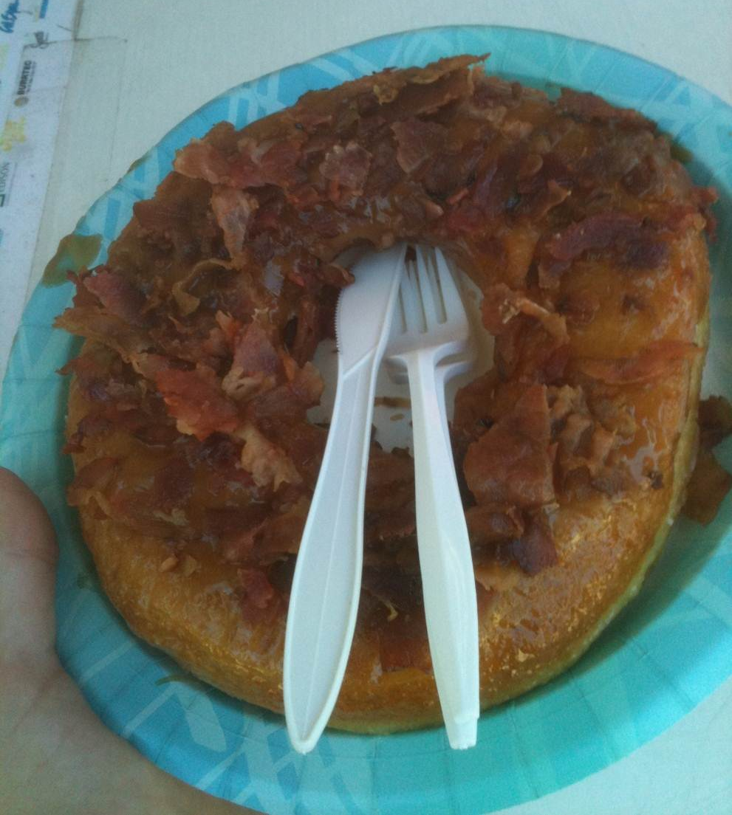
What Ray can't eat, at least if he wants to live forever…
LA County Fair…

Slide 71
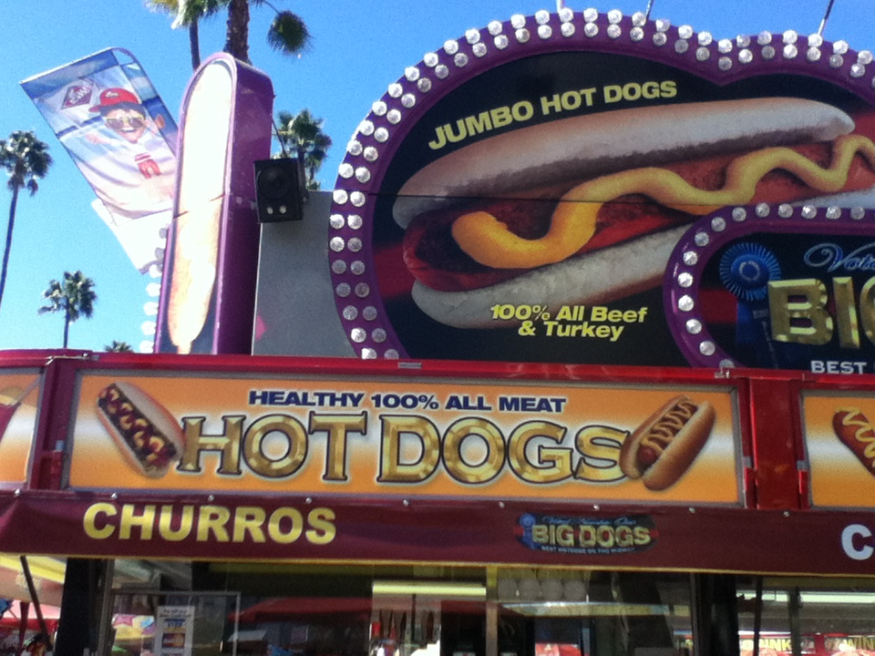
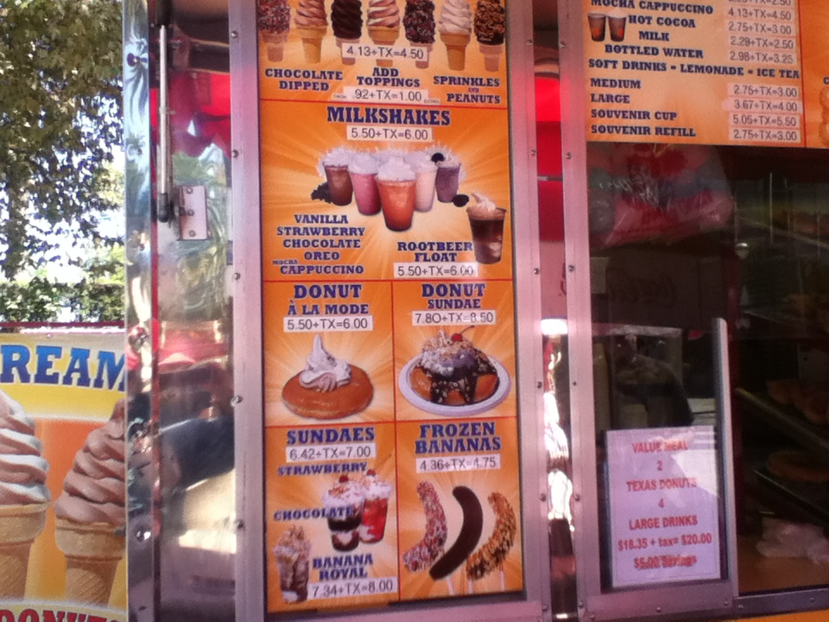
Different underlying assumptions…

Slide 72
Try it...
Specify a truth table defining any function you want
For each input row whose output needs to be 1, build an AND circuit that outputs 1 only for that specific input!
1
2
input
output
x
y
fn(x,y)
0
0
1
3
OR them all together
0
1
0
1
0
0
1
1
1
x
y
x
y
How did we handle the rows outputting zero?

Slide 73
Try it!
Fill in the function values (truth table) for this circuit…
input
output
x
y
(A)
0
0
(B)
0
1
(C)
1
0
(D)
1
1
(1) Which gate implements line (A) of the truth table?
(2) Which gate implements line (D) of the truth table?
(3) Which gates implement the other lines of the truth table?
(4) How would the table change if the top NOT gate were removed?

Slide 74
Try it!
Fill in the function values (truth table) for this circuit…
input
output
A
x
y
z
0
0
0
0
0
1
B
0
1
0
0
1
1
1
0
0
C
1
0
1
1
1
0
1
1
1
D
(1) Which truth table lines do the AND gates A,B,C,D implement?
(2) This circuit uses 9 logic gates – could it use fewer?
(3) If the inputs are considered the bits of a three-bit integer, xyz, what property of integers does this circuit compute?

Slide 75
Try it!
Fill in the function values (truth tables) for these two circuits!
input
output
x
y
z
input
output
x
y
0
0
0
0
0
1
0
0
0
1
0
0
1
0
1
1
1
0
1
0
0
1
1
1
0
1
1
1
0
1
1
1

Slide 76
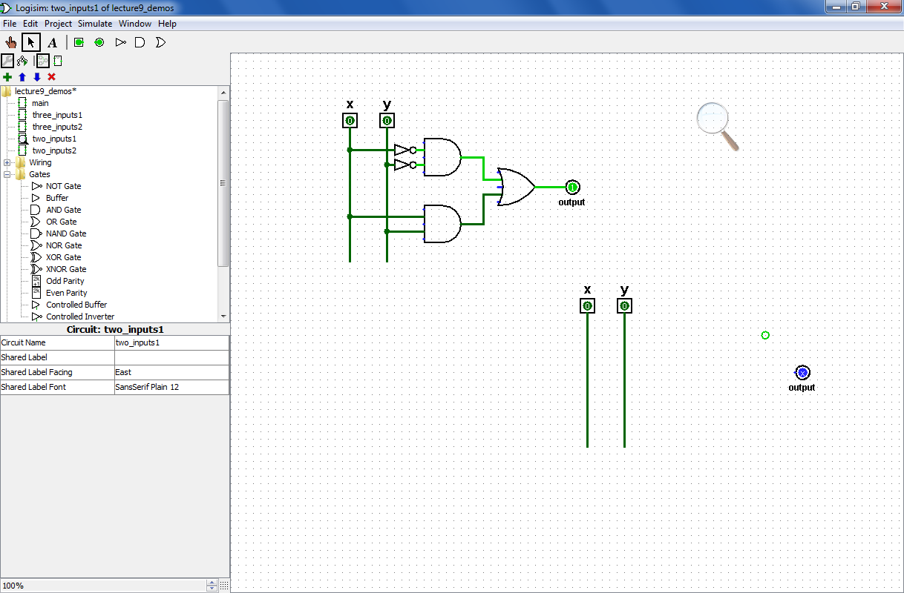
Try it!
Design circuits that implement the functions (truth tables) shown below.
input
output
x
y
z
input
output
x
y
0
0
0
0
0
1
0
0
0
1
0
0
1
0
1
1
1
0
1
0
0
1
1
1
0
1
1
1
0
1
1
1

Slide 77
DIY: design-it-yourself…
x
y
z
fn(x,y,z)
0
0
0
0
0
0
1
1
0
1
0
1
0
1
1
0
1
0
0
1
1
0
1
0
1
1
0
0
1
1
1
1
This looks like fn !

Slide 78
Circuits
are physical functions of bits!
x
y
inputs
z
AND
output
output
w
input
output
x
y
z
w
AND(x,y)
0
0
0
0
0
AND's function:
0
0
0
1
0
fifteen 0s
…12 more rows not shown…
0
1
1
1
0
0
1
1
1
1
1
one 1

Slide 79
AND
AND
NOT
inputs
AND
output
OR
AND outputs 1 when ALL inputs are 1
otherwise it outputs 0

Slide 80
All computation
… consists of functions of bits, or boolean values
Boolean inputs x,y,… can only be 0 or 1.
Boolean functions can output only 0 or 1.
inputs
output
x
y
fn(x,y)
0
0
0
0
1
1
1
0
1
1
1
0
This seems fn !
Truth table

Slide 81
Lots of bits!
inputs
output
x
y
z
fn(x,y,z)
0
0
0
0
0
0
1
1
0
1
0
1
0
1
1
0
1
0
0
1
1
0
1
0
1
1
0
0
1
1
1
1
Even more fn !
Truth table

Slide 82
Physical Logic Gates...
6 NOT gates:
Notes:
these quotes are important to yahoo… !

Slide 83
Claim!
We need only three building blocks to compute anything at all
Three – of course!
AND outputs 1 iff ALL its inputs are 1
AND
OR outputs 1 iff ANY input is 1
OR
NOT
NOT reverses its input

Slide 84
"Quiz"
Name(s):
Write a recursive function frontNum(s) It. should return the # of times the first element of the input s appears consecutively AT THE FRONT of that string:
>>> frontNum('1111010')
4
>>> frontNum('00111000010')
2
def frontNum(s):
Examples…
shortest compressed representation
longest compressed representation
EXTRA
What are the BEST and the WORST compression results you can get for an 8x8 input image (64 bits)?
How can you change fixed-length compression so that all compressed images are smaller than their originals ? That is, how can we make compression always "work" ?

Slide 85
Write a recursive function frontNum(s) It. should return the # of times the first element of the input s appears consecutively AT THE FRONT of that string:
>>> frontNum('00111000010')
2
>>> frontNum('1111010')
4
Examples…
def frontNum(s):

Slide 86
shortest compressed representation
longest compressed representation
What are the BEST and the WORST compression results you can get for an 8x8 image input (64 bits)?
EXTRA
How can you change this compression algorithm so that all compressed images are smaller than their originals ? That is, how can we make compression always work ?

Slide 87
Minterm Expansion
Truth Table
… is a proof that AND, OR, and NOT suffice to construct any function!
input
output
x
y
XOR(x,y)
0
0
0
0
1
1
1
0
1
1
1
0
Process
Build circuits of NOTs and AND that computes each "1" row.
OR them together.
Notes:
87

Slide 88
Bit functions are truth tables!
Truth Table
input
output
Any function can be represented as a table of inputs and outputs.
x
y
XOR(x,y)
0
0
0
0
1
1
1
0
1
1
1
0
If we create a circuit that always outputs 0, how much does it already do correctly !?
What more do we need?
Notes:
88

Slide 89
Minterm Expansion
Truth Table
input
output
x
y
XOR(x,y)
0
0
0
0
1
1
What is a circuit that outputs 1 ONLY WHEN x is 0 and y is 1 ?
1
0
1
1
1
0
x
y
output
Notes:
89

Slide 90
What's in the image?
What do these peaks mean?
Plot of total intensity across each row of pixels
Why is it important to have binarized first?

Slide 91
Minterm Expansion
1
Specify the Truth Table defining the function
2
Build separate circuits for each output-1 row using ANDs and NOTs
Combine them with OR.
input
output
x
y
XOR(x,y)
0
0
0
0
1
1
1
0
1
1
1
0
KEY
input x
This circuit always outputs 0 - except for the second row, when x is 0 and y is 1
AND
input y
This is not a bubble, it's a NOT bubble!
What about the third row?
Notes:
91

Slide 92
Minterm Expansion
1
Specify the Truth Table defining the function
2
Build separate circuits for each output-1 row using ANDs and NOTs
Combine them with OR.
input
output
x
y
XOR(x,y)
0
0
0
0
1
1
1
0
1
1
1
0
input x
AND
KEY
input y
This circuit always outputs 0 - except for the third row!
AND
Notes:
92

Slide 93
Minterm Expansion
1
Specify the Truth Table defining the function
2
Build separate circuits for each output-1 row using ANDs and NOTs
Combine them with OR.
input
output
x
y
XOR(x,y)
0
0
0
0
1
1
1
0
1
1
1
0
input x
AND
input y
output
OR
AND
These are not bubbles, they’re NOT bubbles
Notes:
93

Slide 94
Minterm Expansion
1
Specify the Truth Table defining the function
2
Build separate circuits for each output-1 row using ANDs and NOTs
Combine them with OR.
input
output
x
y
XOR(x,y)
Or you can start here…
0
0
0
0
1
1
"the formula"
1
0
1
3
xy + xy
1
1
0
input x
AND
input y
output
OR
AND
Notes:
94

Slide 95
"Rails"
1
Specify the Truth Table defining the function
2
Build separate circuits for each output-1 row using ANDs and NOTs
Combine them with OR.
input
output
x
y
x
y
XOR(x,y)
x
y
0
0
0
0
1
1
1
0
1
AND
1
1
0
OR
AND
This wire ("rail") carries x's value.
This wire ("rail") carries y's value.
Notes:
95

Slide 96
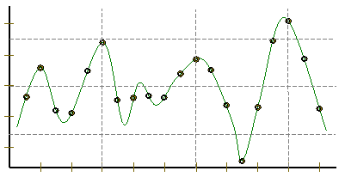
Representing Sound
Ex. Cr.
physics
continuous plot of air pressure vs. time
sampling
samples taken every ~ 1/22050nd of a second
Pressure
Time
quantization
Each sample is measured on a pressure scale from -32,767 to 32,767. (This fits into 2 bytes.)
storage
pulse code modulation
Raw audio data - such as what is written to the surface of a CD - is simply a list of these values.
plus formatting information
uncompressed sound data

Slide 97
Constructive Proof !
Specify a truth table defining any function you want
For each input row whose output needs to be 1, build an AND circuit that outputs 1 only for that specific input!
i
ii
input
output
x
y
fn(x,y)
0
0
0
0
1
1
iii
OR them all together
1
0
1
1
1
0
NOT
AND
OR
NOT
AND
x
y

Slide 98
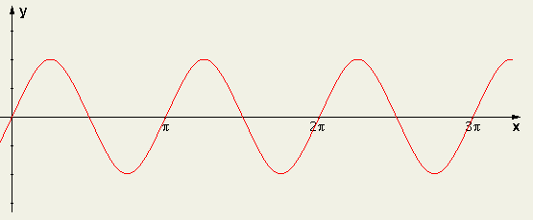
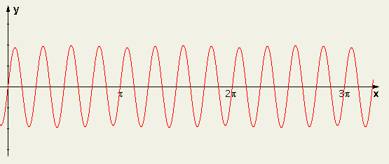
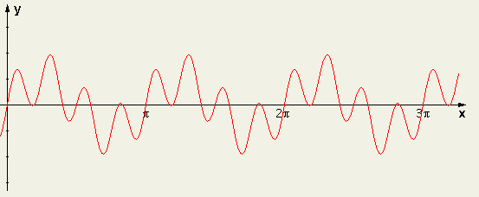
Sound: frequency
Ex. Cr.
We can create "pure" tones with a sine or cosine wave.
sin(2x)
We can add "pure" tones to create chords or other effects
sin(8x)
Any sound data is simply a sum of sine and cosine waves
A list of frequencies + their strength represents any sound!
sin(2x) + sin(8x)
How can we tell what frequencies make up a particular sound?
multiply by the frequency you want to test, and then add!

Slide 99
A bit of intuition…
Sometimes the bits are almost visible:
21 << 1
5 & 6
5 | 6
42
?
?
21 >> 1
5 ^ 6
10
?

Slide 100
More bits of Python
Which results will Python produce here?
5 & 6
5 | 6
A
0
1
B
1
0
C
2
3
D
3
5
E
4
7

Slide 101
Minterm Expansion
1
Specify the Truth Table defining the function
2
Build separate circuits for each output-1 row using ANDs and NOTs
Combine them with OR.
input
output
x
y
XOR(x,y)
0
0
0
0
1
1
1
0
1
1
1
0
KEY
input x
This circuit always outputs 0 - except for the second row, when x is 0 and y is 1
AND
input y
This is not a bubble, it's a NOT bubble!
What about the third row?
Notes:
101

Slide 102
Minterm Expansion
Specify a truth table defining any function you want
For each input row whose output needs to be 1, build an AND circuit that outputs 1 only for that specific input!
1
2
input
output
x
y
fn(x,y)
0
0
0
3
OR them all together
0
1
1
1
0
1
1
1
0
input x
AND
input y
output
OR
AND
How did we handle the rows outputting zero?

Slide 103
Claim: All computation
1
Specify the Truth Table defining the function
Formula !
1.5
input
output
x
y
XOR(x,y)
0
0
0
SELECT EACH ROW whose output is 1.
0
1
1
2
1
0
1
1
1
0
then combine…
I need proof!
Requires only 3 gates: AND, OR, and NOT

Slide 104
Minterm Expansion
1
Specify the Truth Table defining the function
Formula !
1.5
input
output
x
y
XOR(x,y)
0
0
0
SELECT EACH ROW whose output is 1.
0
1
1
2
1
0
1
1
1
0
then combine…

Slide 105
Minterm Expansion
1
Specify the Truth Table defining the function
Formula !
1.5
xy + xy
input
output
This is a constructive proof that AND, OR, and NOT suffice to construct any (boolean) function!
x
y
XOR(x,y)
0
0
0
SELECT EACH ROW whose output is 1.
0
1
1
2
1
0
1
1
1
0
then combine…
input x
AND
input y
output
OR
AND
These are not bubbles, they’re NOT bubbles
Notes:
105

Slide 106
Designing a circuit
the not equal circuit (!=)
We usually know what we want to do…
We just have to determine how to build it!
"English"
Truth Table
Formula
What is the general way to get a formula?
input bits
output bit
f(x,y) should output 1 when x != y otherwise, output 0
x
y
x != y
0
0
0
1
1
0
1
1
Circuit

Slide 107
Logic Gates
input
output
input
output
x
y
AND(x,y)
x
y
OR(x,y)
input
output
0
0
0
0
0
0
x
NOT(x)
0
1
0
0
1
1
0
1
1
0
0
1
0
1
1
0
1
1
1
1
1
1
input
x
x
y
x
y
NOT
AND
OR
xy
x + y
x
output
"x and y"
"x or y"
"not x"

Slide 108
A bit of intuition…
Sometimes the bits are almost visible:
10101
101
110
101
110
21 << 1
5 & 6
5 | 6
10101
101
110
000
21 >> 1
5 ^ 6
~0
This is NOT legal Python! Is it?

Slide 109
Which way is up?
This landscape image is determined to contain a portrait document.
Intensity profiles
Right-side up?

Slide 110
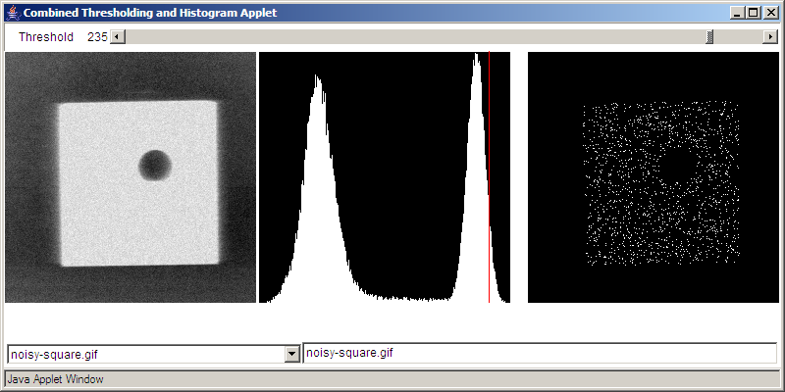
Binary Data
All data is binary…
I consider myself naturally ternary
But some data is naturally binary!
Original Image
Histogram of intensities
BINARY image

Slide 111
hw4pr4 (extra)
IM will be a Python list.
What structure will IM have ?
import cs5png
IM = cs5png.getRGB( 'olin.png' )
cs5png.saveRGB( IM, 'out.png' )
A
C
just a list
a list of lists of lists
B
D
a list of lists
a list of lists of lists of lists!
E
a list of lists of lists of lists of lists!!

Slide 112
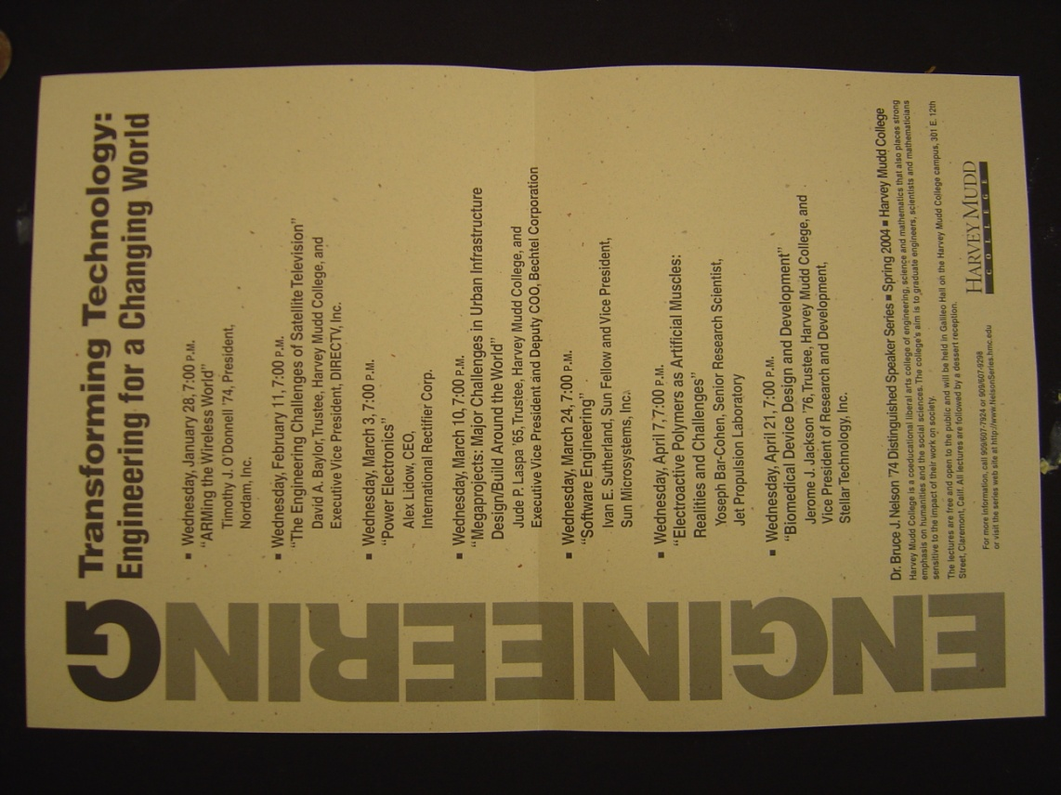
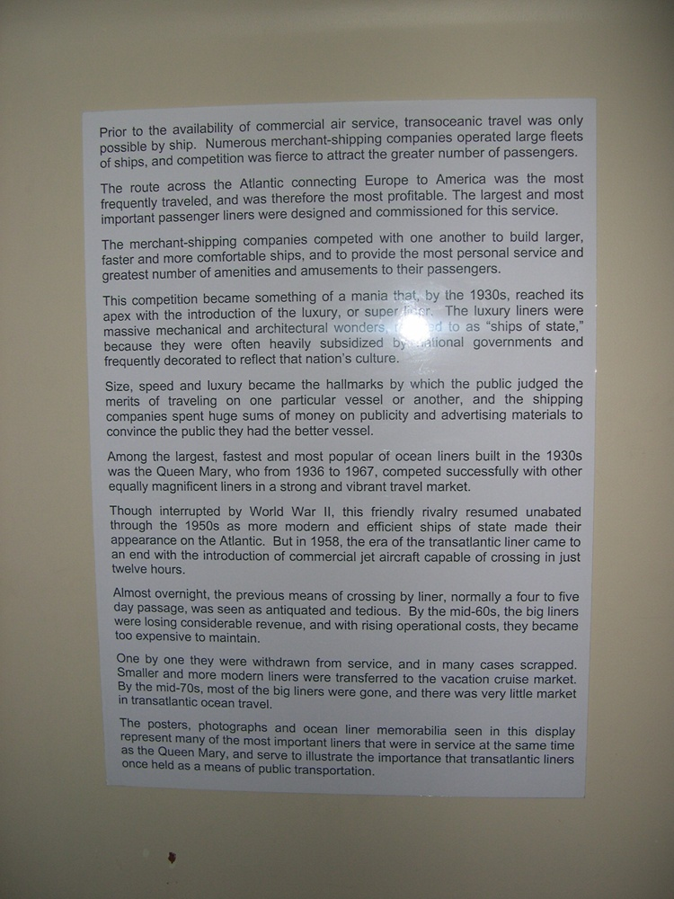
HMC clinic …
camera ~ scanner

Slide 113
CS 101 Today
Jessica's word
diner 2
diner 1
Too many bits? Compress!
Beyond binary … to bits themselves
In 2009 Chris did the floating pt. stuff in the previous lecture
Hw #4: due 10/7 @ 11:59 pm
King of ANDs
Queen of ORs
Jack of NOTs
Hw #5: due 10/14 @ 11:59 pm
Mon., 10/15 in-class
Exam 1:
>>> .1
Tue., 10/16 in-class
"Quiz"-type problems (+ reading)
0.10000000000001
may bring 1 page of notes
>>> .01*10 == .01/.1
False
What is python thinking?!?

Slide 114
CS 101 Today
Matt's word
diner 1
diner 1
Binary - is it ever used by people?
Beyond binary … to bits themselves
Hw #4: due 10/7 @ 11:59 pm
King of ANDs
Queen of ORs
Jack of NOTs
Hw #5: due 10/14 @ 11:59 pm
Mon., 10/15 in-class
Exam 1:
>>> .1
Tue., 10/16 in-class
"Quiz"-type problems (+ reading)
0.10000000000001
may bring 1 page of notes
>>> .01*10 == .01/.1
False
What is python thinking?!?

Slide 115
IEEE* floats
*Institute of Electrical and Electronics Engineers
Python uses double precision floats
64 bits == 8 bytes each

Slide 116
.0625
sinking with floats
.125
.25
.5
0.0000
0.0000
exact decimal equivalents
0.0001
0.0625
0.0010
0.1250
0.0011
0.1875
0.0100
0.2500
0.0101
0.3125
In reality, 23 bits or 52 bits will be used to represent the fractional part of a floating-point number
…
…
0.1100
0.7500
0.1101
0.8125
0.1110
0.8750
0.1111
0.9375
lots of gaps in here…
4 bits
Imagine we had only 4 bits …

Slide 117
.0625
sinking with floats !
.125
.25
.5
0.0000
0.0000
0.0001
0.0625
We type the decimal value 0.1
The computer represents it as the closest available float:
This float's decimal value is 0.1250
So, it acts like you typed 0.1250 !
The "error" is
necessarily limited binary precision
our own high expectations!
not fundamentally a rounding issue
0.0010
0.1250
0.0011
0.1875
0.0100
0.2500
0.0101
0.3125
…
…
0.1100
0.7500
0.1101
0.8125
0.1110
0.8750
0.1111
0.9375
4 bits

Slide 118
Low-level AI?
"Actuation"
"Sensing"

Slide 119
.0625
sinking with floats !
.125
.25
.5
0.0000
0.0000
0.0001
0.0625
We type the decimal value 0.1
The computer represents it as the closest available float:
This float's decimal value is 0.1250
So, it acts like you typed 0.1250 !
The "error" is
necessarily limited binary precision
our own high expectations!
not fundamentally a rounding issue
0.0010
0.1250
0.0011
0.1875
0.0100
0.2500
0.0101
0.3125
…
…
0.1100
0.7500
0.1101
0.8125
0.1110
0.8750
0.1111
0.9375
4 bits
Additional work can be done to compute with the decimal digits themselves - and thus avoid these issues.
from decimal import *
str vs. int

Slide 120
Designing a circuit
the equals to circuit (==)
We usually know what we want to do…
We just have to determine how to build it!
"English"
Truth Table
Formula
What is the general way to get a formula?
input bits
output bit
f(x,y) should output 1 when x = y otherwise, output 0
x
y
x == y
0
0
0
1
1
0
1
1
Circuit

Slide 121
"Quiz"
Name(s):
Write a recursive function startCount(s) It. should return the # of times the first element of the input s appears consecutively AT THE START of that string:
def startCount(s):
>>> startCount('1111010')
4
>>> startCount('00111000010')
2
Examples…
shortest compressed representation
longest compressed representation
What are the BEST and the WORST compression results you can get for an 8x8 square input?
EXTRA
How can you change this compression algorithm so that all compressed images are smaller than their originals? That is, how can we make compression always work?

Slide 122
I thought that binary came already built-in
Building in Binary
Underneath the strings, floats, and ints are simply bits…
'forty-two'
how many bits are used to represent this data?

Slide 123
I thought that binary came already built-in
Building in Binary
Underneath the strings, floats, and ints are simply bits…
'forty-two'
how many bits are used to represent this data?
11001101101111111001011101001111001101101111010011101111101111
9*8 bits == 72 bits
8 bits each for 9 ASCII characters

Slide 124
Building in Binary
Underneath the strings, floats, and ints are simply bits…
Each bit is represented as a voltage (1 is +5v or 0 is 0v)
It might be stored in memory
Or carried along wires to interact with other information
42
101010
input
output
+
adder
110011
51
which is
in decimal
input
9
001001

Slide 125
All computation…
bit values
reduces to functions of boolean values
binary values
other aliases
Boolean variables x,y,… can only be 0 or 1.
or True/False
Boolean functions can output only 0 or 1.
Truth tables describe boolean functions:
Everything is finite (no real numbers!)
input
output
x
y
f(x,y)

Slide 126
All computation
bit values
reduces to functions of boolean values
binary values
Boolean variables x,y,… can only be 0 or 1.
Boolean functions can output only 0 or 1.
Truth tables describe boolean functions:
input
output
x
y
f(x,y)
There are 4 possible input combinations for x and y :
0
0
0
0
1
0
What is this f?
1
0
0
1
1
1
It's a lousy, two-bit function, if you ask me!

Slide 127
Basic Boolean functions
input
output
input
output
x
y
AND(x,y)
x
y
OR(x,y)
input
output
0
0
0
0
0
0
x
NOT(x)
0
1
0
0
1
1
0
1
1
0
0
1
0
1
1
0
1
1
1
1
1
1
AND outputs 1 only if BOTH inputs are 1
OR outputs 1 if EITHER input is 1
NOT reverses its input
It must mean something that there are three of these functions…

Slide 128
Logic Gates
input
output
input
output
x
y
AND(x,y)
x
y
OR(x,y)
input
output
0
0
0
0
0
0
x
NOT(x)
0
1
0
0
1
1
0
1
1
0
0
1
0
1
1
0
1
1
1
1
1
1
input
input
x
y
x
x
y
Not a bubble, a not bubble… !
x + y
x
xy
output
"x or y"
output
"x and y"
"not x"

Slide 129
Logic Gates
x
y
x
y
x
input
Any function of bits can be built from these three gates:
NOT
AND
OR
and that means?
xy
x + y
x
"x and y"
"x or y"
"not x"
output

Slide 130
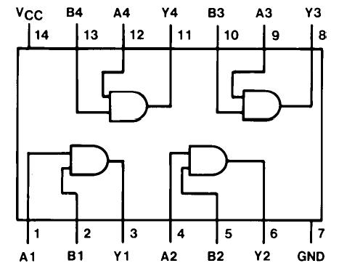
Logic Gates
x
y
x
y
x
input
Any function of bits can be built from these three gates:
NOT
AND
OR
and that means?
xy
x + y
x
"x and y"
"x or y"
"not x"
output
"Quad and gate"
these quotes are important to google… !

Slide 131
Sound: frequency
Ex. Cr.
We can create "pure" tones with a sine or cosine wave.
sin(2x)
We can add "pure" tones to create chords or other effects
sin(8x)
Any sound data is simply a sum of sine and cosine waves
A list of frequencies + their strength represents any sound!
sin(2x) + sin(8x)
How can we tell what frequencies make up a particular sound?
multiply by the frequency you want to test, and then add!

Slide 132
I thought that binary came already built-in
Building in Binary
Underneath the strings, floats, and ints are simply bits…
'forty-two'
how many bits are used to represent this data?
11001101101111111001011101001111001101101111010011101111101111
9*8 bits == 72 bits
8 bits each for 9 ASCII characters

Slide 133
Building in Binary
Underneath the strings, floats, and ints are simply bits…
Each bit is represented as a voltage (1 is +5v or 0 is 0v)
It might be stored in memory
Or carried along wires to interact with other information
42
101010
input
output
+
adder
110011
51
which is
in decimal
input
9
001001

Slide 134
All computation
bit values
reduces to functions of boolean values
binary values
Boolean variables x,y,… can only be 0 or 1.
Boolean functions can output only 0 or 1.
Truth tables describe boolean functions:
input
output
x
y
f(x,y)
There are 4 possible input combinations for x and y :
0
0
0
0
1
0
What is this f?
1
0
0
1
1
1
It's a lousy, two-bit function, if you ask me!

Slide 135
Basic Boolean functions
input
output
input
output
x
y
AND(x,y)
x
y
OR(x,y)
input
output
0
0
0
0
0
0
x
NOT(x)
0
1
0
0
1
1
0
1
1
0
0
1
0
1
1
0
1
1
1
1
1
1
AND outputs 1 only if BOTH inputs are 1
OR outputs 1 if EITHER input is 1
NOT reverses its input
It must mean something that there are three of these functions…

Slide 136
Logic Gates
input
output
input
output
x
y
AND(x,y)
x
y
OR(x,y)
input
output
0
0
0
0
0
0
x
NOT(x)
0
1
0
0
1
1
0
1
1
0
0
1
0
1
1
0
1
1
1
1
1
1
input
input
x
y
x
x
y
Not a bubble, a not bubble… !
x + y
x
xy
output
"x or y"
output
"x and y"
"not x"

Slide 137
Logic Gates
x
y
x
y
x
input
Any function of bits can be built from these three gates:
NOT
AND
OR
and that means?
xy
x + y
x
"x and y"
"x or y"
"not x"
output
"Quad and gate"
these quotes are important to yahoo… !

Slide 138
Designing a circuit
the not equal circuit (!=)
We usually know what we want to do…
We just have to determine how to build it!
"English"
Truth Table
Formula
What is the general way to get a formula?
input bits
output bit
f(x,y) should output 1 when x != y otherwise, output 0
x
y
x != y
0
0
0
1
1
0
1
1
Circuit

Slide 139
I think we'll need a bit more (or several)
Try it!
the less than or equal circuit (<=)
We usually know what we want to do…
We just have to determine how to build it!
"English"
Truth Table
Formula
What is the general way to get a formula?
input bits
output bit
f(x,y) should output 1 when x <= y otherwise, output 0
x
y
x != y
0
0
0
1
1
0
1
1
Circuit

Slide 140
Good luck with Hw 4!

Slide 141
Designing a circuit
the equals to circuit (==)
We usually know what we want to do…
We just have to determine how to build it!
"English"
Truth Table
Formula
What is the general way to get a formula?
input bits
output bit
f(x,y) should output 1 when x = y otherwise, output 0
x
y
x == y
0
0
0
1
1
0
1
1
Circuit

Slide 142
"Quiz"
Name(s):
Write a recursive function startCount(s) It. should return the # of times the first element of the input s appears consecutively AT THE START of that string:
def startCount(s):
>>> startCount('1111010')
4
>>> startCount('00111000010')
2
Examples…
shortest compressed representation
longest compressed representation
What are the BEST and the WORST compression results you can get for an 8x8 square input?
EXTRA
How can you change this compression algorithm so that all compressed images are smaller than their originals? That is, how can we make compression always work?

Slide 143
Constructing a circuit
For example, start with the formula
The Truth Table
The circuit
input
output
x + y
x
y
x + y
In English…

Slide 144
Constructing a circuit
the not equal test
More often we know what we want from f
But we have to figure out how to build it!
In English…
Truth Table
Formula
Is there a general way to get a formula?
f(x,y) should output 1 when x != y
Circuit

Slide 145
Circuit-building
"Quiz"
Name(s):
Design a "less than or equal to" circuit for 2 bits:
input
output
x
y
x <= y
(1) Create a truth table
x <= y
0
0
0
1
1
0
1
1
(2) Create a formula
(3) Design a circuit for it…
Ex. Cr.: how many different boolean functions with 2 inputs are there?
How about with N inputs?

Slide 146
Design a "less than or equal to" circuit for 2 bits:
input
output
x
y
x <= y
(1) Create a truth table
x <= y
0
0
0
1
1
0
1
1

Slide 147
Design a "less than or equal to" circuit for 2 bits:
input
output
x
y
x <= y
(1) Create a truth table
x <= y
0
0
1
0
1
1
1
0
0
1
1
1
(2) Create a formula
(3) Design a circuit for it…
2-bits? N-bits?
Friday: more bits!

Slide 148
See you Friday!

Slide 149
"Easy"
You think you know when you can learn, are more sure when you can write, even more when you can teach, but certain when you can program.
Subtleties in tasks we take for granted…

Slide 150
What are these shifts?
One strategy for these:
Convert the 5 and 100 to binary
Shift left or right
Convert back to decimal
5 << 4
100 >> 3
128
64
32
16
8
4
2
1
128
64
32
16
8
4
2
1
Shifting, adding, and subtracting are faster than multiplying and dividing.
Knowing this, what is a "faster" strategy for multiplying a number N by 7 ?

Slide 151
Write a recursive function startCount(s) It. should return the # of times the first element of the input s appears consecutively AT THE START of that string:
>>> startCount('00111000010')
2
>>> startCount('1111010')
4
Examples…
def SC(s):

Slide 152
Write a recursive function startCount(s) It. should return the # of times the first element of the input s appears consecutively AT THE START of that string:
>>> startCount('00111000010')
2
>>> startCount('1111010')
4
Examples…
def SC(s
default arguments!

Slide 153
See you in Lab!

Slide 154
Shiftiness with Python
"Quiz"
Shiftiness with Python
Name(s):
Shiftiness with Python
What will be the results of these shifts ?
One strategy for these:
5 << 4
Convert the 5 and 100 to binary
Shift left or right
100 >> 3
Convert back to decimal
Shifting, adding, and subtracting are faster than multiplying and dividing.
Knowing this, what is a "faster" strategy for multiplying a number N by 7 ?
Write a recursive function startCount(s) It. should return the # of times the first element of the input s appears consecutively AT THE START of that string:
def startCount(s):
>>> startCount('00111000010')
2
>>> startCount('1111010')
4
Examples…

Slide 155
50 of these Setun ternary machines were made at Moscow University ~1958
They were deployed all over the CCCP.
A redesign was underway until 1970…
http://sovietcomputing.com/node/47
http://museum.e-ukraine.org/PHOTOS/Setun-1.html
Notes:
in 1970 - he was moved to an attic room in a student dormatory at MSU! The new univ. rector felt that computer design was not a real science and sought to get rid of Nikolai Brusentsov - also, there had been inquiries from foreign interests, but those were never filled…
He continued working at MSU until very recently (how recently?)

