Slide 1
More bits of CS
Jotto Corner
Mo/Kepa
AM guess
my guess
PM guess
my guess
alien: 2
whole: 1
diner: 1
savvy: 1
flock: ?
alien: 2
bears: 2
diner: 0
savvy: 1
flock: ?
Too many bits? Compress!
Below binary: physical circuits
1125
1249
925
574
words remaining
Circuit design, part 1
I'd call this a KNOT gate…
Hw #4 due Mon. 10/5
pr0 (reading) A bug and a crash!
pr1 (lab) binary ~ decimal
pr2 conversion + compression
extra image processing...
This circuit was NOT, in fact, designed!
Lots of tutoring hrs, as usual...

Slide 2
Bits' big idea?
Aha! This can be implemented just with wiring!
purely mechanical
Take-home
Python
Bitwise reason
'101010'
42
left-shifting by 1 doubles a value
42 << 1
84
in binary, columns double in value leftward
'1010100'
84
'101010'
42
right-shifting by 1 halves a value
42 >> 1
21
in binary, columns halve in value rightward
'10101'
21
Do I halve to remember this?
No - it falls out!

Slide 3
Lab Debriefing & hw4pr2.py
in
42
ntb( 42 )
ntb( 21 ) + '0'
ntb( 10 ) + '1'
ntb( 5 ) + '0'
ntb( 2 ) + '1'
ntb( 1 ) + '0'
ntb( 0 ) + '1'
'101010'
''
out
def numToBin( N ):
""" converts a decimal int to a binary string
"""
if N==0: return ''
elif N%2==0: return numToBin( N/2 ) + '0'
elif N%2==1: return numToBin( N/2 ) + '1'

Slide 4
Lab Debriefing & hw4pr2.py
in
42
ntb( 42 )
ntb( 21 ) + '0'
ntb( 10 ) + '1'
ntb( 5 ) + '0'
ntb( 2 ) + '1'
ntb( 1 ) + '0'
ntb( 0 ) + '1'
'101010'
''
out
def numToBin( N ):
""" converts a decimal int to a binary string
"""
if N==0: return ''
elif N%2==0: return numToBin( N/2 ) + '0'
elif N%2==1: return numToBin( N/2 ) + '1'
these are awfully similar…

Slide 5
Lab Debriefing & hw4pr2.py
in
42
ntb( 42 )
ntb( 21 ) + '0'
ntb( 10 ) + '1'
ntb( 5 ) + '0'
ntb( 2 ) + '1'
ntb( 1 ) + '0'
ntb( 0 ) + '1'
'101010'
''
out
fleek-ified!
def numToBin( N ):
""" converts a decimal int to a binary string
"""
if N==0: return ''
else: return numToBin( N/2 ) + str( N%2 )
What if you wanted base-3 output?! base-B output?

Slide 6
Lab Debriefing & hw4pr2.py
in
btn('101010')
'101010'
2*btn('10101') + 0
2*btn('1010') + 1
2*1
2*btn('101') + 0
2*2*2*1
2*btn('10') + 1
2*2*2*2*2*1
2*btn('1') + 0
2*btn('') + 1
42
0
out
def binToNum( S ):
""" converts a binary string to a decimal int
"""
if S=='': return 0
elif S[-1]=='0': return 2*binToNum(S[:-1]) + 0
elif S[-1]=='1': return 2*binToNum(S[:-1]) + 1
again, awfully similar…

Slide 7
Lab Debriefing & hw4pr2.py
in
btn('101010')
'101010'
2*btn('10101') + 0
2*btn('1010') + 1
2*1
2*btn('101') + 0
2*2*2*1
2*btn('10') + 1
2*2*2*2*2*1
2*btn('1') + 0
2*btn('') + 1
42
0
out
fleek-ified!
def binToNum( S ):
""" converts a binary string to a decimal int
"""
if S=='': return 0
else: return 2*binToNum(S[:-1]) + int( S[-1] )
What if you wanted base-3 input?! base-B input?
saves the need for another if

Slide 8
Insight: Ancient Egyptian Multiplication
Insight from bits…
or Russian Peasants' Multiplication
Notes:
This algorithm for multiplying two numbers was evidently widely used by peasants in Russia into the 19th century and is evidently still used in some parts of Russia!
The algorithm goes like this: Write down the two numbers side-by-side. In this case, 21 and 6. Then divide 21 by 2 (rounding down) and multiply 6 by 2. Repeat this process until the number in the left column becomes 1. Then, highlight those rows in which the first number is odd. In those rows, collect all the number in the second column and add them up. That’s the desired product!

Slide 9
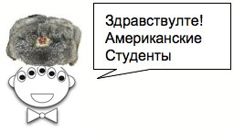
Insight: Ancient Egyptian Multiplication
halver
dbler
AEM/RPM algorithm
21 × 6 == 126
Write the factors in two columns.
Repeatedly halve the LEFT and double the RIGHT. (toss remainders…)
Pull out the RIGHT values where the LEFT values are odd.
Sum those values for the answer!
halver
dbler
21 6
Why does this work?
halver
dbler
11 × 15 == 165
halver
dbler
11 15
Try it here
or Russian Peasants' Multiplication
Buddy, can you spare an eye?
Notes:
This algorithm for multiplying two numbers was evidently widely used by peasants in Russia into the 19th century and is evidently still used in some parts of Russia!
The algorithm goes like this: Write down the two numbers side-by-side. In this case, 21 and 6. Then divide 21 by 2 (rounding down) and multiply 6 by 2. Repeat this process until the number in the left column becomes 1. Then, highlight those rows in which the first number is odd. In those rows, collect all the number in the second column and add them up. That’s the desired product!

Slide 10
Insight: Egyptian + Russian Multiplication
Decimal
Binary
110
10101
6
x
21
21 6
10 12
5 24
2 48
1 96
110
0000
11000
000000
1100000
6
24
96
6
12
24
48
+
96
+
1111110
126
126
Notes:
To see why it works, let’s convert the numbers in both columns to binary.

Slide 11
Insight: Egyptian + Russian Multiplication
Decimal
Binary
1111
1011
15
x
11
11 15
5 30
2 60
1 120
1111
11110
000000
1111000
15
30
120
15
30
60
+
120
+
10100101
165
165
Notes:
To see why it works, let’s convert the numbers in both columns to binary.

Slide 12
Ariane 5
This week's reading: bits can be vital
IndexError
TypeError
HumanError
16 bits
64 bits
version 4
version 5

Slide 13
Any more recent stories of bit-overflow?

Slide 14
Any more recent stories of bit-overflow?

Slide 15
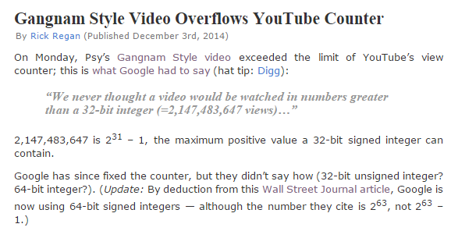
Any more recent stories of bit-overflow?

Slide 16
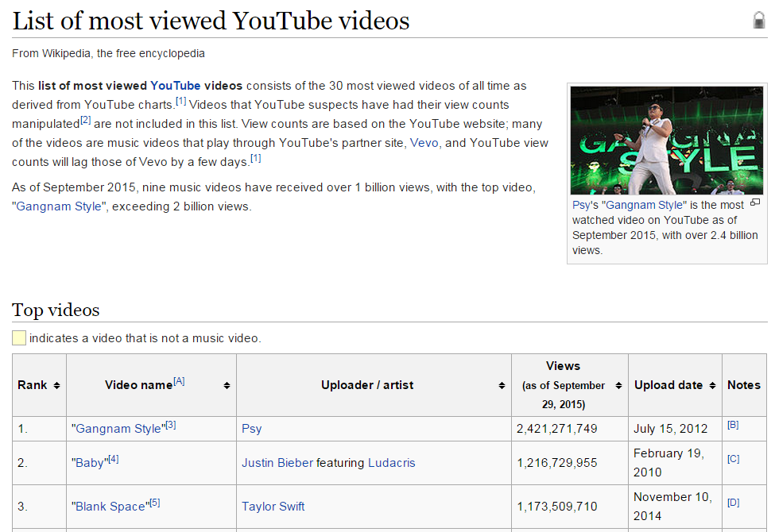
Any more recent stories of bit-overflow?

Slide 17
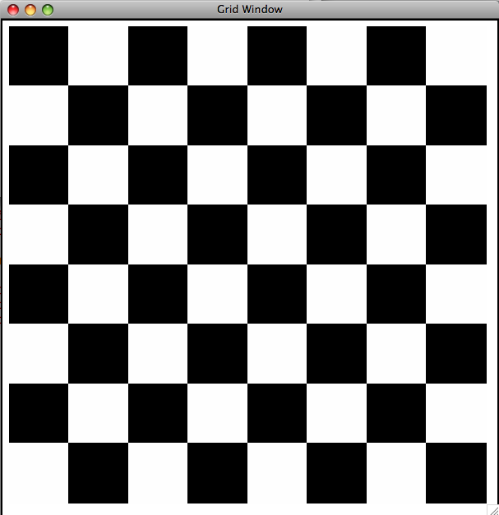
Hw4: binary image compression
10101010
01010101
10101010
01010101
10101010
01010101
10101010
01010101
Binary Image
Encoding as raw bits
one big string of 64 characters
"1010101001010101101010100101010110101010010101011010101001010101"

Slide 18
likelier images to compress…
home!

Slide 19
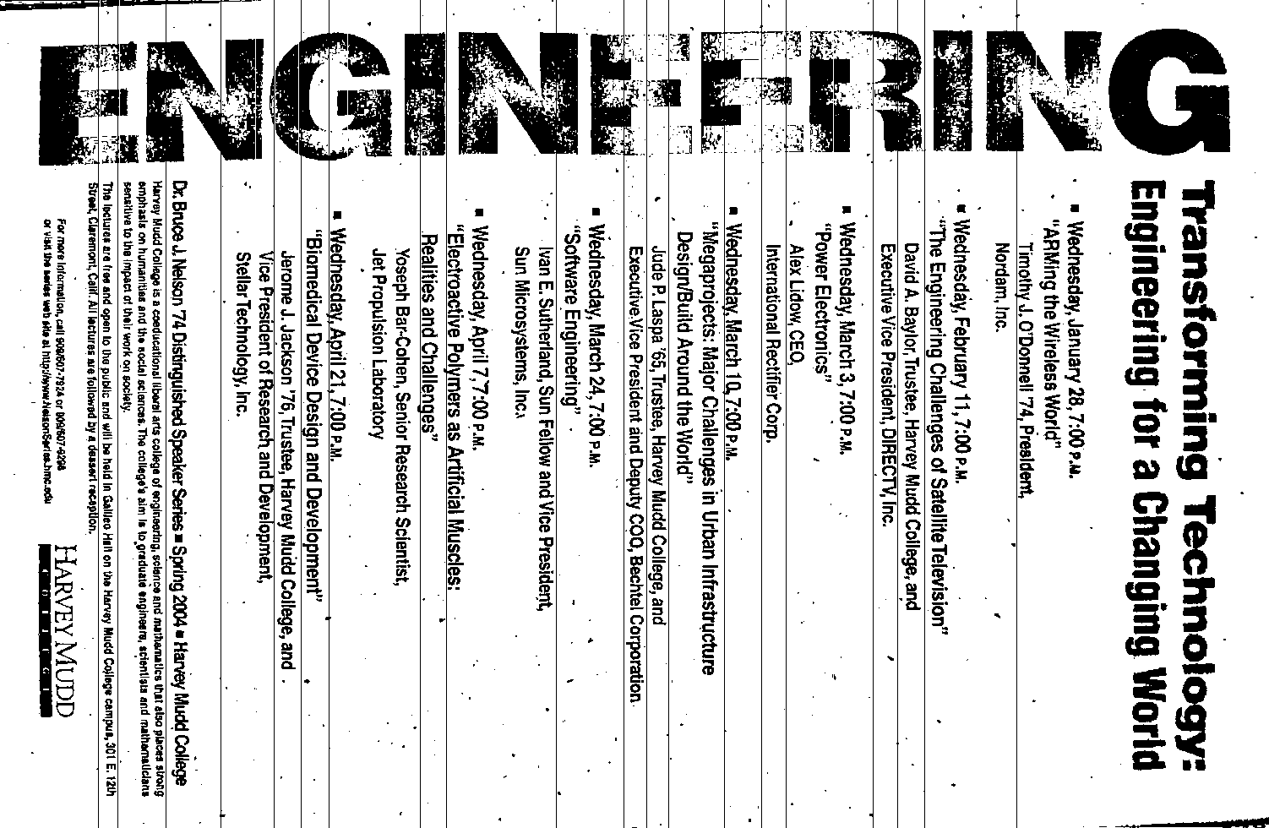
other possible images to compress…

Slide 20
But how is it possible to throw away 47/48ths of the data!?
everywhere!

Slide 21
Hw4: lossless binary image compression
00000000
00000000
11111111
11111111
00000000
00000000
00000000
00001111
same-data streaks
Binary Image
Encoding as raw bits
one big string of 64 characters
If our images tend to have long streaks of unchanging data, how might we represent it more efficiently, but still in binary?
"0000000000000000111111111111111100000000000000000000000000001111"

Slide 22
Hw4: lossless image compression
0 is the first digit
1 is the next digit
0 is the next digit
1 is the final digit
00000000
00000000
11111111
11111111
00000000
00000000
00000000
00001111
There are 16 of them.
Again, there are 16 of them.
There are 28
There are 4
0100001100000111001100
0100001100000111001100
One possible idea:
bit #repeats
See any problems with this?

Slide 23
Hw4: lossless image compression
0 is the first digit
00000000
00000000
00000000
00000000
00000000
00000000
00000000
000000…
and there are 1,098,188 of them.
0100001100000111001100
It's ambiguous! this could just be a huge number of 0 pixels!
0100001100000111001100
1,098,188 zeros!
One possible idea:
bit #repeats
See any problems with this?

Slide 24
fixed-width compression
0 is the first digit
1 is the next digit
and so on…
00000000
00000000
11111111
11111111
00000000
00000000
00000000
00001111
There are 16 of them.
Again, there are 16 of them.
28 zeros
4 ones
00010000100100000001110010000100
7 bits: # of repeats
7 bits: # of repeats
8-bit data block
8-bit data block
8-bit data block
8-bit data block
00010000100100000001110010000100
We need fixed-width blocks:
bit #repeats
8-bits total

Slide 25
If you use 7 bits to hold the # of consecutive repeats, what is the largest number of bits that one block can represent?
00010000
7 bits?
1 bit: the initial pixel
7 bits: # of repeats
B bits?
8-bit total data block
What if you need a larger # of repeats?

Slide 26
hw4 pr2
def compress( I ):
""" returns the RLE of the
input binary image, I """
def uncompress( CI ):
""" returns the binary image I
from the run-length-encoded,
"compressed" input, CI """

Slide 27
hw4 pr2
a binary image
"0000000000000000111111111111111100000000000000000000000000001111"
16 zeros
16 ones
28 zeros
4 ones
def compress( I ):
""" returns the RLE of the
input binary image, I """
the "compressed" image
"00010000100100000001110010000100"
16
16
28
4
def uncompress( CI ):
""" returns the binary image I
from the run-length-encoded,
"compressed" input, CI """
back to the original binary image
"0000000000000000111111111111111100000000000000000000000000001111"
16 zeros
16 ones
28 zeros
4 ones

Slide 28
hw4 pr2
a binary image
"0000000000000000111111111111111100000000000000000000000000001111"
16 zeros
16 ones
28 zeros
4 ones
what helper function might be of use here?
def compress( I ):
""" returns the RLE of the
input binary image, I """
the "compressed" image
"00010000100100000001110010000100"
16
16
28
4
def uncompress( CI ):
""" returns the binary image I
from the run-length-encoded,
"compressed" input, CI """
back to the original binary image
"0000000000000000111111111111111100000000000000000000000000001111"
16 zeros
16 ones
28 zeros
4 ones

Slide 29
Try it!
Name(s) _________________________________
Don't hand this in…
Examples…
Write a recursive function, frontNum(S)
It should return the # of times the first element of the input S appears consecutively at the start of S:
>>> frontNum('1111010')
4
>>> frontNum('00111000010')
2
def frontNum(S):
if
return
elif
return
else:
return
len(S)<=1:
S[0] ==
shortest
longest
What are the BEST / WORST compression results you can get for an 8x8 input image (64 bits)?
EXTRA! How can you change the algorithm so that compressed images are always smaller than the originals?

Slide 30
shortest compressed representation
longest compressed representation
What are the BEST and the WORST compression results you can get for an 8x8 image input (64 bits)?
?
How could we improve this compression algorithm so that all compressed images are smaller than their originals ? That is, how can we make compression always work ?

Slide 31
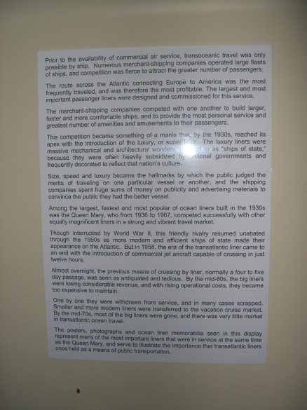
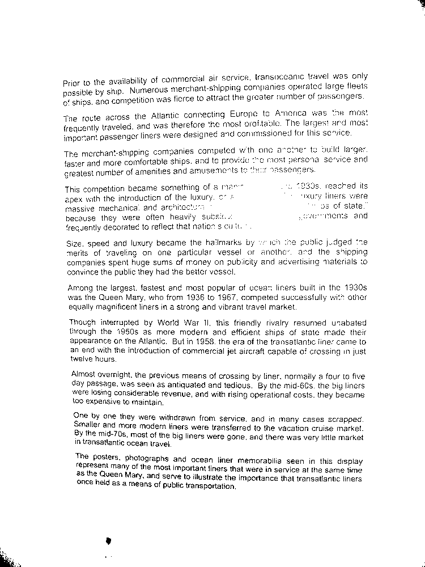
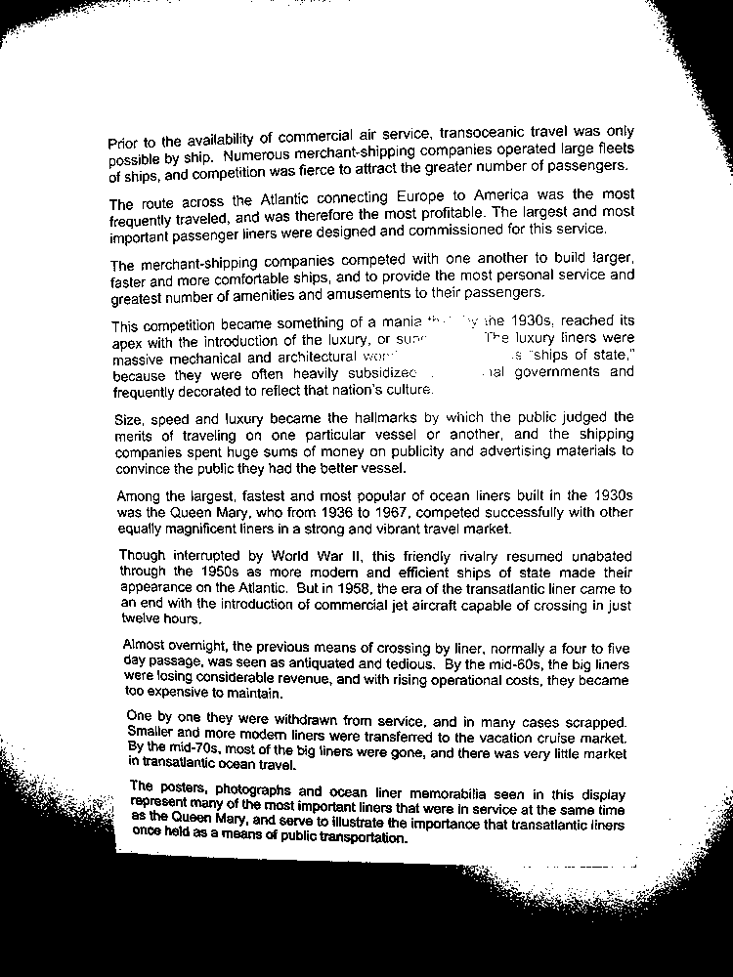
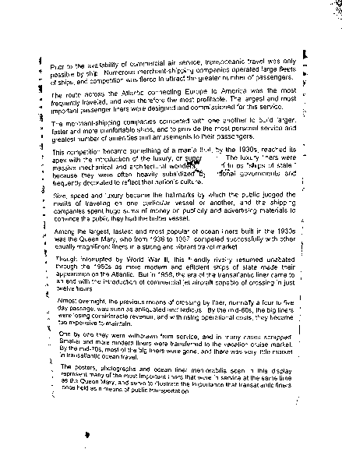
Binary images in practice...
Original Image
T = 78/255
T = 120/255
Adaptive T
T = 120/255
Adaptive Threshold
No magic!
(unfortunately!)

Slide 32
Portrait vs. landscape?

Slide 33
Portrait vs. landscape?
Intensity profiles
Lots of peaks == lots of text lines
This landscape image is determined to contain a portrait document.
few peaks == few text lines
Right-side up?

Slide 34
Portrait vs. landscape?
Intensity profiles
Lots of peaks == lots of text lines
This landscape image is determined to contain a portrait document.
few peaks == few text lines
Right-side up?

Slide 35
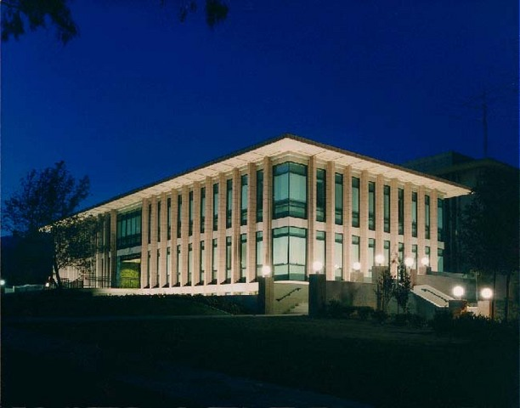
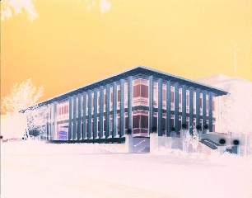
hw4pr3 (extra)
Image processing...
import cs5png
Pix = cs5png.getRGB( 'olin.png' )
Images are represented by Python lists of ... ?
newIM = invert( Pix )
cs5png.saveRGB( Pix )

Slide 36
It's all bits!
images, text, sounds, data, …
even the string 'forty*two' is represented as a sequence of bits…
'forty*two'
011001100110111101110010011101000111100100101010011101000111011101101111
9 ASCII characters
8 bits each
9*8 == 72 bits total
All computation boils down to manipulating bits!

Slide 37
In a computer, each bit is represented as a voltage (1 is +5v and 0 is 0v)
Computation is simply the deliberate combination of those voltages!
101010
(1) set input voltages
42
ADDER circuit
But what's that green thing?
9
001001

Slide 38
In a computer, each bit is represented as a voltage (1 is +5v and 0 is 0v)
Computation is simply the deliberate combination of those voltages!
101010
(1) set input voltages
42
(2) perform computation
ADDER circuit
But what's that green thing?
110011
9
001001

Slide 39
In a computer, each bit is represented as a voltage (1 is +5v and 0 is 0v)
Computation is simply the deliberate combination of those voltages!
101010
(1) set input voltages
42
(2) perform computation
ADDER circuit
51
But what's that green thing?
110011
(3) read output voltages
9
001001
Richard Feynman: "Computation is just a physics experiment that always works!"

Slide 40
All computation
is simply functions of bits
binary inputs A and B
output, A+B
00
00
000
00
01
001
00
10
This week: you'll build this in Python.
010
00
11
011
01
00
001
01
01
010
01
10
011
01
11
bitwise
addition function
100
10
00
010
10
01
011
10
10
100
10
11
101
11
00
011
11
01
100
11
10
101
11
11
110
Next week: you'll design this with wires.
A
B

Slide 41
is circuit addition!
Adding strings?
is syntactic addition!
S
T
'31'
'11'
def add10(S,T):
""" adds the *strings* S and T
as decimal numbers
"""
if len(S) == 0: return T
if len(T) == 0: return S
eS = S[-1]
eT = T[-1]
if eS == '0' and eT == '1': return add10(S[:-1],T[:-1]) + '1'
if eS == '1' and eT == '1': return add10(S[:-1],T[:-1]) + '2'
if eS == '2' and eT == '1': return add10(S[:-1],T[:-1]) + '3'
if eS == '3' and eT == '1': return add10(S[:-1],T[:-1]) + '4'
# Lots more rules - how many in all?
eS ~ the "end of S"
eT ~ the "end of T"

Slide 42
Carrying on…
hw4: addB
'23'
S
T
'19'
'23'
'19'
def add10(S,T):
""" adds the *strings* S and T
as decimal numbers
"""
if len(S) == 0: return T
if len(T) == 0: return S
eS = S[-1]
eT = T[-1]
if eS == '0' and eT == '1': return add10(S[:-1],T[:-1]) + '1'
if eS == '1' and eT == '1': return add10(S[:-1],T[:-1]) + '2'
if eS == '2' and eT == '1': return add10(S[:-1],T[:-1]) + '3'
if eS == '3' and eT == '1': return add10(S[:-1],T[:-1]) + '4'
# what if we have to carry to the next column?
if eS == '3' and eT == '9':
return
eS ~ the "end of S"
eT ~ the "end of T"

Slide 43
Carrying on…
hw4: addB
S
T
'23'
'19'
def add10(S,T):
""" adds the *strings* S and T
as decimal numbers
"""
if len(S) == 0: return T
if len(T) == 0: return S
eS = S[-1]
eT = T[-1]
if eS == '0' and eT == '1': return add10(S[:-1],T[:-1]) + '1'
if eS == '1' and eT == '1': return add10(S[:-1],T[:-1]) + '2'
if eS == '2' and eT == '1': return add10(S[:-1],T[:-1]) + '3'
if eS == '3' and eT == '1': return add10(S[:-1],T[:-1]) + '4'
# what if we have to carry to the next column?
if eS == '3' and eT == '9':
return
eS ~ the "end of S"
eT ~ the "end of T"

Slide 44
is circuit addition!
Adding strings?
is syntactic addition!
syntactic ~ meaning-free
Multiplying by machine:
is circuit multiplying!
is syntactic multiplying!
Doing anything by machine…
is circuit interaction!
is syntactic interaction!
means it can be done purely via surface syntax, which means it can be done without thinking…
Notes:
meaning-free vs meaningless

Slide 45
Our building blocks: logic gates
AND outputs 1 only if ALL inputs are 1
OR outputs 1 if ANY input is 1
NOT reverses its input
AND
OR
NOT
These circuits are physical functions of bits…
… and all mathematical functions can be built from them!

Slide 46
AND
drill sergeant metaphor?
straight-backed; everything must be True
inputs
AND
output
AND outputs 1 when ALL inputs are 1
otherwise it outputs 0

Slide 47
AND
straight-backed; everything must be True to output True
x
inputs
AND
output
y
output
input
output
x
y
AND(x,y)
AND's function:
0
0
0
0
1
0
"Truth table"
1
0
0
1
1
1

Slide 48
AND
straight-backed; everything must be True to output True
inputs
AND
output
How many different input combinations yield an output of 0 here?
AND outputs 1 when ALL inputs are 1
otherwise it outputs 0

Slide 49
AND
is a physical function of bits!
x
y
inputs
z
AND
output
output
w
input
output
x
y
z
w
AND(xyzw)
AND's function:
0
0
0
0
0
0
0
0
1
0
fifteen 0s
…12 more rows not shown…
0
1
1
1
0
0
1
1
1
1
1
one 1

Slide 50
OR
camp counselor metaphor?
easy-going: if anything is OK, everything's OK
inputs
OR
output
OR outputs 1 when ANY input is 1
It outputs 0 only if all inputs are 0.

Slide 51
OR
easy-going: if anything is True, the output is True
x
inputs
OR
output
y
output
input
output
x
y
OR(x,y)
OR's function:
0
0
0
0
1
1
1
0
1
1
1
1

Slide 52
OR
easy-going: if anything is OK, everything's OK
inputs
OR
output
How many different 4-input combinations yield an output of 1?
OR outputs 1 when ANY input is 1
It outputs 0 only if all inputs are 0.

Slide 53
OR
easy-going: if anything is OK, everything's OK
x
y
inputs
z
OR
output
output
w
input
output
x
y
z
w
OR(xyzw)
OR's function:
0
0
0
0
0
one 0
0
0
0
1
1
…12 more rows not shown…
1
1
1
1
0
1
fifteen 1s
1
1
1
1
1

Slide 54
NOT
"NOT bubble" (optional – or the only thing needed!)
inputs
x
NOT
output
NOT's function:
input
output
x
NOT(x)
0
1
one 1
1
0
one 0

Slide 55
Our building blocks: logic gates
input
output
input
output
x
y
AND(x,y)
x
y
OR(x,y)
input
output
x
NOT(x)
0
0
0
0
0
0
0
1
0
0
1
1
0
1
1
0
0
1
0
1
1
0
1
1
1
1
1
1
AND outputs 1 only if ALL inputs are 1
OR outputs 1 if ANY input is 1
NOT reverses its input
AND
OR
NOT

Slide 56
Claim !?
We need only these three building blocks to compute anything at all
I need proof!
AND
AND outputs 1 iff ALL its inputs are 1
OR
OR outputs 1 iff ANY input is 1
NOT
NOT reverses its input

Slide 57
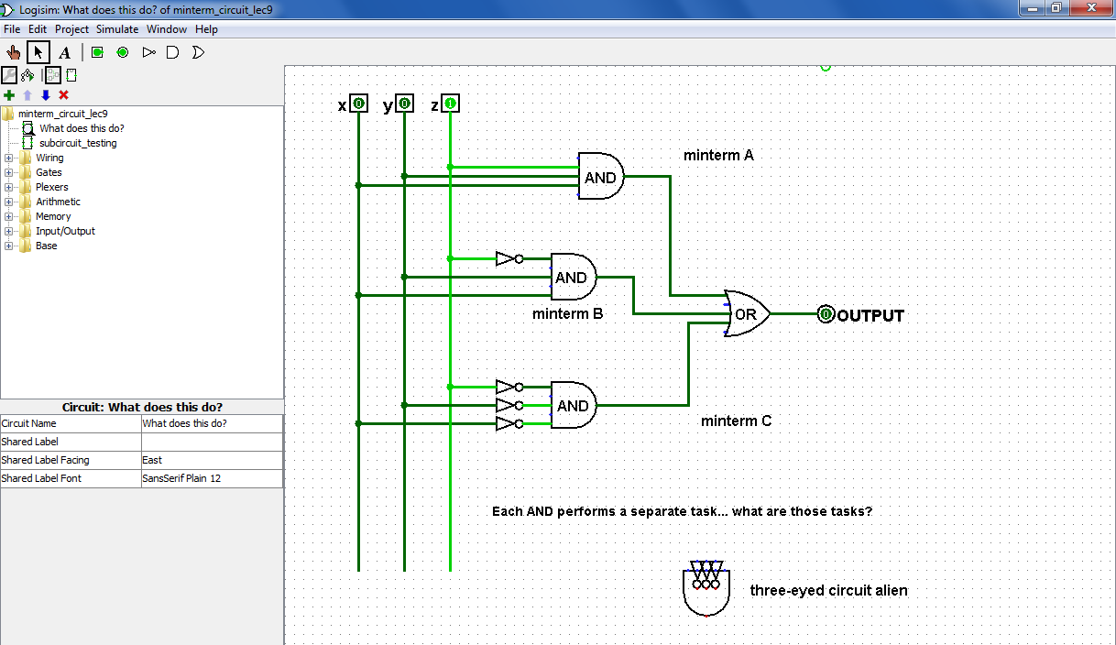
From gates to circuits...
What inputs make this circuit output 1?
Logisim
What inputs make this circuit output 0?

Slide 58
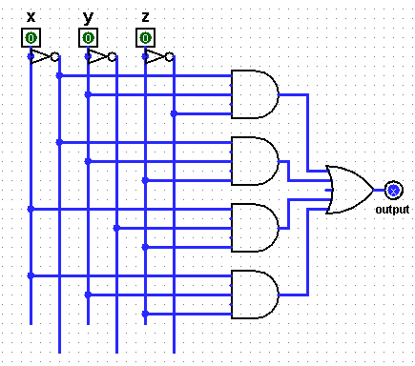
Quiz
Fill in the function values for this circuit (the truth table)
Name(s) ___________________________________
Each input x, y, and z can independently be 0 or 1, for 8 total input possibilities:
inputs
circuit
output
x
y
z
A
0
0
0
0
0
1
0
1
0
B
0
1
1
1
0
0
C
1
0
1
1
1
0
1
1
1
1
D
Each output is 0 or 1
(1) This circuit uses 9 logic gates – how many of each? AND ___ OR ___ NOT ___
(2) Follow the inputs of x=1, y=1, z=1 and see why the overall output is 1 ... (already labeled)
(3) For each of the 8 possible inputs, write the circuit output in the truth table. What f'n is it?
(4) This circuit uses 9 logic gates – could it use fewer? If so, how?! If not, how do you know?!

Slide 59
Quiz
Fill in the function values for this circuit (the truth table)
Try this on the back page first…
Each input x, y, and z can independently be 0 or 1, for 8 total input possibilities:
inputs
circuit
output
x
y
z
A
0
0
0
0
0
1
0
1
0
B
0
1
1
1
0
0
C
1
0
1
1
1
0
1
1
1
1
D
Each output is 0 or 1
(1) This circuit uses 9 logic gates – how many of each? AND ___ OR ___ NOT ___
(2) Follow the inputs of x=1, y=1, z=1 and see why the overall output is 1 ... (already labeled)
(3) For each of the 8 possible inputs, write the circuit output in the truth table. What f'n is it?
(4) This circuit uses 9 logic gates – could it use fewer? If so, how?! If not, how do you know?!

Slide 60
from circuit design…
next 2 weeks
…to a full computer!
Have an outst ing and f tuitous week(end)!
Why ?!

Slide 62
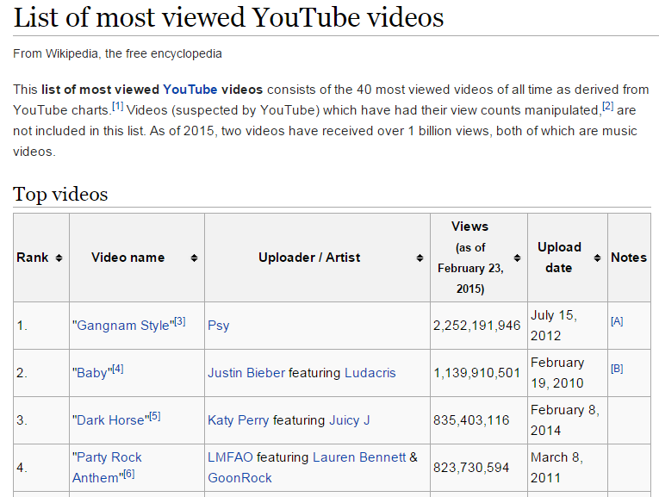
Any more recent stories of bit-overflow?

Slide 63
Hw4: lossless image compression
0 is the first digit
1 is the next digit
0 is the next digit
1 is the final digit
00000000
00000000
11111111
11111111
00000000
00000000
00000000
00001111
There are 16 of them.
Again, there are 16 of them.
There are 28
There are 4
0100001100000111001100
0100001100000111001100
One possible idea:
bit #repeats
See any problems with this?

Slide 64
Try it!
Name(s) _________________________________
Don't hand this in…
Examples…
Write a recursive function, frontNum(S)
It should return the # of times the first element of the input S appears consecutively at the start of S:
>>> frontNum('1111010')
4
>>> frontNum('00111000010')
2
def frontNum(S):
if
return
elif
return
else:
return
len(S)<=1:
S[0] …
shortest
longest
What are the BEST / WORST compression results you can get for an 8x8 input image (64 bits)?
EXTRA! How can you change the algorithm so that compressed images are always smaller than the originals?

Slide 65
shortest compressed representation
longest compressed representation
What are the BEST and the WORST compression results you can get for an 8x8 image input (64 bits)?
??
How could we improve this compression algorithm so that all compressed images are smaller than their originals ? That is, how can we make compression always work ?

Slide 66
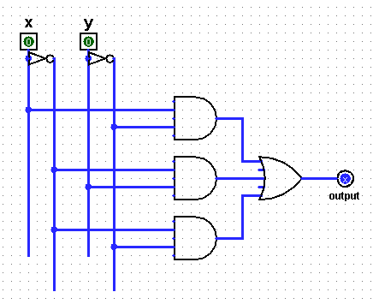
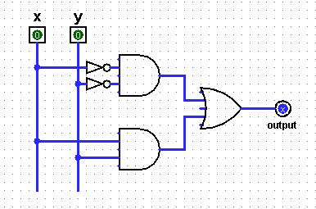
Quiz
Find the outputs for these circuits
Name(s) ___________________________________
inputs
output
truth table
inputs
output
truth table
x
y
x
y
(A)
0
0
0
0
(B)
0
1
0
1
(C)
1
0
1
0
(D)
1
1
1
1
top
AND
top
AND
OR
middle
AND
OR
lower
AND
bottom AND
(1) Which gate runs line (A) of the truth table?
(These gates have been rearranged relative to the truth-table rows they control.)
(2) Which gate runs line (D) of the truth table?

Slide 67
Fill in the function values (truth table) for this circuit…
Three bits ?
input
output
x
y
z
A
0
0
0
0
0
1
0
1
0
B
0
1
1
1
0
0
C
1
0
1
1
1
0
1
1
1
D
(1) Which truth table lines do the AND gates A, B, C, and D implement?
(2) This circuit uses 9 logic gates – could it use fewer?
(3) What property of integers (up to 7) does this circuit compute?

Slide 68
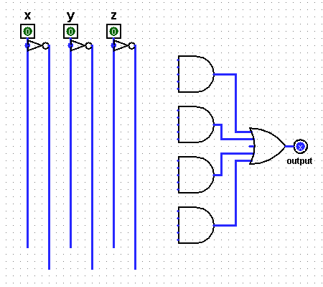
DIY !
Draw the upstream wires to build a circuit for the truth table at left…
input
output
x
y
z
A
0
0
0
0
0
0
1
1
0
1
0
1
B
0
1
1
0
1
0
0
1
C
1
0
1
0
1
1
0
0
1
1
1
1
D
(*) Given a truth table, could you now design the circuit for it?

Slide 69
Constructive Proof !
Specify a truth table defining any function you want
For each input row whose output needs to be 1, build an AND circuit that outputs 1 only for that specific input!
i
ii
input
output
x
y
fn(x,y)
0
0
0
This is a three i'ed proof!
0
1
1
iii
OR them all together
1
0
1
1
1
0

Slide 70
Constructive Proof !
Specify a truth table defining any function you want
For each input row whose output needs to be 1, build an AND circuit that outputs 1 only for that specific input!
i
ii
input
output
x
y
fn(x,y)
0
0
0
0
1
1
iii
OR them all together
1
0
1
1
1
0
x
y
NOT
AND
Does this work for the red row?
x
y
Does this work for any other rows?

Slide 71
Constructive Proof !
Specify a truth table defining any function you want
For each input row whose output needs to be 1, build an AND circuit that outputs 1 only for that specific input!
i
ii
input
output
x
y
fn(x,y)
0
0
0
0
1
1
iii
OR them all together
1
0
1
1
1
0
How did we handle the rows outputting zero?
x
y
NOT
AND
OR
NOT
AND
x
y

Slide 72
Constructive Proof !
Specify a truth table defining any function you want
For each input row whose output needs to be 1, build an AND circuit that outputs 1 only for that specific input!
i
ii
input
output
x
y
fn(x,y)
This is a constructive proof that AND, OR, and NOT suffice to build any (boolean) function!
0
0
0
0
1
1
iii
OR them all together
1
0
1
1
1
0
How did we handle the rows outputting zero?
x
y
NOT
AND
OR
NOT
AND
x
y

Slide 73
Constructive Proof !
Specify a truth table defining any function you want
For each input row whose output needs to be 1, build an AND circuit that outputs 1 only for that specific input!
i
ii
But... ALL functions are just boolean functions: because everything is in binary!
input
output
x
y
fn(x,y)
This is a constructive proof that AND, OR, and NOT suffice to build any (boolean) function!
0
0
0
0
1
1
iii
OR them all together
1
0
1
1
1
0
How did we handle the rows outputting zero?
x
y
NOT
AND
OR
NOT
AND
x
y

Slide 74
Try it!
Given the truth table on the right, draw the circuit that implements it!
input
output
x
y
z
0
0
0
0
0
0
1
1
0
1
0
1
output
0
1
1
0
1
0
0
1
1
0
1
0
1
1
0
0
1
1
1
1
(1) Use the previous examples as a guide…
(2) Use a single OR gate beside the output…
(3) How many AND gates will be needed "upstream" of the OR gate? Which of the AND gates' inputs will need NOT gates?

Slide 75
Try it!
Fill in the output values for this circuit…
(truth table)
input
output
x
y
top
AND
(A)
0
0
OR
(B)
0
1
(C)
1
0
lower
AND
(D)
1
1
(1) Which gate implements line (A) of the truth table?
(2) Which gate implements line (D) of the truth table?
Rails and NAND! This one – hand in…
(3) Which gates implement the other lines of the truth table?
(4) How would the table change if the top NOT gate were removed?

Slide 76
Try it!
Fill in the function values (truth table) for this circuit…
input
output
A
x
y
z
0
0
0
B
0
0
1
0
1
0
0
1
1
C
1
0
0
1
0
1
D
1
1
0
1
1
1
(1) Which truth table lines do the AND gates A,B,C,D implement?
Rails and prime and oddparity !
(2) This circuit uses 9 logic gates – could it use fewer?
(3) If the inputs are considered the bits of a three-bit integer, xyz, what property of integers does this circuit compute?

Slide 77
Try it!
Given the truth table on the right, draw the circuit that implements it!
input
output
x
y
z
0
0
0
0
0
0
1
1
0
1
0
1
output
0
1
1
0
1
0
0
1
1
0
1
0
1
1
0
0
1
1
1
1
(1) Use the previous examples as a guide…
(2) Use a single OR gate beside the output…
(3) How many AND gates will be needed "upstream" of that OR gate? Which of the AND gates' inputs will need NOT gates?

Slide 79
OK, so binary > decimal
>
but why not balanced ternary ?

Slide 80
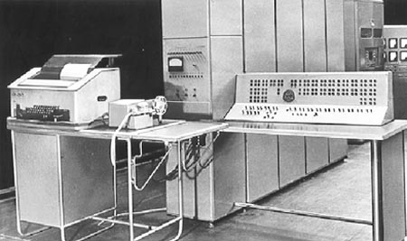
Balanced ternary computers…
I feel unbalanced…
50 of these Setun ternary machines were made at Moscow U. ~1958
+5v
This wasn't even the first!
0v
-5v
This project was discontinued in 1970… though not because of the ternary design!

Slide 81
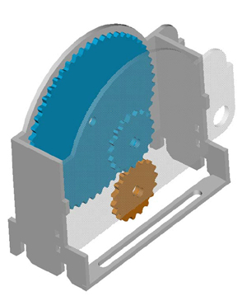
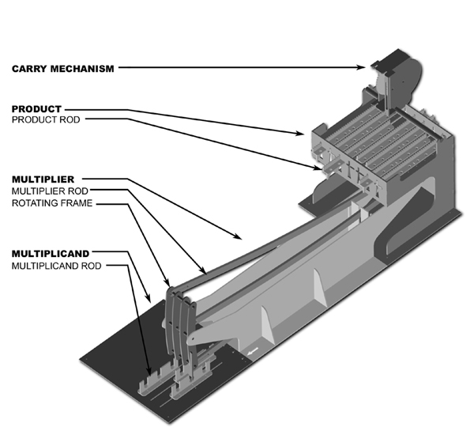
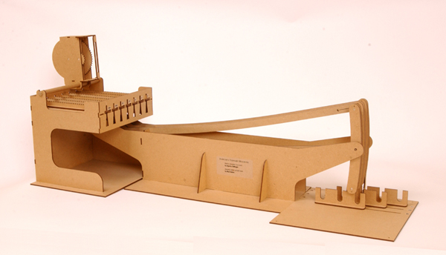
Thomas Fowler's Ternary Computer – from the 1830's!
balanced ternary calculations from Fowler's papers
T. Fowler 1777-1843, Treasurer of the Poor Law Union
the 3:1 carry mechanism
the 2005 reconstruction
ternary representation
Notes:
http://www.mortati.com/glusker/fowler/fowlerbio.htm
"In the 1830’s, Fowler was Treasurer of the Poor Law Union. This job required a considerable number of repetitive monetary calculations, made more complex by the pre-decimal British currency."

Slide 82
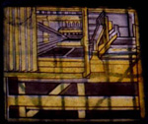
Fowler's machine was rebuilt from two sources:
a two-page description (but no images!) by mathematician A. DeMorgan
a picture of it as a stained-glass window in Fowler's church: St. Michael's of Great Torrington, North Devon, U.K.!
http://www.mortati.com/glusker/fowler/index.htm

Slide 83
Fowler's machine was rebuilt from two sources:
a two-page description (but no images!) by mathematician A. DeMorgan
In honor of Fowler, this week's HW may be submitted in stained glass …
a picture of it as a stained-glass window in Fowler's church: St. Michael's of Great Torrington, North Devon, U.K.!
http://www.mortati.com/glusker/fowler/index.htm

Slide 84
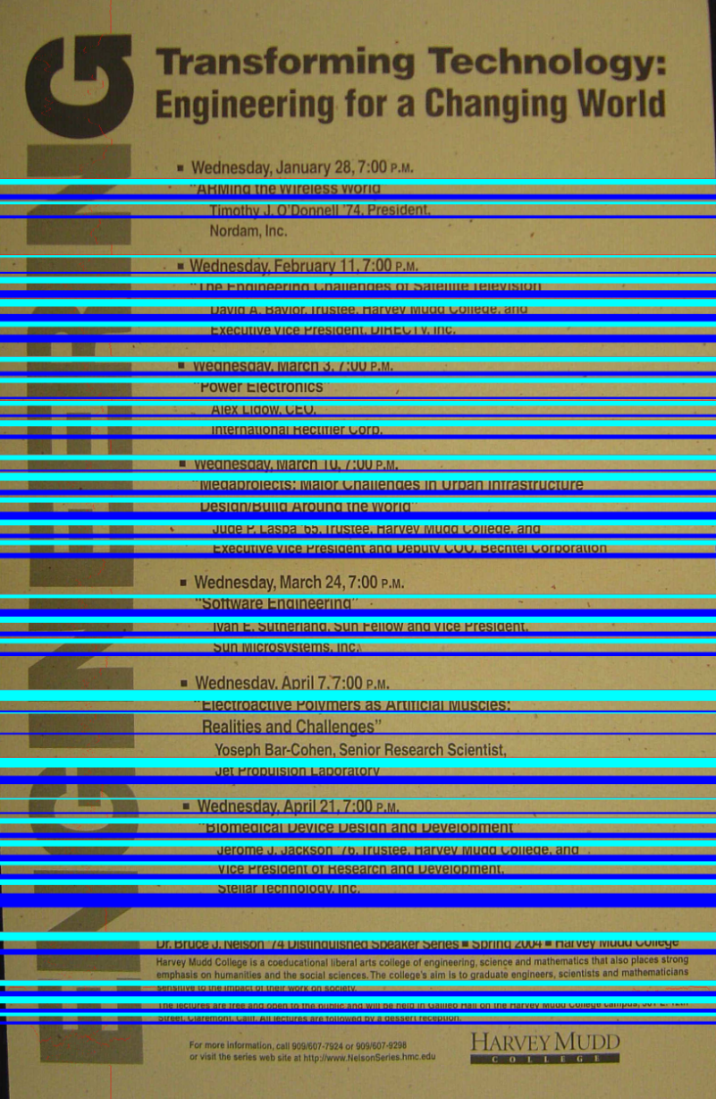
Up vs. down?
Each line is divided into thirds…
Top and bottom “thirds” are compared for text density
The higher-density direction is presumed to be ascenders ~ up!

Slide 85
Use it or lose it!

Slide 86
Use it or lose it!
t
L
t
L
exact_change( 12, [ 1,5,1,1,1,5 ] )
True
exact_change( 12, [ 10,5,1,5,5 ] )
False
Can you make the target value t with the coins in L ?
def exact_change( t, L ):
if t == 0: return True
if t < 0 or L == []: return False
USEIT = exact_change( t-L[0], L[1:] )
LOSEIT = exact_change( t, L[1:] )
return USEIT or LOSEIT

Slide 87
Use it or lose it - or lose-it!
S
T
S
T
LCS('richard','kristin')
'ri'
LCS('gattaca','tacgaacta')
'gaaca'
What's the longest common subsequence of S and T ?
def LCS( S, T ):
if S == '' or T == '': return ''
if S[0] == T[0]: # USEIT!
return S[0] + LCS( S[1:], T[1:] )
LI_S = LCS( S[1:], T ) # LOSEIT from S
LI_T = LCS( S, T[1:] ) # LOSEIT from T
if len( LI_S ) > len( LI_T ): return LI_S
else: return LI_T

Slide 88
likelier images to compress

Slide 89
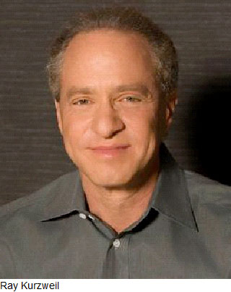
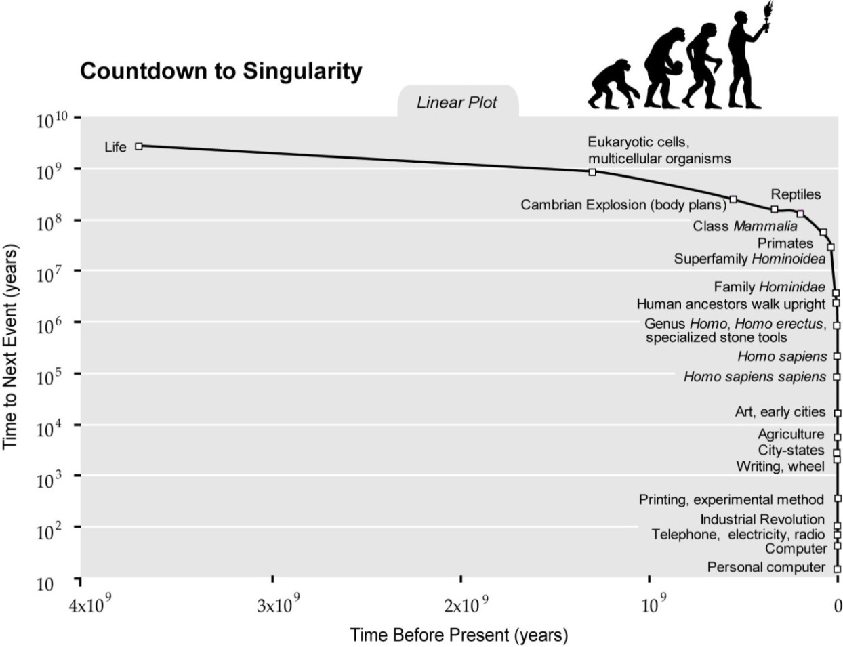
Ray Kurzweil

Slide 90
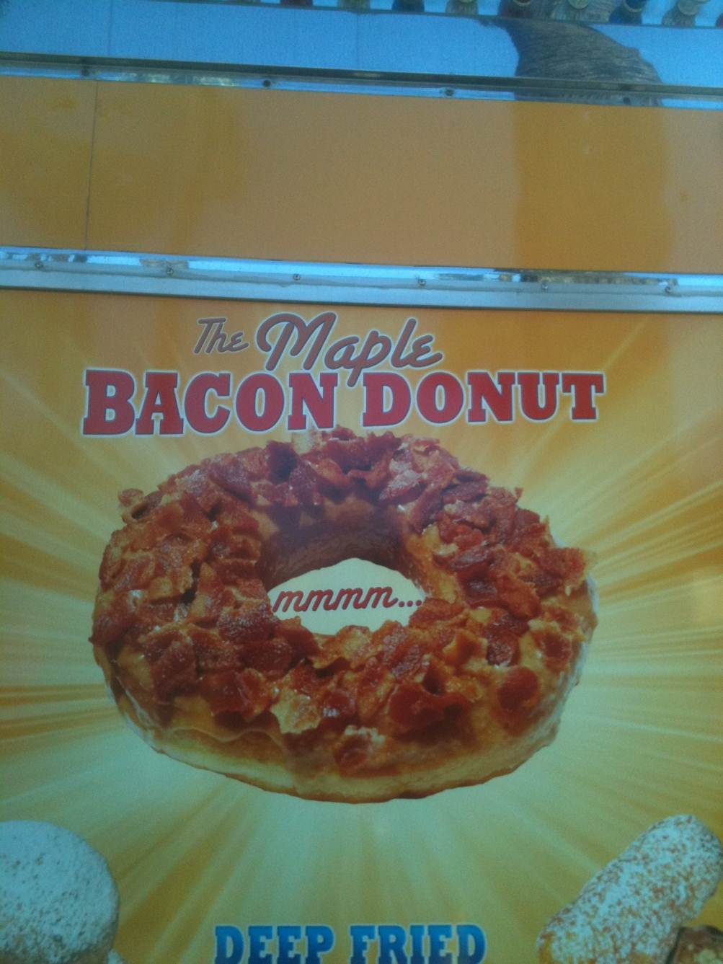
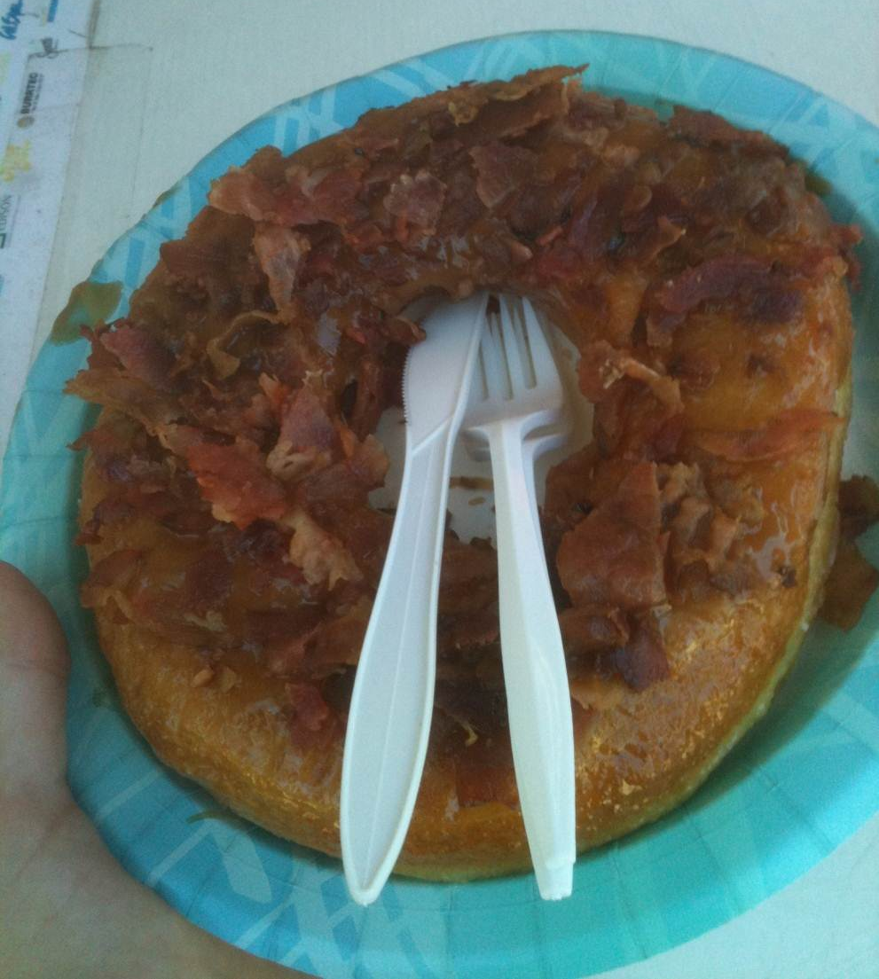
What Ray can't eat, at least if he wants to live forever…
LA County Fair…

Slide 91
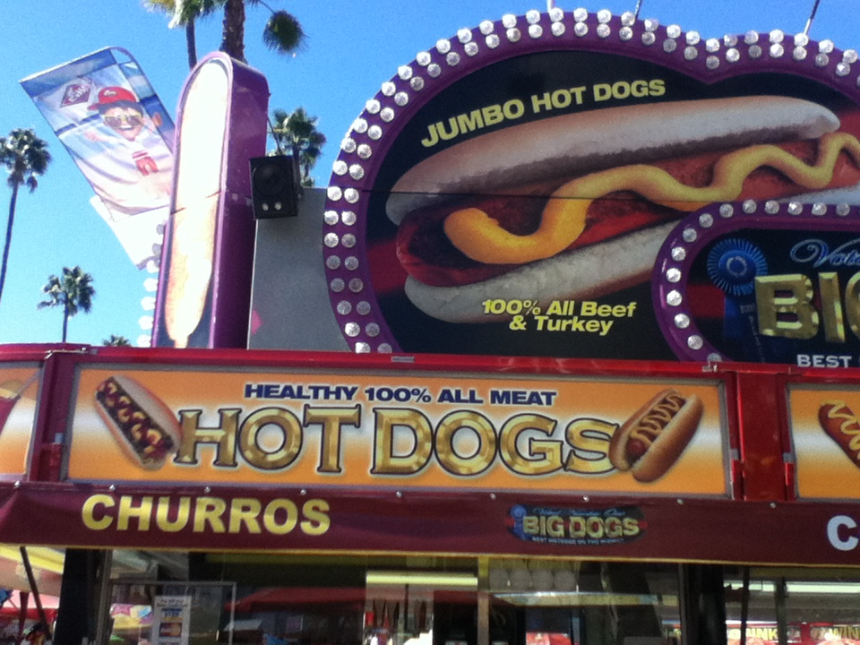
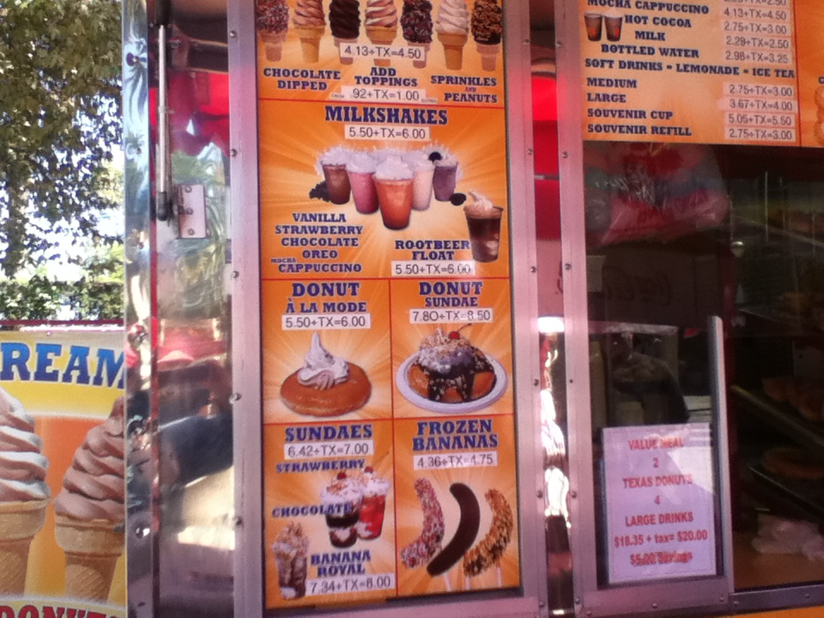
Different underlying assumptions…

Slide 92
Try it...
Specify a truth table defining any function you want
For each input row whose output needs to be 1, build an AND circuit that outputs 1 only for that specific input!
1
2
input
output
x
y
fn(x,y)
0
0
1
3
OR them all together
0
1
0
1
0
0
1
1
1
x
y
x
y
How did we handle the rows outputting zero?

Slide 93
Try it!
Fill in the function values (truth table) for this circuit…
input
output
x
y
(A)
0
0
(B)
0
1
(C)
1
0
(D)
1
1
(1) Which gate implements line (A) of the truth table?
(2) Which gate implements line (D) of the truth table?
(3) Which gates implement the other lines of the truth table?
(4) How would the table change if the top NOT gate were removed?

Slide 94
Try it!
Fill in the function values (truth table) for this circuit…
input
output
A
x
y
z
0
0
0
0
0
1
B
0
1
0
0
1
1
1
0
0
C
1
0
1
1
1
0
1
1
1
D
(1) Which truth table lines do the AND gates A,B,C,D implement?
(2) This circuit uses 9 logic gates – could it use fewer?
(3) If the inputs are considered the bits of a three-bit integer, xyz, what property of integers does this circuit compute?

Slide 95
Try it!
Fill in the function values (truth tables) for these two circuits!
input
output
x
y
z
input
output
x
y
0
0
0
0
0
1
0
0
0
1
0
0
1
0
1
1
1
0
1
0
0
1
1
1
0
1
1
1
0
1
1
1

Slide 96
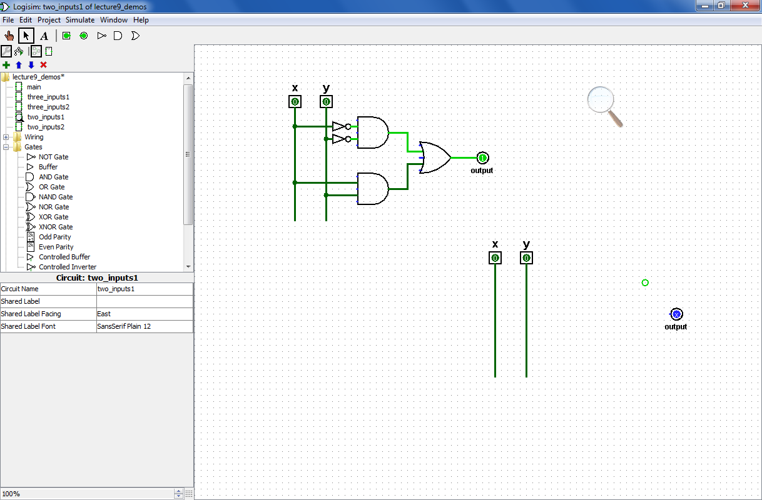
Try it!
Design circuits that implement the functions (truth tables) shown below.
input
output
x
y
z
input
output
x
y
0
0
0
0
0
1
0
0
0
1
0
0
1
0
1
1
1
0
1
0
0
1
1
1
0
1
1
1
0
1
1
1

Slide 97
DIY: design-it-yourself…
x
y
z
fn(x,y,z)
0
0
0
0
0
0
1
1
0
1
0
1
0
1
1
0
1
0
0
1
1
0
1
0
1
1
0
0
1
1
1
1
This looks like fn !

Slide 98
Circuits
are physical functions of bits!
x
y
inputs
z
AND
output
output
w
input
output
x
y
z
w
AND(x,y)
0
0
0
0
0
AND's function:
0
0
0
1
0
fifteen 0s
…12 more rows not shown…
0
1
1
1
0
0
1
1
1
1
1
one 1

Slide 99
AND
AND
NOT
inputs
AND
output
OR
AND outputs 1 when ALL inputs are 1
otherwise it outputs 0

Slide 100
All computation
… consists of functions of bits, or boolean values
Boolean inputs x,y,… can only be 0 or 1.
Boolean functions can output only 0 or 1.
inputs
output
x
y
fn(x,y)
0
0
0
0
1
1
1
0
1
1
1
0
This seems fn !
Truth table

Slide 101
Lots of bits!
inputs
output
x
y
z
fn(x,y,z)
0
0
0
0
0
0
1
1
0
1
0
1
0
1
1
0
1
0
0
1
1
0
1
0
1
1
0
0
1
1
1
1
Even more fn !
Truth table

Slide 102
Physical Logic Gates...
6 NOT gates:
Notes:
these quotes are important to yahoo… !

Slide 103
Claim!
We need only three building blocks to compute anything at all
Three – of course!
AND outputs 1 iff ALL its inputs are 1
AND
OR outputs 1 iff ANY input is 1
OR
NOT
NOT reverses its input

Slide 104
"Quiz"
Name(s):
Write a recursive function frontNum(s) It. should return the # of times the first element of the input s appears consecutively AT THE FRONT of that string:
>>> frontNum('1111010')
4
>>> frontNum('00111000010')
2
def frontNum(s):
Examples…
shortest compressed representation
longest compressed representation
EXTRA
What are the BEST and the WORST compression results you can get for an 8x8 input image (64 bits)?
How can you change fixed-length compression so that all compressed images are smaller than their originals ? That is, how can we make compression always "work" ?

Slide 105
Write a recursive function frontNum(s) It. should return the # of times the first element of the input s appears consecutively AT THE FRONT of that string:
>>> frontNum('00111000010')
2
>>> frontNum('1111010')
4
Examples…
def frontNum(s):

Slide 106
shortest compressed representation
longest compressed representation
What are the BEST and the WORST compression results you can get for an 8x8 image input (64 bits)?
EXTRA
How can you change this compression algorithm so that all compressed images are smaller than their originals ? That is, how can we make compression always work ?

Slide 107
Minterm Expansion
Truth Table
… is a proof that AND, OR, and NOT suffice to construct any function!
input
output
x
y
XOR(x,y)
0
0
0
0
1
1
1
0
1
1
1
0
Process
Build circuits of NOTs and AND that computes each "1" row.
OR them together.
Notes:
107

Slide 108
Bit functions are truth tables!
Truth Table
input
output
Any function can be represented as a table of inputs and outputs.
x
y
XOR(x,y)
0
0
0
0
1
1
1
0
1
1
1
0
If we create a circuit that always outputs 0, how much does it already do correctly !?
What more do we need?
Notes:
108

Slide 109
Minterm Expansion
Truth Table
input
output
x
y
XOR(x,y)
0
0
0
0
1
1
What is a circuit that outputs 1 ONLY WHEN x is 0 and y is 1 ?
1
0
1
1
1
0
x
y
output
Notes:
109

Slide 110
What's in the image?
What do these peaks mean?
Plot of total intensity across each row of pixels
Why is it important to have binarized first?

Slide 111
Minterm Expansion
1
Specify the Truth Table defining the function
2
Build separate circuits for each output-1 row using ANDs and NOTs
Combine them with OR.
input
output
x
y
XOR(x,y)
0
0
0
0
1
1
1
0
1
1
1
0
KEY
input x
This circuit always outputs 0 - except for the second row, when x is 0 and y is 1
AND
input y
This is not a bubble, it's a NOT bubble!
What about the third row?
Notes:
111

Slide 112
Minterm Expansion
1
Specify the Truth Table defining the function
2
Build separate circuits for each output-1 row using ANDs and NOTs
Combine them with OR.
input
output
x
y
XOR(x,y)
0
0
0
0
1
1
1
0
1
1
1
0
input x
AND
KEY
input y
This circuit always outputs 0 - except for the third row!
AND
Notes:
112

Slide 113
Minterm Expansion
1
Specify the Truth Table defining the function
2
Build separate circuits for each output-1 row using ANDs and NOTs
Combine them with OR.
input
output
x
y
XOR(x,y)
0
0
0
0
1
1
1
0
1
1
1
0
input x
AND
input y
output
OR
AND
These are not bubbles, they’re NOT bubbles
Notes:
113

Slide 114
Minterm Expansion
1
Specify the Truth Table defining the function
2
Build separate circuits for each output-1 row using ANDs and NOTs
Combine them with OR.
input
output
x
y
XOR(x,y)
Or you can start here…
0
0
0
0
1
1
"the formula"
1
0
1
3
xy + xy
1
1
0
input x
AND
input y
output
OR
AND
Notes:
114

Slide 115
"Rails"
1
Specify the Truth Table defining the function
2
Build separate circuits for each output-1 row using ANDs and NOTs
Combine them with OR.
input
output
x
y
x
y
XOR(x,y)
x
y
0
0
0
0
1
1
1
0
1
AND
1
1
0
OR
AND
This wire ("rail") carries x's value.
This wire ("rail") carries y's value.
Notes:
115

Slide 116
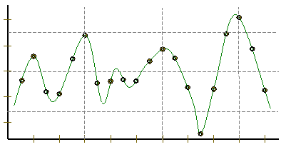
Representing Sound
Ex. Cr.
physics
continuous plot of air pressure vs. time
sampling
samples taken every ~ 1/22050nd of a second
Pressure
Time
quantization
Each sample is measured on a pressure scale from -32,767 to 32,767. (This fits into 2 bytes.)
storage
pulse code modulation
Raw audio data - such as what is written to the surface of a CD - is simply a list of these values.
plus formatting information
uncompressed sound data

Slide 117
Constructive Proof !
Specify a truth table defining any function you want
For each input row whose output needs to be 1, build an AND circuit that outputs 1 only for that specific input!
i
ii
input
output
x
y
fn(x,y)
0
0
0
0
1
1
iii
OR them all together
1
0
1
1
1
0
NOT
AND
OR
NOT
AND
x
y

Slide 118
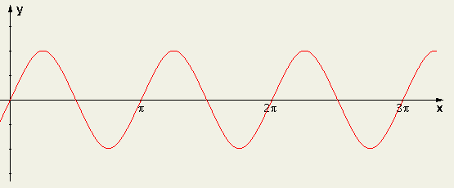
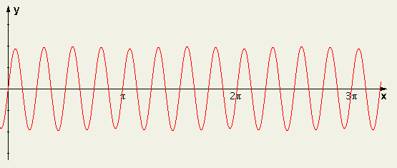
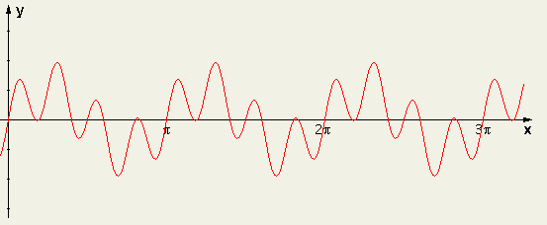
Sound: frequency
Ex. Cr.
We can create "pure" tones with a sine or cosine wave.
sin(2x)
We can add "pure" tones to create chords or other effects
sin(8x)
Any sound data is simply a sum of sine and cosine waves
A list of frequencies + their strength represents any sound!
sin(2x) + sin(8x)
How can we tell what frequencies make up a particular sound?
multiply by the frequency you want to test, and then add!

Slide 119
A bit of intuition…
Sometimes the bits are almost visible:
21 << 1
5 & 6
5 | 6
42
?
?
21 >> 1
5 ^ 6
10
?

Slide 120
More bits of Python
Which results will Python produce here?
5 & 6
5 | 6
A
0
1
B
1
0
C
2
3
D
3
5
E
4
7

Slide 121
Minterm Expansion
1
Specify the Truth Table defining the function
2
Build separate circuits for each output-1 row using ANDs and NOTs
Combine them with OR.
input
output
x
y
XOR(x,y)
0
0
0
0
1
1
1
0
1
1
1
0
KEY
input x
This circuit always outputs 0 - except for the second row, when x is 0 and y is 1
AND
input y
This is not a bubble, it's a NOT bubble!
What about the third row?
Notes:
121

Slide 122
Minterm Expansion
Specify a truth table defining any function you want
For each input row whose output needs to be 1, build an AND circuit that outputs 1 only for that specific input!
1
2
input
output
x
y
fn(x,y)
0
0
0
3
OR them all together
0
1
1
1
0
1
1
1
0
input x
AND
input y
output
OR
AND
How did we handle the rows outputting zero?

Slide 123
Claim: All computation
1
Specify the Truth Table defining the function
Formula !
1.5
input
output
x
y
XOR(x,y)
0
0
0
SELECT EACH ROW whose output is 1.
0
1
1
2
1
0
1
1
1
0
then combine…
I need proof!
Requires only 3 gates: AND, OR, and NOT

Slide 124
Minterm Expansion
1
Specify the Truth Table defining the function
Formula !
1.5
input
output
x
y
XOR(x,y)
0
0
0
SELECT EACH ROW whose output is 1.
0
1
1
2
1
0
1
1
1
0
then combine…

Slide 125
Minterm Expansion
1
Specify the Truth Table defining the function
Formula !
1.5
xy + xy
input
output
This is a constructive proof that AND, OR, and NOT suffice to construct any (boolean) function!
x
y
XOR(x,y)
0
0
0
SELECT EACH ROW whose output is 1.
0
1
1
2
1
0
1
1
1
0
then combine…
input x
AND
input y
output
OR
AND
These are not bubbles, they’re NOT bubbles
Notes:
125

Slide 126
Designing a circuit
the not equal circuit (!=)
We usually know what we want to do…
We just have to determine how to build it!
"English"
Truth Table
Formula
What is the general way to get a formula?
input bits
output bit
f(x,y) should output 1 when x != y otherwise, output 0
x
y
x != y
0
0
0
1
1
0
1
1
Circuit

Slide 127
Logic Gates
input
output
input
output
x
y
AND(x,y)
x
y
OR(x,y)
input
output
0
0
0
0
0
0
x
NOT(x)
0
1
0
0
1
1
0
1
1
0
0
1
0
1
1
0
1
1
1
1
1
1
input
x
x
y
x
y
NOT
AND
OR
xy
x + y
x
output
"x and y"
"x or y"
"not x"

Slide 128
A bit of intuition…
Sometimes the bits are almost visible:
10101
101
110
101
110
21 << 1
5 & 6
5 | 6
10101
101
110
000
21 >> 1
5 ^ 6
~0
This is NOT legal Python! Is it?

Slide 129
Which way is up?
This landscape image is determined to contain a portrait document.
Intensity profiles
Right-side up?

Slide 130
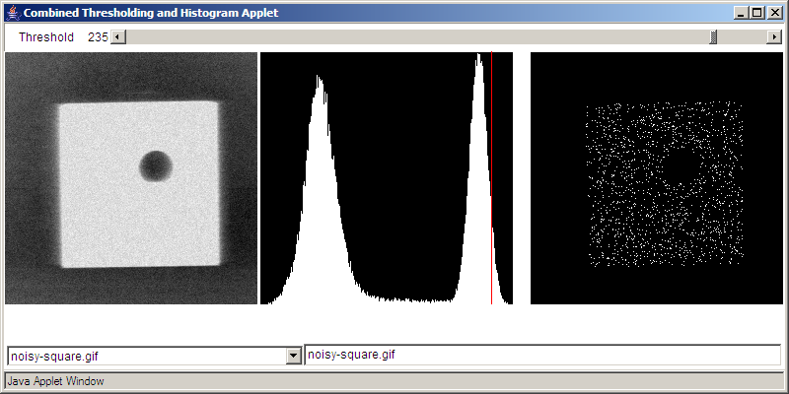
Binary Data
All data is binary…
I consider myself naturally ternary
But some data is naturally binary!
Original Image
Histogram of intensities
BINARY image

Slide 131
hw4pr4 (extra)
IM will be a Python list.
What structure will IM have ?
import cs5png
IM = cs5png.getRGB( 'olin.png' )
cs5png.saveRGB( IM, 'out.png' )
A
C
just a list
a list of lists of lists
B
D
a list of lists
a list of lists of lists of lists!
E
a list of lists of lists of lists of lists!!

Slide 132
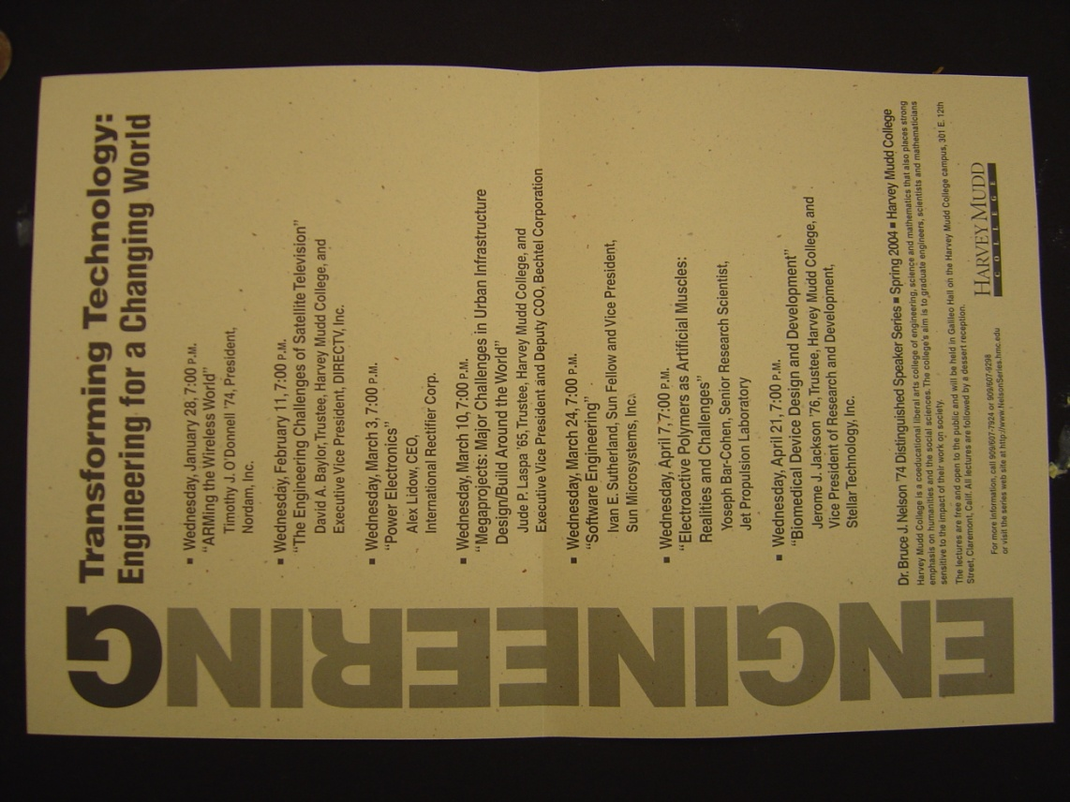
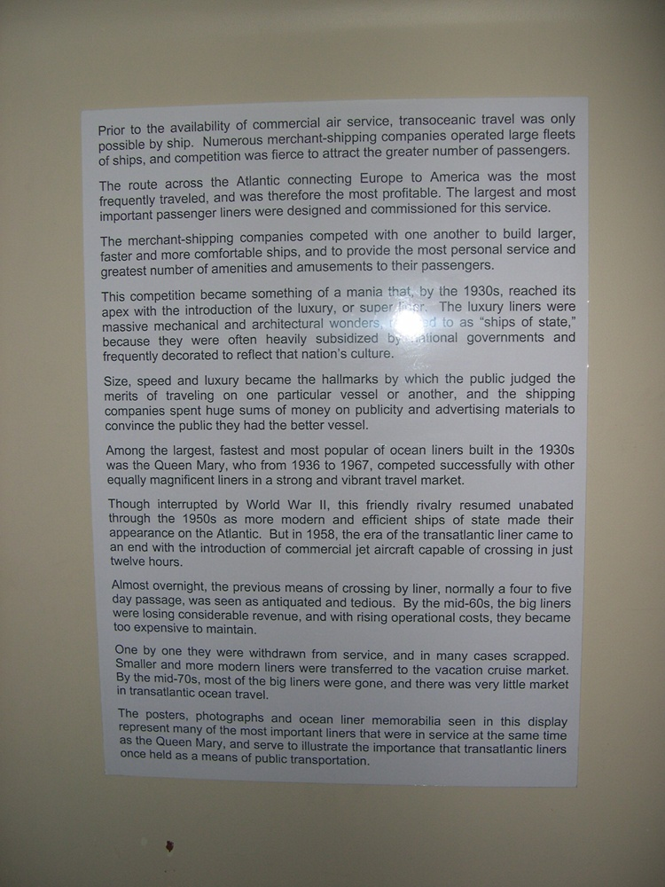
HMC clinic …
camera ~ scanner

Slide 133
CS 101 Today
Jessica's word
diner 2
diner 1
Too many bits? Compress!
Beyond binary … to bits themselves
In 2009 Chris did the floating pt. stuff in the previous lecture
Hw #4: due 10/7 @ 11:59 pm
King of ANDs
Queen of ORs
Jack of NOTs
Hw #5: due 10/14 @ 11:59 pm
Mon., 10/15 in-class
Exam 1:
>>> .1
Tue., 10/16 in-class
"Quiz"-type problems (+ reading)
0.10000000000001
may bring 1 page of notes
>>> .01*10 == .01/.1
False
What is python thinking?!?

Slide 134
CS 101 Today
Matt's word
diner 1
diner 1
Binary - is it ever used by people?
Beyond binary … to bits themselves
Hw #4: due 10/7 @ 11:59 pm
King of ANDs
Queen of ORs
Jack of NOTs
Hw #5: due 10/14 @ 11:59 pm
Mon., 10/15 in-class
Exam 1:
>>> .1
Tue., 10/16 in-class
"Quiz"-type problems (+ reading)
0.10000000000001
may bring 1 page of notes
>>> .01*10 == .01/.1
False
What is python thinking?!?

Slide 135
IEEE* floats
*Institute of Electrical and Electronics Engineers
Python uses double precision floats
64 bits == 8 bytes each

Slide 136
.0625
sinking with floats
.125
.25
.5
0.0000
0.0000
exact decimal equivalents
0.0001
0.0625
0.0010
0.1250
0.0011
0.1875
0.0100
0.2500
0.0101
0.3125
In reality, 23 bits or 52 bits will be used to represent the fractional part of a floating-point number
…
…
0.1100
0.7500
0.1101
0.8125
0.1110
0.8750
0.1111
0.9375
lots of gaps in here…
4 bits
Imagine we had only 4 bits …

Slide 137
.0625
sinking with floats !
.125
.25
.5
0.0000
0.0000
0.0001
0.0625
We type the decimal value 0.1
The computer represents it as the closest available float:
This float's decimal value is 0.1250
So, it acts like you typed 0.1250 !
The "error" is
necessarily limited binary precision
our own high expectations!
not fundamentally a rounding issue
0.0010
0.1250
0.0011
0.1875
0.0100
0.2500
0.0101
0.3125
…
…
0.1100
0.7500
0.1101
0.8125
0.1110
0.8750
0.1111
0.9375
4 bits

Slide 138
Low-level AI?
"Actuation"
"Sensing"

Slide 139
.0625
sinking with floats !
.125
.25
.5
0.0000
0.0000
0.0001
0.0625
We type the decimal value 0.1
The computer represents it as the closest available float:
This float's decimal value is 0.1250
So, it acts like you typed 0.1250 !
The "error" is
necessarily limited binary precision
our own high expectations!
not fundamentally a rounding issue
0.0010
0.1250
0.0011
0.1875
0.0100
0.2500
0.0101
0.3125
…
…
0.1100
0.7500
0.1101
0.8125
0.1110
0.8750
0.1111
0.9375
4 bits
Additional work can be done to compute with the decimal digits themselves - and thus avoid these issues.
from decimal import *
str vs. int

Slide 140
Designing a circuit
the equals to circuit (==)
We usually know what we want to do…
We just have to determine how to build it!
"English"
Truth Table
Formula
What is the general way to get a formula?
input bits
output bit
f(x,y) should output 1 when x = y otherwise, output 0
x
y
x == y
0
0
0
1
1
0
1
1
Circuit

Slide 141
"Quiz"
Name(s):
Write a recursive function startCount(s) It. should return the # of times the first element of the input s appears consecutively AT THE START of that string:
def startCount(s):
>>> startCount('1111010')
4
>>> startCount('00111000010')
2
Examples…
shortest compressed representation
longest compressed representation
What are the BEST and the WORST compression results you can get for an 8x8 square input?
EXTRA
How can you change this compression algorithm so that all compressed images are smaller than their originals? That is, how can we make compression always work?

Slide 142
I thought that binary came already built-in
Building in Binary
Underneath the strings, floats, and ints are simply bits…
'forty-two'
how many bits are used to represent this data?

Slide 143
I thought that binary came already built-in
Building in Binary
Underneath the strings, floats, and ints are simply bits…
'forty-two'
how many bits are used to represent this data?
11001101101111111001011101001111001101101111010011101111101111
9*8 bits == 72 bits
8 bits each for 9 ASCII characters

Slide 144
Building in Binary
Underneath the strings, floats, and ints are simply bits…
Each bit is represented as a voltage (1 is +5v or 0 is 0v)
It might be stored in memory
Or carried along wires to interact with other information
42
101010
input
output
+
adder
110011
51
which is
in decimal
input
9
001001

Slide 145
All computation…
bit values
reduces to functions of boolean values
binary values
other aliases
Boolean variables x,y,… can only be 0 or 1.
or True/False
Boolean functions can output only 0 or 1.
Truth tables describe boolean functions:
Everything is finite (no real numbers!)
input
output
x
y
f(x,y)

Slide 146
All computation
bit values
reduces to functions of boolean values
binary values
Boolean variables x,y,… can only be 0 or 1.
Boolean functions can output only 0 or 1.
Truth tables describe boolean functions:
input
output
x
y
f(x,y)
There are 4 possible input combinations for x and y :
0
0
0
0
1
0
What is this f?
1
0
0
1
1
1
It's a lousy, two-bit function, if you ask me!

Slide 147
Basic Boolean functions
input
output
input
output
x
y
AND(x,y)
x
y
OR(x,y)
input
output
0
0
0
0
0
0
x
NOT(x)
0
1
0
0
1
1
0
1
1
0
0
1
0
1
1
0
1
1
1
1
1
1
AND outputs 1 only if BOTH inputs are 1
OR outputs 1 if EITHER input is 1
NOT reverses its input
It must mean something that there are three of these functions…

Slide 148
Logic Gates
input
output
input
output
x
y
AND(x,y)
x
y
OR(x,y)
input
output
0
0
0
0
0
0
x
NOT(x)
0
1
0
0
1
1
0
1
1
0
0
1
0
1
1
0
1
1
1
1
1
1
input
input
x
y
x
x
y
Not a bubble, a not bubble… !
x + y
x
xy
output
"x or y"
output
"x and y"
"not x"

Slide 149
Logic Gates
x
y
x
y
x
input
Any function of bits can be built from these three gates:
NOT
AND
OR
and that means?
xy
x + y
x
"x and y"
"x or y"
"not x"
output

Slide 150
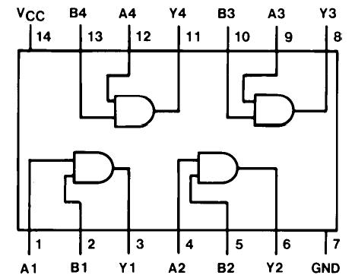
Logic Gates
x
y
x
y
x
input
Any function of bits can be built from these three gates:
NOT
AND
OR
and that means?
xy
x + y
x
"x and y"
"x or y"
"not x"
output
"Quad and gate"
these quotes are important to google… !

Slide 151
Sound: frequency
Ex. Cr.
We can create "pure" tones with a sine or cosine wave.
sin(2x)
We can add "pure" tones to create chords or other effects
sin(8x)
Any sound data is simply a sum of sine and cosine waves
A list of frequencies + their strength represents any sound!
sin(2x) + sin(8x)
How can we tell what frequencies make up a particular sound?
multiply by the frequency you want to test, and then add!

Slide 152
I thought that binary came already built-in
Building in Binary
Underneath the strings, floats, and ints are simply bits…
'forty-two'
how many bits are used to represent this data?
11001101101111111001011101001111001101101111010011101111101111
9*8 bits == 72 bits
8 bits each for 9 ASCII characters

Slide 153
Building in Binary
Underneath the strings, floats, and ints are simply bits…
Each bit is represented as a voltage (1 is +5v or 0 is 0v)
It might be stored in memory
Or carried along wires to interact with other information
42
101010
input
output
+
adder
110011
51
which is
in decimal
input
9
001001

Slide 154
All computation
bit values
reduces to functions of boolean values
binary values
Boolean variables x,y,… can only be 0 or 1.
Boolean functions can output only 0 or 1.
Truth tables describe boolean functions:
input
output
x
y
f(x,y)
There are 4 possible input combinations for x and y :
0
0
0
0
1
0
What is this f?
1
0
0
1
1
1
It's a lousy, two-bit function, if you ask me!

Slide 155
Basic Boolean functions
input
output
input
output
x
y
AND(x,y)
x
y
OR(x,y)
input
output
0
0
0
0
0
0
x
NOT(x)
0
1
0
0
1
1
0
1
1
0
0
1
0
1
1
0
1
1
1
1
1
1
AND outputs 1 only if BOTH inputs are 1
OR outputs 1 if EITHER input is 1
NOT reverses its input
It must mean something that there are three of these functions…

Slide 156
Logic Gates
input
output
input
output
x
y
AND(x,y)
x
y
OR(x,y)
input
output
0
0
0
0
0
0
x
NOT(x)
0
1
0
0
1
1
0
1
1
0
0
1
0
1
1
0
1
1
1
1
1
1
input
input
x
y
x
x
y
Not a bubble, a not bubble… !
x + y
x
xy
output
"x or y"
output
"x and y"
"not x"

Slide 157
Logic Gates
x
y
x
y
x
input
Any function of bits can be built from these three gates:
NOT
AND
OR
and that means?
xy
x + y
x
"x and y"
"x or y"
"not x"
output
"Quad and gate"
these quotes are important to yahoo… !

Slide 158
Designing a circuit
the not equal circuit (!=)
We usually know what we want to do…
We just have to determine how to build it!
"English"
Truth Table
Formula
What is the general way to get a formula?
input bits
output bit
f(x,y) should output 1 when x != y otherwise, output 0
x
y
x != y
0
0
0
1
1
0
1
1
Circuit

Slide 159
I think we'll need a bit more (or several)
Try it!
the less than or equal circuit (<=)
We usually know what we want to do…
We just have to determine how to build it!
"English"
Truth Table
Formula
What is the general way to get a formula?
input bits
output bit
f(x,y) should output 1 when x <= y otherwise, output 0
x
y
x != y
0
0
0
1
1
0
1
1
Circuit

Slide 160
Good luck with Hw 4!

Slide 161
Designing a circuit
the equals to circuit (==)
We usually know what we want to do…
We just have to determine how to build it!
"English"
Truth Table
Formula
What is the general way to get a formula?
input bits
output bit
f(x,y) should output 1 when x = y otherwise, output 0
x
y
x == y
0
0
0
1
1
0
1
1
Circuit

Slide 162
"Quiz"
Name(s):
Write a recursive function startCount(s) It. should return the # of times the first element of the input s appears consecutively AT THE START of that string:
def startCount(s):
>>> startCount('1111010')
4
>>> startCount('00111000010')
2
Examples…
shortest compressed representation
longest compressed representation
What are the BEST and the WORST compression results you can get for an 8x8 square input?
EXTRA
How can you change this compression algorithm so that all compressed images are smaller than their originals? That is, how can we make compression always work?

Slide 163
Constructing a circuit
For example, start with the formula
The Truth Table
The circuit
input
output
x + y
x
y
x + y
In English…

Slide 164
Constructing a circuit
the not equal test
More often we know what we want from f
But we have to figure out how to build it!
In English…
Truth Table
Formula
Is there a general way to get a formula?
f(x,y) should output 1 when x != y
Circuit

Slide 165
Circuit-building
"Quiz"
Name(s):
Design a "less than or equal to" circuit for 2 bits:
input
output
x
y
x <= y
(1) Create a truth table
x <= y
0
0
0
1
1
0
1
1
(2) Create a formula
(3) Design a circuit for it…
Ex. Cr.: how many different boolean functions with 2 inputs are there?
How about with N inputs?

Slide 166
Design a "less than or equal to" circuit for 2 bits:
input
output
x
y
x <= y
(1) Create a truth table
x <= y
0
0
0
1
1
0
1
1

Slide 167
Design a "less than or equal to" circuit for 2 bits:
input
output
x
y
x <= y
(1) Create a truth table
x <= y
0
0
1
0
1
1
1
0
0
1
1
1
(2) Create a formula
(3) Design a circuit for it…
2-bits? N-bits?
Friday: more bits!

Slide 168
See you Friday!

Slide 169
"Easy"
You think you know when you can learn, are more sure when you can write, even more when you can teach, but certain when you can program.
Subtleties in tasks we take for granted…

Slide 170
What are these shifts?
One strategy for these:
Convert the 5 and 100 to binary
Shift left or right
Convert back to decimal
5 << 4
100 >> 3
128
64
32
16
8
4
2
1
128
64
32
16
8
4
2
1
Shifting, adding, and subtracting are faster than multiplying and dividing.
Knowing this, what is a "faster" strategy for multiplying a number N by 7 ?

Slide 171
Write a recursive function startCount(s) It. should return the # of times the first element of the input s appears consecutively AT THE START of that string:
>>> startCount('00111000010')
2
>>> startCount('1111010')
4
Examples…
def SC(s):

Slide 172
Write a recursive function startCount(s) It. should return the # of times the first element of the input s appears consecutively AT THE START of that string:
>>> startCount('00111000010')
2
>>> startCount('1111010')
4
Examples…
def SC(s
default arguments!

Slide 173
See you in Lab!

Slide 174
Shiftiness with Python
"Quiz"
Shiftiness with Python
Name(s):
Shiftiness with Python
What will be the results of these shifts ?
One strategy for these:
5 << 4
Convert the 5 and 100 to binary
Shift left or right
100 >> 3
Convert back to decimal
Shifting, adding, and subtracting are faster than multiplying and dividing.
Knowing this, what is a "faster" strategy for multiplying a number N by 7 ?
Write a recursive function startCount(s) It. should return the # of times the first element of the input s appears consecutively AT THE START of that string:
def startCount(s):
>>> startCount('00111000010')
2
>>> startCount('1111010')
4
Examples…

Slide 175
50 of these Setun ternary machines were made at Moscow University ~1958
They were deployed all over the CCCP.
A redesign was underway until 1970…
http://sovietcomputing.com/node/47
http://museum.e-ukraine.org/PHOTOS/Setun-1.html
Notes:
in 1970 - he was moved to an attic room in a student dormatory at MSU! The new univ. rector felt that computer design was not a real science and sought to get rid of Nikolai Brusentsov - also, there had been inquiries from foreign interests, but those were never filled…
He continued working at MSU until very recently (how recently?)

