Slide 1
CS 5 Today
“All the News that fits is printed”
Weather: Water pellets falls from sky.
What is it?! Mayor urges calm.
Sports: HMC bowling team
in the gutter. Team pins hopes
on CS 5 prof.
News in Brief
“My CS 5 Lecture Notes Were Stolen
by 5-Eyed Aliens” claims distraught
CS 5 Professor.
Penguins slated to teach CS 5
black go missing. Police
commence search. Page 42
“Hoch-Shanahan smoothies
may cause déjà vu,” new study
reports. Page 42
“All HMC vacations to be
cancelled and classes to meet on
Saturdays and Sundays as well,”
administrators announce. Page 42
Claremont, CA: A Harvey Mudd CS Professor claims that his
lecture notes were stolen by 5-eyed smiling aliens early on
Monday morning. “I wrote up some notes for my lecture and,
while I went out to get a cup of coffee before class, 5-eyed smiling
aliens snuck into my office and stole my notes to eat for breakfast,”
claimed the distraught professor. “We’re obligated to investigate
every claim,” said a campus security officer, “but we’re skeptical
of this one. Five-eyed smiling aliens are not known to eat class
notes for breakfast. They much prefer Spam-flavored Pop Tarts
and Jolt Cola. We’re investigating, but we suspect that 3-eyed
aliens from CS 5 Gold were the actual perpetrators of this terrible
crime.” Why are you reading this drivel? Don’t you have anything
better to do?
“Hoch-Shanahan smoothies
may cause déjà vu,” new study
reports. Page 42
“The secret ingredient in our
soft-serve ice cream is pureed
Spam!” announces cafeteria
supervisor. Page 42

Slide 2
Getting Help and Office Hours
Come to office hours and/or set up times to come talk to Geoff and Zach! Also, grutoring hours are great!
Be sure to put "CS5" in your e-mail subject lines!

Slide 3
Member
>>> member(42, [1, 3, 5, 42, 7])
True
>>> member(42, [“spam”, “is”, “yummy”])
False
def member(x, L):
Worksheet please!

Slide 4
Writing Map and Reduce
>>> map(dbl, [0, 1, 2, 3])
[0, 2, 4, 6]
>>> reduce(add, [1, 2, 3])
6
The shortest possible list has length 0
def map(f, L):
The shortest possible list has length 1
def reduce(g, L):
In your notes
Worksheet please!

Slide 5
Filter
Java doesn’t have a filter!
def even(x):
’’’returns True iff x is even’’’
return x % 2 == 0
>>> filter(even, range(100))
[0, 2, 4, 6, …, 98]
A function that returns
either True or False
Is called a predicate

Slide 6
Filter
def short (List):
’’’returns True iff List has len <= 2’’’
return len(List) <= 2
>>> filter(short, [ [“spam”, “yum”], [42], [1, 2, 3]])
filter can be written from scratch using recursion.

Slide 7
Functions are Data
def divides(n):
def div(k):
return n % k == 0
return div
>>> f = divides(10)
>>> f
<function f at 0x661f0>
>>> f(2)
>>> listOfFunctions = [divides(10), divides(20)]
>>> listOfFunctions[0](2)

Slide 8
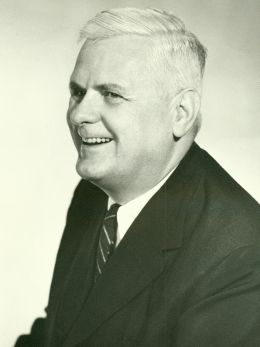
mython (a “pure” functional language)
myNumber = 42
myFood = “spam”
def dbl(x):
return 2 * x
dbl = (x):
return 2 * x
dbl = lambda(x):
return 2 * x
>>> dbl(21)
42
Alonzo Church
1903-1955
Notes:
Alonzo Church invented the lambda calculus, which inspired many features of modern functional languages (including, of course, the lambda itself.)

Slide 9
Python (an “impure” functional language)
myNumber = 42
myFood = “spam”
def dbl(x):
return 2 * x
dbl = lambda(x):
return 2 * x
dbl = lambda x: 2 * x
>>> dbl(21)
42
Alonzo Church
1903-1955
One line
no parentheses on the input variable
return is implicit
Notes:
American mathematician, invented the lambda calculus and the Church-Turing thesis (basically, says that a human can calculate on pencil and paper if and only if a Turing machine can do it).

Slide 10
Lambda
aka “anonymous functions”
>>> filter(lambda x: x%2 == 0, range(100))
>>> filter(lambda List: len(List) <= 2,
[[“spam”, “yum”], [42], [1, 2, 3]])

Slide 11
Lambda
even = lambda x: x%2 == 0
def even(x):
'''returns True iff x is even'''
return x % 2 == 0
short = lambda List: len(List) <= 2
def short(List):
'''returns True iff List has len <= 2'''
return len(List) <= 2

Slide 12
Lambda Evil
def ugly(item, L):
newL = map(lambda x: x == item, L)
return sum(newL) > 0
This is exploiting the fact that True==1 and False==0.
Notes:
This is bad style. You can do it, but the next slide is better.

Slide 13
Lambda
def mystery(item, L):
newL = map(lambda x: x == item, L)
return reduce(lambda x, y: x or y, newL)
MUCH better!
Notes:
This is bad style. You can do it, but the next slide is better:

Slide 14
A Prime Example
Write a function called prime(n) that returns True if n is
prime and False otherwise by testing all possible divisors
from 2 to n-1 (or sqrt of n)
def prime(n):
possibleDivisors = range(2, n)
divisors = filter(lambda X: n % X == 0, possibleDivisors)
return ???
A version of this was an extra-credit problem in Homework 0!

Slide 15
A Prime Example
Write a function called prime(n) that returns True if n is
prime and False otherwise by testing all possible divisors
from 2 to n-1 (or sqrt of n)
def prime(n):
possibleDivisors = range(2, n)
divisors = filter(lambda x: n % x == 0, possibleDivisors)
return len(divisors) == 0
Alternatively, which of these works?…
def divides(X):
return n % X == 0
def prime(n):
possibleDivisors = range(2, n)
divisors = filter(divides,
possibleDivisors)
return len(divisors) == 0
def prime(n):
def divides(X):
return n % X == 0
possibleDivisors = range(2, n)
divisors = filter(divides,
possibleDivisors)
return len(divisors) == 0

Slide 16
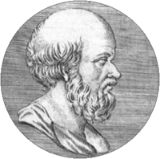
Listing Primes…
Eratosthenes
200 BCE
Objective: Find all primes less than or equal to some given n.
Approach 1: Test 2, 3, …, n for primality
Approach 2: The Sieve of Eratosthenes…
2, 3, 4, 5, 6, 7, 8, 9, 10, 11, 12, 13, 14, 15,…
2, 3, 4, 5, 6, 7, 8, 9, 10, 11, 12, 13, 14, 15,…
2, 3, 4, 5, 6, 7, 8, 9, 10, 11, 12, 13, 14, 15,…

Slide 17
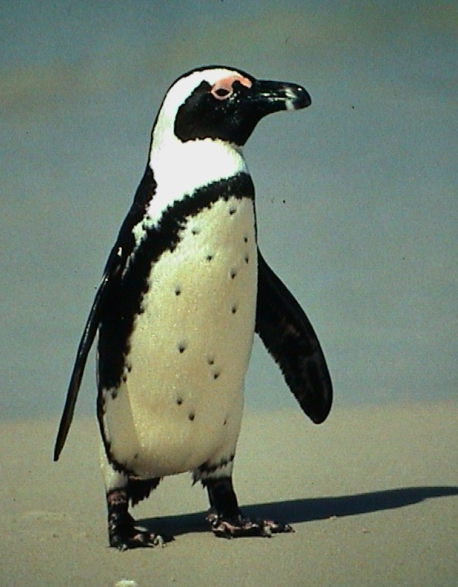
Nifty Sifty…
>>> sieve([2, 3, 4, 5, 6, 7, 8, 9])
[2, 3, 5, 7]
def primes(n):
'''Returns the list of primes <= n'''
return sieve(range(2, n+1))
def sieve(L):
if L == []: return []
else: return ???
This is a fun challenge. Try it in your notes!

Slide 18
Nifty Sifty…
>>> sieve([2, 3, 4, 5, 6, 8, 9])
[2, 3, 5, 7]
def primes(n):
'''Returns the list of primes <= n'''
return sieve(range(2, n+1))
def sieve(L):
if L == []: return []
else: return [L[0]] + ???

Slide 19
Filter it, Baby!
>>> sieve([2, 3, 4, 5, 6, 7, 8, 9])
[2, 3, 5, 7]
def sieve(L):
if L == []: return []
else: return [L[0]] + primes
filter(lambda x: x % L[0] != 0, L[1:])
This is a good start, but we’re not quite done!
Notes:
Note that this really isn’t the sieve; see Prof. O’Neill’s paper on the subject (using the Haskell language). Google “O’Neill sieve” to find it. Her approach is faster but also a few lines longer.

Slide 20
Is This Sweet or What!?
>>> sieve([2, 3, 4, 5, 6])
[2, 3, 5]
def sieve(L):
if L == []: return []
else: return [L[0]] + primes
sieve(filter(lambda x: x % L[0] != 0, L[1:]))
def primes(n):
return sieve(range(2, n+1))
demo!

Slide 21
The Alien's Life Advice
Don't be Hermione Granger
Let somebody else answer for a change

Slide 22
Use-It-Or-Lose-It

Slide 23
Power Set!
This really demonstrates the power of functional programming!
>>> powerset([1, 2])
[[], [2], [1], [1, 2]]
>>> powerset([1, 2, 3])
[[], [3], [2], [2, 3], [1], [1, 3], [1, 2], [1, 2, 3]]
>>> powerset([1])
>>> powerset([])
The order in which the subsets
are presented is unimportant
but within each subset, the
order should be consistent
with the input set.

Slide 24
Power Set!
def powerset(L):
In your notes…

Slide 25
The Packing Problem
>> subset(12, [2, 3, 4, 7, 10, 42])
True
>>> subset(8, [2, 3, 4, 7, 10, 42])
False
def subset(target, L):
Two inputs means two base cases!

Slide 26
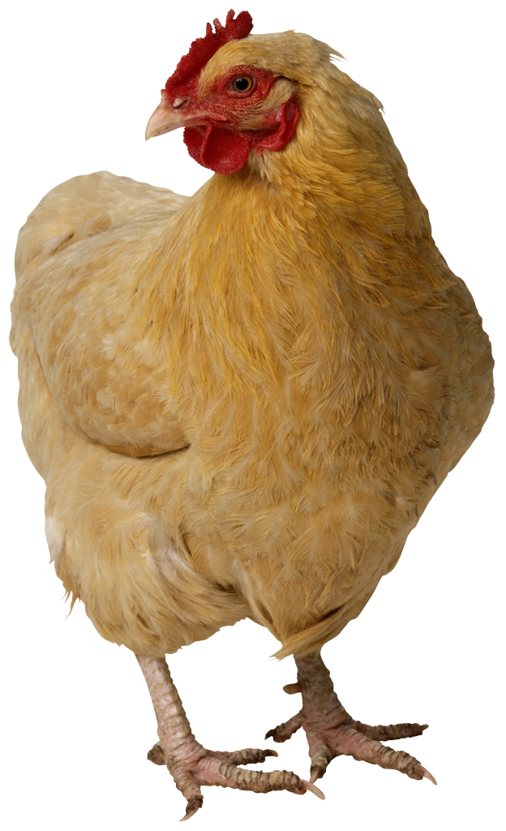
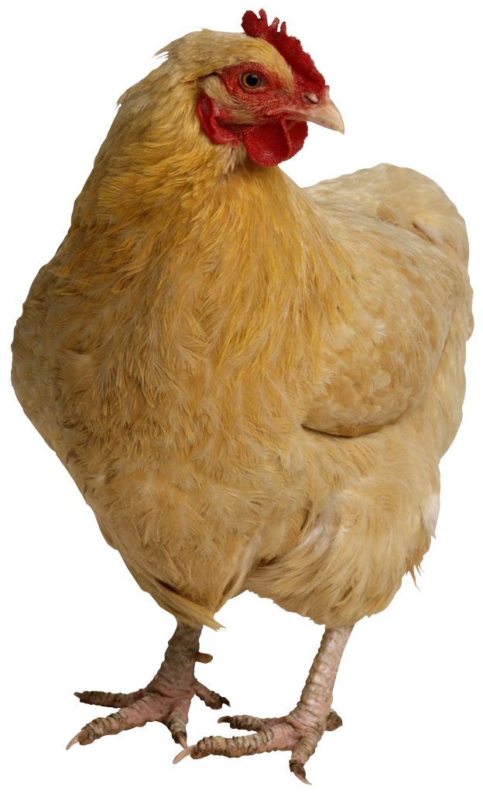
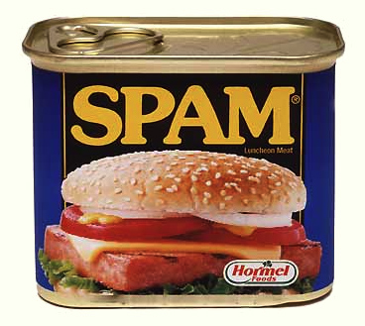
The Knapsack Problem…
Item Weight Value
Spam 2 100
Tofu 3 112
Chocolate 4 125
Knapsack Capacity: 5? 6? 7?
Kingdom of Shmorbodia
>>> knapsack(7, [ [2, 100], [3, 112], [4, 125] ])
237
Prof. I. Lai thinks that a “greedy solution” is the way to go!
Worksheet and Demo

Slide 27
The Knapsack Revisited…
Item Weight Value
Spam 2 100
Tofu 3 112
Chocolate 4 125
Knapsack Capacity: 5? 6? 7?
Kingdom of Shmorbodia
>>> knapsack(7, [ [2, 100], [3, 112], [4, 125] ])
[237, [ [3, 112], [4, 125] ] ]

Slide 28
Comparing DNA via Longest Common Subsequence (LCS)
AGGACAT
ATTACGAT
>>> LCS(“AGGACAT”, “ATTACGAT”)
5
>>> LCS(“spam”, “sam!”)
3
>>> LCS(“spam”, “xsam”)
3
I prefer spam to an xsam!

Slide 29
Recursive Approach…
def LCS(S1, S2):
if BASE CASE
else:
LCS(“spam”, “sam!”)
Try this in your notes!
Solution follows

Slide 30
Recursive Approach…
def LCS(S1, S2):
if S1 == "" or S2 == "": return 0
else:
LCS(“spam”, “sam!”)

Slide 31
Recursive Approach…
def LCS(S1, S2):
if S1 == "" or S2 == "": return 0
else:
if S1[0] == S2[0]: # DO THE FIRST SYMBOLS MATCH?
return 1 + ???
else:
LCS(“spam”, “sam!”)

Slide 32
Recursive Approach…
def LCS(S1, S2):
if S1 == "" or S2 == "": return 0
else:
if S1[0] == S2[0]: # DO THE FIRST SYMBOLS MATCH?
return 1 + LCS(S1[1:], S2[1:])
else:
LCS(“spam”, “sam!”)

Slide 33
Recursive Approach…
def LCS(S1, S2):
if S1 == "" or S2 == "": return 0
else:
if S1[0] == S2[0]: # DO THE FIRST SYMBOLS MATCH?
return 1 + LCS(S1[1:], S2[1:])
else:
return max(LCS(S1, S2[1:]), LCS(S1[1:], S2))
LCS(“spam”, “sam!”)

