Slide 1



The CS 5 Times
Arts: New band “The Recursions” performs songs from
first album on first album.
Sports: HMC Web surfing team advances to Nationals
“Zach and Geoff
to be Replaced by
Two Penguins,” says HMC Dean
Claremont(AP): Beginning next week, CS 5 will be taught by a pair of penguins, announced an HMC dean. “Penguins are very smart,” said the dean, “and they are also quite adorable, which is more than we can say about the CS 5 faculty. Plus, we won’t need to heat their offices in the winter.”
Photos of the two new
CS 5 penguin professors

Slide 2


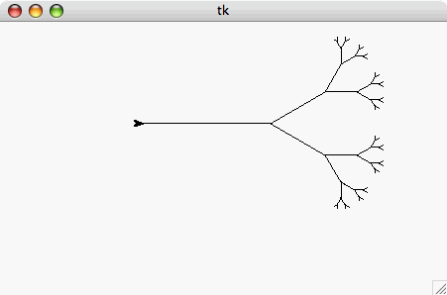
This Week
Homework 2:
  Reading on AI and Jeopardy
  Lab: Black lab is different from Gold this week
  Problem 2: Groodies
  Problem 3: Sorting
  Problem 4: Giigle Maps
You’re ready
for this today!
You’re ready
for this today!
Thursday!
Optional BONUS problem

Slide 3

Speaking of Illness…
Please e-mail the prof as soon as you feel bad!

Slide 4
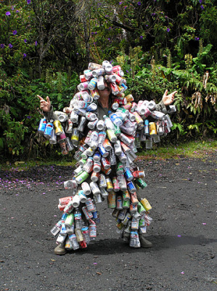
Comparing DNA via Longest
Common Subsequence (LCS)
AGGACAT
ATTACGAT
>>> LCS(“AGGACAT”, “ATTACGAT”)
5
>>> LCS(“can”, “man!”)
2

Slide 5
Recursive Approach…
def LCS(s1, s2):
if BASE CASE:
???
else:
LCS(“spam”, “sam!”)
Try this in your notes!
Solution follows

Slide 6
Recursive Approach…
def LCS(s1, s2):
if s1 == "" or s2 == "":
return 0
else:
LCS(“spam”, “sam!”)

Slide 7
Recursive Approach…
def LCS(s1, s2):
if s1 == "" or s2 == "":
return 0
else:
if s1[0] == s2[0]: # DO THE FIRST SYMBOLS MATCH?
return 1 + ???
else:
LCS(“spam”, “sam!”)

Slide 8
Recursive Approach…
def LCS(s1, s2):
if s1 == "" or s2 == "":
return 0
else:
if s1[0] == s2[0]: # DO THE FIRST SYMBOLS MATCH?
return 1 + LCS(s1[1:], s2[1:])
else:
LCS(“spam”, “sam!”)

Slide 9
Recursive Approach…
def LCS(s1, s2):
if s1 == "" or s2 == "":
return 0
else:
if s1[0] == s2[0]: # DO THE FIRST SYMBOLS MATCH?
return 1 + LCS(s1[1:], s2[1:])
else:
return max(LCS(s1, s2[1:]), LCS(s1[1:], s2))
LCS(“spam”, “sam!”)
What does it actually do when it runs?

Slide 10
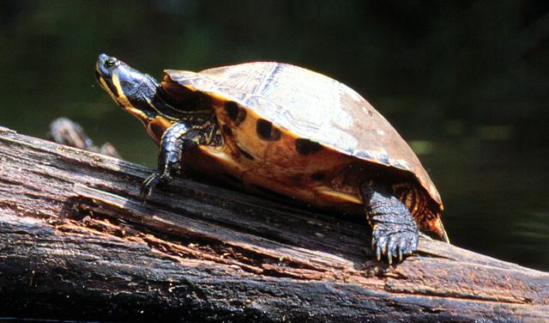

Turtle Graphics
forward(100)
right(90)

Slide 11
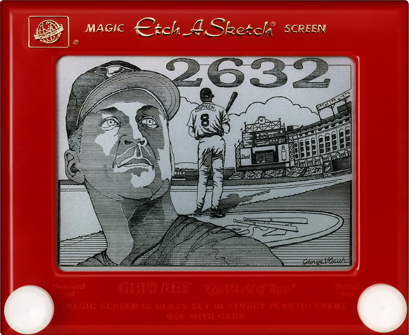
Etch-a-Sketch craziness…
No way this is real…
except that it is !
Notes:
This is Cal Ripken, Jr., who played in 2,632 consecutive major-league games to break Lou Gehrig's previous "Iron Man" record of 2,130. He voluntarily ended the streak after reaching 2,632. The drawing is by George Vlosich, "The world's greatest Etch-a-Sketch artist," who takes 70-80 hours to complete a work.

Slide 12
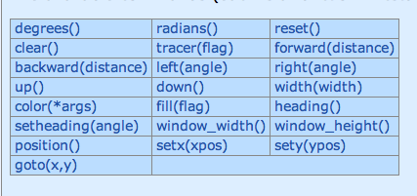
Turtle Graphics
Follow the instructions for downloading
the turtle graphics modules and then type:
>>> import turtle
>>> turtle.forward(50)
>>> turtle.right(90)
>>> turte.backward(50)
Problem 2 has a link to the turtle documentation

Slide 13


Fractals
Notes:
On the left, each part of the fern is in fact a duplicate of the larger fern. Likewise for the tree on the right!

Slide 14
“I Wonder About Trees” – Robert Frost
“We wonder about Robert Frost” - Trees
>>> svTree(128, 6)
Notes:
svTree stands for "side view of tree"

Slide 15
trunk length
recursion level
>>> svTree(100, 3)

Slide 16
trunk length
recursion level
>>> svTree(100, 3)
100 long!

Slide 17
trunk length
recursion level
>>> svTree(100, 3)
svTree(50, 2)
100 long!

Slide 18
trunk length
recursion level
>>> svTree(100, 3)
svTree(50, 2)
100 long!

Slide 19
trunk length
recursion level
>>> svTree(100, 3)
svTree(25, 1)
svTree(50, 2)
100 long!

Slide 20
trunk length
recursion level
>>> svTree(100, 3)
svTree(25, 1)
svTree(50, 2)
100 long!

Slide 21
trunk length
recursion level
>>> svTree(100, 3)
svTree(25, 1)
svTree(50, 2)
100 long!

Slide 22
trunk length
recursion level
>>> svTree(100, 3)
svTree(25, 1)
svTree(50, 2)
100 long!

Slide 23
trunk length
recursion level
>>> svTree(100, 3)
svTree(25, 1)
svTree(50, 2)
100 long!

Slide 24
trunk length
recursion level
>>> svTree(100, 3)
svTree(25, 1)
svTree(50, 2)
100 long!

Slide 25
trunk length
recursion level
>>> svTree(100, 3)
svTree(25, 1)
svTree(50, 2)
100 long!

Slide 26
trunk length
recursion level
>>> svTree(100, 3)
svTree(25, 1)
svTree(50, 2)
100 long!

Slide 27
trunk length
recursion level
>>> svTree(100, 3)
svTree(25, 1)
svTree(50, 2)
100 long!

Slide 28
trunk length
recursion level
>>> svTree(100, 3)
svTree(25, 1)
svTree(50, 2)
100 long!

Slide 29
trunk length
recursion level
>>> svTree(100, 3)
svTree(25, 1)
svTree(50, 2)
100 long!

Slide 30
The Alien's Life Advice
Help the person sitting next to you
…or let them help you!

Slide 31
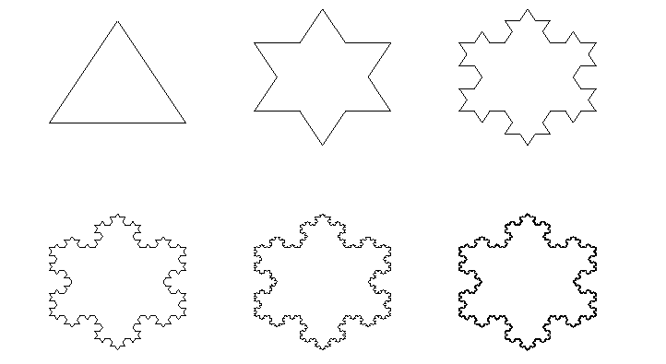
SnowFlake Fractals
The Koch Snowflake Fractal:
level 0
level 1
level 2
level 3
level 4
level 5

Slide 32
Snowflake Fractals
The Koch Snowflake Fractal:
level 0
level 1
level 2
level 3
level 4
level 5
level 0
1/3
1/3
level 1
1/3
1/3
1/3

Slide 33
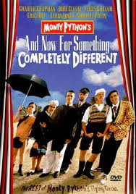
And now for something completely different…
(…or at least it will seem different until we see that it’s not!)

Slide 34
Tuples (“Immutable Lists”)
>>> foo = (42, 'hello', (5, 'spam'), 'penguin')
>>> foo
(42, 'hello', (5, 'spam'), 'penguin')
>>> foo[0]
42
>>> foo[-1]
'penguin'
>>> foo[0:2]
(42, 'hello')
>>> foo[0:1]
(42,)

Slide 35
Tuples (“Immutable Lists”)
>>> foo = (42, 'hello', (5, 'spam'), 'penguin')
>>> foo
(42, 'hello', (5, 'spam'), 'penguin')
>>> foo[0]
42
>>> foo[-1]
'penguin'
>>> foo[0:2]
(42, 'hello')
>>> foo[0:1]
(42,)
>>> foo[0] = 100
BARF!!!

Slide 36
Dictionaries
>>> D = {}
>>> D["Geoff"]= "spam"
>>> D["Zach"]= "donuts"
>>> D["Alien"]= 42
>>> D["Geoff"]
'spam'
>>> D["Alien"]
42
>>> D["Napoleon Dynamite"]
BARF!
“Geoff”, “Zach”, and “Alien” are called the
“keys” in the dictionary. Any immutable
object can be a key.
Notes:
Immutable includes strings, integers, floats, and tuples but NOT lists – even if they're nested inside tuples, they're illegal.

Slide 37
Dictionaries
>>> D = {}
>>> D["Geoff"]= "spam"
>>> D["Zach"]= "donuts"
>>> D["Alien"]= 42
>>> D["Geoff"]
'spam'
>>> D["Alien"]
42
>>> D["Napoleon Dynamite"]
BARF!
>>> D
{ 'Geoff': 'spam', 'Zach': 'donuts', 'Alien' : 42 }

Slide 38
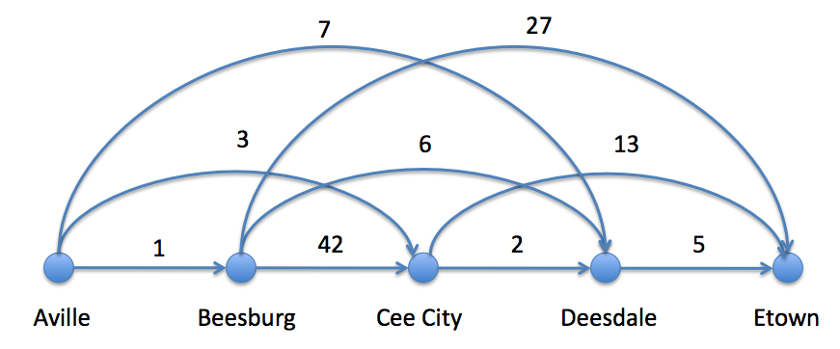
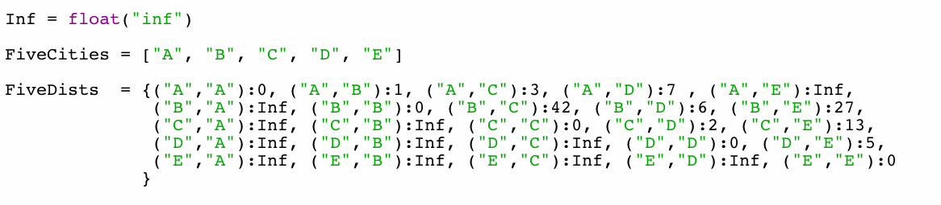
Giigle maps
>>> FiveDists[ ("B", "C") ]
42

Slide 39
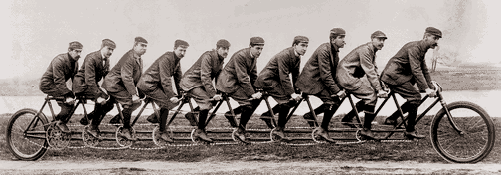
Sometimes We Need to Make More Than 2 Recursive Calls!
Notes:
…and we’ll cover that in this week’s homework.

Slide 40
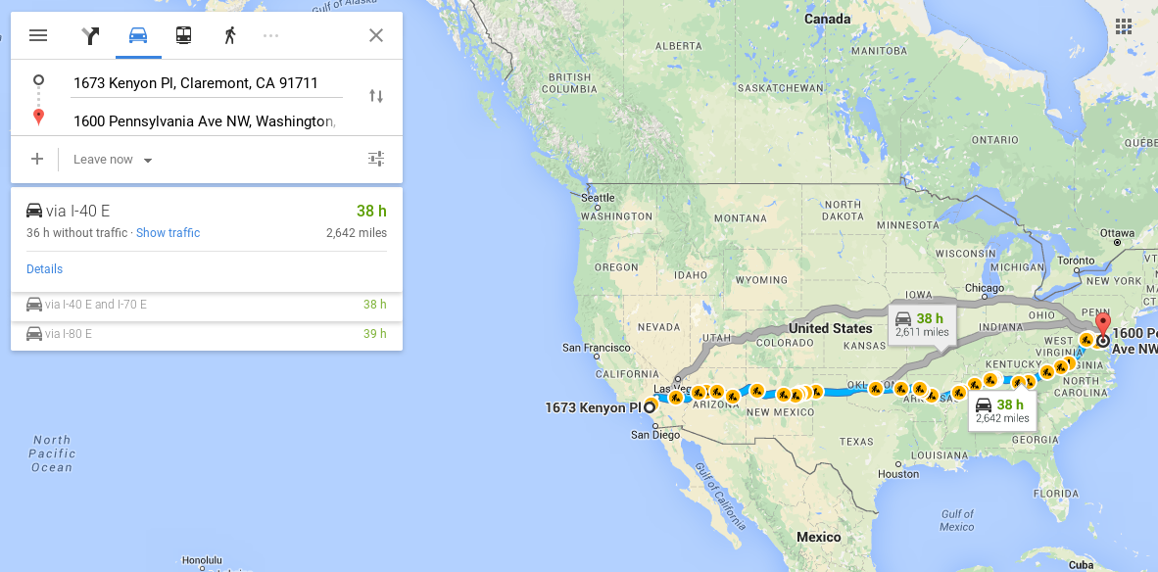
Finding Shortest Paths

Slide 41
Giigle maps
7
27
3
6
13
1
42
2
5
Aville
Beesburg
Cee City
Deesdale
Etown
All roads point east!
Shortest path?
Is greed good?
How does the use-it-or-lose-it idea get used here?

Slide 42
Bonus problem!
>>> shortestPath (FiveCities, FiveDists)
10
>>> shortestPath (["C", "D", "E"], FiveDists)
7
>>> shortestPath (["E"], FiveDists)
0
Notes:
The shortest path is A->C->D->E.

Slide 43
Bonus problem!
def shortestPath (Cities, Distances):
'''Returns the length of the shortest path
from the leftmost to the rightmost city in
in the Cities list.'''
if BLAH:
return BLAH BLAH
else:
return BLAH BLAH BLAH
Just four lines of code!!!
It’s fitting that
map gets used
here!

