Slide 1
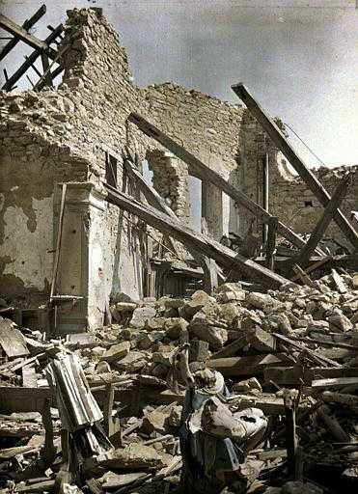
The CS 5 Times
Dormitory Destroyed
Claremont (PP): A Harvey Mudd College dormitory
was left in shambles Tuesday after an unexpected
low-frequency resonance caused it to self-destruct.
“I didn’t mean any harm,” reported a shaken
student. “I was doing my CS lab, and I thought it
would be cool to share my sounds with the other Westies, so I hooked my computer up to the dorm speakers. Who knew that 42 Hertz was a special frequency?”
Rescuers worked frantically to recover the student’s hard drive, which reportedly contained notes for an upcoming physics exam. At press time, the drive remained buried under tons of rubble, and hope for a positive outcome was fading. “I’d give anything for a copy of the Lorentz velocity transformation equations,” wailed the distraught student.
Upon hearing of this offer, North dorm residents reportedly got together and, after much difficulty, reconstructed the equation and offered it in return for West’s best speakers.
“West” dormitory after unfortunate incident.

Slide 2
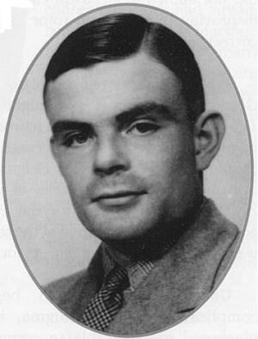
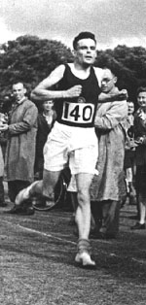
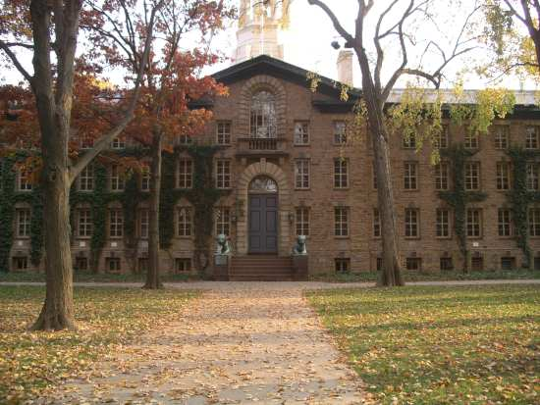
True Story: Alan Turing
Alan Turing 1912-1954
1938 Princeton Ph.D.
thesis on uncomputability
Notes:
Talented runner; sometimes ran 40 miles to London for meetings. Tried out for 1948 Olympics (marathon), ran 2:46 despite an injury.

Slide 3
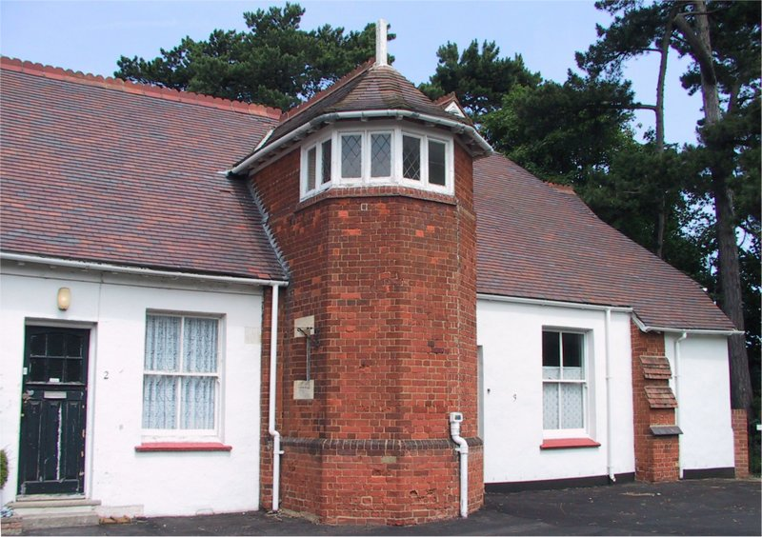
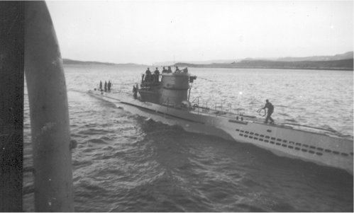
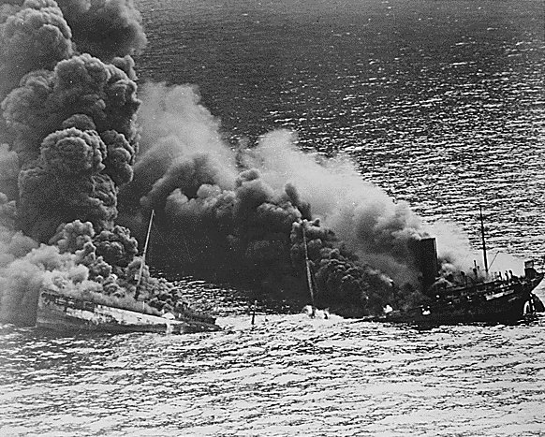
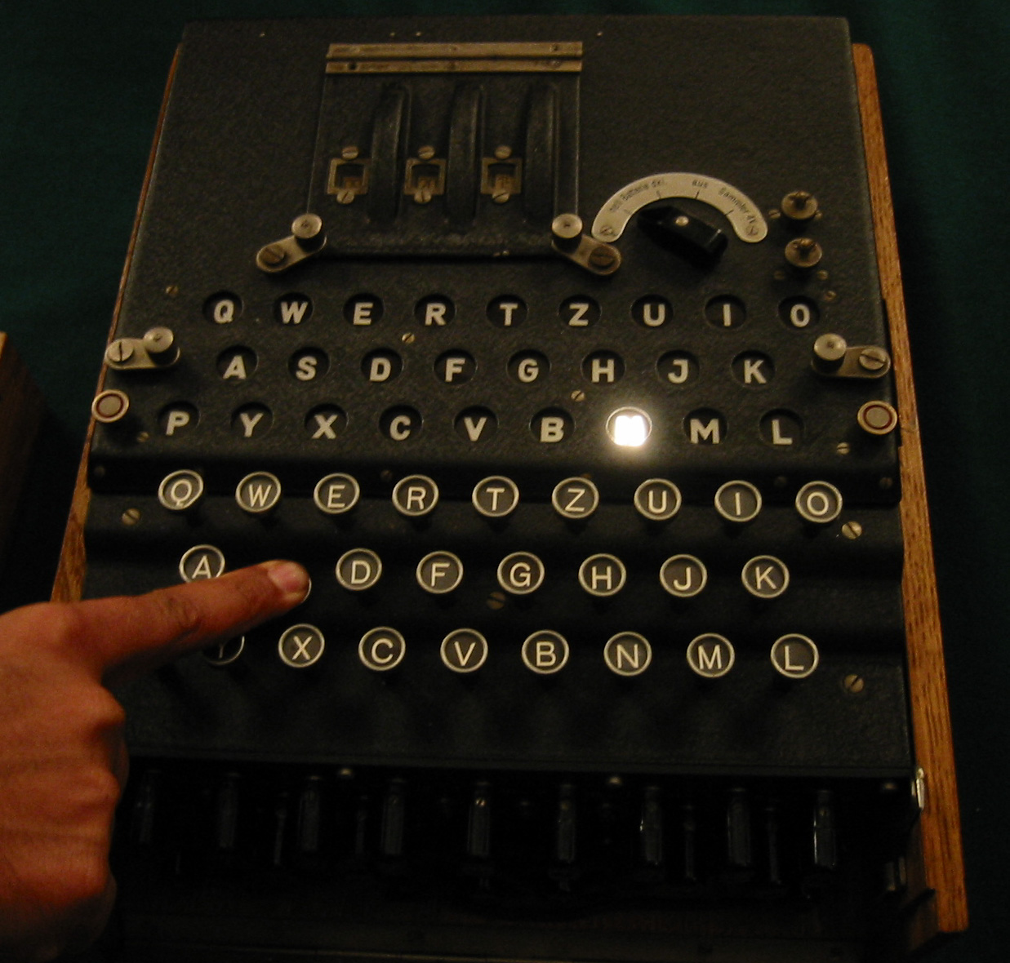
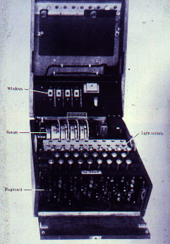
Alan Turing
Bletchley Park
German WWII U-Boat
Allied Tanker hit by U-Boat Torpedo
Enigma
Notes:
Enigma machine was crucial both to early German successes and later Allied win. Some of Turing’s cryptography papers weren’t released until April 2012.

Slide 4
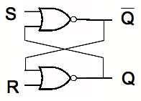
A 1-Bit Memory
This stuff is truly unforgettable!
OR + NOT = NOR
Notes:
Next slides have animations to explain how this works.

Slide 5
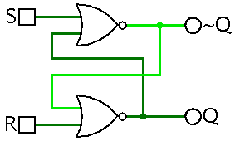
A 1-Bit Memory

Slide 6
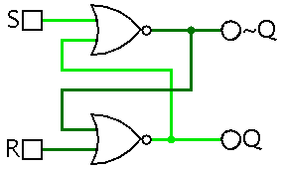
Setting a 1-Bit Memory

Slide 7
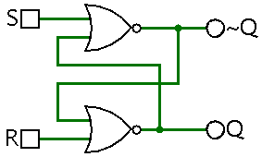
Initializing a 1-Bit Memory
Notes:
This circuit is the simplest type of "latch" or a "flip-flop". It is called an "S-R latch" or sometimes an "R-S" one.

Slide 8
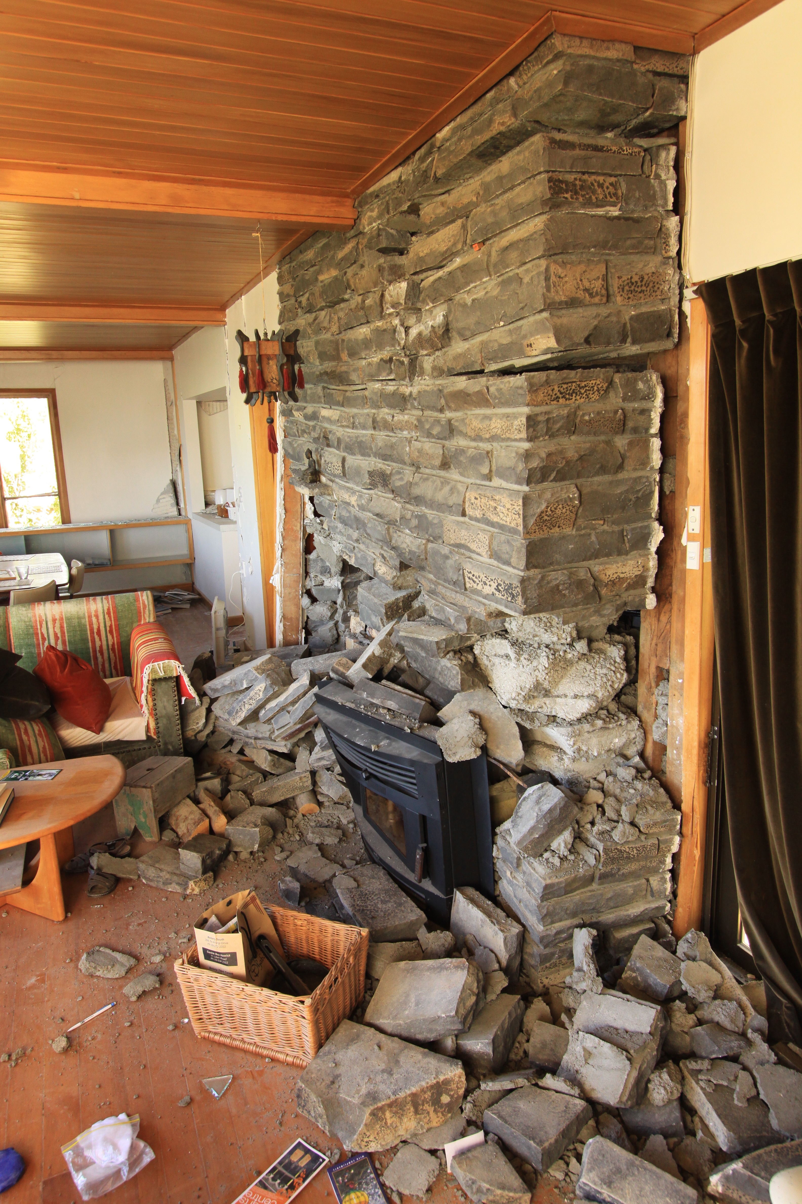
DROP! COVER! HOLD ON!

Slide 9
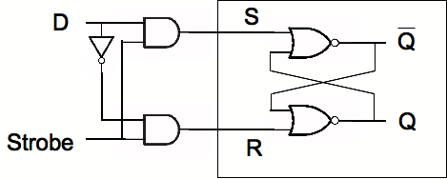
From S-R Latches to D-Latches
>
Worksheet!
Notes:
WORKSHEET PROBLEM: What does this circuit do when "Strobe" is high? What about when it is low?
Strobes are often called clocks, and may be represented by greater-than signs or triangles. In Logisim, S-R flip-flops have clocks. Clocks can be active-low, active-high, or edge-triggered on either the rising or the falling edge. In Logisim, flip-flops clock on the rising edge.

Slide 10
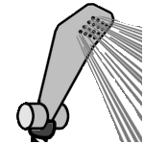
The Alien’s Life Advice
Shower!
You only think you don’t smell bad.
And wash your clothes!

Slide 11
A Random Access Memory (RAM)
1
0
2 address
bits
00
3 data
bits (out)
01
1
1
0
3 data
bits (in)
10
Read
Write
11
1

Slide 12
A Random Access Memory (RAM)
2 address
bits
00
3 data
bits (out)
01
3 data
bits (in)
1
1
0
10
Read
Write
11

Slide 13
A Random Access Memory (RAM)
1
0
2 address
bits
1
1
0
3 data
bits (out)
3 data
bits (in)
1
1
0
1
Read
Write

Slide 14
A Random Access Memory (RAM)
2 address
bits
D
D
D
D
Latch
Q
D
Latch
Q
D
Latch
Q
Strobe
Strobe
Strobe
D
D
D
D
Latch
Q
D
Latch
Q
D
Latch
Q
3 data
bits (in)
3 data
bits (out)
Strobe
Strobe
Strobe
D
D
D
D
Latch
Q
D
Latch
Q
D
Latch
Q
Read
Write
Strobe
Strobe
Strobe
D
D
D
D
Latch
Q
D
Latch
Q
D
Latch
Q
Strobe
Strobe
Strobe

Slide 15
A Random Access Memory (RAM)
2 address
bits
D
D
D
D
Latch
Q
D
Latch
Q
D
Latch
Q
Decoder
Strobe
Strobe
Strobe
D
D
D
D
Latch
Q
D
Latch
Q
D
Latch
Q
3 data
bits (in)
3 data
bits (out)
Strobe
Strobe
Strobe
D
D
D
D
Latch
Q
D
Latch
Q
D
Latch
Q
Read
Write
Strobe
Strobe
Strobe
D
D
D
D
Latch
Q
D
Latch
Q
D
Latch
Q
Strobe
Strobe
Strobe

Slide 16
A Random Access Memory (RAM)
2 address
bits
D
D
D
D
Latch
Q
D
Latch
Q
D
Latch
Q
Decoder
Strobe
Strobe
Strobe
D
D
D
D
Latch
Q
D
Latch
Q
D
Latch
Q
3 data
bits (in)
3 data
bits (out)
Strobe
Strobe
Strobe
D
D
D
D
Latch
Q
D
Latch
Q
D
Latch
Q
Read
Write
Strobe
Strobe
Strobe
D
D
D
D
Latch
Q
D
Latch
Q
D
Latch
Q
Strobe
Strobe
Strobe

Slide 17
A Random Access Memory (RAM)
2 address
bits
D
D
D
D
Latch
Q
D
Latch
Q
D
Latch
Q
Decoder
Strobe
Strobe
Strobe
D
D
D
D
Latch
Q
D
Latch
Q
D
Latch
Q
3 data
bits (in)
3 data
bits (out)
Strobe
Strobe
Strobe
D
D
D
D
Latch
Q
D
Latch
Q
D
Latch
Q
Read
Write
Strobe
Strobe
Strobe
D
D
D
D
Latch
Q
D
Latch
Q
D
Latch
Q
Strobe
Strobe
Strobe

Slide 18
A Random Access Memory (RAM)
2 address
bits
D
D
D
D
Latch
Q
D
Latch
Q
D
Latch
Q
Decoder
Strobe
Strobe
Strobe
D
D
D
D
Latch
Q
D
Latch
Q
D
Latch
Q
3 data
bits (in)
3 data
bits (out)
Strobe
Strobe
Strobe
D
D
D
D
Latch
Q
D
Latch
Q
D
Latch
Q
Read
Write
Strobe
Strobe
Strobe
D
D
D
D
Latch
Q
D
Latch
Q
D
Latch
Q
Strobe
Strobe
Strobe

Slide 19
A Random Access Memory (RAM)
2 address
bits
D
D
D
D
Latch
Q
D
Latch
Q
D
Latch
Q
Decoder
Strobe
Strobe
Strobe
D
D
D
D
Latch
Q
D
Latch
Q
D
Latch
Q
3 data
bits (in)
3 data
bits (out)
Strobe
Strobe
Strobe
D
D
D
D
Latch
Q
D
Latch
Q
D
Latch
Q
Read
Write
Strobe
Strobe
Strobe
D
D
D
D
Latch
Q
D
Latch
Q
D
Latch
Q
Strobe
Strobe
Strobe

Slide 20
A Random Access Memory (RAM)
2 address
bits
D
D
D
D
Latch
Q
D
Latch
Q
D
Latch
Q
Decoder
Strobe
Strobe
Strobe
D
D
D
D
Latch
Q
D
Latch
Q
D
Latch
Q
3 data
bits (in)
3 data
bits (out)
Strobe
Strobe
Strobe
D
D
D
D
Latch
Q
D
Latch
Q
D
Latch
Q
Read
Write
Strobe
Strobe
Strobe
D
D
D
D
Latch
Q
D
Latch
Q
D
Latch
Q
Strobe
Strobe
Strobe

Slide 21
A Random Access Memory (RAM)
2 address
bits
D
D
D
D
Latch
Q
D
Latch
Q
D
Latch
Q
Decoder
Strobe
Strobe
Strobe
D
D
D
D
Latch
Q
D
Latch
Q
D
Latch
Q
3 data
bits (in)
3 data
bits (out)
Strobe
Strobe
Strobe
D
D
D
D
Latch
Q
D
Latch
Q
D
Latch
Q
Read
Write
Strobe
Strobe
Strobe
D
D
D
D
Latch
Q
D
Latch
Q
D
Latch
Q
Strobe
Strobe
Strobe
Notes:
Note that a real modern RAM would have literally hundreds of millions of “rows” of memory, each of which might be 8 bits (columns) wide or wider!

Slide 22
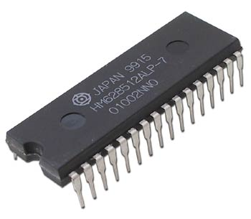
A Random Access Memory (RAM)
A 512K RAM
(About 4.2 million bits)

Slide 23
Small Memory, “Big” Memory…
8 address
bits
2 address
bits
3 data
bits (in)
3 data
bits (out)
X data
bits (in)
X data
bits (out)
Read
Write
Read
Write
X

Slide 24
A “Calculator”
Load 5 into Register 0
Instruction Register
Register 0
0
Register 1
0
Register 2
0
Register 3
0

Slide 25
A “Calculator”
Load 5 into Register 0
Instruction Register
Register 0
5
Register 1
0
Register 2
0
Register 3
0

Slide 26
A “Calculator”
Instruction Register
Register2=Register0+Register1
Register 0
5
Register 1
0
Register 2
0
Register 3
0

Slide 27
A “Calculator”
Instruction Register
Register2=Register0+Register1
Register 0
5
Register 1
0
Register 2
5
Register 3
0

Slide 28
A “Calculator”
Instruction Register
Register2=Register0+Register2
Register 0
5
Register 1
0
Register 2
5
Register 3
0

Slide 29
A “Calculator”
Instruction Register
Register2=Register0+Register2
Register 0
5
Register 1
0
Register 2
10
Register 3
0

Slide 30
A “Calculator”
Instruction Register
Register2=Register0+Register2
5
00000101
Register 0
Register 1
0
00000000
Register 2
10
00001010
Register 3
0
00000000

Slide 31
A “Calculator”
00 add
01 subtract
10 multiply
11 divide
Instruction Register
Register2=Register0+Register2
5
00000101
Register 0
Register 1
0
00000000
Register 2
10
00001010
Register 3
0
00000000

Slide 32
A “Calculator”
00 add
01 subtract
10 multiply
11 divide
Instruction Register
Register2=Register0+Register2
00______
5
00000101
Register 0
Register 1
0
00000000
Register 2
10
00001010
Register 3
0
00000000

Slide 33
A “Calculator”
00 add
01 subtract
10 multiply
11 divide
Instruction Register
Register2=Register0+Register2
0010____
5
00000101
Register 0
Register 1
0
00000000
Register 2
10
00001010
Register 3
0
00000000

Slide 34
A “Calculator”
00 add
01 subtract
10 multiply
11 divide
Instruction Register
Register2=Register0+Register2
001000__
5
00000101
Register 0
Register 1
0
00000000
Register 2
10
00001010
Register 3
0
00000000

Slide 35
A “Calculator”
00 add
01 subtract
10 multiply
11 divide
Instruction Register
Register2=Register0+Register2
00100010
5
00000101
Register 0
Register 1
0
00000000
Register 2
10
00001010
Register 3
0
00000000

Slide 36
A Computer!
00 add
01 subtract
10 multiply
11 divide
Memory Location
Binary Base 10
00110010
00000000 0
00000000
00011010
00000001 1
Program Counter
10001100
00000010 2
00000000
00000011 3
Instruction Register
00000100 4
00000010
Register 0
00000000
Register 1
00000001
Register 2
Register 3
00000000
11111111 255
Central Processing Unit (CPU)
Memory

Slide 37
A Computer!
00 add
01 subtract
10 multiply
11 divide
Memory Location
Binary Base 10
00110010
00000000 0
00000000
00011010
00000001 1
Program Counter
10001100
00000010 2
00000000
00000011 3
Instruction Register
00000100 4
00000010
Register 0
00000000
Register 1
00000001
Register 2
Register 3
00000000
11111111 255
Central Processing Unit (CPU)
Memory

Slide 38
A Computer!
00 add
01 subtract
10 multiply
11 divide
Memory Location
Binary Base 10
00110010
00000000 0
00000000
00011010
00000001 1
Program Counter
10001100
00000010 2
00000000
00000011 3
Instruction Register
00000100 4
00000010
Register 0
00000000
Register 1
00000001
Register 2
Register 3
00000000
11111111 255
Central Processing Unit (CPU)
Memory

Slide 39
A Computer!
00 add
01 subtract
10 multiply
11 divide
Memory Location
Binary Base 10
00110010
00000000 0
00000000
00011010
00000001 1
Program Counter
10001100
00000010 2
00110010
00000011 3
Instruction Register
00000100 4
00000010
Register 0
00000000
Register 1
00000001
Register 2
Register 3
00000000
11111111 255
Central Processing Unit (CPU)
Memory

Slide 40
A Computer!
00 add
01 subtract
10 multiply
11 divide
Memory Location
Binary Base 10
00110010
00000000 0
00000000
00011010
00000001 1
Program Counter
10001100
00000010 2
00110010
Register3=Register0+Register2
00000011 3
Instruction Register
00000100 4
00000010
Register 0
00000000
Register 1
00000001
Register 2
Register 3
00000000
11111111 255
Central Processing Unit (CPU)
Memory

Slide 41
A Computer!
00 add
01 subtract
10 multiply
11 divide
Memory Location
Binary Base 10
00110010
00000000 0
00000000
00011010
00000001 1
Program Counter
10001100
00000010 2
00110010
Register3=Register0+Register2
00000011 3
Instruction Register
00000100 4
00000010
Register 0
00000000
Register 1
00000001
Register 2
Register 3
00000011
11111111 255
Central Processing Unit (CPU)
Memory

Slide 42
A Computer!
00 add
01 subtract
10 multiply
11 divide
Program Counter Incremented
Memory Location
Binary Base 10
00110010
00000000 0
00000001
00011010
00000001 1
Program Counter
10001100
00000010 2
00110010
00000011 3
Instruction Register
00000100 4
00000010
Register 0
00000000
Register 1
00000001
Register 2
Register 3
00000011
11111111 255
Central Processing Unit (CPU)
Memory

Slide 43
A Computer!
00 add
01 subtract
10 multiply
11 divide
Memory Location
Binary Base 10
00110010
00000000 0
00000001
00011010
00000001 1
Program Counter
10001100
00000010 2
00110010
00000011 3
Instruction Register
00000100 4
00000010
Register 0
00000000
Register 1
00000001
Register 2
Register 3
00000011
11111111 255
Central Processing Unit (CPU)
Memory

Slide 44
A Computer!
00 add
01 subtract
10 multiply
11 divide
What is this command saying?
Memory Location
Binary Base 10
00110010
00000000 0
00000001
00011010
00000001 1
Program Counter
10001100
00000010 2
00011010
00000011 3
Instruction Register
00000100 4
00000010
Register 0
00000000
Register 1
00000001
Register 2
Register 3
00000011
11111111 255
Central Processing Unit (CPU)
Memory

Slide 45
A Computer!
00 add
01 subtract
10 multiply
11 divide
Memory Location
Binary Base 10
00110010
00000000 0
00000001
00011010
00000001 1
Program Counter
10001100
00000010 2
00011010
Register1=Register2+Register2
00000011 3
Instruction Register
00000100 4
00000010
Register 0
00000000
Register 1
00000001
Register 2
Register 3
00000011
11111111 255
Central Processing Unit (CPU)
Memory

Slide 46
A Computer!
00 add
01 subtract
10 multiply
11 divide
Memory Location
Binary Base 10
00110010
00000000 0
00000001
00011010
00000001 1
Program Counter
10001100
00000010 2
00011010
Register1=Register2+Register2
00000011 3
Instruction Register
00000100 4
00000010
Register 0
00000010
Register 1
00000001
Register 2
Register 3
00000011
11111111 255
Central Processing Unit (CPU)
Memory

Slide 47
A Computer!
00 add
01 subtract
10 multiply
11 divide
Program Counter Incremented
Memory Location
Binary Base 10
00110010
00000000 0
00000010
00011010
00000001 1
Program Counter
10001100
00000010 2
00011010
00000011 3
Instruction Register
00000100 4
00000010
Register 0
00000010
Register 1
00000001
Register 2
Register 3
00000011
11111111 255
Central Processing Unit (CPU)
Memory
Notes:
What happens next?

Slide 48
A Computer!
00 add
01 subtract
10 multiply
11 divide
Memory Location
Binary Base 10
00110010
00000000 0
8 bit
address
00000010
00011010
00000001 1
Program Counter
10001100
00000010 2
00011010
00000011 3
Instruction Register
00000100 4
00000010
Register 0
8 bit
data in
8 bit data out
00000010
Register 1
00000001
Register 2
Register 3
00000011
Read
11111111 255
Write
Central Processing Unit (CPU)
Memory
Notes:
What happens next?

Slide 49
A Computer!
00 add
01 subtract
10 multiply
11 divide
Memory Location
Binary Base 10
00110010
00000000 0
8 bit
address
00000010
00011010
00000001 1
Program Counter
10001100
00000010 2
00011010
00000011 3
Instruction Register
00000100 4
00000010
Register 0
8 bit
data in
8 bit data out
00000010
Register 1
00000001
1
Register 2
Register 3
00000011
Read
11111111 255
Write
Central Processing Unit (CPU)
Memory
Notes:
What happens next?

Slide 50
A Computer!
00 add
01 subtract
10 multiply
11 divide
Memory Location
Binary Base 10
00110010
00000000 0
8 bit
address
00000010
00011010
00000001 1
Program Counter
10001100
00000010 2
00011010
00000011 3
Instruction Register
00000100 4
00000010
Register 0
8 bit
data in
8 bit data out
00000010
Register 1
00000001
1
Register 2
Register 3
00000011
Read
11111111 255
Write
Central Processing Unit (CPU)
Memory
Notes:
What happens next?

Slide 51
A Computer!
00 add
01 subtract
10 multiply
11 divide
Memory Location
Binary Base 10
00110010
00000000 0
8 bit
address
00000010
00011010
00000001 1
Program Counter
10001100
00000010 2
00011010
00000011 3
Instruction Register
00000100 4
00000010
Register 0
8 bit
data in
8 bit data out
00000010
10001100
Register 1
00000001
1
Register 2
Register 3
00000011
Read
11111111 255
Write
Central Processing Unit (CPU)
Memory
Notes:
What happens next?

Slide 52
A Computer!
00 add
01 subtract
10 multiply
11 divide
Memory Location
Binary Base 10
00110010
00000000 0
8 bit
address
00000010
00011010
00000001 1
Program Counter
10001100
00000010 2
00011010
00000011 3
Instruction Register
00000100 4
00000010
Register 0
8 bit
data in
8 bit data out
00000010
10001100
Register 1
00000001
Register 2
Register 3
00000011
Read
11111111 255
Write
Central Processing Unit (CPU)
Memory
Notes:
What happens next?

Slide 53
A Computer!
00 add
01 subtract
10 multiply
11 divide
Memory Location
Binary Base 10
00110010
00000000 0
8 bit
address
00000010
00011010
00000001 1
Program Counter
10001100
00000010 2
10001100
00000011 3
Instruction Register
00000100 4
00000010
Register 0
8 bit
data in
8 bit data out
00000010
Register 1
00000001
Register 2
Register 3
00000011
Read
11111111 255
Write
Central Processing Unit (CPU)
Memory
Notes:
What happens next?

Slide 54
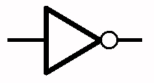
A Computer!
00 add
01 subtract
10 multiply
11 divide
Memory Location
Binary Base 10
00110010
00000000 0
8 bit
address
00000010
00011010
00000001 1
Program Counter
10001100
00000010 2
10001100
00000011 3
Instruction Register
00000100 4
00000010
Register 0
8 bit
data in
8 bit data out
00000010
Register 1
00000001
Register 2
Register 3
00000011
Read
11111111 255
Write
Central Processing Unit (CPU)
Memory
Notes:
There are more decoders - one for each of the four instructions!
WHAT HAPPENS NEXT???

Slide 55
A Computer!
00 add
01 subtract
10 multiply
11 divide
Memory Location
Binary Base 10
00110010
00000000 0
8 bit
address
00000010
00011010
00000001 1
Program Counter
10001100
00000010 2
10001100
00000011 3
Instruction Register
1
00000100 4
00000010
Register 0
8 bit
data in
8 bit data out
00000010
Register 1
00000001
Register 2
Register 3
00000011
Read
11111111 255
Write
Central Processing Unit (CPU)
Memory
Notes:
There are more decoders - one for each of the four instructions!
WHAT HAPPENS NEXT???

Slide 56
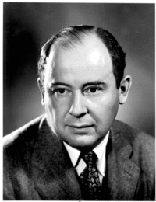
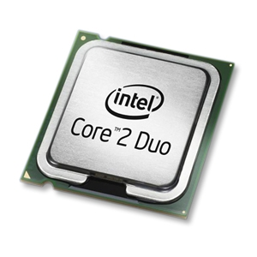
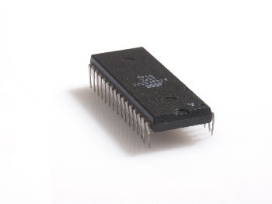
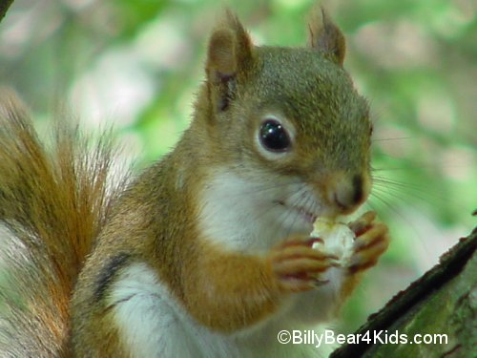
The von Neumann “Architecture”
John von Neumann
Ripple-carry adder
Multiplier,
Registers, etc.
Lots of latches!
CPU
RAM
central processing unit
random access memory
Program Counter
00110010
00011010
Instruction Register
10001100
r0
Large but
slow memory
A few fast
registers
r1
r2
…
r15

Slide 57
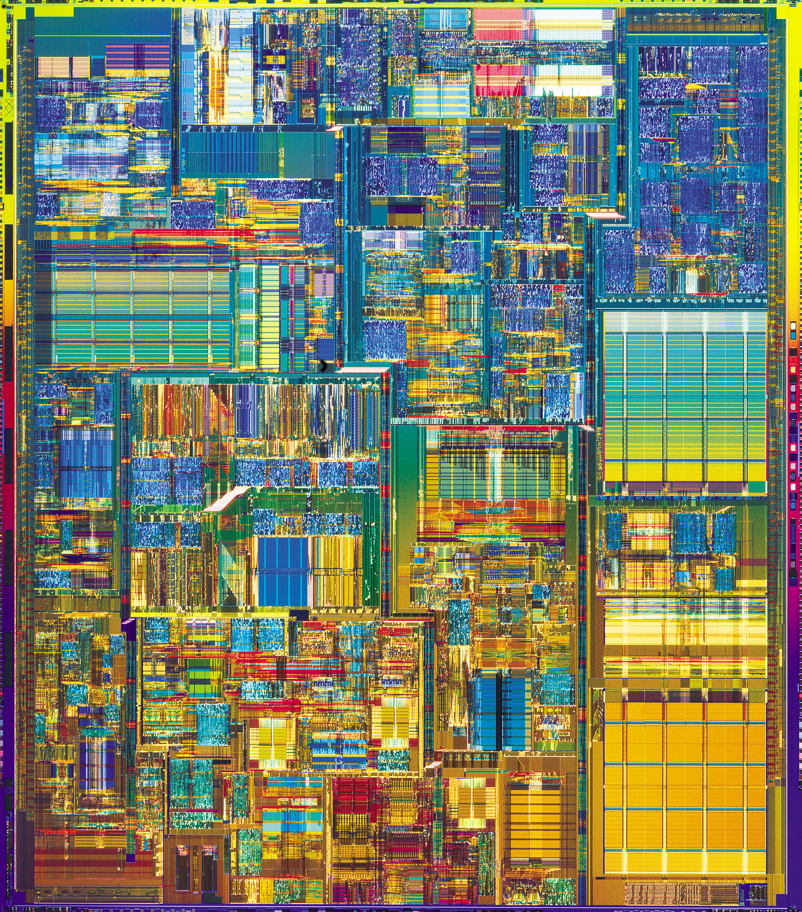
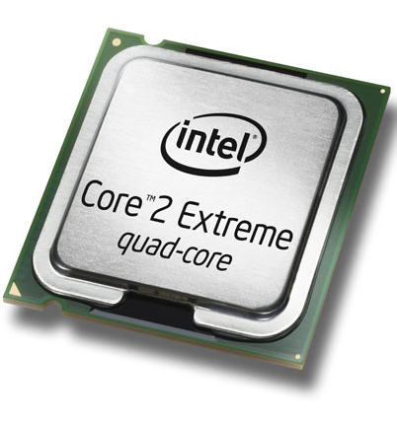
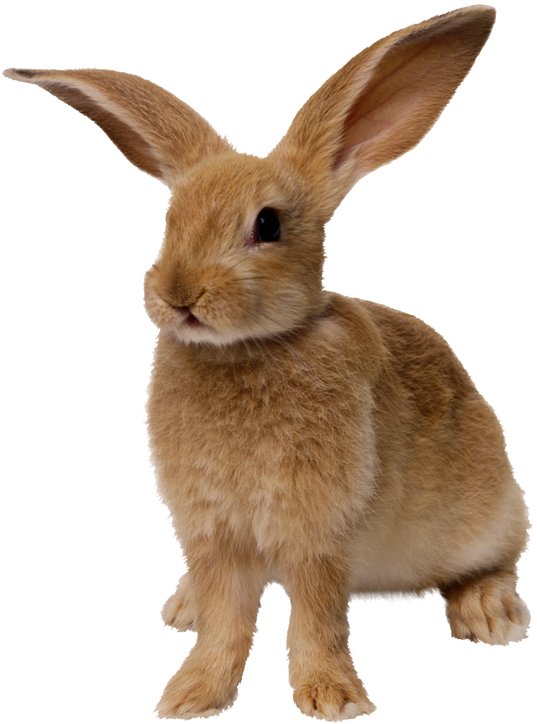
2006
Intel Core 2 Duo
3 GHz clock
64-bit processor
291 million transistors
65 nm wires
It doesn’t look all that fast to me!

Slide 58
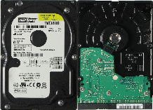
A Short Aside…
CPU
Main Memory
(RAM)
Disk Drive
16 Registers (“Bytes”)
10⁹ “Bytes” of
memory
10¹² “Bytes” of
memory
1 cycle
200 cycles
? cycles
10⁷ cycles
Actual
time:
<10⁻⁹ sec
<10⁻⁷ sec
<10⁻² sec
If “cycle”
= 1 sec
???
1 sec
3-5 minutes
4.5 MONTHS!

Slide 59
A Short Aside…
CPU
Main Memory
(RAM)
Disk Drive
16 Registers (“Bytes”)
10⁹ “Bytes” of
memory
10¹² “Bytes” of
memory
1 cycle
200 cycles
? cycles
Actual
time:
<10⁻⁹ sec
<10⁻⁷ sec
<10⁻² sec
If “cycle”
= 1 sec
1 sec

