Slide 1
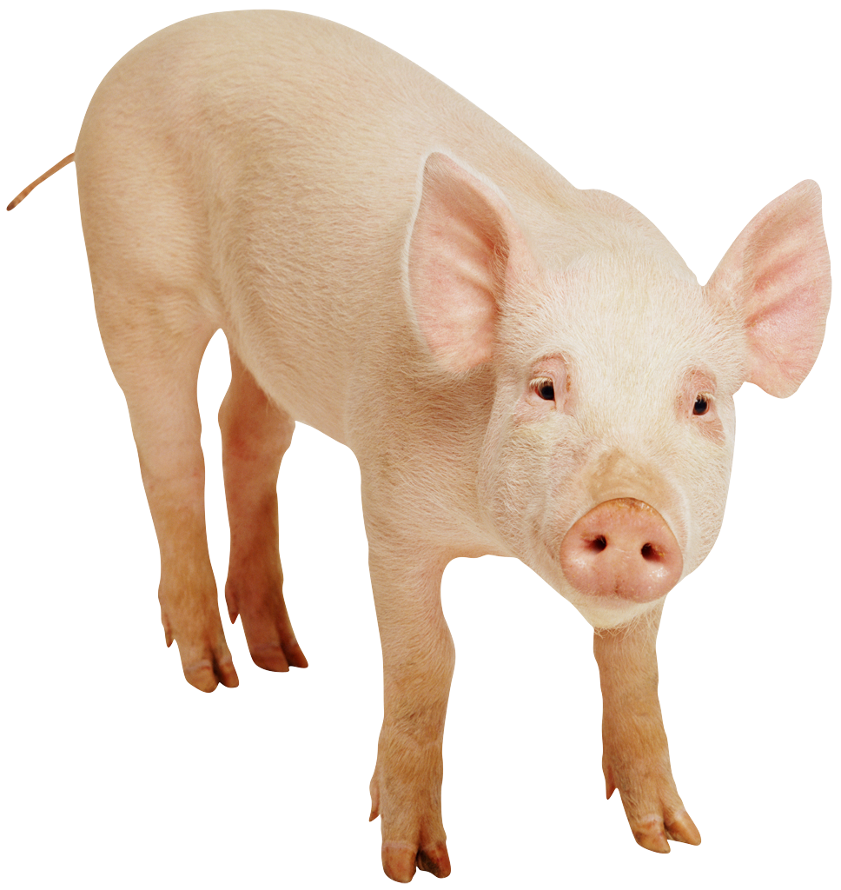
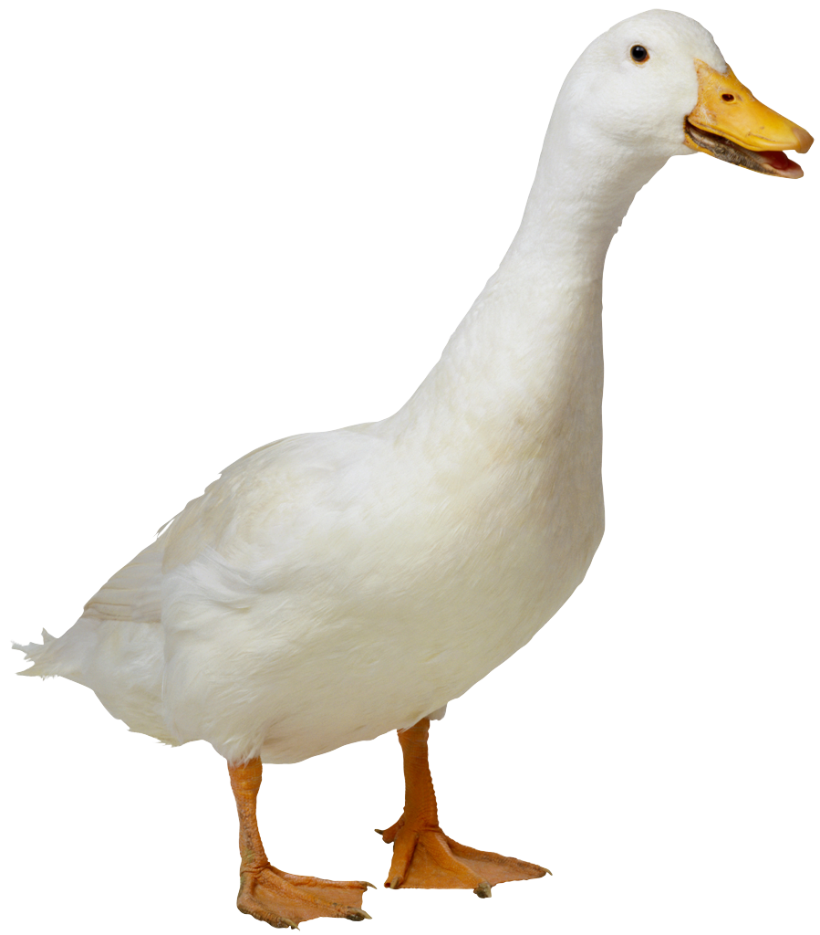
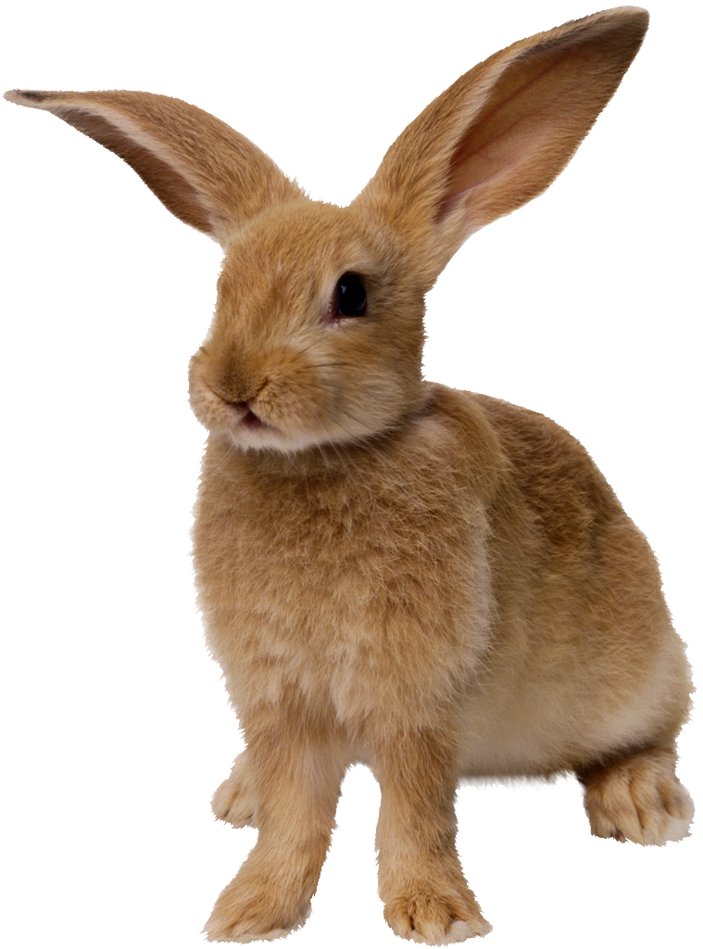
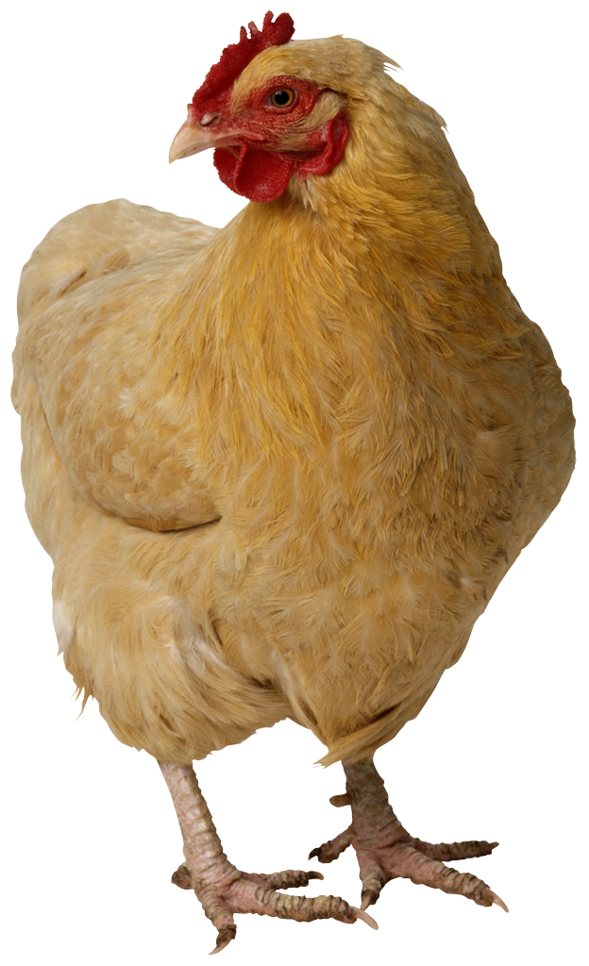
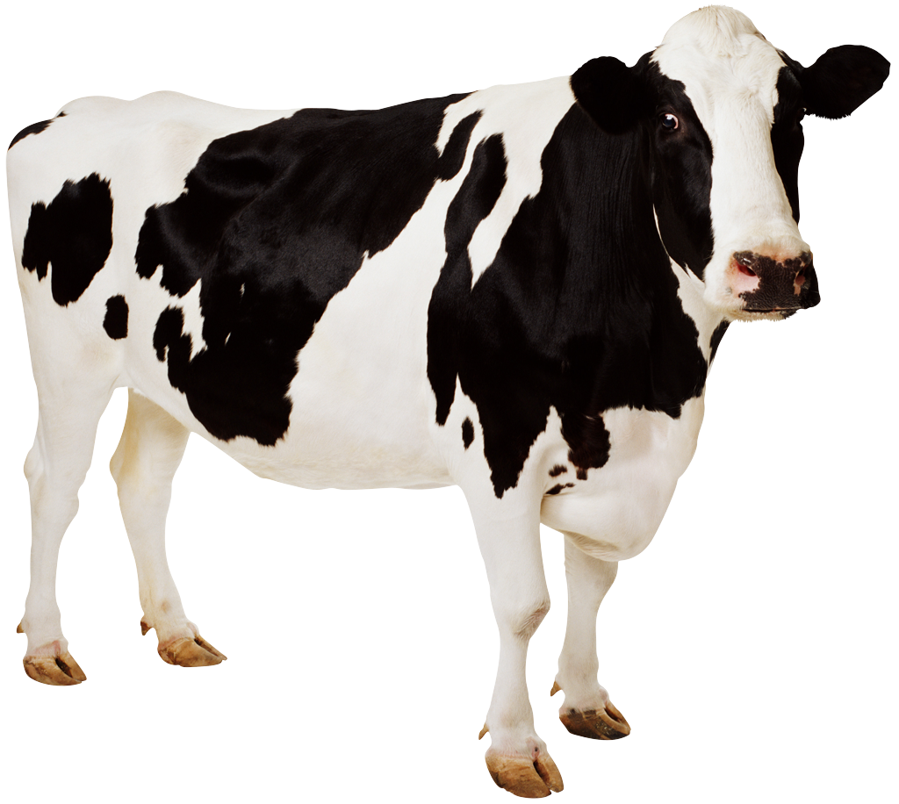
CS 5 Today
Sports: HMC CS Professor to coach 2012 U.S. Olympic chocolate-eating team
Weather: 63.79% chance of weather today
News in Brief
Psychics predict that there was no CS 5 lecture yesterday. Definitive proof of paranormal phenomena!
(Claremont AP): A group of psychics has made an extraordinary set of predictions that, one-by-one, are being corroborated by scientists. “It is indeed true that we didn’t have CS 5 yesterday,” said one CS 5 professor. The psychics have also predicted that fall break will occur sometime within the next 3-10 days.
CS 5 alien abducted
by aliens
(p. 42)
Page 42 will no longer
be published
(p. 42)
Farm animals displace
penguins, invade
CS 5 notes
(p. 42)
We’re going to milk this for all it’s worth!

Slide 2
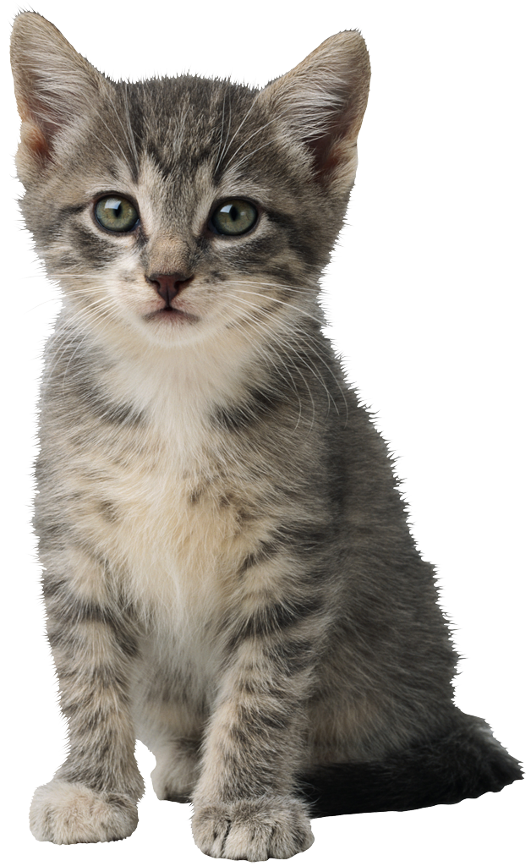
Machine Language Versus…
16 bits wide in Hmmm
Memory Location
Binary Base 10
16 bits wide in Hmmm
00110010
00000000 0
8 bit
address
00000000
00011010
00000001 1
Program Counter
10011101
00000010 2
00110010
00000011 3
Instruction Register
r0 is always 0!
00000100 4
00000000
Register 0
8 bit
data in
8 bit data out
00000010
Register 1
00000001
Register 2
Register 15
00000011
Read
11111111 255
Write
Central Processing Unit (CPU)
Memory
Notes:
What happens next?

Slide 3
…Assembly Language!
16 bits wide in Hmmm
Memory Location
Binary Base 10
16 bits wide in Hmmm
add r3 r0 r2
00000000 0
8 bit
address
00000000
add r1 r2 r2
00000001 1
Program Counter
mul r1 r3 r1
00000010 2
00110010
00000011 3
Instruction Register
r0 is always 0!
00000100 4
00000000
Register 0
8 bit
data in
8 bit data out
00000010
Register 1
00000001
Register 3
Register 15
00000011
Read
11111111 255
Write
Central Processing Unit (CPU)
Memory
Notes:
What happens next?

Slide 4
Hmmm Assembly Language
add r2 r2 r2
reg2 = reg2 + reg2
crazy, perhaps, but used ALL the time
sub r2 r1 r4
reg2 = reg1 - reg4
which is why it is written this way in python!
mul r7 r6 r2
reg7 = reg6 * reg2
div r1 r1 r1
reg1 = reg1 / reg1
INTEGER division—no remainders
setn r1 42
you can replace 42 with anything from -128 to 127
reg1 = 42
addn r1 -1
reg1 = reg1 - 1
a shortcut
read r10
read from keyboard and write to screen
Each of these instructions (and many more) gets implemented for a particular processor and particular machine…
write r1

Slide 5
jumps
Unconditional jump
jumpn 42
Replaces the PC (program counter) with 42. “Jump to program line number 42.”
Conditional jumps
jeqzn r1 #
IF r1 == 0 THEN jump to line number #
jgtzn r1 #
IF r1 > 0 THEN jump to the location in #
jltzn r1 #
IF r1 < 0 THEN jump to the location in #
jnezn r1 #
IF r1 != 0 THEN jump to the location in #
Register jump
This IS making me jumpy!
jumpr r1
Jump to the line # stored in reg1!

Slide 6
Worksheet
Feeling Jumpy?
1
Write an assembly-language program that reads one integer as keyboard input. Then, the program should compute the factorial of that input in register r13 and write it out. You may assume without checking that the input will be a positive integer.
2
Write an assembly-language program that reads two integers r1 and r2 as keyboard input. Then, the program should compute r1^{r2} in register r13 and write it out. You may assume that r2 >= 0.
Memory - RAM
Memory - RAM
Registers - CPU
0
Registers - CPU
0
0
1
0
1
r0
r0
2
2
r1
3
r1
3
r2
4
r2
4
r3
5
r3
5
6
6
r4
7
r4
7
r5
8
r5
8
9
9
10
10
Notes:
Note that the next slide has the Hmmm instruction set for reference purposes.

Slide 7
Notes:
There are 24 instructions in the Hmmm instruction set. A few (copy, nop, and neg) are pseudo-ops.

Slide 8
Why Assembly Language?
It’s only the foolish that never climb Mt. Fuji—or that climb it again.
Who writes most of the assembly language used?
Notes:
The compiler!

Slide 9
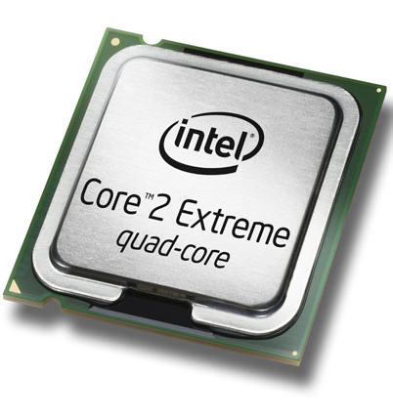
The Compiler
A program that translates from human-usable language into assembly language and machine language
Compiler
0000 0001 0000 0001
1000 0010 0001 0001
0110 0010 0010 0001
0000 0010 0000 0010
x = 6
y = 7
z = x*y
print z
0000 0000 0000 0000
setn r1 6
setn r2 7
mul r3 r1 r2
write r3
executable machine code
assembly or byte-code
the code
0000 0001 …
0010 0001 …
Interpreter
0110 0010 …
1000 0001 …
machine code
interpreting byte code

Slide 10
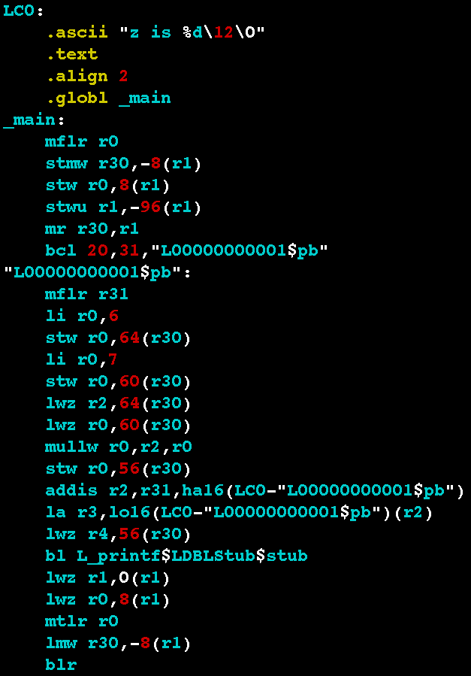
Examples
x = 6
y = 7
z = x*y
print z
Power PC
Core 2 Duo
.globl main
.type main,function
main:
.LFB2:
pushq %rbp
.LCFI:
movq %rsp,%rbp
.LCFI1:
subq $16,%rsp
.LCFI2:
movl $6,-12(%rbp)
movl $7,-8(%rbp)
movl -12(%rbp),%eax
imull -8(%rbp),%eax
movl %eax,-4(%rbp)
movl -4(%rbp),%esi
movl $.LC0,%edi
movl $0,%eax
call printf
leave
ret
The code
Each processor has its own endearing idiosyncrasies...

Slide 11
storer Goes TO Memory
Hmmm CPU
Hmmm RAM
r1
0
read r1
1
blah
2
blah
3
setn r15 42
indirect store
4
storer r1 r15
5
blah
r15
42
…
…
storer r1 r15
42
42
43
…

Slide 12
loadr Comes FROM Memory
Hmmm CPU
Hmmm RAM
r1
loadr r1 r15
0
.
1
.
2
.
3
.
4
.
5
Blah blah blah
6
.
indirect load
7
loadr r1 r15
r15
42
…
8
.
…
storer r1 r15
42
43
…

Slide 13
calln = setn + jumpn!
A function call in python:
Hmmm's call operation:
puts NEXT line # into r14,
then jumps to line 4
def main():
r1 = input()
result = factorial(r1)
print result
def factorial(r1):
# do work
return result
0 read r1
1 calln r14 4
2 write r13
3 halt
4 do stuff and
5 answer in r13
6 jumpr r14

Slide 14
Factorial: Function Call!
Hmmm CPU
Hmmm RAM
0
read r1
input
r0
0
1
calln r14 4
function call
Input value: x
2
write r13
r1
output
3
halt
Final result - return value - in progress
4
setn r13 1
the function!
r13
5
jeqzn r1 9
location / line to return TO
6
mul r13 r13 r1
loop
r14
2
7
addn r1 -1
8
jumpn 5
9
jumpr r14
return

Slide 15
Which Factorial Is It?
0
read r1
input
def fac1():
r1 = input()
r13 = 1
while r1 != 0:
r13 = r13 * r1
r1 += -1
print r13
return
def fac2(r1):
if r1 == 0:
return 1
else:
return r1 * fac2(r1-1)
1
setn r13 1
initialize result to 1
2
jeqzn r1 6
3
mul r13 r13 r1
loop
4
addn r1 -1
5
jumpn 2
6
write r13
output
7
halt
Notes:
Ask them to identify whether this is the iterative or recursive factorial.

Slide 16
The Alien’s Life Advice
Travel! And study abroad!
How else are you going to meet a nice alien?

Slide 17
Function Calls…
def main():
r1 = input()
r13 = emma(r1)
r13 = r13 + r1
print r13
return
def emma(r1):
r1 = r1 + 1
r13 = sarah(r1)
r13 = r13 + r1
return r13
def sarah(r1):
r1 = r1 + 42
r13 = r1 + 1
return r13
r1=3
Chew on this…
emma(3)
r1=3
r1=4
You should be worried!
sarah(4)
r13=47
r13=??
r1=4
r1=46
r13=47
return(47)
Notes:
This slide has seven animations. The sequence shows how r1 (in particular) has its value preserved across calls, and is local to each function.

Slide 18
Function Calls…
def main():
r1 = input()
r13 = emma(r1)
r13 = r13 + r1
print r13
return
def emma(r1):
r1 = r1 + 1
r13 = sarah(r1)
r13 = r13 + r1
return r13
def sarah(r1):
r1 = r1 + 42
r13 = r1 + 1
return r13
r1=3
Chew on this…
emma(3)
r1=3
r1=4
sarah(4)
r13=47
r13=??
r1=4
r1=46
r13=47
return(47)

Slide 19
Function Calls…
def main():
r1 = input()
r13 = emma(r1)
r13 = r13 + r1
print r13
return
def emma(r1):
r1 = r1 + 1
r13 = sarah(r1)
r13 = r13 + r1
return r13
def sarah(r1):
r1 = r1 + 42
r13 = r1 + 1
return r13
r1=3
emma(3)
r13=??
r1=3
r1=4
sarah(4)
r13=47
r13=51
return(51)
r1=4
r1=46
r13=47
return(47)
Notes:
This slide continues the animations showing return values.

Slide 20
Function Calls…
def main():
r1 = input()
r13 = emma(r1)
r13 = r13 + r1
print r13
return
def emma(r1):
r1 = r1 + 1
r13 = sarah(r1)
r13 = r13 + r1
return r13
def sarah(r1):
r1 = r1 + 42
r13 = r1 + 1
return r13
r1=3
emma(3)
r13=51
r13=54
54
r1=3
r1=4
sarah(4)
r13=47
Cool, but how
does this work!?
r13=51
return(51)
r1=4
r1=46
r13=47
return(47)

Slide 21
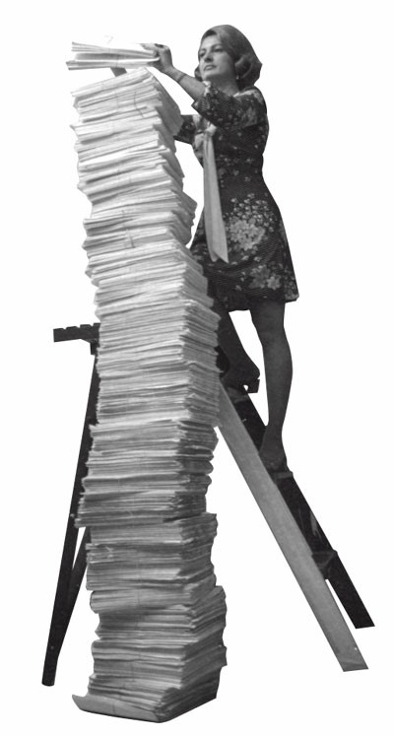
The Stack!
AFLAC, ShmAFLAC!
Be careful up there!
Insert (“push”)
Remove (“pop”)

Slide 22
Watch carefully…
What if I don’t give a hoot?!

Slide 23
Function Calls…
Hmmm code up here!
The stack in RAM!
def main():
r1 = input()
r13 = emma(r1)
r13 = r13 + r1
print r13
return
def emma(r1):
r1 = r1 + 1
r13 = sarah(r1)
r13 = r13 + r1
return r13
def sarah(r1):
r1 = r1 + 42
r13 = r1 + 1
return r13
3
r1=3
4
r1
3
3
4
4
46
r13
47
return
address
r14
Notes:
This slide has multiple animations showing how the stack works.

Slide 24
Function Calls…
Hmmm code up here!
The stack in RAM!
def main():
r1 = input()
r13 = emma(r1)
r13 = r13 + r1
print r13
return
def emma(r1):
r1 = r1 + 1
r13 = sarah(r1)
r13 = r13 + r1
return r13
def sarah(r1):
r1 = r1 + 42
r13 = r1 + 1
return r13
3
r1=3
4
r1
3
4
46
r13
47
return
address
r14

Slide 25
Function Calls…
Hmmm code up here!
The stack in RAM!
def main():
r1 = input()
r13 = emma(r1)
r13 = r13 + r1
print r13
return
def emma(r1):
r1 = r1 + 1
r13 = sarah(r1)
r13 = r13 + r1
return r13
def sarah(r1):
r1 = r1 + 42
r13 = r1 + 1
return r13
3
4
r1
3
3
4
4
46
r13
47
51
54
return
address
r14

Slide 26
Function Calls…
Hmmm code up here!
The stack in RAM!
def main():
r1 = input()
r13 = emma(r1)
r13 = r13 + r1
print r13
return
def emma(r1):
r1 = r1 + 1
r13 = sarah(r1)
r13 = r13 + r1
return r13
def sarah(r1):
r1 = r1 + 42
r13 = r1 + 1
return r13
3
4
r1
3
4
r13
54
return
address
r14

Slide 27
Now Without Pigs and Geese!
We object to this!!!
RAM!
def main():
r1 = input()
r13 = emma(r1)
r13 = r13 + r1
print r13
return
def emma(r1):
r1 = r1 + 1
r13 = sarah(r1)
r13 = r13 + r1
return r13
def sarah(r1):
r1 = r1 + 42
r13 = r1 + 1
return r13
0
01001001
r1=3
1
11001011
…
r1
3
26
01001011
27
r13
return
value
28
r14
return
address
29
r15
26
stack
pointer
30
…
255

Slide 28
Now Without Pigs and Geese!
It was better with pigs and geese!
00 setn r15 26 # set stack pointer to 26
01 read r1 # start of main
02 storer r1 r15 # store r1 on the stack
03 addn r15 1 # increment stack pointer
04 calln r14 10 # call emma
05 addn r15 -1 # decrement stack pointer
06 loadr r1 r15 # load r1 from the stack
07 add r13 r13 r1 # r13 = r13 + r1
08 write r13
09 halt
10 addn r1 1 # start of emma!
11 storer r1 r15 # store r1 on the stack
12 addn r15 1 # increment stack pointer
13 storer r14 r15 # save return addr on stack
14 addn r15 1 # increment stack pointer
15 calln r14 22 # call sarah
16 addn r15 -1 # decrement stack pointer
17 loadr r14 r15 # load ret addr from stack
18 addn r15 -1 # decrement stack pointer
19 loadr r1 r15 # load r1 from the stack
20 add r13 r13 r1 # r13 = r13 + r1
21 jumpr r14 # return!
22 addn r1 42 # start of sarah!
23 setn r2 1 # put 1 in a register
24 add r13 r1 r2
25 jumpr r14 # return
def main():
r1 = input()
r13 = emma(r1)
r13 = r13 + r1
print r13
return
def emma(r1):
r1 = r1 + 1
r13 = sarah(r1)
r13 = r13 + r1
return r13
def sarah(r1):
r1 = r1 + 42
r13 = r1 + 1
return r13
save
restore
save
restore
Notes:
This slide is a teaser for next time.

