Slide 1
CS 5 Black
(Random) Collection of Awesome
CS Stuff
2013-11-05
(That day that Prof. Lewis lectured)

Slide 2
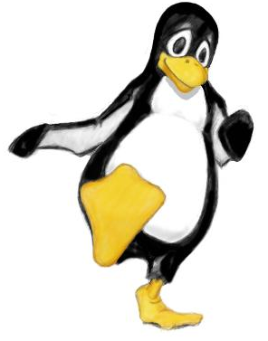
The CS 5 Enquirer
“DANCING WITH THE STARS” PENGUIN HAS LOVE CHILD!
Hollywood: Millions of Americans joined millions of Antarcticans in watching their newest idol, Fred “A Stare” Penguin, compete for top honors on the wild(life)ly popular show.
But the Enquirer has learned that Fred has a checkered past. Long before moving to the U.S. in search of fame and fortune, he volunteered in the Antarctic Army. Our intrepid reporters have discovered that while he was posted to New Zealand, Fred became “involved” with Ginger, a Little Blue penguin he met there.
“He was such a great dancer,” sobbed Ginger. “I thought he loved me. But when I laid an egg, he didn’t even take care of it through the winter! He abandoned me! Oh, what’s the use? He’ll never come back!”

Slide 3
Midterm
This Thursday, November 7th
8.5 by 11 sheet with writing on both sides
Hmmm commands provided!
Be sure you know higher-order functions
(functions that return functions)

Slide 4
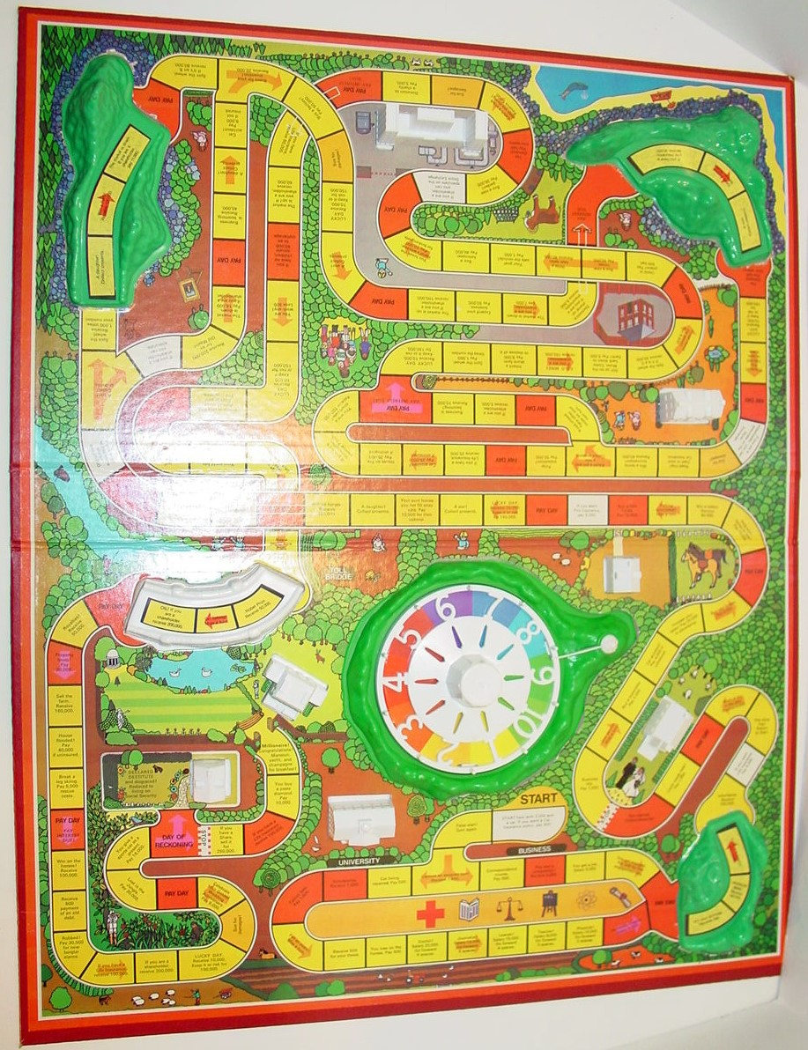
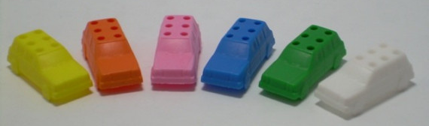
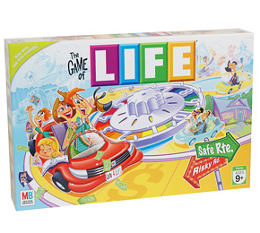

Slide 5
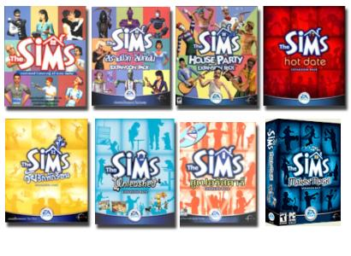
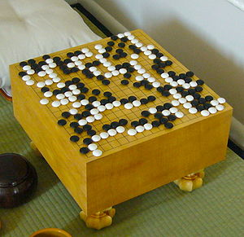



The Game of Life
1. Any live cell with fewer than two neighbors dies of loneliness.
2. Any live cell with more than three neighbors dies of overcrowding.
3. Any live cell with two or three neighbors lives, unchanged, to the next generation.
4. Any dead cell with exactly three neighbors comes to life.
The inventor did this by hand.
It is a pain!
You try! ☺
Never start coding before you can do “it” by hand!

Slide 6
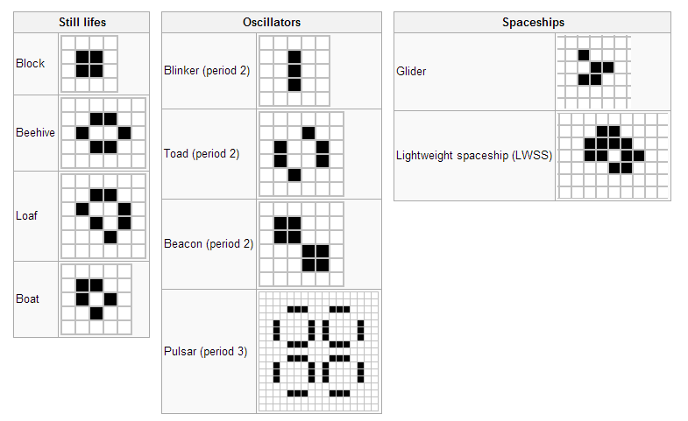

Slide 7
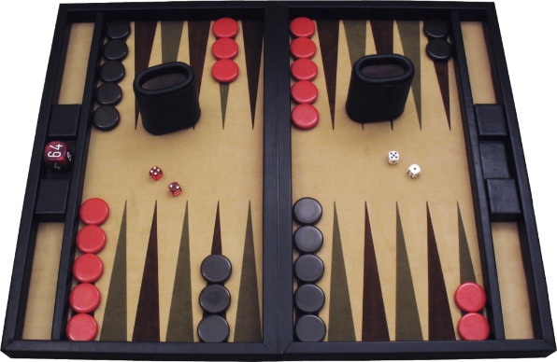
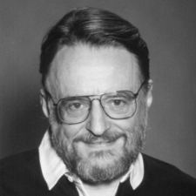
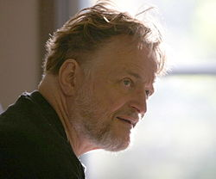
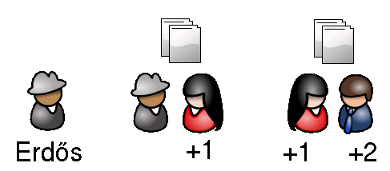
John Conway’s Game of Life
Wikkipedia says that in college I’d play backgammon for hours in the common room
I’m pretty awesome at naming things. (e.g. I also invented “Phutball (short for Philosopher's Football)”
I bet you $50 that no pattern can grow indefinitely
Maria
You
John
John Conway

Slide 8




John Conway’s Game of Life
Oscillators of varying periods

Slide 9
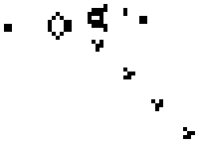
John Conway’s Game of Life
Gosper’s Glider “Gun”

Slide 10
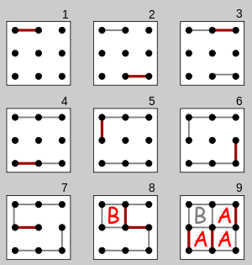
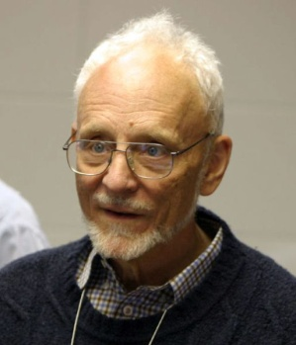
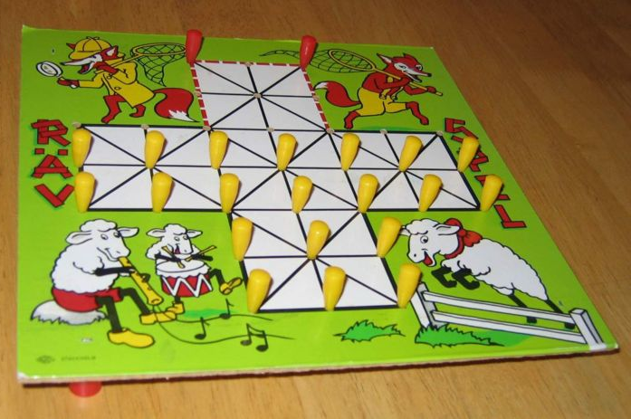
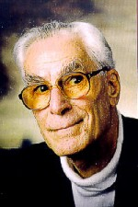
Life is “Universal” (1982)
Elwyn Berlekamp
John Conway
Richard Guy
Notes:
Elwyn Berlekamp was a major investigator of Reed-Solomon codes, which are the basis of all ECC codes used in disk drives. John Conway invented the Game of Life. Richard Guy discovered the smallest known unistable polyhedron. The three together wrote Winning Ways for Your Mathematical Plays, which analyzes two-player combinatorial games such as chess, nim, go, and other games where two players take turns modifiying a shared board. This book was the basis of combinatorial game theory.
In that book, the authors also proved that Life is universal, in the sense that it can compute any function computable by a Turing machine.

Slide 11
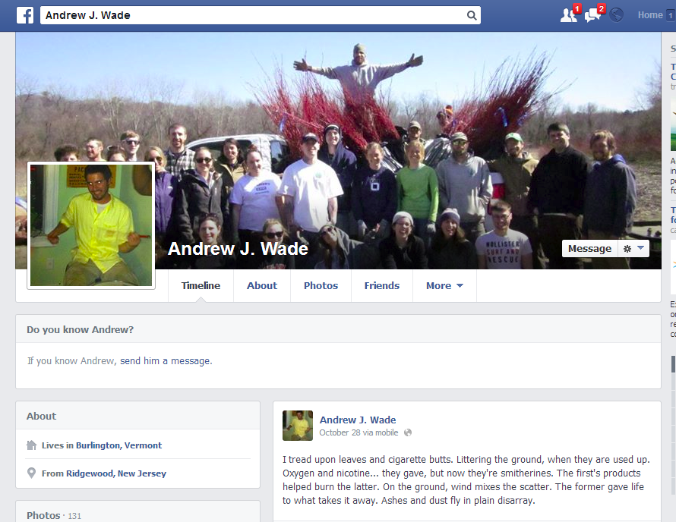
New stuff with the Game of Life
“On May 18, 2010, Andrew J. Wade announced a self-constructing pattern dubbed Gemini which creates a copy of itself while destroying its parent. This pattern replicates in 34 million generations”
“Andrew J. Wade lives in Toronto, Ontario with his life partner. He has one child. He does no dishes and will do none for the foreseeable future.”

Slide 12
2-D “Arrays”
>>> A = [ [0, 0, 0, 1], [1, 1, 0, 0], [0, 0, 0, 1] ]
>>> A = [ [0, 0, 0, 1],
[1, 1, 0, 0],
[0, 0, 0, 1] ]
>>> A[0][3]
???

Slide 13
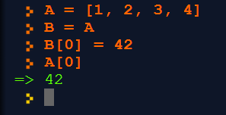
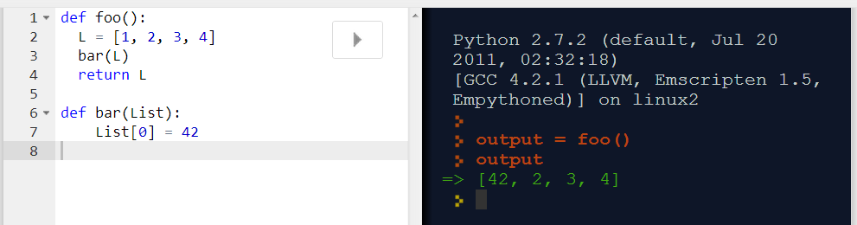
Shallow Copy
>>> A = [1, 2, 3, 4]
>>> B = A
>>> B[0] = 42
>>> A[0]
________________ ←
def foo():
L = [1, 2, 3, 4]
bar(L)
return L
def bar(List):
List[0] = 42

Slide 14
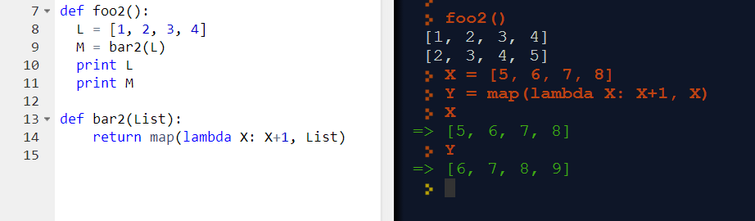
Deep Copy
def foo2():
L = [1, 2, 3, 4]
M = bar2(L)
print L
print M
def bar2(List):
return map(lambda X: X+1, List)

Slide 15
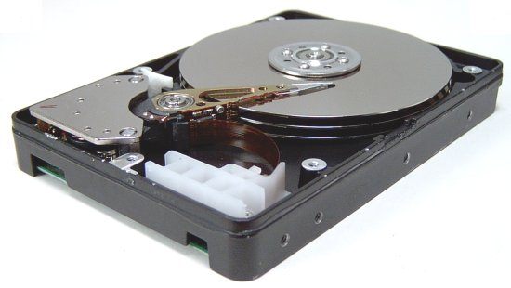

A RAID on Unreliability
Hard drives are enormously reliable
  1,000,000 hours before failure
    == 114 years!
  Catch: must replace every 5 years…
Amazon's problem: for every thousand drives, one failure every 1000 hours
Drive failure == data loss
Notes:
Data loss is good only if it's your debt they lose track of.

Slide 16
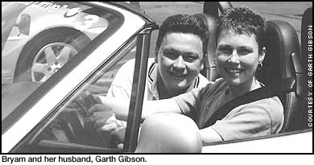
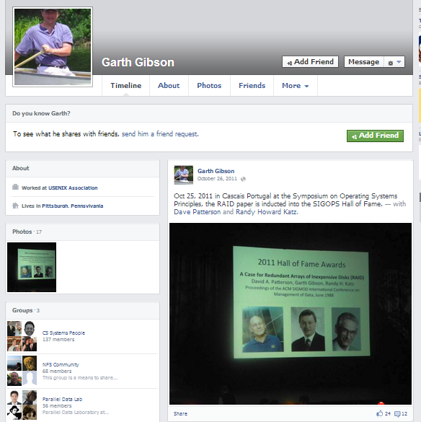
Garth Gibson

Slide 17
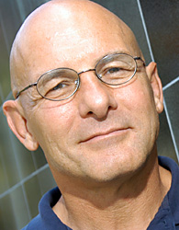
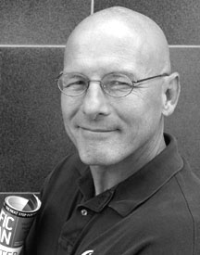

David (Dave) Patterson
Since 2003 he has ridden in the annual Waves to Wine MS charity event as part of Bike MS; he was the top fundraiser in 2006, 2007, 2008, 2009, 2010, 2011, and 2012. In total, he has raised more than $200,000 for Multiple Sclerosis.

Slide 18
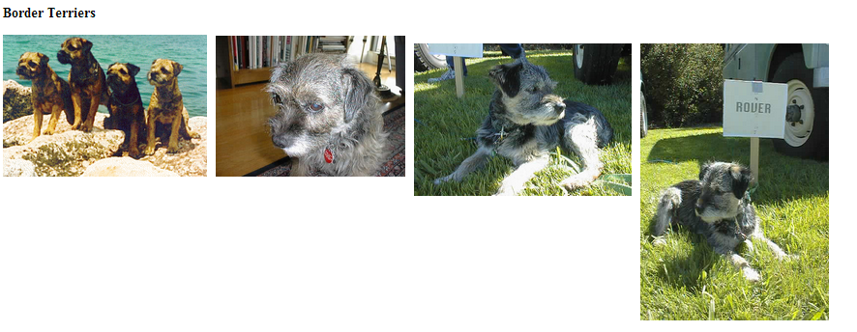
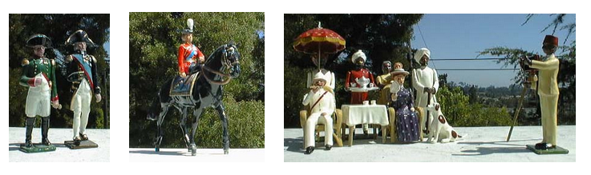
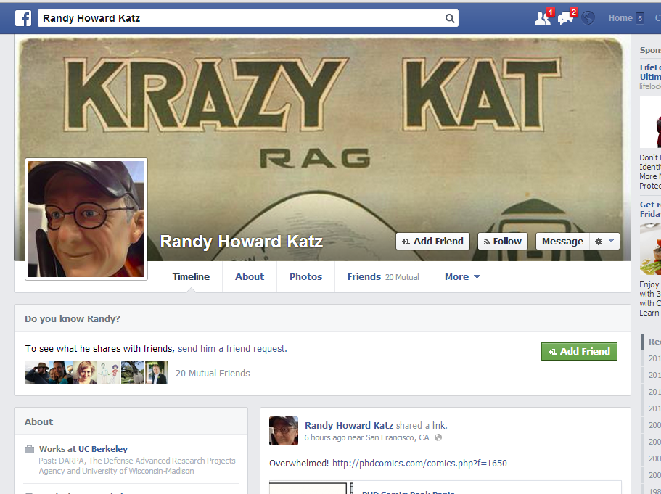

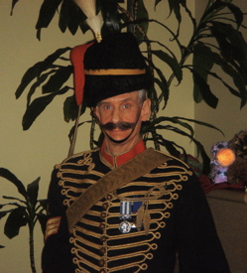
Randy Katz

Slide 19

Digression: Error-Correcting Codes
0
0
1
0
1
?
1
0
1
1
?
0
1
Single-bit error detection
That's my cosmic ray!

Slide 20
Digression: Error-Correcting Codes
0
0
1
0
1
0
1
0
0
…
0
Multiple-bit error correction
  Requires more than one error-check bit
  Generally detects more than it corrects
  See Math 171/172 for deep details

Slide 21
Error Correction on Hard Disks
Every block (512x8 = 4096 bits up to 4096x8 = 32768 bits) has error correction code (ECC) appended
  ECC is typically 300-800 bits
  Capable of correcting burst error of 100-600 bits
ECC can't fix a spindle-motor failure!

Slide 22

Redundant Arrays of In{expensive,dependent} Disks
Major insight: when a spindle fails, you know which one
Just spread your data across nine disks:
Sweet!
Bit 0
Bit 1
Bit 2
Bit 3
Bit 4
Bit 5
Bit 6
Bit 7
Parity
X
This is RAID-3, which for efficiency reasons isn't used in most real systems

Slide 23
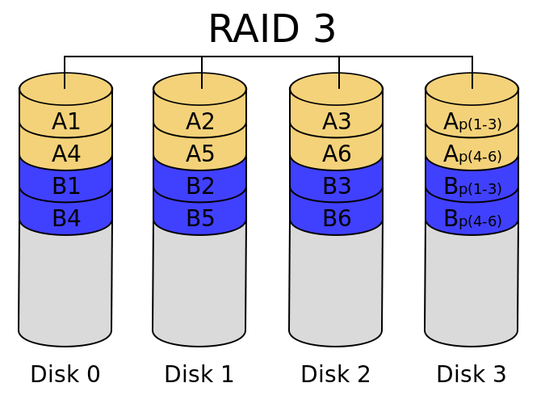

Slide 24
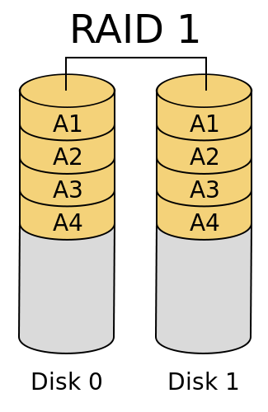

Slide 25
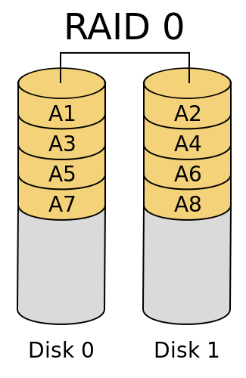

Slide 26
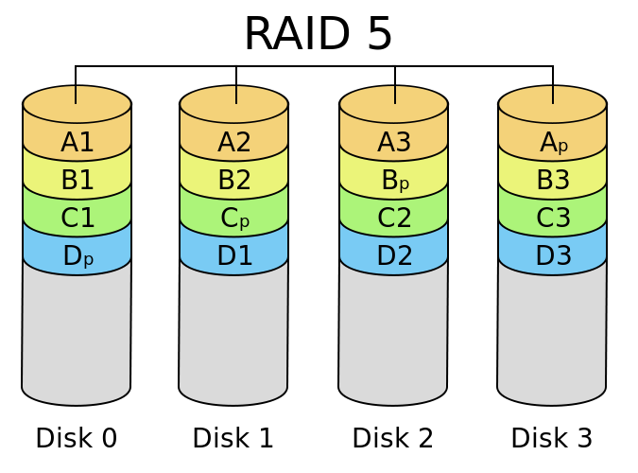

Slide 27

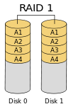
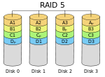
Modern RAID Levels
Original RAID paper defined five "levels" of redundancy
  No rhyme nor reason to numbering
Sixth level (RAID-0) added for performance without reliability
Levels used today:
  0: "Striping" for better performance
  1: "Mirroring" on two disks in case one fails
  5: "Striped redundancy" recovers from one-disk failure
    When failure happens, reconstruct on new drive
Notes:
There are also combinations of levels, e.g. RAID-10.

Slide 28
The Dumb-Operator Problem
RAID-5 uses parity disk (cleverly optimized for better performance) to be able to recover from single-disk failure
Problem 1 (rare, but worrisome): it takes time to reconstruct disk after operator replaces it with a fresh one
  Possibility of second drive failing during that time
Problem 2: operator replaces wrong disk!
  Turns out to be more common than first problem

Slide 29
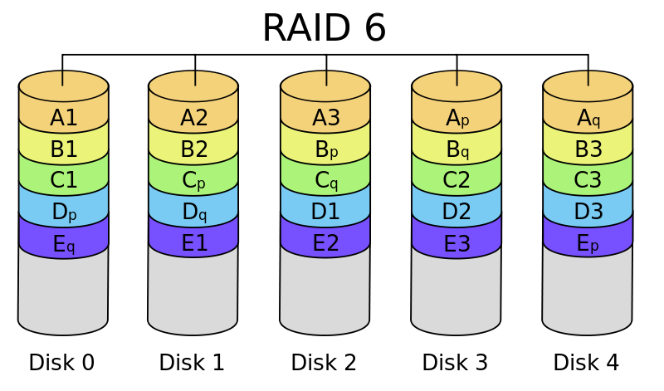
RAID-6
Solution to the double-failure problem
"Row diagonal parity" introduced by Network Appliance in 2004
Triple failures are rare enough to ignore (for most people)
Notes:
It turns out that although the block error rate is very small (10^-15 or better), high-capacity installations read so many blocks that this translates to more than one undetected error every day! There are also errors in other parts of the transport: the controller, the cables, the memory, and the software. A major focus of current research is finding out how to handle these errors.
There is also "bit rot", where data sitting on the disk disappears. Most modern RAID arrays deal with bit rot by periodically reading every block and checking the parity; if an error is detected, recovery procedures are initiated before the data is too far gone to get back.

Slide 30

The Alien’s Life Advice
Believe in yourself
Everybody else is struggling, too

Slide 31
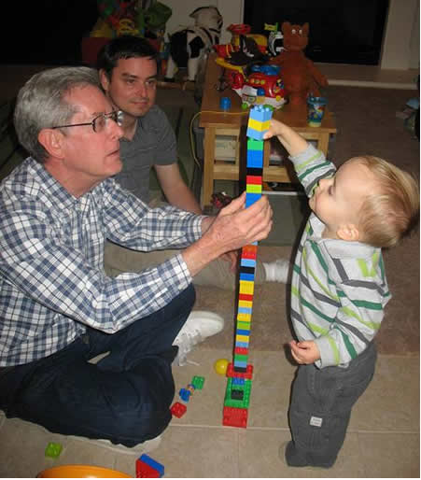

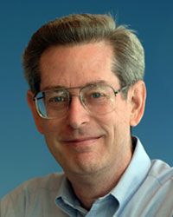
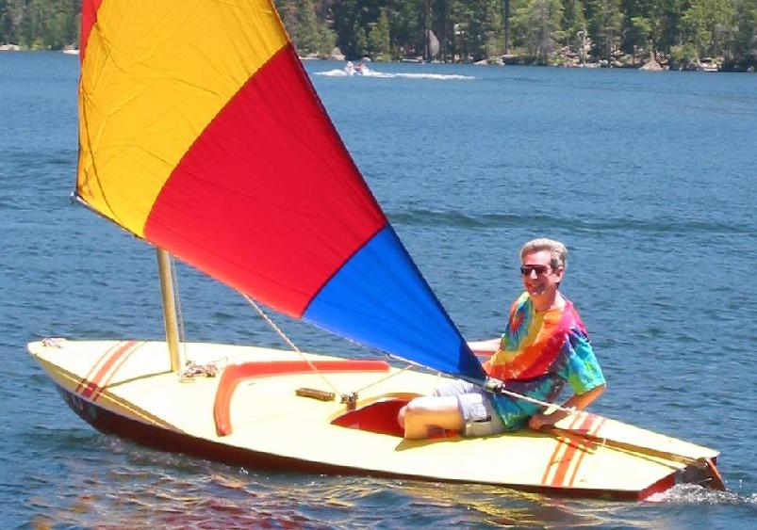
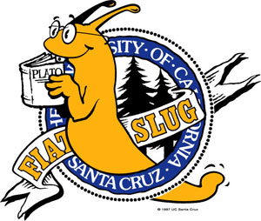
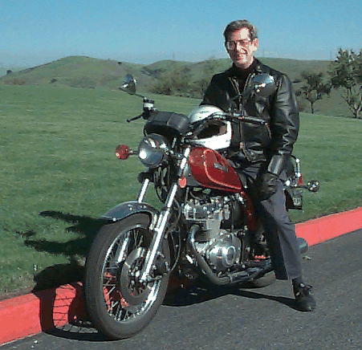
Structured Query Language
mysql> select gpa from students where first_name = 'Donald' and last_name = 'Chamberlin' and
grad_year = 1966;
+------+
| gpa |
+------+
| 3.87 |
+------+
1 row in set (0.00 sec)
Don Chamberlin HMC '66
Notes:
SQL was developed by Don Chamberlin, an HMC grad. It is used in nearly every database system today.

Slide 32
The Power of SQL
mysql> select title, price from products where type = 'DVD' and genre = 'comedy' and title like 'The Hangover%' order by price descending; -- Highest price first
mysql> update products set price = price / 10 where title = 'The Hangover Part II';
mysql> update users set password = 'secret', access = 'all' where username = 'geoff'; -- Give full access

Slide 33
SQL in Web Sites
def lookupDVD(title_words):
print "select title, price from products where type = 'DVD' and title like '" + title_words + "' order by price ascending;"
Notes:
Real Web sites are obviously more complicated but they use this same idea.

Slide 34
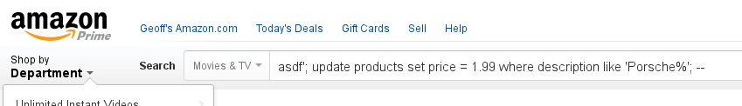
SQL Injection
def lookupDVD(title_words):
print "select title, price from products where type = 'DVD' and title like '" + title_words + "' order by price ascending;"
select title, price from products where type = 'DVD' and title like 'asdf '; update products set price = 1.99 where description like 'Porsche%'; -- ' order by price ascending;
Notes:
Sadly, even today this works on a lot of Web sites.

Slide 35
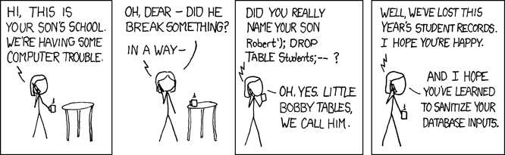
SQL Injection
Notes:
This is one of the most famous xkcd cartoons. The official title is "Exploits of a Mom".

Slide 36
The Moral
NEVER trust input from a user!

Slide 37
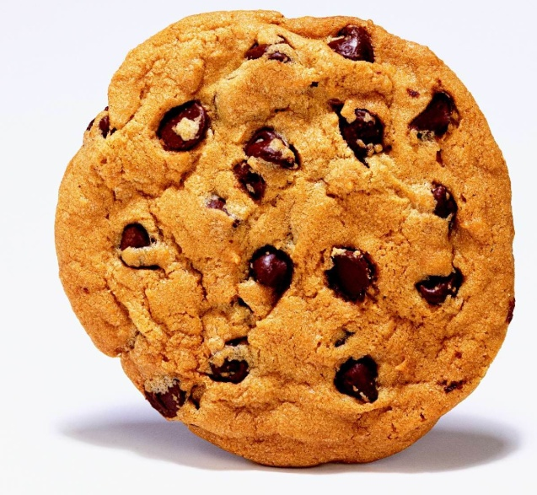

Cookies
You've heard of how Web servers use cookies to remember things about you
Hey, that's my cookie!
Shopping cart idea: use cookie to remember what you ordered & its price…
Notes:
Big oops: what if user modifies cookie before sending it back?

Slide 38
The Moral
NEVER trust input from a user!
…even you think it originally came from you!

Slide 39
BONUS

Slide 40
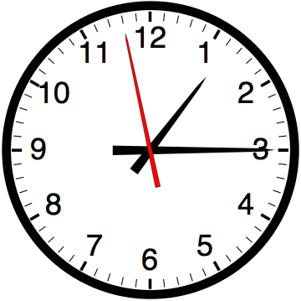

Slide 41


Computer
Science
&
= AWESOME

Slide 42
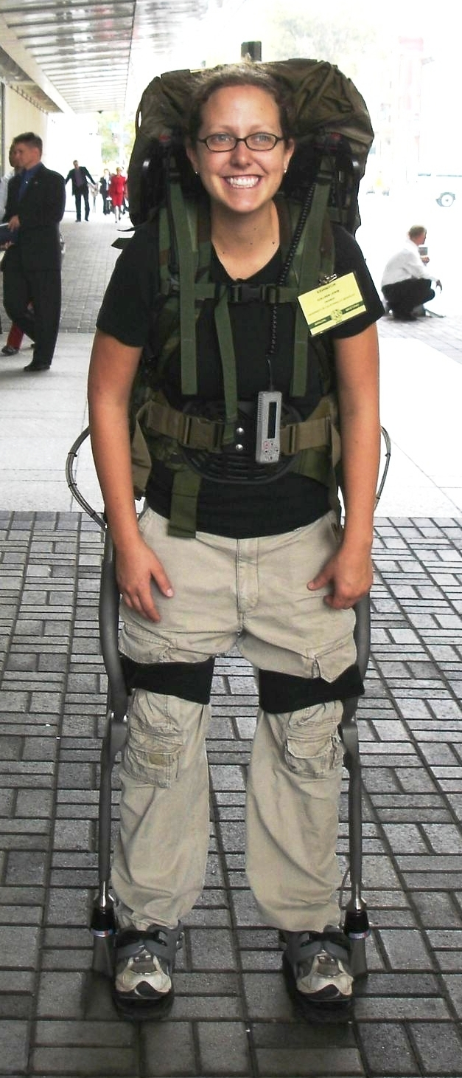
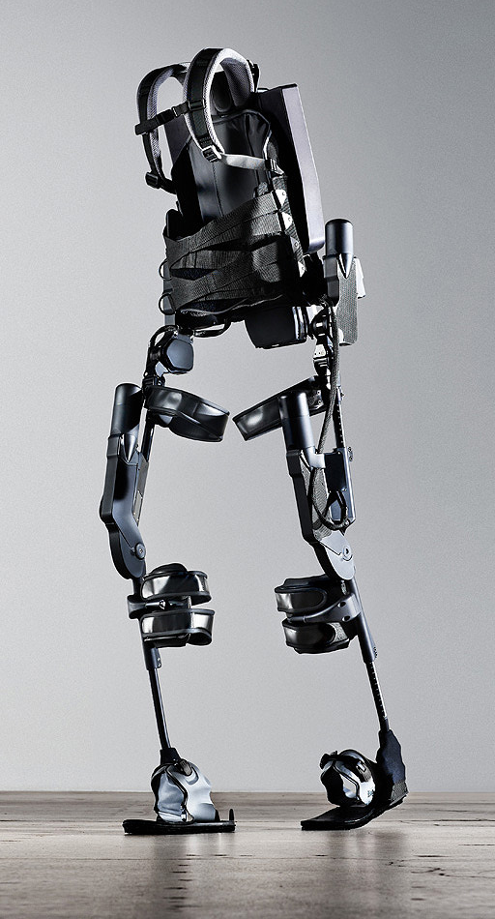
http://www.youtube.com/watch?v=pzRmNYA8LlY

Slide 43

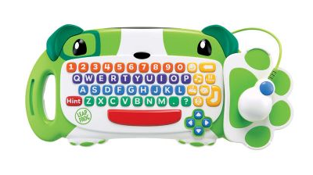
ClickStart

Slide 44
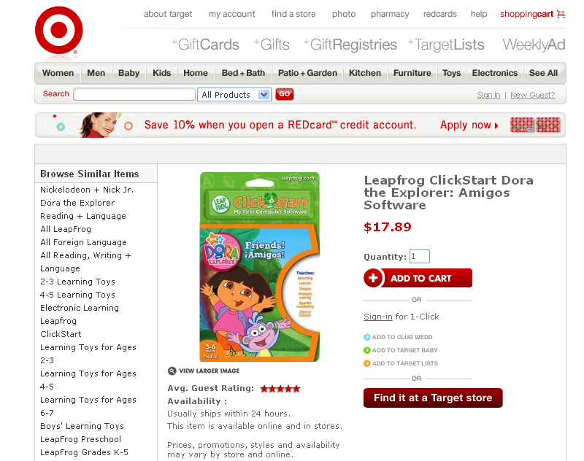

Slide 45
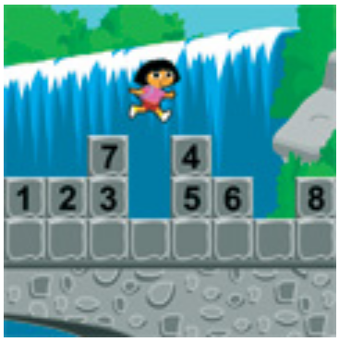
How should we represent the blocks in the computer?
Independent variables
2D Array
OpenList
I don’t know

Slide 46
The value in the array tells me what art asset to use
Each level is really a 3x10 vector!
0 | 0 | 7 | 0 | 4 | 0 | 0 | 0
1 | 2 | 3 | -4 | 5 | 6 | -7 | 8
B | B | B | B | B | B | B | B
Negative values tell me what block needs to go here to win!

Slide 47
0 | 0 | 7 | 0 | 4 | 0 | 0 | 0
1 | 2 | 3 | -4 | 5 | 6 | -7 | 8
0 | 0 | 0 | B | 0 | 0 | 0 | 0

Slide 48
BUGS!

Slide 49


Slide 50

It is really sad when stuff you’ve made is on sale!

Slide 51

And it can get worse!!!!

Slide 52



Which image is fake?
  A. Top Left
  B. Bottom Left
  C. Bottom Right

Slide 53


Slide 54


