Slide 1

The CS 5 Times-Picayune
Claremont Penguin Takes Olympics Gold
London: In a stunning upset, a local penguin has been retroactively awarded the gold medal in the women’s 10-meter platform diving event at the Antarctic Olympics.
“All of the judges agreed that her dives were flawless,” stated an unidentified official. “But our computerized scoring system calculated her totals incorrectly. A careful audit has revealed that the computer system we purchased from a Saudi Arabian manufacturer could malfunction in the presence of water. Worse, it would break down completely if exposed to fish oil. We’re terribly sorry, but it could have happened to anybody.”
Other observers were less forgiving. “How anyone could use a desert computer at a water-based event is beyond me,” said a U.S. coach. I have no clue what they were thinking—and it’s clear that they have no clue, period.”
The penguin herself was apparently too excited to comment, limiting herself to a few load squawks.
Notes:
Have demo window ready.

Slide 2


Rocket Science!
>>> fuelNeeded = 42.0/1000
>>> tank1 = 36.0/1000
>>> tank2 = 6.0/1000
>>> tank1 + tank2 >= fuelNeeded
True? False? Maybe? DEMO!
Notes:
Perhaps demo this in Python.

Slide 3
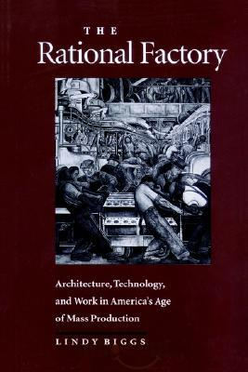

Wishful Thinking…
>>> from Rational import *
>>> fuelNeeded = Rational(42, 1000)
>>> tank1 = Rational(36, 1000)
>>> tank2 = Rational(6, 1000)
>>> tank1 + tank2 >= fuelNeeded
True
That would be so SWEET!
The Rational factory!

Slide 4
Thinking Rationally
The “constructor”
Why is this code so selfish?
class Rational(object):
def _ _init_ _(self, n, d):
if d == 0:
print "Invalid denominator!"
sys.exit(1) # import sys for this to work (ugly!)
else:
self.numerator = n
self.denominator = d
Nothing is returned here!
In a file called Rational.py
>>> from Rational import *
>>> myNum1 = Rational(1, 3)
>>> myNum2 = Rational(2, 6)
>>> myNum1.numerator
?
>>> myNum1.denominator
?
>>> myNum2.numerator
?
myNum1
numerator = 1
denominator = 3
myNum2
numerator = 2
denominator = 6
Notes:
This slide has two animations. The first shows arrows from (1, 3) to (n, d). The second pops up "Nothing is returned here!".
Point out that even though both numbers are equal, they have different internal representations! Is this a problem?

Slide 5
Thinking Rationally
This is so class-y!
from exceptions import ValueError
class Rational(object):
def _ _init_ _(self, n, d):
if d == 0:
raise ValueError("Invalid Denominator!") else:
self.numerator = n
self.denominator = d
def isZero(self):
return self.numerator == 0
>>> myNum1 = Rational(1, 3)
>>> myNum2 = Rational(0, 6)
>>> myNum1.isZero()
?
>>> myNum2.isZero()
?
numerator = 1
denominator = 3
myNum1
myNum2
numerator = 0
denominator = 6
Notes:
This slide has an animation that connects myNum1 to self.

Slide 6
Thinking Rationally
from exceptions import *
class Rational(object):
def _ _init_ _(self, n, d):
if d == 0:
raise ValueError("Invalid Denominator!") else:
self.numerator = n
self.denominator = d
def isZero(self):
return self.numerator == 0
__init__ially I thought this was weird, but now I like it!
>>> myNum1 = Rational(1, 3)
>>> myNum2 = myNum1
>>> myNum2.numerator = 42 # CHEATING!
>> myNum1
<Rational instance at 0xdb3918>
myNum1
numerator = 1
denominator = 3
Notes:
This ties back to try/except.
Although Python lets you "reach inside" a rational, you shouldn't do so. In fact, Rational can make it harder by starting "numerator" with two underscores—but even then you can cheat if you really want to.

Slide 7
Thinking Rationally
class Rational(object):
def _ _init_ _(self, n, d):
self.numerator = n
self.denominator = d
def isZero(self):
return self.numerator == 0
def _ _str_ _ (self):
return str(self.numerator) + "/" + str(self.denominator)
>>> myNum = Rational(1, 3)
>>> myNum._ _str_ _()
?
>>> myNum
?
>>> print myNum
?
myNum
numerator = 1
denominator = 3
Notes:
The explicit call to "str" gives "1/3". But myNum alone just gives "Rational instance…". But print gives 1/3.

Slide 8
Thinking Rationally
class Rational(object):
def _ _init_ _(self, n, d):
self.numerator = n
self.denominator = d
def isZero(self):
return self.numerator == 0
def _ _repr_ _ (self):
return "Rational(" + str(self.numerator) + \
", " + str(self.denominator) + ")"
>>> myNum = Rational(1, 3)
>>> myNum.__repr__()
Rational(1, 3)
>>> myNum
Rational(1, 3)
myNum
numerator = 1
denominator = 3

Slide 9
Thinking Rationally
class Rational(object):
def _ _init_ _(self, n, d):
self.numerator = n
self.denominator = d
def isZero(self):
return self.numerator == 0
# The lazy way to do both str and repr
def _ _repr_ _ (self):
return str(self.numerator) + “/” + str(self.denominator)
>>> myNum1 = Rational(1, 3)
>>> myNum2 = Rational(2, 6)
>>> print myNum2
2/6
>>> myNum1 == myNum2
False
numerator = 1
denominator = 3
myNum1
myNum2
numerator = 2
denominator = 6

Slide 10
Thinking Rationally
class Rational(object):
def _ _init_ _(self, n, d):
self.numerator = n
self.denominator = d
def isZero(self):
return self.numerator == 0
def _ _repr_ _ (self):
return str(self.numerator) + “/” + str(self.denominator)
def equals(self, other):
return self.numerator * other.denominator ==
self.denominator * other.numerator
Working at cross purposes?
1
2
3
6
>>> myNum1 = Rational(1, 3)
>>> myNum2 = Rational(2, 6)
>>> myNum1.equals(myNum2)
True
>>> myNum2.equals(myNum2)
True
numerator = 1
denominator = 3
myNum1
myNum2
numerator = 2
denominator = 6

Slide 11
Thinking Rationally
class Rational(object):
def _ _init_ _(self, n, d):
self.numerator = n
self.denominator = d
def isZero(self):
return self.numerator == 0
def _ _repr_ _ (self):
return str(self.numerator) + “/” + str(self.denominator)
def _ _eq_ _(self, other):
return self.numerator * other.denominator == self.denominator * other.numerator
>>> myNum1 = Rational(1, 3)
>>> myNum2 = Rational(2, 6)
>>> myNum1 == myNum2
True
>>> myNum2 == myNum1
True
numerator = 1
denominator = 3
This is what I would really like!
myNum1
myNum2
numerator = 2
denominator = 6

Slide 12

The Alien’s Life Advice
Look people in the eye when you talk to them!
Unless they have really amazing shoes…

Slide 13
Thinking Rationally
class Rational(object):
def _ _init_ _(self, n, d):
self.numerator = n
self.denominator = d
def add(self, other):
Start by assuming that the denominators are the same,
but then try to do the case that they may be different!
What kind of thing is add returning?
>>> myNum1 = Rational(36, 1000)
>>> myNum2 = Rational(6, 1000)
>>> myNum3 = myNum1.add(myNum2)
>>> myNum3
42000/1000000
numerator = 36
denominator = 1000
myNum1
myNum2
numerator = 6
denominator = 1000

Slide 14
Thinking Rationally
class Rational(object):
def _ _init_ _(self, n, d):
self.numerator = n
self.denominator = d
def _ _add_ _(self, other):
newDenominator = self.denominator*other.denominator
newNumerator = self.numerator*other.denominator + \
other.numerator*self.denominator
return Rational(newNumerator, newDenominator)
This is what I would really, really like!
>>> myNum1 = Rational(36, 1000)
>>> myNum2 = Rational(6, 1000)
>>> myNum3 = myNum1 + myNum2
>>> myNum3
42/1000
numerator = 36
denominator = 1000
myNum1
myNum2
numerator = 6
denominator = 1000
Notes:
Two notes: First, __add__ returns a new rational. Second, if you do very many adds, you’ll wind up with denominator overflow. How could you cure that problem?

Slide 15
Overloaded Operator Naming
+ __add__
- __sub__
* __mul__
/ __div__
// __floordiv__
% __mod__
** __pow__
+ __pos__
- __neg__
__abs__
__int__
__float__
__complex__
== __eq__
!= __ne__
<= __le__
>= __ge__
< __lt__
> __gt__
>>> myNum = Rational(9, 2)
>>> myNum.int()
Barf!
>>> int(myNum)
4
def _ _int_ _(self):
return self.numerator/self.denominator
Very _ _int_ _eresting!

Slide 16
Putting It All Together
class Rational(object):
def __init__(self, n, d):
self.numerator = n
self.denominator = d
def __add__(self, other):
newNumerator = self.numerator*other.denominator + self.denominator*other.numerator
newDenominator = self.denominator*other.denominator
return Rational(newNumerator, newDenominator)
def __eq__(self, other):
return self.numerator*other.denominator == self.denominator*other.numerator
def __ge__(self, other):
return self.numerator*other.denominator >= self.denominator*other.numerator
def __repr__(self):
return str(self.numerator) + "/" + str(self.denominator)
Mission accomplished!
>>> from Rational import *
>>> fuelNeeded = Rational(42, 1000)
>>> tank1 = Rational(36, 1000)
>>> tank2 = Rational(6, 1000)
>>> tank1 + tank2 >= fuelNeeded
True

Slide 17
Putting It All Together
class Rational(object):
def __init__(self, n, d):
self.numerator = n
self.denominator = d
def __add__(self, other):
newNumerator =
newDenominator =
return Rational(newNumerator, newDenominator)
def __eq__(self, other):
return ???
def __ge__(self, other):
return ???
def __repr__(self):
return str(self.numerator) + "/" + str(self.denominator)
Mission accomplished!
>>> from Rational import *
>>> fuelNeeded = Rational(42, 1000)
>>> tank1 = Rational(36, 1000)
>>> tank2 = Rational(6, 1000)
>>> tank1 + tank2 >= fuelNeeded
True

Slide 18
Rationals Are Now “First Class” Citizens!
>>> r1 = Rational(1, 2)
>>> r2 = Rational(1, 4)
>>> r3 = Rational(1, 8)
>>> L = [r1, r2, r3]

Slide 19

More OOPS…
In lab… “Virtual Art”: Predicting the future with a Date class
Next time… building classes for 2D graphics!
Coming soon: 3D graphics is even “classier”
Arthur “Art” Benjamin

Slide 20



True Story
Dan Aguayo
Max Krohn
Jeremy Stribling
Notes:
WMSCI Story
Show the website
Show the movie

Slide 21
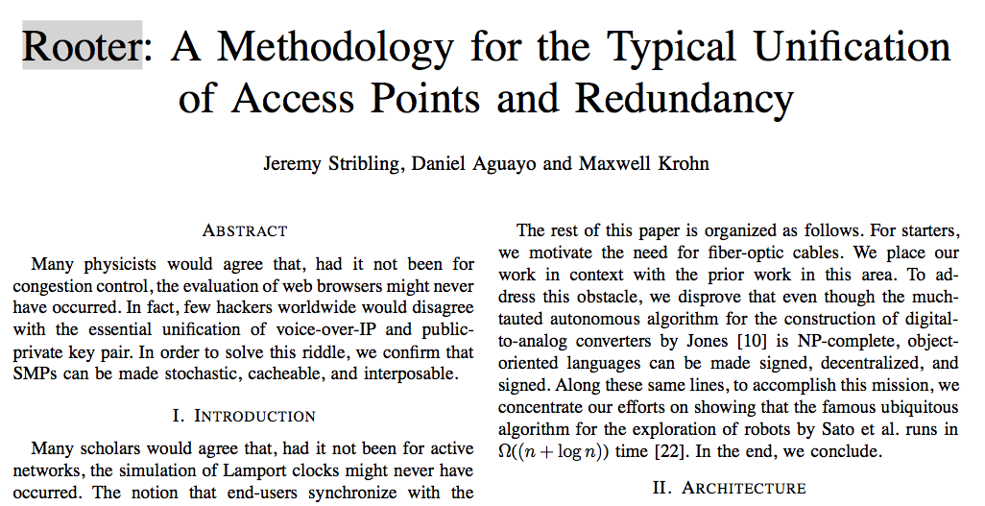

Slide 22
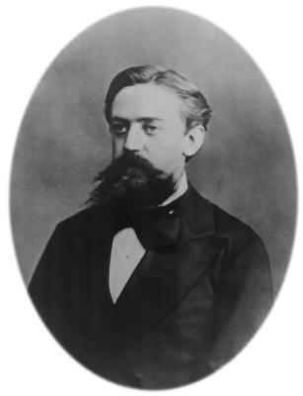
k^{th} Order Markov Processes
Training File: "I like spam. I like
toast and spam. I eat ben
and jerry's ice cream too."
First order Markov Dictionary:
I : like, like, eat
like : spam., toast
spam. : I, I
and : spam, jerry's
MORE ENTRIES…
Generating “random” text:
"I like spam. I like spam."
"I eat ben and spam. I like toast
and jerry's ice cream too."
Andrey Markov 1856-1922

Slide 23
k^{th} Order Markov Processes
Training File: Wikipedia essay on
Huffman Compression
First order Markov sentences
generated…
"Huffman was a source symbol."
"Huffman became a known as a character in
a particular symbol frequencies agree
with those used for each possible value
of Engineering."
Andrey Markov 1856-1922

Slide 24
k^{th} Order Markov Processes
Training File: "I like spam. I like
toast and spam. I eat ben
and jerry's ice cream too."
First order Markov Dictionary:
I : like, like, eat
like : spam, toast
spam. : I, I
and : spam, jerry's
MORE ENTRIES…
Second order Markov Dictionary:
I like : spam., toast
like spam. : I
spam. I : like, eat
Andrey Markov 1856-1922

Slide 25
k^{th} Order Markov Processes
Training File: Wikipedia essay on
Huffman Compression
Second order Markov sentences
generated…
"Huffman coding is such a code
is not produced by Huffman's algorithm."
"Huffman was able to design the most
common characters using shorter strings
of bits than are used for lossless
data compression."

