Slide 1
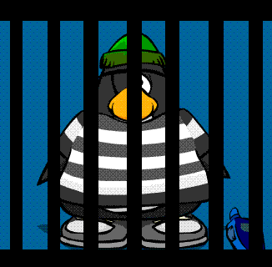
CS 5 Post-Herald-Penguin-Times-Mercury
Penguin Jailed in Hacking Case
Claremont (Muddraker): Residents of East Dorm were rudely awakened Monday morning when a police battering ram suddenly knocked a hole in the dormitory's wall as part of an operation to capture a rogue penguin. “We entered at 10 AM so we could be sure everyone was asleep,” explained police captain R. Ayder. “The penguin was captured without incident.”
Interviews with the penguin’s suitemates revealed that it had been accused of computer fraud. “He was a big sushi fan,” stated F. Rosh, a first-year student. “He was always getting deliveries of fresh fish and sharing them with us. We didn’t realize that he had used an SQL injection to get it all for free.”
Another onlooker suggested that the penguin shouldn’t be punished severely. “He was lonely, all this way from the Antarctic in the Southern California heat. Who can blame him for getting fish any way he can? “

Slide 2

Final Projects!
Next Tuesday:
Final project details and demos
How about an exact simulation of the weather on Antares III?

Slide 3
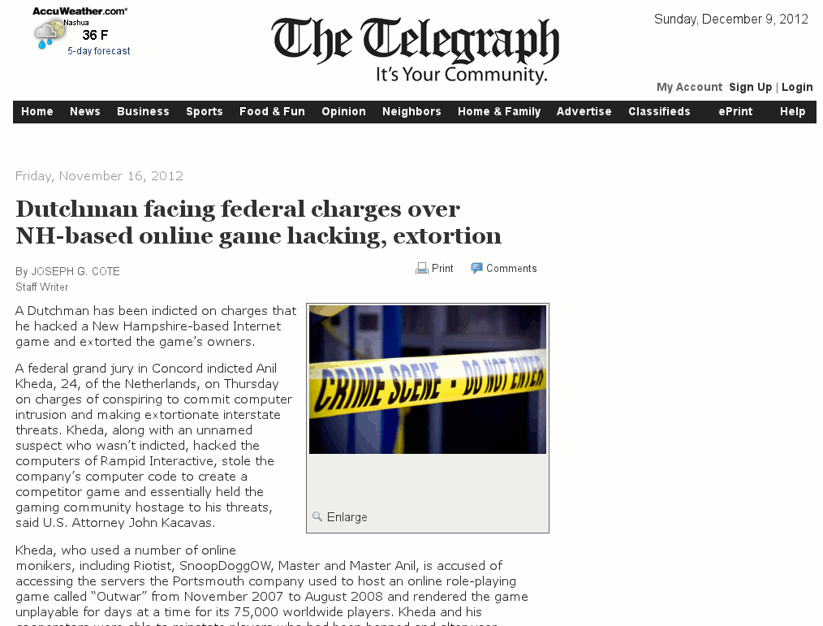
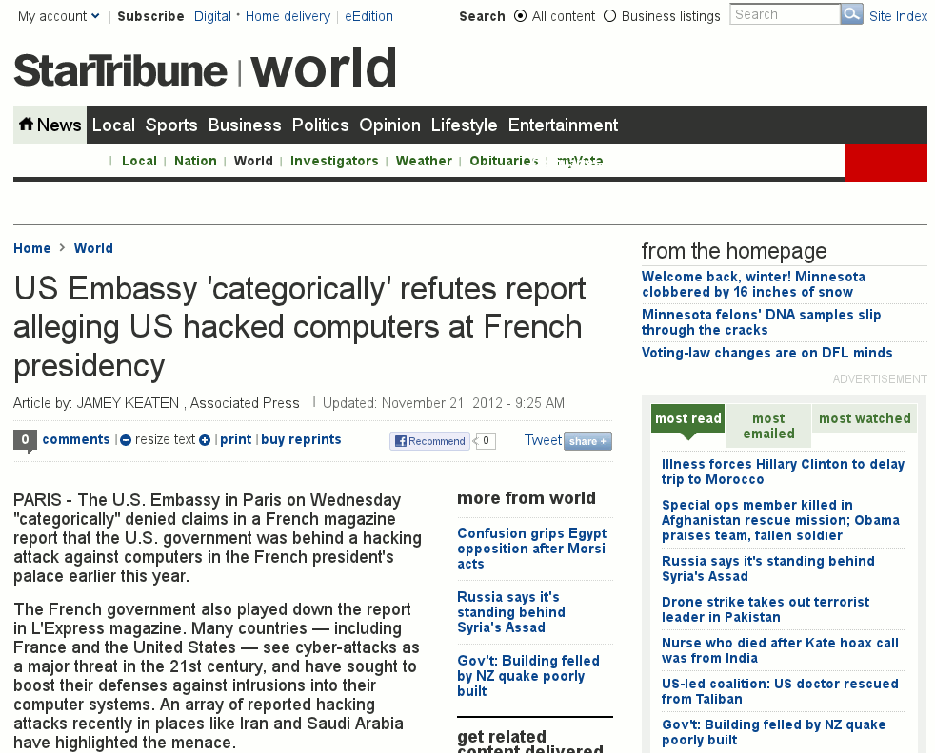
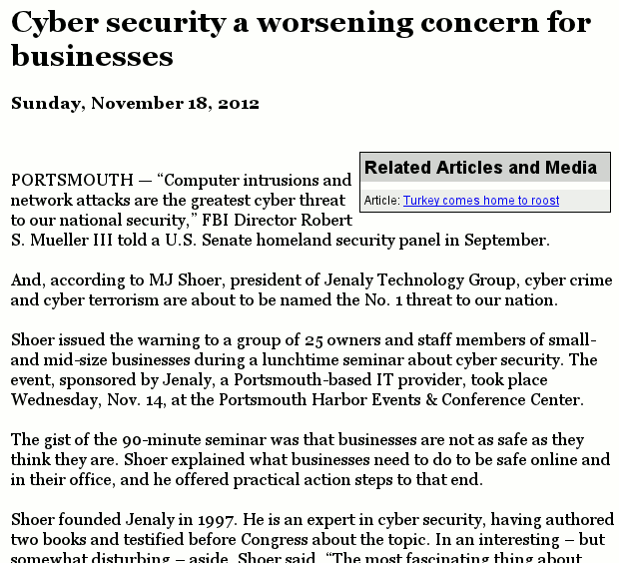
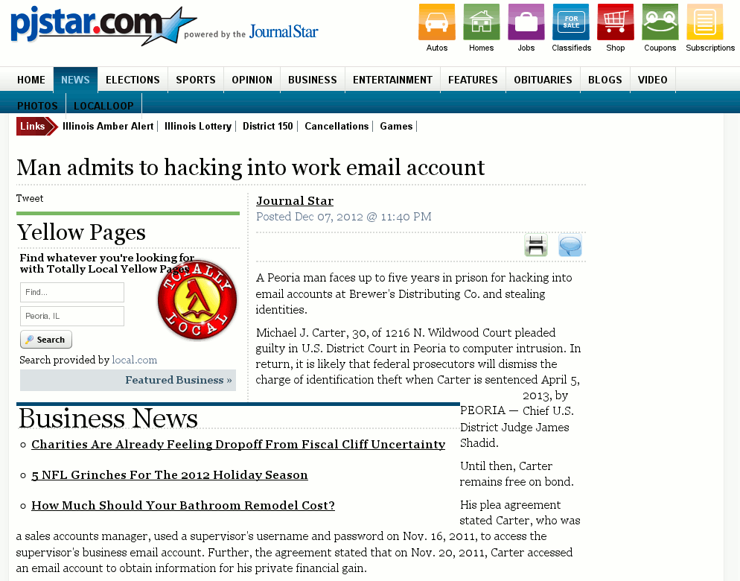
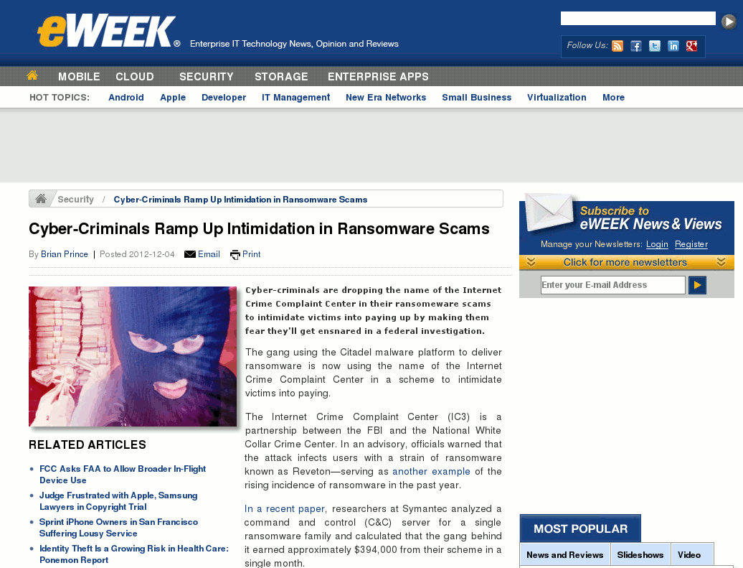
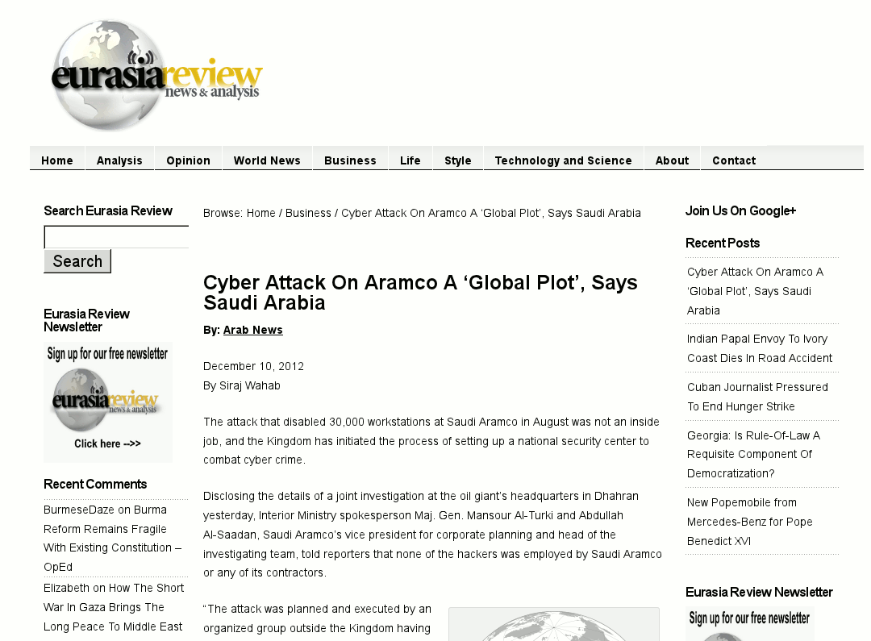
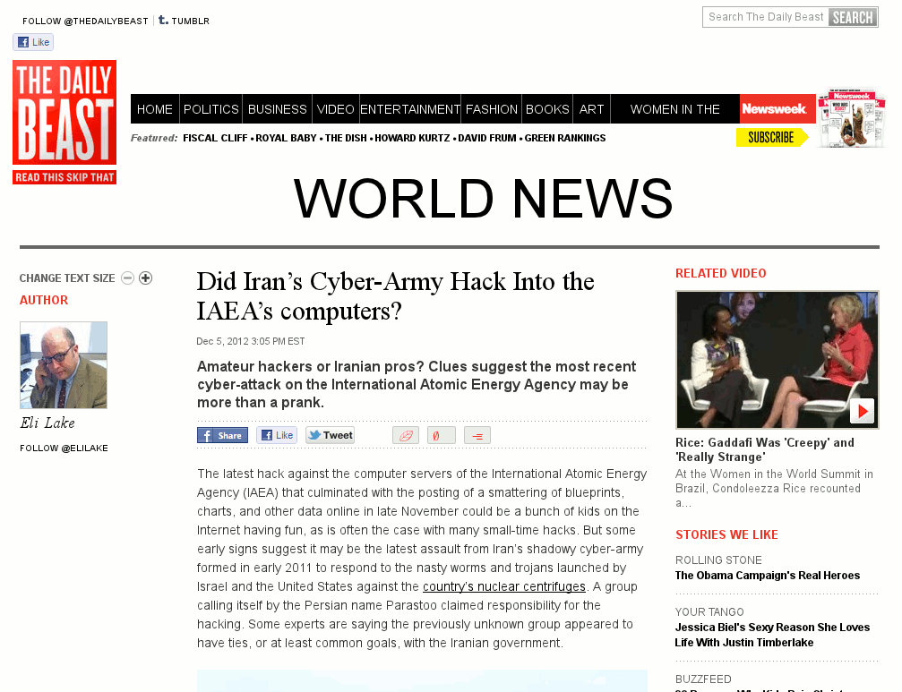
Security!
Five-Eyed Alien Steals Only Copy of CS 5 Final!

Slide 4
Security!

Slide 5
What Do the Bad Guys Do?
Probe random machines (including yours)
Guess passwords
Social engineering
And more!
5eyes?

Slide 6




Basic Protection
Shared machines mean shared data
Paranoid
Public!
Notes:
Macs and Windows assume you’re stupid, so they default to not sharing anything. (This wasn’t always true on either platform, but they’ve changed.) Facebook wants you to publicize your life—you're their product. Linux assumes you’re smart and friendly, so it defaults to sharing.

Slide 7
Basic Linux Protection
Your account on Knuth (and thus the lab Macs) defaults to paranoid
To make files public, use chmod:
chmod a+r publicfile.txt
For more info, see this qref:
https://www.cs.hmc.edu/twiki/bin/view/QREF/Chmod
Notes:
Chmod on Linux is pretty primitive: oversimplifying, you have the choice between keeping things secret and making them available to everyone. There are no friends and friends of friends like on Facebook.

Slide 8
Passwords
Most common passwords of 2012:
password
123456
12345678
abc123
qwerty
monkey
letmein
Sneaky!

Slide 9
Password Guessing
200 common first names at 1 guess per second⇨3 minutes to success!
“Online” guessing done in parallel
“Offline” guessing at 100,000,000/second
350 billion per second with 25-GPU cluster!
Notes:
Don't use your friend's (or your dog's) name as a password. Crackers try millions of passwords on millions of machines every second. If your password is in a dictionary, they'll find it.
The 350 billion/second result was for the Windows NTLM password hashing scheme and was announced 12/10/2012. (But you have to have the hashes.)

Slide 10
Password Guessing
200 common first names at 1 guess per second⇨3 minutes to success!
“Online” guessing done in parallel
“Offline” guessing at 100,000,000/second
Notes:
Don't use your friend's (or your dog's) name as a password. Crackers try millions of passwords on millions of machines every second. If your password is in a dictionary, they'll find it.
The 350 billion/second result was for the Windows NTLM password hashing scheme and was announced 12/10/2012. (But you have to have the hashes.)

Slide 11
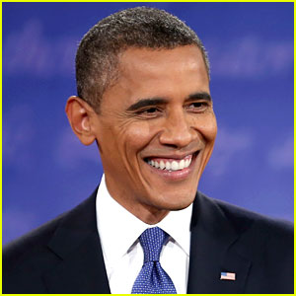
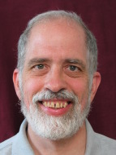
They Don’t Care Who You Are
✓
Notes:
A few crackers are looking to get into the CIA. But most just want machines to play with. That means you're vulnerable.

Slide 12
They Don’t Care Who You Are
Notes:
A few crackers are looking to get into the CIA. But most just want machines to play with. That means you're vulnerable.

Slide 13
Strong Passwords
You’ve heard the rules:
More than 8 letters: 26⁸ ≈ 10¹¹
Upper/lower: 52⁸ ≈ 10¹³
Digits: 62⁸ ≈ 10¹⁴
Punctuation: 95⁸ ≈ 10¹⁶
They don't work!
Better: four English words (see diceware.com)
Notes:
It's important to use nonstandard substitutions. Don't use 1 for i, 3 for e, and $ for s; instead use things like ! for shriek or yell. Deliberately misspell things (Harvie Muddd).
BTW, at 350 billion per second, 10^16 combinations can be tried in under six hours. Going to 9 characters gives you a factor of 100 (surprise); 600 hours is a bit less than a month.

Slide 14
Know What's Important
Use a super-strong password for your bank account
…but it's OK to use a bad one for your subscription to Popular Science

Slide 15
Bad Rules
“At least one capital letter”
…at the beginning
“At least one digit”
…it’ll be a 1 at the end
Notes:
People are predictable. They capitalize at the beginning, add digits at the end, substitute 3 for e, etc. That hardly challenges the bad guys at all. People who enforce rules like these are idiots. Don't be one of those, and don't pick that kind of predictably bad password.

Slide 16

My Favorite Password Ever
!!URdead
Don’t use this one!
Notes:
This is read as "bang bang you're dead." It was the system adminstrator's password when I was in grad school. It's a great example of how to pick a hard-to-guess password that's easy to remember, even though it's only 8 characters. But since I just published it, it's a horrible choice. It'll be in the crackers' dictionaries soon.

Slide 17
Forced Password Changes
What’s the threat?
How do forced changes protect against it?
When don’t forced changes help?
I use 5eyes, then 6eyes, 7eyes, etc. Easy to remember!
Worksheet problem
Notes:
The alien is animated. Do worksheet, then discuss. Don't show the alien until after discussion.
The threat is that it takes time to guess a password. If you know it takes time X, and you force changes at X<<x, the chances of a compromise from a successful guess are much lower. In addition, if somebody does guess a password, a forced change can reduce the amount of time available for doing damage.
Forced changes are silly if X is extremely large (which is the normal case for outsider attacks where the hashed passwords aren't available). They are also silly if x is so long that there's plenty of time to do damage.
The other problem with forced password changes is that they encourage people to choose bad passwords, since the change is nearly always at an inconvenient time. (See the alien's comment.)

Slide 18
Forced Password Changes
What’s the threat?
How do forced changes protect against it?
When don’t forced changes help?
Worksheet problem
Notes:
The threat is that it takes time to guess a password. If you know it takes time X, and you force changes at X<<x, the chances of a compromise from a successful guess are much lower. In addition, if somebody does guess a password, a forced change can reduce the amount of time available for doing damage.
Forced changes are silly if X is extremely large (which is the normal case for outsider attacks where the hashed passwords aren't available). They are also silly if x is so long that there's plenty of time to do damage.
The other problem with forced password changes is that they encourage people to choose bad passwords, since the change is nearly always at an inconvenient time. (See the alien's comment.)

Slide 19
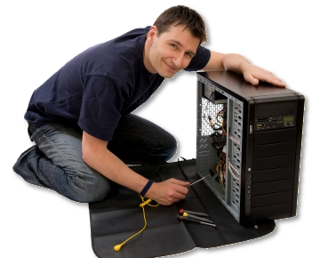
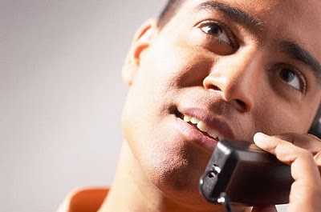
Social Engineering
Hi, I’m at a customer site and they must have changed the password on me!
Sure, here it is on the wall. !!URdead
Notes:
Kevin Mitnick's "The Art of Deception" is full of fun stories of social engineering. People like to be helpful, and if you carry a clipboard and a smile they will probably give you the keys to the kingdom.

Slide 20

The Alien’s Life Advice
Don’t pick a major too soon.
You Earthlings have a lot of fascinating subjects!

Slide 21
Phishing
From: Owasso Seventh2 <Owasso.Seventh2@owasso.k12.ok.us>
Subject: Message To: Email Account Owner!
Date: Thu, 6 Dec 2012 00:00:53 +0000
Message To: Email Account Owner!
IMPORTANT WARNING MESSAGE FROM THE WEB-MAIL ADMIN TEAM, A 2012 DFXG
Virus has been detected on your mail and your account will be
terminated in a short time from our database. Please click on the
below link and lo-gin your full email address for maintenance and
Virus Scanning, Read the page
http://sever.net46.net/update.html
Thanks for your understanding and Co-operation
Notes:
You've seen these; do you understand what they're doing? The idea is to get you to give them your user name and password. The best ones are designed to scare you into logging in to your bank account ("We have detected an intrusion into your Paypal account; click here to validate the transaction.") and use logos, etc. from the original site. They can be very hard for the non-expert to spot, so the best defense is to NEVER click on a link in an e-mail unless you don't care where it actually leads.
Note that phishing e-mails can also lead to evil sites where you don't need to enter a password (see next slide).

Slide 22
Advanced Phishing
From: "secure.email@citi.com" <secure.email@citi.com>
Subject: You have received a secure message
To: <eoa@cs.hmc.edu>
Date: Thu, 6 Dec 2012 13:45:19 +0000
You have received a secure message
Read your secure message by opening the attachment, securedoc.html. You
will be prompted to open (view) the file or save (download) it to your
computer. For best results, save the file first, then open it with
Internet Explorer. If you have concerns about the validity of this
message, please contact the sender directly. For questions please
contact the Citi Secure Email Help Desk at (866) 535-2504. First time
users - will need to register after opening the attachment. About
Email Encryption - http://www.citi.com/citi/citizen/privacy/email.htm
Notes:
Here, the attachment is malware. You can also get stuck with malware by visiting the wrong Web site. Caution is in order!

Slide 23
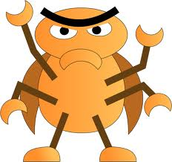


What’s Going On Here?
+
=
!
Evil file
Buggy viewer

Slide 24
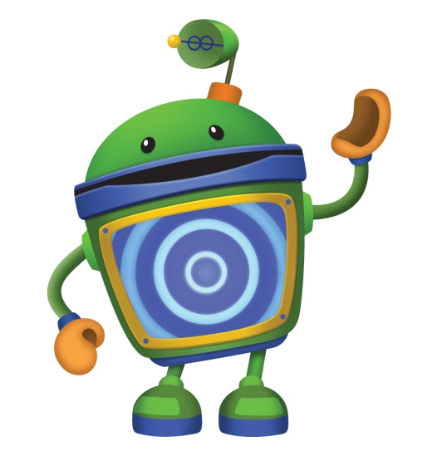

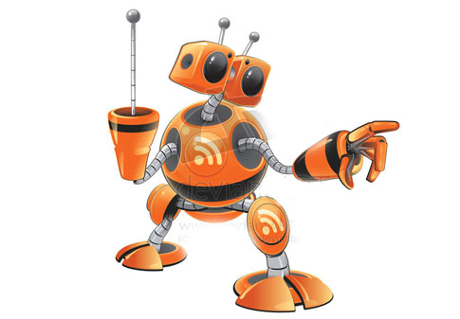
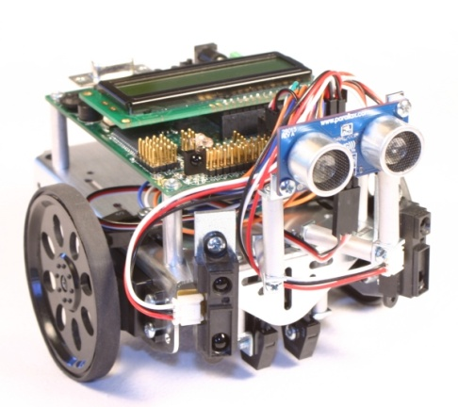
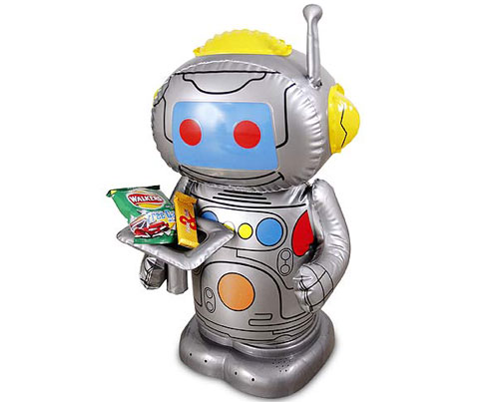

Why Do They Bother?
password
abc123
qwerty
letmein
monkey
Notes:
The bad guys have all sorts of goals. One is to steal your banking passwords, but another is to create "bots" that can be used to spam, attack other sites, etc.

Slide 25


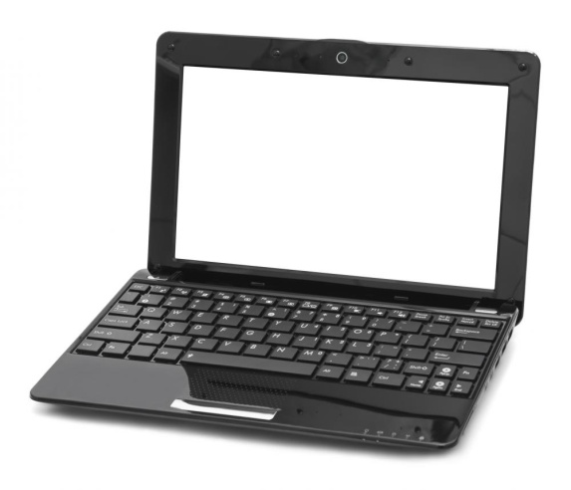
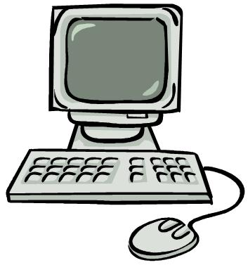
Here’s the Worst Part…
Notes:
One of the biggest uses of bots is to…try to recruit more bots. The biggest bot operators have tens of thousands of computers under their control, and they rent them to anybody who wants to (mis)use them.

Slide 26
Input Validation
Please enter number of colors: four
Notes:
As you know, Python bombs if you give it invalid input. But bring up a Python shell here and run mastermind2.py. Show that you can simply type code[0], etc. to solve the puzzle! Mastermind2 has been hacked to make this easier, but with mastermind.py itself you could type the rather dd string __import__('sys')._getframe(2).f_locals['code'][0] to accomplish the same result.

Slide 27
Input Validation
def get_number():
while True:
print "Enter a number: ",
ans = raw_input()
try:
value = int(ans)
return value
except:
print "Bad value!"
Notes:
The try/except clause is a way to protect yourself. "Except" is executed if anything goes wrong; here, we complain and try again.

Slide 28
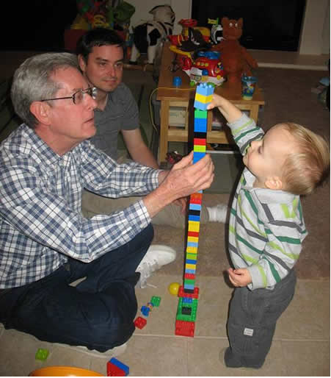
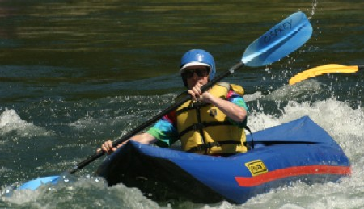
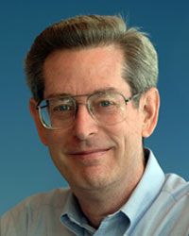
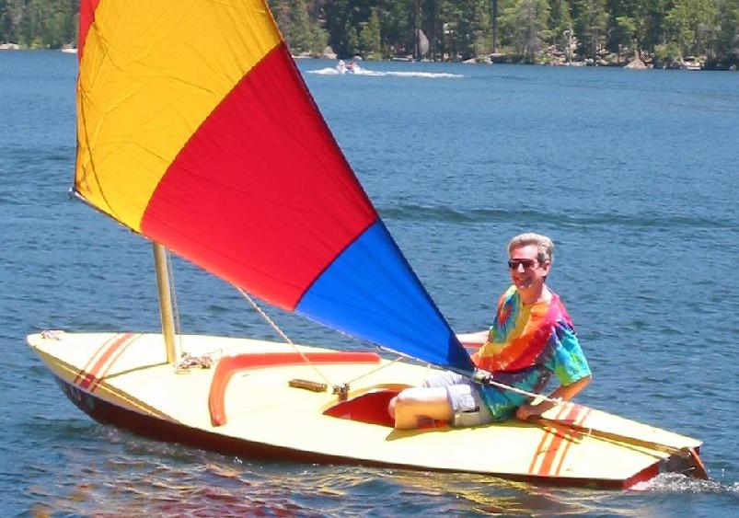
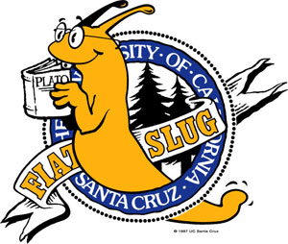
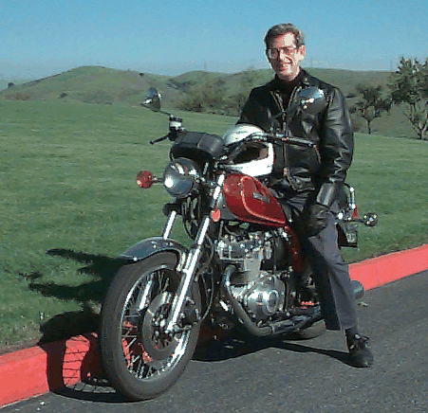
Structured Query Language
mysql> select gpa from students where first_name = 'Donald' and last_name = 'Chamberlin' and
grad_year = 1966;
+------+
| gpa |
+------+
| 3.87 |
+------+
1 row in set (0.00 sec)
Don Chamberlin HMC '66
Notes:
SQL was developed by Don Chamberlin, an HMC grad. It is used in nearly every database system today.

Slide 29
The Power of SQL
mysql> select title, price from products where type = 'DVD' and genre = 'comedy' and title like 'The Hangover%' order by price descending; -- Highest price first
mysql> update products set price = price / 10 where title = 'The Hangover Part II';
mysql> update users set password = 'secret', access = 'all' where username = 'geoff'; -- Give full access

Slide 30
SQL in Web Sites
def lookupDVD(title_words):
print "select title, price from products where type = 'DVD' and title like ' " + title_words + " ' order by price ascending;"
Notes:
Real Web sites are obviously more complicated but they use this same idea.

Slide 31
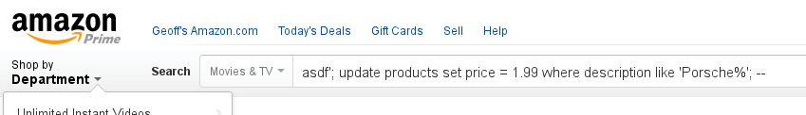
SQL Injection
def lookupDVD(title_words):
print "select title, price from products where type = 'DVD' and title like ' " + title_words + " ' order by price ascending;"
select title, price from products where type = 'DVD' and title like 'asdf '; update products set price = 1.99 where description like 'Porsche%'; -- ' order by price ascending;
Notes:
Sadly, even today this works on a lot of Web sites.
This slide has two animations. The first brings up the Amazon query. The second circles the query and shows the injected SQL.

Slide 32
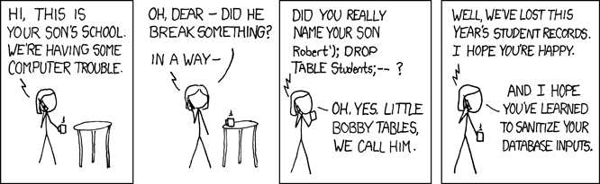
SQL Injection
Notes:
This is one of the most famous xkcd cartoons. The official title is "Exploits of a Mom".

Slide 33
The Moral
NEVER trust input from a user!

Slide 34
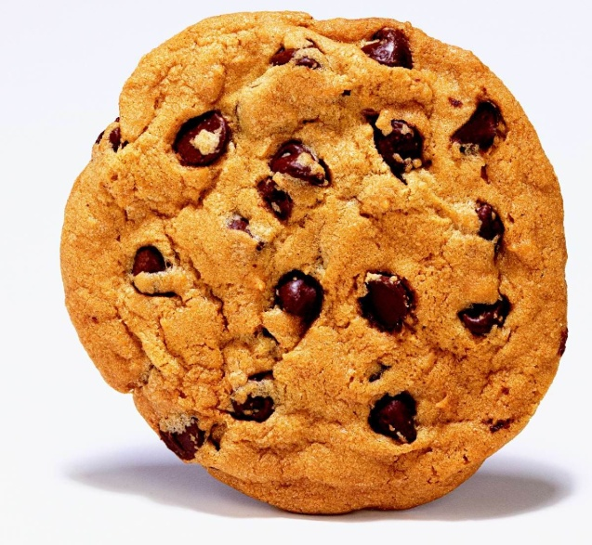

Cookies
You've heard of how Web servers use cookies to remember things about you
Hey, that's my cookie!
Shopping cart idea: use cookie to remember what you ordered & its price…
Notes:
Big oops: what if user modifies cookie before sending it back?

Slide 35
The Moral
NEVER trust input from a user!
…even you think it originally came from you!

Slide 36
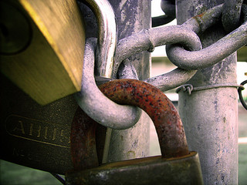
Secure the Weakest Link
Be sure to consider all possible attacks!
But concentrate on the most vulnerable parts

Slide 37
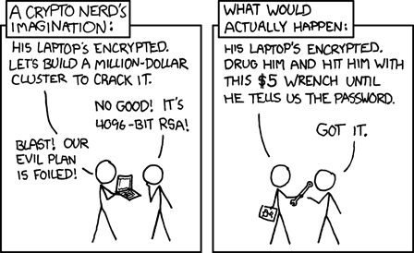
Secure the Weakest Link
Notes:
Tooltip: Actual actual reality: nobody cares about his secrets. (Also, I would be hard pressed to find that wrench for $5.)

Slide 38
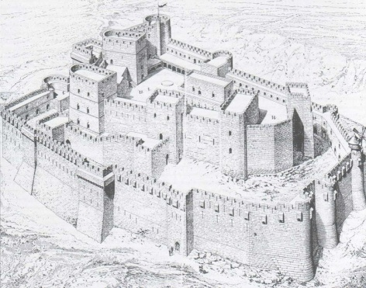
Defense in Depth
Single failure shouldn't compromise everything
  Store encrypted passwords so breakin doesn't reveal them
  Validate input, but other functions should re-validate arguments
General rule: each part of system should mistrust all other parts

Slide 39
Fail Securely
If password verifier isn't available, what happens?
  Bad: "I didn't get a reject, so it's OK"
  Good: refuse all accesses
Bad: I need to use security software I don't have, so let's download it…from the server I don't trust yet
Notes:
This slide has an animation.

Slide 40

Principle of Least Privilege
Give minimum access needed to do job
Web server shouldn't have write access if it only needs to read
Edward Snowden shouldn't be able to read random documents without getting permission first!
Notes:
This slide has an animation.

Slide 41
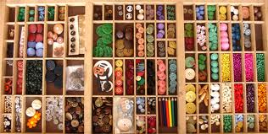
Compartmentalize
Closely related: divide things into related pieces so losing one doesn't lose all
Bad: Unix/Linux have only two privilege levels: user (can't do squat) and root (can do everything).
Good: Windows gives limited power (reset printer but not reboot) to each account

Slide 42

Value Simplicity
Complex things break
  ⇒ Broken things compromise security
Complex things hard to understand
  ⇒ Hard to be sure there are no holes

Slide 43
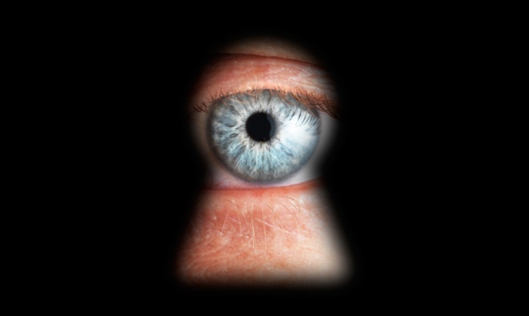
Promote Privacy
Don't ask for data you don't need (SSN)
Don't store data permanently
Think about "What if I lose this data?"

Slide 44
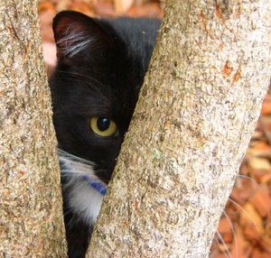
Hiding Secrets is Hard
"Security through obscurity" doesn't work
Assume everybody has access to everything:
  Source code
  Design
  Database layout (schema)
  General methodologies
If bad guy cracks a secret, are all of them gone?

Slide 45
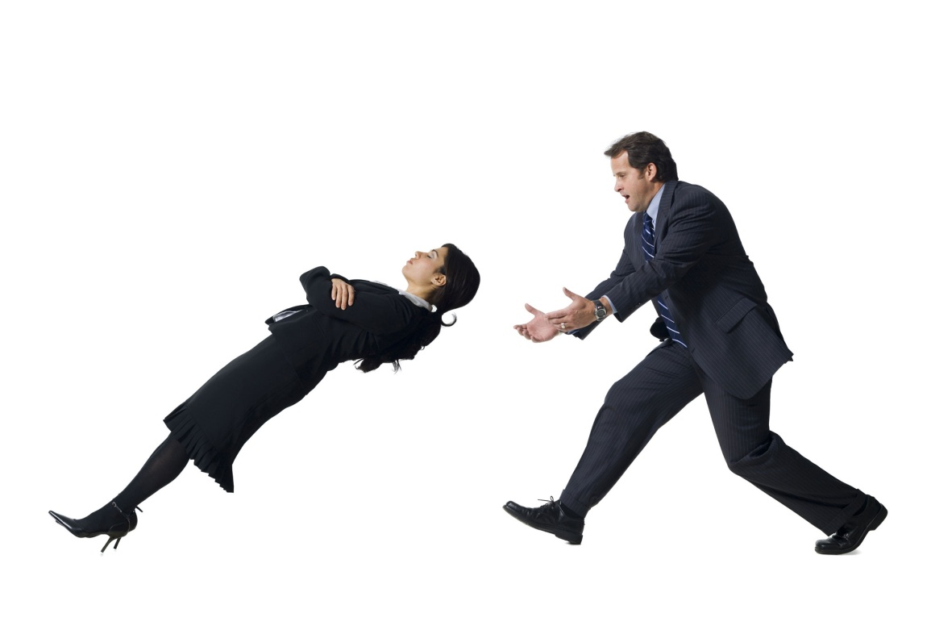
Trust Reluctantly
Assume all functions are (might be) malicious
Assume all other computers are bad
Assume all users can be socially engineered
Open-source code? Shrinkwrapped software?
Can you be secure in the face of failures?

Slide 46

Use Community Resources
DO NOT reimplement encryption code
Use widely respected software
Stay aware of latest patches, attack trends, etc.

Slide 47

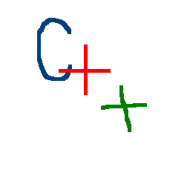

Use Safe Languages
Some languages notorious for being tricky
  C, Java,
Others try to provide security
Others protect against common mistakes
But even safe languages have hidden traps!
Notes:
This slide has three animations.

