Slide 1
Bowling Modeling
A quest for excellence…
Craig Weidert
April 16, 2007
Scientific Computing – Prof. Yong

Slide 2
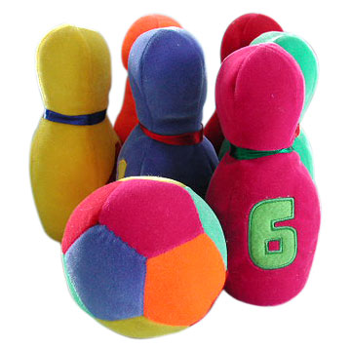
The Game
Bowling has a rich history
Essentially, two chances to knock down the 10 pins arranged on the lane
Rules solidified in the early 20th Century
~100 million players today

Slide 3
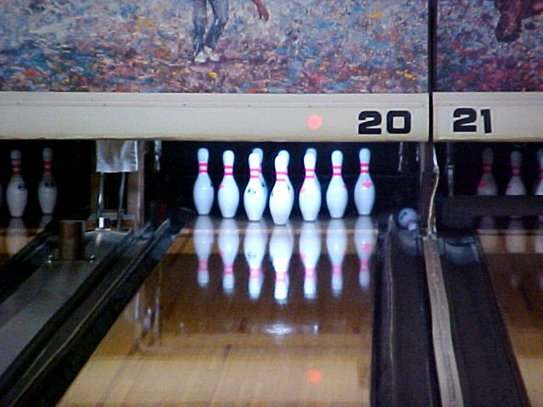
The Challenge
The Lane
  Standard dimensions: 60 feet by 42 inches
  Oil Parameters
    μ = .04 for first two thirds of lane
    μ = .2 for last third of lane
The Pins
  Ten pins arranged in a triangle 36 inches on a side
  15 in tall, 4.7 inches wide, about 3 and a half pounds

Slide 4
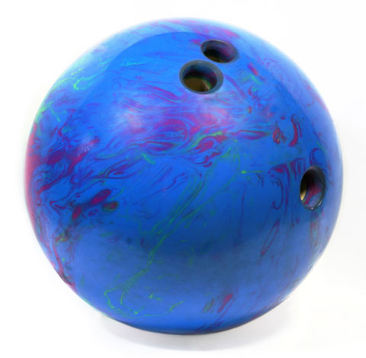
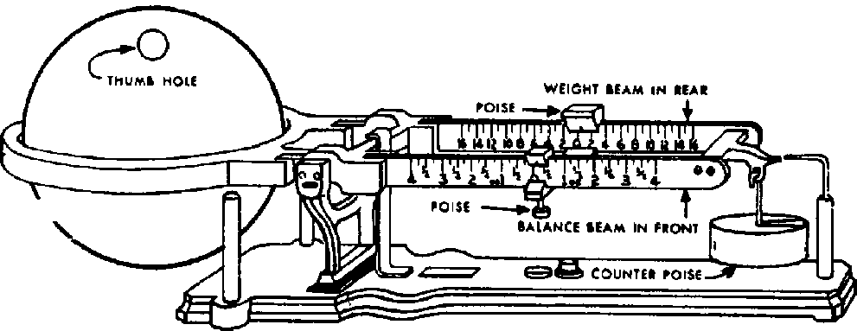
The Ball
Made of polyester or urethane
Radius is 4.25-4.3 inches
16 pound maximum
Heavier inner core covered with outer material
Offset center of mass
  Less than 1 mm
  Helps with spin

Slide 5
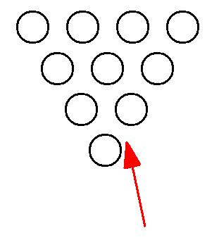
How the Pros Do It
Splits are the worst
Spins are more devastating
  Throw or release the ball in such a way that spin is imparted
Best bet: six degree pocket angle
I should like to model bowling ball paths

Slide 6
Previous Work
Current literature tends to be either geared towards bowling manufacturers or to make overly simplistic assumptions
Hopkins and Patterson
  Ball is a uniform sphere
  Did not consider offset center of mass or variable friction
Zecchini and Foutch
  No center of mass offset
Frohlich
  Complete as far as I know
  Used basic standard time step of .001 second
  All of the equations I used are from this paper

Slide 7
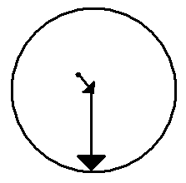
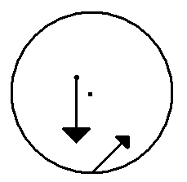
Vectors and Forces
cm
R_{Δ}
cm
cb
cb
F_{g}
R_{con}
F_{con}

Slide 8
Differential Equations
Mass * position’’ = F_{con} + F_{g}
d/dt (Iω) = (r_{Δ} x R_{con}) x F_{con}
If I is non-diagonal, LHS expands to: d/dt (Iω) = (I₀ + I_{dev})α +ω x (I_{dev}ω)
  No ω x (I₀ω) term since ω, I₀ are parallel
  ω x (I_{dev}ω) is the “rolls funny” term
At every step must calculate slippage: (R_{con} x ω) - Velo

Slide 9
Differential Equations (cont)
Normal force varies
Slipping
  (I₀ + I_{dev} + I_{Δ} + I_{ΔΔ})α = τ_{fric} + τ_{dev} + τ_{Δ} + τ_{ΔΔ}
Rolling
  (I₀ + I_{dev} + I_{Roll} + I_{Δ})α = τ_{dev} + τ_{Δ} + τ_{ΔΔ}

Slide 10
Modeling Details
Find y₀, theta₀, ω₀, v₀ such that pocket angle, impact point were ideal
12 dimensional ordinary differential equation
Used ode45
Error: square of the difference in ideal, real angles plus square difference in y error
Gutter avoidance

Slide 11
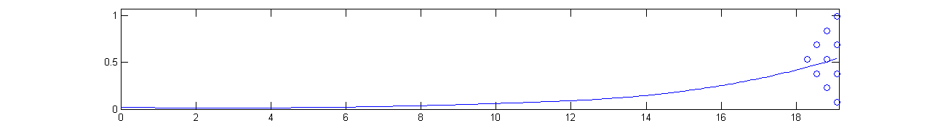
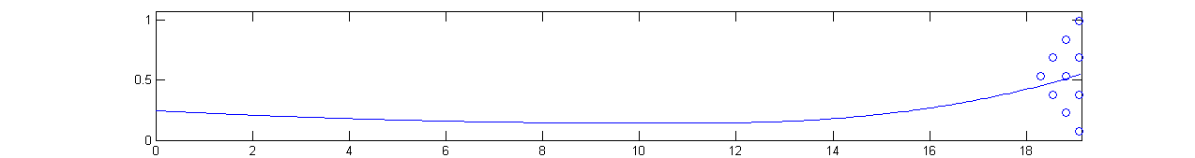
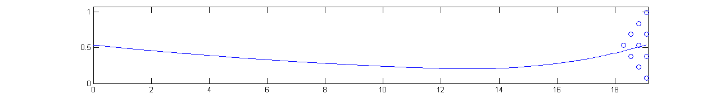
Results
Possible to achieve desired impact point, pocket angle from multiple starting positions
  Corresponds to thorough experimental work I have done on this project
For all paths, a initial velocity of around 8 m/s and an ω₀ of about 30 rad/s was sufficient

Slide 12
Difficulties / Future Work
Moment of inertia tensor
  Since ball is not symmetric, the moment of inertia must be a 3 by 3 matrix
    Involves
    Not sure whether this should be in lane frame
  Breaking the effects of COM offset?
  Will work on this in the next week
Differing oil patterns on lane

Slide 13
Acknowledgements
Cliff Frohlich
Prof Yong
Junbo Park

