Slide 1

Chapter 7
Wireless and
Mobile Networks
A note on these slides:
The slides used in this class were derived from ones provided by Jim Kurose and Keith Ross, authors of the textbook for the course.
I would like to thank the authors for making the slides available. They retain copyright in all of the original material.
Computer Networking: A Top Down Approach
Copyright 1996-2016
J.F Kurose and K.W. Ross, All Rights Reserved
7th edition
Jim Kurose, Keith Ross
Pearson/Addison Wesley
April 2016

Slide 2
Ch. 6: Wireless and Mobile Networks
Background:
Number of wireless (mobile) phone subscribers now exceeds count of wired subscribers (5 to 1)!
Number of wireless Internet-connected devices equals wireline ones
  laptops, Internet-enabled phones promise “any time” untethered Internet access
two important (but different) challenges
  wireless: communication over wireless link(s)
  mobility: handling the mobile user who changes point of attachment to network

Slide 3
Chapter 7 outline
7.1 Introduction
Wireless
7.2 Wireless links, characteristics
  CDMA
6.73 IEEE 802.11 wireless LANs (“Wi-Fi”)
67.4 Cellular Internet Access
  architecture
  standards (e.g., 3G, LTE)
Mobility
7.5 Principles: addressing and routing to mobile users
7.6 Mobile IP
7.7 Handling mobility in cellular networks
7.8 Mobility and higher-layer protocols

Slide 4






Elements of a wireless network
wireless hosts
laptop, smartphone
run applications
may be stationary (non-mobile) or mobile
  wireless does not always mean mobility
network
infrastructure

Slide 5

Elements of a wireless network
base station
typically connected to wired network
relay—responsible for sending packets between wired network and wireless host(s) in its “area”
  e.g., cell tower, 802.11 access point
network
infrastructure

Slide 6
Elements of a wireless network
wireless link
typically used to connect mobile(s) to base station
can also be used as backbone link
multiple-access protocol coordinates link access
various data rates, transmission distance
network
infrastructure

Slide 7
Characteristics of selected wireless links
1300
802.11 ac
450
802.11n
54
802.11a,g
802.11a,g point-to-point
5-11
802.11b
4G: LTE WIMAX
4
3G: UMTS/WCDMA-HSPDA, CDMA2000-1xEVDO
Data rate (Mbps)
1
802.15
.384
2.5G: UMTS/WCDMA, CDMA2000
.056
2G: IS-95, CDMA, GSM
Indoor
10-30m
Outdoor
50-200m
Mid-range
outdoor
200m – 4 Km
Long-range
outdoor
5Km – 20 Km

Slide 8
Elements of a wireless network
infrastructure mode
base station connects mobiles into wired network
handoff: mobile changes which base station provides connection
network
infrastructure

Slide 9
Elements of a wireless network
ad-hoc mode
no base stations
nodes can only transmit to other nodes within link coverage
nodes organize themselves into a network, route among themselves

Slide 10
Wireless network taxonomy
single hop
multiple hops
host connects to
base station (WiFi,
WiMAX, cellular)
which connects to
larger Internet
host may have to
relay through several
wireless nodes to
connect to larger
Internet: mesh net
infrastructure
(e.g., APs)
no base station, no
connection to larger
Internet. May have to
relay to reach
a given wireless node
MANET, VANET
no
infrastructure
no base station, no
connection to larger
Internet (Bluetooth,
ad-hoc nets)

Slide 11
Chapter 7 outline
7.1 Introduction
Wireless
7.2 Wireless links, characteristics
  CDMA
7.3 IEEE 802.11 wireless LANs (“Wi-Fi”)
7.4 Cellular Internet Access
  architecture
  standards (e.g., 3G, LTE)
Mobility
7.5 Principles: addressing and routing to mobile users
7.6 Mobile IP
7.7 Handling mobility in cellular networks
7.8 Mobility and higher-layer protocols

Slide 12
Wireless Link Characteristics (1)
important differences from wired link…
  decreased signal strength: radio signal attenuates as it propagates through matter (path loss)
  interference from other sources: standardized wireless network frequencies (e.g., 2.4 GHz) shared by other devices (e.g., phone); non-communicating devices (e.g., motors) interfere as well
  multipath propagation: radio signal reflects off objects around, arriving at destination at slightly different times
…all make communication across (even a point-to-point) wireless link much more “difficult”

Slide 13
Wireless Link Characteristics (2)
SNR: signal-to-noise ratio
  larger SNR—easier to extract signal from noise (a “good thing”)
SNR versus BER tradeoffs
  given physical layer: increase power ⇒ increase SNR ⇒ decrease BER
  given SNR: choose physical layer that meets BER requirement, giving highest throughput
    SNR may change with mobility: dynamically adapt physical layer (modulation technique, rate)
10⁻¹
10⁻²
10⁻³
BER
10⁻⁴
10⁻⁵
10⁻⁶
10⁻⁷
10
20
30
40
SNR(dB)
QAM256 (8 Mbps)
QAM16 (4 Mbps)
BPSK (1 Mbps)

Slide 14


Wireless network characteristics
Multiple wireless senders and receivers create additional problems (beyond multiple access):
A
B
C
C
A’s signal
strength
C’s signal
strength
B
A
Hidden-terminal problem
B, A hear each other
B, C hear each other
A, C can not hear each other—means A, C unaware of their interference at B
space
Signal attenuation:
B, A hear each other
B, C hear each other
A, C can not hear each other interfering at B

Slide 15
Code Division Multiple Access (CDMA)
unique “code” assigned to each user; i.e., code set partitioning
  all users share same frequency, but each user has own “chipping” sequence (i.e., code) to encode data
  allows multiple users to “coexist” and transmit simultaneously with minimal interference (if codes are “orthogonal”)
encoded signal = (original data) X (chipping sequence)
decoding: inner product of encoded signal and chipping sequence

Slide 16
CDMA encode/decode
channel output Z_{i,m}
Z_{i,m}= d_{i}.c_{m}
data
bits
d₀ = 1
1
1
1
1
1
d₁ = -1
1
1
1
-
-
-
-
1
-
-
-
1
-
1
1
1
1
1
sender
1
1
slot 1
channel
output
slot 0
channel
output
1
1
1
1
1
code
1
1
-
-
-
1
-
1
1
1
-
-
-
1
-
1
1
1
slot 1
slot 0
M
D_{i} = Σ Z_{i,m}.c_{m}
m=1
M
received
input
1
1
1
1
1
1
1
1
d₀ = 1
-
-
-
-
1
-
-
-
1
-
1
1
1
1
1
1
d₁ = -1
1
slot 1
channel
output
slot 0
channel
output
1
1
1
1
1
code
1
1
-
-
-
1
-
1
1
1
-
-
-
1
-
1
1
1
receiver
slot 1
slot 0
Notes:
M is number of bits in code

Slide 17
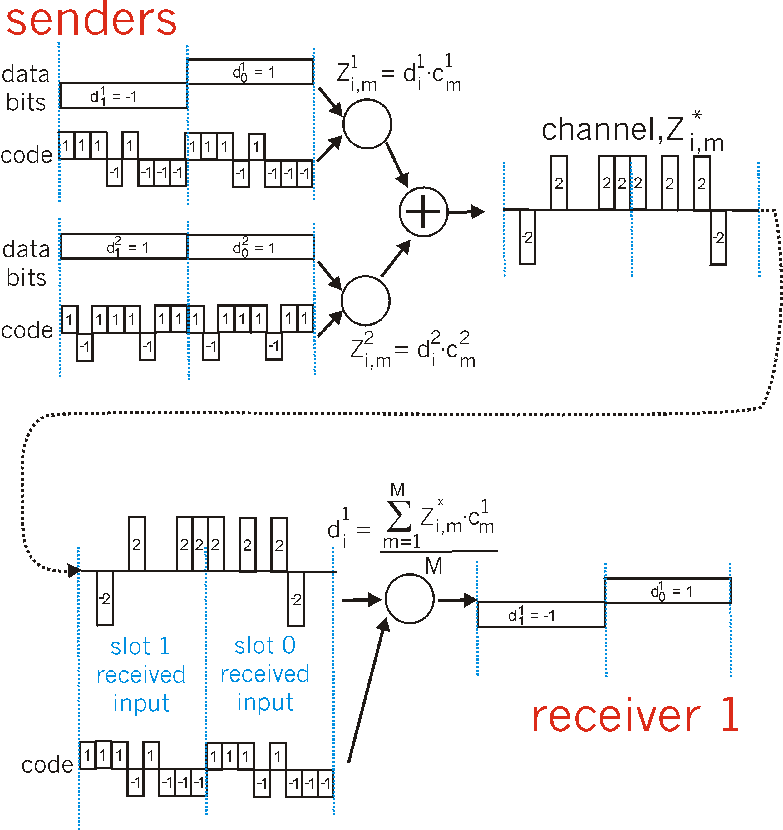
CDMA: two-sender interference
channel sums together transmissions by sender 1 and 2
Sender 1
Sender 2
using same code as sender 1, receiver recovers sender 1’s original data from summed channel data!
Notes:
Codes are orthogonal: dot product is zero. (Dot product: multiply corresponding elements and then sum result.)

Slide 18
Chapter 7 outline
7.1 Introduction
Wireless
7.2 Wireless links, characteristics
  CDMA
7.3 IEEE 802.11 wireless LANs (“Wi-Fi”)
7.4 Cellular Internet Access
  architecture
  standards (e.g., 3G, LTE)
Mobility
7.5 Principles: addressing and routing to mobile users
7.6 Mobile IP
7.7 Handling mobility in cellular networks
7.8 Mobility and higher-layer protocols

Slide 19
IEEE 802.11 Wireless LAN
802.11b
2.4-5 GHz unlicensed spectrum
up to 11 Mbps
direct sequence spread spectrum (DSSS) in physical layer
  all hosts use same chipping code
802.11a
  5-6 GHz range
  up to 54 Mbps
802.11g
  2.4-5 GHz range
  up to 54 Mbps
802.11n: multiple antennae
  2.4-5 GHz range
  up to 200 Mbps
all use CSMA/CA for multiple access
all have base-station and ad-hoc network versions

Slide 20




802.11 LAN architecture
wireless host communicates with base station
  base station = access point (AP)
Basic Service Set (BSS) (aka “cell”) in infrastructure mode contains:
  wireless hosts
  access point (AP): base station
  ad hoc mode: hosts only
Internet
hub, switch
or router
BSS 1
BSS 2

Slide 21
802.11: Channels, association
802.11b: 2.4GHz–2.485GHz spectrum divided into 11 channels at different frequencies
  AP admin chooses frequency for AP
  interference possible: channel can be same as that chosen by neighboring AP!
host: must associate with an AP
  scans channels, listening for beacon frames containing AP’s name (SSID) and MAC address
  selects AP to associate with
  may perform authentication [Chapter 8]
  will typically run DHCP to get IP address in AP’s subnet

Slide 22


802.11: passive/active scanning
BBS 1
BBS 2
BBS 1
BBS 2
1
AP 2
AP 1
1
1
AP 2
AP 1
2
2
2
3
3
4
H1
H1
passive scanning:
Beacon frames sent from APs
Association Request frame sent: H1 to selected AP
Association Response frame sent from selected AP to H1
active scanning:
Probe Request frame broadcast from H1
Probe Response frames sent from APs
Association Request frame sent: H1 to selected AP
Association Response frame sent from selected AP to H1

Slide 23



IEEE 802.11: multiple access
avoid collisions: 2⁺ nodes transmitting at same time
802.11: CSMA—sense before transmitting
  don’t collide with ongoing transmission by other node
802.11: no collision detection!
  difficult to receive (sense collisions) when transmitting due to weak received signals (fading)
  can’t sense all collisions in any case: hidden terminals, fading
  goal: avoid collisions: CSMA/C(ollision)A(voidance)
A
B
C
C
B
A’s signal
strength
C’s signal
strength
A
space

Slide 24
IEEE 802.11 MAC Protocol: CSMA/CA
802.11 sender
1 if sense channel idle for Distributed Inter-Frame Space (DIFS) then
  transmit entire frame (no CD)
2 if sense channel busy then
  start random backoff time
  timer counts down while channel idle
  transmit when timer expires
  if no ACK, increase random backoff interval, repeat 2
802.11 receiver
- if frame received OK
return ACK after Short Inter-Frame Space (SIFS) (ACK needed due to hidden-terminal problem)
sender
receiver
DIFS
data
SIFS
ACK

Slide 25
Avoiding collisions (more)
idea: allow sender to “reserve” channel rather than randomly send data frames: avoid collisions of long data frames
sender first transmits small request-to-send (RTS) packets to BS using CSMA
  RTSs may still collide with each other (but they’re short)
BS broadcasts clear-to-send CTS in response to RTS
CTS heard by all nodes, names particular sender
  sender transmits data frame
  other stations defer transmissions
avoids data-frame collisions completely
by using small reservation packets!

Slide 26


Collision Avoidance: RTS-CTS exchange
A
B
AP
RTS(B)
RTS(A)
reservation collision
RTS(A)
CTS(A)
CTS(A)
DATA (A)
defer
time
ACK(A)
ACK(A)

Slide 27
802.11 frame: addressing
2
2
6
6
6
2
6
0 - 2312
4
frame
control
duration
address
1
address
2
address
3
seq
control
address
4
payload
CRC
Address 4: used only in ad-hoc mode
Address 1: MAC address
of wireless host or AP
to receive this frame
Address 3: MAC address
of router interface to which AP is attached
Address 2: MAC address
of wireless host or AP
transmitting this frame

Slide 28

802.11 frame: addressing
Internet
H1
R1
router
R1 MAC addr H1 MAC addr
dest. address
source address
802.3 frame
AP MAC addr H1 MAC addr R1 MAC addr
address 1
address 2
address 3
802.11 frame

Slide 29
802.11 frame: more
frame seq #
(for RDT)
duration of reserved
transmission time (RTS/CTS)
2
2
6
6
6
2
6
0 - 2312
4
frame
control
duration
address
1
address
2
address
3
seq
control
address
4
payload
CRC
2
2
4
1
1
1
1
1
1
1
1
Protocol
version
Type
Subtype
To
AP
From
AP
More
frag
Retry
Power
mgt
More
data
WEP
Rsvd
frame type
(RTS, CTS, ACK, data)

Slide 30

802.11: mobility within same subnet
H1 remains in same IP subnet: IP address can remain same
switch: which AP is associated with H1?
  self-learning (Ch. 5): switch will see frame from H1 and “remember” which switch port can be used to reach H1
BBS 1
H1
BBS 2

Slide 31
802.11: advanced capabilities
Rate adaptation
base station, mobile dynamically change transmission rate (physical layer modulation technique) as mobile moves, SNR varies
10⁻¹
10⁻²
10⁻³
BER
10⁻⁴
10⁻⁵
10⁻⁶
10⁻⁷
10
20
30
40
SNR(dB)
1. SNR decreases, BER increases as node moves away from base station
QAM256 (8 Mbps)
QAM16 (4 Mbps)
2. When BER becomes too high, switch to lower transmission rate but with lower BER
BPSK (1 Mbps)
operating point

Slide 32
802.11: advanced capabilities
power management
node-to-AP: “I am going to sleep until next beacon frame”
  AP knows not to transmit frames to this node
  node wakes up before next beacon
beacon frame: contains list of mobiles with AP-to-mobile frames waiting to be sent
  node will stay awake if AP-to-mobile frames to be received; otherwise sleep again until next beacon frame

Slide 33
802.15: personal-area network
less than 10m diameter
replacement for cables (mouse, keyboard, headphones)
ad-hoc: no infrastructure
leader/followers:
  followers request permission to send (to leader)
  leader grants requests
802.15: evolved from Bluetooth specification
  2.4-2.5 GHz radio band
  up to 721 kbps
F
P
P
radius of
coverage
L
F
F
P
P
L
Leader device
Follower device
Parked device (inactive)
F
P

Slide 34
Chapter 7 outline
7.1 Introduction
Wireless
7.2 Wireless links, characteristics
  CDMA
7.3 IEEE 802.11 wireless LANs (“Wi-Fi”)
7.4 Cellular Internet access
  architecture
  standards (e.g., 3G, LTE)
Mobility
7.5 Principles: addressing and routing to mobile users
7.6 Mobile IP
7.7 Handling mobility in cellular networks
7.8 Mobility and higher-layer protocols

Slide 35
Components of cellular network architecture
MSC
connects cells to wired phone net
manages call setup (more later!)
handles mobility (more later!)
cell
covers geographical region
base station (BS) analogous to 802.11 AP
mobile users attach to network through BS
air interface: physical and link layer protocol between mobile and BS
Mobile
Switching
Center
Public telephone
network
Mobile
Switching
Center
wired network

Slide 36


Cellular networks: the first hop
Two techniques for sharing mobile-to-BS radio spectrum
combined FDMA/TDMA: divide spectrum in frequency channels, divide each channel into time slots
CDMA: code division multiple access
time slots
frequency
bands

Slide 37
2G (voice) network architecture
Base station system (BSS)
MSC
BTS
BSC
G
Public
telephone
network
Gateway
MSC
Legend
Base transceiver station (BTS)
Base station controller (BSC)
Mobile Switching Center (MSC)
Mobile subscribers

Slide 38
3G (voice+data) network architecture
MSC
G
Public
telephone
network
radio
network
controller
Gateway
MSC
G
Public
Internet
SGSN
Key insight: new cellular data
network operates in parallel
(except at edge) with existing
cellular voice network
voice network unchanged in core
data network operates in parallel
GGSN
Serving GPRS Support Node (SGSN)
Gateway GPRS Support Node (GGSN)

Slide 39
3G (voice+data) network architecture
MSC
G
Public
telephone
network
radio
network
controller
Gateway
MSC
G
Public
Internet
SGSN
GGSN
radio interface
(WCDMA, HSPA)
radio access network
Universal Terrestrial Radio
Access Network (UTRAN)
core network
General Packet Radio Service
(GPRS) Core Network
public
Internet

Slide 40
3G versus 4G LTE network architecture
MSC
G
Public
telephone
network
3G
radio
network
controller
Gateway
MSC
G
Public
Internet
SGSN
GGSN
4G-LTE
HSS
MME
G
G
Public
Internet
S-GW
P-GW
radio access network
Universal Terrestrial Radio
Access Network (UTRAN)
Evolved Packet Core
(EPC)
Notes:
MME = Mobility Management Entity
HSS = Home Subscriber Server
S-GW: Serving Gateway
P-GW: Packet Gateway

Slide 41
4G: differences from 3G
all-IP core: IP packets tunneled (through core IP network) from base station to gateway
no separation between voice and data—all traffic carried over IP core to gateway
Mobility
Management
Entity (MME)
Home Subscriber
Server(HSS)
(like HLR+VLR)
Serving
Gateway
(S-GW)
Packet data
network
Gateway
(P-GW)
UE
(user element)
eNodeB
(base station)
HSS
MME
control
G
G
Public
Internet
data
S-GW
P-GW
radio access network
Universal Terrestrial Radio
Access Network (UTRAN)
Evolved Packet Core
(EPC)
Notes:
HLR = Home Location Register; VLR = Visitor LR

Slide 42


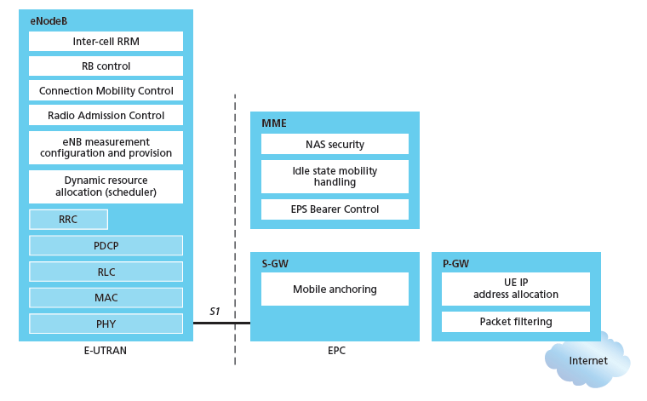
Functional split of major LTE components
We give up! WAAAY too many acronyms!
handles idle/active UE transitions
pages UE
sets up eNodeB-PGW tunnel (aka bearer)
holds idle UE info
QoS enforcement

Slide 43
Functional split of major LTE components
handles idle/active UE transitions
pages UE
sets up eNodeB-PGW tunnel (aka bearer)
holds idle UE info
QoS enforcement

Slide 44

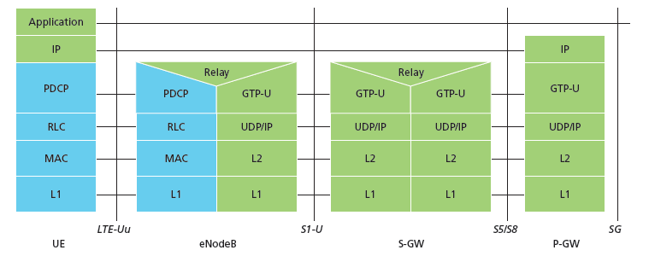
Radio+Tunneling: UE—eNodeB—PGW
IP packet from UE encapsulated in GPRS Tunneling Protocol (GTP) message at ENodeB
GTP message encapsulated in UDP, then encapsulated in IP. large IP packet addressed to SGW
G
G
UE
eNodeB
S-GW
P-GW
tunnel
link-layer radio net

Slide 45
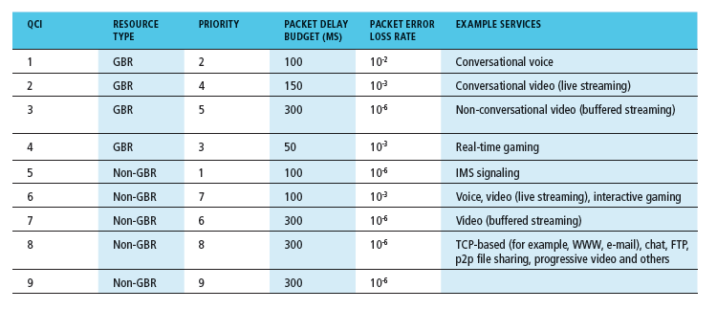
Quality of Service in LTE
QoS from eNodeB to SGW: minimum and maximum guaranteed bit rates
QoS in radio access network: one of 12 QCI values

Slide 46
Chapter 7 outline
7.1 Introduction
Wireless
7.2 Wireless links, characteristics
  CDMA
7.3 IEEE 802.11 wireless LANs (“Wi-Fi”)
7.4 Cellular Internet Access
  architecture
  standards (e.g., 3G, LTE)
Mobility
7.5 Principles: addressing and routing to mobile users
7.6 Mobile IP
7.7 Handling mobility in cellular networks
7.8 Mobility and higher-layer protocols

Slide 47
What is mobility?
spectrum of mobility, from the network perspective:
no mobility
high mobility
mobile wireless user,
using same access
point
mobile user, connecting/ disconnecting from network using DHCP
mobile user, passing through multiple access points while maintaining ongoing connections (like cell phone)

Slide 48



Mobility: vocabulary
home network: permanent “home” of mobile
(e.g., 128.119.40/24)
home agent: entity that will perform mobility functions on behalf of mobile, when mobile is remote
wide-area network
permanent address: address in home network, can always be used to reach mobile
e.g., 128.119.40.186

Slide 49
Mobility: more vocabulary
permanent address: remains constant (e.g., 128.119.40.186)
visited network: network in which mobile currently resides (e.g., 79.129.13/24)
care-of-address: address in visited network.
(e.g., 79,129.13.2)
wide-area network
foreign agent: entity in visited network that performs mobility functions on behalf of mobile.
correspondent: wants to communicate with mobile

Slide 50

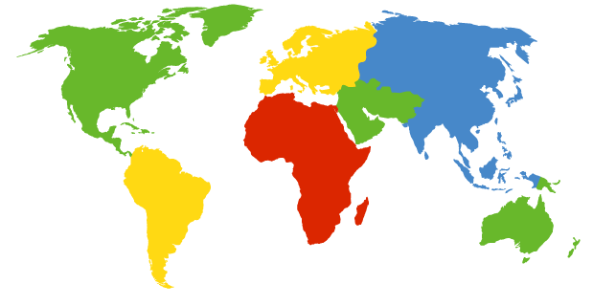

How do you contact a mobile friend?
Consider friend frequently changing addresses, how do you find her?
I wonder where Anisha moved to?
search all phone books?
call her parents?
expect her to let you know where she is?
Facebook!

Slide 51
Mobility: approaches
let routing handle it: routers advertise permanent address of mobile-nodes-in-residence via usual routing table exchange.
  routing tables indicate where each mobile located
  no changes to end-systems
let end systems handle it:
  indirect routing: communication from correspondent to mobile goes through home agent, then forwarded to remote
  direct routing: correspondent gets foreign address of mobile, sends directly to mobile

Slide 52
Mobility: approaches
let routing handle it: routers advertise permanent address of mobile-nodes-in-residence via usual routing table exchange.
  routing tables indicate where each mobile located
  no changes to end-systems
let end-systems handle it:
  indirect routing: communication from correspondent to mobile goes through home agent, then forwarded to remote
  direct routing: correspondent gets foreign address of mobile, sends directly to mobile
not
scalable
to millions of
mobiles

Slide 53
Mobility: registration
home network
visited network
1
2
wide-area network
mobile contacts foreign agent on entering visited network
foreign agent contacts home agent: “this mobile is resident in my network”
end result:
foreign agent knows about mobile
home agent knows location of mobile

Slide 54

Mobility via indirect routing
foreign agent receives packets, forwards to mobile
home agent intercepts packets, forwards to foreign agent
visited
network
home
network
3
wide-area network
2
1
correspondent addresses packets using home address of mobile
4
mobile replies directly to correspondent

Slide 55
Indirect Routing: comments
mobile uses two addresses:
  permanent address: used by correspondent (hence mobile location is transparent to correspondent)
  care-of address: used by home agent to forward datagrams to mobile
foreign agent functions may be done by mobile itself
triangle routing: correspondent–home network–mobile
  inefficient when
  correspondent, mobile
  are in same network

Slide 56
Indirect routing: moving between networks
suppose mobile user moves to another network
  registers with new foreign agent
  new foreign agent registers with home agent
  home agent updates care-of address for mobile
  packets continue to be forwarded to mobile (but with new care-of address)
mobility, changing foreign networks transparent: ongoing connections can be maintained!

Slide 57



Mobility via direct routing
foreign agent receives packets, forwards to mobile
visited
network
correspondent forwards directly to foreign agent
home
network
3
1
2
4
correspondent requests, receives foreign address of mobile
mobile replies directly to correspondent

Slide 58

Mobility via direct routing: comments
overcomes triangle routing problem
non-transparent to correspondent: correspondent must get care-of address from home agent
  what if mobile changes visited network?
3
1
2
4

Slide 59

Accommodating mobility with direct routing
anchor foreign agent: FA in first visited network
data always routed first to anchor FA
when mobile moves: new FA arranges to have data forwarded from old FA (chaining)
foreign net visited
at session start
anchor
foreign
agent
wide-area network
2
1
4
3
new
foreign
network
5
correspondent
agent
new foreign
agent
correspondent

Slide 60
Chapter 7 outline
7.1 Introduction
Wireless
7.2 Wireless links, characteristics
  CDMA
7.3 IEEE 802.11 wireless LANs (“Wi-Fi”)
7.4 Cellular Internet Access
  architecture
  standards (e.g., 3G, LTE)
Mobility
7.5 Principles: addressing and routing to mobile users
7.6 Mobile IP
7.7 Handling mobility in cellular networks
7.8 Mobility and higher-layer protocols

Slide 61
Mobile IP
RFC 3344
has many features we’ve seen:
  home agents, foreign agents, foreign-agent registration, care-of addresses, encapsulation (packet-within-a-packet)
three components to standard:
  indirect routing of datagrams
  agent discovery
  registration with home agent

Slide 62

Mobile IP: indirect routing
foreign-agent-to-mobile packet
packet sent by home agent to foreign agent: a packet within a packet
dest: 128.119.40.186
dest: 79.129.13.2
dest: 128.119.40.186
Permanent address: 128.119.40.186
Care-of address: 79.129.13.2
dest: 128.119.40.186
packet sent by correspondent

Slide 63
Mobile IP: agent discovery
agent advertisement: foreign and home agents advertise service by broadcasting ICMP messages (type field = 9)
H,F bits: home or foreign agent
R bit: registration required

Slide 64


Mobile IP: registration example
visited network: 79.129.13/24
home agent
HA: 128.119.40.7
foreign agent
COA: 79.129.13.2
mobile agent
MA: 128.119.40.186
ICMP agent adv.
COA: 79.129.13.2
….
registration req.
registration req.
COA: 79.129.13.2
HA: 128.119.40.7
MA: 128.119.40.186
Lifetime: 9999
identification: 714
encapsulation format
….
COA: 79.129.13.2
HA: 128.119.40.7
MA: 128.119.40.186
Lifetime: 9999
identification:714
….
registration reply
HA: 128.119.40.7
MA: 128.119.40.186
Lifetime: 4999
Identification: 714
encapsulation format
….
registration reply
HA: 128.119.40.7
MA: 128.119.40.186
Lifetime: 4999
Identification: 714
….
time

Slide 65
Components of cellular network architecture
review:
correspondent
wired public telephone
network
MSC
MSC
MSC
MSC
MSC
different cellular networks,
operated by different providers

Slide 66
Handling mobility in cellular networks
home network: network of cellular provider you subscribe to (e.g., Sprint PCS, Verizon)
  home location register (HLR): database in home network containing permanent cell phone #, profile information (services, preferences, billing), information about current location (could be in another network)
visited network: network in which mobile currently resides
  visitor location register (VLR): database with entry for each user currently in network
  could be home network

Slide 67

GSM: indirect routing to mobile
HLR
home
network
2
correspondent
home
Mobile
Switching
Center
home MSC consults HLR,
gets roaming number of
mobile in visited network
1
call routed
to home network
3
Public switched
telephone
network
VLR
Mobile
Switching
Center
4
home MSC sets up 2nd leg of call
to MSC in visited network
mobile
user
MSC in visited network completes
call through base station to mobile
visited
network

Slide 68
GSM: handoff with common MSC
handoff goal: route call via new base station (without interruption)
reasons for handoff:
  stronger signal to or from new BSS (continuing connectivity, less battery drain)
  load balance: free up channel in current BSS
  GSM doesn't mandate why to perform handoff (policy), only how (mechanism)
handoff initiated by old BSS
VLR
Mobile
Switching
Center
old
routing
new
routing
old BSS
new BSS

Slide 69
GSM: handoff with common MSC
1. old BSS informs MSC of impending handoff, provides list of 1⁺ new BSSs
2. MSC sets up path (allocates resources) to new BSS
3. new BSS allocates radio channel for use by mobile
4. new BSS signals MSC, old BSS: ready
5. old BSS tells mobile: perform handoff to new BSS
6. mobile, new BSS signal to activate new channel
7. mobile signals via new BSS to MSC: handoff complete. MSC reroutes call
8 MSC↔old BSS resources released
VLR
Mobile
Switching
Center
4
2
1
8
7
3
old BSS
5
6
new BSS

Slide 70
GSM: handoff between MSCs
anchor MSC: first MSC visited during call
  call remains routed through anchor MSC
new MSCs add on to end of MSC chain as mobile moves to new MSC
optional path minimization step to shorten multi-MSC chain
home network
correspondent
Home MSC
anchor MSC
PSTN
MSC
MSC
MSC
(a) before handoff

Slide 71
GSM: handoff between MSCs
anchor MSC: first MSC visited during call
  call remains routed through anchor MSC
new MSCs add on to end of MSC chain as mobile moves to new MSC
optional path minimization step to shorten multi-MSC chain
home network
correspondent
Home MSC
anchor MSC
PSTN
MSC
MSC
MSC
(b) after handoff

Slide 72

Handling Mobility in LTE
Paging: idle UE may move from cell to cell: network does not know where the idle UE is resident
  paging message from MME is broadcast by all eNodeBs to locate UE
handoff: similar to 3G:
  preparation phase
  execution phase
  completion phase
source
MME
P-GW
target
MME
old
routing
new
routing
old
eNodeB
new
eNodeB

Slide 73
Mobility: cellular versus Mobile IP
cellular element |  | Comment on cellular element | Mobile IP element
Home system | Network to which mobile user’s permanent phone number belongs |  |  | Home network
Gateway Mobile Switching Center, or “home MSC”. Home Location Register (HLR) | Home MSC: point of contact to obtain routable address of mobile user. HLR: database in home system containing permanent phone number, profile information, current location of mobile user, subscription information |  |  | Home agent
Visited System | Network other than home system where mobile user currently resides |  |  | Visited network
Visited Mobile services Switching Center. Visitor Location Record (VLR) | Visited MSC: responsible for setting up calls to and from mobile nodes in cells associated with MSC. VLR: temporary database entry in visited system, containing subscription information for each visiting mobile user |  |  | Foreign agent
Mobile Station Roaming Number (MSRN), or “roaming number” | Routable address for telephone call segment between home MSC and visited MSC, visible to neither the mobile nor the correspondent. |  |  | Care-of address

Slide 74
Wireless, mobility: impact on higher layer protocols
logically, impact should be minimal…
  best-effort service model remains unchanged
  TCP and UDP can (and do) run over wireless, mobile
…but performance-wise:
  packet loss and delay due to bit errors (discarded packets, delays for link-layer retransmissions) and handoff
  TCP interprets loss as congestion, will decrease congestion window unnecessarily
  delay impairments for real-time traffic
  limited bandwidth of wireless links

Slide 75
Chapter 7 summary
Wireless
wireless links:
  capacity, distance
  channel impairments
  CDMA
IEEE 802.11 (“Wi-Fi”)
  CSMA/CA reflects wireless channel characteristics
cellular access
  architecture
  standards (e.g., 3G, 4G LTE)
Mobility
principles: addressing, routing to mobile users
  home, visited networks
  direct, indirect routing
  care-of-addresses
case studies
  mobile IP
  mobility in GSM, LTE
impact on higher-layer protocols

