Slide 1
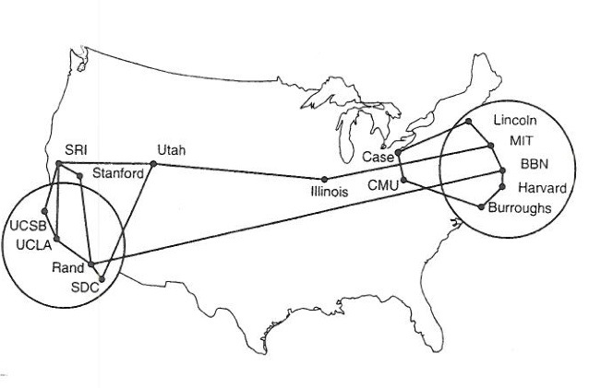
CS 125 – Applications DNS Reading: K&R C2
Note to Students:
The course slides are a combination of slides from:
Peterson & Davie
Kurose & Ross
My previous lectures
I claim no copyright for any of the material and would recommend either book for a detailed treatment of the material.

Slide 2
IP Suite In Action: End Hosts vs. Routers
host
host
HTTP message
HTTP
HTTP
TCP segment
TCP
TCP
router
router
IP packet
IP packet
IP packet
IP
IP
IP
IP
Ethernet
interface
Ethernet
interface
SONET
interface
SONET
interface
Ethernet
interface
Ethernet
interface
Frame

Slide 3
Domain Name System (DNS)
RFC 1034, STD 13
Name Syntax and rules for delegating authority over names
Specify implementation of a distributed system that maps names to addresses & Protocols to accomplish this

Slide 4
Goals of Today’s Lecture
Computer science concepts underlying DNS
Indirection: names in place of addresses
Hierarchy: in names, addresses, and servers
Caching: of mappings from names to/from addresses
Inner-workings of DNS
DNS resolvers and servers
Iterative and recursive queries
TTL-based caching
Web and DNS
Influence of DNS queries on Web performance
Server selection and load balancing

Slide 5
Names: Overview
What do names do?
identify objects
help locate objects
define membership in a group
specify a role
convey knowledge of a secret
Name space
defines set of possible names
consists of a set of name to value bindings

Slide 6
Host Names vs. IP addresses
Host names
Mnemonic name appreciated by humans
Variable length, alpha-numeric characters
Provide little (if any) information about location
Examples: www.cnn.com and ftp.eurocom.fr
IP addresses
Numerical address appreciated by routers
Fixed length, binary number
Hierarchical, related to host location (network)
Examples: 64.236.16.20 and 193.30.227.161

Slide 7
Separating Naming and Addressing
Names are easier to remember
www.cnn.com vs. 64.236.16.20
Addresses can change underneath
Move www.cnn.com to 64.236.16.20
E.g., renumbering when changing providers
Name could map to multiple IP addresses
www.cnn.com to multiple replicas of the Web site
Map to different addresses in different places
Address of a nearby copy of the Web site
E.g., to reduce latency, or return different content
Multiple names for the same address
E.g., aliases like ee.mit.edu and cs.mit.edu

Slide 8
History: Global Namespace maintained in Local File
Original name to address mapping
Flat namespace
/etc/hosts
SRI kept main copy
Downloaded regularly
Count of hosts was increasing: moving from a machine per domain to machine per user
Many more downloads
Many more updates

Slide 9
Global Namespace : Central Server
Central server
One place where all mappings are stored
All queries go to the central server
Many practical problems
Single point of failure
High traffic volume
Distant centralized database
Single point of update
Does not scale
Need a distributed, hierarchical collection of servers

Slide 10
Global Namespace: Domain Name System (DNS)
Properties of DNS
Hierarchical name space divided into zones
Distributed over a collection of DNS servers
Hierarchy of DNS servers
Root servers
Top-level domain (TLD) servers
Authoritative DNS servers
Local DNS server
Performing the translations
Local DNS servers
Resolver software

Slide 11
Domain Name System (DNS)
Elements
Resolver
Stub: simple, only asks questions
Recursive: takes a simple query and makes all necessary steps to get the full answer.
Caching: A recursive resolver that stores prior results and reuses them
Server
Authoritative: the servers that contain the zone file for a zone, one Primary and one or more Secondaries
Caching: A recursive resolver that stores prior results and reuses them
Some perform both roles at the same time.

Slide 12
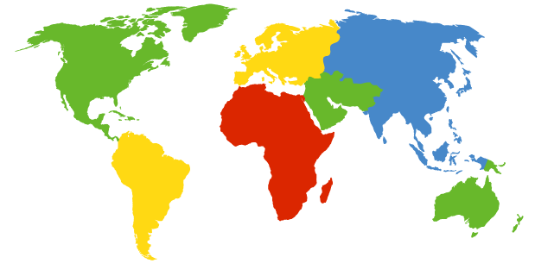
DNS Root Servers
13 root servers (see http://www.root-servers.org)
Given replicas, checkout how many servers there are
Labeled A through M
A Verisign, Dulles, VA
C Cogent, Herndon, VA (also Los Angeles)
D U Maryland College Park, MD
G US DoD Vienna, VA
H ARL Aberdeen, MD
J Verisign, ( 11 locations)
K RIPE London (also Amsterdam, Frankfurt)
I Autonomica, Stockholm (plus 3 other locations)
E NASA Mt View, CA
F Internet Software C. Palo Alto, CA (and 17 other locations)
m WIDE Tokyo
B USC-ISI Marina del Rey, CA
L ICANN Los Angeles, CA

Slide 13
TLD and Authoritative DNS Servers
Top-level domain (TLD) servers
Generic domains (e.g., com, org, edu + new ones)
Country domains (e.g., uk, fr, ca, jp)
Typically managed professionally
Network Solutions maintains servers for “com”
Educause maintains servers for “edu”
Authoritative DNS servers
Provide public records for hosts at an organization
For the organization’s servers (e.g., Web and mail)
Can be maintained locally or by a service provider

Slide 14
Distributed Hierarchical Database
unnamed root
com
edu
org
ac
uk
zw
arpa
generic domains
organizational
country domains
geographic
bar
ac
in-
addr
west
east
cam
12
foo
my
usr
34
my.east.bar.edu
usr.cam.ac.uk
56
12.34.56.0/24

Slide 15
Name Servers
Partition hierarchy into zones
edu
com
gov
mil
org
net
uk
fr
princeton
■ ■ ■
mit
cisco
■ ■ ■
yahoo
nasa
■ ■ ■
nsf
arpa
■ ■ ■
navy
acm
■ ■ ■
ieee
cs
ee
physics
ux01
ux04
Root
Each zone implemented by two or more name servers
name server
Princeton
■ ■ ■
Cisco
name server
name server
CS
■ ■ ■
EE
name server
name server

Slide 16
Using DNS
Local DNS server (“default name server”)
Usually near the end hosts who use it
Local hosts configured with local server (e.g., /etc/resolv.conf) or learn the server via DHCP
Client application
Extract server name (e.g., from the URL)
Do gethostbyname() to trigger resolver code
Server application
Extract client IP address from socket
Optional gethostbyaddr() to translate into name

Slide 17
Example
root DNS server
Host at cis.poly.edu wants IP address for gaia.cs.umass.edu
2
3
TLD DNS server
4
local DNS server
dns.poly.edu
5
7
6
Recursive
Or
Iterative?
1
8
authoritative DNS server
dns.cs.umass.edu
requesting host
cis.poly.edu
gaia.cs.umass.edu

Slide 18
Recursive vs. Iterative Queries
Recursive query
Ask server to get answer for you
E.g., request 1 and response 8
Iterative query
Ask server who to ask next
E.g., all other request-response pairs
root DNS server
2
3
TLD DNS server
4
local DNS server
dns.poly.edu
5
7
6
1
8
authoritative DNS server
dns.cs.umass.edu
requesting host
cis.poly.edu

Slide 19
DNS Caching
Performing all these queries takes time
And all this before the actual communication takes place
E.g., 1-second latency before starting Web download
Caching can substantially reduce overhead
The top-level servers very rarely change
Popular sites (e.g., www.cnn.com) visited often
Local DNS server often has the information cached
How DNS caching works
DNS servers cache responses to queries
Responses include a “time to live” (TTL) field
Server deletes the cached entry after TTL expires

Slide 20
Negative Caching
Remember things that don’t work
Misspellings likewww.cnn.comm and www.cnnn.com
These can take a long time to fail the first time
Good to remember that they don’t work
… so the failure takes less time the next time around

Slide 21
DNS Resource Records
RR format: (name, value, type, ttl)
DNS: distributed db storing resource records (RR)
Type=A
name is hostname
value is IP address
Type=CNAME
name is alias name for some “canonical” (the real) name
www.ibm.com is really
servereast.backup2.ibm.com
value is canonical name
Type=NS
name is domain (e.g. foo.com)
value is hostname of authoritative name server for this domain
Type=MX
value is name of mailserver associated with name

Slide 22
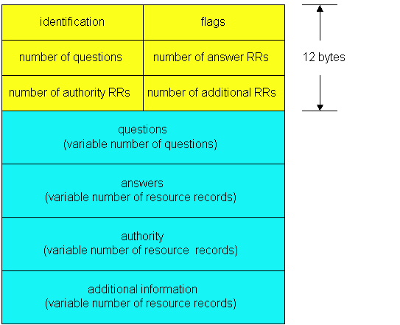
DNS Protocol
DNS protocol : query and reply messages, both with same message format
Message header
Identification: 16 bit # for query, reply to query uses same #
Flags:
Query or reply
Recursion desired
Recursion available
Reply is authoritative

Slide 23
DNS protocol, messages
2 bytes
2 bytes
identification
flags
# questions
# answer RRs
# authority RRs
# additional RRs
name, type fields
for a query
questions (variable # of questions)
RRs in response
to query
answers (variable # of RRs)
records for
authoritative servers
authority (variable # of RRs)
additional “helpful”
info that may be used
additional info (variable # of RRs)

Slide 24
Reliability
DNS servers are replicated
Name service available if at least one replica is up
Queries can be load balanced between replicas
UDP used for queries - WHY
Need reliability: must implement this on top of UDP
Try alternate servers on timeout
Exponential back off when retrying same server
Same identifier for all queries
Don’t care which server responds

Slide 25

Inserting Resource Records into DNS
Example: just created startup “FooBar”
Register foobar.com at Network Solutions
Provide registrar with names and IP addresses of your authoritative name server (primary and secondary)
Registrar inserts two RRs into the com TLD server:
(foobar.com, dns1.foobar.com, NS)
(dns1.foobar.com, 212.212.212.1, A)
Put in authoritative server dns1.foobar.com
Type A record for www.foobar.com
Type MX record for foobar.com
HMC CS DNS Table

Slide 26
Playing With Dig on UNIX
Dig (or nslookup) program
Allows querying of DNS system
Use flags to find name server (NS)
Disable recursion so that operates one step at a time
unix> dig +norecurse @a.root-servers.net NS www.cs.princeton.edu
;; AUTHORITY SECTION:
edu. 2D IN NS L3.NSTLD.COM.
edu. 2D IN NS D3.NSTLD.COM.
edu. 2D IN NS A3.NSTLD.COM.
edu. 2D IN NS E3.NSTLD.COM.
edu. 2D IN NS C3.NSTLD.COM.
edu. 2D IN NS G3.NSTLD.COM.
edu. 2D IN NS M3.NSTLD.COM.
edu. 2D IN NS H3.NSTLD.COM.

Slide 27
DNS and the Web

Slide 28
DNS Query in Web Download
User types or clicks on a URL
E.g., http://www.cnn.com/2006/leadstory.html
Browser extracts the site name
E.g., www.cnn.com
Browser calls gethostbyname() to learn IP address
Triggers resolver code to query the local DNS server
Eventually, the resolver gets a reply
Resolver returns the IP address to the browser
Then, the browser contacts the Web server
Creates and connects socket, and sends HTTP request

Slide 29
Multiple DNS Queries
Often a Web page has embedded objects
E.g., HTML file with embedded images
Each embedded object has its own URL
… and potentially lives on a different Web server
E.g., http://www.myimages.com/image1.jpg
Browser downloads embedded objects
Usually done automatically, unless configured otherwise
Requires learning the address for www.myimages.com

Slide 30
When are DNS Queries Unnecessary?
Browser is configured to use a proxy
E.g., browser sends all HTTP requests through a proxy
Then, the proxy takes care of issuing the DNS request
Requested Web resource is locally cached
E.g., cache has http://www.cnn.com/2006/leadstory.html
No need to fetch the resource, so no need to query
Browser recently queried for this host name
E.g., user recently visited http://www.cnn.com/
So, the browser already called gethostbyname()
… and may be locally caching the resulting IP address

Slide 31

Web Server Replicas
Popular Web sites can be easily overloaded
Web site often runs on multiple server machines
Internet

Slide 32
Directing Web Clients to Replicas
Simple approach: different names
www1.cnn.com, www2.cnn.com, www3.cnn.com
But, this requires users to select specific replicas
More elegant approach: different IP addresses
Single name (e.g., www.cnn.com), multiple addresses
E.g., 64.236.16.20, 64.236.16.52, 64.236.16.84, …
Authoritative DNS server returns many addresses
And the local DNS server selects one address
Authoritative server may (should) vary the order of addresses

Slide 33
Clever Load Balancing Schemes
Selecting the “best” IP address to return
Based on server performance
Based on geographic proximity
Based on network load
…
Example policies
Round-robin scheduling to balance server load
U.S. queries get one address, Europe another
Tracking the current load on each of the replicas

Slide 34
Challenge: What About DNS Caching?
Problem: DNS caching
What if performance properties change?
Web clients still learning old “best” Web server
… until the cached information expires
Solution: Small Time-to-Live values
Setting artificially small TTL values
… so replicas picked based on fresh information
Disadvantages: abuse of DNS?
Many more DNS request/response messages
Longer latency in initiating the Web requests

Slide 35
Attacking DNS
redirect attacks
man-in-middle
Intercept queries
DNS poisoning
Send bogus relies to DNS server, which caches
exploit DNS for DDoS
send queries with spoofed source address: target IP
requires amplification
DDoS attacks
bombard root servers with traffic
not successful to date
traffic filtering
local DNS servers cache IPs of TLD servers, allowing root server bypass
bombard TLD servers
potentially more dangerous

Slide 36
DNSSEC
RFC 3833, Summary of DNS Weakness
Role: Protect DNS
DNS Rrset is signed by the zone it belongs to
Zone DS Rrset is vouched for by parent zone.
DNSSEC is intended to protect DNS clients from forged DNS data
What DNSSEC does not do:
Make data in DNS any more current….

Slide 37
Conclusions
Domain Name System
Distributed, hierarchical database
Distributed collection of servers
Caching to improve performance
Readings
DNS Related RFCs > 100
DNSSEC - 4033, 4034, 4035
Original - 1034, 1035

