Slide 1
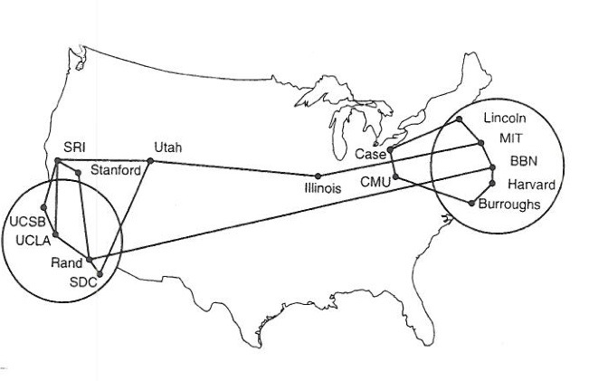
Interneting Control Protocols
Reading: Chapter 4
ARP - RFC 826, STD 37
DHCP - RFC 2131
ICMP - RFC 0792, STD 05
Note to Students:
The course slides are a combination of slides from:
Peterson & Davie
Kurose & Ross
My previous lectures
I claim no copyright for any of the material and would recommend either book for a detailed treatment of the material

Slide 2
Goals of Today’s Lecture
Bootstrapping an end host
  Learning its own configuration parameters (DHCP)
  What do you need to know?
IP level issues
  Error reporting and monitoring (with ICMP)
Locating Host
  Learning the link-layer addresses of other nodes (ARP)

Slide 3
Thus Far in the Class…
host
host
HTTP message
HTML
HTML
TCP segment
TCP
TCP
router
router
IP
IP packet
IP packet
IP packet
IP
IP
IP
Ethernet
interface
Ethernet
interface
SONET
interface
SONET
interface
Ethernet
interface
Ethernet
interface

Slide 4
So Far in the Class…
Top - Application protocols
Mentioned: Transport services built on IP
  TCP: reliable byte stream with congestion control
  UDP: unreliable message delivery
Bottom – Physical & Link
Internet Protocol (IP)
  Best-effort packet delivery service
  IP addresses and IP prefixes
  Packet forwarding based on longest-prefix match
NOW
  Try to set up host communication via IP Addresses
  Try to understand IP traffic issues

Slide 5
How To Bootstrap an End Host?
What IP address the host should use? Why?
What local Domain Name System server to use? Why?
How to send packets to remote destinations?
How to ensure incoming packets arrive? But best effort
???
1.2.3.7
1.2.3.156
host
host
...
DNS
host
host
...
DNS
1.2.3.0/24
5.6.7.0/24
1.2.3.19
router
router
router

Slide 6
Avoiding Manual Configuration
Dynamic Host Configuration Protocol (DHCP)
  End host learns how to send packets
  Learn IP address, DNS servers, and gateway
Address Resolution Protocol (ARP)
  Others learn how to send packets to that end host
  Learn mapping between IP address and MAC address
  Why? …All traffic is embedded in media (MAC) frames and delivered to host that way
???
1.2.3.7
1.2.3.156
host
host
...
DNS
host
host
...
DNS
1.2.3.0/24
5.6.7.0/24
1.2.3.19
router
router
router

Slide 7
Key Ideas in Both DHCP & ARP
Broadcasting: when in doubt, shout!
  Broadcast query to all hosts in the local-area-network
  … when you don’t know how to identify the right one
Caching: remember the past for a while
  Store the information you learn to reduce overhead
  Remember your own address & other host’s addresses
Soft state: eventually forget the past
  Associate a time-to-live field with the information
  … and either refresh or discard the information
  Key for robustness in the face of unpredictable change

Slide 8
LANS:
Need Yet Another Kind of Identity
LANs are designed for arbitrary network protocols
  Not just for IP and the Internet
Using IP address would require reconfiguration
  Every time the adapter was moved or powered up
Broadcasting all data to all adapters is expensive
  Requires every host on the LAN to inspect each packet
In general, Do NOT know the media type!!
Motivates separate Medium Access Control (MAC) addresses -- Media Level
Also motivated by IP riding on any media

Slide 9
MAC Address vs. IP Address
MAC addresses
  Hard-coded (not really) in read-only memory when adaptor is built
  Like a social security number
  Flat name space of 48 bits (e.g., 00-0E-9B-6E-49-76) moving to 64
  Portable, and can stay the same as the host moves
  Used to get packet between interfaces on same network
IP addresses
  Configured, or learned dynamically
  Like a postal mailing address
  Hierarchical name space of 32 bits (e.g., 12.178.66.9) IPv4
  Not portable, and depends on where the host is attached
  Used to get a packet to destination IP subnet

Slide 10
MAC Addresses on a LAN
1A-2F-BB-76-09-AD
LAN
= adapter
71-65-F7-2B-08-53
58-23-D7-FA-20-B0
0C-C4-11-6F-E3-98

Slide 11
Bootstrapping Problem
Host doesn’t have an IP address yet
  So, host doesn’t know what source IP address to use
Host doesn’t know who to ask for an IP address
  So, host doesn’t know what destination address to use
Solution: shout to discover a server who can help
  Broadcast a server-discovery message
  Server sends a reply offering an address
host
host
...
host
DHCP server

Slide 12
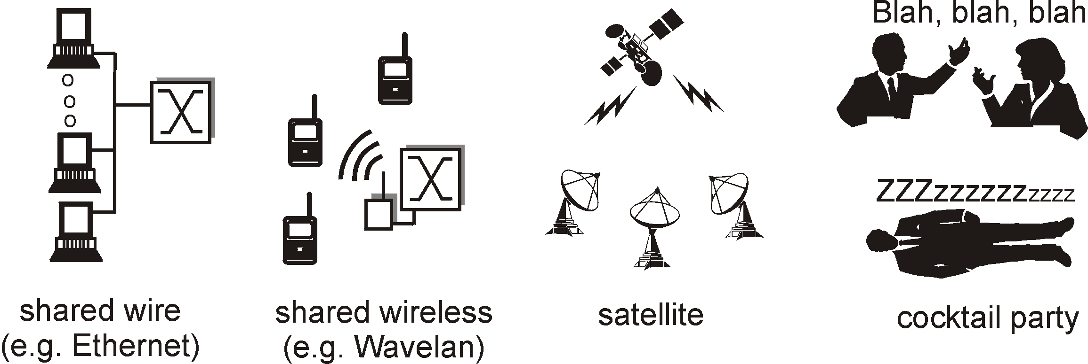
Broadcasting
Broadcasting: sending to everyone
  Special destination address: FF-FF-FF-FF-FF-FF
  All adapters on the LAN receive the packet
Delivering a broadcast packet
  Easy on a “shared media”
  Like shouting in a room – everyone can hear you
  E.g., Ethernet, wireless, and satellite links
  Switches MUST forward

Slide 13
Response from the DHCP Server
DHCP “offer message” from the server
  Configuration parameters (proposed IP address, mask, gateway router, DNS server, ...)
  Lease time (the time the information remains valid)
Multiple servers may respond
  Multiple servers on the same broadcast media
  Each may respond with an offer
  The client can decide which offer to accept
Accepting one of the offers
  Client sends a DHCP request echoing the parameters
  The DHCP server responds with an ACK to confirm
  … and the other servers see they were not chosen

Slide 14
Dynamic Host Configuration Protocol
DHCP discover
(broadcast)
arriving
client
DHCP offer
DHCP server
233.1.2.5
DHCP request
(broadcast)
I accept
DHCP ACK

Slide 15
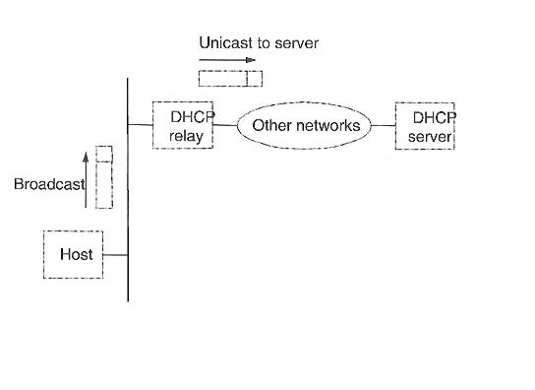
DHCP in Operation

Slide 16
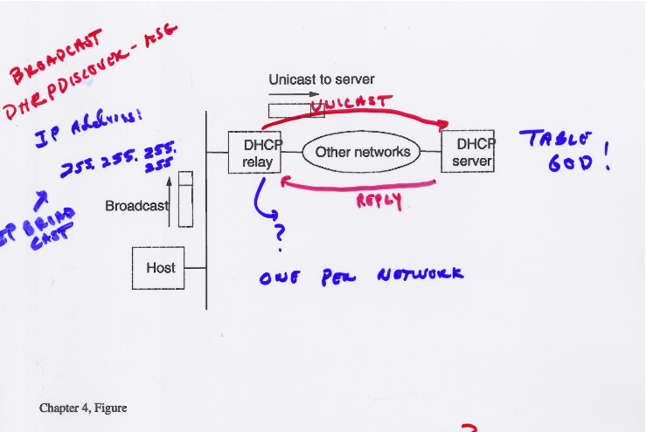

Slide 17
DHCP: more than IP addresses
DHCP can return more than just allocated IP address on subnet:
  address of first-hop router for client
  name and IP address of DNS sever
  network mask (indicating network versus host portion of address)

Slide 18


DHCP: example
DHCP
DHCP
UDP
IP
Eth
Phy
connecting laptop needs its IP address, addr of first-hop router, addr of DNS server: use DHCP
DHCP
DHCP
DHCP
DHCP
DHCP request encapsulated in UDP, encapsulated in IP, encapsulated in 802.1 Ethernet
DHCP
DHCP
UDP
IP
Eth
Phy
168.1.1.1
DHCP
DHCP
DHCP
Ethernet frame broadcast (dest: FFFFFFFFFFFF) on LAN, received at router running DHCP server
DHCP
router with DHCP
server built into
router
Ethernet demuxed to IP demuxed, UDP demuxed to DHCP

Slide 19
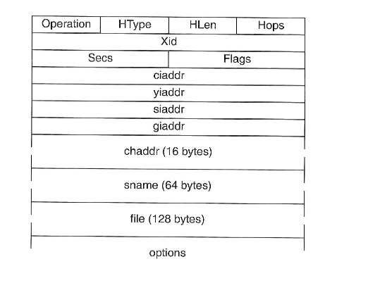
DHCP Packet Format

Slide 20
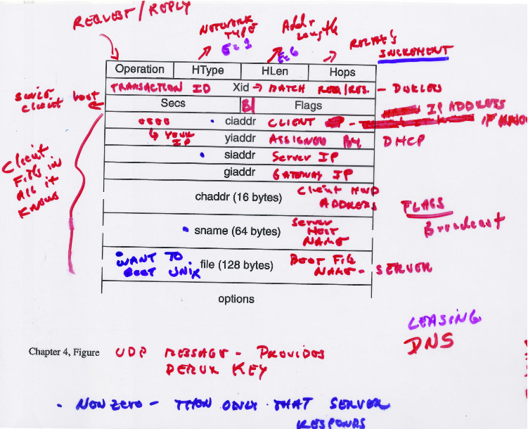

Slide 21
DHCP: Wireshark output (home LAN)
reply
Message type: Boot Reply (2)
Hardware type: Ethernet
Hardware address length: 6
Hops: 0
Transaction ID: 0x6b3a11b7
Seconds elapsed: 0
Bootp flags: 0x0000 (Unicast)
Client IP address: 192.168.1.101 (192.168.1.101)
Your (client) IP address: 0.0.0.0 (0.0.0.0)
Next server IP address: 192.168.1.1 (192.168.1.1)
Relay agent IP address: 0.0.0.0 (0.0.0.0)
Client MAC address: Wistron_23:68:8a (00:16:d3:23:68:8a)
Server host name not given
Boot file name not given
Magic cookie: (OK)
Option: (t=53,l=1) DHCP Message Type = DHCP ACK
Option: (t=54,l=4) Server Identifier = 192.168.1.1
Option: (t=1,l=4) Subnet Mask = 255.255.255.0
Option: (t=3,l=4) Router = 192.168.1.1
Option: (6) Domain Name Server
Length: 12; Value: 445747E2445749F244574092;
IP Address: 68.87.71.226;
IP Address: 68.87.73.242;
IP Address: 68.87.64.146
Option: (t=15,l=20) Domain Name = "hsd1.ma.comcast.net."
Message type: Boot Request (1)
Hardware type: Ethernet
Hardware address length: 6
Hops: 0
Transaction ID: 0x6b3a11b7
Seconds elapsed: 0
Bootp flags: 0x0000 (Unicast)
Client IP address: 0.0.0.0 (0.0.0.0)
Your (client) IP address: 0.0.0.0 (0.0.0.0)
Next server IP address: 0.0.0.0 (0.0.0.0)
Relay agent IP address: 0.0.0.0 (0.0.0.0)
Client MAC address: Wistron_23:68:8a (00:16:d3:23:68:8a)
Server host name not given
Boot file name not given
Magic cookie: (OK)
Option: (t=53,l=1) DHCP Message Type = DHCP Request
Option: (61) Client identifier
Length: 7; Value: 010016D323688A;
Hardware type: Ethernet
Client MAC address: Wistron_23:68:8a (00:16:d3:23:68:8a)
Option: (t=50,l=4) Requested IP Address = 192.168.1.101
Option: (t=12,l=5) Host Name = "nomad"
Option: (55) Parameter Request List
Length: 11; Value: 010F03062C2E2F1F21F92B
1 = Subnet Mask; 15 = Domain Name
3 = Router; 6 = Domain Name Server
44 = NetBIOS over TCP/IP Name Server
……
request

Slide 22
Deciding What IP Address to Offer
Server as centralized configuration database
  All parameters are statically configured in the server
  E.g., a dedicated IP address for each MAC address
  Avoids complexity of configuring hosts directly
  … while still having a permanent IP address per host
Or, dynamic assignment of IP addresses
  Server maintains a pool of available addresses
  … and assigns them to hosts on demand
  Leads to less configuration complexity
  … and more efficient use of the pool of addresses
  Though, it is harder to track the same host over time
Or Mix of the two

Slide 23
Soft State: Refresh or Forget
Why is a lease time necessary?
  Client can release the IP address (DHCP RELEASE)
    E.g., “ipconfig /release” at the DOS prompt
    E.g., clean shutdown of the computer
  But, the client might not release the address
    E.g., the host crashes (blue screen of death!)
    E.g., buggy client software
  And you don’t want the address to be allocated forever
Performance trade-offs
  Short lease time: returns inactive addresses quickly
  Long lease time: avoids overhead of frequent renewals

Slide 24
So, Now the Host Knows Things
IP address
Mask
Gateway router
DNS server
…
Get from a DHCP server that knows all
And can send packets to other IP addresses
  But, how to learn the MAC address of the destination?

Slide 25
Sending Packets Over a Link
1.2.3.53
1.2.3.156
host
host
...
Web
IP packet
1.2.3.53
1.2.3.156
router
Adaptors only understand MAC addresses
  Translate the destination IP address to MAC address
  Encapsulate the IP packet inside a link-level frame

Slide 26
Address Translation
How, given an IP address does a host send a datagram to a physical address?
Map IP addresses into physical addresses
  destination host, or
  next hop router
Techniques
  encode physical address in host part of IP address (IPv6)
  table-based, need to build and maintain table
ARP Address Resolution Protocol
  returns physical address
  table of IP to physical address bindings
  broadcast request if IP address not in table
  target machine responds with its physical address
  table entries are discarded if not refreshed

Slide 27
ARP - Address Resolution Protocol Table
Every node maintains an ARP table, ARP table at each host!!
  (IP address, MAC address) pair
Consult the table when sending a packet
  Map destination IP address to destination MAC address
  Encapsulate and transmit the data packet
But, what if the IP address is not in the table?
  Sender broadcasts: “Who has IP address 1.2.3.156?”
  Receiver responds: “MAC address 58-23-D7-FA-20-B0”
  Sender caches the result in its ARP table
No need for network administrator to get involved

Slide 28
ARP protocol: same LAN
A wants to send datagram to B
  B’s MAC address not in A’s ARP table.
A broadcasts ARP query packet, containing B's IP address
  destination MAC address = FF-FF-FF-FF-FF-FF
  all nodes on LAN receive ARP query
B receives ARP packet, replies to A with its (B's) MAC address
  frame sent to A’s MAC address (unicast)
A caches (saves) IP-to-MAC address pair in its ARP table until information becomes old (times out)
  soft state: information that times out (goes away) unless refreshed
ARP is “plug-and-play”:
  nodes create their ARP tables without intervention from net administrator

Slide 29
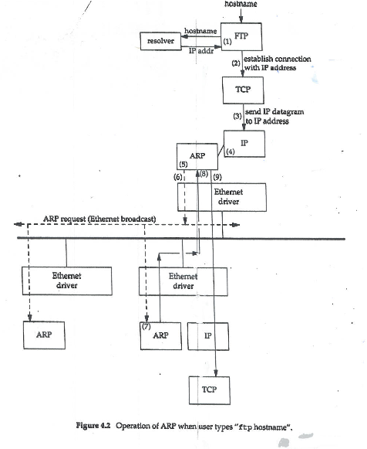

Slide 30
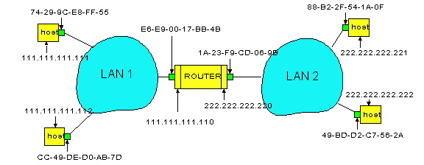
Example: A Sending a Packet to B
How does host A send an IP packet to host B?
A
R
B
A sends packet to R, and R sends packet to B.

Slide 31
Host A Decides to Send Through R
Host A constructs an IP packet to send to B
  Source 111.111.111.111, destination 222.222.222.222
Host A has a gateway router R
  Used to reach destinations outside of 111.111.111.0/24
  Address 111.111.111.110 for R learned via DHCP
A
R
B

Slide 32
Host A Sends Packet Through R
Host A learns the MAC address of R’s interface
  ARP request: broadcast request for 111.111.111.110
  ARP response: R responds with E6-E9-00-17-BB-4B
Host A encapsulates the packet and sends to R
A
R
B

Slide 33
R Decides how to Forward Packet
Router R’s adaptor receives the packet
  R extracts the IP packet from the Ethernet frame
  R sees the IP packet is destined to 222.222.222.222
Router R consults its forwarding table
  Packet matches 222.222.222.0/24 via other adaptor
A
R
B

Slide 34
R Sends Packet to B
Router R’s learns the MAC address of host B
  ARP request: broadcast request for 222.222.222.222
  ARP response: B responds with 49-BD-D2-C7-56-2A
Router R encapsulates the packet and sends to B
A
R
B

Slide 35
ARP Details
Request Format
  HardwareType: type of physical network (e.g., Ethernet)
  ProtocolType: type of higher layer protocol (e.g., IP)
  HLEN & PLEN: length of physical and protocol addresses
  Operation: request or response
  Source/Target-Physical/Protocol addresses
Notes
  table entries timeout in about 10 minutes
  update table with source when you are the target
  update table if already have an entry
  do not refresh table entries upon reference

Slide 36
ARP Packet Format
0
8
16
31
Hardware type = 1
ProtocolType = 0x0800
HLen = 48
PLen = 32
Operation
SourceHardwareAddr (bytes 0
―
3)
SourceHardwareAddr (bytes 4
―
5)
SourceProtocolAddr (bytes 0
―
1)
SourceProtocolAddr (bytes 2
―
3)
TargetHardwareAddr (bytes 0
―
1)
―
5)
TargetHardwareAddr (bytes 2
TargetProtocolAddr (bytes 0
―
3)

Slide 37
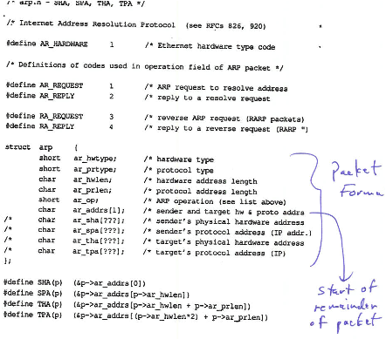

Slide 38
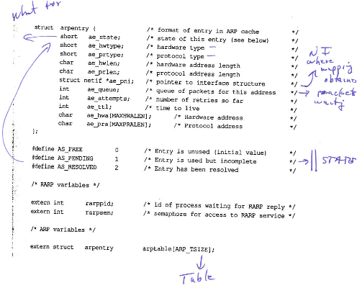

Slide 39
Error Reporting & Other IP Issues
Examples of errors a router may see
  Router doesn’t know where to forward a packet
  Packet’s time-to-live field expires
Router doesn’t really need to respond
  Best effort means never having to say you’re sorry
  So, IP could conceivably just silently drop packets
But, silent failures are really hard to diagnose
  IP includes basic feedback about network problems
  Internet Control Message Protocol (ICMP)

Slide 40
Internet Control Message Protocol (ICMP)
Sent to Source Host - NOT Routers (why?)
Echo (ping)
Redirect (from router to source host)
Destination unreachable (protocol, port, or host)
TTL exceeded (so datagrams don’t cycle forever)
Checksum failed
Reassembly failed
Cannot fragment

Slide 41
Internet Control Message Protocol
ICMP runs on top of IP
  In parallel to TCP and UDP
  Though still viewed as an integral part of IP
Diagnostics
  Triggered when an IP packet encounters a problem
    E.g., time exceeded or destination unreachable
  ICMP packet sent back to the source IP address
    Includes the error information (e.g., type and code)
    … and an excerpt of the original data packet for identification
  Source host receives the ICMP packet
    And inspects the except of the packet (e.g., protocol and ports)
    … to identify which socket should receive the error

Slide 42
IP Error Handling
What’s a gateway to do?
Gateway/Router is autonomous
No real coordination with source
Destination machine could be off
Time-to-Live gone
Congestion at Router/Gateway
Use Internet Control Message Protocol - ICMP
“Any IP device to any IP device”
Rides in IP

Slide 43
Example: Time Exceeded
Host sends an IP packet
  Each router decrements the time-to-live field
If time-to-live field reaches 0
  Router generates an ICMP message
  Sends a “time exceeded” message back to the source
1.2.3.7
5.6.7.156
host
host
...
DNS
host
host
...
DNS
8.9.10.11
Time exceeded
router
router
router

Slide 44
Traceroute: Exploiting “Time Exceeded”
Time-To-Live field in IP packet header
  Source sends a packet with a TTL of n
  Each router along the path decrements the TTL
  “TTL exceeded” sent when TTL reaches 0
Traceroute tool exploits this TTL behavior
Time
exceeded
TTL=1
source
destination
TTL=2
Send packets with TTL=1, 2, … and record source of “time exceeded” message

Slide 45
Ping: Echo and Reply
ICMP includes a simple “echo” function
  Sending node sends an ICMP “echo” message
  Receiving node sends an ICMP “echo reply”
Ping tool
  Tests the connectivity with a remote host
  … by sending regularly spaced echo commands
  … and measuring the delay until receiving the reply
Pinging a host
  “ping www.cs.princeton.edu” or “ping 12.157.34.212”
  Used to test if a machine is reachable and alive
  (However, some nodes have ICMP disabled… ☹)

Slide 46
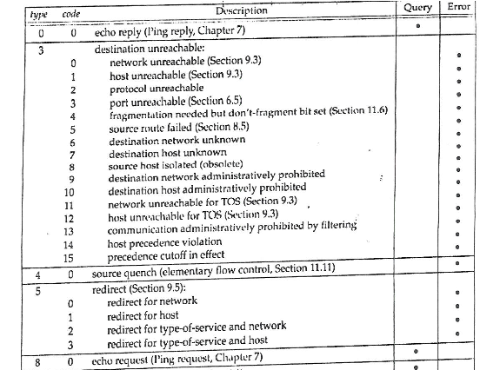

Slide 47
Conclusion
Important control functions
  Bootstrapping
  Error reporting and monitoring
Internet control protocols
  Dynamic Host Configuration Protocol (DHCP)
  Address Resolution Protocol (ARP)
  Internet Control Message Protocol (ICMP)

Slide 48
13:17 [mae@mike:] 1 % arp -a
neutron.cs.hmc.edu (134.173.42.1) at e0:d1:73:7e:e6:c8 on en8 ifscope [ethernet]
gute.cs.hmc.edu (134.173.42.41) at 74:46:a0:4e:17:20 on en8 ifscope [ethernet]
greebo.cs.hmc.edu (134.173.42.42) at a4:5d:36:b6:30:fc on en8 ifscope [ethernet]
mallet.cs.hmc.edu (134.173.42.59) at 90:b1:1c:88:eb:78 on en8 ifscope [ethernet]
chp.cs.hmc.edu (134.173.42.128) at 2c:76:8a:3e:d9:db on en8 ifscope [ethernet]
berg.cs.hmc.edu (134.173.42.129) at 74:46:a0:50:32:ef on en8 ifscope [ethernet]
ark.cs.hmc.edu (134.173.42.130) at 68:5:ca:38:5d:f8 on en8 ifscope [ethernet]
jumbo.cs.hmc.edu (134.173.42.168) at 0:14:38:8f:2a:9f on en8 ifscope [ethernet]
cortana.cs.hmc.edu (134.173.42.196) at 0:24:36:f4:9b:b8 on en8 ifscope [ethernet]
? (134.173.42.255) at ff:ff:ff:ff:ff:ff on en8 ifscope [ethernet]
? (134.173.192.1) at a2:1:0:0:0:e on en0 ifscope [ethernet]
? (134.173.223.255) at ff:ff:ff:ff:ff:ff on en0 ifscope [ethernet]
? (224.0.0.251) at 1:0:5e:0:0:fb on en8 ifscope permanent [ethernet]
? (239.255.255.250) at 1:0:5e:7f:ff:fa on en8 ifscope permanent [ethernet]
? (239.255.255.250) at 1:0:5e:7f:ff:fa on en0 ifscope permanent [ethernet]
broadcasthost (255.255.255.255) at ff:ff:ff:ff:ff:ff on en8 ifscope [ethernet]

Slide 49
13:18 [mike@knuth:] 1 % arp -a
oldiotta.cs.hmc.edu (134.173.42.158) at ac:1f:6b:91:21:30 [ether] on br0
diffie.cs.hmc.edu (134.173.42.91) at 00:14:22:7c:88:3f [ether] on br0
wilkes.cs.hmc.edu (134.173.42.167) at 00:11:43:fd:4d:2e [ether] on br0
clover.cs.hmc.edu (134.173.42.33) at 40:6c:8f:54:90:14 [ether] on br0
rue.cs.hmc.edu (134.173.42.96) at 40:6c:8f:32:b8:bf [ether] on br0
pecan.cs.hmc.edu (134.173.42.175) at 68:fe:f7:02:83:d5 [ether] on br0
gute.cs.hmc.edu (134.173.42.41) at 74:46:a0:4e:17:20 [ether] on br0
hickory.cs.hmc.edu (134.173.42.171) at 68:fe:f7:02:82:d1 [ether] on br0
toyon.cs.hmc.edu (134.173.42.183) at 68:fe:f7:02:82:a3 [ether] on br0
banana.cs.hmc.edu (134.173.42.49) at 02:8b:06:40:c0:de [ether] on br0
sumac.cs.hmc.edu (134.173.42.179) at 68:fe:f7:02:87:b9 [ether] on br0
ranunculus.cs.hmc.edu (134.173.42.124) at 68:5b:35:7c:4a:59 [ether] on br0
iottavm2.cs.hmc.edu (134.173.42.187) at 00:0c:29:1b:f2:97 [ether] on br0
lothlorien.cs.hmc.edu (134.173.42.5) at <incomplete> on br0
olympia.cs.hmc.edu (134.173.42.68) at 10:dd:b1:df:2b:a3 [ether] on br0
neutron.cs.hmc.edu (134.173.42.1) at e0:d1:73:7e:e6:c8 [ether] on br0
state.cs.hmc.edu (134.173.42.139) at 00:3e:e1:b7:2a:8b [ether] on br0
elm.cs.hmc.edu (134.173.42.202) at <incomplete> on br0
azalea.cs.hmc.edu (134.173.42.80) at ac:87:a3:32:e2:ea [ether] on br0
george.cs.hmc.edu (134.173.42.155) at d8:cb:8a:18:87:63 [ether] on br0
newknuth.cs.hmc.edu (134.173.42.101) at 78:7b:8a:af:c2:2e [ether] on br0
max.cs.hmc.edu (134.173.42.164) at 10:dd:b1:ea:74:44 [ether] on br0
shuffler.cs.hmc.edu (134.173.42.97) at 00:25:90:e8:3d:ce [ether] on br0
endpin.cs.hmc.edu (134.173.42.160) at 80:18:44:e0:39:b4 [ether] on br0
satsuki.cs.hmc.edu (134.173.42.109) at 00:50:b6:8c:ee:26 [ether] on br0
olive.cs.hmc.edu (134.173.42.172) at 68:fe:f7:02:83:70 [ether] on br0
jumbo.cs.hmc.edu (134.173.42.168) at 00:14:38:8f:2a:9f [ether] on br0
greebo.cs.hmc.edu (134.173.42.42) at a4:5d:36:b6:30:fc [ether] on br0
tamarack.cs.hmc.edu (134.173.42.180) at 68:fe:f7:02:82:08 [ether] on br0
juniper.cs.hmc.edu (134.173.42.184) at 68:fe:f7:02:82:37 [ether] on br0
baobab.cs.hmc.edu (134.173.42.69) at 34:15:9e:17:9c:e8 [ether] on br0
vilkes.cs.hmc.edu (134.173.42.132) at 52:54:00:8c:bf:e8 [ether] on br0
chp.cs.hmc.edu (134.173.42.128) at 2c:76:8a:3e:d9:db [ether] on br0
kay.cs.hmc.edu (134.173.42.2) at 0c:c4:7a:6a:e5:aa [ether] on br0
church.cs.hmc.edu (134.173.42.140) at 00:30:48:fe:4c:16 [ether] on br0
geranium.cs.hmc.edu (134.173.42.22) at 40:6c:8f:54:8e:98 [ether] on br0
birnam.cs.hmc.edu (134.173.42.93) at 10:dd:b1:df:13:31 [ether] on br0
boerkoel2.cs.hmc.edu (134.173.42.89) at 00:50:b6:8c:fe:68 [ether] on br0
larkspur.cs.hmc.edu (134.173.42.26) at 40:6c:8f:54:87:1e [ether] on br0
purves.cs.hmc.edu (134.173.42.165) at 00:25:90:58:dd:16 [ether] on br0
chestnut.cs.hmc.edu (134.173.42.102) at 78:7b:8a:b0:f5:28 [ether] on br0
vmhost.iotta.cs.hmc.edu (134.173.42.161) at d4:ae:52:c5:94:ef [ether] on br0
columbia.cs.hmc.edu (134.173.42.98) at a4:5d:36:5d:74:27 [ether] on br0
mangrove.cs.hmc.edu (134.173.42.173) at 68:fe:f7:02:82:c2 [ether] on br0
watcher.cs.hmc.edu (134.173.42.169) at <incomplete> on br0
ginkgo.cs.hmc.edu (134.173.42.181) at 68:fe:f7:02:82:76 [ether] on br0
pinyon.cs.hmc.edu (134.173.42.177) at 68:fe:f7:02:80:6f [ether] on br0
common.cs.hmc.edu (134.173.42.51) at <incomplete> on br0
acacia.cs.hmc.edu (134.173.42.185) at 68:fe:f7:02:82:a2 [ether] on br0
mallet.cs.hmc.edu (134.173.42.59) at 90:b1:1c:88:eb:78 [ether] on br0
rhododendron.cs.hmc.edu (134.173.42.122) at 68:5b:35:7c:4b:72 [ether] on br0
parchmon.cs.hmc.edu (134.173.42.133) at 52:54:00:d7:1a:c9 [ether] on br0
berg.cs.hmc.edu (134.173.42.129) at 74:46:a0:50:32:ef [ether] on br0
anemone.cs.hmc.edu (134.173.42.3) at 40:6c:8f:32:95:e6 [ether] on br0
router42.cs.hmc.edu (134.173.42.200) at e0:d1:73:7e:e6:c8 [ether] on br0
primrose.cs.hmc.edu (134.173.42.11) at c4:2c:03:10:aa:eb [ether] on br0
birch.cs.hmc.edu (134.173.42.74) at 68:fe:f7:02:82:a8 [ether] on br0
inuyasha.cs.hmc.edu (134.173.42.149) at 00:0a:95:a6:72:88 [ether] on br0
sequoia.cs.hmc.edu (134.173.42.86) at ac:87:a3:08:1d:24 [ether] on br0
lotus.cs.hmc.edu (134.173.42.82) at ac:87:a3:32:f7:01 [ether] on br0
mallow.cs.hmc.edu (134.173.42.27) at 40:6c:8f:54:91:ab [ether] on br0
buckthorn.cs.hmc.edu (134.173.42.103) at 78:7b:8a:af:b5:a8 [ether] on br0
sivapithecus.cs.hmc.edu (134.173.42.166) at 00:25:90:58:c2:e8 [ether] on br0
papaya.cs.hmc.edu (134.173.42.174) at 68:fe:f7:02:84:1f [ether] on br0
saturn.cs.hmc.edu (134.173.42.107) at e0:d5:5e:b2:79:4b [ether] on br0
hawthorn.cs.hmc.edu (134.173.42.170) at 68:fe:f7:02:82:5f [ether] on br0
mango.cs.hmc.edu (134.173.42.52) at 10:dd:b1:a4:df:7a [ether] on br0
tanoak.cs.hmc.edu (134.173.42.182) at 68:fe:f7:02:80:7a [ether] on br0
bow.cs.hmc.edu (134.173.42.60) at <incomplete> on br0
iottavm1.cs.hmc.edu (134.173.42.186) at 00:0c:29:6e:07:bb [ether] on br0
durandal.cs.hmc.edu (134.173.42.197) at 00:24:36:f4:9d:42 [ether] on br0
ark.cs.hmc.edu (134.173.42.130) at 68:05:ca:38:5d:f8 [ether] on br0
elderflower.cs.hmc.edu (134.173.42.12) at 98:5a:eb:df:3b:dc [ether] on br0
snapdragon.cs.hmc.edu (134.173.42.8) at 40:6c:8f:54:8a:73 [ether] on br0
press.cs.hmc.edu (134.173.42.138) at 0c:c4:7a:3b:34:96 [ether] on br0
hazel.cs.hmc.edu (134.173.42.20) at 78:7b:8a:af:b5:fe [ether] on br0
yapton.cs.hmc.edu (134.173.42.150) at <incomplete> on br0
13:18 [mike@knuth:] 2 %

Slide 50
16:47 [mae@TontoPD:] 3 % arp -a
bkemae66-18.home (10.207.1.1) at 60:38:e0:8d:0:c6 on en0 ifscope [ethernet]
\casita.home (10.207.1.100) at 9c:20:7b:a2:de:48 on en0 ifscope [ethernet]
brw008092cb80bc.home (10.207.1.120) at 0:80:92:cb:80:bc on en0 ifscope [ethernet]
popsipadpropd.home (10.207.1.121) at 98:1:a7:52:99:26 on en0 ifscope [ethernet]
palm-desert.home (10.207.1.123) at 68:64:4b:26:34:73 on en0 ifscope [ethernet]
tontopd.home (10.207.1.136) at 60:3:8:91:2c:30 on en0 ifscope permanent [ethernet]
? (10.207.1.255) at ff:ff:ff:ff:ff:ff on en0 ifscope [ethernet]
? (224.0.0.251) at 1:0:5e:0:0:fb on en0 ifscope permanent [ethernet]
? (239.255.255.250) at 1:0:5e:7f:ff:fa on en0 ifscope permanent [ethernet]
broadcasthost (255.255.255.255) at ff:ff:ff:ff:ff:ff on en0 ifscope [ethernet]

