Slide 1

Links
P&D Chapter 2
K&R Chapter 6
Note to Students:
The course slides are a combination of slides from:
Peterson & Davie
Kurose & Ross
My previous lectures
I claim no copyright for any of the material and would recommend either book for a detailed treatment of the material

Slide 2
Goals of Today’s Lecture
Link-layer services
Encoding, framing, and error detection
Error correction and flow control
Sharing a shared media
Channel partitioning
Taking turns
Random access
Shared Networks
Ethernet
Token ring - brief
Wireless – skip
Cable

Slide 3
Message, Segment, Packet, and Frame
Host-Node
host
HTTP message
HTTP
HTTP
TCP segment
TCP
TCP
Router- Node
router
IP
IP packet
IP packet
IP packet
IP
IP
IP
Ethernet
interface
Ethernet
interface
SONET
interface
SONET
interface
Ethernet
interface
Ethernet
interface
SONET frame
Ethernet frame
Links
Ethernet frame

Slide 4















Access networks and physical media
Q: How to connect end systems to edge router?
residential access nets
institutional access networks (school, company)
mobile access networks
keep in mind:
bandwidth (bits per second) of access network?
shared or dedicated?

Slide 5

Access network: digital subscriber line (DSL)
central office
telephone
network
DSL
modem
splitter
DSLAM
ISP
voice, data transmitted
at different frequencies over
dedicated line to central office
DSL access
multiplexer
use existing telephone line to central office DSLAM
data over DSL phone line goes to Internet
voice over DSL phone line goes to telephone net
< 2.5 Mbps upstream transmission rate (typically < 1 Mbps)
< 24 Mbps downstream transmission rate (typically < 10 Mbps)

Slide 6
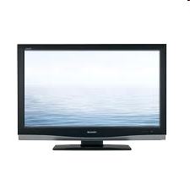


Access network: cable network
cable headend
…
cable
modem
splitter
C
O
N
T
R
O
L
V
I
D
E
O
V
I
D
E
O
V
I
D
E
O
V
I
D
E
O
V
I
D
E
O
V
I
D
E
O
D
A
T
A
D
A
T
A
1
2
3
4
5
6
7
8
9
Channels
frequency division multiplexing: different channels transmitted
in different frequency bands

Slide 7
Access network: cable network
cable headend
…
cable
modem
splitter
CMTS
cable modem
termination system
data, TV transmitted at different
frequencies over shared cable
distribution network
ISP
HFC: hybrid fiber coax
asymmetric: up to 30Mbps downstream transmission rate, 2 Mbps upstream transmission rate
network of cable, fiber attaches homes to ISP router
homes share access network to cable headend
unlike DSL, which has dedicated access to central office BUT Low speed

Slide 8





Access network: home network
wireless
devices
Where is Bottleneck?
to/from headend or central office
often combined
in single box
cable or DSL modem
wireless access
point (54 Mbps)
router, firewall, NAT
wired Ethernet (1 Gbps)

Slide 9









Access Network: Enterprise (Ethernet)
institutional link to
ISP (Internet)
institutional router
Ethernet
switch
institutional mail,
web servers
typically used in companies, universities, etc.
10 Mbps, 100Mbps, 1Gbps, 10Gbps transmission rates
today, end systems typically connect into Ethernet switch

Slide 10









Access Network: Wireless
shared wireless access network connects end system to router
via base station aka “access point”
wide-area wireless access
provided by telco (cellular) operator, 10’s km
between 1 and 10 Mbps
3G, 4G: LTE
wireless LANs:
within building (100 ft.)
802.11b/g/n (WiFi): 11, 54, 450 Mbps transmission rate
to Internet
Two Different
Networks
to Internet

Slide 11

Host: sends packets of data
host sending function:
takes application message
breaks into smaller chunks, known as packets, of length L bits
transmits packet into access network at transmission rate R – how fast can put bits on wire
link transmission rate, aka link capacity, aka link bandwidth
two packets,
L bits each
2
1
R: link transmission rate
host
packet
transmission
delay
time needed to
transmit L-bit
packet into link
L (bits)
R (bits/sec)
=
=

Slide 12
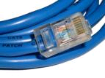
Physical media
bit: propagates between transmitter/receiver pairs
physical link: what lies between transmitter & receiver
guided media:
signals propagate in solid media: copper, fiber, coax
unguided media:
signals propagate freely, e.g., radio
twisted pair (TP)
two insulated copper wires
Category 5: 100 Mbps, 1 Gbps Ethernet
Category 6: 10Gbps

Slide 13


Physical media: coax, fiber
coaxial cable:
two concentric copper conductors
bidirectional
broadband:
multiple channels on cable
HFC
fiber optic cable:
glass fiber carrying light pulses, each pulse a bit
high-speed operation:
high-speed point-to-point transmission (e.g., 10’s-100’s Gbps transmission rate)
low error rate:
repeaters spaced far apart
immune to electromagnetic noise

Slide 14
Physical media: radio
signal carried in electromagnetic spectrum
no physical “wire”
bidirectional
propagation environment effects:
reflection
obstruction by objects
interference
radio link types:
terrestrial microwave
e.g. up to 45 Mbps channels
LAN (e.g., WiFi)
54 Mbps
wide-area (e.g., cellular)
4G cellular: ~ 10 Mbps
satellite
Kbps to 45Mbps channel (or multiple smaller channels)
270 msec end-end delay
geosynchronous versus low altitude

Slide 15


Link layer: introduction
terminology:
hosts and routers: nodes
communication channels that connect adjacent nodes along communication path: links
wired links
wireless links
LANs
layer-2 packet: frame, encapsulates datagram
data-link layer has responsibility of
transferring datagram from one node
to physically adjacent node over a link via frames

Slide 16
Adaptors Communicating
datagram
link layer protocol
frame
frame
sending
node
adapter
adapter
receiving
node
Link layer implemented in adaptor (network interface card)
Ethernet card, PCMCI card, 802.11 card
Sending side:
Encapsulates datagram (packet) in frames
Adds error checking bits, flow control, etc.??
Receiving side
Looks for errors, flow control, etc.
Extracts datagram (how is datagram found) and passes to receiving node

Slide 17
Link Layer Protocol for Each Hop
TCP/IP packet transferred over multiple hops
Each hop has a link layer protocol
May be different on different hops
Analogy: trip from HMÇ to Auckland
Limo: HMC to LAX
Plane: LAX to Auckland AP
Car: Auckland AP to hotel
Refining the analogy
Tourist == datagram/packet
Transport segment == communication link
Transportation mode == link-layer protocol
Travel agent == routing algorithm
Transport vehicle == frame

Slide 18
Link layer services
framing, link access:
encapsulate datagram into frame, adding header, trailer
channel access if shared medium
“MAC” addresses used in frame headers to identify source, destination
different from IP address!
reliable delivery between adjacent nodes
seldom used on low bit-error link (fiber, some twisted pair)
wireless links: high error rates
Q: why both link-level and end-end reliability?

Slide 19
Link-Layer Services
Encoding
Representing the 0s and 1s on the link
Framing
Encapsulating packet into frame, adding header, trailer
Using MAC addresses, rather than IP addresses
Error detection
Errors caused by signal attenuation, noise.
Receiver detecting presence of errors
Error correction
Receiver correcting errors without retransmission
Flow control
Pacing between adjacent sending and receiving nodes

Slide 20
Encoding
Signals propagate over physical links
Source node encodes the bits into a signal
Receiving node decodes the signal back into bits
Simplify some electrical engineering details
Assume two discrete signals, high and low
E.g., could correspond to two different voltages
Simple approach
High for a 1,
low for a 0
NRZ:
NonReturn to Zero
0 0 1 1 0 0 1 1 0 0 0 1 1 1 1 1 0 0

Slide 21
Problem With Simple Approach
Long strings of 0s or 1s introduce problems
No transitions from low-to-high, or high-to-low..Why?
Receiver keeps average of signal it has received
Uses the average to distinguish between high and low
Long flat strings make receiver sensitive to small change
Transitions also necessary for clock recovery
Receiver uses transitions to drive its own clock
Long flat strings do not produce any transitions
Can lead to clock drift at the receiver

Slide 22
Alternative Encodings
Non-return to Zero Inverted (NRZI)
make a transition from current signal to encode a one; stay at current signal to encode a zero
solves the problem of consecutive ones
Manchester
transmit XOR of the NRZ encoded data and the clock
only 50% efficient (bit rate = 1/2 baud rate)
Always a rise or a fall

Slide 23
Encodings (cont)

Slide 24
Encodings (cont)
4B/5B
every 4 bits of data encoded in a 5-bit code
5-bit codes selected to have no more than one leading 0 and no more than two trailing 0s
thus, never get more than three consecutive 0s
resulting 5-bit codes are transmitted using NRZI
achieves 80% efficiency

Slide 25
Framing
Break sequence of bits into a frame
Typically implemented by network adaptor
HOW??

Slide 26
Framing
Sentinel-based
Delineate frame with special pattern (e.g., 01111110)
Problem: what if special patterns occurs within frame?
Solution: escaping the special characters -
E.g., sender always inserts a 0 after five 1s – “bit stuffing”
… and receiver always removes a 0 appearing after five 1s
Similar to escaping special characters in C programs
01111110
Frame contents
01111110

Slide 27
Framing (Continued)
Counter-based
Include the payload length in the header
… instead of putting a sentinel at the end
Problem: what if the count field gets corrupted?
Causes receiver to think the frame ends at a different place
Solution: catch later when doing error detection
And wait for the next sentinel for the start of a new frame
Clock-based
Make each frame a fixed size
No ambiguity about start and end of frame
But, may be wasteful of bandwidth: empty msg or many headers

Slide 28
Framing Approaches
Sentinel-based
delineate frame with special pattern: 01111110
e.g., HDLC, SDLC, PPP
problem: special pattern appears in the payload
solution: bit stuffing
sender: insert 0 after five consecutive 1s
receiver: delete 0 that follows five consecutive 1s

Slide 29
Framing Approaches (cont)
Counter-based
include payload length in header
e.g., DDCMP
problem: count field corrupted
solution: catch when CRC fails

Slide 30
Framing Approaches (cont)
Clock-based
each frame is 125us long (9x90 bytes)
e.g., SONET: Synchronous Optical Network
STS-n (STS-1 = 51.84 Mbps)

Slide 31
Error Detection
Errors are unavoidable
Electrical interference, thermal noise, etc.
Error detection
Transmit extra (redundant) information
Use redundant information to detect errors
Extreme case: send two copies of the data
Trade-off: accuracy vs. overhead
Techniques for detecting errors
Parity checking
Checksum
Cyclic Redundancy Check (CRC)

Slide 32
Error Detection Techniques
Parity check
Add an extra bit to a 7-bit code
Odd parity: ensure an odd number of 1s
E.g., 0101011 becomes 01010111
Even parity: ensure an even number of 1s
E.g., 0101011 becomes 01010110
Checksum
Treat data as a sequence of 16-bit words
Compute a sum of all the 16-bit words, with no carries
Transmit the sum along with the packet
Cyclic Redundancy Check (CRC)
See book for details

Slide 33
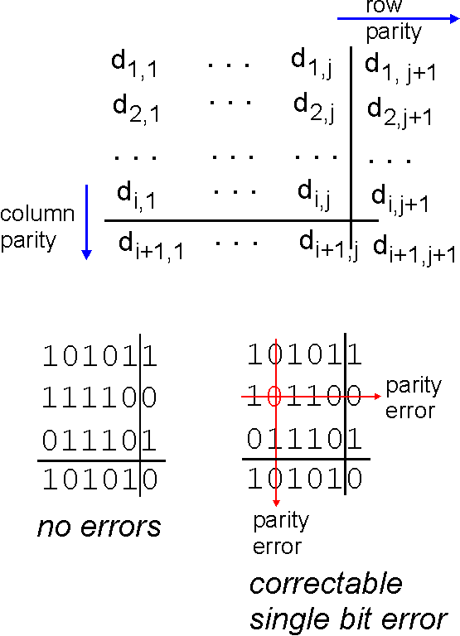
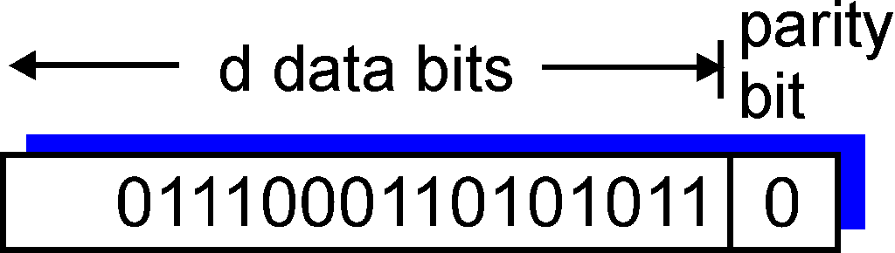
Parity checking
single bit parity:
detect single bit errors
two-dimensional bit parity:
detect and correct single bit errors
0
0
* Check out the online interactive exercises for more examples: http://gaia.cs.umass.edu/kurose_ross/interactive/

Slide 34
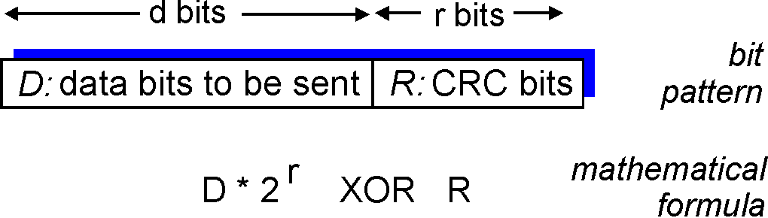
CRC Check
powerful error-detection coding
view data bits, D, as a binary number
choose r+1 bit pattern (generator), G
goal: choose r CRC bits, R, such that
<D,R> exactly divisible by G (modulo 2)
receiver knows G, divides <D,R> by G. If non-zero remainder: error detected!
can detect all burst errors less than r+1 bits
widely used in practice (Ethernet, 802.11 WiFi, ATM)

Slide 35
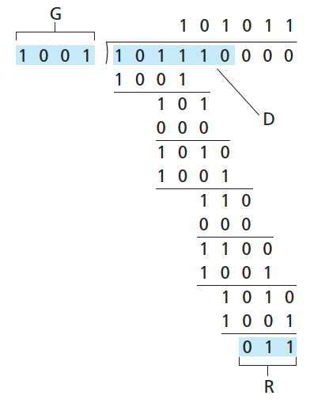
CRC example
want:
D.2^{r} XOR R = nG
equivalently:
D.2^{r} = nG XOR R
equivalently:
if we divide D.2^{r} by G, want remainder R to satisfy:
D.2^{r}
G
R = remainder [ ]
* Check out the online interactive exercises for more examples: http://gaia.cs.umass.edu/kurose_ross/interactive/

Slide 36
CRC cont: Selecting C(x)
All single-bit errors, as long as the x^{k} and x⁰ terms have non-zero coefficients.
All double-bit errors, as long as C(x) contains a factor with at least three terms
Any odd number of errors, as long as C(x) contains the factor (x + 1)
Any ‘burst’ error (i.e., sequence of consecutive error bits) for which the length of the burst is less than k bits.
Most burst errors of larger than k bits can also be detected
See literature for common C(x)

Slide 37
Errors cont: Internet Checksum Algorithm
View message as a sequence of 16-bit integers; sum using 16-bit ones-complement arithmetic; take ones-complement of the result.
u_short
cksum(u_short *buf, int count)
{
register u_long sum = 0;
while (count--)
{
sum += *buf++;
if (sum & 0xFFFF0000)
{
/* carry occurred, so wrap around */
sum &= 0xFFFF;
sum++;
}
}
return ~(sum & 0xFFFF);
}

Slide 38
Internet checksum (review)
goal: detect “errors” (e.g., flipped bits) in transmitted packet (note: used at transport layer only)
sender:
treat segment contents as sequence of 16-bit integers
checksum: addition (1’s complement sum) of segment contents
sender puts checksum value into UDP checksum field
receiver:
compute checksum of received segment
check if computed checksum equals checksum field value:
NO - error detected
YES - no error detected. But maybe errors nonetheless?

Slide 39
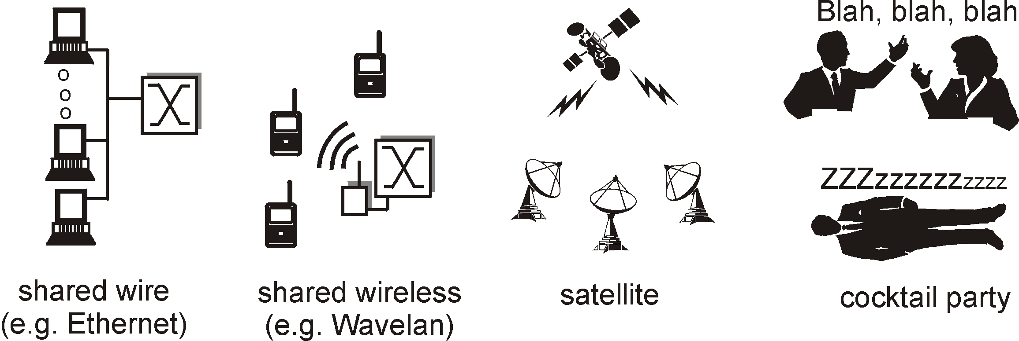
Links Point-to-Point vs. Broadcast Media
Point-to-point
PPP for dial-up access
Point-to-point link between Ethernet switch and host
Broadcast (shared wire or medium)
Traditional Ethernet
802.11 wireless LAN

Slide 40
Multiple Access Protocol
Single shared broadcast channel
Avoid having multiple nodes speaking at once
Otherwise, collisions lead to garbled data
Multiple access protocol
Distributed algorithm for sharing the channel
Algorithm determines which node can transmit
Classes of techniques
Channel partitioning: divide channel into pieces
Taking turns: passing a token for the right to transmit
Random access: allow collisions, and then recover

Slide 41

Channel Partitioning: TDMA
TDMA: time division multiple access
Access to channel in "rounds"
Each station gets fixed length slot in each round
Time-slot length is packet transmission time
Unused slots go idle
Example: 6-station LAN with slots 1, 3, and 4

Slide 42
Channel Partitioning: FDMA
FDMA: frequency division multiple access
Channel spectrum divided into frequency bands
Each station assigned fixed frequency band
Unused transmission time in bands go idle
Example: 6-station LAN with bands 1, 3, and 4
time
frequency bands

Slide 43
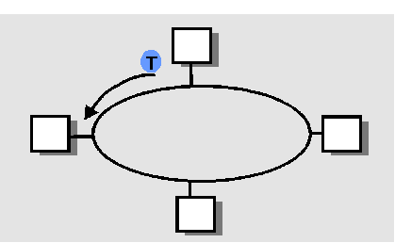
“Taking Turns” MAC protocols
Polling
Master node “invites” slave nodes to transmit in turn
Concerns:
Polling overhead
Latency
Single point of failure (master)
Token passing
Control token passed from one node to next sequentially
Token message
Concerns:
Token overhead
Latency
Single point of failure (token)

Slide 44
Random Access Protocols
When node has packet to send
Transmit at full channel data rate R.
No a priori coordination among nodes
Two or more transmitting nodes ➜ “collision”,
Random access MAC protocol specifies:
How to detect collisions
How to recover from collisions
Examples
ALOHA and Slotted ALOHA
CSMA, CSMA/CD, CSMA/CA

Slide 45
Key Ideas of Random Access
Carrier sense
Listen before speaking, and don’t interrupt
Checking if someone else is already sending data
… and waiting till the other node is done
Collision detection
If someone else starts talking at the same time, stop
Realizing when two nodes are transmitting at once
…by detecting that the data on the wire is garbled
Randomness
Don’t start talking again right away
Waiting for a random time before trying again

Slide 46
Slotted ALOHA – 70’s
Assumptions
All frames same size
Time divided into equal slots (time to transmit a frame)
Nodes start to transmit frames only at start of slots
Nodes are synchronized
If two or more nodes transmit, all nodes detect collision
Operation
When node obtains fresh frame, transmits in next slot
No collision: node can send new frame in next slot
Collision: node retransmits frame in each subsequent slot with probability p until success

Slide 47
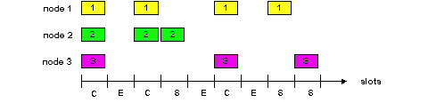
Slotted ALOHA
Pros
Single active node can continuously transmit at full rate of channel
Highly decentralized: only nodes in slots need to be in sync
Simple
Cons
Collisions, wasting slots
Idle slots
Nodes may be able to detect collision in less than time to transmit packet
Clock synchronization

Slide 48
CSMA (Carrier Sense Multiple Access)
Collisions hurt the efficiency of ALOHA protocol
At best, channel is useful 37% of the time
CSMA: listen before transmit
If channel sensed idle: transmit entire frame
If channel sensed busy, defer transmission
Human analogy: don’t interrupt others!

Slide 49
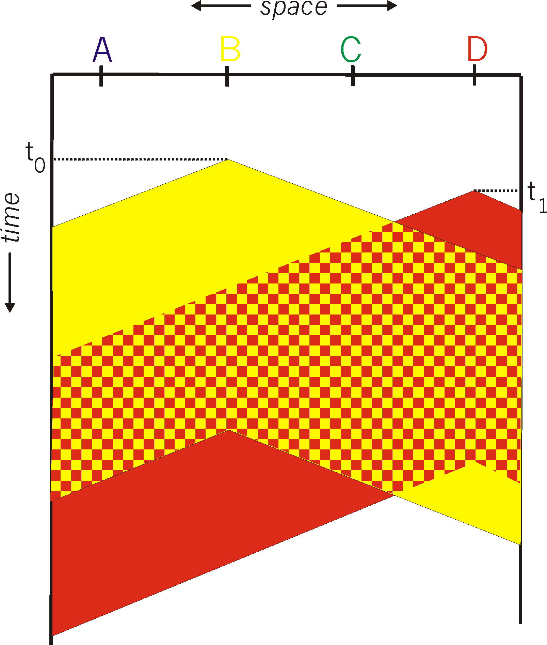
CSMA Collisions
Collisions can still occur:
propagation delay means
two nodes may not hear
each other’s transmission
Collision:
entire packet transmission
time wasted

Slide 50
CSMA/CD (Collision Detection)
CSMA/CD: carrier sensing, deferral as in CSMA
Collisions detected within short time
Colliding transmissions aborted, reducing wastage
Collision detection
Easy in wired LANs: measure signal strengths, compare transmitted, received signals
Difficult in wireless LANs: receiver is shut off while transmitting
Human analogy: the polite conversationalist

Slide 51
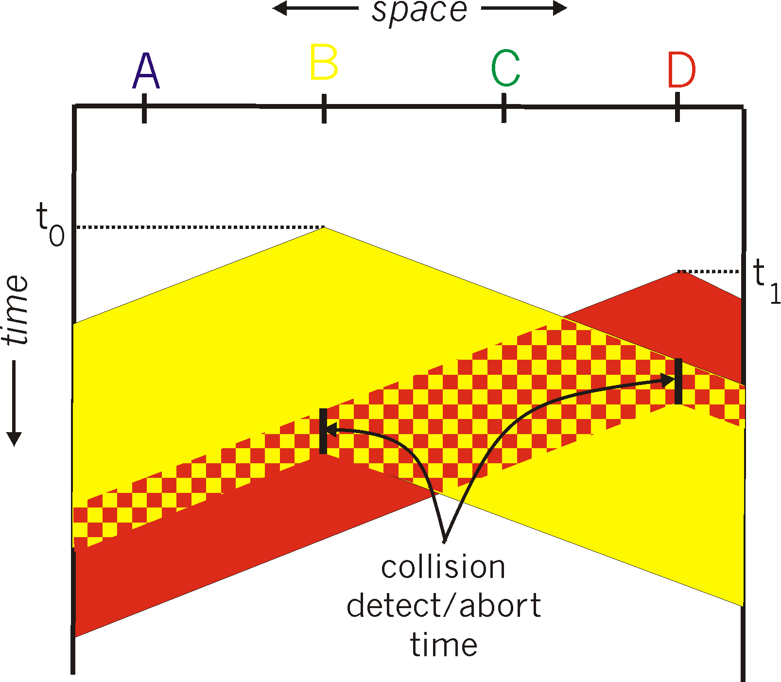
CSMA/CD Collision Detection

Slide 52
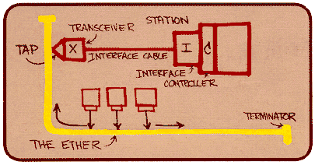
Shared Access Networks: bus - Ethernet
Metcalfe’s Ethernet sketch

Slide 53
Ethernet Overview
History
Dominant wired LAN technology
Simpler, cheaper than token ring and ATM
developed by Xerox PARC in mid-1970s
roots in Aloha packet-radio network
standardized by Xerox, DEC, and Intel in 1978
CSMA/CD
carrier sense
multiple access
collision detection
Frame Format
Preamble = 7 of 10101010, 1 of 10101011

Slide 54
Ethernet Uses CSMA/CD
Carrier sense: NIC waits for link to be idle
Channel idle: start transmitting
Channel busy: wait until idle
Collision detection: listen while transmitting
No collision: transmission is complete
Collision: abort transmission, and send jam signal
Random access: exponential back-off
After collision, wait a random time before trying again
After m^{th} collision, choose K randomly from {0, …, 2^{m}-1}
… and wait for K*512 bit times before trying again

Slide 55
Unreliable, Connectionless Service
Connectionless
No handshaking between sending and receiving adapter.
Unreliable
Receiving adapter doesn’t send ACKs or NACKs
Packets passed to network layer can have time gaps
Gaps will be filled if application is using TCP
i.e., TCP creates a data stream
Otherwise, the application will see the gaps
Ethernet’s MAC protocol: unslotted CSMA/CD with binary backoff

Slide 56
Ethernet (cont)
Addresses
unique, 48-bit unicast address assigned to each adapter
example: 8:0:e4:b1:2
broadcast: all 1s
multicast: first bit is 1
Bandwidth: 10Mbps, 100Mbps, 1Gbps, & climbing
Max Length: 2500m (500m segments with 4 repeaters)
Signal timing
Approach (Problem?): Distributed algorithm that provides fair access

Slide 57
Transmit Algorithm
If line is idle…
send immediately
upper bound message size
must wait 9.6us between back-to-back frames, why?
If line is busy…
wait until idle and transmit immediately
called 1-persistent (special case of p-persistent)

Slide 58
Algorithm (cont)
If collision…
jam for 32 bits, then stop transmitting frame
minimum frame is 64 bytes (header + 46 bytes of data)
delay and try again
1st time: 0 or 51.2us
2nd time: 0, 51.2, or 102.4us
3rd time51.2, 102.4, or 153.6us
nth time: k x 51.2us, for randomly selected k=0..2^{n} - 1
give up after several tries (usually 16)
exponential backoff

Slide 59
802.3 Ethernet standards: link & physical layers
many different Ethernet standards
common MAC protocol and frame format
different speeds: 2 Mbps, 10 Mbps, 100 Mbps, 1Gbps, 10 Gbps, 40 Gbps
different physical layer media: fiber, cable
application
transport
network
link
physical
MAC protocol
and frame format
100BASE-TX
100BASE-T2
100BASE-FX
100BASE-T4
100BASE-SX
100BASE-BX
copper (twister
pair) physical layer
fiber physical layer

Slide 60
Limitations on Ethernet Length
A
B
latency d
Latency depends on physical length of link
Time to propagate a packet from one end to the other
Suppose A sends a packet at time t
And B sees an idle line at a time just before t+d
… so B happily starts transmitting a packet
B detects a collision, and sends jamming signal
But A doesn’t see collision till t+2d

Slide 61
Limitations on Ethernet Length
A
B
latency d
A needs to wait for time 2d to detect collision
So, A should keep transmitting during this period
… and keep an eye out for a possible collision
Imposes restrictions on Ethernet
Maximum length of the wire: 2500 meters
Minimum length of the packet: 512 bits (64 bytes)

Slide 62
Benefits of Ethernet
Easy to administer and maintain
Inexpensive
Increasingly higher speed
Moved from shared media to switches
Change everything except the frame format
A good general lesson for evolving the Internet
Can Ethernet become so congested that it dies??

Slide 63
Cable access network
Internet frames, TV channels, control transmitted
downstream at different frequencies
cable headend
…
CMTS
…
splitter
cable
modem
cable modem
termination system
ISP
upstream Internet frames, TV control, transmitted
upstream at different frequencies in time slots
multiple 40Mbps downstream (broadcast) channels
single CMTS transmits into channels
multiple 30 Mbps upstream channels
multiple access: all users contend for certain upstream channel time slots (others assigned)

Slide 64
Cable access network
cable headend
MAP frame for
Interval [t1, t2]
CMTS
Downstream channel i
Upstream channel j
t₁
t₂
Residences with cable modems
Minislots containing
minislots request frames
Assigned minislots containing cable modem
upstream data frames
DOCSIS: data over cable service interface spec
FDM over upstream, downstream frequency channels
TDM upstream: some slots assigned, some have contention
downstream MAP frame: assigns upstream slots
request for upstream slots (and data) transmitted random access (binary backoff) in selected slots

Slide 65
Summary of MAC protocols
channel partitioning, by time, frequency or code
Time Division, Frequency Division
random access (dynamic),
ALOHA, S-ALOHA, CSMA, CSMA/CD
carrier sensing: easy in some technologies (wire), hard in others (wireless)
CSMA/CD used in Ethernet
CSMA/CA used in 802.11
taking turns
polling from central site, token passing
Bluetooth, FDDI, token ring

Slide 66
Conclusions
TCP/IP runs on a variety of link layer technologies
Point-to-point links vs. shared media
Wide varieties within each class
Link layer performs key services
Encoding, framing, and error detection
Optionally error correction and flow control
Shared media introduce interesting challenges
Decentralized control over resource sharing
Partitioned channel, taking turns, and random access
Ethernet as a wildly popular example

Slide 67
Future Issue: Interconnection LANS
device
device
device
device

