Slide 1
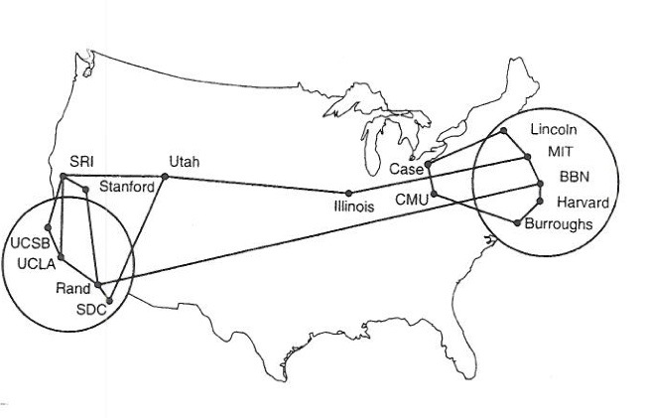
Network Management
Goals:
Understand Network Management Problem
Understand SNMP Approach
Understand SNMP Protocol
Note to Students:
The course slides are a combination of slides from:
Peterson & Davie
Kurose & Ross
My previous lectures
I claim no copyright for any of the material and would recommend either book for a detailed treatment of the material

Slide 2
Network Management
Outline:
Introduction to network management
  motivation
  major components
Internet network management framework
  MIB: management information base
  SMI: data definition language
  SNMP: protocol for network management
  security and administration
Presentation services: ASN.1

Slide 3
What is network management?
autonomous systems (aka “network”): 100s or 1000s of interacting hardware/software components
other complex systems requiring monitoring, control:
  jet airplane
  nuclear power plant
  others?
"Network management includes the deployment, integration
and coordination of the hardware, software, and human
elements to monitor, test, poll, configure, analyze, evaluate,
and control the network and element resources to meet the
real-time, operational performance, and Quality of Service
requirements at a reasonable cost." --MAKE NETWORK WORK
No standard Link Protocol

Slide 4
Architecture for network management
Standard Paradigm, Protocols. Different Tools
definitions:
managing entity
agent
data
managing
entity
managed devices contain
managed objects whose
data is gathered into a
Management Information
Base (MIB)
Develop Local Policies
data
managed device
agent
data
network
management
protocol
managed device
agent
data
agent
data
managed device
managed device

Slide 5
Management Model = Monitor, Interpret, Control
Management
Platform
Management Protocol
Enterprise Network Computing System
Agents: provide device monitoring/control
Platform: interpretation of NM data & control
Management protocol: queries of device data
Management Information Bases (MIB): standardize management data representation & access
Picture shows that NetMgt is in another network ‘plane’

Slide 6
Network Management Issues
Operation costs dominate network management
Cost of equipment: commodity market
Complexity of network operations is driven up by
  Growth in scale and heterogeneity
    2 LANs vs 100 LANs
  Shift to distributed computing requires distributed management
Operations depend on costly expert staff
  “Lights out” is a myth
Operational and Management Planes are combined in the network – fear that NM could take over the network.

Slide 7
Network Management: The Model
Network
Management
Station
Network
Device
?
Device Stuff
Management
Applications
Mgmt
Data
Struct
Mgmt
Agt
Communication
Protocol
Network Management Paradigm
Add NM onto a Nodes Functionality

Slide 8
The Model: Network Management System
Network Management Station
  Execute management applications
  Monitor and control network elements
  May be fancy or useful or both; may be character, window, or script oriented
  NM application peers with SNMP application entities in the Agents of managed network devices/elements
  Examples: HP OpenView, Spectrum, MRTG
  Can provide WEB based views

Slide 9
The Model:
Device – Any Network Node
Network Devices/Elements
  Anything and everything connected to network
  Have a primary task, e.g., router
  Have management agents (Agents) that respond to Network Management Station queries and commands
  Have instrumentation to keep track of network management variables
  Support inter-layer communications mechanisms
Agents
  Agents usually include 2 components:
    Protocol engine – got to talk on network
    Management profiles – must agree what to talk about

Slide 10
Network Management standards
SNMP: Simple Network Management Protocol
Internet roots (SGMP)
started simple Why??
deployed, adopted rapidly
growth: size, complexity
currently: SNMP V3
de facto network management standard
OSI CMIP
Common Management Information Protocol
designed 1980’s: the unifying net management standard
too slowly standardized

Slide 11
SNMP overview: 4 key parts
Management information base (MIB):
  distributed information store of network management data
Structure of Management Information (SMI):
  data definition language for MIB objects
SNMP protocol
  convey manager<->managed object info, commands
security, administration capabilities
  major addition in SNMPv3
  SNMPv1 still dominates (telnet like) Why??

Slide 12
SNMP Based Network Management
Managed
Element
Network
Management
Station
Management
Protocol
Network
Device
Management
Information
Primary
Task
Management
Applications
Mgmt
Data
Struct
Mgmt
Agt
SNMP
Protocol
Database In
SMI Format
NMS
Agent

Slide 13
Details: SMI
Structure of Management Information
SMI - Structure of Management Information
  Defines how information is structured
  Uses an object information model
  Defines a set of generic types
    INTEGER, COUNTER, GAUGE, etc.
  Defines rules for MIB documents
  Defines rules for revising MIB documents
  Guarantees consistency of data “Templates”
  “Neither specifies the objects which are managed, nor the protocols used to manage these objects”

Slide 14
Details: Structure of Management Information
SMI
  Places restrictions on the types of variables allowed in MIB – Integer, Octets, Strings – NO FLOATS
  Specifies rules for naming these variables
  Creates rules for defining new types, for example:
      IP address – 4 octet strings
      Counter – Integer 0 to 2^²² – 1
  Form of specification:
    Abstract Syntax Notation 1 (ASN.1)
    Notation used for documents
    Compact encoded representation of same info for communication
    Guarantees interoperability unlike two compilers for “Pascal”

Slide 15
SMI: data definition language
Purpose: syntax, semantics of management data well-defined, unambiguous
base data types:
  straightforward, boring
OBJECT-TYPE
  data type, status, semantics of managed object
MODULE-IDENTITY
  groups related objects into MIB module
Basic Data Types
INTEGER
Integer32
Unsigned32
OCTET STRING
OBJECT IDENTIFIED
IPaddress
Counter32
Counter64
Guage32
Time Ticks
Opaque

Slide 16
Network Management System Details
Management Information Base
MIB

Slide 17
SNMP MIB
MIB module specified via SMI
MODULE-IDENTITY
(100 standardized MIBs, more vendor-specific)
MODULE
OBJECT TYPE:
OBJECT TYPE:
OBJECT TYPE:
objects specified via SMI
OBJECT-TYPE construct

Slide 18
MIB example: UDP module
Object ID Name Type Comments
1.3.6.1.2.1.7.1 UDPInDatagrams Counter32 total # datagrams delivered
at this node
1.3.6.1.2.1.7.2 UDPNoPorts Counter32 # underliverable datagrams
no app at portl
1.3.6.1.2.1.7.3 UDInErrors Counter32 # undeliverable datagrams
all other reasons
1.3.6.1.2.1.7.4 UDPOutDatagrams Counter32 # datagrams sent
1.3.6.1.2.1.7.5 udpTable SEQUENCE one entry for each port
in use by app, gives port #
and IP address

Slide 19
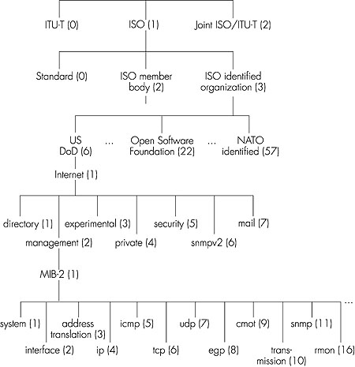
OSI
Object
Identifier
Tree
Check out www.alvestrand.no/objectid

Slide 20
SNMP Naming
question: how to name every possible standard object (protocol, data, more..) in every possible network standard??
answer: ISO Object Identifier tree:
  hierarchical naming of all objects
  each branchpoint has name, number
1.3.6.1.2.1.7.1
ISO
ISO-ident. Org.
US DoD
Internet
udpInDatagrams
UDP
MIB2
management

Slide 21
SNMP Based Network Management
Managed
Element
Network
Management
Station
Management
Protocol
Network
Device
Management
Information
Primary
Task
Management
Applications
Mgmt
Data
Struct
Mgmt
Agt
SNMP
Protocol
Database In
SMI Format
NMS
Agent

Slide 22
Management Information Base
MIB – Management Information Base
  Describes what information is managed
  Defines objects anywhere: protocols, network, nodes, application
  Places information in the tree (Virtual Information Store) defined by the SMI
  Also used to cause action

Slide 23
Management Information Base
Variable Naming
  A variable is named using an OBJECT IDENTIFIER (OID), an administrative assigned unique name
  i.e., 1.3.6.1.2.1.1.1.0
  Symbolic representation of variable names
    OBJECT DESCRIPTOR synonym for OID used by humans – sysDescr

Slide 24
Management Information Base
Variable Names – Management
  Managed objects accessed via virtual information store – MIB
  MIB Objects defined using Abstract Syntax Notation One (ASN.1)
  MIB conceptually organized as a tree with named edges
  Objects are leaves of the tree (SMI Tree structure)
  Path from root through tree to the object uniquely identifies that object
  Different parts of the tree controlled by different administrative naming authorities – delegated

Slide 25
Example – RFC 1213 MIB-II
Network Working Group K. McCloghrie
Request for Comments: 1213 Hughes LAN Systems, Inc.
Obsoletes: RFC 1158 M. Rose
Performance Systems International
Editors
March 1991
Management Information Base for Network Management
of TCP/IP-based internets:
MIB-II
Status of this Memo
This memo defines the second version of the Management Information
The objects defined in MIB-II have the OBJECT IDENTIFIER prefix:
mib-2 OBJECT IDENTIFIER ::= { mgmt 1 }
which is identical to the prefix used in MIB-I.
3.1. Deprecated Objects
In order to better prepare implementors for future changes in the
MIB, a new term "deprecated" may be used when describing an object.
A deprecated object in the MIB is one which must be supported, but
one which will most likely be removed from the next version of the
MIB (e.g., MIB-III).
MIB-II marks one object as being deprecated:
atTable

Slide 26
Example – RFC 1213 MIB-II cont’d
3.4. The System Group
Four new objects are added to this group:
sysContact
sysName
sysLocation
sysServices
These provide contact, administrative, location, and service
information regarding the managed node.
3.7. The IP Group
The access attribute of the variable ipForwarding has been changed
from read-only to read-write.
    o o o
    o o o
    o o o
Groups
- System
- Interfaces
- Address Translation (deprecated)
- IP
- ICMP
- TCP
- UDP
- EGP
- Transmission
- SNMP

Slide 27
Example – RFC 1271 RMON MIB
Network Working Group S. Waldbusser
Request for Comments: 1271 Carnegie Mellon University
November 1991
Remote Network Monitoring Management Information Base
4.3. Structure of MIB
The objects are arranged into the following groups:
- statistics
- history
- alarm
- host
- hostTopN
- matrix
- filter
- packet capture
- event
    o o o
    o o o
    o o o
4.3.1. The Statistics Group
The statistics group contains statistics measured by the probe for
each monitored interface on this device. This group currently
consists of the etherStatsTable but in the future will contain tables
for other media types including Token Ring and FDDI.
What does
Each group do
In Ethernet ??

Slide 28
Example – RFC 1271 RMON MIB cont’d
Definitions
RFC1271-MIB DEFINITIONS ::= BEGIN
IMPORTS
Counter FROM RFC1155-SMI
DisplayString FROM RFC1158-MIB
mib-2 FROM RFC1213-MIB
OBJECT-TYPE FROM RFC-1212;
rmon OBJECT IDENTIFIER ::= { mib-2 16 }
    o o o
    o o o
    o o o
EntryStatus ::= INTEGER
{ valid(1),
createRequest(2),
underCreation(3),
invalid(4)
}
-- The status of a table entry.

Slide 29
The Model: Management Protocol
Carries network management information
Communications method between NMS and Agents
Allows management information to be inspected (read) or altered (written)
Self-contained unit of information
Message format changes with SNMP versions, but PDU (Protocol Data Unit) is (almost) unchanged

Slide 30
SNMP Based NetMgt:
The SNMP Protocol
SNMP Protocol Exchange
  Communication of management information among management entities is realized in SNMP through exchange of SNMP protocol messages.
  The exchange of SNMP messages requires only an unreliable datagram service, every message is entirely and independently represented by a single transport datagram, typically UDP – no TCP.

Slide 31
SNMP protocol
Two ways to convey MIB info, commands:
managing
entity
managing
entity
request
trap msg
response
agent
data
agent
data
Managed device
Managed device
request/response mode
trap mode

Slide 32
Details: The Protocol
SNMP – Simple Network Management Protocol
  Does NOT define a list of commands
    E.g., boot, clear, etc.
  Rather classes all operations in a fetch-store paradigm:
    E.g., set “boot” to 1 causes Agent to reboot
  Simple, flexible, adaptable, etc.
Hence, very simple set of operations available
via The Protocol:
  Get-request – fetch a value from a specific variable
  Get-next-request – fetch next value after this one
  Get-response – response to Get or Set
  Set request – store a value in a specific variable
  Trap – reply triggered by an event

Slide 33
Details: Summary of five SNMP Operations
Notice the port numbers

Slide 34
Details: SNMP Message Format
Version – 0
Community – authority
PDU Type
  0 – get-request
  1 – get-next
  2 – set-request
  3 – get –response
  4 – trap
Request ID – NMS message management
Error Status
  0 – no error
  1 – too big
  2 – no such name
  3 – bad value
Error Index – which variable screwed up
VARBIN’s name/value pairs

Slide 35
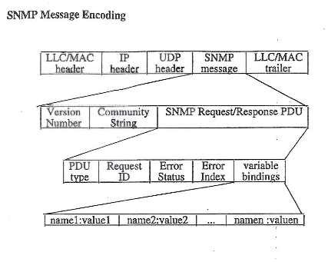

Slide 36
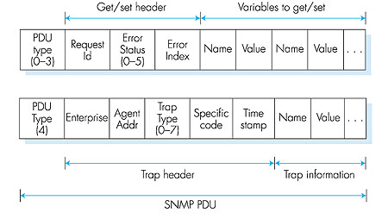
SNMP protocol: message formats

Slide 37
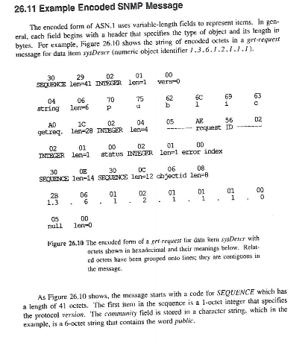

Slide 38
SNMP security and administration
encryption: DES-encrypt SNMP message
authentication: compute, send MIC(m,k): compute hash (MIC) over message (m), secret shared key (k)
protection against playback: use nonce
view-based access control
  SNMP entity maintains database of access rights, policies for various users
  database itself accessible as managed object!

Slide 39
Network Management: summary
Network Management
  extremely important: continued cost of network
  ASN.1 for data description
  SNMP protocol as a tool for conveying information
Network Management
  more art than science
    what to measure/monitor
    how to respond to failures?
    alarm correlation/filtering?

Slide 40
History: Fundamental Axioms
Simple Stupid Devices
  The impact of adding network management to managed nodes must be minimal, reflecting a lowest common denominator.
  If network management is viewed as an essential aspect of an internet, then it must be universally deployed on the largest possible collection of devices in the network.
UDP
  When all else fails, network management must continue to function, if at all possible.

Slide 41
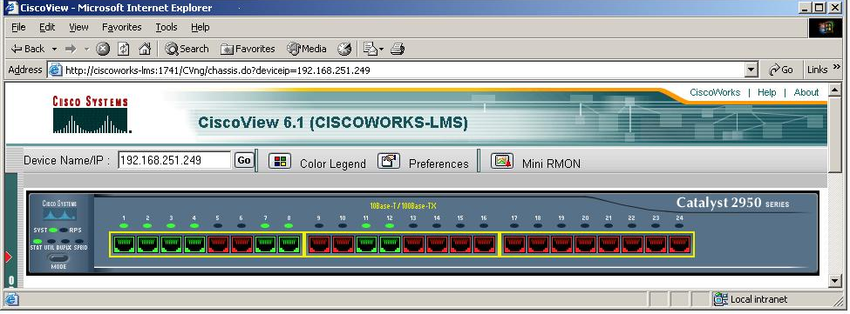
Example: CiscoWorks – Device View

Slide 42
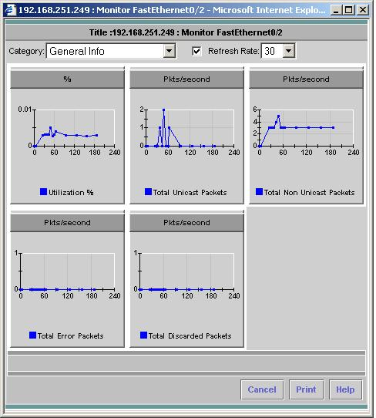
Example: CiscoWorks - Performance

Slide 43
References
RFC 3418 Management Information Base (MIB) for the Simple Network Management Protocol (SNMP), Presuhn R, December 2002.
RFC 3417 Transport Mappings for the Simple Network Management Protocol (SNMP), Presuhn R, December 2002.
RFC 3416 Version 2 of the Protocol Operations for the Simple Network Management Protocol (SNMP), Presuhn R, December 2002.
RFC 3415 View-based Access Control Model (VACM) for the Simple Network Management Protocol (SNMP), McCloghrie K, Presuhn R, Wijnen B, December 2002.
RFC 3414 User-based Security Model (USM) for version 3 of the Simple Network Management Protocol (SNMPv3), Blumenthal U, Wijnen B, December 2002.
RFC 3413 Simple Network Management Protocol (SNMP) Applications, Levi D, Meyer P, Stewart B, December 2002.
RFC 3412 Message Processing and Dispatching for the Simple Network Management Protocol (SNMP), Case J, Harrington D, Presuhn R, Wijnen B, December 2002.
RFC 3411 An Architecture for Describing Simple Network Management Protocol (SNMP) Management Frameworks, Harrington D, Presuhn R, Wijnen B, December 2002.
RFC 3410 Introduction and Applicability Statements for Internet-Standard Management Framework, Case J, Mundy R, Partain D, Stewart B, December 2002.

