Slide 1
Routing Protocols
Reading: KR Chapter 5
Overview: Books on Routing, BGP is a life/career
Note to Students:
The course slides are a combination of slides from:
Peterson & Davie
Kurose & Ross
My previous lectures
I claim no copyright for any of the material and would recommend either book for a detailed treatment of the material

Slide 2
IP Suite In Action: End Hosts vs. Routers
host
host
HTTP message
HTTP
HTTP
TCP segment
TCP
TCP
router
router
IP packet
IP packet
IP packet
IP
IP
IP
IP
Ethernet
interface
Ethernet
interface
SONET
interface
SONET
interface
Ethernet
interface
Ethernet
interface

Slide 3
How to Make Routing Scale
Without CIDR but Hierarchical Addresses
Inefficient use of Hierarchical Address Space
class C with 2 hosts (2/255 = 0.78% efficient)
class B with 256 hosts (256/65535 = 0.39% efficient)
With CIDR - Still Too Many Networks
routing tables do not scale
route propagation protocols do not scale

Slide 4
Forwarding Algorithm
D = destination IP address
for each entry (SubnetNum, SubnetMask, NextHop)
D1 = SubnetMask & D
if D1 = SubnetNum
if NextHop is an interface
deliver datagram directly to D
else
deliver datagram to NextHop
Use a default router if nothing matches
Not necessary for all 1s in subnet mask to be contiguous: be liberal in what you accept, conservative in what you send
Can put multiple subnets on one physical network
Subnets not visible from the rest of the Internet

Slide 5
Historical: Internet Structure
Stanford
NSFNET backbone
ISU
BARRNET
MidNet
regional
Westnet
■ ■ ■
regional
regional
Berkeley
PARC
NCAR
UNM
UNL
KU
UA

Slide 6
Today: Internet Structure
Large corporation
“Consumer”
ISP
Peering
point
Backbone service provider
Peering
point
“Consumer”
ISP
Large corporation
“Consumer”
ISP
Small
corporation

Slide 7
Route Propagation
Know a smarter router
hosts know local router
local routers know site routers
site routers know core router
core routers know everything
Area, Domain ==Autonomous System (AS)
corresponds to an administrative domain
examples: University, company, backbone network
assign each AS a 16-bit number
Two-level routing protcols
interior gateway protocol (each AS selects its own)
exterior gateway protocol (Internet-wide standard)

Slide 8
Internet approach to scalable routing
“autonomous systems” (AS) (a.k.a. “domains”)
intra-AS routing
routing among hosts, routers in same AS (“network”)
all routers in AS must run same intra-domain protocol
routers in different AS can run different intra-domain routing protocol
gateway router: at “edge” of its own AS, has link(s) to router(s) in other AS’es
inter-AS routing
routing among AS’es
gateways perform inter-domain routing (as well as intra-domain routing)

Slide 9
Interconnected ASes
3c
3a
2c
3b
AS3
2a
1c
2b
AS2
1a
1b
1d
AS1
forwarding table configured by both intra- and inter-AS routing algorithm
intra-AS routing determine entries for destinations within AS
inter-AS & intra-AS determine entries for external destinations
Intra-AS
Routing
algorithm
Inter-AS
Routing
algorithm
Forwarding
table

Slide 10
Inter-AS tasks
suppose router in AS1 receives datagram destined outside of AS1:
router should forward packet to gateway router, but which one?
AS1 must:
learn which dests are reachable through AS2, which through AS3
propagate this reachability info to all routers in AS1
job of inter-AS routing!
3c
3a
3b
AS3
2c
other
networks
1c
2a
other
networks
1a
2b
1b
AS2
AS1
1d

Slide 11
Intra-AS Routing
also known as interior gateway protocols (IGP)
most common intra-AS routing protocols:
RIP: Routing Information Protocol
OSPF: Open Shortest Path First (IS-IS protocol essentially same as OSPF)
IGRP: Interior Gateway Routing Protocol (Cisco proprietary for decades, until 2016)

Slide 12
Reducing Problem: Reduced!
Participating Nodes = # of ASs
Interdomain Route = Path to AS Border Route, AS Router
Therefore Complexity of Interdomain routing == order of number of ASs
e.g. Claremont Colleges
Complexity of Intradomain routing = order of number of networks in an AS
e.g., HMC vs Pitzer, etc.
e.g., HMC cs vs math, etc

Slide 13
Popular Interior Gateway Protocols
RIP: Route Information Protocol
developed for XNS
distributed with Unix
distance-vector algorithm
based on hop-count
OSPF: Open Shortest Path First
recent Internet standard
uses link-state algorithm
supports load balancing
supports authentication

Slide 14
Example Routing Protocol Routing Information Protocol (RIP)
Distance Vector protocol
Nodes send distance vectors every 30 seconds
… or, when an update causes a change in routing
Link costs in RIP
All links have cost 1 – Hop Count Why??
Valid distances of 1 through 15
… with 16 representing infinity
Small “infinity” → smaller “counting to infinity” problem
RIP is limited to fairly small networks
E.g., used in the Princeton campus network

Slide 15
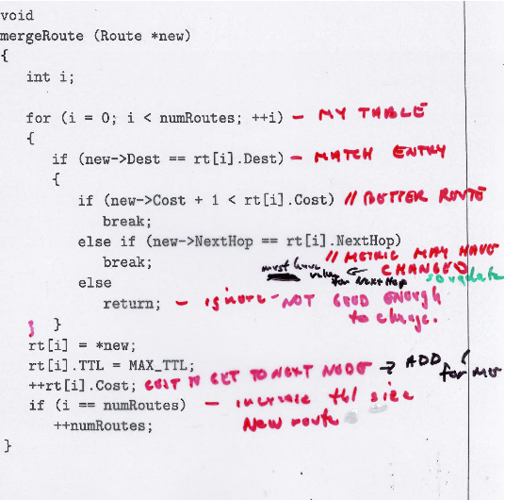

Slide 16
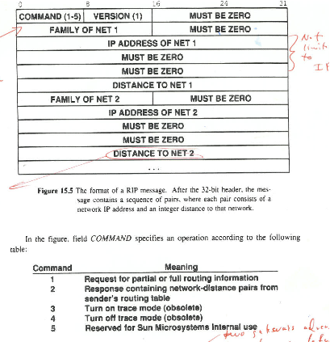

Slide 17
OSPF (Open Shortest Path First)
“open”: publicly available
uses link-state algorithm
link state packet dissemination
topology map at each node
route computation using Dijkstra’s algorithm
router floods OSPF link-state advertisements to all other routers in entire AS
carried in OSPF messages directly over IP (rather than TCP or UDP
link state: for each attached link
IS-IS routing protocol: nearly identical to OSPF

Slide 18
OSPF “advanced” features
security: all OSPF messages authenticated (to prevent malicious intrusion)
multiple same-cost paths allowed (only one path in RIP)
for each link, multiple cost metrics for different TOS (e.g., satellite link cost set low for best effort ToS; high for real-time ToS)
integrated uni- and multi-cast support:
Multicast OSPF (MOSPF) uses same topology data base as OSPF
hierarchical OSPF in large domains.

Slide 19
Hierarchical OSPF
boundary router
backbone router
backbone
area
border
routers
area 3
internal
routers
area 1
area 2

Slide 20
Hierarchical OSPF
two-level hierarchy: local area, backbone.
link-state advertisements only in area
each nodes has detailed area topology; only know direction (shortest path) to nets in other areas.
area border routers: “summarize” distances to nets in own area, advertise to other Area Border routers.
backbone routers: run OSPF routing limited to backbone.
boundary routers: connect to other AS’es.

Slide 21
Inter-AS tasks
ASs not interconnected:
suppose router in AS1 receives datagram destined outside of AS1:
router should forward packet to gateway router, but which one?
AS1 must:
learn which dests are reachable through AS2, which through AS3
propagate this reachability info to all routers in AS1
job of inter-AS routing!
3c
3a
3b
AS3
2c
other
networks
1c
2a
other
networks
1a
2b
1b
AS2
AS1
1d

Slide 22
Internet inter-AS routing: BGP
BGP (Border Gateway Protocol): the de facto inter-domain routing protocol
“glue that holds the Internet together”
BGP provides each AS a means to:
eBGP: obtain subnet reachability information from neighboring ASes
iBGP: propagate reachability information to all AS-internal routers.
determine “good” routes to other networks based on reachability information and policy
allows subnet to advertise its existence to rest of Internet: “I am here”

Slide 23
BGP-4: Border Gateway Protocol
AS Types
stub AS: has a single connection to one other AS
carries local traffic only (HMC)
multihomed AS: has connections to more than one AS
refuses to carry transit traffic (Boeing)
transit AS: has connections to more than one AS
carries both transit and local traffic (ISP)
Each AS has:
one or more border routers
one BGP speaker that advertises:
local networks
other reachable networks (transit AS only)
gives path information – list of ASs
Reachability over optimality
Internet = interconnected set of ASs

Slide 24
BGP Example
Speaker for AS2 advertises reachability to P and Q
network 128.96, 192.4.153, 192.4.32, and 192.4.3, can be reached directly from AS2
Speaker for backbone advertises
networks 128.96, 192.4.153, 192.4.32, and 192.4.3 can be reached along the path (AS1, AS2).
Speaker can cancel previously advertised paths

Slide 25
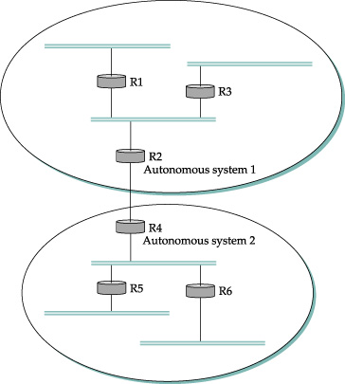
AS = Routing Domain
Interdomain routing
R2, R4 = Border Router
EGP and IGP ability
Interdomain
Routing

Slide 26
BGP messages
BGP messages exchanged between peers over TCP connection
BGP messages:
OPEN: opens TCP connection to remote BGP peer and authenticates sending BGP peer
UPDATE: advertises new path (or withdraws old)
KEEPALIVE: keeps connection alive in absence of UPDATES; also ACKs OPEN request
NOTIFICATION: reports errors in previous msg; also used to close connection

Slide 27
BGP route selection
router may learn about more than one route to destination AS, selects route based on:
local preference value attribute: policy decision
shortest AS-PATH
closest NEXT-HOP router: hot potato routing
additional criteria

Slide 28
BGP: achieving policy via advertisements
legend:
provider
B
network
X
W
A
customer
C
network:
Y
Suppose an ISP only wants to route traffic to/from its customer networks (does not want to carry transit traffic between other ISPs)
A advertises path Aw to B and to C
B chooses not to advertise BAw to C:
B gets no “revenue” for routing CBAw, since none of C, A, w are B’s customers
C does not learn about CBAw path
C will route CAw (not using B) to get to w

Slide 29
Why different Intra-, Inter-AS routing ?
policy:
inter-AS: admin wants control over how its traffic routed, who routes through its net.
intra-AS: single admin, so no policy decisions needed
scale:
hierarchical routing saves table size, reduced update traffic
performance:
intra-AS: can focus on performance
inter-AS: policy may dominate over performance

Slide 30
Conclusions
Routing is a distributed algorithm
React to changes in the topology
Compute the shortest paths
Two main shortest-path algorithms
Dijkstra → link-state routing (e.g., OSPF and IS-IS)
Bellman-Ford → distance vector routing (e.g., RIP)
Convergence process
Changing from one topology to another
Transient periods of inconsistency across routers

