Slide 1
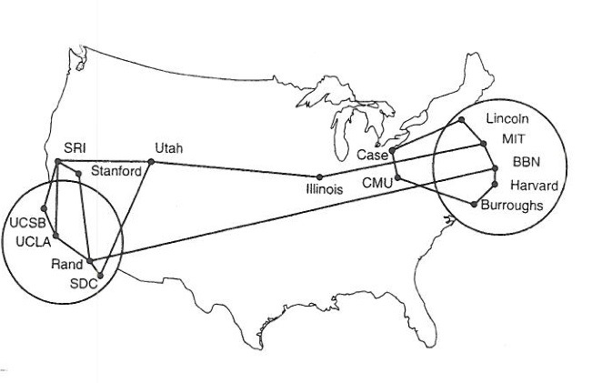
IETF Structure and Internet Standards Process Suppose you wanted to build an open organization to control and management a large network…
Orignally: Scott Bradner

Slide 2
The IETF
Internet Engineering Task Force
Formed in 1986
Was not considered important for a long time - good!!
Not government approved - great!!
People not companies
www.ietf.org
“We reject kings, presidents and voting. We believe in rough consensus and running code” Dave Clark

Slide 3
IETF Overview
IETF has no members, no voting
~1000 at 3 yearly meetings, more on mail lists
100ish working groups (where real work happens)
If it matters to the Internet, it matters to IETF
7 areas (for organizational convenience)
ART, GEN, INT, OPS, RTG, SEC, TSV
IETF Management: IESG (ADs, chosen by community)
Architectural guidance & liaisons: IAB (also chosen by community)
Product: standards and other documents
www.ietf.org

Slide 4
IETF “Standards”
IETF standards not standards “because we say so”
Only standards if/when people use them
No formal recognition
No submitting to “traditional” standards bodies
Formal process of implementation and use makes something a standard

Slide 5
Organization of the IETF
Internet
Society
IAB
IETF
IESG
area
area
IRTF
IANA
IANA
RFC
area
“the IETF”

Slide 6
The Internet Society (ISOC)
Non-profit, non-governmental, international, professional membership organization
Provides organizational and administrative home for IETF
The ISOC Board of Trustees part of IETF appeal chain
The ISOC president appoints chair of IETF nomcom
IAB chartered by the ISOC
The ISOC president is on the IAB mailing list & calls
IETF (through IAB) appoints 3 ISOC trustees
join at www.isoc.org

Slide 7
Internet Research Task Force (IRTF)
Focused on long term problems in the Internet, e.g.,
Internet Congestion
Internet Measurement/Management
Network Management
For more information see http://www.irtf.org

Slide 8
Internet Architecture Board (IAB)
Provides overall architectural advice to the IESG, the IETF & the ISOC
Advises the IESG on IETF working group formation
Deals with IETF external liaisons
Appoints the IRTF chair
Selects the IETF-IANA
Oversees the RFC Editor
Hosts workshops
Chartered by the ISOC

Slide 9
Internet Assigned Number Authority (IANA)
Assigns parameters and keeps them from colliding
protocol numbers and port numbers
IP addresses
mostly delegated to the 4 (going on 5) IP Address registries
domain names
deals with top level domains (TLDs)
rest delegated to DNS name registries
Functions split with the creation of ICANN
Internet Corporation for Assigned Names and Numbers
Independent corporation to take over IANA functions
Under contract with US government
Now IETF-IANA and non-IETF-IANA

Slide 10
RFC Editor
Historically Jon Postel and helpers
Now a small group funded by the ISOC
rfc-editor@rfc-editor.org
Semi-independent
Gets requests to publish IETF IDs from IESG
Gets requests to publish independent informational and experimental RFCs
asks IESG for advice on publishing independent RFCs but can exercise own discretion
presumption is to publish technically competent IDs which sometimes is a conflict with IESG

Slide 11
Organization of the IETF
Internet
Society
IAB
IETF
IESG
area
area
IRTF
IANA
IANA
RFC
area
“the IETF”

Slide 12
Area Directors (ADs)
Nominated by the community – this include all IETF members
Selected by nomcom - a volunteer nomination committee
Responsible for setting direction in Area
Responsible for managing process in Area
approve BOFs & working group charters
then go to IESG & IAB for final approval
Reviews working group documents - 2000 pages/month
Most Areas have 2 ADs

Slide 13
Internet Engineering Steering Group (IESG)
IETF Chair + rest of ADs
IETF process management and RFC approval body
Approves WG creation
Reviews & approves publication of IETF documents
reviews and comments on non-IETF submissions
Multi-disciplinary technical review group

Slide 14
IETF Secretariat
Organizes/Coordinates
plenary meetings
mailing lists hosted by IETF
Internet-Draft directory
IESG teleconferences
day to day work of IESG and working groups
Provided by some company
Funded from IETF meeting fees & (soon) ISOC

Slide 15
Selecting IETF Management
RFC 3777/6869 describes process
IESG & IAB members normally have 2-year terms
Picked by a nominations committee (nomcom)
nomcom chair appointed by the ISOC president
nomcom selects community nominees for each job
reviews one half of the IESG, half of the IAB each year
includes the IETF chair
IESG approved by IAB, IAB approved by the ISOC BoT
nomcom selected randomly from list of volunteers
volunteers have to have been at 3 of last 5 IETF meetings
very random selection process

Slide 16
Working Groups
This is where the IETF primarily get its work done
RFC 2418/3934 describes WG operation
Working group focused by charter agreed between chair(s) and area director
restrictive charters with deliverables and milestones
working groups closed when their work is done
Charter approved by IESG with IAB advice
AD with IESG has final say on charter & chair(s)

Slide 17
Working Groups (continued)
“...rough consensus and running code.”
No formal voting
can do show of hands or hum
Does NOT require unanimity
Disputes resolved by discussion and implementation
Mailing list and face-to-face meetings
most work happens on mailing lists
all decisions must be verified on mailing list
face-to-face discussion to resolve disagreements

Slide 18
IETF Documents
All open - no “confidential contributions”
Developed as Internet-Drafts
anyone can submit - “expire” in 6 months
some IDs are working group documents
Published as RFCs
archival publications (never changed once published)
different types: (not all RFCs are standards!)
informational, experimental, BCP, standards track, historic
3-stage standards track
Proposed Standard, Draft Standard, Internet Standard
Interoperability AND conformance

Slide 19
Working Documents
Internet-Draft - IDs
input to the process or for background information
no admissions control other than IPR statements
anyone can submit an ID
zapped from IETF directory after 6 months
but many mirrors exist
almost all RFCs must pre-exist as IDs
exceptions: some RFCs created by IANA or RFC Editor

Slide 20
What is a RFC?
IETF document publication series
RFC == Request for Comments
now just a name
now tend to be more formal documents than early RFCs
Over 8000 RFCs
RFC 1 Host Software - Apr 7 1969
“Not all RFCs are standards”
see RFC 1796
though some vendors imply otherwise
Many types of RFCs, key to understanding significance

Slide 21
RFC Repository Contains:
Standards track
OSPF, IPv6, IPsec ...
Obsolete Standards
RIPv1
Requirements
Host Requirements
Policies
Classless InterDomain
Routing
April fool’s day jokes
IP on Avian Carriers ...
... updated for QoS
Poetry
‘Twas the night before startup
White papers
On packet switches with infinite storage
Corporate documentation
Ascend multilink protocol (mp+)
Experimental history
Netblt
Process documents
IETF Standards Process

Slide 22
Standards Track RFCs:
Start at Proposed Standard (PS)
good idea, no known problems
implementation required at AD discretion
Advance to Draft Standard (DS)
stable Proposed Standard specification
multiple interoperable implementations
note IPR restriction
Advance again to Internet Standard (STD)
Draft Standard with wide deployment and use
Best Current Practices (BCP)
generally policies or IETF procedures
(best way we know how)

Slide 23
IETF Standards Process
(Protocol) Specification published as Internet Draft
Discussed in a working group - creates revised IDs
ID sent to IESG after working group consensus
IESG issues IETF Last Call (2 weeks)
anyone can comment
IESG considers comments and its own review
may approve publication as standards track RFC
may point out issues to working group & return ID

Slide 24
IETF RFC Submission Process
Working group doc, or
individual standards track doc
Submit
Concerns
IESG
RFC Editor
Published RFC
“Last Call”
Comments,
suggestions
IETF Community
Review

