Slide 1
The IPv6 Header

Slide 2
Structure of an IPv6 Packet
Router based header, key design,
How does it compare to IPv4?
IPv6
Header
Extension
Headers
Upper Layer
Protocol Data Unit
Payload
IPv6 Packet

Slide 3
Basic Headers
IPv6 – focused on fast/easy routing
32 bits
IPv4
Notes:
Remove GPN from headers

Slide 4
Basic Headers
Fields
Version (4 bits) – only field to keep same position and name
Class (8 bits) – was Type of Service (TOS), renamed - QoS related
Flow Label (20 bits) – new field – QoS related
Payload Length (16 bits) – length of data, slightly different from total length (extension headers)
Next Header (8 bits) – type of the next header, new idea
Hop Limit (8 bits) – was time-to-live, renamed
Source address (128 bits)
Destination address (128 bits)
Notes:
Michael suggestted having descriptions display when cursor is over field in previous page

Slide 5
Resource Allocation (Flows)
Flow - a sequence of packets sent between two nodes for which the source requires special handling
Designed to allow an application to reserve resources end-to-end, e.g.,
Guaranteed data rate
Maximum delay
Intended to exploit underlying Quality of Service features in technologies that first occurred in technologies such as Frame Relay and ATM and are now needed (Desired?) by many applications

Slide 6
Flow Label Subfields
Traffic Class (TClass)
Packet priority (lower number = lower priority)
Range is 0 - 7 when source provides congestion control (TCP)
Range is 8 - 15 for traffic that needs QoS and wants the network to support QoS (UDP/RTP/video/voice)
Flow Identifier is a number that associates the packet with an established flow
How will the router manage flows?

Slide 7
Basic Headers
Simplifications
Fixed length of all fields, not like old options field
Remove Header Checksum – rely on checksums at other layers – Really Best Effort
No hop-by-hop fragmentation – fragment offset irrelevant – MTU discovery required of source
Add extension headers – next header type (sort of a protocol type, or replacement for options)
Basic principle: Routers along the way should do minimal processing – Just look at Primary Header
64-bit alignment
No more checksum
Redundant with error checking in other layers (and too much overhead in router)
40 bytes long – twice as large as the default IPv4 header
Notes:
Discuss PMTU discovery because it is significantly different than IPv4

Slide 8
IPv4 Header Fields Missing in the IPv6 Base Header
The yellow fields in the IPv4 header do not appear in the IPv6 Base Header

Slide 9
Summary: Changes from IPv4 to IPv6
Expanded addressing capabilities
Header format simplification, i.e., fast processing and specific headers.
Improved support for extensions and options
Flow labeling capability
Authentication and privacy capabilities
Notes:
Add canned IPv6 dumps
Perhaps demonstrate live IPv6 dumps with ethereal or show canned dumps with ethereal

Slide 10
Header Types
Look in packet for next header, but always the same location….mask
Can be Extension Header
Can be a Protocol Header, i.e., ICMP, TCP, UDP, or other normal types

Slide 11
Values of the Next Header Field
Value Header
0 Hop-by-Hop Options Header
6 TCP
17 UDP
41 Encapsulated IPv6 Header
43 Routing Header
44 Fragment Header
50 Encapsulating Security Payload
51 Authentication Header
58 ICMPv6
59 No next header
60 Destination Options Header

Slide 12
Parsing Extension Headers
The Next Header field in a base header or extension header indicates what header/data segment follows
The standard IPv4 protocol codes still indicate Transport protocols (TCP = 6, UDP = 17)
43
51
6

Slide 13
The Chain of Pointers Formed by the Next Header field
IPv6 Header
Next Header = 6 (TCP)
TCP Segment
IPv6 Header
Next Header = 43 (Routing)
Routing Header
Next Header = 6 (TCP)
TCP Segment
IPv6 Header
Next Header = 43 (Routing)
Routing Header
Next Header = 51 (AH)
Authentication Header
Next Header = 6 (TCP)
TCP Segment

Slide 14
Extension Headers Order
1. Hop-by-Hop Options header
2. Destination Options header (for intermediate destinations when the Routing header is present)
3. Routing header
4. Fragment header
5. Authentication header
6. Encapsulating Security Payload header
Destination Options header (for the final destination)
Upper Layer Header, e.g., TCP, UDP

Slide 15
Extension Headers
Header Options in General
The usual next header and length fields
Any options that might be defined

Slide 16
IPv6 Extension Headers vs. IPv6 Options
Most Extension Headers serve one specific function (fragmentation, routing, etc.)
Two special Extension Headers serve as containers for multiple (unspecified) Options
The Hop-by-Hop Options - Extension Header includes options that must be processed by each router
The Destination Options - Extension Header includes options that are only processed at the destination

Slide 17
Extension Headers
Hop-by-Hop Extension Header
The usual format of an options header
An example is the jumbo packet
Payload length encoded
Can’t be less than 65,535
Can’t be used with fragmentation header

Slide 18
Structure of an Option
note: type, length, value
Option Type
Option Length
Option data
. . .

Slide 19
Ex: Structure of the Pad1 Option
Option Type
= 0

Slide 20
Ex: Structure of the PadN Option
Option Type
Option Length
Option data
= 1
. . .

Slide 21
Extension Header Containing Two Options

Slide 22
Structure of the Routing Header
Next Header
Header Extension Length
Routing Type
Segments Left
Routing type-specific data
. . .

Slide 23
Structure of the Routing Type 0 Header
Next Header
Header Extension Length
Routing Type
Segments Left
Reserved
Address 1
Address N
= 0
. . .

Slide 24
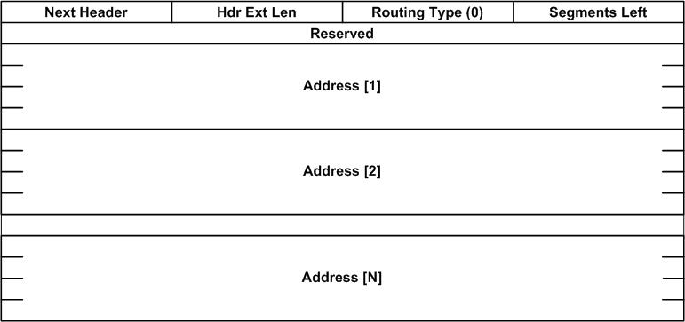
Extension Headers
Routing Header

Slide 25
Structure of the Fragment Header
Next Header
Reserved
Fragment Offset
Reserved
More Fragments Flag
Identification

Slide 26
Structure of the Authentication Header
Next Header
Payload Length
Reserved
Security Parameters Index
Sequence Number
Authentication Data
. . .

Slide 27
Structure of the ESP Header and Trailer
Security Parameters Index
Sequence Number
Payload Data
Padding
Padding Length
Next Header
Authentication Data
. . .
. . .
. . .

