Slide 1
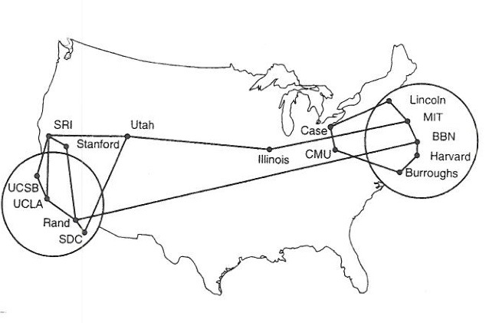
Internet Addresses
Reading: KR Chapter 4
Note to Students:
The course slides are a combination of slides from:
Peterson & Davie
Kurose & Ross
My previous lectures
I claim no copyright for any of the material and would recommend either book for a detailed treatment of the material

Slide 2
Internet Addresses
Outline/Goals
IP addresses RFC 950, STD 05
  Dotted-quad notation
  IP prefixes for aggregation
Address allocation
  Classful addresses
  Classless InterDomain Routing (CIDR) - RFC 4632, BDP 122, RFC 1817
  Growth in the number of prefixes over time
Packet forwarding
  Forwarding tables
  Longest-prefix match forwarding
  Where forwarding tables come from – KR 5

Slide 3
Internet Addresses
Hide Physical Network
Make Internet appear as a single, uniform entity
Help in routing
Universal Communications Service
    Allow any host to communicate with any other host, don’t care about actual location.

Slide 4
Host Identifiers
Name - what an object is
Address - where it is—logically vs physical (MAC)
Route - how to get there

Slide 5
IP Address (IPv4)
A unique 32-bit number
Identifies an interface (on a host, on a router, …)
Represented in dotted-quad notation
12
34
158
5
00001100
00100010
10011110
00000101

Slide 6
Grouping Related Hosts
The Internet is an “inter-network”
  Used to connect networks together, not hosts
  Needs a way to address a network (i.e., group of hosts)
host
host
...
host
host
host
...
host
LAN 1
LAN 2
router
router
router
WAN
WAN
LAN = Local Area Network – interconnected hosts
WAN = Wide Area Network – interconnected networks

Slide 7
Scalability Challenge
Suppose hosts had arbitrary addresses
  Then every router would need a lot of information
  …to know how to direct packets toward the host
1.2.3.4
5.6.7.8
2.4.6.8
1.2.3.5
5.6.7.9
2.4.6.9
host
host
...
host
host
host
...
host
LAN 1
LAN 2
router
router
router
WAN
WAN
1.2.3.4
1.2.3.5
forwarding table

Slide 8
Internet Address Structure
Historical - Classful
Properties
  globally unique
  hierarchical: network + host
Dot Notation
  10.3.2.4
  128.96.33.81
  192.12.69.77
128
16384
2097152

Slide 9
Internet Address Range
Class A: 0.0.0.0 - 127.255.255.255
Class B: 128.0.0.0 - 191.255.255.255
Class C: 192.0.0.0 - 223.255.255.255
Class D: 224.0.0.0 - 239.255.255.255
Class E: 240.0.0.0 - 247.255.255.255

Slide 10
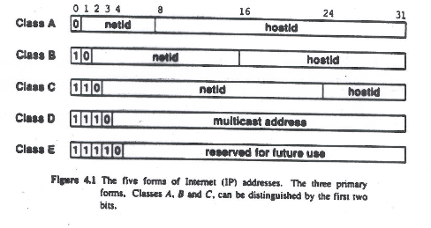
Original Internet Address Allocations

Slide 11
Classful (Historic) Addressing
In the olden days, only fixed allocation sizes
  Class A: 0*
    Very large /8 blocks (e.g., MIT has 18.0.0.0/8)
  Class B: 10*
    Large /16 blocks (e.g,. Princeton has 128.112.0.0/16)
  Class C: 110*
    Small /24 blocks (e.g., AT&T Labs has 192.20.225.0/24)
  Class D: 1110*
    Multicast groups
  Class E: 11110*
    Reserved for future use
This is why folks use dotted-quad notation!

Slide 12
Easy to Add New Hosts
No need to update the routers
  E.g., adding a new host 5.6.7.213 on the right
  Doesn’t require adding a new forwarding entry
1.2.3.4
1.2.3.7
1.2.3.156
5.6.7.8
5.6.7.9
5.6.7.212
host
host
...
host
host
host
...
host
LAN 1
LAN 2
router
router
router
host
WAN
WAN
5.6.7.213
1.2.3.0
5.6.7.0
forwarding table

Slide 13
IP Address with a 24-bit Subnet Mask
Address
12
34
158
5
00001100
00100010
10011110
00000101
11111111
11111111
11111111
00000000
Mask
255
255
255
0

Slide 14
Now Classless
Hierarchical Addressing: IP Prefixes
Still Divided into network & host portions (left and right)
12.34.158.0/24 is a 24-bit prefix with 2⁸ addresses
NOT CLASS A
12
34
158
5
00001100
00100010
10011110
00000101
Network (24 bits)
Host (8 bits)

Slide 15
Scalability Improved
Number related hosts from a common subnet
  1.2.3.0/24 on the left LAN
  5.6.7.0/24 on the right LAN
1.2.3.4
1.2.3.7
1.2.3.156
5.6.7.8
5.6.7.9
5.6.7.212
host
host
...
host
host
host
...
host
LAN 1
LAN 2
router
router
router
WAN
WAN
1.2.3.0/24
LAN 1
LAN 2
5.6.7.0/24
forwarding table

Slide 16
Easy to Add New Hosts
No need to update the routers
  E.g., adding a new host 5.6.7.213 on the right
  Doesn’t require adding a new forwarding entry
1.2.3.4
1.2.3.7
1.2.3.156
5.6.7.8
5.6.7.9
5.6.7.212
host
host
...
host
host
host
...
host
LAN 1
LAN 2
router
router
router
host
WAN
WAN
5.6.7.213
1.2.3.0/24
5.6.7.0/24
forwarding table

Slide 17
IP Address with a 24-bit Subnet Mask
Address
12
34
158
5
00001100
00100010
10011110
00000101
11111111
11111111
11111111
00000000
Mask
255
255
255
0

Slide 18
Hierarchical addressing: route aggregation
hierarchical addressing allows efficient advertisement of routing
information:
Organization 0
200.23.16.0/23
??
Organization 1
200.23.18.0/23
“Send me anything
with addresses
beginning
200.23.16.0/20”
Organization 2
200.23.20.0/23
.
Fly-By-Night-ISP
.
.
.
.
Internet
Organization 7
.
200.23.30.0/23
ISPs-R-Us
“Send me anything
with addresses
beginning
199.31.0.0/16”

Slide 19
General Weaknesses in IP Addressing
When host moves, its IP address must change
Classful - Change in network size, e.g., class C moves to class B
Classless – Change in network size, may require new allocation
Routing is based on Network Address, multiple interfaces have multiple unrelated addresses
Traffic is based on Host Address
Not enough addresses

Slide 20
Address Allocation

Slide 21
Classless Inter-Domain Routing (CIDR)
Use two 32-bit numbers to represent a network.
Network number = IP address + Mask
IP Address : 12.4.0.0 IP Mask: 255.254.0.0
Address
00001100
00000100
00000000
00000000
Mask
11111111
11111110
00000000
00000000
Network Prefix
for hosts
Written as 12.4.0.0/15

Slide 22
CIDR: Hierarchal Address Allocation
Prefixes are key to Internet scalability
  Address allocated in contiguous chunks (prefixes)
  Routing protocols and packet forwarding based on prefixes
  Today, routing tables contain ~150,000-200,000 prefixes
12.0.0.0/16
12.1.0.0/16
:
:
:
12.3.0.0/24
12.2.0.0/16
12.3.1.0/24
12.3.0.0/16
:
:
:
:
:
12.0.0.0/8
12.3.254.0/24
12.253.0.0/19
12.253.32.0/19
12.253.64.0/19
12.254.0.0/16
12.253.96.0/19
12.253.128.0/19
12.253.160.0/19

Slide 23
Scalability: Address Aggregation
Provider is given 201.10.0.0/21
Provider
201.10.0.0/22
201.10.4.0/24
201.10.5.0/24
201.10.6.0/23
Routers in the rest of the Internet just need to know how to reach 201.10.0.0/21. The provider can direct the IP packets to the appropriate customer.

Slide 24
But, Aggregation Not Always Possible
201.10.0.0/21
Provider 1
Provider 2
201.10.0.0/22
201.10.4.0/24
201.10.5.0/24
201.10.6.0/23
Multi-homed customer with 201.10.6.0/23 has two providers. Other parts of the Internet need to know how to reach these destinations through both providers.

Slide 25
Scalability Through Hierarchy
Hierarchical addressing
  Critical for scalable system
  Don’t require everyone to know everyone else
  Reduces amount of updating when something changes
Non-uniform hierarchy
  Useful for heterogeneous networks of different sizes
  Initial class-based addressing was far too coarse
  Classless InterDomain Routing (CIDR) helps
Next few slides
  History of the number of globally-visible prefixes
  Plots are # of prefixes vs. time

Slide 26
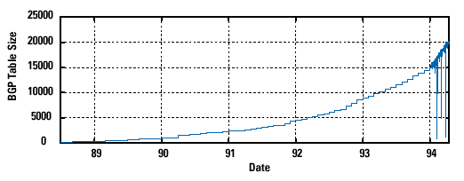
Pre-CIDR (1988-1994): Steep Growth
Growth faster than improvements in equipment capability

Slide 27
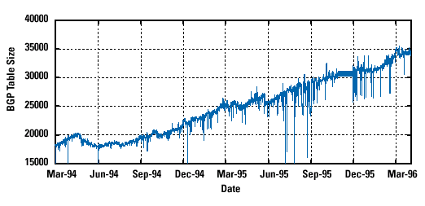
CIDR Deployed (1994-1996): Much Flatter
Efforts to aggregate (even decreases after IETF meetings!)

Slide 28
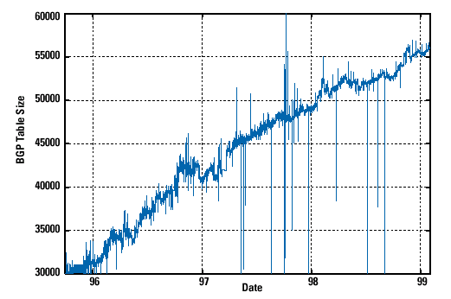
CIDR Growth (1996-1998): Roughly Linear
Good use of aggregation, and peer pressure in CIDR report

Slide 29
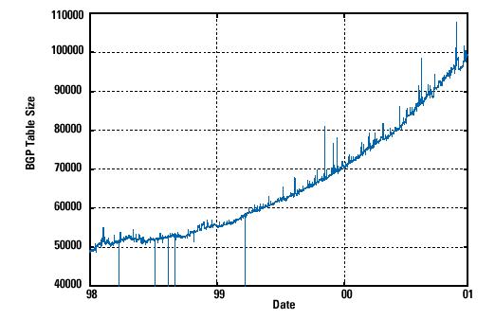
Boom Period (1998-2001): Steep Growth
Internet boom and increased multi-homing

Slide 30
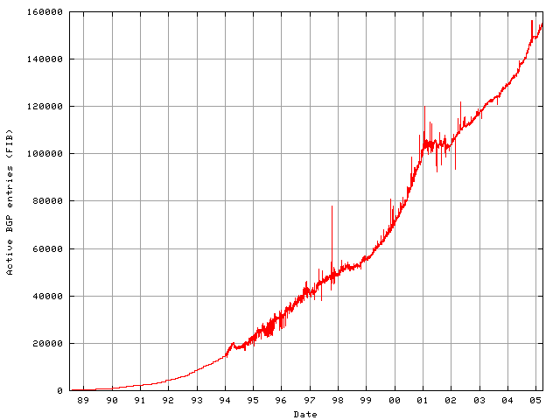
Long-Term View (1989-2005): Post-Boom

Slide 31
Obtaining a Block of Addresses Now
Separation of control
  Prefix: assigned to an institution
  Addresses: assigned by the institution to their nodes
Who assigns prefixes?
  Internet Corporation for Assigned Names and Numbers
    Allocates large address blocks to Regional Internet Registries
  Regional Internet Registries (RIRs)
    E.g., ARIN (American Registry for Internet Numbers)
    Allocates address blocks within their regions
    Allocated to Internet Service Providers and large institutions
  Internet Service Providers (ISPs)
    Allocate address blocks to their customers
    Who may, in turn, allocate to their customers…

Slide 32
Figuring Out Who Owns an Address
Address registries
  Public record of address allocations
  Internet Service Providers (ISPs) should update when giving addresses to customers
  However, records are notoriously out-of-date
Ways to query
  UNIX: “whois –h whois.arin.net 128.112.136.35”
  http://www.arin.net/whois/
  http://www.geektools.com/whois.php
  …

Slide 33
Example Output for 128.112.136.35
OrgName: Princeton University
OrgID: PRNU
Address: Office of Information Technology
Address: 87 Prospect Avenue
City: Princeton
StateProv: NJ
PostalCode: 08544-2007
Country: US
NetRange: 128.112.0.0 - 128.112.255.255
CIDR: 128.112.0.0/16
NetName: PRINCETON
NetHandle: NET-128-112-0-0-1
Parent: NET-128-0-0-0-0
NetType: Direct Allocation
RegDate: 1986-02-24

Slide 34
Are 32-bit Addresses Enough?
Not all that many unique addresses
  2³² = 4,294,967,296 (just over four billion)
  Plus, some are reserved for special purposes
  And, addresses are allocated in larger blocks
And, many devices need IP addresses
  Computers, PDAs, routers, tanks, toasters, …
Long-term solution: a larger address space
  IPv6 has 128-bit addresses (2¹²⁸ = 3.403 × 10³⁸) enough??
Short-term solutions: limping along with IPv4
  Private addresses
  Network address translation (NAT)
  Dynamically-assigned addresses (DHCP)

Slide 35
Hard Policy Questions
How much address space per geographic region?
  Equal amount per country?
  Proportional to the population?
  What about addresses already allocated?
Address space portability?
  Keep your address block when you change providers?
  Pro: avoid having to renumber your equipment
  Con: reduces the effectiveness of address aggregation
Keeping the address registries up to date?
  What about mergers and acquisitions?
  Delegation of address blocks to customers?
  As a result, the registries are horribly out of date

Slide 36
Conclusions
IPv4 address
  A 32-bit number
  Allocated in prefixes
  Non-uniform hierarchy for scalability and flexibility
  Too small....
Solutions:
  NAT
  DHCP
  IPv6

