Slide 1
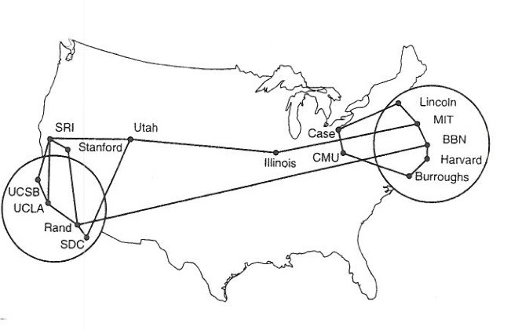
CS 125 – Applications The TOP Reading: K&R C2
Note to Students:
The course slides are a combination of slides from:
Peterson & Davie
Kurose & Ross
My previous lectures
I claim no copyright for any of the material and would recommend either book for a detailed treatment of the material.

Slide 2
IP Suite In Action: End Hosts vs. Routers
host
host
HTTP message
HTTP
HTTP
TCP segment
TCP
TCP
router
router
IP packet
IP packet
IP packet
IP
IP
IP
IP
Ethernet
interface
Ethernet
interface
SONET
interface
SONET
interface
Ethernet
interface
Ethernet
interface
Frame

Slide 3
Some network apps
e-mail
web
text messaging
remote login
P2P file sharing
multi-user network games
streaming stored video (YouTube, Hulu, Netflix)
voice over IP (e.g., Skype)
real-time video conferencing
social networking
Search
????
…

Slide 4
Chapter 2: application layer
our goals:
conceptual, implementation aspects of network application protocols
transport-layer service models
client-server paradigm
peer-to-peer paradigm
content distribution networks
learn about protocols by examining popular application-level protocols
HTTP
FTP
SMTP / POP3 / IMAP
DNS
creating network applications
socket API

Slide 5
Apps: Creating a network app
application
transport
network
data link
physical
write programs that:
run on (different) end systems
communicate over network
e.g., web server software communicates with browser software
no “need” to write software for network-core devices
network-core devices do not run user applications
applications on end systems allows for rapid app development, propagation
application
transport
network
data link
physical
application
transport
network
data link
physical

Slide 6
Application-Layer Protocols
Network applications run on end systems
They depend on the network to provide a service
… but cannot run software on the network elements
Network applications run on multiple machines
Different end systems communicate with each other
Software is often written by multiple parties
Leading to a need to explicitly define a protocol – MyEXP
Types of messages (e.g., requests and responses)
Message syntax (e.g., fields, and how to delineate)
Semantics of the fields (i.e., meaning of the information)
Rules for when and how a process sends messages

Slide 7
Application vs. Application-Layer Protocols
Application-layer protocol is just one piece
Defining how the end hosts communicate
Example: World Wide Web
HyperText Transfer Protocol is the ‘transfer’ protocol
But the Web includes other components, such as document formats (HTML), Web browsers, servers, …
Example: electronic mail
Simple Mail Transfer Protocol (SMTP) is the’transfer’ protocol
But e-mail includes other components, such as mail servers, user mailboxes, mail readers

Slide 8
Application architectures
possible structure of applications:
client-server
peer-to-peer (P2P)

Slide 9
Client-server architecture
server:
always-on host
permanent & known IP address
data centers for scaling
clients:
communicate with server
may be intermittently connected
may have dynamic IP addresses
do not communicate directly with each other
Note: Both Fixed & Dynamic IP Addresses
client/server

Slide 10
P2P architecture
no always-on server
arbitrary end systems directly communicate
peers request service from other peers, provide service in return to other peers
self scalability – new peers bring new service capacity, as well as new service demands
peers are intermittently connected and change IP addresses
complex management
peer-peer

Slide 11
Processes communicating
process: program running within a host
within same host, two processes communicate using inter-process communication (defined by OS)
processes in different hosts communicate by exchanging messages
clients, servers
client process: process that initiates communication
server process: process that waits to be contacted
aside: applications with P2P architectures have client processes & server processes

Slide 12
Sockets
process sends/receives messages to/from its socket
socket analogous to “door”
sending process shoves message (e.g., letter) out door
sending process relies on transport infrastructure (e.g., US mail) on other side of door to deliver message to socket at receiving process
application
socket
application
controlled by
app developer
process
process
transport
transport
network
network
controlled
by OS
link
Internet
link
physical
physical

Slide 13
Addressing processes
to receive messages, process must have identifier
host device has unique 32-bit IP address
Q: does IP address of host on which process runs suffice for identifying the process?
identifier includes both IP address and port numbers associated with process on host.
example port numbers:
HTTP server: 80
mail server: 25
to send HTTP message to gaia.cs.umass.edu web server:
IP address: 128.119.245.12
port number: 80
A: no, many processes can be running on same host

Slide 14
App-layer protocol defines
types of messages exchanged,
e.g., request, response
message syntax:
what fields in messages & how fields are delineated
message semantics
meaning of information in fields
rules for when and how processes send & respond to messages
open protocols:
defined in RFCs
allows for interoperability
e.g., HTTP, SMTP
proprietary protocols:
e.g., Skype

Slide 15
Analyzing App Protocols
Commands and replies
Telnet sends commands in binary, whereas Many other protocols are text based
Many of the protocols have similar request methods and response codes
Data types
Telnet, FTP, and SMTP transmit text data in standard U.S. 7-bit ASCII
FTP also supports transfer of data in binary form
SMTP uses MIME standard for sending non-text data
HTTP incorporates some key aspects of MIME (e.g., classification of data formats)

Slide 16
Analyzing App Protocols (Cont.)
Transport
Telnet, FTP, SMTP, and HTTP all depend on reliable transport protocol
Telnet, SMTP, and HTTP use a single TCP connection
… but FTP has separate control and data connections
State
In Telnet, FTP, and SMTP, the server retains information about the session with the client
E.g., FTP server remembers client’s current directory
In contrast, HTTP servers are stateless

Slide 17
What transport service does an app need?
data integrity
some apps (e.g., file transfer, web transactions) require 100% reliable data transfer
other apps (e.g., audio) can tolerate some loss
throughput
some apps (e.g., multimedia) require minimum amount of throughput to be “effective”
other apps (“elastic apps”) make use of whatever throughput they get
timing
some apps (e.g., Internet telephony, interactive games) require low delay to be “effective”
security
encryption, data integrity, …

Slide 18
Transport service requirements: common apps
application
file transfer
e-mail
Web documents
real-time audio/video
stored audio/video
interactive games
text messaging
data loss
no loss
no loss
no loss
loss-tolerant
loss-tolerant
loss-tolerant
no loss
throughput
elastic
elastic
elastic
audio: 5kbps-1Mbps
video:10kbps-5Mbps
same as above
few kbps up
elastic
time sensitive
no
no
no
yes, 100’s msec
yes, few secs
yes, 100’smsec
yes and no

Slide 19
Internet transport protocol services
TCP service:
reliable transport between sending and receiving process
flow control: sender won’t overwhelm receiver
congestion control: throttle sender when network overloaded
does not provide: timing, minimum throughput guarantee, security
connection-oriented: setup required between client and server processes
UDP service:
unreliable data transfer between sending and receiving process
does not provide: reliability, flow control, congestion control, timing, throughput guarantee, security, or connection setup,
BEST EFFORT
Q: why bother? Why is there a UDP?
Missing?? Throughput/Timing

Slide 20
Internet apps: transport protocols
application
layer protocol
SMTP [RFC 2821]
Telnet [RFC 854]
HTTP [RFC 2616]
FTP [RFC 959]
HTTP (e.g., YouTube), RTP [RFC 1889]
SIP, RTP, proprietary
(e.g., Skype)
underlying
transport protocol
TCP
TCP
TCP
TCP
TCP or UDP
TCP or UDP
application
e-mail
remote terminal access
Web
file transfer
streaming multimedia
Internet telephony

Slide 21
Securing TCP
TCP & UDP
no encryption
cleartext passwds sent into socket traverse Internet in cleartext
SSL
provides encrypted TCP connection
data integrity
end-point authentication
SSL is at app layer
apps use SSL libraries, that “talk” to TCP
SSL socket API
cleartext passwords sent into socket traverse Internet encrypted
see Chapter 8

Slide 22
Reflecting on Application-Layer Protocols
Protocols are tailored to the applications
Each protocol is customized to a specific need
Protocols have many key similarities
Each new protocol was influenced by the previous ones
New protocols commonly borrow from the older ones
Protocols depend on same underlying substrate
Ordered reliable stream of bytes (i.e., TCP)
Domain Name System (DNS)
Relevance of the protocol standards process
Important for interoperability across implementations
Yet, not necessary if same party writes all of the software
…which is increasingly common (e.g., P2P software)

