Slide 1
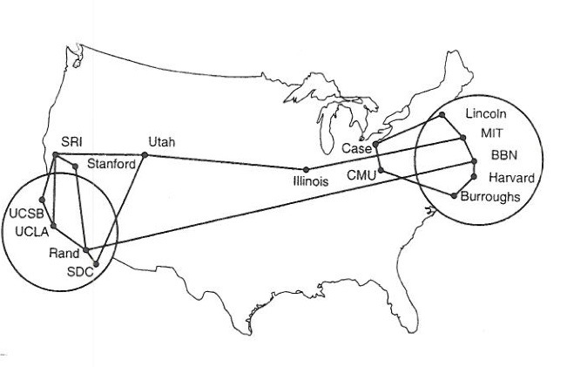
Internetworking
Network Layer
Outline/Goals
  Best Effort Service Model
  IP - The Protocol, RFC 791, STD 5
  KR - Chapter 4!!!
Note to Students:
The course slides are a combination of slides from:
Peterson & Davie
Kurose & Ross
My previous lectures
I claim no copyright for any of the material and would recommend either book for a detailed treatment of the material

Slide 2
KR Chapter 4: network layer
chapter goals:
understand principles behind network layer services, focusing on data plane:
  network layer service models
  forwarding versus routing
  how a router works
  generalized forwarding
instantiation, implementation in the Internet

Slide 3
The Problem
At the bottom: a single network
  Point to point
  Shared media
  Extended by bridges, hubs, and switches
New Problem
  Interconnecting different networks
Issues
  Scale … unknown size
  Heterogeneity … service over clouds
  Selecting Network
  Selecting Host

Slide 4
Message, Segment, Packet, and Frame
Host-Node
host
HTTP message
HTTP
HTTP
TCP segment
TCP
TCP
Here
Router- Node
router
IP
IP packet
IP packet
IP packet
IP
IP
IP
Ethernet
interface
Ethernet
interface
SONET
interface
SONET
interface
Ethernet
interface
Ethernet
interface
SONET frame
Ethernet frame
Links
Ethernet frame

Slide 5
Network Layer supports Internetworking
Internet protocols define a format for a common network layer protocol and rules for transmitting this protocol (packets & rules) over all known types of media.
Restriction:
Need to support the service offered by the least capable networking technology, e.g., dial-up modem, US Mail, …

Slide 6
IP Internet
Concatenation of Networks
Protocol Stack
Routers forward based only on IP Addr

Slide 7
IP Service Model
Global Addressing Scheme – find a Network, find a node
Packets or Datagrams – message units
Connectionless (datagram-based) – no path determination by host
Best-effort delivery (unreliable service) – never guarantee delivery
Datagram format clearly specified by RFC – No Exceptions ??

Slide 8
IP Service Model:
Why Packets?
Data traffic is bursty – Still True?? (Streaming)
  Logging into remote machines
  Exchanging e-mail messages
Don’t want to waste reserved bandwidth
  No traffic exchanged during idle periods
Better to allow multiplexing
  Different transfers share access to same links
Packets can be delivered by most anything
  RFC 2549: IP over Avian Carriers (aka birds)
… still, packet switching can be inefficient
  Extra header bits on every packet

Slide 9
History: Why IP Packets?
IP proposed in the early 1970s
  Defense Advanced Research Project Agency (DARPA)
Goal: connect existing networks
  To develop an effective technique for multiplexed utilization of existing interconnected networks
  E.g., connect packet radio networks to the ARPAnet
Motivating applications
  Remote login to server machines
  Inherently bursty traffic with long silent periods
Prior ARPAnet experience with packet switching
  Previous DARPA project
  Demonstrated store-and-forward packet switching

Slide 10

IP Service Model:
Best-Effort Packet Delivery
Packet switching
  Divide messages into a sequence of packets
  Headers with source and destination address
Best-effort delivery – delivery service with NO state
  Packets may be lost or Delayed
  Packets may be corrupted
  Packets may be delivered out of order
source
destination
IP network

Slide 11
IP Service Model:
Why Best-Effort?
IP means never having to say you’re sorry…
  Don’t need to reserve bandwidth and memory
  Don’t need to do error detection & correction
  Don’t need to remember from one packet to next
  Push all other concerns to end hosts, NOT the middle
Easier to survive failures
  Transient disruptions are okay during failover
… but, applications do want efficient, accurate transfer of data in order, in a timely fashion - NOT IPs problem

Slide 12
Layering in the IP Protocols
HTTP
Telnet
FTP
DNS
RTP
Top
Provide
Services
of Top
Transmission Control
Protocol (TCP)
User Datagram
Protocol (UDP)
Internet Protocol
SONET
Ethernet
ATM
Bottom

Slide 13
IP Service Model:
Best-Effort is Enough ??
No error detection or correction
  Higher-level protocol can provide error checking
Successive packets may not follow the same path
  Not a problem as long as packets reach the destination
Packets can be delivered out-of-order
  Receiver can put packets back in order (if necessary)
Packets may be lost or arbitrarily delayed
  Sender can send the packets again (if desired)
No network congestion control (beyond “drop”)
  Sender can slow down in response to loss or delay

Slide 14
Other Main Driving Goals (In Order)
Communication should continue despite failures
  Survive equipment failure or physical attack
  Traffic between two hosts continue on another path
Support multiple types of communication services
  Differing requirements for speed, latency, & reliability
  Bidirectional reliable delivery vs. message service
Accommodate a variety of networks
  Both military and commercial facilities
  Minimize assumptions about the underlying network

Slide 15
Other Driving Goals, Somewhat Met
Permit distributed management of resources
  Nodes managed by different institutions
  … though this is still rather challenging
Cost-effectiveness
  Statistical multiplexing through packet switching
  … though packet headers and retransmissions wasteful
Ease of attaching new hosts
  Standard implementations of end-host protocols
  … though still need a fair amount of end-host software
Accountability for use of resources
  Monitoring functions in the nodes
  … though this is still fairly limited and immature

Slide 16
IP Datagram Structure
4-bit
Version
4-bit
Header
Length
8-bit
Type of Service
(TOS)
16-bit Total Length (Bytes)
16-bit Identification
3-bit
Flags
13-bit Fragment Offset
8-bit Time to
Live (TTL)
8-bit Protocol
16-bit Header Checksum
32-bit Source IP Address
32-bit Destination IP Address
Options (if any)
Payload

Slide 17
IP Packet Header Fields
Version number (4 bits)
  Indicates the version of the IP protocol
  Necessary to know what other fields to expect
  Typically “4” (for IPv4), and sometimes “6” (for IPv6)
Header length (4 bits) – Why 32 bit words??
  Number of 32-bit words in the header
  Typically “5” (for a 20-byte IPv4 header)
  Can be more when “IP options” are used
Type-of-Service (8 bits)
  Allow packets to be treated differently based on needs
  E.g., low delay for audio, high bandwidth for bulk transfer

Slide 18
IP Packet Header Fields (Continued)
Total length (16 bits)
  Number of bytes in the packet
  Maximum size is 63,535 bytes (2¹⁶ -1)
  … though underlying links may impose harder limits
Fragmentation information (32 bits)
  Packet identifier, flags, and fragment offset
  Supports dividing a large IP packet into fragments
  … in case a link cannot handle a large IP packet
Time-To-Live (8 bits)
  Used to identify packets stuck in forwarding loops

Slide 19
More:Time-to-Live (TTL) Field
Potential robustness problem
  Forwarding loops can cause packets to cycle forever
  Confusing if the packet arrives much later
Time-to-live field in packet header
  TTL field decremented by each router on the path
  Packet is discarded when TTL field reaches 0…
  …and “time exceeded” message is sent to the source
  Used by Traceroute

Slide 20
Application of TTL in Traceroute
Time-To-Live field in IP packet header
  Source sends a packet with a TTL of n
  Each router along the path decrements the TTL
  “TTL exceeded” sent when TTL reaches 0
Traceroute tool exploits this TTL behavior
So much for middle just routing
Time
exceeded
TTL=1
source
destination
TTL=2
Send packets with TTL=1, 2, … and record source of “time exceeded” message

Slide 21
Ex: Traceroute: Berkeley to CNN
Hop number, IP address, DNS name
1 169.229.62.1
2 169.229.59.225
3 128.32.255.169
4 128.32.0.249
5 128.32.0.66
6 209.247.159.109
7 *
8 64.159.1.46
9 209.247.9.170
10 66.185.138.33
11 *
12 66.185.136.17
13 64.236.16.52
inr-daedalus-0.CS.Berkeley.EDU
soda-cr-1-1-soda-br-6-2
vlan242.inr-202-doecev.Berkeley.EDU
gigE6-0-0.inr-666-doecev.Berkeley.EDU
qsv-juniper--ucb-gw.calren2.net
POS1-0.hsipaccess1.SanJose1.Level3.net
?
?
pos8-0.hsa2.Atlanta2.Level3.net
pop2-atm-P0-2.atdn.net
?
pop1-atl-P4-0.atdn.net
www4.cnn.com
No response
from router
No name resolution

Slide 22
IP Packet Header Fields (Continued)
Protocol (8 bits)
  Identifies the higher-level protocol
    E.g., “6” for the Transmission Control Protocol (TCP)
    E.g., “17” for the User Datagram Protocol (UDP)
  Important for demultiplexing at receiving host
    Indicates what kind of header to expect next
protocol=6
protocol=17
IP header
IP header
TCP header
UDP header

Slide 23
IP Packet Header Fields (Continued)
Checksum (16 bits)
  Sum of all 16-bit words in the IP packet header
  If any bits of the header are corrupted in transit
  … the checksum won’t match at receiving host
  Receiving host discards corrupted packets
    Sending host will retransmit the packet, if needed
134
+ 212
= 346
134
+ 216
= 350
Mismatch!

Slide 24
IP Packet Header (Continued)
Two IP addresses
  Source IP address (32 bits)
  Destination IP address (32 bits)
Destination address
  Unique identifier for the receiving host
  Allows each node to make forwarding decisions
Source address
  Unique identifier for the sending host
  Recipient can decide whether to accept packet
  Enables recipient to send a reply back to source

Slide 25
What if the Source Lies?
Source address should be the sending host
  But, who’s checking, anyway?
  You could send packets with any source you want
Why would someone want to do this?
  Launch a denial-of-service attack
    Send excessive packets to the destination
    … to overload the node, or the links leading to the node
  Evade detection by “spoofing”
    But, the victim could identify you by the source address
    So, you can put someone else’s source address in the packets
  Also, an attack against the spoofed host
    Spoofed host is wrongly blamed
    Spoofed host may receive return traffic from the receiver
  Ingress Filtering

Slide 26
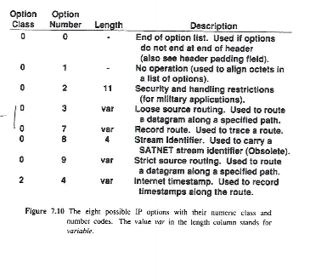
IP Options

Slide 27
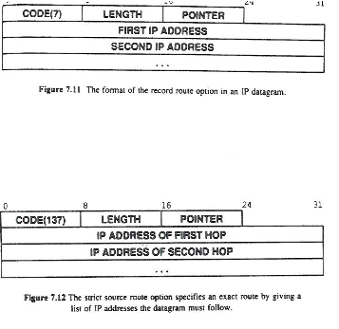
IP Options

Slide 28
Fragmentation and Reassembly
Each network has some MTU – Maximum Transmission Unit
Design decisions
  fragment when necessary (MTU < Datagram)
  try to avoid fragmentation at source host - does not know
  re-fragmentation is possible
  fragments are self-contained datagrams, i.e., with own IP header
  delay reassembly until destination host
  do not recover from lost fragments
  Router/Gateway works hard, fixes Source’s bad choice
  When can you not fragment???

Slide 29
Example
Start of header
Ident = x
0
Offset = 0
Rest of header
(a)
1400 data bytes
Start of header
Ident = x
1
Offset = 0
Rest of header
512 data bytes
(b)
Start of header
Ident = x
1
Offset = 64
Rest of header
512 data bytes
Start of header
Ident = x
0
Offset = 128
Rest of header
376 data bytes

Slide 30
IP datagram structure
IP protocol version
number
32 bits
header length
(bytes)
head.
len
type of
service
total datagram
length (bytes)
ver
length
“type” of data
flgs
fragment
offset
16-bit identifier
fragmentation/
reassembly
max number
remaining hops
(decremented at
each router)
time to
live
upper
layer
header
checksum
32 bit source IP address
upper layer protocol
to deliver payload to
32 bit destination IP address
options (if any)
e.g. timestamp,
record route
taken, specify
list of routers
to visit.
data
(variable length,
typically a TCP
or UDP segment)
how much overhead?
20 bytes of TCP
20 bytes of IP
= 40 bytes + app layer overhead

Slide 31
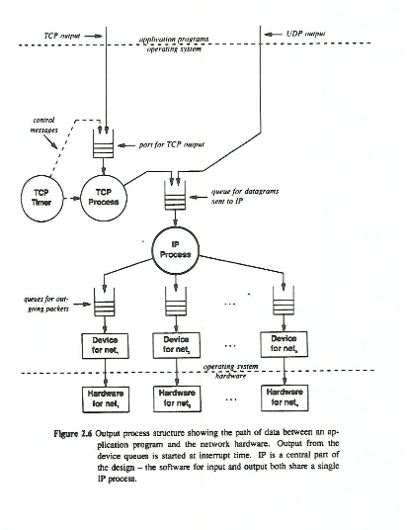
Multiple Links

Slide 32
