Slide 1
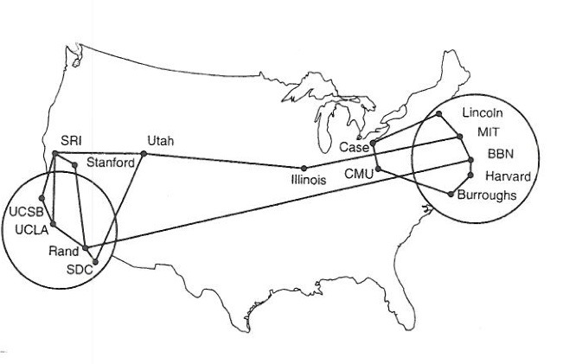
CS 125 – Networking
Reading: K&R C1
Note to Students:
The course slides are a combination of slides from:
Peterson & Davie
Kurose & Ross
My previous lectures
I claim no copyright for any of the material and would recommend either book for a detailed treatment of the material.

Slide 2
Suppose You Want to Build A Network
Potential to…
  Grow to Global Proportions
  Support Diverse Applications
  teleconferencing
  video-on-demand
  distributed computing
  digital libraries
  any new application, e.g., text messaging, phone,

Slide 3
Suppose You Want to Build A Network …
Potential to…
  Built from general purpose ideas
  Not optimized for particular application or technology or company
  Support Explosive Growth
  Ease of incorporating new applications
  Ease of changes to core technologies
  Ease of supporting new devices
  Ease of implementation – software & hardware

Slide 4
Suppose You Want to Build A Network …
Potential to Support Different Perspectives…
  User: services applications need, e.g., guarantee that each message sent is delivered without error in ‘reasonable’ time.
  Designer: cost-effective design, e.g., network resources are efficiently utilized and fairly (?) allocated to different users
  Providers: system that is easy to administer and manage, e.g., faults can be isolated, cost allocation

Slide 5
Suppose You Want to Build A Network …
What available technologies would serve as building blocks?
What software architecture would you use?
How would you incorporate the future?
What principles would you enforce?
How would you manage development & maintenance?

Slide 6
This Class:
Attempts to answer those questions.
Answers are restricted by the technologies at the time of creation.
Moore’s Law – 1965ish, while known not a driving force
Today: would we do it different, could we do it different?
Tomorrow: will the Internet survive?
Are there principles that would survive?

Slide 7
Start with:
Fundamental Requirement
A Computer Network must provide: general, cost-effective, fair, robust, secure, and high performance connectivity among a large diverse set of nodes/users/apps.
Can we agree on a definition of these terms?

Slide 8
A Solution: Internetworking
Abstraction that deals with complexity of multiple underlying communication technologies tied together in a global network, i.e., no specific low level (wire) network technology
Essence of this course – chase Internetworking abstraction
  Architecture
  Protocols
  While stressing a set of guiding principles

Slide 9
A Solution: The Internet
“Largest Enginnered System Ever”
This Course:
Investigate Interneting at all levels in all ways.
In particular the Internet
Today:
  Terms and concepts that you will see throughout the semester
Issue:
Research becomes commercial
Research continues in parallel with commercial

Slide 10
Today
our goal:
get “feel” and terminology
more depth, detail later in course
approach:
  use Internet as example
overview:
what’s the Internet?
what’s a protocol?
network edge; hosts, access net, physical media
network core: packet/circuit switching, Internet structure
performance: loss, delay, throughput
security
protocol layers, service models
history

Slide 11

‘The’ Internet: The monolithic view
THE
INTERNET – Network of Networks !!!!
4
3
5
2
7
6
1
Web server
Client
Browser

Slide 12
A Definition: Network
A network can be defined recursively as...
  two or more nodes connected by a link, or
  two or more networks connected by a node

Slide 13
Internet: Building Blocks
Nuts & Bolts
Nodes: PC, special-purpose hardware…
  Hosts, servers…any machine connected to network
  Switches, routers, gateways…any networking device
  Things – you name it (people?)
Links: coax cable, optical fiber, twisted pair, avian carrier, …
  point-to-point
  or
  multiple access
(a)
(b)
■ ■ ■

Slide 14
















Internet: “nuts and bolts”
Internet: “network of networks”
  Interconnected ISPs
protocols control sending, receiving of messages
  e.g., TCP, IP, HTTP, Skype, 802.11
Internet standards
  RFC: Request for comments?
  IETF: Internet Engineering Task Force?
mobile network
global ISP
home
network
regional ISP
institutional
network

Slide 15
What’s the Internet: a service view
mobile network
infrastructure that provides services to applications:
  Web, VoIP, email, games, e-commerce, social nets, …
provides programming interface to apps
  hooks that allow sending and receiving app programs to “connect” to Internet
  provides service options, analogous to postal service
global ISP
home
network
regional ISP
institutional
network

Slide 16
What’s a protocol?
human protocols:
“what’s the time?”
“I have a question”
introductions
… specific messages sent
… specific actions taken when messages received, or other events
network protocols:
machines rather than humans
all communication activity in Internet governed by protocols
protocols define format, order of messages sent and received among network entities, and actions taken on message transmission, receipt

Slide 17
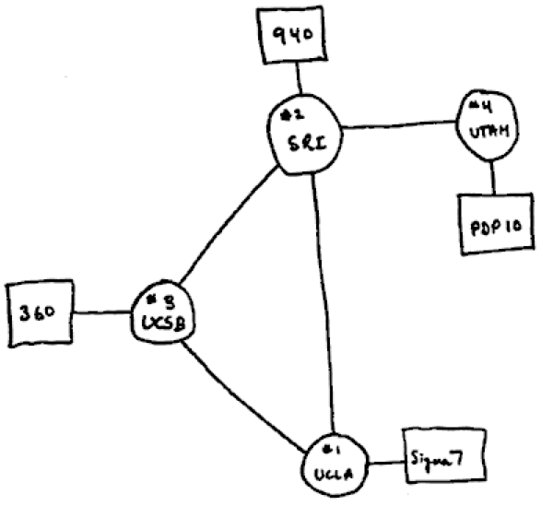
Why “Internet”
An internet = Network of networks
Standardized format and protocols for speaking between HETEROGENOUS networks

Slide 18
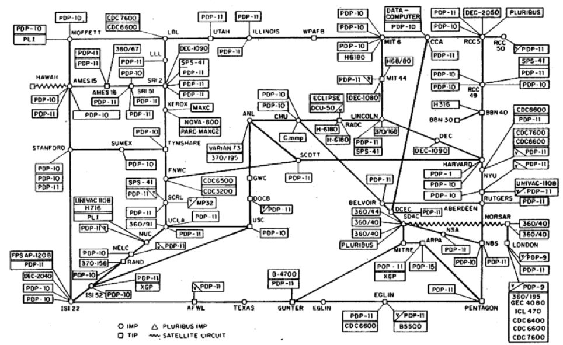
Why “Internet”
Network of networks
Standardized format and protocols for speaking between HETEROGENOUS networks

Slide 19
Closer look at network structure:
network edge:
  hosts: clients and servers
  servers often in data centers
mobile network
global ISP
access networks, physical media: wired, wireless communication links
home
network
regional ISP
network core:
  interconnected routers
  network of networks
institutional
network

Slide 20









Internet: The core
“Mesh” of interconnected routers
packet-switching: hosts break application-layer messages into packets
  forward packets from one router to the next, across links on path from source to destination
  each packet transmitted at full link capacity

Slide 21
Two key network-core functions
routing: determines source-destination route taken by packets
  routing algorithms
forwarding: move packets from router’s input to appropriate router output
routing algorithm
local forwarding table
header value
output link
0100
0101
0111
1001
3
2
2
1
1
3
2
0111
destination address in arriving
packet’s header

Slide 22
Connection Strategies: lowest level
Circuit switching: carry bit streams through a known connected network -- setup for each connection
  original telephone network
Packet switching: store-and-forward messages, at each hop the next path is pre-determined
  US postal system
  Internet

Slide 23

Alternative: circuit switching
end-end resources (allocated to) reserved for “call” between source & dest:
in diagram, each link has four circuits.
  call gets 2nd circuit in top link and 1st circuit in right link.
dedicated resources: no sharing
  circuit-like (guaranteed) performance
circuit segment idle if not used by call (no sharing)
commonly used in traditional telephone networks

Slide 24
Packet switching vs circuit switching
packet switching allows more users to use network!
example:
1 Mb/s link
each user:
  100 kb/s when “active”
  active 10% of time
circuit-switching:
  10 users
packet switching:
  with 35 users, probability > 10 active at same time is less than .0004 *
N
users
…..
1 Mbps link
Q: how did we get value 0.0004?
Q: what happens if > 35 users ?
* Check out the online interactive exercises for more examples: http://gaia.cs.umass.edu/kurose_ross/interactive/

Slide 25
Packet switching (on demand) vs circuit switching (reserved)
is packet switching a “slam dunk winner?”
great for bursty data
  resource sharing
  simpler, no call setup
excessive congestion possible: packet delay and loss
  protocols needed for reliable data transfer, congestion control
Q: How to provide circuit-like behavior?
  bandwidth guarantees needed for audio/video apps – technology will solve this, but new apps will make it worse.
  still an unsolved problem (chapter 7)
Q: human analogies of reserved resources (circuit switching) versus on-demand allocation (packet-switching)?

Slide 26
Internet: network of networks
End systems connect to Internet via access ISPs (Internet Service Providers)
  residential, company and university ISPs
Access ISPs in turn must be interconnected.
  so that any two hosts can send packets to each other
Resulting network of networks is very complex
  evolution was driven by economics and national policies
Let’s take a stepwise approach to describe current Internet structure

Slide 27
Internet: network of networks
Question: given millions of access ISPs, how to connect them together?
…
…
access
net
access
net
access
net
access
net
access
net
access
net
access
net
…
…
access
net
access
net
access
net
access
net
access
net
access
net
…
access
net
access
net
…
access
net

Slide 28
Internet : network of networks
Option: connect each access ISP to every other access ISP?
…
…
access
net
access
net
access
net
access
net
access
net
…
…
access
net
access
net
…
connecting each access ISP to each other directly doesn’t scale: O(N²) connections.
NO WAY!!
…
…
access
net
access
net
…
access
net
access
net
access
net
…
access
net
…
access
net
access
net
…
access
net

Slide 29
Internet: network of networks
Option: connect each access ISP to ONE global transit ISP?
Customer and provider ISPs have economic agreement.
…
…
access
net
access
net
access
net
access
net
access
net
access
net
access
net
…
…
global
ISP
access
net
access
net
access
net
access
net
access
net
access
net
…
access
net
access
net
…
access
net

Slide 30
Internet: network of networks
But if one global ISP is viable business, there will be competitors ….
…
…
access
net
access
net
access
net
access
net
access
net
access
net
ISP A
access
net
…
…
access
net
ISP B
access
net
ISP C
access
net
access
net
access
net
access
net
…
access
net
access
net
…
access
net

Slide 31
Internet: network of networks
But if one global ISP is viable business, there will be competitors …. which must be interconnected
Internet exchange point
…
…
access
net
access
net
access
net
access
net
access
net
IXP
access
net
access
net
ISP A
…
…
access
net
IXP
ISP B
access
net
ISP C
access
net
access
net
peering link
access
net
access
net
…
access
net
access
net
…
access
net

Slide 32
Internet: network of networks
… and regional networks may arise to connect access nets to ISPs
…
…
access
net
access
net
access
net
access
net
access
net
IXP
access
net
access
net
ISP A
…
…
access
net
IXP
ISP B
access
net
ISP C
access
net
access
net
access
net
regional net
access
net
…
access
net
access
net
…
access
net

Slide 33
Internet: network of networks
… and content provider networks (e.g., Google, Microsoft, Akamai) may run their own network, to bring services, content close to end users
…
…
access
net
access
net
access
net
access
net
access
net
IXP
access
net
access
net
ISP A
…
…
Content provider network- Goggle
access
net
IXP
ISP B
access
net
ISP C
access
net
access
net
access
net
regional net
access
net
…
access
net
access
net
…
access
net

Slide 34
Tier-1 ISP: e.g., Sprint
POP: point-of-presence
to/from backbone
peering
…
…
…
…
…
to/from customers

Slide 35
Internet structure: network of networks
Philosophical View
Tier 1 ISP
Tier 1 ISP
Google
IXP
IXP
IXP
Regional ISP
Regional ISP
access
ISP
access
ISP
access
ISP
access
ISP
access
ISP
access
ISP
access
ISP
access
ISP
at center: small # of well-connected large networks
“tier-1” commercial ISPs (e.g., Level 3, Sprint, AT&T, NTT), national & international coverage
content provider network (e.g., Google): private network that connects it data centers to Internet, often bypassing tier-1, regional ISPs

Slide 36
Internet: loss and delay?
packets queue in router buffers
packet arrival rate to link (temporarily) exceeds output link capacity
packets queue, wait for turn
packet being transmitted (delay)
A
B
packets queueing (delay)
free (available) buffers: arriving packets
dropped (loss) if no free buffers

Slide 37
Four sources of packet delay
transmission
A
propagation
B
nodal
processing
queueing
d_{nodal} = d_{proc} + d_{queue} + d_{trans} + d_{prop}
d_{proc}: nodal processing
check bit errors
determine output link
typically < msec
d_{queue}: queueing delay
time waiting at output link for transmission
depends on congestion level of router

Slide 38
Four sources of packet delay
transmission
A
propagation
B
nodal
processing
queueing
d_{nodal} = d_{proc} + d_{queue} + d_{trans} + d_{prop}
d_{trans}: transmission delay:
L: packet length (bits)
R: link bandwidth (bps)
d_{trans} = L/R
d_{prop}: propagation delay:
d: length of physical link
s: propagation speed (~2x10⁸ m/sec)
d_{prop} = d/s
d_{trans} and d_{prop}
very different
* Check out the Java applet for an interactive animation on trans vs. prop delay
Notes:
38
Transmission delay – time to put bits on the wire
Propagation delay – distance / speed of light

Slide 39
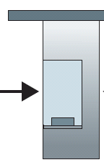
Caravan analogy
100 km
100 km
ten-car
caravan
toll
booth
toll
booth
cars “propagate” at
100 km/hr
toll booth takes 12 sec to service car (bit transmission time)
car ~ bit; caravan ~ packet
Q: How long until caravan is lined up before 2nd toll booth?
time to “push” entire caravan through toll booth onto highway = 12*10 = 120 sec
time for last car to propagate from 1st to 2nd toll both: 100km/(100km/hr)= 1 hr
A: 62 minutes

Slide 40
Caravan analogy (more)
100 km
100 km
ten-car
caravan
toll
booth
toll
booth
suppose cars now “propagate” at 1000 km/hr
and suppose toll booth now takes one min to service a car
Q: Will cars arrive to 2nd booth before all cars serviced at first booth?
A: Yes! after 7 min, first car arrives at second booth; three cars still at first booth

Slide 41
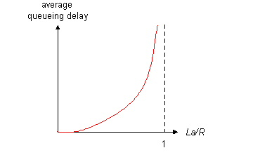

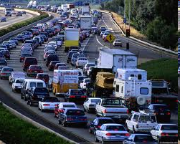
Queueing delay (revisited)
R: link bandwidth (bps)
L: packet length (bits)
a: average packet arrival rate
average queueing delay
traffic intensity
= La/R
La/R ~ 0: avg. queueing delay small
La/R -> 1: avg. queueing delay large
La/R > 1: more “work” arriving
than can be serviced, average delay infinite!
La/R ~ 0
La/R -> 1
* Check online interactive animation on queuing and loss

Slide 42
“Real” Internet delays and routes
what do “real” Internet delay & loss look like?
traceroute program: provides delay measurement from source to router along end-end Internet path towards destination. For all i:
  sends three packets that will reach router i on path towards destination
  router i will return packets to sender
  sender times interval between transmission and reply.
3 probes
3 probes
3 probes

Slide 43
“Real” Internet delays, routes
traceroute: gaia.cs.umass.edu to www.eurecom.fr
3 delay measurements from
gaia.cs.umass.edu to cs-gw.cs.umass.edu
1 cs-gw (128.119.240.254) 1 ms 1 ms 2 ms
2 border1-rt-fa5-1-0.gw.umass.edu (128.119.3.145) 1 ms 1 ms 2 ms
3 cht-vbns.gw.umass.edu (128.119.3.130) 6 ms 5 ms 5 ms
4 jn1-at1-0-0-19.wor.vbns.net (204.147.132.129) 16 ms 11 ms 13 ms
5 jn1-so7-0-0-0.wae.vbns.net (204.147.136.136) 21 ms 18 ms 18 ms
6 abilene-vbns.abilene.ucaid.edu (198.32.11.9) 22 ms 18 ms 22 ms
7 nycm-wash.abilene.ucaid.edu (198.32.8.46) 22 ms 22 ms 22 ms
8 62.40.103.253 (62.40.103.253) 104 ms 109 ms 106 ms
9 de2-1.de1.de.geant.net (62.40.96.129) 109 ms 102 ms 104 ms
10 de.fr1.fr.geant.net (62.40.96.50) 113 ms 121 ms 114 ms
11 renater-gw.fr1.fr.geant.net (62.40.103.54) 112 ms 114 ms 112 ms
12 nio-n2.cssi.renater.fr (193.51.206.13) 111 ms 114 ms 116 ms
13 nice.cssi.renater.fr (195.220.98.102) 123 ms 125 ms 124 ms
14 r3t2-nice.cssi.renater.fr (195.220.98.110) 126 ms 126 ms 124 ms
15 eurecom-valbonne.r3t2.ft.net (193.48.50.54) 135 ms 128 ms 133 ms
16 194.214.211.25 (194.214.211.25) 126 ms 128 ms 126 ms
17 * * *
18 * * *
19 fantasia.eurecom.fr (193.55.113.142) 132 ms 128 ms 136 ms
trans-oceanic
link
* means no response (probe lost, router not replying)
* Do some traceroutes from exotic countries at www.traceroute.org

Slide 44
Packet loss
queue (aka buffer) preceding link in buffer has finite capacity
packet arriving to full queue dropped (aka lost) (leaky bucket or tail drop)
lost packet may be retransmitted by previous node, by source end system, or not at all
buffer
(waiting area)
A
packet being transmitted
B
packet arriving to
full buffer is lost
* Check out the Java applet for an interactive animation on queuing and loss

Slide 45
Throughput
throughput: rate (bits/time unit) at which bits transferred between sender/receiver
  instantaneous: rate at given point in time
  average: rate over longer period of time
server, with
file of F bits
to send to client
link capacity
R_{s} bits/sec
link capacity
R_{c} bits/sec
server sends bits
(fluid) into pipe
pipe that can carry
fluid at rate
R_{s} bits/sec)
pipe that can carry
fluid at rate
R_{c} bits/sec)

Slide 46
Throughput (more)
R_{s} < R_{c} What is average end-end throughput?
R_{s} bits/sec
R_{c} bits/sec
R_{s} > R_{c} What is average end-end throughput?
R_{s} bits/sec
R_{c} bits/sec
bottleneck link
link on end-end path that constrains end-end throughput

Slide 47
Throughput: Internet scenario
per-connection end-end throughput: min(R_{c},R_{s},R/10)
in practice: R_{c} or R_{s} is often bottleneck
R_{s}
R_{s}
R_{s}
R
R_{c}
R_{c}
R_{c}
10 connections (fairly) share backbone bottleneck link R bits/sec
* Check out the online interactive exercises for more examples: http://gaia.cs.umass.edu/kurose_ross/interactive/

Slide 48
Internet Pieces
Networks are complex,
with many “pieces”:
  hosts
  routers
  links of various media
  applications
  protocols
  hardware, software
Question:
is there any hope of organizing structure of network?
…. or at least our discussion of networks?

Slide 49
Why layering?
dealing with complex systems:
explicit structure allows identification, relationship of complex system’s pieces
  layered reference model for discussion
modularization eases maintenance, updating of system
  change of implementation of layer’s service transparent to rest of system
  e.g., change in gate procedure doesn’t affect rest of system
layering considered harmful?

Slide 50
Protocols??
Define a Protocol??
Building blocks of a network architecture
Each protocol object has two different interfaces
  service interface: operations on/by this protocol (API)
  peer-to-peer interface: messages exchanged with peer (RFC)
Term “protocol” is overloaded
  specification of peer-to-peer interface
  module that implements this interface

Slide 51
Protocol Interfaces

Slide 52
Internet protocol stack
application: supporting network applications - messages
  FTP, SMTP, HTTP
transport: process-process data transfer –segments or packets
  TCP, UDP
network: routing of datagrams from source to destination
  IP, routing protocols
link: data transfer between neighboring network elements-frames
  Ethernet, 802.111 (WiFi), PPP
physical: bits “on the wire”
application
transport
network
link
physical

Slide 53
Protocol Machinery
Protocol Graph
  most peer-to-peer communication is indirect
  peer-to-peer is direct only at hardware level
Host 1
Host 2
File
Digital
Video
File
Digital
Video
application
library
application
application
library
application
application
application
The Net

Slide 54
Protocol Machinery (cont)
Multiplexing and Demultiplexing (demux key)
Encapsulation (header/body)
Host
Host
Application
Application
Application
Application
program
program
program
program
Data
Data
RRP
RRP
RRP Data
RRP Data
HHP
HHP
HHP RRP Data

Slide 55
Layer Encapsulation in
User A
User B
Application
Get index.html
App-to-app
channels
Connection ID
Host-to-host
connectivity
Source/Destination
Link hardware
Link Address

Slide 56
Internet Architecture
Defined by Internet Engineering Task Force (IETF)
Hourglass Design
Overload: Application vs Application Protocol (FTP, HTTP)
FTP
HTTP
NV
TFTP
Apps
Transport
Network
Link/Data
TCP
UDP
Hour Glass
IP
NET
1
NET
2
■ ■ ■
NET
n

Slide 57
IP Suite In Action:
End Hosts vs. Routers
host
host
HTTP message
HTTP
HTTP
TCP segment
TCP
TCP
router
router
IP packet
IP packet
IP packet
IP
IP
IP
IP
Ethernet
interface
Ethernet
interface
SONET
interface
SONET
interface
Ethernet
interface
Ethernet
interface
Frame

Slide 58
ISO ‘Paper’ Architecture

Slide 59
OSI levels
Physical – electro-mechanical interface
Data Link – transmission, framing, error control over link. Divided into media dependent and independent
Network – data transfer across network, independent of media or topology
Transport – reliability and multiplexing of data
Session – adds control mechanisms to data exchange, e.g., start stop, port numbers
Presentation – structure and coding (ASCII, little-endian, big-endian
Application – User application, e.g., ftp, telnet

Slide 60
ISO/OSI reference model
presentation: allow applications to interpret meaning of data, e.g., encryption, compression, machine-specific conventions
session: synchronization, checkpointing, recovery of data exchange
Internet stack “missing” these layers!
  these services, if needed, must be implemented in application
  needed?
application
presentation
session
transport
network
link
physical

Slide 61
Internet: Systems Approach
We reject kings, presidents, and voting. We believe in rough consensus and running code…
Implies doing experimental performance studies
Do not accept existing artifacts as gospel, but instead strive to understand the concepts that are fundamental to the system.
Draw on a collection of design principles that have evolved from experience with computer systems
Study successful, working examples: systems cannot be studied in the abstract
Look at the big picture
Build and test, build and test, ….
Specify and document, specify and document,…

Slide 62
What Goes Wrong in the Network?
Bit-level errors (electrical interference)
Packet-level errors (congestion, dropped)
Link and node failures (new path)
??
Packets are delayed
Packets are deliver out-of-order
Third parties eavesdrop
??
Today’s Internet can barely support apps, yesterday’s and tomorrow’s Internet have same problem

Slide 63
Network security
field of network security:
  how bad guys can attack computer networks
  how we can defend networks against attacks
  how to design architectures that are immune to attacks
Internet not originally designed with (much) security in mind—WHY?
  original vision: “a group of mutually trusting users attached to a transparent network” ☺
  Internet protocol designers playing “catch-up”
  security considerations in all layers!

Slide 64
Bad guys: put malware into hosts via Internet
malware can get in host from:
  virus: self-replicating infection by receiving/executing object (e.g., e-mail attachment)
  worm: self-replicating infection by passively receiving object that gets itself executed
spyware malware can record keystrokes, web sites visited, upload info to collection site
infected host can be enrolled in botnet, used for spam. DDoS attacks

Slide 65
Bad guys: attack server, network infrastructure
Denial of Service (DoS): attackers make resources (server, bandwidth) unavailable to legitimate traffic by overwhelming resource with bogus traffic
1. select target
2. break into hosts around the network (see botnet)
3. send packets to target from compromised hosts
target

Slide 66
Bad guys can sniff packets
packet “sniffing”:
  broadcast media (shared Ethernet, wireless)
  promiscuous network interface reads/records all packets (e.g., including passwords!) passing by
A
C
src:B dest:A payload
B
  wireshark software used for end-of-chapter labs is a (free) packet-sniffer

Slide 67
Bad guys can use fake addresses
IP spoofing: send packet with false source address
A
C
src:B dest:A payload
B
… lots more on security (throughout, Chapter 8)

Slide 68
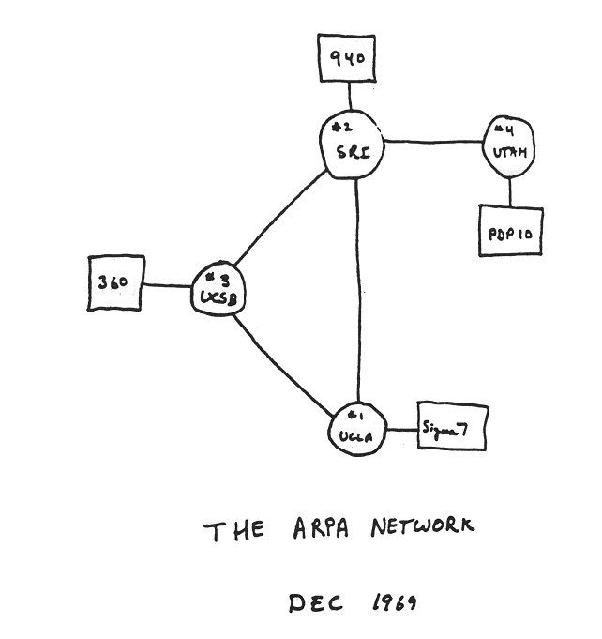
Internet history
1961-1972: Early packet-switching principles
1972:
  ARPAnet public demo
  NCP (Network Control Protocol) first host-host protocol
  first e-mail program
  ARPAnet has 15 nodes
1961: Kleinrock - queueing theory shows effectiveness of packet-switching
1964: Baran - packet-switching in military nets
1967: ARPAnet conceived by Advanced Research Projects Agency
1969: first ARPAnet node operational

Slide 69
Internet history
1972-1980: Internetworking, new and proprietary nets
1970: ALOHAnet satellite network in Hawaii
1974: Cerf and Kahn - architecture for interconnecting networks
1976: Ethernet at Xerox PARC
late70’s: proprietary architectures: DECnet, SNA, XNA
late 70’s: switching fixed length packets (ATM precursor)
1979: ARPAnet has 200 nodes
Cerf and Kahn’s internetworking principles:
  minimalism, autonomy - no internal changes required to interconnect networks
  best effort service model
  stateless routers
  decentralized control
define today’s Internet architecture

Slide 70
Internet history
1980-1990: new protocols, a proliferation of networks
1983: deployment of TCP/IP
1982: smtp e-mail protocol defined
1983: DNS defined for name-to-IP-address translation
1985: ftp protocol defined
1988: TCP congestion control
new national networks: CSnet, BITnet, NSFnet, Minitel
100,000 hosts connected to confederation of networks

Slide 71
Internet history
1990, 2000’s: commercialization, the Web, new apps
early 1990’s: ARPAnet decommissioned
1991: NSF lifts restrictions on commercial use of NSFnet (decommissioned, 1995)
early 1990s: Web
  hypertext [Bush 1945, Nelson 1960’s]
  HTML, HTTP: Berners-Lee
  1994: Mosaic, later Netscape
  late 1990’s: commercialization of the Web
late 1990’s – 2000’s:
more killer apps: instant messaging, P2P file sharing
network security to forefront
est. 50 million host, 100 million+ users
backbone links running at Gbps

Slide 72
Internet history
2005-present
~5B devices attached to Internet (2016)
  smartphones and tablets
aggressive deployment of broadband access
increasing ubiquity of high-speed wireless access
emergence of online social networks:
  Facebook: ~ one billion users
service providers (Google, Microsoft) create their own networks
  bypass Internet, providing “instantaneous” access to search, video content, email, etc.
e-commerce, universities, enterprises running their services in “cloud” (e.g., Amazon EC2)

Slide 73
Introduction: summary
covered a “ton” of material!
Internet overview
what’s a protocol?
network edge, core, access network
  packet-switching versus circuit-switching
  Internet structure
performance: loss, delay, throughput
layering, service models
security
history
you now have:
context, overview, “feel” of networking
more depth, detail to follow!

Slide 74
CS 125 About:
Principles and concepts
General purpose computer networks
Internet Perspective
  Network software
  Designing and building a protocol system
  Analysis of the Internet - Performance
  Network applications.
Web page for course
You will learn
  Knowledge – How Internet Works
  Insight – Naming, layering, …
  Skill – Network programming, Network analysis

Slide 75

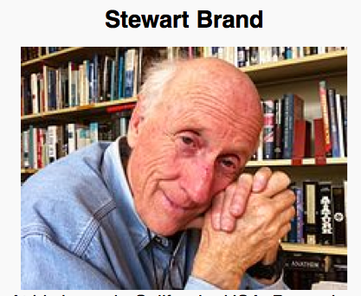




Internet is Relevant
Information wants to be free because it has become so cheap to distribute, copy, and recombine... It wants to be expensive because it can be immeasurably valuable to the recipient. (1985)

Slide 76
The End of The Beginning

