Slide 1

Links
P&D Chapter 2
K&R Chapter 6
Note to Students:
The course slides are a combination of slides from:
Peterson & Davie
Kurose & Ross
My previous lectures
I claim no copyright for any of the material and would recommend either book for a detailed treatment of the material

Slide 2
Goals of Today’s Lecture
Link-layer services
  Encoding, framing, and error detection
  Error correction and flow control
Sharing a shared media
  Channel partitioning
  Taking turns
  Random access
Shared Networks
  Ethernet
  Token ring - brief
  Wireless – skip
  Cable

Slide 3
Message, Segment, Packet, and Frame
Host-Node
host
HTTP message
HTTP
HTTP
TCP segment
TCP
TCP
Router- Node
router
IP
IP packet
IP packet
IP packet
IP
IP
IP
Ethernet
interface
Ethernet
interface
SONET
interface
SONET
interface
Ethernet
interface
Ethernet
interface
SONET frame
Ethernet frame
Links
Ethernet frame

Slide 4















Access networks and physical media
Q: How to connect end systems to edge router?
residential access nets
institutional access networks (school, company)
mobile access networks
keep in mind:
bandwidth (bits per second) of access network?
shared or dedicated?

Slide 5

Access network: digital subscriber line (DSL)
central office
telephone
network
DSL
modem
splitter
DSLAM
ISP
voice, data transmitted
at different frequencies over
dedicated line to central office
DSL access
multiplexer
  use existing telephone line to central office DSLAM
    data over DSL phone line goes to Internet
    voice over DSL phone line goes to telephone net
  < 2.5 Mbps upstream transmission rate (typically < 1 Mbps)
  < 24 Mbps downstream transmission rate (typically < 10 Mbps)

Slide 6
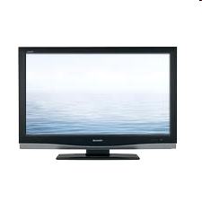


Access network: cable network
cable headend
…
cable
modem
splitter
C
O
N
T
R
O
L
V
I
D
E
O
V
I
D
E
O
V
I
D
E
O
V
I
D
E
O
V
I
D
E
O
V
I
D
E
O
D
A
T
A
D
A
T
A
1
2
3
4
5
6
7
8
9
Channels
frequency division multiplexing: different channels transmitted
in different frequency bands

Slide 7
Access network: cable network
cable headend
…
cable
modem
splitter
CMTS
cable modem
termination system
data, TV transmitted at different
frequencies over shared cable
distribution network
ISP
HFC: hybrid fiber coax
  asymmetric: up to 30Mbps downstream transmission rate, 2 Mbps upstream transmission rate
network of cable, fiber attaches homes to ISP router
  homes share access network to cable headend
  unlike DSL, which has dedicated access to central office BUT Low speed

Slide 8





Access network: home network
wireless
devices
Where is Bottleneck?
to/from headend or central office
often combined
in single box
cable or DSL modem
wireless access
point (54 Mbps)
router, firewall, NAT
wired Ethernet (1 Gbps)

Slide 9









Access Network: Enterprise (Ethernet)
institutional link to
ISP (Internet)
institutional router
Ethernet
switch
institutional mail,
web servers
typically used in companies, universities, etc.
  10 Mbps, 100Mbps, 1Gbps, 10Gbps transmission rates
  today, end systems typically connect into Ethernet switch

Slide 10









Access Network: Wireless
shared wireless access network connects end system to router
  via base station aka “access point”
wide-area wireless access
  provided by telco (cellular) operator, 10’s km
  between 1 and 10 Mbps
  3G, 4G: LTE
wireless LANs:
  within building (100 ft.)
  802.11b/g/n (WiFi): 11, 54, 450 Mbps transmission rate
to Internet
Two Different
Networks
to Internet

Slide 11

Host: sends packets of data
host sending function:
takes application message
breaks into smaller chunks, known as packets, of length L bits
transmits packet into access network at transmission rate R – how fast can put bits on wire
  link transmission rate, aka link capacity, aka link bandwidth
two packets,
L bits each
2
1
R: link transmission rate
host
packet
transmission
delay
time needed to
transmit L-bit
packet into link
L (bits)
R (bits/sec)
=
=

Slide 12
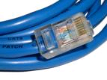
Physical media
bit: propagates between
transmitter/receiver pairs
physical link: what lies between transmitter & receiver
guided media:
  signals propagate in solid media: copper, fiber, coax
unguided media:
  signals propagate freely, e.g., radio
twisted pair (TP)
two insulated copper wires
  Category 5: 100 Mbps, 1 Gbps Ethernet
  Category 6: 10Gbps

Slide 13


Physical media: coax, fiber
coaxial cable:
two concentric copper conductors
bidirectional
broadband:
  multiple channels on cable
  HFC
fiber optic cable:
glass fiber carrying light pulses, each pulse a bit
high-speed operation:
  high-speed point-to-point transmission (e.g., 10’s-100’s Gbps transmission rate)
low error rate:
  repeaters spaced far apart
  immune to electromagnetic noise

Slide 14
Physical media: radio
signal carried in electromagnetic spectrum
no physical “wire”
bidirectional
propagation environment effects:
  reflection
  obstruction by objects
  interference
radio link types:
terrestrial microwave
  e.g. up to 45 Mbps channels
LAN (e.g., WiFi)
  54 Mbps
wide-area (e.g., cellular)
  4G cellular: ~ 10 Mbps
satellite
  Kbps to 45Mbps channel (or multiple smaller channels)
  270 msec end-end delay
  geosynchronous versus low altitude

Slide 15


Link layer: introduction
terminology:
hosts and routers: nodes
communication channels that connect adjacent nodes along communication path: links
  wired links
  wireless links
  LANs
layer-2 packet: frame, encapsulates datagram
data-link layer has responsibility of
transferring datagram from one node
to physically adjacent node over a link via frames

Slide 16
Adaptors Communicating
datagram
link layer protocol
frame
frame
sending
node
adapter
adapter
receiving
node
Link layer implemented in adaptor (network interface card)
  Ethernet card, PCMCI card, 802.11 card
Sending side:
  Encapsulates datagram (packet) in frames
  Adds error checking bits, flow control, etc.??
Receiving side
  Looks for errors, flow control, etc.
  Extracts datagram (how is datagram found) and passes to receiving node

Slide 17
Link Layer Protocol for Each Hop
TCP/IP packet transferred over multiple hops
  Each hop has a link layer protocol
  May be different on different hops
Analogy: trip from HMÇ to Auckland
  Limo: HMC to LAX
  Plane: LAX to Auckland AP
  Car: Auckland AP to hotel
Refining the analogy
  Tourist == datagram/packet
  Transport segment == communication link
  Transportation mode == link-layer protocol
  Travel agent == routing algorithm
  Transport vehicle == frame

Slide 18
Link layer services
framing, link access:
  encapsulate datagram into frame, adding header, trailer
  channel access if shared medium
  “MAC” addresses used in frame headers to identify source, destination
    different from IP address!
reliable delivery between adjacent nodes
  seldom used on low bit-error link (fiber, some twisted pair)
  wireless links: high error rates
    Q: why both link-level and end-end reliability?

Slide 19
Link-Layer Services
Encoding
  Representing the 0s and 1s on the link
Framing
  Encapsulating packet into frame, adding header, trailer
  Using MAC addresses, rather than IP addresses
Error detection
  Errors caused by signal attenuation, noise.
  Receiver detecting presence of errors
Error correction
  Receiver correcting errors without retransmission
Flow control
  Pacing between adjacent sending and receiving nodes

Slide 20
Encoding
Signals propagate over physical links
  Source node encodes the bits into a signal
  Receiving node decodes the signal back into bits
Simplify some electrical engineering details
  Assume two discrete signals, high and low
  E.g., could correspond to two different voltages
Simple approach
  High for a 1,
  low for a 0
  NRZ:
  NonReturn to Zero
0 0 1 1 0 0 1 1 0 0 0 1 1 1 1 1 0 0

Slide 21
Problem With Simple Approach
Long strings of 0s or 1s introduce problems
  No transitions from low-to-high, or high-to-low..Why?
Receiver keeps average of signal it has received
  Uses the average to distinguish between high and low
  Long flat strings make receiver sensitive to small change
Transitions also necessary for clock recovery
  Receiver uses transitions to drive its own clock
  Long flat strings do not produce any transitions
  Can lead to clock drift at the receiver

Slide 22
Alternative Encodings
Non-return to Zero Inverted (NRZI)
  make a transition from current signal to encode a one; stay at current signal to encode a zero
  solves the problem of consecutive ones
Manchester
  transmit XOR of the NRZ encoded data and the clock
  only 50% efficient (bit rate = 1/2 baud rate)
  Always a rise or a fall

Slide 23
Encodings (cont)

Slide 24
Encodings (cont)
4B/5B
  every 4 bits of data encoded in a 5-bit code
  5-bit codes selected to have no more than one leading 0 and no more than two trailing 0s
  thus, never get more than three consecutive 0s
  resulting 5-bit codes are transmitted using NRZI
  achieves 80% efficiency

Slide 25
Framing
Break sequence of bits into a frame
Typically implemented by network adaptor
HOW??

Slide 26
Framing
Sentinel-based
  Delineate frame with special pattern (e.g., 01111110)
  Problem: what if special patterns occurs within frame?
  Solution: escaping the special characters -
    E.g., sender always inserts a 0 after five 1s – “bit stuffing”
    … and receiver always removes a 0 appearing after five 1s
  Similar to escaping special characters in C programs
01111110
Frame contents
01111110

Slide 27
Framing (Continued)
Counter-based
  Include the payload length in the header
  … instead of putting a sentinel at the end
  Problem: what if the count field gets corrupted?
    Causes receiver to think the frame ends at a different place
  Solution: catch later when doing error detection
    And wait for the next sentinel for the start of a new frame
Clock-based
  Make each frame a fixed size
  No ambiguity about start and end of frame
  But, may be wasteful of bandwidth: empty msg or many headers

Slide 28
Framing Approaches
Sentinel-based
  delineate frame with special pattern: 01111110
  e.g., HDLC, SDLC, PPP
  problem: special pattern appears in the payload
  solution: bit stuffing
    sender: insert 0 after five consecutive 1s
    receiver: delete 0 that follows five consecutive 1s

Slide 29
Framing Approaches (cont)
Counter-based
  include payload length in header
  e.g., DDCMP
  problem: count field corrupted
  solution: catch when CRC fails

Slide 30
Framing Approaches (cont)
Clock-based
  each frame is 125us long (9x90 bytes)
  e.g., SONET: Synchronous Optical Network
  STS-n (STS-1 = 51.84 Mbps)

Slide 31
Error Detection
Errors are unavoidable
  Electrical interference, thermal noise, etc.
Error detection
  Transmit extra (redundant) information
  Use redundant information to detect errors
  Extreme case: send two copies of the data
  Trade-off: accuracy vs. overhead
Techniques for detecting errors
  Parity checking
  Checksum
  Cyclic Redundancy Check (CRC)

Slide 32
Error Detection Techniques
Parity check
  Add an extra bit to a 7-bit code
  Odd parity: ensure an odd number of 1s
    E.g., 0101011 becomes 01010111
  Even parity: ensure an even number of 1s
    E.g., 0101011 becomes 01010110
Checksum
  Treat data as a sequence of 16-bit words
  Compute a sum of all the 16-bit words, with no carries
  Transmit the sum along with the packet
Cyclic Redundancy Check (CRC)
  See book for details

Slide 33
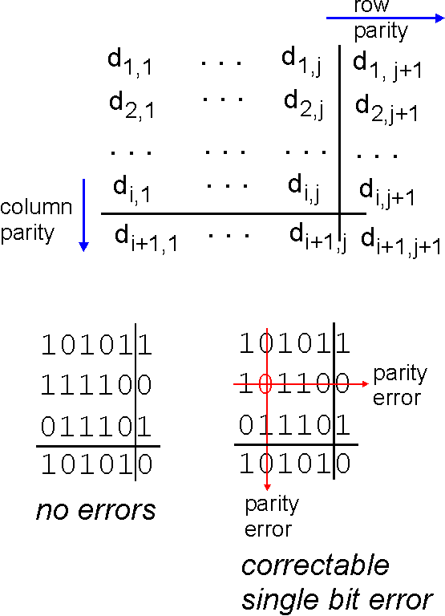
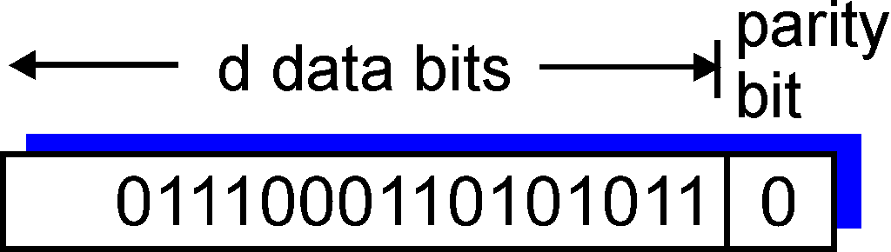
Parity checking
single bit parity:
detect single bit errors
two-dimensional bit parity:
detect and correct single bit errors
0
0
* Check out the online interactive exercises for more examples: http://gaia.cs.umass.edu/kurose_ross/interactive/

Slide 34
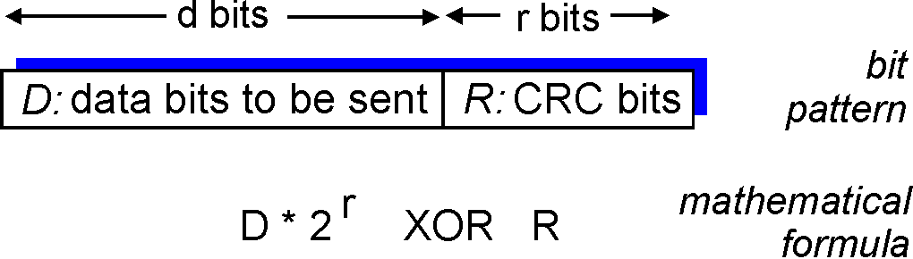
CRC Check
powerful error-detection coding
view data bits, D, as a binary number
choose r+1 bit pattern (generator), G
goal: choose r CRC bits, R, such that
  <D,R> exactly divisible by G (modulo 2)
  receiver knows G, divides <D,R> by G. If non-zero remainder: error detected!
  can detect all burst errors less than r+1 bits
widely used in practice (Ethernet, 802.11 WiFi, ATM)

Slide 35
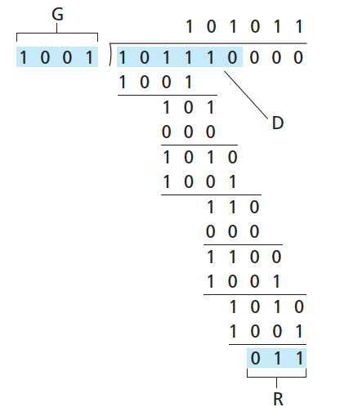
CRC example
want:
  D.2^{r} XOR R = nG
equivalently:
  D.2^{r} = nG XOR R
equivalently:
if we divide D.2^{r} by G, want remainder R to satisfy:
D.2^{r}
G
R = remainder [ ]
* Check out the online interactive exercises for more examples: http://gaia.cs.umass.edu/kurose_ross/interactive/

Slide 36
CRC cont: Selecting C(x)
All single-bit errors, as long as the x^{k} and x⁰ terms have non-zero coefficients.
All double-bit errors, as long as C(x) contains a factor with at least three terms
Any odd number of errors, as long as C(x) contains the factor (x + 1)
Any ‘burst’ error (i.e., sequence of consecutive error bits) for which the length of the burst is less than k bits.
Most burst errors of larger than k bits can also be detected
See literature for common C(x)

Slide 37
Errors cont:
Internet Checksum Algorithm
View message as a sequence of 16-bit integers; sum using 16-bit ones-complement arithmetic; take ones-complement of the result.
u_short
cksum(u_short *buf, int count)
{
register u_long sum = 0;
while (count--)
{
sum += *buf++;
if (sum & 0xFFFF0000)
{
/* carry occurred, so wrap around */
sum &= 0xFFFF;
sum++;
}
}
return ~(sum & 0xFFFF);
}

Slide 38
Internet checksum (review)
goal: detect “errors” (e.g., flipped bits) in transmitted packet (note: used at transport layer only)
sender:
treat segment contents as sequence of 16-bit integers
checksum: addition (1’s complement sum) of segment contents
sender puts checksum value into UDP checksum field
receiver:
compute checksum of received segment
check if computed checksum equals checksum field value:
  NO - error detected
  YES - no error detected. But maybe errors nonetheless?

Slide 39
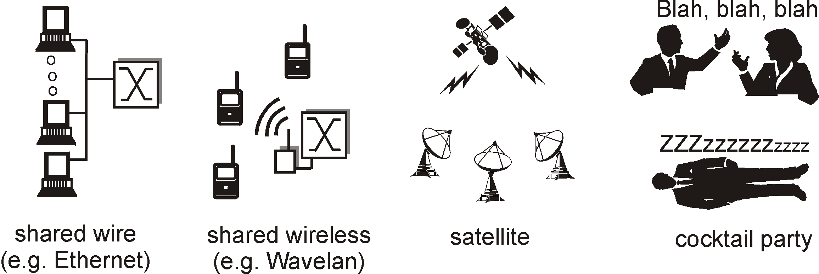
Links
Point-to-Point vs. Broadcast Media
Point-to-point
  PPP for dial-up access
  Point-to-point link between Ethernet switch and host
Broadcast (shared wire or medium)
  Traditional Ethernet
  802.11 wireless LAN

Slide 40
Multiple Access Protocol
Single shared broadcast channel
  Avoid having multiple nodes speaking at once
  Otherwise, collisions lead to garbled data
Multiple access protocol
  Distributed algorithm for sharing the channel
  Algorithm determines which node can transmit
Classes of techniques
  Channel partitioning: divide channel into pieces
  Taking turns: passing a token for the right to transmit
  Random access: allow collisions, and then recover

Slide 41

Channel Partitioning: TDMA
TDMA: time division multiple access
Access to channel in "rounds"
  Each station gets fixed length slot in each round
Time-slot length is packet transmission time
  Unused slots go idle
Example: 6-station LAN with slots 1, 3, and 4

Slide 42
Channel Partitioning: FDMA
FDMA: frequency division multiple access
Channel spectrum divided into frequency bands
  Each station assigned fixed frequency band
Unused transmission time in bands go idle
Example: 6-station LAN with bands 1, 3, and 4
time
frequency bands

Slide 43
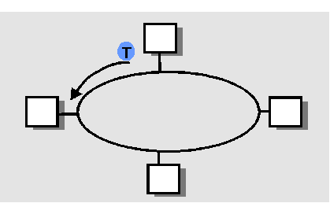
“Taking Turns” MAC protocols
Polling
Master node “invites” slave nodes to transmit in turn
Concerns:
  Polling overhead
  Latency
  Single point of failure (master)
Token passing
Control token passed from one node to next sequentially
Token message
Concerns:
  Token overhead
  Latency
  Single point of failure (token)

Slide 44
Random Access Protocols
When node has packet to send
  Transmit at full channel data rate R.
  No a priori coordination among nodes
Two or more transmitting nodes ➜ “collision”,
Random access MAC protocol specifies:
  How to detect collisions
  How to recover from collisions
Examples
  ALOHA and Slotted ALOHA
  CSMA, CSMA/CD, CSMA/CA
  CS – Carrier Sense
  MA – Multiple Access
  CD – Collision Detection
  CA – Collision Avoidence

Slide 45
Key Ideas of Random Access
Carrier sense
  Listen before speaking, and don’t interrupt
  Checking if someone else is already sending data
  … and waiting till the other node is done
Collision detection
  If someone else starts talking at the same time, stop
  Realizing when two nodes are transmitting at once
  …by detecting that the data on the wire is garbled
Randomness
  Don’t start talking again right away
  Waiting for a random time before trying again

Slide 46
Slotted ALOHA – 70’s
Assumptions
All frames same size
Time divided into equal slots (time to transmit a frame)
Nodes start to transmit frames only at start of slots
Nodes are synchronized
If two or more nodes transmit, all nodes detect collision
Operation
When node obtains fresh frame, transmits in next slot
No collision: node can send new frame in next slot
Collision: node retransmits frame in each subsequent slot with probability p until success

Slide 47
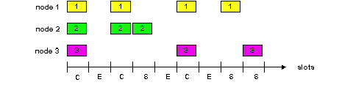
Slotted ALOHA
Pros
Single active node can continuously transmit at full rate of channel
Highly decentralized: only nodes in slots need to be in sync
Simple
Cons
Collisions, wasting slots
Idle slots
Nodes may be able to detect collision in less than time to transmit packet
Clock synchronization

Slide 48
CSMA (Carrier Sense Multiple Access)
Collisions hurt the efficiency of ALOHA protocol
  At best, channel is useful 37% of the time
CSMA: listen before transmit
  If channel sensed idle: transmit entire frame
  If channel sensed busy, defer transmission
Human analogy: don’t interrupt others!

Slide 49
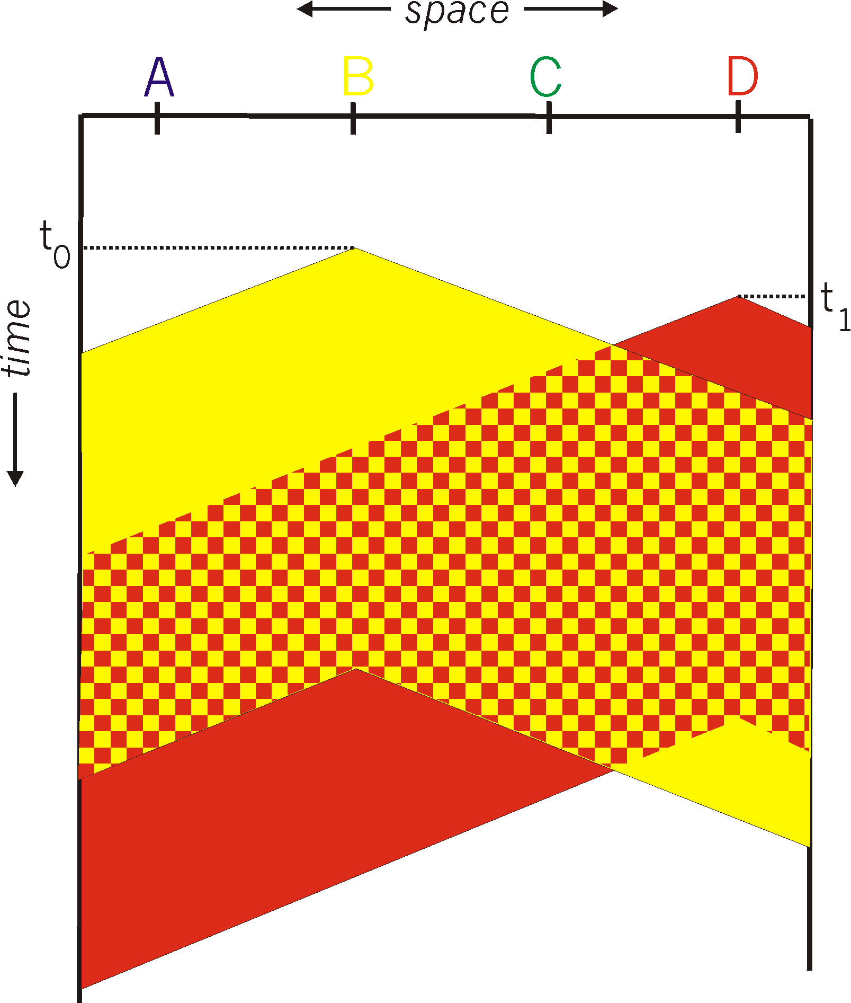
CSMA Collisions
Collisions can still occur:
propagation delay means
two nodes may not hear
each other’s transmission
Collision:
entire packet transmission
time wasted

Slide 50
CSMA/CD (Collision Detection)
CSMA/CD: carrier sensing, deferral as in CSMA
  Collisions detected within short time
  Colliding transmissions aborted, reducing wastage
Collision detection
  Easy in wired LANs: measure signal strengths, compare transmitted, received signals
  Difficult in wireless LANs: receiver is shut off while transmitting
Human analogy: the polite conversationalist

Slide 51
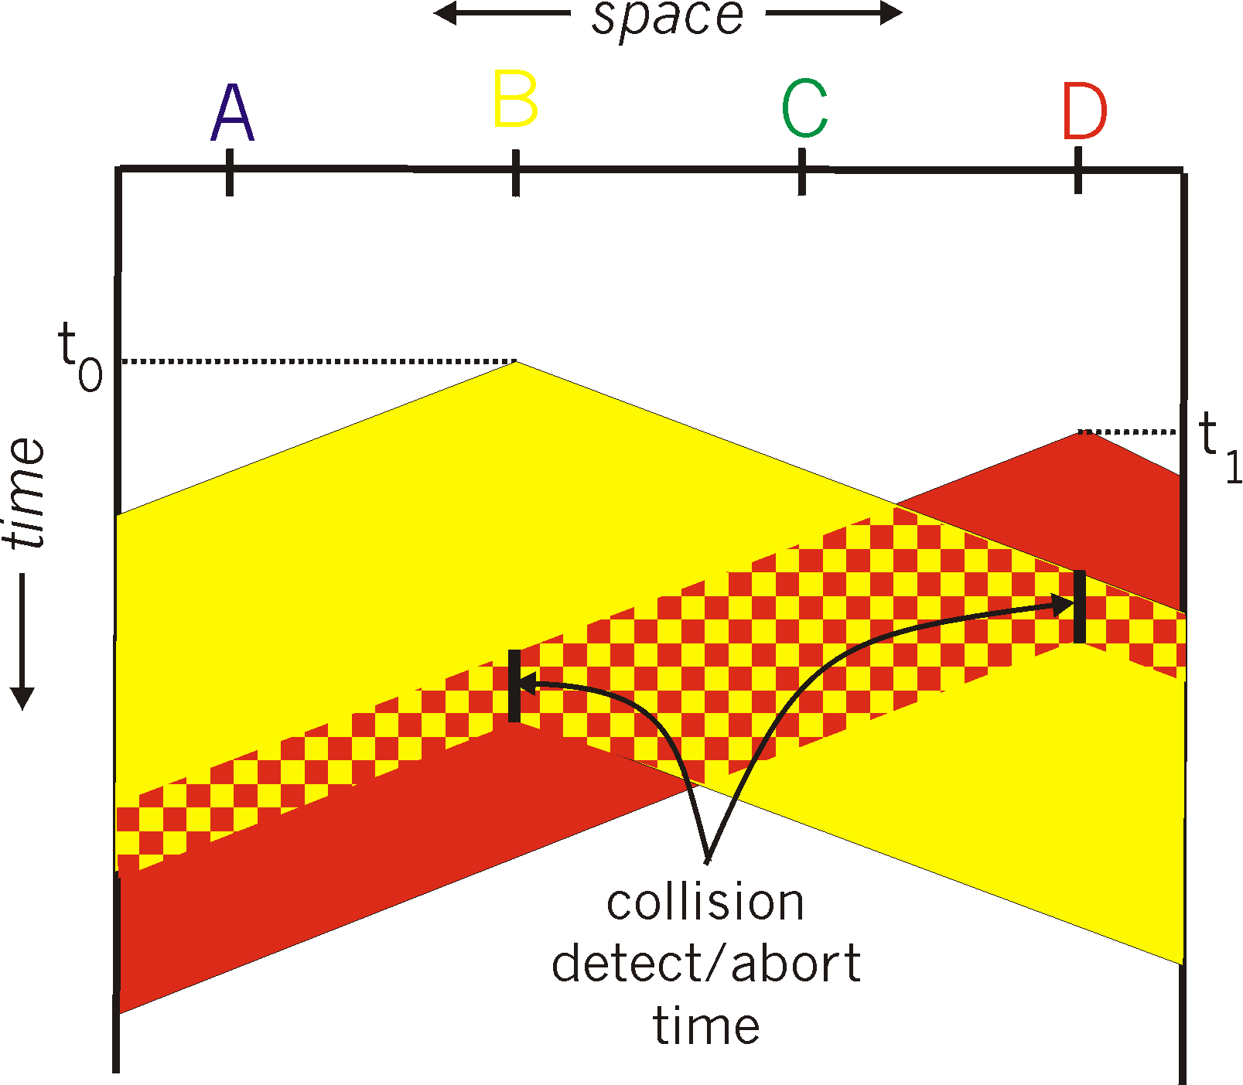
CSMA/CD Collision Detection

Slide 52
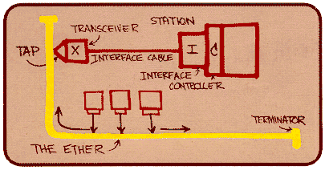
Shared Access Networks: bus – Ethernet
DEMO
Metcalfe’s Ethernet sketch

Slide 53
Ethernet Overview
History
  Has become Dominant wired LAN technology
  Simpler, cheaper than token ring and ATM
  developed by Xerox PARC in mid-1970s
  roots in Aloha packet-radio network
  standardized by Xerox, DEC, and Intel in 1978
CSMA/CD
  carrier sense
  multiple access
  collision detection
Frame Format
Preamble = 7 of 10101010, 1 of 10101011

Slide 54
Ethernet Uses CSMA/CD
Carrier sense: NIC waits for link to be idle
  Channel idle: start transmitting
  Channel busy: wait until idle
Collision detection: listen while transmitting
  No collision: transmission is complete
  Collision: abort transmission, and send jam signal
Random access: exponential back-off
  After collision, wait a random time before trying again
  After m^{th} collision, choose K randomly from {0, …, 2^{m}-1}
  … and wait for K*512 bit times before trying again

Slide 55
Unreliable, Connectionless Service
Connectionless
  No handshaking between sending and receiving adapter.
Unreliable
  Receiving adapter doesn’t send ACKs or NACKs
  Packets passed to network layer can have time gaps
  Gaps will be filled if application is using TCP
    i.e., TCP creates a data stream
  Otherwise, the application will see the gaps
Ethernet’s MAC protocol: unslotted CSMA/CD with binary backoff

Slide 56
Ethernet (cont)
Addresses
  unique, 48-bit unicast address assigned to each adapter
  example: 8:0:e4:b1:2:2f
  broadcast: all 1s
  multicast: first bit is 1
Bandwidth: 10Mbps, 100Mbps, 1Gbps, & climbing
Max Length: 2500m (500m segments with 4 repeaters)
  Signal timing
Approach (Problem?): Distributed algorithm that provides fair access

Slide 57
Transmit Algorithm
If line is idle…
  send immediately
  upper bound message size
  must wait 9.6us between back-to-back frames, why?
If line is busy…
  wait until idle and transmit immediately
  called 1-persistent (special case of p-persistent)

Slide 58
Algorithm (cont)
If collision…
  jam for 32 bits, then stop transmitting frame
  minimum frame is 64 bytes (header + 46 bytes of data)
  delay and try again
    1st time: 0 or 51.2us
    2nd time: 0, 51.2, or 102.4us
    3rd time51.2, 102.4, or 153.6us
    nth time: k x 51.2us, for randomly selected k=0..2^{n} - 1
    give up after several tries (usually 16)
    exponential backoff

Slide 59
802.3 Ethernet standards: link & physical layers
many different Ethernet standards
  common MAC protocol and frame format
  different speeds: 2 Mbps, 10 Mbps, 100 Mbps, 1Gbps, 10 Gbps, 40 Gbps
  different physical layer media: fiber, cable
application
transport
network
link
physical
MAC protocol
and frame format
100BASE-TX
100BASE-T2
100BASE-FX
100BASE-T4
100BASE-SX
100BASE-BX
copper (twister
pair) physical layer
fiber physical layer

Slide 60
Limitations on Ethernet Length
A
B
latency d
Latency depends on physical length of link
  Time to propagate a packet from one end to the other
Suppose A sends a packet at time t
  And B sees an idle line at a time just before t+d
  … so B happily starts transmitting a packet
B detects a collision, and sends jamming signal
  But A doesn’t see collision till t+2d

Slide 61
Limitations on Ethernet Length
A
B
latency d
A needs to wait for time 2d to detect collision
  So, A should keep transmitting during this period
  … and keep an eye out for a possible collision
Imposes restrictions on Ethernet
  Maximum length of the wire: 2500 meters
  Minimum length of the packet: 512 bits (64 bytes)

Slide 62
Benefits of Ethernet
Easy to administer and maintain
Inexpensive
Increasingly higher speed
Moved from shared media to switches
  Change everything except the frame format
  A good general lesson for evolving the Internet
Can Ethernet become so congested that it dies??

Slide 63
Cable access network
Internet frames, TV channels, control transmitted
downstream at different frequencies
cable headend
…
CMTS
…
splitter
cable
modem
cable modem
termination system
ISP
upstream Internet frames, TV control, transmitted
upstream at different frequencies in time slots
multiple 40Mbps downstream (broadcast) channels
  single CMTS transmits into channels
multiple 30 Mbps upstream channels
  multiple access: all users contend for certain upstream channel time slots (others assigned)

Slide 64
Cable access network
cable headend
MAP frame for
Interval [t1, t2]
CMTS
Downstream channel i
Upstream channel j
t₁
t₂
Residences with cable modems
Minislots containing
minislots request frames
Assigned minislots containing cable modem
upstream data frames
DOCSIS: data over cable service interface spec
FDM over upstream, downstream frequency channels
TDM upstream: some slots assigned, some have contention
  downstream MAP frame: assigns upstream slots
  request for upstream slots (and data) transmitted random access (binary backoff) in selected slots

Slide 65
Summary of MAC protocols
channel partitioning, by time, frequency or code
  Time Division, Frequency Division
random access (dynamic),
  ALOHA, S-ALOHA, CSMA, CSMA/CD
  carrier sensing: easy in some technologies (wire), hard in others (wireless)
  CSMA/CD used in Ethernet
  CSMA/CA used in 802.11
taking turns
  polling from central site, token passing
  Bluetooth, FDDI, token ring

Slide 66
Conclusions
TCP/IP runs on a variety of link layer technologies
  Point-to-point links vs. shared media
  Wide varieties within each class
Link layer performs key services
  Encoding, framing, and error detection
  Optionally error correction and flow control
Shared media introduce interesting challenges
  Decentralized control over resource sharing
  Partitioned channel, taking turns, and random access
  Ethernet as a wildly popular example

Slide 67
Future Issue: Interconnection
LANS
device
device
device
device

