Slide 1
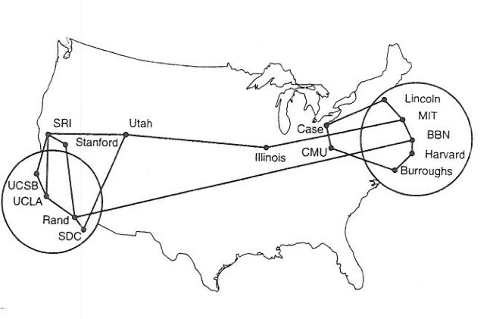
NAT Network Address Translation Reading: KR Chapter 4
Savior or The Devil ?
Note to Students:
The course slides are a combination of slides from:
Peterson & Davie
Kurose & Ross
My previous lectures
I claim no copyright for any of the material and would recommend either book for a detailed treatment of the material

Slide 2
NAT: network address translation
rest of
Internet
local network
(e.g., home network)
10.0.0/24
10.0.0.1
10.0.0.4
10.0.0.2
138.76.29.7
10.0.0.3
all datagrams leaving local
network have same single source NAT IP address: 138.76.29.7, different source port numbers
datagrams with source or
destination in this network
have 10.0.0/24 address for
source, destination (as usual)

Slide 3
NAT: network address translation
motivation: local network uses just one IP address as far as outside world is concerned:
range of addresses not needed from ISP: just one IP address for all devices
can change addresses of devices in local network without notifying outside world
can change ISP without changing addresses of devices in local network
devices inside local net not explicitly addressable or visible by outside world (a security plus)

Slide 4
NAT: network address translation
implementation: NAT router must:
outgoing datagrams: replace (source IP address, port #) of every outgoing datagram to (NAT IP address, new port #)
. . . remote clients/servers will respond using (NAT IP address, new port #) as destination addr
remember (in NAT translation table) every (source IP address, port #) to (NAT IP address, new port #) translation pair
incoming datagrams: replace (NAT IP address, new port #) in dest fields of every incoming datagram with corresponding (source IP address, port #) stored in NAT table
Before next slide – what does table look like??

Slide 5
Blank Slide

Slide 6
NAT: network address translation
NAT translation table
WAN side addr LAN side addr
2: NAT router
changes datagram
source addr from
10.0.0.1, 3345 to
138.76.29.7, 5001,
updates table
1: host 10.0.0.1
sends datagram to
128.119.40.186, 80
138.76.29.7, 5001 10.0.0.1, 3345
…… ……
S: 10.0.0.1, 3345
D: 128.119.40.186, 80
10.0.0.1
1
2
S: 138.76.29.7, 5001
D: 128.119.40.186, 80
10.0.0.4
10.0.0.2
138.76.29.7
S: 128.119.40.186, 80
D: 10.0.0.1, 3345
4
S: 128.119.40.186, 80
D: 138.76.29.7, 5001
3
10.0.0.3
4: NAT router
changes datagram
dest addr from
138.76.29.7, 5001 to 10.0.0.1, 3345
3: reply arrives
dest. address:
138.76.29.7, 5001
* Check out the online interactive exercises for more examples: http://gaia.cs.umass.edu/kurose_ross/interactive/

Slide 7
NAT: network address translation
16-bit port-number field:
60,000 simultaneous connections with a single LAN-side address!
NAT is controversial:
routers should only process up to layer 3
address shortage should be solved by IPv6
violates end-to-end argument
NAT possibility must be taken into account by app designers, e.g., P2P applications
NAT traversal: what if client wants to connect to server behind NAT?
There are ways, but most networks public put servers outside NAT

