Slide 1
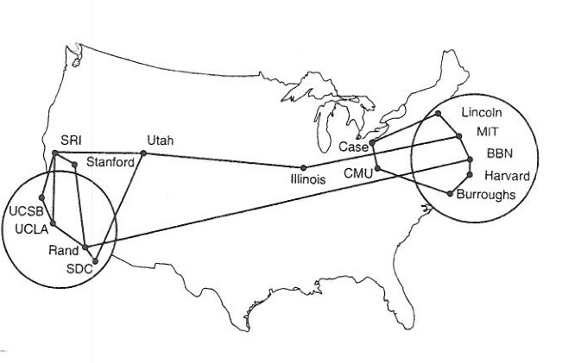
CS 125 – Applications P2P Reading: K&R C2
Note to Students:
The course slides are a combination of slides from:
Peterson & Davie
Kurose & Ross
My previous lectures
I claim no copyright for any of the material and would recommend either book for a detailed treatment of the material.

Slide 2
IP Suite In Action: End Hosts vs. Routers
Host A
Host Z
HTTP message
P2P
P2P
TCP segment
TCP
TCP
router
router
IP packet
IP packet
IP packet
IP
IP
IP
IP
Ethernet
interface
Ethernet
interface
SONET
interface
SONET
interface
Ethernet
interface
Ethernet
interface
Frame

Slide 3
Goals of Today’s Lecture
Scalability in distributing a large file
Single server and N clients
Peer-to-peer system with N peers
Searching for the right peer
Central directory (Napster)
Query flooding (Gnutella)
Hierarchical overlay (Kazaa)
BitTorrent
Transferring large files
Preventing free-riding

Slide 4
Pure P2P architecture
no always-on server
arbitrary end systems directly communicate
peers are intermittently connected and change IP addresses
examples:
file distribution (BitTorrent)
Streaming (KanKan)
VoIP (Skype)

Slide 5
File distribution: client-server vs P2P
Question: how much time to distribute file (size F) from one server to N peers?
peer upload/download capacity is limited resource
u_{s}: server upload capacity
u₁
d_{i}: peer i download capacity
file, size F
u_{s}
d₁
u₂
d₂
server
d_{i}
u_{N}
network (with abundant
bandwidth)
u_{i}
d_{N}
u_{i}: peer i upload capacity

Slide 6
File distribution time: client-server
server transmission: must sequentially send (upload) N file copies:
time to send one copy: F/u_{s}
time to send N copies: NF/u_{s}
F
u_{s}
d_{i}
network
u_{i}
client: each client must download file copy
d_{min} = min client download rate
min client download time: F/d_{min}
time to distribute F
to N clients using
client-server approach
D_{c-s} > max{NF/u_{s,},F/d_{min}}
increases linearly in N

Slide 7
File distribution time: P2P
server transmission: must upload at least one copy
time to send one copy: F/u_{s}
F
u_{s}
d_{i}
client: each client must download file copy
min client download time: F/d_{min}
network
u_{i}
clients: as aggregate must download NF bits
max upload rate (limiting max download rate) is u_{s} + Σu_{i}
time to distribute F
to N clients using
P2P approach
D_{P2P} > max{F/u_{s,},F/d_{min,},NF/(u_{s} + Σu_{i})}
increases linearly in N …
… but so does this, as each peer brings service capacity

Slide 8
Client-server vs. P2P: example
client upload rate = u, F/u = 1 hour, u_{s} = 10u,
d_{min} ≥ u_{s}

Slide 9
P2P file distribution: BitTorrent
file divided into 256Kb chunks
peers in torrent send/receive file chunks
tracker: tracks peers
participating in torrent
torrent: group of peers exchanging chunks of a file
Alice arrives …
… obtains list
of peers from tracker
… and begins exchanging
file chunks with peers in torrent

Slide 10
P2P file distribution: BitTorrent
peer joining torrent:
has no chunks, but will accumulate them over time from other peers
registers with tracker to get list of peers, connects to subset of peers (“neighbors”)
while downloading, peer uploads chunks to other peers
peer may change peers with whom it exchanges chunks
churn: peers may come and go
once peer has entire file, it may (selfishly) leave or (altruistically) remain in torrent
Interesting is the cloud path to each peer, at extremes all traffic passes through a single router, e.g., HMC dorms.

Slide 11
BitTorrent: requesting, sending file chunks
requesting chunks:
at any given time, different peers have different subsets of file chunks
periodically, Alice asks each peer for list of chunks that they have
Alice requests missing chunks from peers, rarest first
sending chunks: tit-for-tat
Alice sends chunks to those four peers currently sending her chunks at highest rate
other peers are choked by Alice (do not receive chunks from her)
re-evaluate top 4 every10 secs
every 30 secs: randomly select another peer, starts sending chunks
“optimistically unchoke” this peer
newly chosen peer may join top 4

Slide 12
BitTorrent: tit-for-tat
(1) Alice “optimistically unchokes” Bob
(2) Alice becomes one of Bob’s top-four providers; Bob reciprocates
(3) Bob becomes one of Alice’s top-four providers
higher upload rate: find better trading partners, get file faster !

Slide 13
Challenges of Peer-to-Peer
Peers come and go
Peers are intermittently connected
May come and go at any time
Or come back with a different IP address
How to locate the relevant peers?
Peers that are online right now
Peers that have the content you want
How to motivate peers to stay in system?
Why not leave as soon as download ends?
Why bother uploading content to anyone else?

Slide 14
P2P Conclusions
Peer-to-peer networks
Nodes are end hosts
Primarily for file sharing, and recently telephony
Finding the appropriate peers
Centralized directory (Napster)
Query flooding (Gnutella)
Super-nodes (KaZaA)
BitTorrent
Distributed download of large files
Anti-free-riding techniques
Great example of how change can happen so quickly in application-level protocols

Slide 15
Applications Summary
most importantly: learned about protocols!
typical request/reply message exchange:
client requests info or service
server responds with data, status code
message formats:
headers: fields giving info about data
data: info(payload) being communicated
important themes:
control vs. messages
in-band, out-of-band
centralized vs. decentralized
stateless vs. stateful
reliable vs. unreliable message transfer
“complexity at network edge” - Abstract

