Slide 1
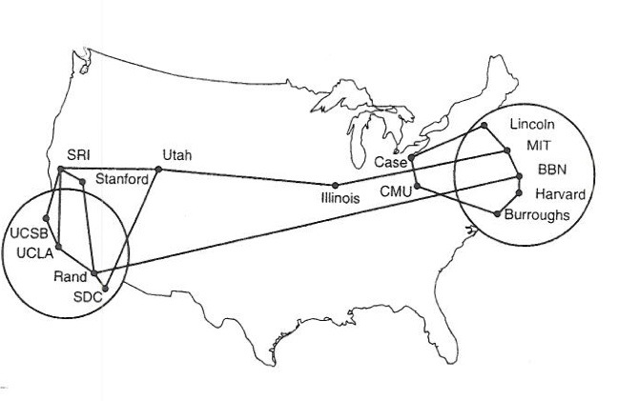
QoS - Quality of Service
Outline
  Real-time Applications -- timely arrival
  Integrated Services
  Differentiated Services

Slide 2
New Applications
Require Delivery Assurances
  Voice, Video, Industrial Control, etc.
  Need more than Best Effort
  Late data worthless
IETF Efforts - Requires underlying Internet infrastructure
  Building Protocol Extensions
    admission control
    Controlled load
    Guaranteed service
  Still need to support Best Effort

Slide 3
Example: Real-time Application
Require “deliver on time” assurances
  must come from inside the network
Example application (audio)
  sample voice once every 125us
  each sample has a playback time (when needed at Receiver)
  packets experience variable delay in network
  add constant factor to playback time: playback point
RealTime needs definition
Microphone
Sampler,
A D
Buffer,
converter
D A
Speaker

Slide 4
Playback Buffer
Playback Point – limited by application, e.g., voice or video
Packet
arrival
Packet
generation
Playback
Sequence number
Network
Buffer
delay
T
ime

Slide 5
Example Distribution of Delays
Delay is variable, need to know ‘variability of delay’ Can you?

Slide 6
Taxonomy
Intolerant – robot, no data
loss acceptable
Tolerate – voice, can tolerate
occasional loss
Adaptive – can move playback
point

Slide 7
QoS Approaches
End-to-end QoS guarantees- extreme is circuit based network
Abstraction is unidirectional flow
Initiated by endpoint
Fine Grained
  Setup by individual apps or flows
  Integrative Services
Course Grained
  Apply to large classes of network data
  Differentiated Services

Slide 8
Integrated Services - RSVP
Service Classes
  guaranteed – packet never arrives late
  controlled-load – tolerant, adaptive apps, VAT Audio uses WFQ
Mechanisms
  signaling protocol – what app needs to tell network - Flowspec
  admission control – router yes or no
  policing – penalty for badness
  packet scheduling – what router does to handle Flowspec

Slide 9
Integrated Services - RSVP
An endpoint uses RSVP to request a simplex flow through an IP Internet with specified QoS bounds. If routers along the path agree to honor the request, they approve it, otherwise, they deny it. If an application needs QoS in two directions, each endpoint must use RSVP to request a separate flow.
Issue from start: Overhead in setting up….Router now has to constantly manage its environment so that it can respond to requests….

Slide 10
Flowspec
Rspec: describes service requested from network, i.e., what I want
  controlled-load: none
  guaranteed: delay target
Tspec: describes flow’s traffic characteristics – What a Router Needs to KNOW
  average bandwidth + burstiness: token bucket filter
  token rate r
  bucket depth B
  must have a token to send a byte
  must have n tokens to send n bytes
  start with no tokens
  accumulate tokens at rate of r per second
  can accumulate no more than B tokens
  allow intelligent admission control decisions – rate, bursts, pauses

Slide 11
Token Bucket Filter
Algorithm:
  I can send a burst of B, but over sufficiently long period, canNOT send more than R bytes/sec. If my flow is 2MBs, can send 1MBs for 2 seconds, then 4 MBs for 1 second, then 2MBs for N secs, etc.
  Allowing bursts, but forcing a constant rate over time

Slide 12
Per-Router Mechanisms
Admission Control - per flow
  decide if a new flow can be supported
  answer depends on service class requested & Router queueing
  not the same as policing - penalty phase
Packet Processing
  classification: associate each packet with the appropriate reservation – more than just flow management….
  scheduling: manage queues so each packet receives the requested service – priority queues in great detail…

Slide 13
RSVP - Resource Reservation Protocol
Called signaling in ATM
Proposed Internet standard: RSVP
Consistent with robustness of today’s connectionless model
Uses soft state (refresh periodically)
Designed to support multicast
Receiver-oriented (TSPEC)
Two messages: PATH (Tspec) and RESV
Source transmits PATH messages every 30 seconds
Destination responds with RESV message (TSPEC + RSPEC)
Merge requirements in case of multicast
Can specify number of speakers

Slide 14
RSVP Example
TSPEC from Sender to anyone
receiving info
Merge requests for multicast
Has softstate refreshed every 30
secs
Contains Sender’s TSPEC and
my RSPEC.. what I need
Sender 1
PATH
Sender 2
R
R
PATH
RESV
(merged)
R
RESV
R
Receiver A
R
RESV
Receiver B

Slide 15
RSVP versus ATM (Q.2931)
RSVP
  receiver generates reservation
  soft state (refresh/timeout)
  separate from route establishment
  QoS can change dynamically
  receiver heterogeneity
ATM
  sender generates connection request
  hard state (explicit delete)
  concurrent with route establishment
  QoS is static for life of connection
  uniform QoS to all receivers

Slide 16
RSVP Notes
RSVP Defines
  Message endpoint sends to router to request QoS
  Messages routers send to other routers
  Replies
RSVP does not specify how enforcement done
Separate protocol needed
Common Open Policy Services (COPS)
  Proposed enforcement protocol for RSVP
  Known as traffic policing
  Checks data sent on flow to ensure that the flow does not exceed pre-established bounds.

Slide 17
Summary
Codec translates between analog and digital forms
RTP used to transfer real-time data
RTP adds timestamp that sender uses to determine playback time
Voice over IP uses
  RTP for digitized voice transfer
RSVP and COPS provide QoS

Slide 18
Summary: Integrated Services
Routers MUST
  Classify Packets -- which flow
  Schedule Packets -- when forwarded
Classify
  Source
  Destination
  Protocol
  Port S/D
  Have TOS bits in IP header, but cannot differentiate flows by TOS
  e.g., premium vs best-effort
Why NOT the Internet Standard?
  Scale
    Per Flow Info
    OC48 - 64 kbps for streaming audio
      39,000 flows ….
    Used for MPLS

Slide 19
Another Approach:
DiffServ -- Differentiated Services
Problem with IntServ: scalability
DiffServ Idea: segregate packets into a small number of classes
  e.g., premium vs best-effort
Packets marked according to class at edge of network – TOS bits
Core routers implement some per-hop-behavior (PHB)
Example: Expedited Forwarding (EF)
  rate-limit EF packets at the edges
  PHB implemented with class-based priority queues or WFQ
To Me – Priority based scheduling and Buffering at each Router

Slide 20
Differentiated Services
Small number of classes of traffic
Premium bit – set by Admin Boundary
Router Behaviors - per hop (PHB)
Use 6 bits to establish -- easy parsing for Router…
  EF, Expedite Forwarding, minimal delay and loss
    control input traffic – do not let combined input streams swamp router – edge routers
    in/out packets
      in – within service limits
      out – outside service limits (drop if must, RED)
  Non EF packets
    need to provide some service to non-EF packets

Slide 21
DiffServ (cont)
Assured Forwarding (AF), PHB – Preferred Hop Behavior
  customers sign service agreements with ISPs
  edge routers mark packets as being “in” or “out” of profile
  core routers run RIO: RED with in/out
  Based on SLA – service level agreement
Probability
queue
Figure
Under low congestion only “out” packets discarded (policing)
Only when queue > Min(in) do “in” packets get dropped

Slide 22
Future
TCP & Congestion will continue
ACKs & timeouts drive end hosts
Today - QoS
  Works such as Diffserv Not universal, but VoIP, video driving Diffserv use
  also helps when Diffserv not enough, i.e., routers like airlines over-subscribe for Hosts to be involved.
UDP?
  no connection overhead
  no reliability overhead
  real time UDP competes with TCP
  right now, TCP, only one that backs off
  open research area

