Slide 1
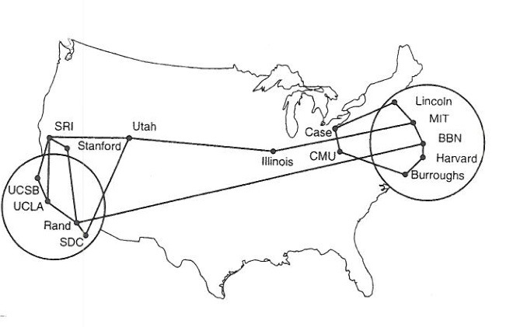
Switching and Lans
Reading: Chapter 6
Note to Students:
The course slides are a combination of slides from:
Peterson & Davie
Kurose & Ross
My previous lectures
I claim no copyright for any of the material and would recommend either book for a detailed treatment of the material

Slide 2
Shuttling Data at The Bottom
Different devices switch different things
  Physical layer: electrical signals (repeaters and hubs)
  Link layer: frames (historically bridges and switches, now just switches)
Application gateway
Transport gateway
Frame
header
Router
Bridge, switch
Frame
Repeater, hub

Slide 3
The Beginning
Hubs: Physical-Layer Repeaters
Hubs are physical-layer repeaters (historical)
  Bits coming from one link go out all other links
  At the same rate, with NO frame buffering
  No CSMA/CD at hub: adapters detect collisions
  Joins multiple lines electrically – just multi port repeater
twisted pair
hub

Slide 4
Interconnecting with Hubs
Sikorsky
Backbone hub interconnects LAN segments
All packets seen everywhere, forming one large collision domain
Cannot interconnect Ethernets of different speeds
Collision Heaven!!!
hub
hub
hub
hub

Slide 5
Limitations of Repeaters and Hubs
One large collision domain
  Every bit is sent everywhere
  So, aggregate throughput is limited
  E.g., three departments each get 10 Mbps independently
  … and then connect via a hub and must share 10 Mbps
Cannot support multiple LAN technologies
  Does not buffer or interpret frames
  So, can’t interconnect between different rates or formats
  E.g., 10 Mbps Ethernet and 100 Mbps Ethernet
Limitations on maximum nodes and distances
  Does not circumvent the limitations of shared media
  E.g., still cannot go beyond 2500 meters on Ethernet

Slide 6
Link Layer Interconnection: Switches – Salvation!!!
Link layer device
  Stores and forwards (Ethernet) frames
  Examines frame header and selectively forwards frame based on MAC dest address
  When frame is to be forwarded on segment, uses CSMA/CD to access THAT segment
Transparent
  Hosts are unaware of presence of switches
Plug-and-play, self-learning
  Switches do not need to be configured

Slide 7
Link Layer: Switches
Typically connect individual computers
  A switch is essentially a smart bridge
  … though typically used to connect hosts, not LANs
  Collision domain moved into switch!! Why?, How?
Like bridges, support concurrent communication
  Host A can talk to C, while B talks to D
  Many ports, many simultaneous conversations – crossbar
B
A
C
switch
D

Slide 8
Switching Hardware
Design Goals
  throughput (depends on traffic model)
  scalability (a function of n)
Ports
  circuit management (e.g., map, route frames)
  buffering (input and/or output)
Fabric
  as simple as possible
  sometimes do buffering (internal)
Control
processor
Switch
fabric
Input
Output
port
port

Slide 9
Buffering
Wherever contention is possible
  input port (contend for fabric)
  internal (contend for output port)
  output port (contend for link)
Head-of-Line Blocking
  input buffering

Slide 10
Crossbar Switches

Slide 11
Workstation-Based or Switch Switching
Aggregate bandwidth
  1/2 of the I/O bus bandwidth – WHY?
  capacity shared among all hosts connected to switch
  example: 1Gbps bus can support 5 x 100Mbps ports (in theory)
Packets-per-second
  must be able to switch small packets
  300,000 packets-per-second is achievable
  e.g., 64-byte packets implies 155Mbps
Switching
Fabric

Slide 12
Switches: Traffic Isolation
Switch breaks subnet into LAN segments when multiple nodes per port – NOT USUAL
Switch filters frames
  Frame only forwarded to the necessary segments
  Segments become separate collision domains
switch
collision
domain
hub
hub
hub
collision domain
collision domain

Slide 13
Switch Advantages Over Hub/Repeater
Only forwards frames as needed
  Filters frames to avoid unnecessary load on segments
  Sends frames only to segments that need to see them
Extends the geographic span of the network
  Separate collision domains allow longer distances, less collisions
Improves privacy by limiting scope of frames
  Hosts can ONLY “snoop” the traffic traversing their segment
  … but not all the rest of the traffic
Applies carrier sense and collision detection – IF NEEDED
  Does not transmit when the link is busy
  Applies exponential back-off after a collision
Can join segments using different technologies

Slide 14
Switch Advantages over Hubs/Repeater
Dedicated access
  Host has direct connection to the switch - Usual
  … rather than a shared LAN connection
Full duplex
  Each connection can send in both directions
  Host sending to switch, and host receiving from switch
  E.g., in 10BaseT and 100BaseT
Completely avoids collisions
  Each connection is a bidirectional point-to-point link
  No need for carrier sense, collision detection, and so on

Slide 15
Switch Disadvantages Over Hubs/Repeater
Delay in forwarding frames
  Switch must receive and parse the frame
  … and perform a look-up to decide where to forward
  Storing and forwarding the packet introduces delay
  Solution: cut-through switching ???
Need to learn where to forward frames
  Switch needs to construct a forwarding table
  Ideally, without intervention from network administrators
  Solution: self-learning
Higher cost
  More complicated devices that cost more money
  But hardware is NOW free

Slide 16

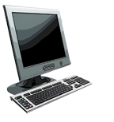

Switch forwarding table
Q: how does switch know A’ reachable via interface 4, B’ reachable via interface 5? HOW
A
C’
B
A: each switch has a switch table, each entry:
  (MAC address of host, interface to reach host, time stamp)
  looks like table???
6
1
2
5
4
3
B’
C
A’
Q: how are entries created, maintained in switch table?
Tell ME
switch with six interfaces
(1,2,3,4,5,6)

Slide 17
Answer: Switch is self-learning
Source: A
Dest: A’
switch learns which hosts can be reached through which interfaces
  when frame received, switch “learns” location of sender: incoming LAN segment
  records sender/location pair in switch table
A
A A’
C’
B
6
1
2
5
4
3
B’
C
A’
MAC addr interface TTL
A
1
60
Switch table
(initially empty)

Slide 18
Switch: frame filtering/forwarding
when frame received at switch:
  1. record incoming link, MAC address of sending host
  2. index switch table using MAC destination address
  3. if entry found for destination
  then {
  if destination on segment from which frame arrived
  then drop frame ## Multiple nodes on link
  else forward frame on interface indicated by entry
  }
  else flood /* forward on all interfaces except arriving
  interface because need to find it */

Slide 19
Self-learning, forwarding: example
Source: A
Dest: A’
A
A A’
frame destination, A’, location unknown:
flood
C’
B
destination A location known:
6
1
2
selectively send
on just one link
Mess with system: send frames with bogus
Source addr.
A A’
A A’
A A’
A A’
A A’
5
4
3
B’
C
A’ A
A’
MAC addr interface TTL
A
1
60
switch table
(initially empty)
A’
4
60

Slide 20

Interconnecting switches
self-learning switches can be connected together:
S₄
S₁
S₃
A
S₂
F
I
B
C
D
E
G
H
Q: sending from A to G - how does S₁ know to forward frame destined to G via S₄ and S₃?
A: self learning! (works exactly the same as in single-switch case!)

Slide 21
Self-learning multi-switch example
Suppose C sends frame to I, I responds to C
S₄
S₁
S₃
A
S₂
F
I
B
C
D
E
G
H
Q: show switch tables and packet forwarding in S₁, S₂, S₃, S₄
BUILD IT

Slide 22
Switch:
Flooding Can Lead to Loops
Switches sometimes need to broadcast frames
  Upon receiving a frame with an unfamiliar destination
  Upon receiving a frame sent to the broadcast address
Broadcasting is implemented by flooding
  Transmitting frame out every interface
  … except the one where the frame arrived
Flooding can lead to forwarding loops
  E.g., if the network contains a cycle of switches
  Either accidentally, or by design for higher reliability

Slide 23
Switch: Loop Solution Spanning Tree Algorithm
Problem: loops
Switches run a distributed spanning tree algorithm
  select which Switches actively forward
  developed by Radia Perlman
  now IEEE 802.1 specification
  Subgraph covers all LANs, no loops
  Problem: Choose Subgraph

Slide 24
Spanning Tree Algorithm Overview
Each switch has unique id (e.g., B1, B2, B3)
Select switch with smallest id as root – key point
Select switch on each LAN closest to root as designated switch (use id to break ties)
Each switch forwards frames over each LAN for which it is the designated switch
A: B5 over B3, hops
B: B5 over B7, ID
I: B4 over B6, ID

Slide 25
Spanning Tree Algorithm Details
Switches exchange configuration messages
  id for switch sending the message
  id for what the sending switch believes to be root switch distance (hops) from sending bridge to root bridge
Each switch records current best configuration message for each port
Initially, each switch believes it is the root – sends out configuration info

Slide 26
Spanning Tree Algorithm Details (cont)
When learn not root, stop generating config messages
  in steady state, only root generates configuration messages
When learn not designated bridge, stop forwarding config messages
  in steady state, only designated bridges forward config messages
Root continues to periodically send config messages
If any switch does not receive config message after a period of time, it starts generating config messages claiming to be the root

Slide 27
Motivation For Cut-Through Switching
Buffering a frame takes time
  Suppose L is the length of the frame
  And R is the transmission rate of the links
  Then, receiving the frame takes L/R time units
Buffering delay can be a high fraction of total delay
  Propagation delay is small over short distances
  Making buffering delay (possibly) a large fraction of total time
A
B
switches

Slide 28
Cut-Through Switching
Start transmitting as soon as possible
  Inspect the frame header and do the look-up
  If outgoing link is idle, start forwarding the frame
Overlapping transmissions
  Transmit the head of the packet via the outgoing link
  … while still receiving the tail via the incoming link
  Sure hope it is a good frame….
A
B
switches

Slide 29
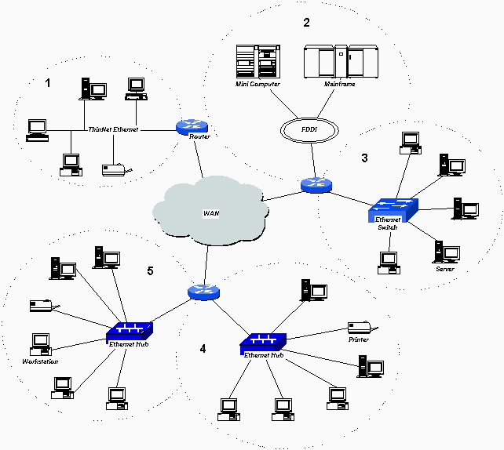
Typical network with Switches and Routers
LAN == Collision Domain

Slide 30
Evolution Toward Virtual LANs
In the olden days…
  Thick cables snaked through cable ducts in buildings
  Every computer they passed was plugged in
  All people in adjacent offices were put on the same LAN
  Independent of whether they belonged together or not
More recently…
  Hubs and switches changed all that
  Every office connected to central wiring closets
  Often multiple LANs (k hubs) connected by switches
  Want flexibility in mapping offices to different LANs
  Routers add some delay
VLAN allows Grouping users based on organizational structure, rather than the physical layout of the building.

Slide 31
Institutional network
mail server
to external
network
router
web server
IP subnet

Slide 32
Why Organize LAN by Organizational Structure?
Security
  Ethernet is a shared media
  Any interface card can be put into “promiscuous” mode
  … and get a copy of all of the traffic (e.g., midterm exam)
  So, isolating traffic on separate LANs improves security
Load
  Some LAN segments are more heavily used than others
  E.g., researchers running experiments get out of hand
  … can saturate their own segment and not the others
  Plus, there may be natural locality of communication
  E.g., traffic between people in the same research group
  Reduce router traffic by keeping on common collision domain

Slide 33
LAN Reality:
People Move and Roles Change
Organizational changes are frequent
  E.g., faculty office becomes a grad-student office
Physical rewiring is a major pain
  Requires unplugging the cable from one port
  … and plugging it into another
  … and hoping you don’t make a mistake
Would like to “rewire” the building in software
  The resulting concept is a Virtual LAN (VLAN)
VLAN – Virtual LAN
  Group devices on different physical LANs as if on same physical LAN
  Shared Collision Domain

Slide 34


VLANs (Smart Switches): motivation
consider:
CS user moves office to EE, but wants connection to CS switch?
single broadcast domain:
  all layer-2 broadcast traffic (ARP, DHCP, unknown location of destination MAC address) must cross entire LAN
  security/privacy, efficiency issues
Computer
Science
Computer
Engineering
Electrical
Engineering

Slide 35
VLANs
port-based VLAN: switch ports grouped (by switch management software) so that single physical switch ……
Virtual Local
Area Network
1
7
9
15
2
8
10
16
switch(es) supporting VLAN capabilities can be configured to define multiple virtual LANS over single physical LAN infrastructure.
…
…
Electrical Engineering
(VLAN ports 1-8)
Computer Science
(VLAN ports 9-15)
… operates as multiple virtual switches
1
7
9
15
2
8
10
16
…
…
Electrical Engineering
(VLAN ports 1-8)
Computer Science
(VLAN ports 9-16)

Slide 36
Port-based VLAN
router
traffic isolation: frames to/from ports 1-8 can only reach ports 1-8
  can also define VLAN based on MAC addresses of endpoints, rather than switch port
1
7
9
15
2
8
10
16
dynamic membership: ports can be dynamically assigned among VLANs
…
…
Electrical Engineering
(VLAN ports 1-8)
Computer Science
(VLAN ports 9-15)
forwarding between VLANS: done via routing (just as with separate switches)
  in practice vendors sell combined switches plus routers

Slide 37
VLANS spanning multiple switches
1
7
9
15
1
3
5
7
2
8
10
16
2
4
6
8
…
…
Electrical Engineering
(VLAN ports 1-8)
Computer Science
(VLAN ports 9-15)
Ports 2,3,5 belong to EE VLAN
Ports 4,6,7,8 belong to CS VLAN
trunk port: carries frames between VLANS defined over multiple physical switches
  frames forwarded within VLAN between switches can’t be vanilla 802.1 frames (must carry VLAN ID info)
  802.1q protocol adds/removed additional header fields for frames forwarded between trunk ports

Slide 38
Making VLANs Work
Switches need configuration tables
  Saying which VLANs are accessible via which interfaces
Changing the Ethernet header
  Adding a field for a VLAN tag
  Implemented on the switches – key point
  … but can still interoperate with old Ethernet cards
  Devices (nodes) do not care, only switches need to understand.

Slide 39
802.1Q VLAN frame format
type
preamble
dest.
address
source
address
data (payload)
CRC
802.1 frame
type
preamble
dest.
address
source
address
data (payload)
CRC
802.1Q frame
2-byte Tag Protocol Identifier
(value: 81-00)
Recomputed
CRC
Tag Control Information (12 bit VLAN ID field,
3 bit priority field like IP TOS)

Slide 40
VLAN Benefits
Increased performance
  Organized collision domains – workgroups with different private services
  Group users into logical networks with smaller collision and broadcast domains –
  Reduce routed traffic
Improved manageability
  Allow centralized configuration of devices located in diverse locations
  Easier to add/subtract nonlocal users
  Configure LANs without moving hosts

Slide 41
VLAN Benefits
Network Tuning
  Group users and software configurations
  IP addresses, subnet masks, etc.
  Bootp and DHCP easier to manage
Increased Security
  sensitive material
  isolate testing

Slide 42
Comparing Hubs, Switches, & Routers

Slide 43
Conclusion
Shuttling data from one link to another
  Bits, frames, …
  Repeaters, hubs, bridges, Switches, …
Key ideas in switches
  Cut-through switching
  Self learning of the switch table
  Spanning trees
  Virtual LANs (VLANs)

