Slide 1
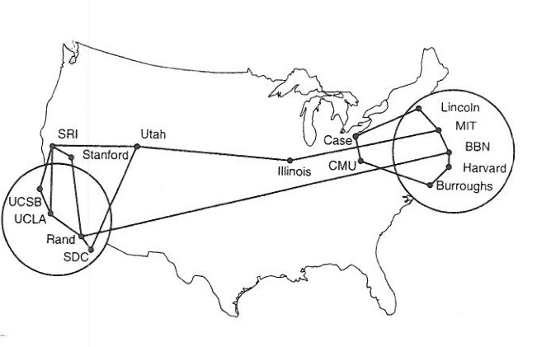
IETF Structure and Internet Standards Process Suppose you wanted to build an open organization to control and management a large network…
Slides Orignally: Scott Bradner

Slide 2
The IETF
Internet Engineering Task Force
Formed in 1986
Was not considered important for a long time - good!!
Not government approved - great!!
People not companies
www.ietf.org
www.ietf.org/about/participate/tao
“We reject kings, presidents and voting. We believe in rough consensus and running code” Dave Clark

Slide 3
IETF Overview
IETF has no members, no voting
~1000 at 3 yearly internation meetings, more on mail lists
100+ working groups (where real work happens)
If it matters to the Internet, it matters to IETF
7 areas (for organizational convenience)
ART, GEN, INT, OPS, RTG, SEC, TSV
IETF Management: IESG (ADs, chosen by community)
Architectural guidance & liaisons: IAB (also chosen by community)
Product: standards and other documents
www.ietf.org

Slide 4
IETF “Standards”
IETF standards not standards “because we say so”
Only standards if/when people use them
No formal recognition
No submitting to “traditional” standards bodies
Formal process of implementation and use makes something a standard

Slide 5
Organization of the IETF
Internet
Society
IAB
IETF
IESG
area
area
IRTF
IANA
IANA
RFC
area
“the IETF”

Slide 6
Organization of the IETF
IETF
Internet
LLC
Society
IAB
IETF
IESG
area
area
IRTF
IANA
IANA
RFC
IANA
area
ICANN
“the IETF”

Slide 7
The Internet Society (ISOC)
Non-profit, non-governmental, international, professional membership organization
Use to Provide organizational and administrative home for IETF Now IETF LLC
Now more an Internet marketing organization
join at www.isoc.org

Slide 8
Internet Research Task Force (IRTF)
Focused on long term problems in the Internet, e.g.,
Internet Congestion
Internet Measurement/Management
Network Management
For more information see http://www.irtf.org

Slide 9
Internet Architecture Board (IAB)
Provides overall architectural advice to the IESG and the IETF
Advises the IESG on IETF working group formation
Deals with IETF external liaisons
Appoints the IRTF chair
Selects the IETF-IANA
Oversees the RFC Editor
Hosts workshops

Slide 10
Internet Assigned Number Authority (IANA)
Assigns parameters and keeps them from colliding
protocol numbers and port numbers
IP addresses
mostly delegated to the 4 (going on 5) IP Address registries
domain names
deals with top level domains (TLDs)
rest delegated to DNS name registries
Functions split with the creation of ICANN - DNS
Internet Corporation for Assigned Names and Numbers
Independent corporation to take over IANA functions
Under contract with US government
Now IETF-IANA and non-IETF-IANA

Slide 11
RFC Editor
Historically Jon Postel and helpers
Now a small group funded by the IETF LLC
rfc-editor@rfc-editor.org
Semi-independent
Gets requests to publish IETF IDs from IESG
Gets requests to publish independent informational and experimental RFCs
asks IESG for advice on publishing independent RFCs but can exercise own discretion
presumption is to publish technically competent IDs which sometimes is a conflict with IESG

Slide 12
Organization of the IETF
IETF
Internet
LLC
Society
IAB
IETF
IESG
area
area
IRTF
IANA
IANA
RFC
IANA
area
ICANN
“the IETF”

Slide 13
Area Directors (ADs)
Nominated by the community – this include all IETF members
Selected by nomcom - a volunteer nomination committee
Responsible for setting direction in Area
Responsible for managing process in Area
approve BOFs & working group charters
then go to IESG & IAB for final approval
Reviews working group documents - 2000 pages/month
Most Areas have 2 ADs

Slide 14
Internet Engineering Steering Group (IESG)
IETF Chair + rest of ADs
IETF process management and RFC approval body
Approves WG creation
Reviews & approves publication of IETF documents
reviews and comments on non-IETF submissions
Multi-disciplinary technical review group

Slide 15
IETF Secretariat
Organizes/Coordinates
plenary meetings
mailing lists hosted by IETF
Internet-Draft directory
IESG teleconferences
day to day work of IESG and working groups
Provided by some company
Funded from IETF meeting fees, and ?

Slide 16
Working Groups
This is where the IETF primarily get its work done
RFC 2418/3934 describes WG operation
Working group focused by charter agreed between chair(s) and area director
restrictive charters with deliverables and milestones
working groups closed when their work is done
Charter approved by IESG with IAB advice
AD with IESG has final say on charter & chair(s)
Compare to Claremont Colleges committees

Slide 17
Working Groups (continued)
“...rough consensus and running code.”
No formal voting
can do show of hands or hum
Does NOT require unanimity
Disputes resolved by discussion and implementation
Mailing list and face-to-face meetings
most work happens on mailing lists
all decisions must be verified on mailing list
face-to-face discussion to resolve disagreements

Slide 18
IETF Documents
All open - no “confidential contributions”
Developed as Internet-Drafts
anyone can submit - “expire” in 6 months
some IDs are working group documents
Published as RFCs
archival publications (never changed once published)
different types: (not all RFCs are standards!)
informational, experimental, BCP, standards track, historic
3-stage standards track, now 2-stage
Proposed Standard, Draft Standard, Internet Standard
Interoperability AND conformance – are the keys

Slide 19
Working Documents
Internet-Draft - IDs
input to the process or for background information
no admissions control other than IPR statements
anyone can submit an ID
zapped from IETF directory after 6 months
but many mirrors exist
almost all RFCs pre-exist as IDs
exceptions: some RFCs created by IANA or RFC Editor

Slide 20
What is a RFC?
IETF document publication series
RFC == Request for Comments
now just a name
now tend to be more formal documents than early RFCs
Over 8000 RFCs
RFC 1 Host Software - Apr 7 1969
“Not all RFCs are standards”
see RFC 1796
though some vendors imply otherwise
Many types of RFCs, key to understanding significance

Slide 21
RFC Repository Contains:
Standards track
OSPF, IPv6, IPsec ...
Obsolete Standards
RIPv1
Requirements
Host Requirements
Policies
Classless InterDomain
Routing
April fool’s day jokes
IP on Avian Carriers ...
... updated for QoS
Poetry
‘Twas the night before startup
White papers
On packet switches with infinite storage
Corporate documentation
Ascend multilink protocol (mp+)
Experimental history
Netblt
Process documents
IETF Standards Process

Slide 22
Standards Track RFCs:
Start at Proposed Standard (PS)
good idea, no known problems
implementation required at AD discretion
Advance to Draft Standard (DS)
stable Proposed Standard specification
multiple interoperable implementations
note IPR restriction
Advance again to Internet Standard (STD)
Draft Standard with wide deployment and use
Best Current Practices (BCP)
generally policies or IETF procedures
(best way we know how)

Slide 23
IETF RFC Submission Process
Working group doc, or
individual standards track doc
Submit
Concerns
IESG
RFC Editor
Published RFC
“Last Call”
Comments,
suggestions
IETF Community
Review

