Slide 1
Jotto!
Frosh
Sophs
Jrs
Srs
audio 2
audio 1
audio 2
audio 1
graze 2
graze 3
graze 1
graze 1
alloy 2
alloy 1
alloy 1
alloy 1
fresh 1
fresh 2
fresh 1
fresh 2
This term's first class to guess another's word earns 1 problem...
This term's last class to have its word guessed earns 1 problem...
Notes:
PERL stories
- use in ACM
- creating scripts
- LTS, BOT

Slide 2
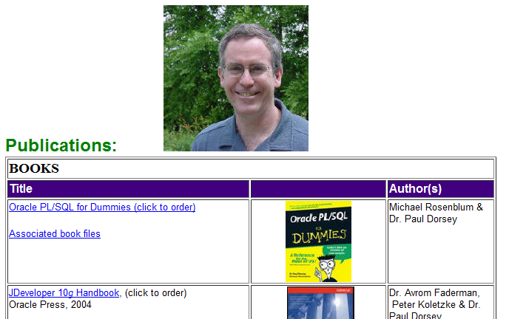
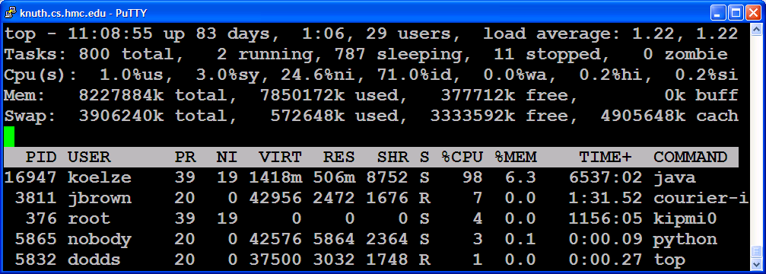
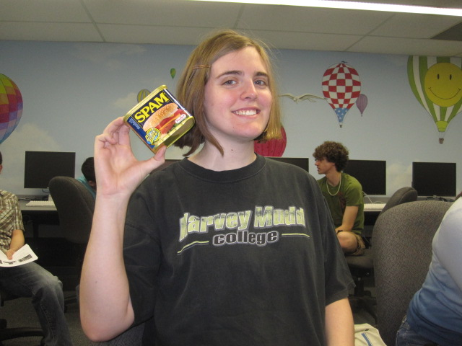
ACM today
Paul Dorsey will talk next week at this time...
Some nice unix commands…
“Nice” enforcement
One of our Nice enforcers!
This week: binary search problems...

Slide 3
ACM today
Paul Dorsey will talk next week at this time...
Remote broadcast message (Tue Feb 1 21:59:15 2011):
Attention Knuth users: if you are currently experiencing excruciating slowness,
that is because several people have been running Practicum problems without nicing them. THIS IS BAD. If you think that a program you are running might be using a
lot of CPU and/or RAM for longer than a few seconds, please nice it like so:
nice -n 19 [your process]
If you've already started running a process that you think might need to be
niced, there are plenty of ways to do so:
1. Invoke "renice" from the command line:
renice -n 19 [process id]
2. Open "top", hit 'r', and type in the PID of the process you want to
renice, and then give it the priority (19 unless you have good reason to
do otherwise).
3. Open "htop", find your process, and repeatedly hit F8 to increase its
niceness.
Some nice unix commands…
“Nice” enforcement
This week: binary search problems...
be sure to be NICE !

Slide 4
top screen nice
Make sure long-running programs are nice !
top watches the progress of all of knuth's processes.
screen
Creates a terminal session independent of a particular connection
to start
screen
to resume
screen -r
What are are all of these columns saying?
particularly this one…
nice!
nice java args +19
Notes:
set up lots of CS 60 grad processes?

Slide 5
Next week
last term's talks were good!
This talk is optional
It is incentivized @ 1.5 problems...
It might count as a colloquium, too...

Slide 6
Course Schedule
Jan 25 Welcome! DP + other problems ~ 4 problems
Feb 1 Lab session ~ 4 problems
Feb 8 Discussion session on graph problems ~ 4 problems
Feb 15 Paul Dorsey ~ 4 problems
Feb 22 Lab session on bin search problems and others... ~ 4 problems
Mar 1 Discussion session on geometry problems ~ 4 problems
Mar 1 Traveling – no CS 189 class
Mar 8 Lab session on geometry problems ~ 4 problems
Mar 15 Spring break... – no CS 189 class
Mar 22 Discussion session on something new... ~ 4 problems
Mar 29 Lab session ~ 4 problems
... we don't meet through April...
≥ 32 problems total
You may submit problems until the end of exams…

Slide 7
This week: binary search
If a desired value is
difficult to compute but easy to check
and
1d (or broken into 1d subproblems)
then we can binary search across all the possible values for it, checking as we go... !

Slide 8
Binary search in a sorted list...
Is an item "present"
– or is a problem solvable?
1 3 4 5 8 10 11 ... 992 997 998 1000
1
1,000
LOW
MID
HIGH

Slide 9
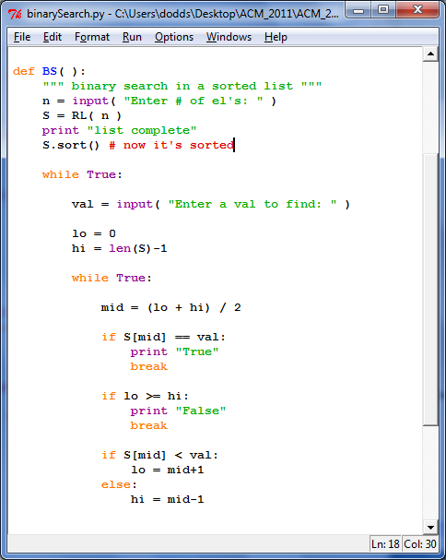
Binary search in a sorted list...
in Python
available on the ACM website

Slide 10
This week: aggr
Input
Output
3
5 3
1
2
8
4
9
Number of cows to house in the new barn…
The largest minimum spacing possible after placing the cows
Number of stalls in which cows can be placed
The locations of stalls
1
2
4
8
9

Slide 11
aggr in Python (in part)
# get the # of stalls (N) and cows (C)
S = []
for i in range(N):
S += [input()] # get the stalls' locations
S.sort() # sort them
lo = 0
hi = max(S)-min(S)+1
input

Slide 12
aggr in Python (in part)
# get the # of stalls (N) and cows (C)
S = []
for i in range(N):
S += [input()] # get the stalls' locations
S.sort() # sort them
lo = 0
hi = max(S)-min(S)+1
while True:
mid = (lo + hi)/2 # no overflow in Python, right?
if mid == hi or mid == lo: break
# does mid work?
if CHECKS_OUT( mid, C, S ):
lo = mid # worked! look higher (set lo to mid)
else:
hi = mid # did not work... look lower (set hi to mid)
print mid
input
binary search
still left to do?

Slide 13
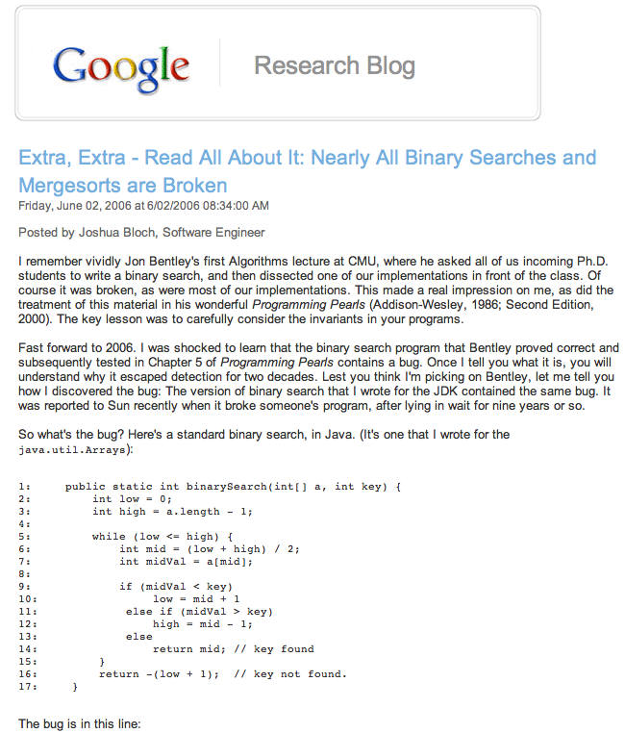

Slide 14
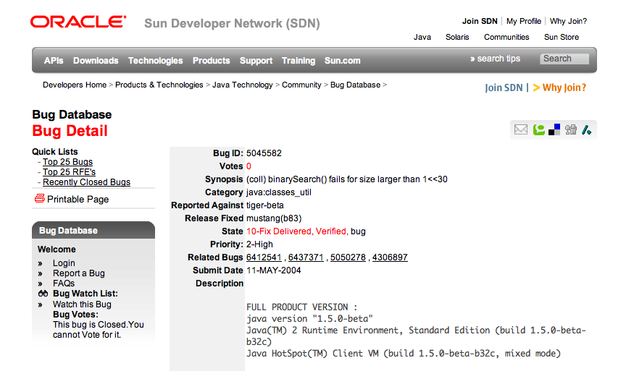
This bug went undetected in Java's libraries for years...

Slide 15
This week's problems…
phoneline
hunger
aggr
cowblank
btwr
this problem is only for those new to ACM...
but if you're returning, you can solve it
in web-form for credit: you should use HTML 5's
canvas object directly (or libraries that use it)
to draw the scenario and results...

Slide 16
Web versions!
Web frameworks are welcome...
As are libraries, e.g., JQuery and its variants...
The locations of stalls
cows!
1
2
4
8
9
This week: HMTL 5 canvas objects

Slide 17
This week's problems…
phoneline
hunger
aggr
cowblank
btwr
this problem is only for those new to ACM...
but if you're returning, you can solve it
in web-form for credit: you should use HTML 5's
canvas object directly (or libraries that use it)
to draw the scenario and results...

Slide 18
This week: phoneline
# of telephone poles, N
Output
Input
# of edges available
4
5 7 1
1 2 5
3 1 4
2 4 8
3 2 3
5 2 9
3 4 7
4 5 6
# of cables you get for free
The minimium possible length of remaining cables needed to connect #1 and #N
2
9
5
5
3
8
6
4
1
3
7
4
#1 is connected to the phone network

Slide 19
MST
Minimum spanning tree: (Prim’s algorithm)
Start anywhere and repeatedly choose the next-smallest edge out from your current tree.

Slide 20
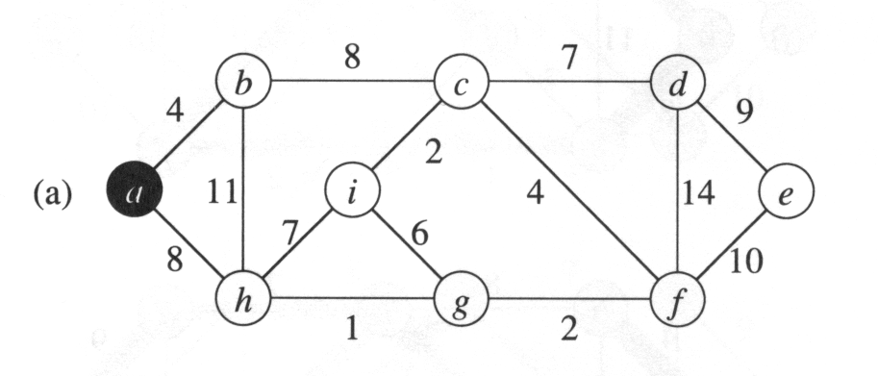
MST
Minimum spanning tree: (Prim’s algorithm)
Start anywhere and repeatedly choose the next-smallest edge out from your current tree.

Slide 21
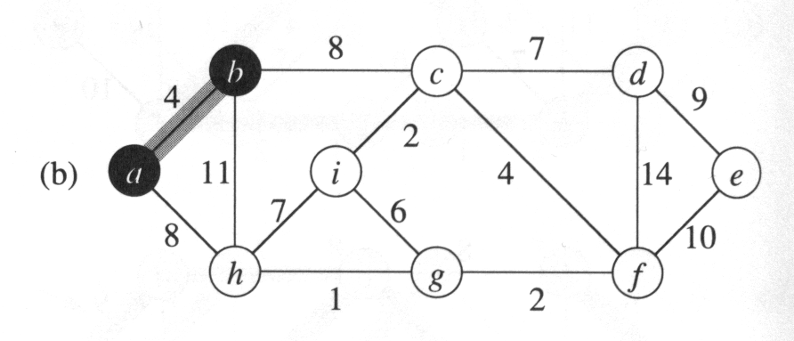
MST
Minimum spanning tree: (Prim’s algorithm)
Start anywhere and repeatedly choose the next-smallest edge out from your current tree.

Slide 22
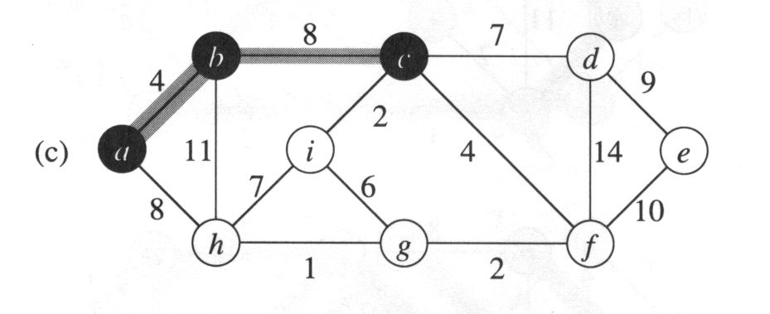
MST
Minimum spanning tree: (Prim’s algorithm)
Start anywhere and repeatedly choose the next-smallest edge out from your current tree.

Slide 23
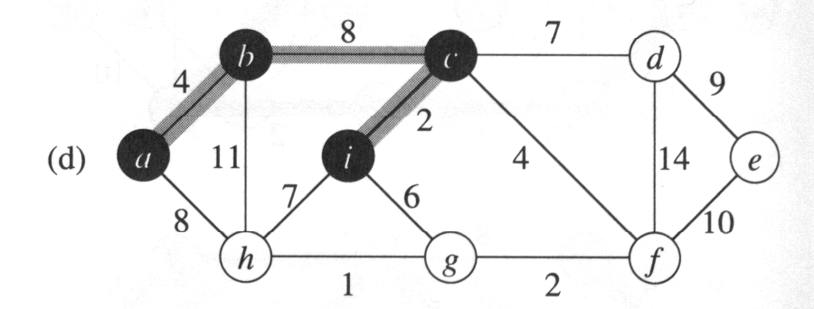
MST
Minimum spanning tree: (Prim’s algorithm)
Start anywhere and repeatedly choose the next-smallest edge out from your current tree.

Slide 24
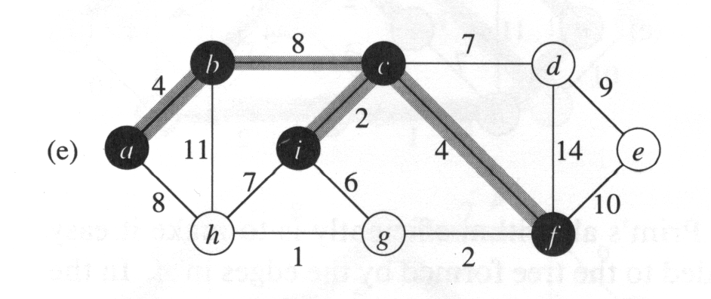
MST
Minimum spanning tree: (Prim’s algorithm)
Start anywhere and repeatedly choose the next-smallest edge out from your current tree.

Slide 25
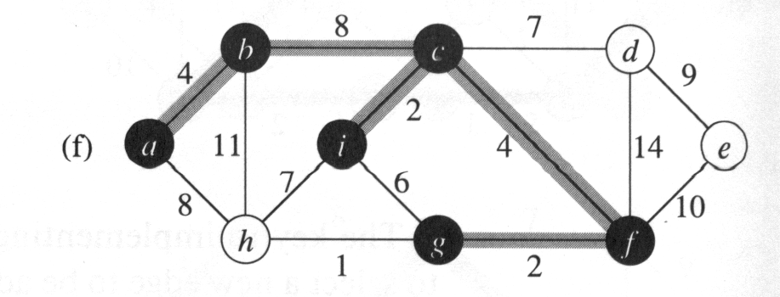
MST
Minimum spanning tree: (Prim’s algorithm)
Start anywhere and repeatedly choose the next-smallest edge out from your current tree.

Slide 26
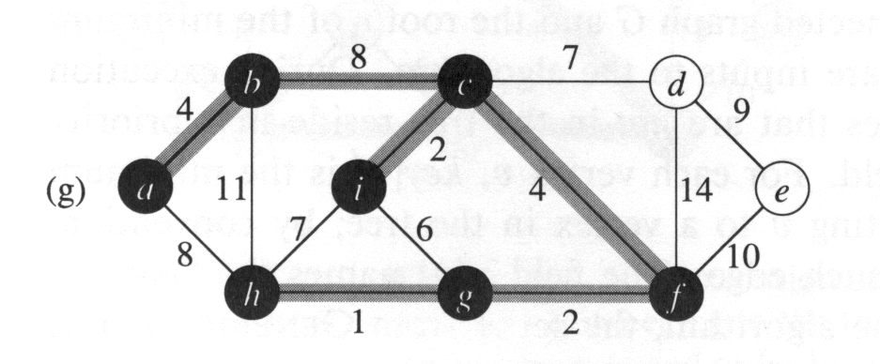
MST
Minimum spanning tree: (Prim’s algorithm)
Start anywhere and repeatedly choose the next-smallest edge out from your current tree.

Slide 27
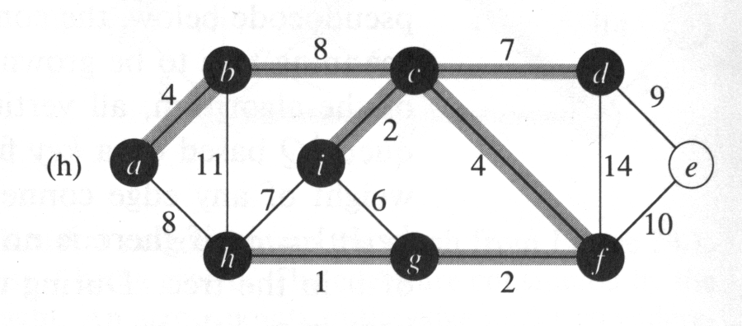
MST
Minimum spanning tree: (Prim’s algorithm)
Start anywhere and repeatedly choose the next-smallest edge out from your current tree.

Slide 28
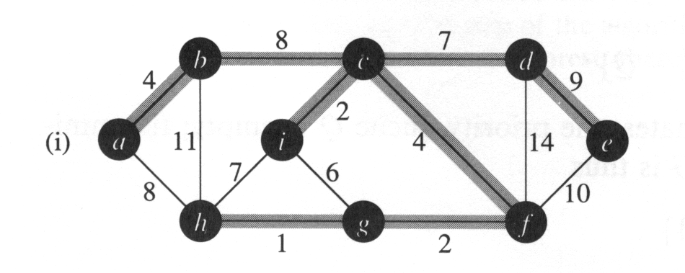
MST
Minimum spanning tree: (Prim’s algorithm)
Start anywhere and repeatedly choose the next-smallest edge out from your current tree.
Done!

Slide 29
Try this week's problems!
phoneline
hunger
aggr
cowblank
btwr
this problem is only for those new to ACM...
but if you're returning, you can solve it
in web-form for credit: you should use HTML 5's
canvas object directly (or libraries that use it)
to draw the scenario and results...

Slide 30
Jotto!
Frosh
Sophs
Jrs
Srs
audio 2
audio 1
audio 2
audio 1
graze 2
graze 3
graze 1
graze 1
alloy 2
alloy 1
alloy 1
alloy 1
fresh 1
fresh 2
fresh 1
fresh 2
This term's first class to guess another's word earns 1 problem...
This term's last class to have its word guessed earns 1 problem...
Notes:
PERL stories
- use in ACM
- creating scripts
- LTS, BOT

Slide 31
Last week: wifi
Input
Output
The # of test cases...
1.0
1
2 3
1
3
10
The smallest max distance achievable
The # of access points and the # of houses
Locations of the houses...
1
3
10

Slide 32
This week: city
# of people to house
Output
Input
cost per unit distance from (0,0)
194
10 20 3
11
22
33
maximum # of stories per building
The minimium cost to house the specified # of people
cost of 1st story
0dist
1dist
0dist
0dist
1dist
1dist
0dist
1dist
2dist
3dist
the central station where everyone works is at (0,0)
distances to it are considered to be |x|+|y|-1

Slide 33
This week: cowset
# of cows available, up to 34
Output
Input
minimum ID sum
5
3 -1 2
1
-2
3
maximum ID sum
The number of subsets whose IDs sum between min and max
ID # for 1st cow
ID # for 2nd cow
Try all subsets...?
ID # for 3rd cow
Farmer Ran is willing to play frisbee with any subset of cows whose IDs sum to any value between the min and max...

Slide 34
This week: cowset
# of cows available, up to 34
Output
Input
minimum ID sum
5
3 -1 2
1
-2
3
maximum ID sum
The number of subsets whose IDs sum between min and max
ID # for 1st cow
ID # for 2nd cow
Takes too long to try all subsets...!
How could Bin Search speed it up?
ID # for 3rd cow
Farmer Ran is willing to play frisbee with any subset of cows whose IDs sum to any value between the min and max...

Slide 35
Problem D from the 2009 World Finals in Stockholm: Pipe Packing
Given a set of four wire diameters:
What is the minimum diameter of pipe that can contain all four wires?
(Constraint: pipes only come in millimeter sizes)

Slide 36
Intuition: Solve this problem by binary search
A lower bound: sum of largest two wire-diameters
An upper bound: sum of all four wire-diameters
Binary search between lower bound and upper bound
Given a pipe diameter and four wire diameters, can you pack the wires inside the pipe?
Choose the smallest integer pipe diameter that fits

Slide 37
Problem D from the 2009 World Finals in Stockholm: Pipe Packing
Given a set of four wire diameters:
What is the minimum diameter of pipe that can contain all four wires?
(Constraint: pipes only come in millimeter sizes)

Slide 38
Intuition: Solve this problem by binary search
A lower bound: sum of largest two wire-diameters
An upper bound: sum of all four wire-diameters
Binary search between lower bound and upper bound
Given a pipe diameter and four wire diameters, can you pack the wires inside the pipe?
Choose the smallest integer pipe diameter that fits

Slide 39
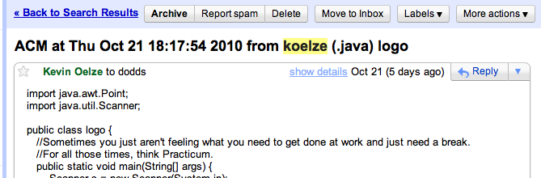
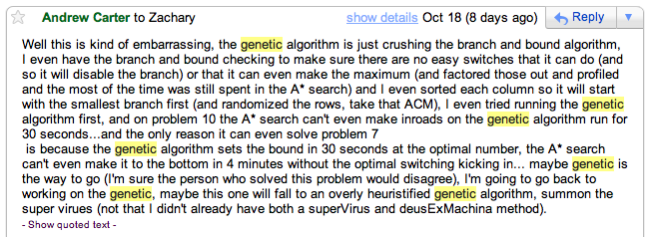
ACM this week!?

