Slide 1
Jotto!
A word-guessing game similar to mastermind…
Sophs
JRs
SRs
Elderly
Pomona
slate 1
slate 3
slate 2
slate 1
slate 3
flair 0
flair 0
flair 1
flair 2
flair 2
stems 1
stems 3
stems 1
stems 2
stems 2
flair 0
flair 0
flair 1
flair 2
flair 2
stems 1
stems 3
stems 1
stems 2
stems 2
This term's first class to guess another's word earns 1 problem...
This term's last class to have its word guessed earns 1 problem...
Notes:
PERL stories
- use in ACM
- creating scripts
- LTS, BOT

Slide 2
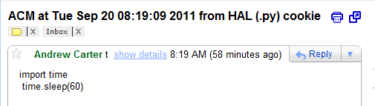
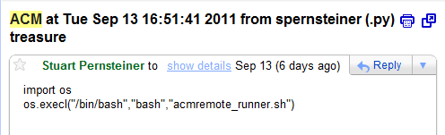
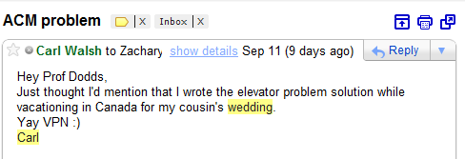
ACM today
Problem-solving strategies...
"HAL"
Be nice!
“Nice” enforcement
One of our Nice enforcers!
Stuart and Paul
Carl

Slide 3
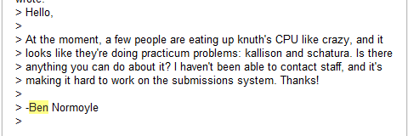
ACM today
Problem-solving strategies...
"HAL"
Be nice!
“Nice” enforcement
One of our Nice enforcers!
Stuart and Paul
Carl
nice -19 /cs/ACM/acmSubmit file.X
does this work?

Slide 4
ACM today
Problem-solving strategies...
Remote broadcast message (Tue Feb 1 21:59:15 2011):
Attention Knuth users: if you are currently experiencing excruciating slowness,
that is because several people have been running Practicum problems without nicing them. THIS IS BAD. If you think that a program you are running might be using a
lot of CPU and/or RAM for longer than a few seconds, please nice it like so:
nice -n 19 [your process]
If you've already started running a process that you think might need to be
niced, there are plenty of ways to do so:
1. Invoke "renice" from the command line:
renice -n 19 [process id]
2. Open "top", hit 'r', and type in the PID of the process you want to
renice, and then give it the priority (19 unless you have good reason to
do otherwise).
3. Open "htop", find your process, and repeatedly hit F8 to increase its
niceness.
“Nice” enforcement
One of our Nice enforcers!
Being nice...

Slide 5
Today: two graph algorithms
APSP
Floyd-Warshall algorithm
all-pairs shortest paths
MST
Prim's algorithm
minimum spanning tree

Slide 6
Floyd Warshall !
Directed graph as adjacency matrix:
an algorithm that finds ALL shortest paths
dst
"to"
Directed graph:
1
2
3
4
100
1
0
14
inf
100
2
14
2
inf
0
14
50
1
src
50
"from"
inf
inf
0
14
3
14
10
4
10
inf
inf
0
4
3
14
0 intermediate nodes

Slide 7
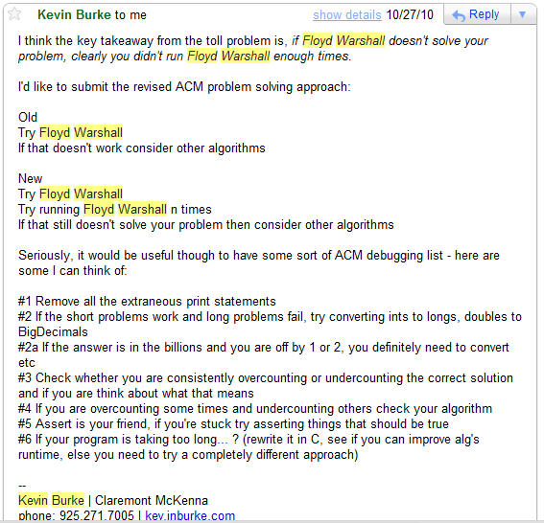
Thanks, Kevin!

Slide 8
Idea: consider waypoints 1 at a time
Step 1
check each src to each dst THROUGH
1
1 entry will change – which?
dst
"to"
1
2
3
4
100
1
0
14
inf
100
2
14
2
inf
0
14
50
1
src
50
"from"
inf
inf
0
14
3
14
10
4
10
inf
inf
0
4
3
14
0 intermediate nodes

Slide 9
Step 2
check each src to each dst THROUGH
2
3 entries will change – which?
dst
"to"
1
2
3
4
100
1
0
14
inf
100
2
14
2
inf
0
14
50
1
src
50
"from"
inf
inf
0
14
3
14
10
4
10
24
inf
0
4
3
14
1 intermediate node(s)
1

Slide 10
Step 3
check each src to each dst THROUGH
3
2 entries will change – which?
dst
"to"
1
2
3
4
100
1
0
14
28
64
2
14
2
inf
0
14
50
1
src
50
"from"
inf
inf
0
14
3
14
10
4
10
24
38
0
4
3
14
1 intermediate node(s)
1

Slide 11
Step 3
check each src to each dst THROUGH
4
3 entries will change – which?
dst
"to"
1
2
3
4
100
1
0
14
28
42
2
14
2
inf
0
14
28
1
src
50
"from"
inf
inf
0
14
3
14
10
4
10
24
38
0
4
3
14
1 intermediate node(s)
1

Slide 12
Done!
O( )
dst
"to"
1
2
3
4
1
0
14
28
42
T[src][dst][k]
2
38
0
14
28
src
T[src][dst][k-1]
"from"
=
min
3
24
38
0
14
T[src][k][k-1] +
T[k][dst][k-1]
4
10
24
38
0
Minimum distance from src to dst using intermediate nodes 1..k
1 intermediate node(s)
1

Slide 13
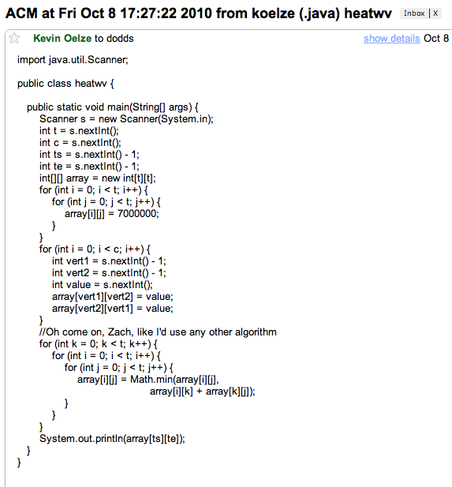
Kevin Oelze's code is available on the ACM website – see if you can spot the FW problem this week...
lose k
T[src][dst][k-1]
=
min
T[src][dst][k]
T[src][k][k-1] +
T[k][dst][k-1]
use-it-or-lose-it!
use k

Slide 14
This week's problems…
Floyd Warshall!
bestspot
meetplace
mtwalk
phoneline
water
Tree problem...
Challenge problems...
Alert! A non-FW graph problem!

Slide 15
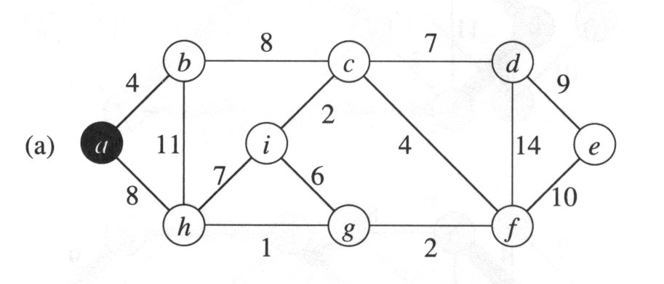
MST
Minimum spanning tree: (Prim’s algorithm)
Strategy: ?
Goal: find the lowest-cost tree that touches each vertex

Slide 16
MST
Minimum spanning tree: (Prim’s algorithm)
Start anywhere and repeatedly choose the next-smallest edge out from your current tree.
Strategy: Greed!
Goal: find the lowest-cost tree that touches each vertex

Slide 17
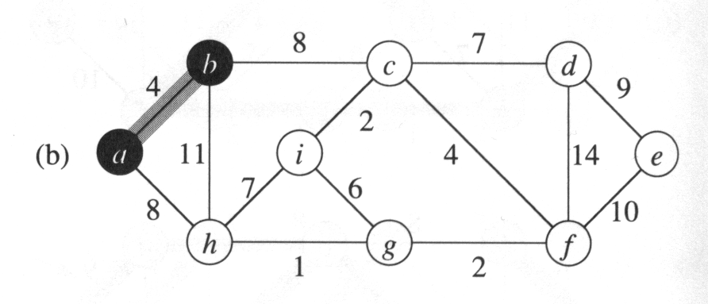
MST
Minimum spanning tree: (Prim’s algorithm)
Start anywhere and repeatedly choose the next-smallest edge out from your current tree.

Slide 18
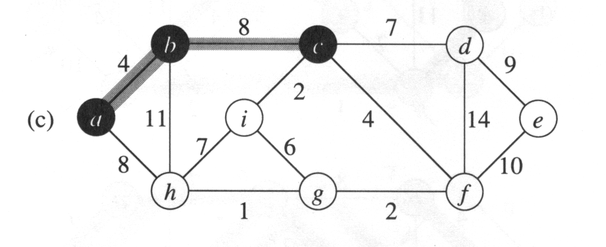
MST
Minimum spanning tree: (Prim’s algorithm)
Start anywhere and repeatedly choose the next-smallest edge out from your current tree.

Slide 19
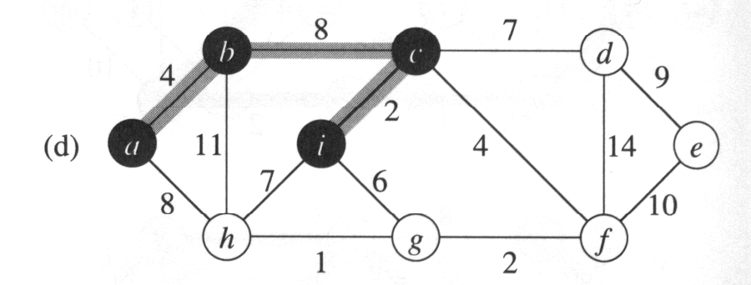
MST
Minimum spanning tree: (Prim’s algorithm)
Start anywhere and repeatedly choose the next-smallest edge out from your current tree.

Slide 20
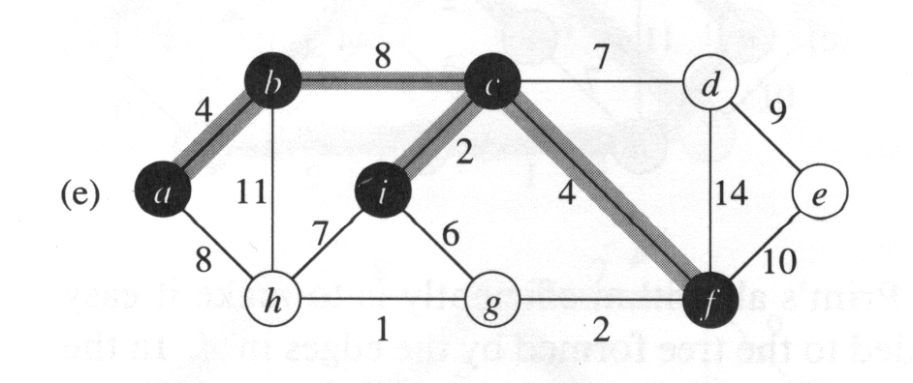
MST
Minimum spanning tree: (Prim’s algorithm)
Start anywhere and repeatedly choose the next-smallest edge out from your current tree.

Slide 21
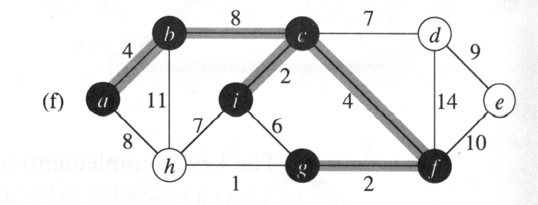
MST
Minimum spanning tree: (Prim’s algorithm)
Start anywhere and repeatedly choose the next-smallest edge out from your current tree.

Slide 22
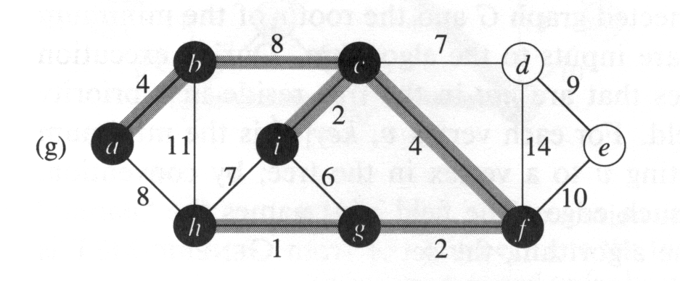
MST
Minimum spanning tree: (Prim’s algorithm)
Start anywhere and repeatedly choose the next-smallest edge out from your current tree.

Slide 23
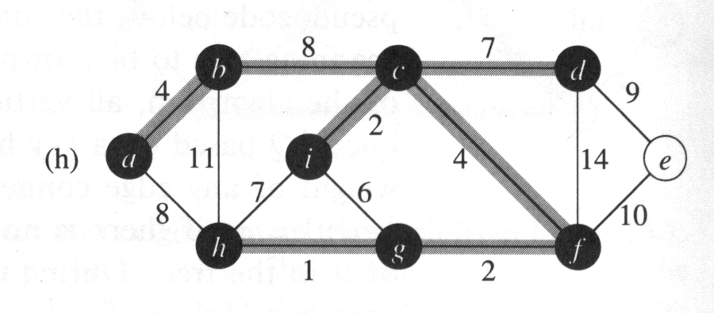
MST
Minimum spanning tree: (Prim’s algorithm)
Start anywhere and repeatedly choose the next-smallest edge out from your current tree.

Slide 24
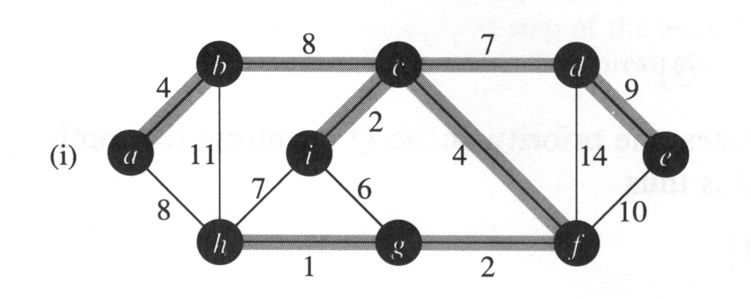
MST
Minimum spanning tree: (Prim’s algorithm)
Start anywhere and repeatedly choose the next-smallest edge out from your current tree.
Done!

Slide 25
This week: water
Input
4
5
4
4
3
0 2 2 2
2 0 3 3
2 3 0 4
2 3 4 0
Number of fields needing water
Cost of drilling a well in each field
Cost of placing a pipe from field src to field dst
Output
?
src
The minimum possible cost to provide water to all of the fields...
dst

Slide 26
This week: water
Input
4
5
4
4
3
0 2 2 2
2 0 3 3
2 3 0 4
2 3 4 0
Number of fields needing water
Cost of drilling a well in each field
Cost of placing a pipe from field src to field dst
Output
9
src
The minimum possible cost to provide water to all of the fields...
dst
How is this MST?

Slide 27
Jotto!
A word-guessing game similar to mastermind…
Sophs
JRs
SRs
Elderly
Pomona
slate 1
slate 3
slate 2
slate 1
slate 3
flair 0
flair 0
flair 1
flair 2
flair 2
stems 1
stems 3
stems 1
stems 2
stems 2
flair 0
flair 0
flair 1
flair 2
flair 2
stems 1
stems 3
stems 1
stems 2
stems 2
This term's first class to guess another's word earns 1 problem...
This term's last class to have its word guessed earns 1 problem...
Notes:
PERL stories
- use in ACM
- creating scripts
- LTS, BOT

Slide 29
This week: binary search
If a desired value is
difficult to compute but easy to check
and
1d (or broken into 1d subproblems)
then we can binary search across all the possible values for it, checking as we go... !

Slide 30
Binary search in a sorted list...
Is an item "present"
– or is a problem solvable?
1 3 4 5 8 10 11 ... 992 997 998 1000
1
1,000
LOW
MID
HIGH

Slide 31
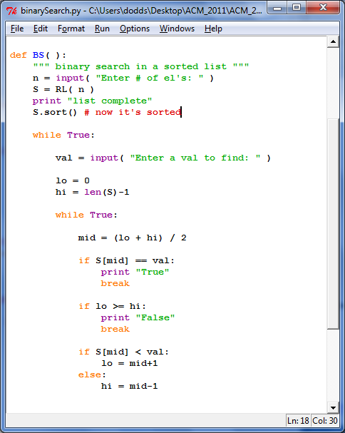
Binary search in a sorted list...
in Python
available on the ACM website

Slide 32
This week: aggr
Input
Output
3
5 3
1
2
8
4
9
Number of cows to house in the new barn…
The largest minimum spacing possible after placing the cows
Number of stalls in which cows can be placed
The locations of stalls
1
2
4
8
9

Slide 33
aggr in Python (in part)
# get the # of stalls (N) and cows (C)
S = []
for i in range(N):
S += [input()] # get the stalls' locations
S.sort() # sort them
lo = 0
hi = max(S)-min(S)+1
input

Slide 34
aggr in Python (in part)
# get the # of stalls (N) and cows (C)
S = []
for i in range(N):
S += [input()] # get the stalls' locations
S.sort() # sort them
lo = 0
hi = max(S)-min(S)+1
while True:
mid = (lo + hi)/2 # no overflow in Python, right?
if mid == hi or mid == lo: break
# does mid work?
if CHECKS_OUT( mid, C, S ):
lo = mid # worked! look higher (set lo to mid)
else:
hi = mid # did not work... look lower (set hi to mid)
print mid
input
binary search
still left to do?

Slide 35
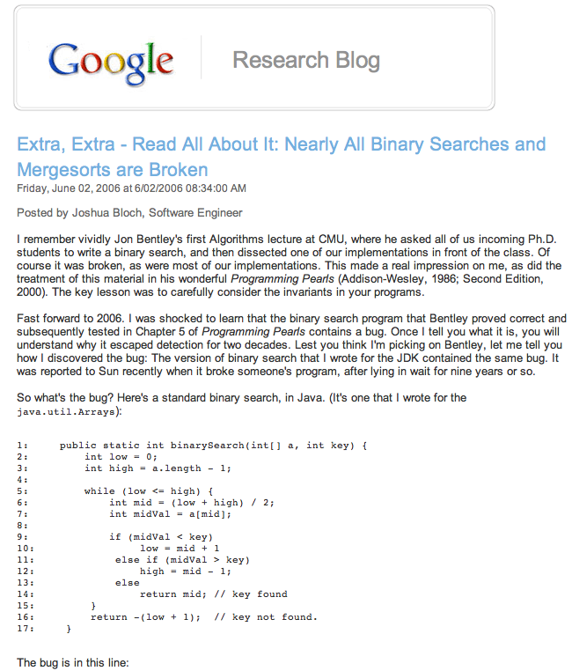

Slide 36
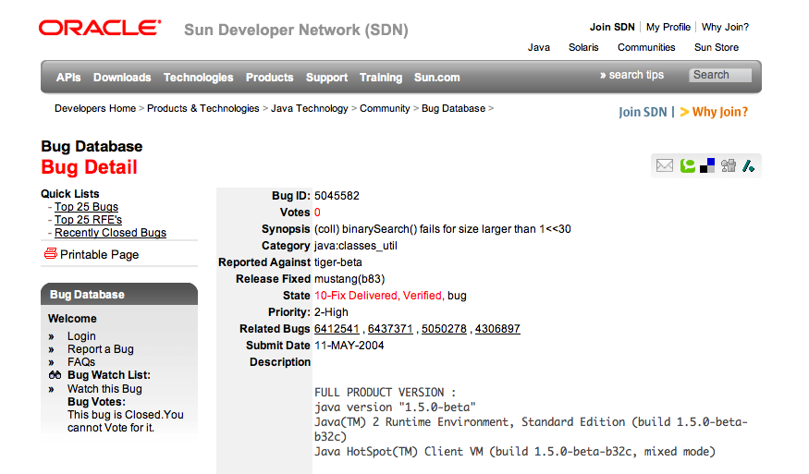
This bug went undetected in Java's libraries for years...

Slide 37
This week's problems…
phoneline
hunger
aggr
cowblank
btwr
this problem is only for those new to ACM...
but if you're returning, you can solve it
in web-form for credit: you should use HTML 5's
canvas object directly (or libraries that use it)
to draw the scenario and results...

Slide 38
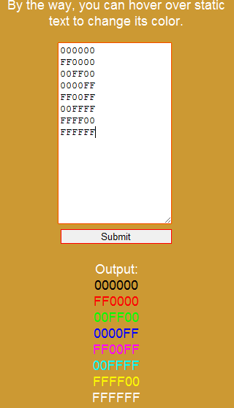
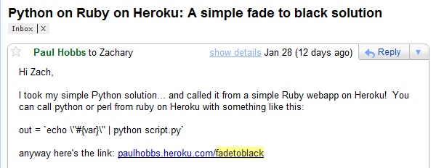
Web versions!
Web frameworks are welcome...
As are libraries, e.g., JQuery and its variants...
The locations of stalls
cows!
1
2
4
8
9
This week: HMTL 5 canvas objects

Slide 39
This week's problems…
phoneline
hunger
aggr
cowblank
btwr
this problem is only for those new to ACM...
but if you're returning, you can solve it
in web-form for credit: you should use HTML 5's
canvas object directly (or libraries that use it)
to draw the scenario and results...

Slide 40
This week: phoneline
# of telephone poles, N
Output
Input
# of edges available
4
5 7 1
1 2 5
3 1 4
2 4 8
3 2 3
5 2 9
3 4 7
4 5 6
# of cables you get for free
The minimium possible length of remaining largest cable needed to connect #1 and #N
2
9
5
5
3
8
6
4
1
3
7
4
#1 is connected to the phone network

Slide 41
Try this week's problems!
phoneline
hunger
aggr
cowblank
btwr
this problem is only for those new to ACM...
but if you're returning, you can solve it
in web-form for credit: you should use HTML 5's
canvas object directly (or libraries that use it)
to draw the scenario and results...

Slide 42
Jotto!
Frosh
Sophs
Jrs
Srs
audio 2
audio 1
audio 2
audio 1
graze 2
graze 3
graze 1
graze 1
alloy 2
alloy 1
alloy 1
alloy 1
fresh 1
fresh 2
fresh 1
fresh 2
armor 2
armor 2
armor 2
armor 1
brave 2
brave 3
brave 1
brave 1
This term's first class to guess another's word earns 1 problem...
This term's last class to have its word guessed earns 1 problem...
Notes:
PERL stories
- use in ACM
- creating scripts
- LTS, BOT

Slide 43
Last week: wifi
Input
Output
The # of test cases...
1.0
1
2 3
1
3
10
The smallest max distance achievable
The # of access points and the # of houses
Locations of the houses...
1
3
10

Slide 44
This week: city
# of people to house
Output
Input
cost per unit distance from (0,0)
194
10 20 3
11
22
33
maximum # of stories per building
The minimium cost to house the specified # of people
cost of 1st story
0dist
1dist
0dist
0dist
1dist
1dist
0dist
1dist
2dist
3dist
the central station where everyone works is at (0,0)
distances to it are considered to be |x|+|y|-1

Slide 45
This week: cowset
# of cows available, up to 34
Output
Input
minimum ID sum
5
3 -1 2
1
-2
3
maximum ID sum
The number of subsets whose IDs sum between min and max
ID # for 1st cow
ID # for 2nd cow
Try all subsets...?
ID # for 3rd cow
Farmer Ran is willing to play frisbee with any subset of cows whose IDs sum to any value between the min and max...

Slide 46
This week: cowset
# of cows available, up to 34
Output
Input
minimum ID sum
5
3 -1 2
1
-2
3
maximum ID sum
The number of subsets whose IDs sum between min and max
ID # for 1st cow
ID # for 2nd cow
Takes too long to try all subsets...!
How could Bin Search speed it up?
ID # for 3rd cow
Farmer Ran is willing to play frisbee with any subset of cows whose IDs sum to any value between the min and max...

Slide 47



Problem D from the 2009 World Finals in Stockholm:
Pipe Packing
Given a set of four wire diameters:
What is the minimum diameter of pipe that can contain all four wires?
(Constraint: pipes only come in millimeter sizes)

Slide 48
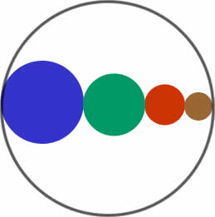
Intuition: Solve this problem by binary search
A lower bound:
sum of largest two wire-diameters
An upper bound: sum of all four wire-diameters
  Binary search between lower bound and upper bound
  Given a pipe diameter and four wire diameters, can you pack the wires inside the pipe?
  Choose the smallest integer pipe diameter that fits

Slide 49
Problem D from the 2009 World Finals in Stockholm:
Pipe Packing
Given a set of four wire diameters:
What is the minimum diameter of pipe that can contain all four wires?
(Constraint: pipes only come in millimeter sizes)

Slide 50
Intuition: Solve this problem by binary search
A lower bound:
sum of largest two wire-diameters
An upper bound: sum of all four wire-diameters
  Binary search between lower bound and upper bound
  Given a pipe diameter and four wire diameters, can you pack the wires inside the pipe?
  Choose the smallest integer pipe diameter that fits

Slide 51
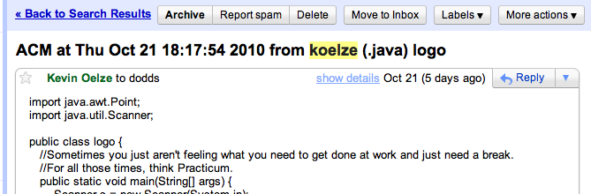
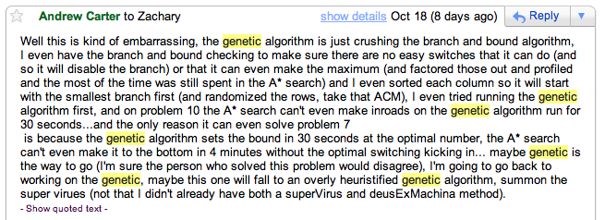
ACM this week!?

