Slide 1
Welcome back!

Slide 2
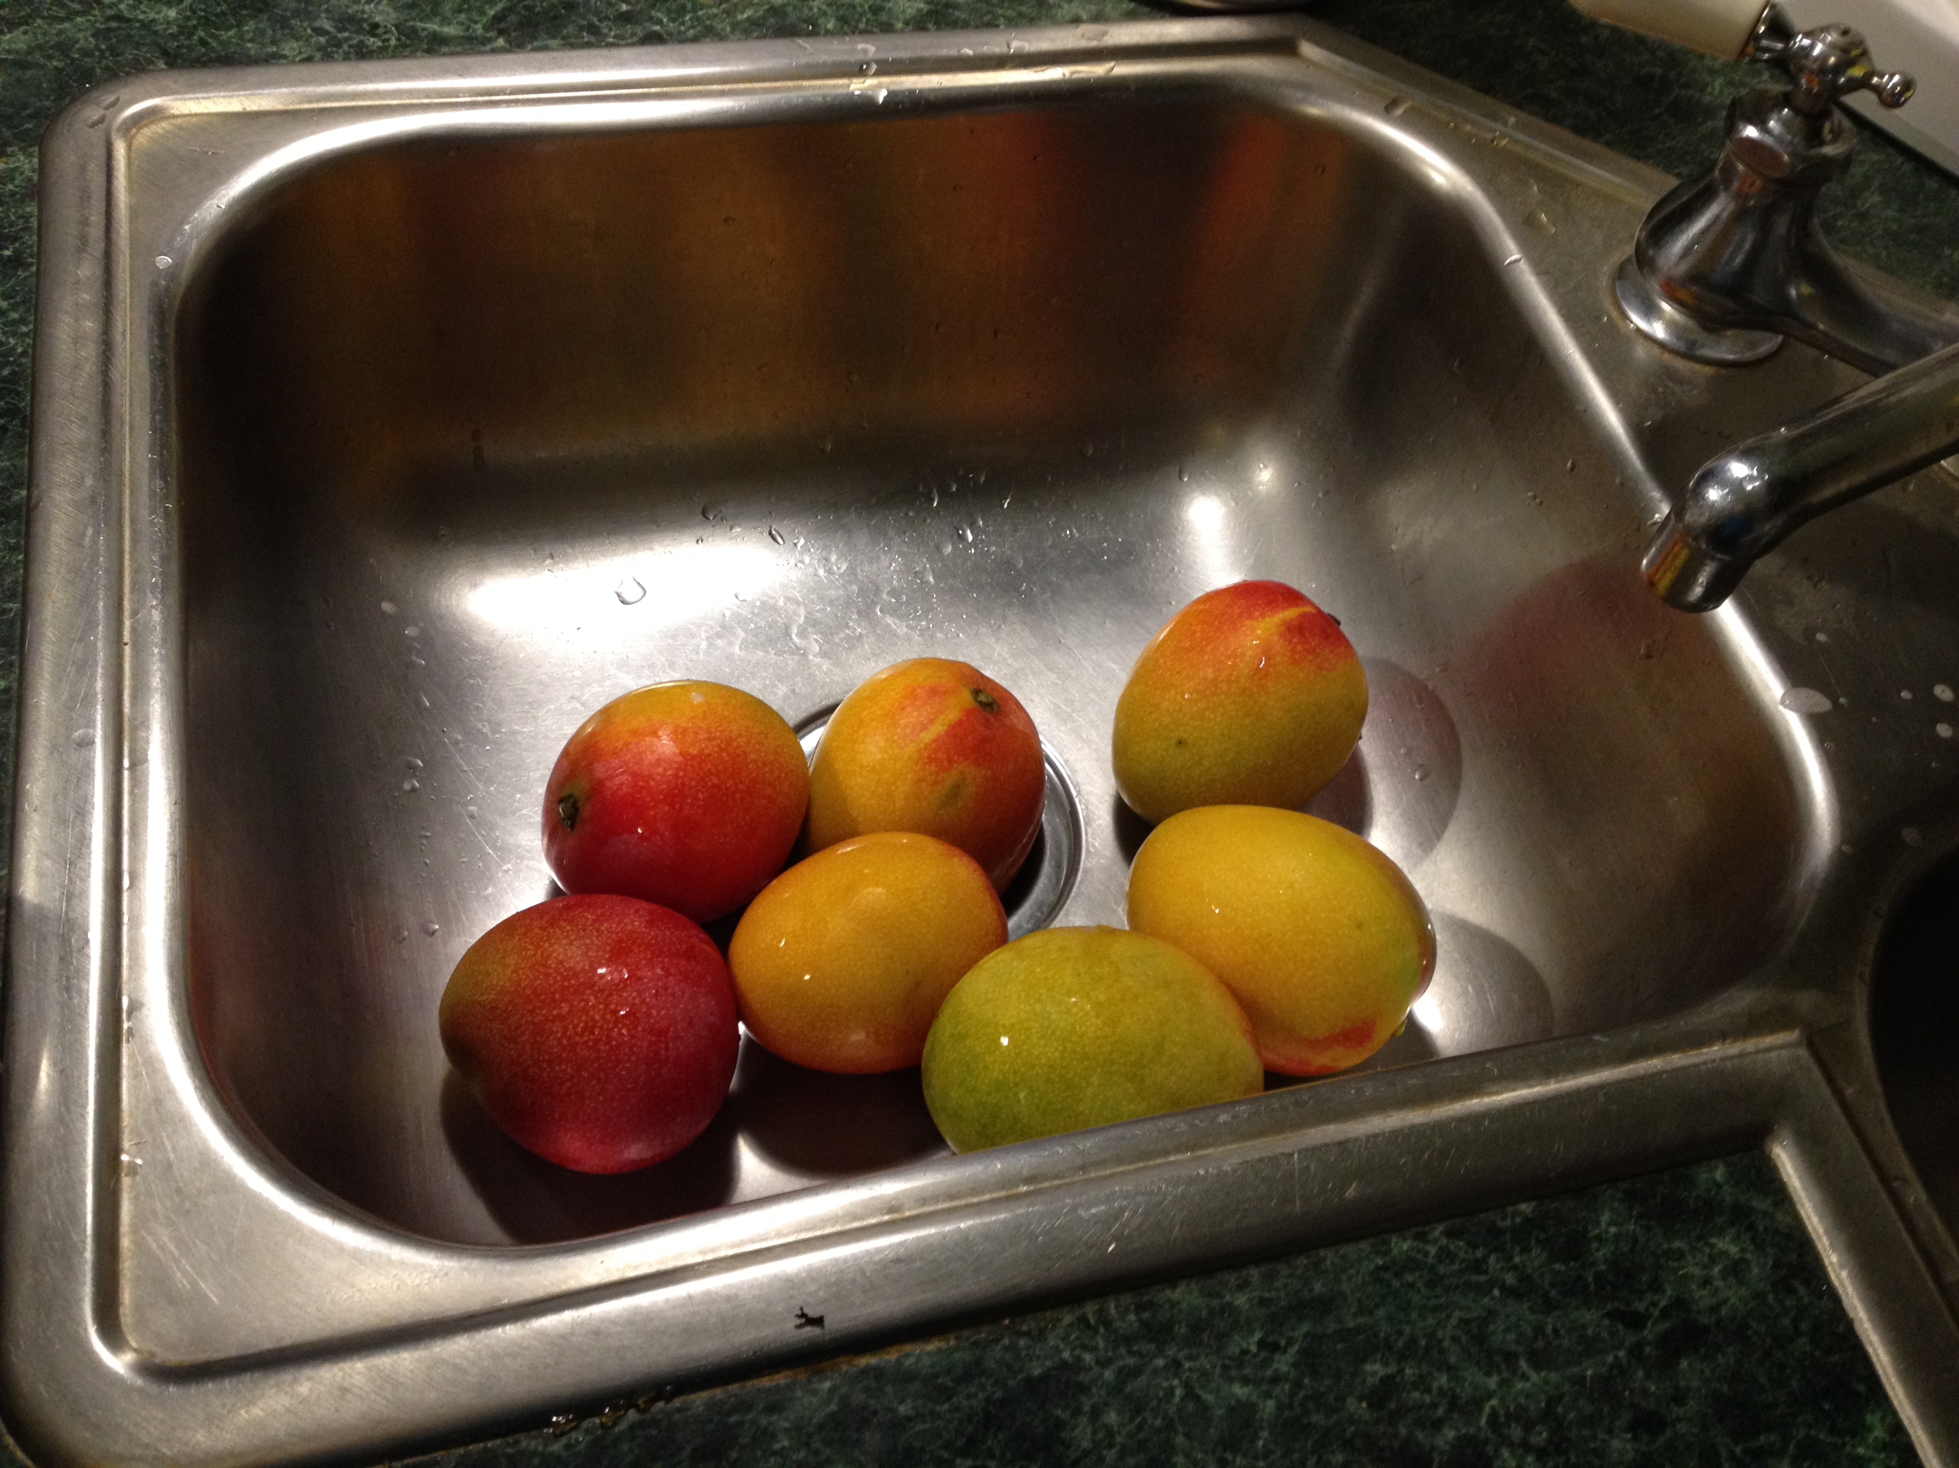

Slide 3
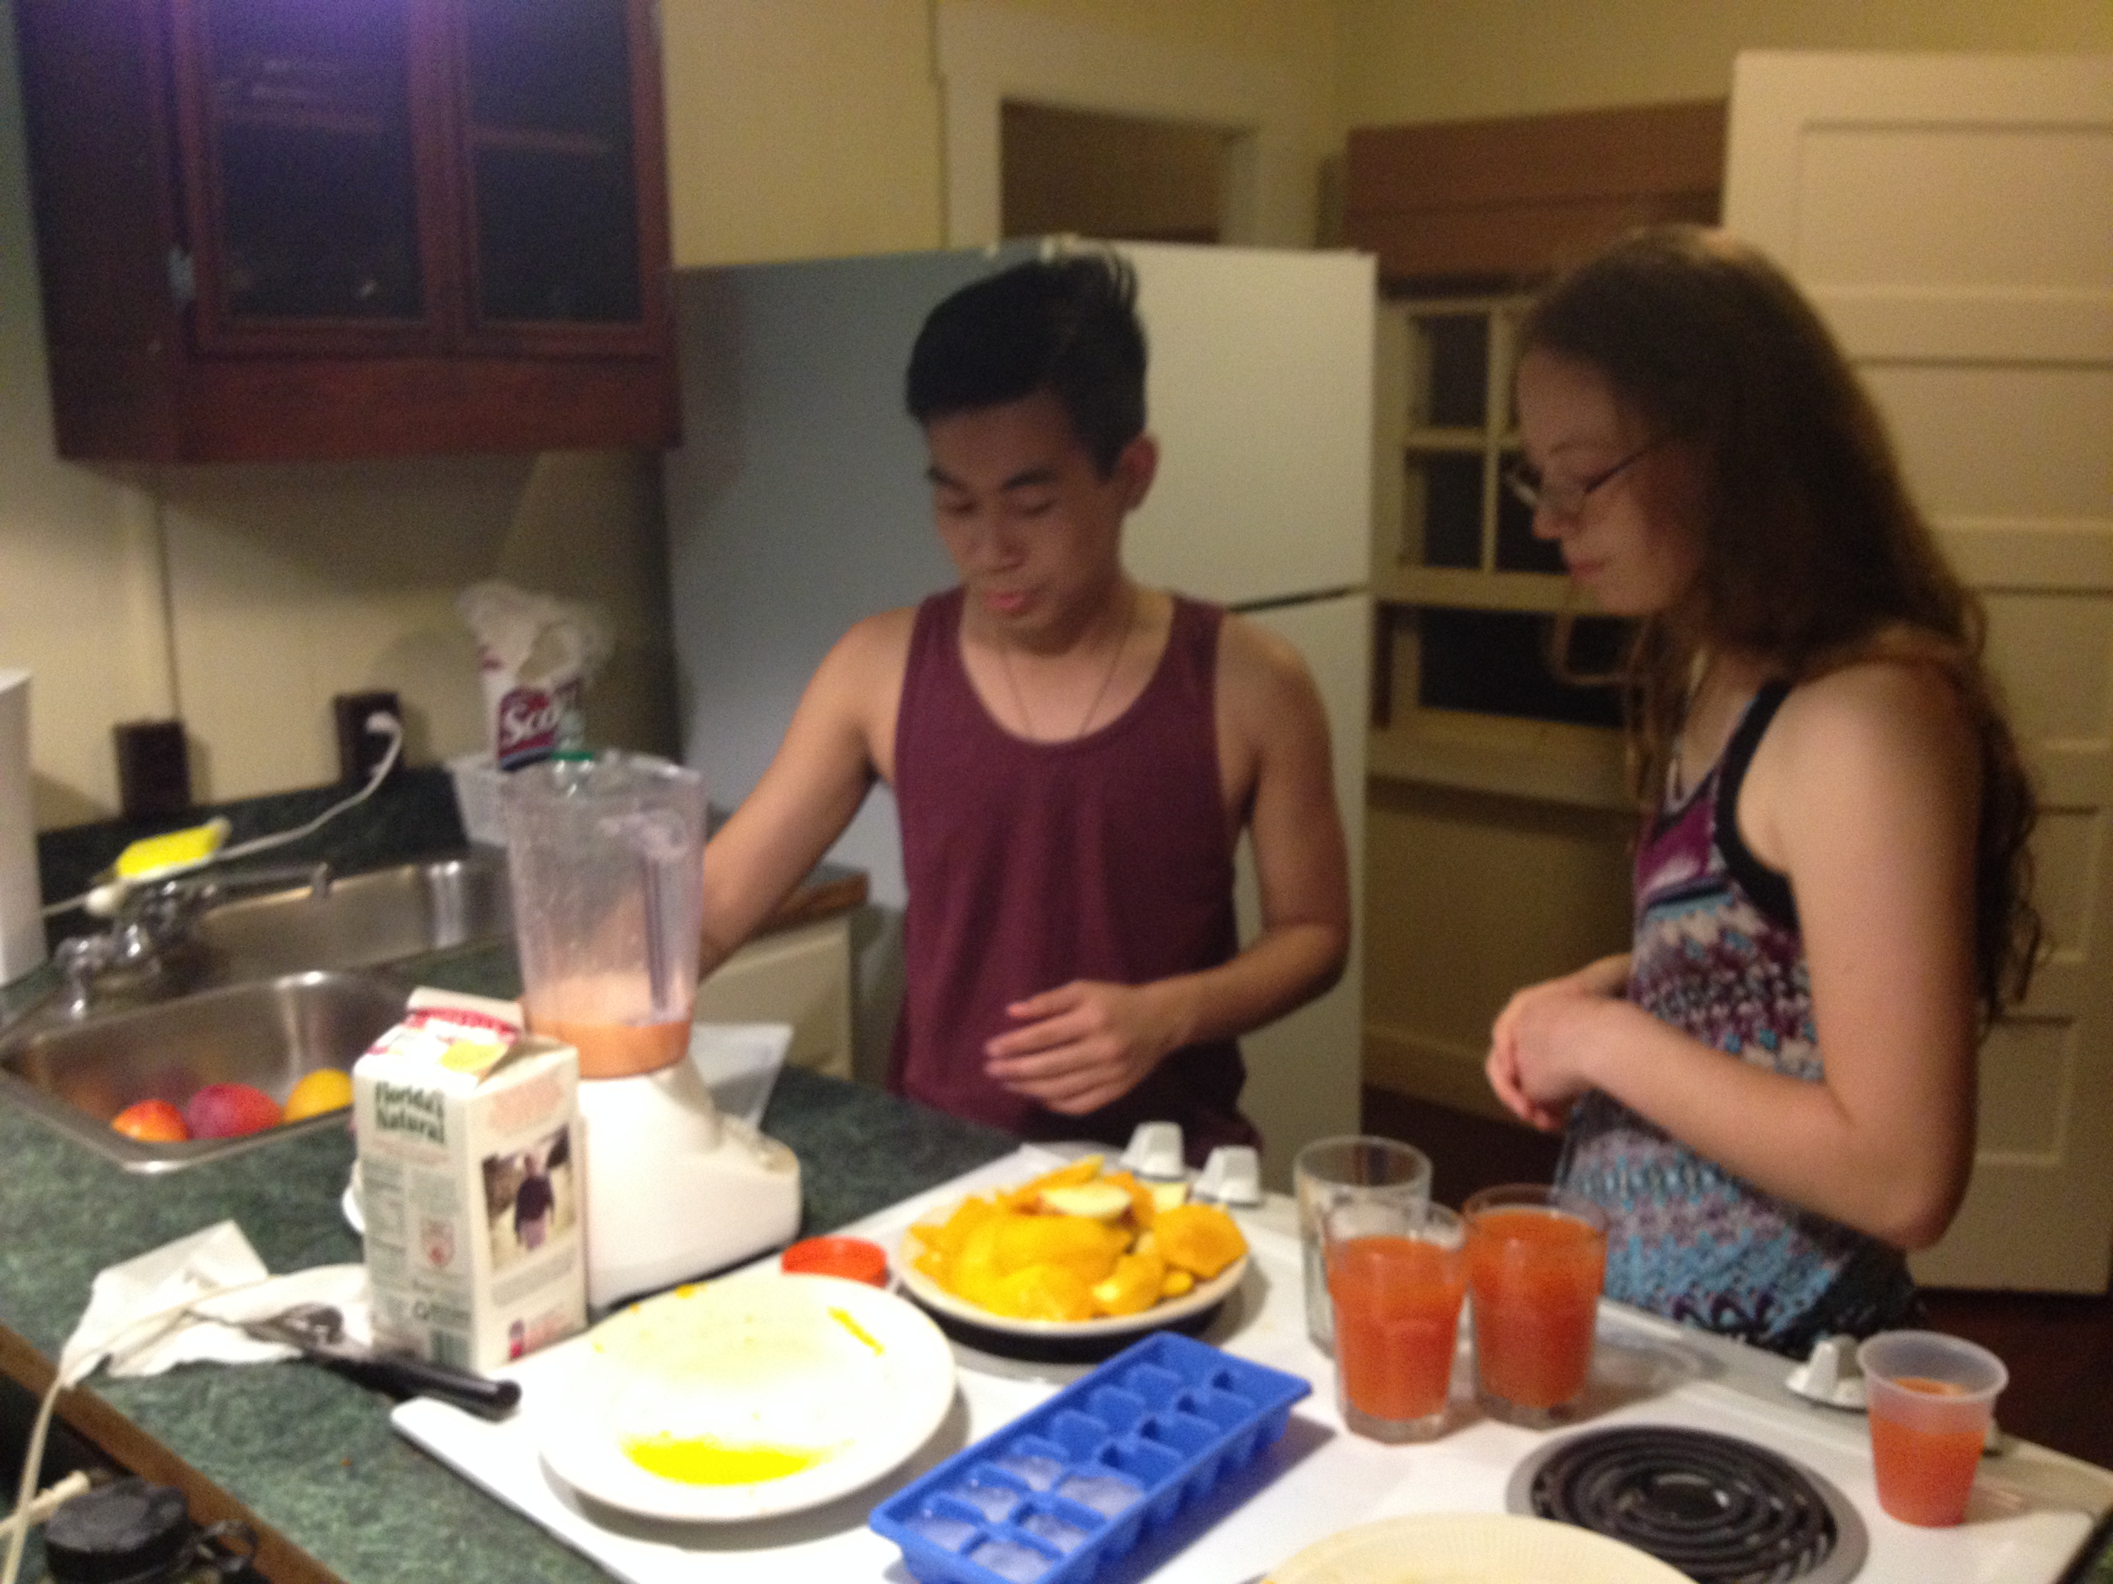

Slide 4
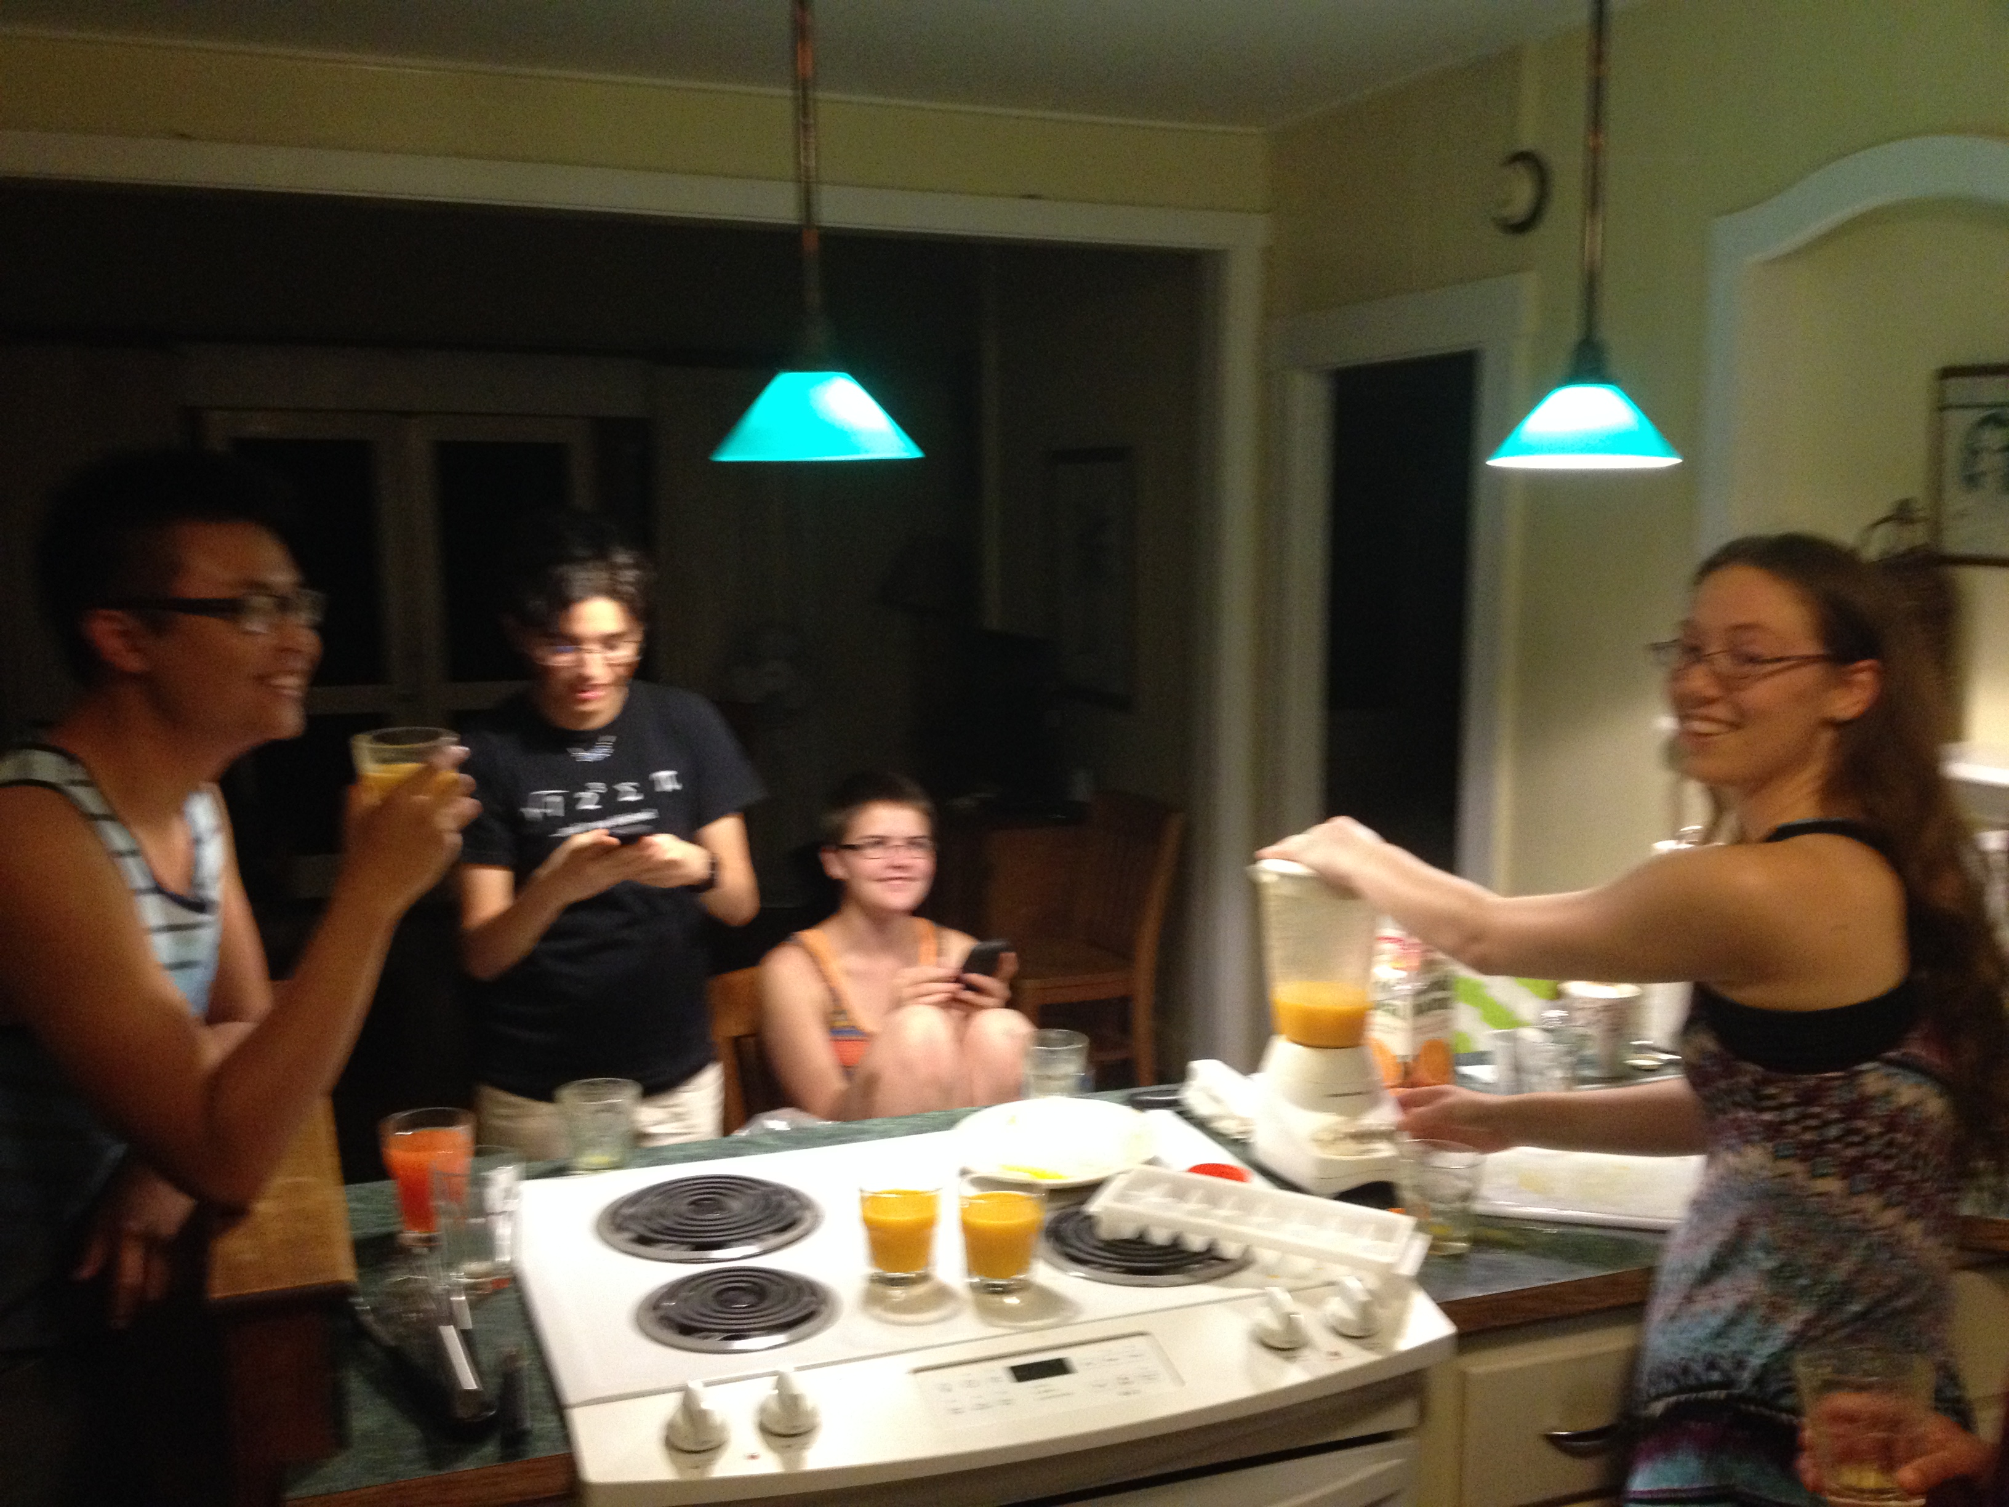

Slide 5
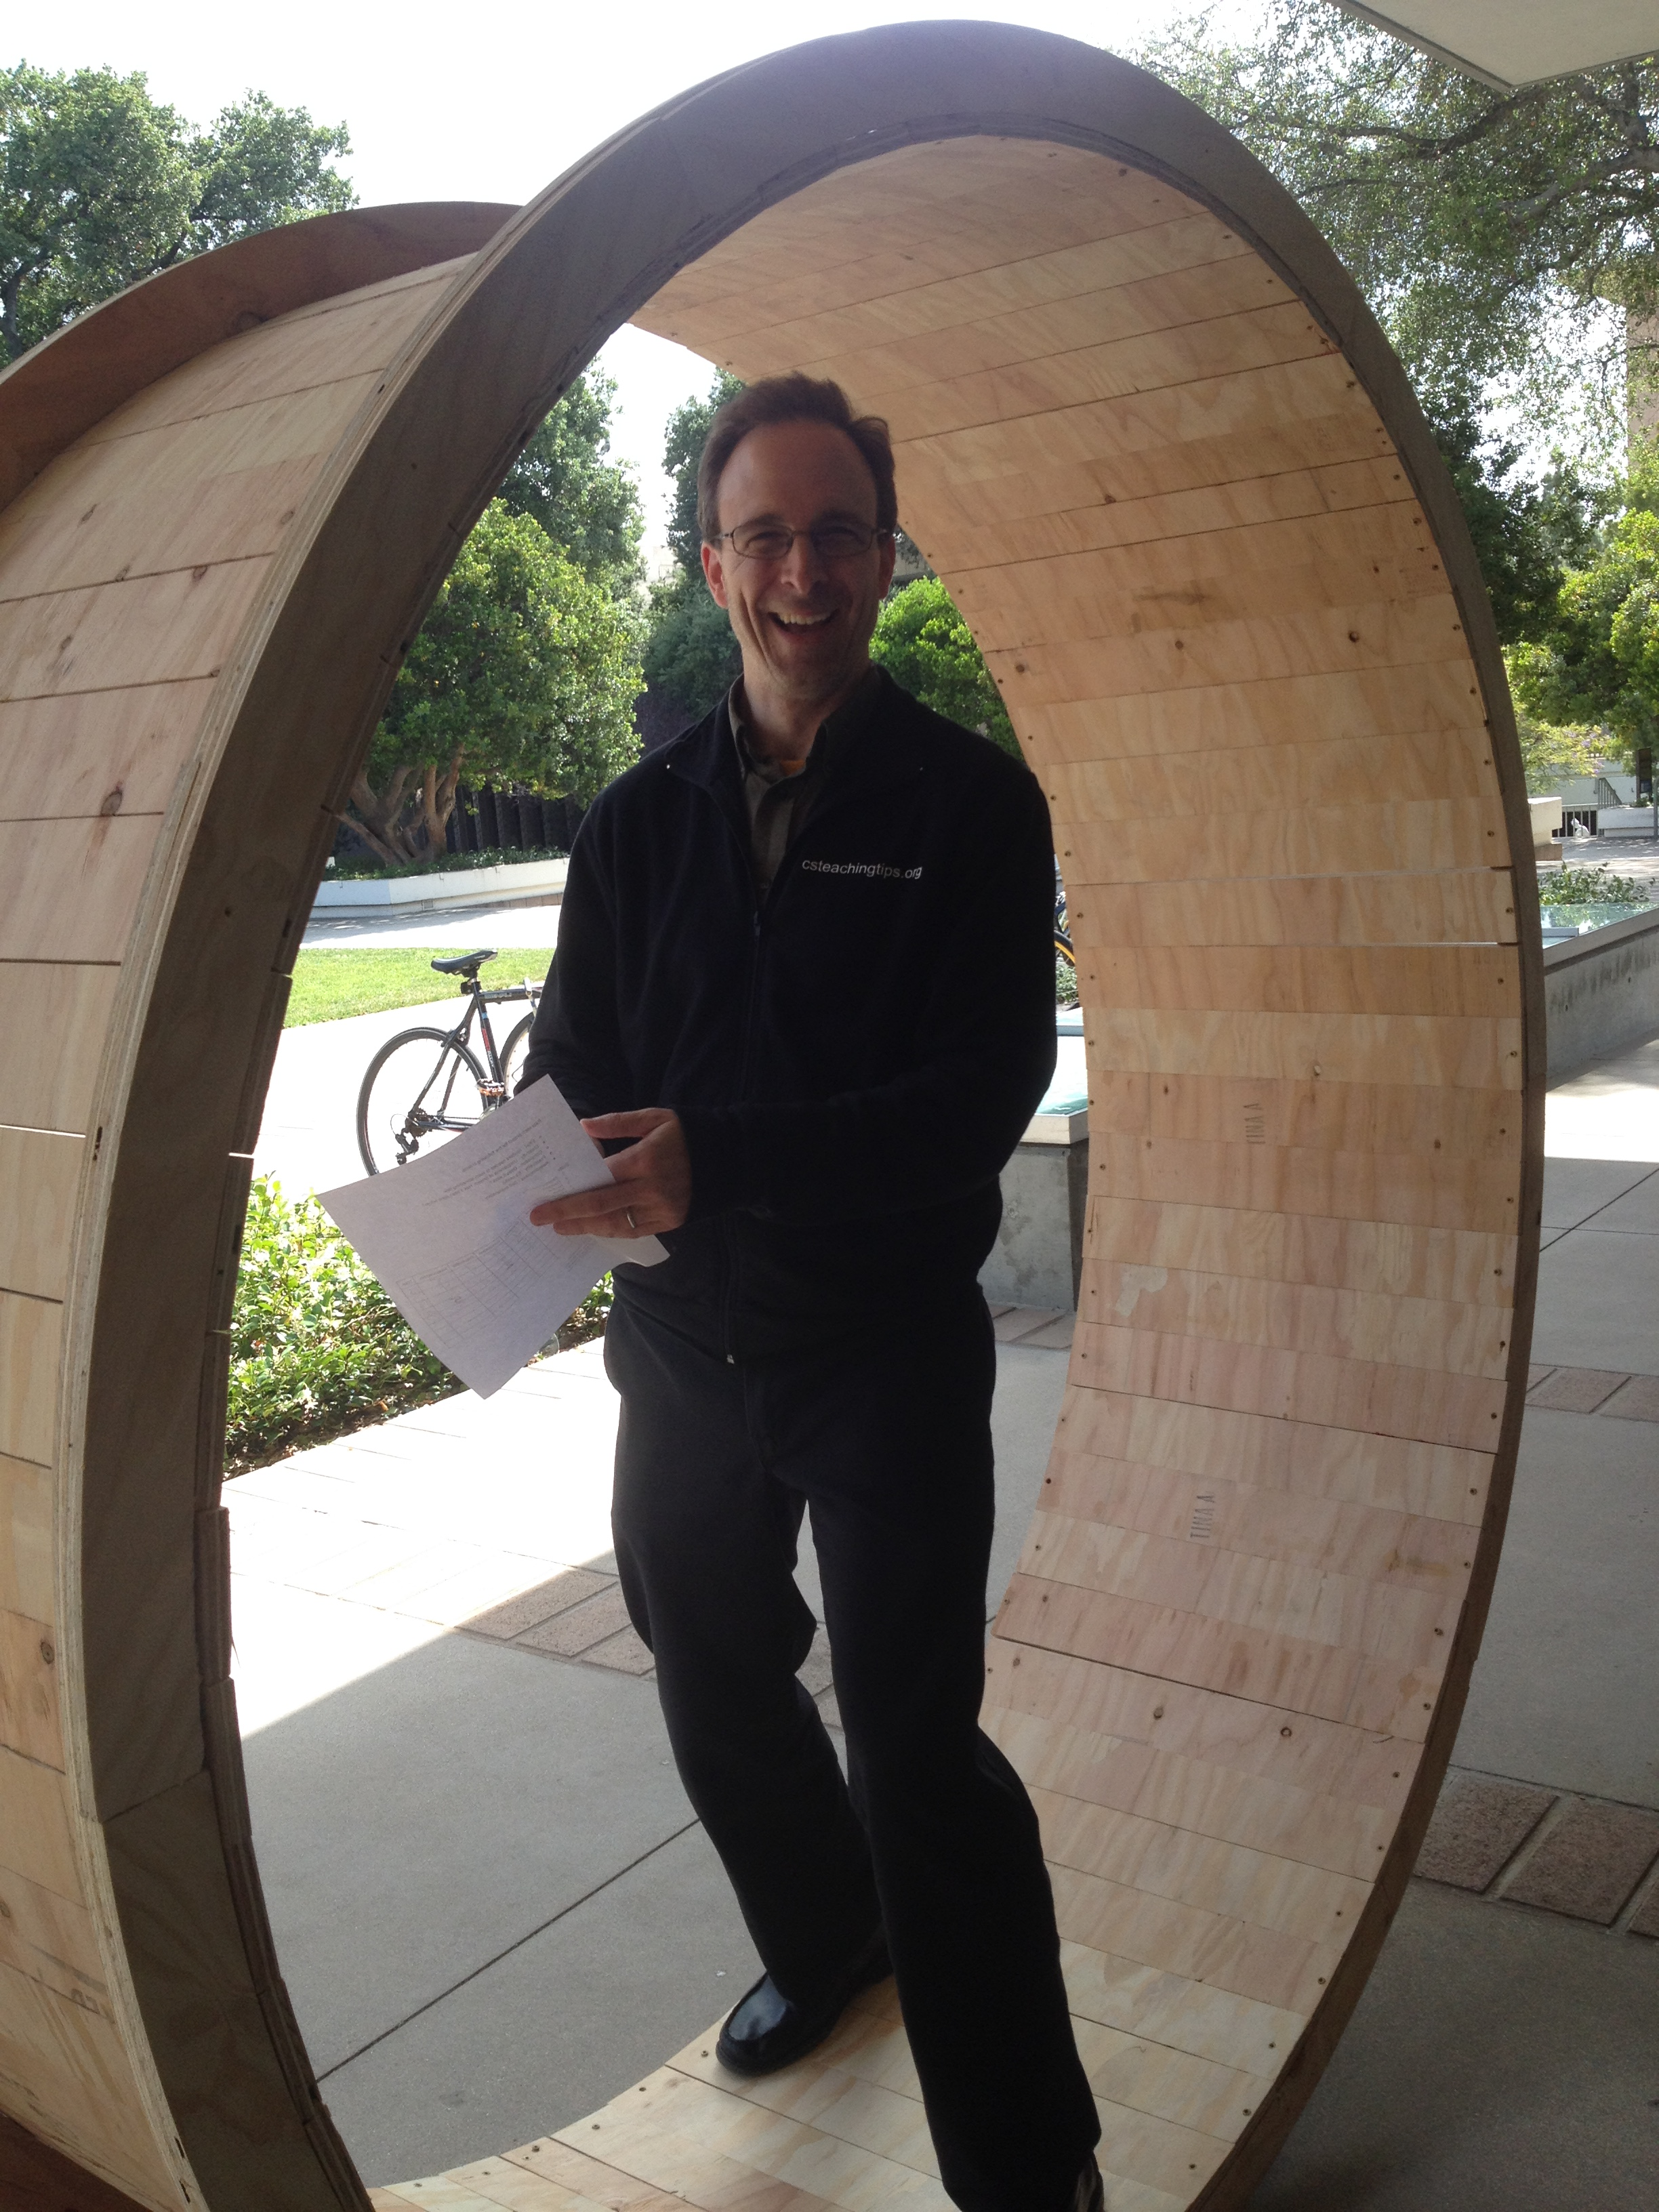

Slide 6
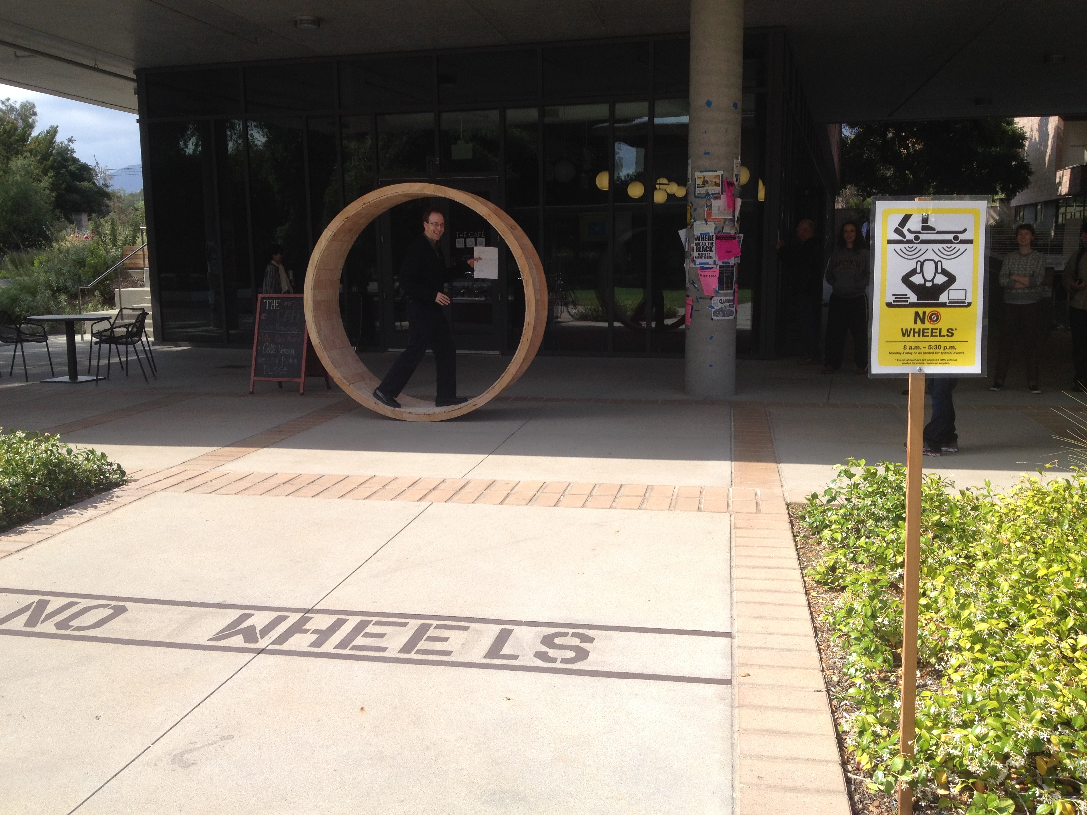

Slide 7
Welcome back!
Today's teams…
Find the others that have something in common with the second picture on your namecard…
Again, introduce yourselves – and find something each pair has in common (that the third person doesn't)
Lunch orders:
Today: Island Taco
(Tomorrow: Gina's)

Slide 8
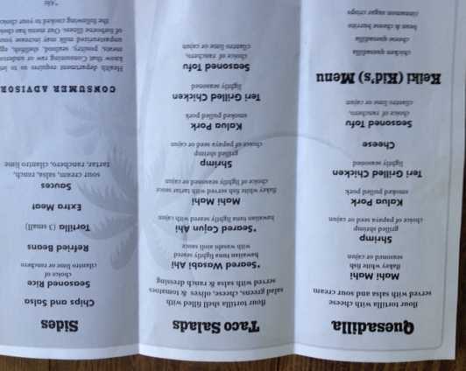
Again, introduce yourselves – and find something each pair has in common (that the third person doesn't)

Slide 9
Why Computer Science?
CS is “good for you”
CS is important and interesting
CS is empowering and fun…
What’s even more important than this last one?

Slide 10
Why Computer Science?
CS is “good for you”
CS is important and interesting
CS is empowering and fun…
Everybody's doing it!
Join in!

Slide 12
CS ~ Data!

Slide 13
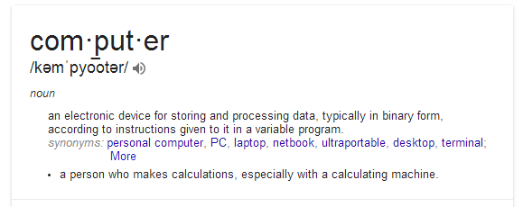
Yesterday we noted two things computers do:
(1) process data (arithmetic) (2) store/retrieve data
Amazingly, this is all that computers do!

Slide 14
Is this all that computers do?
Is this all that computers do?
(1) process data (arithmetic) (2) store/retrieve data
Let's see… Try listing some things we use computers for…

Slide 15
Data: it's what computers do!
We noted two things computers do:
(1) process data (arithmetic) (2) store/retrieve data
And this is the vast majority of computer work!
Rather than computers, they should be called datadogs.

Slide 16
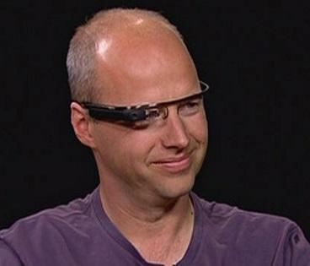
Data: a big example
Google Glass
100 years of HD: 10,000,000 GB
= 10 Petabytes
video #1
Notes:
Added a link to the work 'big'

Slide 17
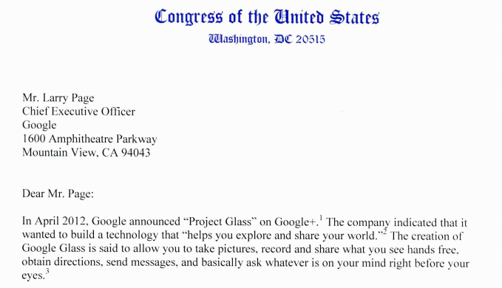
Data: a big example
Google Glass concerns
Is Google Glass dead or hibernating?
5/16/13
video #2

Slide 18
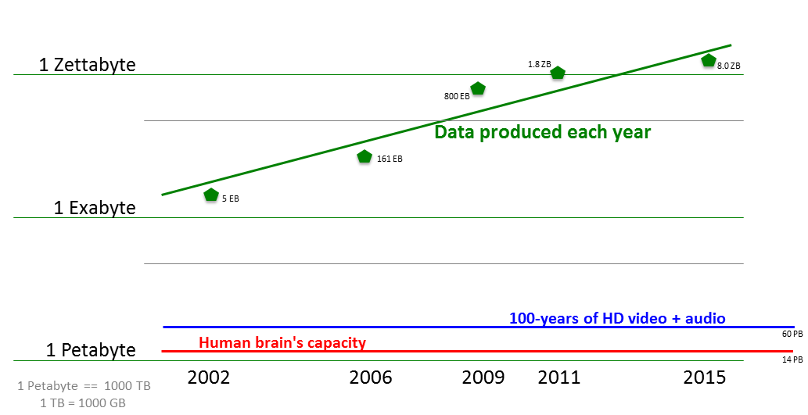
Data: the big picture
There's lots of it to work with!

Slide 19
CS Data: encoding and decoding
To work with data, it is always encoded: converted into a specific form by a set of rules.
Later, it can be decoded: changed back into its original form.

Slide 20
Encoding + Decoding!
One method of encoding a sentence is by having every letter correspond to a number.
For example:
AND 1 - 14 - 4
BUG .
19 - 09 - 07 - 14
Decoded data
Encoded data

Slide 21
Encoding + Decoding!
Or, we could shift every letter by one spot
A B, B C, C D, .....
For example:
ZOO APP
END
NVEE
Decoded data
Encoded data

Slide 22
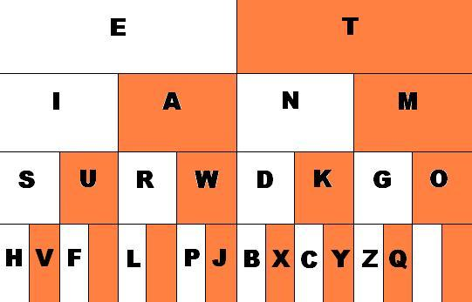
Another data encoding
Morse code encodes letters as dots and dashes
short sound: "dit"
long sound: "dah"
How does this chart represent Morse code?
R
What is the letter A in Morse code? What about the letter
?

Slide 23
Another data encoding
Morse code encodes letters as dots and dashes
short sound: "dit"
long sound: "dah"
white = dot
orange = dash
What is this word?
What is the encoding of SOS in Morse code? How about FOG?

Slide 24
Morse Code
You will use these Morse Code rules to decode the next two secret messages.

Slide 25
Encoding + Decoding
Challenges

Slide 26
Your Mission
The following slides contain encoded words.
Decode each phrase…
Find the rules or pattern for each one!
Later, you will encode, instead of decode.
We will provide one example.
Then, you'll create your own encoding…

Slide 27
25-15-21 19-15-12-22-5-4 20-8-5 6-9-18-19-20 15-14-5
Encoded Sentence:
Rules/Pattern
Decoded sentence
Every letter corresponds to a number.
A = 1, B = 2, C = 3, ...
See the table below:
(Use this space to work it out)

Slide 28
KVTU LFFQ TXJNNJOH
Encoded Sentence:
Rules/Pattern
Decoded sentence
Every letter is shifted by one.
A = B
B = C
C = D, ...
(Use this space to work it out)

Slide 29
REVELC SI SECNETNES GNISREVER
Encoded Sentence:
Rules/Pattern
Decoded sentence
(Use this space to work it out)
(Use this space to work it out)

Slide 30
SENTENCE WIT MISSIN LETTER AR CONFUSIN
Encoded Sentence:
Rules/Pattern
Decoded sentence
(Use this space to work it out)
(Use this space to work it out)

Slide 31
UOY ERA YAWFLAH ENOD
Encoded Sentence:
Rules/Pattern
Decoded sentence
(Use this space to work it out)
(Use this space to work it out)

Slide 32
VEREOYEN OLEVS OCPMTURE CSEICNE
Encoded Sentence:
Rules/Pattern
Decoded sentence
(Use this space to work it out)
(Use this space to work it out)

Slide 33
VOWOLS ORO OMPORTONT ON SONTONCOS
Encoded Sentence:
Rules/Pattern
Decoded sentence
Every vowel is now an “O” !
(Use this space to work it out)

Slide 34
IS IT CATS RAINING DOGS AND
Encoded Sentence:
Rules/Pattern
Decoded sentence
(Use this space to work it out)
(Use this space to work it out)

Slide 35
Morse Code
You will use these Morse Code rules to decode the next two secret messages.

Slide 36
Morse Code
Rules/Pattern
Encoded Sentence:
Decoded sentence
_ _ _ _ _ . _ . . . . .
_ . _ . _ _ _ _ . . . . . . . .
_ . _ . _ _ _ _ _ _ . _ . .
(Use this space to work it out)

Slide 37
Morse Code
Rules/Pattern
Encoded Sentence:
Decoded sentence
_ . _ . _ _ _ _ . _ _ . . _ .
. _ _ . . _ . _ . . . _ _ . .
_ _ _ _ . . . . _ . _ _
_ _ _ . . _ . . _ . . . _ .
. . . . . . . . . . _ . .
(Use this space to work it out)

Slide 38
PUPPIES ARE CUTE
Decoded sentence
Rules/Pattern
Encoded sentence
Pig Latin
If a word begins with a consonant:
the consonant is moved to the end
and an “ay” is added.
If not:
only “ay” is added.
Note: This time you are encoding the sentence.

Slide 39
Original (decoded) Sentence
something not too difficult…
Rules/Pattern
Encoded Sentence:
Now, invent your own code. Write your rules/pattern here:
Next, write your encoded secret message here:
Then, put it on the top of the next page + TRADE!

Slide 40
Trade this page with another team and try to decode each other's sentences!
Encoded Sentence:
… from the previous page
Rules/Pattern
Decoded sentence
(Use this space to work it out)
(Use this space to work it out)

Slide 41
The "digital age" ...
For computers, all data is ultimately represented as a set of numbers.
With binary, all numbers can be represented as a series 1's and 0's.

Slide 42
Binary is just another code!
0
1
2
3
4
5
6
7
8
9
10
…
decimal

Slide 43
Binary is just another code!
0
1
2
3
4
5
6
7
8
9
10
…
000
001
010
011
101
110
111
decimal
binary

Slide 44
Consider this much spam:
Why do we use 37 to encode this amount?
Notes:
intro to binary, cards (10 min)
#outline
need:
-4 decimal cards:
https://docs.google.com/open?id=0BxE1Rhkid9dVTUhuVzctQnhQdG8
-6 binary cards:
https://docs.google.com/open?id=0BxE1Rhkid9dVLWJnWk00cnlfZFk

Slide 45
3 7
tens
ones
3*10
The 3 means "three tens"
7*1
The 7 means "seven ones"
Together, they represent the total amount (what we call thirty-seven)
37
Notes:
intro to binary, cards (10 min)
#outline
need:
-4 decimal cards:
https://docs.google.com/open?id=0BxE1Rhkid9dVTUhuVzctQnhQdG8
-6 binary cards:
https://docs.google.com/open?id=0BxE1Rhkid9dVLWJnWk00cnlfZFk

Slide 46
Our numbers...
Decimal is based on the number 10.
4 3 7
hun- dreds
tens
ones
How is each column value getting larger?
Notes:
There was confusion over writing 22 like 1 12

Slide 47
3 7
tens
ones
In decimal, the columns increase x 10
In binary, the columns increase x 2
That's the difference!
1 0
twos
ones
in binary
Notes:
intro to binary, cards (10 min)
#outline
need:
-4 decimal cards:
https://docs.google.com/open?id=0BxE1Rhkid9dVTUhuVzctQnhQdG8
-6 binary cards:
https://docs.google.com/open?id=0BxE1Rhkid9dVLWJnWk00cnlfZFk

Slide 48
3 7
tens
ones
In decimal, the columns increase x 10
In binary, the columns increase x 2
That's the difference!
2
1 0
=
twos
ones
ones
in binary
in decimal
Notes:
intro to binary, cards (10 min)
#outline
need:
-4 decimal cards:
https://docs.google.com/open?id=0BxE1Rhkid9dVTUhuVzctQnhQdG8
-6 binary cards:
https://docs.google.com/open?id=0BxE1Rhkid9dVLWJnWk00cnlfZFk

Slide 49
Computers' numbers
Binary is based on the number 2.
1 0 1 0
fours
twos
ones
How is each column value getting larger?
What should this column value be?
Notes:
As an exercise, showing them how to count up in binary would be good - later in the lego building
exercise, some were skipping numbers as they counted up.
Additionally, mentioning the tally system (base 1!) would be good since they have likely used it before
but without realizing it is base 1

Slide 50
Decoding binary decimal
Suppose the computer holds this binary number:
1 1 0 1
eights
fours
twos
ones
Let's decode it into decimal:
Notes:
As an exercise, showing them how to count up in binary would be good - later in the lego building
exercise, some were skipping numbers as they counted up.
Additionally, mentioning the tally system (base 1!) would be good since they have likely used it before
but without realizing it is base 1

Slide 51
Practice
Binary
Decimal
twos
4s
ones
From binary to decimal:
101
1011
10000
101010
16s
4s
ones
32s
8s
twos
From decimal to binary:
14
33

Slide 52
Try these!
Binary
Decimal
From binary to decimal:
1001
110
11010
10101
From decimal to binary:
3
14
25
52

Slide 53
Acting out in binary…
We need 110 volunteers...
Don't worry -- you'll only have bit parts in this.
Notes:
As an exercise, showing them how to count up in binary would be good - later in the lego building
exercise, some were skipping numbers as they counted up.
We changed "five" into binary (101), it's funnier
Additionally, mentioning the tally system (base 1!) would be good since they have likely used it before
but without realizing it is base 1

Slide 54
Acting out in binary…
(1) Challenge the class!
have the "bits" create any number and the class has to figure out what it is
(2) Challenge the bits!
have the class suggest a number and challenge the "bits" to create it in binary
(3) Patterns in counting
have the cards count up + down and have the class find the patterns
(4) Even / Odd / More!
have everyone determine patterns in binary #s
Notes:
As an exercise, showing them how to count up in binary would be good - later in the lego building
exercise, some were skipping numbers as they counted up.
We changed "five" into binary (101), it's funnier
Additionally, mentioning the tally system (base 1!) would be good since they have likely used it before
but without realizing it is base 1

Slide 55
but why do computers use binary… ?

Slide 56
The problem is the number of digits!
37
How many different symbols can occupy each digit location in a number?
Notes:
intro to binary, cards (10 min)
#outline
need:
-4 decimal cards:
https://docs.google.com/open?id=0BxE1Rhkid9dVTUhuVzctQnhQdG8
-6 binary cards:
https://docs.google.com/open?id=0BxE1Rhkid9dVLWJnWk00cnlfZFk

Slide 57
The problem is the number of digits!
37
How many different symbols can occupy each digit location in a number?
07 17 27 37 47 57 67 77 87 97
There can be ten different digits!
Notes:
intro to binary, cards (10 min)
#outline
need:
-4 decimal cards:
https://docs.google.com/open?id=0BxE1Rhkid9dVTUhuVzctQnhQdG8
-6 binary cards:
https://docs.google.com/open?id=0BxE1Rhkid9dVLWJnWk00cnlfZFk

Slide 58
Ten symbols is too many!
A computer has to differentiate physically among all its possibilities.
0
1
2
3
4
5
6
7
8
9
ten symbols ~ ten different voltages
This is too difficult to replicate billions of times
engineering!
What digits are these?
Ouch!
Notes:
Number is 8237

Slide 59
Two symbols is easier!
A computer has to differentiate physically among all its possibilities.
0
1
2
3
4
5
6
7
8
9
ten symbols ~ ten different voltages
0
1
two symbols ~ two different voltages
What digits are these?
Easy!
Notes:
Number is 8237

Slide 60
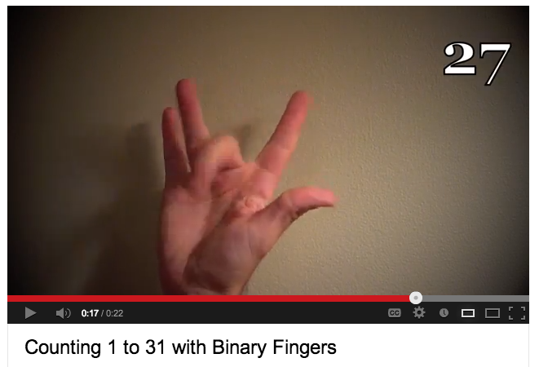
How high can you count
in binary on your fingers?
It's a lot higher than 10!
Some experts on YouTube... (http://www.youtube.com/watch?v=XKpWSKjdv4U)
Notes:
As an exercise, showing them how to count up in binary would be good - later in the lego building
exercise, some were skipping numbers as they counted up.
Additionally, mentioning the tally system (base 1!) would be good since they have likely used it before
but without realizing it is base 1

Slide 61
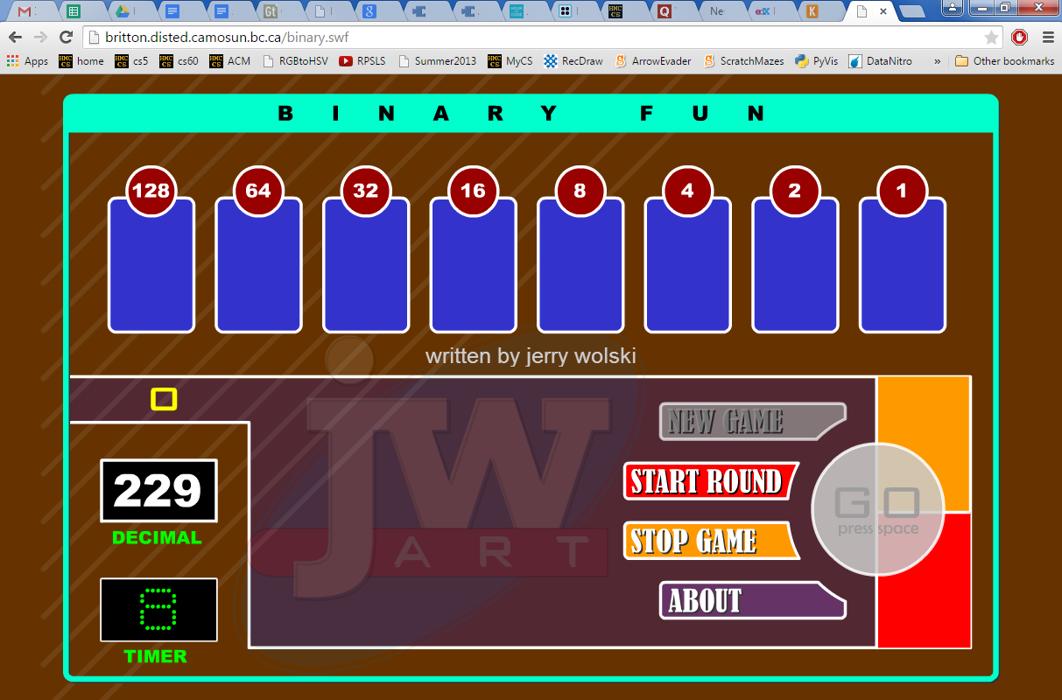
Online binary practice...
Google for: Binary Fun Jerry Wolski
Notes:
Put in links to the games

Slide 62
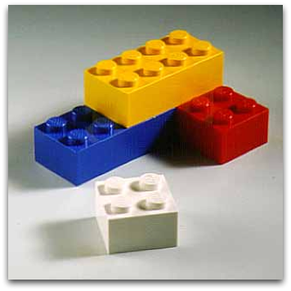
The "digital age" ...
For computers, all data is ultimately represented as 0s and 1s, in binary.
Could you encode a lego tower in binary... ?
Then, have someone else decode it back into the same Lego tower?

Slide 63
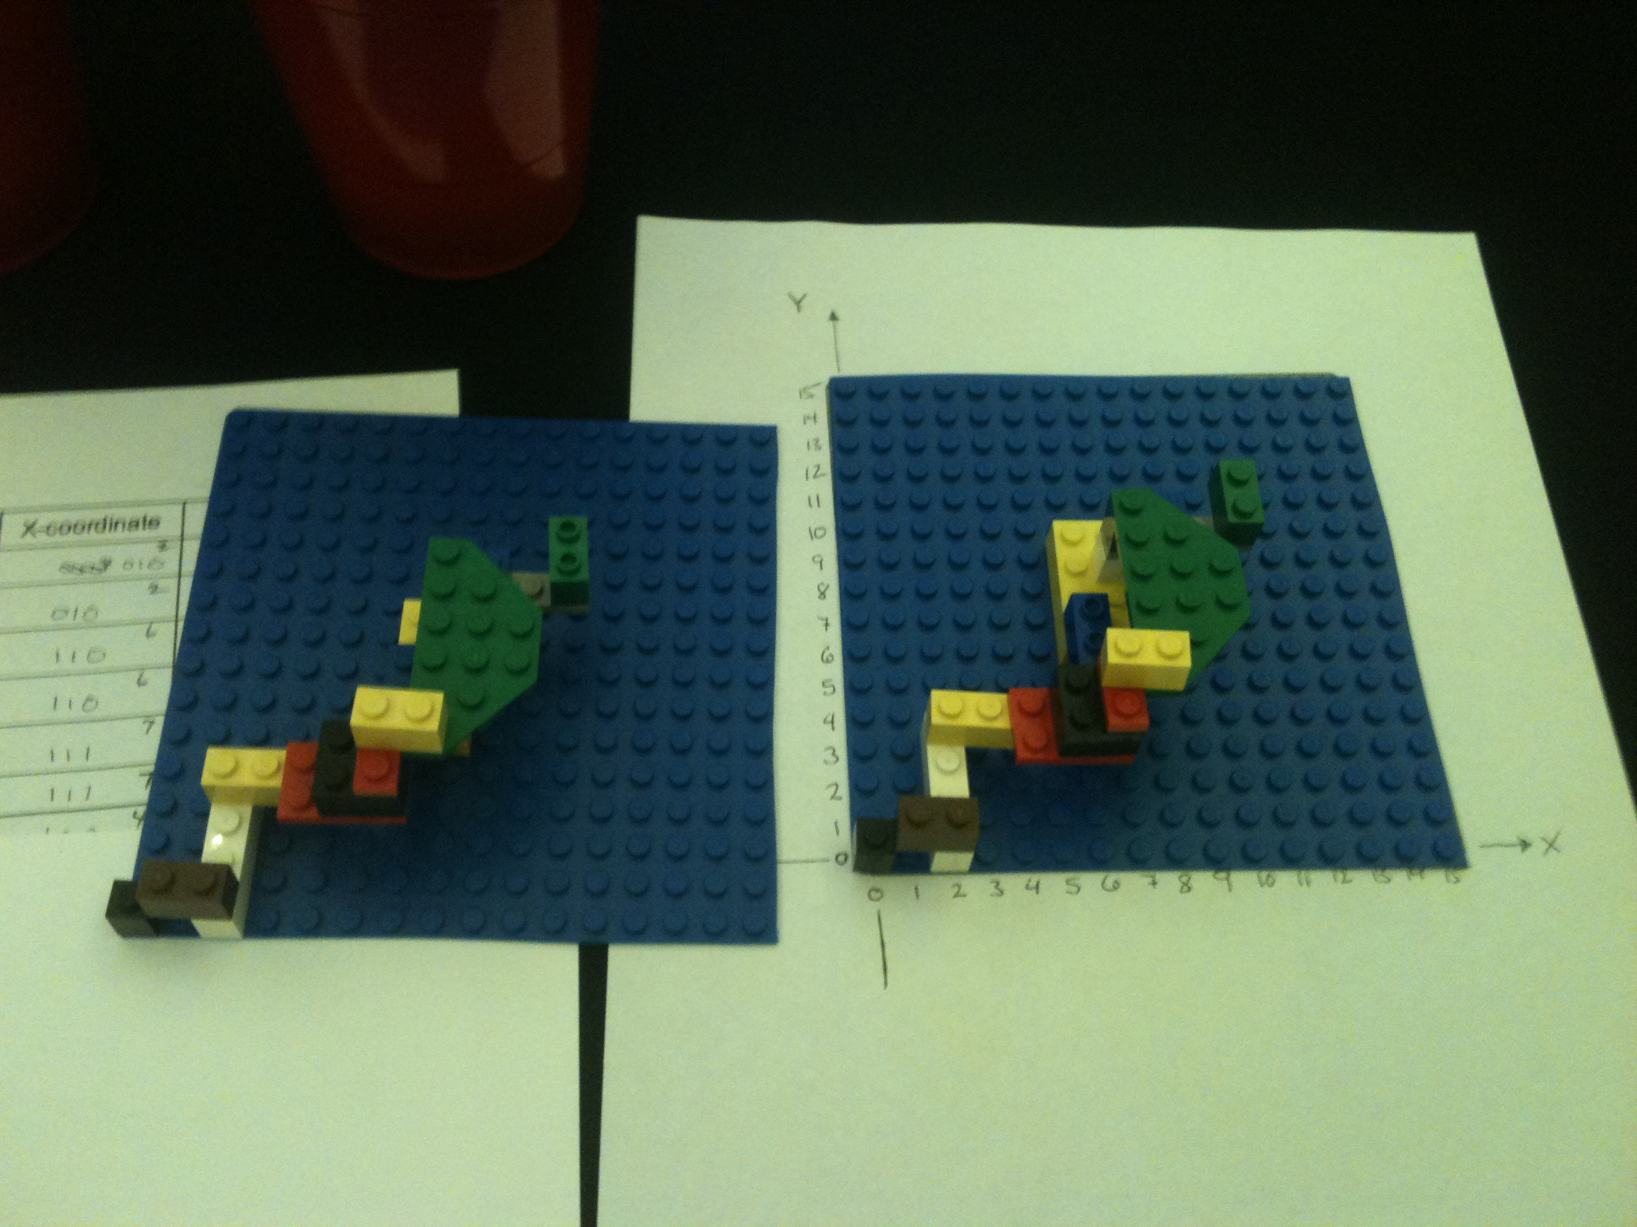
Codes and Data
unit capstone
Lego towers
… in binary
Imagine – Decompose – Specify – Binarize – Execute – Compare – Debug!
Notes:
The third unit is one that was prompted after we tried using the ECS unit on binary with middle-school teachers and get feedback that it needed more motivation, more contextualizing, and more explanation…
We re-envisioned unit 3 as being about codes – much more generally than about binary encodings – and students take on deciphering challenges and inventing their own codes to begin, before working up to binary representation.
The capstone project in this unit is a good example of a creative, hands-on activity that gets students interacting computationally – even though it does not use a computer at all.
For this project, students are given a set of a dozen or so Legos – they can imagine and create a structure of their own design.
Then, they have to decompose what they did into the series of individual block placements and write those in English.
then, they have to encode them in binary – with all of the information needed to reproduce the structure:
- each brick's shape, size, color, pose, and position (see the chart)
The hook is that all of this is done "in secret" by each pair of students – then, two pairs of students swap only their binary instructions, without allowing the other pair to see their tower… each gets a second set of Lego pieces identical to the first, and interprets the binary instructions to build what they hope to be a perfect copy of the original tower…

Slide 64
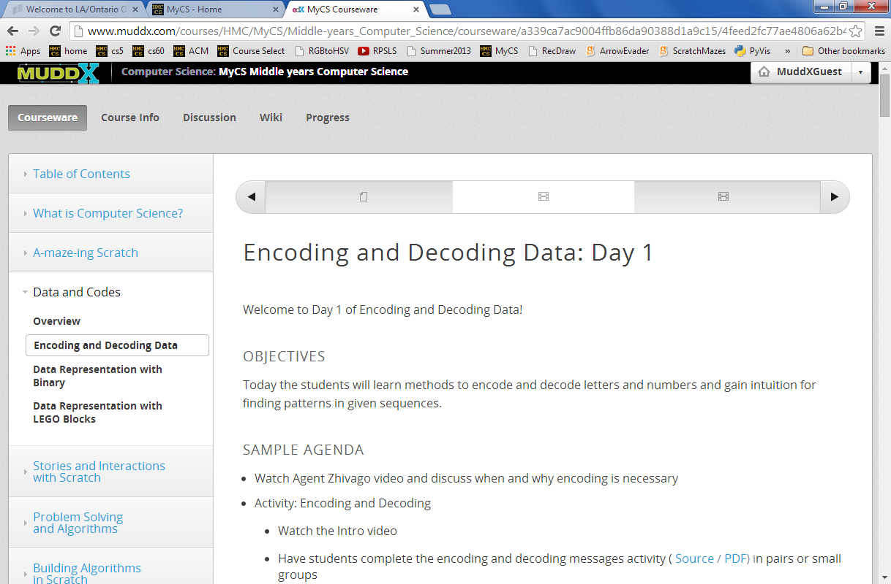
Full, online curriculum…

Slide 65
Let's try it!
Even at their best, screens only reflect your current self,
but colleagues can engage, elevate, and enrich who you are.
- HMC student

Slide 66
Secret Fortress Construction Challenge
You should have two identical LEGO block kits.
Set the extra kit aside, and use one kit to build a LEGO fortress:
Find a secluded spot to build your secret fortress. Don’t let anyone else see it!
Place your Lego baseplate on top of the template on page 2. Note the x and y axes are 0, as usual.
[First-timer advice] Keep your tower to the lower-left corner, where x and y are 7 or less
Write the English instructions for building your tower… (page 3)
Create a binary encoding (the legend) for each type and color of your Legos. (page 3)
Translate the English instructions to binary instructions for your tower! (page 4)
Be sure to copy over the legend, as well!
[Optional] Create a single line of 0s and 1s that you will send to the other team.
[Optional] Text or email that single line of 0s and 1s to the other team.
[Optional] Reassemble the other team's single line of 0s and 1s into binary instructions:
Swap! Make sure you have the chart of the other team's binary instructions…
Make sure you copy the other team's legend with their binary encoding
Convert their binary instructions back to English instructions using the legend.
Try to build their secret fortress!
When both teams are done, compare the fortresses you’ve created.
Were you successful? Why or why not?
Debug! If something went wrong, find where it went wrong -- which step of the process was it?!
There are lots of background materials…
(we'll go light on these for now)

Slide 67
Codes and Data
Imagine – Decompose – Specify – Binarize – Execute – Compare – Debug!
Notes:
But, as you can imagine – and can see – they do not always come out as perfect copies!
In fact, they almost never do…

Slide 68
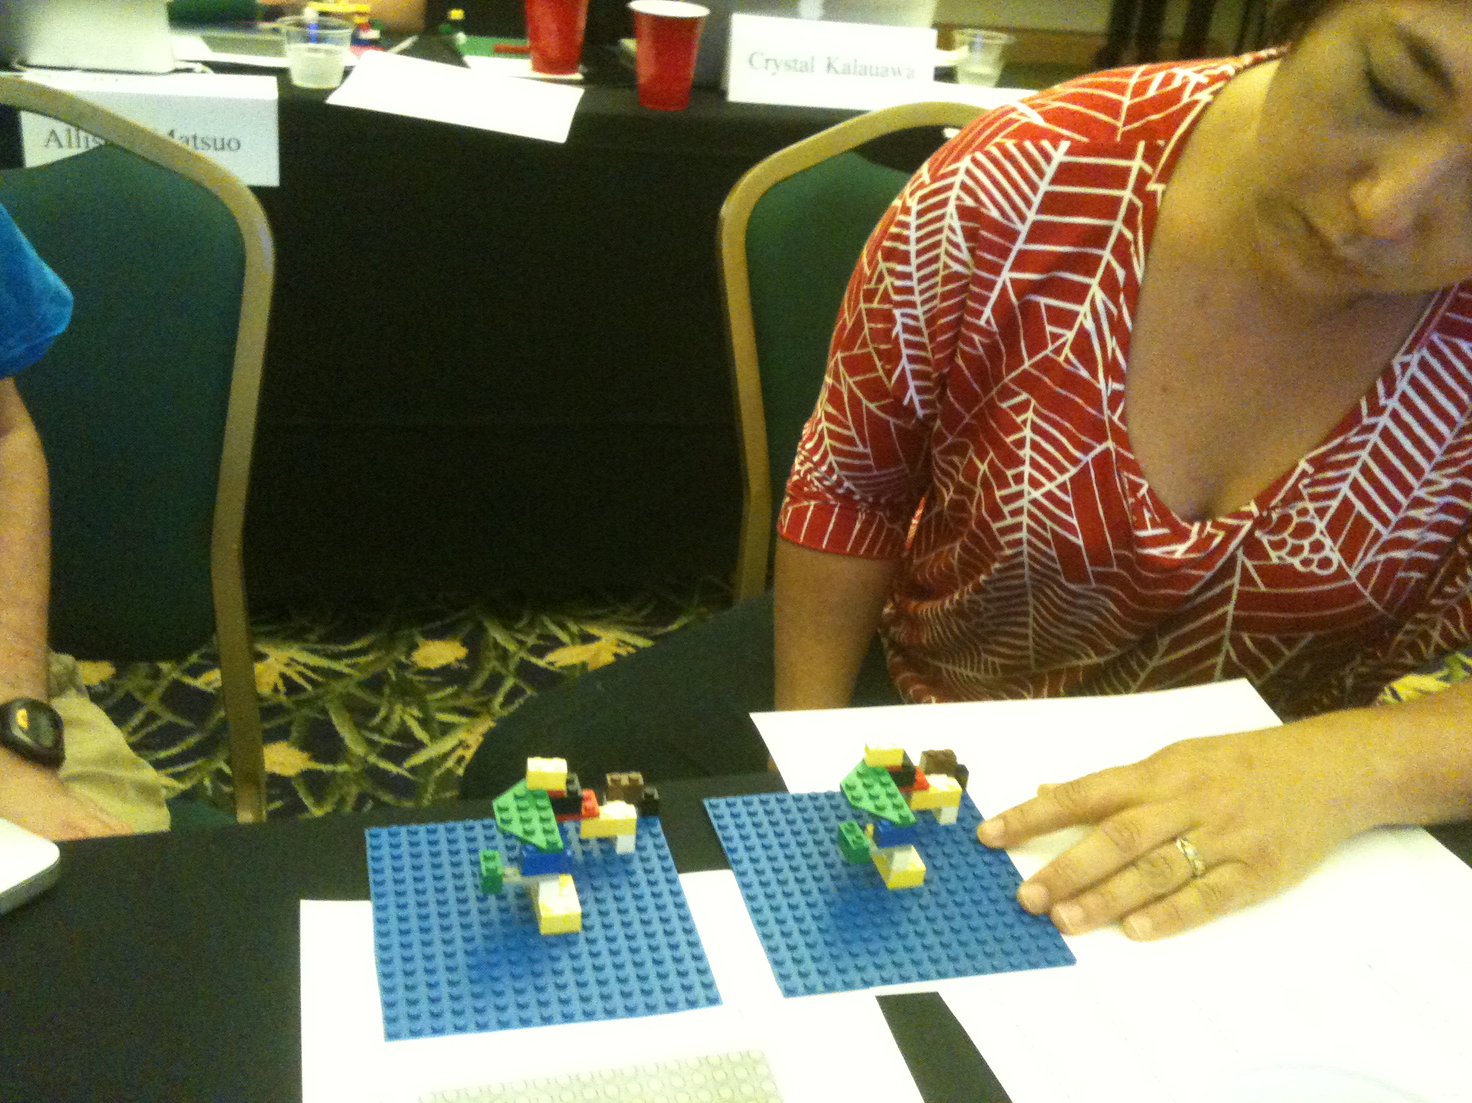
Codes and Data
Imagine – Decompose – Specify – Binarize – Execute – Compare – Debug!
Notes:
but this is where the activity gets interesting – because this is fundamentally a computational system of specification, representation, and execution, every bug is traceable to its source… and this compare step is lots of fun…

Slide 69
Motivating slides… initial day(s)

Slide 70
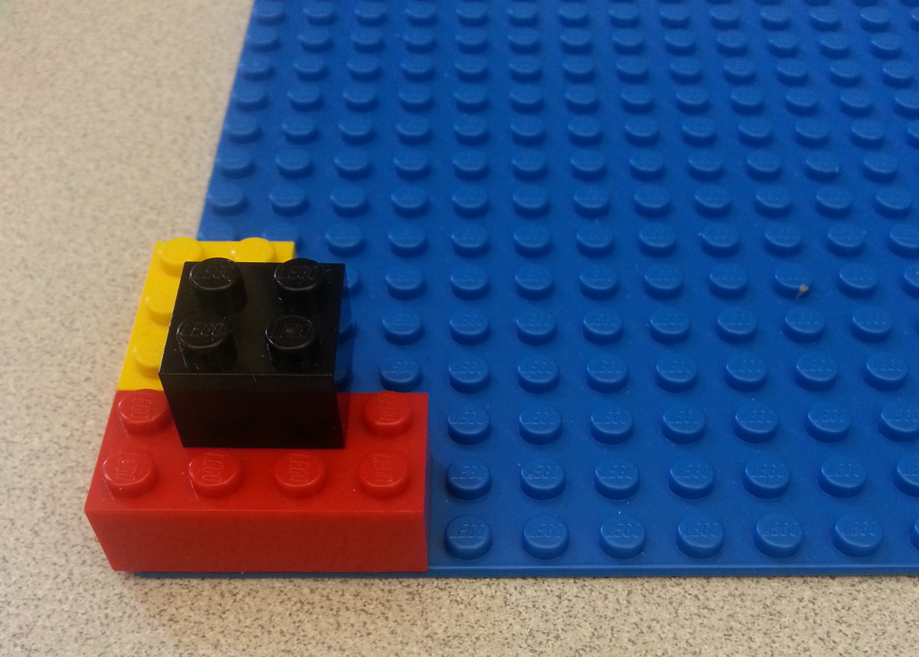
Understanding Block Encoding and Decoding
Name(s): _______________________
In the space below, create a set of building instructions so that a friend can make the exact same LEGO tower shown in the picture.
How clear were your instructions? How precise? Was a friend able to follow them to build the correct tower?

Slide 71
Block Encoding and Decoding
Name(s): _______________________
Now try describing the four attributes of each block to help you make instructions: color, size, position, and orientation.
Do these four attributes fully describe each LEGO block in the tower?
Color | Size | Orientation | Position

Slide 72
Block Encoding and Decoding
Name(s): _______________________
We want to be able to describe all the attributes in binary encoding. Let’s start with color and size.
In the table below, make a legend that matches each color and size to its binary encoding.
Color | Binary Color | Size | Binary Size
Red |  | 2 x 4
Yellow |  | 2 x 3
Black |  | 2 x 2

Slide 73
Block Encoding and Decoding
Name(s): _______________________
y
Next, let’s think about position. Look at the table you made on page 2. Did you define position the same way that your classmates did?
15
14
13
12
11
10
9
8
7
6
5
4
3
2
1
0
Look at this coordinate system. If I told you the bottom left corner of the block was at x=4 and y=2, would you know exactly where the block is?
0 | 1 | 2 | 3 | 4 | 5 | 6 | 7 | 8 | 9 | 10 | 11 | 12 | 13 | 14 | 15
x

Slide 74
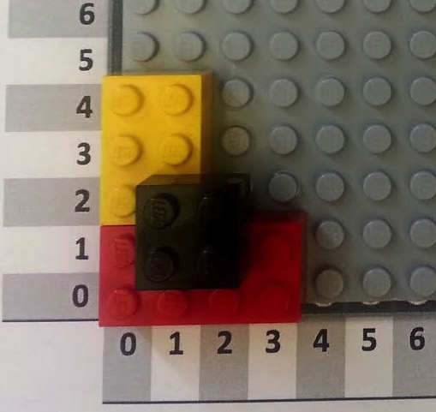
Block Encoding and Decoding
Name(s): _______________________
Using the coordinate system on the last page, give the position of each block in base-10 (regular counting numbers like 1, 2, 3, 4, 5…) and in binary (1, 10, 11, 100, 101…). For consistency, give the position of the bottom left corner of each block.
Block | X Coordinate (base 10) | X Coordinate (binary) | Y Coordinate (base 10) | Y Coordinate (binary)
Red 2 x 4 | 0 |  | 0
Yellow 2 x 3
Black 2 x 2

Slide 75
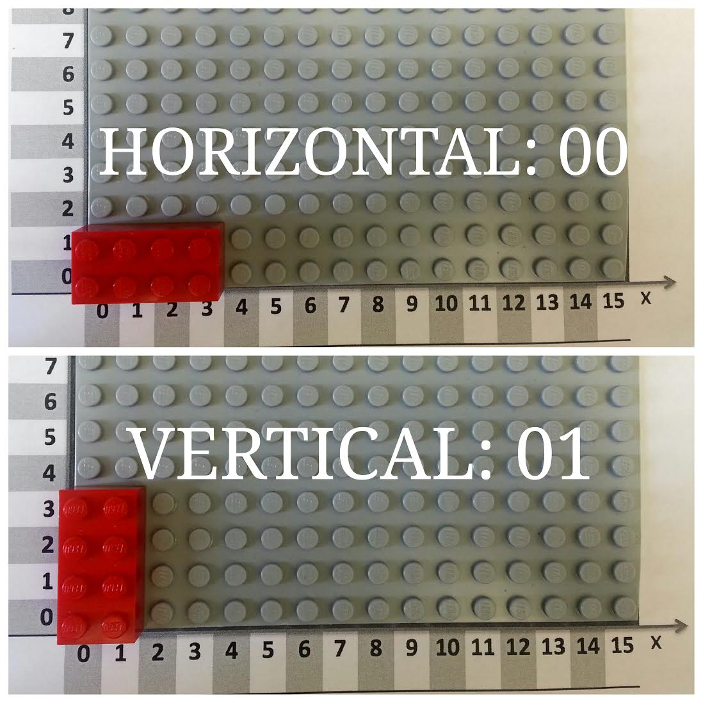
Block Encoding and Decoding
Name(s): _______________________
Now let’s encode the orientation of each block into binary.
Each block can either be horizontal or vertical. We can let 00 represent horizontal, and let
01 represent vertical, as shown in the picture below. Now encode the orientation of the blocks in the tower!
Block | Orientation | Binary Orientation
Red 2 x 4
Yellow 2 x 3
Black 2 x 2

Slide 76
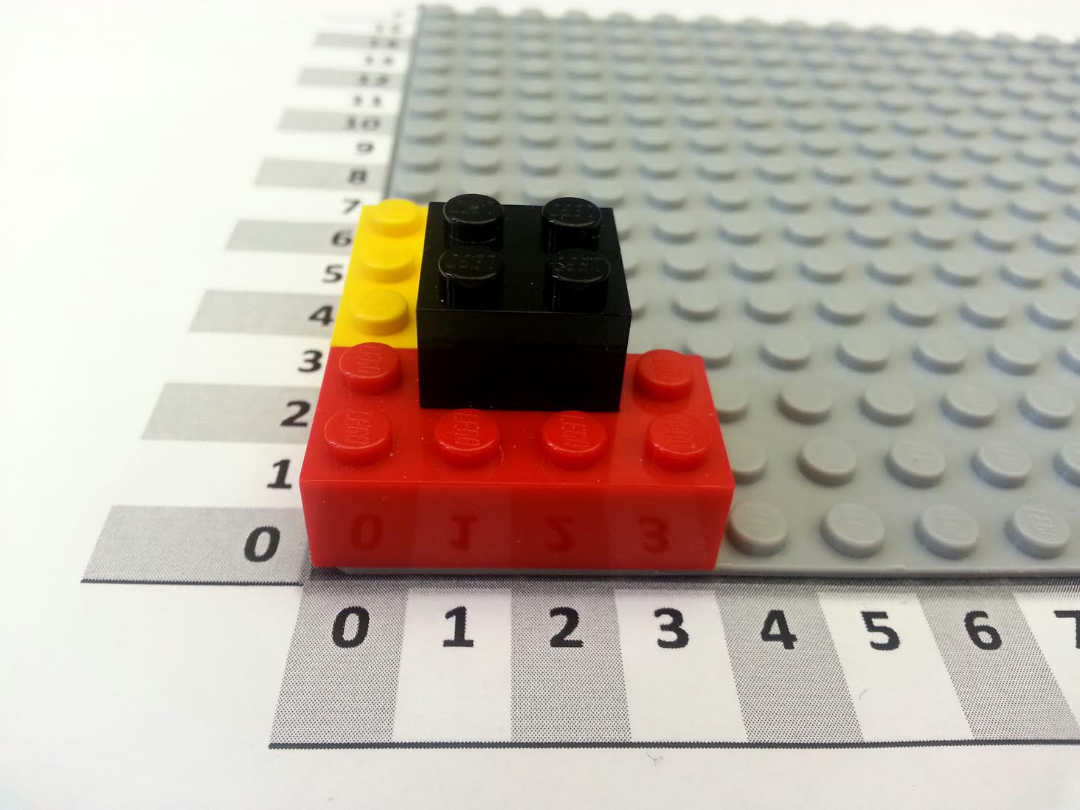
Block Encoding and Decoding
Name(s): _______________________
When we give instructions, the order of the steps can matter! If you crack an egg and then cook it, you have a poached egg. If you cook an egg and then crack it, you have a hard-boiled egg.
We can represent each step as the addition of another block. Look at the instruction tables below. Do they produce the same LEGO tower? In other words, does order matter?
Block | Color | Size | Orientation | X | Y
0 | Red | 2 x 4 | Horizontal | 0 | 0
1 | Yellow | 2 x 3 | Vertical | 0 | 2
2 | Black | 2 x 2 | Horizontal | 1 | 1
Block | Color | Size | Orientation | X | Y
0 | Black | 2 x 2 | Horizontal | 1 | 1
1 | Yellow | 2 x 3 | Vertical | 0 | 2
2 | Red | 2 x 4 | Horizontal | 0 | 0

Slide 77
Block Encoding and Decoding
Name(s): _______________________
Color
Red | 001
Yellow | 010
Black | 011
Here’s a legend for the encoding we’ve been using to convert our regular instruction table to a binary instruction table.
You’ve already converted the color, size, orientation, and position. Now convert the block number from base 10 to binary.
Size
2 x 2 | 010010
2 x 3 | 010011
2 x 4 | 010100
Block | Color | Size | Orientation | X | Y
0 | Red | 2 x 4 | Horizontal | 0 | 0
1 | Yellow | 2 x 3 | Vertical | 0 | 2
2 | Black | 2 x 2 | Horizontal | 1 | 1
Orientation
Horizontal | 00
Vertical | 01
Numbers
0 | 000
1 | 001
2 | 010
3 | 011
4 | 100
5 | 101
6 | 110
7 | 111
Block | Color | Size | Orientation | X | Y
00 | 001 | 010100 | 00 | 000 | 000
01 | 010 | 010011 | 01 | 000 | 010
10 | 011 | 010010 | 00 | 001 | 001
Now you have a complete binary instruction table!

Slide 78
Name(s): _______________________
Activity: Building the Encoding
Color
Red | 001
Yellow | 010
Black | 011
Here’s an encoded instruction table for a small LEGO tower. Can you figure out what this tower is supposed to look like?
Hint: first, decode the instruction table using the legend on the left, and then follow the instructions to recreate the tower.
Size
2 x 2 | 010010
2 x 3 | 010011
2 x 4 | 010100
Block | Color | Size | Orientation | X | Y
0000 | 010 | 010010 | 01 | 000 | 000
0001 | 001 | 010010 | 01 | 011 | 000
0010 | 001 | 010011 | 00 | 001 | 000
0011 | 010 | 010011 | 00 | 001 | 000
Orientation
Horizontal | 00
Vertical | 01
Numbers
0 | 000
1 | 001
2 | 010
3 | 011
4 | 100
5 | 101
6 | 110
7 | 111
Block | Color | Size | Orientation | X | Y

Slide 79
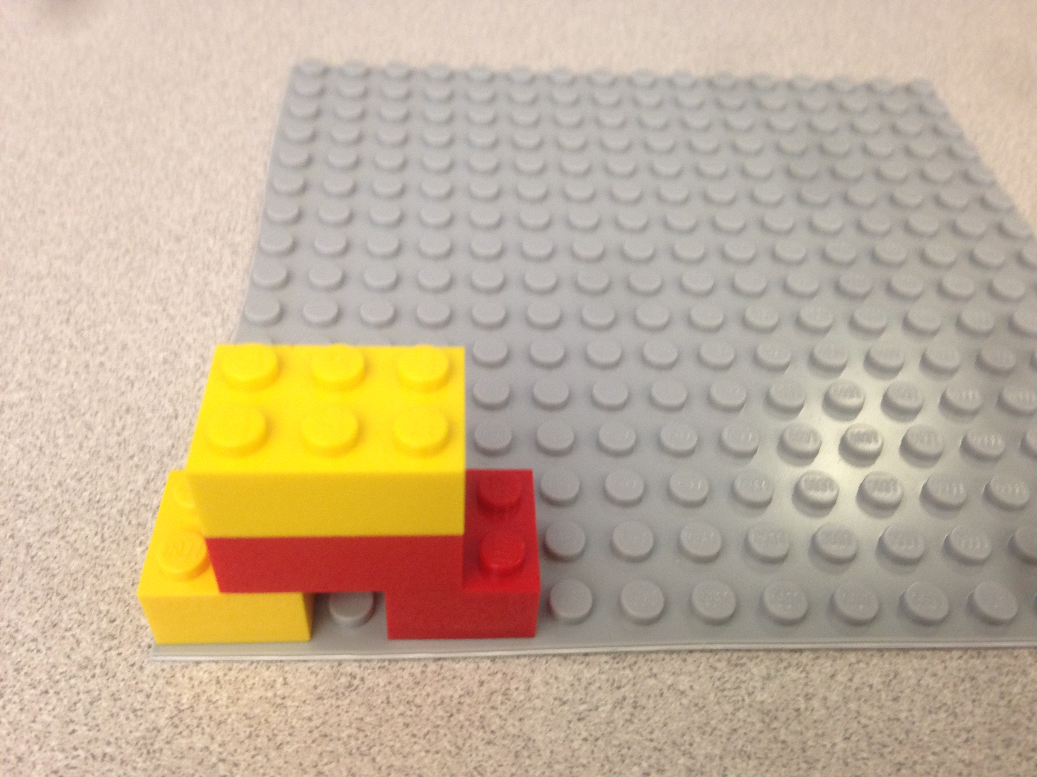
Activity: Building the Encoding
Name(s): _______________________
Using the instructions from the previous page, we can first decode the instructions as below, and then build the tower to get the tower on the right.
Block | Color | Size | Orientation | X | Y
0000 | 010 | 010010 | 01 | 000 | 000
0001 | 001 | 010010 | 01 | 011 | 000
0010 | 001 | 010011 | 00 | 001 | 000
0011 | 010 | 010011 | 00 | 001 | 000
Block | Color | Size | Orientation | X | Y
0 | Yellow | 2 x 2 | Vertical | 0 | 0
1 | Red | 2 x 2 | Vertical | 3 | 0
2 | Red | 2 x 3 | Horizontal | 1 | 0
3 | Yellow | 2 x 3 | Horizontal | 1 | 0

Slide 80
Secret Fortress Construction Challenge
You should have two identical LEGO block kits.
Set the extra kit aside, and use one kit to build a LEGO fortress:
Find a secluded spot to build your secret fortress. Don’t let anyone else see it!
Place your Lego baseplate on top of the template on page 2. Note the x and y axes are 0, as usual.
[First-timer advice] Keep your tower to the lower-left corner, where x and y are 7 or less
Write the English instructions for building your tower… (page 3)
Create a binary encoding (the legend) for each type and color of your Legos. (page 3)
Translate the English instructions to binary instructions for your tower! (page 4)
Be sure to copy over the legend, as well!
[Optional] Create a single line of 0s and 1s that you will send to the other team.
[Optional] Text or email that single line of 0s and 1s to the other team.
[Optional] Reassemble the other team's single line of 0s and 1s into binary instructions:
Swap! Make sure you have the chart of the other team's binary instructions…
Make sure you copy the other team's legend with their binary encoding
Convert their binary instructions back to English instructions using the legend.
Try to build their secret fortress!
When both teams are done, compare the fortresses you’ve created.
Were you successful? Why or why not?
Debug! If something went wrong, find where it went wrong -- which step of the process was it?!
In pairs, unpack one bag of Legos and build this tower…

Slide 81
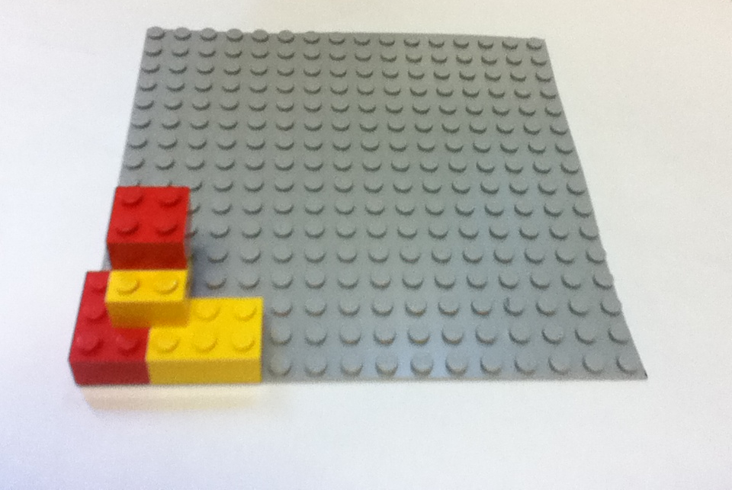
Secret Fortress?

Slide 82
Secret Fortress Base Template
y
15
14
13
12
11
10
9
8
7
6
5
4
3
2
1
0
0 | 1 | 2 | 3 | 4 | 5 | 6 | 7 | 8 | 9 | 10 | 11 | 12 | 13 | 14 | 15
x

Slide 84
Your Legend
Fill in the chart below with English and numeric instructions for your fortress.
Follow the sample line, which says “put the sample block, which is a red 2x4 block, horizontally, with its bottom left corner at the position given by the x-coordinate 6 and the y-coordinate 4.”
Then, fill in the legend to create an encoding for all the bricks you used.
For example, a 2x4 block might be represented with 010100, since 010 is 2 in binary, and 100 is 4 in binary.
Color
Red | 001
Let's go!
Brick Type
2 x 4 | 010100
Chart A. Your team's English Instructions
Block | Color | Brick Type | Orientation | X | Y
Sample | Red | 2x4 | Horizontal | 6 | 4
0
1
2
3
4
5
6
7
8
Orientation
Horizontal | 00
Vertical | 01
Numbers
0 | 000
1 | 001
2 | 010
3 | 011
4 | 100
5 | 101
6 | 110
7 | 111

Slide 85
How could you tell someone how to build this tower – if they could not SEE it!

Slide 86
We definitely need to be able to describe positions of Legos!
Secret Fortress Base Template
y
15
14
13
12
11
10
9
8
7
6
5
4
3
2
1
0
0 | 1 | 2 | 3 | 4 | 5 | 6 | 7 | 8 | 9 | 10 | 11 | 12 | 13 | 14 | 15
x

Slide 87
Your Legend
Fill in the chart below with English and numeric instructions for your fortress.
Follow the sample line, which says “put the sample block, which is a red 2x4 block, horizontally, with its bottom left corner at the position given by the x-coordinate 6 and the y-coordinate 4.”
Then, fill in the legend to create an encoding for all the bricks you used.
For example, a 2x4 block might be represented with 010100, since 010 is 2 in binary, and 100 is 4 in binary.
Color
Red | 001
Let's go!
Brick Type
2 x 4 | 010100
Chart A. Your team's English Instructions
Block | Color | Brick Type | Orientation | X | Y
Sample | Red | 2x4 | Horizontal | 6 | 4
0 | Red | 2x3 | Vertical | 0 | 0
1 | Yellow | 2x3 | Horizontal | 2 | 0
2 | Yellow | 2x2 | Vertical | 1 | 1
3
4
5
6
7
8
Orientation
Horizontal | 00
Vertical | 01
Numbers
0 | 0000
1 | 0001
2 | 0010
3 | 0011
4 | 0100
5 | 0101
6 | 0110
7 | 0111

Slide 88
Your Legend
Now, we fill the legend…
Color
Red | 001
Copy the legend you created on the last page to this page.
Then, translate the instructions in Chart A to binary.
Converting information into binary allows a computer to store it and communicate it. Computers use an electric signal to represent the 1s and no signal to represent the 0s.
Brick Type
2 x 4 | 010100
Chart B. Your team's binary Instructions
Block | Color | Brick Type | Orientation | X | Y
Sample | 001 | 010100 | 00 | 0110 | 0100
0 | (Red) | (2x3) | Vertical | (0) | (0)
1 | (Yellow) | (2x3) | Horizontal | (2) | (0)
2 | (Yellow) | (2x3) | Vertical | (1) | (1)
3 | (Red) | (2x3) | Vertical | (1) | (2)
4
5
6
7
8
Orientation
Horizontal | 00
Vertical | 01
Numbers
0 | 0000
1 | 0001
2 | 0010
3 | 0011
4 | 0100
5 | 0101
6 | 0110
7 | 0111
& convert to binary…

Slide 89
Your Legend
Color
Red | 001
Yellow | 010
Copy the legend you created on the last page to this page.
Then, translate the instructions in Chart A to binary.
Converting information into binary allows a computer to store it and communicate it. Computers use an electric signal to represent the 1s and no signal to represent the 0s.
Brick Type
2 x 4 | 010100
2 x 3 | 010011
2 x 2 | 010010
Chart B. Your team's binary Instructions
Block | Color | Brick Type | Orientation | X | Y
Sample | 001 | 010100 | 00 | 0110 | 0100
0 | 001 (Red) | 010011 (2x3) | 01 Vertical | 0000 (0) | 0000 (0)
1 | 010 (Yellow) | 010011 (2x3) | 00 Horizontal | 0010 (2) | 0000 (0)
2 | 010 (Yellow) | 010010 (2x2) | 01 Vertical | 0001 (1) | 0001 (1)
3 | 001 (Red) | 010010 (2x2) | 01 Vertical | 0001 (1) | 0010 (2)
4
5
6
7
8
Orientation
Horizontal | 00
Vertical | 01
Numbers
0 | 0000
1 | 0001
2 | 0010
3 | 0011
4 | 0100
5 | 0101
6 | 0110
7 | 0111
My answer…

Slide 90
Your Legend
Color
Red | 001
Yellow | 010
Copy the legend you created on the last page to this page.
Then, translate the instructions in Chart A to binary.
Converting information into binary allows a computer to store it and communicate it. Computers use an electric signal to represent the 1s and no signal to represent the 0s.
Brick Type
2 x 4 | 010100
2 x 3 | 010011
2 x 2 | 010010
Chart B. Your team's binary Instructions
Block | Color | Brick Type | Orientation | X | Y
Sample | 001 | 010100 | 00 | 0110 | 0100
0 | 001 | 010011 | 01 | 0000 | 0000
1 | 010 | 010011 | 00 | 0010 | 0000
2 | 010 | 010010 | 01 | 0001 | 0001
3 | 001 | 010010 ( | 01 | 0001 | 0010
4
5
6
7
8
Orientation
Horizontal | 00
Vertical | 01
Numbers
0 | 0000
1 | 0001
2 | 0010
3 | 0011
4 | 0100
5 | 0101
6 | 0110
7 | 0111
just the bits!

Slide 91
Your Legend
Color
Red | 001
Yellow | 010
Copy the legend you created on the last page to this page.
Then, translate the instructions in Chart A to binary.
Converting information into binary allows a computer to store it and communicate it. Computers use an electric signal to represent the 1s and no signal to represent the 0s.
Differentiating delivery
Extra challenge: text one single line of bits
Usual: just swap binary pages (this one)
Simpler: just swap English pages (previous)
Brick Type
2 x 4 | 010100
2 x 3 | 010011
2 x 2 | 010010
Chart B. Your team's binary Instructions
Block | Color | Brick Type | Orientation | X | Y
Sample | 001 | 010100 | 00 | 0110 | 0100
0 | 001 | 010011 | 01 | 0000 | 0000
1 | 010 | 010011 | 00 | 0010 | 0000
2 | 010 | 010010 | 01 | 0001 | 0001
3 | 001 | 010010 ( | 01 | 0001 | 0010
4
5
6
7
8
Orientation
Horizontal | 00
Vertical | 01
Numbers
0 | 0000
1 | 0001
2 | 0010
3 | 0011
4 | 0100
5 | 0101
6 | 0110
7 | 0111
- swap bits -

Slide 92
Their Legend
Extra -- Transferring the bits!
If you send your instructions electronically, they have to be converted to a single line of 0s and 1s! For example, for these sample blocks,
Differentiating delivery!
Simpler: just swap binary pages.
Simplest: just swap English pages.
Color
Red | 001
Yellow | 010
Block | Color | Brick Type | Orientation | X | Y
0001 | 001 | 010100 | 00 | 0110 | 0100
0010 | 010 | 101101 | 01 | 0111 | 0100
Brick Type
2 x 4 | 010100
2 x 3 | 010011
2 x 2 | 010010
You would construct – and send – this line of 0s and 1s:
0001001010100000110010000100101011010101110100
Try it!
Write your binary instructions as a single line of 0s and 1s (it's OK to wrap):
__________________________________________________________________________________________________________________________________________________
Next, send a text or email to the other team with the bits of your tower.
Also, give them your legend or let them copy it…
Below, write down the other team's bits when they send them to you:
__________________________________________________________________________________________________________________________________________________
And copy their legend to the spots on this page.
001 010011 01 0000 0000
010 010011 00 0010 0000
010 010010 01 0001 0001
001 010010 01 0001 0010
Orientation
Horizontal | 00
Vertical | 01
Extra…
Numbers
0 | 0000
1 | 0001
2 | 0010
3 | 0011
4 | 0100
5 | 0101
6 | 0110
7 | 0111

Slide 93
Their Legend
Extra -- Transferring the bits!
If you send your instructions electronically, they have to be converted to a single line of 0s and 1s! For example, for these sample blocks,
Differentiating delivery!
Simpler: just swap binary pages.
Simplest: just swap English pages.
Color
Red | 001
Yellow | 010
Block | Color | Brick Type | Orientation | X | Y
0001 | 001 | 010100 | 00 | 0110 | 0100
0010 | 010 | 101101 | 01 | 0111 | 0100
Brick Type
2 x 4 | 010100
2 x 3 | 010011
2 x 2 | 010010
You would construct – and send – this line of 0s and 1s:
0001001010100000110010000100101011010101110100
Try it!
Write your binary instructions as a single line of 0s and 1s (it's OK to wrap):
__________________________________________________________________________________________________________________________________________________
Next, send a text or email to the other team with the bits of your tower.
Also, give them your legend or let them copy it…
Below, write down the other team's bits when they send them to you:
__________________________________________________________________________________________________________________________________________________
And copy their legend to the spots on this page.
001 010011 01 0000 0000
010 010011 00 0010 0000
010 010010 01 0001 0001
001 010010 01 0001 0010
Orientation
Horizontal | 00
Vertical | 01
Extra…
Numbers
0 | 0000
1 | 0001
2 | 0010
3 | 0011
4 | 0100
5 | 0101
6 | 0110
7 | 0111
010 010011 00 0001 0000 001 010011 01 0010 0000 001 010010 01 0000 0011 010 010010 01 0011 0001

Slide 94
Their Legend
Color
Red | 001
Yellow | 010
Make sure you have the other team's legend.
Then, make sure you have the other team's binary instructions.
If you swapped pages, you should be set.
If you transferred a single-line of 0s and 1s, you will need to make sure you have the correct bits in each spot!
Get the legend, too!
Now, we've swapped.
Brick Type
2 x 4 | 010100
2 x 3 | 010011
2 x 2 | 010010
Chart C. Other team's binary Instructions
Block | Color | Brick Type | Orientation | X | Y
Sample | 001 | 010100 | 00 | 0110 | 0100
0 | 010 | 010011 | 00 | 0001 | 0000
1 | 001 | 010011 | 01 | 0010 | 0000
2 | 001 | 010010 | 01 | 0000 | 0011
3 | 010 | 010010 | 01 | 0011 | 0001
4
5
6
7
8
Orientation
Horizontal | 00
Vertical | 01
Numbers
0 | 0000
1 | 0001
2 | 0010
3 | 0011
4 | 0100
5 | 0101
6 | 0110
7 | 0111
Try it from here…

Slide 95
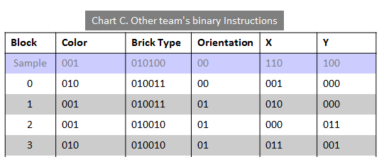
Their Legend
Color
Red | 001
Yellow | 010
Brick Type
2 x 4 | 010100
2 x 3 | 010011
2 x 2 | 010010
Translate the other team's instructions to English instructions.
Chart D. Other team's English Instructions
Block | Color | Brick Type | Orientation | X | Y
Sample | Red | 2x4 | Horizontal | 6 | 4
0 | Yellow | 2x3 | Horizontal | 1 | 0
1
2
3
4
5
6
7
8
Orientation
Horizontal | 00
Vertical | 01
Numbers
0 | 0000
1 | 0001
2 | 0010
3 | 0011
4 | 0100
5 | 0101
6 | 0110
7 | 0111
Decode…

Slide 96
Their Legend
Color
Red | 001
Yellow | 010
Translate the other team's instructions to English instructions.
Brick Type
2 x 4 | 010100
2 x 3 | 010011
2 x 2 | 010010
Chart D. Other team's English Instructions
Block | Color | Brick Type | Orientation | X | Y
Sample | Red | 2x4 | Horizontal | 6 | 4
0 | Yellow | 2x3 | Horizontal | 1 | 0
1 | Red | 2x3 | Vertical | 2 | 0
2 | Red | 2x2 | Vertical | 0 | 3
3 | Yellow | 2x2 | Vertical | 3 | 1
4
5
6
7
8
Orientation
Horizontal | 00
Vertical | 01
Numbers
0 | 0000
1 | 0001
2 | 0010
3 | 0011
4 | 0100
5 | 0101
6 | 0110
7 | 0111
My answers…

Slide 97
DECODED Fortress!
See if they match!
y
15
14
13
12
11
10
9
8
7
6
5
4
3
2
1
0
0 | 1 | 2 | 3 | 4 | 5 | 6 | 7 | 8 | 9 | 10 | 11 | 12 | 13 | 14 | 15
x

Slide 98
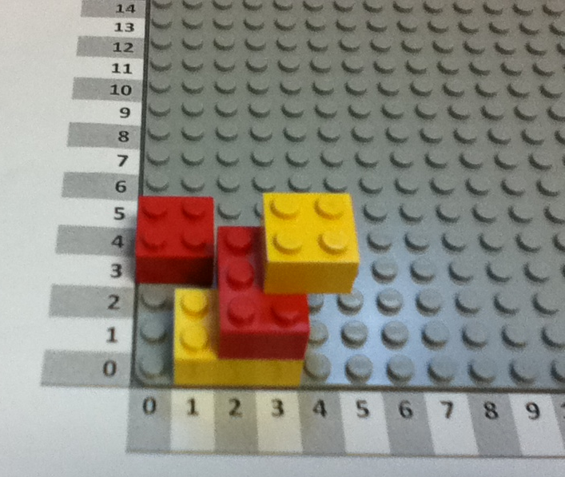
DECODED Fortress!
See if they match!

Slide 99
Bug tracker…
How many differences were they between the original and DECODED towers?
Find where the differences happened and make a mark for each location of these "bugs"
Translating from tower to English
Translating from English to binary
Transferring the bits
Translating from binary to English
Translating from English to tower
If you want to actually draw bugs, even better!

Slide 100
Secret Fortress Construction Challenge
You should have two identical LEGO block kits.
Set the extra kit aside, and use one kit to build a LEGO fortress:
Find a secluded spot to build your secret fortress. Don’t let anyone else see it!
Place your Lego baseplate on top of the template on page 2. Note the x and y axes are 0, as usual.
[First-timer advice] Keep your tower to the lower-left corner, where x and y are 7 or less
Write the English instructions for building your tower… (page 3)
Create a binary encoding (the legend) for each type and color of your Legos. (page 3)
Translate the English instructions to binary instructions for your tower! (page 4)
Be sure to copy over the legend, as well!
[Optional] Create a single line of 0s and 1s that you will send to the other team.
[Optional] Text or email that single line of 0s and 1s to the other team.
[Optional] Reassemble the other team's single line of 0s and 1s into binary instructions:
Swap! Make sure you have the chart of the other team's binary instructions…
Make sure you copy the other team's legend with their binary encoding
Convert their binary instructions back to English instructions using the legend.
Try to build their secret fortress!
When both teams are done, compare the fortresses you’ve created.
Were you successful? Why or why not?
Debug! If something went wrong, find where it went wrong -- which step of the process was it?!
Now, the real thing…
Pairs, pair up!

Slide 101
Don't show the other team your tower!
Secret Fortress Base Template
y
15
14
13
12
11
10
9
8
7
6
5
4
3
2
1
0
0 | 1 | 2 | 3 | 4 | 5 | 6 | 7 | 8 | 9 | 10 | 11 | 12 | 13 | 14 | 15
x

Slide 102
Your Legend
Fill in the chart below with English and numeric instructions for your fortress.
Follow the sample line, which says “put the sample block, which is a red 2x4 block, horizontally, with its bottom left corner at the position given by the x-coordinate 6 and the y-coordinate 4.”
Then, fill in the legend to create an encoding for all the bricks you used.
For example, a 2x4 block might be represented with 010100,
since 010 is 2 in binary, and 100 is 4 in binary.
Color
Red | 001
Brick Type
2 x 4 | 010100
Chart A. Your team's English Instructions
Block | Color | Brick Type | Orientation | X | Y
Sample | Red | 2x4 | Horizontal | 6 | 4
0
1
2
3
4
5
6
7
8
Orientation
Horizontal | 00
Vertical | 01
Numbers
0 | 0000
1 | 0001
2 | 0010
3 | 0011
4 | 0100
5 | 0101
6 | 0110
7 | 0111

Slide 103
Your Legend
Color
Red | 001
Copy the legend you created on the last page to this page.
Then, translate the instructions in Chart A to binary.
Converting information into binary allows a computer to store it and communicate it. Computers use an electric signal to represent the 1s and no signal to represent the 0s.
Brick Type
2 x 4 | 010100
Chart B. Your team's binary Instructions
Block | Color | Brick Type | Orientation | X | Y
Sample | 001 | 010100 | 00 | 0110 | 0100
0
1
2
3
4
5
6
7
8
Orientation
Horizontal | 00
Vertical | 01
Numbers
0 | 0000
1 | 0001
2 | 0010
3 | 0011
4 | 0100
5 | 0101
6 | 0110
7 | 0111

Slide 104
Their Legend
Extra -- Transferring the bits!
If you send your instructions electronically, they have to be converted to a single line of 0s and 1s! For example, for these sample blocks,
Differentiating delivery!
Simpler: just swap binary pages.
Simplest: just swap English pages.
Color
Red | 001
Block | Color | Brick Type | Orientation | X | Y
0001 | 001 | 010100 | 00 | 0110 | 0100
0010 | 010 | 101101 | 01 | 0111 | 0100
Brick Type
2 x 4 | 010100
You would construct – and send – this line of 0s and 1s:
0001001010100000110010000100101011010101110100
Try it!
Write your binary instructions as a single line of 0s and 1s (it's OK to wrap):
__________________________________________________________________________________________________________________________________________________
Next, send a text or email to the other team with the bits of your tower.
Also, give them your legend or let them copy it…
Below, write down the other team's bits when they send them to you:
__________________________________________________________________________________________________________________________________________________
And copy or borrow their legend so that you have their encoding!
Orientation
Horizontal | 00
Vertical | 01
Numbers
0 | 0000
1 | 0001
2 | 0010
3 | 0011
4 | 0100
5 | 0101
6 | 0110
7 | 0111

Slide 105
Their Legend
Color
Red | 001
Make sure you have the other team's legend.
Then, make sure you have the other team's binary instructions.
If you swapped pages, you should be set… .
Brick Type
2 x 4 | 010100
Chart C. Other team's binary Instructions
Block | Color | Brick Type | Orientation | X | Y
Sample | 001 | 010100 | 00 | 0110 | 0100
0
1
2
3
4
5
6
7
8
Orientation
Horizontal | 00
Vertical | 01
Numbers
0 | 0000
1 | 0001
2 | 0010
3 | 0011
4 | 0100
5 | 0101
6 | 0110
7 | 0111

Slide 106
Their Legend
Color
Red | 001
Translate the other team's instructions to English instructions.
Brick Type
2 x 4 | 010100
Chart D. Other team's English Instructions
Block | Color | Brick Type | Orientation | X | Y
Sample | 001 | 010100 | 00 | 110 | 100
0
1
2
3
4
5
6
7
8
Orientation
Horizontal | 00
Vertical | 01
Numbers
0 | 000
1 | 001
2 | 010
3 | 011
4 | 100
5 | 101
6 | 110
7 | 111

Slide 107
DECODED Fortress!
See if they match!
y
15
14
13
12
11
10
9
8
7
6
5
4
3
2
1
0
0 | 1 | 2 | 3 | 4 | 5 | 6 | 7 | 8 | 9 | 10 | 11 | 12 | 13 | 14 | 15
x

Slide 108
Bug tracker…
How many differences were they between the original and DECODED towers?
Find where the differences happened and make a mark for each location of these "bugs"
Translating from tower to English
Translating from English to binary
Transferring the bits
Translating from binary to English
Translating from English to tower
If you want to actually draw bugs, even better!

Slide 109
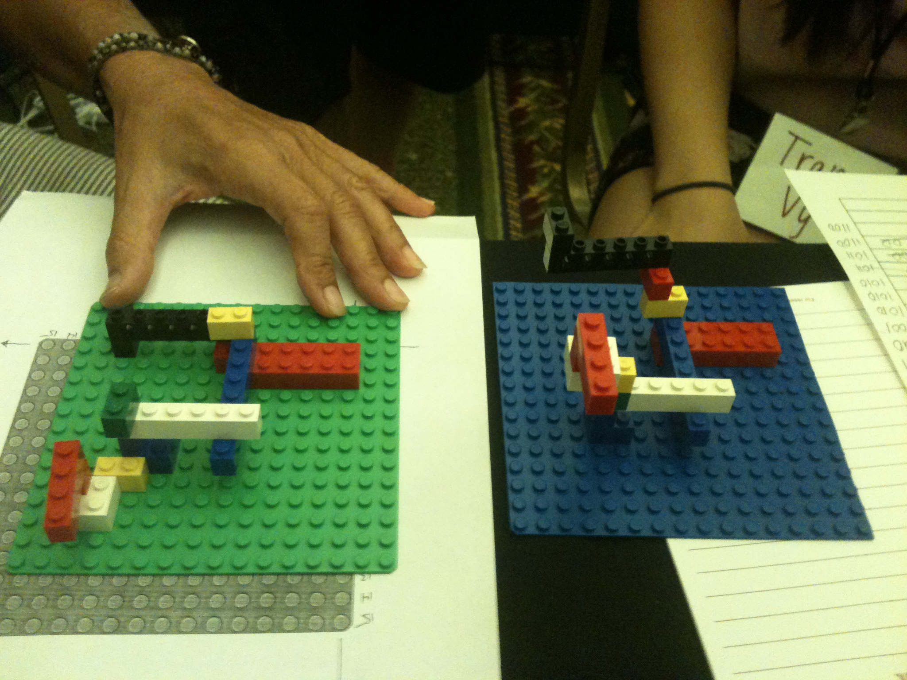
Codes and Data
Imagine – Decompose – Specify – Binarize – Execute – Compare – Debug!
Notes:
Because each team is really getting into the meaning of the bits on the paper and the intent vs. the meaning vs. the syntax of the instructions on the page (though we don't use the term syntax, but encoding or code)

Slide 110
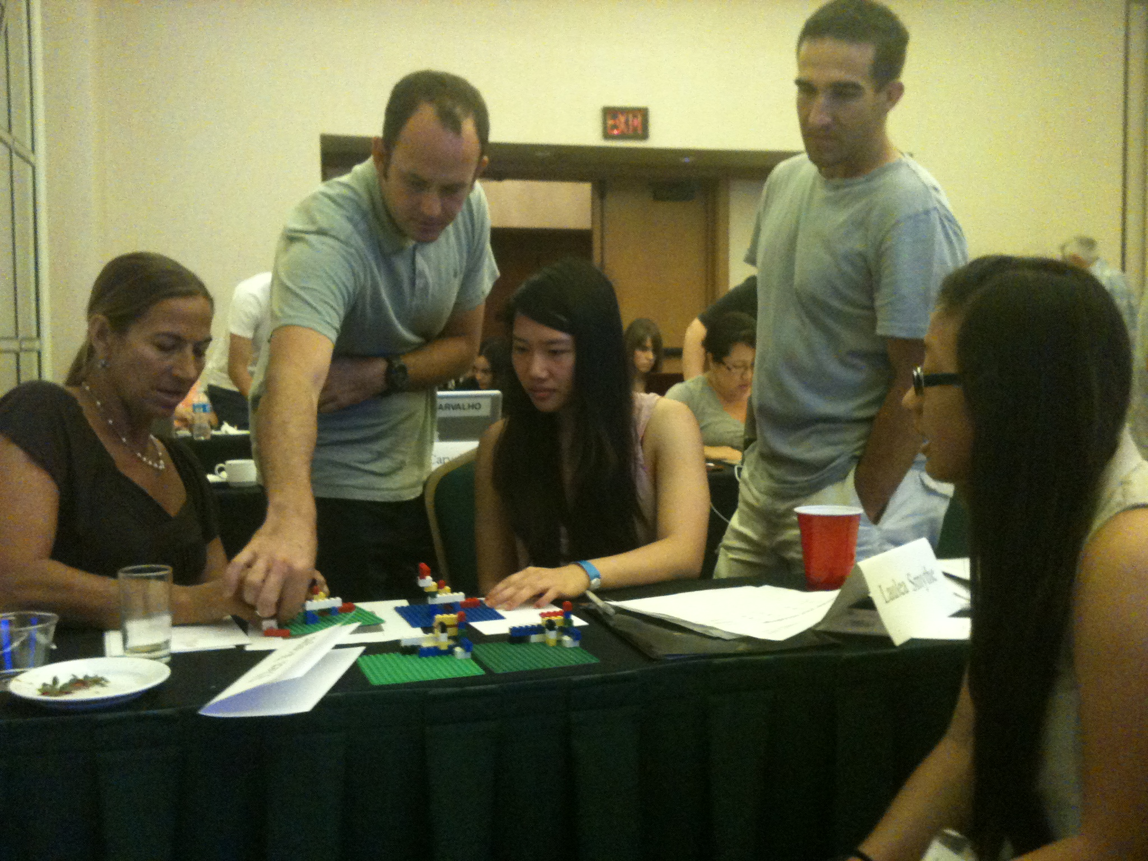
Summer workshops, '11-'14
T
T
M
T
M
T
>100 teachers have taken MyCS workshops: 42 of them in '14
>6000 students taken at least one unit: >4000 surveyed in '15

Slide 111
Lunch!
tomorrow: Gina's – we'll need to order today

Slide 112
Afternoon session
until 2pm: try Scratch + mazes
2 – 3:15pm: create a game… !
show off your game…
@3:15 team-based wrap-up chat

Slide 113
Recommendation ~ try these mazes:
scratch.mit.edu/users/MyCS_Student/studios/
Studio 1: Try 1.1, 1.9, and 1.10.
Studio 2: Try 2.5, 2.8, and 2.10*
Studio 3: Try 3.1, 3.4, 3.7, and 3.10*
Studio 4: Try 4.2, 4.7, and 4.10*
Studio 5: Try 5.4, 5.6, 5.10*
Studio 6: Try 6.2, 6.5, 6.9, 6.10*
Studio 7: Try 7.2, 7.3, 7.6, 7.10*
Studio 8: Try 8.1, 8.2, 8.10*
Studios 9 and 10: *Try at your own risk!
want a challenge? see how few of the purple blocks you can use!

Slide 114
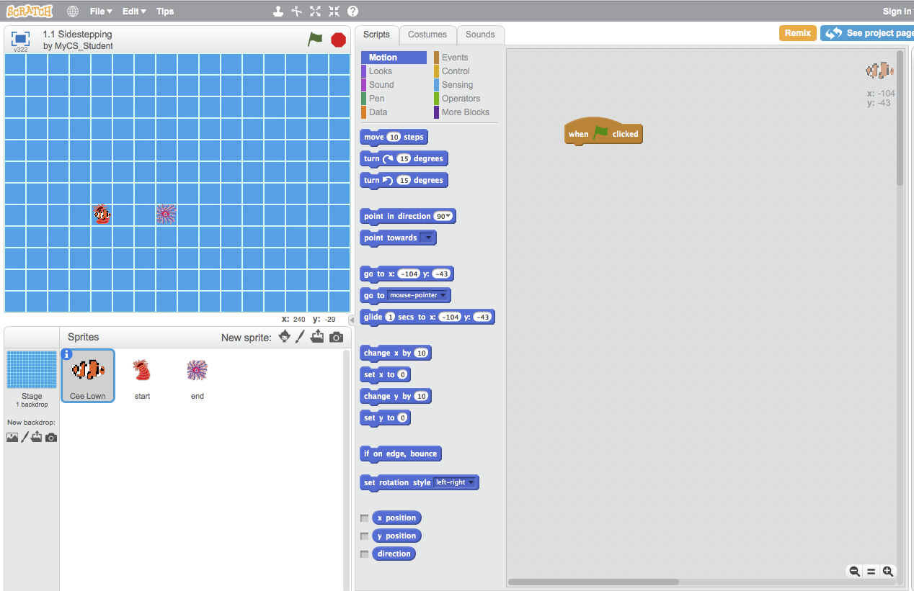
First Puzzle: Sidestepping
Click on 1.1 Sidestepping, then See Inside, and you'll see this:

Slide 115
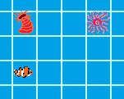
Let's meet our sprites!
Cee Lown, this World's character. The program's commands control him.
The Start: This is where the character begins
The End: Where the clownfish wants to go.
The world: our environment for this puzzle

Slide 116
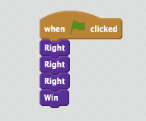
Our goal...
The program blocks.
Our program
We need to write a program that gets our clownfish from the start to the finish.

Slide 117
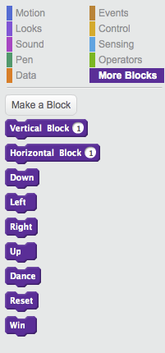
Block programming
We need to move three squares to the right. So, we go to the More Blocks section and drag and drop blocks to make this
I'm feeling a bit blocky myself.

Slide 118
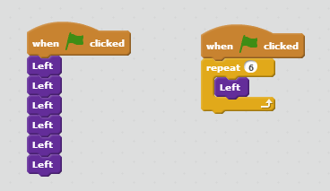
The repeat block
These are identical programs.
Each one moves left 6 times
Try solving the Ocean mazes using the repeat block

Slide 119
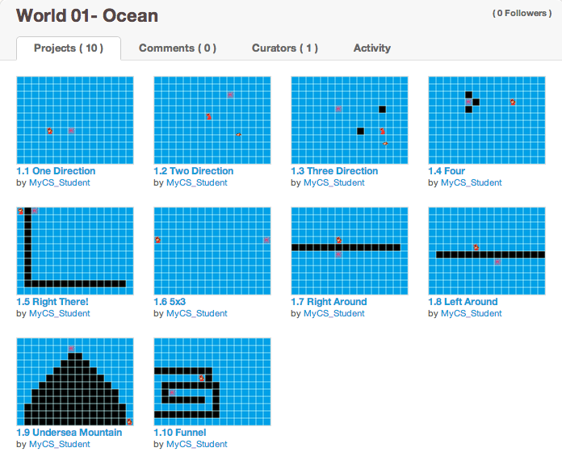
Studio 1 Ocean mazes...
Try (at least) Ocean mazes 1.9 + 1.10
How few purple blocks can you use?

Slide 120
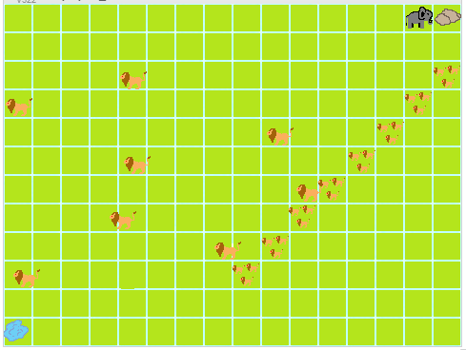
Studio 2
Safari
Enemies!
(predators)
lead to using the WAIT block
2.5, 2.8, 2.10*

Slide 121
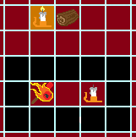
Studio 3
Fire
lead to the use of the IF/THEN/ELSE block
Teleporters
(portals)
3.1, 3.4, 3.7, 3.10*

Slide 122
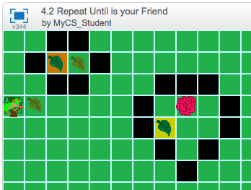
Studio 4
Jungle
many possible teleports...
lead to using the repeat until block
4.2, 4.7, 4.10*

Slide 123
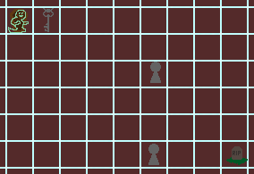
Studio 5
Ghosts
Multiple same-color exits
(for portals)
lead to the sprite-SENSING block
5.4, 5.6, 5.10*
Notes:
In this case, it's not color-SENSING... sprite-sensing?

Slide 124
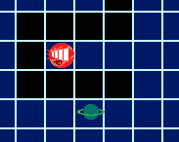
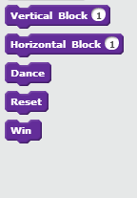
Studio 6
Space
Using horizontal and vertical
positive and negative ~ mathematical coords
6.2, 6.5, 6.9, 6.10*

Slide 125
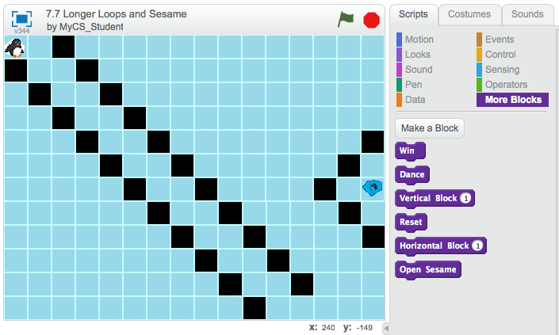
Studio 7
Arctic
Larger loops and Sesame!
more - and more sophisticated - practice with loops...
4.5, 4.7, 4.10*

Slide 126
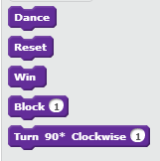
Studio 8
Mech
using only turn and forward
~ basic robot control
8.1, 8.2, 8.10*

Slide 127
Recommendation ~ try these mazes:
scratch.mit.edu/users/MyCS_Student/studios/
Studio 1: Try 1.1, 1.9, and 1.10.
Studio 2: Try 2.5, 2.8, and 2.10*
Studio 3: Try 3.1, 3.4, 3.7, and 3.10*
Studio 4: Try 4.2, 4.7, and 4.10*
Studio 5: Try 5.4, 5.6, 5.10*
Studio 6: Try 6.2, 6.5, 6.9, 6.10*
Studio 7: Try 7.2, 7.3, 7.6, 7.10*
Studio 8: Try 8.1, 8.2, 8.10*
Studios 9 and 10: *Try at your own risk!
want a challenge? see how few of the purple blocks you can use!

Slide 128
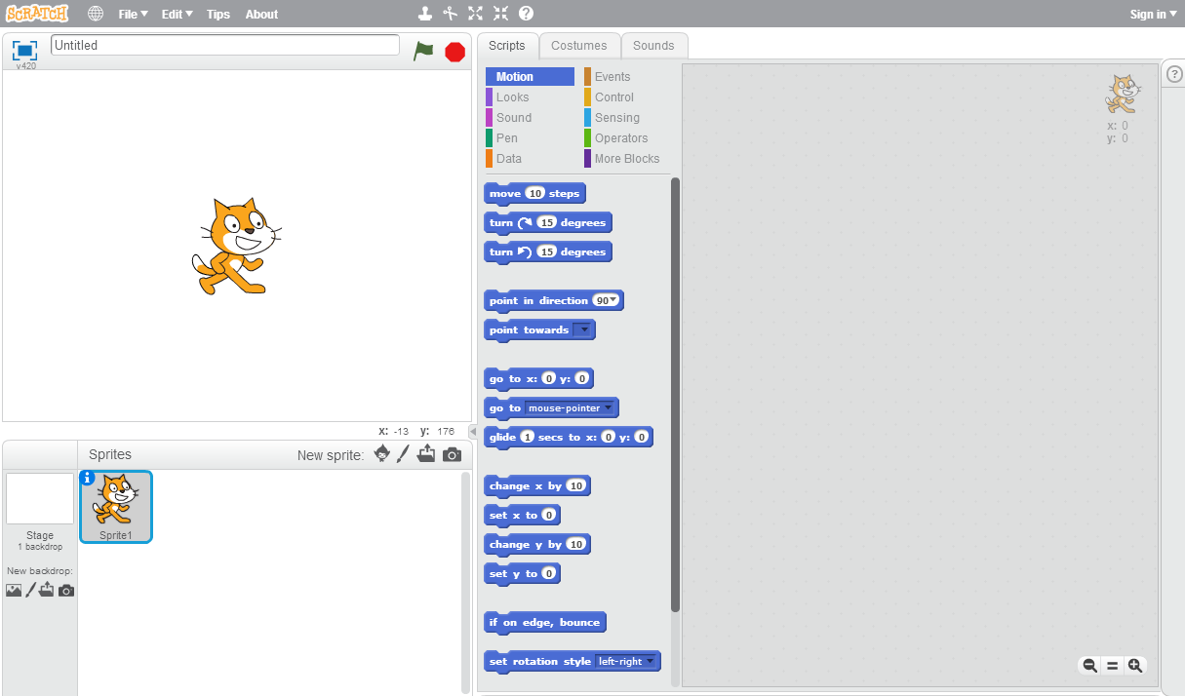
Unit 4: Making a scene with Scratch
Click the "Tips" button
"Scratch in its Natural State"

Slide 129
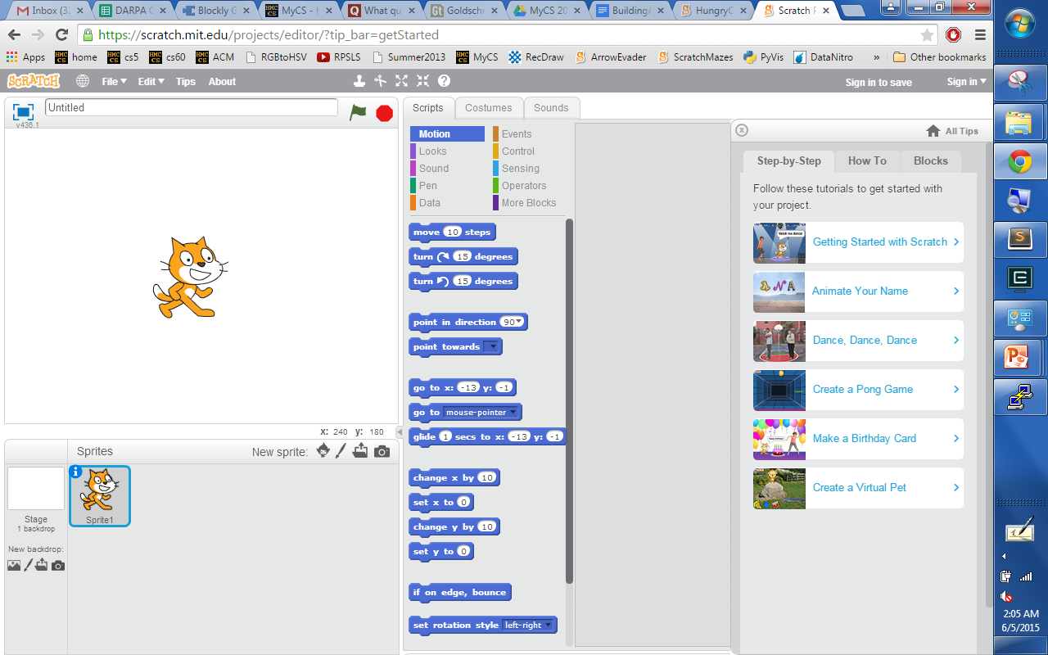
Unit 4: Making a scene with Scratch
First, work through the "Getting Started"
Try one of the others… OR …

Slide 130
Games in Scratch…

Slide 131
Creating a Scratch Game
in 7 steps…
with unlimited room for expansion + creativity!

Slide 132
Step 1: Choose a hero!
(1) Choose a main character or "hero" ...
(one that you will control)
choose one
upload from file
draw your own
take a new picture

Slide 133
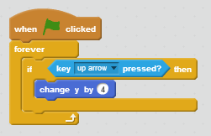
Step 2: Motion with the keyboard
(2a) Add this program to your hero sprite so that you can control it with the up arrow:
(2b) Add more blocks so that all arrow keys work appropriately. Where could you put them?

Slide 134
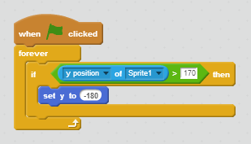
Step 3: Wrap master
(3a) Make sure your "hero" can wrap around the screen from top to bottom:
(3b) Add other wrapping as you see fit!

Slide 135
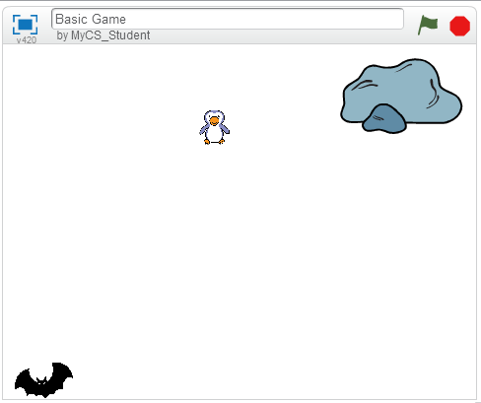
Step 4: Choose a goal.
(4) Create a second sprite ~ the goal!
(something you want the hero to reach)
the fearsome enemy
the goal
the hero
Place it on the other side of the scene.

Slide 136
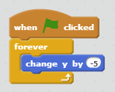
Step 5: Choose an enemy.
(5a) Create a third sprite ~ an enemy!
(something you want the hero to avoid)
Place it in the middle of the scene, and
have the enemy move continuously:
This is a program within the enemy's scripts, not the hero's scripts.
(5b) Also, have your enemy wrap around the screen – use the hero's wrapping program as a guide.

Slide 137
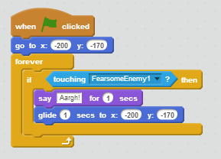
Step 6: Reset if you collide!
(6a) For the hero sprite, when the hero hits the enemy, teleport the hero back to the hero's start:
(6b) It's good to have the hero start there at the beginning, too. Which block does that?

Slide 138
Step 7: Celebrate if you win!
(7a) For the hero sprite, when the hero hits the goal, celebrate.
For this, make another program very similar to the one handling the hero-enemy collisions!
Change the message and add a victory sound/song!
(7b) After celebrating, you should reset the hero…

Slide 139
The sky's the limit!
Now, add at least two of these features:
(a) Add a changing score variable (Data menu)
(b) Have the enemy move randomly (Operators)
(c) Add more enemies
(d) Add "power-ups" that change your hero's size, score, or speed
(e) Add portals to teleport the hero randomly
(f) Have the game end when a timer runs out.
(g) Have a second level that is more dificult.
And... at least two of your own ideas... !

Slide 140
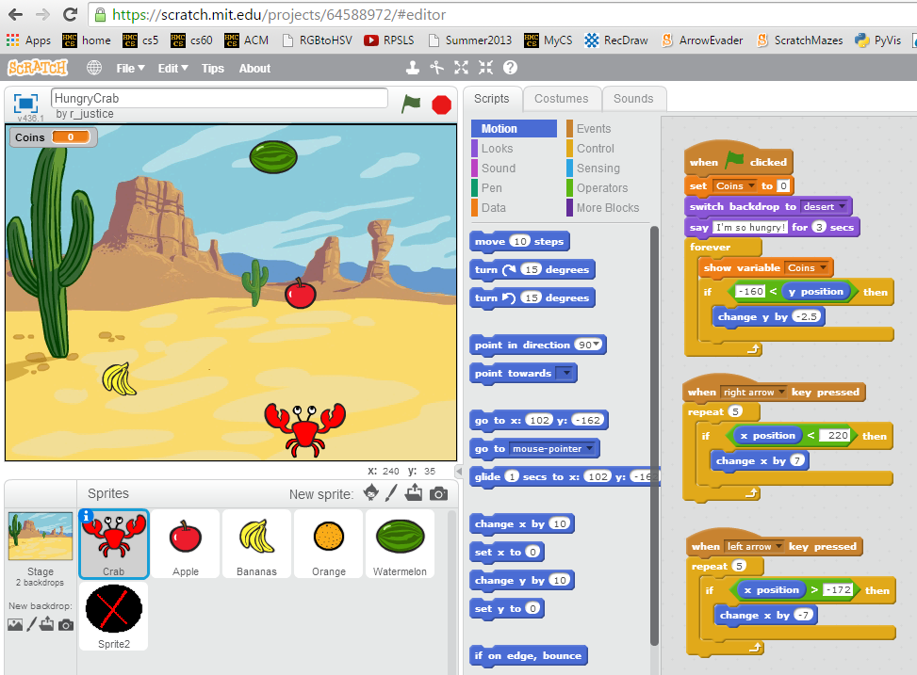
HungryCrab !
See Building a Game – Instructions link for a step-by-step guide to HungryCrab by r_justice

Slide 141
(1) Build your game
(2) Show it off :-)

Slide 142
http://scratch.mit.edu/

Slide 145
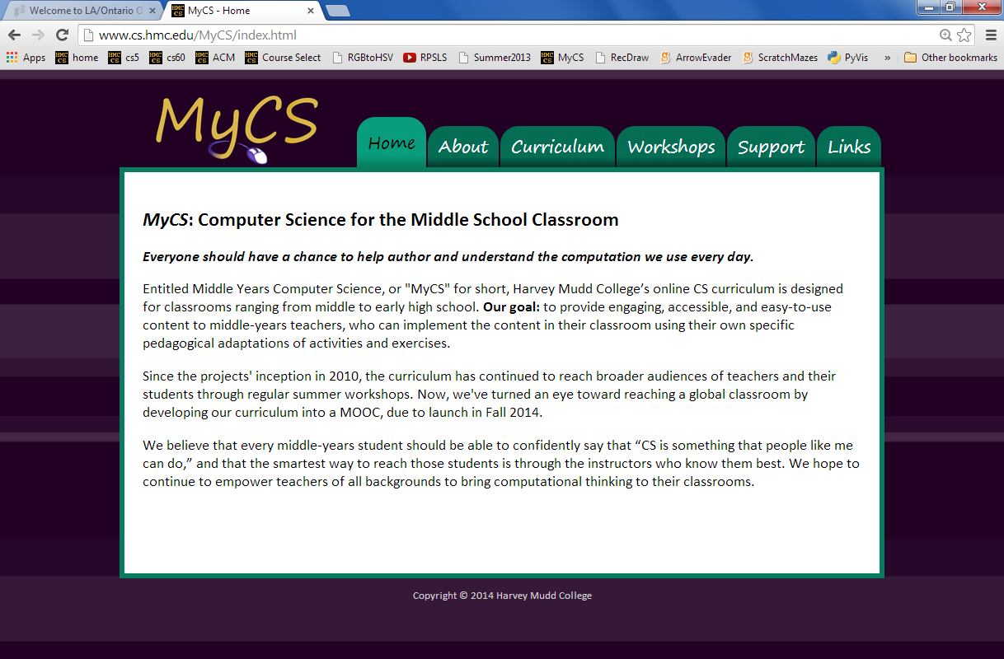
Full, online curriculum…
www.cs.hmc.edu/MyCS

Slide 146
Teacher feedback '13: what's missing?

Slide 147
Afternoon session
until 3pm: work on projects
@ 3pm: show off your work
everyone shows off a project Th afternoon…
then: team-based wrap-up survey/chat

Slide 148
Why CS ~ a course-wide module

Slide 149
Why CS ~ a course-wide module
Watson ~ a follow-up

Slide 150
Why CS ~ a course-wide module

Slide 152
Why CS ~ a course-wide module
Made w/ Code: A Google effort aimed at women especially

Slide 153
Human language is one data encoding
Human languages
ideas
encoding
words
decoding
ideas
The sign says not to go further.
La señal dice no ir más lejos.
Lots of different languages to use!

Slide 154
but the trail was too tempting to skip.
pero el camino era demasiado tentador para saltar.

Slide 155
Language-encoding?
... using online translators ...
Anyone recognize this phrase, now 10 translations later?
not sure if this is an activity...

Slide 156
Translations...

Slide 157
Automatic Translation Today...
WordLens
Microsoft Translation
Notes:
Added the links to the two videos (just click WordLens and Microsoft Translation

Slide 158
Too much Google translate...?
Carly Rae Jepson?
Notes:
Added the link to youtube on the word 'too much'

Slide 159
Today…
Python
AppInv
MyCS (computer)
AppInv
Arduino
MyCS (data!)

Slide 160
One game: Up, up, and away!
(1) Choose a main character...
(something that you want to "fly")
(2) Add (four) blocks like these so that you can move around with the arrows:

Slide 161
One game: Up, up, and away!
(3) Make sure your "hero" can wrap around from right to left:
add other wrapping as you see fit!

Slide 162
One game: Up, up, and away!
(4) Create a second sprite ~ the goal!
(something you want to reach)
(5) Create a third sprite ~ an "enemy"
(something to avoid)
(6) Have the enemy move continuously:

Slide 163
One game: Up, up, and away!
(7) When the enemy hits the hero, teleport the hero back to the start:
it's good to start there at the beginning, too

Slide 164
One game: Up, up, and away!
Now, add at least two of these features:
(a) Add a changing score variable
(b) Have the enemy move randomly
(c) Add more enemies
(d) Add "power-up" sprites that change your hero's size, score, or speed
(e) Add portals that teleport your hero randomly
(f) Have the game end when a timer runs out.
(g) Add music and/or sounds!
And... at least two of your own ideas... !

Slide 166
Unit 4: Making a scene with Scratch
"Scratch in its Natural State"

Slide 167
Block programming
We need to move three squares to the right. So, we go to the More Blocks section and drag and drop blocks to make this
I'm feeling a bit blocky myself.

Slide 168
The repeat block
These are identical programs.
Each one moves left 6 times
Try solving the Ocean mazes using the repeat block

Slide 169
Studio 1 Ocean mazes...
Try (at least) Ocean mazes 1.9 + 1.10
How few purple blocks can you use?

Slide 170
Studio 2
Safari
Enemies!
(predators)
lead to using the WAIT block
2.5, 2.8, 2.10*

Slide 171
Studio 3
Fire
lead to the use of the IF/THEN/ELSE block
Teleporters
(portals)
3.1, 3.4, 3.7, 3.10*

Slide 172
Studio 4
Jungle
many possible teleports...
lead to using the repeat until block
4.2, 4.7, 4.10*

Slide 173
Studio 5
Ghosts
Multiple same-color exits
(for portals)
lead to the sprite-SENSING block
5.4, 5.6, 5.10*
Notes:
In this case, it's not color-SENSING... sprite-sensing?

Slide 174
Studio 6
Space
Using horizontal and vertical
positive and negative ~ mathematical coords
6.2, 6.5, 6.9, 6.10*

Slide 175
Studio 7
Arctic
Larger loops and Sesame!
more - and more sophisticated - practice with loops...
4.5, 4.7, 4.10*

Slide 176
Studio 8
Mech
using only turn and forward
~ basic robot control
8.1, 8.2, 8.10*

Slide 177
Recommendation ~ try these mazes:
scratch.mit.edu/users/MyCS_Student/studios/
Studio 1: Try 1.1, 1.9, and 1.10.
Studio 2: Try 2.5, 2.8, and 2.10*
Studio 3: Try 3.1, 3.4, 3.7, and 3.10*
Studio 4: Try 4.2, 4.7, and 4.10*
Studio 5: Try 5.4, 5.6, 5.10*
Studio 6: Try 6.2, 6.5, 6.9, 6.10*
Studio 7: Try 7.2, 7.3, 7.6, 7.10*
Studio 8: Try 8.1, 8.2, 8.10*
Studios 9 and 10: *Try at your own risk!
want a challenge? see how few of the purple blocks you can use!

Slide 178
Lots of data…
n = 28 teachers

Slide 179
Lots of data…
n = 28 teachers

Slide 180
Mutual assessment…
How compelling was each topic?

Slide 181
Teachers' feedback: MyCS
“I think that participating in the MyCS program will help me to better support my students.”
disagree
neutral
agree
strongly agree

Slide 182
Teachers' feedback: self-efficacy
“I have a personal interest in the field of computing.”
“I feel confident about my ability to accomplish my goals with MyCS.”

Slide 183
Teachers' feedback: professional identity
“I prefer to work on collaborative projects.”
“I enjoy teaching others about scientific and technological topics.”
“Students learn best through project-based curricula that encourages them to be creative and self-expressive.”
Notes:
More time on “Students learn best”

Slide 184
MyCS MOOC
i.e., textbook+
Unify the curriculum + support our teachers
Offered as modules in existing classes
Pathway through the "creator gap":
from PLAY to PAUSE to POINT
Partner geography: Kauai, Pomona, …

Slide 185
MOOC,
complete
Lesson plans
Short videos
Explanations / illustrations
Instructions
Class activities
M.C. questions
Reflections /prompts
Notes:
Students! (name & year)

Slide 186
MOOC,
complete
Lesson plans
Short videos
Explanations / illustrations
Instructions
Class activities
M.C. questions
Reflections /prompts

Slide 187
MOOC,
complete
Lesson plans
Short videos
Explanations / illustrations
Instructions
Class activities
M.C. questions
Reflections /prompts

Slide 188
In-house team
How it's sold…

Slide 189
In-house team
How it feels…

Slide 190
In building students' (computational) identities …
MyCS
… it's teachers who count.
is never complete
Notes:
MyCS is not complete – well, it is complete, but it's not DONE – we have no intention of ever calling it done. We're always looking out for new things that we can include in MyCS – but we want to give our partnering teachers a one-stop resource for the curriculum.
The feedback we get from teachers has and will keep on shaping the curriculum ----- and we are eager for anyone interested in a one-term middle-school CS course to use or remix MyCS for their purposes.
So, to end where we began, this work has been about how teachers relate to the MyCS curriculum, because teachers are the only real leverage available in _building a positive computational identity_ -- and that interpersonal essence is what we want to achieve with MyCS.

Slide 191
my women (left cols) vs. men (right cols)

Slide 192
What have we learned?
Notes:
So, what have _we_ learned from and about the teachers we've worked with?
Well, this past summer we had a chance to bring Elly Schofield - a recent HMC alum - onto the project in order to help us with this teacher-feedback piece of the project…

Slide 193
Lots of data…
n = 28 teachers

Slide 194
But
ROSE data
… building positive computational identity is difficult
"first-world problem"
useful isn't useful
Camilla Schreiner + Svein Sjoberg:
Notes:
Schreiner, Camilla & Sjøberg, Svein
… and in fact, as the joke goes – this really IS a first-world problem…!
What their data showed convincingly is that in first-world countries – being useful as a field – like computing – isn't actually a useful hook for young people – so, how do we reach this formative, middle-years age group?

Slide 195
Overheard @ CE21
I'd say middle-school teachers consider themselves "more about their students" …
… and high-school teachers consider themselves "more about their subjects."
teachers know how to hook their students…
many are seeking content confidence
Notes:
Well, at the middle-school panel of this year's CE 21 conference, a teacher made this interesting observation…
She said [[read]] .. at least each cohort relative to the other…
What this means is that we have an expert group at reaching middle-years students!!
But what those teachers _need_ is confidence in the content, that is, CS and computing.

Slide 196
Mutual assessment…

Slide 197
Teachers' feedback: MyCS
“I think that participating in the MyCS program will help me to better support my students.”
disagree
neutral
agree
strongly agree

Slide 198
Teachers' feedback: self-efficacy
“I have a personal interest in the field of computing.”
“I feel confident about my ability to accomplish my goals with MyCS.”

Slide 199
Teachers' feedback: professional identity
“I prefer to work on collaborative projects.”
“I enjoy teaching others about scientific and technological topics.”
“Students learn best through project-based curricula that encourages them to be creative and self-expressive.”

Slide 200
Teachers' feedback: what's missing?

Slide 201
MyCS MOOC
i.e., textbook+
unify the curriculum + support our teachers
easy to access ~ flexible to use
offered as modules in existing classes accessible pathway: PLAY to PAUSE to POINT
partner geography: Kauai, Pomona, …
The vision
online resource to help teachers bridge the "creator gap" in (CS) curricula

Slide 202
MOOC,
complete
Lesson plans
Short videos
Explanations / illustrations
Instructions
Class activities
M.C. questions
Reflections /prompts

Slide 203
MOOC,
complete
Lesson plans
Short videos
Explanations / illustrations
Instructions
Class activities
M.C. questions
Reflections /prompts

Slide 204
MOOC,
complete
Lesson plans
Short videos
Explanations / illustrations
Instructions
Class activities
M.C. questions
Reflections /prompts

Slide 205
In-house team
How it's sold…
EdX logo
Amazon EC2 logo
MuddX logo

Slide 206
In-house team
How it feels…
EdX logo
Amazon EC2 logo
MuddX logo

Slide 207
Teachers are CS's (esp. MyCS) vectors.
MOOCs are for teachers …
… and the teachers count.

Slide 208
We do need to support teachers
with all that excellent material
18 weeks of day-by-day lesson plans

Slide 209
Our inspiration
(Maddy)

Slide 210
Our inspiration
(Maddy)

Slide 211
Initial attempts…
our students, ourselves

Slide 212
Initial attempts…
… we may need some teachers …

Slide 213
MyCS's curriculum
all here…
one semester of Scratch programming, punctuated by contextual activities
adaptations welcome…

Slide 214
MyCS MOOC
i.e., textbook+
Unify the curriculum + support our teachers
offered as modules in existing classes
accessible pathway:
PLAY to PAUSE to POINT
partner geography: Kauai, Pomona, …
online resource to help teachers bridge the "creator gap" in (CS) curricula

Slide 215
Open-ended Scratch…

Slide 216
Getting started…
Get the Scratch Cat to move…
Find the sprite editor and put some shorts (or other clothes) on the Cat…
Write a program to have the Cat trace the outline of the stage
Create a dance by going through the tutorial with the Scratch Cat…
Add more characters (sprites) from the library or your own to the dance!
Create music that goes with the Cat’s dance...
THEN – use the Pen blocks to trace the cat’s path
Create your own – perhaps either
(A) a dance-instruction tutorial or
(B) a scene involving 2 or more sprites

Slide 217
How computers work

Slide 218
Encoding with legos

Slide 219
More binary activities...
Christmas tree decoding
"beep" and "boop"
1
0
Claremont: CS Fridays ~ binary-encoded emails
Notes:
As an exercise, showing them how to count up in binary would be good - later in the lego building
exercise, some were skipping numbers as they counted up.
Additionally, mentioning the tally system (base 1!) would be good since they have likely used it before
but without realizing it is base 1

Slide 220
How computers work

Slide 221
See you Thursday!

Slide 223
Notes:
As an exercise, showing them how to count up in binary would be good - later in the lego building
exercise, some were skipping numbers as they counted up.
Additionally, mentioning the tally system (base 1!) would be good since they have likely used it before
but without realizing it is base 1

Slide 224
Lego encodings
y
Suppose we want to encode these blocks:
4
3
What characteristics of the blocks will we need to represent?
2
1
0
x
0
1
2
Notes:
This activity was great!
Consider letting the participants come up with their own encodings (don't give them x,y coords, color, orientation guides). Most teachers said that that is what they would like to do with their students.
Leave the 2nd table blank and do it as an example with them.

Slide 225
Lego encodings
y
Suppose we want to encode these blocks:
4
3
What characteristics of the blocks will we need to represents?
2
1
0
x
color | binary
White | 000
Blue | 001
color
0
1
2
brick type | binary
2X3 | 000
2X2 | 001
brick type
CODES
orientation | binary
horizontal | 000
vertical | 001
orientation
+ coordinates!
Notes:
This activity was great!
Consider letting the participants come up with their own encodings (don't give them x,y coords, color, orientation guides). Most teachers said that that is what they would like to do with their students.
Leave the 2nd table blank and do it as an example with them.

Slide 226
Lego encodings
y
Suppose we want to encode these blocks:
4
3
2
1
0
x
0
1
2
We now have this legend (or codes):
Legend/codes:
color | binary
White | 000
Blue | 001
brick type | binary
2X3 | 000
2X2 | 001
orientation | binary
horizontal | 000
vertical | 001
Notes:
This activity was great!
Consider letting the participants come up with their own encodings (don't give them x,y coords, color, orientation guides). Most teachers said that that is what they would like to do with their students.
Leave the 2nd table blank and do it as an example with them.

Slide 227
Lego encodings
y
Suppose we want to encode these blocks:
4
3
2
1
0
x
Next, we place their information in a table:
0
1
2
Color | Brick Type | Orientation | X-coordinate | Y-coordinate
White | 2x3 | vertical | 0 | 0
brick 1
let's use lower-left coordinates!
brick 2
Legend/codes:
color | binary
White | 000
Blue | 001
brick type | binary
2X3 | 000
2X2 | 001
orientation | binary
horizontal | 000
vertical | 001
Notes:
This activity was great!
Consider letting the participants come up with their own encodings (don't give them x,y coords, color, orientation guides). Most teachers said that that is what they would like to do with their students.
Leave the 2nd table blank and do it as an example with them.

Slide 228
Lego encodings
y
Suppose we want to encode these blocks:
4
Finally, we use our codes (legend) for binary:
3
Color | Brick Type | Orientation | X-coordinate | Y-coordinate
000 | 000 | 001 | 0000 | 0000
001
2
1
brick 1
0
x
brick 2
0
1
2
Color | Brick Type | Orientation | X-coordinate | Y-coordinate
White | 2x3 | vertical | 0 | 0
Blue | 2x2 | horiz. | 1 | 3
brick 1
brick 2
Legend/codes:
color | binary
White | 000
Blue | 001
brick type | binary
2X3 | 000
2X2 | 001
orientation | binary
horizontal | 000
vertical | 001
Notes:
This activity was great!
Consider letting the participants come up with their own encodings (don't give them x,y coords, color, orientation guides). Most teachers said that that is what they would like to do with their students.
Leave the 2nd table blank and do it as an example with them.

Slide 229
Lego encodings
y
4
Our encoding is complete!
3
Color | Brick Type | Orientation | X-coordinate | Y-coordinate
000 | 000 | 001 | 0000 | 0000
001 | 001 | 000 | 0001 | 0011
2
1
brick 1
0
x
brick 2
0
1
2
Color | Brick Type | Orientation | X-coordinate | Y-coordinate
White | 2x3 | vertical | 0 | 0
Blue | 2x2 | horiz. | 1 | 3
brick 1
brick 2
Legend/codes:
color | binary
White | 000
Blue | 001
brick type | binary
2X3 | 000
2X2 | 001
orientation | binary
horizontal | 000
vertical | 001
Notes:
This activity was great!
Consider letting the participants come up with their own encodings (don't give them x,y coords, color, orientation guides). Most teachers said that that is what they would like to do with their students.
Leave the 2nd table blank and do it as an example with them.

Slide 230
Let's decode!
Color | Brick Type | Orientation | X-coordinate | Y-coordinate
001 | 001 | 000 | 0000 | 0000
000 | 001 | 001 | 0011 | 0000
000 | 000 | 000 | 0001 | 0000
001 | 000 | 000 | 0001 | 0000
brick 1
brick 2
brick 3
brick 4
Legend/codes:
color | binary
White | 000
Blue | 001
brick type | binary
2X3 | 000
2X2 | 001
orientation | binary
horizontal | 000
vertical | 001

Slide 231
Building your own encoding
In pairs, build a Lego structure.
Then, create codes (a legend) for your legos.
Next, create an English encoding.
Finally, create a binary encoding.
But, do it all in ABSOLUTE SECRECY!
Then, swap with another group -- and see who can decode their tower most accurately!

Slide 232
Create your binary codes here...
you may need to define more orientations for tricky Lego shapes
color | binary
White | 000
Blue | 001
brick type | binary
2x3 | 000
2x2 | 001
orientation | binary
horizontal | 000
vertical | 001

Slide 233
Encode your Legos here... first English, then binary
Block | Color | Brick Type | Orentation | X-coordinate | Y-coordinate
0
1
2
3
4
5
6
7
8
9
10
11
12
13
14
15

Slide 234
Encode your Legos here... first English, then binary
Block | Color | Brick Type | Orentation | X-coordinate | Y-coordinate
0
1
2
3
4
5
6
7
8
9
10
11
12
13
14
15

Slide 235
Encode your Legos here... first English, then binary
Block | Color | Brick Type | Orentation | X-coordinate | Y-coordinate
0
1
2
3
4
5
6
7
8
9
10
11
12
13
14
15
Use one page for English, then use another for binary!

Slide 236
Prompts
agenda for Day 2's lunch
(1) We'd like to show you a "more carefully curated" version of these materials...
Saying "online" wouldn't convey muic...
Idea: leverage the trends in online education
(2) Your thoughts about online education?
(3) We'd love to get your feedback on usefulness...

Slide 237
Scratch Games
or
Python
Day 2, Sessions 3-4

Slide 238
Python resources
play!
tutor.

Slide 239
Games can seem complex...
yet they can also be a better place to start than general animations...
there's a human sprite
single focus of attention
very incremental

Slide 240
Key: step-by-step progress
create two games:
the first is scaffolded
the second is open-ended

Slide 241
Up, up, and away!
you'll need three more, too!
(1)
Choose a flying main character / hero
Add blocks like these so that you can move around with the 4 arrow keys:
swimming is just aquatic flying...
(2)

Slide 242
(3)
Make sure your hero can wrap around
-- at least from right to left:
add other wrapping as you see fit!

Slide 243
(4)
Create a second sprite ~ the goal!
~ something you want to reach
(5)
Create a third sprite ~ an "enemy"
~ something to avoid
(6)
Have your enemy move continuously:

Slide 244
(7)
When the enemy hits the hero, teleport the hero back to the start:
it's good to start there at the beginning, too

Slide 245
(8)
Customize! Add at least two of these:
(a) Add a changing score variable
(b) Add more enemies
(c) Have the enemies move randomly
(d) Add "power-up" sprites that change your hero's size, score, or speed
(e) Add portals that teleport your hero randomly
(f) Have the game end when a timer runs out.
(9)
Then, add two features of your own!
(g) Work with HMCers on these...

Slide 246
Game demonstrations...
...and code reviews

Slide 247
Other game ideas...
minigolf game
Pacman-type game
Asteroids
platformer (Mario)
get examples...
MEE's game
No limits... !
Mary Elise's game...

Slide 248
Thanks, everyone!
'til Wed. ...

Slide 250
Below are extra slides from old versions of the workshop...

Slide 251
Our game: Fly, fly again...
Use these blocks to write a script that makes it so that if you press the UP arrow, the helicopter goes up, but if you DON'T press the up arrow, the helicopter goes down (like gravity!)
Make sure to save when done!

Slide 252
Scratch:
Jokes - Plays - Music - Games
Day 2, Session 3

Slide 253
Scratch: many possibilities!
Robin: Class projects
Justin: Manzanar stagings
Notes:
Find Pomona teachers to show off their students' work, or delete this slide

Slide 254
Scratch: many possibilities!
Robin: Class projects
Justin: Manzanar stagings
as an expressive tool, CS is transformative...

Slide 255
Simple interaction
Knock-knock Joke in Scratch
Science Joke in Scratch
Using blocks like "wait ( ) secs" and "say [ ] for ( ) secs" you can create a conversation between two sprites.

Slide 258
Movement Practice
Can you make your sprite move in a triangle?
In a square?

Slide 259
Notes:
a lot of people figured this out before we showed them, so giving it to them sooner might be good
although, going over controls in image edit screen may be a good idea

Slide 260
Notes:
Consider changing the screen shot to the online version of scratch

Slide 262
Simple Stories
Find or create a Scratch sprite with multiple costumes, and give it some dialogue that involves a costume change.
"Who's on First" in Scratch
"Romeo and Juliet" in Scratch
Notes:
Free time to make a short script w/ changing costumes, maybe make the cat run (10 min)
#outline

Slide 263
But I want to be creative!
Costumes can be drawn in Scratch, or imported in.
Notes:
Creating your own costumes, importing images for costumes (5 min)
demo for each
#outline

Slide 264
Scratch storytelling
(1) Create a knock-knock joke in Scratch
(2) Choose a new sprite - move it in a triangle, then a square.
(3) Build a more elaborate, "staged play" that involves
costume changes
show and hide
movement of the sprites
Notes:
Free time to make a short script w/ changing costumes, maybe make the cat run (10 min)
#outline

Slide 265
Scratch: Music
Day 2, Session 4

Slide 269
Make a song!
Use notes, drums, and rests to create a short song.
When you are done, make sure to save your program -- saving to the desktop is OK
Then, have the other partner make a second song -- and play both songs for a nearby group!

Slide 270
Polyphonic Music
You can use multiple start tabs to create polyphonic music.
Broadcasting is also effective in starting other parts of music.
WARNING: Using too many start tabs can cause the parts to become offset.

Slide 271
Scratch: thoughts?
Could Scratch work as a medium for any other classes -- in the same spirit as ________ staging?
It's increasingly popular in colleges' CS1 courses... !
Notes:
Change "Justin's manzanar" to some other assignment done by a teacher in the current seminar

Slide 272
Thanks & see you tomorrow!
Day 1
Day 3
Tomorrow's plan
Day 4
Day 5

Slide 275
Song Improvements
Use repeats, tempo, and volume to make improvements to your songs or create a new one...
... either way, explore all of the tools!

Slide 284
Keyboard Challenge
Using "Keyboard" by MyCS_Student as a starting point, create a keyboard.
That is, make each key in a row of keys on your computer keyboard correspond to a note in a scale. Want more? Try different instruments!

Slide 287
Notes:
Not sure if this is available on the online version of scratch

Slide 288
Debugging Practice
Use the worksheet to practice debugging.

Slide 289
Numeric encodings
So, letters can be encoded as numbers...
Can all data be encoded as numbers?
sounds?
images?
everything?
Notes:
Added link to 'sounds' which goes to the song Kryptonite by 3 Doors Down

Slide 290
Lego encodings
y
Suppose we want to encode these blocks:
4
3
What characteristics of the blocks will we need to represent?
2
1
0
x
color | binary
red | 000
yellow | 001
color
0
1
2
brick type | binary
2X3 | 000
2X2 | 001
brick type
CODES
orientation | binary
horizontal | 000
vertical | 001
orientation
+ coordinates!
Notes:
This activity was great!
Consider letting the participants come up with their own encodings (don't give them x,y coords, color, orientation guides). Most teachers said that that is what they would like to do with their students.
Leave the 2nd table blank and do it as an example with them.

Slide 291
Lego encodings
y
Suppose we want to encode these blocks:
4
3
2
1
0
x
0
1
2
We now have this legend (or codes):
Legend/codes:
color | binary
White | 000
Blue | 001
brick type | binary
2X3 | 000
2X2 | 001
orientation | binary
horizontal | 000
vertical | 001
Notes:
This activity was great!
Consider letting the participants come up with their own encodings (don't give them x,y coords, color, orientation guides). Most teachers said that that is what they would like to do with their students.
Leave the 2nd table blank and do it as an example with them.

Slide 292
Lego encodings
y
Suppose we want to encode these blocks:
4
3
2
1
0
x
Next, we place their information in a table:
0
1
2
Color | Brick Type | Orientation | X-coordinate | Y-coordinate
White | 2x3 | vertical | 0 | 0
brick 1
let's use lower-left coordinates!
brick 2
Legend/codes:
color | binary
White | 000
Blue | 001
brick type | binary
2X3 | 000
2X2 | 001
orientation | binary
horizontal | 000
vertical | 001
Notes:
This activity was great!
Consider letting the participants come up with their own encodings (don't give them x,y coords, color, orientation guides). Most teachers said that that is what they would like to do with their students.
Leave the 2nd table blank and do it as an example with them.

Slide 293
Lego encodings
y
Suppose we want to encode these blocks:
4
Finally, we use our codes (legend) for binary:
3
Color | Brick Type | Orientation | X-coordinate | Y-coordinate
000 | 000 | 001 | 0000 | 0000
001
2
1
brick 1
0
x
brick 2
0
1
2
Color | Brick Type | Orientation | X-coordinate | Y-coordinate
White | 2x3 | vertical | 0 | 0
Blue | 2x2 | horiz. | 1 | 3
brick 1
brick 2
Legend/codes:
color | binary
White | 000
Blue | 001
brick type | binary
2X3 | 000
2X2 | 001
orientation | binary
horizontal | 000
vertical | 001
Notes:
This activity was great!
Consider letting the participants come up with their own encodings (don't give them x,y coords, color, orientation guides). Most teachers said that that is what they would like to do with their students.
Leave the 2nd table blank and do it as an example with them.

Slide 294
Lego encodings
y
4
Our encoding is complete!
3
Color | Brick Type | Orientation | X-coordinate | Y-coordinate
000 | 000 | 001 | 0000 | 0000
001 | 001 | 000 | 0001 | 0011
2
1
brick 1
0
x
brick 2
0
1
2
Color | Brick Type | Orientation | X-coordinate | Y-coordinate
White | 2x3 | vertical | 0 | 0
Blue | 2x2 | horiz. | 1 | 3
brick 1
brick 2
Legend/codes:
color | binary
White | 000
Blue | 001
brick type | binary
2X3 | 000
2X2 | 001
orientation | binary
horizontal | 000
vertical | 001
Notes:
This activity was great!
Consider letting the participants come up with their own encodings (don't give them x,y coords, color, orientation guides). Most teachers said that that is what they would like to do with their students.
Leave the 2nd table blank and do it as an example with them.

Slide 295
Scratch: thoughts?
Could Scratch be a compelling introduction to programming for middle-school students?

Slide 296
Poster-making: highlights

Slide 297
Poster-making: high-five-lights

Slide 298
Poster-making: highlights

Slide 299
Other posters: Thanks, Abi

Slide 300
Data: another big example
Google Glass
Google Cars
Google has a fleet of self-driving cars...
Sebastian Thrun

Slide 301
Data: another big example
Google Glass
Google Cars
They generate huge amounts of data!

Slide 302
Data: another big example
Google Glass
Google Cars
but it's potential is equally huge

Slide 303
the big picture
Fremont?

Slide 304
MyCS
Mon.
pictures…

Slide 305
Language-encoding?
... using online translators ...
Anyone recognize this phrase, now 10 translations later?
Four score and seven years ago our fathers brought forth on this continent, a new nation, conceived in Liberty, and dedicated to the proposition that all men are created equal.
not sure if this is an activity...

Slide 306
Translations...

Slide 307
Encoding + Decoding
Try some of these... Then, invent your own

Slide 308
Make-your-own code
Can others decode it?

Slide 309
Insights… (thank you!)
Scratch activities

