Slide 1

Maker Movement
101
MakerState
Jenna deBoisblanc

Slide 2
What is the Maker Movement?
“third industrial revolution”
“everyone a maker”
Notes:
- forbes, wired, huffington post are calling the maker movement the “third industrial revolution”
- new, cheap easy-to-learn software and hardware tools open the door to innovation and creativity
- “everyone a maker”

Slide 3
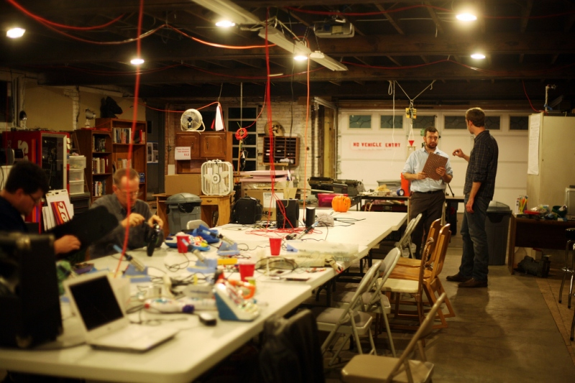
Makerspaces or hackerspaces

Slide 4
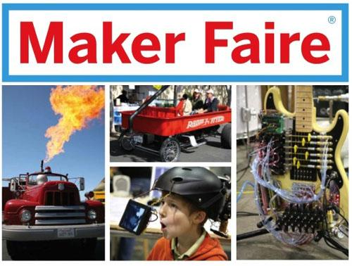
Maker Faire
Notes:
- Maker Faire is popularizing the movement
- Maker Faire is an event created by Make magazine to "celebrate arts, crafts, engineering, science projects and the Do-It-Yourself (DIY) mindset".
- first in 2006 in San Mateo - 20,000 visitors

Slide 5
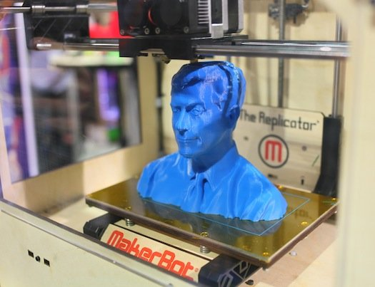
Tools
3D printers
laser cutters
CNC machines
Arduinos
Raspberry Pis

Slide 6
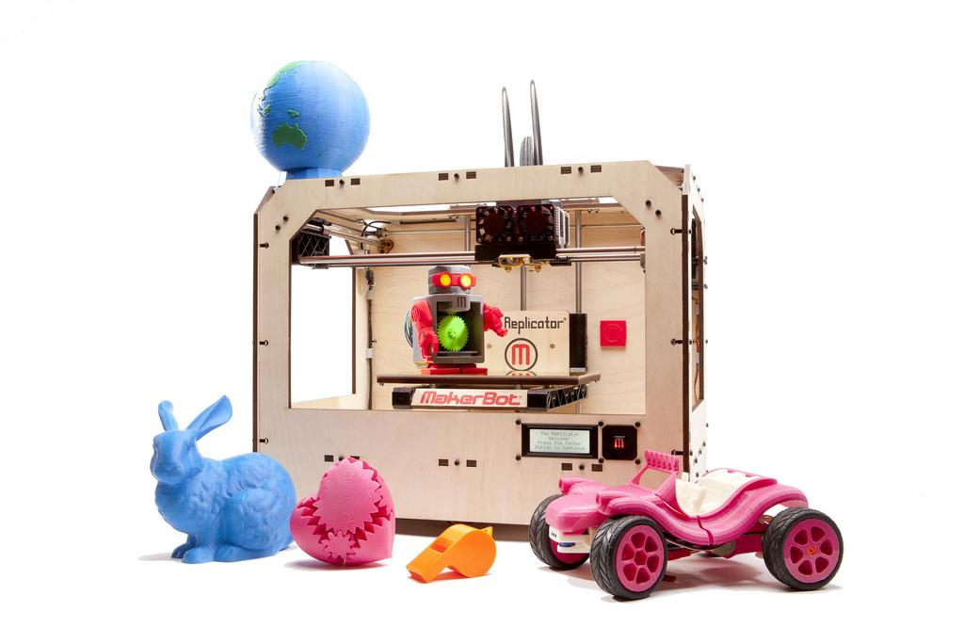
3D Printing

Slide 7
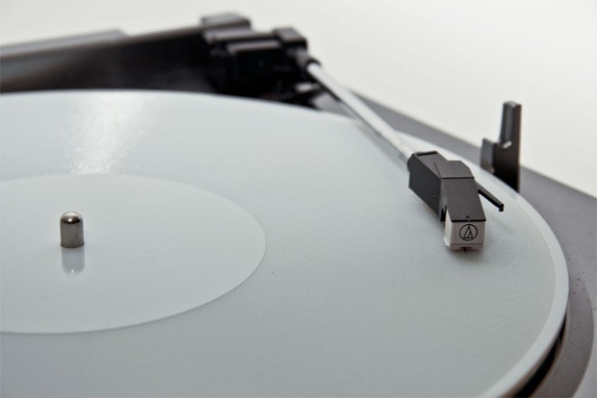
3D printed record

Slide 8
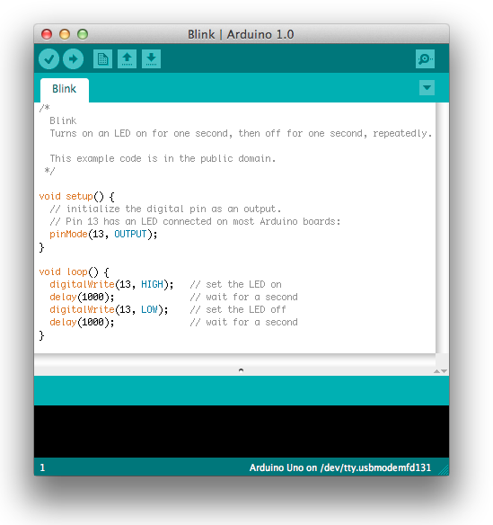
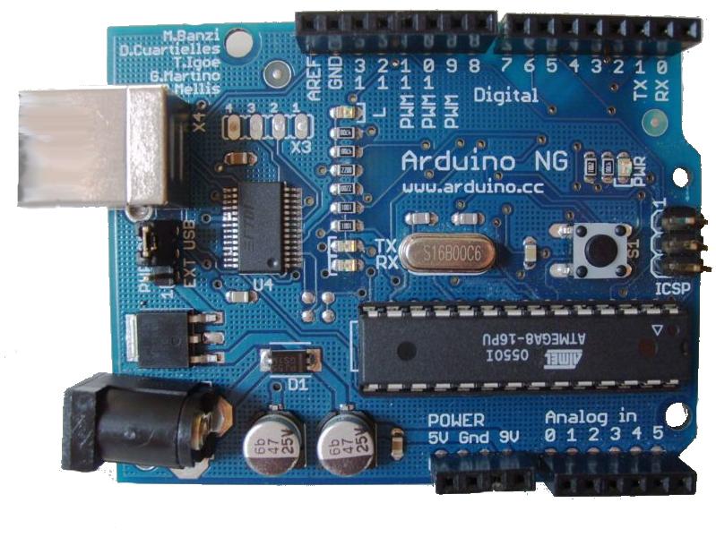
Arduinos
open-source tools for building electronics projects
- hardware
- software

Slide 9
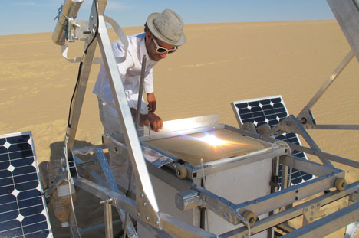
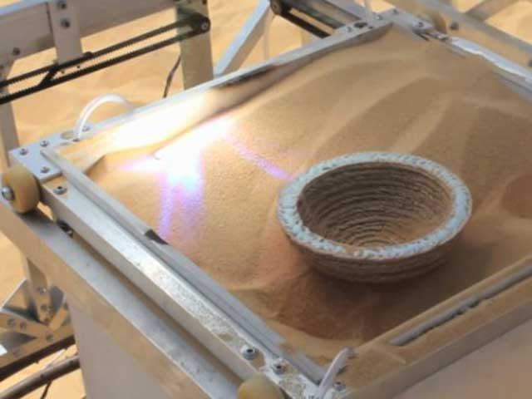
Arduino - examples

Slide 10
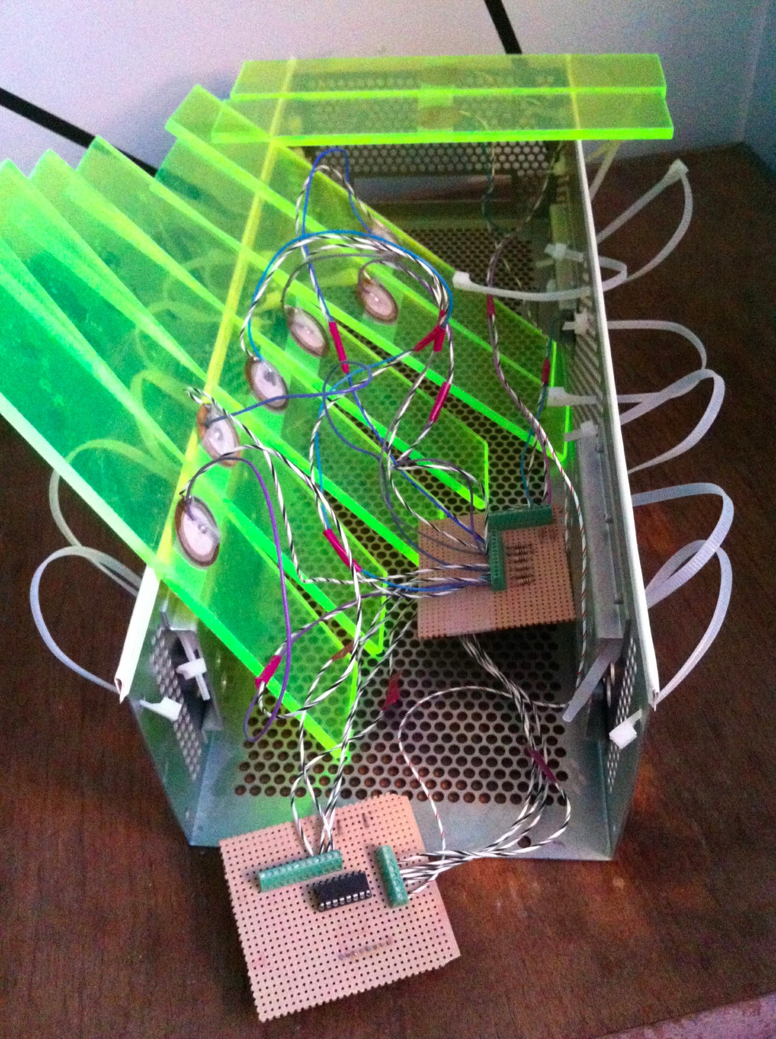
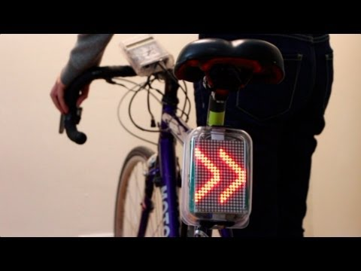
Arduino - examples

Slide 11
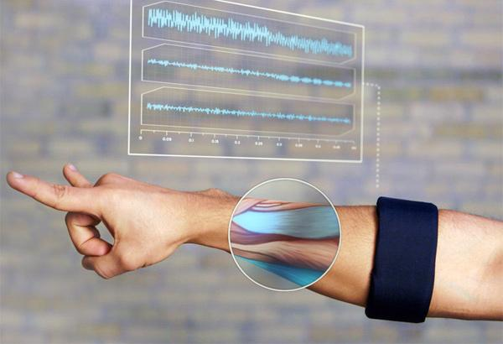
Hardware Startups
“hardware is the new software”
nest
MYO armband
Notes:
more investment and incubators, rapid-prototyping

Slide 12
Maker Demographics
“3D printing may spark a new Industrial Revolution. But that doesn't mean prosperity for all.”
- Salon News
8/10 male
media age - 44
average income - $106,000
97% college graduates

Slide 13
STEM
2nd fastest growing occupation
3 million unfilled jobs in 2020
18% women
12% minorities
Notes:
- Occupations in STEM fields are the second-fastest growing in the nation, just behind health care,
- in the next decade, we going to add over 9 mollion STEM-related jobs, ⅓ of which are projected to be unfilled if we don’t ramp up STEM education.
- 18% of science and engineering degrees are awarded to women

Slide 14
MakerState
Bringing the
Maker Movement
to the
classroom

Slide 15
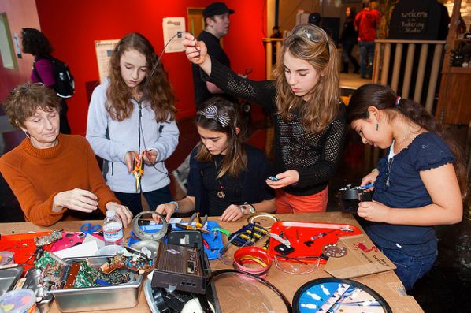
MakerState
hands-on, mastery-based STEAM learning
Notes:
copious amounts of research, experience, and common sense shows that hands-on, experiential learning is the best way to engage students.

Slide 16
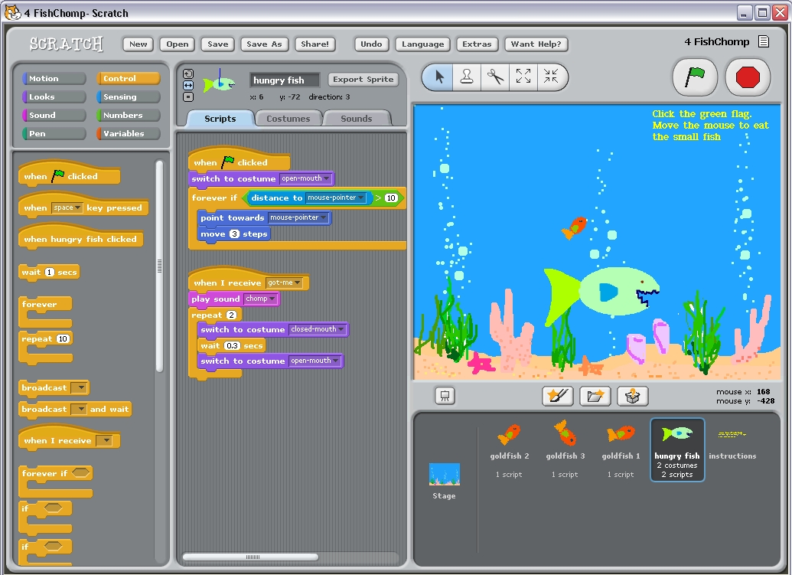
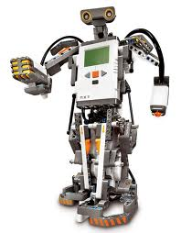
MakerState - Badge System
engineer
programmer
author
designer
entrepreneur
artist

Slide 17
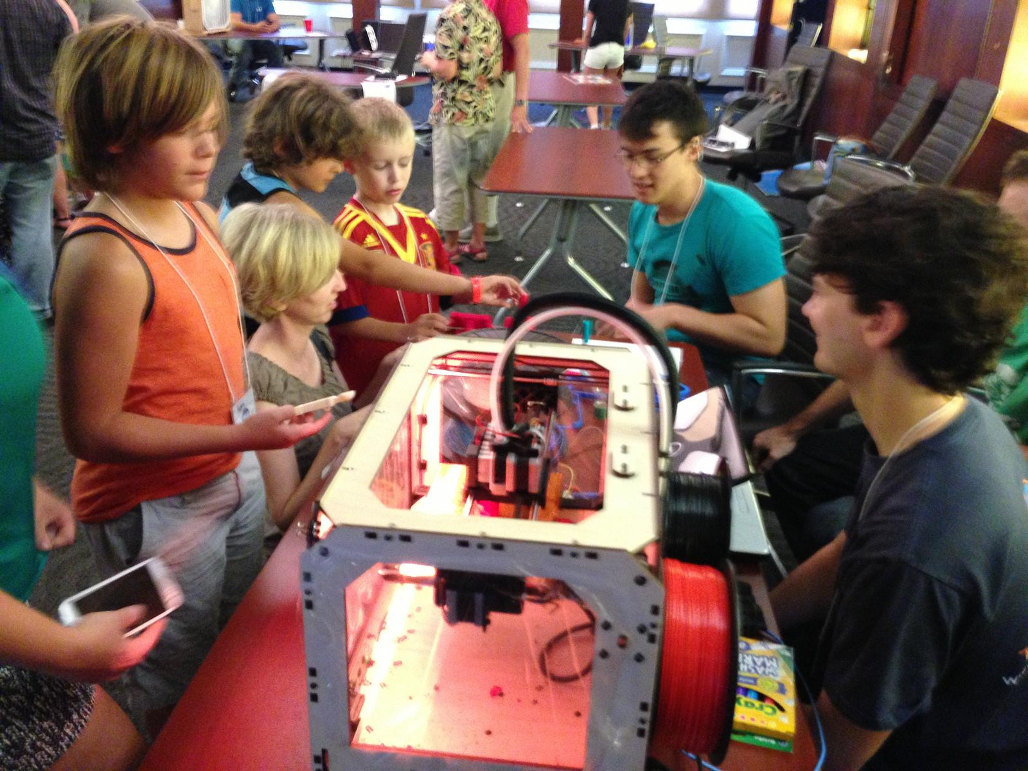
MakerState - Maker Meetups

Slide 18
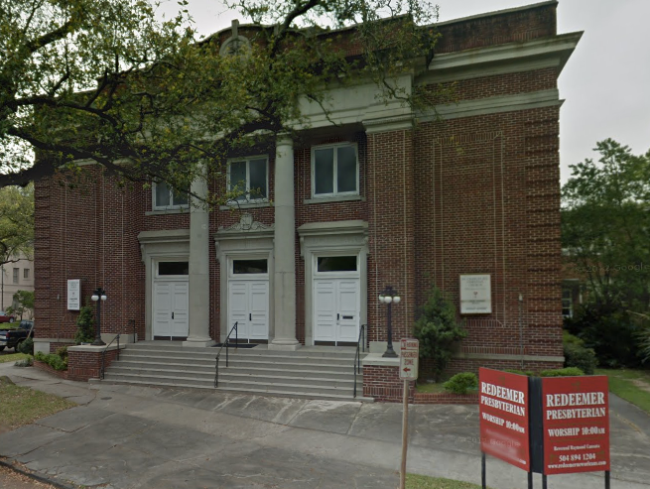
MakerState - Fall Programming

