Slide 1

Tyd'oas canleglhe: waht bcaeh deos tihs pohtoshrgph sohw?
w3lc0m3 b4ck 3v3ry0n3
Thnk y, Lh, fr sggstng ths chllng!

Slide 2
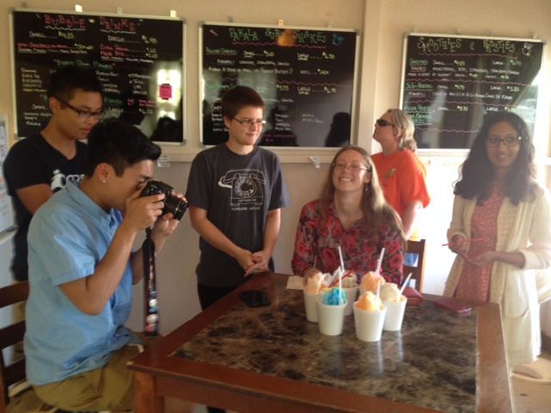

Slide 3
Getting started…
person-sorting activity

Slide 4
Problem Solving & Algorithms

Slide 5
Algorithms... ?
… are what CS is all about!

Slide 6
Algorithms... ?
An algorithm is a step-by-step process for solving problems

Slide 7
Algorithms... ?
enough detail that a even a computer could do it!
An algorithm is a step-by-step process for solving problems
not solving just one problem -- but a whole set of problems

Slide 8
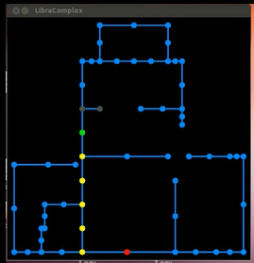
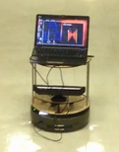
How do I get from A to B?
our map
our robot

Slide 9
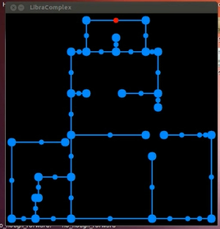
How do I get from A to B,
if I don't know where I am to start?

Slide 10
The CS view of the world...
?
Input
Output
Algorithm
CS's challenge
Once you start looking, you'll find algorithms everywhere!!

Slide 11



Two recent emails…
Which one is the more challenging algorithm?

Slide 12
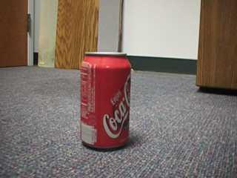
Seeing is an algorithm!
Task: finding coke cans

Slide 13
Where's the coke can?
Goal: a coke-can collecting robot…

Slide 14
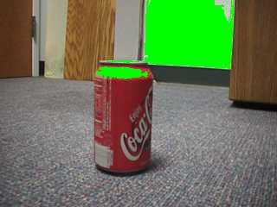
Where's the coke can?
red > 200
not good enough…

Slide 15
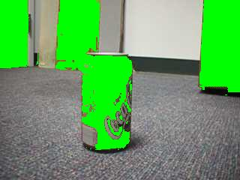
Where's the coke can?
| hue | < 25

Slide 16
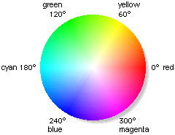
Hue and saturation
hue = 25°
hue = -25°

Slide 17
Where's the coke can?
| hue | < 25
not good enough…

Slide 18
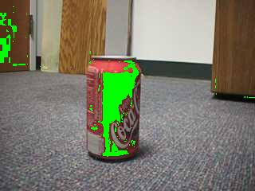
Where's the coke can?
| hue | < 25
saturation > 0.75

Slide 19
Hue and saturation
hue = 25°
sat > 0.75
sat < 0.75
hue = -25°

Slide 20
Where's the coke can?
Aargh!
| hue | < 25
saturation > 0.75
The door is still matched, too… why?

Slide 21
What's red?
Aargh!
| hue | < 25
Remarkably, this problem is, our own fault…!
saturation > 0.75
The door is still matched, too… why?

Slide 22
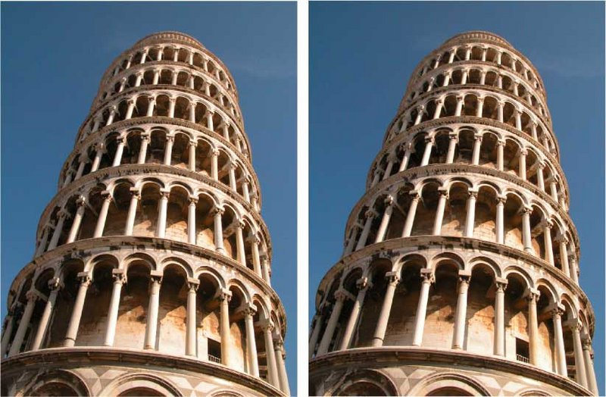

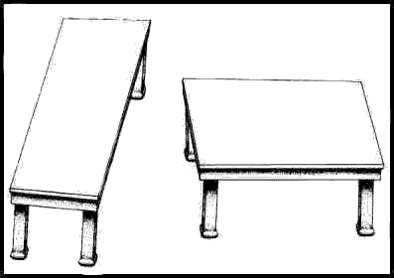
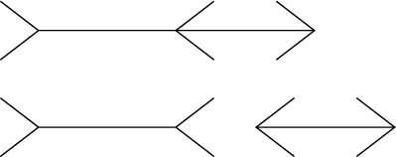
Quiz
Illusions? What algorithms is your brain doing to cause them? Why?
two tones
two towers
two tables
two segments

Slide 23
2 layers

Slide 24
2 layers

Slide 25
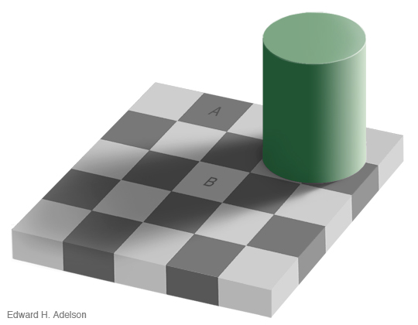
2 layers

Slide 28
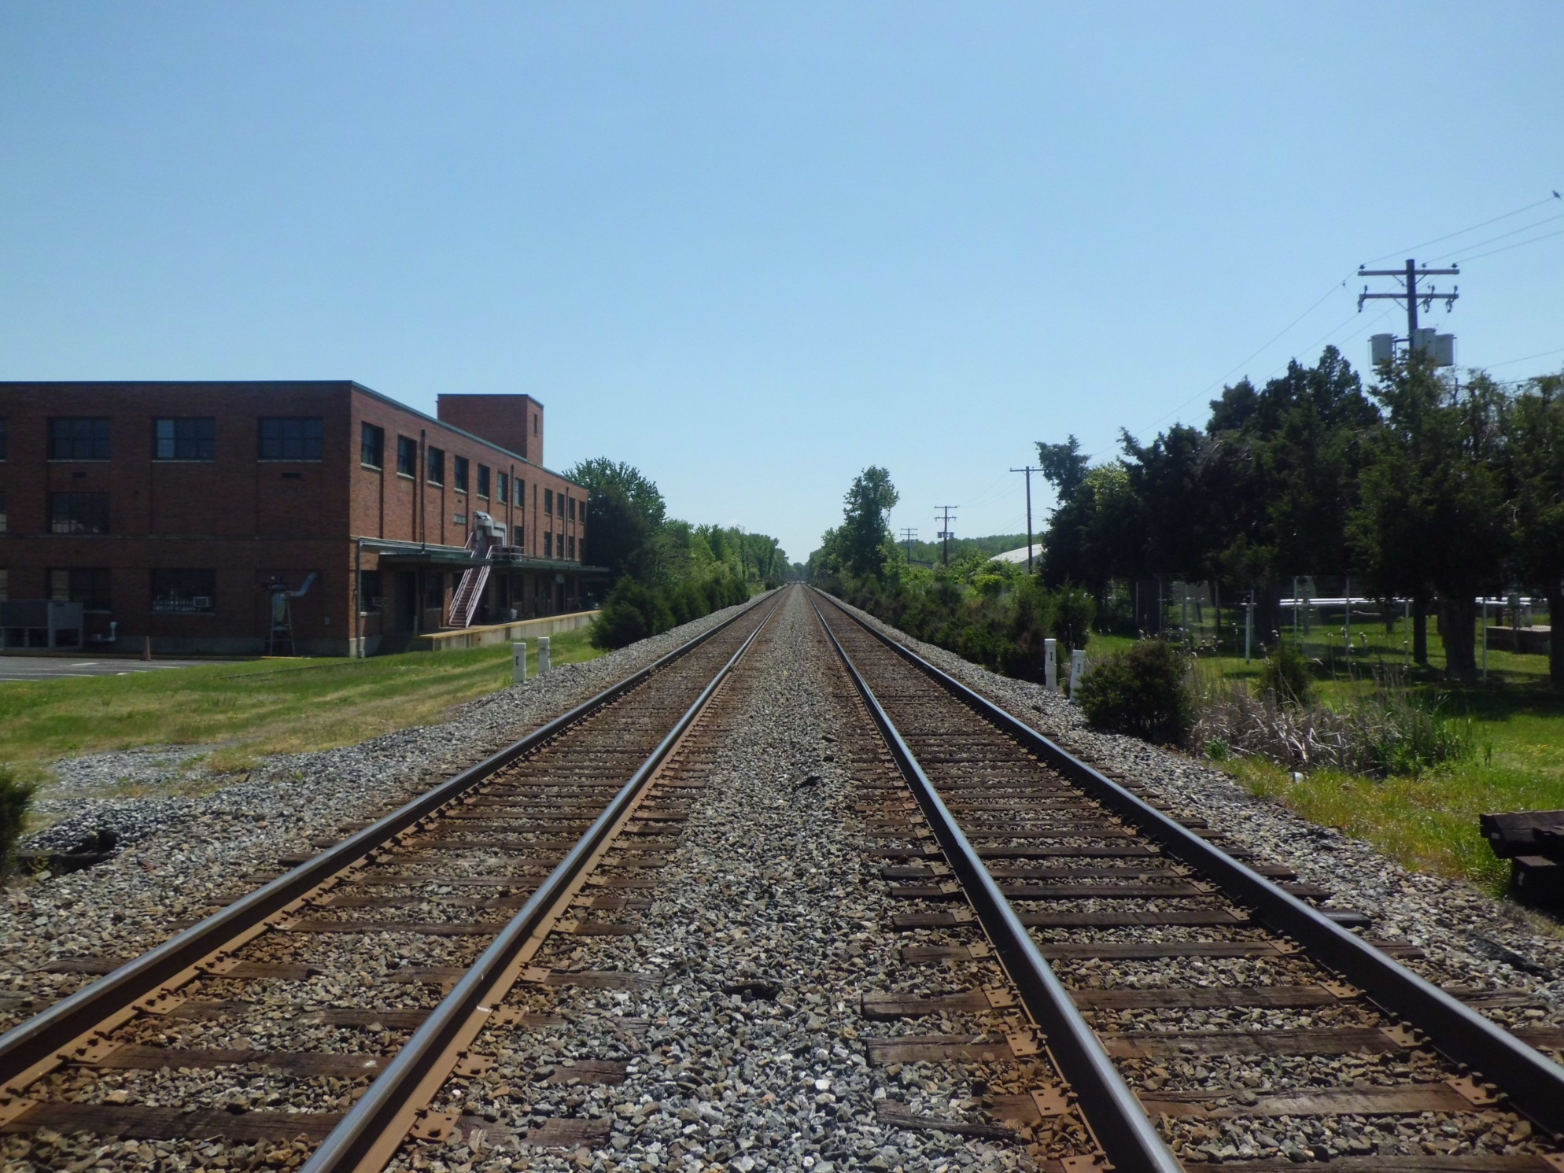
Are these lines parallel?

Slide 29
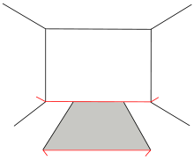

Slide 33
we don't always give our own vision system credit for everything it's doing…

Slide 34
we don't always give our own vision system credit for everything it's doing…

Slide 35
Quiz
Illusions? What computations is your brain doing to cause them?
Seeing is a much more challenging algorithm than it "appears"!

Slide 36
What's red?
Aargh!
| hue | < 25
saturation > 0.75
The door is still matched, too… why?

Slide 37
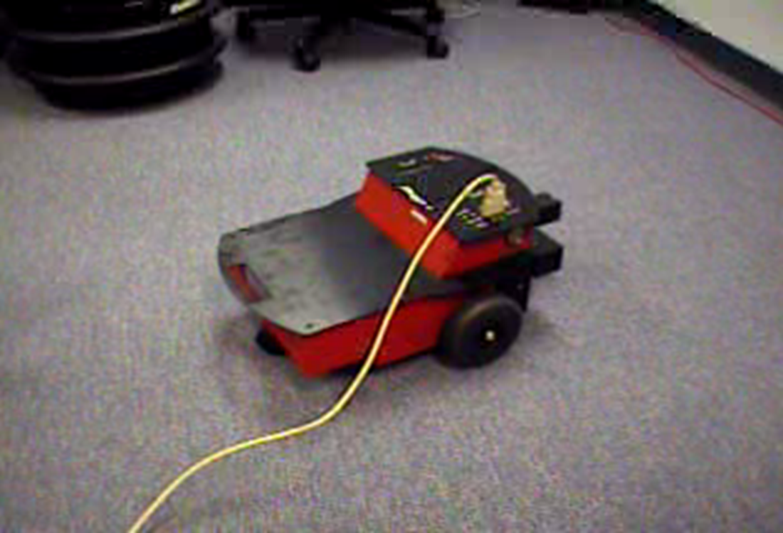
The coke-can collector: wall-avoidance

Slide 38
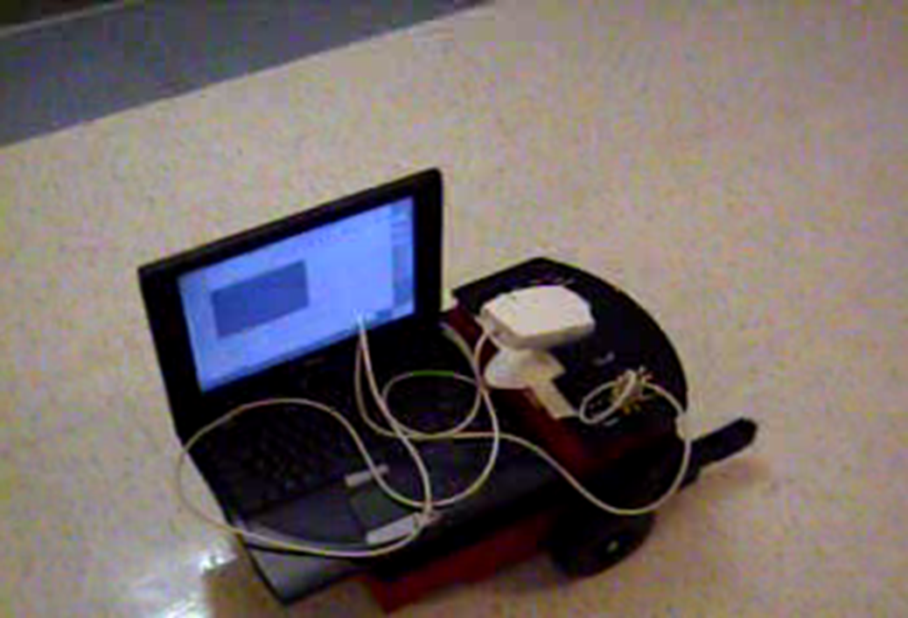
The coke-can collector: seeking…

Slide 39
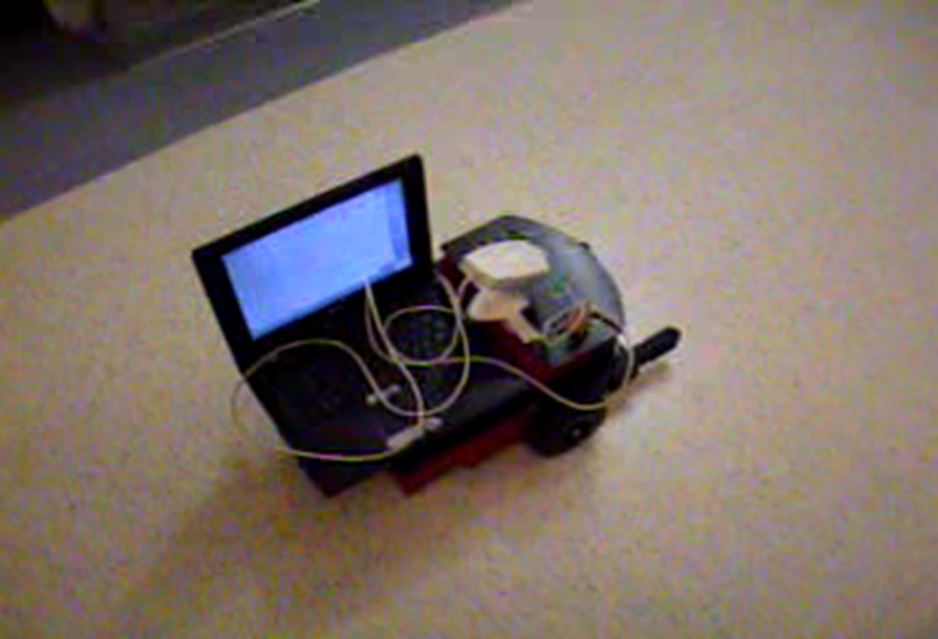
The coke-can collector: seeking…

Slide 40
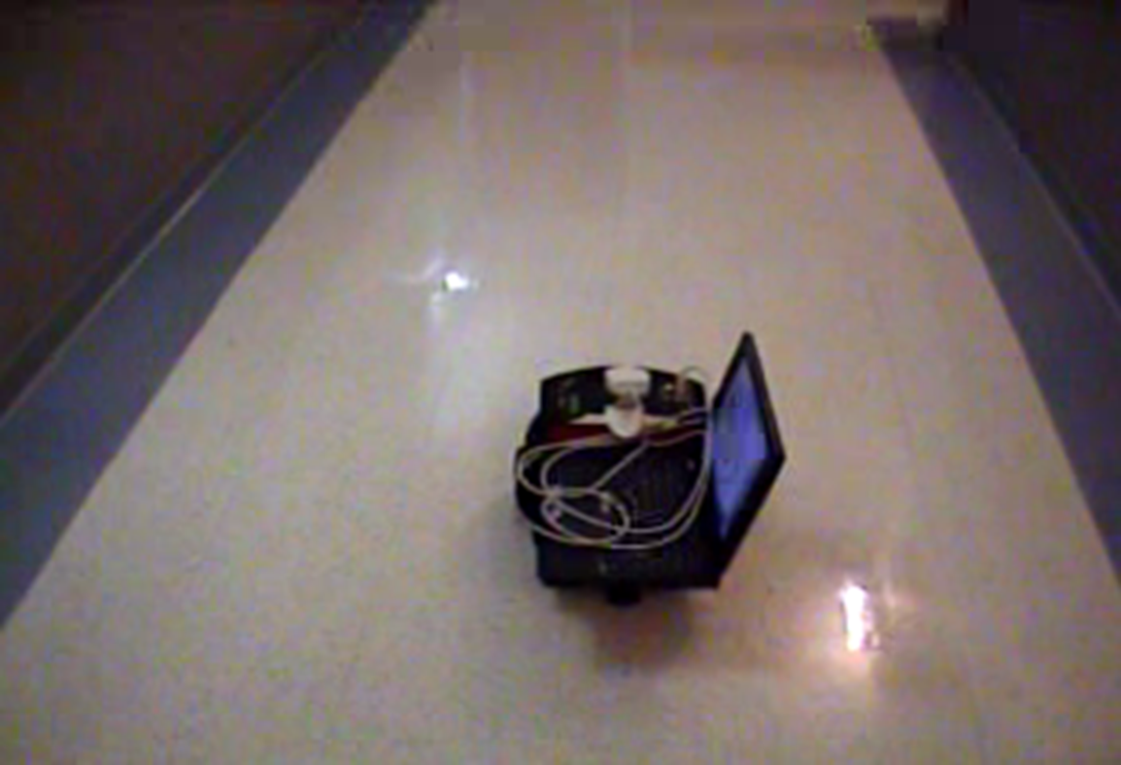
The coke-can collector: success!

Slide 41
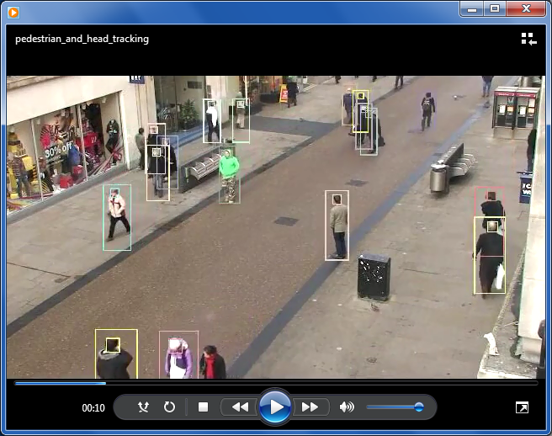
What's possible with seeing algorithms ?
pedestrians, walking…

Slide 42
Algorithms are simply answers to
" How do I … "
-type questions.
It might be that we identify more with our (personal) algorithms than anything else!

Slide 43
The purpose of computing is insight, not numbers.
Algorithms are how we represent problem-solving insights.
An algorithm isn't a solution, it's a process for getting a solution.

Slide 44
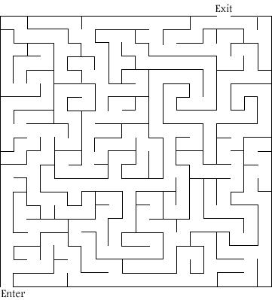
Problem-solving process
Don't worry about solving it as much as
Here's a familiar problem.
How would you solve it? ~ that's the algorithm!
Notes:
[depending...] get a maze that does have a solution.

Slide 45
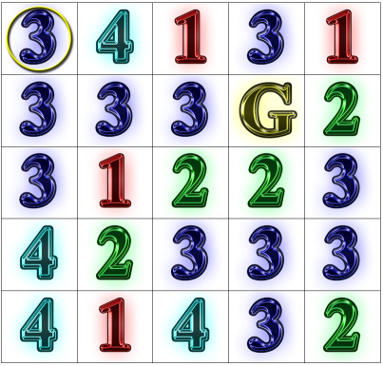
Algorithm ~ a problem-solving process
"rook-jumping maze"
What is the path from the ring to the G?
Notes:
This puzzle was great -- but it took a non-trivial amount of time to solve it.
-> but the time spent was good since it challenged them to find new ways
to think about it
they had to discuss different techniques to solve it like going backwards,
eliminating places that could never be used, etc.

Slide 46
Problem-solving (algorithm)
challenges…
(4 mazes)

Slide 47
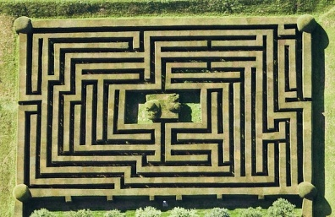
Can you solve the maze here? Start at the entrance on the left, and try to exit out of the top.
As you work, make note of the steps and strategies you used to solve the maze!
Problem Solving and Mazes
A hedge maze:

Slide 48
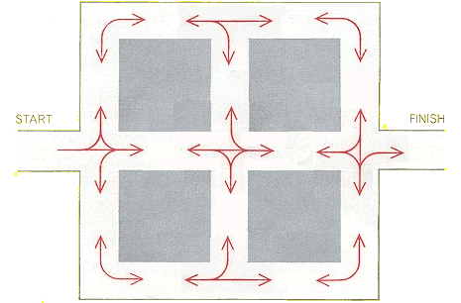
The Restricted Maze:
Travel along the white roads from start to finish. At each intersection, you must follow one of the red arrows. You may only travel in a certain direction only when there is an arrow that follows the same path. For example, You cannot make a right turn from the starting point.
http://www.logicmazes.com/
How is this maze different from the first one? What strategies did you use to solve it?

Slide 49
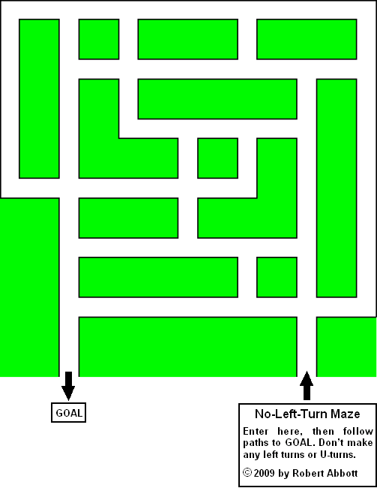
The No-Left-Turn Maze:
Can you solve this maze? Follow the path to get to the goal, but do NOT make any LEFT turns. At each intersection, you may only go straight or turn right.
How is this maze different?
What were some strategies you used to solve this maze?
http://www.logicmazes.com/

Slide 50
The Tilt Maze:
This maze is like the party favor toy: you are the circle (ball) and you want to get to the small square (the goal). When you choose a direction to go in, you must keep traveling in that direction until you hit one of the walls! You must travel in a straight line, and you can only change direction to move in if you’ve hit a wall.
How is this puzzle different from the first three? What new rules did you have to follow?
What strategies did you use to solve this maze?

Slide 51
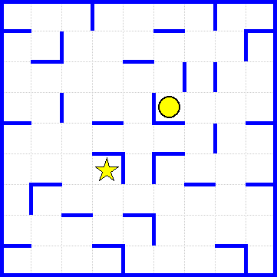
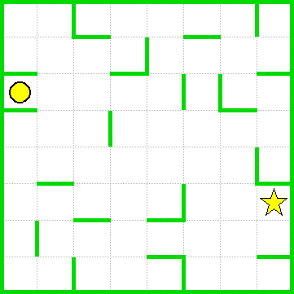
Bonus Mazes: If you finish early, work on these additional tilt-mazes below!

Slide 52
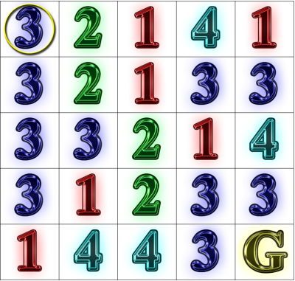
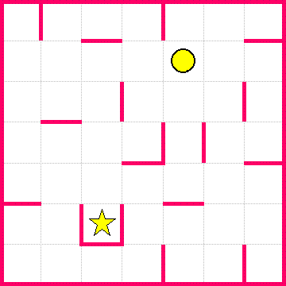
Another tilt and rook-jumping maze…

Slide 53
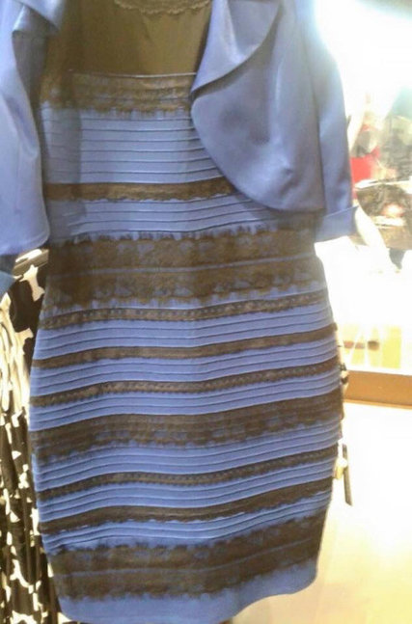
but we all know this… now!

Slide 54
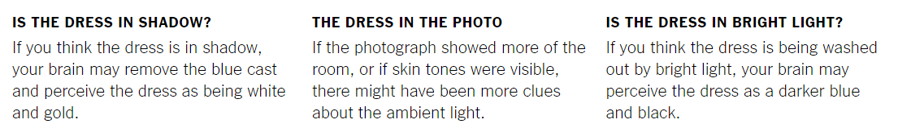
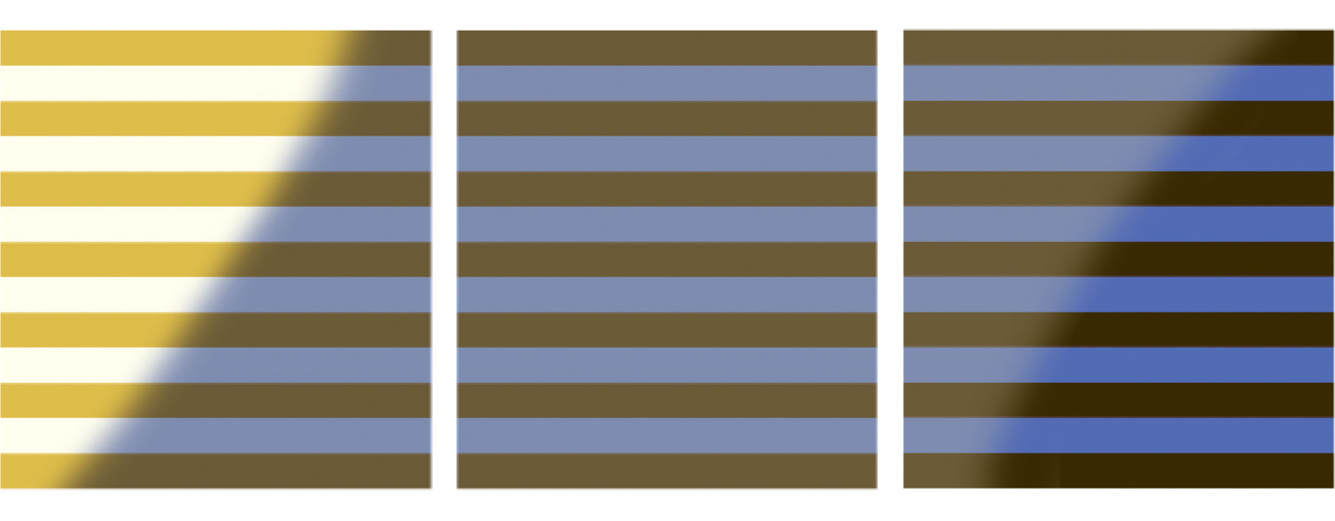
NYT…

Slide 55
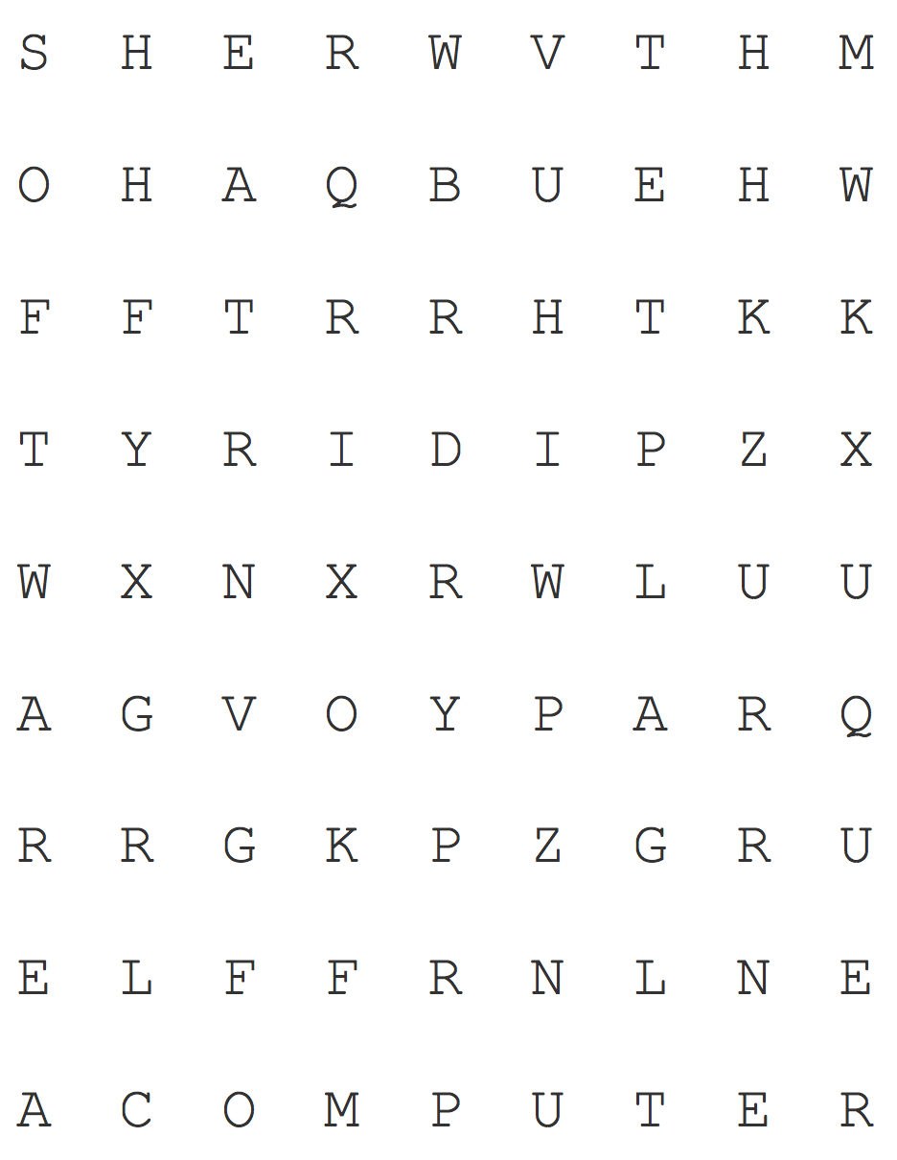
Solving Puzzles
Puzzle 1: Word Search
Find the following words:
Algorithm Software Hardware
Turing Computer
How did you solve the puzzle? Describe some of the steps you used to solve this particular word search.
Puzzle courtesy of http://puzzlemaker.discoveryeducation.com/

Slide 56

Now suppose you had to find 20 words in this puzzle, and then do 50 more like it—it would take a long time, and it probably wouldn’t be very fun, but you have an assistant who has a lot of free time and wants to help! However, your assistant has never done a word search before, and has no idea how to complete the puzzle!
In the space below, write a list of instructions for solving a word search that your assistant can follow!
Puzzle courtesy of http://puzzlemaker.discoveryeducation.com/

Slide 57
But does maze-solving have any real-life applications?

Slide 58
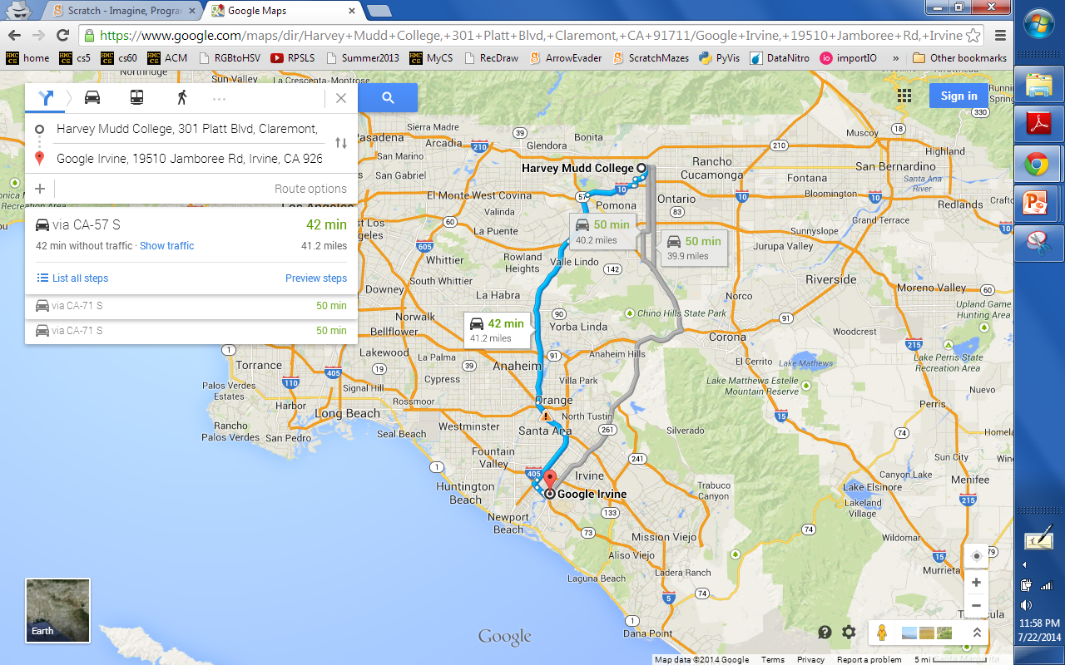
But does maze-solving have any real-life applications?

Slide 59
(1) Searching
Two fundamental algorithms:
(2) Sorting

Slide 60
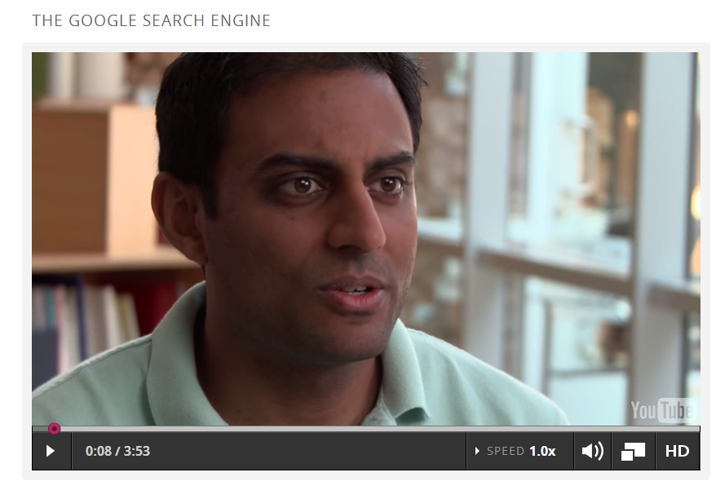
Why searching and sorting?

Slide 61
Searching!
42
4
3
17
99
100
844
1000000000
Where's 42?
Unordered Data

Slide 62
Searching!
844
99
100
4
17
42
3
1000000000
Where's 42?
Unordered List

Slide 63
Searching!
0
42
46
47
81
365
9001
1000000
Where's 42?
Ordered Data

Slide 64
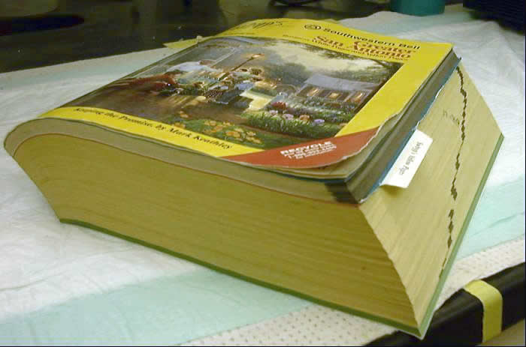
What's this?
it's ordered Data

Slide 65
Searching for data…
81
8246
82
5
365
199
42
12345
Unordered Data
What company makes its living from, essentially, doing precisely this?
makes all the difference!
5
42
81
82
199
365
8246
12345
Ordered Data

Slide 66
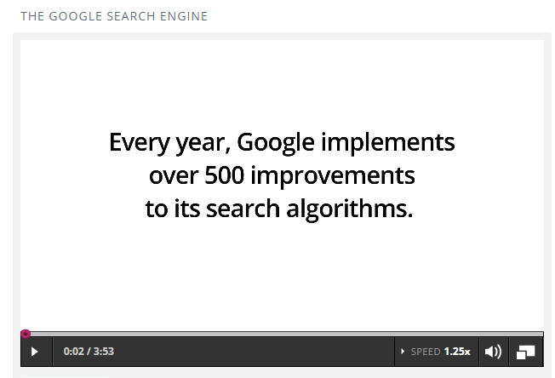
Searching is MUCH faster within ordered data!

Slide 67
but how do we get the list sorted?
844
99
100
4
17
42
3
1000000000

Slide 68
but how do we get the list sorted?
844
99
100
4
17
42
3
1000000000
This is deceptively easy because we "see" the answer automatically!

Slide 69
Step 1: Sorting people!
(1) Have 8 people hold cards to sort
(2) Act out each algorithm (+ count steps)
A. minsort
B. bubblesort
C. mergesort
# of comparisons
# of comparisons
# of comparisons
between each algorithm, mix or change the sorting criteria

Slide 70
3 sort algorithms
A. minsort
how does each one work?
B. bubblesort
C. mergesort

Slide 71
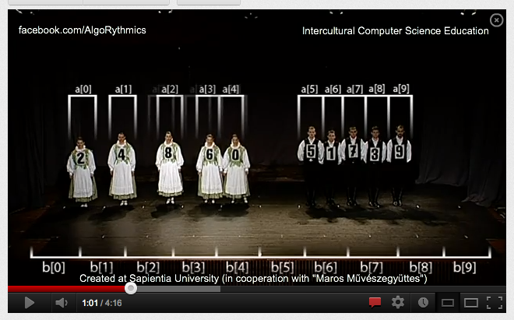
Sorting in dance…
look this up to see the many options...
http://www.youtube.com/watch?v=XaqR3G_NVoo

Slide 72
Step 2: Sorting cups…
(1) Teams make 8 cups with #s on post-its + swap
(2) Run each algorithm + count comparisons
A. minsort
B. bubblesort
C. mergesort
# of comparisons
# of comparisons
# of comparisons
between each algorithm, mix up the cups again – or swap with a different team!

Slide 73
Step 3: Comparing data
(1) Get ALL of the data from all of the teams.
A. minsort
B. bubblesort
C. mergesort
# of comparisons
# of comparisons
# of comparisons
find the average number of steps for each sorting algorithm – Which is fastest?

Slide 74
Is MergeSort for real? Let's see...

Slide 75
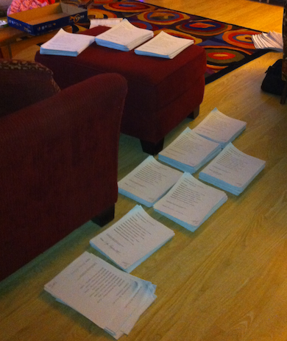
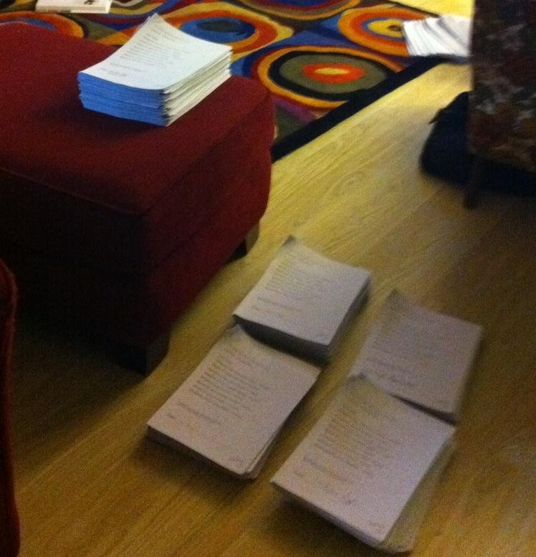
Is MergeSort for real? Let's see...
10 piles of 16
5 piles of 32

Slide 76
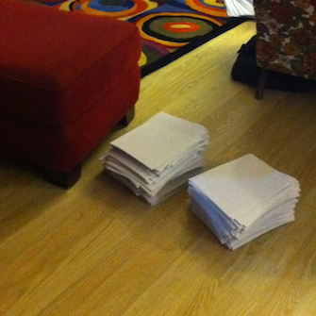
Is MergeSort for real? Let's see...
5 piles of 32
2 piles of 80

Slide 77
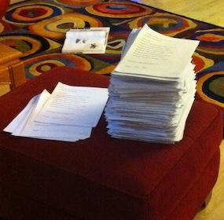
Is MergeSort for real? Let's see...
2 piles of 80
1 pile of 158
158?

Slide 78
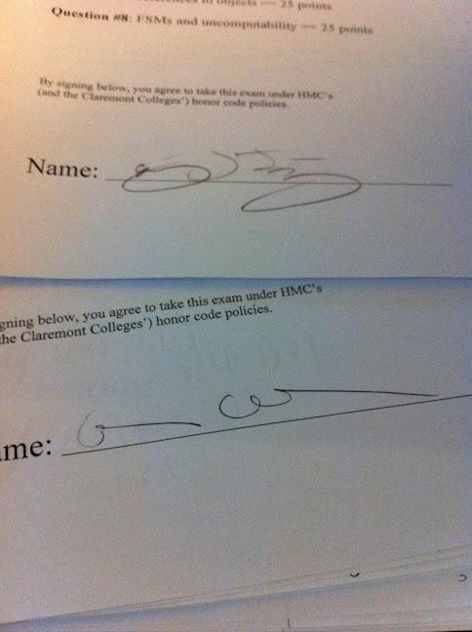
Is MergeSort for real? Yes!
2 piles of 80
1 pile of 158
Not sure who these people were....
158?

Slide 79

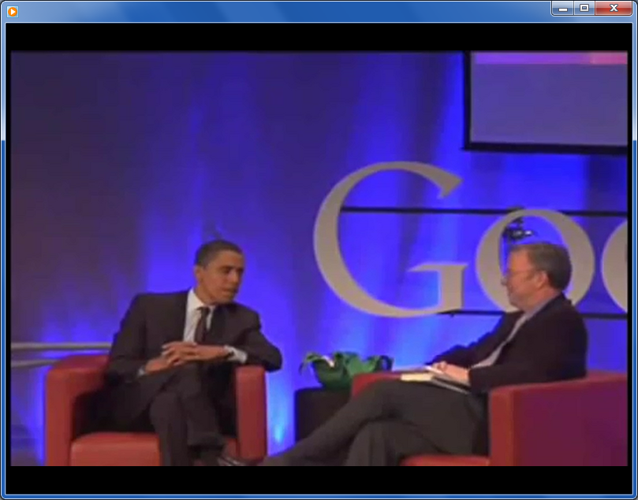
Sorting out sorting?
The president fields a question at Google…

Slide 80
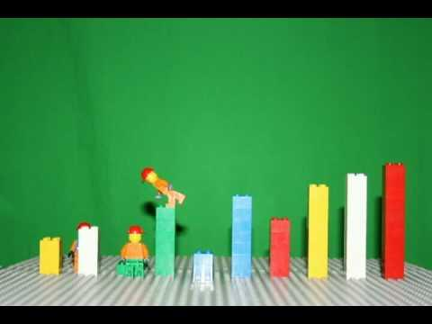
Lego Sorting
http://www.youtube.com/watch?v=MtcrEhrt_K0
Same approach in Scratch
Watch this sorting algorithm... which one is it?

Slide 81
Cup Algorithms
An Introduction to Coding, Functions, and Parameters
overview, activities and answers

Slide 82
Motivation
Algorithms + Robots are cool
Robots need instructions = algorithms!
Robots need very clear instructions in a language they can understand
Let’s create a language for a cup-tower building robot.
We can then express tower algorithms in our language!

Slide 83
Our language (code)
= Pick up cup
= Set cup down
= Move ½ cup width forward
= Move ½ cup width backward
= Flip cup over

Slide 84
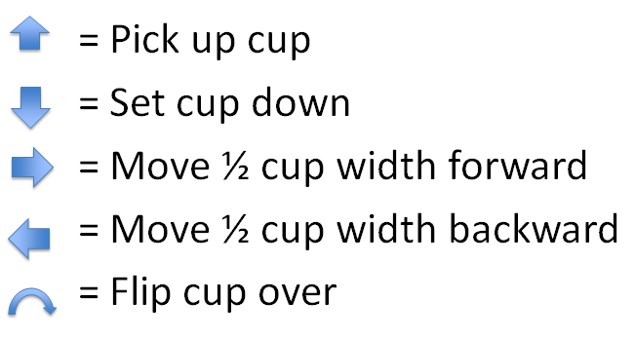
Let’s try our language!
(Example)
Consider this tower, we might
write this as:
0 1 2 3 4

Slide 85
Try it!
1. Decode this stack:
Draw your stack here:

Slide 86
Let’s try our language! (Build)
Answer
Try building a tower by
Following these instructions
0 1 2 3 4

Slide 87
2. Encode this tower:
Try it!
0 1 2 3 4

Slide 88
Now let’s encode!(Encode)
Answer
How would we write our
Robotic instructions?
0 1 2 3 4

Slide 89
Now, try designing your own!
Design a 3-5 cup tower
Encode the tower with the language
Trade codes with a partner
Build their tower using just their code
(no help!)
If the design and the tower are the same, awesome!
If there are some differences, try to figure out why that happened!
similar to the lego-tower activity

Slide 90
Try it!
3. Try building your own tower and writing its code:
4. Exchange codes with a partner, build the stack, then draw it here:
Draw your stack here:
similar to the lego-tower activity

Slide 91
How about this one?
This would take 328 arrows !!
It would be really hard to write, read, or fix if we make mistakes!
Do we have any patterns we can use?

Slide 92
Functions
A function is any process that we can repeat
Let’s use a function to make our language easier to write and understand!
Our new function:
= Move forward times
Example:
5
=

Slide 93
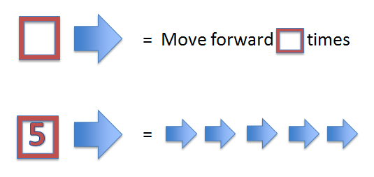
5. Decode this tower:
Try it!
2
2
4
4
6
6
5
5
2
2
Draw your stack here:

Slide 94
Try making this tower!
Answer
2
2
4
4
6
6
5
5
2
2
0 1 2 3 4 5 6

Slide 95
Try it!
6. Encode this tower:
0 1 2 3 4 5 6 7 8

Slide 96
Let’s use our new function!
Answer
Let’s encode this tower!
2
2
Easier to understand
Easier to write
We can build more interesting towers!
4
4
6
6
8
8

Slide 97
We can make any function!
What does this function do?
=
(It places a cup spots away)

Slide 98
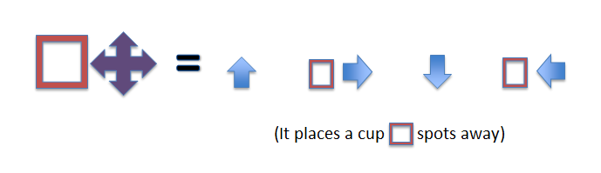
7. Decode this tower:
Try it!
2
4
3
Draw your stack here:

Slide 99
Step By Step
Answer
2
4
3
Step 1
2
Step 2
2
4
Step 3
2
4
3

Slide 100
Try it!
8. Encode this tower:
Hint: use this “place cup” function!
0 1 2 3 4 5 6 7 8

Slide 101
Encoding with our new function
Answer
How would we encode this?
2
4
3
6
5
4

Slide 102
Make your own function!
Let’s re-visit this tower:
Do you see any patterns?
What would a useful function for this be?
How could we write this function?

Slide 103
The flipped tower function
Let’s make a function that makes a flipped tower some spaces away from the start
=
Let’s try using our new symbol!
=
2
4
0 1 2 3 4

Slide 104
Functions are powerful!
2
4
6
8
10
12
14
16
We went from a tower that needed 328 arrows, to one that just just uses 8 symbols!

Slide 105
Create your own function!
Bonus: Part 1
What’s the symbol for your function, and what does it do?
Give an example of a tower that can be made that uses your function
How would you represent your function using only arrows and functions we’ve already created?

Slide 106
Bonus: Part 2
2. Encode a tower that uses your new function at least twice.
3. Exchange codes with a partner, build the stack, then draw it here:
Draw your stack here:

Slide 107
Take-home message
Understanding problems is the key to solving them -- and it's much more important than solving a particular one!
Computer Science is the science of analyzing (and solving) information-based problems.
Often, that means creating algorithms!
could these activities be made to work with your students?

Slide 108
Afternoon session
first: WhyCS? ~ seeing, better…
then: adding hardware…
to blocks-based software
@3:00: wrap-up chat (teams)

Slide 109

Why CS ~ a course-wide module

Slide 110
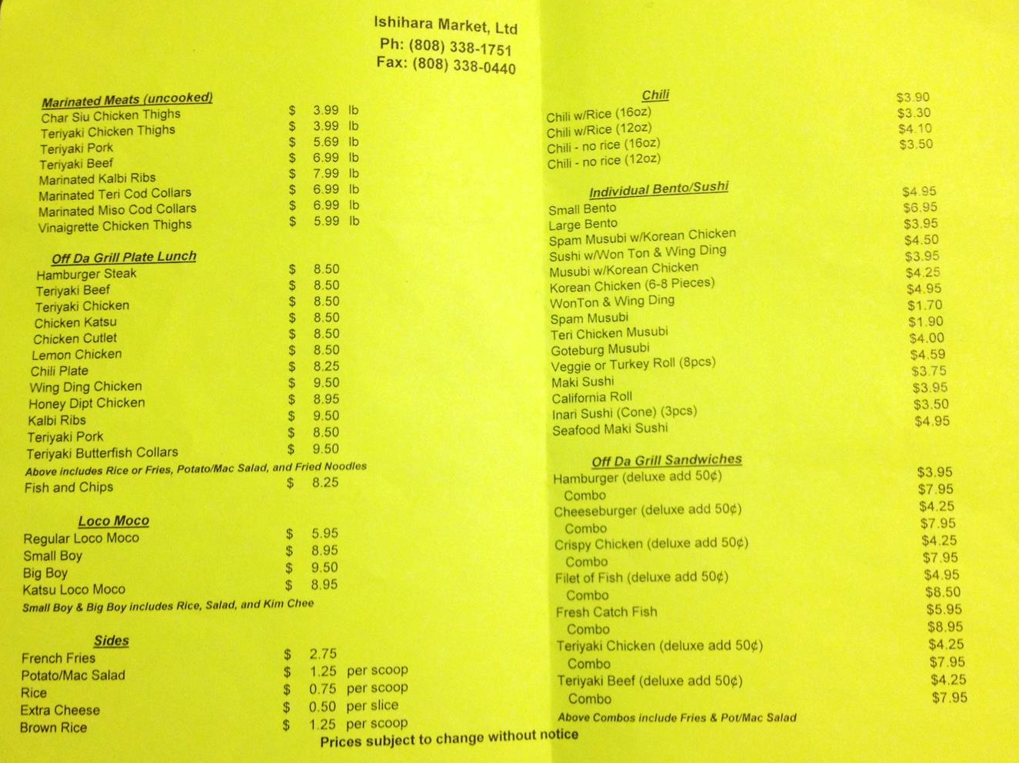
Lunch
Today
& Friday

Slide 111

Maker Movement
101
MakerState
Jenna deBoisblanc

Slide 112
What is the Maker Movement?
“third industrial revolution”
“everyone a maker”
Notes:
- forbes, wired, huffington post are calling the maker movement the “third industrial revolution”
- new, cheap easy-to-learn software and hardware tools open the door to innovation and creativity
- “everyone a maker”

Slide 113
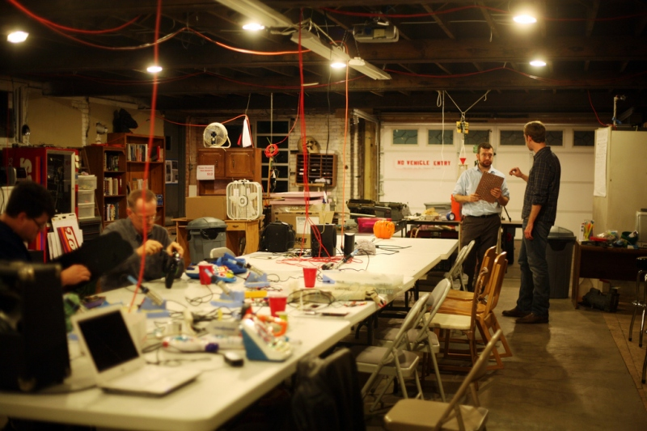
Makerspaces or hackerspaces

Slide 114

Maker Faire
Notes:
- Maker Faire is popularizing the movement
- Maker Faire is an event created by Make magazine to "celebrate arts, crafts, engineering, science projects and the Do-It-Yourself (DIY) mindset".
- first in 2006 in San Mateo - 20,000 visitors

Slide 115

Tools
3D printers
laser cutters
CNC machines
Arduinos
Raspberry Pis

Slide 116

3D Printing

Slide 117

3D printed record

Slide 118


Arduinos
open-source tools for building electronics projects
- hardware
- software

Slide 119


Arduino - examples

Slide 120


Arduino - examples

Slide 121

Hardware Startups
“hardware is the new software”
nest
MYO armband
Notes:
more investment and incubators, rapid-prototyping

Slide 122
Maker Demographics
“3D printing may spark a new Industrial Revolution. But that doesn't mean prosperity for all.”
- Salon News
8/10 male
media age - 44
average income - $106,000
97% college graduates

Slide 123
STEM
2nd fastest growing occupation
3 million unfilled jobs in 2020
18% women
12% minorities
Notes:
- Occupations in STEM fields are the second-fastest growing in the nation, just behind health care,
- in the next decade, we going to add over 9 mollion STEM-related jobs, ⅓ of which are projected to be unfilled if we don’t ramp up STEM education.
- 18% of science and engineering degrees are awarded to women

Slide 124
MakerState
Bringing the
Maker Movement
to the
classroom

Slide 125

MakerState
hands-on, mastery-based STEAM learning
Notes:
copious amounts of research, experience, and common sense shows that hands-on, experiential learning is the best way to engage students.

Slide 126


MakerState - Badge System
engineer
programmer
author
designer
entrepreneur
artist

Slide 127

MakerState - Maker Meetups

Slide 128

One foothold:
Raspberry Pi
monitor
power
network
usb
"the best way to have software + hardware talk to each other"

Slide 129
One foothold:
Raspberry Pi
monitor
power
network
usb
"just a computer! ~ admittedly, an inexpensive one…"

Slide 130

Our foothold:
Arduino
USB
power
"the best way to have software + hardware talk to each other"

Slide 131
Let's try it!

Slide 132
Why CS ~ a course-wide module

Slide 133


Google's car and Google…
Google's driverless vehicle(s)
Its sensed data…
C:\Users\Owner\Desktop\fall2012files\Final week summer 2012\google_car_for_c1.m4v

Slide 134

"…only possible because of our maps."
road surface texture
3d point cloud of obstacles
obstacle permanence
road-lane location
Many hours of computation, additional data collection, and hand-checking…

Slide 135


"…only possible because of our maps."
Local, sensor-based "maps"
Map-matching: 10cm accuracy
GPS: 12-15 foot accuracy
Collect current snapshot of the world, and align it to the most likely position in the map.

Slide 136
Creating a Scratch Game
in 7 steps…
with unlimited room for expansion + creativity!

Slide 137

Step 1: Choose a hero!
(1) Choose a main character or "hero" ...
(one that you will control)
choose one
upload from file
draw your own
take a new picture

Slide 138

Step 2: Motion with the keyboard
(2a) Add this program to your hero sprite so that you can control it with the up arrow:
(2b) Add more blocks so that all arrow keys work appropriately. Where could you put them?

Slide 139

Step 3: Wrap master
(3a) Make sure your "hero" can wrap around the screen from top to bottom:
(3b) Add other wrapping as you see fit!

Slide 140

Step 4: Choose a goal.
(4) Create a second sprite ~ the goal!
(something you want the hero to reach)
the fearsome enemy
the goal
the hero
Place it on the other side of the scene.

Slide 141

Step 5: Choose an enemy.
(5a) Create a third sprite ~ an enemy!
(something you want the hero to avoid)
Place it in the middle of the scene, and
have the enemy move continuously:
This is a program within the enemy's scripts, not the hero's scripts.
(5b) Also, have your enemy wrap around the screen – use the hero's wrapping program as a guide.

Slide 142

Step 6: Reset if you collide!
(6a) For the hero sprite, when the hero hits the enemy, teleport the hero back to the hero's start:
(6b) It's good to have the hero start there at the beginning, too. Which block does that?

Slide 143
Step 7: Celebrate if you win!
(7a) For the hero sprite, when the hero hits the goal, celebrate.
For this, make another program very similar to the one handling the hero-enemy collisions!
Change the message and add a victory sound/song!
(7b) After celebrating, you should reset the hero…

Slide 144
The sky's the limit!
Now, add at least two of these features:
(a) Add a changing score variable (Data menu)
(b) Have the enemy move randomly (Operators)
(c) Add more enemies
(d) Add "power-ups" that change your hero's size, score, or speed
(e) Add portals to teleport the hero randomly
(f) Have the game end when a timer runs out.
(g) Have a second level that is more dificult.
And... at least two of your own ideas... !

Slide 146
Cup Algorithms
An Introduction to Coding, Functions, and Parameters
activities only

Slide 147
Try it!
1. Decode this stack:
Draw your stack here:

Slide 148
2. Encode this tower:
Try it!
0 1 2 3 4

Slide 149
Try it!
3. Try building your own tower and writing its code:
4. Exchange codes with a partner, build the stack, then draw it here:
Draw your stack here:

Slide 150
5. Decode this tower:
Try it!
2
2
4
4
6
6
5
5
2
2
Draw your stack here:

Slide 151
Try it!
6. Encode this tower:
0 1 2 3 4 5 6 7 8

Slide 152
7. Decode this tower:
Try it!
2
4
3
Draw your stack here:

Slide 153
Try it!
8. Encode this tower:
Hint: use this “place cup” function!
0 1 2 3 4 5 6 7 8

Slide 154
Create your own function!
Bonus: Part 1
What’s the symbol for your function, and what does it do?
Give an example of a tower that can be made that uses your function
How would you represent your function using only arrows and functions we’ve already created?

Slide 155
Bonus: Part 2
2. Encode a tower that uses your new function at least twice.
3. Exchange codes with a partner, build the stack, then draw it here:
Draw your stack here:

Slide 156

What if we didn't have a map?!
GeoGuessr ~ you're dropped in a random "street view" location and need to figure out where you are… . Once you have a guess, check how close you were!

Slide 157

Parallel Sorting
Follow the arrows...
At each merge point,
the higher # goes right
the lower # goes left
Which group can sort themselves more quickly?
Notes:
parallel sorting was quite popular with beryl and carling's group -> everyone was saying that their students would love it

Slide 158
Do we compute?
Your demonstrations game/scene/anything…
Your insights on CS + MyCS
Lunch…

Slide 159
Today…
AppInv
Arduino
MyCS (data)
Arduino
Python
MyCS (algorithms!)

Slide 160
We were here…
large cs5 from last fall…
data from HI Pomona HMC…

Slide 161
We were here…
CS ~ increasingly worthwhile

Slide 162

Linear vs. Binary Sorting!
How do they compare?
1) "Min Sort"
2) "Merge Sort"
How does this relate to dictionary-searching?

Slide 163
Sorting out sorting
Let's race three sorting algorithms
1) Act out minsort - count our comparisons: _____
2) Act out mergesort - count comparisons: _____
3) Try a parallel sort network - count: _____
Which one wins?
Notes:
worked better in smaller groups because everyone thinks they know where they need to go even though they don't
needs explicit instruction from person in charge -> could we put one of the teachers in charge so that somebody is learning as we try it out
parallel sorting networks are super popular, tied into mike's talk about parallelism that occurred in computer disassembly previously
need to show teachers how to make the sorting network for any number of numbers to sort
doing with 4 numbers or so vs. doing with 8 could reinforce how fast it can be doing comparisons in parallel
-> sorting networks are supposed to be /fast/ but have a lot of comparisons

Slide 164

An Infamous Equation
How long did it take you guys to learn the quadratic formula?
Did any of you learn songs?
Here's a way to use Scratch your kids might like

Slide 165

Min Sort
"Linear Sorting"
Idea: Search for the smallest element, then the second smallest, and so on...
More detail: Compare pairs of elements to find the smallest. Remove the smallest and place it at the end of the sorted list. Repeat until all elements are in the sorted list.

Slide 166
Merge Sort
"Binary Sorting"
Idea: Split repeatedly, then merge back!
More detail: Split in half repeatedly; when there are only two elements per list, they are easy to sort: just swap if needed!
Then, repeatedly merge two sorted lists by (1) comparing the first elements, and (2) placing the smaller element,
~ until all of the elements are sorted!

Slide 167
Sorting out sorting
Let's race three sorting algorithms
1) Act out minsort - count our comparisons: _____
2) Act out mergesort - count comparisons: _____
3) Try the parallel sorting network - count: _____
Which one wins?
Notes:
worked better in smaller groups because everyone thinks they know where they need to go even though they don't
needs explicit instruction from person in charge -> could we put one of the teachers in charge so that somebody is learning as we try it out
parallel sorting networks are super popular, tied into mike's talk about parallelism that occurred in computer disassembly previously
need to show teachers how to make the sorting network for any number of numbers to sort
doing with 4 numbers or so vs. doing with 8 could reinforce how fast it can be doing comparisons in parallel
-> sorting networks are supposed to be /fast/ but have a lot of comparisons

Slide 168
Other fun things students can make and play with in Scratch
Random Walk: applying randomness to a game
The Game of Life: Studying patterns and predicting possible outcomes
Using cloning in a Scratch game to shoot at villains
Using other types of controls to move your sprite
Solving simple Math Problems in Scratch

Slide 169
Algorithms everywhere
An algorithm is a process for solving problems.
... a couple inspired by the life sciences

Slide 170
Sorting and Searching
Day 3, Session 2

Slide 171

"Algorithm"
An algorithm is a process for solving problems.
Simply put, algorithms are what CS is about.

Slide 172
"Algorithm"
An algorithm is a process for solving problems.
The Nine Algorithms/Chapters:
(1) Ideas Computers Use Every Day
(2) Search Engine Indexing: Finding Needles in the World's Biggest Haystack
(3) PageRank: The algorithm that made Google
(4) Public Key Cryptography: Secrets on a Postcard
(5) Error-Correcting Codes: Mistakes That Fix Themselves
(6) Pattern Recognition: Learning from Experience
(7) Data Compression: Something for Nothing
(8) Databases: The Quest for Consistency
(9) Digital Signatures: Who Really Wrote This Software?
(10) What Is Computable?
(11) Conclusion: More Genius at Your Fingertips?

Slide 173
"Algorithm"
An algorithm is a process for solving problems.
Sorting
The Nine Algorithms/Chapters:
(1) Ideas Computers Use Every Day
(2) Search Engine Indexing: Finding Needles in the World's Biggest Haystack
(3) PageRank: The algorithm that made Google
(4) Public Key Cryptography: Secrets on a Postcard
(5) Error-Correcting Codes: Mistakes That Fix Themselves
(6) Pattern Recognition: Learning from Experience
(7) Data Compression: Something for Nothing
(8) Databases: The Quest for Consistency
(9) Digital Signatures: Who Really Wrote This Software?
(10) What Is Computable?
(11) Conclusion: More Genius at Your Fingertips?
Searching

Slide 174
Searching...
Seeking "spam"
Wubster's dictionary - not in order!
Webster's dictionary - in order
What algorithms can we use to find "spam"?
Notes:
This was cool.
Maybe actually print out a list of words in random order to stand in for "wubster's dictionary".

Slide 175
Linear Search (unsorted data)
Start at the first word.
"Is this the word we want?"
If it's not, go to the next word.
the algorithm
In the worst-case scenario, how many unsorted words would we have to look at before we get to the right one?
An example of a linear search in Scratch can be found here!

Slide 176
Binary Search (sorted data)
Can we find words faster if they're sorted?
If so, how?!?
Webster's Dictionary

Slide 177
Binary Search (sorted book)
the algorithm
Check the word in the middle.
If it's after our word, repeat with the 1st half.
If it's before our word, repeat with the 2nd half.
Seeking "spam" ...
mixplate
must be in here some-where

Slide 178
Binary Search (sorted book)
the algorithm
Check the word in the middle.
If it's after our word, repeat with the 1st half.
If it's before our word, repeat with the 2nd half.
Seeking "spam" ...
mixplate
here some-where
wusubi

Slide 179
Binary Search (sorted book)
the algorithm
Check the word in the middle.
If it's after our word, repeat with the 1st half.
If it's before our word, repeat with the 2nd half.
Seeking "spam" ...
mixplate
here some-where
soy sauce
wusubi

Slide 180
Binary Search (sorted book)
the algorithm
Check the word in the middle.
If it's after our word, repeat with the 1st half.
If it's before our word, repeat with the 2nd half.
Seeking "spam" ...
If our book has 32 words in it, how many do we look at before we definitely find the right one? 64? 1,000,000?
swordfish
An example of a binary search in Scratch can be found here!
Notes:
This was good.
Consider mentioning 20 Questions implementation.

Slide 181
Linear vs. Binary Search
With a large amount of sorted data, binary search is almost always more efficient.
But how do we get our data sorted?
Notes:
relate to Google: unordered search, need to sort
divide and conquer activity as example of binary search method (10 min)
with small boxes - like the santa video??
http://www.youtube.com/watch?v=wVPCT1VjySA&feature=player_embedded

Slide 182

Comparisons
The basic building-block of sorting is
comparing two items.
Consider these two numbers:
and
Which number is larger?
How can you tell?
110111001100100100010100111110101
110111001100100100010101111110101

Slide 183
Let's sort!
dukes
orange
feral burger
bbq
macademia
musubi
spam
coffee
Create 8 post-it notes with these words, one per note...

Slide 184
Let's sort!
First: In pairs, sort your items...!
Note: Computers can compare only two items at a time! The HMC students will help by saying what's smaller/larger...
Then: Sort again, counting the number of pairwise comparisons you make in order to ensure your items are sorted.
Challenge: describe a sorting algorithm that works for all possible cases!
Notes:
cans with pennies in them: 2,5,10,15,20,25,30,37 were the amounts
seemed to go over well

Slide 185
Your sorting algorithms:

Slide 186

This week…
Glass sign-ups?
Welcome back!
Returners
Newcomers
MyCS
Mon.
Python programming
AppInventor
Tue.
AppInventor
Arduino, Circuits, and Robots
Wed.
Arduino, Circuits, and Robots
Python programming
Thu.
Morning – activities and demonstrations for the full group.
Afternoon everyone shows off one of the projects they built this week. primarily because we hope you will show it to your students…!
Fri.
No workshop on Friday.

Slide 187
Today…
AppInv
Arduino
MyCS (data)
Arduino
Python
MyCS (algorithms!)

Slide 188




Our game: Up, up, and away!
First, let's pair up -- so that each pair has both a teacher and an HMC student...

Slide 189

Problem-solving patterns
Q: How many breaks are needed to fully separate these pieces?
Brick-breaking challenge

Slide 190
Break it up...
# of breaks
# of pieces
1
2
3
4
12
B
N

Slide 191
Lunch Prompts: Scratch
(1) How would you imagine using Scratch with your students?
(2) What simple projects would you start with to get students comfortable?
(3) Would it be better for students to work in pairs or alone on Scratch projects?
(4) What other projects or curricular requirements could Scratch be used for?
Notes:
worked better in smaller groups because everyone thinks they know where they need to go even though they don't
needs explicit instruction from person in charge -> could we put one of the teachers in charge so that somebody is learning as we try it out
parallel sorting networks are super popular, tied into mike's talk about parallelism that occurred in computer disassembly previously
need to show teachers how to make the sorting network for any number of numbers to sort
doing with 4 numbers or so vs. doing with 8 could reinforce how fast it can be doing comparisons in parallel
-> sorting networks are supposed to be /fast/ but have a lot of comparisons

Slide 192
Is MergeSort for real? Let's see...

Slide 193
Is MergeSort for real? Let's see...
10 piles of 16
5 piles of 32

Slide 194
Is MergeSort for real? Let's see...
5 piles of 32
2 piles of 80

Slide 195
Is MergeSort for real? Let's see...
2 piles of 80
1 pile of 158
158?

Slide 196
Is MergeSort for real? Yes!
2 piles of 80
1 pile of 158
Not sure who these people were....
158?

Slide 197
Mergesort, in dance
look this up to see the many options...
http://www.youtube.com/watch?v=XaqR3G_NVoo

Slide 198

Sorting Activities from
Searching Algorithms
Sorting Algorithms
Sorting Networks

Slide 199

Our game: Fly, fly again...
Use these blocks to write a script that makes it so that if you press the UP arrow, the helicopter goes up, but if you DON'T press the up arrow, the helicopter goes down (like gravity!)
Make sure to save when done!

Slide 200


Butterfly Game
Create a two-toned background with a butterfly or a sprite of your choice "flying" in it. Use Scratch to change the costume of your sprite when it touches one of the colors.

Slide 201

Helicopter Game
Open Scratch and add the helicopter sprite.
It can be found in the "transportation" folder of sprites.
Notes:
helicopter game (15 min)

Slide 202
Helicopter Game
Change the background to have a start, an end, and some obstacles (color is key!).
Then, make sure that if the helicopter hits an obstacle, it resets back to the start.
You now have a playable game!
Notes:
create background -> copter starts somewhere, has to get to end, resets if hits obstacle
more helicopter game (20 min)

Slide 203
Scratch: Position
Day 3, Session 4

Slide 204


Slide 205


Slide 206


Want smooth motion?
Notes:
Should include glide block also here.
Experiment with drawing using coordinates, make shapes using corner coordinates, drawing challenges from worksheets (35 min)
worksheets:
http://www.cs.hmc.edu/~cs5grad/MyCS/2012_Curriculum/scratch_offline/day_15/worksheet.pdf
http://www.cs.hmc.edu/~cs5grad/MyCS/2012_Curriculum/scratch_offline/day_17/worksheet.pdf
#outline

Slide 207


Coordinate Practice
Review...
New...

Slide 208


Slide 209


Slide 210


Slide 211
Choose Your Challenges
Pick a challenge from the worksheets and implement it.

Slide 212
Scratch: Ifs and Elses

Slide 213

If Block
The "if" block can be found in the control tab.
The if block means, "IF this happens, THEN do this."
You can put blocks ON the if block and IN the if block.
Notes:
Sort of introduces earlier because people were excited about scratch and getting ahead of themselves

Slide 214

Sensing Blocks
Most of the blocks that fit ON the if block are sensing blocks, which can be found in the sensing tab.
Different sensing blocks can detect if a key is pressed, if the sprite is touching something, or if the sprite moves to a certain position.

Slide 215

Forever If
Usually, you don't want to just run the if block once, you want it to always be running.
To make it run forever you can either put it in a forever block or use the forever if block.
Notes:
This slide definitely needs to be shown -> some people missed it we think

Slide 216

Operators
In Scratch, operators let you connect other ideas together.
Many of these operators do things you have seen in math.
Notes:
operators (5 min)

Slide 217


Common Operators
Some operators let you compare values (like numbers).
Other operators let you combine other blocks.

Slide 218

Will the sprite say "Hello!" when you run this script?

Slide 219

What will the variable "X" be after you run this script?

Slide 220
Predict and Test
To get comfortable with operators, partner with the person sitting next to you and go through the worksheet.
Notes:
#outline
section should have printout:
http://www.cs.hmc.edu/~cs5grad/MyCS/2012_Curriculum/scratch_offline/day_26/worksheet.pdf

Slide 221


Slide 222


Slide 223


Slide 224


Slide 225


Slide 226

Broadcast Block
The broadcast block has a sprite send a signal.
You have to give each signal a name.
When another sprite hears that signal, it can start running a new script.
This can be helpful when you don't want one script to start until another script is finished.
Notes:
broadcasting and receiving (5 min)

Slide 227

Receiving a Broadcast Signal
To make a sprite listen for a signal, use the receive block, and choose which message to have it wait for.

Slide 228


Slide 229
Congratulations!
You've gone through an abridged version of the Scratch curriculum!
In the time remaining, team up with a partner and create a small project to show off your Scratch skills to everyone else.
Notes:
create your own project? (30 min)

Slide 230

Two envelopes...
Both envelopes have some money in them. You know that one envelope has double the amount in the other envelope.
Suppose you choose an envelope and you find M money in it. Say, $20.
Now you have the opportunity to trade. Should you?
Notes:
mindblowing.

Slide 231
More 1990's versions...

Slide 232


About face
Do we have face-detection algorithms ourselves?
Notes:
232

Slide 233


Holistic vs. part-based reasoning
Who are these folks?
If I were two faced, why would I be wearing this one?
- Abraham Lincoln
Notes:
Lincoln’s quote!
233

Slide 234
Holistic vs. part-based reasoning
It is more difficult to recognize distinct halves of faces, when aligned.
Holistic? Part-based?
Notes:
Lincoln’s quote!
234

Slide 235


Notes:
Lincoln’s quote!
235

Slide 236
Notes:
Lincoln’s quote!
236

Slide 237


Innate face detection?
Infants prefer the top image to the bottom one…
Evidence for the fusiform face area (FFA), a specialized face-detection module

Slide 238
Innate detection?
Infants prefer the top image to the bottom one…
But they also prefer the first row here:
Still debated as to whether infant preferences are for “faces” or “top-heavy” images

Slide 239


Learned recognition.
Infants prefer the top image to the bottom one…
Evidence for the fusiform face area (FFA), a specialized face-detection module

Slide 240

Peter Thompson 1980
Holistic? Part-based?

Slide 241
Peter Thompson 1980
Holistic? Part-based?

Slide 242


Peter Thompson 1980
Holistic? Part-based?

Slide 243

Parts!
Vector of normalized landmark coordinates (inter-landmark distances)
Slide credit: A. Efros

Slide 244


Parts clearly matter…

Slide 245

Parts clearly matter…

Slide 246

Parts clearly matter…
http://www.youtube.com/watch?v=m56F4EKN9hg

Slide 247

Some parts are more equal than others
The eyebrows turn out to be more important than the eyes…

Slide 248
Some parts are more equal than others
Nixon
Winona Ryder
The eyebrows turn out to be more important than the eyes…

Slide 249

Viola and Jones: Results
How is searching over many scales simplified?

Slide 250


Applications!
Smart cameras
Safety
auto focus,
red eye removal,
auto color correction
Lexus LS600 Driver Monitor System
smile!
Others?

Slide 251



Anonymization!
A Google maps' image over Chad
Opportunity!?
Notes:
opportunity: sell spots to actors!

Slide 252

Face replacement
Nayar et al. Columbia University, 2008
May be able to improve on blurring faces...

Slide 253

Face replacement
by replacing faces from a library of options...
Recognize either of these actors?

Slide 254
Face replacement
Gweneth Paltrow
Denzel Washington

Slide 255

First, create a large library...
Download images from the Internet and process them using a face detector
  Approximately 33,000 faces found
  Detector returns face pose (yaw, pitch, roll) and six fiducial points
  Sort faces according to yaw and pitch angles, and align to a common coordinate system using fiducial points

Slide 256


Algorithm, visualized

Slide 257
How well does it work?
Try it out…
Which of the two images is the original?

Slide 258





Which of these are real?

Slide 260
Face replacement results

Slide 261
Image de-Identification
Original
Notes:
Here is another example… The input image..

Slide 262

Image de-Identification
Replaced
Notes:
And the result of face de-identification

Slide 263



Limitations: Gender
Input
Candidate
Output
Notes:
Since our system does not currently enforce consistency for gender, it is possible for a female face to be replaced with a male one.

Slide 264

Limitations: Occlusion
Input
Candidate
Output
Notes:
Occlusion presents a significant problem to the current implementation of our system.
In this example, the input image is occluded by a hand which causes strong artifact in the result.

Slide 265

You are at a party with a total of 2, 3, 4, 10, or N people (including you)...
Q: How many handshakes do you need in order to greet everyone?
Q: How many handshakes are needed so everyone greets everyone?
# in group
# of h.shakes needed
# in group
# of h.shakes needed
2
2
3
3
10
10
N
N

Slide 266



Another algorithm example...
predicting your movie ratings…

Slide 267

The Netflix Prize
Bob Bell, winner of the "Netflix prize"
Napoleon Dynamite =
Batman Begins =
??
??
Finding Nemo =
Lord of the Rings =
??
??
Some films are difficult to predict… and others are easier!

Slide 268
Prediction errors...
(I don't know this guy)
Bob Bell, winner of the "Netflix prize"
Napoleon Dynamite =
Batman Begins =
1.22
.75
Finding Nemo =
Lord of the Rings =
.67
.42
These scores are the average error (in units of stars) for each film

Slide 269
The purpose of computing is insight, not numbers.
Algorithms are how we represent problem-solving insights.
An algorithm isn't a solution, it's a process for getting a solution.

Slide 270


Searching…
Artist
Take-home message: searching is fast when the data is in order (sorted)
Chef

Slide 271
Real Sorting
Artist's preferences?
Chef's preferences?
Other themes??

Slide 272
Trying things out…
mazes and puzzles
handshake challenge
[[ lesson survey / reflection ]]
searching
sorting
[[ survey: ways to make this work at any age? ]]

Slide 273
We were here…
Pictures of Lego towers!
Tetris ambiguity

Slide 274
Alg. examples
binary magic trick
emails
walls
text
computer vision – the ultimate algorithm!
Markov text generation

Slide 275
Alg. examples
finding a piece of data from a list!
improvise a Jazz melody
find a face – or a coke can
find your way through the halls
emails
walls
text
binary magic trick
computer vision – the ultimate algorithm!
Markov text generation

Slide 276
understanding > solving…
Notes:
Maybe make them play this instead of just explaining it. Make sure there is enough time allocated to this part.

Slide 277

understanding > solving…
Recognize this game show?
http://www.youtube.com/watch?v=WKR6dNDvHYQ
Notes:
Maybe make them play this instead of just explaining it. Make sure there is enough time allocated to this part.

Slide 278



Let's Make a Deal...
Choose... Reveal... Switch or stay?
Let's Make a Deal is in Scratch too!

Slide 279

Let's Make a bigger Deal...
1
2
3
4
5
6
7
8
9
10
A
B
C
D
E
F
G
Notes:
original

Slide 280
Let's Make a bigger Deal...
1
2
3
4
5
6
7
8
9
10
A
B
C
D
E
F
G
Notes:
Next!

