Slide 1
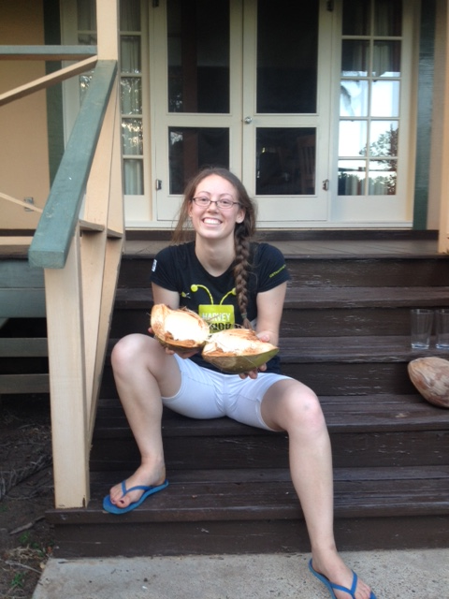
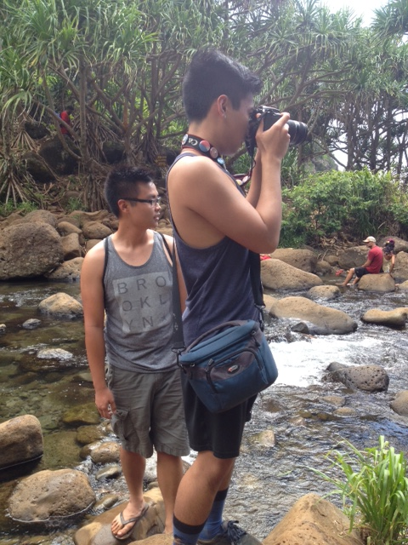
Where are they? (We?)
Notes:
As a community, then, we don't need more material – certainly we're happy for more!
But there are amazing resources out there…
But for all of these wonderful resources, our partnering teachers tell us they want a one-stop curriculum tailored for them.

Slide 2
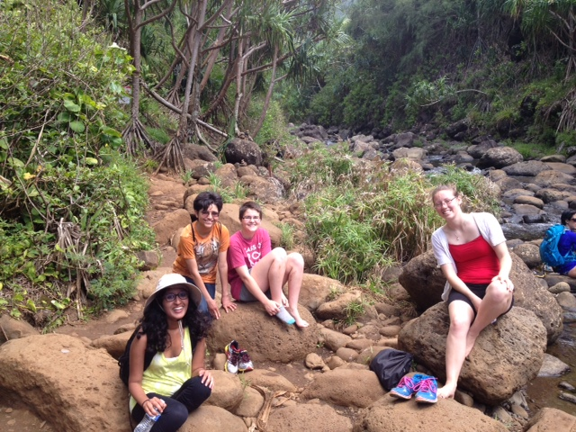
Where are they? (We?)
Notes:
As a community, then, we don't need more material – certainly we're happy for more!
But there are amazing resources out there…
But for all of these wonderful resources, our partnering teachers tell us they want a one-stop curriculum tailored for them.

Slide 3
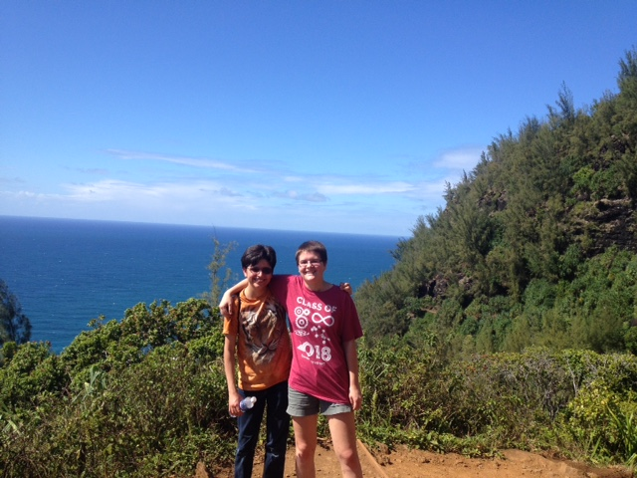
Where are they? (We?)
Notes:
As a community, then, we don't need more material – certainly we're happy for more!
But there are amazing resources out there…
But for all of these wonderful resources, our partnering teachers tell us they want a one-stop curriculum tailored for them.

Slide 4
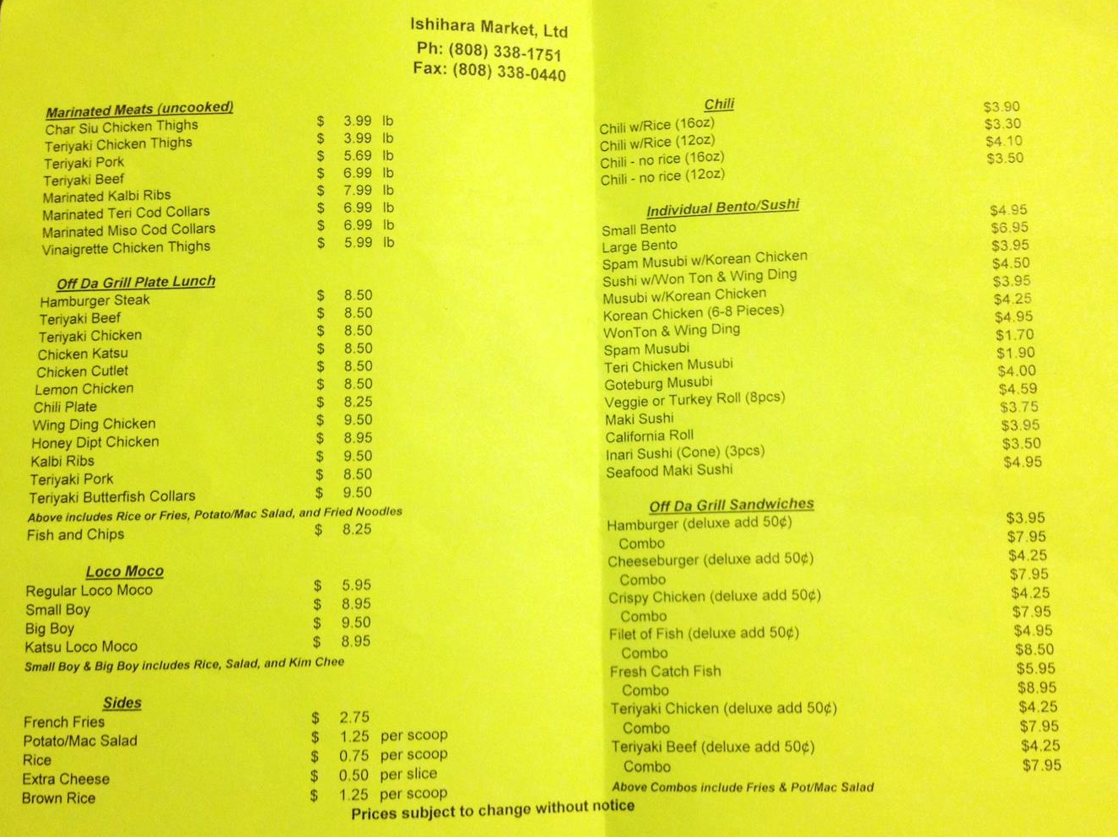
Set for Lunch?
call today @ 9:30am
they do have Hawaiian lunch plates…
alternative: G's

Slide 5
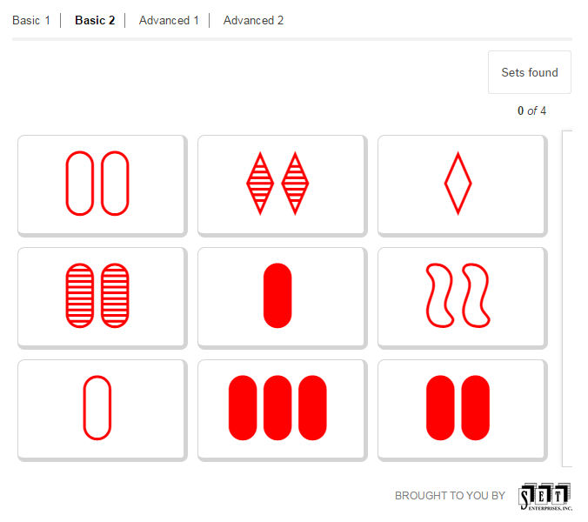
Ice-breaking challenge: Ready … Set …
Notes:
As a community, then, we don't need more material – certainly we're happy for more!
But there are amazing resources out there…
But for all of these wonderful resources, our partnering teachers tell us they want a one-stop curriculum tailored for them.

Slide 6
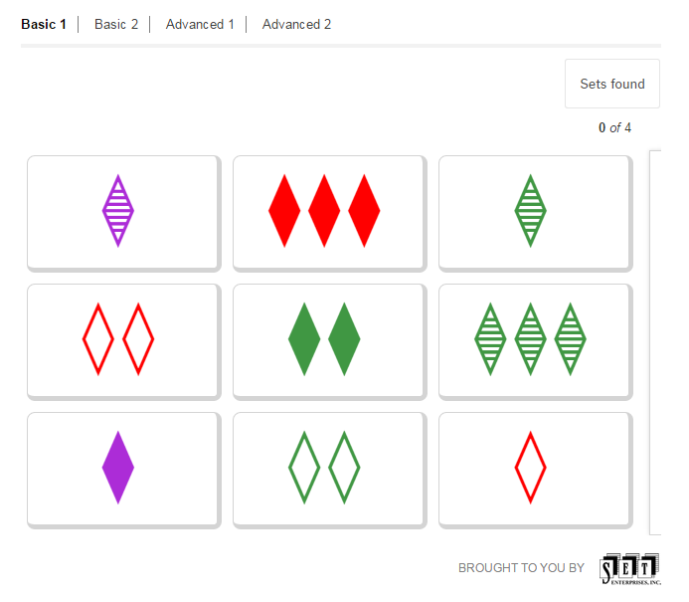
Ice-breaking challenge: Ready … Set …
Notes:
As a community, then, we don't need more material – certainly we're happy for more!
But there are amazing resources out there…
But for all of these wonderful resources, our partnering teachers tell us they want a one-stop curriculum tailored for them.

Slide 7
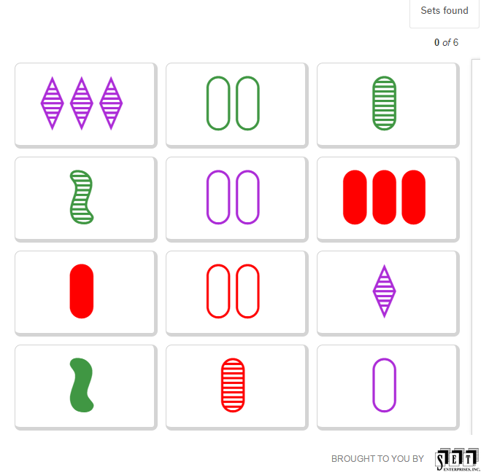
Ice-breaking challenge: Ready … Set …
Notes:
As a community, then, we don't need more material – certainly we're happy for more!
But there are amazing resources out there…
But for all of these wonderful resources, our partnering teachers tell us they want a one-stop curriculum tailored for them.

Slide 8
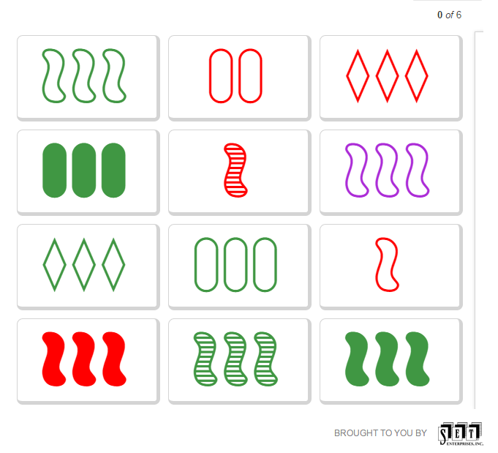
Ice-breaking challenge: Ready … Set …
Notes:
As a community, then, we don't need more material – certainly we're happy for more!
But there are amazing resources out there…
But for all of these wonderful resources, our partnering teachers tell us they want a one-stop curriculum tailored for them.

Slide 9
We don't need more CS stuff…
There is lots of it out there!
Notes:
As a community, then, we don't need more material – certainly we're happy for more!
But there are amazing resources out there…
But for all of these wonderful resources, our partnering teachers tell us they want a one-stop curriculum tailored for them.

Slide 10




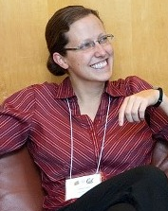
We don't need more CS stuff…
though we're always happy for more!
Notes:
As a community, then, we don't need more material – certainly we're happy for more!
But there are amazing resources out there…
But for all of these wonderful resources, our partnering teachers tell us they want a one-stop curriculum tailored for them.

Slide 11
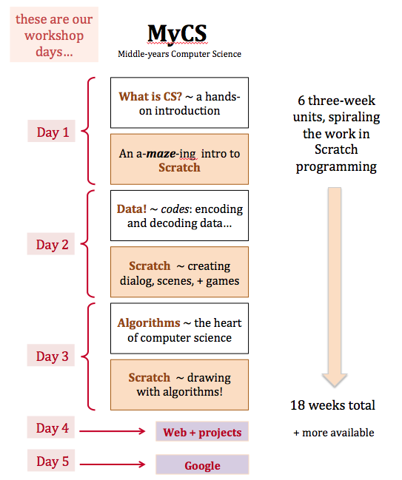
… we need more CS support
with all that excellent material
Notes:
[[read]]
So, what we can do is *support* teachers by organizing these resources in ways that work with their students.

Slide 12
… we need more CS support
with all that excellent material
… we need more CS connections
to other topics
Notes:
[[read]]
So, what we can do is *support* teachers by organizing these resources in ways that work with their students.

Slide 13
Biology-inspired algorithms
What looks complex in biology can often be explained by simple rules

Slide 14

Biology-inspired algorithms
What looks complicated in biology can often be explained by simple rules
Biology creates self-similar forms
Fractals

Slide 15
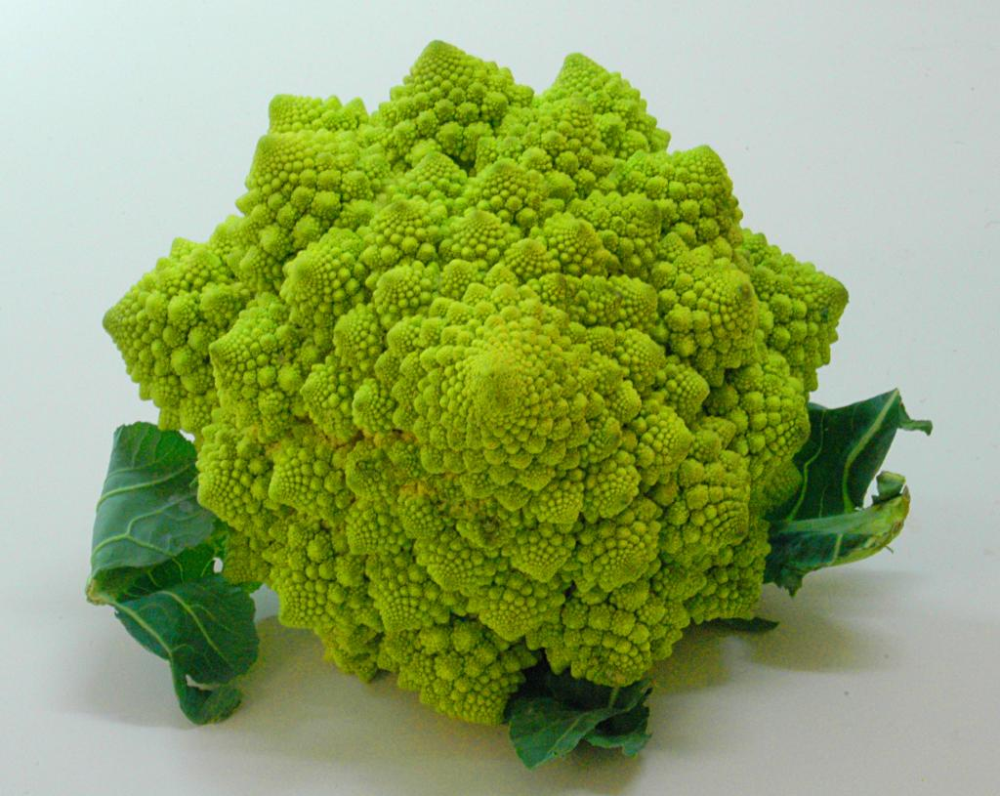

Slide 16
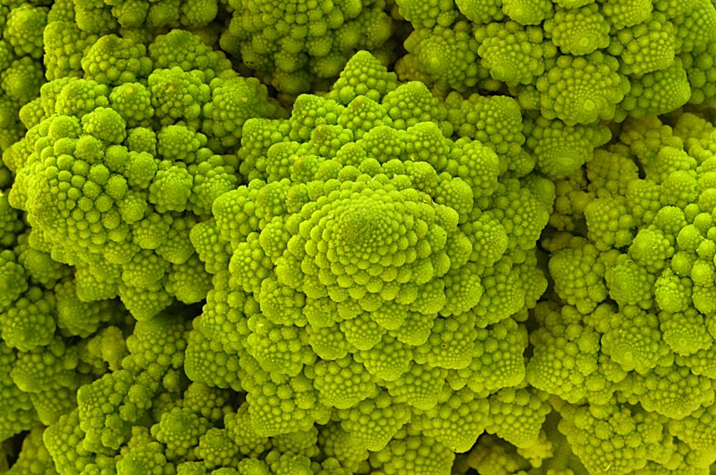
Are these rules for real?
Yes... and no.

Slide 17
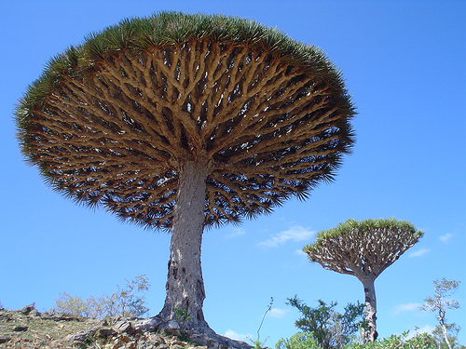
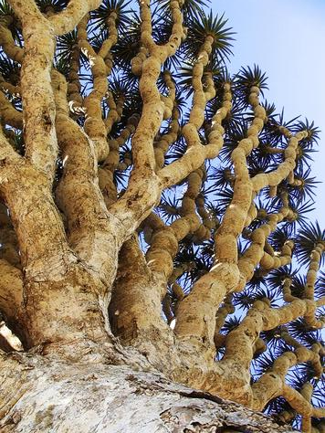
Dragon's-blood Tree

Slide 18

Tree Rules
height = 4 cm
(1) At each new dot:
(2) Draw a T with dots on its ends
(3) Divide height by 2
Go back to step (1) and continue

Slide 19
Tree Rules
height = 4 cm
(1) At each new dot:
(2) Draw a T with dots on its ends
(3) Divide height by 2
Go back to step (1) and continue
height = 4 cm
(1) At each new dot:
(2) Draw a T with dots on its ends
(3) Divide height by 2
Go back to step (1) and continue
Change the underlined parts...
...to create this "tree"

Slide 20

There still has to be an end…

Slide 21
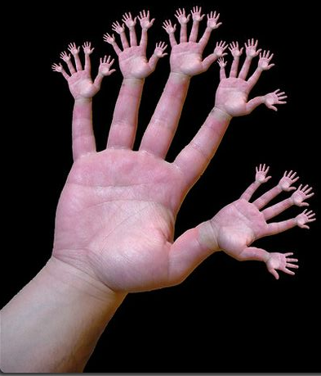
or else!

Slide 22
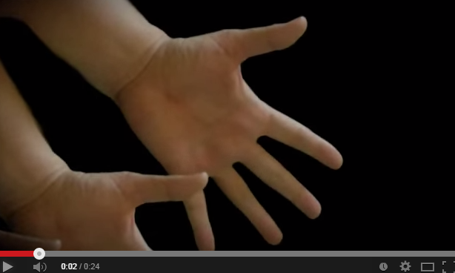
Cyriak: conceptually disruptive self-similarity…
  handfingers
here, it's made far less natural

Slide 23
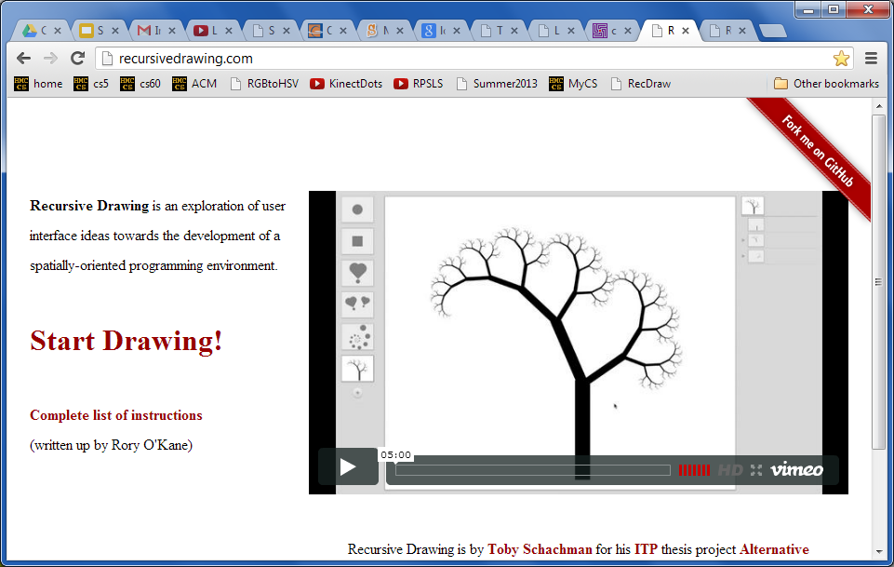
Are these rules for real?
Yes... and no.
An elegant recursive drawing site…

Slide 24
Are these rules for real?
Yes... and no.
Where does fractal growth happen in animals?

Slide 25
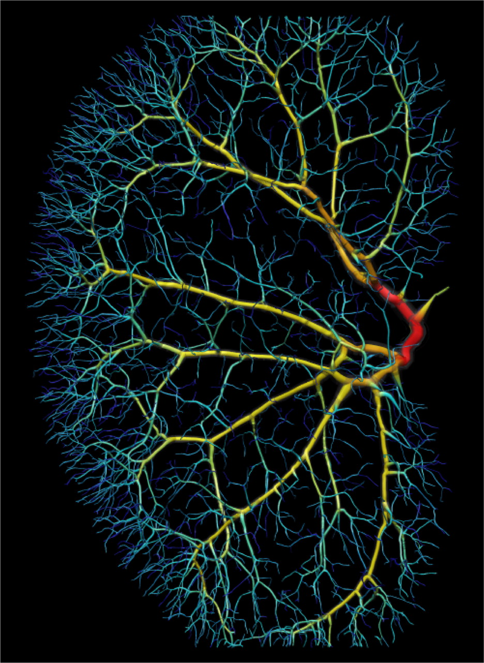
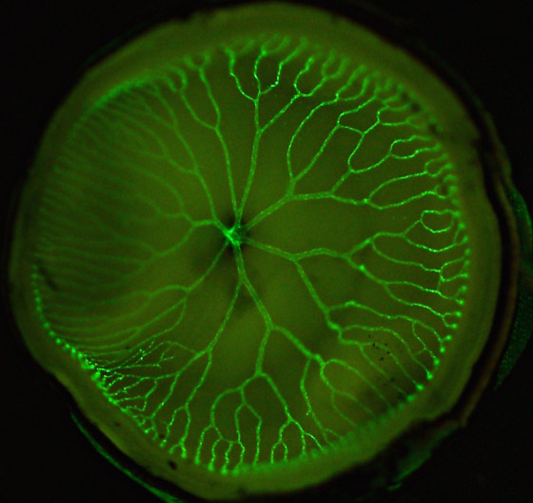
Are these rules for real?
Yes... and no.
What are these?

Slide 26
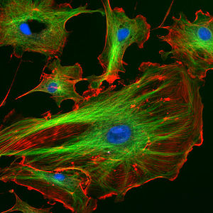
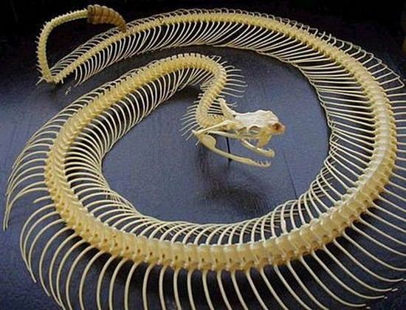
Are these rules for real?
Yes... and no.
green: cell's skeleton (microtubules)
blue?
Comparing skeletons

Slide 27
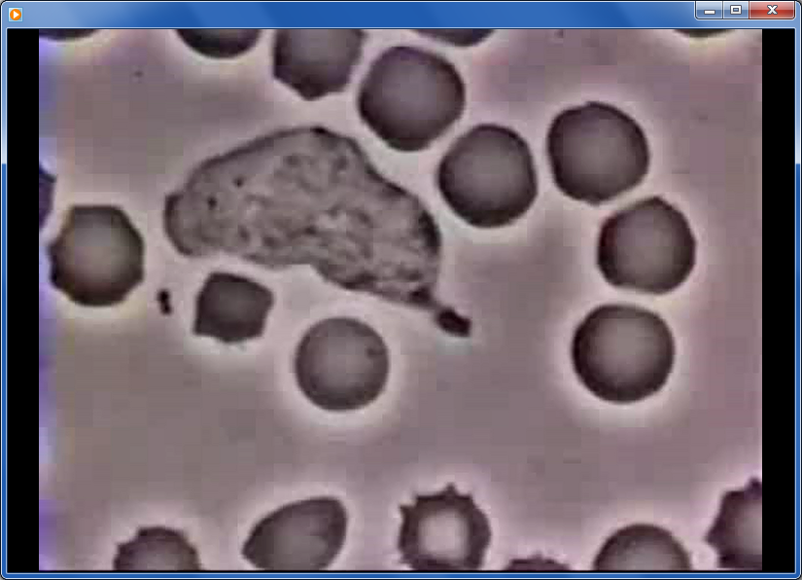
Cells: they live their own lives!

Slide 28
But what controls each cell?

Slide 29
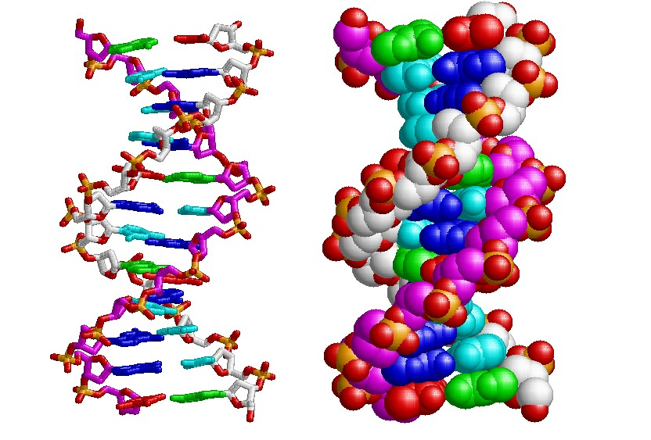
What controls each cell?
each cell has its own program (life)!

Slide 30
Simple cell rules
1
2
3
4
5
6
= Living cell
A
= Empty space
B
B2
C
C3
A grid of cells depending on
(1) their rules (DNA)
(2) environment (neighbors)
D
E
F
How many live cells are in this grid?

Slide 31
Simple cells
1
2
3
4
5
6
= Living cell
A
= Empty space
B
B2
C
C3
Name
Live or empty?
D
E
F

Slide 32
Neighbor cells
1
2
3
4
5
6
= a living cell
A
= empty space
B
Living neighbors
Empty neighbors
C
C3
D
C3
E
F
How many are living?
How many are empty?
Cell C3 has 8 neighbors

Slide 33
Neighbor cells
1
2
3
4
5
6
= Living cell
A
A6
= Empty space
B
B2
C
C3
C4
# of Living neighbors
D
A6
E
E2
E4
C4
F
E4
Each cell's future depends on its living neighbors
E2

Slide 34
The rules…
all depend on how many living neighbors each cell has
1
2
3
4
5
6
A
0
1
1
1
0
0
B
C
2
4
4
3
0
0
D
2
3
4
4
2
1
E
1
2
3
2
1
1
F
0
0
1
2
2
1
BEFORE

Slide 35
The rules…
A living cell with 2 or 3 living neighbors survives. Others die.
An empty cell with exactly 3 living neighbors comes to life.
1
2
3
4
5
6
1
2
3
4
5
6
A
0
1
1
1
0
0
A
B
1
3
2
2
1
1
B
C
2
4
4
3
0
0
C
D
2
3
4
4
2
1
D
E
1
2
3
2
1
1
E
F
0
0
1
2
2
1
F
BEFORE
Which ones will be living AFTER these rules run?

Slide 36
Rules of Life
A living cell with 2 or 3 living neighbors survives. Others die.
An empty cell with exactly 3 living neighbors comes to life.
1
2
3
4
5
6
1
2
3
4
5
6
A
0
1
1
1
0
0
A
B
1
3
2
2
1
1
B
C
2
4
4
3
0
0
C
D
2
3
4
4
2
1
D
E
1
2
3
2
1
1
E
F
0
0
1
2
2
1
F
BEFORE
AFTER

Slide 37
Rules of Life
A living cell with 2 or 3 living neighbors survives. Others die.
An empty cell with exactly 3 living neighbors comes to life.
1
2
3
4
5
6
1
2
3
4
5
6
A
A
B
B
C
C
D
D
E
E
F
F
Fill in the number of living neighbors on top of this grid.
then, fill in the next generation here.

Slide 38
Rules of Life
A living cell with 2 or 3 living neighbors survives. Others die.
An empty cell with exactly 3 living neighbors comes to life.
1
2
3
4
5
6
1
2
3
4
5
6
A
A
B
B
C
C
D
D
E
E
F
Only TWO survive,
F
and TWO are born.
Fill in the next generation here.

Slide 39
Rules of Life
A living cell with 2 or 3 living neighbors survives. Others die.
An empty cell with exactly 3 living neighbors comes to life.
1
2
3
4
5
6
1
2
3
4
5
6
A
A
B
B
C
C
D
D
E
E
F
F
BEFORE
AFTER
next...?

Slide 40
Simple cells
empty space
living cells
+
Simple rules
A living cell with 2 or 3 living neighbors survives. Others die.
An empty cell with exactly 3 living neighbors comes to life.
=
Complex behavior
"Game of Life"

Slide 41
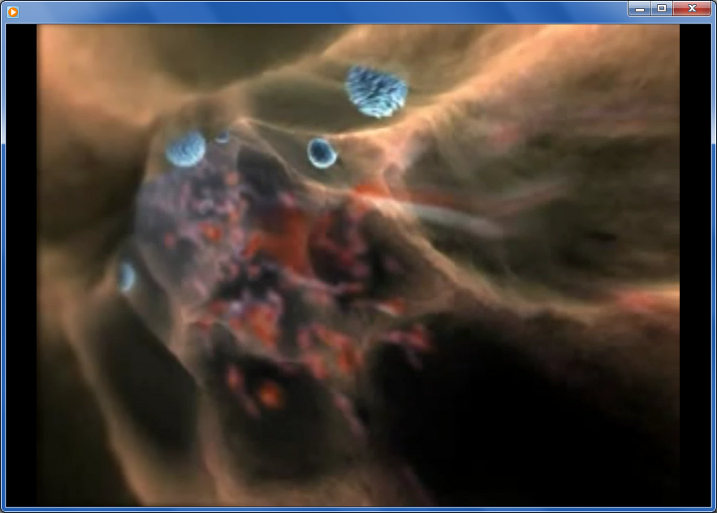
Let's see it in action…
Lives of a cell, Harvard University

Slide 42
Everything's algorithms…

Slide 43
Cup Algorithms
An Introduction to Coding, Functions, and Parameters
overview, activities, and answers

Slide 44
Motivation
Algorithms + Robots are cool
Robots need instructions = algorithms!
Robots need very clear instructions in a language they can understand
Let’s create a language for a cup-tower building robot.
We can then express tower algorithms in our language!

Slide 45
Our language (code)
= Pick up cup
= Set cup down
= Move ½ cup width forward
= Move ½ cup width backward
= Flip cup over

Slide 46
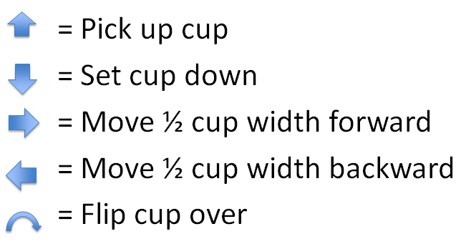
Let’s try our language!
(Example)
Consider this tower, we might
write this as:
0 1 2 3 4

Slide 47
Try it!
1. Decode this stack:
Draw your stack here:

Slide 48
Let’s try our language! (Build)
Answer
Try building a tower by
Following these instructions
0 1 2 3 4

Slide 49
2. Encode this tower:
Try it!
0 1 2 3 4

Slide 50
Now let’s encode!(Encode)
Answer
How would we write our
Robotic instructions?
0 1 2 3 4

Slide 51
Now, try designing your own!
Design a 3-5 cup tower
Encode the tower with the language
Trade codes with a partner
Build their tower using just their code
(no help!)
If the design and the tower are the same, awesome!
If there are some differences, try to figure out why that happened!
similar to the lego-tower activity

Slide 52
Try it!
3. Try building your own tower and writing its code:
4. Exchange codes with a partner, build the stack, then draw it here:
Draw your stack here:
similar to the lego-tower activity

Slide 53
How about this one?
This would take 328 arrows !!
It would be really hard to write, read, or fix if we make mistakes!
Do we have any patterns we can use?

Slide 54
Functions
A function is any process that we can repeat
Let’s use a function to make our language easier to write and understand!
Our new function:
= Move forward times
Example:
5
=

Slide 55
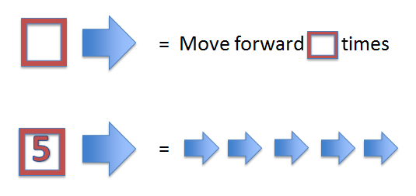
5. Decode this tower:
Try it!
2
2
4
4
6
6
5
5
2
2
Draw your stack here:

Slide 56
Try making this tower!
Answer
2
2
4
4
6
6
5
5
2
2
0 1 2 3 4 5 6

Slide 57
Try it!
6. Encode this tower:
0 1 2 3 4 5 6 7 8

Slide 58
Let’s use our new function!
Answer
Let’s encode this tower!
2
2
Easier to understand
Easier to write
We can build more interesting towers!
4
4
6
6
8
8

Slide 59
We can make any function!
What does this function do?
=
(It places a cup spots away)

Slide 60

7. Decode this tower:
Try it!
2
4
3
Draw your stack here:

Slide 61
Step By Step
Answer
2
4
3
Step 1
2
Step 2
2
4
Step 3
2
4
3

Slide 62
Try it!
8. Encode this tower:
Hint: use this “place cup” function!
0 1 2 3 4 5 6 7 8

Slide 63
Encoding with our new function
Answer
How would we encode this?
2
4
3
6
5
4

Slide 64
Make your own function!
Let’s re-visit this tower:
Do you see any patterns?
What would a useful function for this be?
How could we write this function?

Slide 65
The flipped tower function
Let’s make a function that makes a flipped tower some spaces away from the start
=
Let’s try using our new symbol!
=
2
4
0 1 2 3 4

Slide 66
Functions are powerful!
2
4
6
8
10
12
14
16
We went from a tower that needed 328 arrows, to one that just just uses 8 symbols!

Slide 67
Create your own function!
Bonus: Part 1
What’s the symbol for your function, and what does it do?
Give an example of a tower that can be made that uses your function
How would you represent your function using only arrows and functions we’ve already created?

Slide 68
Bonus: Part 2
2. Encode a tower that uses your new function at least twice.
3. Exchange codes with a partner, build the stack, then draw it here:
Draw your stack here:

Slide 69
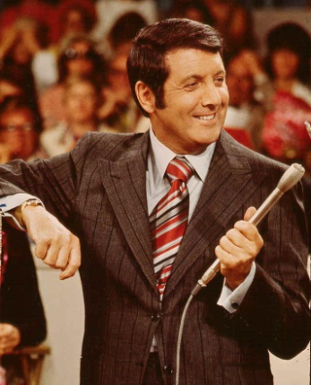
short activity
Monte Hall paradox…
Monte Hall
inspiring the “Monty Hall paradox”

Slide 70
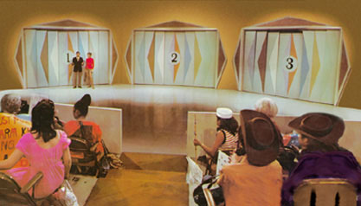
Let's make a deal…
Monty
'63-'86
inspiring the Monty Hall paradox

Slide 71
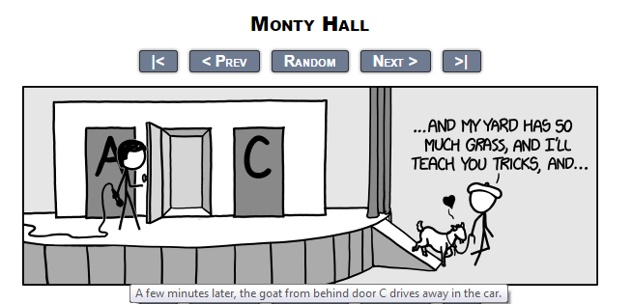
Let's make a deal: what's wrong with goats?!
Monty
inspiring the Monty Hall paradox
… but what if you considered the goat the grand prize!?

Slide 72
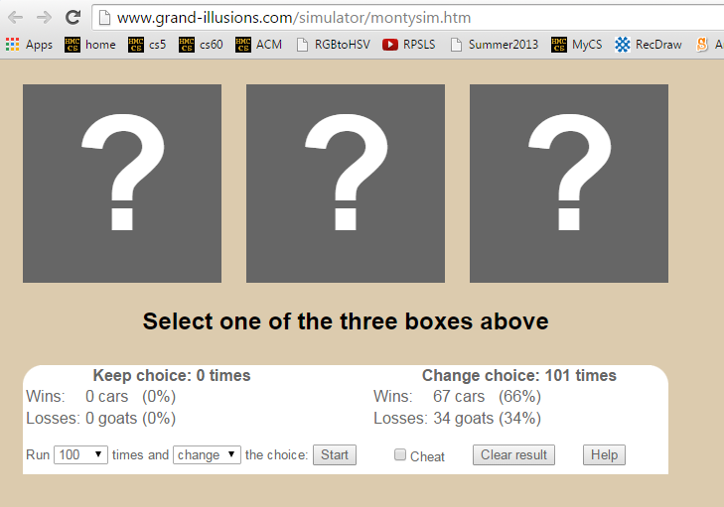
Try it LOTS of times…
Monty
inspiring the Monty Hall paradox

Slide 73
0
1
2
3
4
5
6
7
8
9
A
B
C
D
E
F
G
H

Slide 74

0
1
2
3
4
5
6
7
8
9
A
B
C
D
E
F
G
H

Slide 75
Take-home message
Understanding problems is the key to solving them -- and it's much more important than solving a particular one!
CS is the science of analyzing/solving information-based problems.
Usually, that means algorithms…

Slide 77
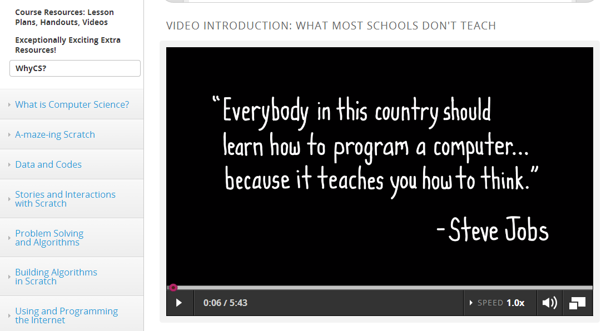
Why CS ~ a course-wide module

Slide 78
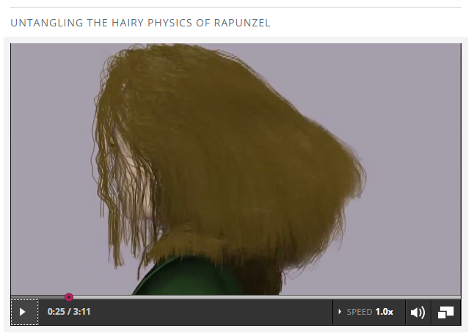
Why CS ~ it's everywhere…

Slide 79
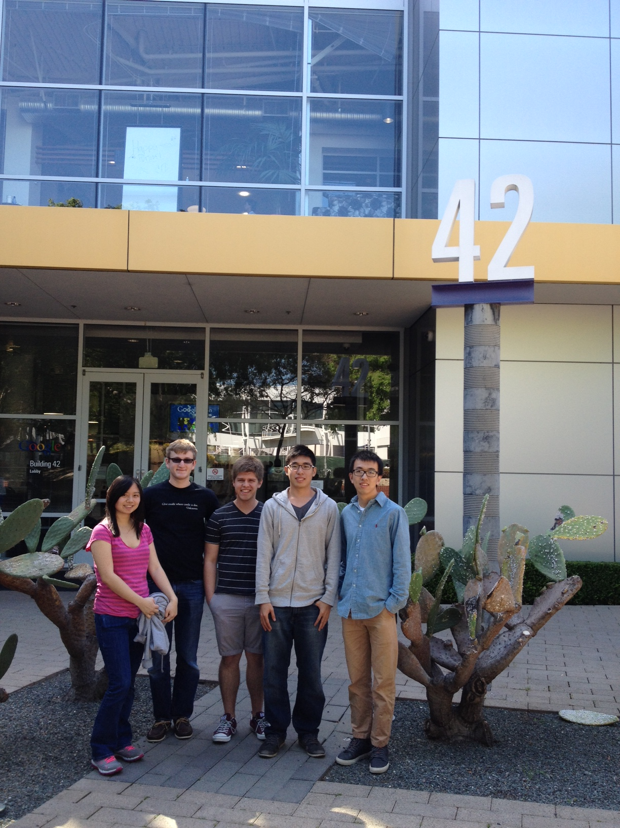
CS tourism!

Slide 80
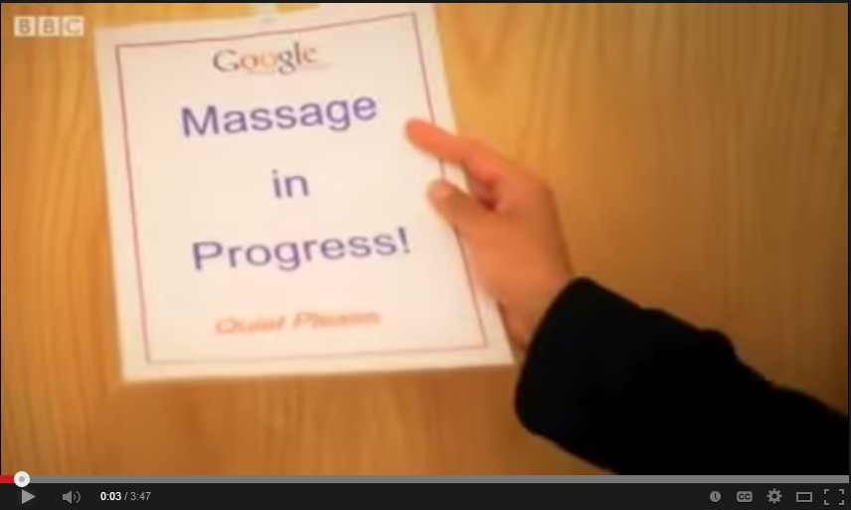
Google's aura?
https://www.youtube.com/watch?v=PA54HWLZ2e4

Slide 81
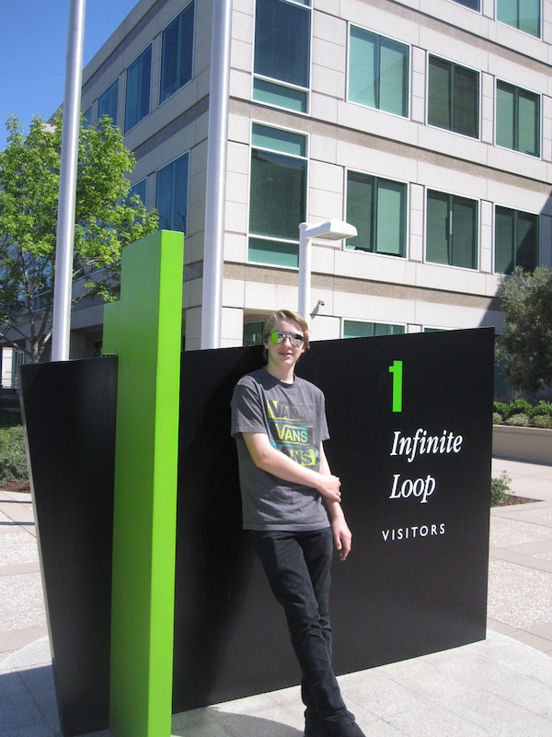
Not only Google…

Slide 82
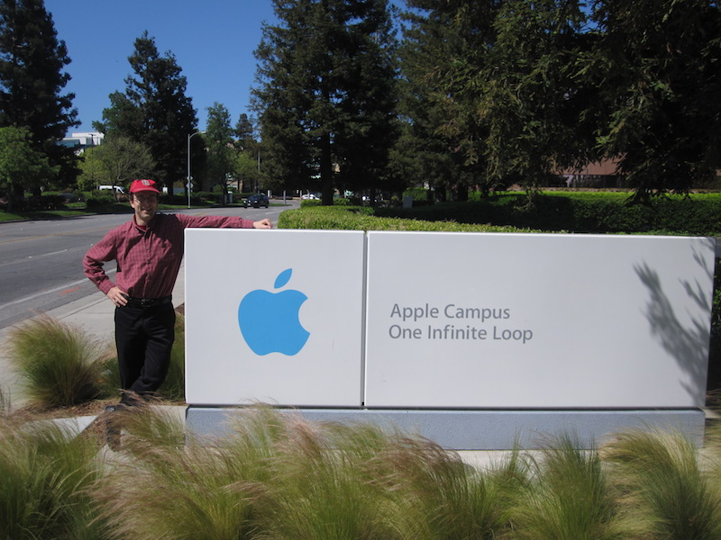

Slide 83
MyCS
Six 3-week units, deployed depending on the teacher, subject, and school.
Broadening topics
Scratch programming
Units 4-6 (can) transition students into a more complete CS pipeline in high-school
What are these other curricula?
Notes:
… and MyCS has evolved into an 18-week curriculum of day-by-day lesson plans.
It is really a scratch-programming course.
But, we borrowed an idea that has worked well in Introductory CS at Harvey Mudd, which is to give regular curricular breaks that offer students a rest from programming and a chance to hook into other facets/contexts in the discipline…
Now, the bottom half of MyCS is closely aligned with material from ScratchEd, ECS, and Colleen Lewis's Scratch curriculum, so to give you a sense of MyCS, I'll share one activity from each of the first three units:

Slide 84
CS curriculum opportunities
13+
CS through Python or …
12
AP CS A: Java programming
11
AP CS Principles: Beauty and Joy
10
ECS: Exploring CS
6-10
MyCS: Middle-years CS
grades

Slide 85
CS curriculum opportunities
13+
CS through Python or …
12
!!! AP CS A: Java programming
11
AP CS Principles: Beauty and Joy
10
ECS: Exploring CS
6-10
MyCS: Middle-years CS
grades
opportunity…

Slide 86
Short activities that might spark interest…
CS First
PencilCode Gym
Scratch Mazes (gentle intro)
Flappy bird…
Hour of Code
LightBot
Python (text-based language)
Geoguessr
@2:30 pm ~ t-shirts & final surveys

Slide 87
Short activities that might spark interest…
CS First
PencilCode Gym
Scratch Mazes (gentle intro)
Flappy bird…
Hour of Code
LightBot
Python (text-based language)
Geoguessr
@2:30 pm ~ t-shirts & final surveys

Slide 88
Short activities that might spark interest…
CS First
PencilCode Gym
Scratch Mazes (gentle intro)
Flappy bird…
Hour of Code
LightBot
Python (text-based language)
Geoguessr
@2:30 pm ~ t-shirts & final surveys

Slide 89
Short activities that might spark interest…
CS First
PencilCode Gym
Scratch Mazes (gentle intro)
Flappy bird…
Hour of Code
LightBot
Python (text-based language)
Geoguessr
@2:30 pm ~ t-shirts & final surveys

Slide 90
Short activities that might spark interest…
CS First
PencilCode Gym
Scratch Mazes (gentle intro)
Flappy bird…
Hour of Code
LightBot
Python (text-based language)
Geoguessr
@2:30 pm ~ t-shirts & final surveys

Slide 91
Short activities that might spark interest…
CS First
PencilCode Gym
Scratch Mazes (gentle intro)
Flappy bird…
Hour of Code
LightBot
Python (text-based language)
Geoguessr
@2:30 pm ~ t-shirts & final surveys

Slide 92
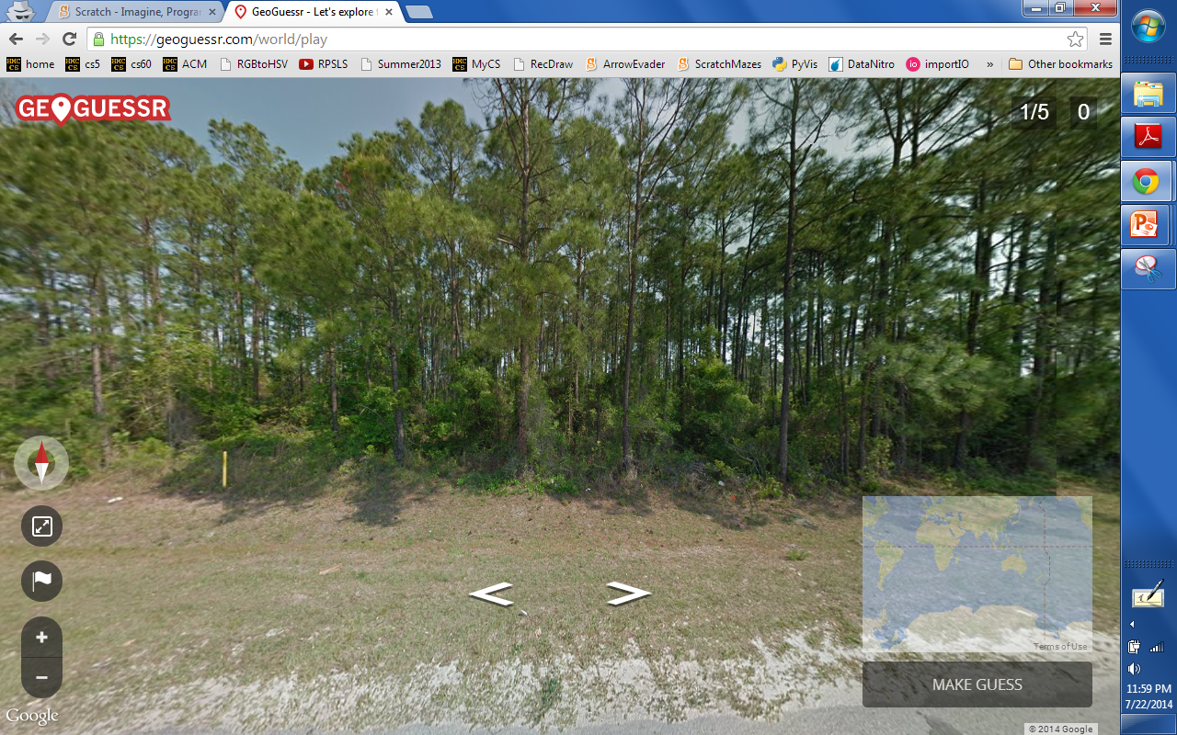
GeoGuessr
GeoGuessr ~ you're dropped in a random "street view" location and need to figure out where you are… . Once you have a guess, check how close you were!

Slide 93
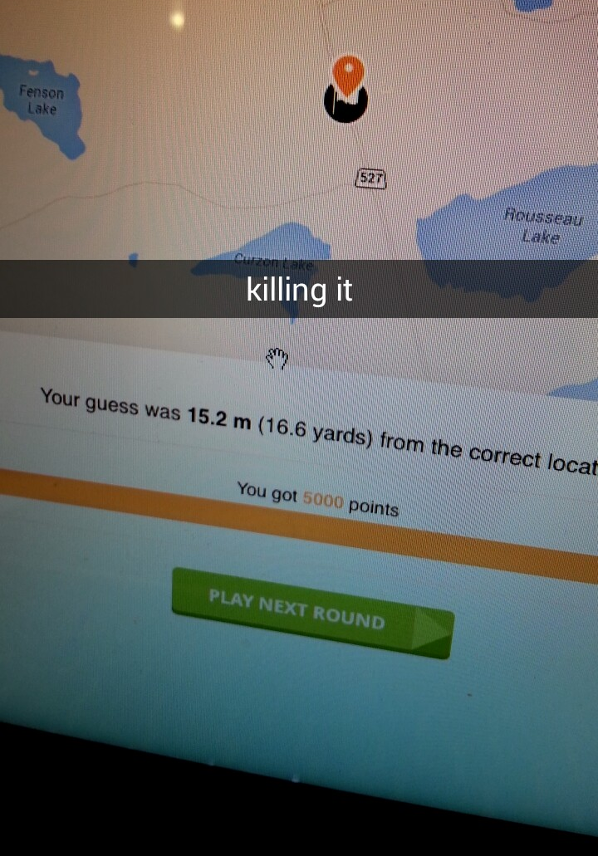
GeoGuessr
GeoGuessr ~ you're dropped in a random "street view" location and need to figure out where you are… . Once you have a guess, check how close you were!

Slide 94
Short activities that might spark interest…
CS First
PencilCode Gym
Scratch Mazes (gentle intro)
Flappy bird…
Hour of Code
LightBot
Python (text-based language)
Try 1-2 of these of your choice – all linked from the MyCS webpage…
Geoguessr
@2:30 pm ~ t-shirts & final surveys

Slide 95
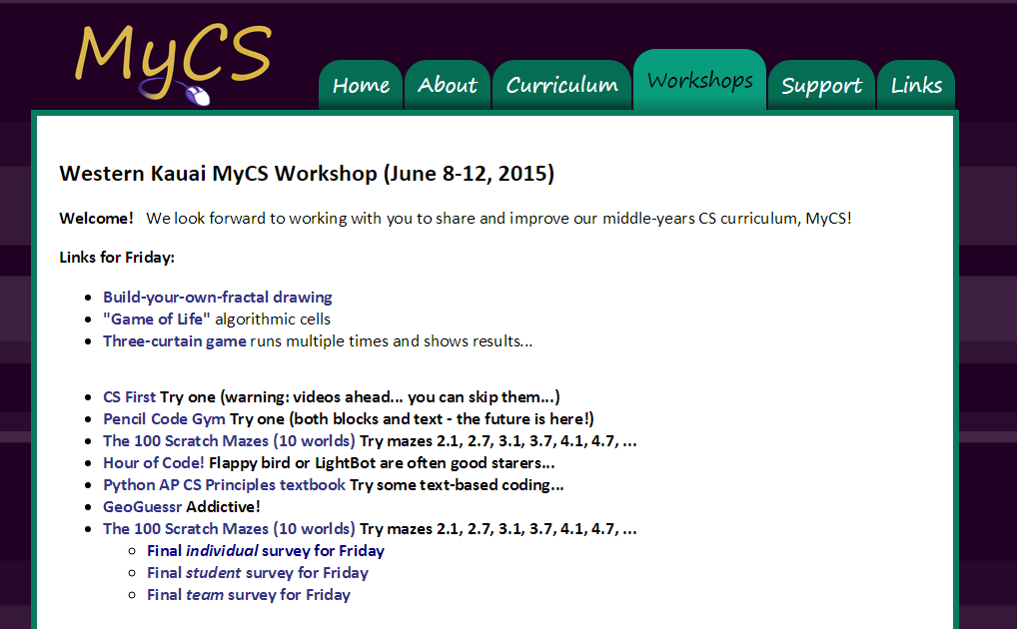
Try it!
www.cs.hmc.edu/MyCS

Slide 96
Our goal
Computing is fun.
… building positive computational identity among middle-years students
I am good at computing.
Programming is hard.
I can become good at computing.
I'm interested in a computing career.
I like the challenge of computing.
Computer jobs are boring.
I'm interested in more computing.
Pre vs. post interest
Computing is something that people like me do.
Notes:
Read this…
and we have taken – verbatim – a number of prompts from surveys that Barb Erikson and Tom McKlin have used for the same age group – but in essence we're interested in getting students to identify with *computing* as at least a _potential_ part of who they are, perhaps best summarized by this last prompt, "computing is something that people like me do."

Slide 97
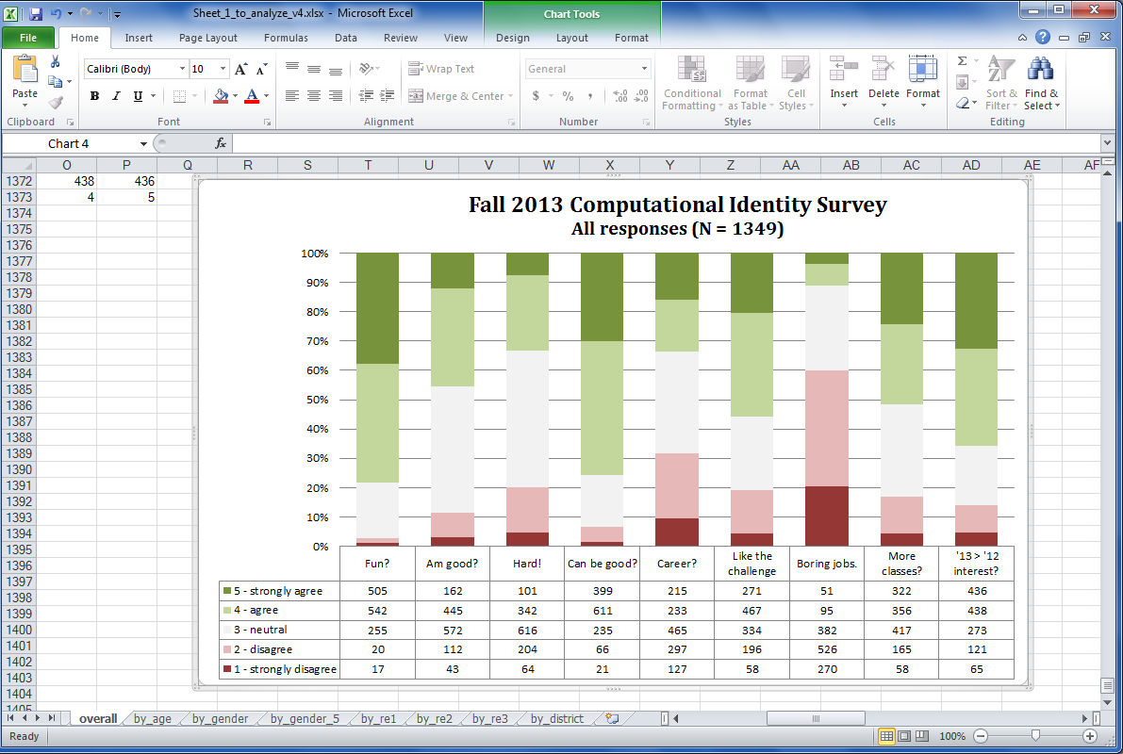
Data on the MyCS experience…

Slide 98
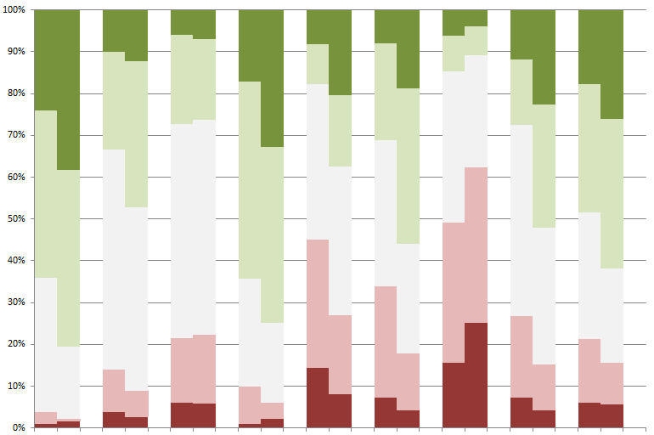
M-y women (left cols) vs. men (right cols)

Slide 99
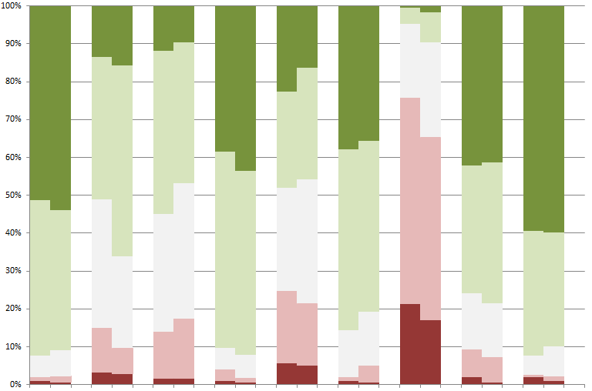
C-y women (left cols) vs. men (right cols)

Slide 100
M-y students vs. C-y students

Slide 101
Final surveys…
www.cs.hmc.edu/MyCS

Slide 102
Thank you!
parting thoughts?
parting t-shirts!
photo!

Slide 103
Workshop schedule: Thursday
9-9:20 ~ Google logistics
CS curricula
9:20-10:20 ~ CS Teaching Tips project
10:20-11 ~ tour/demos/CSTT talk
11:30-2:30 ~ project work
2:30-3 ~ demos ~ gallery walk ~ t-shirts
3pm ~ final surveys / photo

Slide 104
Workshop schedule: Thursday
9-9:20 ~ Google logistics
CS curricula
9:20-10:20 ~ CS Teaching Tips project
10:20-11 ~ tour/demos/talk
11:30-2:30 ~ project work
2:30-3 ~ demos ~ gallery walk ~ t-shirts
3pm ~ final surveys / photo

Slide 105
Workshop schedule: Thursday
9-9:20 ~ Google logistics
CS curricula
9:20-10:20 ~ CS Teaching Tips project
10:20-11 ~ tour/demos/talk
11:30-2:30 ~ project work
2:30-3 ~ demos ~ gallery walk ~ t-shirts
3pm ~ final surveys / photo

Slide 106
Workshop schedule: Thursday
9-9:20 ~ Google logistics
CS curricula
9:20-10:20 ~ CS Teaching Tips project
10:20-11 ~ tour/demos/talk
11:30-2:30 ~ project work
2:30-3 ~ demos ~ gallery walk ~ t-shirts
3pm ~ final surveys / photo

Slide 108
We don't need more stuff…
though we're always happy for more!
Notes:
As a community, then, we don't need more material – certainly we're happy for more!
But there are amazing resources out there…
But for all of these wonderful resources, our partnering teachers tell us they want a one-stop curriculum tailored for them.

Slide 109
… we need more support
with all that excellent material
Notes:
[[read]]
So, what we can do is *support* teachers by organizing these resources in ways that work with their students.

Slide 110
MyCS
Six 3-week units, deployed depending on the teacher, subject, and school.
Broadening topics
Scratch programming
Units 4-6 (can) transition students into a more complete CS pipeline in high-school
Notes:
… and MyCS has evolved into an 18-week curriculum of day-by-day lesson plans.
It is really a scratch-programming course.
But, we borrowed an idea that has worked well in Introductory CS at Harvey Mudd, which is to give regular curricular breaks that offer students a rest from programming and a chance to hook into other facets/contexts in the discipline…
Now, the bottom half of MyCS is closely aligned with material from ScratchEd, ECS, and Colleen Lewis's Scratch curriculum, so to give you a sense of MyCS, I'll share one activity from each of the first three units:

Slide 111
Mutual assessment…
How compelling was each topic?

Slide 112
Workshop schedule: Thursday
9-9:20 ~ Google logistics
CS curricula
9:20-10:20 ~ CS Teaching Tips project
10:20-11 ~ tour/demos
11-noon and 1-2:15 ~ project work
2:15-3 ~ demos / wrap-up survey
3pm ~ t-shirts and photo

Slide 113
Workshop schedule: Thursday
9-9:20 ~ Google logistics
CS curricula
9:20-10:20 ~ CS Teaching Tips project
10:20-11 ~ tour/demos
11-noon and 1-2:15 ~ project work
2:15-3 ~ demos / wrap-up survey
3pm ~ t-shirts and photo

Slide 114
Workshop schedule: Thursday
9-9:20 ~ Google logistics
CS curricula
9:20-10:20 ~ CS Teaching Tips project
10:20-11 ~ tour/demos/CSTT talk
11:30-2:30 ~ project work
2:30-3 ~ demos ~ gallery walk ~ t-shirts
3pm ~ final surveys / photo

Slide 115
Tree Rules
height = 4 cm
(1) At each new dot:
(2) Draw a T with dots on its ends
(3) Divide height by 2
Go back to step (1) and continue
height = 4 cm
(1) At each new dot:
(2) Draw a T with dots on its ends
(3) Divide height by 2
Go back to step (1) and continue
Change the underlined parts...
...to create this "tree"

Slide 116
Rules of Life
A living cell with 2 or 3 living neighbors survives. Others die.
An empty cell with exactly 3 living neighbors comes to life.
1
2
3
4
5
6
1
2
3
4
5
6
A
A
B
B
C
C
D
D
E
E
F
F
BEFORE
Fill in the next generation here.

