Slide 1
Secret Fortress Construction Challenge
You should have two identical LEGO block kits.
Set the extra kit aside, and use one kit to build a LEGO fortress:
Find a secluded spot to build your secret fortress. Don’t let anyone else see it!
Place your Lego baseplate on top of the template on page 2. Note the x and y axes are 0, as usual.
[First-timer advice] Keep your tower to the lower-left corner, where x and y are 7 or less
Write the English instructions for building your tower… (page 3)
Create a binary encoding (the legend) for each type and color of your Legos. (page 3)
Translate the English instructions to binary instructions for your tower! (page 4)
Be sure to copy over the legend, as well!
[Optional] Create a single line of 0s and 1s that you will send to the other team.
[Optional] Text or email that single line of 0s and 1s to the other team.
[Optional] Reassemble the other team's single line of 0s and 1s into binary instructions:
Swap! Make sure you have the chart of the other team's binary instructions…
Make sure you copy the other team's legend with their binary encoding
Convert their binary instructions back to English instructions using the legend.
Try to build their secret fortress!
When both teams are done, compare the fortresses you’ve created.
Were you successful? Why or why not?
Debug! If something went wrong, find where it went wrong -- which step of the process was it?!

Slide 2
Motivating slides… initial day(s)

Slide 3
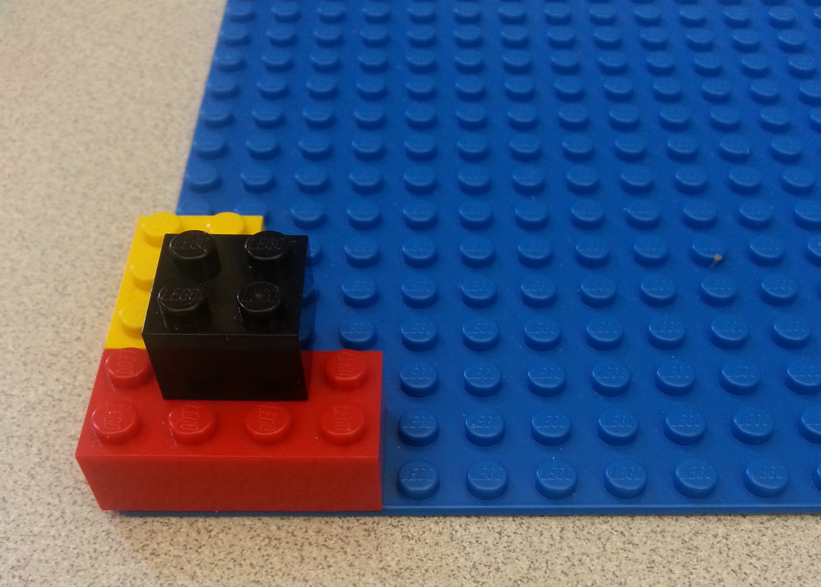
Understanding Block Encoding and Decoding
Name(s): _______________________
In the space below, create a set of building instructions so that a friend can make the exact same LEGO tower shown in the picture.
How clear were your instructions? How precise? Was a friend able to follow them to build the correct tower?

Slide 4
Block Encoding and Decoding
Name(s): _______________________
Now try describing the four attributes of each block to help you make instructions: color, size, position, and orientation.
Do these four attributes fully describe each LEGO block in the tower?
Color | Size | Orientation | Position

Slide 5
Block Encoding and Decoding
Name(s): _______________________
We want to be able to describe all the attributes in binary encoding. Let’s start with color and size.
In the table below, make a legend that matches each color and size to its binary encoding.
Color | Binary Color | Size | Binary Size
Red |  | 2 x 4
Yellow |  | 2 x 3
Black |  | 2 x 2

Slide 6
Block Encoding and Decoding
Name(s): _______________________
y
Next, let’s think about position. Look at the table you made on page 2. Did you define position the same way that your classmates did?
15
14
13
12
11
10
9
8
7
6
5
4
3
2
1
0
Look at this coordinate system. If I told you the bottom left corner of the block was at x=4 and y=2, would you know exactly where the block is?
0 | 1 | 2 | 3 | 4 | 5 | 6 | 7 | 8 | 9 | 10 | 11 | 12 | 13 | 14 | 15
x

Slide 7
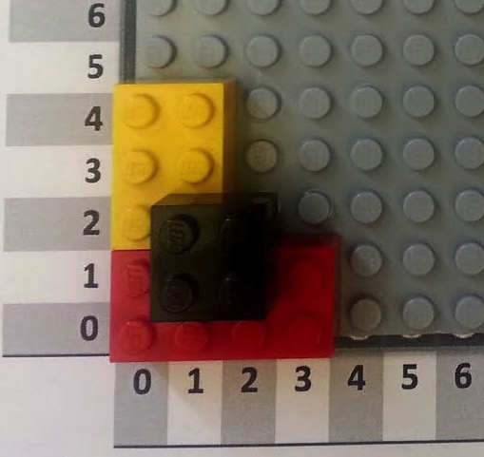
Block Encoding and Decoding
Name(s): _______________________
Using the coordinate system on the last page, give the position of each block in base-10 (regular counting numbers like 1, 2, 3, 4, 5…) and in binary (1, 10, 11, 100, 101…). For consistency, give the position of the bottom left corner of each block.
Block | X Coordinate (base 10) | X Coordinate (binary) | Y Coordinate (base 10) | Y Coordinate (binary)
Red 2 x 4 | 0 |  | 0
Yellow 2 x 3
Black 2 x 2

Slide 8
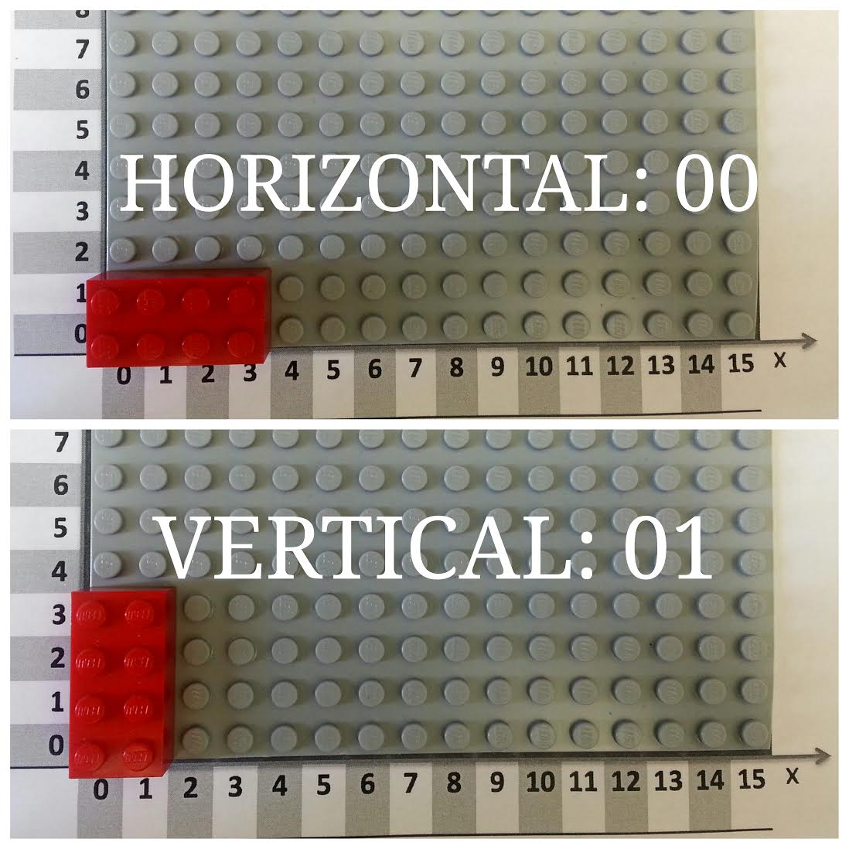
Block Encoding and Decoding
Name(s): _______________________
Now let’s encode the orientation of each block into binary.
Each block can either be horizontal or vertical. We can let 00 represent horizontal, and let
01 represent vertical, as shown in the picture below. Now encode the orientation of the blocks in the tower!
Block | Orientation | Binary Orientation
Red 2 x 4
Yellow 2 x 3
Black 2 x 2

Slide 9
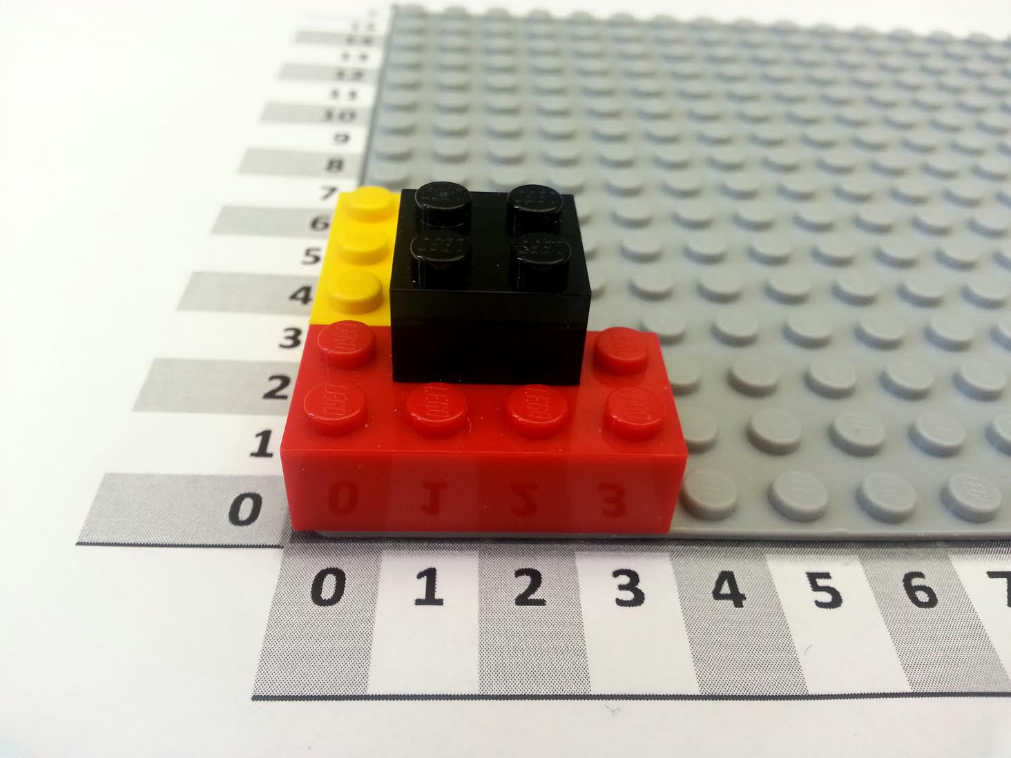
Block Encoding and Decoding
Name(s): _______________________
When we give instructions, the order of the steps can matter! If you crack an egg and then cook it, you have a poached egg. If you cook an egg and then crack it, you have a hard-boiled egg.
We can represent each step as the addition of another block. Look at the instruction tables below. Do they produce the same LEGO tower? In other words, does order matter?
Block | Color | Size | Orientation | X | Y
0 | Red | 2 x 4 | Horizontal | 0 | 0
1 | Yellow | 2 x 3 | Vertical | 0 | 2
2 | Black | 2 x 2 | Horizontal | 1 | 1
Block | Color | Size | Orientation | X | Y
0 | Black | 2 x 2 | Horizontal | 1 | 1
1 | Yellow | 2 x 3 | Vertical | 0 | 2
2 | Red | 2 x 4 | Horizontal | 0 | 0

Slide 10
Block Encoding and Decoding
Name(s): _______________________
Color
Red | 001
Yellow | 010
Black | 011
Here’s a legend for the encoding we’ve been using to convert our regular instruction table to a binary instruction table.
You’ve already converted the color, size, orientation, and position. Now convert the block number from base 10 to binary.
Size
2 x 2 | 010010
2 x 3 | 010011
2 x 4 | 010100
Block | Color | Size | Orientation | X | Y
0 | Red | 2 x 4 | Horizontal | 0 | 0
1 | Yellow | 2 x 3 | Vertical | 0 | 2
2 | Black | 2 x 2 | Horizontal | 1 | 1
Orientation
Horizontal | 00
Vertical | 01
Numbers
0 | 000
1 | 001
2 | 010
3 | 011
4 | 100
5 | 101
6 | 110
7 | 111
Block | Color | Size | Orientation | X | Y
00 | 001 | 010100 | 00 | 000 | 000
01 | 010 | 010011 | 01 | 000 | 010
10 | 011 | 010010 | 00 | 001 | 001
Now you have a complete binary instruction table!

Slide 11
Name(s): _______________________
Activity: Building the Encoding
Color
Red | 001
Yellow | 010
Black | 011
Here’s an encoded instruction table for a small LEGO tower. Can you figure out what this tower is supposed to look like?
Hint: first, decode the instruction table using the legend on the left, and then follow the instructions to recreate the tower.
Size
2 x 2 | 010010
2 x 3 | 010011
2 x 4 | 010100
Block | Color | Size | Orientation | X | Y
0000 | 010 | 010010 | 01 | 000 | 000
0001 | 001 | 010010 | 01 | 011 | 000
0010 | 001 | 010011 | 00 | 001 | 000
0011 | 010 | 010011 | 00 | 001 | 000
Orientation
Horizontal | 00
Vertical | 01
Numbers
0 | 000
1 | 001
2 | 010
3 | 011
4 | 100
5 | 101
6 | 110
7 | 111
Block | Color | Size | Orientation | X | Y

Slide 12
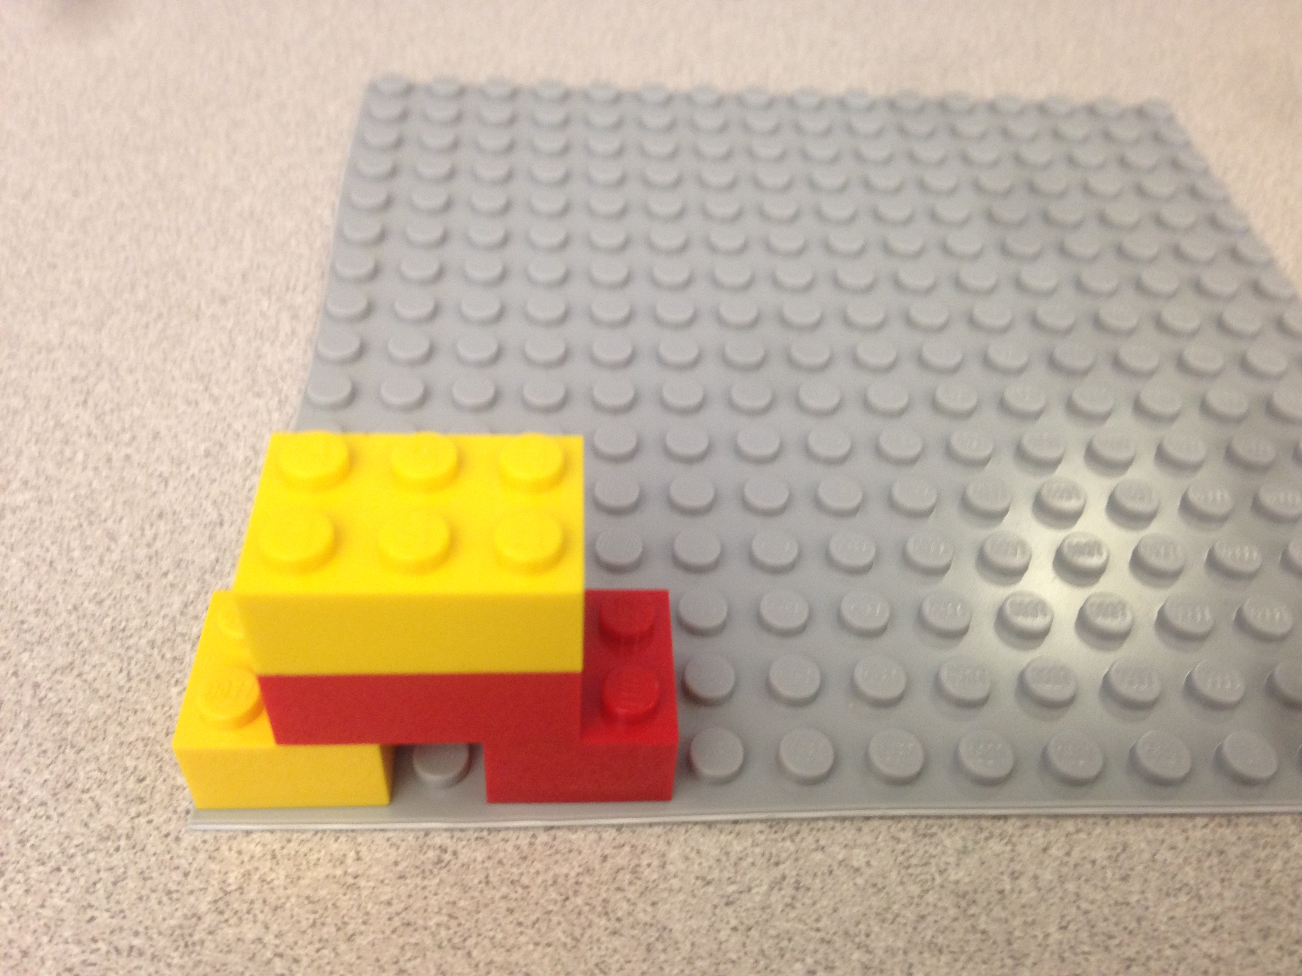
Activity: Building the Encoding
Name(s): _______________________
Using the instructions from the previous page, we can first decode the instructions as below, and then build the tower to get the tower on the right.
Block | Color | Size | Orientation | X | Y
0000 | 010 | 010010 | 01 | 000 | 000
0001 | 001 | 010010 | 01 | 011 | 000
0010 | 001 | 010011 | 00 | 001 | 000
0011 | 010 | 010011 | 00 | 001 | 000
Block | Color | Size | Orientation | X | Y
0 | Yellow | 2 x 2 | Vertical | 0 | 0
1 | Red | 2 x 2 | Vertical | 3 | 0
2 | Red | 2 x 3 | Horizontal | 1 | 0
3 | Yellow | 2 x 3 | Horizontal | 1 | 0

Slide 13
Secret Fortress Construction Challenge
You should have two identical LEGO block kits.
Set the extra kit aside, and use one kit to build a LEGO fortress:
Find a secluded spot to build your secret fortress. Don’t let anyone else see it!
Place your Lego baseplate on top of the template on page 2. Note the x and y axes are 0, as usual.
[First-timer advice] Keep your tower to the lower-left corner, where x and y are 7 or less
Write the English instructions for building your tower… (page 3)
Create a binary encoding (the legend) for each type and color of your Legos. (page 3)
Translate the English instructions to binary instructions for your tower! (page 4)
Be sure to copy over the legend, as well!
[Optional] Create a single line of 0s and 1s that you will send to the other team.
[Optional] Text or email that single line of 0s and 1s to the other team.
[Optional] Reassemble the other team's single line of 0s and 1s into binary instructions:
Swap! Make sure you have the chart of the other team's binary instructions…
Make sure you copy the other team's legend with their binary encoding
Convert their binary instructions back to English instructions using the legend.
Try to build their secret fortress!
When both teams are done, compare the fortresses you’ve created.
Were you successful? Why or why not?
Debug! If something went wrong, find where it went wrong -- which step of the process was it?!

Slide 14
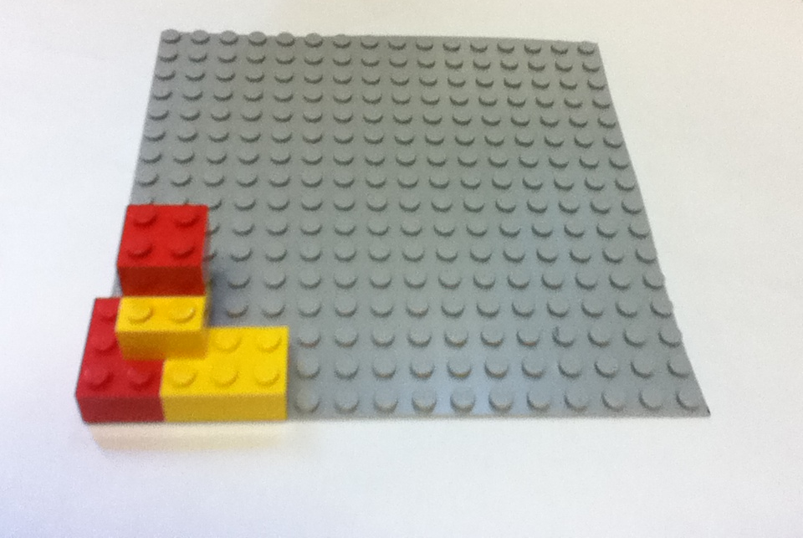
Secret Fortress?

Slide 15
Don't show the other team your tower!
Secret Fortress Base Template
y
15
14
13
12
11
10
9
8
7
6
5
4
3
2
1
0
0 | 1 | 2 | 3 | 4 | 5 | 6 | 7 | 8 | 9 | 10 | 11 | 12 | 13 | 14 | 15
x

Slide 17
Your Legend
Fill in the chart below with English and numeric instructions for your fortress.
Follow the sample line, which says “put the sample block, which is a red 2x4 block, horizontally, with its bottom left corner at the position given by the x-coordinate 6 and the y-coordinate 4.”
Then, fill in the legend to create an encoding for all the bricks you used.
For example, a 2x4 block might be represented with 010100, since 010 is 2 in binary, and 100 is 4 in binary.
Color
Red | 001
Brick Type
2 x 4 | 010100
Chart A. Your team's English Instructions
Block | Color | Brick Type | Orientation | X | Y
Sample | Red | 2x4 | Horizontal | 6 | 4
0
1
2
3
4
5
6
7
8
Orientation
Horizontal | 00
Vertical | 01
Numbers
0 | 000
1 | 001
2 | 010
3 | 011
4 | 100
5 | 101
6 | 110
7 | 111

Slide 18
Your Legend
Fill in the chart below with English and numeric instructions for your fortress.
Follow the sample line, which says “put the sample block, which is a red 2x4 block, horizontally, with its bottom left corner at the position given by the x-coordinate 6 and the y-coordinate 4.”
Then, fill in the legend to create an encoding for all the bricks you used.
For example, a 2x4 block might be represented with 010100, since 010 is 2 in binary, and 100 is 4 in binary.
Color
Red | 001
Brick Type
2 x 4 | 010100
Chart A. Your team's English Instructions
Block | Color | Brick Type | Orientation | X | Y
Sample | Red | 2x4 | Horizontal | 6 | 4
0 | Red | 2x3 | Vertical | 0 | 0
1
2
3
4
5
6
7
8
Orientation
Horizontal | 00
Vertical | 01
Numbers
0 | 000
1 | 001
2 | 010
3 | 011
4 | 100
5 | 101
6 | 110
7 | 111

Slide 19
Your Legend
Fill in the chart below with English and numeric instructions for your fortress.
Follow the sample line, which says “put the sample block, which is a red 2x4 block, horizontally, with its bottom left corner at the position given by the x-coordinate 6 and the y-coordinate 4.”
Then, fill in the legend to create an encoding for all the bricks you used.
For example, a 2x4 block might be represented with 010100, since 010 is 2 in binary, and 100 is 4 in binary.
Color
Red | 001
Brick Type
2 x 4 | 010100
Chart A. Your team's English Instructions
Block | Color | Brick Type | Orientation | X | Y
Sample | Red | 2x4 | Horizontal | 6 | 4
0 | Red | 2x3 | Vertical | 0 | 0
1 | Yellow | 2x3 | Horizontal | 2 | 0
2
3
4
5
6
7
8
Orientation
Horizontal | 00
Vertical | 01
Numbers
0 | 000
1 | 001
2 | 010
3 | 011
4 | 100
5 | 101
6 | 110
7 | 111

Slide 20
Your Legend
Fill in the chart below with English and numeric instructions for your fortress.
Follow the sample line, which says “put the sample block, which is a red 2x4 block, horizontally, with its bottom left corner at the position given by the x-coordinate 6 and the y-coordinate 4.”
Then, fill in the legend to create an encoding for all the bricks you used.
For example, a 2x4 block might be represented with 010100, since 010 is 2 in binary, and 100 is 4 in binary.
Color
Red | 001
Brick Type
2 x 4 | 010100
Chart A. Your team's English Instructions
Block | Color | Brick Type | Orientation | X | Y
Sample | Red | 2x4 | Horizontal | 6 | 4
0 | Red | 2x3 | Vertical | 0 | 0
1 | Yellow | 2x3 | Horizontal | 2 | 0
2 | Yellow | 2x2 | Vertical | 1 | 1
3
4
5
6
7
8
Orientation
Horizontal | 00
Vertical | 01
Numbers
0 | 000
1 | 001
2 | 010
3 | 011
4 | 100
5 | 101
6 | 110
7 | 111

Slide 21
Your Legend
Fill in the chart below with English and numeric instructions for your fortress.
Follow the sample line, which says “put the sample block, which is a red 2x4 block, horizontally, with its bottom left corner at the position given by the x-coordinate 6 and the y-coordinate 4.”
Then, fill in the legend to create an encoding for all the bricks you used.
For example, a 2x4 block might be represented with 010100, since 010 is 2 in binary, and 100 is 4 in binary.
Color
Red | 001
Brick Type
2 x 4 | 010100
Chart A. Your team's English Instructions
Block | Color | Brick Type | Orientation | X | Y
Sample | Red | 2x4 | Horizontal | 6 | 4
0 | Red | 2x3 | Vertical | 0 | 0
1 | Yellow | 2x3 | Horizontal | 2 | 0
2 | Yellow | 2x2 | Vertical | 1 | 1
3 | Red | 2x2 | Vertical | 1 | 2
4
5
6
7
8
Orientation
Horizontal | 00
Vertical | 01
Numbers
0 | 000
1 | 001
2 | 010
3 | 011
4 | 100
5 | 101
6 | 110
7 | 111
Done?

Slide 22
Your Legend
Color
Red | 001
Copy the legend you created on the last page to this page.
Then, translate the instructions in Chart A to binary.
Converting information into binary allows a computer to store it and communicate it. Computers use an electric signal to represent the 1s and no signal to represent the 0s.
Fill legend…
Brick Type
2 x 4 | 010100
Chart B. Your team's binary Instructions
Block | Color | Brick Type | Orientation | X | Y
Sample | 001 | 010100 | 00 | 110 | 100
0 | (Red) | (2x3) | Vertical | (0) | (0)
1 | (Yellow) | (2x3) | Horizontal | (2) | (0)
2 | (Yellow) | (2x3) | Vertical | (1) | (1)
3 | (Red) | (2x3) | Vertical | (1) | (2)
4
5
6
7
8
Orientation
Horizontal | 00
Vertical | 01
Numbers
0 | 000
1 | 001
2 | 010
3 | 011
4 | 100
5 | 101
6 | 110
7 | 111
+ convert…

Slide 23
Your Legend
Color
Red | 001
Copy the legend you created on the last page to this page.
Then, translate the instructions in Chart A to binary.
Converting information into binary allows a computer to store it and communicate it. Computers use an electric signal to represent the 1s and no signal to represent the 0s.
Brick Type
2 x 4 | 010100
Chart B. Your team's binary Instructions
Block | Color | Brick Type | Orientation | X | Y
Sample | 001 | 010100 | 00 | 110 | 100
0 | 001 (Red) | 010011 (2x3) | 01 Vertical | 000 (0) | 000 (0)
1 | 010 (Yellow) | 010011 (2x3) | 00 Horizontal | 010 (2) | 000 (0)
2 | 010 (Yellow) | 010010 (2x2) | 01 Vertical | 001 (1) | 001 (1)
3 | 001 (Red) | 010010 (2x2) | 01 Vertical | 001 (1) | 010 (2)
4
5
6
7
8
Orientation
Horizontal | 00
Vertical | 01
Numbers
0 | 000
1 | 001
2 | 010
3 | 011
4 | 100
5 | 101
6 | 110
7 | 111
My answer…

Slide 24
Your Legend
Color
Red | 001
Yellow | 010
Copy the legend you created on the last page to this page.
Then, translate the instructions in Chart A to binary.
Converting information into binary allows a computer to store it and communicate it. Computers use an electric signal to represent the 1s and no signal to represent the 0s.
Differentiating delivery
Full challenge: text a single line!
Simpler: just swap binary pages (this one)
Simplest: just swap English pages (previous)
Brick Type
2 x 4 | 010100
2 x 3 | 010011
2 x 2 | 010010
Chart B. Your team's binary Instructions
Block | Color | Brick Type | Orientation | X | Y
Sample | 001 | 010100 | 00 | 110 | 100
0 | 001 | 010011 | 01 | 000 | 000
1 | 010 | 010011 | 00 | 010 | 000
2 | 010 | 010010 | 01 | 001 | 001
3 | 001 | 010010 | 01 | 001 | 010
4
5
6
7
8
Orientation
Horizontal | 00
Vertical | 01
Numbers
0 | 000
1 | 001
2 | 010
3 | 011
4 | 100
5 | 101
6 | 110
7 | 111
Swap bits!

Slide 25
Their Legend
Extra -- Transferring the bits!
If you send your instructions electronically, they have to be converted to a single line of 0s and 1s! For example, for these sample blocks,
Differentiating delivery!
Simpler: just swap binary pages.
Simplest: just swap English pages.
Color
Red | 001
Yellow | 010
Block | Color | Brick Type | Orientation | X | Y
0001 | 001 | 010100 | 00 | 110 | 100
0010 | 010 | 101101 | 01 | 111 | 100
Brick Type
2 x 4 | 010100
2 x 3 | 010011
2 x 2 | 010010
You would construct – and send – this line of 0s and 1s:
000100101010000110100001001010110101111100
Try it!
Write your binary instructions as a single line of 0s and 1s (it's OK to wrap):
__________________________________________________________________________________________________________________________________________________
Next, send a text or email to the other team with the bits of your tower.
Also, give them your legend or let them copy it…
Below, write down the other team's bits when they send them to you:
__________________________________________________________________________________________________________________________________________________
And copy their legend to the spots on this page.
Orientation
Horizontal | 00
Vertical | 01
Extra…
Numbers
0 | 000
1 | 001
2 | 010
3 | 011
4 | 100
5 | 101
6 | 110
7 | 111

Slide 26
Their Legend
Color
Red | 001
Yellow | 010
Make sure you have the other team's legend.
Then, make sure you have the other team's binary instructions.
If you swapped pages, you should be set.
If you transferred a single-line of 0s and 1s, you will need to make sure you have the correct bits in each spot!
Now, we've swapped…
Brick Type
2 x 4 | 010100
2 x 3 | 010011
2 x 2 | 010010
Chart C. Other team's binary Instructions
Block | Color | Brick Type | Orientation | X | Y
Sample | 001 | 010100 | 00 | 110 | 100
0 | 010 | 010011 | 00 | 001 | 000
1 | 001 | 010011 | 01 | 010 | 000
2 | 001 | 010010 | 01 | 000 | 011
3 | 010 | 010010 | 01 | 011 | 001
4
5
6
7
8
Orientation
Horizontal | 00
Vertical | 01
Numbers
0 | 000
1 | 001
2 | 010
3 | 011
4 | 100
5 | 101
6 | 110
7 | 111
Try it!

Slide 27
Their Legend
Color
Red | 001
Yellow | 010
Translate the other team's instructions to English instructions.
Brick Type
2 x 4 | 010100
2 x 3 | 010011
2 x 2 | 010010
Chart D. Other team's English Instructions
Block | Color | Brick Type | Orientation | X | Y
Sample | Red | 2x4 | Horizontal | 6 | 4
0 | Yellow | 2x3 | Horizontal | 1 | 0
1
2
3
4
5
6
7
8
Orientation
Horizontal | 00
Vertical | 01
Numbers
0 | 000
1 | 001
2 | 010
3 | 011
4 | 100
5 | 101
6 | 110
7 | 111
Decode…

Slide 28
Their Legend
Color
Red | 001
Yellow | 010
Translate the other team's instructions to English instructions.
Brick Type
2 x 4 | 010100
2 x 3 | 010011
2 x 2 | 010010
Chart D. Other team's English Instructions
Block | Color | Brick Type | Orientation | X | Y
Sample | Red | 2x4 | Horizontal | 6 | 4
0 | Yellow | 2x3 | Horizontal | 1 | 0
1 | Red | 2x3 | Vertical | 2 | 0
2 | Red | 2x2 | Vertical | 0 | 3
3 | Yellow | 2x2 | Vertical | 3 | 1
4
5
6
7
8
Orientation
Horizontal | 00
Vertical | 01
Numbers
0 | 000
1 | 001
2 | 010
3 | 011
4 | 100
5 | 101
6 | 110
7 | 111
My answers…

Slide 29
DECODED Fortress!
See if they match!
y
15
14
13
12
11
10
9
8
7
6
5
4
3
2
1
0
0 | 1 | 2 | 3 | 4 | 5 | 6 | 7 | 8 | 9 | 10 | 11 | 12 | 13 | 14 | 15
x

Slide 30
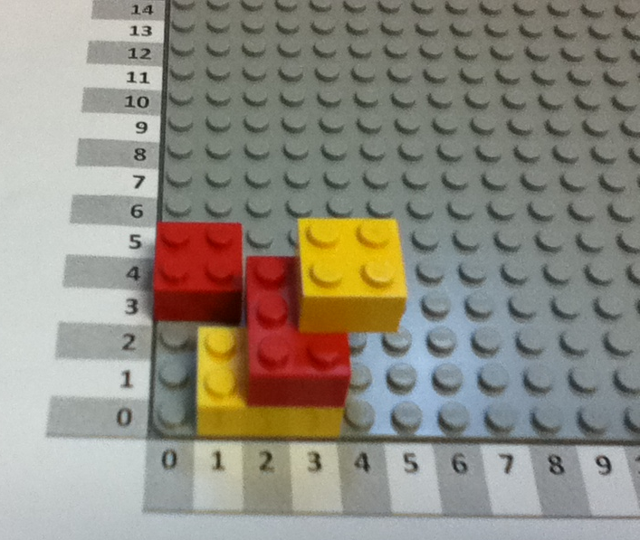
DECODED Fortress!
See if they match!

Slide 31
Bug tracker…
How many differences were they between the original and DECODED towers?
Find where the differences happened and make a mark for each location of these "bugs"
Translating from tower to English
Translating from English to binary
Transferring the bits
Translating from binary to English
Translating from English to tower
If you want to actually draw bugs, even better!

Slide 32
Secret Fortress Construction Challenge
You should have two identical LEGO block kits.
Set the extra kit aside, and use one kit to build a LEGO fortress:
Find a secluded spot to build your secret fortress. Don’t let anyone else see it!
Place your Lego baseplate on top of the template on page 2. Note the x and y axes are 0, as usual.
[First-timer advice] Keep your tower to the lower-left corner, where x and y are 7 or less
Write the English instructions for building your tower… (page 3)
Create a binary encoding (the legend) for each type and color of your Legos. (page 3)
Translate the English instructions to binary instructions for your tower! (page 4)
Be sure to copy over the legend, as well!
[Optional] Create a single line of 0s and 1s that you will send to the other team.
[Optional] Text or email that single line of 0s and 1s to the other team.
[Optional] Reassemble the other team's single line of 0s and 1s into binary instructions:
Swap! Make sure you have the chart of the other team's binary instructions…
Make sure you copy the other team's legend with their binary encoding
Convert their binary instructions back to English instructions using the legend.
Try to build their secret fortress!
When both teams are done, compare the fortresses you’ve created.
Were you successful? Why or why not?
Debug! If something went wrong, find where it went wrong -- which step of the process was it?!

Slide 33
Don't show the other team your tower!
Secret Fortress Base Template
y
15
14
13
12
11
10
9
8
7
6
5
4
3
2
1
0
0 | 1 | 2 | 3 | 4 | 5 | 6 | 7 | 8 | 9 | 10 | 11 | 12 | 13 | 14 | 15
x

Slide 34
Your Legend
Fill in the chart below with English and numeric instructions for your fortress.
Follow the sample line, which says “put the sample block, which is a red 2x4 block, horizontally, with its bottom left corner at the position given by the x-coordinate 6 and the y-coordinate 4.”
Then, fill in the legend to create an encoding for all the bricks you used.
For example, a 2x4 block might be represented with 010100, since 010 is 2 in binary, and 100 is 4 in binary.
Color
Red | 001
Brick Type
2 x 4 | 010100
Chart A. Your team's English Instructions
Block | Color | Brick Type | Orientation | X | Y
Sample | Red | 2x4 | Horizontal | 6 | 4
0
1
2
3
4
5
6
7
8
Orientation
Horizontal | 00
Vertical | 01
Numbers
0 | 000
1 | 001
2 | 010
3 | 011
4 | 100
5 | 101
6 | 110
7 | 111

Slide 35
Your Legend
Color
Red | 001
Copy the legend you created on the last page to this page.
Then, translate the instructions in Chart A to binary.
Converting information into binary allows a computer to store it and communicate it. Computers use an electric signal to represent the 1s and no signal to represent the 0s.
Brick Type
2 x 4 | 010100
Chart B. Your team's binary Instructions
Block | Color | Brick Type | Orientation | X | Y
Sample | 001 | 010100 | 00 | 110 | 100
0
1
2
3
4
5
6
7
8
Orientation
Horizontal | 00
Vertical | 01
Numbers
0 | 000
1 | 001
2 | 010
3 | 011
4 | 100
5 | 101
6 | 110
7 | 111

Slide 36
Their Legend
Extra -- Transferring the bits!
If you send your instructions electronically, they have to be converted to a single line of 0s and 1s! For example, for these sample blocks,
Differentiating delivery!
Simpler: just swap binary pages.
Simplest: just swap English pages.
Color
Red | 001
Block | Color | Brick Type | Orientation | X | Y
0001 | 001 | 010100 | 00 | 110 | 100
0010 | 010 | 101101 | 01 | 111 | 100
Brick Type
2 x 4 | 010100
You would construct – and send – this line of 0s and 1s:
000100101010000110100001001010110101111100
Try it!
Write your binary instructions as a single line of 0s and 1s (it's OK to wrap):
__________________________________________________________________________________________________________________________________________________
Next, send a text or email to the other team with the bits of your tower.
Also, give them your legend or let them copy it…
Below, write down the other team's bits when they send them to you:
__________________________________________________________________________________________________________________________________________________
And copy their legend to the spots on this page.
Orientation
Horizontal | 00
Vertical | 01
Numbers
0 | 000
1 | 001
2 | 010
3 | 011
4 | 100
5 | 101
6 | 110
7 | 111

Slide 37
Their Legend
Color
Red | 001
Make sure you have the other team's legend.
Then, make sure you have the other team's binary instructions.
If you swapped pages, you should be set.
If you transferred a single-line of 0s and 1s, you will need to make sure you have the correct bits in each spot!
Brick Type
2 x 4 | 010100
Chart C. Other team's binary Instructions
Block | Color | Brick Type | Orientation | X | Y
Sample | 001 | 010100 | 00 | 110 | 100
0
1
2
3
4
5
6
7
8
Orientation
Horizontal | 00
Vertical | 01
Numbers
0 | 000
1 | 001
2 | 010
3 | 011
4 | 100
5 | 101
6 | 110
7 | 111

Slide 38
Their Legend
Color
Red | 001
Translate the other team's instructions to English instructions.
Brick Type
2 x 4 | 010100
Chart D. Other team's English Instructions
Block | Color | Brick Type | Orientation | X | Y
Sample | 001 | 010100 | 00 | 110 | 100
0
1
2
3
4
5
6
7
8
Orientation
Horizontal | 00
Vertical | 01
Numbers
0 | 000
1 | 001
2 | 010
3 | 011
4 | 100
5 | 101
6 | 110
7 | 111

Slide 39
DECODED Fortress!
See if they match!
y
15
14
13
12
11
10
9
8
7
6
5
4
3
2
1
0
0 | 1 | 2 | 3 | 4 | 5 | 6 | 7 | 8 | 9 | 10 | 11 | 12 | 13 | 14 | 15
x

Slide 40
Bug tracker…
How many differences were they between the original and DECODED towers?
Find where the differences happened and make a mark for each location of these "bugs"
Translating from tower to English
Translating from English to binary
Transferring the bits
Translating from binary to English
Translating from English to tower
If you want to actually draw bugs, even better!

