Slide 1
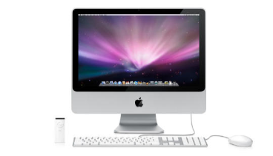
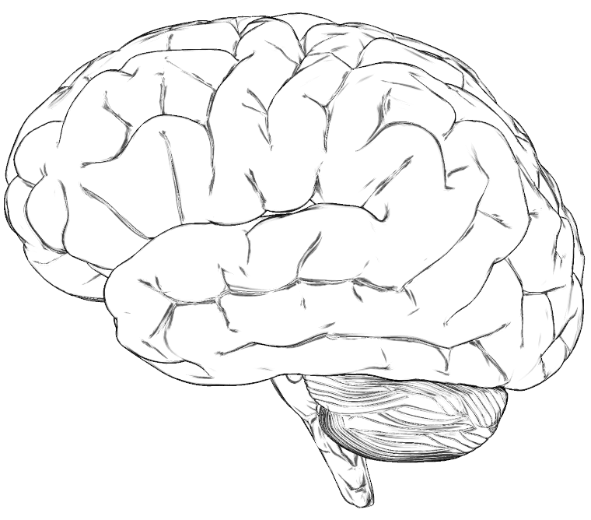
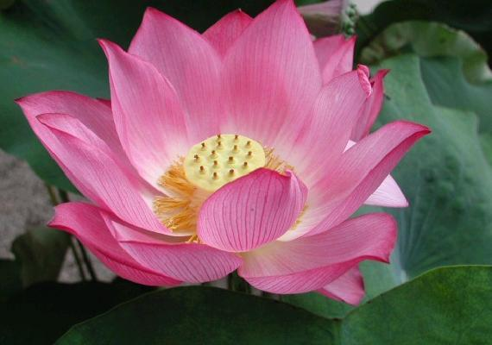
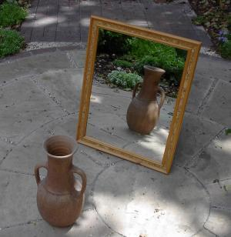
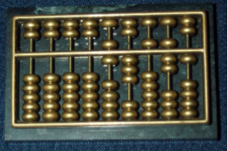
For each of these items, decide if it's a computer...
Computer
Not a computer
Computer
Not a computer
iPhone
Mac
Computer
Not a computer
Computer
Not a computer
flower
brain
Computer
Not a computer
Computer
Not a computer
abacus
... and why.
mirror

