Slide 1
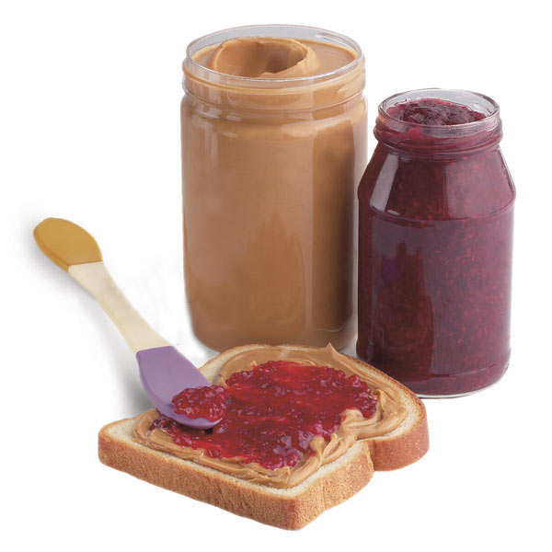
Name(s): _______________________
The Peanut Butter & Jelly Computer
A typical computer is made out of hardware components that store and display information, and software that tells the hardware how to store and display information. The hardware and software interact to create a functional computer.
The peanut butter & jelly computer makes PB&J sandwiches. Its hardware components are the “agents” that actually make the PB&J sandwich. Its software components are responsible for giving the hardware components instructions on how to make the PB&J sandwich.
Part 1: Hardware
In the space below, make a list of all the hardware components in the PB&J computer.

Slide 2
Name(s): _______________________
Part 2: Software
Create a set of instructions for the hardware components of the PB&J computer.

