Slide 1
Encoding and Decoding Data

Slide 2
Data is often encoded, or converted into a different form using a set of rules, and then decoded and changed back into its original state.

Slide 3
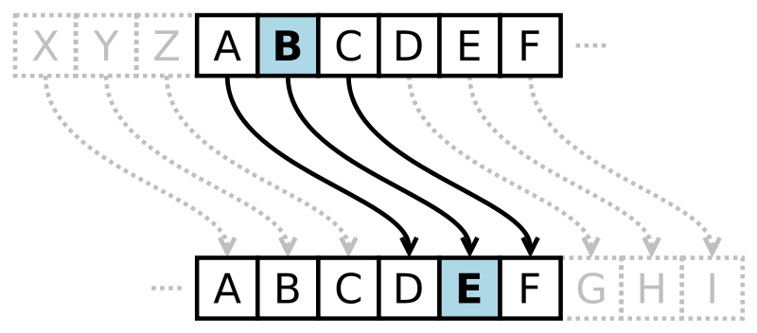
Why Encode and then Decode Data?
Encoding data allows only for people who know the pattern to decode and understand the data. This comes in handy when you want a specific person to get your message, but want to keep it a secret to everyone else.

Slide 4
Morse Code
Morse Code is a set of rules used to encode data
Every letter is represented by a set of dots and dashes

Slide 5
Example 1
Using the rules above where A = 1, B = 2, C = 3 ect. decode the following message
20-8-9-19 9-19 6-21-14

Slide 6
Example 2
Using the code above, decode the following message
ZPV EJE JU

Slide 7
Answers to Examples
Example 1: THIS IS FUN
Example 2: YOU DID IT

